Slide 1
In God You Trust?
Joshua 11
Notes:
When was the last time you felt overwhelmed by your situation?

Slide 2
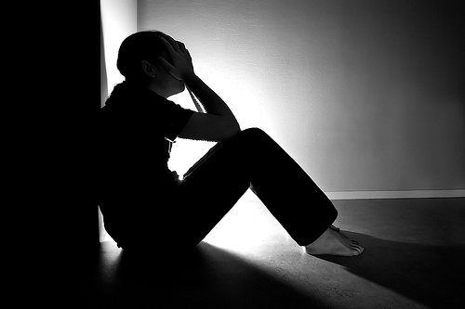
In God you trust?
Notes:
Exams…papers…presentations…time not enough!
Deal with your paralysing fear of public speaking
Personal issues – family issues…dealing with a wayward child and unresponsive audience…
IMPOSSIBLE! DEPRESSING! DISCOURAGING!
Look at Joshua 11 and what God did in Joshua’s situation and learn that this is why you can trust God with your impossible situations!

Slide 3
Joshua 11:1-5 (NIV)
¹When Jabin king of Hazor heard of this, he sent word to Jobab king of Madon, to the kings of Shimron and Akshaph, ² and to the northern kings who were in the mountains, in the Arabah south of Kinnereth, in the western foothills and in Naphoth Dor on the west; ³ to the Canaanites in the east and west; to the Amorites, Hittites, Perizzites and Jebusites in the hill country; and to the Hivites below Hermon in the region of Mizpah.
⁴They came out with all their troops and a large number of horses and chariots—a huge army, as numerous as the sand on the seashore. ⁵ All these kings joined forces and made camp together at the Waters of Merom to fight against Israel.

Slide 4
Joshua 11:6-9 (NIV)
⁶ The Lord said to Joshua, “Do not be afraid of them, because by this time tomorrow I will hand all of them, slain, over to Israel. You are to hamstring their horses and burn their chariots.”
⁷ So Joshua and his whole army came against them suddenly at the Waters of Merom and attacked them, ⁸ and the Lord gave them into the hand of Israel. They defeated them and pursued them all the way to Greater Sidon, to Misrephoth Maim, and to the Valley of Mizpah on the east, until no survivors were left. ⁹ Joshua did to them as the Lord had directed: He hamstrung their horses and burned their chariots.

Slide 5
Joshua 11:1-5 (NIV)
¹When Jabin king of Hazor heard of this, he sent word to Jobab king of Madon, to the kings of Shimron and Akshaph, ² and to the northern kings who were in the mountains, in the Arabah south of Kinnereth, in the western foothills and in Naphoth Dor on the west; ³ to the Canaanites in the east and west; to the Amorites, Hittites, Perizzites and Jebusites in the hill country; and to the Hivites below Hermon in the region of Mizpah.
⁴They came out with all their troops and a large number of horses and chariots—a huge army, as numerous as the sand on the seashore. ⁵ All these kings joined forces and made camp together at the Waters of Merom to fight against Israel.

Slide 6
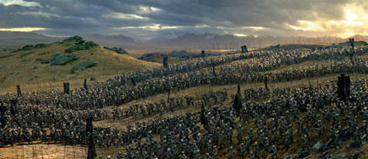
“And they came out with all their troops, a great horde, in number like the sand that is on the seashore, with very many horses and chariots.” Joshua 11:4

Slide 7
Joshua 11:6-9 (NIV)
⁶ The Lord said to Joshua, “Do not be afraid of them, because by this time tomorrow I will hand all of them, slain, over to Israel. You are to hamstring their horses and burn their chariots.”
⁷ So Joshua and his whole army came against them suddenly at the Waters of Merom and attacked them, ⁸ and the Lord gave them into the hand of Israel. They defeated them and pursued them all the way to Greater Sidon, to Misrephoth Maim, and to the Valley of Mizpah on the east, until no survivors were left. ⁹ Joshua did to them as the Lord had directed: He hamstrung their horses and burned their chariots.

Slide 8
“… I will give you every place where you set your foot, as I promised Moses. Your territory will extend from the desert to Lebanon, and from the great river, the Euphrates—all the Hittite country—to the Mediterranean Sea in the west. No one will be able to stand against you all the days of your life. As I was with Moses, so I will be with you; I will never leave you nor forsake you.” Joshua 1:3-5

Slide 9
“So Joshua took the entire land, just as the Lord had directed Moses, and he gave it as an inheritance to Israel according to their tribal divisions. Then the land had rest from war.” Joshua 11:23

Slide 10
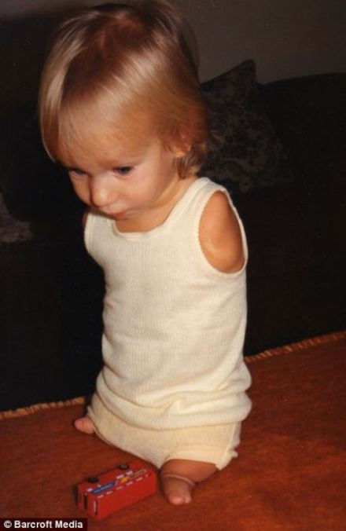
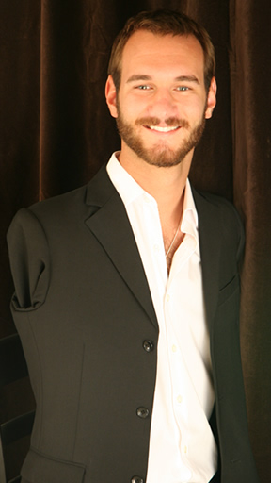
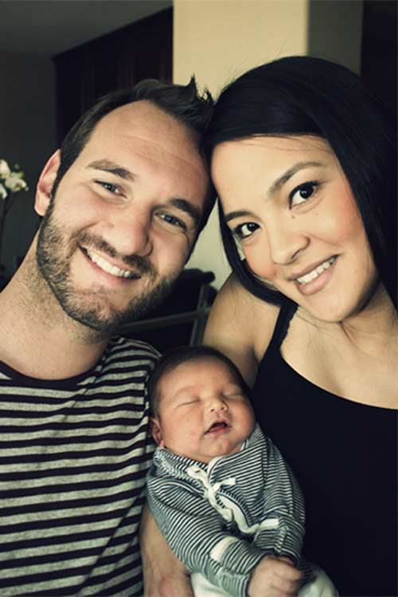
God turns the impossible into victories
Notes:
In the case of both Joshua and Nick, God can turn the impossible situations into victories and trophies of His power and goodness. What impossible situation are you facing today? Would you choose to surrender it to God and trust Him with it?

Slide 11
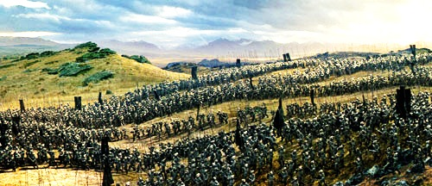
I. You can trust God because He is the mighty deliverer

Slide 12
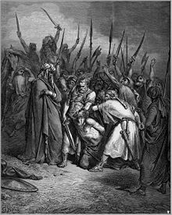
II. You can be victorious when you trust and obey God (v.10-18)

Slide 13
Joshua 11:10-18 (NIV)
¹⁰ At that time Joshua turned back and captured Hazor and put its king to the sword.(Hazor had been the head of all these kingdoms.) ¹¹ Everyone in it they put to the sword. They totally destroyed them, not sparing anyone that breathed, and he burned Hazor itself.
¹² Joshua took all these royal cities and their kings and put them to the sword. He totally destroyed them, as Moses the servant of the Lord had commanded. ¹³ Yet Israel did not burn any of the cities built on their mounds—except Hazor, which Joshua burned. ¹⁴ The Israelites carried off for themselves all the plunder and livestock of these cities, but all the people they put to the sword until they completely destroyed them, not sparing anyone that breathed.

Slide 14
Joshua 11:10-18 (NIV)
¹⁵ As the Lord commanded his servant Moses, so Moses commanded Joshua, and Joshua did it; he left nothing undone of all that the Lord commanded Moses. ¹⁶ So Joshua took this entire land: the hill country, all the Negev, the whole region of Goshen, the western foothills, the Arabah and the mountains of Israel with their foothills,¹⁷ from Mount Halak, which rises toward Seir, to Baal Gad in the Valley of Lebanon below Mount Hermon. He captured all their kings and put them to death. ¹⁸ Joshua waged war against all these kings for a long time.

Slide 15
Joshua 11:10-18 (NIV)
¹⁰ At that time Joshua turned back and captured Hazor and put its king to the sword.(Hazor had been the head of all these kingdoms.) ¹¹ Everyone in it they put to the sword. They totally destroyed them, not sparing anyone that breathed, and he burned Hazor itself.
¹² Joshua took all these royal cities and their kings and put them to the sword. He totally destroyed them, as Moses the servant of the Lord had commanded. ¹³ Yet Israel did not burn any of the cities built on their mounds—except Hazor, which Joshua burned.

Slide 16
Joshua 11:10-18 (NIV)
¹⁴ The Israelites carried off for themselves all the plunder and livestock of these cities, but all the people they put to the sword until they completely destroyed them, not sparing anyone that breathed.
¹⁵ As the Lord commanded his servant Moses, so Moses commanded Joshua, and Joshua did it; he left nothing undone of all that the Lord commanded Moses.

Slide 17
Deuteronomy 7:1-4(NIV)
¹ When the Lord your God brings you into the land you are entering to possess and drives out before you many nations—the Hittites, Girgashites, Amorites, Canaanites, Perizzites, Hivites and Jebusites, seven nations larger and stronger than you— ² and when the Lord your God has delivered them over to you and you have defeated them, then you must destroy them totally. Make no treaty with them, and show them no mercy. ³ Do not intermarry with them. Do not give your daughters to their sons or take their daughters for your sons, ⁴ for they will turn your children away from following me to serve other gods, and the Lord’s anger will burn against you and will quickly destroy you.

Slide 18
II. You can be victorious when you trust and obey God (v.10-18)

Slide 19
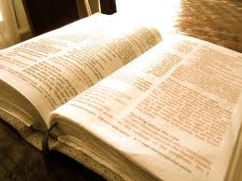
Take hold of God’s word in your life
1. Trust His promises
2. Obey His promptings

Slide 20
II. You can be victorious when you trust and obey God

Slide 21
III. Rebellion against God brings destruction (v.19-22)

Slide 22
Joshua 11:19-22 (NIV)
²⁰ Except for the Hivites living in Gibeon, not one city made a treaty of peace with the Israelites, who took them all in battle. ²⁰ For it was the Lord himself who hardened their hearts to wage war against Israel, so that he might destroy them totally, exterminating them without mercy, as the Lord had commanded Moses.
²¹ At that time Joshua went and destroyed the Anakites from the hill country: from Hebron, Debir and Anab, from all the hill country of Judah, and from all the hill country of Israel. Joshua totally destroyed them and their towns. ²² No Anakites were left in Israelite territory; only in Gaza, Gath and Ashdod did any survive.

Slide 23
Joshua 11:1-5 (NIV)
¹When Jabin king of Hazor heard of this, he sent word to Jobab king of Madon, to the kings of Shimron and Akshaph, ² and to the northern kings who were in the mountains, in the Arabah south of Kinnereth, in the western foothills and in Naphoth Dor on the west; ³ to the Canaanites in the east and west; to the Amorites, Hittites, Perizzites and Jebusites in the hill country; and to the Hivites below Hermon in the region of Mizpah.
⁴They came out with all their troops and a large number of horses and chariots—a huge army, as numerous as the sand on the seashore. ⁵ All these kings joined forces and made camp together at the Waters of Merom to fight against Israel.

Slide 24
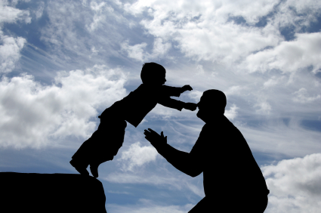
Trust and obey because God is our mighty deliverer!

