Slide 1
A CRUEL AND BRUTAL GOD IN JOSHUA 10?

Slide 2
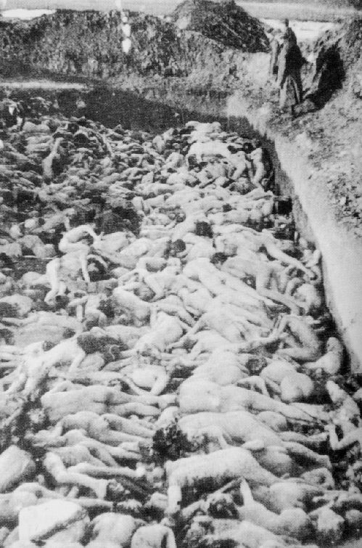
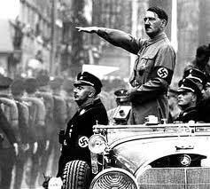
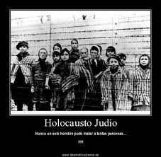
THE HOLOCAUST

Slide 3
THE STATS
6 million Jews
11 million Romanians
40,000 Concentration/
Extermination camps

Slide 4
ATTEMPTS AT JUSTICE
Nuremberg trials (1945-46)
Geneva Convention
Humanitarian measures

Slide 5
JOSHUA 10:28-43
Is the LORD in breach of the Geneva Convention?
Is God a war criminal?
Is Jesus more humane God than the LORD of the OT?
What about the Crusades (11th-13th centuries)?

Slide 6
JOSHUA 10:28-30
²⁸That day, Joshua took Makkedish. He put the city and its king to the sword and totally destroyed everyone in it. He left no survivors. And he did to the king of Makkedah as he had done to the king of Jericho. ²⁹Then Joshua and all Israel with him moved on from Makkedah to Libnah and attacked it. ³⁰The Lord also gave that city and its king into Israel's hand. The city and everyone in it Joshua put to the sword. He left no survivors there. And he did to its king as he had done to the king of Jericho.

Slide 7
JOSHUA 10:30-33
³¹Then Joshua and all Israel with him moved on from Libnah to Lachish; he took up positions against it and attacked it. ³²The Lord gave Lachish into Israel's hands, and Joshua took it on the second day. The city and everyone in it he put to the sword, just as he had done to Libnah. ³³Meanwhile, Horam king of Gezer had come up to help Lachish, but Joshua defeated him and his army – until no survivors were left.

Slide 8
JOSHUA 10:34-37
³⁴Then Joshua and all Israel with him moved on from Lachish to Eglon; they took up positions against it and attacked it. ³⁵They captured it that same day and put it to the sword and totally destroyed everyone in it, just as they had done to Lachish. ³⁶Then Joshua and all Israel with him went up from Eglon to Hebron and attacked it. ³⁷They took the city and put it to the sword, together with its king, its villages and everyone in it. They left no survivors. Just as at Eglon, they totally destroyed it and everyone in it.

Slide 9
JOSHUA 10:38-39
³⁸Then Joshua and all Israel with him turned around and attacked Debir. ³⁹They took the city, its king and its villages, and put them to the sword. Everyone in it they totally destroyed. They left no survivors. They did to Debir and its king as they had done to Libnah and its king and to Hebron.

Slide 10
JOSHUA 10:28-43
⁴⁰So Joshua subdued the whole region, including the hill country, the Negev, the western foothills and the mountain slopes, together with all their kings. He left no survivors. He totally destroyed all who breathed, just as the Lord, the God of Israel, had commanded. ⁴¹Joshua subdued them from Kadesh Barnea to Gaza and from the whole region of Goshen to Gibeon. ⁴²All these kings and their lands Joshua conquered in one campaign, because the Lord, the God of Israel, fought for Israel. ⁴³Then Joshua returned with all Israel to the camp at Gilgal.

Slide 11
Background
Yahweh promised to give land to Israel (Joshua 1:3-4)
Condition = obey laws of Moses
Law includes total destruction – no mercy (Deut 7:2)
Earlier, sin of Canaanites not reached full measure yet

Slide 12
Background
Now, it is time for God to give land
Cross Jordan river – conquer Jericho
Wall of Jericho fell because obedience
Burnt everyone in it except Rahab
But Achan took devoted things – lost in Ai

Slide 13
Background
Repented – stoned Achan – won Ai
Gibeonites scared – deceived Israel to enter peace treaty
Gibeonites knew they could not win over Israel for Yahweh is with them
Jerusalem king felt threatened – formed coalition with 4 other Amorite kings to attack Gibeon

Slide 14
Background
Gibeonites called Israel to honour peace treaty – God fought for Israel through hailstone and stopping sun
Jerusalem king felt threatened – formed coalition with 4 other Amorite kings to attack Gibeon
Joshua put to death the 5 kings – used opportunity to capture strong cities in southern territory

Slide 15
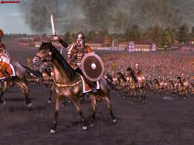
ATTACK & CHARGE !!!

Slide 16
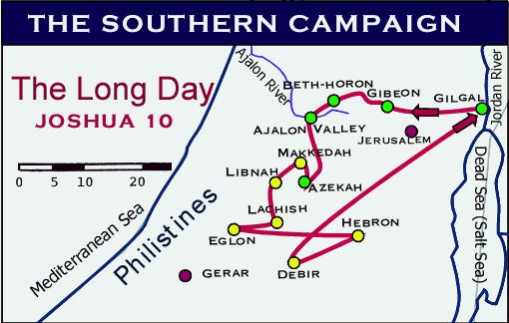

Slide 17
BATTLE 1: MAKKEDISH
"Joshua put the city and its king to the sword and totally destroyed everyone in it, and left no survivors. Joshua did the King of Makkedish exactly the way he did to King of Jericho"

Slide 19
BATTLE 2 : LIBNAH
"The Lord also gave that city and its king into Israel's hand. Joshua put the city and everyone in it to the sword and left no survivors. Joshua did to the king of Libnah as he had done to the king of Jericho"

Slide 21
BATTLE 3 : LACHISH
"The Lord gave Lachish into Israel's hands and Joshua took it on the second day. He put to sword everyone in it, just as he did to Libnah"
"Horam, the king of Gezer came to help Lachish but Joshua defeated him and his army and left no survivors"

Slide 23
BATTLE 4 : EGLON
"Israelites captured it that same day and killed and destroyed everyone in it, just as they had done to Lachish"

Slide 25
BATTLE 5 : HEBRON
"They put the king and everyone in it to sword and left no survivors, showing no mercy. Just as Eglon, they totally destroyed everyone in it"

Slide 27
BATTLE 6 : DEBIR
"Joshua and all Israel turned around and attacked Debir…put to sword everyone in the city, totally destroyed them and left no survivors. They did to Debir and its king as they had done to Libnah and its king and to Hebron"

Slide 29
NARRATOR'S SUMMARY
"Joshua subdued the whole region…together with all their kings, and left no survivors for he totally destroyed all living beings just as the Lord had commanded"
"Joshua subdued them from Kadesh Barnea to Gaza and from the whole region of Goshen to Gibeon"
"Conquered in one campaign because the Lord fought for Israel"

Slide 30
Question???
Isn't God cruel by asking Israelites to kill everyone, including babies and innocent children
Change our lenses – Ancient warfare – battle between gods, e.g. Trojan War – sacred aspect in war
Reasonable to devote everything in the land to the god who won
God of Israel vs. god(s) of Canaanites

Slide 31
Question???
It was Yahweh's war, not Israelites' war
A Holy God expects his land and his people maintain holiness
Canaanites were displaced because of their sins, failed to repent
Yahweh maintained his impartiality by evicting his people from the land – "exile"
We have a God who is more interested in holiness than anything else – not cruel

Slide 32
MAIN IDEA
"Joshua and Israel could take the Southern territory with ease and swiftly because they obeyed God's instruction - God fought for them"

Slide 33
APPLICATION
What warfare are we asked to fight today?
Jesus died for our sin on cross – our sins must be totally devoted to God for total destruction
We are temple of God – purge evil within us for God's Spirit lives in us

Slide 34
APPLICATION
Romans 8:12-13
"So then, brothers and sisters, we are debtors, not to the flesh, to live according to the flesh. For if you live according to the flesh you will die, but if by the Spirit you put to death the misdeeds of the body, you will live."

Slide 35
APPLICATION
Colossians 3:5
"Put to death therefore whatever belongs to your earthly nature: sexual immorality, impurity, lust, evil desires and greed, which is idolatry. Because of these, the wrath of God is coming."

Slide 36
APPLICATION
Obey God by putting to death our sins – will live a victorious life for God will fight for us
Do you have one foot in heaven but one foot in the world?
Don't always give the excuse that sanctification is a progressive process
Put on the armour of God – Eph. 6:10-18

Slide 37
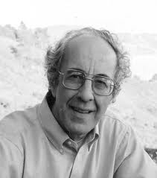
APPLICATION
Henri Nouwen

Slide 38
APPLICATION
Are you honest with yourself about your sin?
Are you dealing with it now or you are just letting it continue?
Put sword to your sins – totally destroy them!
When we are obedient – God will fight for us

