Slide 1
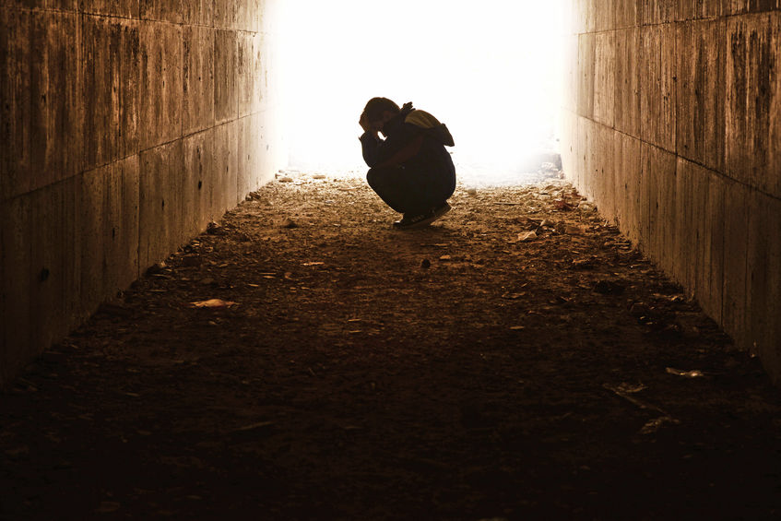
Be Comforted
Jeremiah
Dr. Rick Griffith • Crossroads International Church Singapore
CICFamily.com • BibleStudyDownloads.org

Slide 2
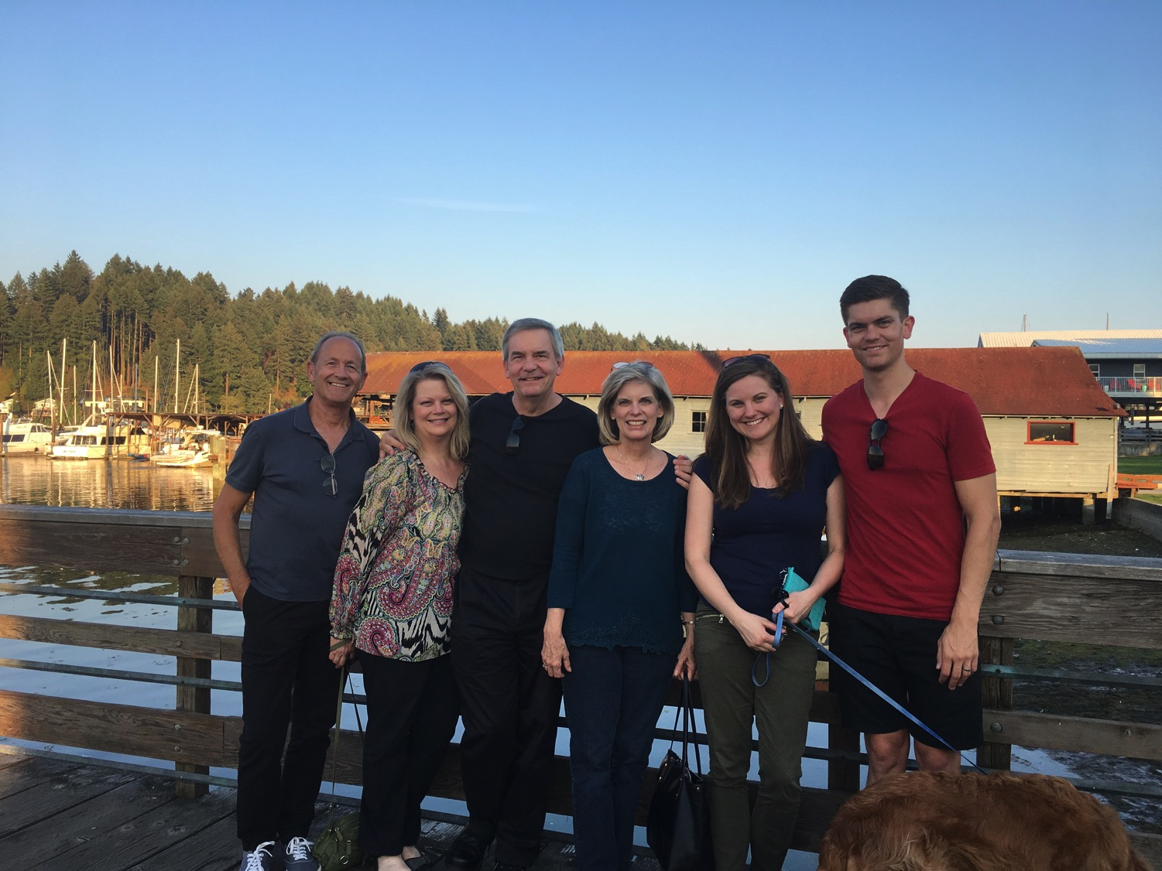
3-days travel, 4-day visit
Notes:
It is wonderful to be with you all again after taking a week off to be with my family in the USA. This is a first for us—three days of flying to have four and half days with my family—but when a $4000 trip costs only $100 now since our son is a pilot, we had little excuse not to go!

Slide 3
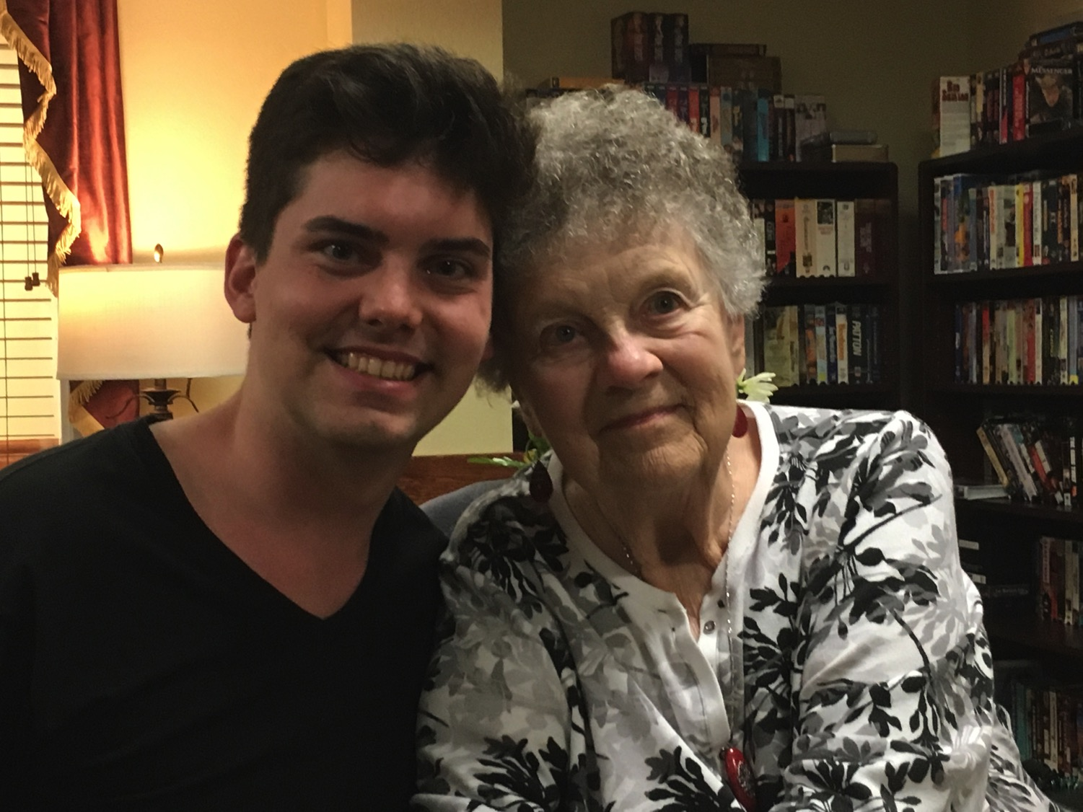
We all need to be comforted
Notes:
We had special times with our youngest son John and Susan's mother.

Slide 4
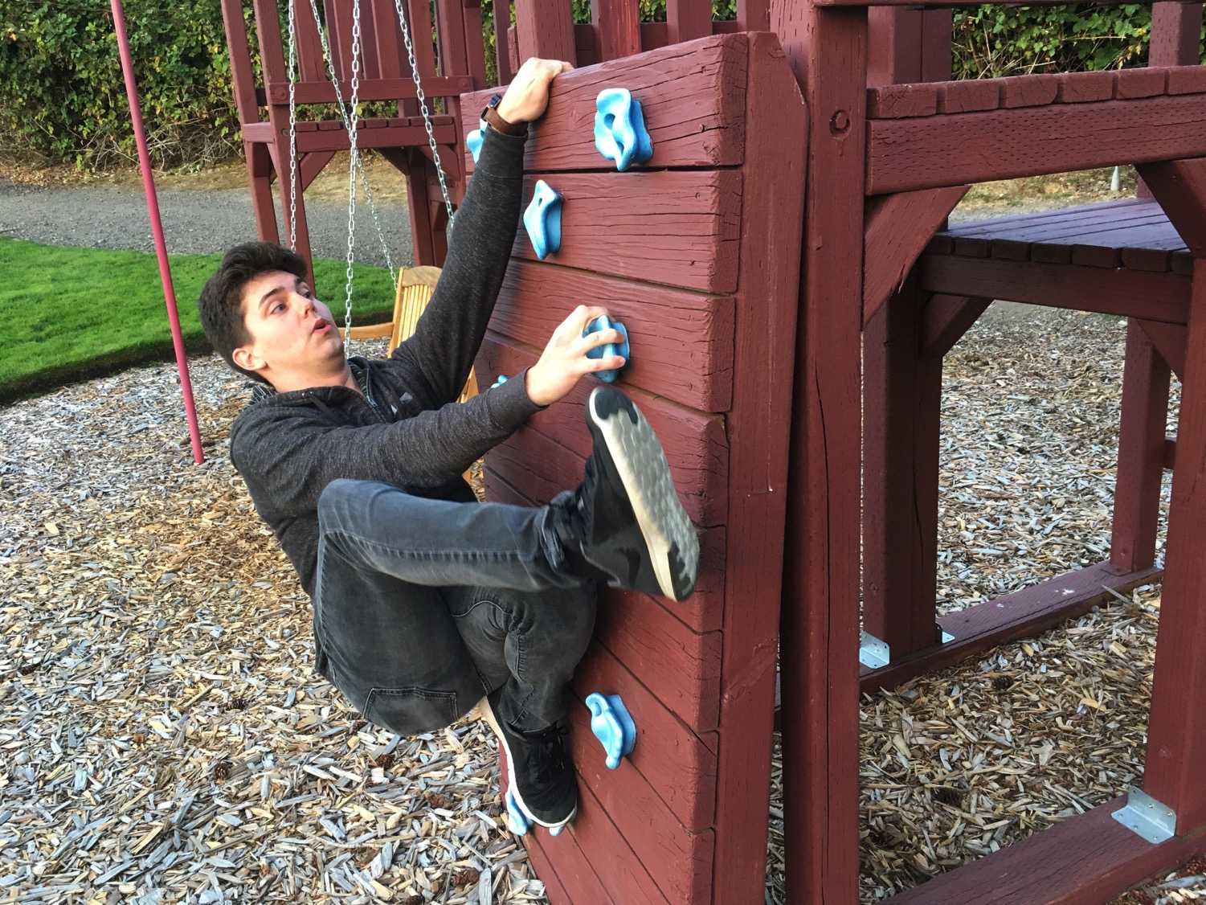
3-day travel, 4-day visit
Notes:
John even showed off his climbing skills.

Slide 5
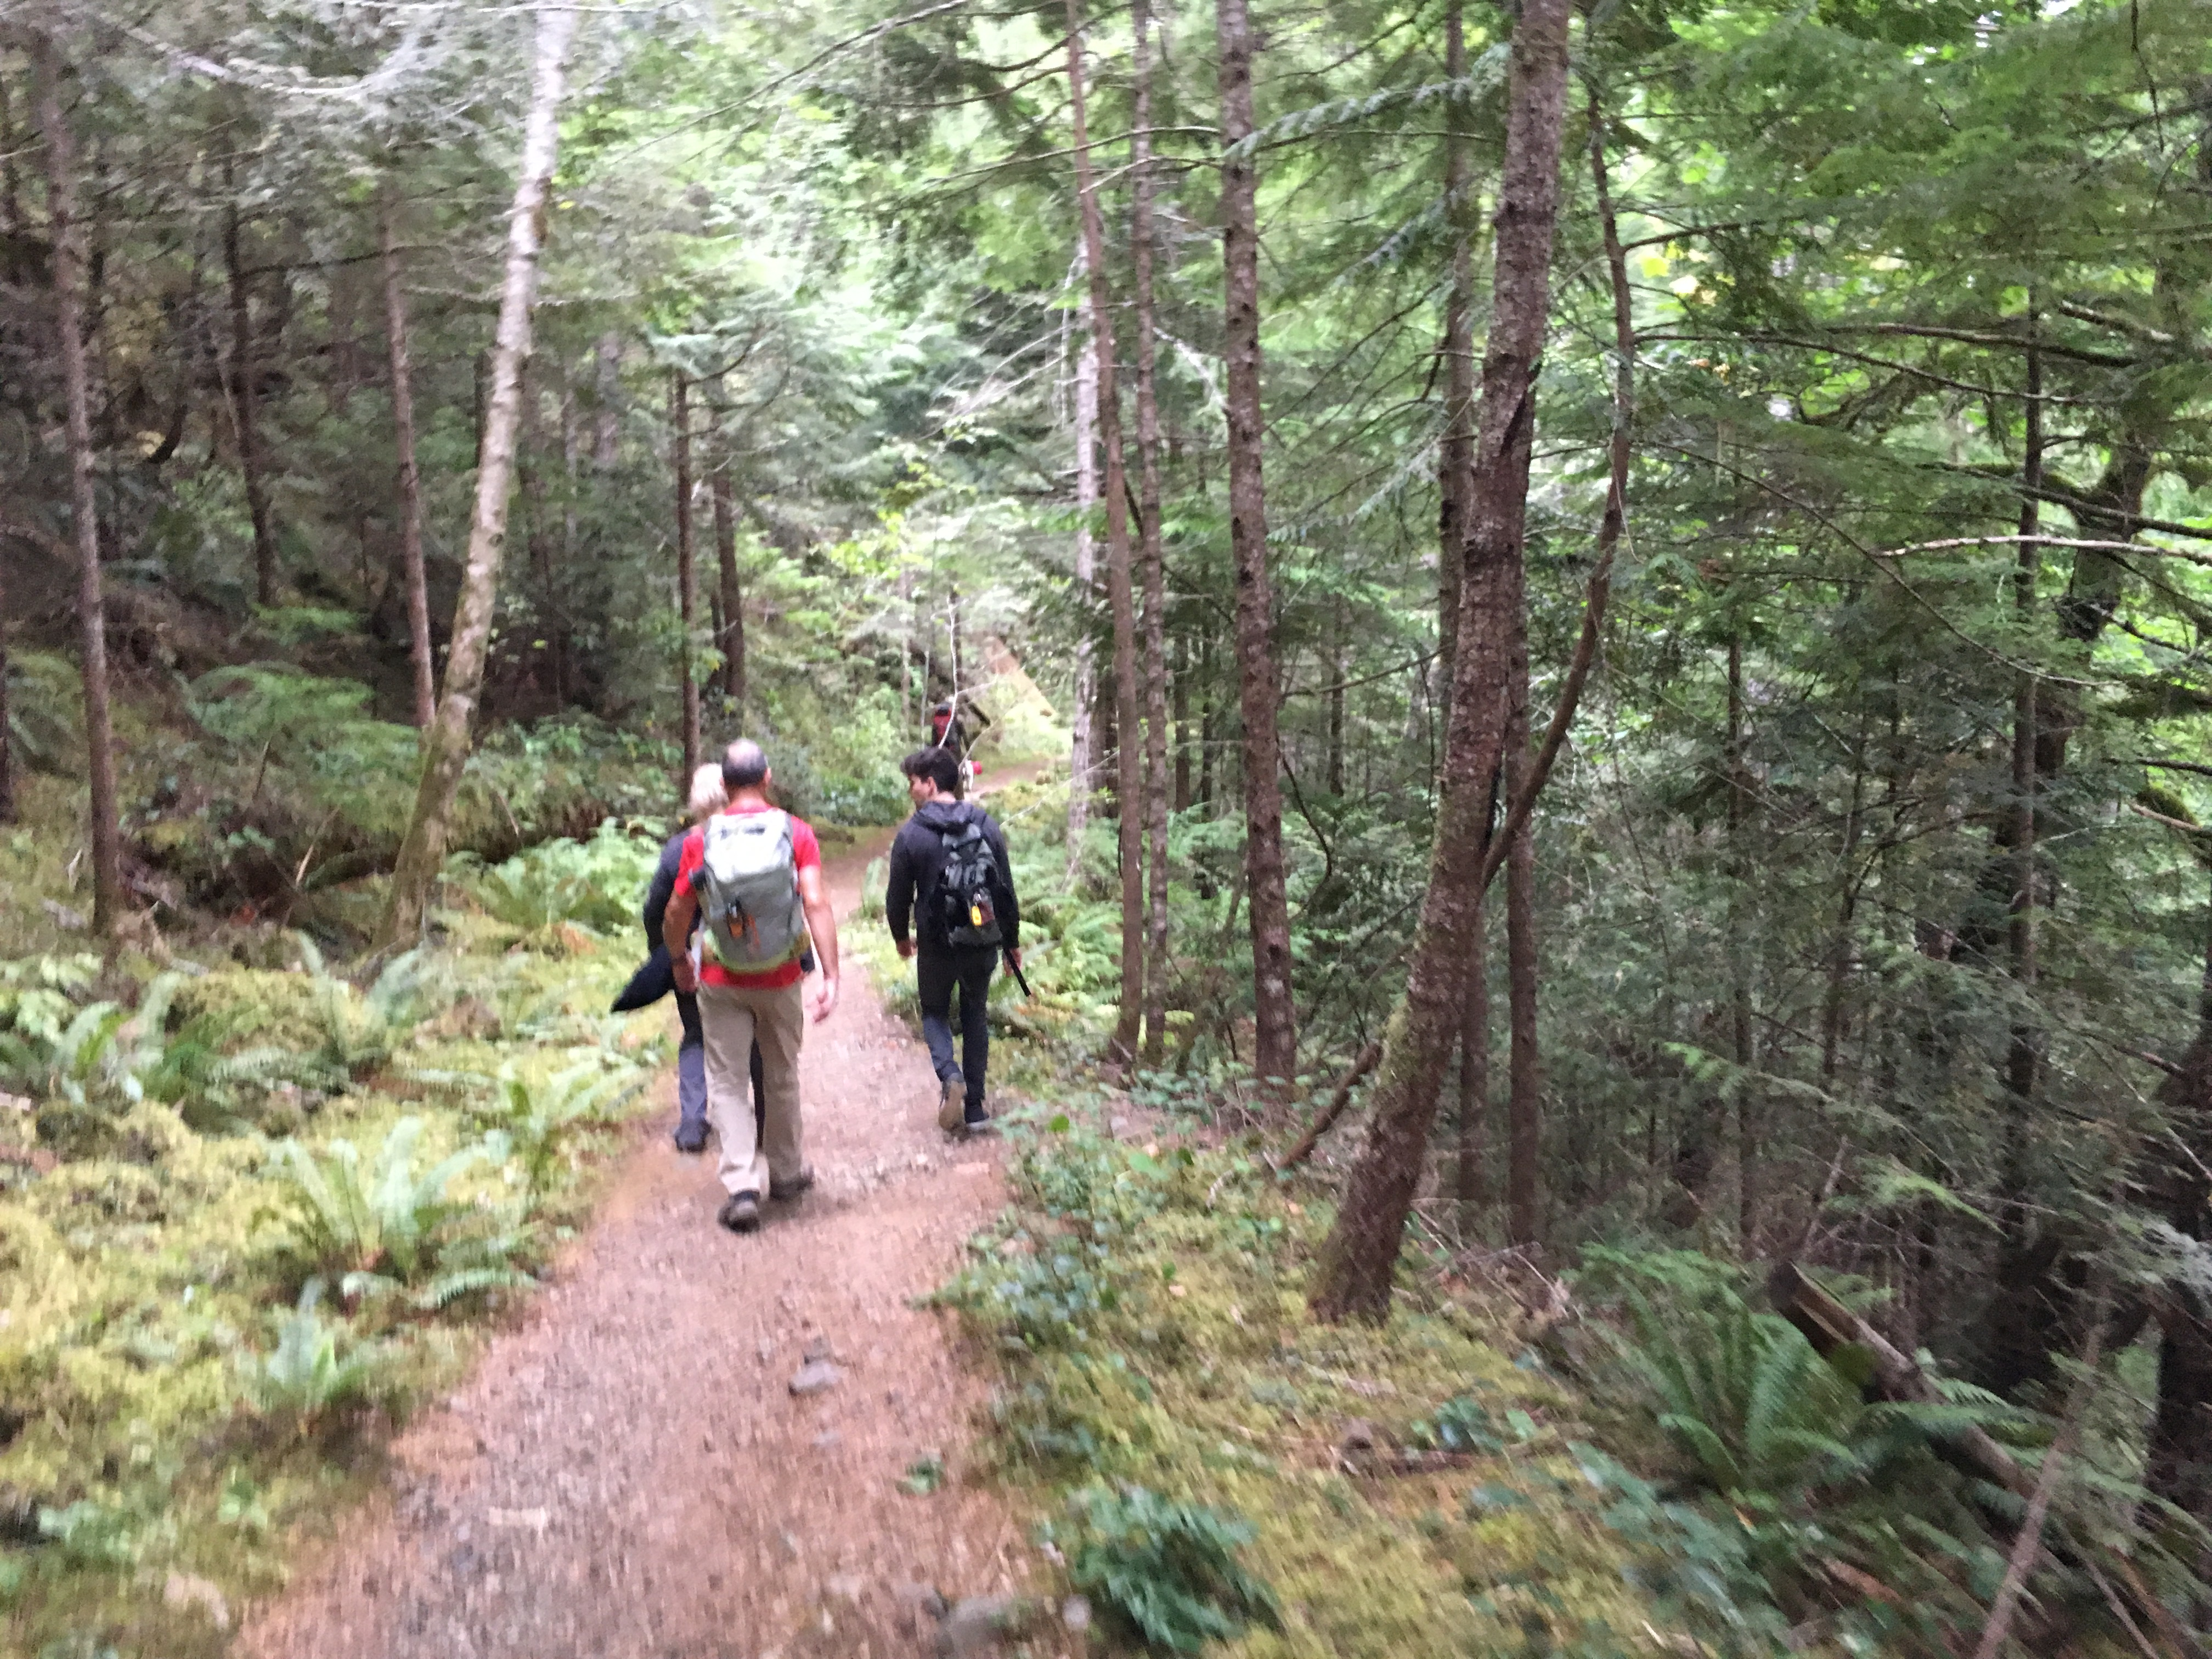
3-day travel, 4-day visit
Notes:
We got in some hiking…

Slide 6
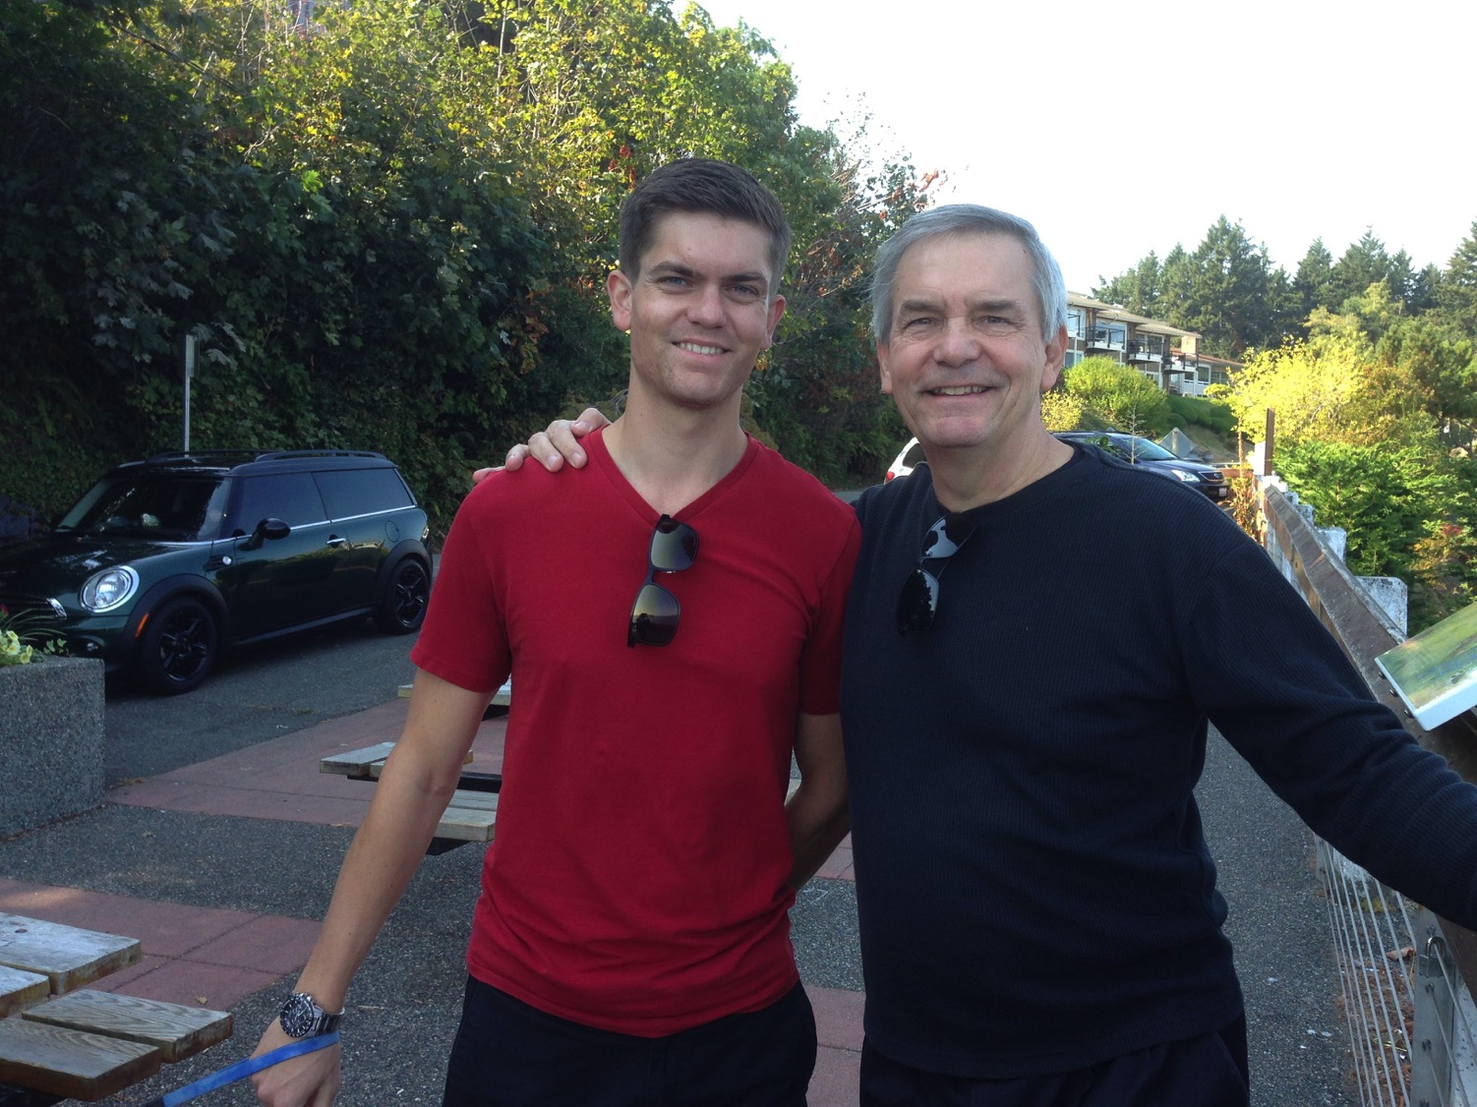
We all need to be comforted
Notes:
This was due to our United pilot son, Stephen.

Slide 7

Let's Study Through Scripture
The Bible: Book by Book
Notes:
As we study the Scripture book-by-book, today we come to the book of Jeremiah.

Slide 8
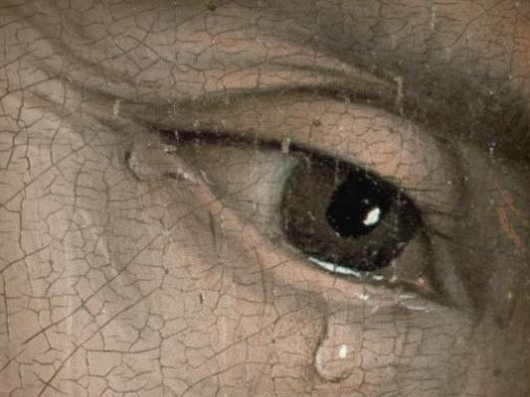
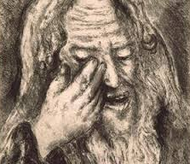
"The Weeping Prophet"
Notes:
Jeremiah was the only prophet to live through the 586 BC fall of Jerusalem. God called him to show God’s compassion even in Judah’s darkest hours. Jeremiah is known as "The Weeping Prophet." I suspect you would weep also if you saw your country ravaged and destroyed before your very eyes and you were powerless to stop it. It actually makes sense that God would call one like him who experienced such loss to be one who teaches us the need to be comforted.

Slide 9

We all need to be comforted
Notes:
That’s because we all need to be comforted at various times of our lives. This is true for women, of course, but not only for women.

Slide 10
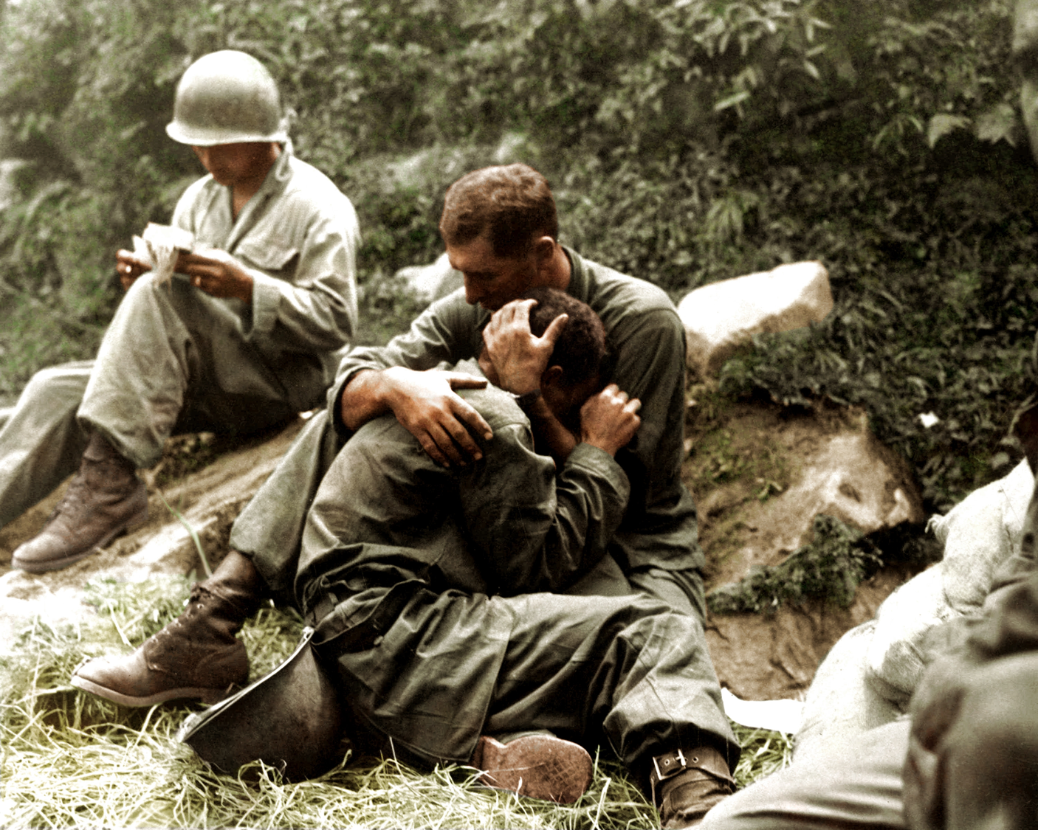
We all need to be comforted
Notes:
Men also need comfort many times.

Slide 11
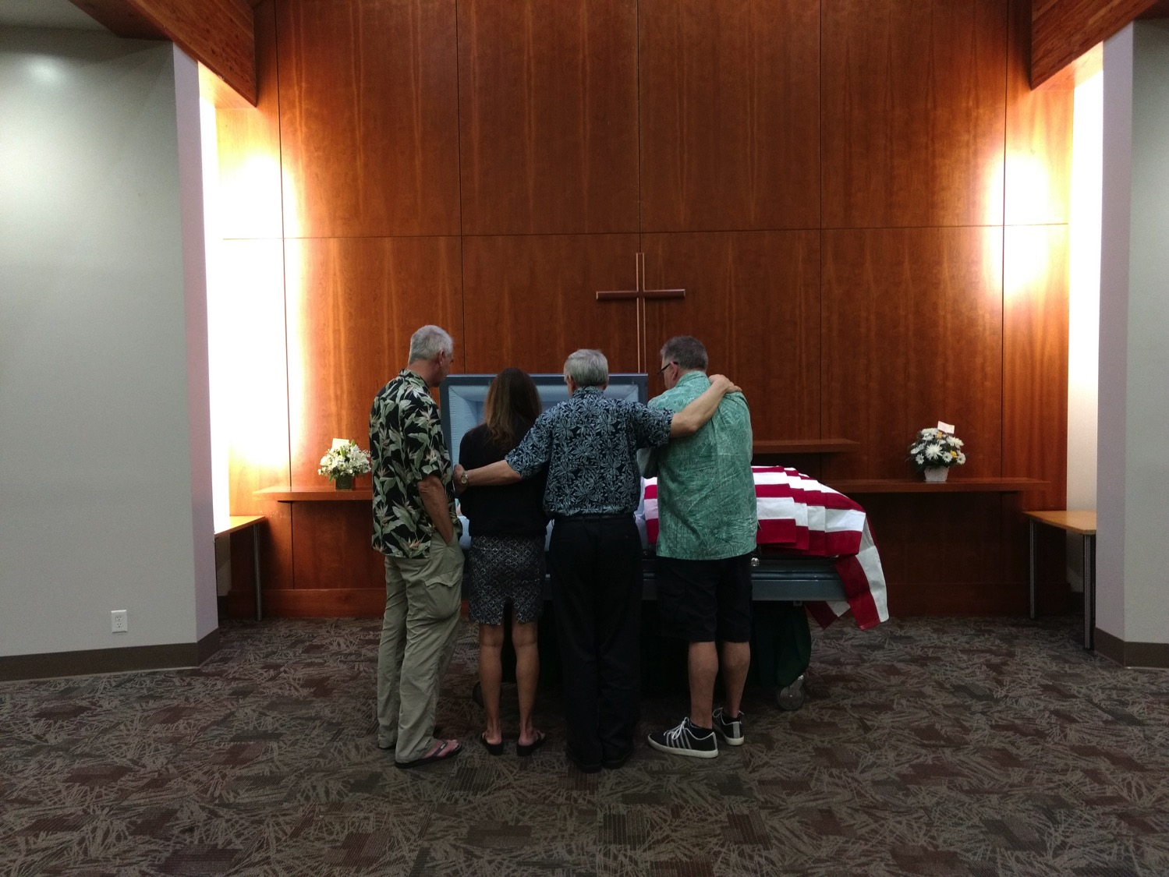
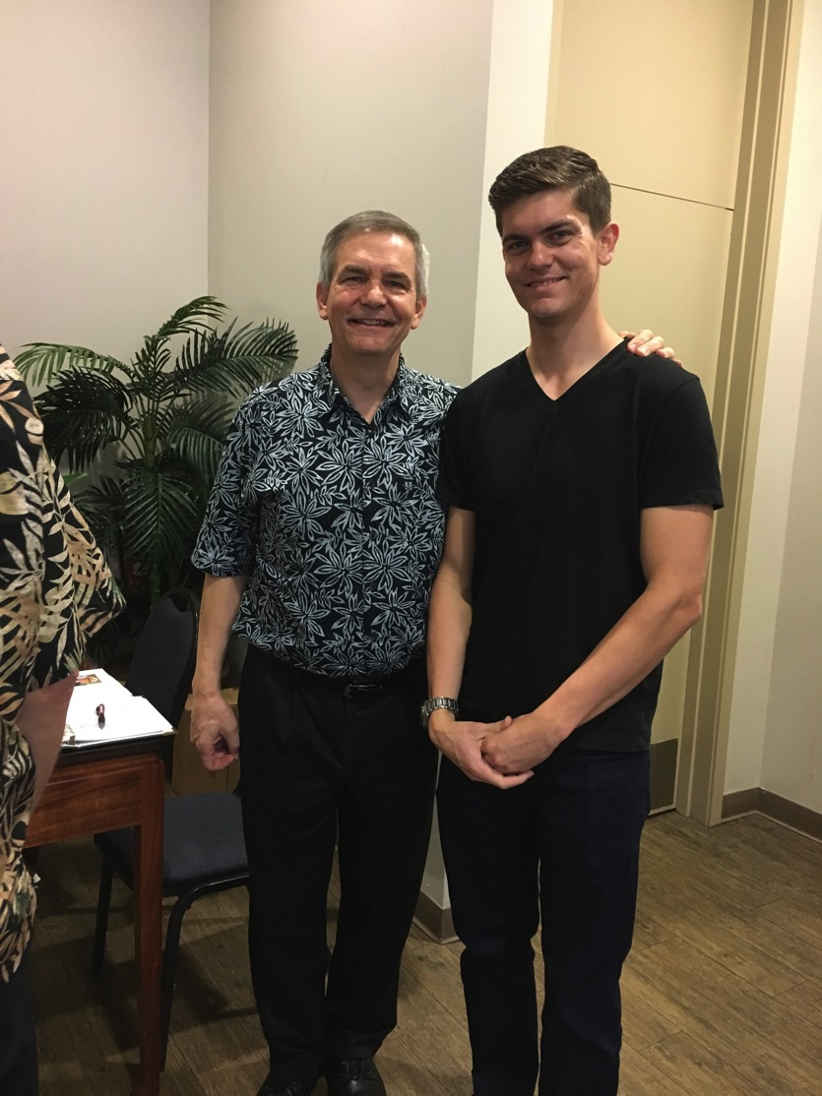
We all need to be comforted
Notes:
As one who often gives comfort, I found myself as one needing to be on the receiving end in January. It was challenging to be both the son and the officiating minister at my father’s memorial service,
• but God granted comfort from this same son, Stephen, who made the effort to fly to be there as a support.

Slide 12
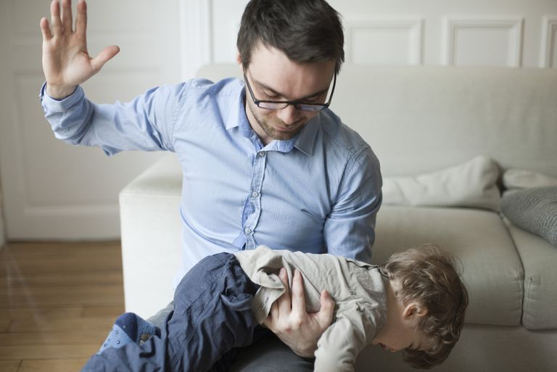
Balance discipline with comfort.
Notes:
Of course, we all know that life is not only about comfort. One of the signs of growing up is to realize that we must balance discipline with comfort.
Discipline shows us when we are off track and need to realign.

Slide 13
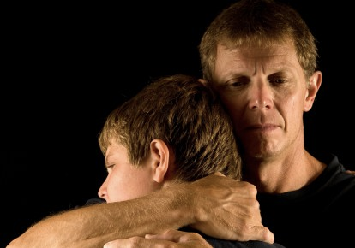
Balance discipline with comfort.
Notes:
But comfort helps us feel appreciated and loved.

Slide 14

Discipline.
Notes:
What images or memories come to your mind when you hear the word "discipline"?
When you were growing up, were you disciplined in a balanced way?
Did you receive mostly harsh discipline?
Or did your parents give you no discipline at all?
Or did you experience a good balance where standards (the principle of the thing) were matched with support? Did you receive comfort along with the discipline?

Slide 15
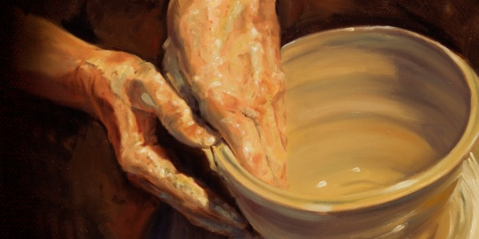
How does God comfort even those he disciplines?
Notes:
In what ways can we see God's compassion even when he has to punish sin?
A good father does not discipline in harshness and then reject and neglect his child.
Like the best earthly father, God wants us to realize that, despite his discipline, he also offers his comfort.

Slide 16
Josiah's Sons & Prophets
232
342
Daniel
605
Ezekiel
City Fell
Jehoahaz
Josiah
Jehoiakim
Jehoiachin
Zedekiah
609
597
586
(3 mos.)
(11 yrs.)
(3 mos.)
(11 yrs.)
Jeremiah
627
Brief Puppet Kings
Notes:
Jeremiah was the only prophet to live through the 586 BC fall of Jerusalem. God called him to show God’s compassion even in Judah’s darkest hours. How? Josiah was the last good king, who died in 609. • After him the reigns of his descendants alternated between 3 months• to 11 years • to 3 months • to 11 years once again! • But God spoke to these godless kings through three major prophets. Jeremiah was the only one to preach in Jerusalem until the city fell in 586, • while Daniel was taken to Babylon in 605 • and Ezekiel in 597.

Slide 17
Key Word
474
343
Inevitable
Jeremiah
Notes:
By the time we get to Jeremiah, God proclaims that the exile will definitely come. It is inevitable.

Slide 18
Theme
474
Deserved Captivity & Undeserved Restoration
Jeremiah
Notes:
Jeremiah’s theme is that captivity is deserved but also the restoration is undeserved and will also happen.

Slide 19
Key Verse
474
"…For the LORD our God has doomed us to perish and given us poisoned water to drink, because we have sinned against him" (8:14b).
Jeremiah
Notes:
Judgment was because of Judah’s sin, as the key verse indicates in 8:14.

Slide 20
Be Comforted
Jeremiah
Dr. Rick Griffith • Crossroads International Church Singapore
CICFamily.com • BibleStudyDownloads.org

Slide 21
How does God comfort even those he disciplines?
4 ways...
Notes:
In what ways can we see God's compassion even when he has to punish sin?

Slide 22
I. God calls messengers who are honest with us (Jer 1).
How does God comfort even those he disciplines?
Notes:
He appoints candid people to show us both his discipline and restoration.

Slide 23
Slides on
Jeremiah 1
Notes:
God comforted Judah through Jeremiah to both judge and restore (Jer 1).

Slide 24
Length of Prophetic Ministries
Isaiah
65 Years
Hosea
45 Years
Jeremiah
40+ Years
Micah
25 Years
Notes:
Jeremiah reveals himself as author and reveals that his ministry lasted over four decades from Josiah's thirteenth year (627 BC) to the exile (1:1-3; 586 BC).

Slide 25
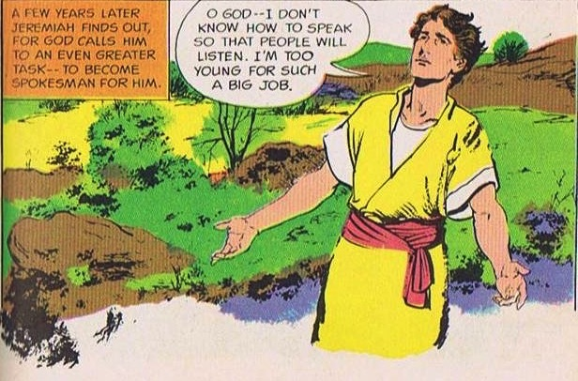
God Calls and Commissions Jeremiah
King Josiah's reign and reforms did not last.
God calls a YOUNG MAN!
Jer. 1:4-9
Source: The Picture Bible (Chariot Books, David C Cook, 1978)
Notes:
When God called and commissioned him to be a prophet Jeremiah was a young man, maybe a teenager, in the thirteenth year of King Josiah's reign. But he protests that he is too young for such a big job.

Slide 26

God's Assurance to Jeremiah
"Before I formed you in the womb
I knew you, before you were born
I set you apart;
I appointed you as a prophet to
the nations…
Do not say, 'I am only a child.'
You must go to everyone I send you to and say whatever I command you. Do not be afraid of them for I am with you and will rescue you… Now, I have put my words in your mouth …
Jer. 1:5, 7-9
Notes:
God assured Jeremiah – He knew, set apart, appointed him. And said he would put His words into His mouth. The Lord reached out His hand and touched his mouth. He is to stand up against nations and kingdoms, uproot and tear them down. He is to build up and plant others.
Jeremiah’s success was not determined by the size of his “church”!
In fact, like Isaiah, Ezekiel, and, frankly, all the prophets, his success was in saying and doing what God commanded to a stubborn and rebellious people who were bent on their own way all their days until the Babylonians stormed the gates of their capital—and remained stubborn and rebellious even afterwards.

Slide 27
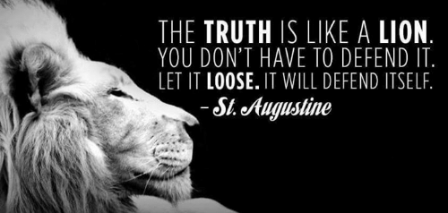
Is God trying to comfort you through his truthful messengers?
Notes:
I will be honest with you—my main goal is to be honest with you!
That honest truth includes both the things we like to hear and those things that we do not like.
• St. Augustine said, “The truth is like a lion. You don’t have to defend it. Let it loose. It will defend itself.”
My prayer is that those of us who need comfort will find it here today. God is, after, the “God of all comfort” (2 Cor). That is the “building up” aspect of pastoral ministry. I have come to build you up.
But God has also called me to “tear down.” That means that God’s primary goal in your life is not to make you comfortable. It is to make you like his son Jesus. That will take some tearing down of patterns that hinder Christlikeness in us.

Slide 28
How does God comfort even those he disciplines?
Notes:
In what ways can we see God's compassion even when he has to punish sin?

Slide 29
I. God calls messengers who are honest with us (Jer 1).
How does God comfort even those he disciplines?
Notes:
He appoints candid people to show us both his discipline and restoration.

Slide 30
II. God has limited discipline but unlimited blessing
(Jer 2–45).
How does God comfort even those he disciplines?
Notes:
The LORD's punishment is always less than his rewards.

Slide 31
Slides on
Jeremiah 2
Notes:
God comforted Judah throughout Jerusalem's fall that the 70-year exile would result in a new covenant (Jer 2–45).
God indicts the nation for its sinful treatment of God seen in its ingratitude, idolatry, immorality, and irrationality (Jer 2; see esp. 2:10-11).

Slide 32
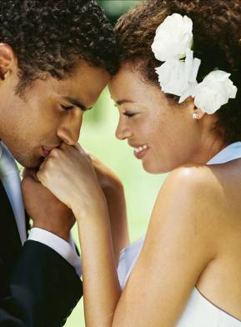

Judah's Relationship With God
A young bride
Unfaithful …. many lovers,
one named Baal
Jer. 2–4
Notes:
So, Jeremiah prophesies before the fall of Jerusalem. He proclaims God has just reasons for judging the nation – its punishment is deserved! God reminds them of the days He blessed them. But they have been idolatrous and spiritually rebellious.
• Judah is like an unfaithful wife who defiled herself with her lovers, to follow Baal and many other gods. He likens Israel and Judah to two sisters. Judah did not learn anything from Israel's judgment! Judgment will come from Babylon, so repent!

Slide 33
Slides on
Jeremiah 6
Notes:
God calls the nation to repent from spiritual adultery to motivate the people to escape the impending judgment of the Babylonians (Jer 3–6).

Slide 34
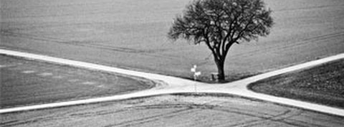
"This is what the LORD says:
'Stand at the crossroads and look; ask for the ancient paths, ask where the good way is, and walk in it, and you will find rest for your souls'"
(Jeremiah 6:16a NIV).
Notes:
This verse reminds us of some of our key priorities based on this theme verse for Crossroads International Church:
1. We must look out for people in need going through various crossroads in their lives.
2. We must prioritize that which is proven and not pursue every new fad that comes down the road.
3. We must instead pursue the Word of God, making the Bible central to all we do—and obey it.
4. We must be a place of rest for people in the very stressed out country of Singapore.

Slide 35
Slides on
Jeremiah 7
Notes:
Jeremiah's temple address aims to convince the people to turn from their false reliance on the temple and idolatry to avoid impending judgment (Jer 7–10).

Slide 36
Worthless Public Worship
Trusted in empty words
And "God will not destroy the temple"
God tells Jeremiah to ...
Stop praying for Judah
Their evil had become unthinkable.
They even sacrificed their own children!
Jer. 7–8
Notes:
Jeremiah preaches at the temple as people came by to worship. He warns them they are trusting in the empty words to save them, thinking God will not allow the temple to be destroyed. They think God will bless Judah no matter how they lived just because of the Davidic covenant. God instructs Jeremiah to stop praying for the people. Their evil had become unthinkable and were even sacrificing their children to pagan gods.

Slide 37
Slides on
Jeremiah 11

Slide 38
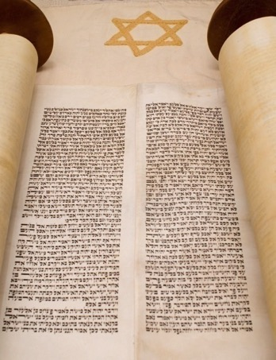

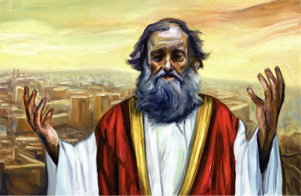
Covenant, Conspiracies & Complaints
Men from Anathoth
conspire to kill him
Jeremiah preaches
Covenant broken
Jeremiah complains
to God;
God encourages him
Jer. 11–12
Notes:
Jeremiah preaches the covenant sermon to proclaim that Judah has violated God's covenant through its idolatry. What is their response? The men of Anathoth, Jeremiah's own home town, plot against his life because they do not like what they hear. Jeremiah struggles from their mocking and persecution. He complains to God about the prosperity of the wicked but God encourages him and warns him to continue. God says, Worse events are coming, but the destruction will bring Judah to repent.

Slide 39
Slides on
Jeremiah 24

Slide 40
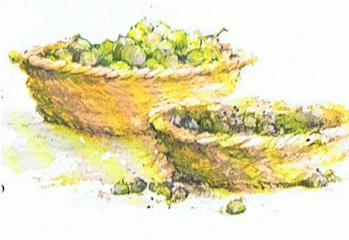
No Repentance in Jerusalem after Nebuchadnezzar
Depiction of People Through Figs at the Temple
Good figs
– Exiles in Babylon who had begun to repent.
– God will take care of them and bring them back.
Bad, rotten figs
– King Zedekiah and his court and all people in Jerusalem
– Still plotting and scheming against Babylon
– Not fit to keep
Jer. 24
Picture Source: The Children's Bible in 365 stories, Lion Publishing, 1985
Notes:
God uses another object lesson of 2 basket of figs in front of the temple. The good figs are those in Babylon whom God will protect, bless and one day restore. The bad figs symbolizes Zedekiah and those who remained in Jerusalem who still refused to submit to Babylon rule. This faithless group will die by sword, famine and disease.

Slide 41
Slides on
Jeremiah 25

Slide 42
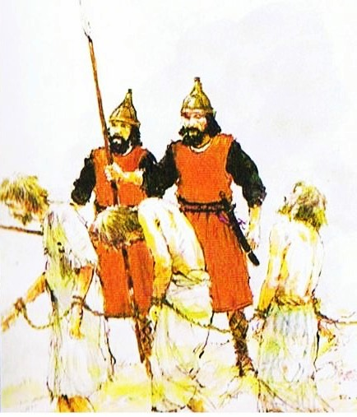
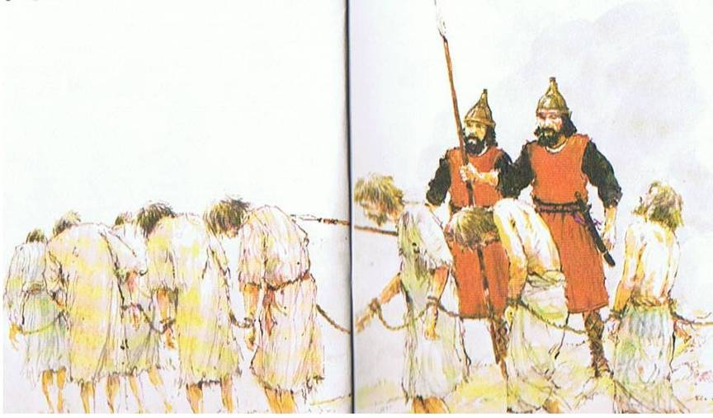
Nebuchadnezzar comes (597 BC)
70-year captivity
predicted
Takes exiles and King Jehoiachin away. Places Zedekiah on throne, gives another chance for Judah to submit to Babylon.
Picture Source: The Children's Bible in 365 stories, Lion Publishing, 1985
Jer. 24–25
Notes:
Now 8 years after Jeremiah's prophecy about Nebuchadnezzar, Nebuchadnezzar came and took King Jehoiachin away with many other exiles. He placed his uncle, Zedekiah (Josiah's other son) in charge and gave Judah one more chance to submit to Babylon's rule.
• Here God revealed to Jeremiah the 70 years captivity.

Slide 43

Two 70-Year Exiles
560
Two 70-Year Exiles
People Exile
605
586
539
536
516
Temple Exile
"'This entire land will become a desolate wasteland. Israel and her neighboring lands will serve the king of Babylon for seventy years. ¹²Then, after the seventy years of captivity are over, I will punish the king of Babylon and his people for their sins,' says the LORD. 'I will make the country of the Babylonians a wasteland forever'" (Jer 25:11-12 NLT).
Notes:
The first exile of people • in 605 was followed by the full destruction of the temple • in 586. These two key dates begin two separate 70-year exiles! • Cyrus decreed that the people could return in 539, • which was completed in 536, which was 70 years after Daniel was taken and can properly be called • the People Exile. But the temple was not rebuilt • until 516, giving us another 70-year exile called • the Temple Exile. God told Jeremiah that the exile would last 70 years (Jer 25:11-12). This was doubly true, whether we consider him talking about the people or the temple! Both lasted 70 years!

Slide 44
Nebuchadnezzar's Six Deportations to Babylon
492
Size | Date | King of Judah | Number taken | Key Captives | Results/ Comments
1 Minor | 605 BC | Jehoiakim | Few (Dan 1:3) | Daniel, 3 friends & nobility & royalty | Tribute imposed. Egypt powerful.
2 Moderate | 598 BC | Jehoiakim | 3023 (Jer. 52:28) |  | Minor deportation
3 Major | 597 BC | Jehoiachin | 10,000 (2 Kings 24:14) | Jehoiachin, Ezekiel, Mordecai | Neb. deports many; installs Zedekiah
4 Minor | 587 BC | Zedekiah | 832 (Jer. 52:29) |  | Before destruction
5 Major | 586 BC | Zedekiah | ca. 10,400 (2 Kings 25:11) | Zedekiah | Jerusalem & temple destroyed
6 Minor | 582 BC |  | 745 (Jer. 52:30) |  | 4 years after Jerusalem's destruction
Notes:
Nebuchadnezzar actually had SIX deportations to Babylon. The 597 BC deportation was the third of the six and the first of 2 major deportations, with 10,000 people deported.

Slide 45
Slides on
Jeremiah 27
Notes:
Jerusalem’s leaders reject Jeremiah and lead to captivity as unavoidable (Jer 26–29).

Slide 46
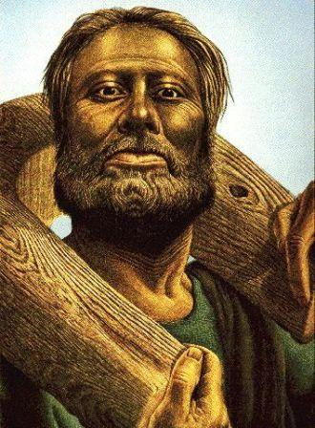
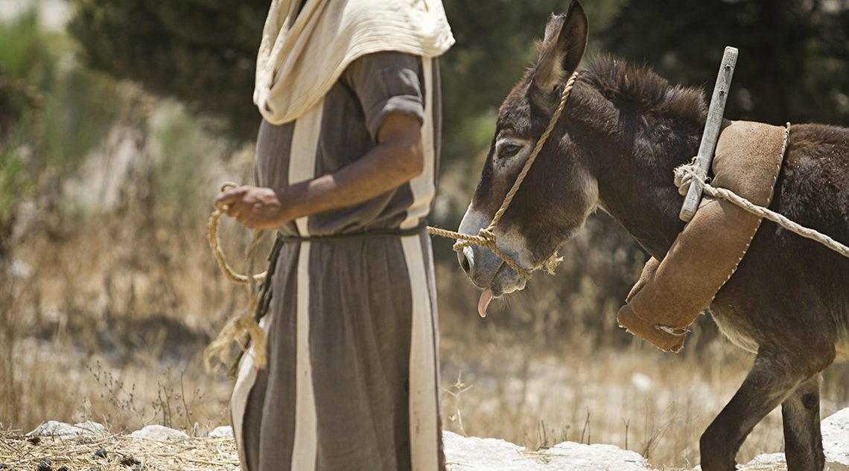
Jerusalem's leaders resist Babylon's rule
Jeremiah wears a yoke to symbolize Judah's
future submission to Babylon.
Jer. 27–28
Notes:
At the beginning of Zedekiah's reign, there is talk of revolt against Babylon. As animals wore a yoke to inndicate their submissions, • so God instructs Jeremiah to wear a yoke to symbolize Judah's future submission to Babylon. God will place all nations under Nebuchadnezzar's yoke; any nation that resisted would perish. He urges the king not to listen to the false prophets.

Slide 47
Slides on
Jeremiah 28
Notes:
The false prophets continued to predict peace for the rebellious people in chapter 28.

Slide 48
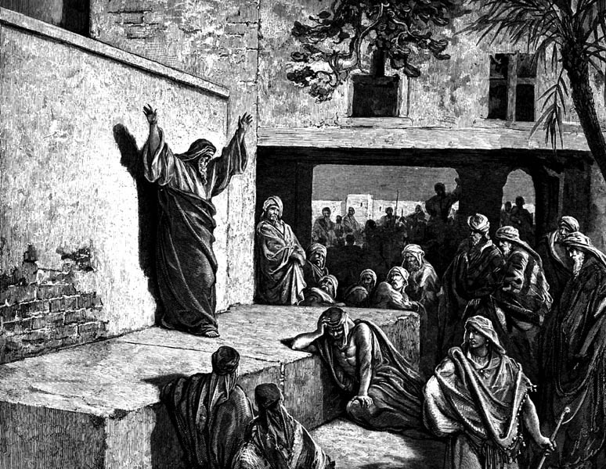
Jeremiah (25:11-12) vs. Hananiah (28:2-3)
True
False
"You'll
stay 70
years!"
"You'll return in 2 years!"
Lived 23 years more (51:64)
Died 2 months later (28:17)
Notes:
One way you can tell a false prophet is if he only predicts good news!

Slide 49
Slides on
Jeremiah 29

Slide 50

How are Prophets Different?
437b-c
Biblical
Pagan
Unsolicited
Divination
Divine call
Prophet himself
Anywhere
Cultic place
Forth-telling
Fore-telling

Slide 51
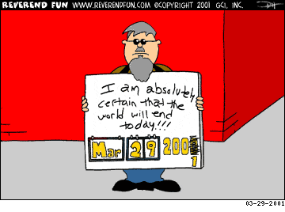
False prophecies change
I am absolutely certain that the world will end today!!!

Slide 52
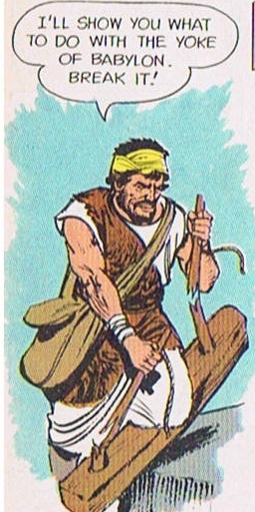
Opposition by False Prophets
The false prophet Hananiah breaks Jeremiah's yoke to symbolize God breaking Babylon's power and claims that the captivity will be only two years. Two months later, he dies.
The false prophet Shemaiah also preaches against Jeremiah.
Jer. 28–29
Notes:
Jeremiah faces serious opposition from false prophets. Hananiah seizes Jeremiah's yoke and breaks it, claiming God would break Babylon's power and the captivity is not 70 years, but only 2 years. Well, he pays for his lies with his own life. He dies 2 months later. After him, Shemaiah the false prophet also opposes Jeremiah.

Slide 53
Slides on
Jeremiah 30
Notes:
Israel’s future restoration with a new covenant (The Book of Comfort) should encourage the remnant that God has not forgotten his promises (Jer 30–33).

Slide 54
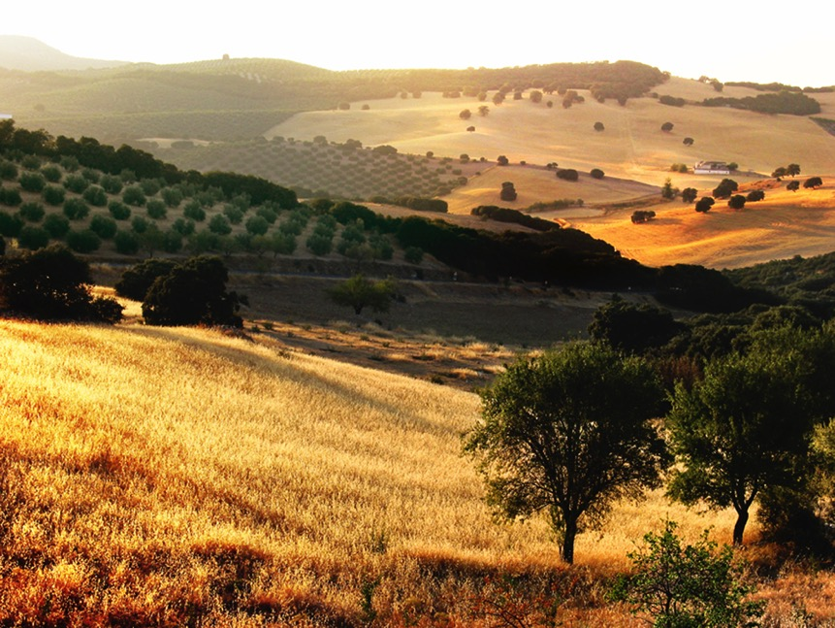
Book of Comfort & New Covenant
Jer. 30–33
Jeremiah redeems a field (Jer. 32) – a sign of hope!
God has not cast aside His people!
A glorious future would follow their judgment.
They will return to the land.
Notes:
Scholars refer to Jeremiah 30-33 as the Book of Comfort or Book of Consolation. Jeremiah's prophecies contained strong words against God's sinful people. But God has not cast aside His people nor forgotten His covenant. He promises a glorious future would follow their judgment and they will return to the land. The Lord instructs Jeremiah to buy a field in Jerusalem from his cousin, Hanamel, as a sign of hope. The land will once again have value and God's people will return to claim it again.

Slide 55
Slides on
Jeremiah 31
Notes:
Israel and Judah will be reunited in the land with a new heart under a new covenant [after Messiah’s second coming] (Jer 30–31).

Slide 56
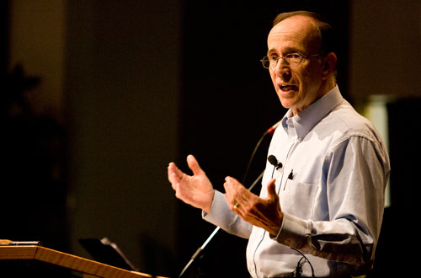
"How to Get Rid of the Jews"
³⁵ This is what the LORD says,
he who appoints the sun
to shine by day,
who decrees the moon and stars
to shine by night,
who stirs up the sea
so that its waves roar—
the LORD Almighty is his name:
³⁶ "Only if these decrees vanish
from my sight," declares the LORD,
"will the descendants of Israel ever cease
to be a nation before me."
³⁷ This is what the LORD says:
"Only if the heavens above can be measured
and the foundations of the earth below be searched out
will I reject all the descendants of Israel
because of all they have done,"
declares the LORD (Jer. 31:35-37 NIV).
Notes:
A pastor once announced to his congregation, • "Next week I will speak on the topic of 'How to Get Rid of the Jews.'" The news spread throughout the small town to the extent that on the next Sunday, after the doors had closed and just before a packed service began, the doors opened again and into the church walked the city's chief rabbi, followed by two of his lawyers! They walked down the center aisle all the way to the front, then took seats in the very front row.
The service continued with songs, prayers, offering and finally the pastor stood at the pulpit. "I am thrilled to see so many at church today, including our distinguished rabbi and his friends. My topic today is 'How to Get Rid of the Jews.' The text is from Jeremiah, chapter 31. Please turn in your Bibles to Jeremiah 31, verse 35.'" [Animate slide and read vv. 35-37]
At this point, the rabbi smiled, the pastor winked, the congregation sighed in relief, and the lawyers realized that their job was over.
God was clear to Jeremiah that his covenant with the Jews is an eternal covenant, not dependent on them. He promised a New Covenant that assures that at some future point the nation will again trust in him by believing in Messiah, after which God will forgive their sins.

Slide 57
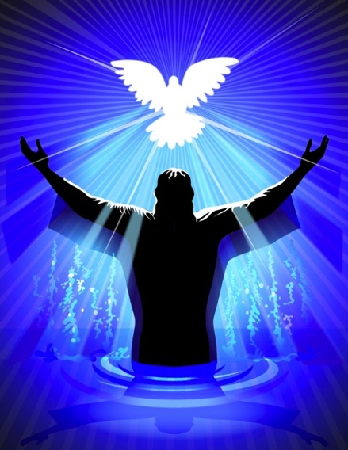

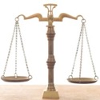
New Covenant & Branch of David
Branch of David – New King
and Priest - Jer. 33
New Covenant – law written on our hearts and Spirit to guide - Jer. 31
Notes:
These wonderful chapters contain the New Covenant where God will forgive Judah's sins, God's laws will be written on their hearts and His Spirit will guide them. Jeremiah also prophesies restoration of Judah under the new King from the Branch of David's line and promises to bless the priesthood.

Slide 58
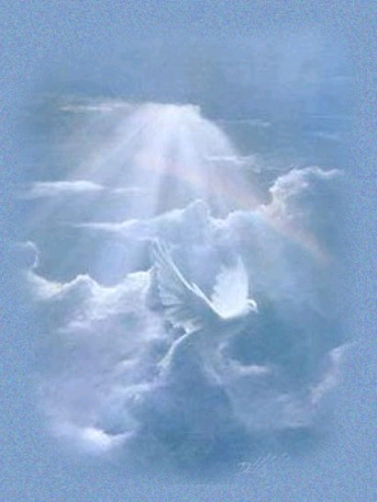
The New Covenant
(Jeremiah 31:31-34)
IN BRIEF
Notes:
These verses are the key verses on the New Covenant in the whole Bible.

Slide 59
Four Unconditional Biblical Covenants
476
ABRAHAMIC
Genesis 12:1-3
BLESSING
LAND
SEED
LAND
Deut. 30:1-10
DAVIDIC
2 Sam. 7:12-16
NEW
Jer. 31:31-34
The new covenant is God's unconditional amplification of the blessing promise in the Abrahamic Covenant where Judah and Israel will experience national and spiritual redemption.
Notes:
Three covenants amplify the Abrahamic covenant. The new covenant was one of them.
(cf. Deut. 30:1-10) promises:
Land from Wadi of Egypt to Euphrates River (Isa. 27:12)
Eternal possession of land (Gen. 17:8) after exile/restoration
Whole world blessed via the land (Isa. 14:1-2)
2 Samuel 7:12-16 promises perpetual:
Sons ("house" never wiped out)
Kingdom (political dynasty)
Throne (right to rule by descendants)
Temple (son to build it)
Jeremiah 31:31-34 promises:
Forgiveness
Indwelling Spirit
New heart, nature, mind
Reunification of Israel and Judah
No need for evangelism

Slide 60

The New Covenant
Jeremiah 31:31-34
³¹"The time is coming," declares the LORD, "when I will make a new covenant with the house of Israel and with the house of Judah.
³²It will not be like the covenant I made with their forefathers when I took them by the hand to lead them out of Egypt, because they broke my covenant, though I was a husband to them," declares the LORD.
³³"This is the covenant I will make with the house of Israel after that time," declares the LORD.

Slide 61
The New Covenant
Jeremiah 31:31-34
^{33b} "I will put my law within them, and I will write it on their hearts. And I will be their God, and they shall be my people. And no longer shall each one teach his neighbor and each his brother, saying, 'Know the LORD,' for they shall all know me, from the least of them to the greatest, declares the LORD. For I will forgive their iniquity, and I will remember their sin no more."

Slide 62
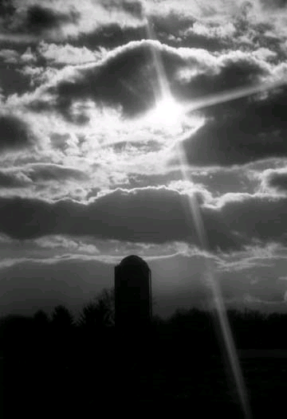
Provisions
477
FULFILLED
Indwelling of the Holy Spirit
(Jer. 31:33 with Ezek. 36:27)
New nature, heart & mind
(Jer. 31:33; Isa. 59:21)
Forgiveness of sins
(Jer. 31:34b)
NOT YET FULFILLED
Everyone will know the Lord
(Jer. 31:34a)
Israel and Judah will be reunited (Jer. 31:31)
Notes:
There are debates about the how far or when or to whom the covenant refers. This is because Jeremiah 31 declares the covenant is for Israel and Judah but in the New Testament it is declared for the church (Luke 22:20; 1 Cor 11:25; 2 Cor.3:6; Heb 8:8;9:15).
So questions arise. Is there a new covenant? Is it especially for the church? Or is it only for Israel? Or was there two covenants? Or are these promises built upon each other?

Slide 63
Kingdom & Covenants Timeline
9g
CH-Add
OS-22
OS-337
NS-9g
Dr. Rick Griffith • Singapore Bible College • BibleStudyDownloads.org
Kingdom Teaching...
Adam rules with God (Gen. 1:26, 28; 2:19)
Satan begins rule as god of this world (Gen. 3:15;
2 Cor. 4:4)
God covenants with Abraham to reestablish man's rule via Israel as a "kingdom of priests" (Gen. 12:1-3; Exod. 19:6)
Israel's failure to witness to nations as a kingdom of priests is judged via exile under foreign rule
Israel rejects Messiah's offer of kingdom (Matt. 12:41-42; 23:37-39)
Jesus extends His kingdom in mystery form to the Church (Matt. 13)
Christ subdues Israel's enemies and nation believes (Rom. 11:26-27)
Christ rules over everything with saints (Eph. 1:9-10; Rev. 20:1-6; 22:5b)
Fall of Man (Gen. 3)
Noahic Covenant
Genesis 6:18; 9:8-17
Land Covenant
ISRAEL
CHURCH
MESSIANIC KINGDOM
(National Focus)
The "New Man" (Eph. 2:15)
Millennial Eternal
22 &
337
land
Genesis 15:18 (cf. Deut. 30:1-10) promises:
Land from Wadi of Egypt to Euphrates River (Isa. 27:12)
Eternal possession of land (Gen. 17:8) after exile/restoration
Whole world blessed via the land (Isa. 14:1-2)
Israel judged for rejecting Messiah by dispersion away from land for 19 centuries
(AD 70–AD 1948) but now partially restored (Ezek. 37:1-7)
Full restoration (Ezek. 37:8-28) Jerusalem world capital
(Isa. 2:1-5)
New Jerusalem
(Rev. 21–22)
Davidic Covenant
Christ is Head over His Church, which is a spiritual temple (Eph. 2:19-22; 2 Cor. 6:16)
Christ reigns over the world
(Isa. 11)
with saints (Rev. 5:10; 20:4-6)
Christ hands kingdom over to Father (1
Cor. 15:24)
Genesis 12:1-3
2 Samuel 7:12-16 promises:
Sons ("house" never wiped out)
Kingdom (political dynasty)
Throne (right to rule by descendants)
Temple (son to build it)
seed
Abrahamic Covenant
New Covenant
All
things made new!
(Rev. 21:5)
All 5 elements fulfilled in national restoration (Zech. 8)
Jeremiah 31:31-34 promises:
Forgiveness
Indwelling Spirit
New heart, nature, mind
Reunification of Israel and Judah
No need for evangelism
Mosaic Law replaced with first three elements of the New Covenant (Luke 22:20; 2 Cor. 3:6)
blessing
Mosaic Covenant
Law abolished, fulfilled, and replaced at the cross (Rom. 7:1-6;
1 Cor. 9:19-21; Heb. 8:13)
Ninth Edition
8 Aug 2020
Temporary (Gal. 3:19) and conditional (Deut. 28) to reveal sin (Rom. 7:7) and regulate Israel (Gal. 3:23-25)
Scripture has a dual kingdom-covenant theme. Israel's role from Abraham to Christ expands to include the Church (continuity) yet the Church never replaces the nation as the "new Israel" (discontinuity). Israel will again enjoy world prominence after trusting Christ at His second coming.
Notes:
All agree that a partial fulfillment of the covenant to Abraham exists now to the Church in the indwelling Holy Spirit and forgiveness of sins (Jer 31:31-34)—and the ultimate fulfillment will be in the eternal state.
The main area of disagreement relates to the time period from now to eternity. Will there be a literal land, throne, and worldwide blessing to national (ethnic) Israel before the eternal kingdom? This chart shows verses giving a resounding YES to that question in a present partial fulfillment and a future full fulfillment in the normal sense of language in the verses cited. But the messianic kingdom will be in two stages—first in a millennial fulfillment to last 1000 years, but then, after that, the eternal stage in the new Jerusalem after the destruction of our present heavens and earth (Rev 21). What an amazing future remains for those who trust Jesus!
____________
CH-02-Nature-103
OS-02-Exodus-267-p22
OS-05-Deut-248-p22
OS-10-2Sam-96-p22
OS-24-Jeremiah-
NS-09-Gal-125
NS-19-Hebrews-319
SA-08-Mosaic Law-19

Slide 64


"Old" Replaced by "New"
Wayne Grudem, Systematic Theology, 521
"What then is the 'old covenant' in contrast with the 'new covenant' in Christ? It is not the whole of the Old Testament, because the covenants with Abraham and David are never called 'old' in the New Testament. Rather, only the covenant under Moses, the covenant made at Mount Sinai (Ex. 19-24) is called the 'old covenant' (2 Cor. 3:14; cf. Heb. 8:6, 13), to be replaced by the "new covenant" in Christ (Luke 22:20; 1 Cor. 11:25; 2 Cor. 3:6; Heb. 8:8, 13; 9:15; 12:24)."
Notes:
Christians are not under the covenant with Moses. We are new covenant believers.

Slide 65

Do you focus on God’s unlimited comfort or his limited discipline?
Notes:
You might ask, “Well which should I focus on? God has both, right?”
Yes, he does. Whatever your concern today, he offers you his unlimited comfort in this Book of Comfort. He cannot care for you more than he does right now!
But he also offers you his limited discipline. He will hold you accountable for how you live—not for salvation, since that is by faith in our Lord Jesus Christ—but accountable for your actions that lead to reward in the coming kingdom. Like the farmer who prunes his plant for greater yield later, he may be trimming you down in discipline for your glorious future.

Slide 66
How does God comfort even those he disciplines?
Notes:
In what ways can we see God's compassion even when he has to punish sin?

Slide 67
I. God calls messengers who are honest with us (Jer 1).
How does God comfort even those he disciplines?
Notes:
He appoints candid people to show us both his discipline and restoration.

Slide 68
II. God has limited discipline but unlimited blessing
(Jer 2–45).
How does God comfort even those he disciplines?
Notes:
The LORD's punishment is always less than his rewards.

Slide 69
III. God applies the same standard to all people
(Jer 46–51).
How does God comfort even those he disciplines?
Notes:
He will judge unbelievers as well as his own people.

Slide 70
Slides on
Jeremiah 46

Slide 71
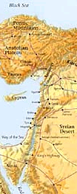
Nations Prophesied Against (46–51)
485
1. EGYPT (46:1-27) - To be defeated by Babylonians
2. PHILISTIA (47:1-6) - To be overrun by Egyptians
3. MOAB (48:1-47) - To be conquered by Babylon
4. AMMON (49:1-6) - To be destroyed and re-established in
the millennium.
5. EDOM (49:7-22) - To become as Sodom and Gomorrah
6. DAMASCUS (49:23-27) - To be destroyed in a single day
7. KEDAR & HAZOR (49:28-35) - To be destroyed by Nebuchadnezzar
8. ELAM (49:34-39) - To be overrun by Nebuchadnezzar and
re-established during the millennium.
9. BABYLON (50:1–51:64) - Final destruction of the empire.
Notes:
However, more than just the people of Judah alone, there were prophecies that were addressed to the other non-Israelite cities in those days.

Slide 72
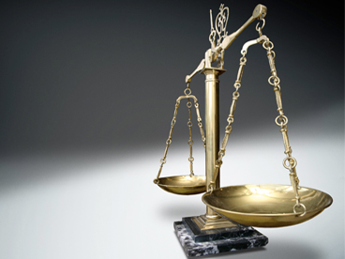
Do you recognize that God has been fair with you?
Notes:
None of these nations received the same level of revelation that Israel got, but they still were responsible based on the moral law that God has put into the heart of every person. They should not have persecuted Israel.
Likewise, God has been and will be fair to you. Now “fair” doesn’t mean that every one of us has had the same experiences in life. It only means that the way God has dealt with you is just—as he dealt fairly with these nations who refused him.

Slide 73
Slides on
Jeremiah 52
Notes:
God balanced Jerusalem’s fall with Jehoiachin’s elevation so the exiles would see that they also would be elevated in a return to the land (Jer 52).

Slide 74
IV. God balances justice with mercy (Jer 52).
How does God comfort even those he disciplines?
Notes:
He judges but also restores.

Slide 75
An Evil End to Judah
256
1
Josiah
640-609
(31 yrs.)
Good king in white
Evil kings in yellow
3
5
2
Johanan
(no rule)
Jehoiakim (Eliakim)
609-597
(11 yrs.)
Zedekiah
(Mattaniah)
597-586
(11 yrs.)
Jehoahaz
(Shallum)
609
(3 mos.)
4
Jehoiachin
(Jeconiah/Coniah)
597
(3 mos.)
Babylon
Exiled
Notes:
The last five kings of Judah comprised only three generations. That's because it was such a turbulent time that two of them served only 3 months each! Josiah was the final good king with a long rule of 31 years,
• but his son Jehoahaz ruled only three months before getting exiled to Egypt, the rising superpower
• who replaced him with his brother Jehoiakim. However, Egypt lost to Babylon, the rising competitor to the north, so the third generation here in the person of
• Jehoiachin also reigned only 3 months like his uncle Jehoahaz. Jehoiachin was then exiled ahead of the rest of Judah to Babylon, and his other uncle,
• Zedekiah, became Judah's puppet king under Babylon. But none of these last four kings would submit to the LORD, and Zedekiah was the last Jewish king to this day. Jeremiah tried to get him to submit to God's discipline, but to no avail. In 586 the city was destroyed, temple was raided and made into ruins, and 10,000 people were forcably exiled to Babylon.

Slide 76
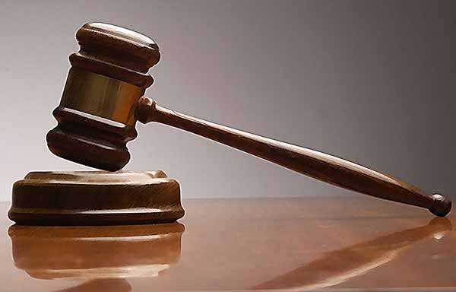
Do you focus on God’s discipline instead of his mercy in your life?
Notes:
Few, if any, of us has had our country totally destroyed, though this still happens today in places like Iraq, Syria, Lebanon, and even closer to home like Jakarta in 1998 when a fourth of the city was destroyed. Yet even in these situations, God has shown his mercy. Many have trusted Christ by being expulse from their country.
But on a more personal level, do you think more of God’s judgment or his grace in your own life? Do you realize have much he has blessed you? The old song tells us to “count your many blessings, count them one by one.” Do you?

Slide 77
How does God comfort even those he disciplines?
Notes:
In what ways can we see God's compassion even when he has to punish sin?

Slide 78
Main Idea of Jeremiah
God works within his own limits so we will submit to his discipline.
Notes:
Be encouraged that the LORD restrains his own punishing our sin for us to return to him.

Slide 79
I. God calls messengers who are honest with us (Jer 1).
How does God comfort even those he disciplines?
Notes:
The LORD assures that he has a representative who tells us both his discipline and restoration.

Slide 80
II. God has limited discipline but unlimited blessing
(Jer 2–45).
How does God comfort even those he disciplines?
Notes:
The LORD's punishment is always less than his rewards.

Slide 81
III. God applies the same standard to all people
(Jer 46–51).
How does God comfort even those he disciplines?
Notes:
He will judge unbelievers as well as his own people.

Slide 82
IV. God balances justice with mercy (Jer 52).
How does God comfort even those he disciplines?
Notes:
He judges but also restores.

Slide 83

APPLICATIONS
Notes:
Where does Jeremiah show up in our lives today?

Slide 84
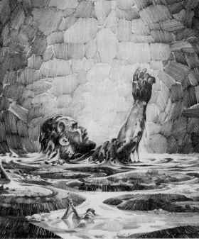
APPLICATION #1: ARE YOU LIKE JEREMIAH?
The prophet Jeremiah's life illustrates how costly serving the Lord can be.

Slide 85

Jeremiah's Difficult & Sacrificial Ministry
Preached for 40+ years
Noted people's sins to show God's justice
Preached accepting God's discipline by submitting to 70-year Babylonian captivity
Commanded to remain unmarried (16:2)
Persecuted by his family, hometown people and the religious world
Thrown into prison (37:5)
Carried off by force to Egypt where he continued to preach against sin (43:1-7)
Notes:
• He remained faithful over the long haul—are you?
• He did not shy away or reinterpret God’s difficult words to those who needed to see he was fair (just) to them for their sins
• His message was so out-of-the-ordinary that he even told his people to give up during war
• Singleness may not have been his preference, but he submitted to God’s will here
• His family rejected him, as did his hometown people. - Therefore thus says the LORD concerning the men of Anathoth, who seek your life, and say, "Do not prophesy in the name of the LORD, or you will die by our hand"
• He was thrown into prison after being accused of being in league with the enemy by Zedekiah
• He was forced to go to Egypt. How would you feel if you were forced to do something against your own will?
After the fall, facing the prospect of real trouble from Babylon, the people sought Jeremiah's advice.
Jeremiah told God wanted them to stay in the land but they rejected his counsel.
A large group still fled to Egypt, taking Jeremiah and Baruch.
Even in Egypt, Jeremiah continued to prophesy that God would use Babylon to judge Egypt.

Slide 86
God's Assurance to Jeremiah
"Before I formed you in the womb
I knew you, before you were born
I set you apart;
I appointed you as a prophet to
the nations…
Do not say, 'I am only a child.'
You must go to everyone I send you to and say whatever I command you. Do not be afraid of them for I am with you and will rescue you… Now, I have put my words in your mouth …
Jer. 1:5,7-9
Notes:
God assures Jeremiah – He knew, set apart, appointed him. And said he would put His words into His mouth. The Lord reached out His hand and touched his mouth. He is to stand up against nations and kingdoms, uproot and tear them down. He is to build up and plant others.

Slide 87
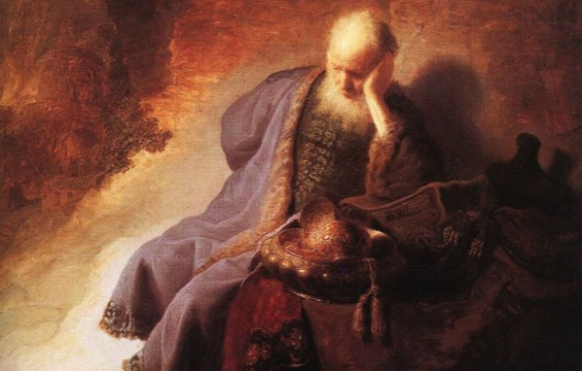
Are You Like Jeremiah?
  How does Jeremiah's costly service convict you of what you need to do to be more faithful and obedient to God?
  Do you question your calling? Do you resent the task God has given you to do?

Slide 88
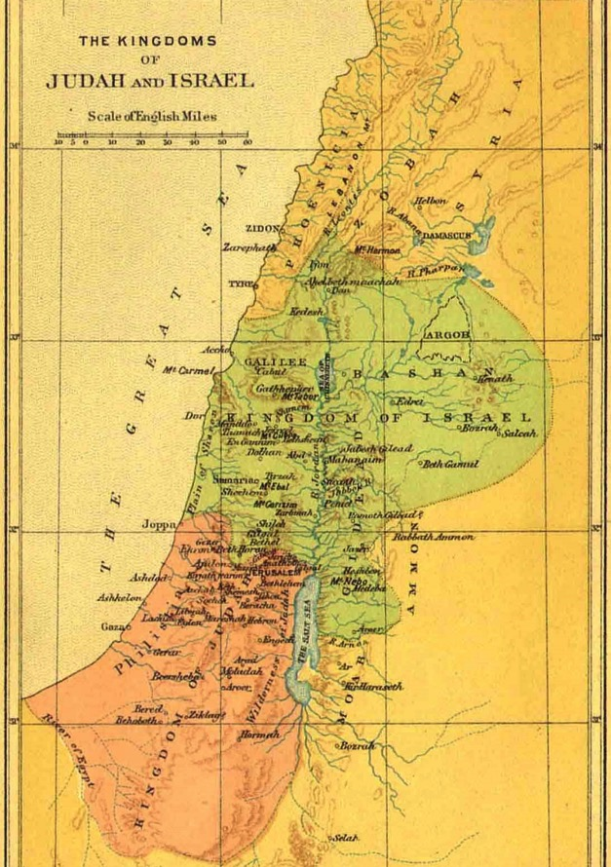
APPLICATION #2: ARE YOU LIKE JUDAH?
If we choose to continue to sin we'll eventually come to the point where God's discipline is inevitable.

Slide 89
Judah's Sin
"Even the stork that flies across the sky knows the time of her migration, as do the turtledove, the swallow, and the crane. They all return at the proper time each year.
But not my people! They do not know the LORD’s laws."
Animals observe God's laws but not God's people.
People act as though they have never heard His laws.
Jeremiah 8:7 NLT
Notes:
Judah’s sin focused on “I” priorities: ingratitude, idolatry, immorality, irrationality

Slide 90
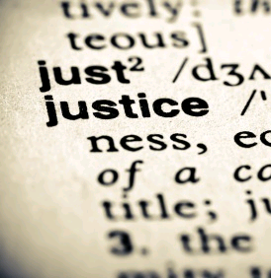
Judah's Sin Eventually Resulted in God's Discipline
  Judah's kings and leaders were judged and punished. Jeremiah 22
2. Jews endured 70 years of Babylonian exile. Jeremiah 25:11
  God also judged nations that persecuted Judah.
  Jeremiah 46–51
Notes:
Jehoahaz will be judged through his death in exile (22:10-12).
Jehoiakim will be judged through a terrible death without burial (22:13-23).
Jehoiachin will be judged by not having any of his immediate descendents sit upon the throne (22:24-30)

Slide 91
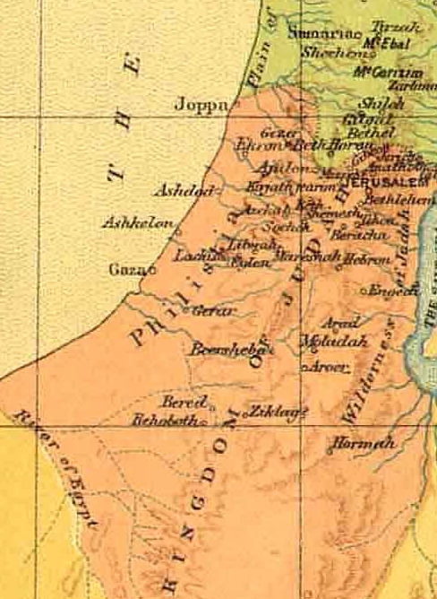
Are You Like Judah?
  In what area of your life do you continue in sin or resist repenting?
  Do you accept God's just discipline?

Slide 92
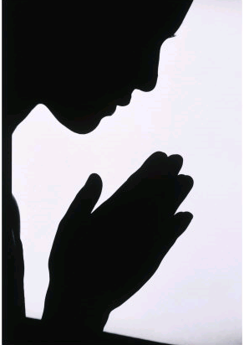
APPLICATION #3: ARE YOU LIKE THE FAITHFUL REMNANT?
There is hope after discipline because God's justice is balanced with mercy and faithfulness.

Slide 93
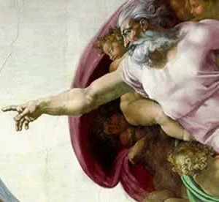
Nature of Judgment in Jeremiah
1. Against both Judah and Gentile Nations
2. Reveals God's justice, sovereignty, faithfulness and mercy
3. Balanced with hope in New Covenant and Restoration

Slide 94

Are You Part of the Faithful Remnant?
NO HOPE?
  Do you put your hope in your faithful and merciful God?
  Do you look forward to the Day of the LORD and the complete restoration it promises?
or...

Slide 95
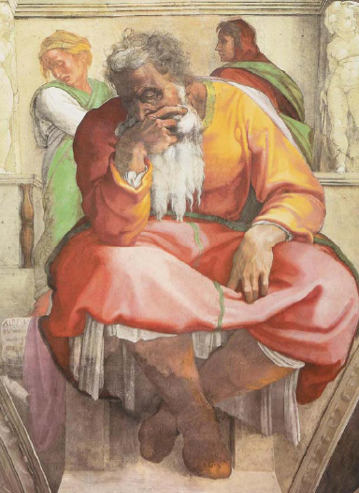
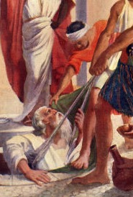
How Then Should You Live?

Slide 96
Black

Slide 97


OT Preaching link at BibleStudyDownloads.org
Get this presentation and script for free!

