Slide 1
3 Reasons to
Isaiah 9:1-7
Preached by Dr. Jim Harmeling at Crossroads International Church Singapore • cicfamily.com Uploaded by Dr. Rick Griffith • Singapore Bible College Files in many languages for free download at BibleStudyDownloads.org

Slide 2
What is your top reason for celebrating Christmas?

Slide 3
3 Reasons to
Isaiah 9:1-7

Slide 4
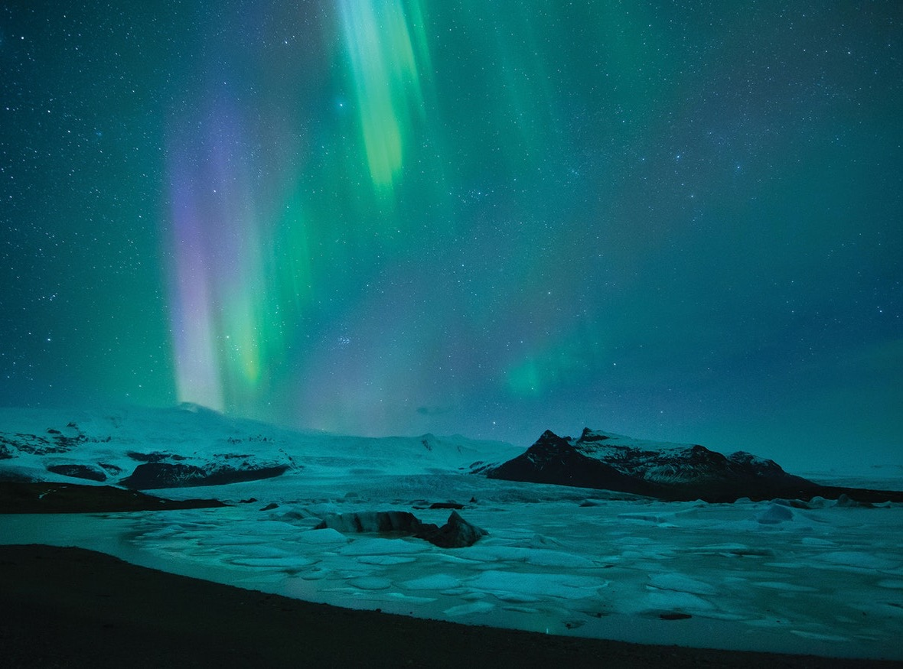
God says the future is bright
(Isaiah 9:1-3)

Slide 5
Matthew 4:13-17
¹³ And leaving Nazareth he went and lived in Capernaum by the sea, in the territory of Zebulun and Naphtali, ¹⁴ so that what was spoken by the prophet Isaiah might be fulfilled:
¹⁵ “The land of Zebulun and the land of Naphtali, the way of the sea, beyond the Jordan, Galilee of the Gentiles—¹⁶ the people dwelling in darkness have seen a great light, and for those dwelling in the region and shadow of death, on them a light has dawned.”

Slide 6
God will relieve human oppression in impossible ways (v. 4)
Matthew 11:28-30
²⁸ Come to me, all who labor and are heavy laden, and I will give you rest. ²⁹ Take my yoke upon you, and learn from me, for I am gentle and lowly in heart, and you will find rest for your souls.
³⁰ For my yoke is easy, and my burden is light.”

Slide 7
God will relieve human oppression in impossible ways (v. 4)
God will end all military combat (v. 5)
Isaiah 2:4
“He shall judge between the nations, and shall decide disputes for many peoples; and they shall beat their swords into plowshares, and their spears into pruning hooks; nation shall not lift up sword against nation, neither shall they learn war anymore.”

Slide 8
God will relieve human oppression in impossible ways (v. 4)
God will end all military combat (v. 5)
God will send a man to permanently lead us (vs. 6-7)
“Wonderful counselor”

Slide 9
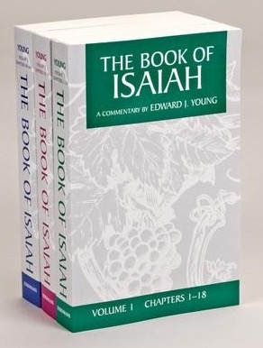
“The Old Testament usage of this word compels us to the conclusion that it here designates the Messiah not merely as someone extraordinary, but as One who in His very person and being is a Wonder; He is that which surpasses human thought and power; He is God Himself.”

Slide 10
God will relieve human oppression in impossible ways (v. 4)
God will end all military combat (v. 5)
God will send a man to permanently lead us (vs. 6-7)
“Wonderful Counselor”
“Mighty God”
“Everlasting Father”
“Prince of Peace”

Slide 11
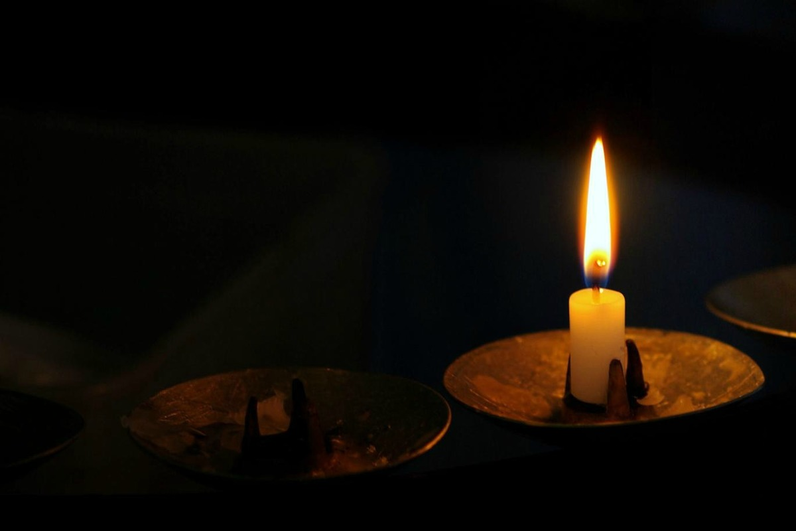

Slide 12
Black

Slide 13
OT Preaching link at BibleStudyDownloads.org
Get this presentation for free!
Notes:
OT Preaching (op)

