Slide 1
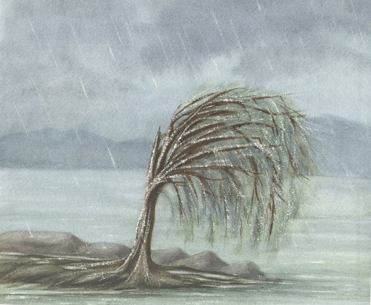
The Call to Endure
Isaiah 6
Dr. Rick Griffith • Crossroads International Church Singapore
CICFamily.com & BibleStudyDownloads.org

Slide 2
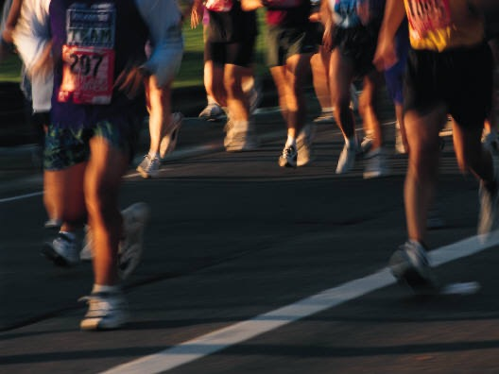
The Marathon
Notes:
I wonder how many joggers we have here? Raise your hands please. I respect you all, but I never understood why people jog.
You always end up right where you started—but more tired.
I think most people jog early in the morning because this is before their brain figures out what they're doing.
I guess there is one advantage, though—you die healthier!
No, seriously, for every mile you jog, you add one minute to your life. This enables you, at the age of 85, to spend an additional five months in a nursing home at $5000 a month.

Slide 3
The Marathon
Ministry
V
Notes:
However, one race we cannot avoid is the Christian race—and for us who are serious about Christ, the ministry marathon.
This makes me think of my friend John. He took preaching with me in seminary. He always had perfect sermons—flawless delivery, insightful comments, nice balance between humor and seriousness.
In fact, out of 300 graduating preachers, the school had the four best speakers each preach in chapel the last week of class—and John was one of those four.
Of course, every guy's wife always came to hear her husband preach on his day. Do you know what John's wife told him the morning he was to preach? Not only was she NOT coming, but she was divorcing him. The last I heard of John, he was selling tires for a living, a lonely man. He started his race well, but didn't finish well.

Slide 4
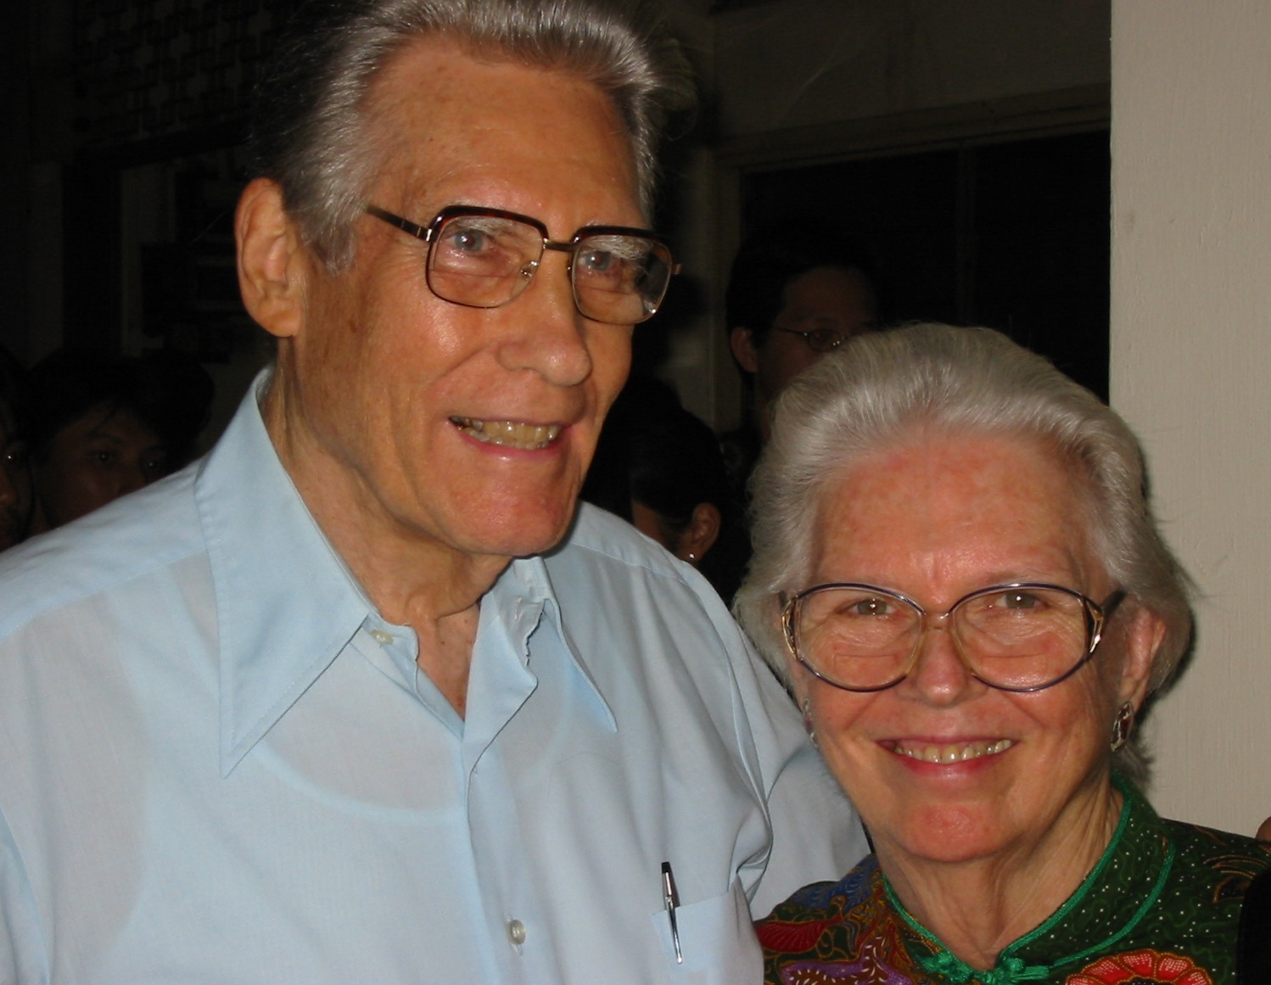
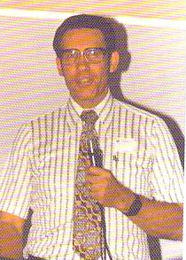
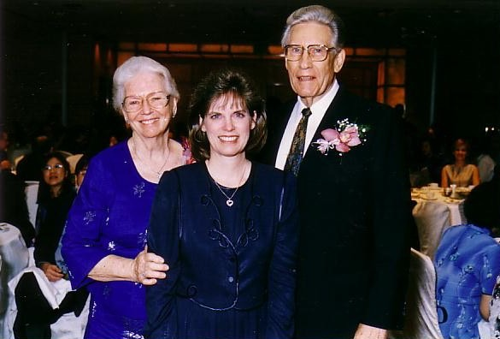
Dr. & Mrs. Poulson
Notes:
On the other hand, others faithfully run the race for decades.
Dr. Ernie Poulson arrived in Singapore as a missionary on March 17, 1953. Yes, he and his wife have served faithfully in Singapore for 62 years! They have run their marathon well.

Slide 5
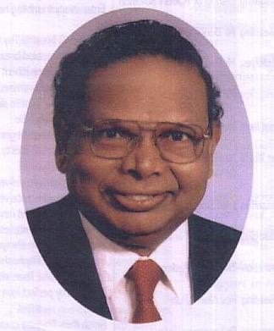
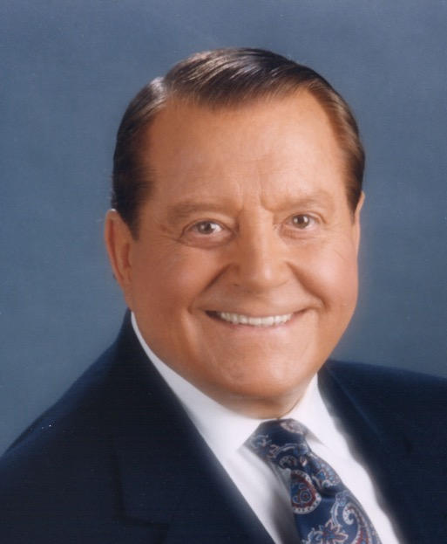
Black Slide
Dr. G. D. James
Dr. Bill Bright
Notes:
Two well-known runners finished their race in 2004: Dr. G. D. James who founded Asia Evangelistic Fellowship and Dr. Bill Bright, founder of CCC.

Slide 6

The Call to Endure
Notes:
Need: How about you? Will you serve Christ for the long haul? Will you end faithful?
Will you be married to your same spouse 20 years from now?
Will you be a John or a Dr. Poulson?
Will you be faithful or not in your own marathon?

Slide 7
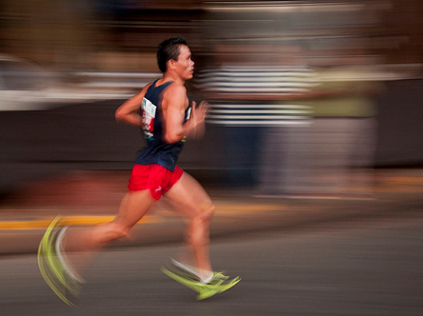
How can you run the marathon— serve Christ for the long haul?
Tips on running our spiritual marathon
Notes:
How can you still be hanging in there faithfully with God after many years?

Slide 8
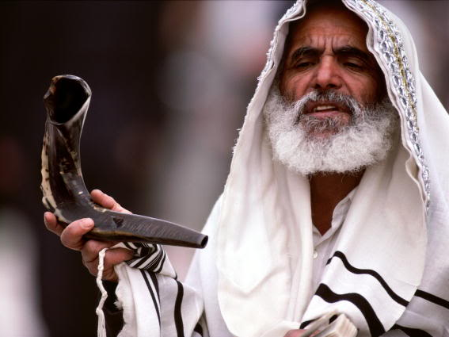
Who was Isaiah?
Notes:
To know how to serve Christ long-term it's great to have a good model to follow—like Isaiah.

Slide 9

When Isaiah Wrote
453
End of the
Kings of Israel
Pekah
Hoshea
Kings of Judah
Uzziah
Jotham
Ahaz
Hezekiah
Isaiah's 60-Year Ministry
(739-680 BC)
Notes:
9
Isaiah 1:1 says [read] which means that his ministry lasted about 60 years (739-680 BC)!

Slide 10
The Assyrian Threat
Assyrian Expansion
Nineveh
Mediterranean
Sea
Syria
Israel
Judah
Persian
Gulf
Egypt
Notes:
He saw Assyria advance westward to destroy Israel and almost all of Judah.
How did he run the marathon so faithfully for so long?

Slide 11
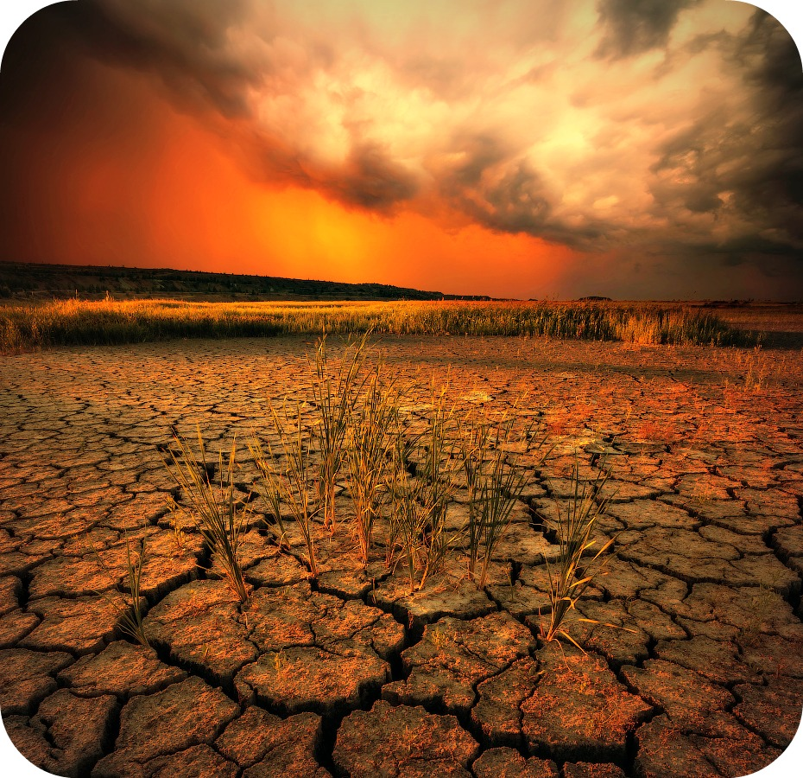
Isaiah 6:
The Call to Endure
Notes:
Isaiah 6 will give us a couple of training tips on how to faithfully persevere in the Christian life.
The first way to serve faithfully in your marathon for Christ is to realize that…

Slide 12

I. God called you to run the race (6:1-8).
Notes:
See the Lord's holiness and say "yes" to his call!

Slide 13
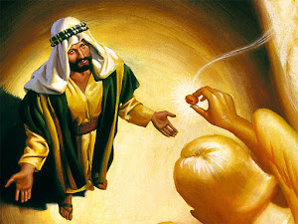
God's Vision
God showed Isaiah his holiness (6:1-4).
Notes:
Read verses 1-4

Slide 14
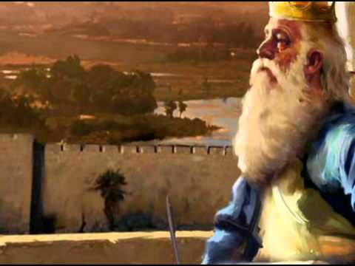
"In the year King Uzziah died…"
Notes:
Uzziah was mostly a godly king—but the people continued in idolatry.

Slide 15
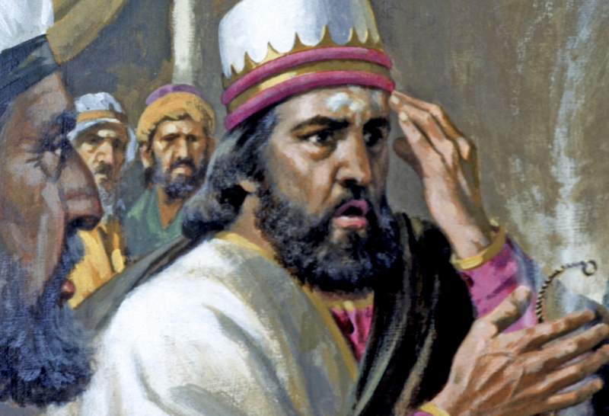
"In the year King Uzziah died…"
Notes:
However, at the end of his life he proudly took the role of a priest, entered the Temple, was struck with leprosy, and lived out his days in a separate house. How sad…

Slide 16
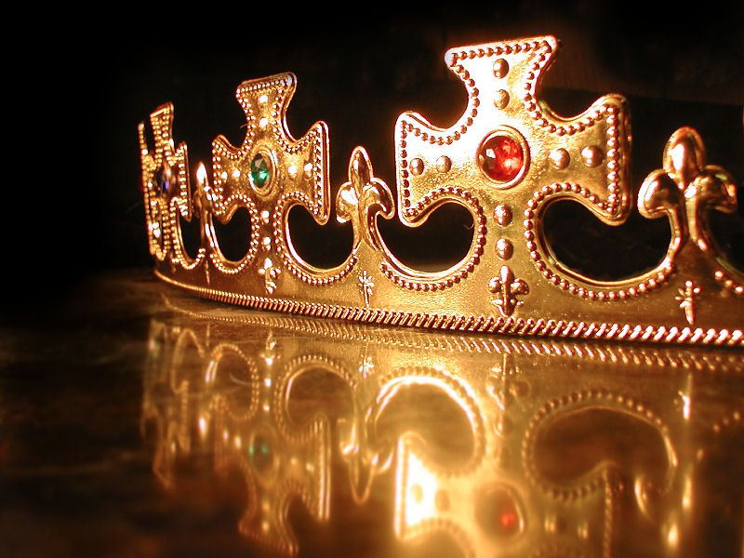
"In the year King Uzziah died…"
Notes:
Still, this must have been a difficult era for Judah, especially if their sights were on their earthly king. This was the perfect time to focus on their heavenly king!

Slide 17
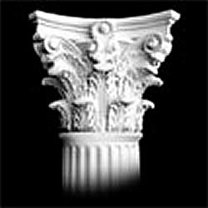

Contrasts…
Uzziah
God and/or Isaiah
Died in 739 BC
Very much alive
Sinful people
Holy
Proud king
Humble prophet
Leper
Ceremonially clean
Excluded from Temple
Worshipped at Temple
Notes:
One scholar points out, "This time notation points to a contrast between the human king and the divine King (v. 5), God Himself and to some contrasts between Uzziah and Isaiah. In Uzziah's long (52-year), prosperous reign (2 Chron. 26:1-15) many people were away from the Lord and involved in sin (2 Kings 15:1-4; Uzziah is also called Azariah). By contrast, God is holy (Isa. 6:3). In pride, Uzziah disobediently entered the temple (insensitive to the sin involved) and was struck with leprosy which made him ceremonially unclean (2 Chron. 26:16-20). Isaiah, however, was sensitive to sin, for he stated that he and his people were spiritually unclean (Isa. 6:5). Though Uzziah was excluded from the temple (2 Chron. 26:21) Isaiah was not" (John A. Martin, "Isaiah," in The Bible Knowledge Commentary, 1:1044).

Slide 18
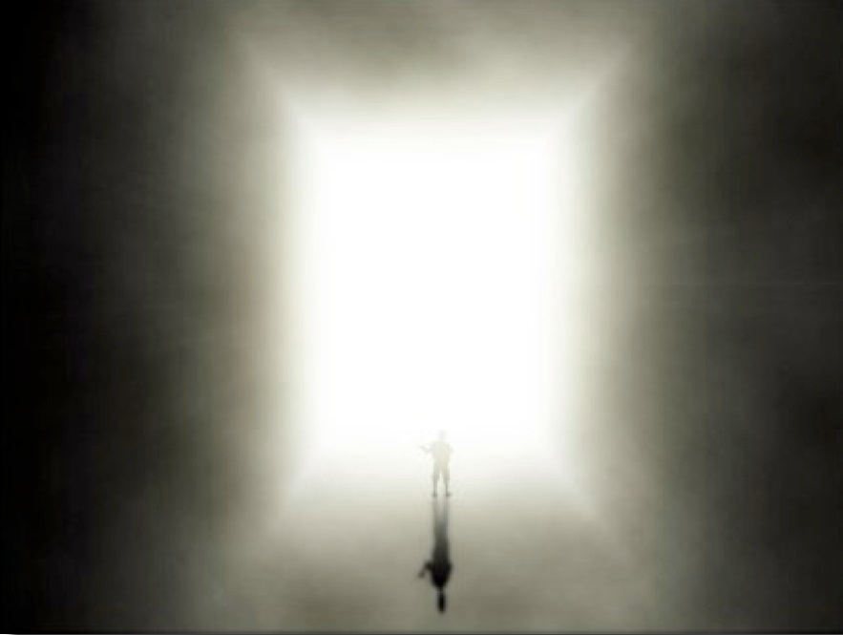
"I saw the LORD"
Notes:
The important part is that Isaiah saw the Lord!
Even kings don't get to see God—but those God calls get to see him!

Slide 19
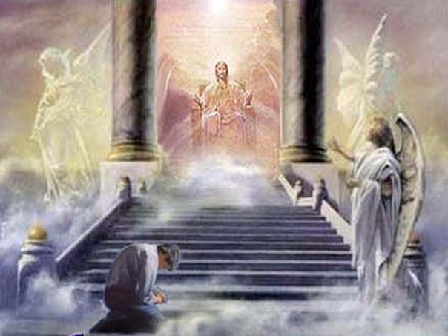
"It was in the year King Uzziah died that I saw the Lord. He was sitting on a lofty throne, and the train of his robe filled the Temple"
(Isa. 6:1 NLT).
Notes:
Was this throne on earth or in heaven (1b)?
Arguments have been posed for both, but no one really knows whether this is an earthly Temple and throne or a heavenly one.
However, if the throne and Temple were in the same place, they would both be in heaven.

Slide 20
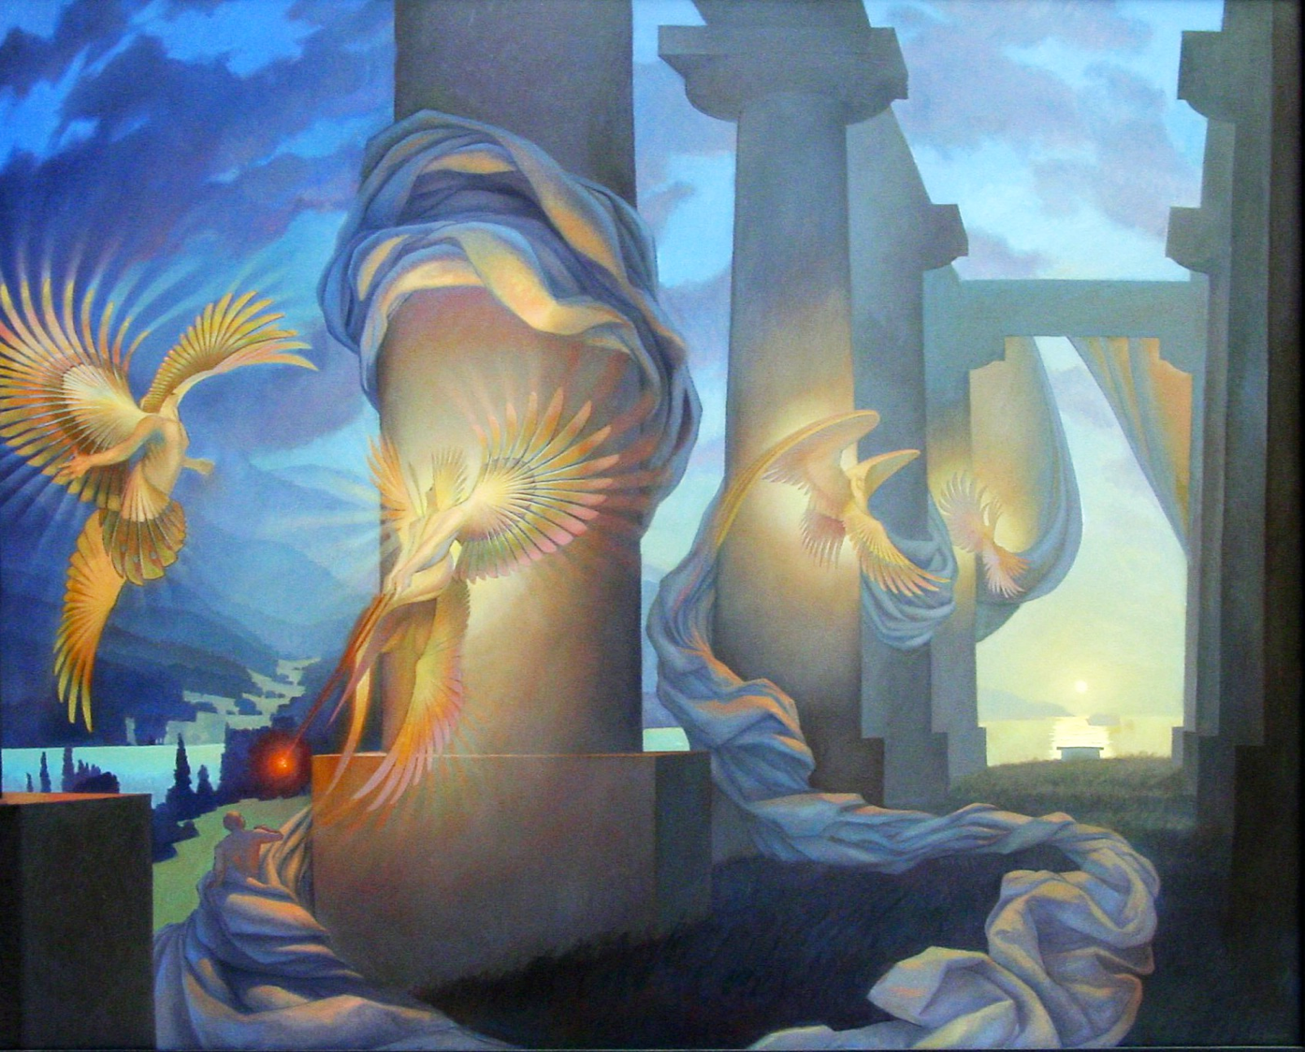
"The train of his robe filled the Temple"
Notes:
What does "the train of his robe filled the Temple" indicate (1c)?
Perhaps God was on his heavenly throne, but his glory went all the way down to earth and filled the earthly Temple! I can't say for sure, though.
The point is that, during national sorrow, God still reigns! He also still calls his people.

Slide 21
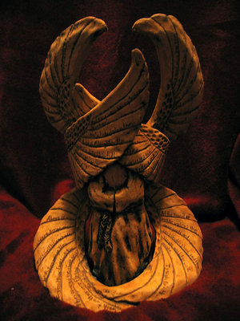
"Attending him were mighty seraphim, each having six wings. With two wings they covered their faces, with two they covered their feet, and with two they flew"
(Isa. 6:2 NLT)
Notes:
What's the deal with the angels covering three parts of their bodies (2)?
• Faces: The name seraph means, "burning one" and yet they hid their faces from God, who had a far greater brightness and glory (Grogan)! Others think burning means that they burned with zeal for God (BKC).
• Feet: They covered their feet as a sign of humility (Grogan).
• Flying: The other wings enabled them to move about.

Slide 22
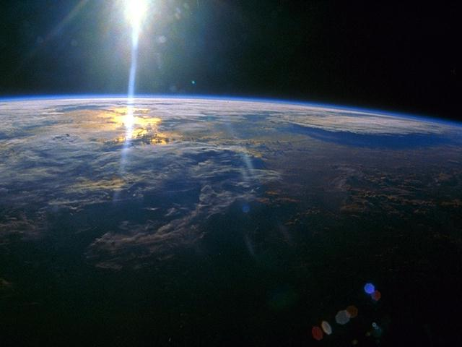
"They were calling out to each other,
'Holy, holy, holy
is the LORD of Heaven's Armies!
The whole earth is filled with his glory!'"
(Isa. 6:3 NLT)
Notes:
This emphasizes God's essential nature as totally pure.

Slide 23
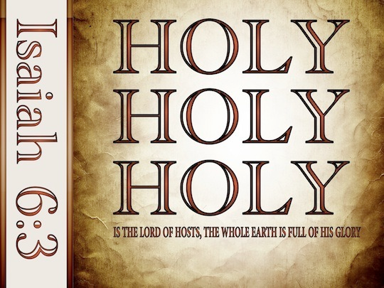
Holy, Holy, Holy!
Notes:
Nowhere in the Bible do we see any other attribute of God in a threefold repetition: "glory, glory, glory" or "all powerful, all powerful, all powerful" or "omnipresent, omnipresent, omnipresent" or any other quality of God.
This may indicate the Trinity, but, more than that, it reminds us that God is completely without sin. This can be said of no other god, showing our God as unique.

Slide 24
"Their voices shook the Temple to its foundations, and the entire building was filled with smoke" (Isa. 6:4 NLT).
Notes:
The voice of the angels shook the Temple!

Slide 25
"Then I said, 'It's all over! I am doomed, for I am a sinful man. I have filthy lips, and I live among a people with filthy lips. Yet I have seen the King, the LORD of Heaven's Armies'" (Isa. 6:5 NLT).
Notes:
Isaiah's Response: He humbly volunteered to be sent (6:5-8).
We will never be any good for God until we see that he is good for us.

Slide 26
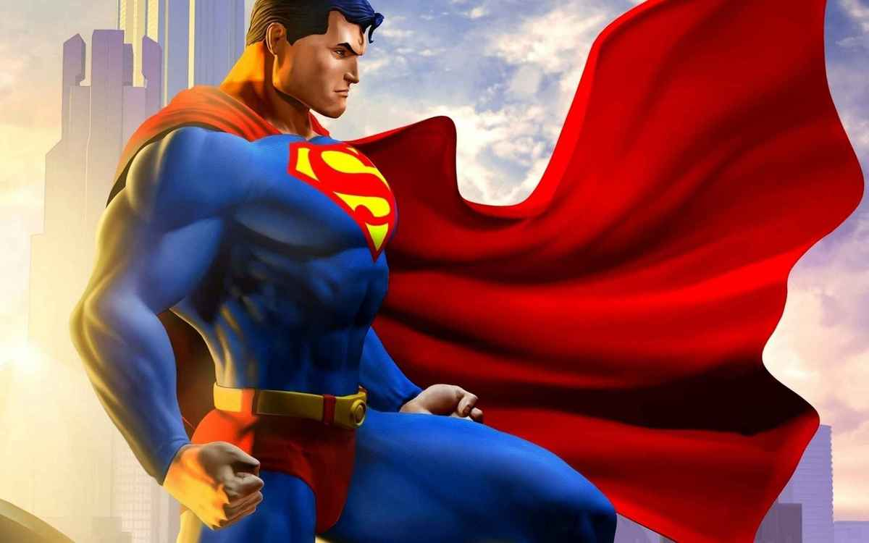
"God, spare us from illusions about ourselves!"
Notes:
We cannot serve out of our capacity; we can only fall at his feet to serve out of our weakness and his strength.
Isaiah stands in stark contrast to the rest of the nation that justified themselves in the midst of their idolatry!

Slide 27
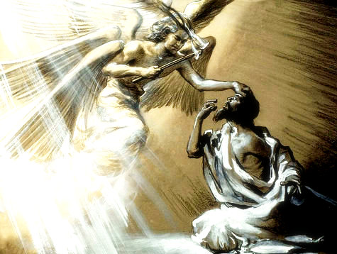
"Then one of the seraphim flew to me with a live coal in his hand, which he had taken with tongs from the altar" (Isa. 6:6 NLT)
Notes:
"This vision of God's majesty, holiness, and glory made Isaiah realize that he was a sinner. When Ezekiel saw God's glory he too responded with humility. (Cf. the responses of Job, Job 42:5-6; Peter, Luke 5:8; and the Apostle John, Rev. 1:17.)" (BKC).
We need God's forgiveness ourselves before we can convince others that they also can be forgiven.

Slide 28
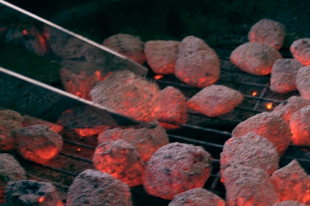
Hot! Hot! Hot!
Notes:
Rather than holy, holy, holy, I'd say hot! Hot! Hot!

Slide 29
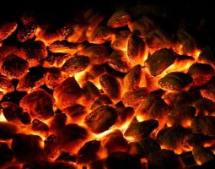
"He touched my lips with it and said, 'See, this coal has touched your lips. Now your guilt is removed, and your sins are forgiven'" (Isa. 6:7 NLT)
Notes:
Isaiah allowed the coals to purify him from his own sin.
"Before we can minister to others, we must permit God to minister to us. Before we pronounce 'woe' upon others, we must sincerely say, 'Woe is me!'" (Wiersbe, 37).

Slide 30
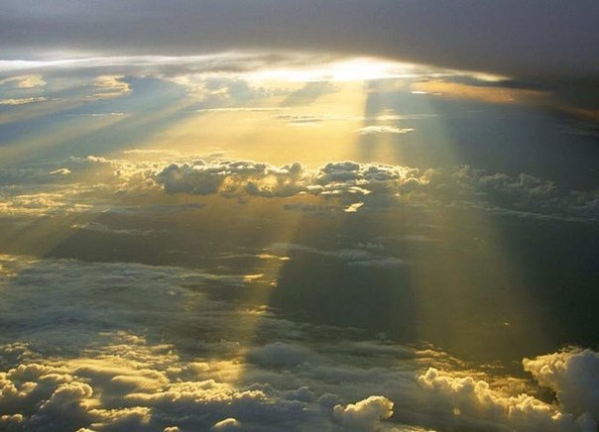
"Then I heard the Lord asking, 'Whom should I send as a messenger to this people? Who will go for us?' I said, 'Here I am. Send me'" (Isa. 6:8 NLT)
Notes:
Why would God need to send a messenger to his people (8)? Why couldn't God just tell them by himself?
God does the work—but he does it through people.
A cook can make a great meal—but the cook does it through instruments like pots, pans, and knives.
Likewise, we are but tools in God's hands—yet we need to be willing tools, as he does not force his will upon us.

Slide 31
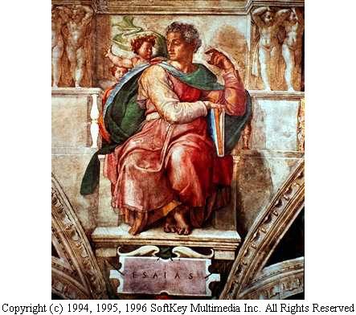
Call of Isaiah (6:1-8)
"Who will go for us?" "I will!"
Notes:
Is this just about Isaiah's call? No. God also called you into his service!

Slide 32
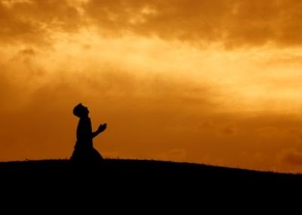
"Here am I. Send me!"
Notes:
We typically think of ourselves as doing something for God. How arrogant!
The reality is that God is the Grand Coach and he calls us to serve on his team! How amazing!

Slide 33
How can you run the marathon— serve Christ for the long haul?
Tips on running our spiritual marathon

Slide 34
I. God called you to run the race (6:1-8).
Notes:
See the Lord's holiness and say "yes" to his call!

Slide 35
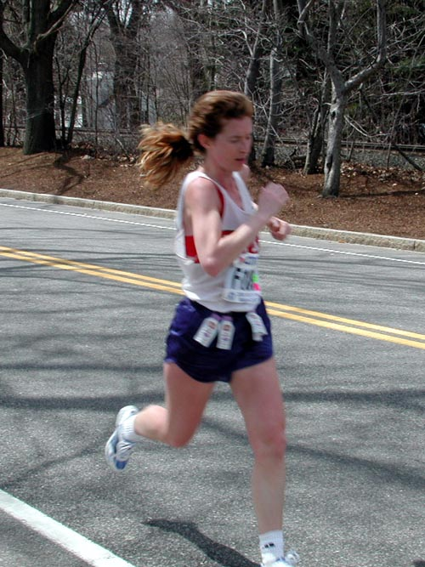
II. A marathon isn't easy but you will succeed
(6:9-13).
Notes:
Ministry is tough, but ultimately God will bless our endurance.

Slide 36

God called Isaiah:
"Preach to people who won't listen" (6:9-10)
Notes:
Wow, I hope that’s not my calling!

Slide 37
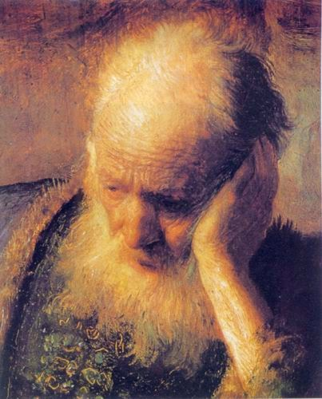
Rejection
"And he said, 'Yes, go, and say to this people, "Listen carefully, but do not understand. Watch closely, but learn nothing." ¹⁰Harden the hearts of these people. Plug their ears and shut their eyes. That way, they will not see with their eyes nor hear with their ears, nor understand with their hearts and turn to me for healing'"
(6:9-10 NLT).
Notes:
Why the warning to tell the people so they will not believe (9-10)? Aren't we supposed to witness to people so they will believe?
Of course, we want people to trust Christ. God does also, as he says that he does not want anyone to perish (2 Pet. 3:9).
But the response of people to our message is not our responsibility—it is their own will.
These verses actually look forward to people's reactions to Jesus and his message, as the gospel of John notes. John 12:41 says, "Isaiah was referring to Jesus when he said this, because he saw the future and spoke of the Messiah's glory."

Slide 38
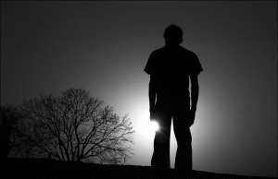
How long, O LORD?
"Then I said, 'Lord, how long will this go on?' And he replied,
'Until their towns are empty,
their houses are deserted,
and the whole country is a wasteland;
¹²until the LORD has sent everyone away,
and the entire land of Israel lies deserted'"
(6:11-12 NLT).
Notes:
If God called you to stubborn people, probably one of your first questions would be, “Well, OK, but for how long?” At least there must be some comfort if you were rejected only for a few weeks or months or years. Perhaps a temporary rejection was on Isaiah’s mind when he asked in verse 11, “How long, O Lord?” Yet what was the answer?

Slide 39

God to Isaiah: "Preach in hardship until no one is left"
(6:11-13)
Notes:
God's Command: Isaiah must preach until no one was left to hear with the promise of sure success (6:11-13).
He told him to preach until there are no inhabited cities, no houses and no good farmland. Why? Because the people have been forced out of the country.
How long would it take until the country was wasted (11-12)?
Isaiah lived around 700 BC.
Judah was destroyed in 586 BC, so the nation would still have 100 more years to repent. But that also meant that the rest of Isaiah’s life would be devoted to stubborn people!

Slide 40
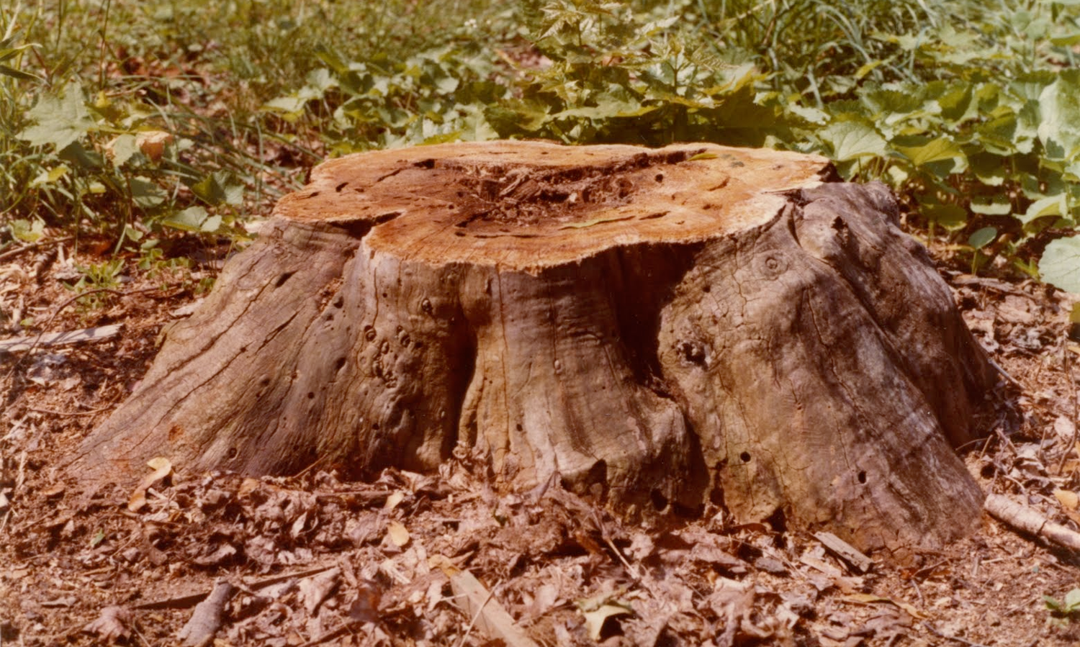
"If even a tenth—a remnant—survive, it will be invaded again and burned.
But as a terebinth or oak tree leaves a stump when it is cut down, so Israel's stump will be a holy seed" (6:13 NLT).
Notes:
But did you notice that a message of hope concludes the chapter, for even a felled tree still has a stump left?
Verse 13 says that even the 10% left will be judged twice—but there still would be a stump left!
What does the “stump” mean (13)?
God wouldn’t totally reject his people, despite his discipline.
He would continue the “holy seed” to fulfill his promises to Israel, even in our own future.
God told Isaiah that three parts of his listeners’ bodies would be defective: their ears, eyes, and hearts.
It’s interesting that Jesus applied this same text to the people of his day.

Slide 41
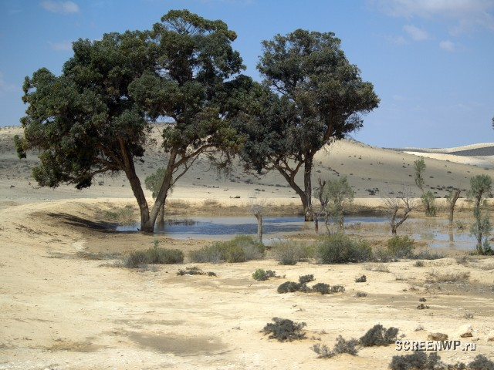
Serving Christ is difficult but eventually successful.
Notes:
Hebrews 11 records not heroes of faith but heroes of endurance!
Persecution awaits the faithful—including some of us here.
All of us have the daily pressures of living for Christ.
Some of you will face extreme difficulty upon getting back to your country.
All of us will continue to have to balance family, ministry, and our walk with God—or else we will drop out of the marathon.

Slide 42
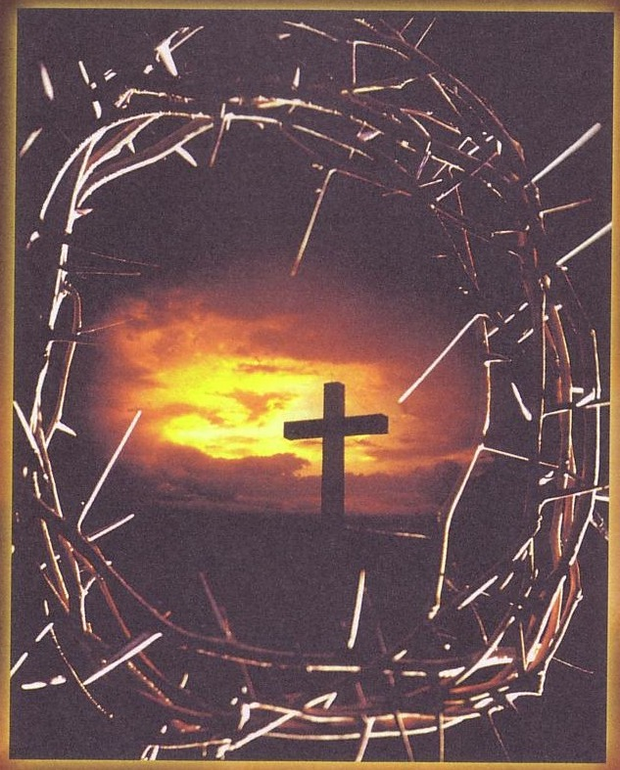
Endure
Notes:
But where did we get the idea that serving God would be easy?
Just look at Isaiah, Jeremiah, the disciples, and Jesus Himself!

Slide 43
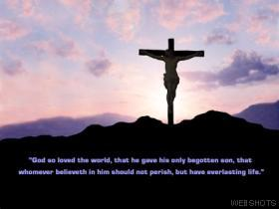
"Everyone who wants to live a godly life in Christ Jesus will be persecuted"
(2 Tim. 3:12)
Notes:
Jesus also said, “In this world you will have tribulation.”

Slide 44
How can you run the marathon— serve Christ for the long haul?
Tips on running our spiritual marathon

Slide 45

Realize that you are called to difficulty but ultimate success
—Main Idea—
Notes:
Doing God’s will isn’t easy, but it always will eventually turn out well.

Slide 46
I. God called you to run the race (6:1-8).
Notes:
See the Lord's holiness and say "yes" to his call!

Slide 47
II. A marathon isn't easy but you will succeed
(6:9-13).
Notes:
Ministry is tough, but ultimately God will bless our endurance.

Slide 48
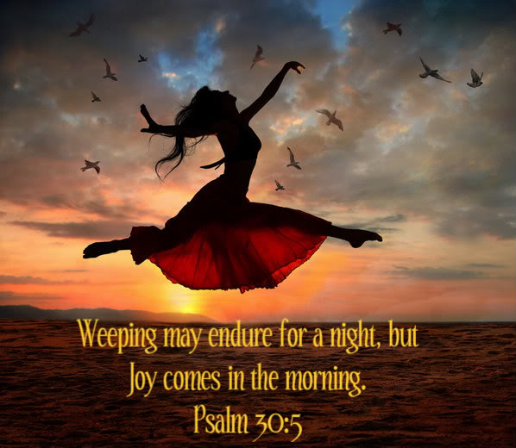
Psalm 30:5

Slide 49
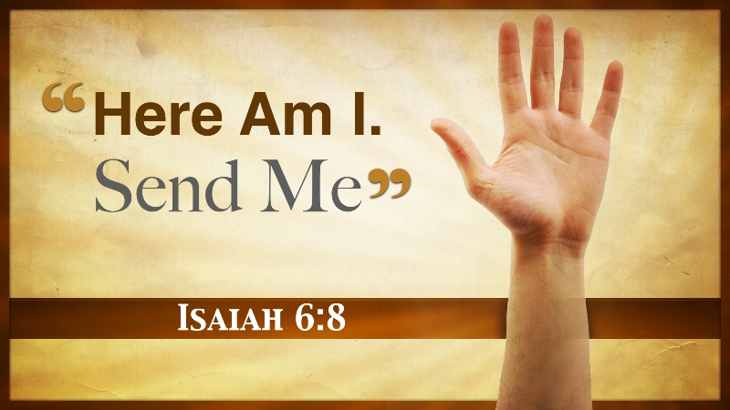
"Here am I. Send me!"
Notes:
Isaiah chose to respond affirmatively. Have you?

Slide 50
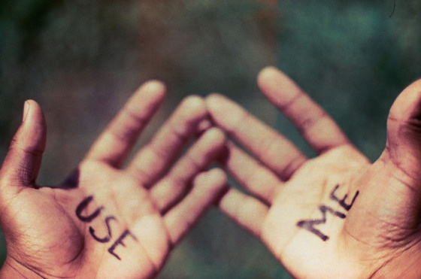
Use Me
Notes:
Let's bow. How do you need to change your view of the present or the future?
Are your present expectations defective as you run your spiritual marathon?
Have you somehow been deceived into thinking that your service for Christ shouldn't cost you anything?
If you sense that it is time to tell God that you are ready to accept the price He has for you, tell Him now.
Or do you need to better understand the glorious future that awaits you from that stump that's left?
Why? Knowing that our marathon has a glorious goal helps us press on now!

Slide 51
Black

Slide 52


OT Preaching Link at BibleStudyDownloads.org
Get this presentation for free!
Notes:
OT Survey (os)

