Slide 1
Endure!
Isaiah 6:1-13; 11:1-5
Preached by Dr. Rick Griffith at Crossroads International Church Singapore • cicfamily.com Uploaded by Dr. Rick Griffith • Singapore Bible College Files in many languages for free download at BibleStudyDownloads.org

Slide 2
Black Slide

Slide 3
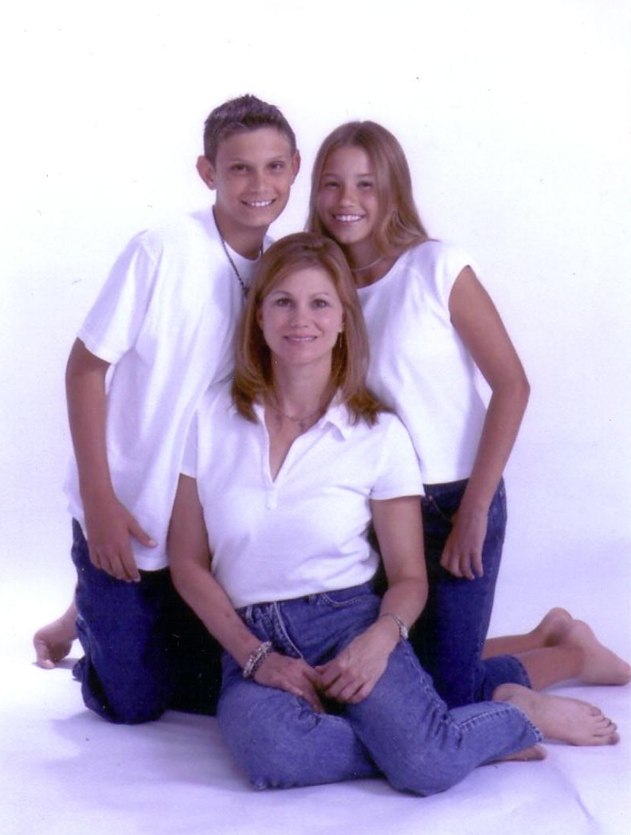
No Mike

Slide 4
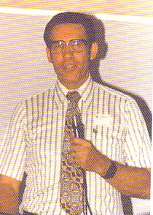
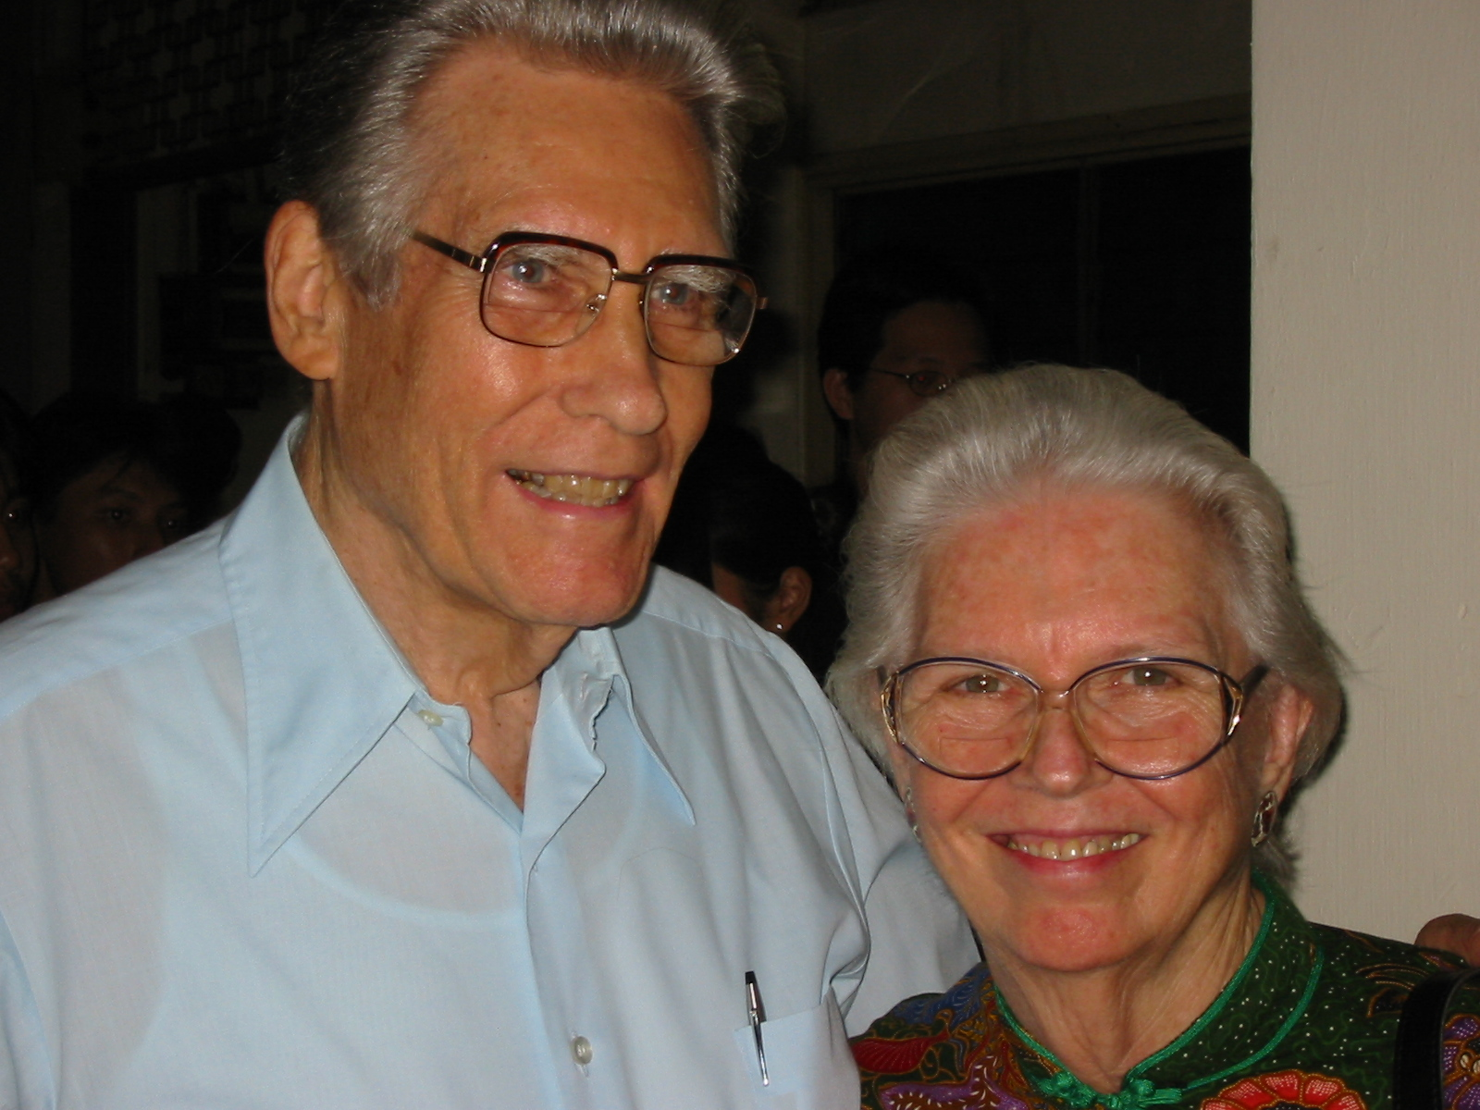
Dr. & Mrs. Poulson

Slide 5
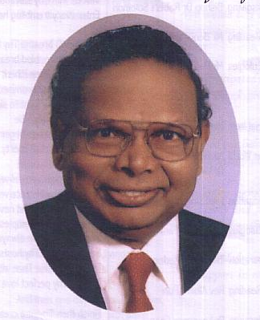
Black Slide
Dr. G. D. James
Dr. Bill Bright

Slide 7
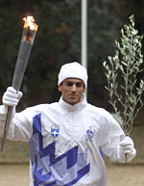
But how can you run the marathon— serve Christ for the long haul?
Tips on running our spiritual marathon

Slide 8
Isaiah’s 65 Year Ministry (745-680 BC)
End of the
Kings of Israel
Pekah
Hoshea
Kings of Judah
Uzziah
Jotham
Ahaz
Hezekiah

Slide 9
The Assyrian Threat
The Assyrian Threat
Assyrian Expansion
Nineveh
Mediterranean
Sea
Aram
Israel
Judah
Persian
Gulf
Egypt

Slide 10
Black Slide

Slide 11
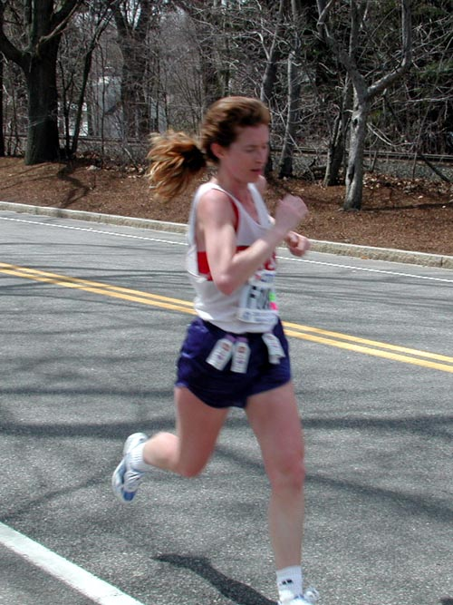
I. Realize that running the marathon is not easy

Slide 12
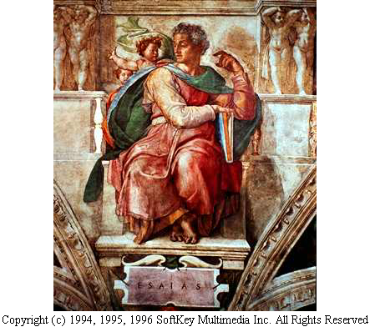
Call of Isaiah (6:1-8)
“Who will go for us?” “I will!”

Slide 13
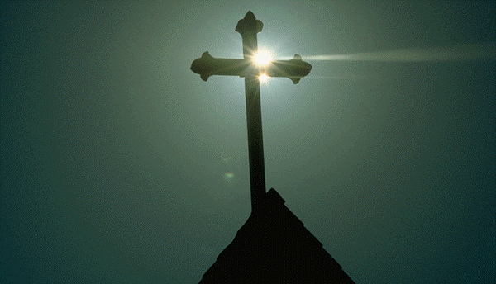
God called Isaiah to a life of rejection and hardship (6:9-10)

Slide 14
Black Slide

Slide 15
God to Isaiah: “Preach in hardship until no one is left” (6:11-13)

Slide 16
Black Slide

Slide 18
Captain Kurt
1943
2003

Slide 19
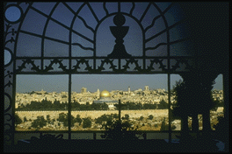
Service for Christ now is not easy either.

Slide 20
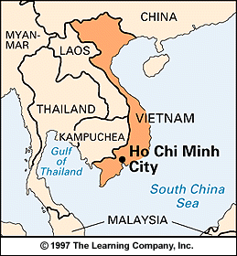
Vietnam
• Hanoi
Singapore

Slide 21
Communist N. Vietnam

Slide 22
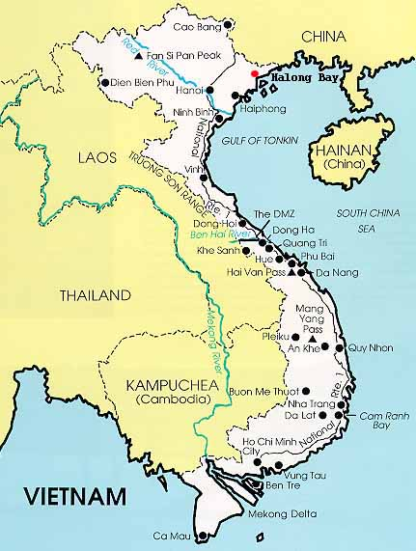
Vietnamese Hmong Churches
Before 412 Destroyed - 354 Remaining 58
Communist purge of tribal churches in November 2002

Slide 23
Black Slide

Slide 24
“Everyone who wants to live a godly life in Christ Jesus will be persecuted” (2 Tim. 3:12)

Slide 25
Beautiful Downtown Singapore

Slide 26
Multi-cultural Singapore has its challenges

Slide 27
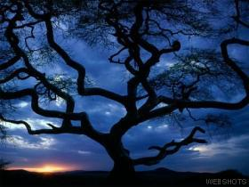
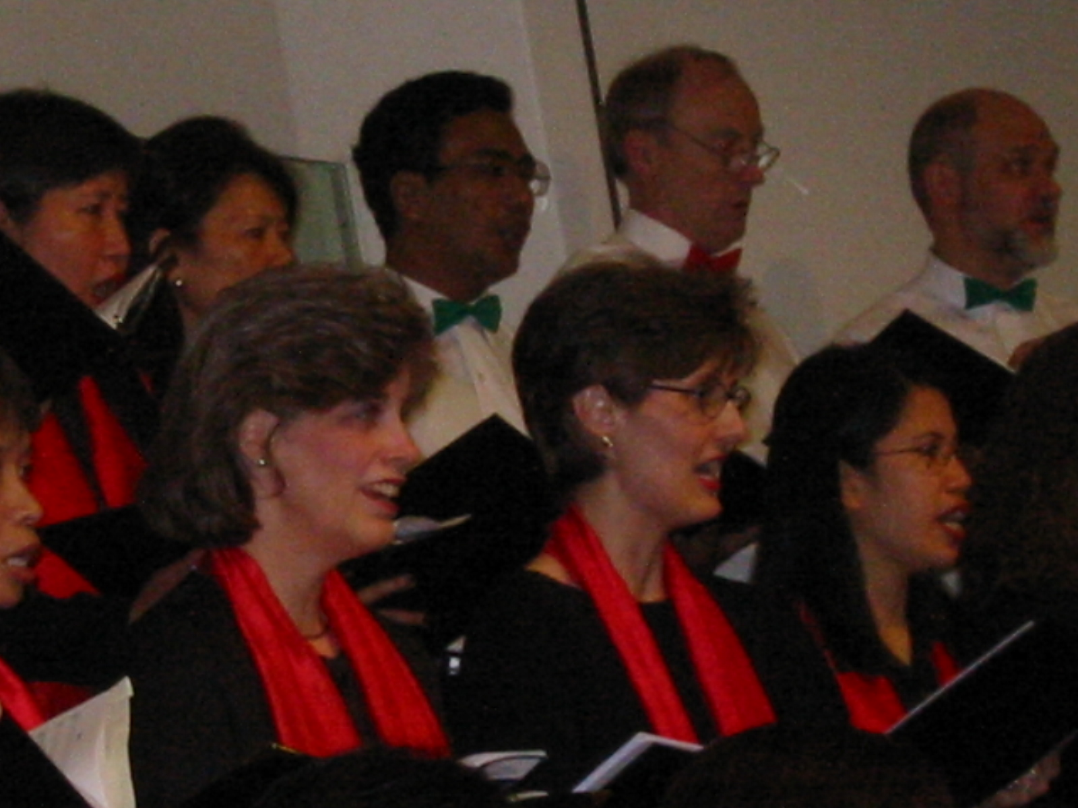
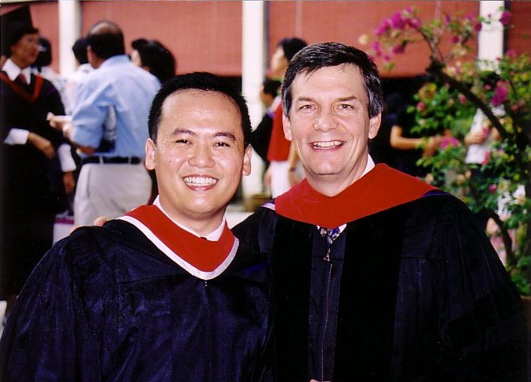
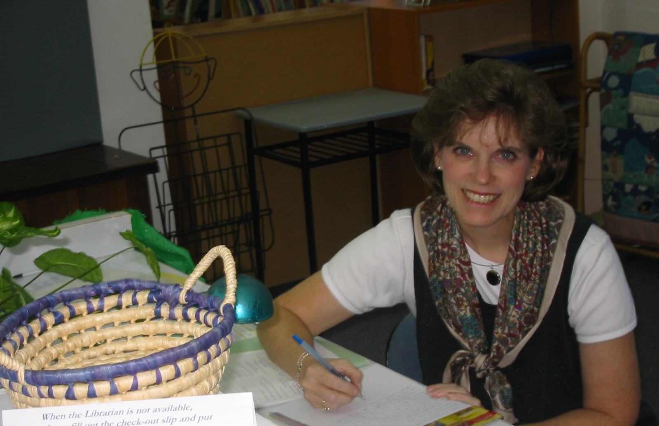
Ministry Alphabet Soup
Internet Biblical Seminary
International Baptist Church
Biblical Education by Extension
International Community School
Singapore Bible College
CBInternational

Slide 28
Black Slide

Slide 29
Black Slide
Crown of Thorns

Slide 30
Black Slide

Slide 31
II. Run with your eyes on your future hope

Slide 32
Black Slide

Slide 33
Christ will have a Spirit-led and righteous rule (11:1-5)
Christ will have a Spirit-led and righteous rule (11:1-5)

Slide 34
Black Slide

Slide 35
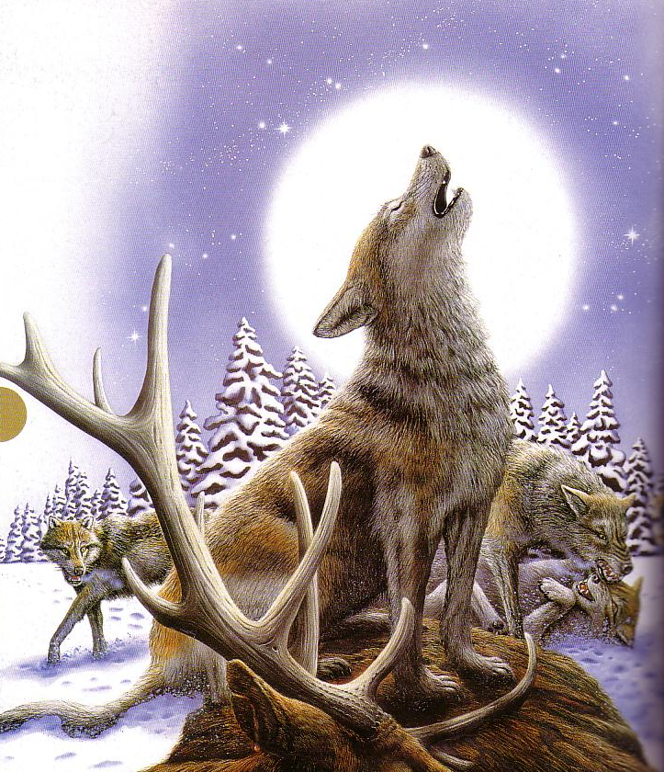
Animals

Slide 36
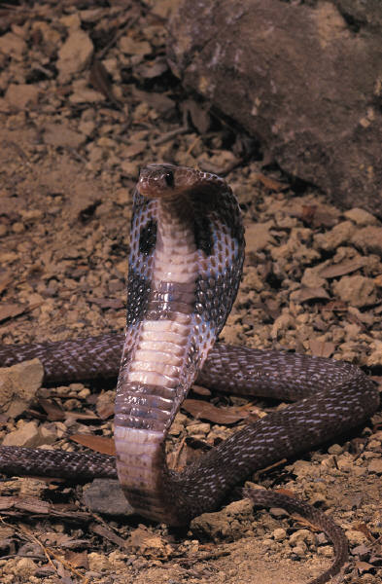
Wanna pet?

Slide 37
Black Slide

Slide 38
Why know what God says about the future?

Slide 39
Why know what God says about the future?
How you live now is based on how you view what is to come

Slide 40
Why know what God says about the future?
How you live now is based on how you view what is to come
Hundreds of verses on the future are as good as fulfilled now

Slide 42
The Main Idea: Endurance comes from seeing your present difficulties in light of your fantastic future

Slide 44
Black

Slide 45
OT Preaching link at BibleStudyDownloads.org
Get this presentation for free!
Notes:
OT Preaching (op)

