Slide 1
Follow the King
Hope for the Future of the World
Isaiah 9:1-11
Preached by Dr. Jim Harmeling at Crossroads International Church Singapore • cicfamily.com Uploaded by Dr. Rick Griffith • Singapore Bible College Files in many languages for free download at BibleStudyDownloads.org

Slide 2
Revelation 20:4-6
⁴ Then I saw thrones, and seated on them were those to whom the authority to judge was committed. Also I saw the souls of those who had been beheaded for the testimony of Jesus and for the word of God, and those who had not worshiped the beast or its image and had not received its mark on their foreheads or their hands. They came to life and reigned with Christ for a thousand years. ⁵ The rest of the dead did not come to life until the thousand years were ended. This is the first resurrection. ⁶ Blessed and holy is the one who shares in the first resurrection! Over such the second death has no power, but they will be priests of God and of Christ, and they will reign with him for a thousand years.

Slide 3
He leads with humility (v. 1)

Slide 4
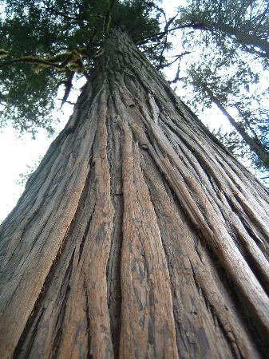
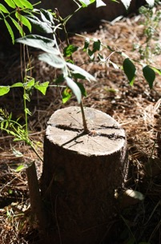
Egypt
Assyria
Babylon
Medo-Persia
Greece
Rome
FOLLOW THAT TWIG!!!

Slide 5
He leads with humility (v. 1)
He leads with the power of God (v. 2)
He knows the cause of all problems
He rightly addresses each issue and accomplishes what he wants to do
Philippians 2:13
“for it is God who works in you, both to will and to work for his good pleasure.”

Slide 6
He leads with humility (v. 1)
He leads with the power of God (v. 2)
He knows the cause of all problems
He rightly addresses each issue and accomplishes what he wants to do
He accords with the will of God

Slide 7
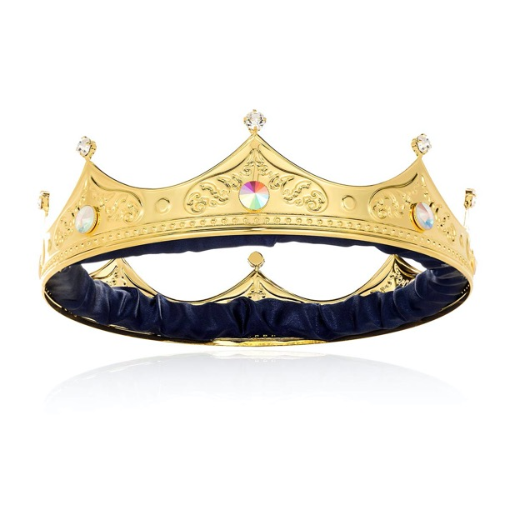
“Consequently with Him there commences a new epoch, in which the Son of David and His righteousness acquire a world-subduing force, and find their home in a humanity that has sprung, like Himself, out of deep humiliation.”
Franz Delitzsch

Slide 8
He leads with humility (v. 1)
He leads with the power of God (v. 2)
He leads with justice and righteousness (vs. 3-5)

Slide 9
Isaiah 11:4
“he shall strike the earth with the rod of his mouth, and with the breath of his lips he shall kill the wicked.”
Revelation 19:15
“From his mouth comes a sharp sword with which to strike down the nations, and he will rule them with a rod of iron.”

Slide 10
He leads with humility (v. 1)
He leads with the power of God (v. 2)
He leads with justice and righteousness (vs. 3-5)
He leads effectively (vs. 6-9)

Slide 12
Black

Slide 13
OT Preaching link at BibleStudyDownloads.org
Get this presentation for free!
Notes:
OT Preaching (op)

