Slide 1
Ezra 9:1-15
AVOID PAGANISM
Tjen Le Hoa • Homiletics 1 Class Sermon Uploaded by Dr. Rick Griffith • Singapore Bible College All files in many languages for free download at BibleStudyDownloads.org

Slide 2
Abortion Rates worldwide 2010-2014: 56.3 million
Only 7% of abortions have a health reason

Slide 3
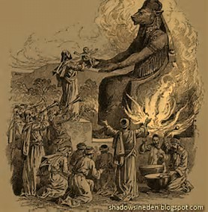
Canaanite
Child Sacrifice

Slide 4
Are you aware of many pagan practices around you?

Slide 5
False Idols

Slide 6
Idolatry happens when we take good things and make them ultimate things (Timothy Keller)

Slide 7
Why should we avoid pagan practices?

Slide 8
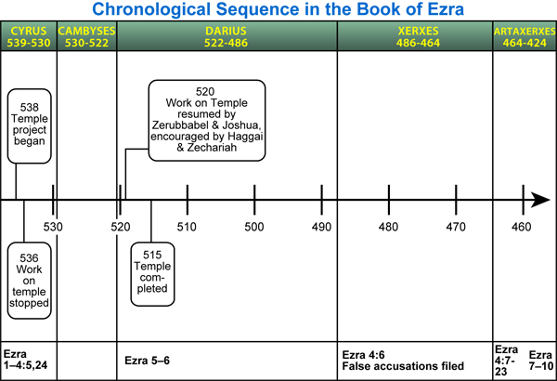
Internetseminary.org

Slide 9
http://www.internetseminary.org

Slide 10
Ezra left Babylon for Jerusalem in 458 B.C. on the first day of the first month. He arrived in Jerusalem after a 4-month journey on the first day of the fifth month. https://biblicalstudies.org.uk/pdf/grace-journal/10-3_16.pdf

Slide 12
Separate yourself from paganism rather than risk your faith

Slide 13
¹After these things had been done, the leaders came to me and said, “The people of Israel, including the priests and the Levites, have not kept themselves separate from the neighboring peoples with their detestable practices, like those of the Canaanites, Hittites, Perizzites, Jebusites, Ammonites, Moabites, Egyptians and Amorites.

Slide 14
² They have taken some of their daughters as wives for themselves and their sons, and have mingled the holy race with the peoples around them. And the leaders and officials have led the way in this unfaithfulness.”

Slide 15
I. Pagan practices will risk your faith

Slide 16
A. Israel’s intermarriage was a serious problem because intermarriage would risk the lineage of Messiah

Slide 17
¹After these things had been done, the leaders came to me and said, “The people of Israel, including the priests and the Levites, have not kept themselves separate from the neighboring peoples with their detestable practices, like those of the Canaanites, Hittites, Perizzites, Jebusites, Ammonites, Moabites, Egyptians and Amorites.

Slide 18
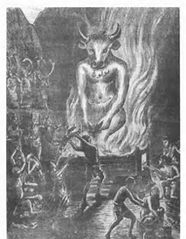
Detestable practices of the pagans: child sacrifice, seeking signs through animal organs, consulting the dead, temple prostitution, idolatry

Slide 19
² They have taken some of their daughters as wives for themselves and their sons, and have mingled the holy race with the peoples around them. And the leaders and officials have led the way in this unfaithfulness.”

Slide 20
If continued mingled the holy race No more Israel (Messiah lineage) disastrous to all the families of the earth
Why a serious problem?
Matthew Levering, Ezra and Nehemiah, 97

Slide 21
B. Avoid pagan practices because such practices will risk your faith

Slide 22
Kings who turned away from God because of marrying pagans: Solomon Ahab These leaders had made Israel become unfaithful to God

Slide 23
Can Christians marry non-believers?

Slide 24
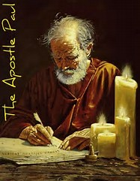
2 Corinthians 6:14 Do not yoke together with unbelievers

Slide 25
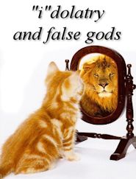

Slide 26
Idolatry = if we love something or someone more than God

Slide 27
II. Pagan practices will effect the whole community

Slide 28
A. Ezra lamented and confessed in public prayer.

Slide 29
Ezra's Lamentation: - tore his inner and outer clothes - pulled out his hair - sat until evening - everyone who trembled joined Ezra

Slide 30
Ezra's Prayer: - Israel is unfaithful but God is faithful - God remembered His promise by bringing them back from exile

Slide 31
Ezra Prayer: - God punished less than the Israel deserved by preserving the remnant - God is righteous, Israel is guilty

Slide 32
B. We should repent and practice godliness

Slide 33
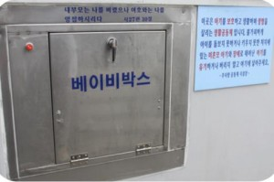
The Story of The Dropbox

Slide 34
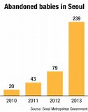
Abandoned babies in Seoul
Source Seoul Metropolitan Government

Slide 35
DON’T THROW THEM AWAY. BRING THEM HERE.

Slide 36
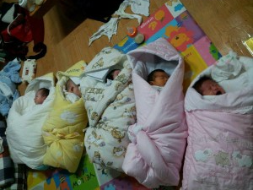

Slide 38
If you profess to be a Christian yet find full satisfaction in worldly pleasures and pursuits, your profession is false. (Charles Spurgeon)

Slide 39
Black

Slide 40
OT Preaching link at BibleStudyDownloads.org
Get this presentation and script for free!
Notes:
NT Preaching (np)

