Slide 1
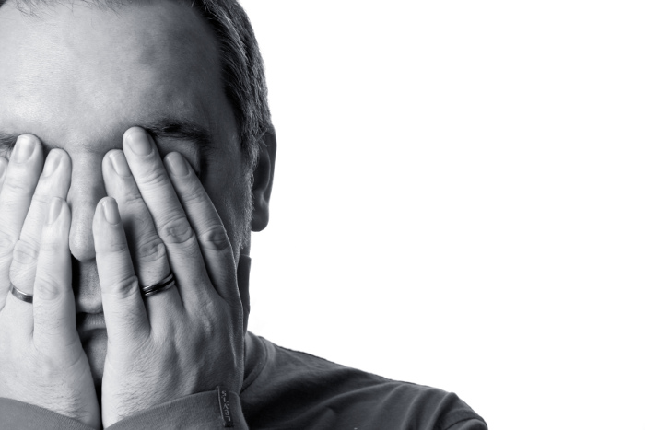
Workaholic Woes
Ecclesiastes 4
Dr. Rick Griffith • Crossroads International Church Singapore
CICFamily.com • BibleStudyDownloads.org

Slide 2
Work

Slide 3
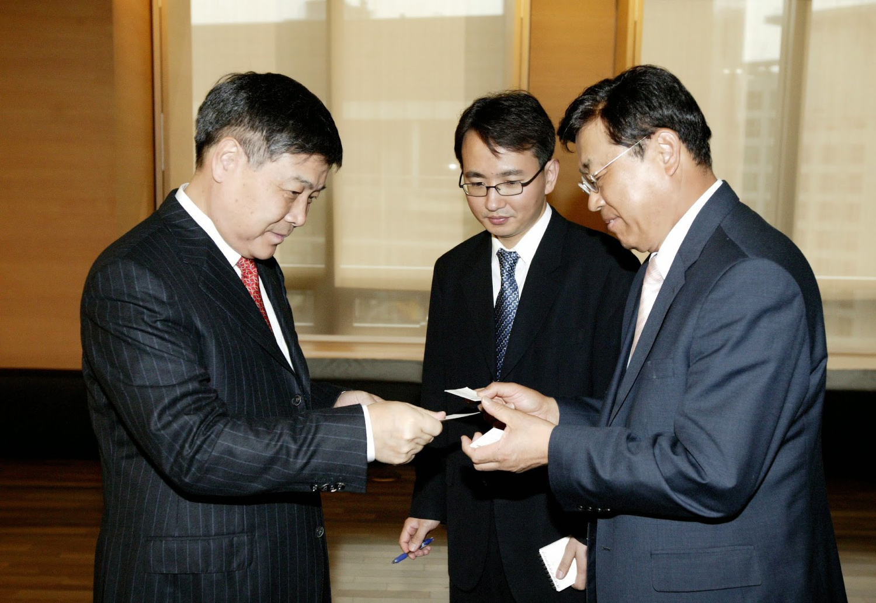
Work in Korea

Slide 4
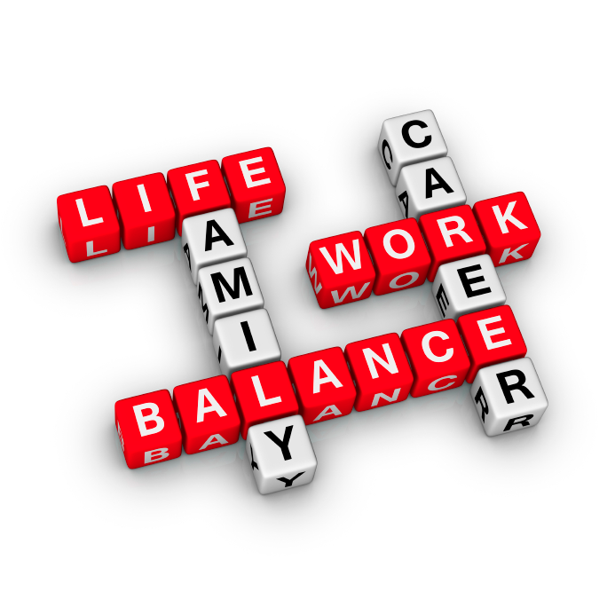
Balance

Slide 5
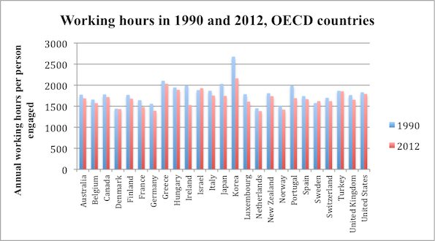
Working Hours in 1990 & 2012, OECD Countries
Notes:
http://www.economist.com/blogs/freeexchange/2013/09/working-hours

Slide 6
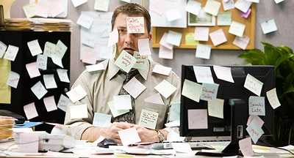
Way too much to do!

Slide 7
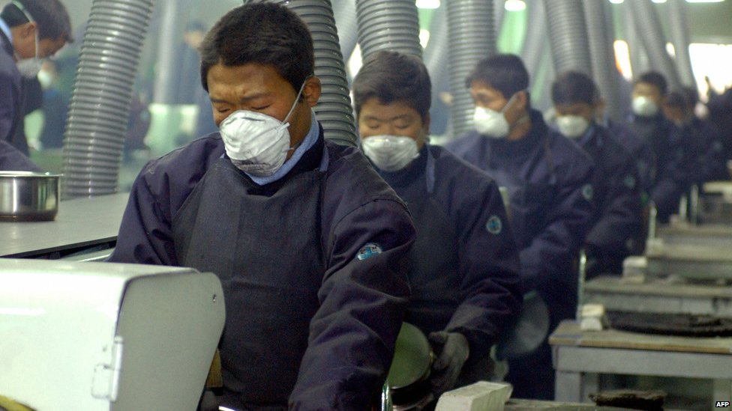
Work in Korea

Slide 8
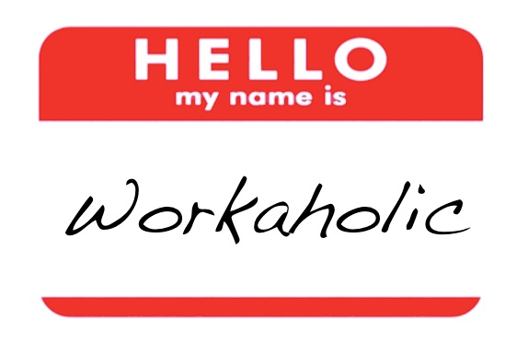
Hello, my name is Workaholic

Slide 9
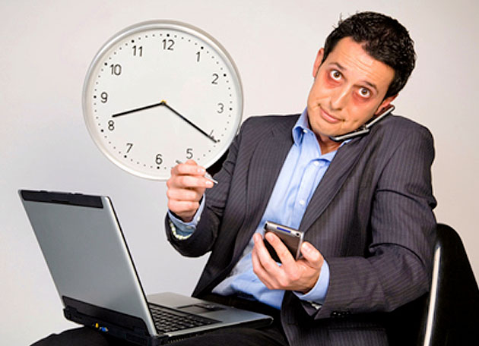
"Well, I enjoy my job—but it would be nice to enjoy it less hours each week!"

Slide 10
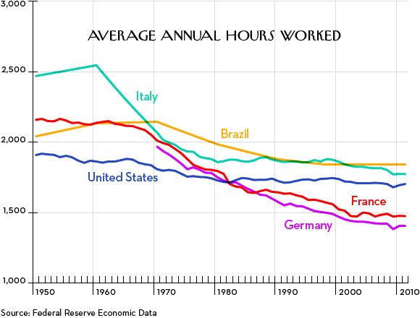
Average Annual Hours Worked
Notes:
http://www.newyorker.com/business/currency/why-the-french-are-fighting-over-work-hours

Slide 11
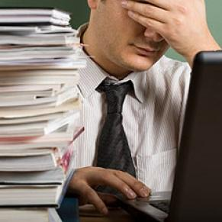
Why avoid being a workaholic?

Slide 12
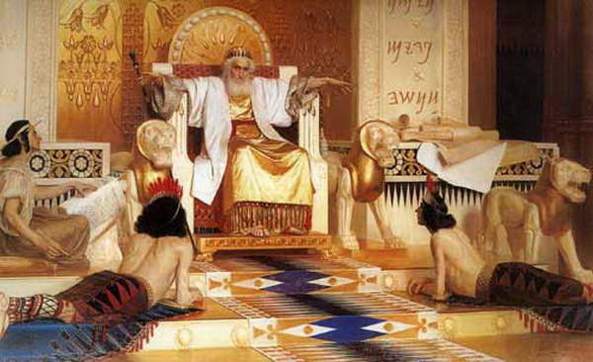
The Fleeting Nature of Human Achievement & Wisdom
Solomon

Slide 13
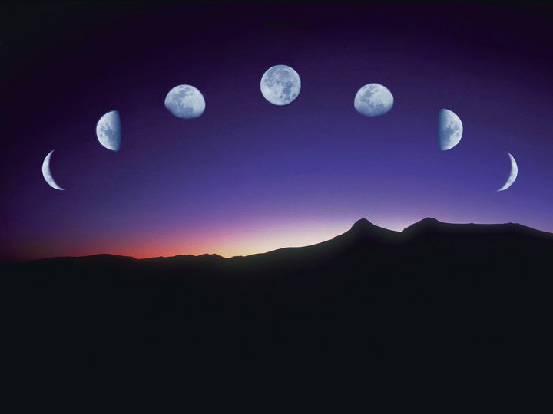
Our Study in Ecclesiastes
Work & Wisdom Don't Last

Slide 14
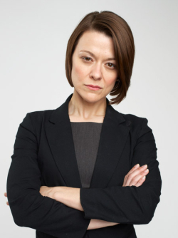
"The Curses of the Lonely Workaholic" —Irving L. Jensen
Notes:
http://www.cc.com/shows/workaholics/bios/alice-murphy
The foul-mouthed Senior Sales Manager of TelAmeriCorp, Alice Murphy incessantly rejects Adam's pathetic sexual advances and reins in the guys after their endless antics while Jillian rolls her calls. Her hands are constantly full and her temper is always short. Stick to the script, make some sales and just maybe you won't get your ass kicked.

Slide 15
Workaholic Woes
Ecclesiastes 4

Slide 16
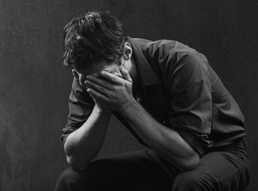
Workaholic Woes
No Comforters

Slide 17
Who Needs Comfort?
"Again, I observed all the oppression that takes place under the sun. I saw the tears of the oppressed, with no one to comfort them. The oppressors have great power, and their victims are helpless" (4:1 NLT).
"And behold I saw the tears of the oppressed and that they had no one to comfort them; and on the side of their oppressors was power, but they had no one to comfort them" (4:1 NAU).

Slide 18
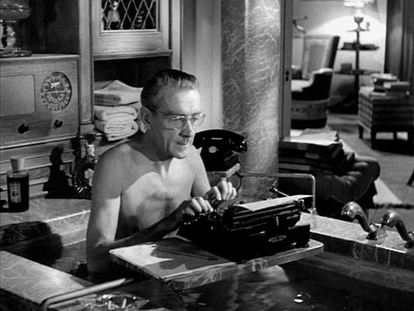
Comfort him?

Slide 19
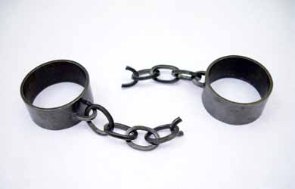
"So I concluded that the dead are better off than the living. ³But most fortunate of all are those who are not yet born. For they have not seen all the evil that is done under the sun" (4:2-3 NLT).

Slide 20
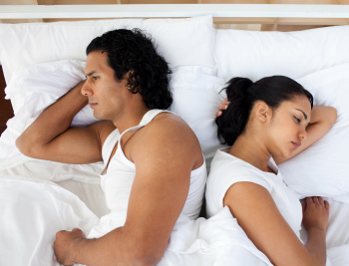
Workaholic Woes
No Comforters
No Rest

Slide 21
Title

Slide 22
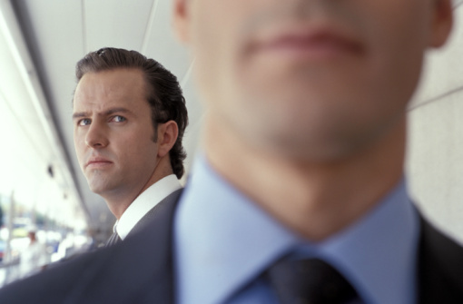
"Then I observed that most people are motivated to success because they envy their neighbors. But this, too, is meaningless—like chasing the wind" (4:4 NLT).

Slide 23
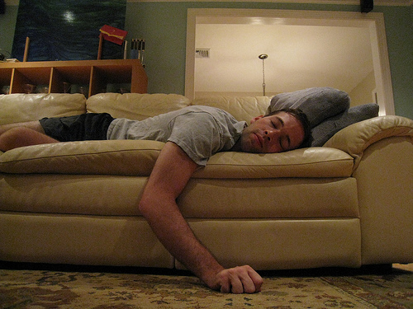
"Fools fold their idle hands, leading them to ruin" (4:5 NLT).

Slide 24
"And yet, 'Better to have one handful with quietness than two handfuls with hard work and chasing the wind'" (4:6 NLT).

Slide 25
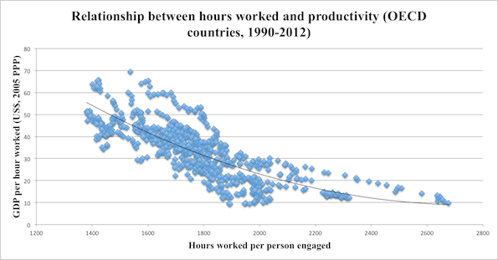
Relationship between hours worked and productivity (OECD countries, 1990-2012)
Notes:
The Greeks are some of the most hardworking in the OECD, putting in over 2,000 hours a year on average. Germans, on the other hand, are comparative slackers, working about 1,400 hours each year. But German productivity is about 70% higher.
http://www.economist.com/blogs/freeexchange/2013/09/working-hours

Slide 26
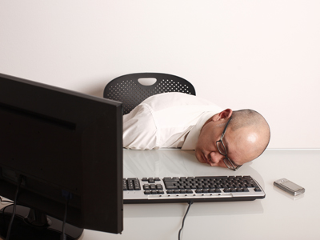
Singaporean Workers
31% of employees stay late at work
50% regularly take work home to finish in the evening
Notes:
http://sbr.com.sg/hr-education/news/workaholic-singaporeans-31-employees-stay-late-work
HR & EDUCATION | Staff Reporter, Singapore Published: 10 Nov 11 - See more at: http://sbr.com.sg/hr-education/news/workaholic-singaporeans-31-employees-stay-late-work#sthash.6HoJrSgp.dpuf
Workaholic Singaporeans: 31% of employees stay late at work
The other 69 % are clock watchers who meticulously drop their work and rush out the door on time.
Half of workers in Singapore spend well over eight hours a day at the office and 50 percent regularly take work home to finish in the evening. This evidence of long working hours is seen in the latest global survey findings from Regus, canvassing the opinions of over 12,000 business people in 85 countries. Arguably, pressure on working hours has increased in recent years because of slow economic recovery in mature economies and, conversely, very rapid growth in emerging ones. A country like Singapore – which has a very work-centric culture – is no exception to this rule. Key findings include:-
- 31% of Singapore workers usually work between nine and eleven hours every day compared to an average of 38% of workers elsewhere in the world. - 19% of workers in Singapore and 10% globally regularly work more than eleven hours a day; - In Singapore, 50% of workers take tasks home to finish at the end of the day more than three times a week compared to 43% globally;
Globally, only 5% of women work 60-hour weeks compared to more than twice that number (12%) for men. They are also less likely (32%) to take work home more than three times a week, than are men (48%);
Remote workers globally are more likely to work eleven hour days (14%) than fixed office workers (6%) and to take tasks home to finish (59%) than fixed office workers (26%);
Workers in smaller companies were more likely to take work home with them (48%) more than three times a week than those working in large firms (29%).
William Willems, Regional Vice-President, Regus, Asia-Pacific observes: "This study finds a clear blurring of the line between work and home. In Singapore, where the National Institute For Occupational Mental Health reports that a quarter of workers view their job as the number one cause of stress, the long-term effects of this over-work could be damaging both to workers' health and to overall productivity as workers drive themselves too hard and become disaffected, depressed or even physically ill.
"While women were found to be less likely to work longer hours, probably because they are more likely to be employed in part-time work, small company workers are more likely to clock up the hours than large company employees. Workers in small businesses are perhaps more likely to feel that the impact of the single employee on the success of a project is more marked.
Martin Cerullo, Managing Director for Development for Alexander Mann Solutions in Asia-Pacific, noted that much of the issue has to do with globalisation of the economy. "With an economy based primarily on trading, Singapore undoubtedly has relationships with countries all over the world with various time differences to consider. Furthermore, the advancement of technology has facilitated the access of work beyond the office. As a result, it is not uncommon that workers find themselves working more hours," said Cerullo.
Willems points out "While our survey found remote and mobile workers generally worked longer hours, there is a growing body of evidence suggesting that remote workers are more productive, have a higher job satisfaction and lower stress levels. These workers typically spend far less time commuting, freeing up more time for their job. Businesses that enable their employees to work from locations closer to home and manage their time more independently will offset the stress of a poor work-life balance and gain more productive, committed and healthy staff."
- See more at: http://sbr.com.sg/hr-education/news/workaholic-singaporeans-31-employees-stay-late-work#sthash.6HoJrSgp.dpuf

Slide 27
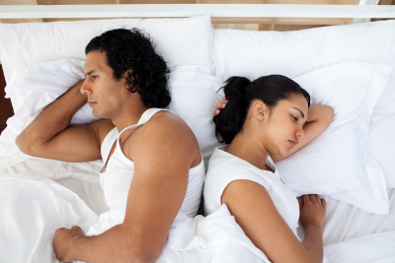
The compulsive competitor never gets real rest

Slide 28
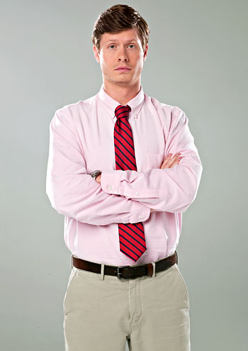
Workaholic Woes
No Comforters
No Rest
No Beneficiaries

Slide 29
"There was a man all alone; he had neither son nor brother. There was no end to his toil" (4:7-8a NIV).

Slide 30
"…yet his eyes were not content with his wealth" (4:8b NIV).

Slide 31
"'For whom am I toiling,' he asked, 'and why am I depriving myself of enjoyment?' This too is meaningless—a miserable business!" (4:8c NIV).

Slide 32
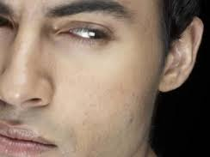
Workaholic Woes
No Comforters
No Rest
No Beneficiaries
No Friends

Slide 33
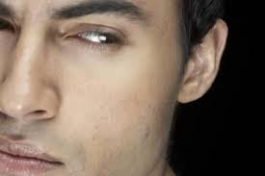
Workaholism = loneliness

Slide 34
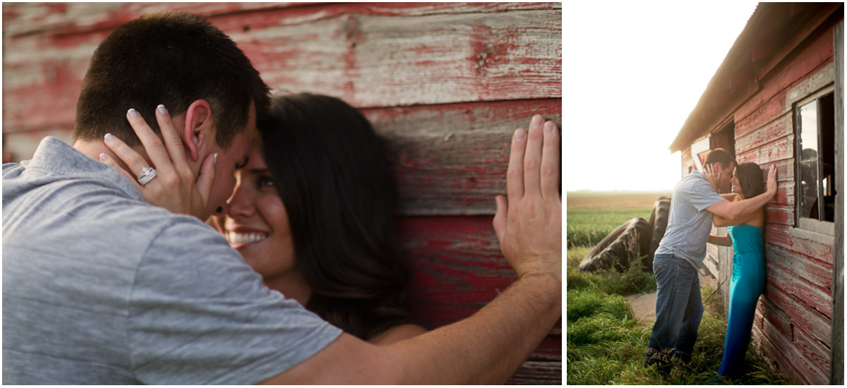
Is this verse about marriage?
"Two are better than one, because they have a good return for their work" (4:9 NIV).

Slide 35
Friends accomplish more than two independent workaholics (4:9)
"Two are better than one, because they have a good return for their work" (4:9 NIV).

Slide 36
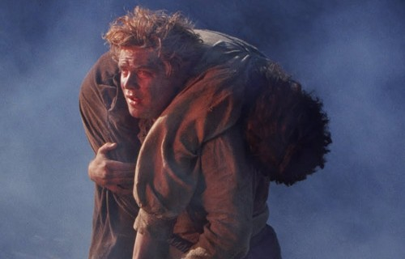
Friends help each other when weak (4:10)
"If one falls down, his friend can help him up. But pity the man who falls and has no one to help him up!" (4:10 NIV).

Slide 37
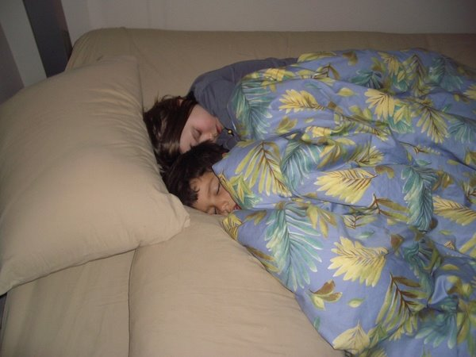
Friends comfort each other when vulnerable (4:11)
"Also, if two lie down together, they will keep warm. But how can one keep warm alone?" (4:11 NIV).

Slide 38
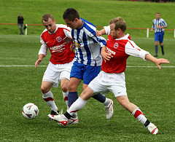
Friends protect each other when attacked (4:12)
"Though one may be overpowered, two can defend themselves" (4:12a NIV).

Slide 39
Friends protect each other when attacked (4:12)
"A cord of three strands is not quickly broken" (4:12b NIV).

Slide 40
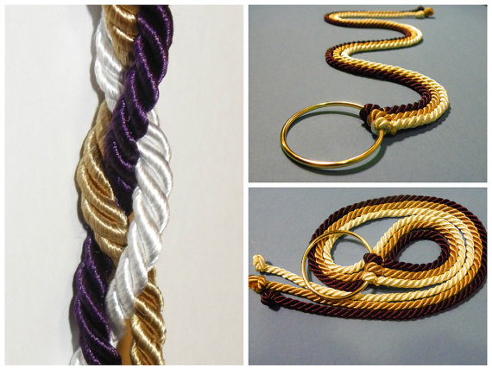
Marriage?

Slide 41
Marriage?

Slide 42
Marriage?

Slide 43
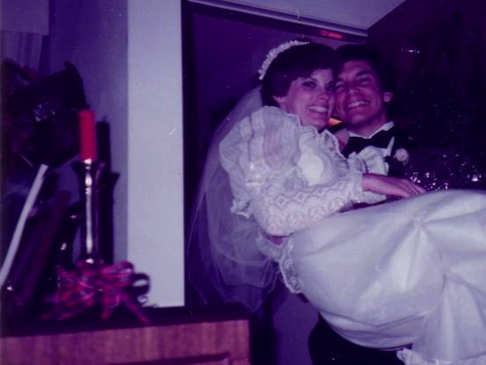
Marriage: 30 December 1983

Slide 44
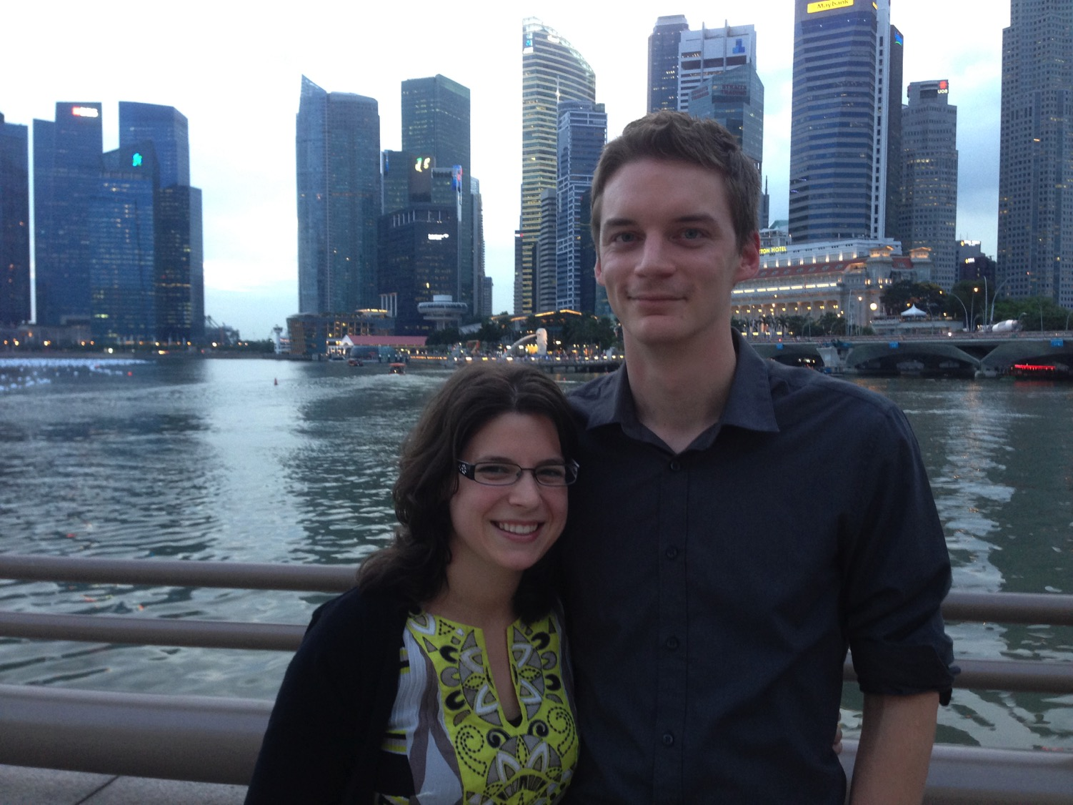
Kurt & Cara September 12

Slide 45
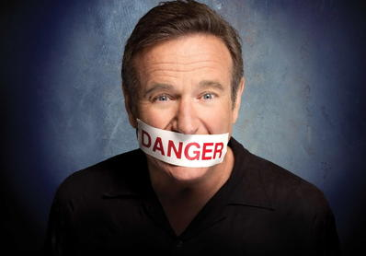
Robin Williams

Slide 46
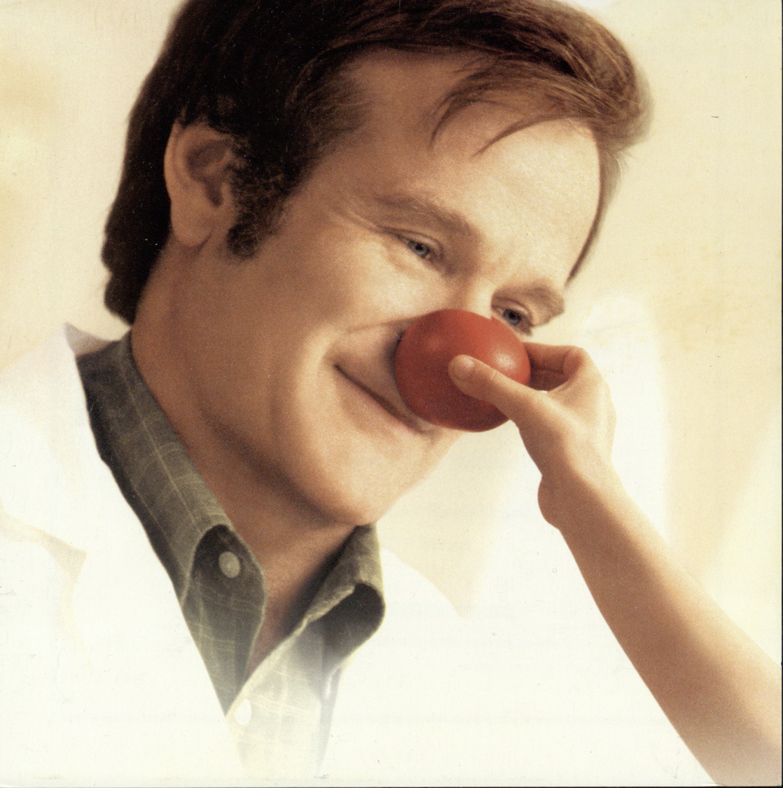
Robin Williams

Slide 47
Robin Williams

Slide 48
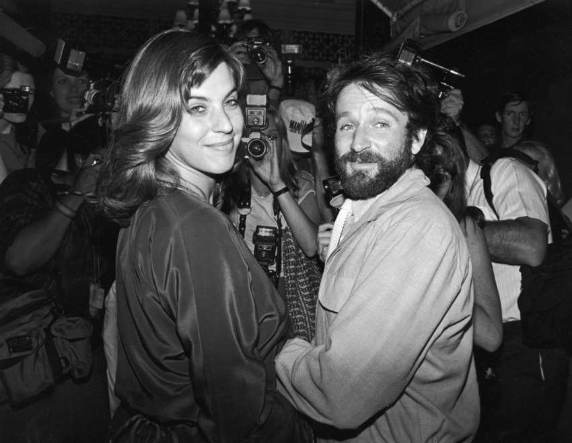
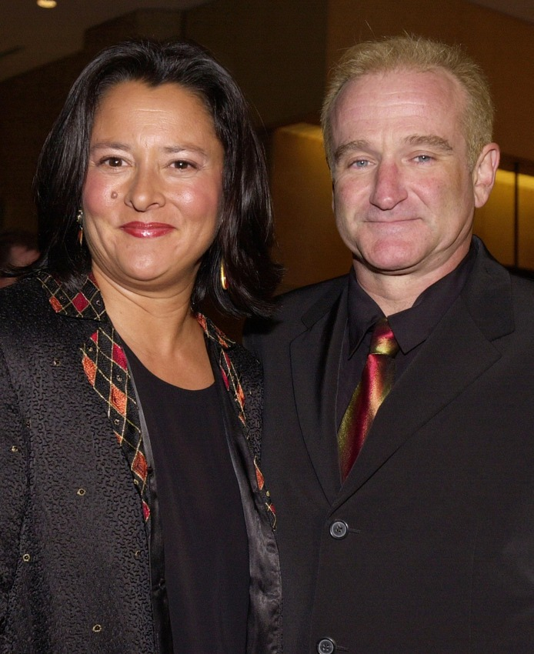
Robin Williams

Slide 49
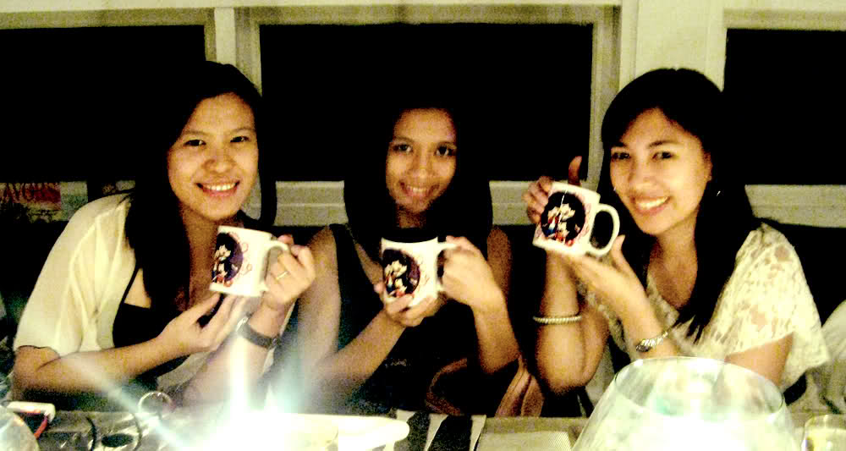
Friends protect each other when attacked (4:12)
"A cord of three strands is not quickly broken" (4:12b NIV).

Slide 50
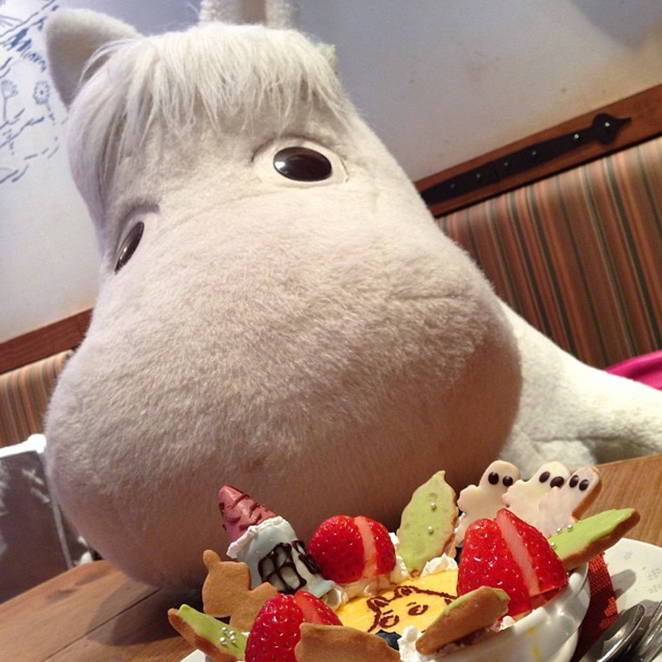
The Moomin

Slide 51
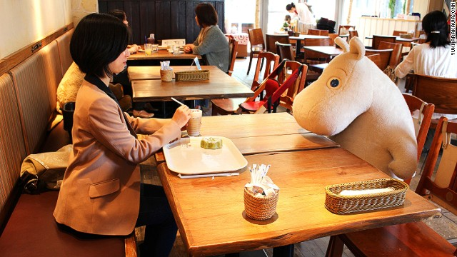
Moomin Café, Japan

Slide 52
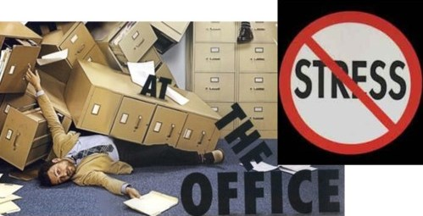
Workaholics often work alone

Slide 53
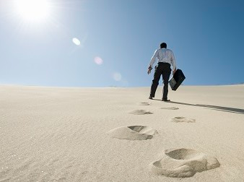
Workaholic Woes
No Comforters
No Rest
No Followers
No Beneficiaries
No Friends

Slide 54
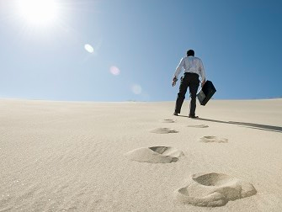
Workaholics rarely have followers

Slide 55
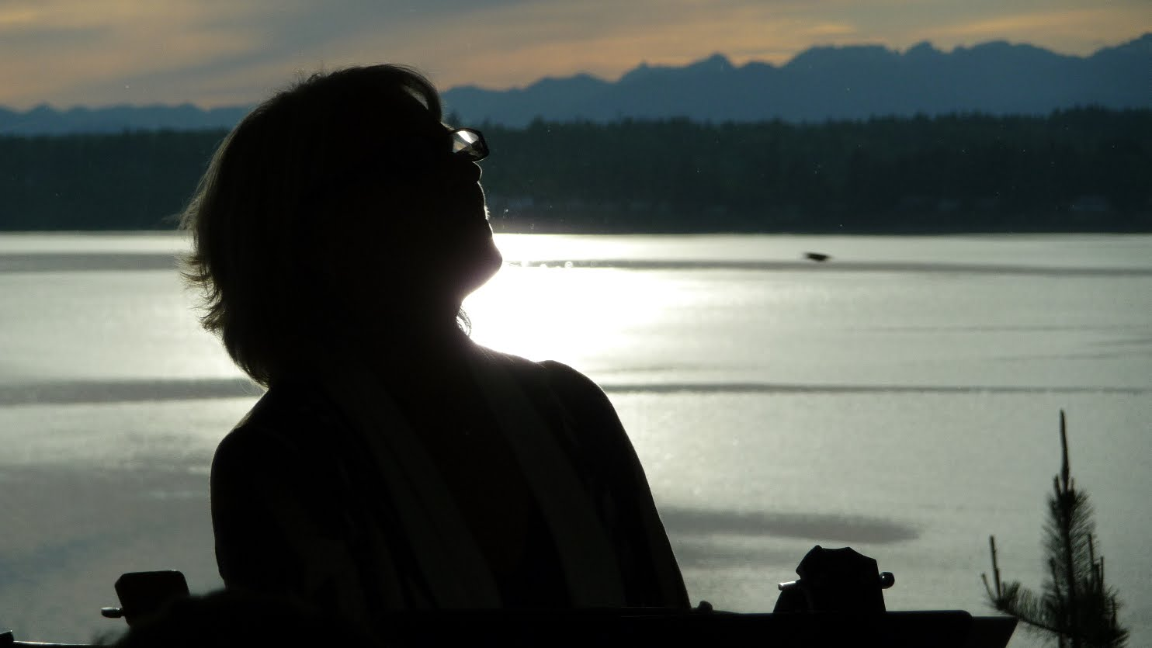
"It is better to be a poor but wise youth than an old and foolish king who refuses all advice" (4:13 NLT).

Slide 56
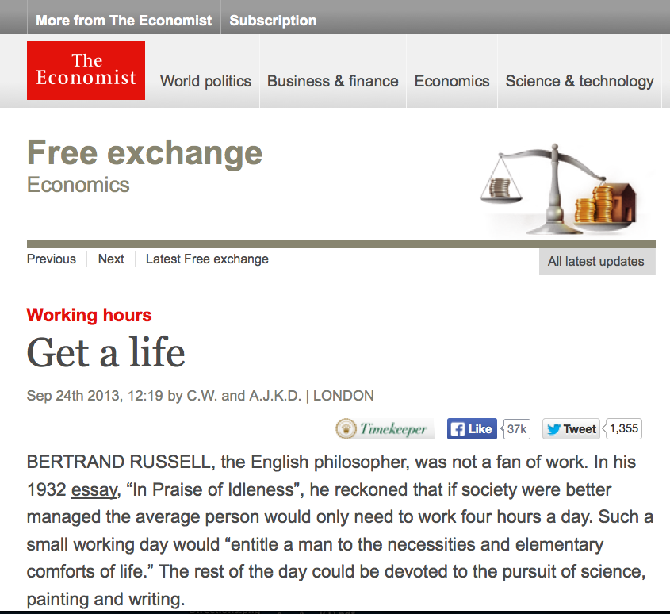
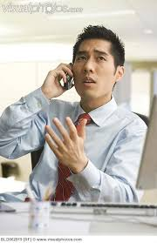
"Scripture" (Eccl. NLT).

Slide 57
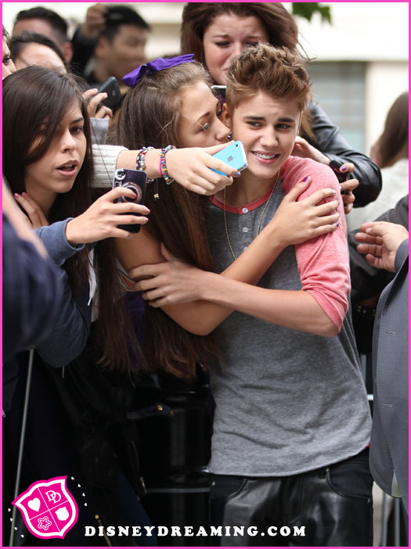
"Such a youth could rise from poverty and succeed. He might even become king, though he has been in prison. ¹⁵But then everyone rushes to the side of yet another youth who replaces him. ¹⁶Endless crowds stand around him, but then another generation grows up and rejects him, too. So it is all meaningless—like chasing the wind" (4:14-16 NLT).

Slide 58
Why avoid being a workaholic?

Slide 59
Workaholic Woes
No Comforters
No Rest
No Followers
No Beneficiaries
No Friends

Slide 60
Main Idea
Work at not becoming a workaholic.

Slide 61
Workaholic Woes
No Comforters
No Rest
No Followers
No Beneficiaries
No Friends

Slide 62
Black

Slide 63
OT Preaching link at BibleStudyDownloads.org
Get this presentation and script for free!

