Slide 1
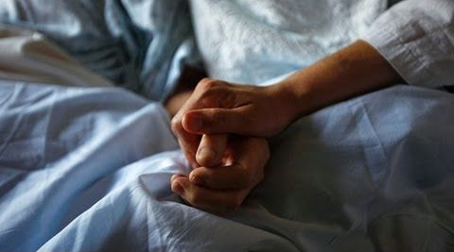
Be Kind
2 Samuel
Dr. Rick Griffith • Crossroads International Church Singapore
CICFamily.com • BibleStudyDownloads.org

Slide 2

Kindness is needed.
Notes:
People need kindness.

Slide 3
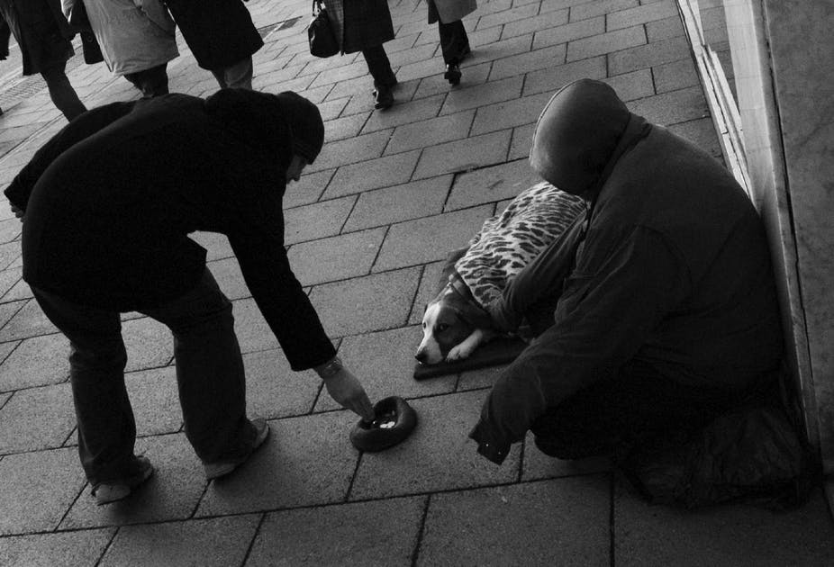
Kindness
Notes:
How are you doing at showing kindness when others are sad?

Slide 4
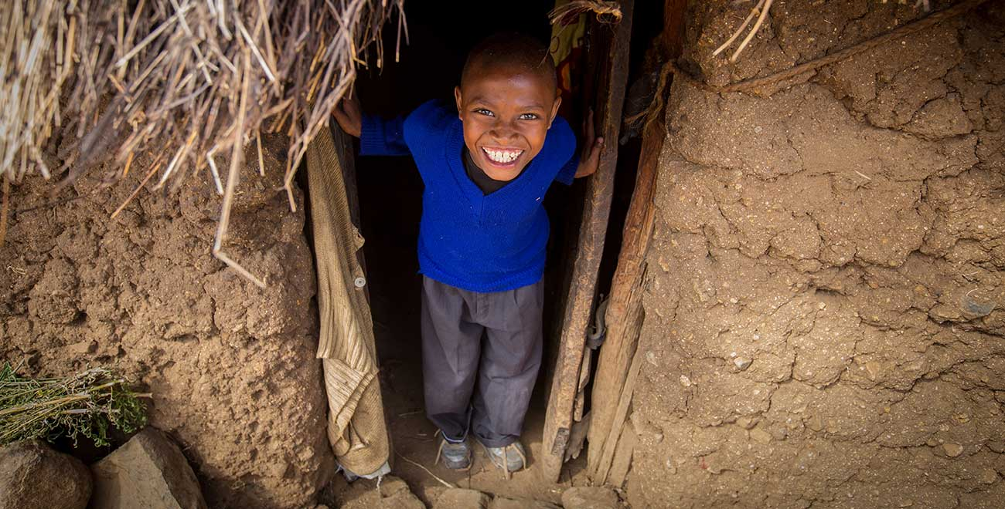
How does God model kindness to us so we can be kind to others?
Notes:
He shows it to us in the Christmas story probably more than anywhere else in Scripture with the exception of the death of Christ.

Slide 5
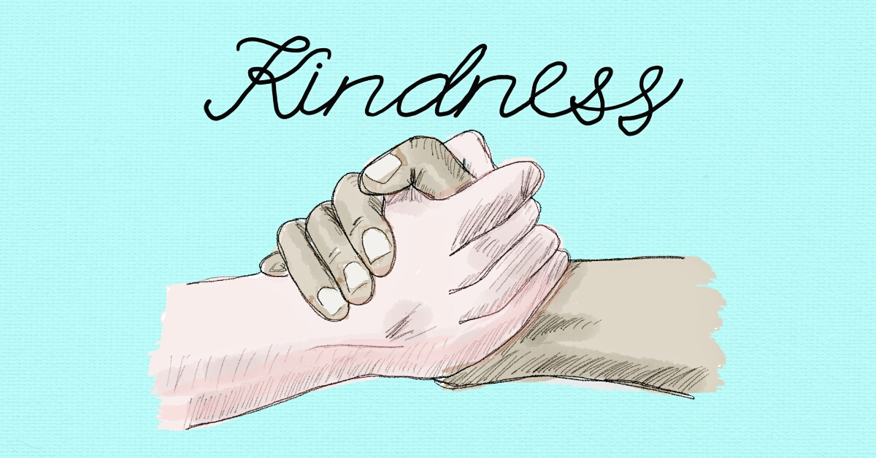
Background
Notes:
We last studied 1 Samuel where we saw three key transitions—

Slide 6
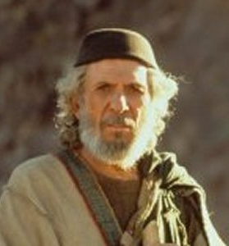
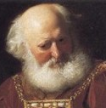
Transition #1
196
1 Samuel 1–7
Eli
Samuel
Notes:
The first transition of national leadership from Eli to Samuel marked the end of judges with Samuel as the last judge (1 Sam 1–7).

Slide 7
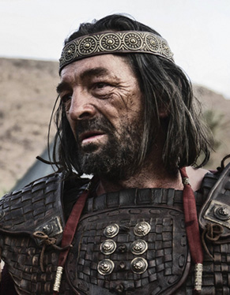
Transition #2
196
1 Samuel 8–15
Samuel
Saul
Notes:
The second transition of national leadership from Samuel to Saul marked the start of the monarchy due to Israel's evil motives (1 Sam 8–12).

Slide 8

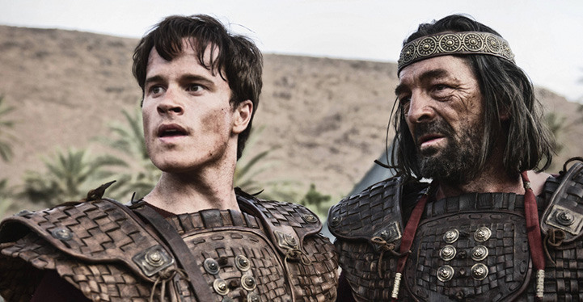
Transition #3 from Saul to David
Transition #3
198
1 Samuel 16–31
Saul
David

Slide 9

How will David respond?

Slide 10
How does God model kindness to us so we can be kind to others?
2 ways
Notes:
Restatement

Slide 11

I. God’s kindness gives us leaders (2 Sam 1–10).
Notes:
The LORD grants us his divinely appointed kings to follow.

Slide 12
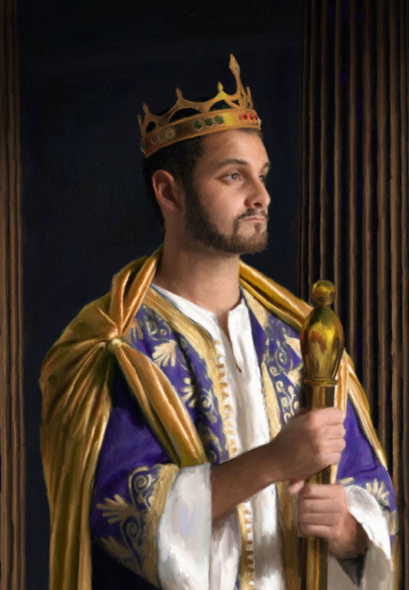
God led Israel by establishing David as king over a renewed, perpetual kingdom
(2 Sam 1–10).
Notes:
Restatement

Slide 13
Slides on
2 Samuel 1
Notes:
David reigned over Judah at Hebron after Saul's death and trusted God to prepare the entire kingdom without force (2 Sam 1–4).

Slide 14
2 Samuel 1–10 Chart
209
E S T A B L I S H M E N T
T R I U M P H
O B E D I E N C E
CHAPTERS 1–10
F A I T H | B L E S S I N G
1–4 | 5–10
Over Judah | Over All Israel
From HEBRON | From JERUSALEM
7 Yrs. (1011–1004 BC) | 7 Yrs.? (1004–997? BC)
Notes:
David's rule over Judah at Hebron is a test of faith because he refuses to seize the kingdom by force (2 Sam 1–4).

Slide 15
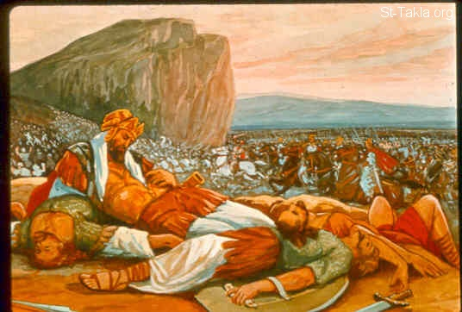
Saul died with his sons Jonathan, Abinadab, and Malkishua (1 Sam. 31:2)
200
Notes:
Saul is out of the way now, but will David change his leadership style to become one who seizes power?

Slide 16
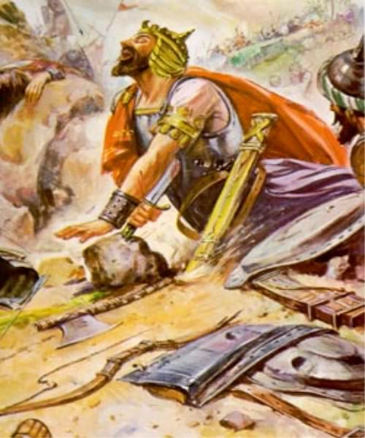
Saul killed himself
(1 Sam. 31:4) but an Amalekite lied by saying he did it instead (2 Sam. 1:10)
200
Notes:
Actually, the messenger of Saul's death lies to David by saying that he killed Saul. David then kills the messenger to show that he would not grasp for poer by worldly means!

Slide 17
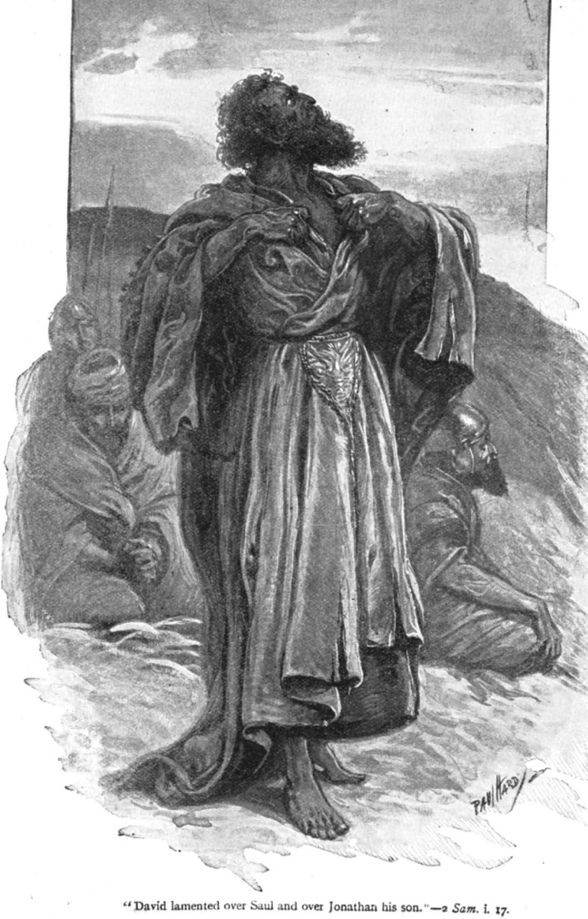
Grief over Saul (1:17)
David lamented over the deaths of Saul and Jonathan
(2 Samuel 1:17)

Slide 18

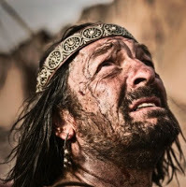
David laments the death of Saul and his sons (2 Sam. 1:17-27)
200

Slide 19
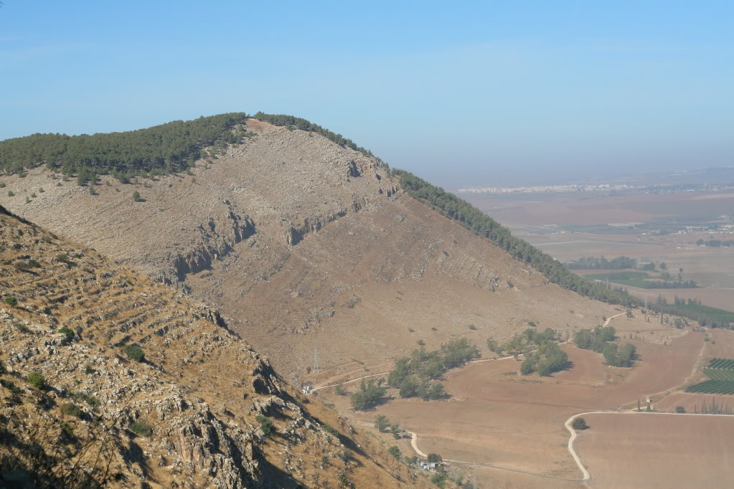
Mount Gilboa today
"O mountains of Gilboa, let there be no dew or rain upon you, nor fruitful fields producing offerings of grain. For there the shield of the mighty heroes was defiled; the shield of Saul will no longer be anointed with oil"
(2 Sam. 1:21 NLT).
Notes:
David even places a curse on the place of Saul's death in northern Israel at Mount Gilboa. To this day it has little or no vegetation!
"Most of east side of Mt. Gilboa looks barren, although modern foresting added green colors to some parts of this side of the mountain"
("Saul's Shoulder," http://www.biblewalks.com/Sites/SaulShoulder.html accessed 23 Dec 2017).

Slide 20
Slides on
2 Samuel 2

Slide 21
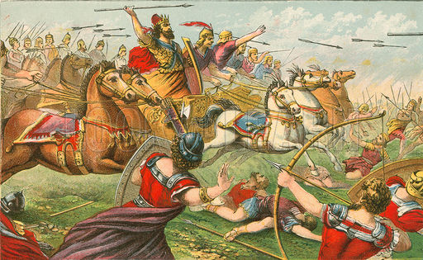
David defeats Abner
Field of Swords
2 Samuel 2:15-17
Notes:
David became king of Judah at Hebron, but Saul's commander Abner crowned Saul's son Ish-Bosheth king over Judah against God's purposes (2:1-11).

Slide 22
Slides on
2 Samuel 3
Notes:
David refused to take the kingdom by force but trusted God to judge rivals to his throne (2:12–4:12).

Slide 23
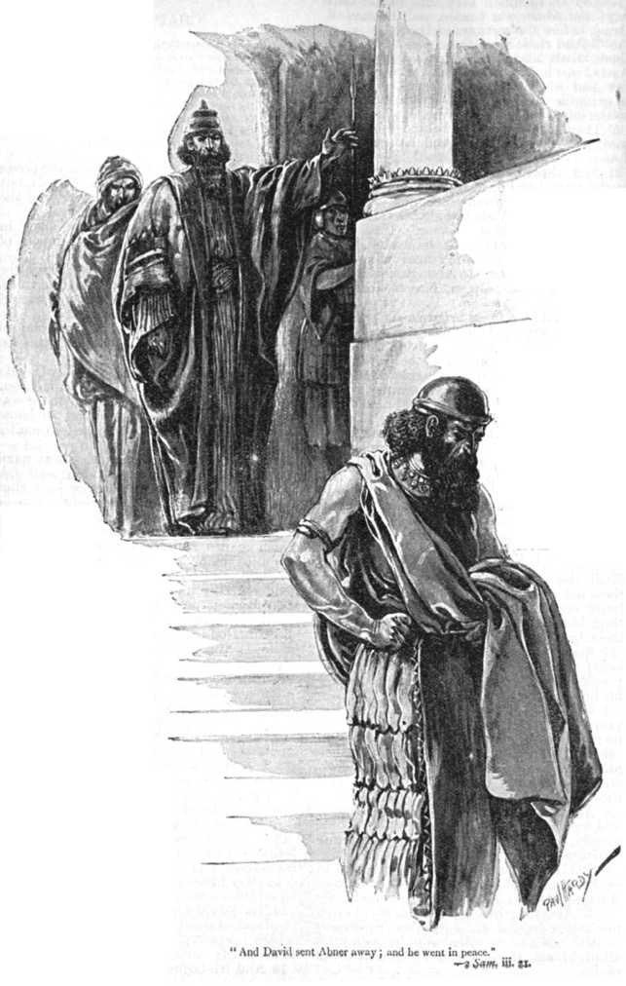
Abner sent away (3:21)
David sent Abner away in peace
(2 Sam. 3:21)
Notes:
Abner initially fought David's commander Joab but then defected to David's side and Joab killed him to remove a potential rival to the throne (2:12–3:39).

Slide 24
Slides on
2 Samuel 4

Slide 25
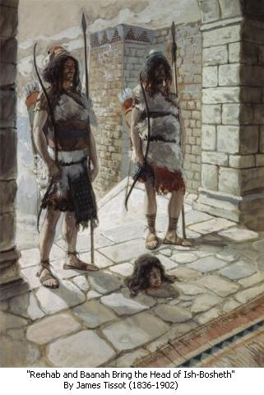
David killed
Ish-Bosheth’s murderers to punish seizing his kingdom for him by force (2 Sam 4).
200

Slide 26
Slides on
2 Samuel 5
Notes:
David reigned over all Israel at Jerusalem and renewed the kingdom as evidence of God's blessing on him and his dynasty (2 Sam 5–10).

Slide 27

Chapters 5–10 shows David over all Israel at Jerusalem with new…
211
5 Capital (Jerusalem)
6 Worship center (Ark moved)
7 Dynasty (Davidic Covenant)
8 Boundary (Kingdom Expansion)
9 Son (Mephibosheth)
10 Vassals (Ammon and Syria)
Notes:
The key word of chapters 5–10 is NEW!

Slide 28

David: Hebron to Jerusalem
171
Asher
Naphtali
Zebulun
Manasseh
Issachar
2 Samuel 5
Manasseh
Gad
Ephraim
Dan
Benjamin
Jerusalem
Reuben
Judah
Hebron
Simeon

Slide 29
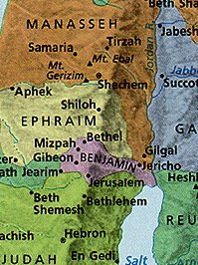
Central Location
Jerusalem was in Benjamin next to Judah but close to the northern tribes
Jerusalem
Notes:
29
Some say Jerusalem was in the "navel" of Israel, meaning the center!

Slide 30
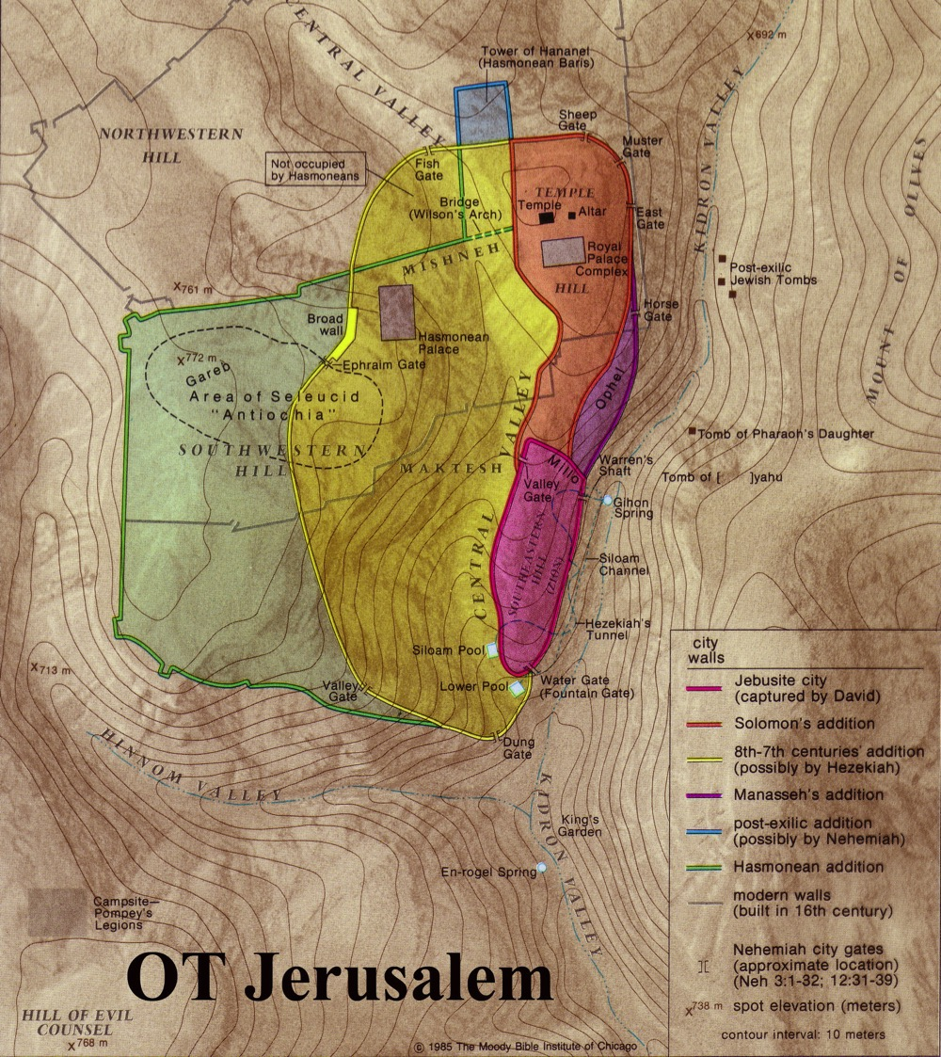
Jerusalem was a Border City
The OT border between Benjamin and Judah ran just south of the city
Benjamin
Judah

Slide 31
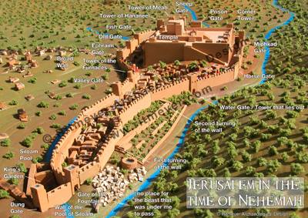
Jerusalem had room to expand to the north for a temple
Chapter 5

Slide 32
Slides on
2 Samuel 6

Slide 33
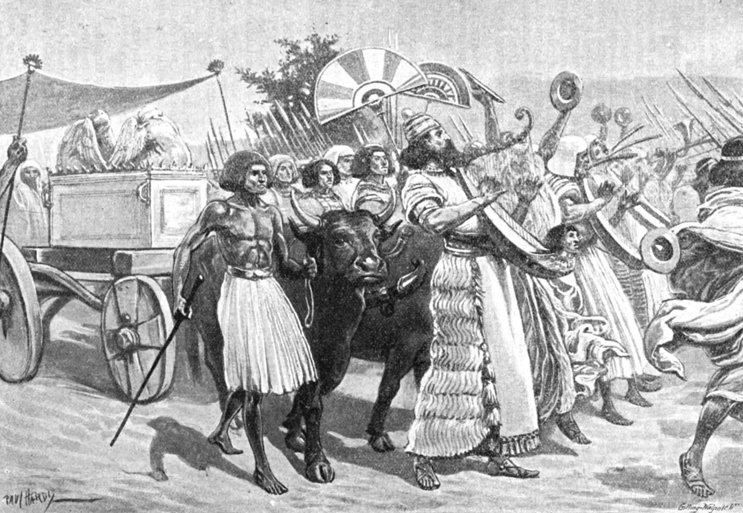
King David brought the Ark to Jerusalem
(2 Samuel 6:5-15)
New Worship Center
(2 Sam 6)

Slide 34
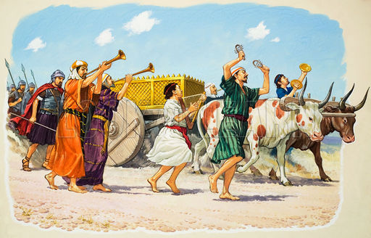
David and the ark (2 Samuel 6)
200

Slide 35
Slides on
2 Samuel 7

Slide 36
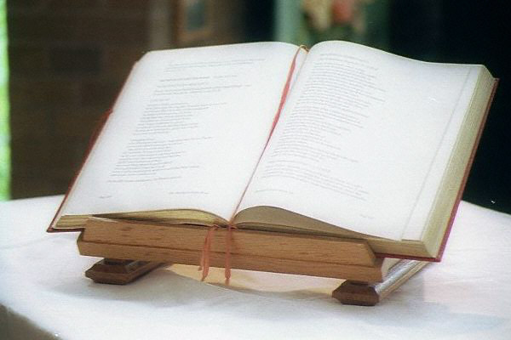
209
KEY WORD:
COVENANT
New Dynasty
(2 Sam 7)

Slide 37
KEY VERSE
209
2 Samuel 7:12-16
New Dynasty
(2 Sam 7)

Slide 38
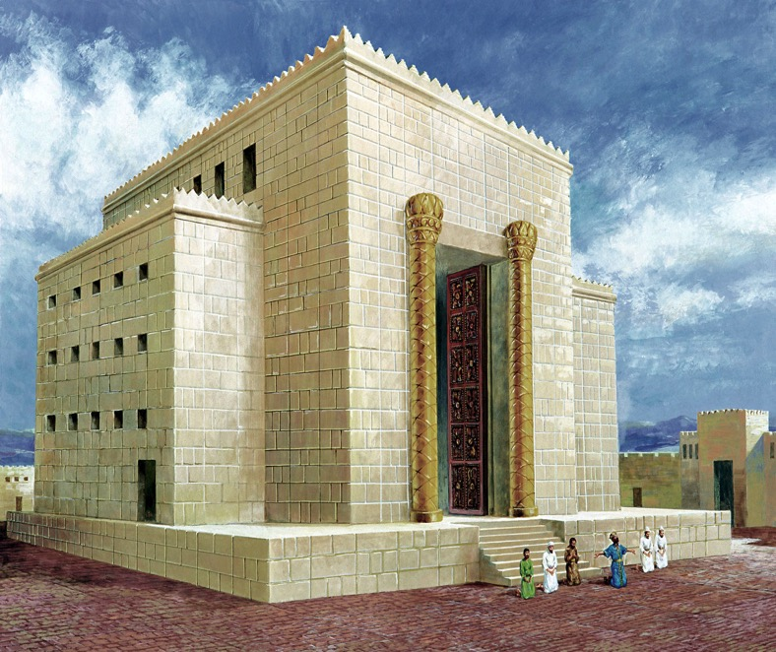


David's House:
"I want to build a house for you…"
D
A
V
I
D

Slide 39
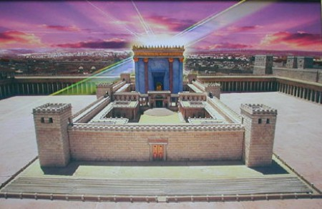
But who would build the Temple ?
God's House:
"I want to build a house for you…"

Slide 40
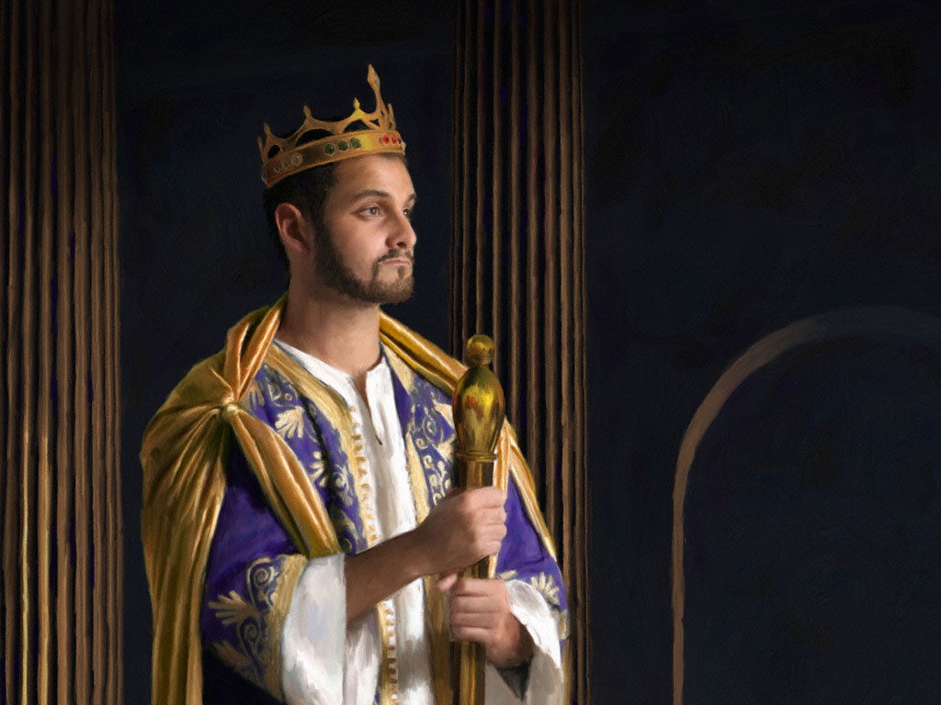
KEY VERSE:
2 Samuel 7:12-13
209
"For when you (David) die, I will raise up one of your descendants, and I will make his kingdom strong. He is the one who will build a house—a temple—for my name. And I will establish the throne of his kingdom forever."

Slide 41

Promises of the Davidic Covenant
22
What did God promise David in 2 Samuel 7:12-16?
New Dynasty
(2 Sam 7)

Slide 42
Davidic Covenant
2 Samuel 7:12-16
"And when your days are fulfilled and you sleep with your fathers, I will set up after you YOUR OFFSPRING who shall be born to you, and I will establish HIS KINGDOM.
He shall build a house for My Name [and My Presence], and I will establish the THRONE of HIS KINGDOM FOREVER.
I will be his Father, and he shall be My son. When he commits iniquity, I will chasten him with the rod of men and with the stripes of the sons of men.
But My mercy and loving-kindness SHALL NOT DEPART from him, as I took [them] from Saul, whom I took away from before you.
And your house and your kingdom shall be made sure forever before you; YOUR THRONE shall be ESTABLISHED FOREVER."

Slide 43
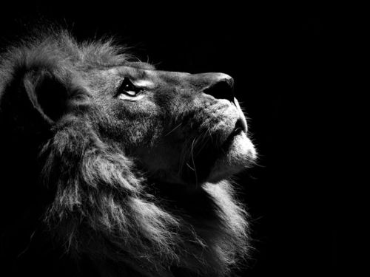
How does the Davidic Covenant relate to Jesus?

Slide 44
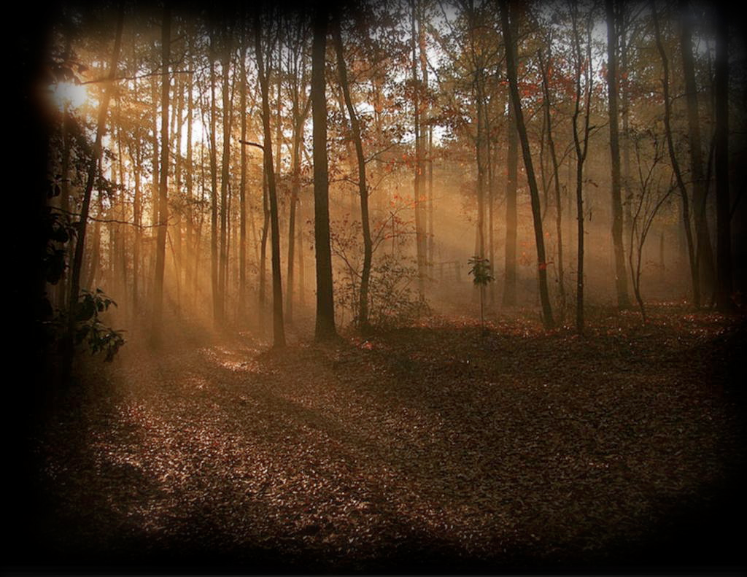
Jesus is the Promised
Son Of David
Nine times Jesus is called "son of David" in Matthew (compared to twice in Mark and Luke and none in John). David is referred to 59 times in the New Testament (NIV).
Jesus' birthplace, Bethlehem, is recalled as "the city of David" (Matt. 2:1; 1 Sam. 20:6)

Slide 45
Promises of the Davidic Covenant
22
What did God promise David in 2 Samuel 7:12-16?
Sons: "house" never wiped out
Kingdom: political dynasty (each Jerusalem king will be one of his direct descendants)
Throne: As an eternal covenant (v. 16), the right to rule will remain with his family forever
Temple: Solomon will build it
Discipline: God will punish disobedient kings but still unconditionally keep these promises
New Dynasty
(2 Sam 7)

Slide 46
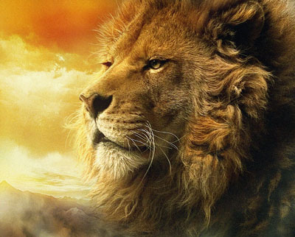
Messiah from Judah
Since Jacob's blessing in Genesis 49:9-10, the lion has depicted a king…
"Judah, my son, is a young lion that has finished eating its prey. Like a lion he crouches and lies down; like a lioness—who dares to rouse him?
¹⁰The scepter will not depart from Judah, nor the ruler's staff from his descendants, until the coming of the one to whom it belongs, the one whom all nations will honor" (NLT).

Slide 47
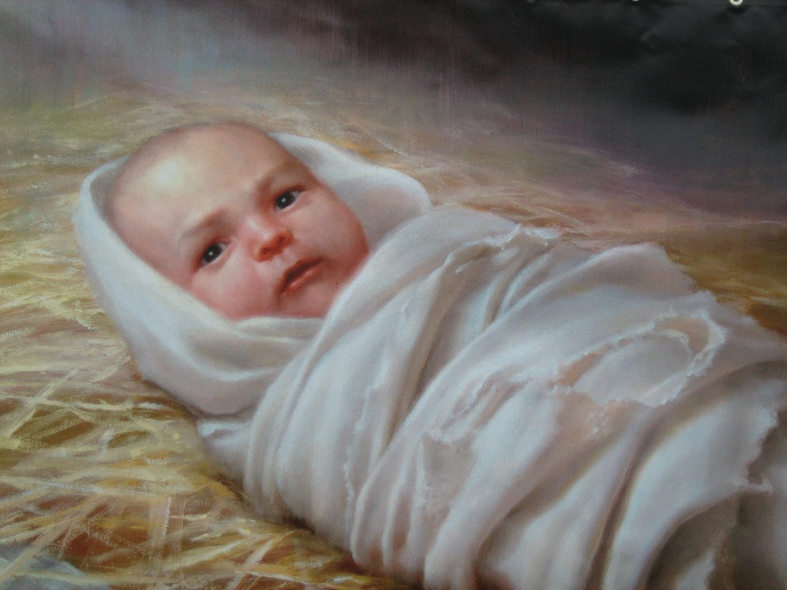
What would be the Messiah's lineage?

Slide 48

The Kingdom in Matthew 1
218b
Fall of the Kingdom
Establishing the Eternal Kingdom
ABRAHAM
Solomon
Shealtiel
Isaac
Rehoboam
Zerubbabel
Jacob
Abijah
Abiud
Judah
Asa
Eliakim
Perez
Jehoshaphat
Azor
"Thus there were fourteen generations in all from Abraham to David, fourteen from David to the exile to Babylon, and fourteen from the exile to Christ."
Matthew 1:17
Hezron
Jehoram
Zadok
Ram
Uzziah
Akim
Amminadab
Jotham
Eliud
Nahshon
Ahaz
Eleazar
Salmon
Hezekiah
Matthan
Boaz
Manasseh
Jacob
Obed
Amon
Joseph +
Mary
Rise of the Kingdom
Jesse
Josiah
KING DAVID
JECONIAH (EXILE)
JESUS CHRIST

Slide 49
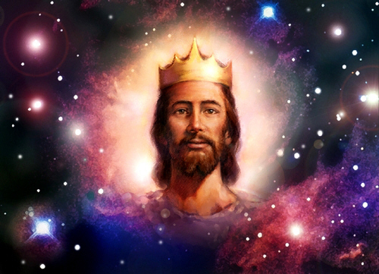
Matthew says Jesus is King!

Slide 50
Slides on
2 Samuel 8

Slide 51

David's Victories
Zobah
140
Phoenicia
Aram
2 Samuel 8
Israel
Ammon
Philistia
Moab
Egypt
Edom
Notes:
David expanded the kingdom with a new boundary through military victories in the north and south as God's fulfillment of his promise to give Israel rest from its enemies (2 Sam 8).

Slide 52
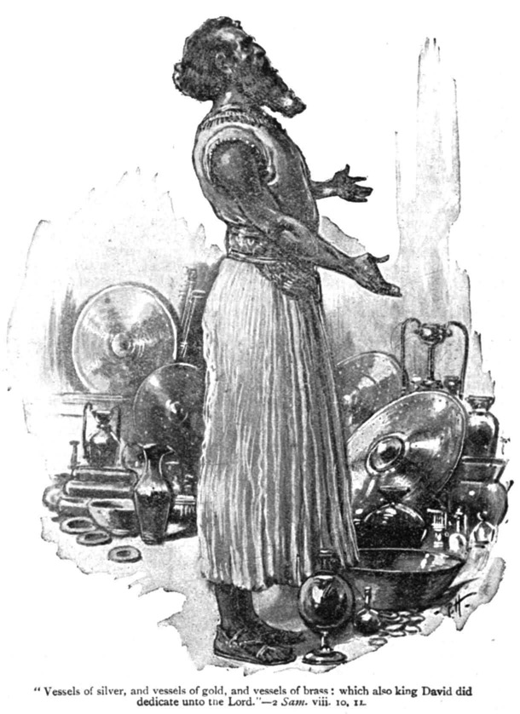
New Boundary
(2 Sam 8)
"King David dedicated all these gifts to the LORD, along with the silver and gold he had set apart from the other nations he had subdued"
(2 Samuel 8:11)

Slide 53
Slides on
2 Samuel 9
Notes:
David honored Jonathan's son Mephibosheth as a new son to show loyalty to Saul (2 Sam 9).

Slide 54
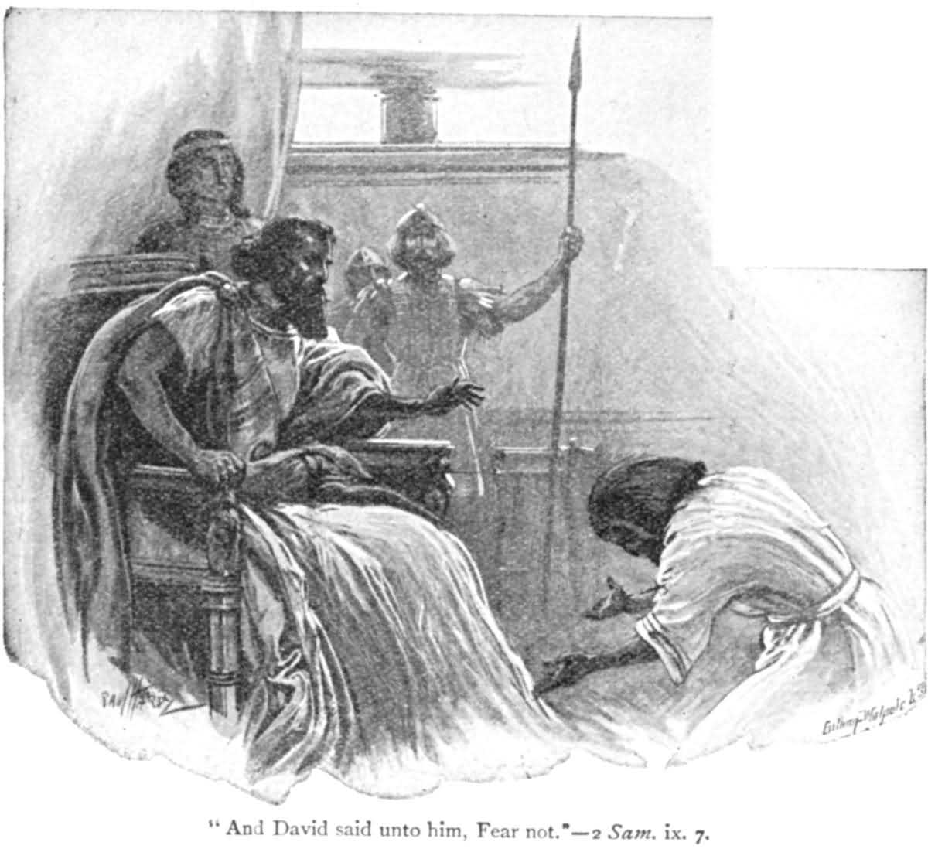
New Son
(2 Sam 9)
But David said, "Don't be afraid!" (to Mephibosheth, Jonathan's son)
2 Samuel 9:7

Slide 55
Slides on
2 Samuel 10
Notes:
David’s victory over ungrateful Ammon and Syria acquired them as new vassals (2 Sam 10).

Slide 56
David's New Vassal States
Zobah
140
Phoenicia
Aram
2 Samuel 10
Israel
Ammon
Philistia
Moab
Egypt
Edom

Slide 57
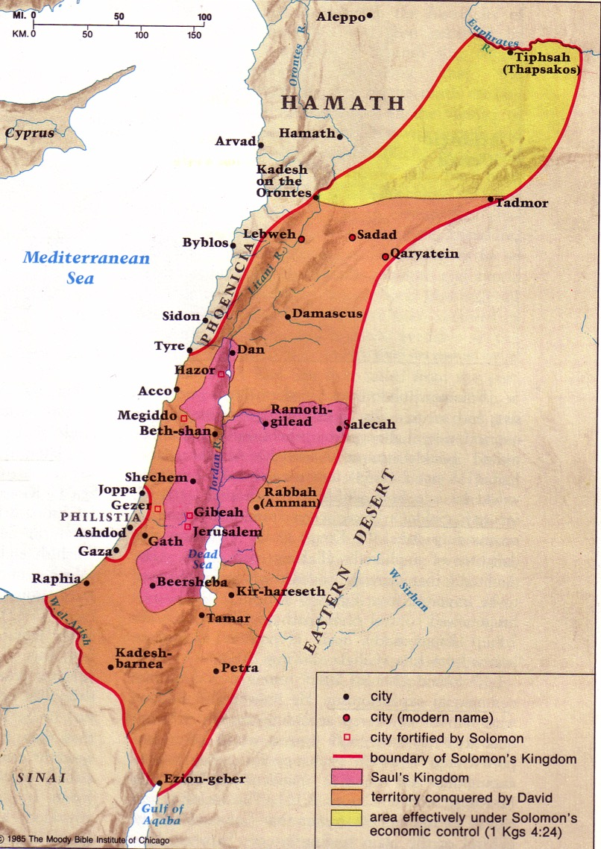
David's Conquests
209
Moody Atlas of Bible Lands, 121
New Vassals
(2 Sam 10)

Slide 58
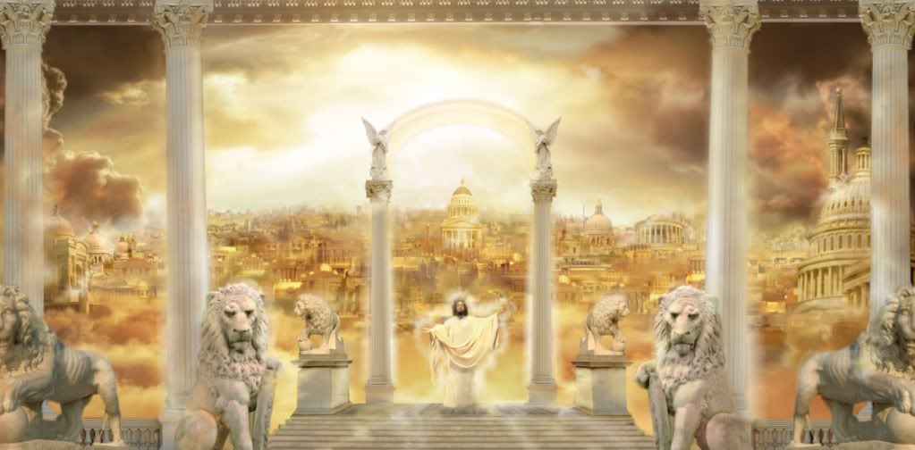
God is kind to give us Jesus as King.
Notes:
Restatement

Slide 59

We Want Democracy.
Demos ("people") + kratos (to rule")
Notes:
Our human tendency is to like to be in control.
We like to elect our leaders because we feel that we can do the best job in directing our lives.
But how are we doing at being in control? Just look at the world we live in where we seize control! If you haven’t noticed, it’s a mess.

Slide 60
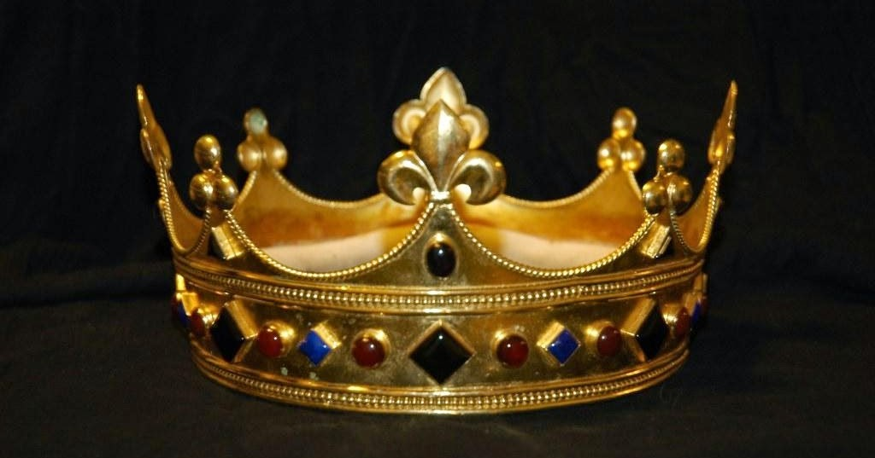
We prefer democracy but God mandates kingship
Notes:
We are far better to see that God shows his kindness to us when he gives the leader we really need in Christ.

Slide 61
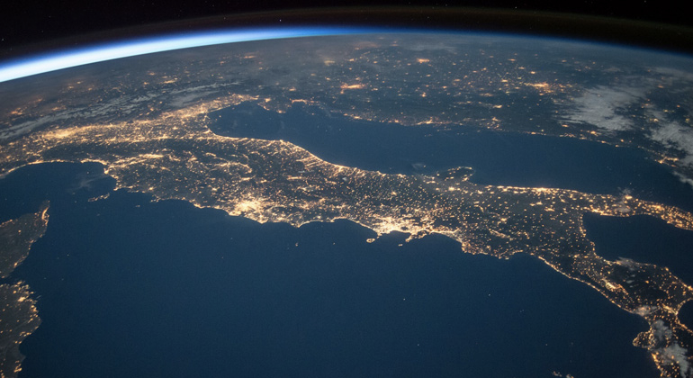
Rule from Rome?
Notes:
How are we doing with rule from Rome now like there was in the first century?

Slide 62
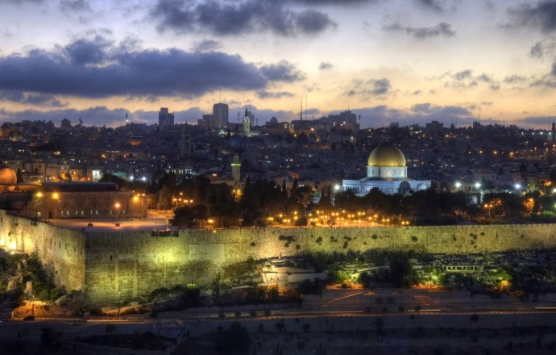
Jerusalem
Notes:
Matthew 2 shows us that the Jews were more disturbed at the birth of Jesus than they were with Herod’s rule!

Slide 63
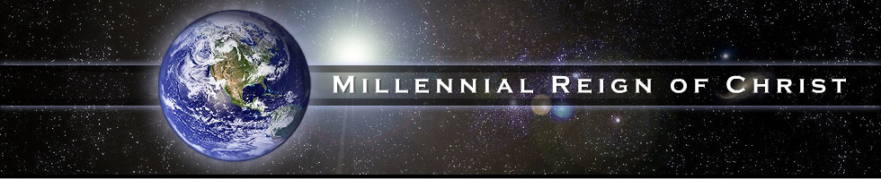
1000 Years!
MILLENNIAL REIGN OF CHRIST
Notes:
Yet Jesus is the Prince of Peace to those who believe: “Peace on earth to all with whom he is pleased.” He will rule in peace for 1000 years over those who believe!

Slide 64
How does God model kindness to us so we can be kind to others?
2 ways
Notes:
Restatement

Slide 65
I. God’s kindness gives us leaders (2 Sam 1–10).
Notes:
The LORD grants us his divinely appointed kings to follow.

Slide 66
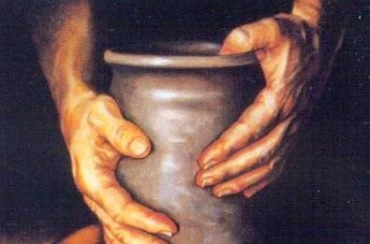
II. God’s kindness gives us discipline (2 Sam 11–24).
Notes:
The LORD blesses us with inconveniences to turn us back to him.

Slide 67
Slides on
2 Samuel 11

Slide 68
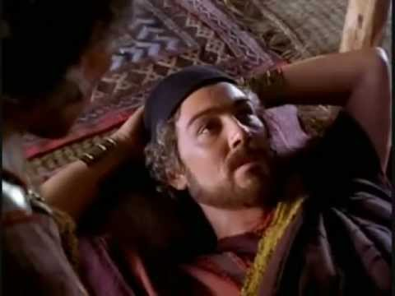
When life is "too good" then watch out…

Slide 69
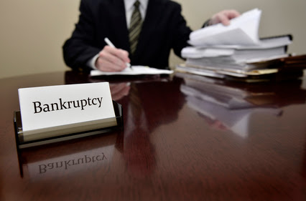
Chapter 11 = Bankruptcy
Bankruptcy

Slide 70
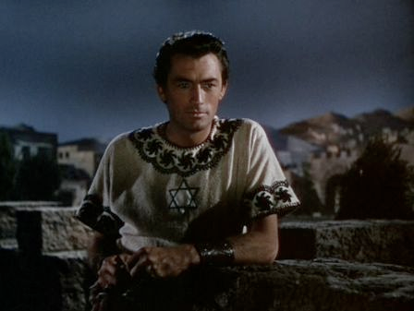
An idle mind…
…leads to…
an idol mind…
"In the spring when kings go out to war…" (11:1)

Slide 71
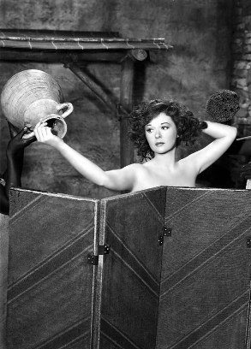
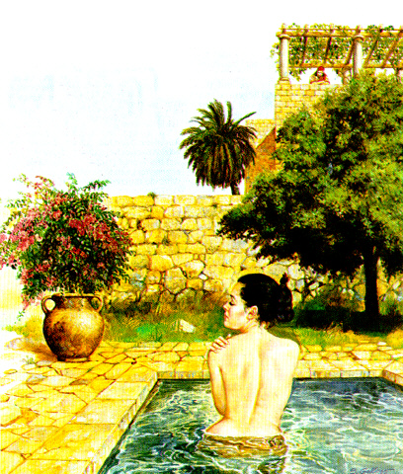
Bath for Bathsheba

Slide 72
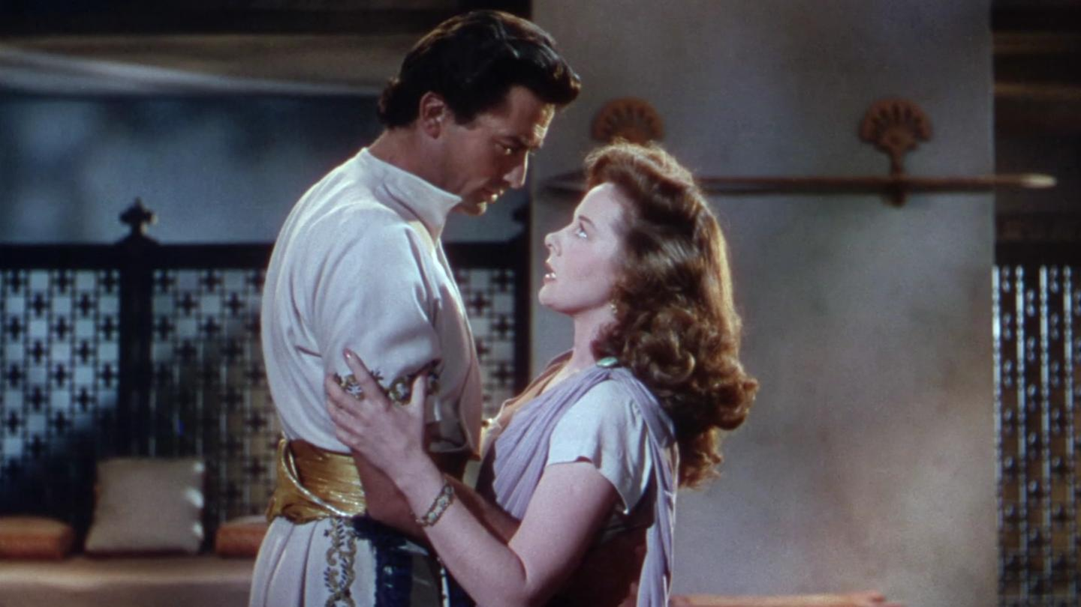
The inevitable conclusion

Slide 73
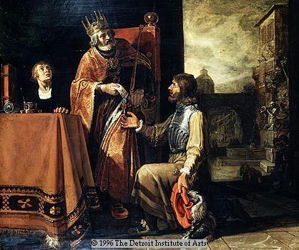
Uriah the Hittite and his wicked king, David

Slide 74
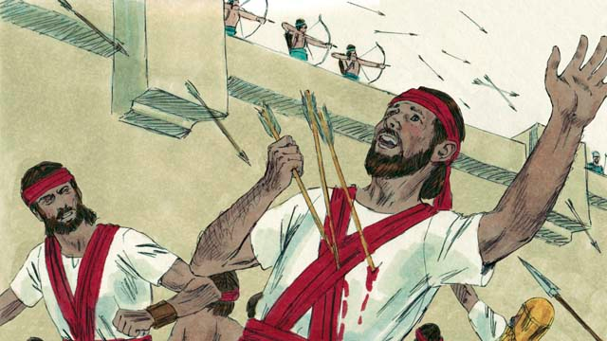
Uriah was killed along with several other Israelite soldiers
(2 Sam. 11:17)

Slide 75
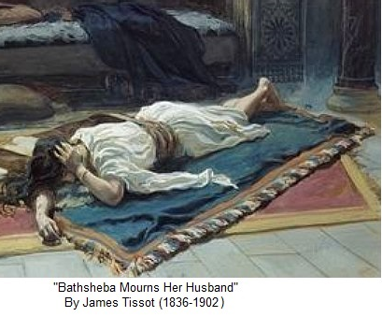
The Heartache David Caused
Bathsheba Mourns Her Husband

Slide 76
Slides on
2 Samuel 12

Slide 77
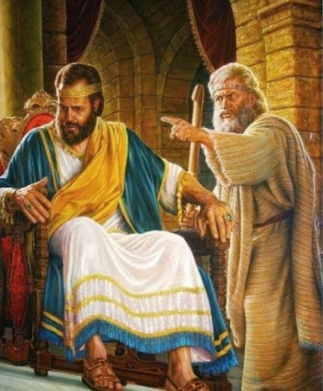
"You are the man!"
Nathan rebukes David for his sins
(12:1-12)

Slide 78

Bathsheba's baby dies

Slide 79

Their baby dies
God judges David's family
(12:1-12)

Slide 80

Descendants of David

Slide 81

FAMILY TROUBLES
SON of ADULTERY dies… (12:15-23)
STILL, GRACE of GOD…
David's second son from Bathsheba is
named SOLOMON alias Jedidiah–
"beloved of the LORD"—because the LORD loved him
(12:24-25)

Slide 82
Slides on
2 Samuel 13

Slide 83

Amnon & Tamar
David was judged through the rape of his daughter via his son

Slide 84

But Amnon's half-brother Absalom was full brother to Tamar

Slide 85

Absalom killed Amnon two years later

Slide 86

David mourns death of Amnon
(2 Samuel 13:37)

Slide 87
Slides on
2 Samuel 14

Slide 88

The Wise Woman of Tekoa (2 Samuel 14)

Slide 89
Slides on
2 Samuel 15

Slide 90

213
POLITICAL TROUBLES
(2 Samuel 15–20)
ABSALOM
SHEBA
ADONIJAH, later in Solomon's era
Notes:
David's political troubles from Absalom and Sheba's rebellions actually removed Absalom as a rival to David’s throne (2 Sam 15–20).

Slide 91


ABSALOM, David's handsome and
likeable son… still rebels against him.
Notes:
Absalom rivaled his father's throne but David refused to protect his kingdom by force, resulting in Absalom's death and the protection of David’s dynasty (2 Sam 15–18).

Slide 92

What kind of king will David become when he later has the same power as Saul? How will he respond to the third king, Absalom?
199
A TALE OF
THREE KINGS
A study in brokeness

Slide 93


"David and Zadok were alone once more. 'And now, what will you do, David? In your youth, you spoke no word against an unworthy king. What will you do now with an equally unworthy youth?' 'As I said,' replied David, 'These are the times I hate the most, Zadok. Nonetheless, against all reason, I judge my own heart first and rule against its interests.
I will do what I did under Saul.
I will leave the destiny of the kingdom in God's hands alone. Perhaps he is finished with me. Perhaps I have sinned too greatly and am no longer worthy to lead. Only God knows if that is true, and it seems he will not tell."
—Gene Edwards, A Tale of Three Kings, 93

Slide 94

Tyndale's Life Application Bible, NIV
Notes:
Absalom won over many in Israel to become king, forcing David from Jerusalem into exile since he was unwilling to protect his kingdom by force (15:1–16:14).

Slide 95

David had to flee to the wilderness to avoid war between him and Absalom. He wept in the Kidron Valley.
2 Samuel 15

Slide 96
Slides on
2 Samuel 16

Slide 97

Shimei opposed David by throwing stones at him. However, David refused to punish Shimei (2 Samuel 16:5-14).

Slide 98
Slides on
2 Samuel 17

Slide 99

Ahithophel gives Absalom good advice to pursue David at once (2 Sam 17:1-4)

Slide 100

Hushai gives Absalom bad advice to pursue David later (2 Sam 17:5-14)

Slide 101
Slides on
2 Samuel 18

Slide 102

A bad hair day for Absalom (18:9)

Slide 103

"'Enough of this nonsense,'
Joab said. Then he took three daggers and plunged them into Absalom's heart as he dangled from the oak still alive."
2 Samuel 18:14

Slide 104

2 Sam. 18:33
"The king was overcome with emotion. He went up to his room over the gateway and burst into tears. And as he went, he cried, 'O my son Absalom! My son, my son Absalom! If only I could have died instead of you! O Absalom, my son, my son.'"

Slide 105
Slides on
2 Samuel 19

Slide 106

Divided Kingdom
140
Phoenicia
Aram
2 Samuel 19
David returned to a restored kingdom in Jerusalem but the north-south division persisted.
Israel
Ammon
Philistia
Judah
Moab
Egypt
Edom

Slide 107

Misplaced Grief
Joab rebukes David for his poor leadership (19:5-7)

Slide 108
Slides on
2 Samuel 20

Slide 109
DAVID'S FINAL YEARS
214
An appendix in chapters 21–24
of David's final years provides additional accounts of his failures and successes as indication of God's continued blessing upon his line while still punishing sin.

Slide 110
Slides on
2 Samuel 21

Slide 111
Appendix Chart
209
A P P E N D I X
T R I B U T E
S U M M A R Y
CHAPTERS 21–24
H U M I L I T Y | P R I D E
21–23 | 24
OVER ALL I S R A E L
From JERUSALEM
33 Yrs. (1004–971 BC)
Notes:
An appendix of David's failures and successes in his final years proves God blessed his line while punishing sin (2 Sam 21–24).

Slide 112
Slides on
2 Samuel 22

Slide 113

David kept the humility of his youth.
The result was that many risked their lives for him.

Slide 114
Slides on
2 Samuel 23

Slide 115

"David's Mighty Men"
By James Tissot (1836-1902)

Slide 116

2 Samuel 23:8-11
David's Mighty Men

Slide 117

"David remarked longingly to his men, 'Oh, how I would love some of that good water from the well by the gate in Bethlehem.' ¹⁶ So the Three broke through the Philistine lines, drew some water from the well by the gate in Bethlehem, and brought it back to David. But he refused to drink it. Instead, he poured it out as an offering to the LORD"
(2 Samuel 23:15-16 NLT)
198

Slide 118
Slides on
2 Samuel 24

Slide 119

Araunah's Threshing Floor
(2 Sam 24:18-19)
Notes:
"After David’s sin in the the matter of taking a census of the people of Israel, and his acknowledgment of the sin, he was told by Gad to build an altar (2 Samuel 24:1-10). The instructions are specific.
And Gad came that day to David and said to him, “Go up, raise an altar to the LORD on the threshing floor of Araunah the Jebusite.” So David went up at Gad’s word, as the LORD commanded. (2 Samuel 24:18-19 ESV)
Araunah was gracious in his offer to allow David to take any of his property needed — the oxen, the threshing sledge, and the yokes of the oxen for the wood. He said, “All this, O king, Araunah gives to the king.”
David’s reply is one of those memorable statements of Scripture.
But the king said to Araunah, “No, but I will buy it from you for a price. I will not offer burnt offerings to the LORD my God that cost me nothing.” So David bought the threshing floor and the oxen for fifty shekels of silver. (2 Samuel 24:24 ESV)
Artist Balage Balogh has provided us a beautiful illustration of the threshing floor of Araunah [above] on what we later know to be Mount Moriah. See more of his work at Archaeology Illustrated.
It is generally understood that this is the place where Abraham came to offer Isaac, in the mount of the LORD three days from Beersheba (Genesis 22:4, 14). It is where Solomon began to build the temple in 966 B.C.
Then Solomon began to build the house of the LORD in Jerusalem on Mount Moriah, where the LORD had appeared to David his father, at the place that David had appointed, on the threshing floor of Ornan the Jebusite. (2 Chronicles 3:1 ESV)."
Araunah’s threshing floor
Posted on August 18, 2010 | 4 Comments
Ferrel Jenkins
https://ferrelljenkins.wordpress.com/2010/08/18/araunahs-threshing-floor/
Accessed 24 Dec 2017

Slide 120

Israel's "First" Temple
1 Kings 5:5
ROYALTY
S - D - S
Handbook pg. 32-37
30
Notes:
Of course, we have no picture of that Temple. However, this painting shows us its probable grandeur and beauty.

Slide 121

God also shows his kindness to us in his discipline.
Notes:
We seem to understand horizontal discipline better than vertical discipline.
We can see how valuable it is for a mother or father to discipline their children—that’s a horizontal discipline on a human level.
However, we seem to struggle with giving this same privilege to the God who knows best how to discipline us!

Slide 122

III. David pictures Jesus.
Notes:
So God’s kindness gives us leaders and discipline as he did for Israel regarding David. But how does all this kindness to David and from David relate to Jesus? Well, connecting the dots between the OT and NT, we see that…
[God’s kindness to David recalls God’s kindness to us through Jesus.]
[Many qualities of David are also true of Jesus.]

Slide 123

David to Jesus
  Both came from the line of Judah (Gen 49:10).
  Both were born in Bethlehem (1 Sam 15; Matt 2:1).
  Both came from humble roots—a shepherd and carpenter.
  Both protect from evil with courage but also with the heart of a shepherd.
  Both were appointed to rule Israel without seeking it.
  Both were exalted to rule the whole world.
  Both not only start in Bethlehem but also end in Jerusalem.
Notes:
Restatement

Slide 124

Micah 4:6-7 NLT
"In that coming day,” says the LORD, “I will gather together those who are lame, those who have been exiles, and those whom I have filled with grief. ⁷Those who are weak will survive as a remnant; those who were exiles will become a strong nation. Then I, the LORD, will rule from Jerusalem [Hebrew Mount Zion] as their king forever."

Slide 125
Micah 4:8 NLT
"As for you, Jerusalem, the citadel of God’s people, your royal might and power will come back to you again. The kingship will be restored to my precious Jerusalem."

Slide 126
How does God model kindness to us so we can be kind to others?
Notes:
Restatement

Slide 127

Main Idea
God will rule the world through David’s Descendent,
Jesus.
Notes:
Restatement

Slide 128
I. God’s kindness gives us leaders (2 Sam 1–10).
Notes:
The LORD grants us his divinely appointed kings to follow.

Slide 129
II. God’s kindness gives us discipline (2 Sam 11–24).

Slide 130
III. David pictures Jesus.
Notes:
Restatement

Slide 131
How do you respond to God’s kindness in Jesus?
Trust Jesus as your Savior and coming King
Show God’s kindness to others

Slide 132

Kindness
Notes:
Text

Slide 133

Kindness
Notes:
Text

Slide 134

There is no exercise better for the heart than reaching down and lifting people up.
—John Holmes
Notes:
Text

Slide 136


OT Preaching • BibleStudyDownloads.org
Get this presentation and script for free!
Notes:
OT Survey (os)

