Slide 1

FAITHFUL BY A THREAD
2 Chronicles 21–23
Dr. Rick Griffith • Crossroads International Church Singapore
CICFamily.com • BibleStudyDownloads.org

Slide 2

New York, August 2001

Slide 3
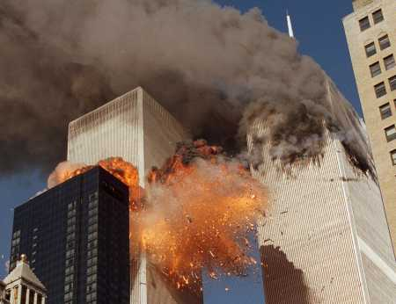
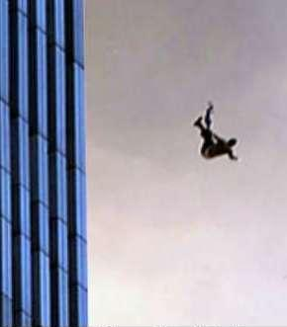
The Twin Towers

Slide 4
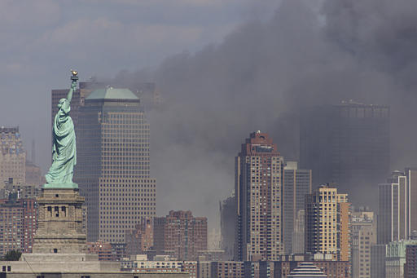
The Statue of Liberty

Slide 5
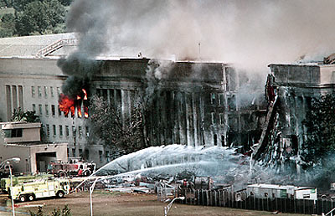
The Pentagon

Slide 6
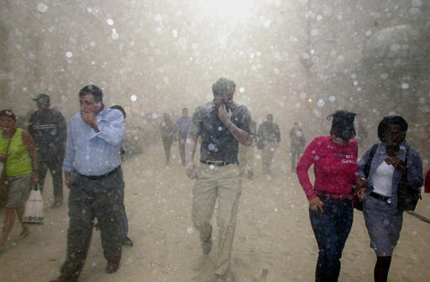
The Dust Aftermath

Slide 7
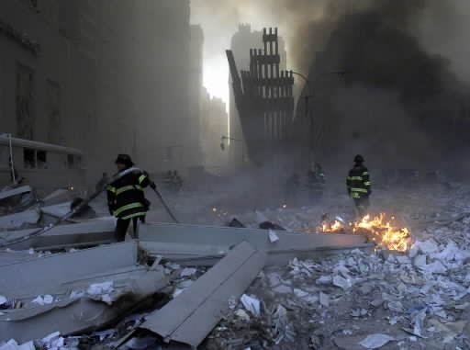
Remaining Firefighters

Slide 8
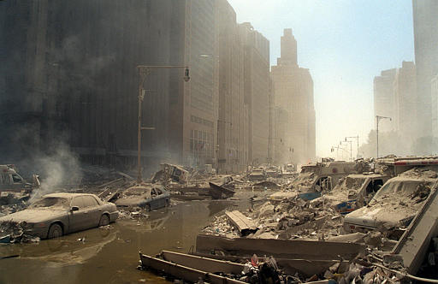
The Street

Slide 9
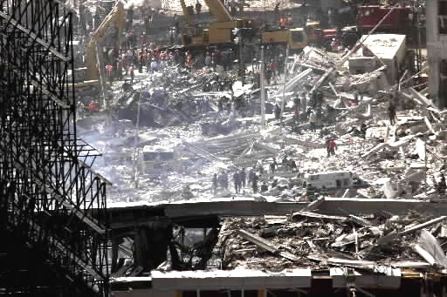
The Clean-up

Slide 10

Ten Years Later
…is God faithful?

Slide 11
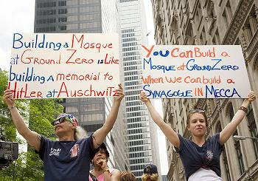
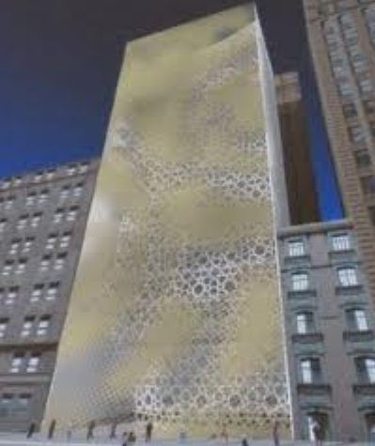
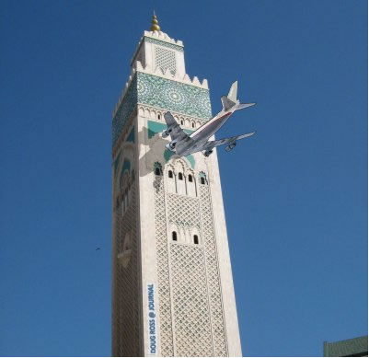
Cordoba House

Slide 12
Cordoba House

Slide 13
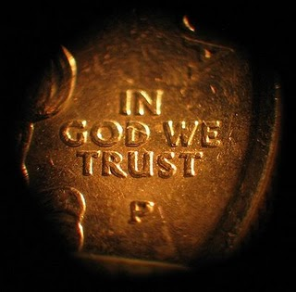
No Prayer Allowed?!

Slide 14
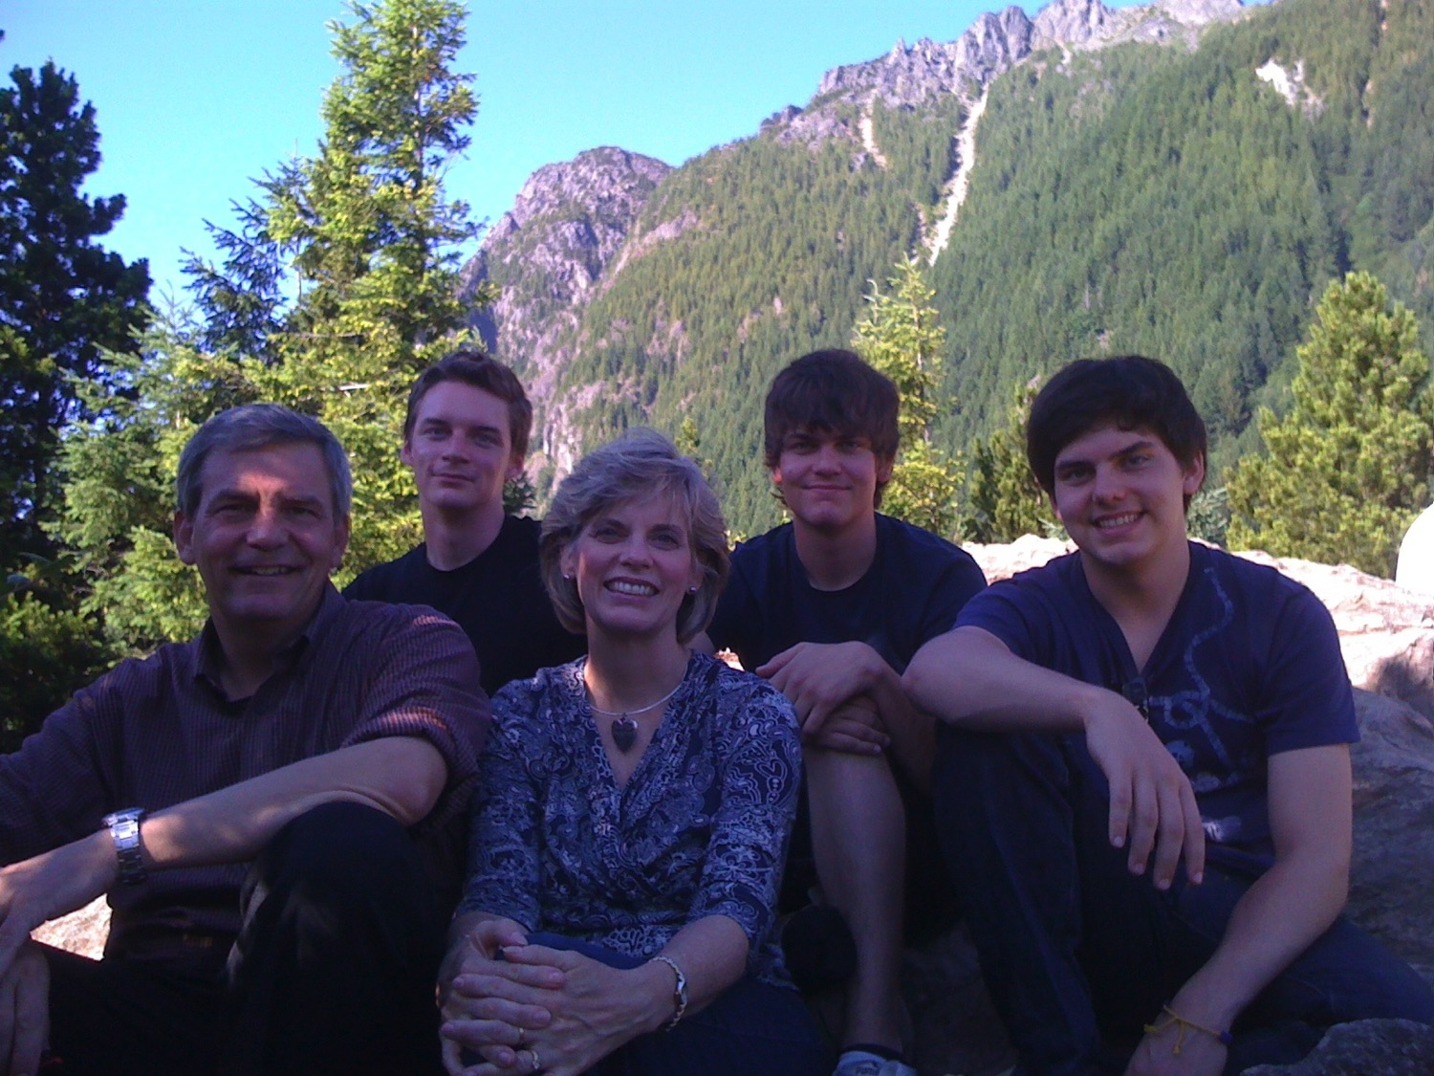
2011

Slide 15
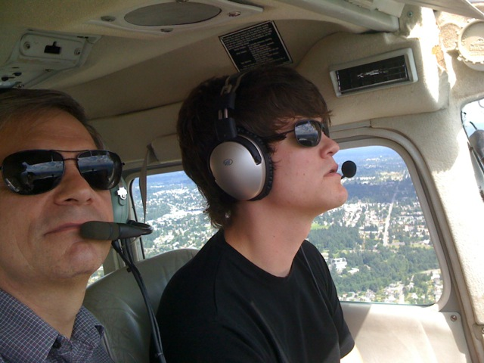
Stephen the Pilot

Slide 16
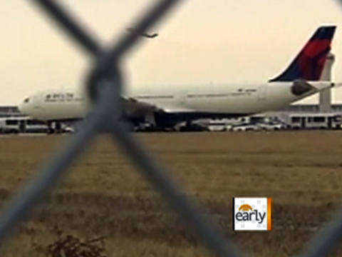
Aviation

Slide 17

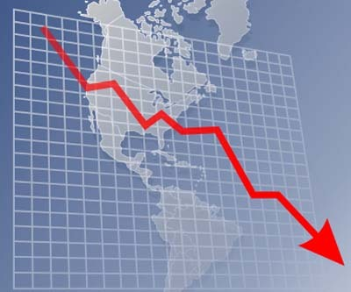
Dollar Devaluation

Slide 18

The Economy

Slide 19
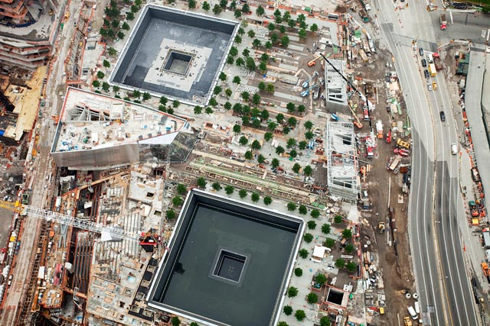
How can we know whether God has abandoned us?

Slide 20
Genesis 12:1-3
7
Genesis 12
The Lord had said to Abram,
“Leave your country, your people and your father’s household, and go to the land I will show you.
1
“I will make you into a great nation
and I will bless you;
I will make your name great,
and you will be a blessing.
2
ABRAHAM
The CALL
I will bless those who bless you,
and whoever curses you I will curse;
and all peoples on earth
will be blessed through you.”
L - S - B
3
Handbook pg. 19-24
13
2

Slide 21
Three Promises
7
Genesis 12
The Lord had said to Abram,
“Leave your country, your people and your father’s household, and go to the land I will show you.
1
A LAND
“I will make you into a great nation
and I will bless you;
I will make your name great,
and you will be a blessing.
2
A SEED
ABRAHAM
The CALL
I will bless those who bless you,
and whoever curses you I will curse;
and all peoples on earth
will be blessed through you.”
L - S - B
3
A BLESSING
Handbook pg. 19-24
14
2

Slide 22
Amplifying Covenants
7
Abrahamic Covenant
Gen. 12:1-3
LAND SEED BLESSING
ROYALTY
S - D - S
Palestinian Davidic
Deut. 30:1-10
2 Sam. 7:4-16
1 Chron. 17:3-15
Handbook pg. 32-37
25

Slide 23
THE DAVIDIC COVENANT
7
ITS THREE GUARANTEES
2 Samuel 7
¹⁶ Your house and your kingdom will endure forever before me; your throne will be established forever.
house
kingdom
forever
ROYALTY
S - D - S
throne
forever
Handbook pg. 32-37
5
24

Slide 24

1 Chronicles Book Chart
1 Chronicles
262
David's Line Established
David's Line
David's Concern (Ark / Temple)
Chapters 1–9
Chapters 10–29
Genealogy
History
Ancestry
Activity
Saul's Throne to David
David's Throne to Solomon
4143-1011 BC (3132 years)
1011-971 BC (40 years)
Davidic Line
1–3
Tribal
Lines
4–8
Priests /
Levites
9:1-34
Saul's Line
9:35-44
Accession to Throne
10–12
Respect for Ark
13–17
Military Victories
18–20
Temple Prep.
21–29

Slide 25
2 Chronicles Book Chart
2 Chronicles
271
David's Line Preserved
Solomon
Davidic Dynasty
Chapters 1–9
Chapters 10–36
Temple Constructed
Temple Destroyed
Royalty
Ruins
40 Years
393 Years
971-931 BC
931-538 BC
Wealth & Wisdom
1
Temple Construction
2–7
Successes
& Death
8–9
Kingdom Divides via Rehoboam
10–12
7 Bad,
8 Good Kings
13–35
4 Bad Kings then Judah Falls
36
1 Kings 1–11
1 Kings 12–22
2 Kings 1–25

Slide 26
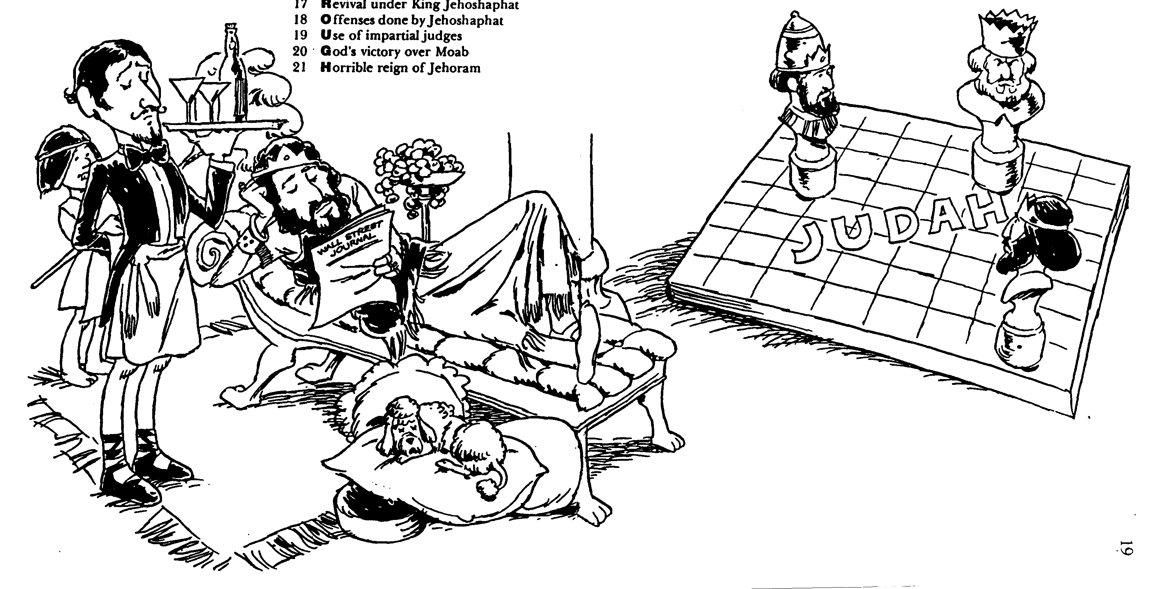
God's Response
2 Chron. 21–23
Idolatry
True Worship

Slide 27
I. God ultimately defeats those who worship idols.

Slide 28
Family Wickedness (2 Chron. 21–22)
238
Ethbaal
King of Sidonians
Omri
King of Israel
Asa
King of Judah
(Line of David)
Jezebel
Ahab
Jehoshaphat
Athaliah
Jehoram
All brothers killed
(2 Ch 21:4)
Good kings in white; queen in gray italics
Notes:
It may sound confusing, but there were two kings who lived at the same time in the northern and southern kingdoms who were named Jehoram and two named also Ahaziah—Ahaziah of Israel on the left and Ahaziah of Judah on the right. In 2 Kings 11:2 (cf. 2 Chron. 22:11), we read how the Davidic line was all wiped out by the mother of Ahaziah of Judah—all except one of her grandsons named Joash. God’s promise of an eternal king through David (2 Sam. 7:14) would have been unfulfilled had it not been through the courage of Jehoshebah, Ahaziah’s sister, who saved the life of the infant nephew, Joash. In fact, the line dwindled to only one living descendant of David the preceding two generations also!

Slide 29
Family Wickedness (2 Chron. 21–22)
238
Ethbaal
King of Sidonians
Omri
King of Israel
Asa
King of Judah
(Line of David)
Jezebel
Ahab
Jehoshaphat
Ahaziah
Jehoram (Joram)
Athaliah
Jehoram
All brothers killed
(2 Ch 21:4)
All brothers killed
(2 Ch 22:1)
Killed by Jehu
Ahaziah
All brothers killed
(2 Ch 22:11)
Joash
Good kings in white; queen in gray italics
Notes:
It may sound confusing, but there were two kings who lived at the same time in the northern and southern kingdoms who were named Jehoram and two named also Ahaziah—Ahaziah of Israel on the left and Ahaziah of Judah on the right. In 2 Kings 11:2 (cf. 2 Chron. 22:11), we read how the Davidic line was all wiped out by the mother of Ahaziah of Judah—all except one of her grandsons named Joash. God’s promise of an eternal king through David (2 Sam. 7:14) would have been unfulfilled had it not been through the courage of Jehoshebah, Ahaziah’s sister, who saved the life of the infant nephew, Joash. In fact, the line dwindled to only one living descendant of David the preceding two generations also!

Slide 30
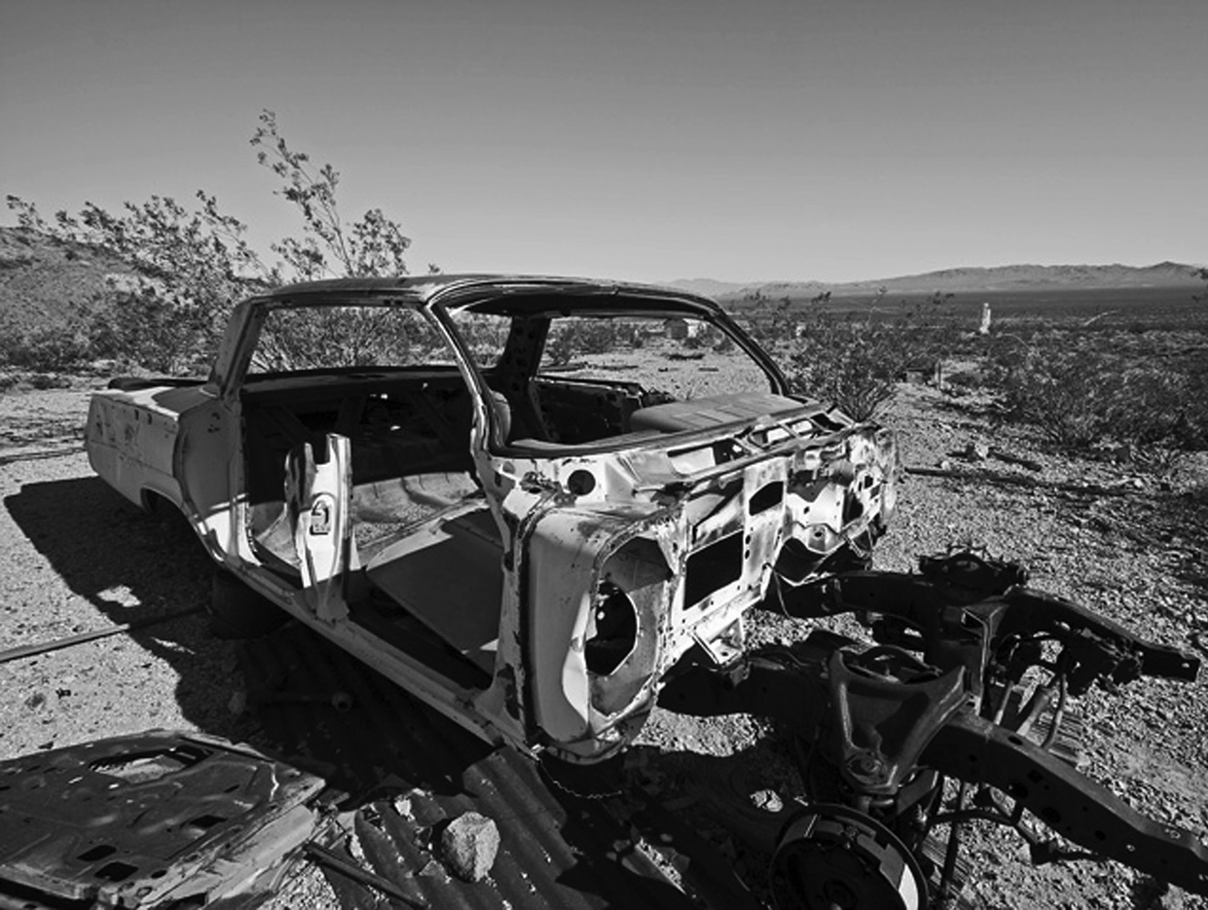
God still disciplines idolaters today

Slide 31

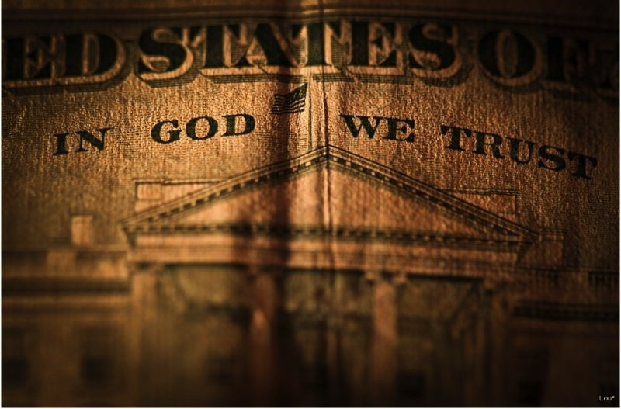
In God We Trust?
1962 Prayer in schools
1963 Bible reading in schools
1973 Abortion restrictions
1985 Nativity scenes prohibited
2003 Sodomy laws eliminated
2004 No intelligence allowed
2011 Gay marriage legalized

Slide 32

Housing

Slide 33
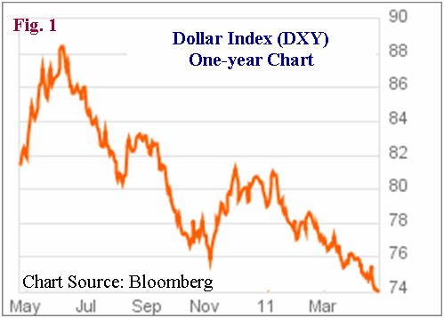
Title

Slide 34

California
49th in Education (2011)
49th in Unemployment (12%)
50th in Creating
New Businesses (2010)

Slide 35
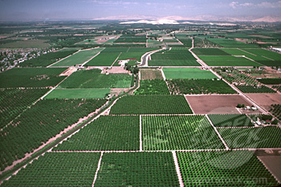
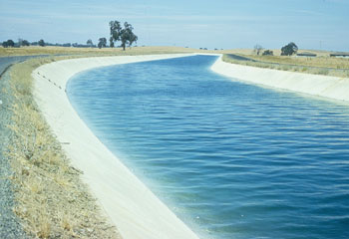
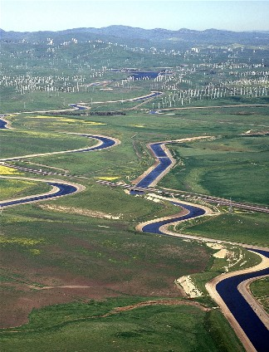
The California Canal

Slide 36
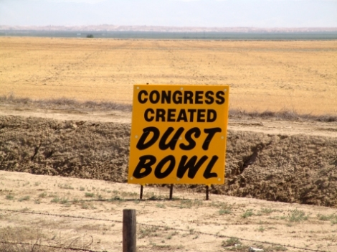
Congress Created Dust Bowl

Slide 37
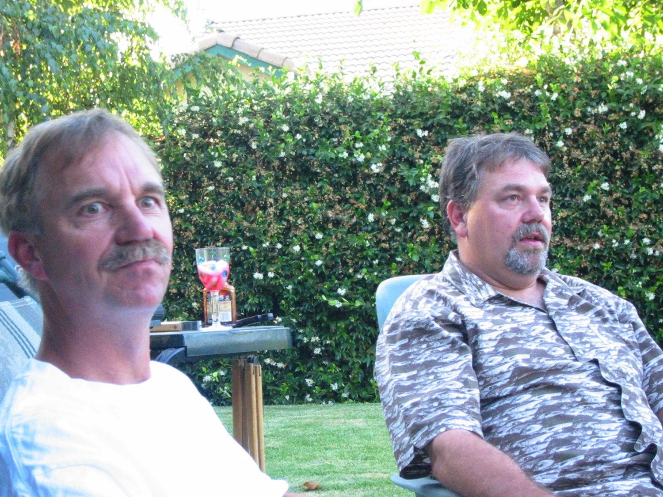
My two brothers

Slide 38
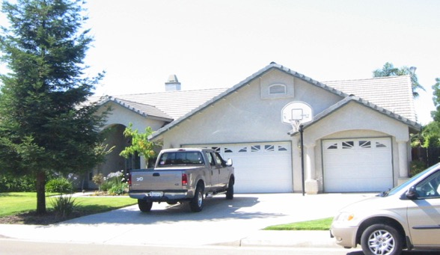
Five More Homes
+$50,000
+$50,000
+$50,000
+$50,000
+$50,000
+$50,000

Slide 39
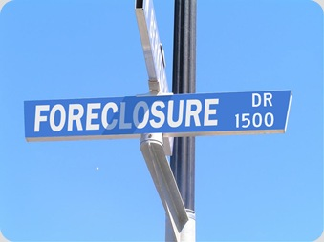
Phil

Slide 40

Faithful By A Thread

Slide 41
I. God ultimately defeats those who worship idols.

Slide 42

II. God keeps His promises to those who worship Him.

Slide 43

Family Righteousness (22:10-12)
238
Aaron
Priest of Israel
Asa
King of Judah
(Line of David)
Jehoshaphat
Athaliah
Jehoram
Ahaziah
Unnamed Nurse
Jehoiada
Jehoshebah
Joash
Righteous in white; queen in gray italics
Notes:
In 2 Kings 11:2 (cf. 2 Chron. 22:11), we read how the Davidic line was all wiped out by the mother of Ahaziah of Judah—all except one of her grandsons named Joash. God’s promise of an eternal king through David (2 Sam. 7:14) would have been unfulfilled had it not been through the courage of Jehoshebah, Ahaziah’s sister and husband of Jehoiada the priest. Jehoshebah saved the life of her infant nephew, Joash, with the courageous help of his unnamed nurse who raised him for 6 years in the temple out of the murderous eye of Athaliah.

Slide 44
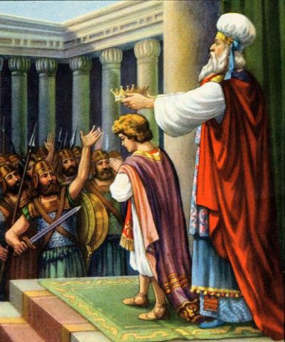
Jehoiada Crowns Joash
(2 Chron. 23:11)

Slide 45
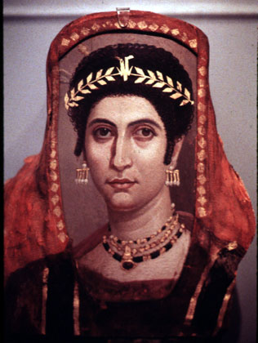
Athaliah Killed
(2 Chron. 23:14-15)

Slide 46
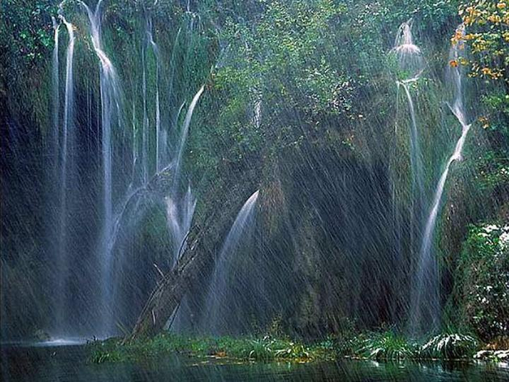
God still keeps His promises to those who worship Him today

Slide 47
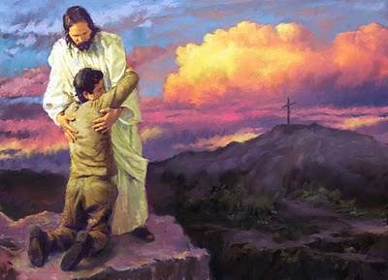
God still keeps His promises to those who worship Him today

Slide 48

Our Crossroads Era
2006-2011
“...and my God shall supply all of your needs...” (Phil. 4:19)

Slide 49
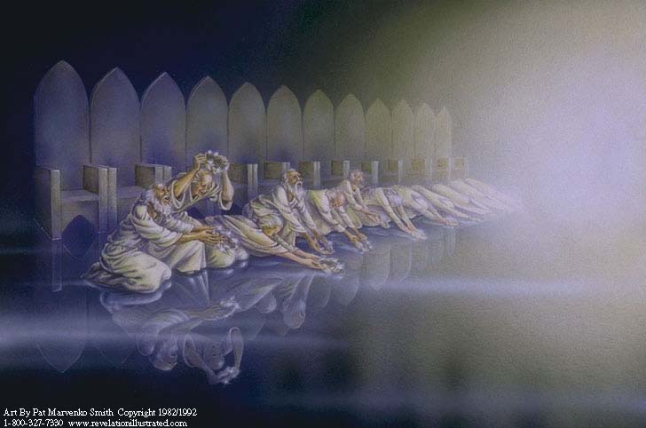
The elders cast their crowns (Rev. 7:9)

Slide 50
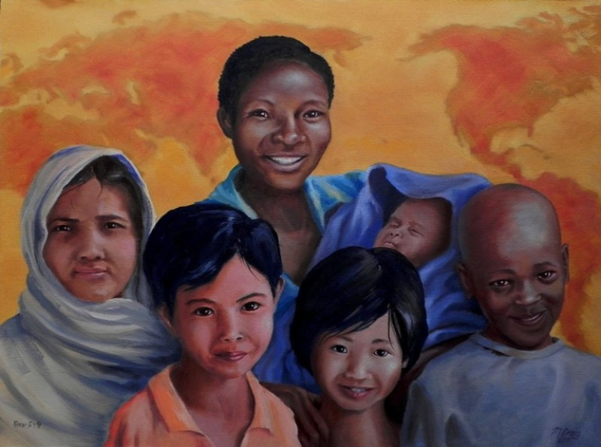
“From every tribe, nation, language and people” (Rev. 7:9)

Slide 51
Three-Part Genealogy of Christ Through Joseph (Matt. 1:1-17)
From Abraham to David
-14 generations
From David to Captivity in Babylon
-14 generations
From Captivity to Christ
-14 generations

Slide 52
The Kingdom in Matthew 1
Fall of the Kingdom
Establishing the Eternal Kingdom
ABRAHAM
Solomon
Shealtiel
Isaac
Rehoboam
Zerubbabel
Jacob
Abijah
Abiud
Judah
Asa
Eliakim
Perez
Jehoshaphat
Azor
Thus there were fourteen generations in all from Abraham to David, fourteen from David to the exile to Babylon, and fourteen from the exile to Christ.
Matthew 1:17
Hezron
Jehoram
Zadok
Ram
Uzziah
Akim
Amminadab
Jotham
Eliud
Nahshon
Ahaz
Eleazar
Salmon
Hezekiah
Matthan
Boaz
Manasseh
Jacob
Obed
Amon
Joseph +
Mary
Rise of the Kingdom
Jesse
Josiah
KING DAVID
JECONIAH (EXILE)
JESUS CHRIST

Slide 53
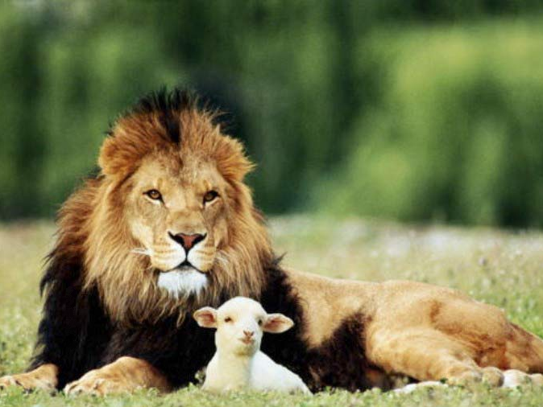
Isaiah 11:6-9
⁶ And the wolf will dwell with the lamb, and the leopard will lie down with the young goat, and the calf and the young lion and the fatling together; and a little boy will lead them. ⁷ Also the cow and the bear will graze, their young will lie down together, and the lion will eat straw like the ox.
⁸ The nursing child will play by the hole of the cobra, and the weaned child will put his hand on the viper's den.
⁹ They will not hurt or destroy in all My holy mountain, for the earth will be full of the knowledge of the LORD as the waters cover the sea.
Notes:
53

Slide 54
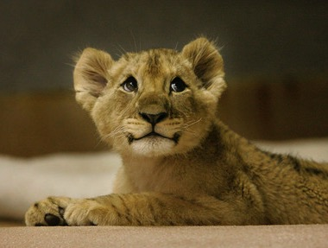
Even lions tamed!
Notes:
54

Slide 55
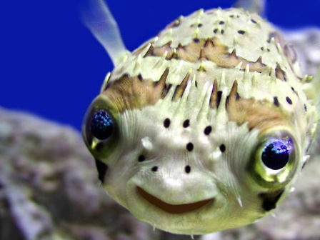
Romans 8:19-21
“The creation waits in eager expectation for the sons of God to be revealed. . . The creation itself will be liberated from its bondage to decay and brought into the glorious freedom of the children of God.”
Notes:
55

Slide 56
The Main Idea
God judges idolaters but keeps His promises to those who worship Him.

Slide 57
I. God ultimately defeats those who worship idols.

Slide 58
II. God keeps His promises to those who worship Him.

Slide 59
What now?
Questions to Ponder
1. Do you worship idols?
2. Do you trust God for your future?

Slide 60
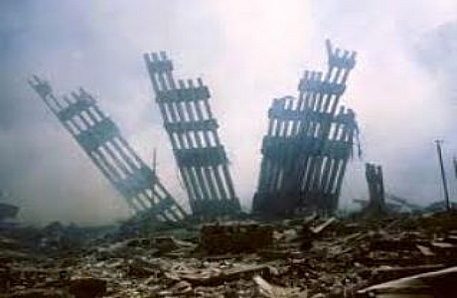
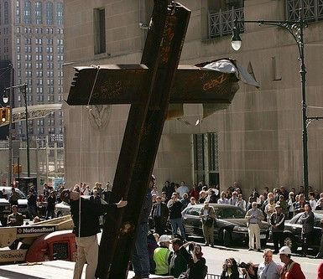
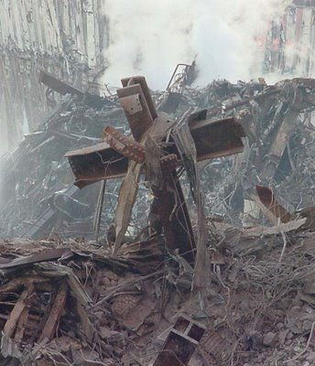
There's a Future in the Cross

Slide 61
Black

Slide 62


OT Preaching link at BibleStudyDownloads.org
Get this presentation and script for free!

