Slide 1
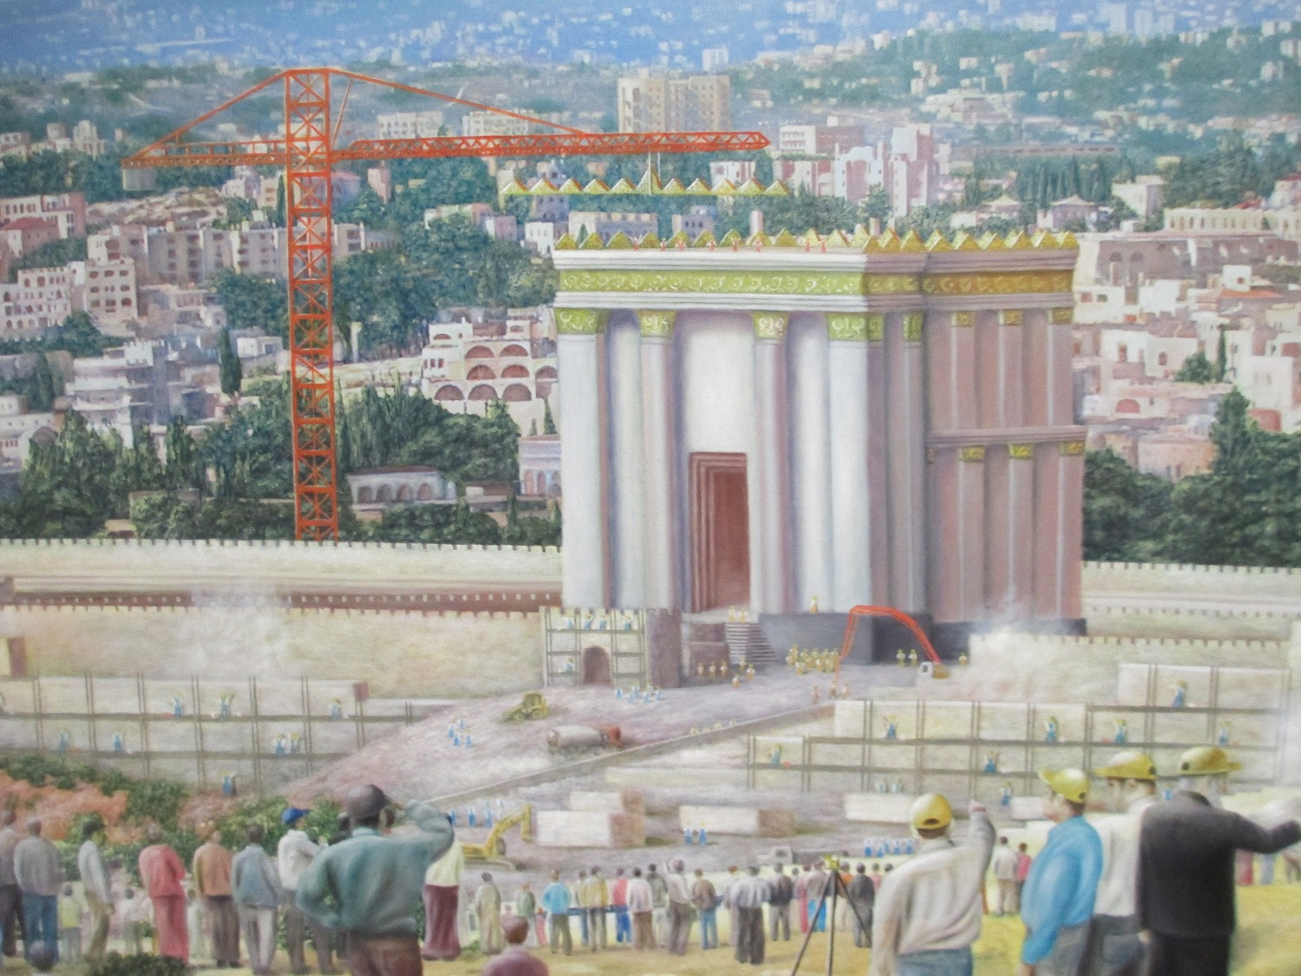
The Tribulation Temple
Matthew 24:15
Dr. Randall Price • World of the Bible Ministries International
Uploaded by Dr. Rick Griffith • Jordan Evangelical Theological Seminary
BibleStudyDownloads.org

Slide 2

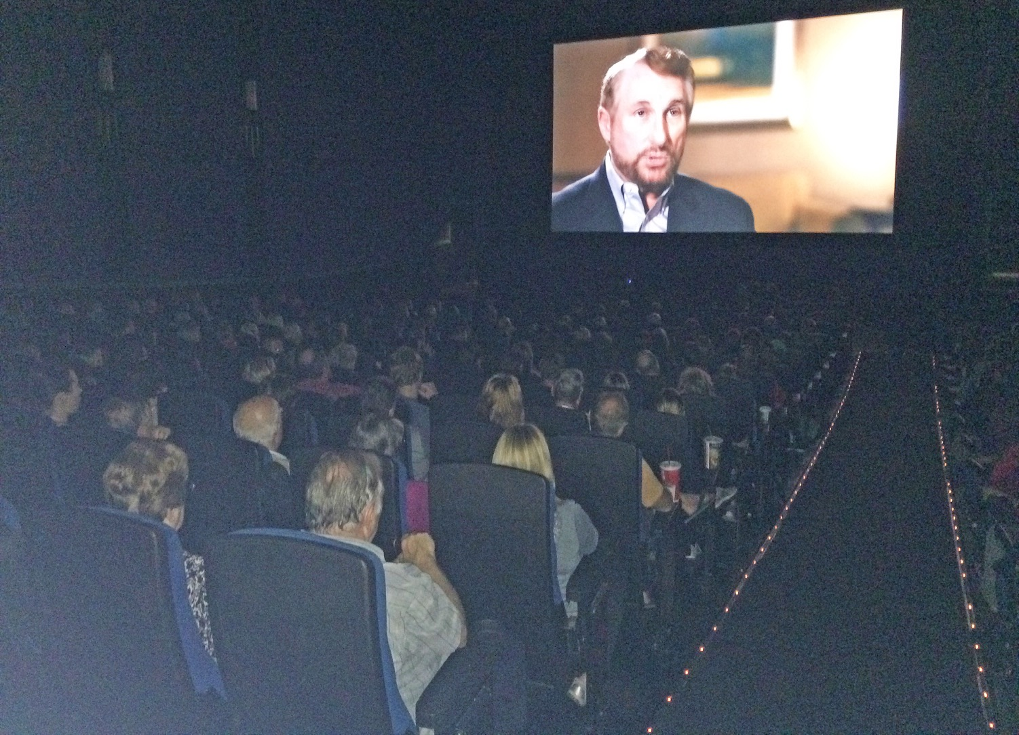
FINDING NOAH
Lynchburg
316

Slide 3
Bringing the World of the Bible to the Word of the Church
World of the Bible .com

Slide 4

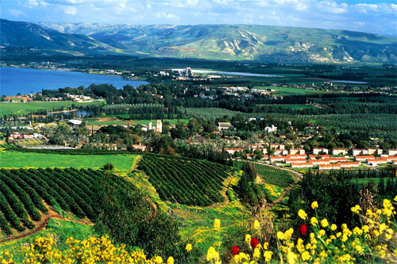
World of the Bible 2016 Tours
Israel Adventure Tour June 4-15
Second Timers Tour June 14-25
See the Details at www.worldofthebible.com

Slide 5
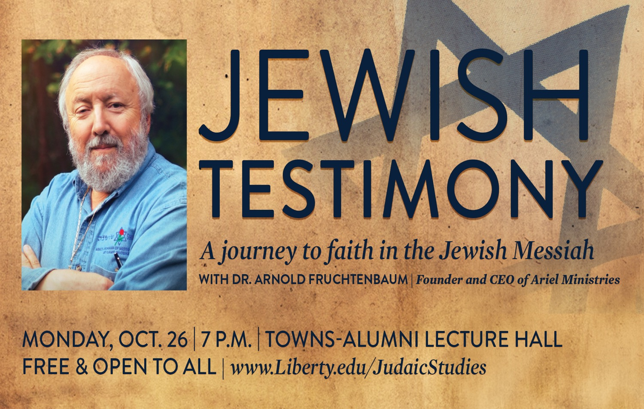
WORTH TWO (2) QUIZ GRADES!!!

Slide 6
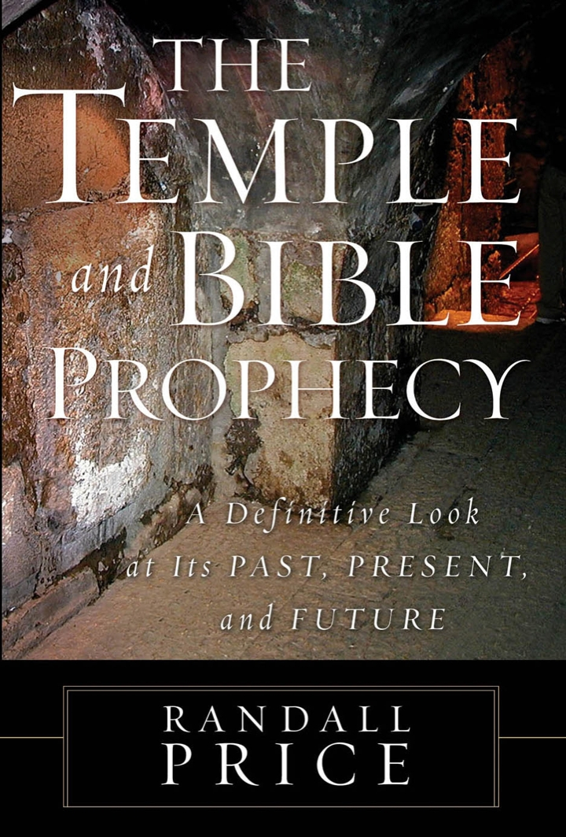
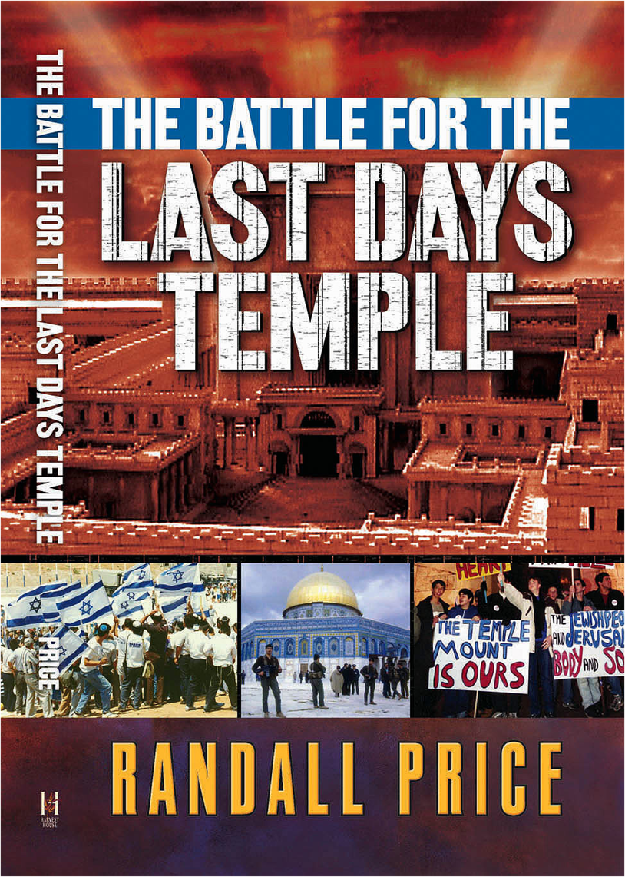

Slide 7
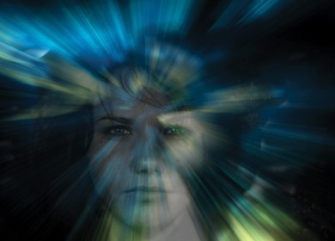
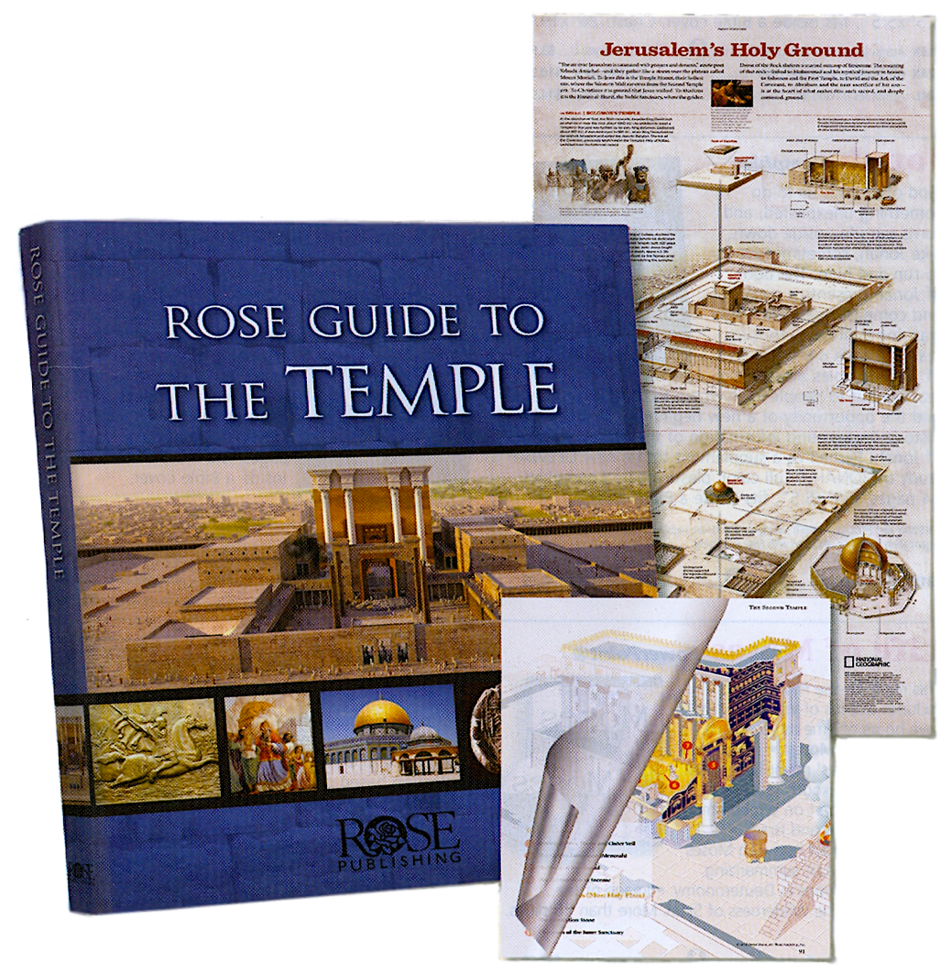
Fold-out Posters of
the Temple through Time
Full
color
photos,
original
drawings,paintings,
diagrams
Overlays of
Tabernacle &
Temples

Slide 8
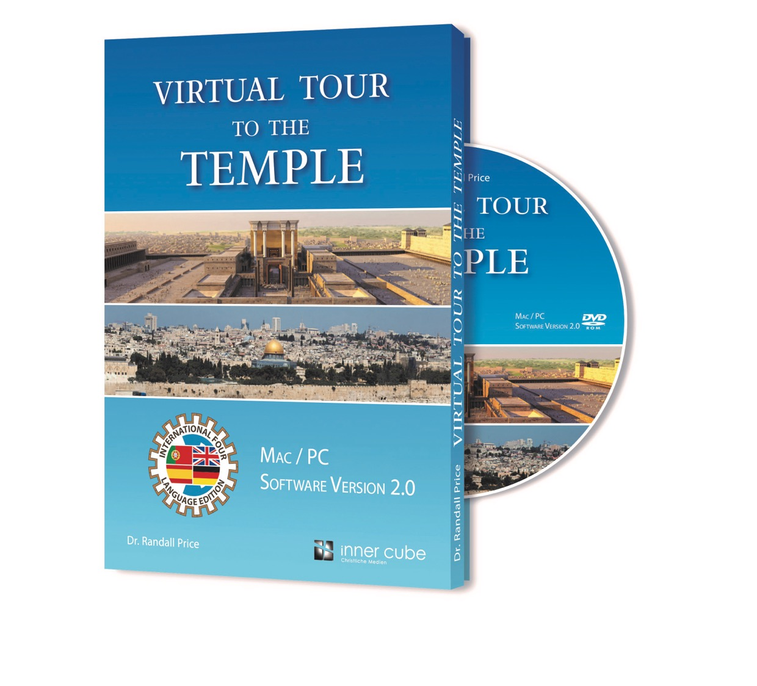
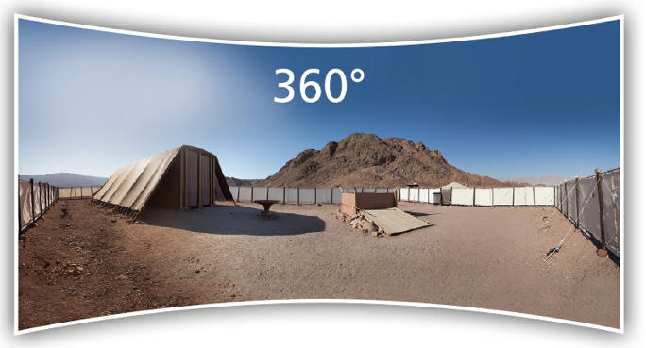
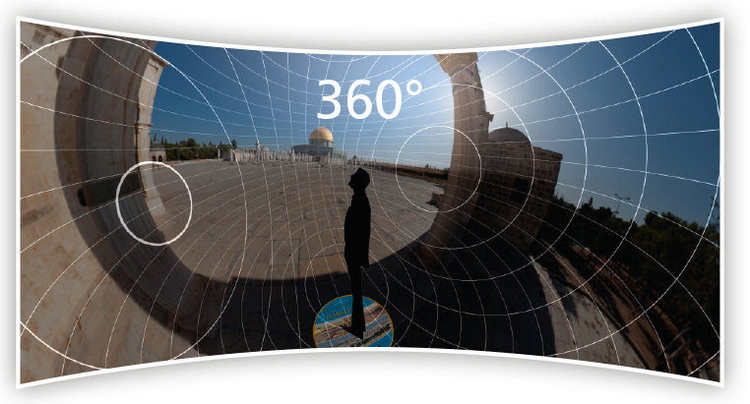
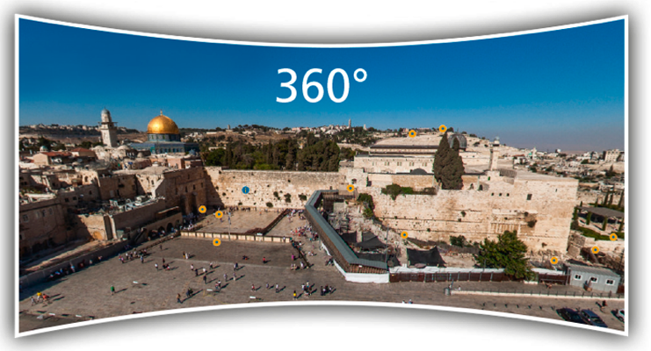

Slide 9
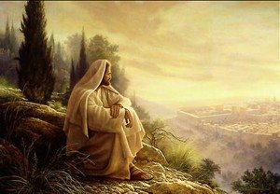
THE OLIVET DISCOURSE
Jesus’ Teaching on
the End Time
Lesson 6

Slide 10
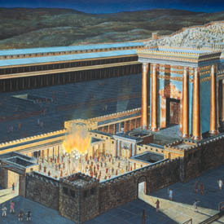
Two Stages of the Abomination of Desolation
Stage 1 – The presence of the Antichrist himself in the Temple – in the Holy of holies (2 Thessalonians 2:4).
Stage 2 – The image of the Antichrist in the Temple (Revelation 13:11-15).
This image will remain in the Temple for another 30 days after the Antichrist is cast into the Lake of Fire (Daniel 12:11).

Slide 11
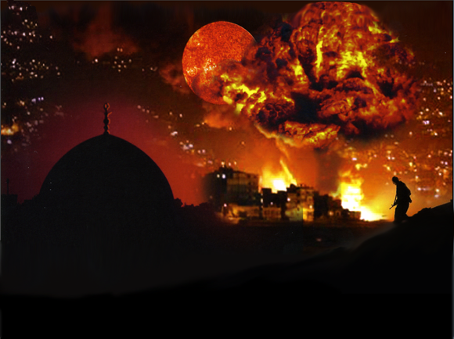
“And there was given me a measuring rod like a staff; and someone said, ‘Rise and measure the temple of God, and the altar, and those who worship in it. And leave out the court which is outside the temple, and do not measure it, for it has been given to the nations; and they will tread under foot the holy city for forty-two months.’” Rev. 11:1–2

Slide 12
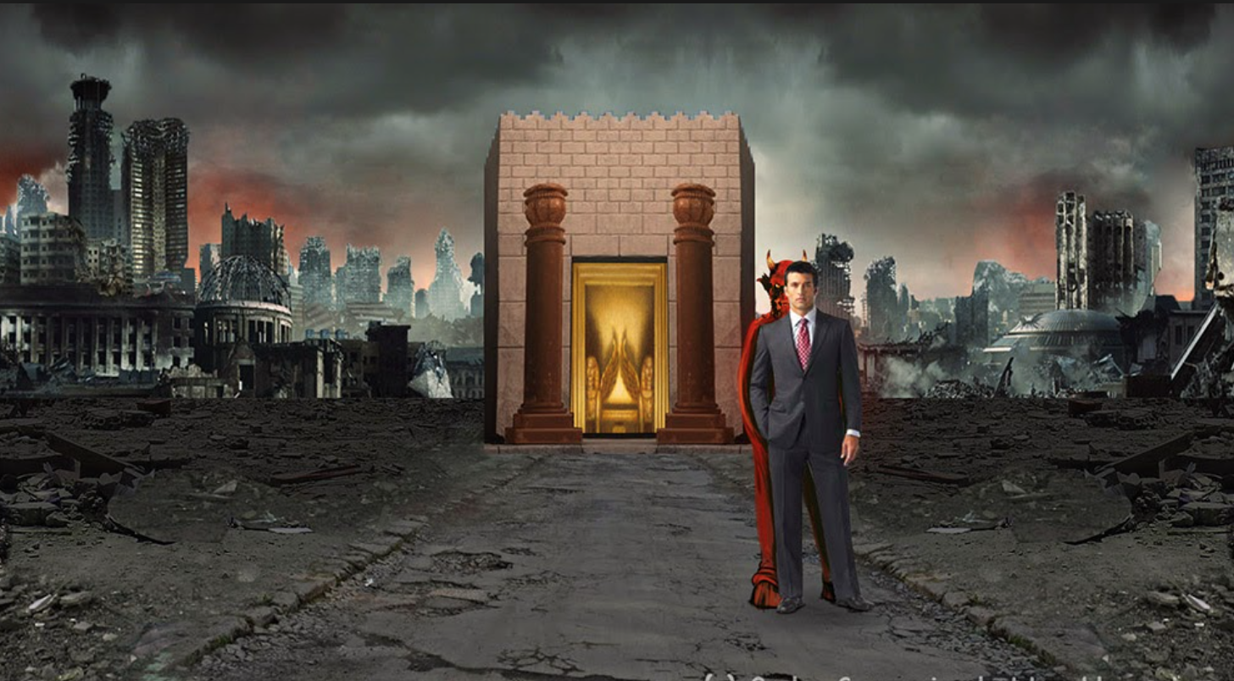
“Let no one in any way deceive you, for it will not come unless the apostasy comes first, and the man of lawlessness is revealed, the son of destruction …”
2 Thessalonians 2:3a

Slide 13
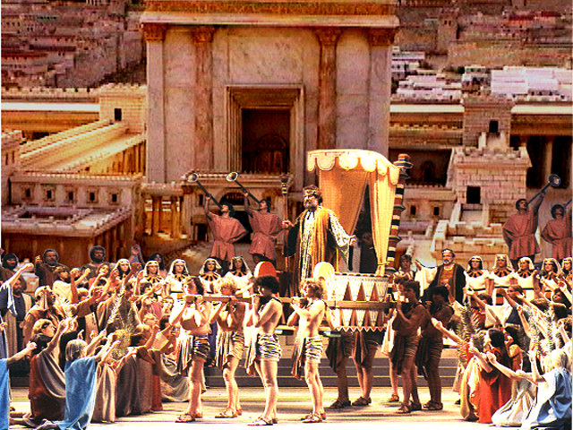
“… who opposes and exalts himself above every so-called god or object of worship, so that he takes his seat in the Temple of God, displaying himself as being God.”
2 Thessalonians 2:3-4

Slide 14
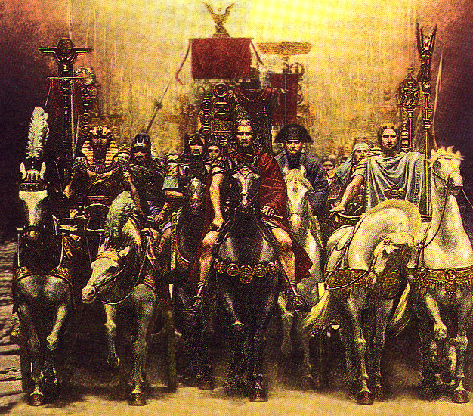
RIDER ON THE WHITE HORSE
THE ANTICHRIST
“Then the king will do as he pleases, and he will exalt and magnify himself above every god, and will speak monstrous things against the God of gods; and he will prosper until the indignation is finished, for that which is decreed will be done. And he will show no regard for the gods of his fathers or for the desire of women, nor will he show regard for any other god; for he will magnify himself above them all. But instead he will honor a god of fortresses, a god whom his fathers did not know; he will honor him with gold, silver, costly stones, and treasures.” Daniel 11:36–38

Slide 15
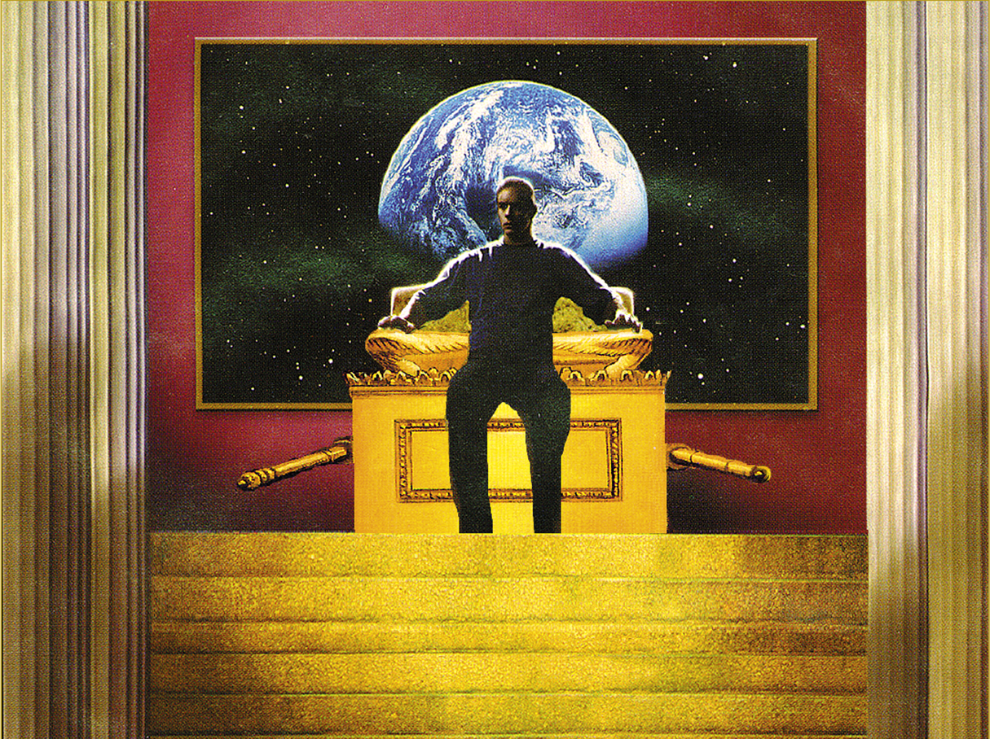
“and on the wing of abominations will come one who makes desolate, even until a complete destruction, one that is decreed, is poured out on the one who makes desolate.”
Daniel 9:27b-c

Slide 16
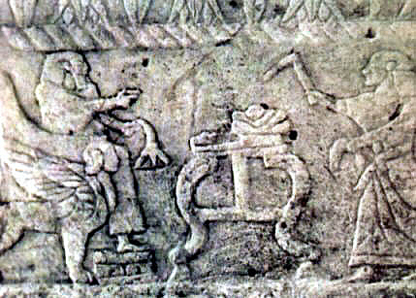

Slide 17
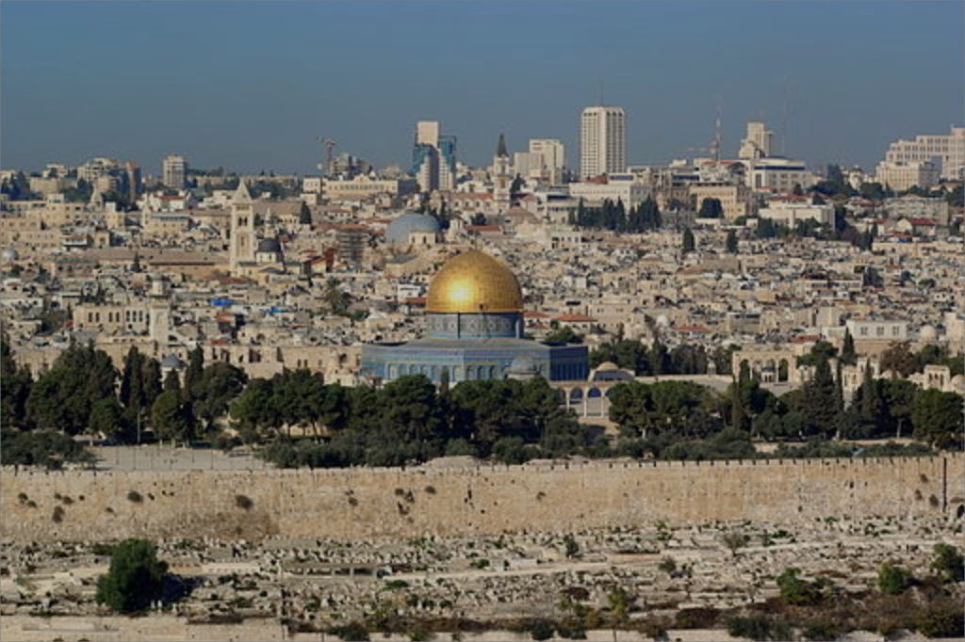
Temple Mount Only Decided Politically
In a verdict handed down in 1996, the Supreme Court made the following remarks: “No court in Israel needs proof that encroachment on the territory of the Temple Mount by the Muslim Waqf, to expand the Muslim prayer area, causes real offense to the religious and national sentiments of large parts of the Jewish public in regard to the site most sacred to Jews. [...] The spread of the Muslims to an additional prayer area severely offends the sensibilities of Jews in regard to the site. [...] This is the dispute simply put, without any embellishment.” The court added, “However, the reality on the Temple Mount [...] is by no means simple. It is extremely delicate and complicated, to the extent that the court cannot ignore it, and in regard to the said dispute, it cannot restrict itself to the rules of law, as it is normally accustomed. [...] This is one of those cases in which a judicial ruling is not the reasonable way to decide the dispute, and a decision of this kind goes beyond the boundaries of the law. It is the political echelon, and not the court [...] that must give content and meaning to the historical call: ‘The Temple Mount is ours.”
Opinion On the Issue of the Works on the Temple Mount (9/10): 2

Slide 18
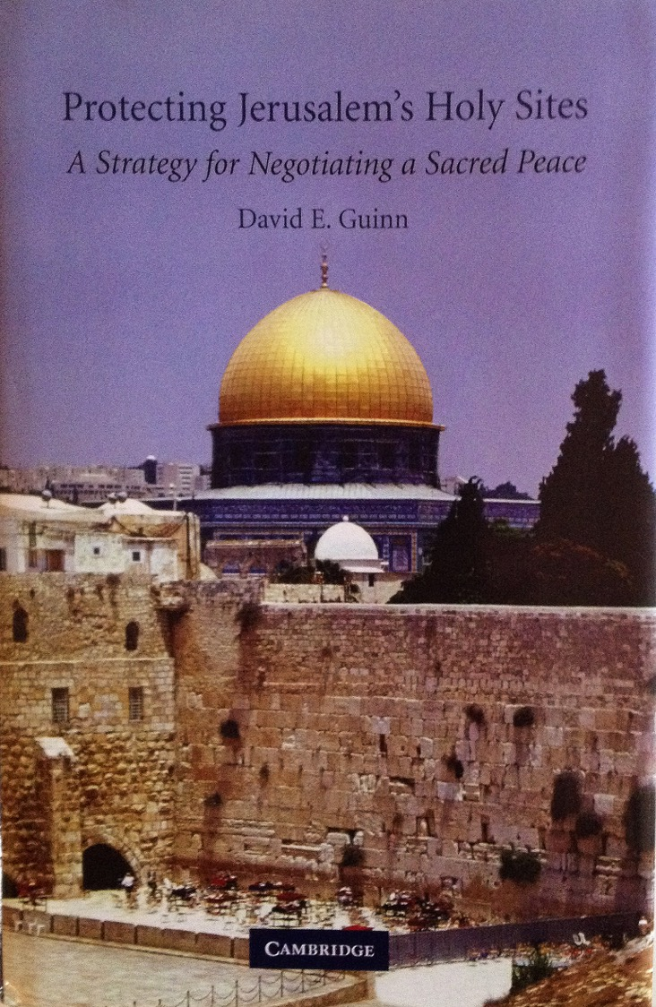
Common Heritage of
Mankind Legal Regime
“Given the emphasis upon the international community’s interest in the sites, under the concept of heritage of humankind, representatives from the international community need to be included as mediators and guarantors. These would likely come from the United Nations (UNESCO) and drawn from regional powers such as the Arab League, NATO, or interested states such as the U.S., the E.U., and Russia. … Any proposed legal regime will require interfaith cooperation composed of religious leaders from the region. It may be supplemented by international religious leaders who may serve as mediators.” Pp. 180-183

Slide 19
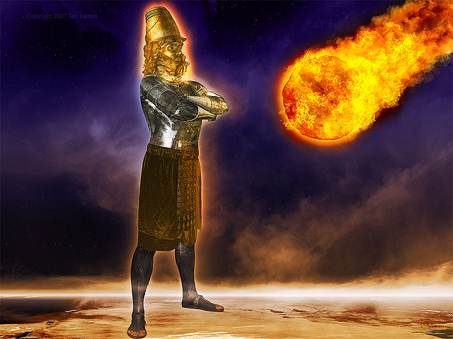
“You continued looking until a stone was cut out without hands, and it struck the statue on its feet of iron and clay, and crushed them. Then the iron, the clay, the bronze, the silver and the gold were crushed all at the same time, and became like chaff from the summer threshing floors;
and the wind carried them away so that not a trace of them was found. But the stone that struck the statue became a great mountain and filled the whole earth.”
Daniel 2:34–35

Slide 20
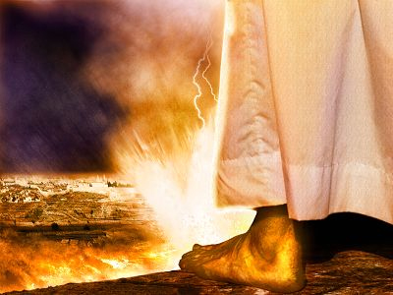
“Then the LORD will go forth and fight against those nations, as when He
fights on a day of battle. And in that
day His feet will stand on the Mount
of Olives, which is in front of
Jerusalem on the east; and the
Mount of Olives will be split in its
middle from east to west by a very l
arge valley, so that half of the mountain will move toward the north and the other half toward the south.” Zechariah 14:3–5

Slide 21
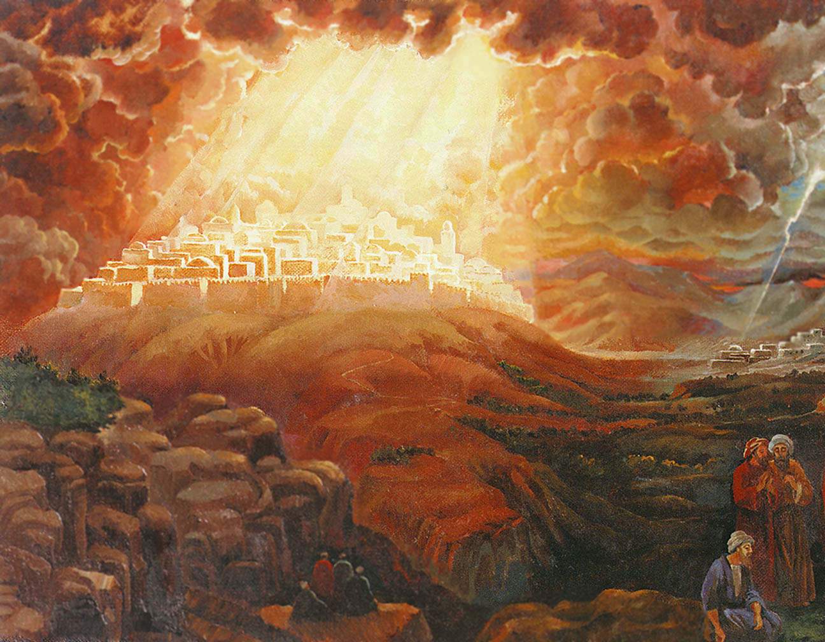
“Thus says the LORD, ‘I will return to Zion and dwell in the midst of Jerusalem. Then Jerusalem will be called the City of Truth, and the mountain of the LORD of hosts will be called the Holy Mountain.” Zechariah 8:3

Slide 22
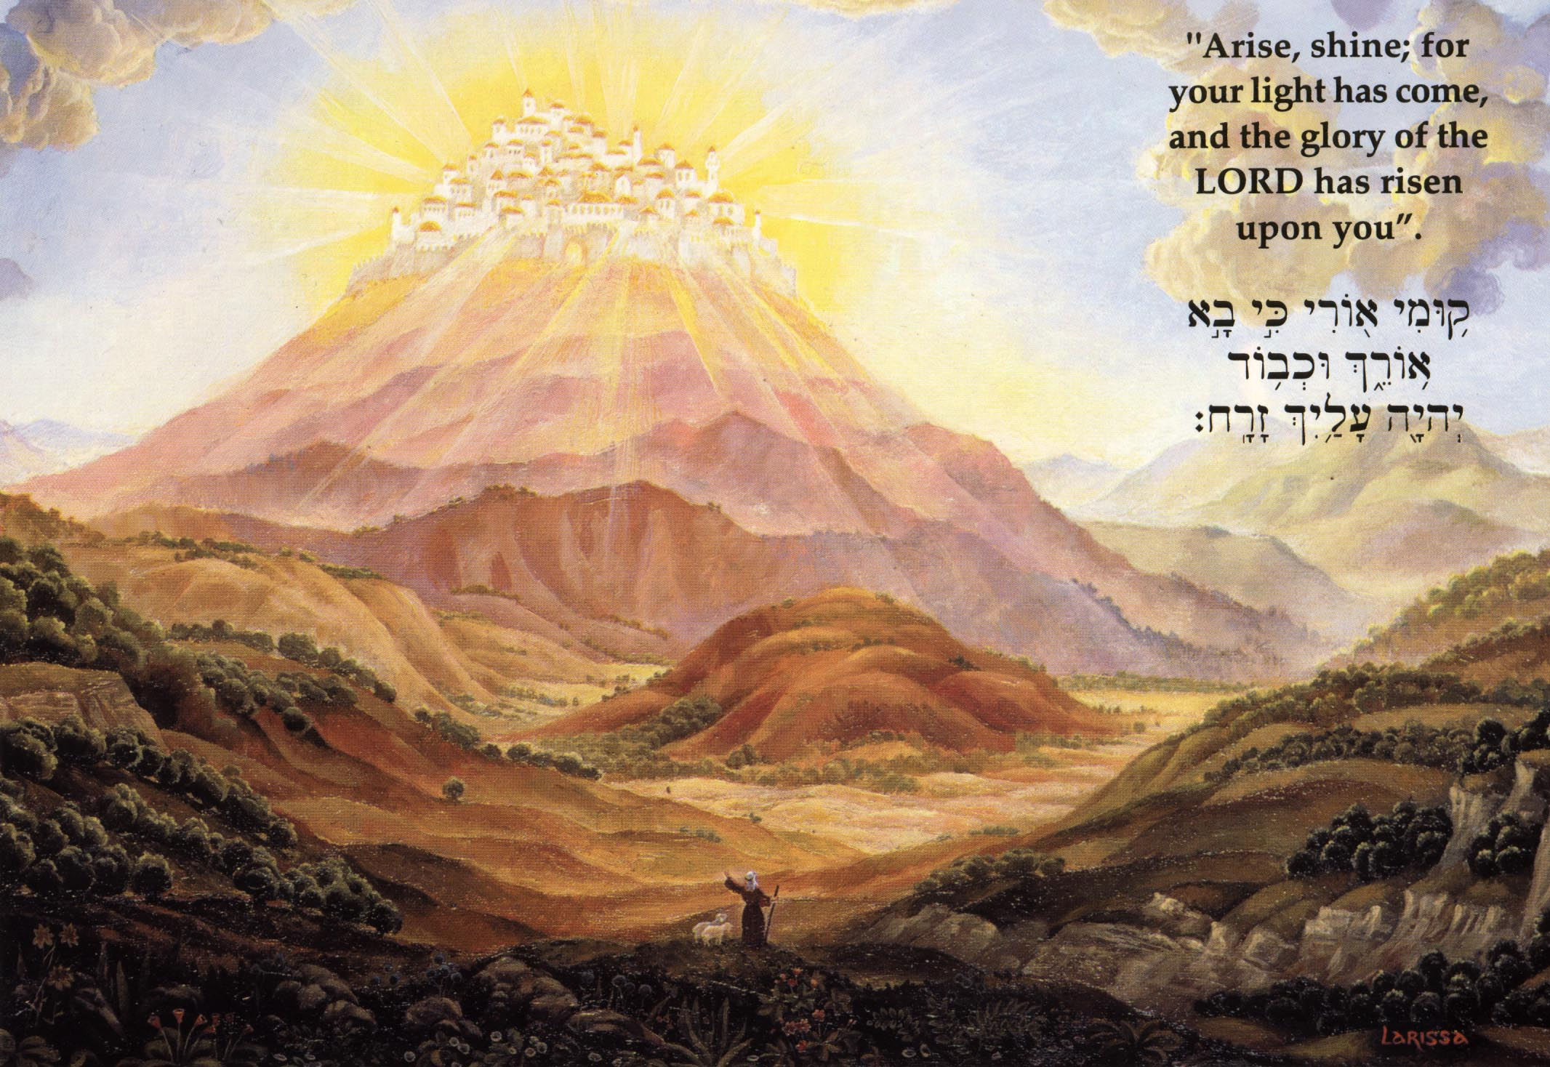
All the land will be changed into a plain from Geba to Rimmon south of Jerusalem; but Jerusalem will rise and remain on its site from Benjamin’s Gate as far as the place of the First Gate to the Corner Gate, and from the Tower of Hananel to the king’s wine presses. And people will live in it, and there will be no more curse, for Jerusalem will dwell in security.
Zechariah 14:10-11

Slide 23
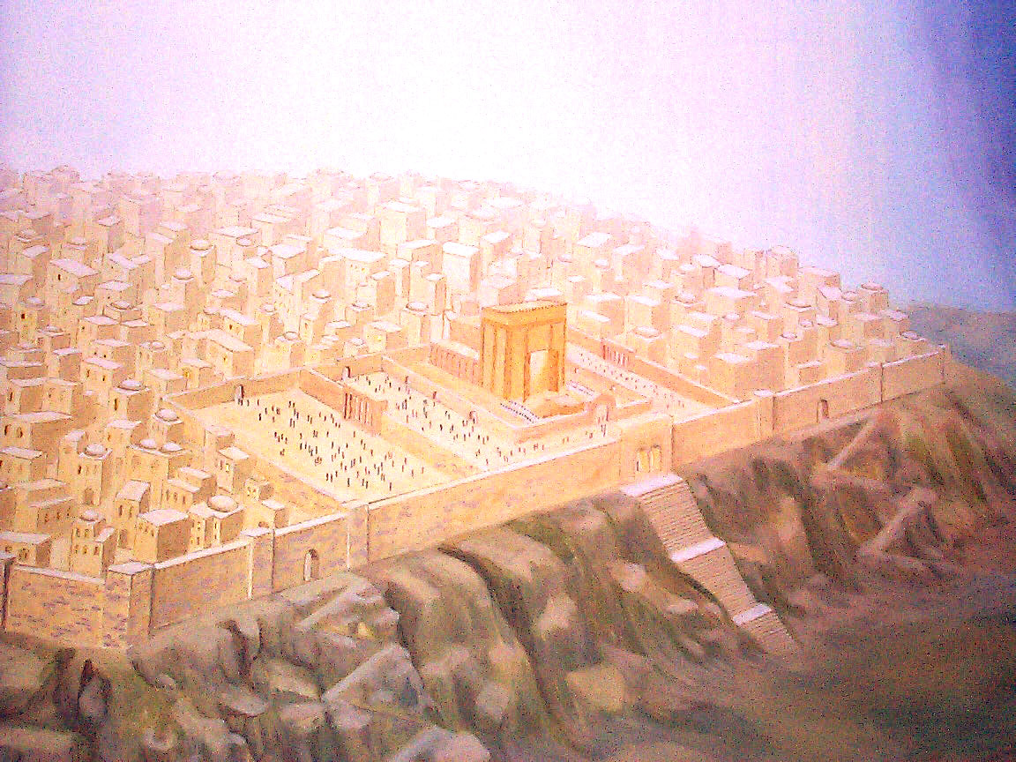
“And I will make a covenant of peace with them; it will be an everlasting covenant with them. And I will place them and multiply them, and will set My Sanctuary in their midst forever. My dwelling place also will be with them; and I will be My people. And the nations will know that I am the Lord who sanctifies Israel, when My Sanctuary is in their midst forever.”
Ezekiel 37:27-28

Slide 24
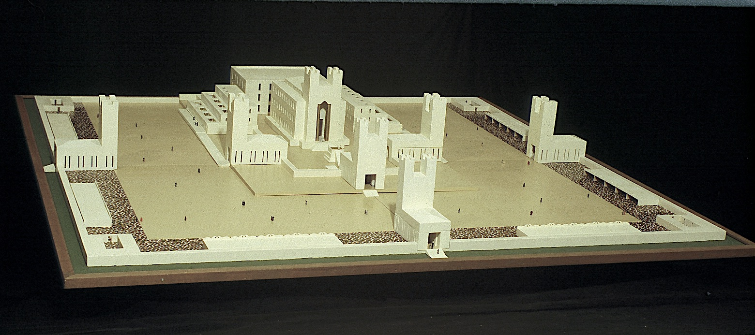

Slide 25
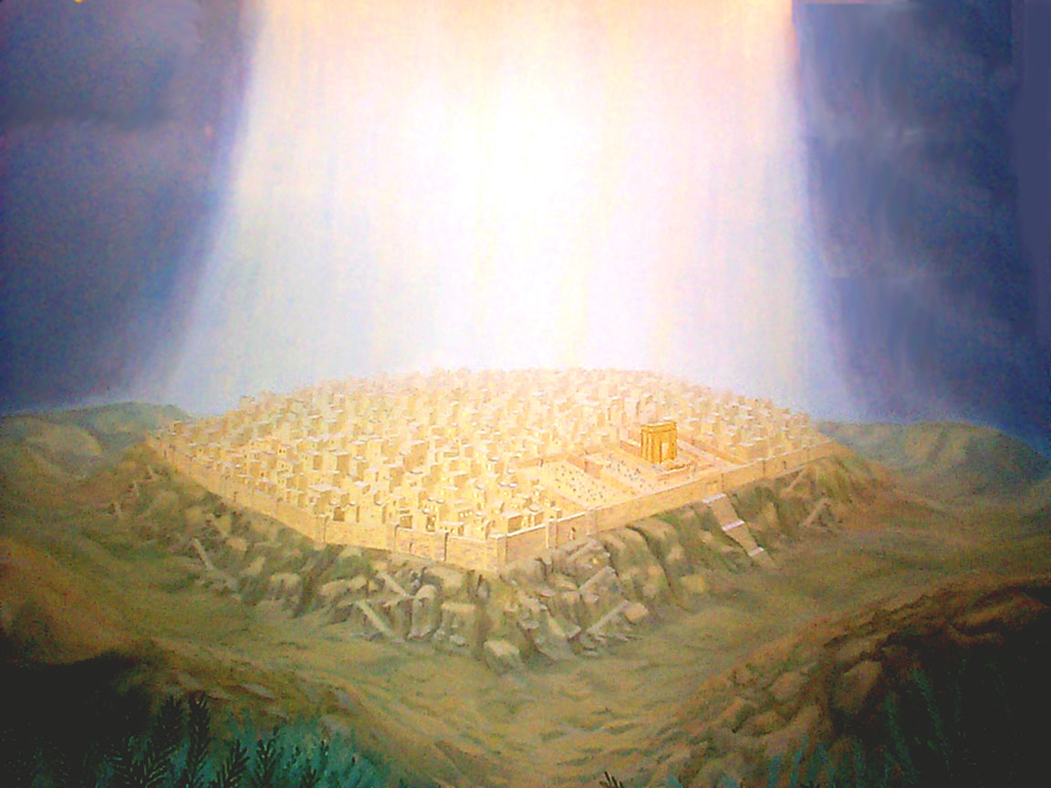
“… I will set up one of your descendants after you, who shall be of your sons; and I will establish his kingdom. He shall build for Me a house, and I will establish his throne forever. I will be his father, and he shall be My son; and I will not take My lovingkindness away from him … But I will settle him in My house and in My kingdom forever, and his throne shall be established forever.” 1 Chronicles 17:11-14

Slide 26


Slide 27
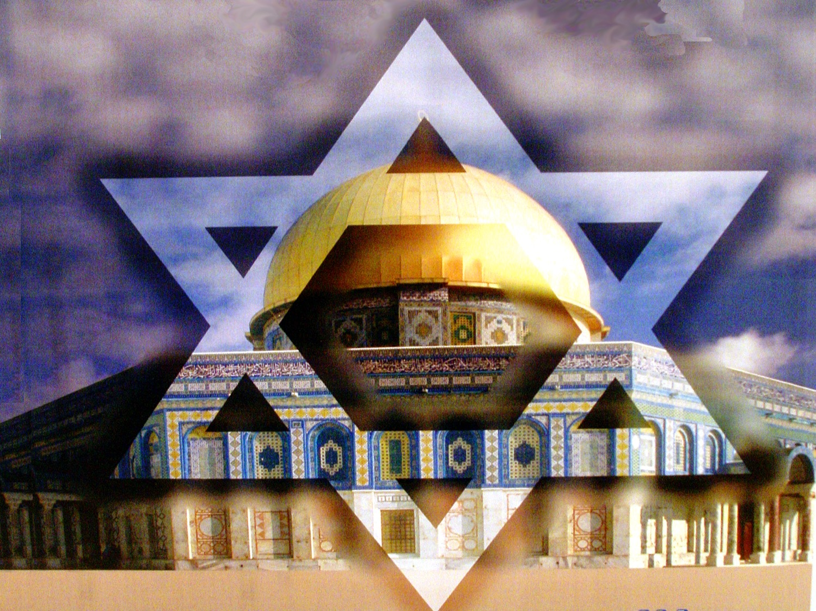
June 7
1967

Slide 28
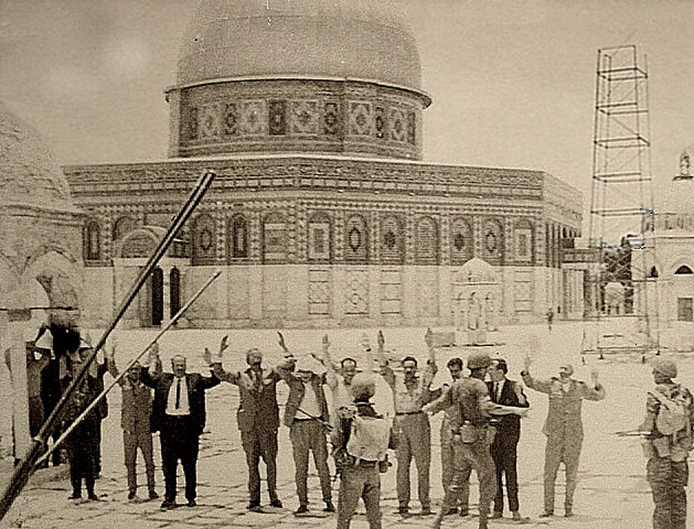
Israel returns to the Temple Mount

Slide 29
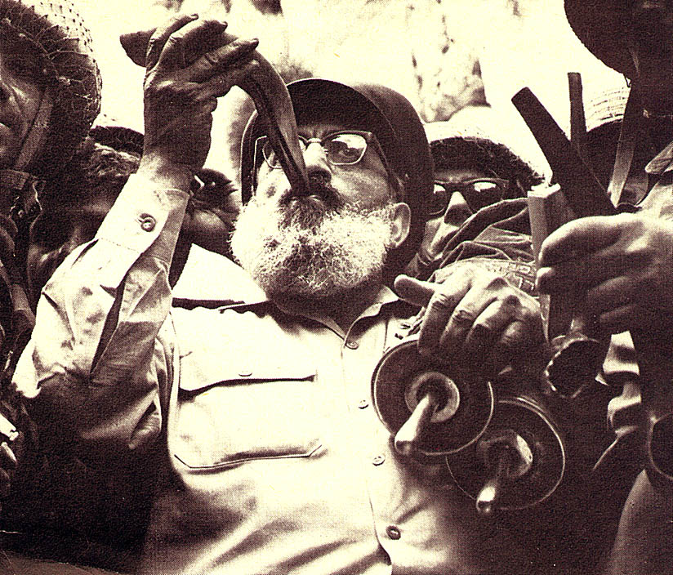
Rabbi Shlomo Goren (1967)

Slide 30
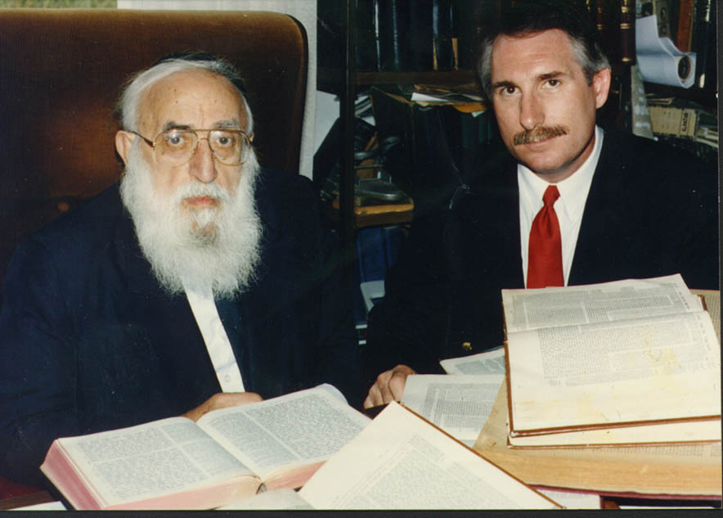
Rabbi Shlomo Goren (1993)

Slide 31
Jewish Plans to Rebuild the Temple

Slide 32
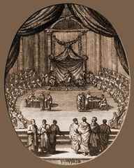
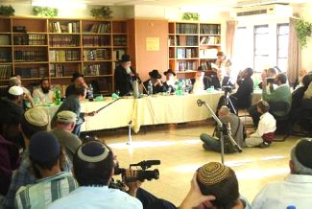
The Jewish Sanhedrin
Re-inaugurated on October 13, 2004 in Tiberias, Israel with 71 rabbis. The last meeting before 2004 was in Tiberias in about A.D. 425.
The monthly meeting on February 7-9, 2005 focused on the rebuilding of the temple in Jerusalem.

Slide 33
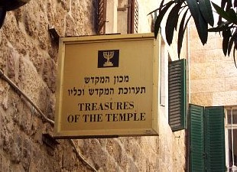
THE TEMPLE INSTITUTE

Slide 34
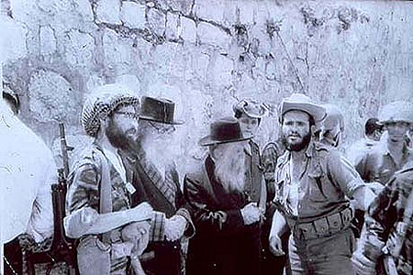
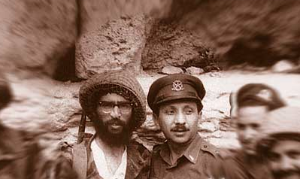
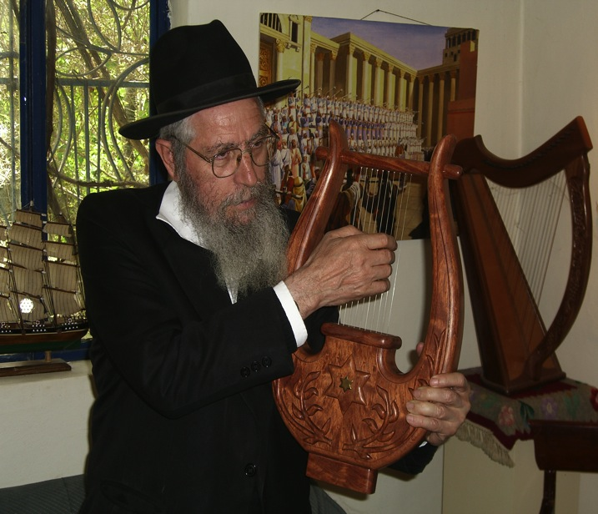
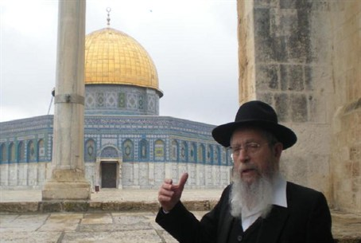
Rabbi Yisrael Ariel
Founder of the Temple Institute

Slide 35
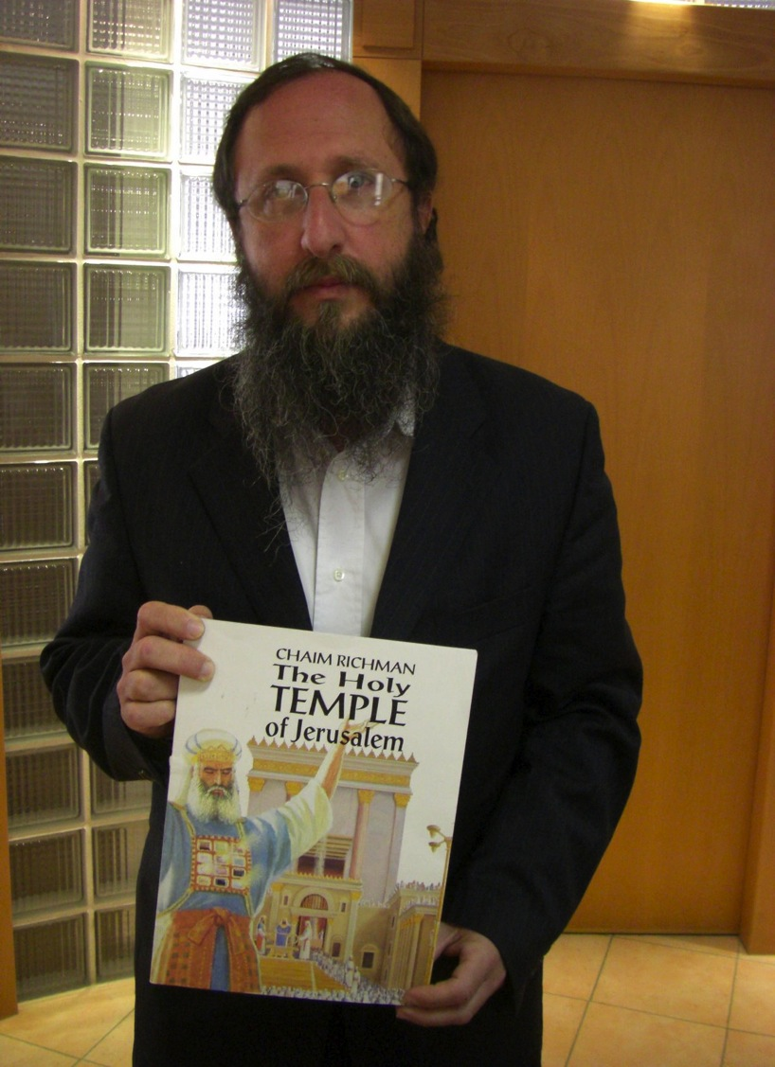

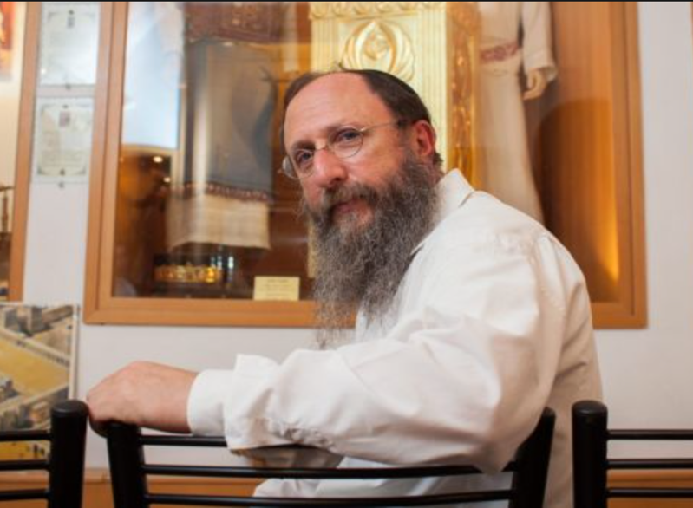
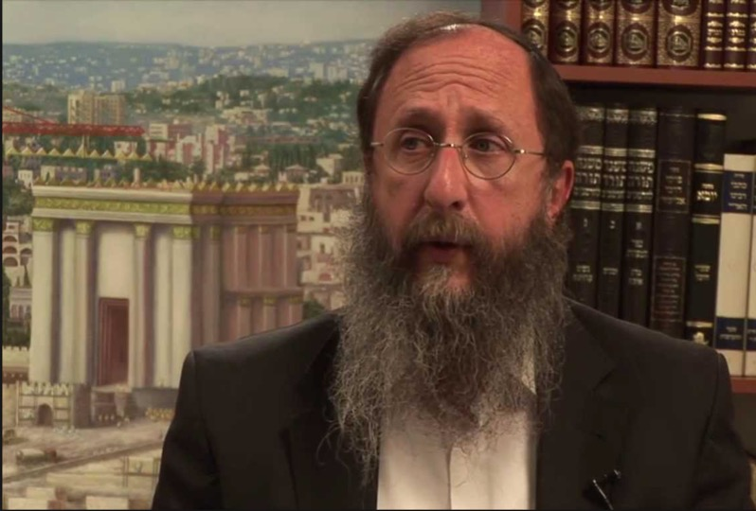
Rabbi Chaim Richman
International Director, Temple Institute

Slide 36
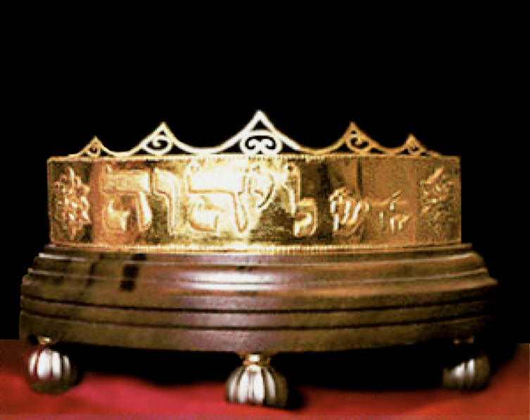
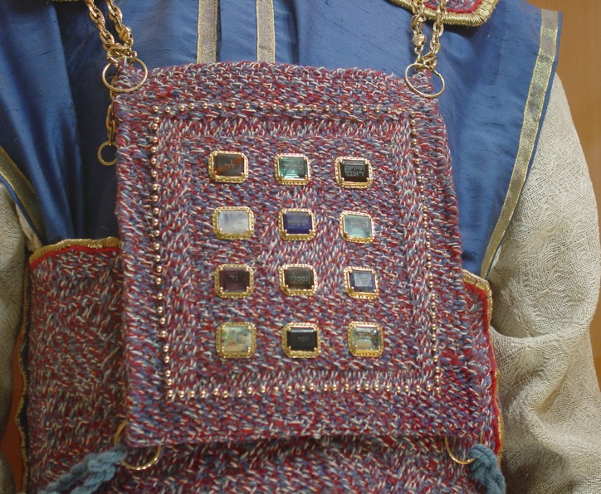
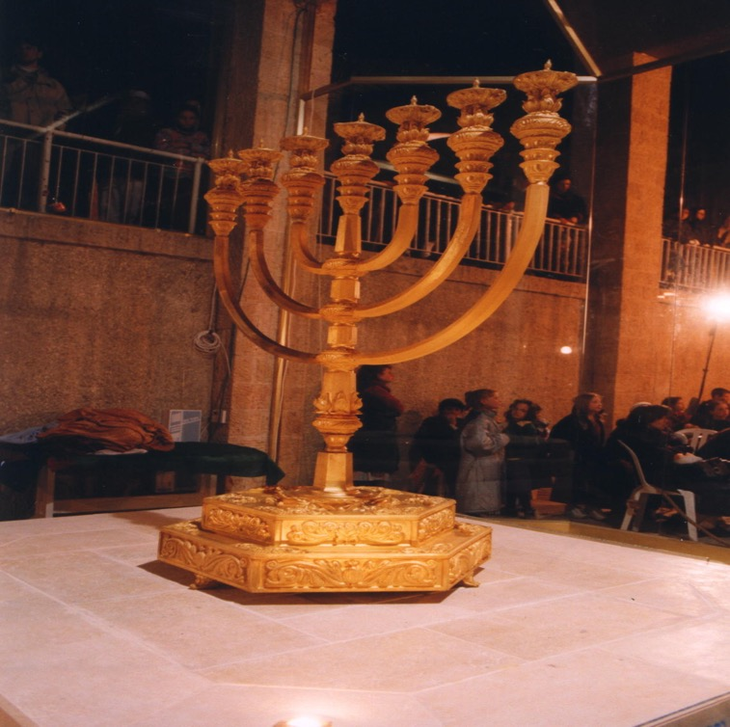
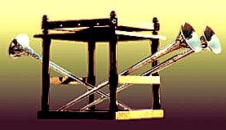

Slide 37
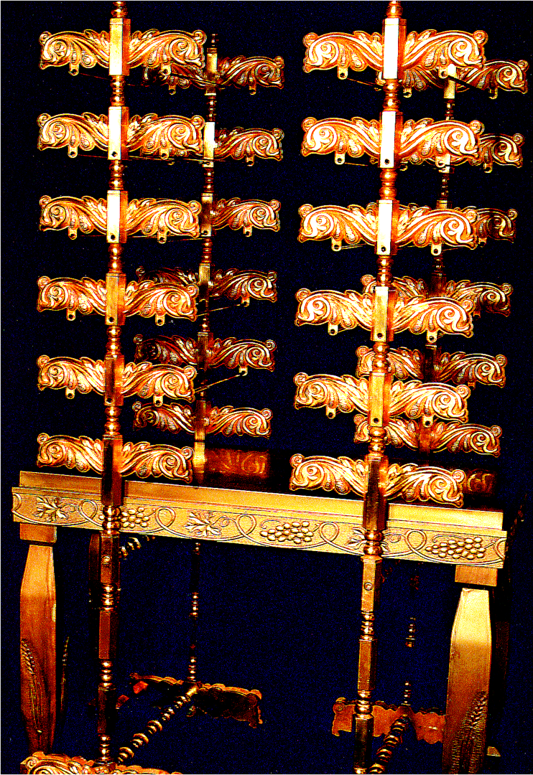
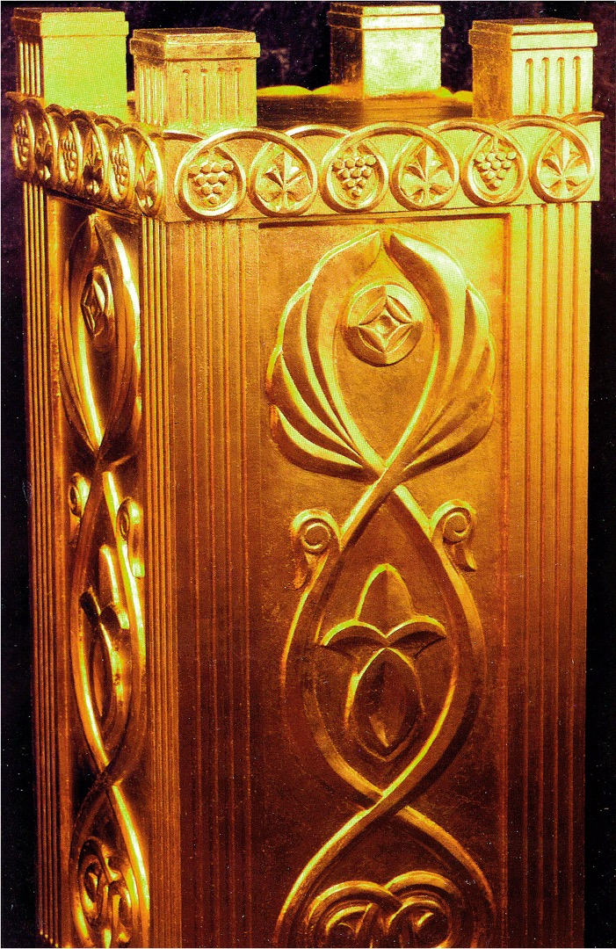

Slide 38
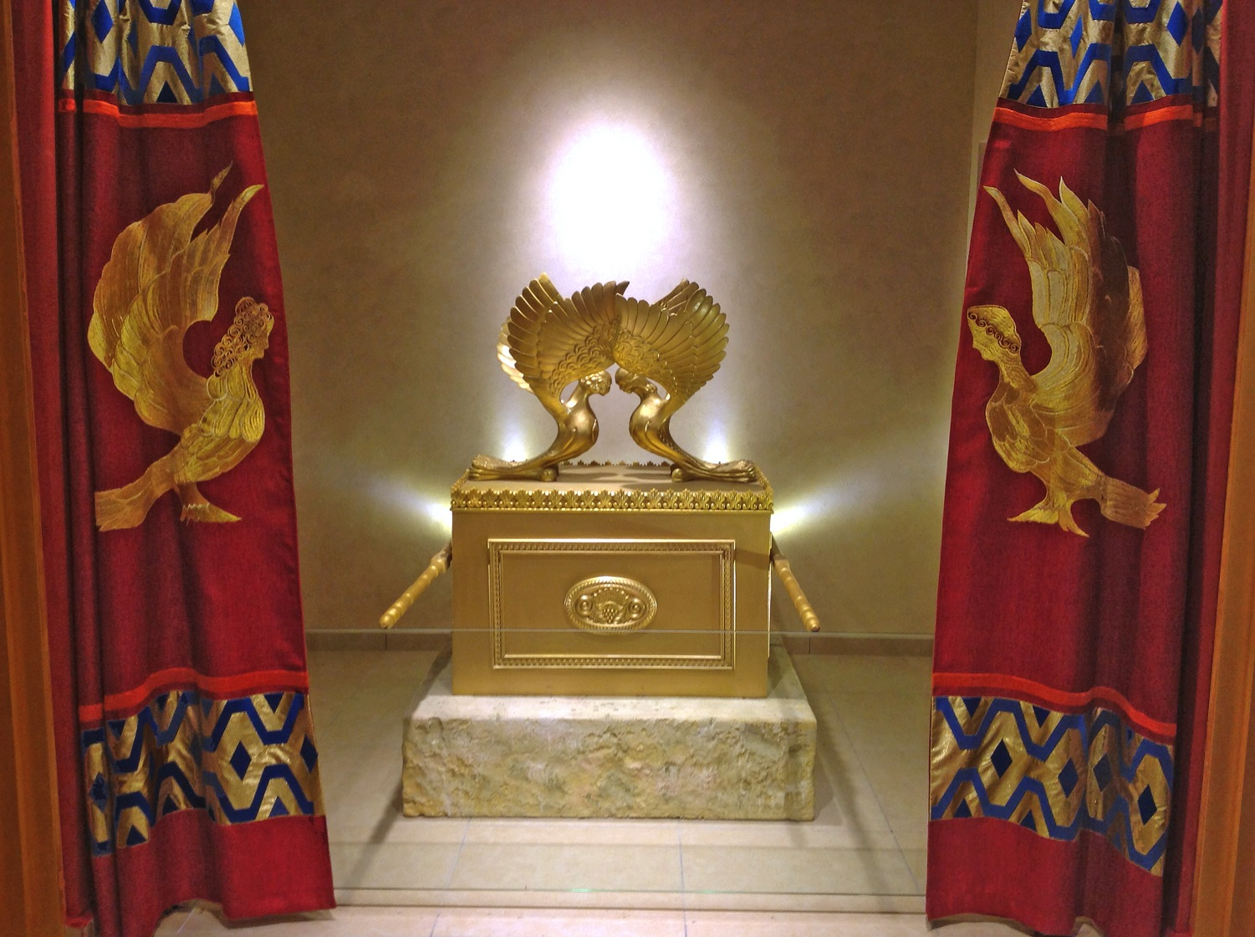


Slide 39


Slide 40




Slide 41



Priests practicing their duties at Passover

Slide 42

The Temple Mount Faithful

Slide 43

March to the Temple Mount, Tisha B'Av 2005

Slide 44


Slide 45


Slide 46


LOCATING DAVIDIC DESCENDANTS

Slide 47


Partial List of Names of Families that Trace their Descent to King David
Many great rabbis and rabbinical houses that trace their ancestry back to David Hamelech. This group of great scholars and leaders include: Hillel, Rabban Gamliel, Rabbi Yehuda Hanasi, Yochanan Hasandler, Rashi, the Rambam and Yosef Karo as well as the more contemporary gedolim like the Baal Shem Tov, the Breslevor Rebbe and the first Lubavicher Rebbe, Shneur Zalman of Liadi.

Slide 48

IDENTIFYING THE PRIESTHOOD

Slide 49



Slide 51

PROBLEM OF
PALESTINIAN
TEMPLE MOUNT
DENIAL

Slide 52

THE TEMPLE MOUNT
The Most Volitile 35 Acres on Earth

Slide 53

Contested Holy Sites
Temple Mount
Dome of the Rock
Haram es-Sharif
Quibyat es-Sakhra
Wailing Wall
Al-Aqsa Mosque
Al-Buraq Wall
Masjid al-Aqsa

Slide 54

"Allah"
Arab inscription cut into eastern wall of the Temple Mount

Slide 55

Muslim authorities removing archaeological layers

Slide 56

Ancient
stones (many
from the Temple
Itself) thrown out as rubble from mosque construction site.

Slide 57

20,000 tons!

Slide 58

500,000 Israelis swear to stand with Jerusalem and the Temple Mount

Slide 59



Slide 60

For I will gather all the nations against Jerusalem
to battle, and the city will be captured, the houses plundered … and half the city exiled … Zechariah 14:2
"For I will gather
all the nations
against Jerusalem
to battle, and the
city will be captured,
the houses plundered …
Zechariah 14:2
For I will gather all the nations
against Jerusalem to battle,
and the city will be captured,
the houses plundered …
Zechariah 14:2

Slide 61
Temple Mount Only Decided Politically
In a verdict handed down in 1996, the Supreme Court made the following remarks: “No court in Israel needs proof that encroachment on the territory of the Temple Mount by the Muslim Waqf, to expand the Muslim prayer area, causes real offense to the religious and national sentiments of large parts of the Jewish public in regard to the site most sacred to Jews. [...] The spread of the Muslims to an additional prayer area severely offends the sensibilities of Jews in regard to the site. [...] This is the dispute simply put, without any embellishment.” The court added, “However, the reality on the Temple Mount [...] is by no means simple. It is extremely delicate and complicated, to the extent that the court cannot ignore it, and in regard to the said dispute, it cannot restrict itself to the rules of law, as it is normally accustomed. [...] This is one of those cases in which a judicial ruling is not the reasonable way to decide the dispute, and a decision of this kind goes beyond the boundaries of the law. It is the political echelon, and not the court [...] that must give content and meaning to the historical call: ‘The Temple Mount is ours.”
Opinion On the Issue of the Works on the Temple Mount (9/10): 2

Slide 62
Common Heritage of
Mankind Legal Regime
“Given the emphasis upon the international community’s interest in the sites, under the concept of heritage of humankind, representatives from the international community need to be included as mediators and guarantors. These would likely come from the United Nations (UNESCO) and drawn from regional powers such as the Arab League, NATO, or interested states such as the U.S., the E.U., and Russia. … Any proposed legal regime will require interfaith cooperation composed of religious leaders from the region. It may be supplemented by international religious leaders who may serve as mediators.” Pp. 180-183

Slide 63

Malachi 3:1

Slide 64

Homepage at BibleStudyDownloads.org
Use this QR Code for Access
Notes:
Apologetics & Evangelism (ae)

Slide 65


Olivet Discourse link at BibleStudyDownloads.org
Get this presentation for free!
Notes:
Olivet Discourse (od)

