Slide 1
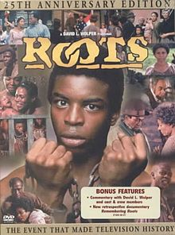
Slavery
Kunta Kinte
Dr. Rick Griffith • Jordan Evangelical Theological Seminary • BibleStudyDownloads.org

Slide 2
Presentation
a – Introduction and definition of slavery
b – Slaves in ancient societies
c – Treatment of slaves
e – What does slavery reveal about people?
d – What the Mosaic law taught on slavery
e – Mosaic vs. Pagan slavery laws
f – Slavery during Roman Empire
g –Paul's teaching on slavery
h – Conclusion

Slide 3
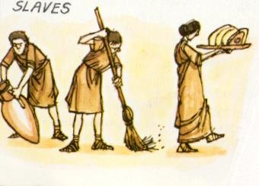
Slavery
Aristotle
"the slave is a living tool
and the tool is a lifeless slave"
Notes:
Paraphrase Aristotle and illustrate how slavery today has different terms: prostitution, human trafficking, work pass where the salary of the first 7 months of the year goes to the agent.

Slide 4

Origins of Slavery:
Introduction and definition
How slavery originated cannot be precisely ascertained
Earliest evidence of slavery stemmed back to 3000 BC, from Sumerian civilization in Southern Mesopotamia (modern Iraq)

Slide 5
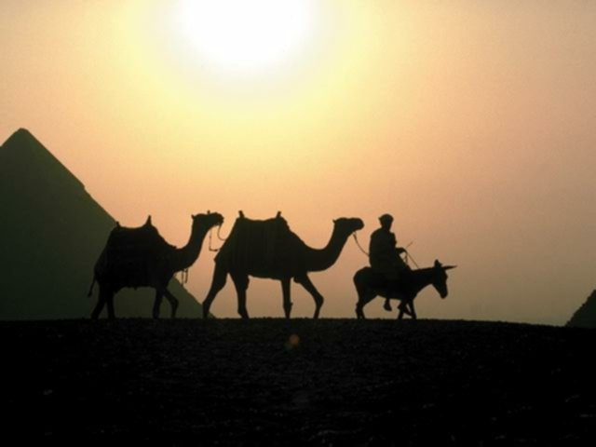
Sources of Slavery
Introduction and definition
1. POW
2. Debt
3. Born to debtors
4. Capture – Joseph was captured and sold into slavery for 20 pieces of silver
5. Voluntary servitude

Slide 6
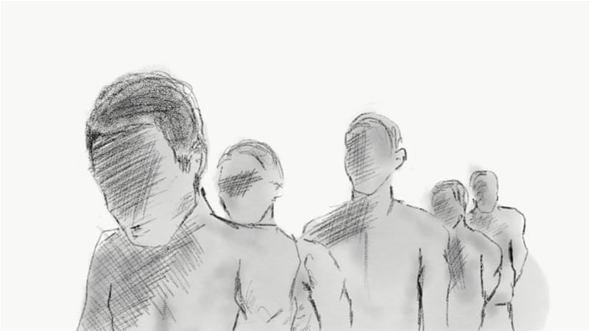
Forms of Slavery
Introduction and definition
Different forms of slavery
Lowest on the social ladder
House slaves (e.g., Hagar the Egyptian in Abraham's household)
Temple slaves
Work slaves
Slaves to Kings––some scarred
City slaves
Artisans

Slide 7
Sumerian Definition
Introduction and definition
Sumerian word for slave means "person from a foreign land"
Captives made into "people of restricted freedom"
Captives seized in battle, not local inhabitants
Used to construct canals, plant & harvest crops

Slide 8
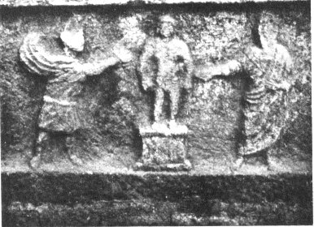
Other definitions:
Introduction and definition
State of person purchased by another
A system of forced labor
Control of a person against his or her will
Securing work from one under harsh conditions for little or no pay
Slave being examined

Slide 9
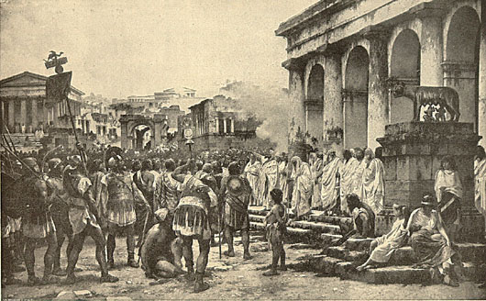
Introduction and definition
Slavery in Ancient Rome
Roman law: slave is a thing, a chattel, a mortal object

Slide 10
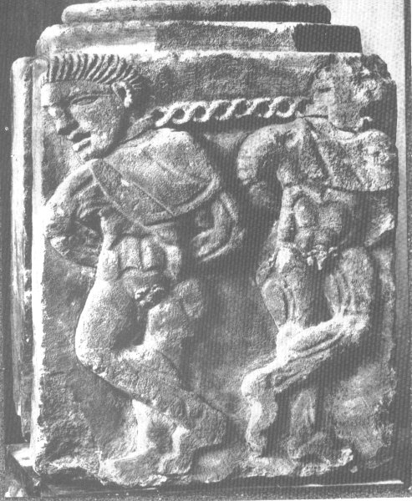
Roman law vs. Greek Law:
Introduction and definition
Roman Law
Slaves no different from livestock
Piece of property
Denied majority of fundamental rights – not allowed to marry or form families
Greek Law
Slaves had some freedoms
To be own representative
Go where he desires to go
Do what he desires to do
Stone carving of two slaves

Slide 11
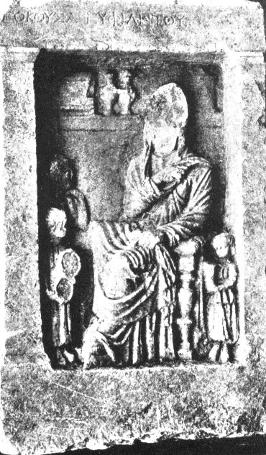
Important terms:
Introduction and definition
Peculium – allowance
Manumission – slave given freedom and released from all of his duties
3 common methods used by Roman master to manumit his slaves
Census
Vindicta
Testamentum
Woman with her slaves

Slide 12
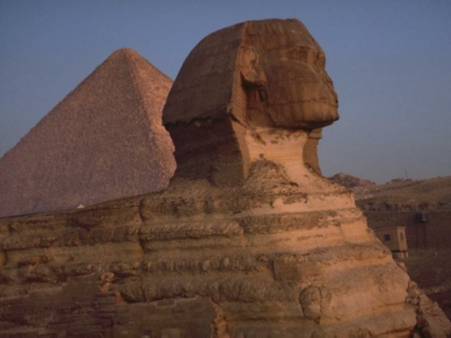
Slaves in Ancient Societies
Major population group in ancient social strata
All ancient civilizations had slavery
Slave trade was common – Joseph was
sold to slavery in Egypt

Slide 13

Slaves in Ancient Societies
In Babylon the social strata was:
King
Nobles – awilu
Free Citizens of low estate-mushkenu
Slave-wardu
Most slaves were POWs
Free citizens could be sold into slavery due to offences or debts
- Almost impossible for slaves to become free

Slide 14
Slaves in Ancient Societies
Population of the entire defeated land was commonly taken into slavery:
During reign of Thutmose III slaves were part of the tributes paid by the defeated foe:
  "…in that year 295 male and female slaves, 68 horses, 3 gold dishes, 3 silver dishes"
  (Report from the 42nd (?) year of the reign of Thutmose III)
Joshua subjected the Gibeonites to slavery:
  "you shall never cease being slaves, both hewers of wood and drawers of water for the house of my God"
  (Joshua 9:23)

Slide 15
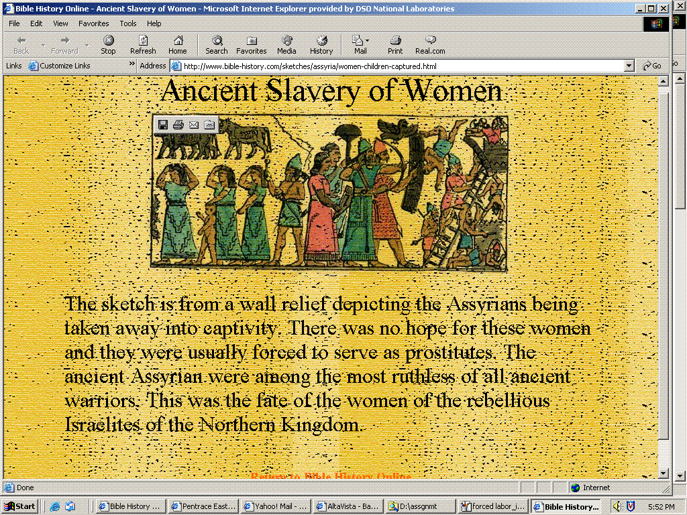
Slaves in Ancient Societies
Ancient Slavery of Women
The sketch is from a wall relief depicting the Assyrians being taken away into captivity. There was no hope for these women and they were usually forced to serve as prostitutes. The ancient Assyrians were among the most ruthless of all ancient warriors. This was the fate of the women of the rebellious Israelites of the Northern Kingdom.

Slide 16
Slaves in Ancient Societies
Slavery was readily legitimized
Essential for functioning of ancient civilizations
Ancient civilization were agricultural, & labor intensive
Most ancient cities were built by slaves
Egyptian Pyramids might have been a longstanding monument of such practices

Slide 17
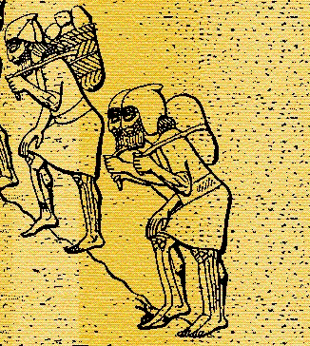
Slaves in Ancient Societies
Common Practice in
Ancient Near East (ANE)
Reflected low morality of
ANE civilization
Little value on human life due to seeing humans as slaves created for the gods
Slaves were property, and therefore mostly treated like animals

Slide 18
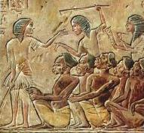
Treatment of Slaves
Treatment largely depended on the character of the master:
Early Egypt – Slaves were sacrificed and buried with the dead king to serve him in the nether world

Slide 19
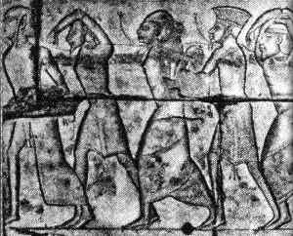
Treatment of Slaves
Work slaves in mines worked long hours on meager rations
- they were "worked to death… as one wears out a machine"

Slide 20
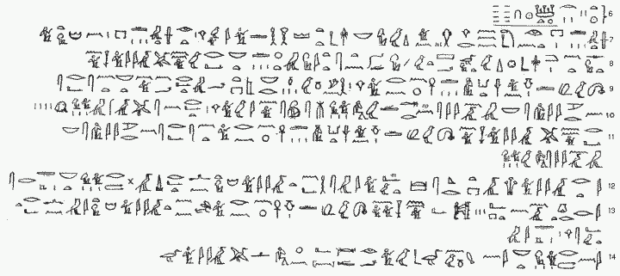
Treatment of Slaves
As property, slaves could be sold in wills:
Title of Property made by Uab
In it slaves were property given to his wife. The wife was also free to give away children born to him by his slaves.

Slide 21
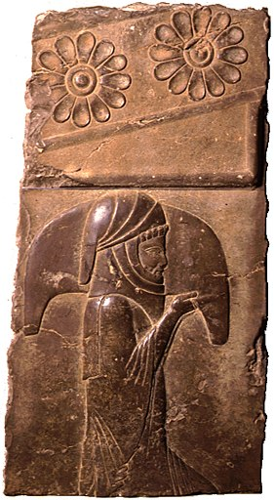
Treatment of Slaves
Some minorities with exceptional abilities were treated better.
Examples:
1. Daniel
2. Joseph
Court Servant—probably one
that serves the king

Slide 22
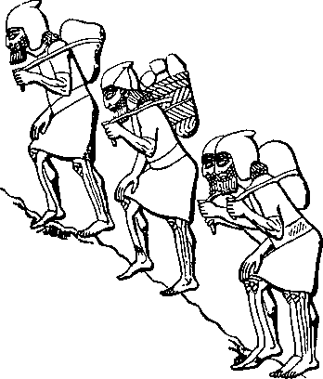
What does slavery reveal about people ?
Slavery is a product of the fall of man and has existed since the Fall
Slavery was a means of survival
Slavery as an alternative to killing is more humanitarian
  Rather than killing enemies, they were sometimes made as slaves (Deut. 20:11)
  Gibeonites preferred slavery over death (Josh. 9:3-27)
  Joseph was sold as a slave instead of being put to death (Gen. 37:12-38)

Slide 23
What does slavery reveal about people?
Warm affection between master and slave could exist:
  Punishment for attempted rape of a master's wife was death. However, Potiphar only imprisoned Joseph due to their closeness (Gen. 39:4-6, 19-20)
  Canaanites started as slaves to Israel but ended up intermarrying them and causing them to worship Baal (Judg. 1:27–3:6)
  Jewish slaves could choose to stay with their master rather than be freed after 6 years (Exod. 21:6)

Slide 24
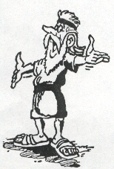
What does the Mosaic Law teach about slavery?
When God gave the Law to Moses, slavery was part of the world, and so the Law of God recognized slavery
Types of Slavery Laws:
  Acquisition of Slaves
  Manumission
  Religious rights
  Civil rights
  Marriages

Slide 25
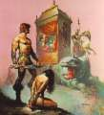
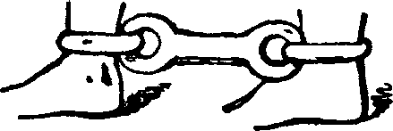
1. Laws on Acquisition of Slaves
What does the Mosaic Law teach about slavery?
Only foreign slaves could be made permanent slaves. Hebrew slaves were freed after 6 years or the year of Jubilee.
War captives could be made slaves (Deut. 20:10-11)
As restitution for theft (Exod. 22:1-3)
By default on debts (Deut. 15:1-2)

Slide 26

1. Laws on Acquisition of Slaves
What does the Mosaic Law teach about slavery?
By purchase (Lev 25:44-46)
  Foreigners could be bought and sold as slaves, and considered as property
  No kidnapping of free-born person to sell as a slave was allowed (Exod. 21:16; Deut. 24:7)
  Prices of slaves varied widely, according to age, sex and number of years till Jubilee (Lev. 25:47-53)
By Birth (Exod. 21:4; Lev. 25:54)

Slide 27


2. Manumission Law
Exod. 21:1-11; Lev. 25:39-55; Deut. 15:12-18
What does the Mosaic Law teach about slavery?
This law helped avoid the risk of having a big population of slaves during an economic crisis
Hebrew slaves would be freed after serving 6 years (Exod. 21:2)
  Slaves with a wife given by master must go alone
  Slaves wanting to stay permanently may do so, but they would have their ears pierced
Freed slaves released with liberal pay (Deut. 15:12-15)

Slide 28

2. Manumission Law
What does the Mosaic Law teach about slavery?
Runaway slaves were to go free, as the return of a fugitive was forbidden (Deut. 23:15-16)
In the year of Jubilee, all Hebrew slaves were made free, in connection with the restoration of property and land (Lev. 25:39-40)

Slide 29
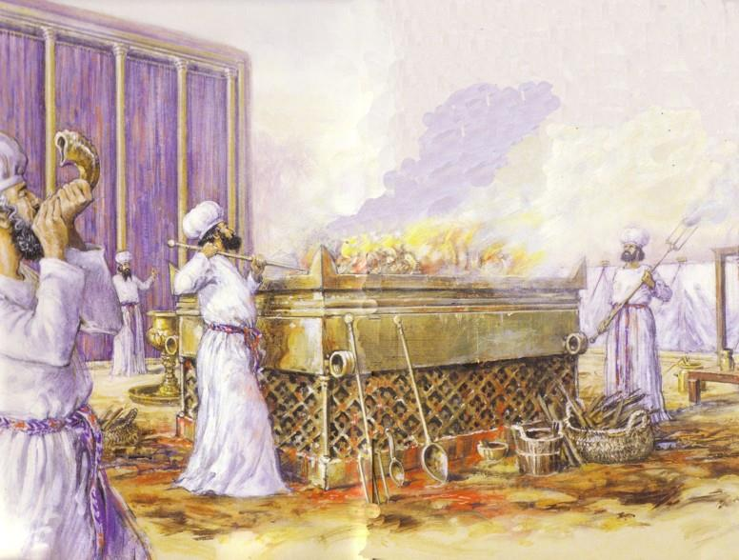
3. Law on Religious Rights
What does the Mosaic Law teach about slavery?
Slaves were considered part of the owner's family and shared in the family's religious life
Slaves were granted Sabbath rest (Exod. 20:10; 23:12)
Slaves were to be circumcised and partake in feasts (Exod. 12:43-45)

Slide 30

4. Laws on Civil rights
What does the Mosaic Law teach about slavery?
Masters would be punished if they killed their slaves (Exod. 21:20)
Slaves were set free if they were maimed by their master (Exod. 21:26-27)

Slide 31
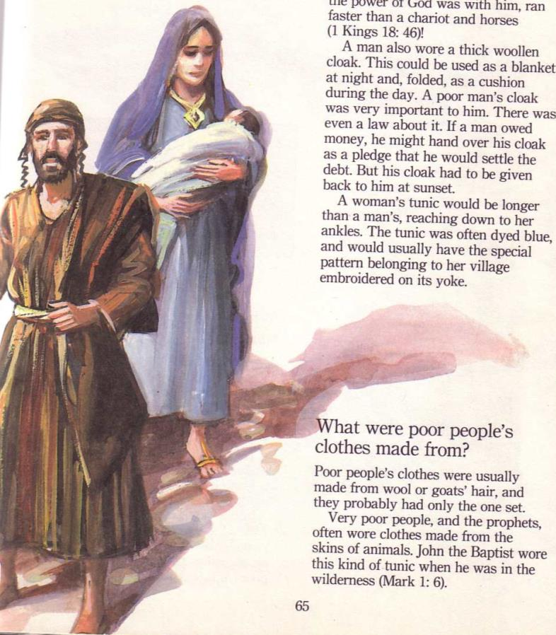

5. Laws on Slave Marriages
What does the Mosaic Law teach about slavery?
Single slaves could be given wives by their master (Exod. 21:2-4)
Such wives were usually foreigners
Wives given by a master were permanent slaves and not released after six years

Slide 32

Comparing Mosaic Laws and Pagan Laws
Comparing Mosaic Law and Pagan Laws
1. Term of service before release
Law of Hammurapi § §117
[§117] If a liability has become due against a man and he has (Bab. Ana kaspim) sold his wife and his son or his daughter or bound them, or each of them, or himself (Bab. It-ta-an-di-in) over into servitude (Bab, ana kissatim), for 3 years they shall do work in the house of him who has bought them or taken them in servitude; in the fourth year their release shall be established.
Mosaic Law (Deut 15:12-14)
If a fellow Hebrew, a man or a woman, sells himself to you and serves you six years, in the seventh year you must let him go free. And when you release him, do not send him away empty-handed. Supply him liberally from your flock, your threshing floor and your winepress. Give to him as the LORD your God has blessed you.

Slide 33

Comparing Mosaic Laws and Pagan Laws
Comparing Mosaic Law and Pagan Laws
Marriage of Slaves
Law of Ur-Nammu or Shulgi
If a male slave marries a female slave, his beloved, and that male slave later is given his freedom, she/he will not be evicted from (lit. leave) the house.
If a male slave marries a native woman, she/he shall place one male child in the service of his master; … any other child of the native woman will not be owned by the master, nor will be pressed into slavery
Mosaic Law (Ex 21:2-4)
"If you buy a Hebrew servant, he is to serve you for six years. But in the seventh year, he shall go free, without paying anything. If he comes alone, he is to go free alone; but if he has a wife when he comes, she is to go with him. If his master gives him a wife and she bears him sons or daughters, the woman and her children shall belong to her master, and only the man shall go free.

Slide 34

Comparing Mosaic Laws and Pagan Laws
Comparing Mosaic Law and Pagan Laws
3. Violation of slave woman
Law of Ur-Nammu or Shulgi
If a man acts in violation of the rights of another and deflowers the virgin slave woman of a man, he shall weigh and deliver five shekels of silver
Mosaic Law (Lev 19:20)
'If a man sleeps with a woman who is a slave girl promised to another man but who has not been ransomed or given her freedom, there must be due punishment. Yet they are not to be put to death, because she had not been freed.
Law of Dadusha of Eshnunna
If a man should deflower the slave woman of another man, he shall weigh and deliver twenty shekels of silver, but the slave woman remains the property of her master

Slide 35
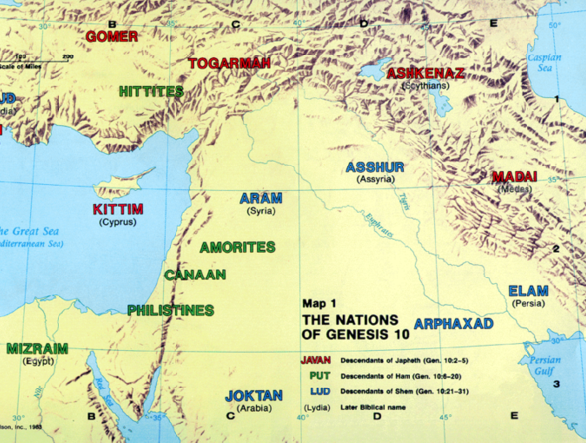
Comparing Mosaic Laws and Pagan Laws
Comparing Mosaic Law and Pagan Laws
Action for runaway slaves
Law of Ur-Nammu or Shulgi
If [a slave or (?)] a slave woman … ventures beyond the borders of his or her city and a man returns him or her, the slave's master shall weigh and deliver … shekels of silver to the man who returned the slave
Mosaic Law (Deut 23:15-16)
If a slave has taken refuge with you, do not hand him over to his master. Let him live among you wherever he likes and in whatever town he chooses. Do not oppress him.

Slide 36
Comparing Mosaic Laws and Pagan Laws
Comparing Mosaic Law and Pagan Laws
Action for runaway slaves
Law of Lipit-Ishtar
If a man's female slave or male slave flees within a city, and it is confirmed that the slave dwelled in a man's house for one month, the one who harbored the fugitive shall give slave for slave.
If he has no slave, he shall weigh and deliver fifteen shekels of silver.
If a man's slave contests his slave status against his master, and it is proven that his master has been compensated for his slavery twofold, that slave shall be freed.

Slide 37

Comparing Mosaic Laws and Pagan Laws
Comparing Mosaic Law and Pagan Laws
Payment for injuring a slave
Hittite Laws
If anyone blinds a male or female slave or knocks out his tooth, he shall pay ten shekels of silver. He shall look to his house for it.
Mosaic Law (Ex 21:26,27)
"If a man hits a manservant or maidservant in the eye and destroys it, he must let the servant go free to compensate for the eye. And if he knocks out the tooth of a manservant or maidservant, he must let the servant go free to compensate for the tooth.

Slide 38
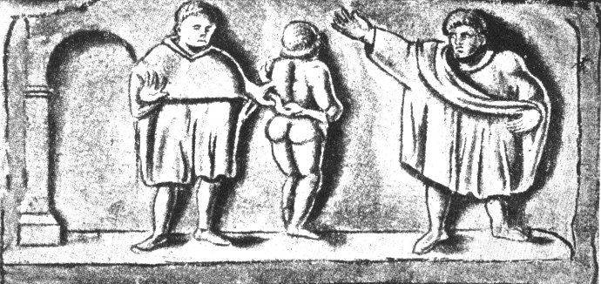
Features of slavery during Roman
Features of Slavery during Roman Empire
When Romans conquered the Mediterranean, they took millions of slaves to Italy. The Italians were major importers of slaves with slaves accounting for 40 percent of the population!
Laws which promoted or restricted the Roman slave system:
Lex Poetelia (326 BC)
Lex Aelia Sentia (AD 4)
Lex Fufia Caninia (AD 2)
Lex lunia Sorbana
Slave sold in Roman
slave trade

Slide 39
Features of Slavery during Roman Empire
Motives
  Roman masters were less interested in economic exploitation than in having a more robust lifestyle.
  For wealthy Romans, the motive was basically that of status.

Slide 40
Features of Slavery during Roman Empire
Entry into Slavery
  Roman military conquests
  Natural reproduction
  Rescue from exposure
  International trade
  Piracy
  Sold themselves into slavery for various reasons

Slide 41
Features of Slavery during Roman Empire
Treatment
  Depending on the disposition and personality of master
  Slaves working in private homes were better treated than slaves working on farms and ranches

Slide 42
Features of Slavery during Roman Empire
Legal controls on masters
  Slave owners were answerable to the law of mistreatment of slaves
  Slave owners were restricted from executing their slaves
  The law courts often sided with slaves against masters

Slide 43
Features of Slavery during Roman Empire
Legal recourse of slaves
  Slaves could litigate on their behalf (assault/abuse)
  Legal means for slaves to seek freedom
  Slaves could effect a transfer of ownership
  In addition to legal power, slaves had certain economic power

Slide 44
Features of Slavery during Roman Empire
Legal agent status
  Could own property, enter into legal transactions such as loans, leases or service contracts
  Acted on behalf of their master in his business dealings, such as loans, sales, issuance of receipts, etc.
  They could own slaves themselves

Slide 45
Features of Slavery during Roman Empire
Legal exit/Manumission
  Manumission was widespread, frequent and expected by the majority of slaves
  It was so frequent that it required some limitations
  Social status motivation of the system made for frequent manumissions
  Some manumissions were for noble matters

Slide 46
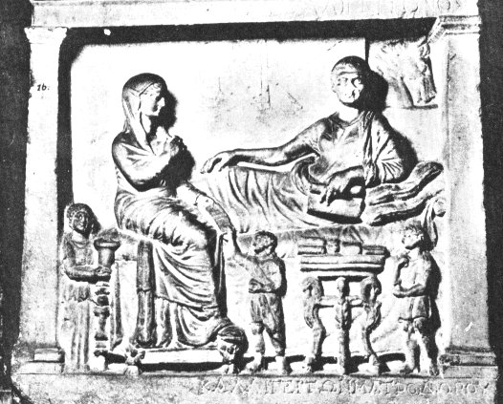
Features of Slavery during Roman Empire
Manumitted slaves were converted from being property to a free Roman citizen. But they were typically looked down by Rome's freeborn citizens.
Post manumission practices:
Obseqium – required freedmen and women to openly grovel in the presence of former masters
Operae – ex-slave required to return to their slave professions for a certain number of days annually
Slaves were often depicted as small

Slide 47
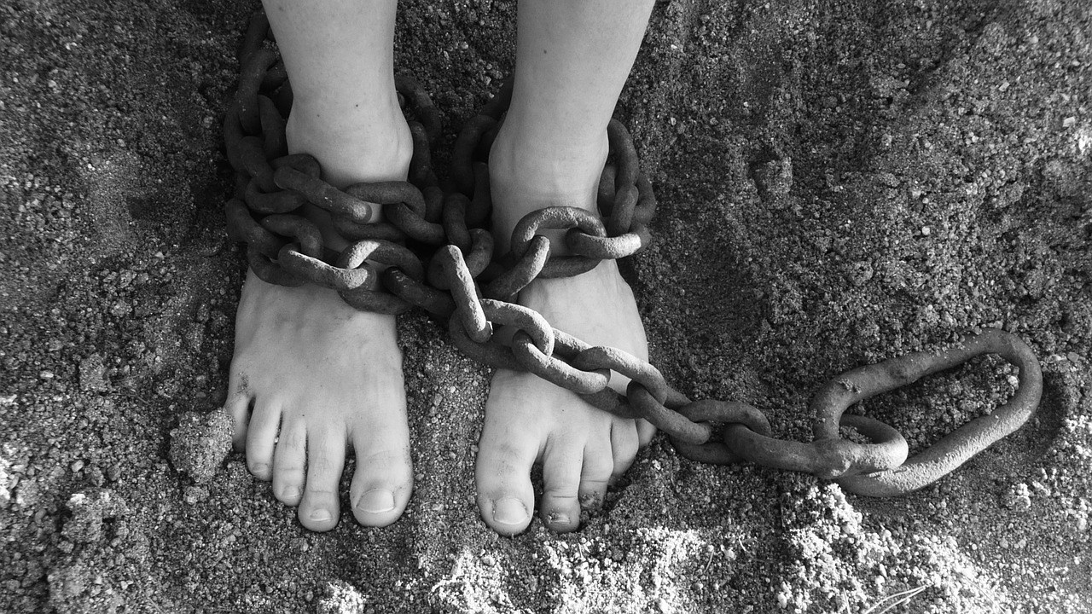
"If a man has sex with a slave girl whose freedom has never been purchased but who is committed to become another man's wife, he must pay full compensation to her master. But since she is not a free woman, neither the man nor the woman will be put to death" (Lev 19:20 NLT).

Slide 48
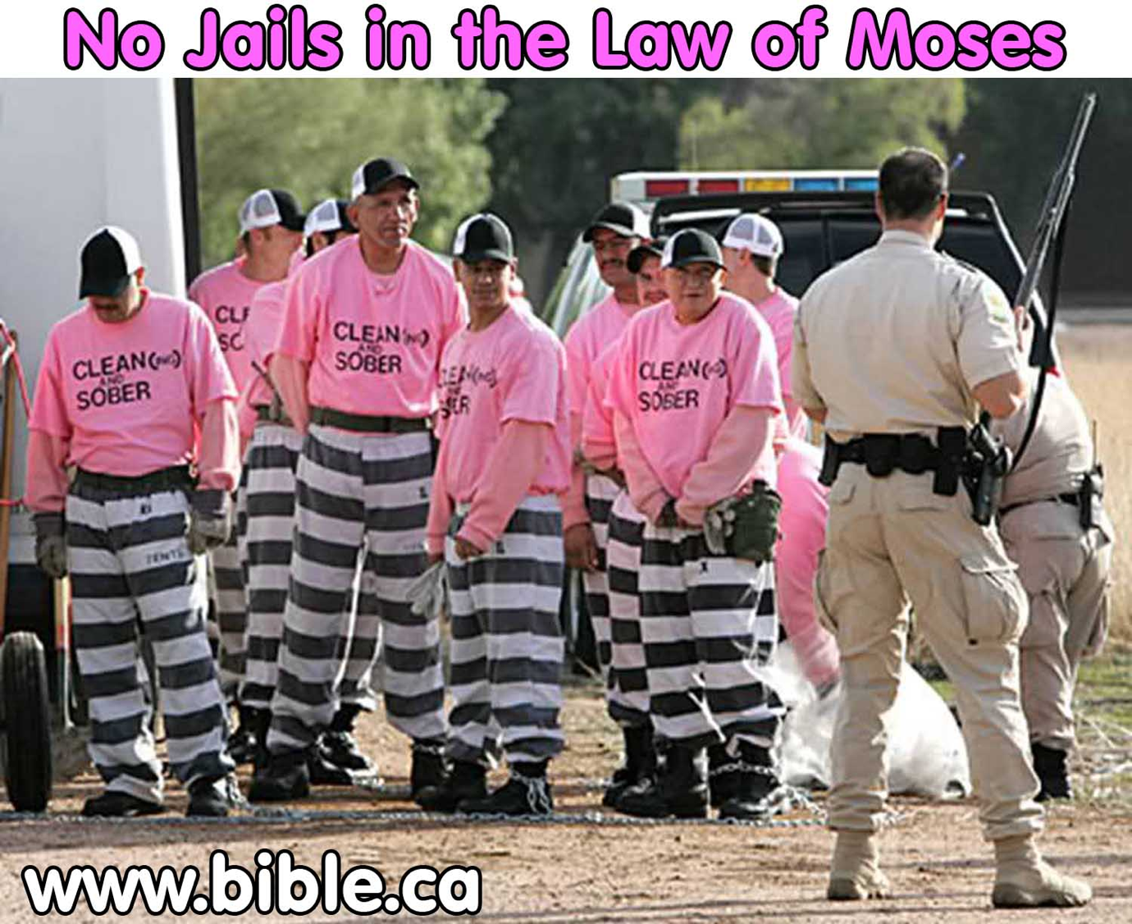
"So Christ has truly set us free. Now make sure that you stay free, and don't get tied up again in slavery to the law" (Gal. 5:1 NLT).
No Prisons or Jails in the Law of Moses
Notes:
Slavery Instead of Jails in Mosaic Legal System!
Have you ever noticed that there were no prisons in the law of Moses? People were stoned, beaten, fined but NEVER sent to prison or confined in any way including shackles or stocks etc. This brand new study sheds a positive light on the role slavery had in rehabilitating criminals and providing welfare for the poor. Confinement was something completely foreign in the Jewish Legal system. It was far better rehabilitation to put criminals in a family context to take care of children and learn important life skills than to put them in a cell and prisoner context where they would turn bitter and become better educated on how to commit further crimes without getting caught. The USA return rate to prison has been as high as 80%, so perhaps we should learn some good lessons from how God brought about change to individuals in ancient Israel. Slavery is far better than imprisonment.
See the full article at http://www.bible.ca/sin-no-jails-prisons-in-judaism-old-testament-law-of-moses-slavery-welfare-jewish-comparison.htm

Slide 49
NT Paul's teaching on slavery
Paul rebuked voluntary slavery for ambitious reasons (1 Cor. 7:23)
Paul discouraged mistreating slaves but did not specifically prohibit slave trading (1 Tim. 1:9-10)
The biblical emphasis on kindness towards others, respect, and goodness prevented abuse of slaves by masters (Eph. 6:5; Col. 3:22; 1 Tim. 6:2; Tit. 2:9)
The biblical emphasis on being a new creation in Christ argues for the removal of many ethnic, social or cultural barriers between people (Gal. 3:28; Col. 3:11; Philemon 16)

Slide 50
Illustration of Philemon Regarding Slavery
NT Paul's teaching on slavery
The emphasis on non-legalism, limited hierarchical authority, and conscience-based decision making might suggest that decisions concerning any given master-slave situation not be solved by unilateral pronouncements, but rather by individuals in the midst of the situation.
This situation is illustrated in the book of Philemon.

Slide 51
Illustration of Philemon on Slavery
NT Paul's teaching on slavery
Paul wishes Philemon to free Onesimus upon his return (vv. 15-17)
Paul had the authority to command Philemon to do so (v. 17)
Paul seeks for Philemon's action to be conscience-driven and from the Christian ethic of love (vv. 9, 14, 20, 21)

Slide 52
Conclusion

Slide 53
Bibliography
Arnold, Bill T. and Beyer, Bryan E. Readings from the Ancient Near East. Grand Rapids: Baker, 2002
Chirichigno, Gregory C. Debt-Slavery in Israel and the Ancient Near East. Sheffield: JSOT Press, 1993
Rupprecht, A. "Slave, Slavery" in The Zondervan Pictorial Encyclopedia of the Bible. Vol. 4. ed. Merrill C. Tenney. Zondervan, 1976. pp. 453–460

Slide 54
Useful Websites
http://www.christian-thinktank.com, Glenn Miller, "Does God Condone Slavery in the Bible?"
http://www.bible.org, Daniel Wallace, "Some Initial Reflections on Slavery in the New Testament"
http://www.brfwitness.org, Harold Martin, "The Bible Teaching on Slavery"

Slide 55
Black

Slide 56


OT Backgrounds link at BibleStudyDownloads.org
Get this presentation for free!
Notes:
NT Survey (ns)

