Slide 1
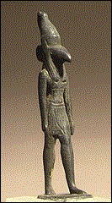
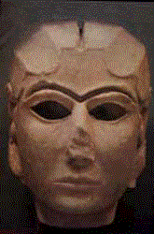
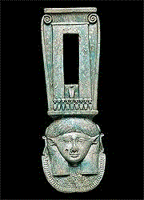
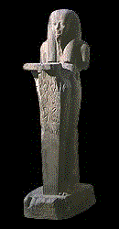
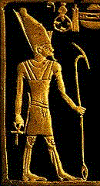
Pagan Religions
160a
PAGAN RELIGIONS
Dr. Rick Griffith • Singapore Bible College • BibleStudyDownloads.org

Slide 2
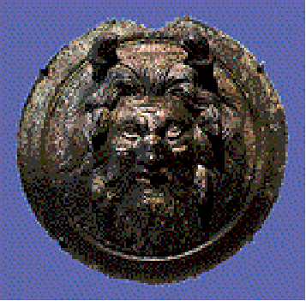
What is the key reason we see so many religions in the world?
Answer in your small groups
Why are there such divergent beliefs since we all had the same biological source in Adam and Eve?

Slide 3
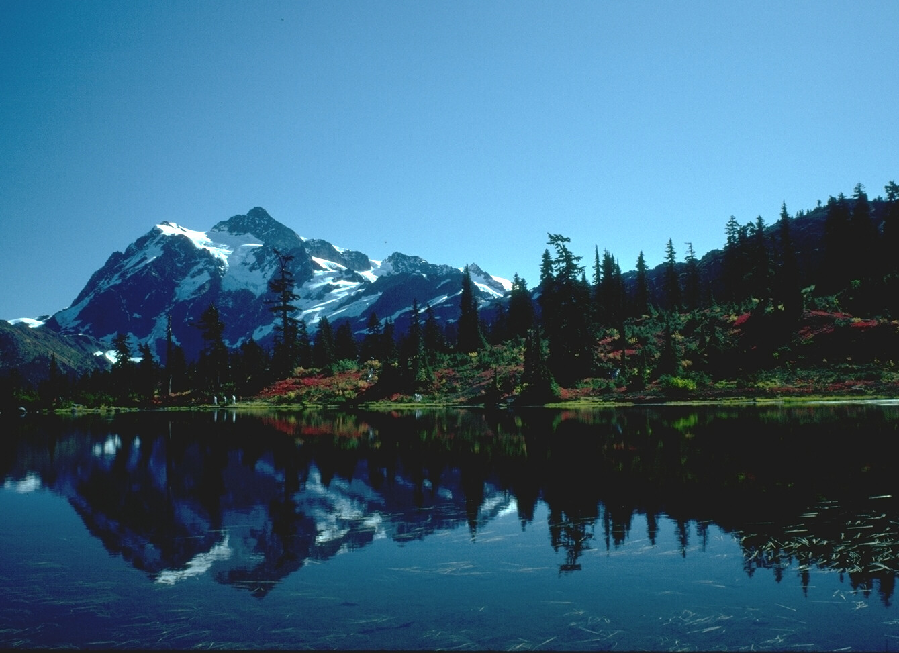
Romans 1:20
Person who is Limitless
Person who is Supernatural
For since the creation of the world God's invisible qualities-- his eternal power and divine nature-- have been clearly seen, being understood from what has been made, so that men are without excuse (NIV).
For since the creation of the world God's invisible qualities-- his eternal power and divine nature-- have been clearly seen, being understood from what has been made, so that men are without excuse (NIV).

Slide 4
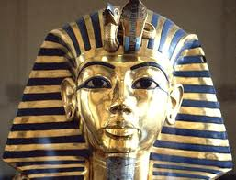
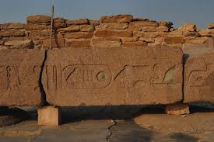
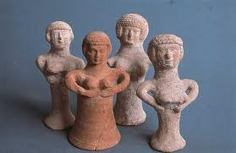
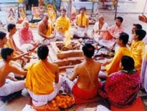
Scope
160b
Scope:
Let's compare and contrast the major pagan religions of antiquity. How did their worship differ from one another?

Slide 5
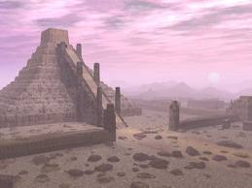
Methodology
160b
Methodology:
Gather information on pagan religions of the main people groups (Sumerians, Babylonians, Assyrians, Canaanites, Egyptians, etc.)
Comparative analysis of religions under 3 main categories: characteristics of gods, temple worship, general beliefs and practices.
Consider what we can learn from these counterfeit religions.

Slide 6
Sumerian-Babylonian gods
160b

Slide 7
ENLIL
160c
SUMERIAN HIGH GOD
Lord of the airspace
God of heaven and earth
Responsible for the Flood
Creator of mankind
Banished to 'hell' for raping Ninlil

Slide 8
MARDUK
160c
BABYLONIAN HIGH GOD
'King of the Igigi'
four eyes, four ears, emits fire from his mouth
Anu installed to lead pantheon
Given more than 50 names:
1. Asarluhi, 2. Marduk, 3. The Son, The Majesty of the Gods, 4. Marukka, 5. Mershakushu, 6. Lugal-dimmer-ankia (King of heaven and earth), 7. Bel, 8. Nari-lugal-dimmer-ankia, 9. Asarluhi, 10. Namtila, 11. Namru, 12. 'Asare, 13. Asar-alim, 14. Asar-alim-nuna, 15. Tutu, 16. Zi-ukkina, 17. Ziku, 18. Agaku, 19. Shazu, 20. Zisi, 21. Suhrim, 22. Suhgurim, 23. Zahrim, 24. Zahgurim, 25. Enbilulu, 26. Epadun, 27. Gugal, 28. Hegal, 29. Sirsir, 30. Malah, 31. Gil, 32. Gilima, 33. Agilima, 34. Zulum, 35. Mummu, 36. Zulum-ummu, 37. Gizh- numun-ab, 38. Lugal-ab-dubur, 39. Pagal-guena, 40. Lugal-Durmah, 41. Aranuna, 42. Dumu-duku, 43. Lugal-duku, 44. Lugal-shuanna, 45. Iruga, 46. Irqingu, 47. Kinma, 48. Kinma, 49. E-sizkur, 50. Addu, 51. Asharu, 52. Neberu, 53. Enkukur

Slide 9
Canaanite gods
160c

Slide 10
BAAL
160d
CANAANITE HIGH GOD
Prince of the earth, god of fertility, lord of sky and earth, god of thunder and lightning etc
Lord, master, owner
Chief male deity of the Phoenicians and Canaanites
Slain by Mot & revived by Anath
Worshipped in the high places of Moab (Num. 22:41)

Slide 11
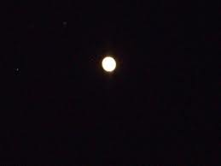
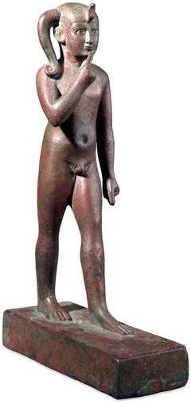
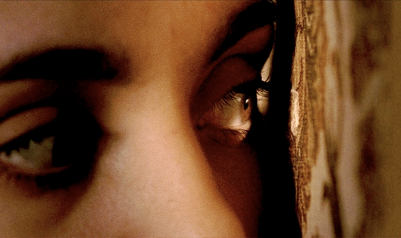
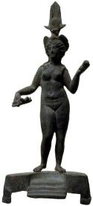
The Baal Cycle
Baal Rises
Baal Rises
Mot kills Baal
Mot kills Baal
Winter
Spring
Summer
Fall
Winter
Spring

Slide 12
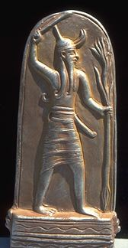
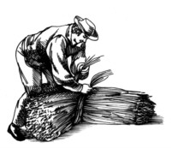
Religion
90
Baal fertility cycle (Baal Epic)
Mot (death) in winter defeated by Baal (life) in spring
Temple prostitution and sexual fertility rites in religious worship helped Baal resurrect in spring

Slide 13
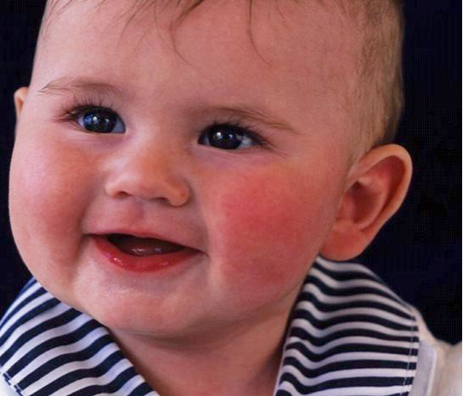
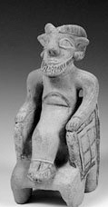
Child Sacrifice to Baal
91
During worship live babies were placed on the burning hot hands of the statue of Baal.
After dying they were then pushed into a hole underneath.

Slide 14
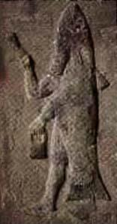
DAGON
160d
PHILISTINE HIGH GOD
Hebrew word "dag" (fish): Human with back half as fish
Hebrew/Akkadian word 'dagan' (grain): a grain god
Upper torso: man; Back half: fish
Temples at Gaza, etc. (Judges 21,23)

Slide 15
Egyptian gods
160d

Slide 16
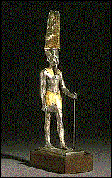
AMUN
160e
EGYPTIAN HIGH GOD
'King of the Gods'
Man with a ram-head
Wore ostrich plumed hat
Later called Amun-Ra

Slide 17
Similar gods
Similar gods
160e

Slide 18
Pagan gods were like humans
160e
Had families and could procreate
Ate and feasted - even got drunk!
Experienced human feelings of jealousy, anger, lust, etc.
Fought amongst themselves
Had varying powers but none omnipotent
Could die and re-live again

Slide 19
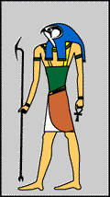
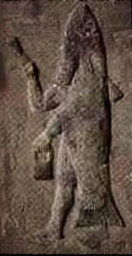
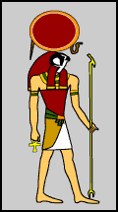
Portrayed as Human-Animal
160f
Dagon (fish tail)
Horus (hawk head)
Enlil (horse legs)
Ra (eagle head)
Anubis (jackal head)

Slide 20
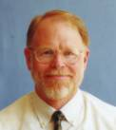
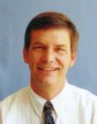
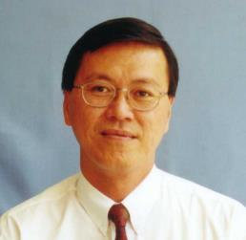
WHO DOES NOT BELONG HERE? ? ?

Slide 21
Pagan Beliefs on Creation
160f
The Sumer-Babylonian myths depict creation with war and violence (a classic case of the "fittest survive" mentality).
Egypt's creator was powerful but when he became Pharaoh and lived with men, his power dissipated into the air.

Slide 22
Pagan Beliefs on the Great Flood
160f
1. Babylonian flood - result of a disagreement among the gods vs Assyrian - earth was overpopulated
Assyrian
2. Both Ziusudra (Babylonian) and Utnapishtim (Assyrian) were given immortality
Humanity overpopulated
The gods, led by Enlil, agreed to cleanse the earth
Utnapishtim was warned of a flood by the god Ea in a dream
He built a seven-level ship with all living creatures aboard
It stormed for six days
He released dove, sparrow & raven, then knew water had receded
Sacrificed to the gods and he & his wife given immortality

Slide 23
Pagan Beliefs on Life after Death
160g
1. Besides Egyptians who believed in some form of hope in next life based on works, the other cultures did not have favorable views of the after-life

Slide 24
Pagan Beliefs on Relationship with Gods
160g
1. Consideration for morality was not so distinct in Sumer-Babylonian and Canaanite/ Phoenician cultures
2. Egyptians' motivation for morals was based on fear and entry to heaven on good works

Slide 25
Pagan Worship by Priests
160g
Sumer-Babylonian
Egyptian
Assyrian
King = official representative of deity, insuring fertility of land by careful observance of the New Year ritual
Elaborate priestly bureaucracy to maintain temple and its deity
Queen might manage affairs of temple goddess
Pharaoh = divine, ultimate high priest who built temples and oversaw their maintenance.
Lay priests operated small chapels with patron deities not worshipped anywhere else.
Epic of Ugarit
King represented human community before gods.
12 priestly families with a high priest among them
Others: consecrated persons (possibly cultic prostitutes), singers, makers of vestments and sculptors. Priests functioned as scribes as well.
1. Political rulers assumed to have close contact with gods
2. Women functioned with special roles in the temple

Slide 26
Pagan Worship in Temples
160h
Sumer-Babylonian
Egyptian
Assyrian
Temple = 1/3 of city, may lease land for income
Ziggurat, a stepped tower of 3-7 stages
divine statue at foot of temple carved from wood, adorned with precious stones
Temples built on ruins , eventually becoming man-made mountains
Hypostyle hall for religious rituals - priests and pharaoh only
Second hall - high priest and pharaoh only
Sanctuary -> shrine where the statue of the god or goddess was kept - god or goddess may enter statue.
Sacred lake next to the temple
Temples = dwelling place of deity
courts = festive assemblies
statue to depict deity
Tophet (child cemeteries) contain some 20,000 cinerary urns with the remains of infant children and animals.
1. Grand architecture depicting central importance of religion
2. Existence of statues to represent gods

Slide 27
Pagan Worship - Rites & Rituals
160h
Both sexes went to temples not to worship but to be worshipped!

Slide 28
Pagan Worship - Rites & Rituals
160h
Their immorality was so depraved that they killed people just for their material prosperity!
Moabites
Philistines
National god Chemosh, worshipped primarily by offering the first-born son (2 Kings 3:26-27)
Baal, Lord of Heaven
worshipped by both ritual immorality and child sacrifice (2 Kings 16:7, 21:6).

Slide 29
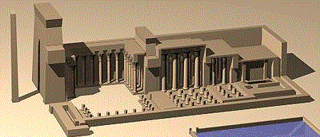
Babylonian & Assyrian Temples
160h

Slide 30
THE TOWER OF BABEL (Gen. 11:1-5)
In this classic story, people were building a colossal staged temple-tower or multi-storeyed ziggurat that would reach heaven. But did they really believe they could reach their gods? Most likely the tower would be used as a place of worship. Actually, their purpose for the tower was to provide a common religious rallying point, lest the people be scattered. The builders were in open defiance of God's command (Gen. 9:1) .

Slide 31
What common characteristics were true of most, if not all, Ancient Near East pagan religions? Give at least two traits.
In other words...

Slide 32
Uniqueness of Pagan Religion
Polytheistic
Gods sinful
Blemished sacrifices
Offerings
Priestesses
Local deities
Religions of the plains (left-stage)
Worship motivated by fear or finances
Visual images of gods (idols)
Temple prostitutes
Had to care for their gods
Mythology acceptable
Political leaders

Slide 33
How was Israel's religion distinct from these other religions of the OT era? Give at least two contrasts.

Slide 34
Israel's Distinct Worship
Monotheistic (worshipped the true God)
Holy God without sin
Priesthood by genealogy
YHWH not a local deity
Salvation by faith (?)
Attested by genuine miracles
Religion of the desert (right-stage)
No physical depiction of God
Moral standards of worshipers & leaders
Covenant relationship with God
God initiated
Can't manipulate God
Male priests only

Slide 35
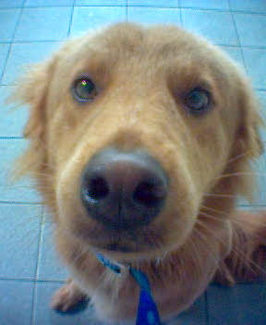
But what does this all have to do with me?
Let's now see the Discovery Channel movie on superstitions of the Hungry Ghost…

Slide 36
How did reading these pagan writings for today's class help you appreciate Judaism? How did this possibly aid your own walk with God?

Slide 37
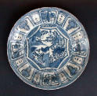
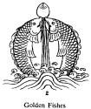
Buddhism

Slide 38
Hinduism

Slide 39
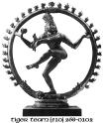
Hinduism

Slide 40
Application
160i
Application
Israel was influenced by paganism (Ps. 106:34-42), so today, we should beware syncretism. - Children colouring book ('the many faces of the Great Mother' - Ashteroth) - Girl scouts oath (reduce emphasis of God) - World Council of Churches (prayers to goddess Sophia)
God centeredness vs self indulgence (2 Cor. 10:4-5)
"Pay attention to all that I have said to you, and make no mention of the names of other gods, nor let it be heard on your lips"
(Exodus 23:13 ESV).

Slide 41
Bibliography
Hoerth, Alfred J.; Mattingly, Gerald L.; and Yamauchi, Edwin M., eds. Peoples of the Old Testament World. Grand Rapids, Michigan: Baker Books 1994.
Gower, Ralph. The New Manners and Customs of Bible Times. Chicago: Moody, 1987.
Hindson, Edward E. The Philistines and the Old Testaments. Grand Rapids, Michigan: Baker, 1983.
Websites

Slide 42
ORIGINALLY PRESENTED BY:
PAGAN RELIGIONS
ALVIN
AI CHENG
MAGNAI

Slide 43
Black

Slide 44
OT Backgrounds link at BibleStudyDownloads.org
Get this presentation and script for free!

