Slide 1
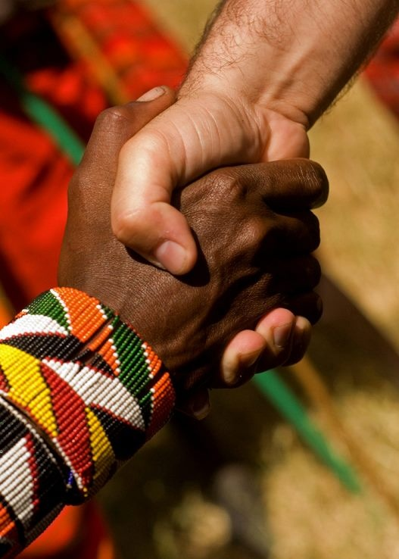
“Accept one another as Christ has accepted you” (Rom 15:7)
Romans 16:1–27
Preached by Andrew B. Spurgeon at Crossroads International Church Singapore • cicfamily.com Uploaded by Dr. Rick Griffith • Singapore Bible College Thousands of files in 44 languages for free at BibleStudyDownloads.org

Slide 2
Theme
“Accept one another just as Christ has accepted us for the glory of God” (Rom 15:7)

Slide 3
Summary
While we were sinners, God demonstrated his love for us by sending his son, Jesus Christ, to die for us. We who believe in him have salvation and a renewed life, where we ought to love one another, obey the government, and accept one another just as Christ accepted us.

Slide 4
Chapter 16:1–27
The Unsung Heroes
a person who makes a substantive yet unrecognized contribution; a person whose bravery is unknown or unacknowledged

Slide 5
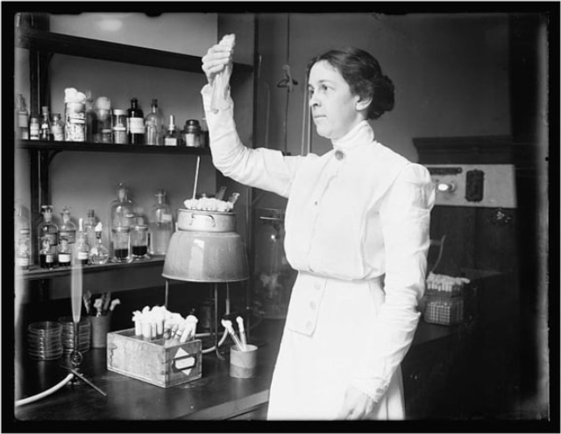
Chapter 16:1–27
Alice Catherine Evans — a microbiologist who championed the pasteurization of milk, saving countless lives.

Slide 6
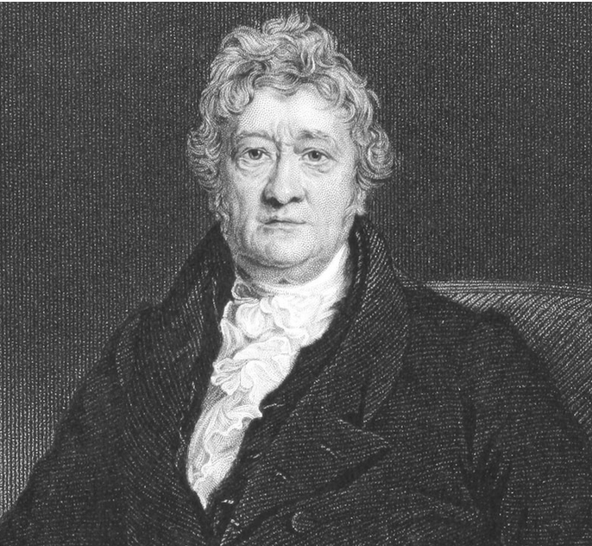
Chapter 16:1–27
Thomas Clarkson
— did the research that led William Wilberforce to work towards abolishing British slavery.

Slide 7
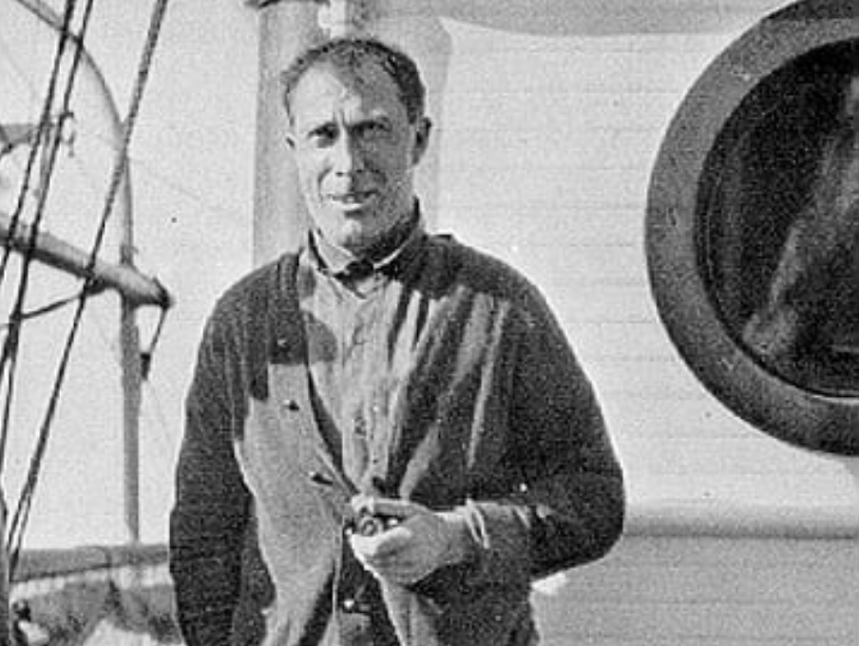
Chapter 16:1–27
Bob Bartlett — an arctic explorer who guided survivors 150 miles by dog sledge to find land.

Slide 8
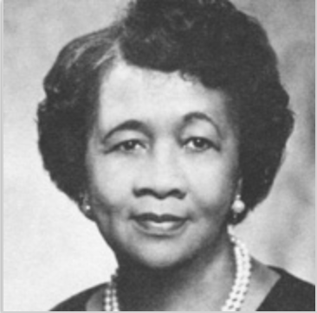
Chapter 16:1–27
Dorothy Height — as the president of the National Council of Negro Women from 1957 to 1997, she helped bring awareness to poverty, voting rights, and AIDS.

Slide 9
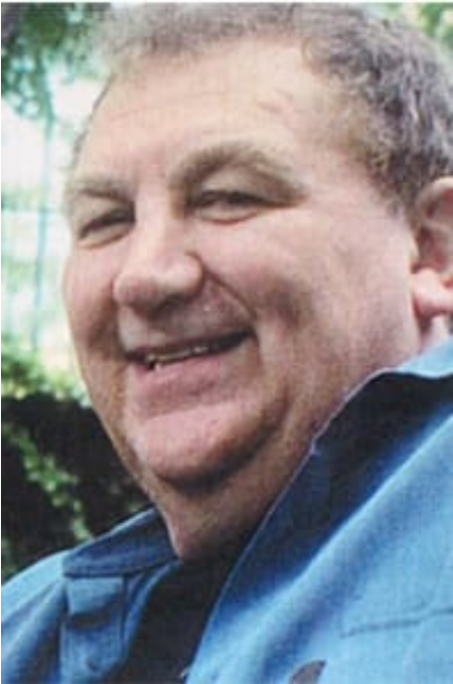
Chapter 16:1–27
Rick Rescorla — a security director for Morgan Stanley during 9/11 attack. He led all but 13 of 2,700 Morgan Stanley’s employees to safety.

Slide 10
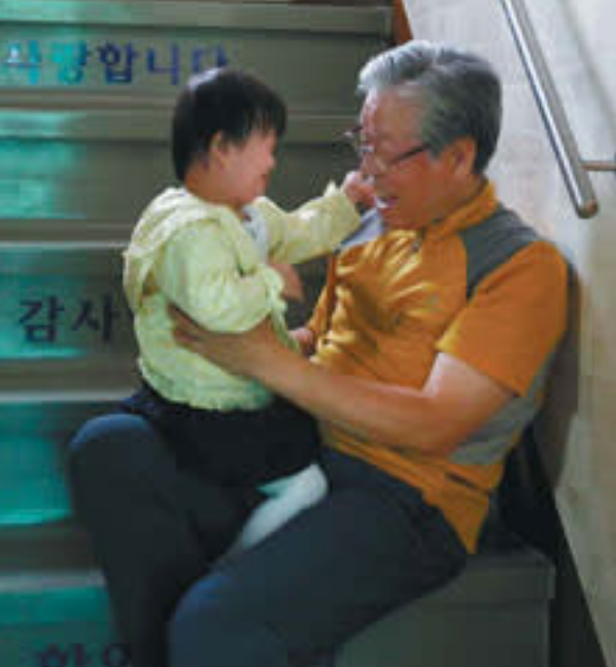
Chapter 16:1–27
Pastor Lee Jong-rak
— a pastor in S. Korea, who created the “baby box,” where people can leave babies they didn’t want so that others can adopt.

Slide 11
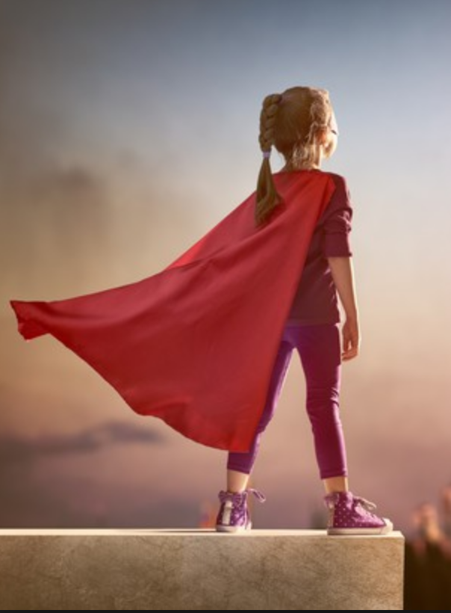
Chapter 16:1–27
Romans 16 has a list of unsung heroes . . .
Thirty-seven individuals
Several families
Five house churches

Slide 12
Chapter 16:1–27
1
Messengers
2
Converts
3
Friends
4
Workers
5
Patrons
6
Social Elites
7
Slaves

Slide 13
Chapter 16:1–27
1
Messengers
Phoebe (v. 1-2)
Tertius (v. 22)

Slide 14
Chapter 16:1–27
“I commend to you our sister Phoebe, a deacon of the church in Cenchreae. I ask you to receive her in the Lord in a way worthy of his people and to give her any help she may need from you, for she has been the benefactor of many people, including me” (v. 1-2; Acts 15:22; Col 4:7–9).

Slide 15
Chapter 16:1–27
“I, Tertius, who wrote down this letter, greet you in the Lord” (v. 22)
Latin name = “third”

Slide 16
Chapter 16:1–27
2
Converts
Ephenetus (v. 5)
Apelles (v. 10)

Slide 17
Chapter 16:1–27
“Greet my beloved Epenetus, who was the first convert to Christ in the province of Asia” (cf. 1 Cor 16:15 Stephanus, first convert in Achaia)

Slide 18
Chapter 16:1–27
“Greet Apelles, who is approved in Christ”
He endured persecution for his faith.

Slide 19
Chapter 16:1–27
3
Friends = agapetos, agapete
Ephenetus (v. 5)
Ampliatus (v. 8), a slave name
Stachys (v. 9) = an ear of corn
Persis (v. 12), a lady

Slide 20
Chapter 16:1–27
4
Workers
Prisca and Aquila (v. 3-5)
Mary (v. 6)
Andronicus and Junia(s) (v. 7)
Urbanus (v. 9)

Slide 21
Chapter 16:1–27
4
Workers
Tryphena and Tryphosa (v. 12)
Persis (v. 12)
Timothy (v. 21)
Lucius, Jason, Sosipater (v. 21)

Slide 22
Chapter 16:1–27
“Greet Prisca and Aquila, my co-workers in Christ Jesus. They risked their lives for me. Not only I but all the churches of the Gentiles are grateful to them. Greet also the church that meets at their house” (v. 3–5a; Acts 18:1–3)

Slide 23
Chapter 16:1–27
“Greet Mary, who worked very hard for you” (v. 6)

Slide 24
Chapter 16:1–27
“Greet Andronicus and Junia(s) (Iounian), my fellow Jews who have been in prison with me. They are outstanding among the apostles, and they were in Christ before I was” (v. 7)

Slide 25
Chapter 16:1–27
“Greet Urbanus, our co-worker in Christ”
(v. 9a)
Name = “belongs to the urbs,” city, Rome

Slide 26
Chapter 16:1–27
“Greet Tryphena and Tryphosa, those women who work hard in the Lord. Greet my dear friend Persis, another woman who has worked very hard in the Lord” (v. 12)
Names = “Dainty” and “Delicate”

Slide 27
Chapter 16:1–27
“Timothy, my co-worker, sends his greetings to you, as do Lucius, Jason and Sosipater, my fellow Jews” (v. 21)
Timothy was like a son (1 Cor 16:10); coauthored many letters (e.g. 2 Cor, Phil).
Others were traveling companions, Jews.

Slide 28
Chapter 16:1–27
5
Patrons
Phoebe (v. 1-2), Prisca and Aquila (v. 3-5)
Aristobulus (v 10), Narcissus (v. 11)
Asyncritus (v. 14), Philologus (v. 15)

Slide 29
Chapter 16:1–27
“Greet those who belong to the family of Aristobulus” (v. 10b); Greet those in the family of Narcissus who are in the Lord” (11:b)
Aristobulus was Herod the Great’s son.
Narcissus = Tiberius Claudius Narcissus, a wealthy freedman of Emperor Claudius.

Slide 30
Chapter 16:1–27
“Greet Asyncritus, Phlegon, Hermes, Patrobas, Hermas and the other brothers and sisters with them” (v. 14)
Asyncritus = “incomparable”
Plegon = “burning”
Hermes and Patrobas = slave names
Hermas was the name of the “good luck”

Slide 31
Chapter 16:1–27
“Greet Philologus, Julia, Nereus and his sister, and Olympas and all the Lord’s people who are with them” (v. 15)
All imperial names = they were royalty Philologus = “a scholar”
All others are gods’ names

Slide 32
Chapter 16:1–27
6
Social Elites
Phoebe, Prisca and Aquila
Aristobulus, Narcissus, Julia, Nereus, Olympas
Gaius, Erastus, Quartas (v. 23)

Slide 33
Chapter 16:1–27
“Gaius, whose hospitality I and the whole church here enjoy, sends you his greetings” (v. 23a)
Gaius = Paul baptized him (1 Cor 1:14)

Slide 34
Chapter 16:1–27
“Erastus, who is the city’s magistrate of public works, and our brother Quartus send you their greetings” (v. 23)
Erastus was an aedile
Quartus = “fourth” (earlier Tertius “third”)

Slide 35
Chapter 16:1–27
7
Slaves
Ampliatus (v. 8), Urbanus (belonging to the urbs, city), Stachys (“ear of corn” v. 9),
Asyncritus (incomparable), Phlegon (burning), Hermes, Patrobas, Hermas (“good luck” v. 14)

Slide 36
Chapter 16:1–27
Jews
Prisca, Aquila, Andronicus, Junia(s), Apelles,
Herodion, Rufus, his mother, Timothy, Lucius,
Jason, Sosipater . . .

Slide 37
Chapter 16:1–27
Gentiles
Phoebe, Ampliatus, Urbanus, Stachys, Phlegon, Hermes, Patrobas, Hermas, Julia,
Nereux, His sister, Lympas . . .

Slide 38
Chapter 16:1–27
Males
Aquila, Epenetus, Andronicus, Ampliatus, Urbanus, Stachys, Apelles, Aristobulus, Herodion, Narcissus, Rufus . . .

Slide 39
Chapter 16:1–27
Females
Phoebe, Prisca, Mary, Tryphena, Tryphosa, Rufus’s mother, Julia . . .

Slide 40
Chapter 16:1–27
Free-people
Phoebe, Prisca and Aquila,
Aristobulus, Narcissus, Julia, Nereus, Olympas
Gaius, Erastus, Quartus . . .

Slide 41
Chapter 16:1–27
Slaves
Ampliatus, Urbanus, Stachys, Phlegon, Hermes, Patrobas, Hermas . . .

Slide 42
Conclusion
“Accept one another just as Christ has accepted us for the glory of God” (Rom 15:7)

Slide 43
Conclusion
What better way to acknowledge that truth than by listing them (from various backgrounds, race, and gender) all together in a single letter!

Slide 44
Conclusion
“I urge you, brothers and sisters, to watch out for those who cause divisions and put obstacles in your way that are contrary to the teaching you have learned. Keep away from them. For such people are not serving our Lord Christ, but their own appetites. By smooth talk and flattery they deceive the minds of naive people” (16:17–18)

Slide 45
Theme
“Accept one another just as Christ has accepted us for the glory of God” (Rom 15:7)
Acknowledge the unsung heroes!

Slide 46
NT Sermons link at BibleStudyDownloads.org
Get this presentation and notes for free!

