Slide 1
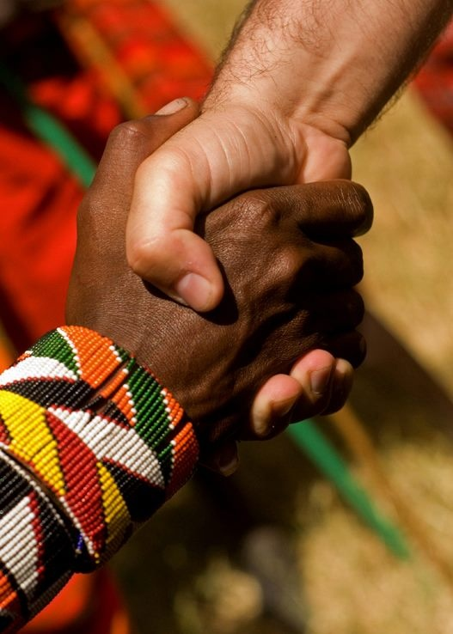
“Accept one another as Christ has accepted you” (Rom 15:7)
Romans 14:1–15:7
Preached by Andrew B. Spurgeon at Crossroads International Church Singapore • cicfamily.com Uploaded by Dr. Rick Griffith • Singapore Bible College Thousands of files in 44 languages for free at BibleStudyDownloads.org

Slide 2
Theme
“Accept one another just as Christ has accepted us for the glory of God” (Rom 15:7)

Slide 3
Summary
While we were sinners, God demonstrated his love for us by sending his son, Jesus Christ, to die for us. Anyone who believes in him will have salvation. Those who have this salvation have a renewed life—to love one another and to obey the government.

Slide 4
Chapter 14:1—15:7
“Accept one another just as Christ has accepted us for the glory of God” (Rom 15:7)

Slide 5
Chapter 14:1—15:7
Acceptance
Disputable Matters

Slide 6
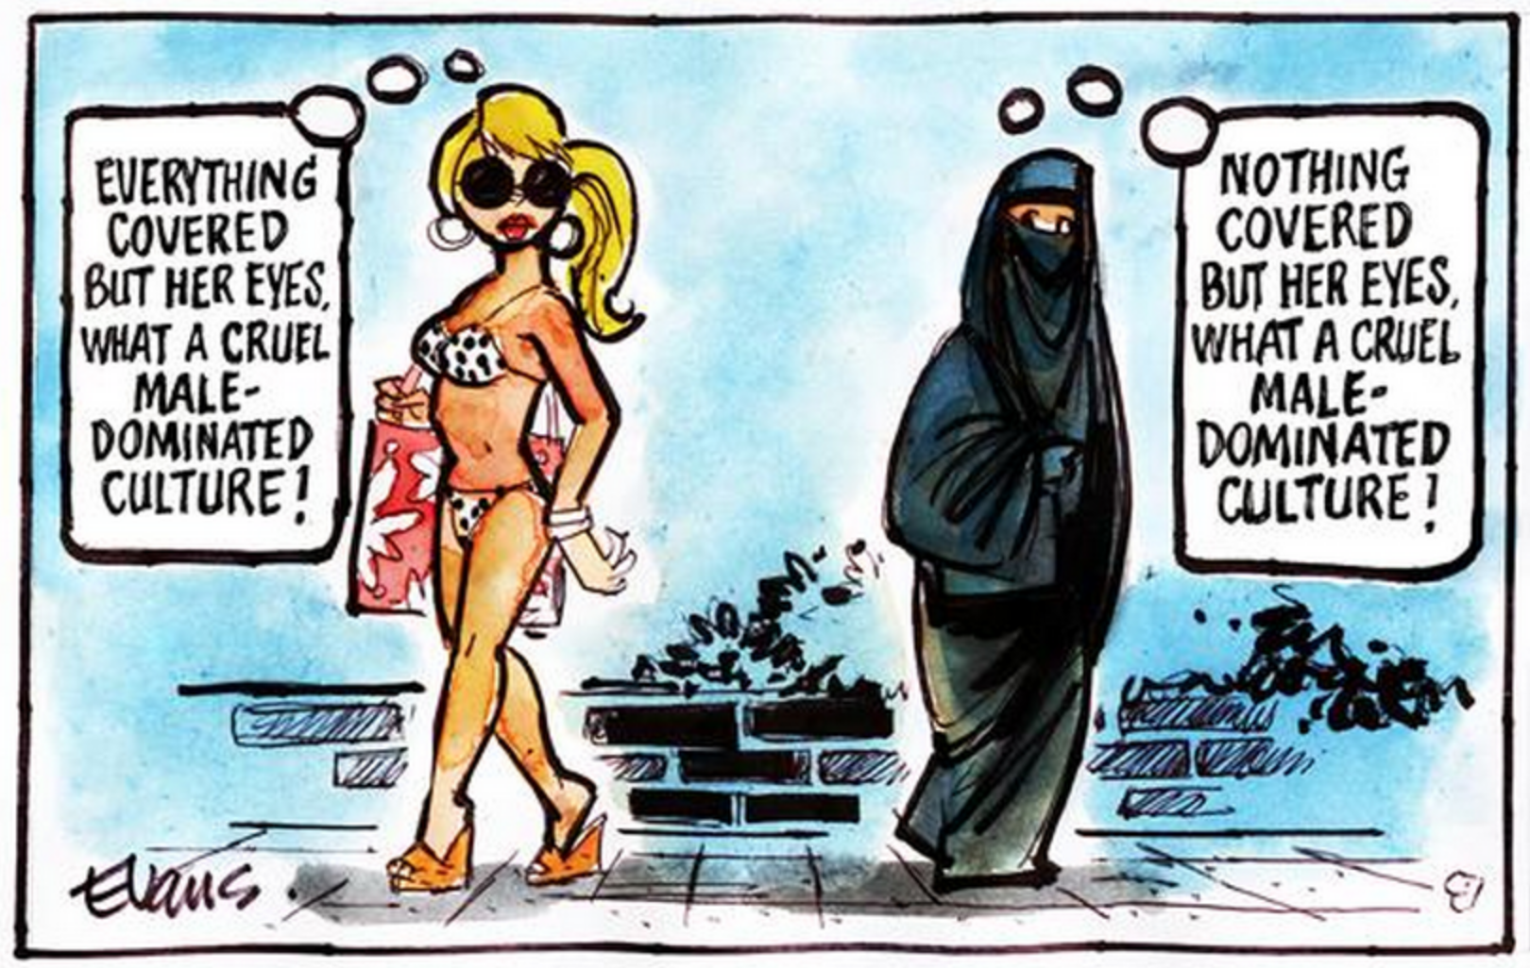
Cultural Difference

Slide 7
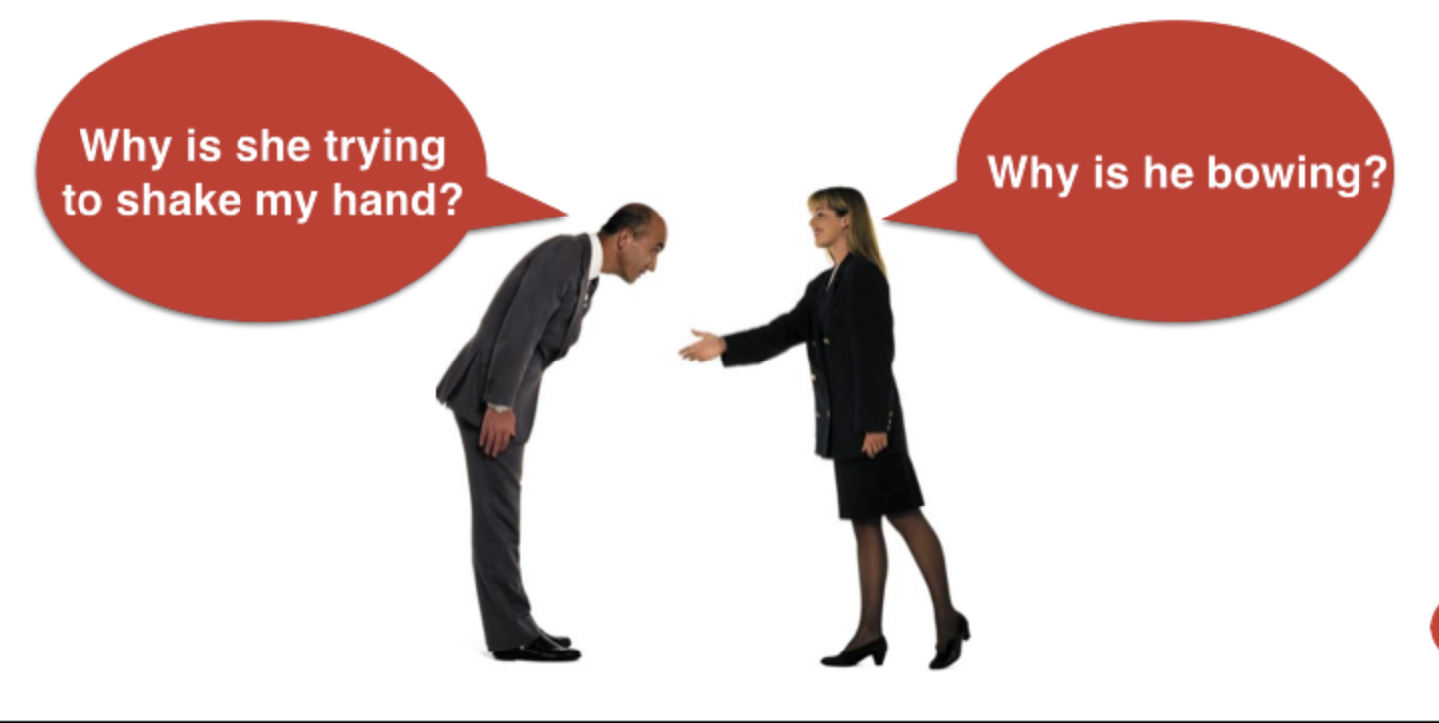
Cultural Difference

Slide 8
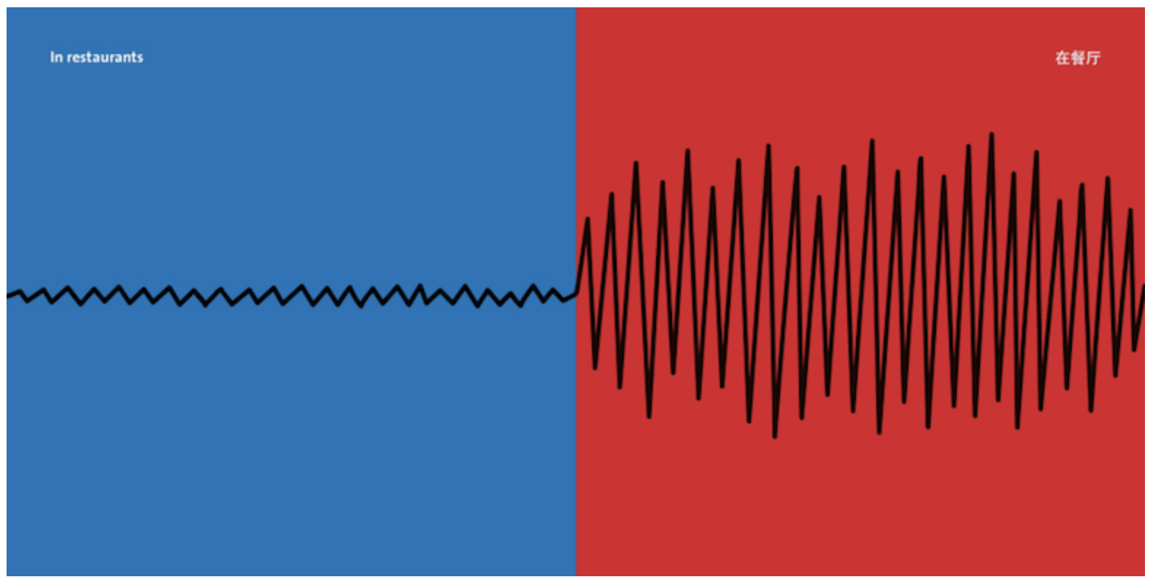
Cultural Difference

Slide 9
Cultural Difference

Slide 10
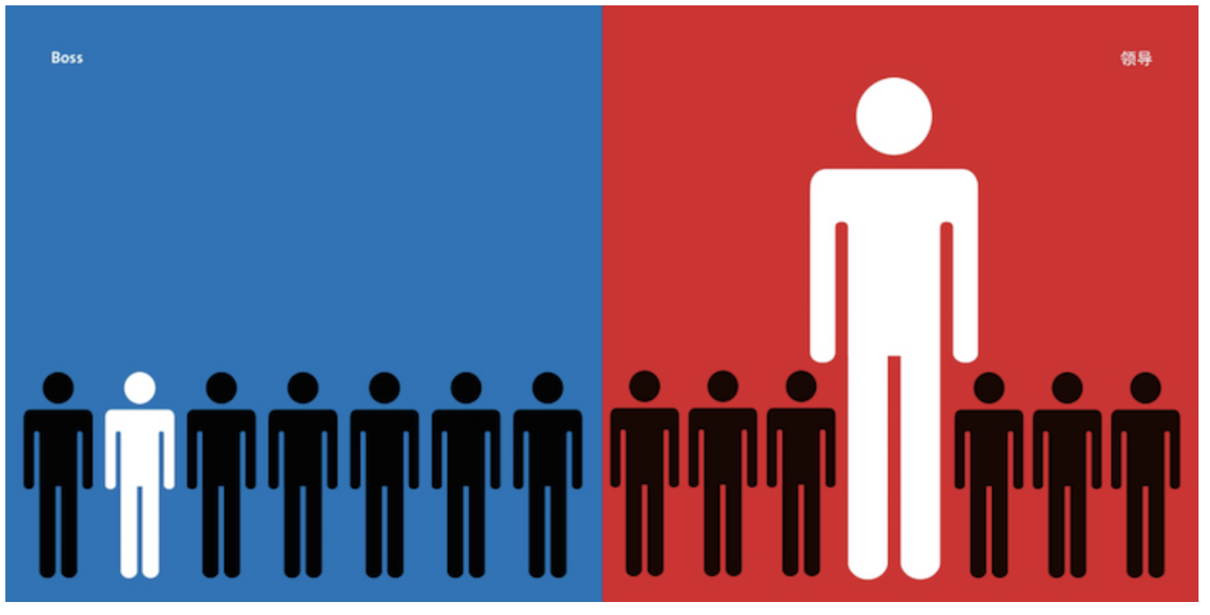
Cultural Difference

Slide 11
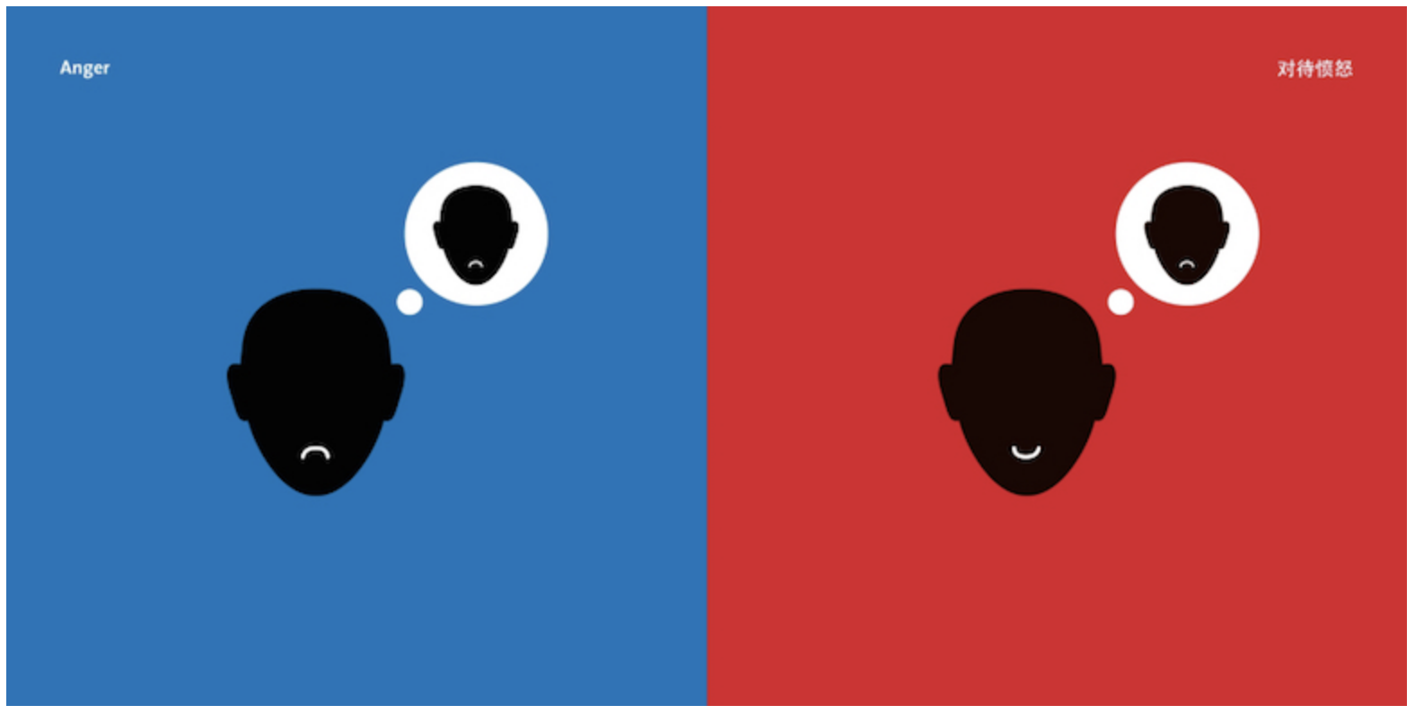
Cultural Difference

Slide 12
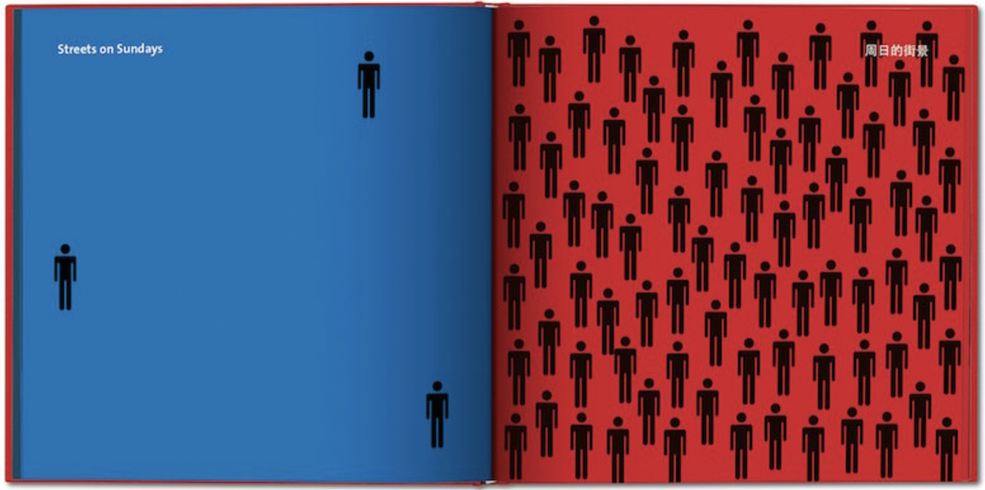
Cultural Difference

Slide 13
Chapter 14:1—15:7
“Accept one another just as Christ has accepted us for the glory of God” (Rom 15:7)

Slide 14
Chapter 14:1—15:7
Key Principle # 1
Tolerance

Slide 15
Chapter 14:1—15:7
Disputable Matter # 1
“One believes he/she can eat everything; the weak eats only vegetables” (14:2)

Slide 16
Chapter 14:1—15:7
Context
The Gentiles ate everything (didn’t have kosher regulations); the Jews, fearing they might violate kosher regulations, ate only vegetables.

Slide 17
Chapter 14:1—15:7
Context
Strong = Gentiles
Weak = Jews

Slide 18
Chapter 14:1—15:7
General Command
“Accept the weak in faith without disputing over disputable matters” (14:1)

Slide 19
Chapter 14:1—15:7
Specifically,
“The one who eats everything must not despise the one who does not” (14:3a)
The Gentiles shouldn’t despise the customs of the Jews.

Slide 20
Chapter 14:1—15:7
Specifically,
“The one who does not eat everything must not condemn the one who does” (14:3b)
The Jews shouldn’t condemn the customs of the Gentiles.

Slide 21
Chapter 14:1—15:7
Why? #1
“God has accepted him/her” (14:3c)

Slide 22
Chapter 14:1—15:7
Why? #2
“Who are you to judge someone else’s servant?” (14:4a)

Slide 23
Chapter 14:1—15:7
Parenthetically,
“Before one’s own master one stands or falls, but God is able to make his servants stand” (14:4b)

Slide 24
Cultural Difference

Slide 25
Chapter 14:1—15:7
Disputable Matter # 2
“One discerns between a day and another; another reckons each day to be the same” (14:5a)
Sabbath & festival days

Slide 26
Chapter 14:1—15:7
Principle #1
It must be a personal conviction (not imposed or imposing)
“Each must be fully convinced in his/her own mind” (14:5b)

Slide 27
Chapter 14:1—15:7
Principle #2
It must be “for the Lord”
“The one who values a day values for the Lord” (14:6a)

Slide 28
Chapter 14:1—15:7
It must be “for the Lord”
“The one who eats [meat] eats it for the Lord—giving thanks to God; and the one who doesn’t eat, abstains for the Lord, giving thanks to God” (14:6b)

Slide 29
Chapter 14:1—15:7
Principle #3
It must be self-denial
“None of us live for ourselves; none of us die for ourselves” (14:7)

Slide 30
Chapter 14:1—15:7
It must be self-denial
“If we live, we live for the Lord. If we die, we die for the Lord. Whether we die or live, we are of the Lord” (14:8)

Slide 31
Chapter 14:1—15:7
Parenthetically,
“This is why Christ died and lives—for him to rule the dead and the living” (14:9)

Slide 32
Chapter 14:1—15:7
Principle #4
It must not be judgmental of others
“Why do you condemn your brother/sister? Why do you despise your brother/sister” (14:10a)

Slide 33
Chapter 14:1—15:7
It must not be judgmental of others
“We all will stand before the judgment seat of God” (14:10b)
As the Scripture says:

Slide 34
Chapter 14:1—15:7
“‘As I live,’ says the Lord, ‘every knee will bow to me, and every tongue confess to God’”
Isaiah 45:23; Rom 14:11

Slide 35
Chapter 14:1—15:7
It must not be judgmental of others
“And each of us will give personal account to God” (14:12). “So, we should no longer judge one another” (14:13)

Slide 36
Chapter 14:1—15:7
Meat vrs. Vegetable
Accept the weak in faith
The strong shouldn’t despise the weak; the weak shouldn’t condemn the strong
God accepted them both
We can’t judge another’s servant

Slide 37
Chapter 14:1—15:7
Special Days vrs. Ordinary Days
It must be a personal conviction
It must be for the Lord
It must be self-denial
It must not be judgmental of others

Slide 38
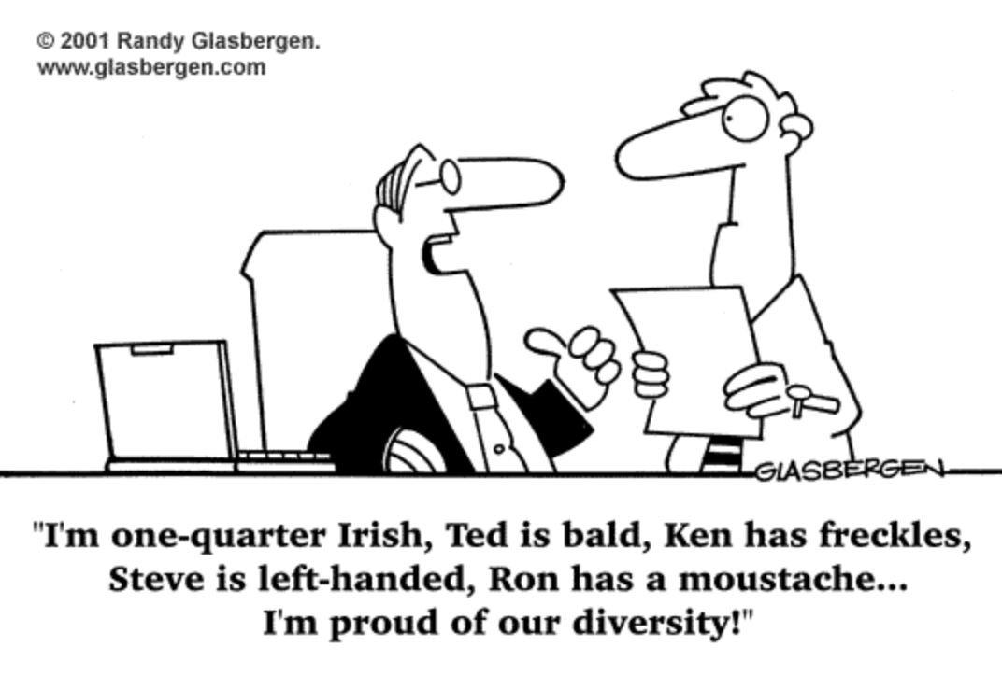
Cultural Difference

Slide 39
Chapter 14:1—15:7
Although tolerance is needed in personal preferences (14:1–13a), one has no right to stumble another (14:13b–23).

Slide 40
Chapter 14:1—15:7
Key Principle # 2
Don’t Stumble

Slide 41
Chapter 14:1—15:7
Question #1
Is it stumbling to someone?
“Decide, all the more, not to place a tripping or stumbling [stone] before a brother/sister” (14:13b)

Slide 42
Chapter 14:1—15:7
“I know, and I am convinced in the Lord, nothing is unacceptable in itself, except it is unacceptable to the one who considers it unacceptable” (14:14)

Slide 43
Chapter 14:1—15:7
Principle #2
Is it loving?
“If your brother/sister is grieved by what you are eating, you are not walking in love” (14:15a)

Slide 44
Chapter 14:1—15:7
Principle #2
Is it loving?
“Don’t loose that one—for whom Christ died—by your eating” (14:15)

Slide 45
Chapter 14:1—15:7
Principle #3
Does it guard my testimony?
“Don’t let your good [name] be blasphemed [by your eating]” (14:16)

Slide 46
Chapter 14:1—15:7
“Kingdom of God is not eating and drinking, but righteousness and peace and joy in the Holy Spirit. Anyone who serves the Lord in this way pleases the Lord and receives the approval of the people”
(14:17–18)

Slide 47
Chapter 14:1—15:7
Principle #4
Does it promote peace and edification?
“Therefore, let’s pursue the things of peace and the things that edify one another” (14:19)

Slide 48
Chapter 14:1—15:7
“Do not dislodge the work of God for the sake of food. All are indeed clean, but it is unclean to the one who by eating stumbles. It is good not to eat meat or drink wine—if by which a your brother/sister is stumbled” (14:20–21)

Slide 49
Chapter 14:1—15:7
Principle #5
Am I boasting?
“This faith you have—you keep it between yourself and God” (14:22a)

Slide 50
Chapter 14:1—15:7
Principle #6
Am I striving to be free?
“Blessed is the person who doesn’t condemn him/herself in what he/she accepts” (14:22b)

Slide 51
Chapter 14:1—15:7
Principle #7
Is it of faith?
“Whoever doubts when he/she eats, condemns him/herself because it is not from faith. Anything that is not from faith is sin” (14:23)

Slide 52
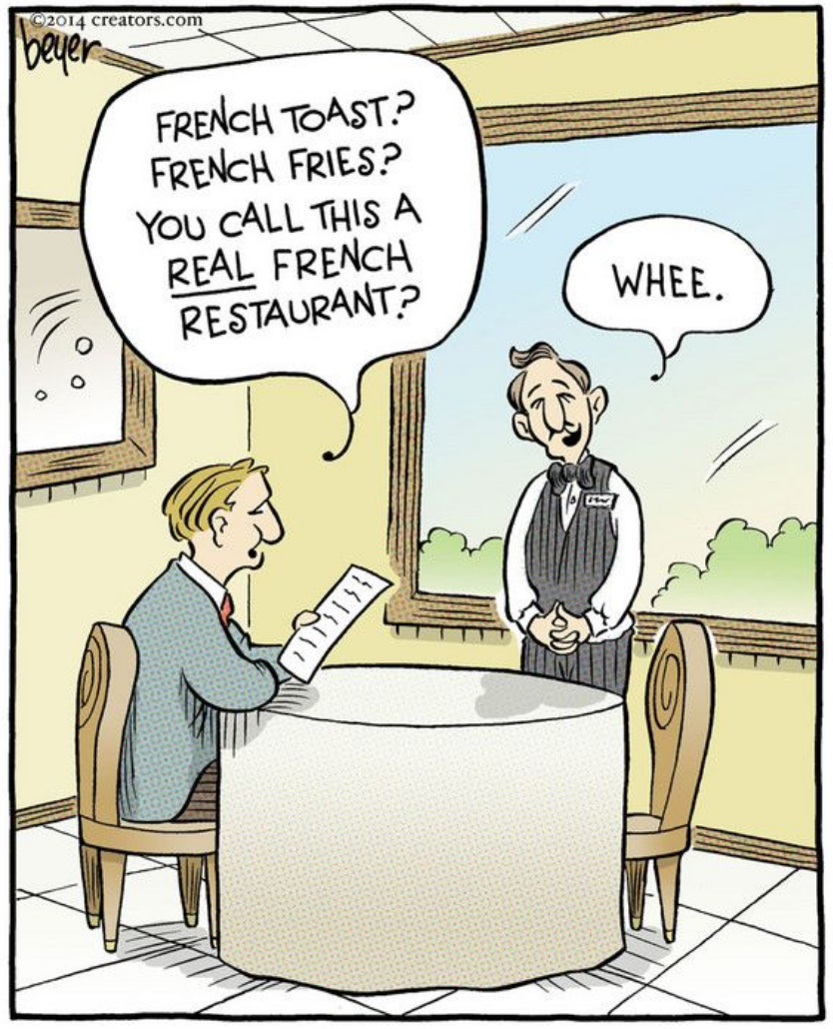
Cultural Difference

Slide 53
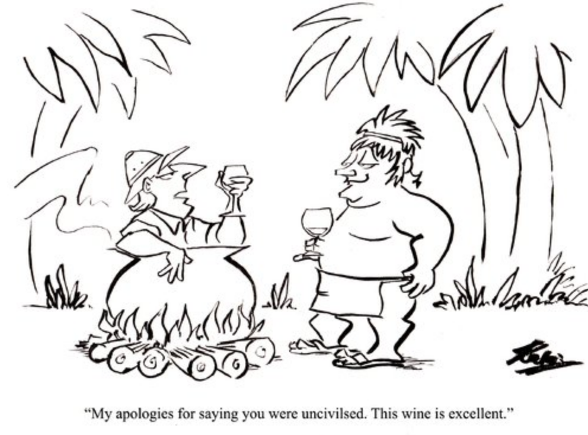
Cultural Difference

Slide 54
Chapter 14:1—15:7
Although tolerance is needed in personal preferences (14:1–13a), one has no right to stumble another (14:13b–23). Better yet, a believe ought to bear the burden of another (15:1–7).

Slide 55
Chapter 14:1—15:7
Key Principle # 3
Bear One Another’s Burden

Slide 56
Chapter 14:1—15:7
Most Significant Principle
Bear the weak-one’s burden
“We, the strong, are obligated to bear the burden of the weak and not to please ourselves” (15:1)

Slide 57
Chapter 14:1—15:7
“Each of you should please your neighbor, for good, for building up, as Christ didn’t please himself, but as it is written, “the insults of those who insulted me fell upon me” (15:2–3)

Slide 58
Chapter 14:1—15:7
Parenthetically,
“Everything written-before was written for our teaching so that through endurance and through encouragement of the Scriptures we might have hope” (15:4)

Slide 59
Chapter 14:1—15:7
“God of endurance and comfort will give you the mind of Christ Jesus towards one another so that with one accord and one mouth you may glorify God and Father of our Lord Jesus Christ” (15:6)

Slide 60
Chapter 14:1—15:7
“Therefore, accept one another just as Christ has accepted us for the glory of God” (Rom 15:7)
It’s the responsibility of anyone who thinks he/she is a “mature-person,” to bear the burden of the weak.

Slide 61
Chapter 14:1—15:7
Conclusion

Slide 62
Chapter 14:1—15:7
Meat vrs. Vegetable
Accept the weak in faith
The strong shouldn’t despise the weak; the weak shouldn’t condemn the strong
God accepted them both
We can’t judge another’s servant

Slide 63
Chapter 14:1—15:7
Special Days vrs. Ordinary Days
It must be a personal conviction
It must be for the Lord
It must be self-denial
It must not be judgmental of others

Slide 64
Chapter 14:1—15:7
Questions to ask:
Is it stumbling?
Is it loving?
Does it guard my testimony?
Does it promote peace and edification?
Am I boasting about it?
Does it stem from faith?

Slide 65
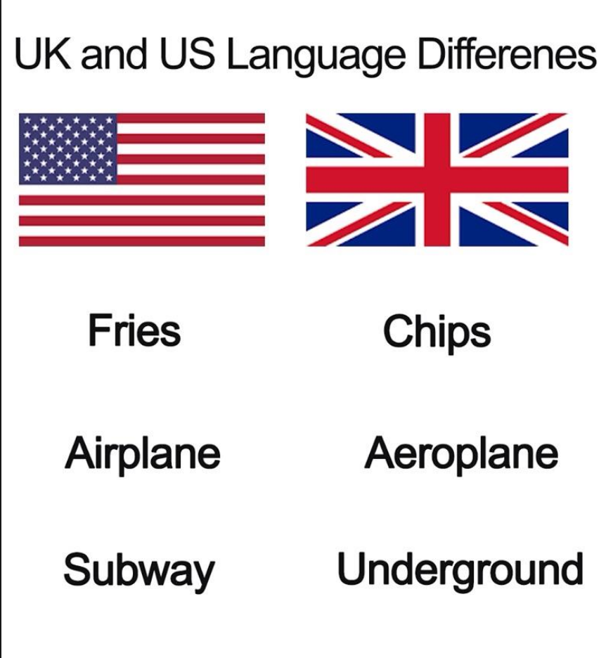
Cultural Difference

Slide 66
Chapter 14:1—15:7
Significant Principles
Tolerance
Not stumbling
Bearing one another’s burden!

Slide 67
NT Sermons link at BibleStudyDownloads.org
Get this presentation and notes for free!

