Slide 1
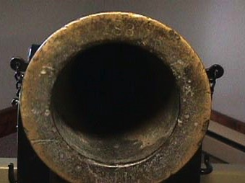
Shootin' the Canon
Dr. Rick Griffith, Crossroads International Church Singapore
cicfamily.com & BibleStudyDownloads.org

Slide 2
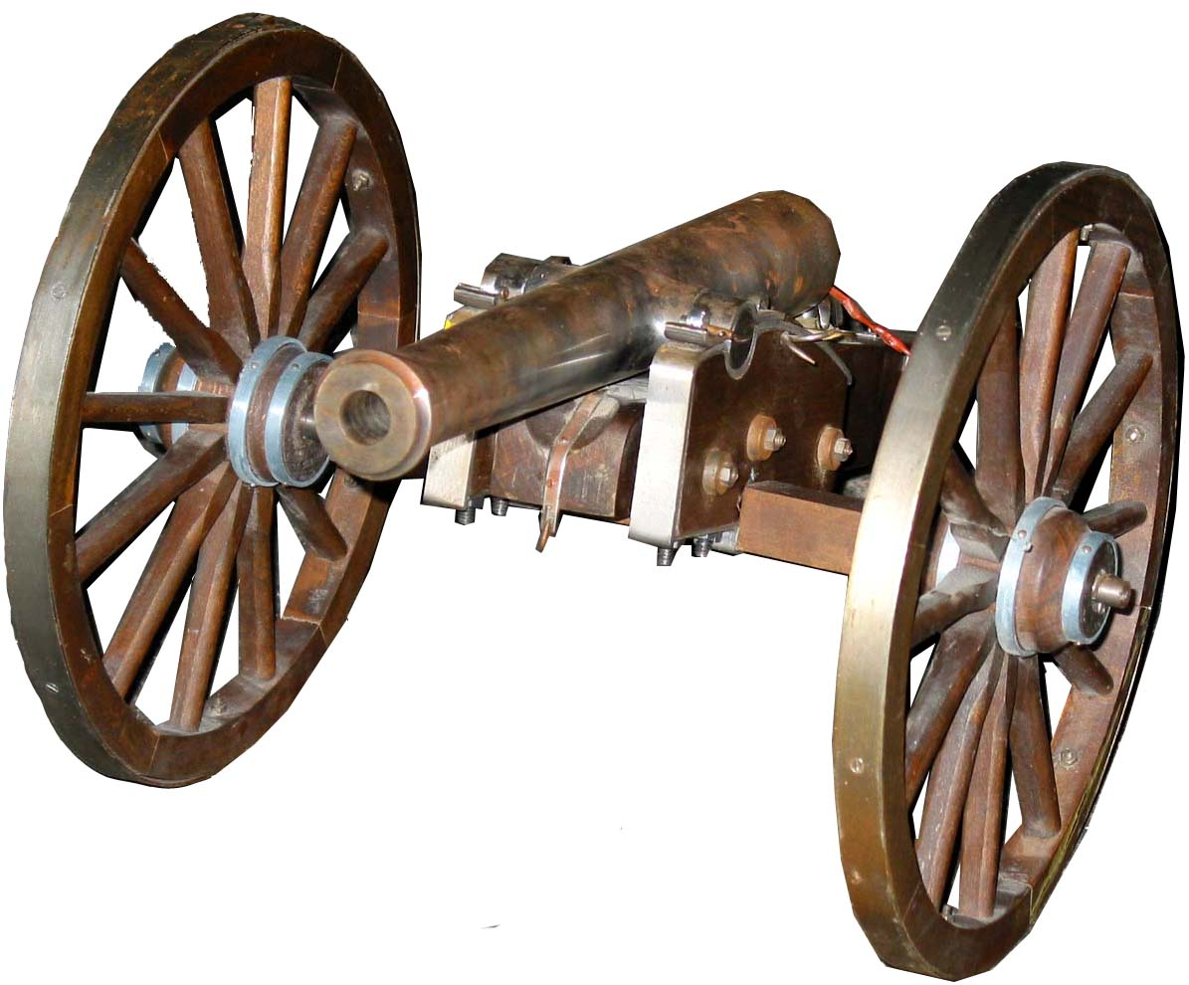
Get your enemy's big guns

Slide 3
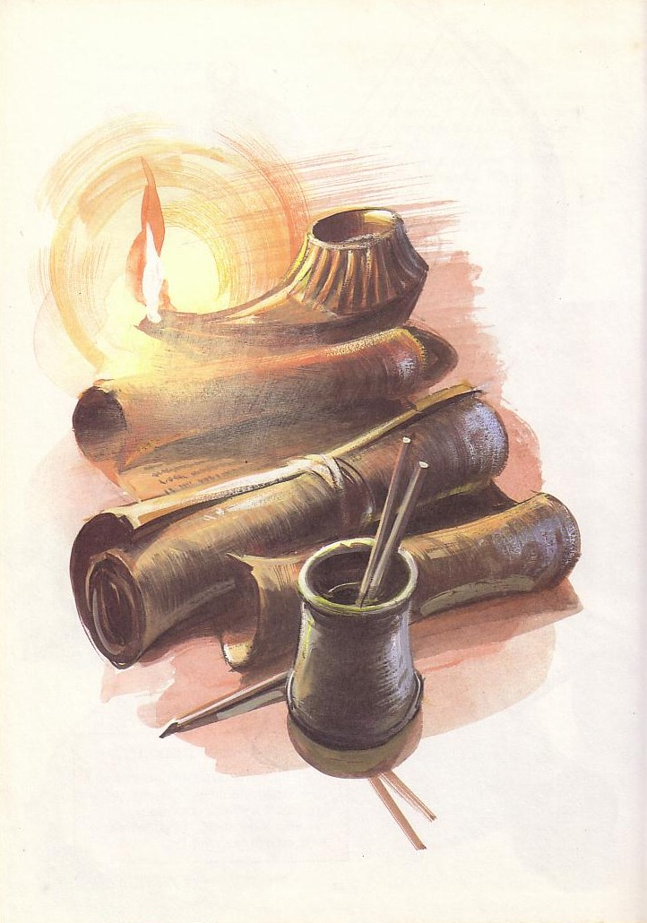

Spelling is Important
Cannon
Canon

Slide 4
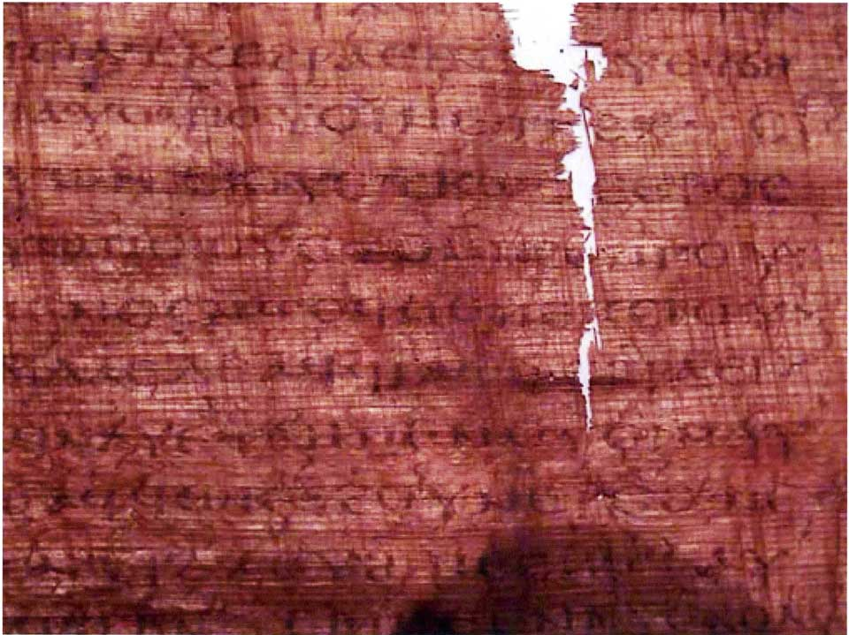
The Gospel of Judas
Judas said, "Master, could it be that my seed is under the control of the rulers?" Jesus answered and said to him, "… you will grieve much when you see the kingdom and all its generation." When he heard this, Judas said to him, "What good is it that I have received it? For you have set me apart for that generation." Jesus answered and said, "You will become the thirteenth, and you will be cursed by the other generations—and you will come to rule over them. In the last days they will curse your ascent [47] to the holy [generation]."
Notes:
Another recent attack is the mantra that the Gospel of Thomas, which is Cerinthian Gnostic--the one that denied Christ's deity.

Slide 5
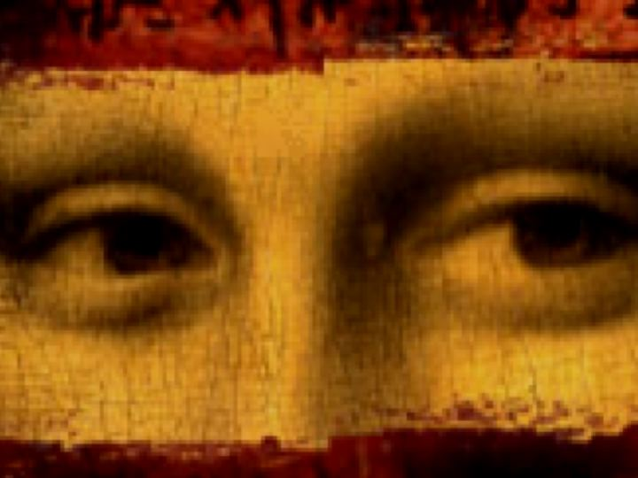
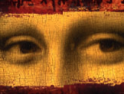
Debunking
The Da Vinci Code
A Seminar by Dr. Rick Griffith, Singapore Bible College
Available for free download at www.sbc.edu.sg/Rick
Notes:
These slides are being continually updated on the site, even though the file name still gives the original 26 April date.

Slide 6
破解
达芬奇密码
These seminar slides are also available in Chinese
Available for free download at www.sbc.edu.sg/Rick
Notes:
Presently only 145 of the more than 200 slides are translated, but they still give a basic critique of Brown's book.

Slide 7
The Revelation
Dr. Rick Griffith, Singapore Bible College

Slide 8

I. God guards His Word by judging those who tamper with it
(Rev. 22:18-19)

Slide 9

A Stern Warning (22:18-19)
"I warn everyone who hears the prophecy of this book:
If anyone adds anything to them, God will add to him the plagues described in this book.
If anyone takes words away from this book of prophecy, God will take away from him his share in the tree of life and the holy city, which are described in this book"

Slide 10
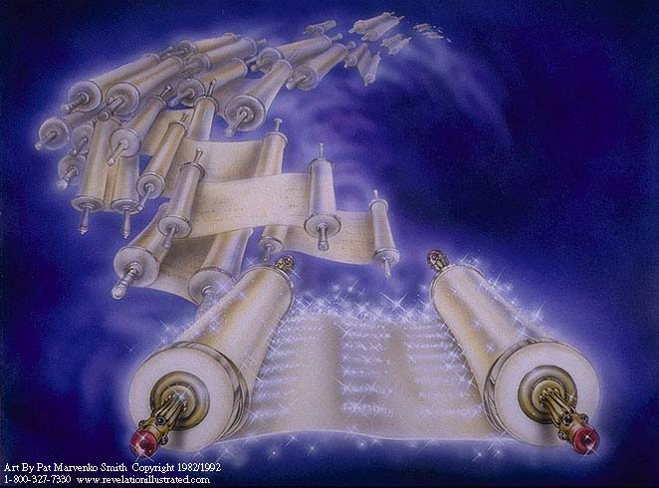
The Books (20:12)

Slide 11
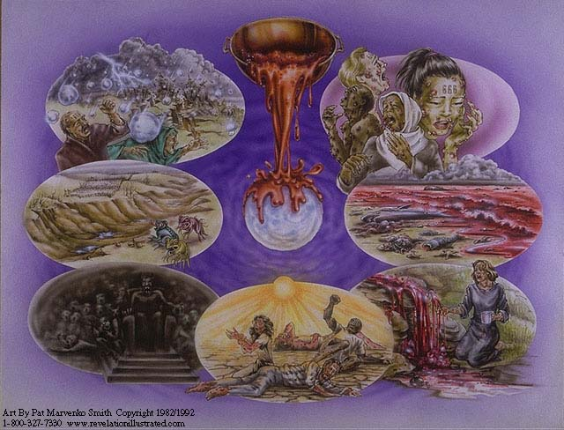
Judgment for Additions

Slide 12
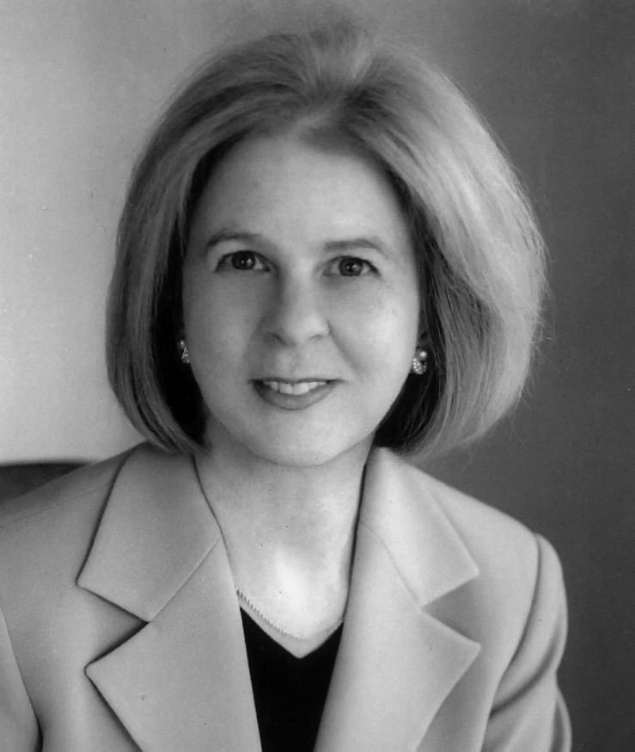
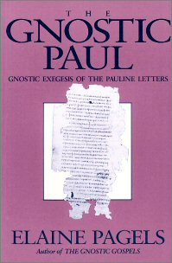
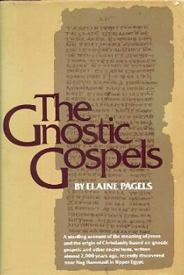
Some Liberals Add Books
Elaine Pagels teaches at Princeton that first century Christianity was also Gnostic!
Notes:
Pagels is a strong proponent of Gnostic thought which believed that salvation was not by faith in Christ but by receiving a supposed "secret knowledge" from God.

Slide 13
NT Apocrypha: 18 Gospels
The Gospel of:
• Bartholomew • the Birth of Mary
• Basilides • Pseudo-Matthew
• Cerinthus • the Hebrews
• the Ebionites • Philip
• Mary Magdalene • Thomas
• Marcion • Infancy Gospel of Thomas
Notes:
These Gnostic works do not amount to "80 gospels" as Brown claims. What they say is so esoteric that few read them.

Slide 14
NT Apocrypha: 21 "Acts"
Apostolic History of Abdias
Fragmentary Story of Andrew
Ascent of James
Martyrdom of Matthew
Passion of Paul
Passion of Peter and Paul
Notes:
Perhaps Brown's "80 gospels" sloppily includes the 16 gospels plus 21 other supposed histories, though none of these (like the Gnostic gospels) is written by an eyewitness. Instead all take on well-known names to take on an air of authenticity.

Slide 15
NT Apocrypha: 21 "Acts"
The Acts of:
• Andrew
• Andrew and Matthias • Peter
• Andrew and Paul • Peter and Andrew
• Barnabas • Peter and Paul
• James the Great • Philip
• John • Pilate
• John by Prochorus • Thaddeus
• Paul • Thomas

Slide 16
NT Apocrypha: Others
APOCALYPSES
James Stephen
Paul Thomas
Peter the Virgin
EPISTLES
Epistles of Christ and Abgarus
Epistle of the Apostles
Third Epistle to the Corinthians
Epistle to the Laodiceans
Epistle of Lentulus
Epistles of Paul and Seneca
Apocryphal Epistle of Titus
Notes:
Even adding these pretend epistles and apocalypses sum up to 50 works.

Slide 17
Brown's Key Sources are Gnostic
Two Types Addressed in 1 John
Docetic Gnosticism
From dokeo, "to seem"
(Christ only seemed to be a man)
Matter is Evil
Depreciated Materialism
Denied Christ's Humanity
Touched Jesus (1:1)
Led to Asceticism
Immorality exalted
Cerinthian Gnosticism
From Cerinthus, founder in Asia
(Christ only seemed to be God)
Spirit is Good
Exalted Knowledge (gnosis)
Denied Christ's Deity
Water & Blood (5:6)
Led to Pride
Education exalted
Notes:
Many Gnostics did the opposite of Brown's thesis--they denied Jesus was a real man. Others exalted the spirit so much that they denied his deity. Brown supposes that this latter heretical group was normative Christianity!

Slide 18
The Gospel of Judas
Jesus said, "… Truly [I] say to you, Judas... you will exceed all of them. For you will sacrifice the man that clothes me" (sections 55-56).
Notes:
This strange request of Christ for Judas to set him free from his body is the typical Gnostic desire to free oneself from the material world. This is the kind of stuff Brown advocates, but at least there is ONE manuscript of the Gospel of Judas. Brown has NO manuscripts for his heretical beliefs about Jesus and Mary Magdalene.

Slide 19
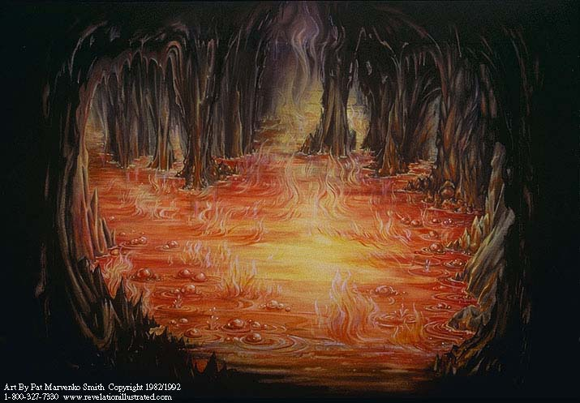
Judgments for Subtractions

Slide 20
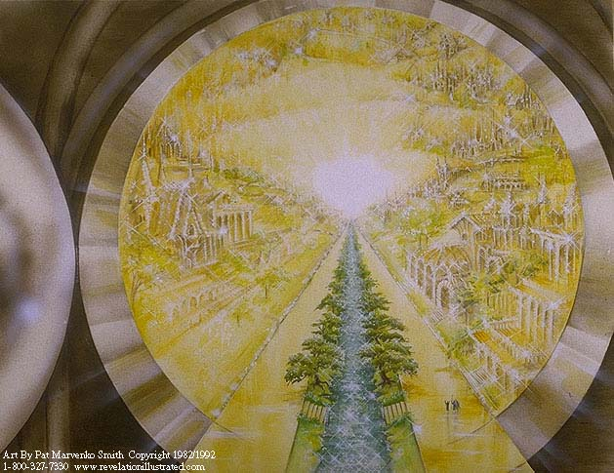
The Tree of Life (22:2)

Slide 21
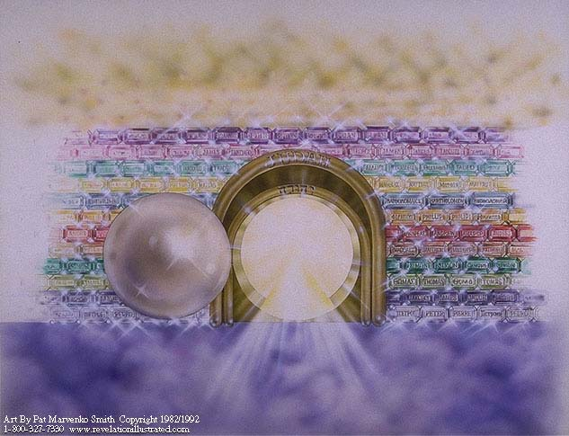
Gates from a Single Pearl (21:21)!

Slide 22

Subtractors
Marcion (AD 170)
Thomas Jefferson (1813)
Jehovahs Witnesses (1961)

Slide 23
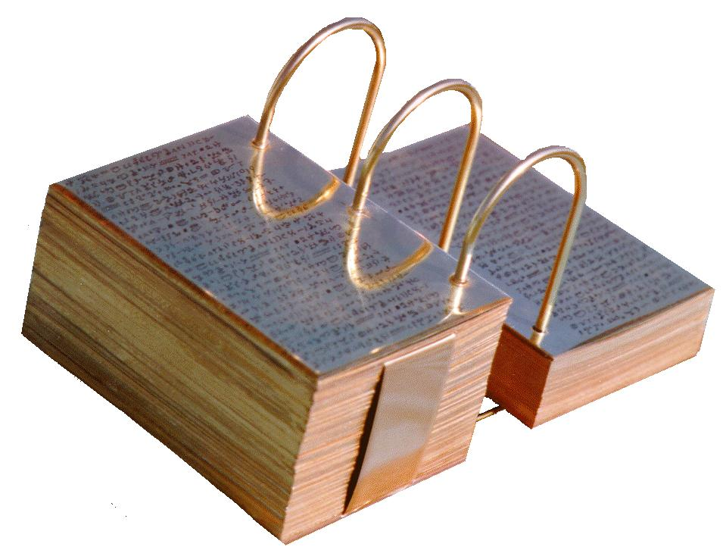
Mormons Add & Subtract
The supposed "golden plates"

Slide 24
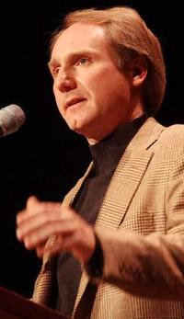
Brown's "Winner" Idea
"History is always written by the winners. When two cultures clash, the loser is obliterated, and the winner writes the history books—books which glorify their own cause" (DVC, 215)
Is this true?

Slide 25

Who were the "Winners"?
Romans "beat" Christians but the NT books still survived
Competing views of history often coexist
History is still revised by losers (e.g., Japanese)
Notes:
Paul Maier also notes, "I can give you some interesting instances where history was written by the losers. For example, one of the greatest civil wars in the ancient world was the famous Peloponnesian War. [Its history] was written by Thucydides, who was an Athenian, and the Athenians lost the war. Sparta won. And yet, Thucydides wrote a very objective treatment of what happened in the Peloponnesian War" (in Lee Strobel and Garry Poole, "Exploring The Da Vinci Code" (Grand Rapids: Zondervan, 2006), 16.

Slide 26

Smearing History
Brown
"Gospel"
Matthew
Mark
Luke
John
Selected for their "Male Bias"
Supposed 80 Gospels!
Matthew
Mark
Luke
John
Gospel
Truth
18 Heretical Gospels Written
1st Cent.
AD 325
Council of Nicaea
Notes:
In reality, of the 20 issues discussed at Nicaea, not one of them related to the correct books for the NT.

Slide 27
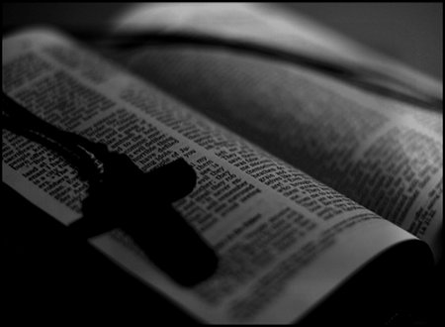
II. God Guided the Development of the Canon.

Slide 28
Clearing History
Acceptance of the Four Gospels Before Nicaea
Individuals
Didache (120-150)
Papias (130-140)
Pseudo-Barnabas (70-130)
Clement of Rome (95-97)
Polycarp (110-150)
Irenaeus (130-202)
X= Citation
or allusion
Hermas (115-140)
O= Named
as authentic
Matthew
Mark
Luke
John
X
X
X
X
X
O
X
X
X
O
X
X
X
O
X
X
X
O
Gospel of Thomas
AD 50-140
Gospel of Judas
AD 170?
1st Cent.
AD 325
Council of Nicaea
Geisler & Nix, Introduction to the Bible (Chicago: Moody, 1968)
Notes:
This is found in H. Wayne House, Chronological & Background Charts to the New Testament, It is also the last page of the notes for this seminar. The point here is that our four gospels were consistently cited whereas "Brown's Gnostic gospels" were likely not even written until the second century (even if Thomas appeared as early as AD 40 it was still deemed heretical).

Slide 29

Irenaeus (AD 180)
"They declare that Judas the traitor was thoroughly acquainted with these things, and that he alone, knowing the truth as no others did, accomplished the mystery of the betrayal; by him all things, both earthly and heavenly, were thus thrown into confusion. They produce a fictitious history of this kind, which they style the Gospel of Judas."
Against Heresies 1.31.1
Notes:
http://www.ccel.org/fathers2/ANF-01/anf01-60.htm#P7477_2003920

Slide 30
Irenaeus (AD 180)
"It is not possible that the Gospels can be either more or fewer in number than they are. For, since there are four zones of the world… and four principal winds… it is fitting that [the Church] should have four pillars…." (then he lists Matthew, Mark, Luke & John)
Against Heresies 3.11.8
Notes:
http://www.ccel.org/fathers2/ANF-01/anf01-60.htm#P7477_2003920

Slide 31
Irenaeus (AD 180)
"Matthew also issued a written Gospel among the Hebrews in their own dialect, while Peter and Paul were preaching at Rome, and laying the foundations of the Church. After their departure, Mark, the disciple and interpreter of Peter, did also hand down to us in writing what had been preached by Peter. Luke also, the companion of Paul, recorded in a book the Gospel preached by him. Afterwards, John, the disciple of the Lord, who also had leaned upon His breast, did himself publish a Gospel during his residence at Ephesus in Asia."
Against Heresies 3.1
Notes:
http://www.ccel.org/fathers2/ANF-01/anf01-60.htm#P7477_2003920

Slide 32
Clearing History
Acceptance of the Four Gospels Before Nicaea
Individuals
Canons
Translations
Origen (185-254)
Didache (120-150)
Papias (130-140)
Pseudo-Barnabas (70-130)
Justin Martyr (150-55)
Clement of Rome (95-97)
Polycarp (110-150)
Irenaeus (130-202)
Tatian Diatesseron (170)
Old Latin (150-170)
Old Syriac (200)
Hermas (115-140)
Marcion (140)
Cyril of Jerusalem (315-386)
Muratonian (170)
X= Citation
or allusion
Barococcio (206)
Apostolic (300)
O= Named
as authentic
Matthew
Mark
Luke
John
O
O
O
X
X
X
X
X
O
X
X
O
O
O
O
X
X
X
O
X
X
O
O
O
O
O
O
O
X
X
X
O
X
X
O
O
O
O
O
O
O
O
X
X
X
O
O
X
O
O
O
O
O
O
O
Gospel of Thomas
AD 50-140
Gospel of Judas
AD 170?
1st Cent.
AD 325
Council of Nicaea
Geisler & Nix, Introduction to the Bible (Chicago: Moody, 1968)
Notes:
This is found in H. Wayne House, Chronological & Background Charts to the New Testament, It is also the last page of the notes for this seminar. The point here is that our four gospels were consistently cited whereas "Brown's Gnostic gospels" were likely not even written until the second century (even if Thomas appeared as early as AD 40 it was still deemed heretical).

Slide 33
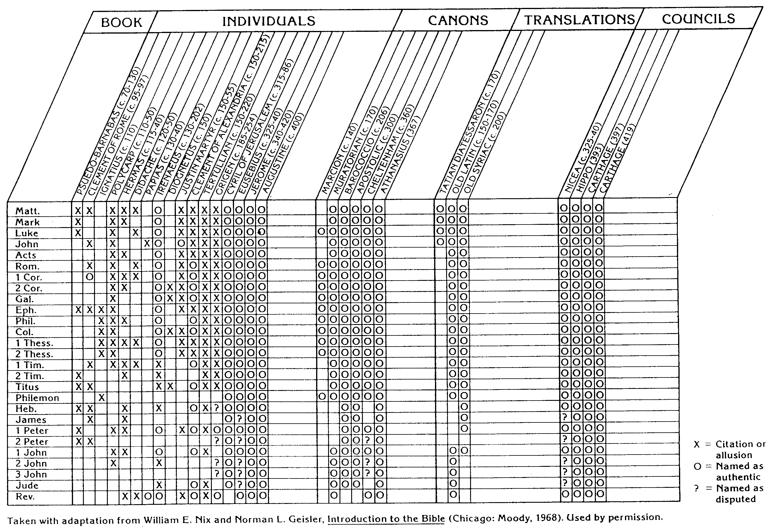
NT Canon during 1st 4C
For Further Details see...
The NT Canon in the First Four Centuries
H. Wayne House, Chronological & Background Charts to the NT
Notes:
This page appears at the end of your notes. Note that the first council that officially affirmed our 27 NT books was not Nicaea, but Hippo in 393.

Slide 34
NT Canonicity
Requirements
What did it take for early documents to be considered Scripture?
Written by Apostle (or under an Apostle)
Widely Accepted (used by churches)
Theologically Sound (no false doctrine)
None of these applied to the books Dan Brown says were the "real Scripture," such as the Gospel of Philip & Gospel of Thomas
Notes:
The "canon" or "rule" meant the officially recognized books of Scripture. None of the councils DETERMINED this list. They only AFFIRMED what the church had believed for generations.

Slide 35

Paul Called Luke's Gospel "Scripture" within 5 years!
For the Scripture says, "Do not muzzle the ox while it is treading out the grain," and "The worker deserves his wages" (1 Timothy 5:18).
Macedonia
Paul Wrote 1 Timothy
AD 62
Caesarea
Luke Written
AD 57-59
Stay in that house, eating and drinking whatever
they give you, for
the worker deserves his wages… (Luke 10:7)
Notes:
Look how EARLY certain books were deemed to be Scripture!

Slide 36
Peter Also Called Paul's Letters "Scripture"!
Paul's Letters Written
AD 49-62
Rome
Peter Wrote 2 Peter
AD 64
"…Our dear brother Paul also wrote to you with the wisdom God gave him. He writes the same way in all his letters, speaking in them of these matters. His letters contain some things that are hard to understand, which ignorant and unstable people distort, as they do the other Scriptures, to their own destruction" (2 Peter 3:15-16)
Notes:
Paul still had three more letters to write (1-2 Tim. Tit) when Peter deemed what he had ALREADY written as Scripture on par with the OT.

Slide 37

Is the Bible reliable?
Brown accuses via the mouth of "historian" Leigh Teabing…
"The Bible is a product of man, my dear. Not of God… [It] has evolved through countless translations, additions, and revisions. History has never had a definitive version of the book."
DVC, 195
Notes:
We are led to believe that some versions of the Bible have differing numbers of books--and that the fact that the Bible has been translated into more languages than any other book makes it suspect. No, this is a sign of worldwide recognition of it as the Word of God

Slide 38
Extant Copies of Pagan vs. NT Writings
# | Author | When Written | Earliest Copy | Time Span | Number of Copies
6 | Plato | 347 BC | AD 900 | 1200 yrs | 7
12 | Catullus | 54 BC | AD 1550 | 1600 yrs | 3
14 | Pliny | AD 113 | AD 850 | 750 yrs | 7
NT | Paul, Luke, etc. | AD 95 | AD 250 | 150 yrs | 24,772
Notes:
The Bible comes out FAR better than ANY ancient document in terms of age and number of manuscript copies. The Greek copies number about 14,000 of these 24,000.

Slide 39
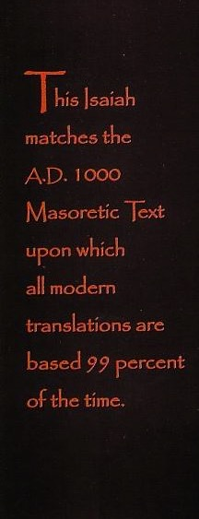
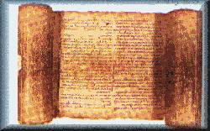
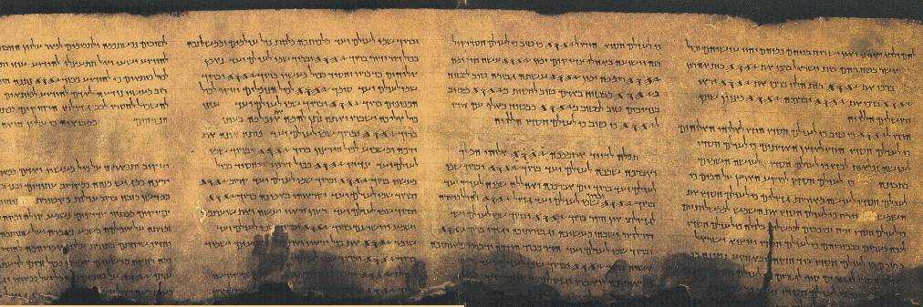
Accuracy of Transmission
Masoretic Isaiah Scroll
Isaiah AD 1000
1200 years earlier!
Isaiah 200 BC
Dead Sea Isaiah Scroll

Slide 40


ISAIAH: QUMRAN v. THE MASORETES
200 BC
AD 1000
Of the 166 Hebrew words in Isaiah 53, only seventeen letters in Dead Sea Scroll 1QIsb differ from the Masoretic Text:
10 letters = spelling differences
4 letters = stylistic changes
3 letters = added word for "light" (vs. 11)
17 letters = no affect on biblical teachings
Geisler & Nix, Intro to the NT, 382

Slide 41
Why are these books doubted?
Why are these books doubted?
Not written by apostles
Never recognized as authoritative
False theology
No claim of inspiration
Lack of dynamic character

Slide 42


How Do We Respond to Attacks Against Scripture Today?
III. Hold the Scripture in High Regard!
Presentation_ID
42
42
© 2003 Cisco Systems, Inc. All rights reserved.
42
Notes:
By "enemy" I mean those attacking our faith.

Slide 43
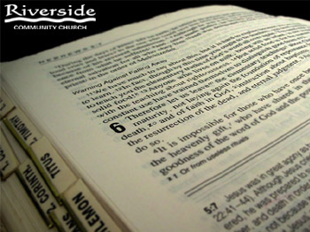
The One Book
Learn the order
Read it through
Read it every day
Notes:
Don't become an expert on Dan Brown. This heresy will soon pass away, but "the Word of the Lord is forever" so know God's eternal Word better than any book!

Slide 44

Our Key Idea
God guided and guarded His Word—so we should hold it up high!

Slide 45
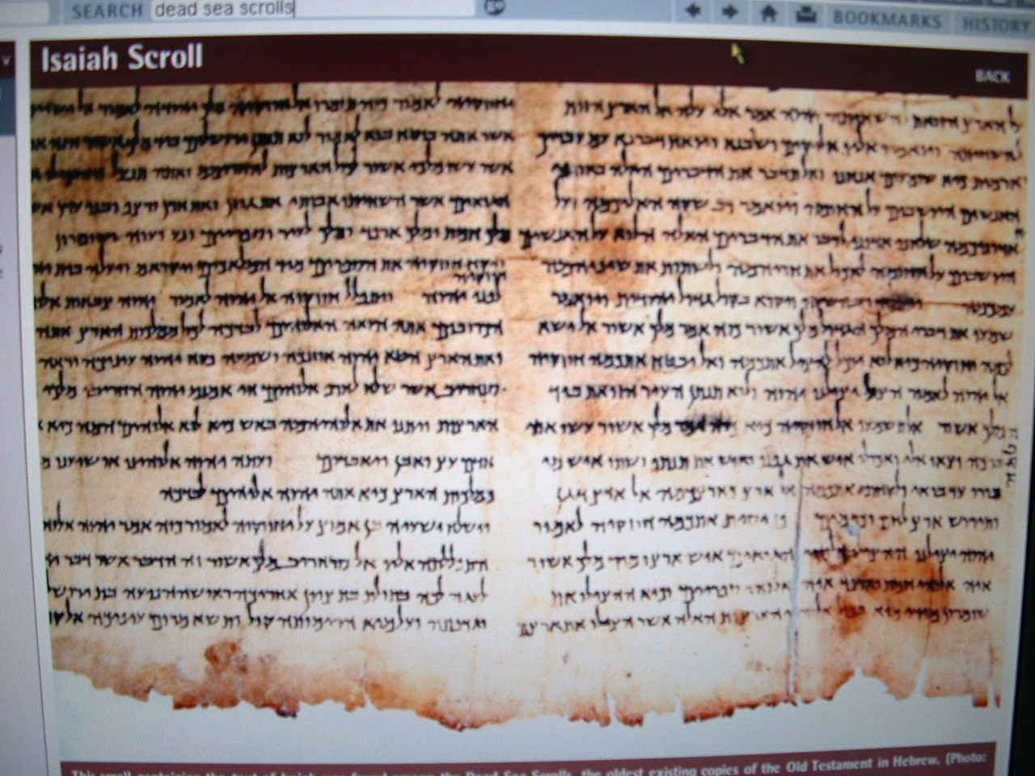
A Challenge
Learn the order
Read it through
Read it every day

Slide 46
Black

Slide 47


NT Preaching link at BibleStudyDownloads.org
Get this presentation and script for free!
Notes:
NT Preaching (np)

