Slide 1
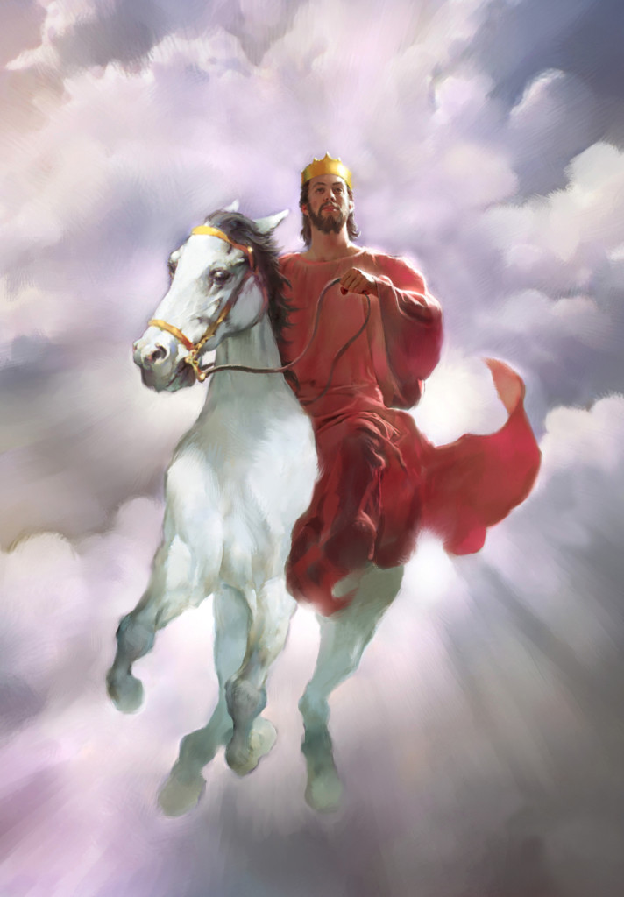
The Second Coming
Rev 19:11-21
Dr. Rick Griffith • Crossroads International Church • BibleStudyDownloads.org

Slide 2
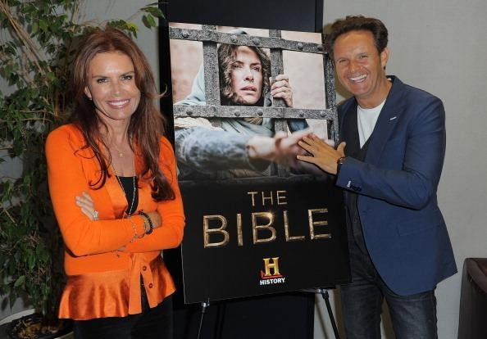
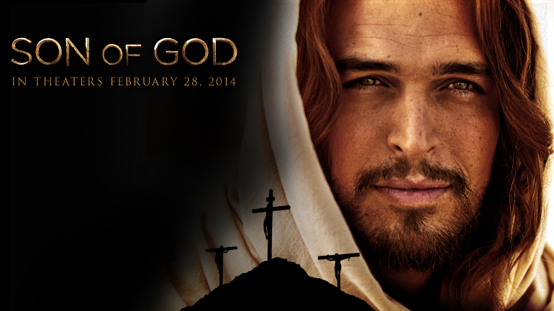
"Son of God"
Shows Through Wednesday
Shows Through Wednesday
Producers
Roma Downey & Mark Burnett

Slide 3
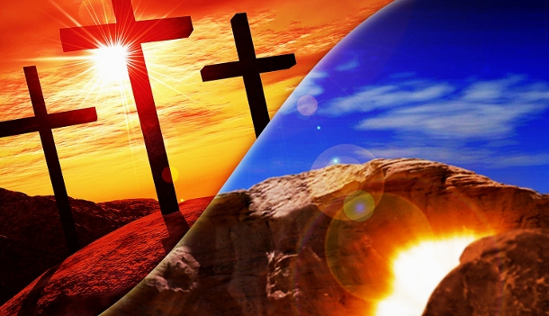
Cross to Burial to Resurrection

Slide 4


Attacks Against Scripture Today
Presentation_ID
4
4
© 2003 Cisco Systems, Inc. All rights reserved.
4
What teaching do you hear today that seeks to undermine the truthfulness of our faith?

Slide 5
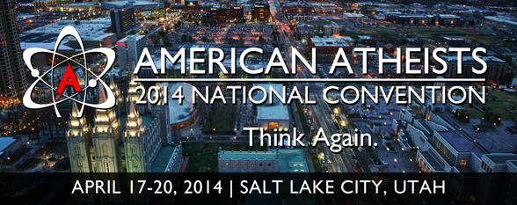
Atheists at Mormon HQ Today

Slide 6
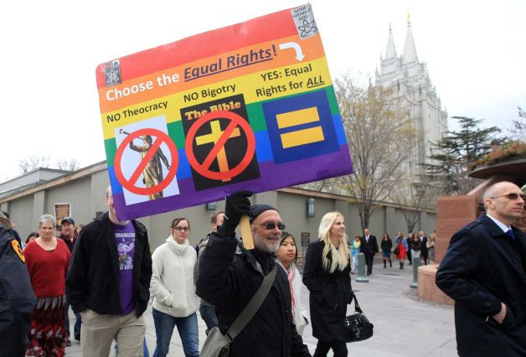
Atheists at Mormon HQ 6 July 14

Slide 7
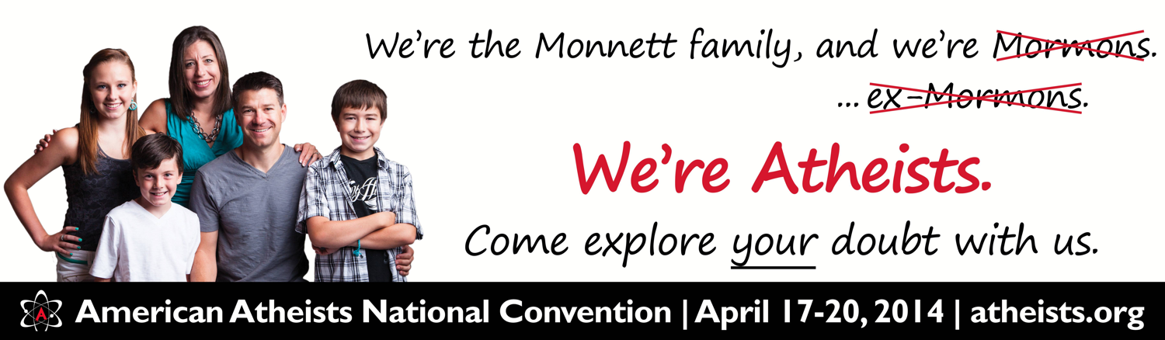
Atheists at Mormon HQ Today

Slide 8
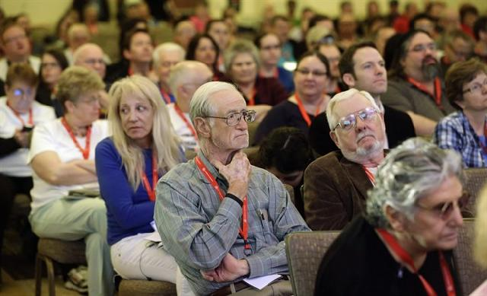
Atheists at Mormon HQ Today

Slide 9
Skeptics Mock
Three Key Truths
290b
"…in the last days scoffers will come, mocking the truth and following their own desires. ⁴They will say, 'What happened to the promise that Jesus is coming again?'"
(2 Pet. 3:3b-4a NLT).
Christ's Return
Presentation_ID
9
9
© 2003 Cisco Systems, Inc. All rights reserved.
9

Slide 10
Skeptics Mock
Three Key Truths
290b
"'From before the times of our ancestors, everything has remained the same since the world was first created.' They deliberately forget that God made the heavens by the word of his command, and he brought the earth out from the water and surrounded it with water" (2 Pet. 3:4b-5 NLT).
Christ's Return
Creation
Presentation_ID
10
10
© 2003 Cisco Systems, Inc. All rights reserved.
10

Slide 11
Skeptics Mock
Three Key Truths
290b
"Then he used the water to destroy the ancient world with a mighty flood"
(2 Pet. 3:6 NLT).
Christ's Return
Global Flood
Creation
Presentation_ID
11
11
© 2003 Cisco Systems, Inc. All rights reserved.
11

Slide 12
Skeptics Mock
Three Key Truths
290b
Christ's Return
Global Flood
Creation
Presentation_ID
12
12
© 2003 Cisco Systems, Inc. All rights reserved.
12

Slide 13

Jesus Wins!
Series on Revelation

Slide 14
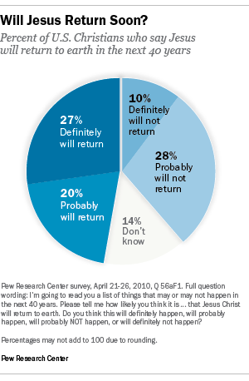
In 2010 the Pew Research Center showed 47% of Americans believe Jesus will return by 2050
Notes:
March 26, 2013
U.S. Christians’ Views on the Return of Christ
http://www.pewforum.org/2013/03/26/us-christians-views-on-the-return-of-christ/ accessed 19 April 2014

Slide 15
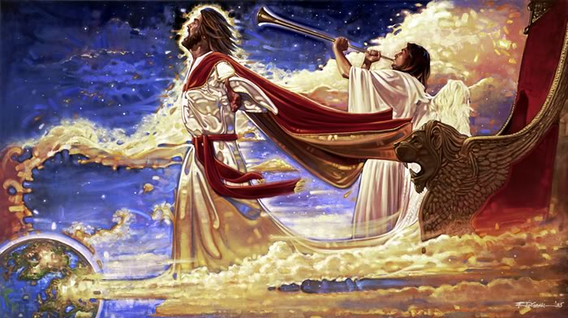
Why must Christ return?
Notes:
Nine Reasons Why Christ Must Return
John MacArthur
http://www.christianity.com/theology/end-times/nine-reasons-why-christ-must-return-11607117.html accessed 19 April 2014

Slide 16
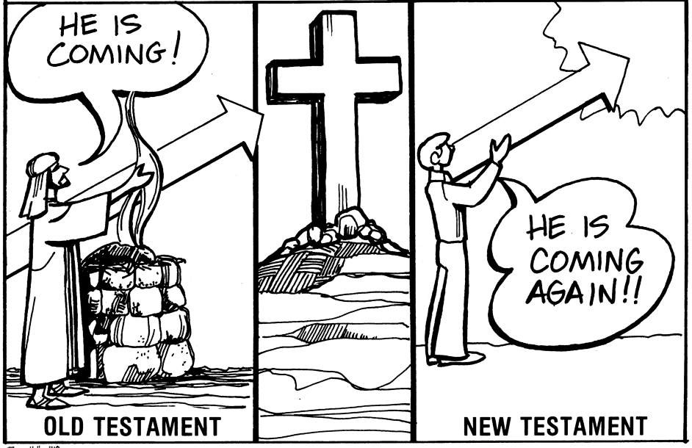
Focus: The Return of Christ
419
322
G
Terry Hall, Bible Panorama, 140
HE IS COMING !
Why must Jesus return?
HE IS COMING AGAIN !
OLD TESTAMENT
NEW TESTAMENT

Slide 17

Content of the Judgments
337
 | SEALS | TRUMPETS | BOWLS
1 | White: conqueror | Hail & fire: 1/3 vegetation | Sores
2 | Red: war | Fire: 1/3 sea creatures | Sea to blood
3 | Black: famine | Star: 1/3 fresh water | Fresh water to blood
4 | Pale: death | Dark: 1/3 sun, moon, stars | Sun burns men
 |  | (Trumpets 5-7 are woes)
5 | Martyrs reassured | Woe #1: locusts | Beast's kingdom dark
6 | Wrath: earthquake, signs | Woe #2: Euphrates prep | Euphrates dries up
 | (144,000 sealed) | (Trump #7 = mystery)
7 | 1/2 hour silence | Woe #3: victory imminent | Earthquake & hail
H O R S E S
W O E S
Adapted from Robert Gromacki, NT Survey and H. Wayne House, Chronological & Background Charts of the NT, 19

Slide 18
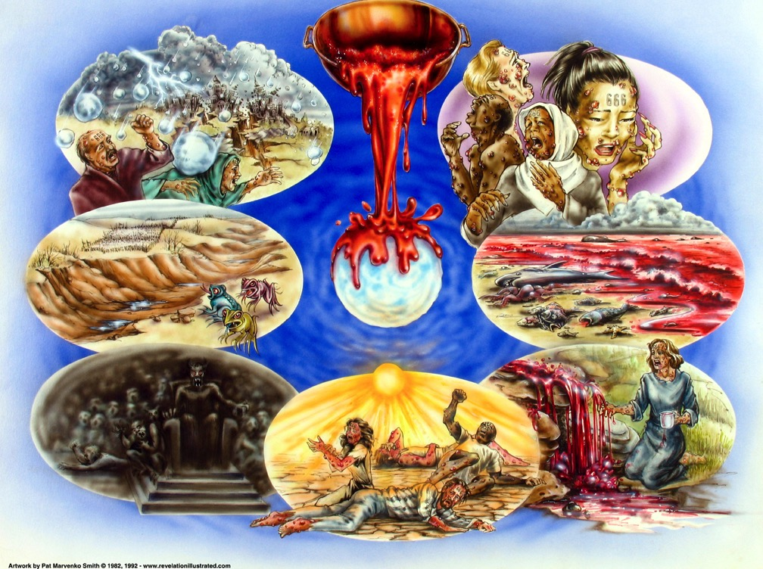
Bowl Judgments (Rev. 16)
392
Used with permission

Slide 19
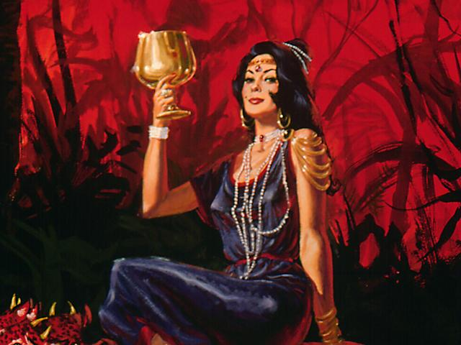
The Harlot (17:1-2 NLT)
"One of the seven angels who had poured out the seven bowls came over and spoke to me. 'Come with me,' he said, 'and I will show you the judgment that is going to come on the great prostitute, who rules over many waters.
396
²The kings of the world have committed adultery with her, and the people who belong to this world have been made drunk by the wine of her immorality.'"

Slide 20
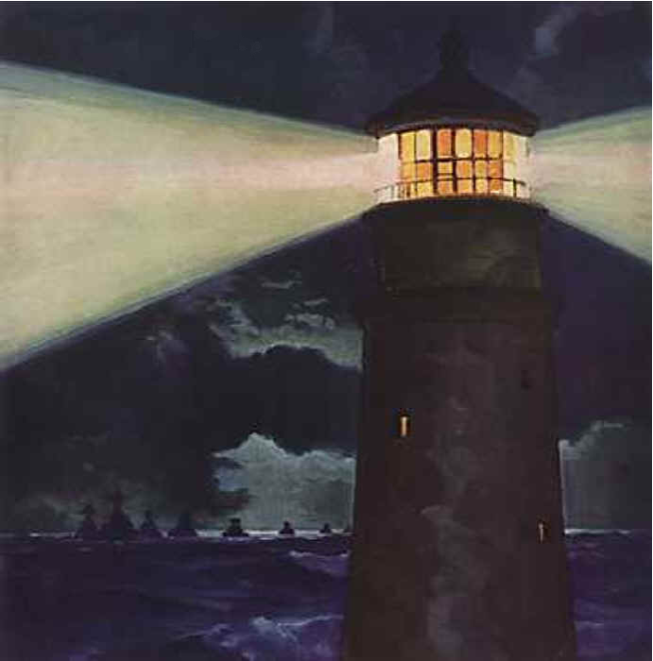
Views on End Times Babylon
400
The World System
A Religion (Islam, Catholics, Astrology, One World Religion/New Age)
A City (Babylon, Rome, Jerusalem)
A Nation

Slide 21
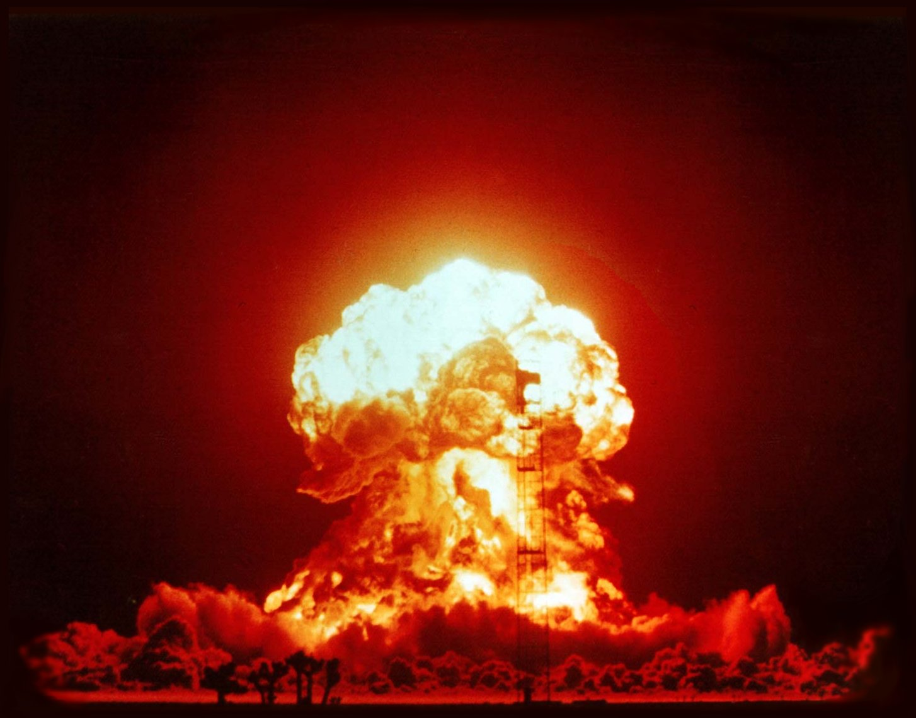
Babylon Ruined in One Hour by Fire
406
Pt. 6
"In a single moment
all the wealth of the city is gone!”
(18:17a NLT)
Used with permission
Notes:
She will be completely destroyed by the Antichrist and his ten-nation confederacy (17:16a) by fire (17:16b; 18:8) in only one hour (18:10, 17, 19).

Slide 22
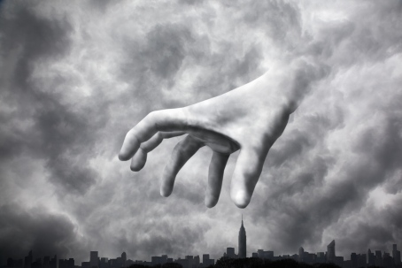
Earth Mourns (18:9-24)
414
Used with permission

Slide 23
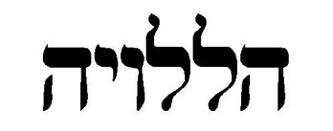

Heaven Rejoices (19:1-2 NLT)
414
"After this, I heard what sounded like a vast crowd in heaven shouting,
'Praise the LORD!
Salvation and glory and power belong to our God.
²His judgments are true and just.
He has punished the great prostitute
who corrupted the earth with her immorality.
He has avenged the murder of his servants.'"
Used with permission
Notes:
"God has been reigning on the throne of heaven, but He is now about to conquer the thrones of earth as well as the kingdom of Satan and “the beast.” In His sovereignty, He has permitted evil men and evil angels to do their worst; but now the time has come for God's will to be done on earth as it is in heaven. Domitian was emperor of Rome when John was on Patmos, and one of his assumed titles was “Lord and God.” How significant it must have been, then, to John's readers that he used the word alleluia four times in the first six verses of this chapter—truly, only Jehovah is worthy of worship and praise" (Wiersbe).

Slide 24

The Marriage & Wedding Supper of the Lamb
415
Notes:
24

Slide 25
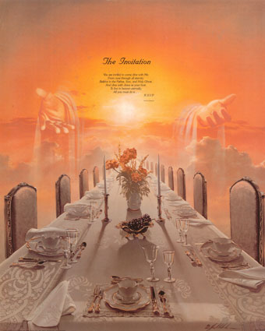
The Invitation in Revelation 19:7-9 (NAU)
    ⁷ "Let us rejoice and be glad and give the glory to Him, for the marriage of the Lamb has come and His bride has made herself ready.
    ^{8 "}It was given to her to clothe herself in fine linen, bright and clean; for the fine linen is the righteous acts of the saints.
⁹ "Then he said to me, 'Write, "Blessed are those who are invited to the marriage supper of the Lamb."' And he said to me, 'These are true words of God.'"
415
Notes:
25

Slide 26

"Pre-Trib" Rapture
416
Second Coming
Rapture
(Wedding)
(Supper)
Tribulation
Millennium
Church Age
Eternal Kingdom
7 years
1000 years
Judgment
Notes:
26

Slide 27
Why must Christ return?
2 reasons

Slide 28
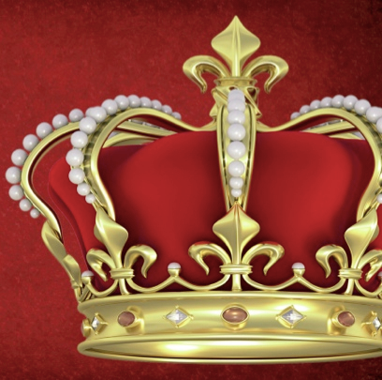
I. Christ must prove he is King
(19:11-16).

Slide 29
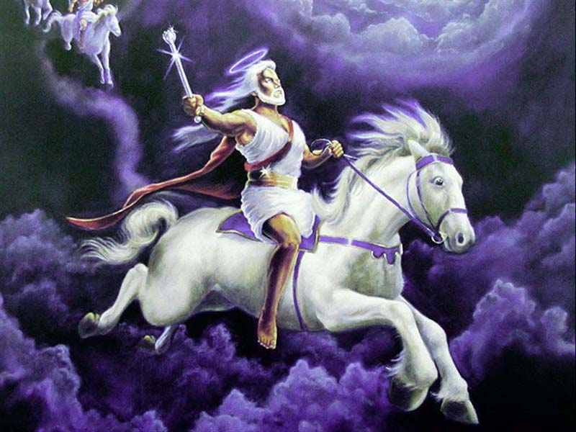
"Then I saw heaven opened, and a white horse was standing there. Its rider was named Faithful and True, for he judges fairly and wages a righteous war" (19:11 NLT).
Jesus will return as the Righteous Judge (19:11-12).

Slide 30
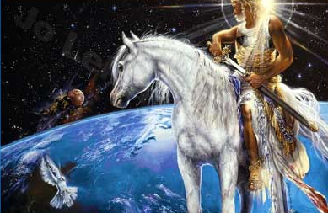
"His eyes were like flames of fire, and on his head were many crowns. A name was written on him that no one understood except himself"
(19:12 NLT).

Slide 31
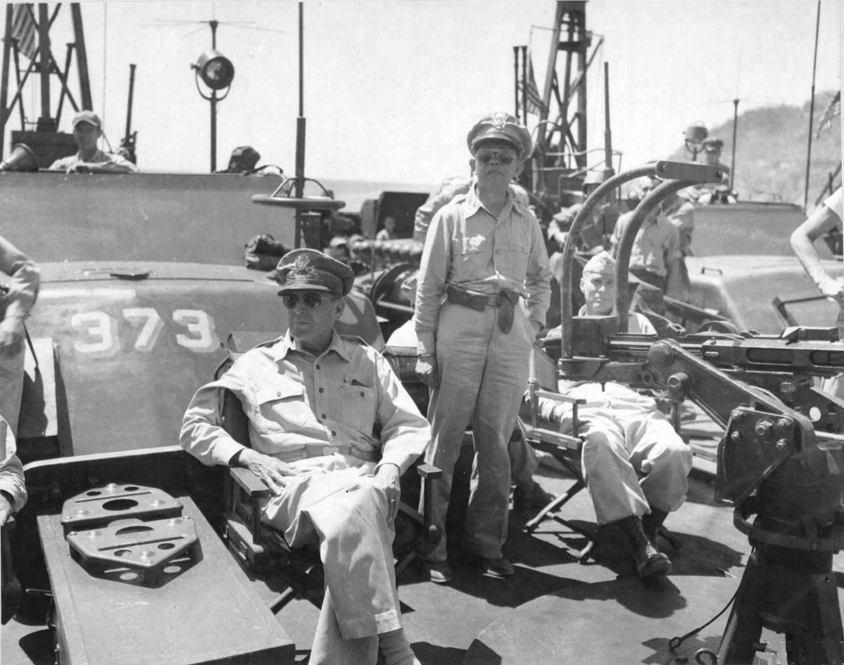
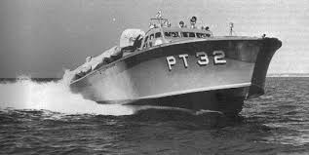
"I will return!" (1942)
Douglas MacArthur
Notes:
His famous speech, in which he said, "I came through and I shall return", was first made at Terowie, a small town in South Australia, on 20 March.^{[139]} Washington asked MacArthur to amend his promise to "We shall return". He ignored the request.
http://en.wikipedia.org/wiki/Douglas_MacArthur#Philippines_Campaign_.281941.E2.80.9342.29
http://content.time.com/time/magazine/article/0,9171,974392-6,00.html

Slide 32
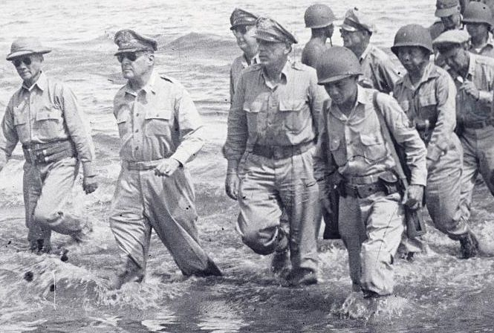
"I will return!" (1945)
Douglas MacArthur

Slide 33
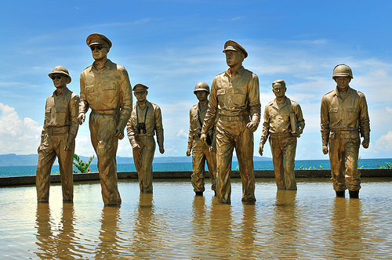
"I will return!" (2014)
Douglas MacArthur

Slide 34
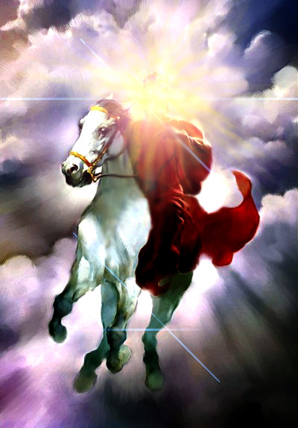
"He wore a robe dipped in blood, and his title was the Word of God" (19:13 NLT).
Jesus will return to fulfill God’s Word (19:13).

Slide 35
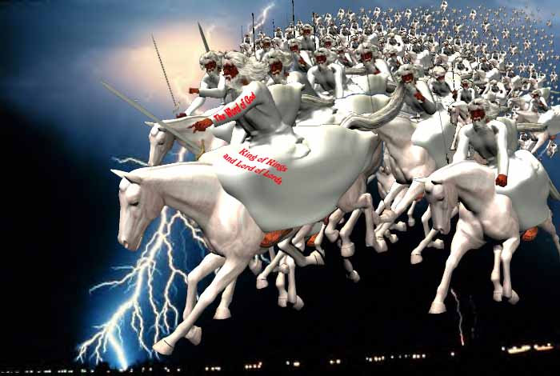
"The armies of heaven, dressed in the finest of pure white linen, followed him on white horses" (19:14 NLT).
Jesus will return as the Commander of Heaven’s Armies:

Slide 36
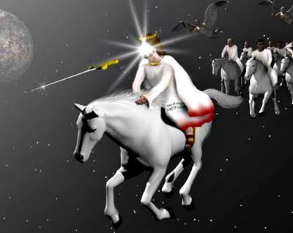
"From his mouth came a sharp sword to strike down the nations. He will rule them with an iron rod. He will release the fierce wrath of God, the Almighty, like juice flowing from a winepress" (19:15 NLT).
Jesus will return as the Ruling King (19:15-16) .

Slide 37
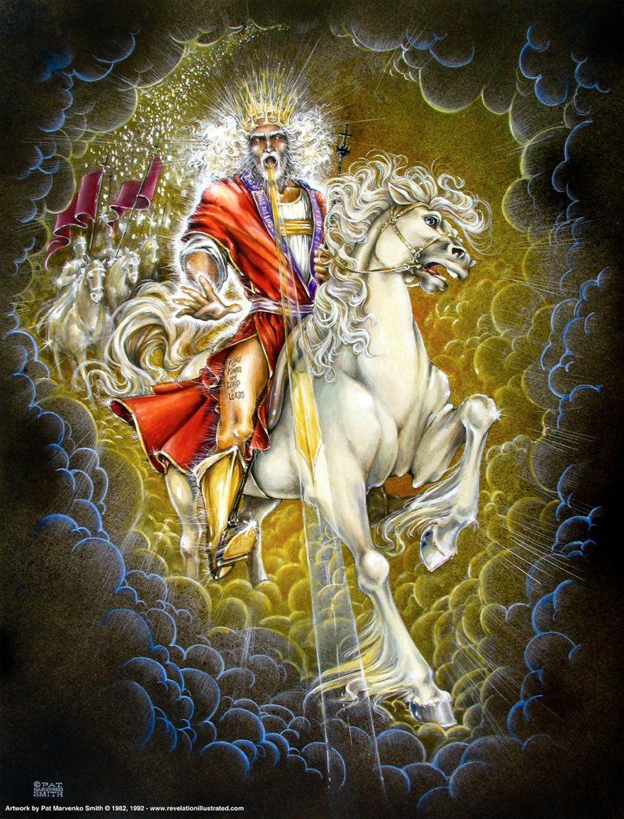
"On his robe at his thigh was written this title: King of all kings and Lord of all lords"
(19:16 NLT).
417

Slide 38



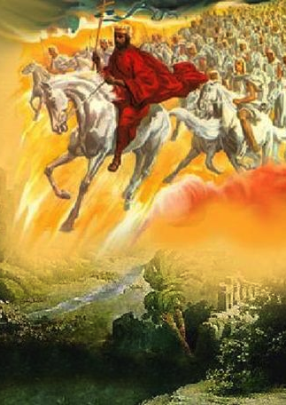
Future Benefits
(Rev. 19–22)
421
Heaven
(Rev. 21–22)
Millennium
(Rev. 20)
Return
(Rev. 19)

Slide 39
I. Christ must prove he is King
(19:11-16).

Slide 40
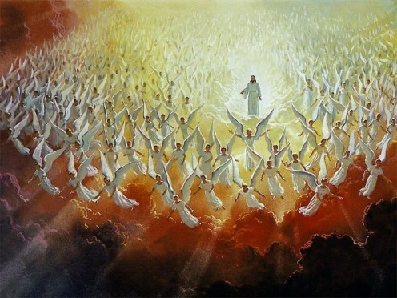
II. Christ must prove he is Victor (19:17-21).

Slide 41
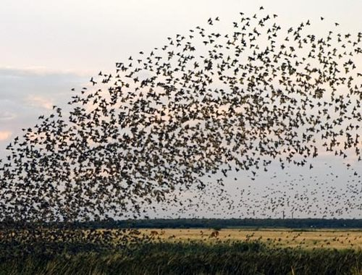
"Then I saw an angel standing in the sun, shouting to the vultures flying high in the sky: 'Come! Gather together for the great banquet God has prepared'" (19:17 NLT).
Bird Feast

Slide 42
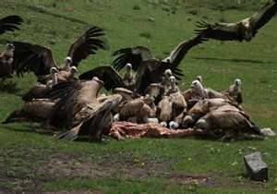
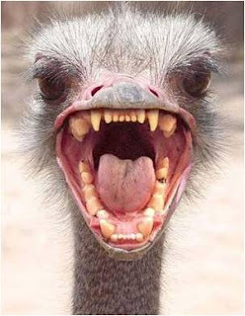
"Come and eat the flesh of kings, generals, and strong warriors; of horses and their riders; and of all humanity, both free and slave, small and great" (19:18 NLT).
Bird Feast

Slide 43
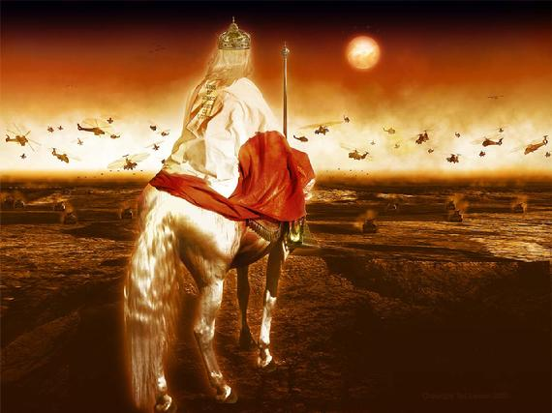
"Then I saw the beast and the kings of the world and their armies gathered together to fight against the one sitting on the horse and his army" (19:19 NLT).
Armies Gathered

Slide 44
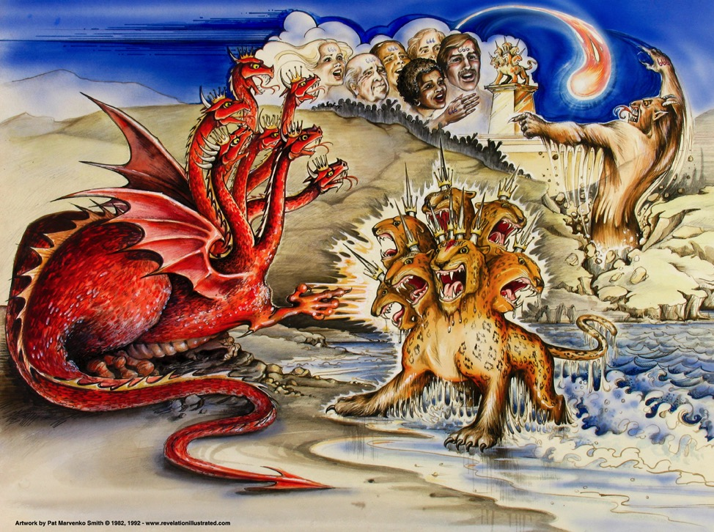
Beasts of Rev. 13
387
Dragon =
Satan
Land Beast =
False Prophet
Sea Beast =
Antichrist
Used with permission
Notes:
Slide 83 is adapted from Rev 1 intro slide
Slides 84-91 copied from Rev 20-22 presentation

Slide 45

The Dried Euphrates (Bowl #6)
393
Kings of the East
Revelation 16:12
"The sixth angel poured out his bowl on the great river Euphrates, and its water was dried up to prepare the way for the kings from the East."
Notes:
45

Slide 46
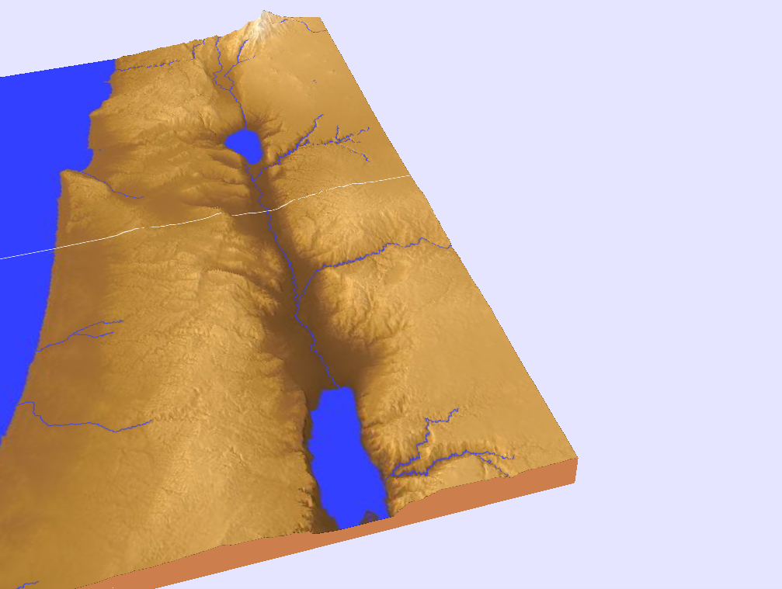
The Campaign of Armageddon (16:16 NLT)
394
Har ("hill") +
Megiddo ("place of troops" or "place of slaughter")
"And the demonic spirits gathered all the rulers and their armies to a place with the Hebrew name Armageddon
(Har-magedon NAU)"
Notes:
"The name Armageddon comes from two Hebrew words, har Megiddo, the hill of Megiddo. The word Megiddo means 'place of troops' or 'place of slaughter.' It is also called the Plain of Esdraelon and the Valley of Jezreel. The area is about fourteen miles wide and twenty miles long, and forms what Napoleon called “the most natural battlefield of the whole earth.” Standing on Mount Carmel and overlooking that great plain, you can well understand why it would be used for gathering the armies of the nations.
It was on this plain that Barak defeated the armies of Canaan (Jud. 5:19). Gideon met the Midianites there (Jud. 7) and it was there that King Saul lost his life (1 Sam. 31). Titus and the Roman army used this natural corridor, as did the Crusaders in the Middle Ages. British General Allenby used it when he defeated the Turkish armies in 1917.
From a human viewpoint, it appears that the armies of the nations are gathering on their own; but John makes it clear that the military movement is according to God's plan. The satanic trinity, through demonic powers, will influence the nations and cause the rulers to assemble their armies. They will even work miracles that will impress the rulers and cause them to cooperate. But all this will merely fulfill the will of God and accomplish His purposes (see Rev. 17:17). The Gentile nations will look on Armageddon as a battle, but to God, it will be only a 'supper' for the fowls of the air (Rev. 19:17–21)" (Wiersbe).

Slide 47
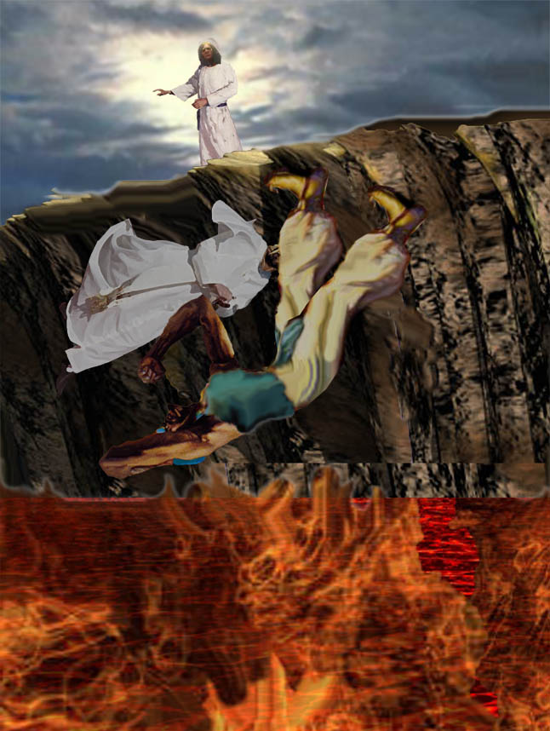
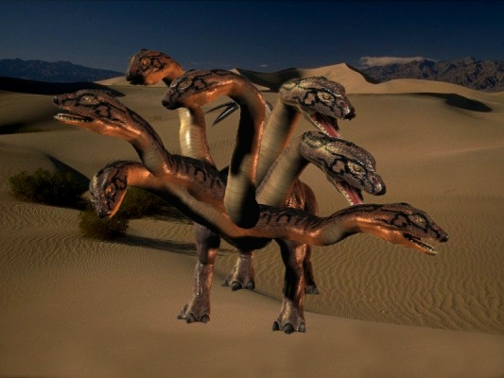
Beast & False Prophet cast into lake of burning sulfur
(19:20)
"And the beast was captured, and with him the false prophet who did mighty miracles on behalf of the beast—miracles that deceived all who had accepted the mark of the beast and who worshiped his statue. Both the beast and his false prophet were thrown alive into the fiery lake of burning sulfur" (19:20 NLT).

Slide 48
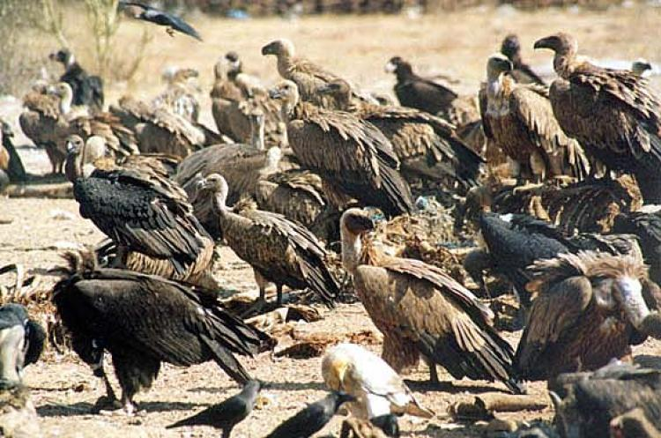

"Their entire army was killed by the sharp sword that came from the mouth of the one riding the white horse. And the vultures all gorged themselves on the dead bodies" (19:21 NLT).
The Army Killed & Eaten

Slide 49
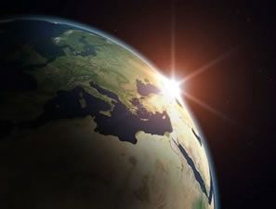
Why the Return?

Slide 50
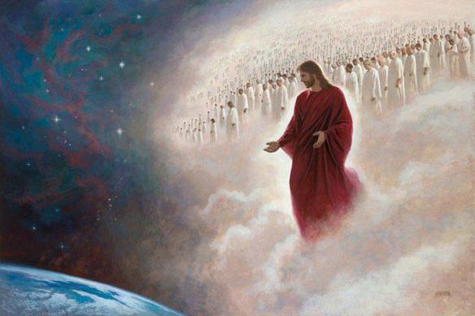
Main Idea
Jesus must return to claim his crown and defeat his enemies

Slide 51
I. Christ must prove he is King
(19:11-16).

Slide 52
II. Christ must prove he is Victor (19:17-21).

Slide 53
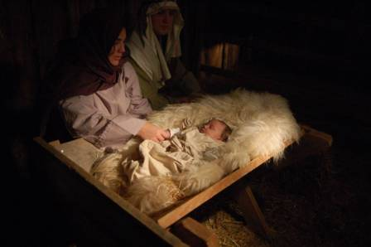
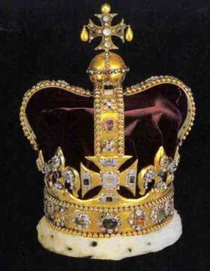
Christ's Two Comings
420
FIRST COMING | (CHURCH AGE) | SECOND COMING
Laid in a manger |  | Lands on a mountain
Came as a lamb |  | Comes as the Lord
Lowly and poor |  | Lavish and powerful
Died for His enemies |  | Death to His enemies
Tempted by Satan |  | Traps Satan in bottomless pit
Lived in a world of unrighteousness |  | Leads the world in righteousness
Died for sins and rose again |  | Directs and reigns
Ruth & Larry Moody; cited by Terry Hall, Bible Panorama, 117
Notes:
The Book of Revelation helps complete our picture of Jesus by not only seeing him in the left column, but the right as well.

Slide 54
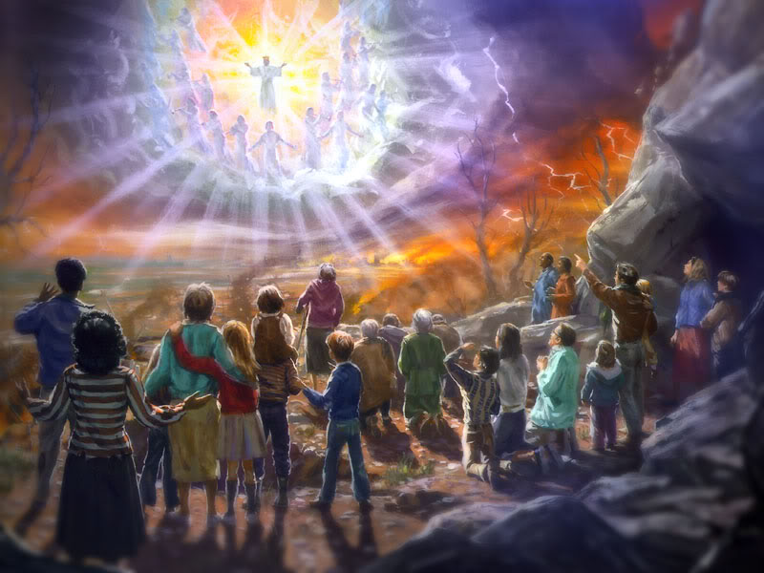
How do you acknowledge Christ’s ultimate rule and power in your own life today?

Slide 55
Life's Most Important Question:
417
What Will You Do With Jesus?
Yes
No
?
Is Jesus God made man?
Did Jesus die for your sins?
Did Jesus rise from the dead?
Are you trusting in Jesus?
Did Jesus give you eternal life?
Will Jesus return to earth for you?
Notes:
What is life's most important question? (Get answers from class)
It matters little how you answer most questions in life, but this one is the key one that affects now and eternity.
How do you personally answer each of these other questions?

Slide 56
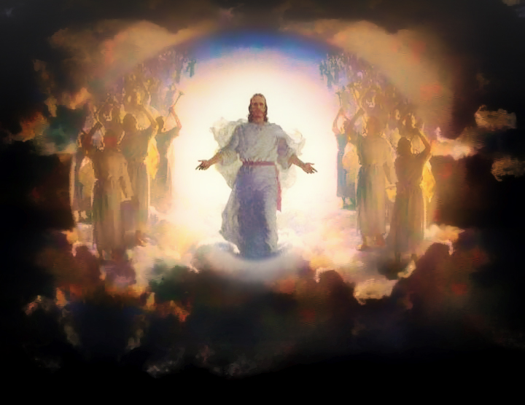
Recognize His Resurrection Power

Slide 57
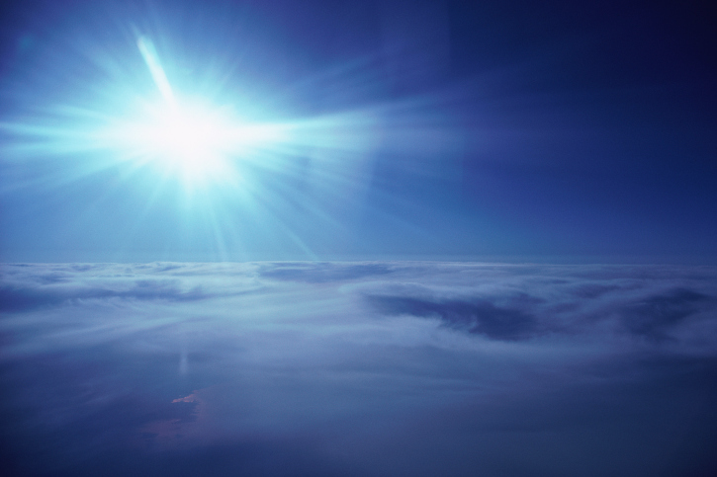
Love His Appearing!
"I have fought the good fight, I have finished the race, and I have remained faithful. ⁸And now the prize awaits me—the crown of righteousness, which the Lord, the righteous Judge, will give me on the day of his return. And the prize is not just for me but for all who eagerly look forward to his appearing"
(2 Timothy 4:7-8 NLT)

Slide 58
Black

Slide 59
Jesus Wins!
Series on Revelation

Slide 60
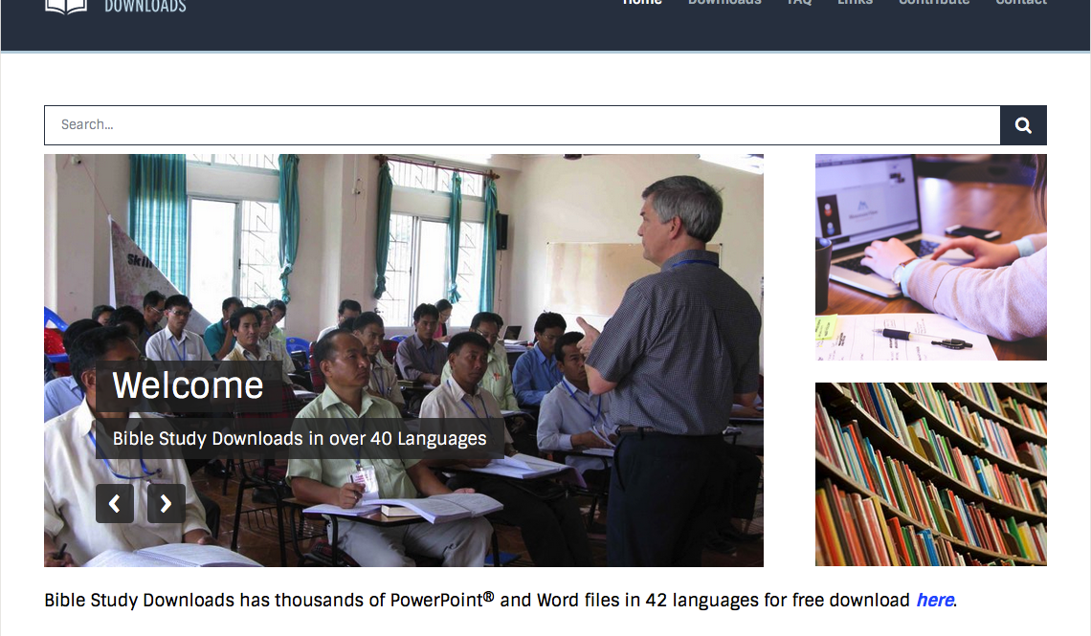

NT Preaching link at BibleStudyDownloads.org
Get this presentation and script for free!
Notes:
NT Preaching (np)

