Slide 1
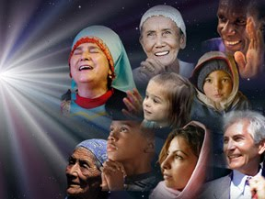
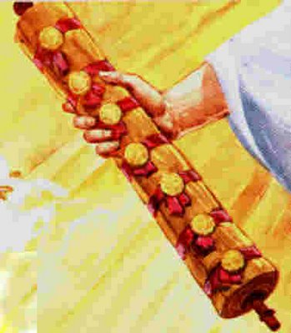
The Christ of Balance
Seals & Salvation
Revelation 6:1–8:5
Rick Griffith • Crossroads International Church • biblestudydownloads.com
Dr. Rick Griffith • Singapore Bible College • BibleStudyDownloads.org

Slide 2
Balance in Life

Slide 3
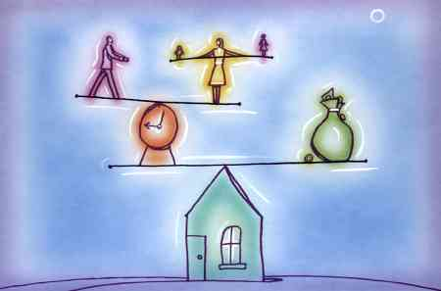
Balance in Life

Slide 4
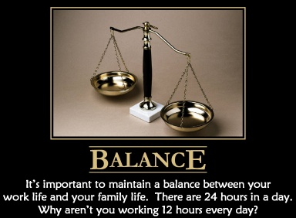
Balance in Life

Slide 5
Balance in Life

Slide 6
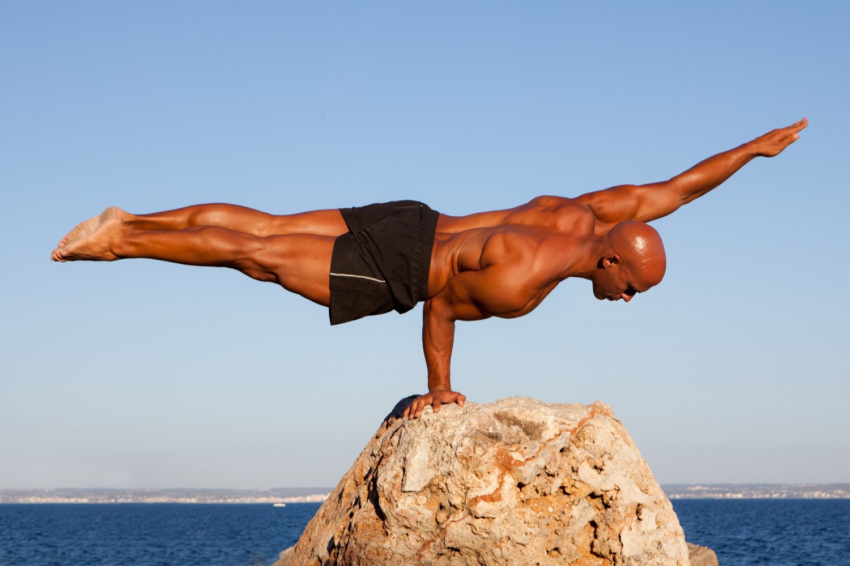
Are You Balanced?

Slide 7
Balance
Justice
Grace

Slide 8
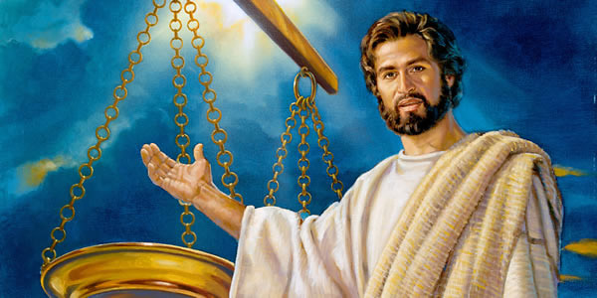
Is Jesus Balanced?

Slide 9
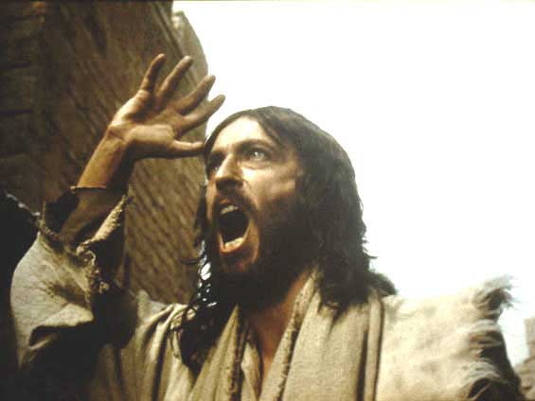
The Angry Jesus

Slide 10
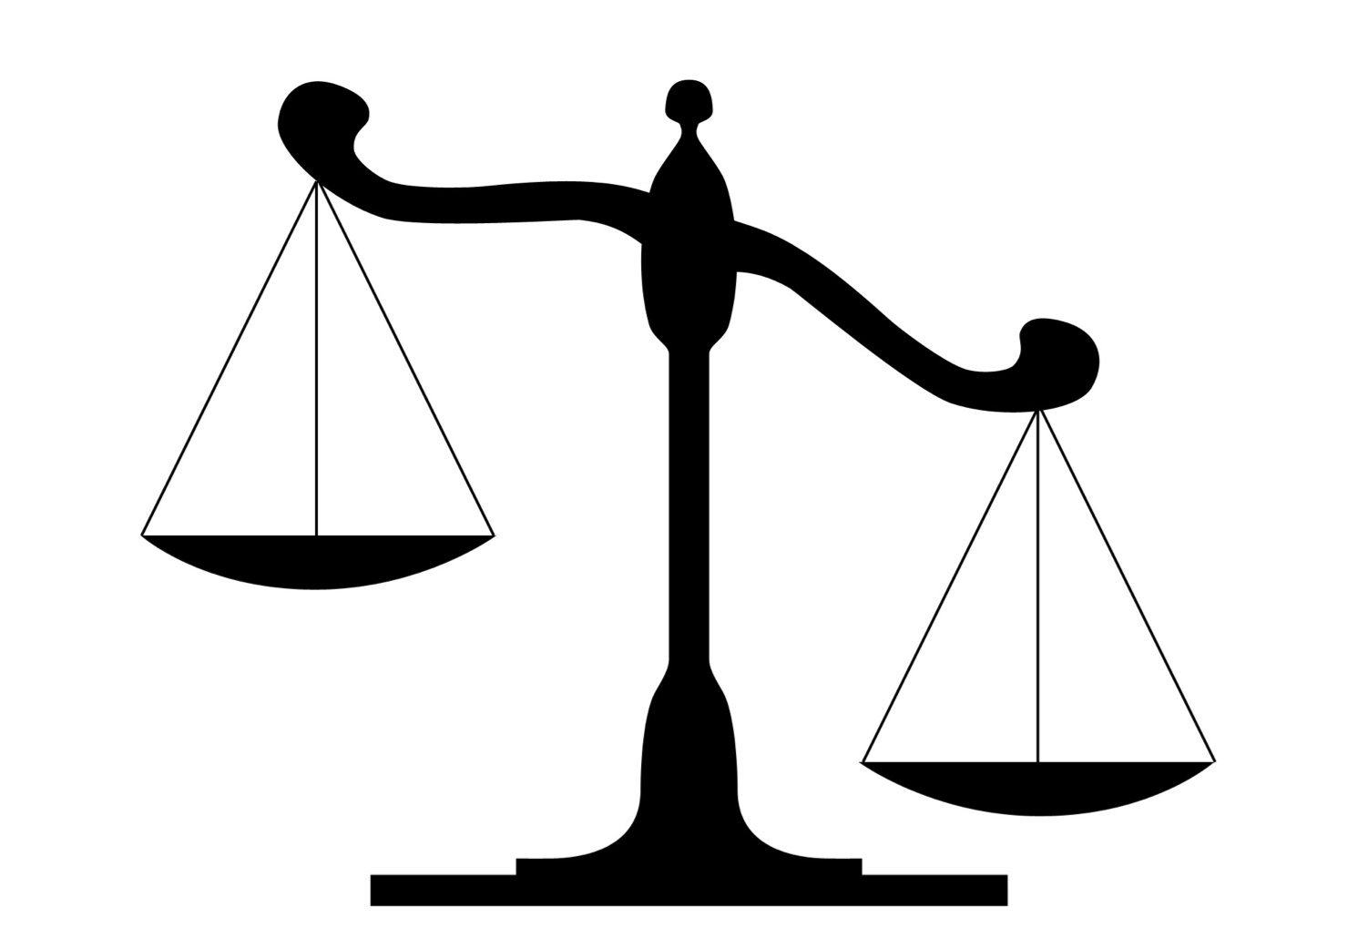
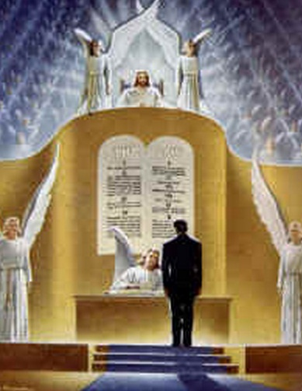
Which depicts Jesus?
Grace
Justice

Slide 11
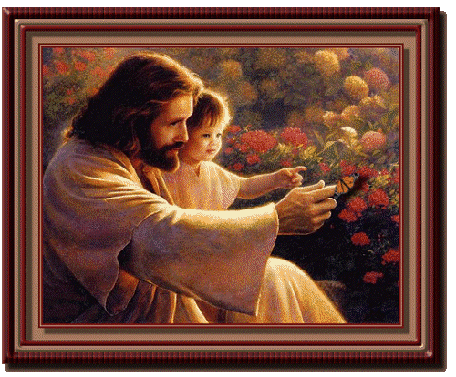
Jesus the Flower Sniffer

Slide 12
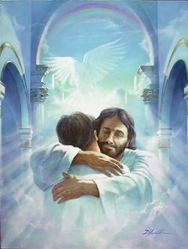
Which depicts Jesus?
Justice
Grace

Slide 13
Revelation
Sovereignty of Christ in Future Victory
Sovereignty in His Person |  |  | Sovereignty over Churches | Sovereignty in End-Time Events
Chapter 1 |  |  | Chapters 2–3 | Chapters 4–22
"What you have seen" (1:19a) |  |  | "What is now" (1:19b) | "What will take place later" (1:19c)
Past |  |  | Present | Future
Christ Unveiled |  |  | Churches Unveiled | Consummation Unveiled
God on Earth |  |  | God's Ambassadors on Earth | Hell on Earth to Heaven on Earth
The Judge |  |  | The Assignments | The Judgments & Rewards
Subject 1:1-3 | Worship of Trinity 1:4-8 | Glorified Christ 1:9-20 | Seven Churches of Asia: Ephesus Smyrna Pergamum Thyatira Sardis Philadelphia Laodicea | Tribulation 4:1–19:10 | Second Coming 19:11-21 | Millennium 20 | Eternal State 21:1–22:5 | Closing: Imminency 22:6-21
AD 95

Slide 14
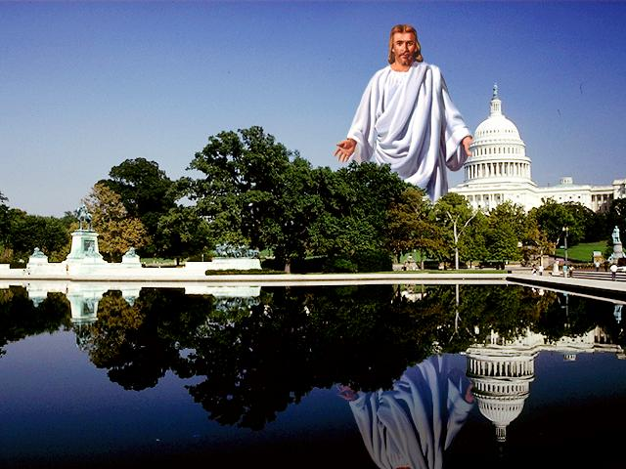
Real Rule Never Changes
367
III. John records future end-time events that demonstrate the sovereignty and final triumph of Jesus Christ as an encouragement to believers struggling with external opposition (Rev. 4–22)
Dr. Rick Griffith • Singapore Bible College • biblestudydownloads.com

Slide 15
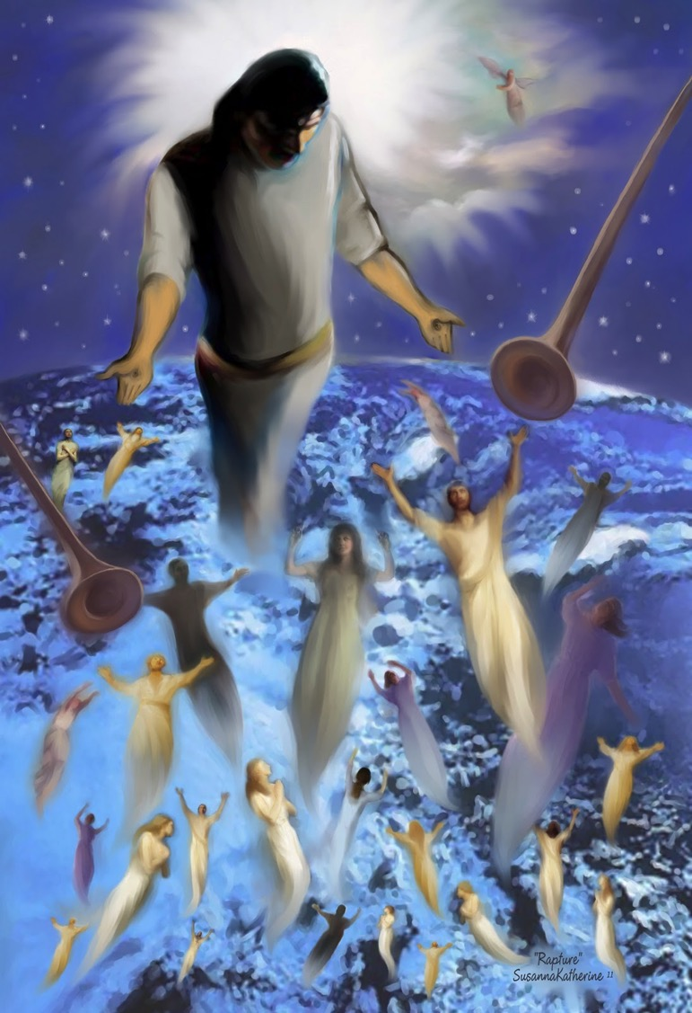
"Come up here, and I will show you what must take place after this" (4:1b)
367
Does this depict the Rapture of the church?

Slide 16
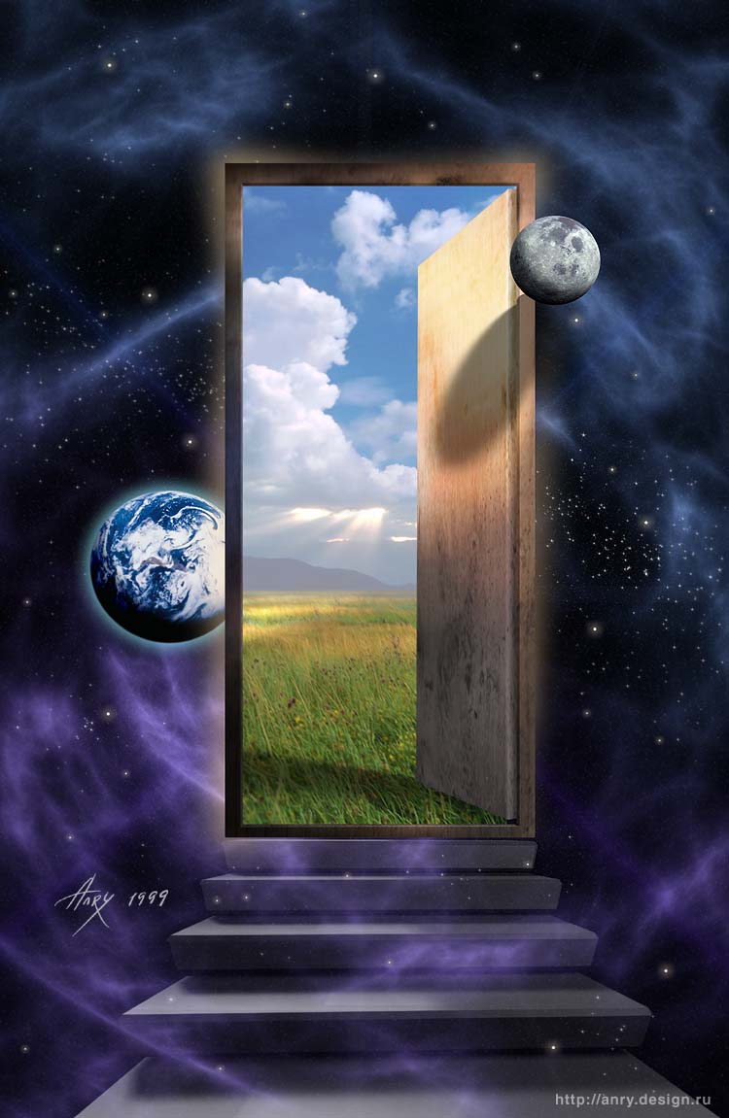
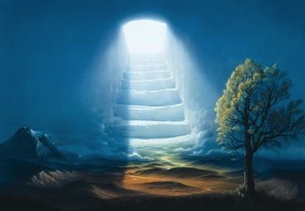
"Come up here, and I will show you what must take place after this" (4:1b)
367
This isn't the Rapture. God was bringing John up to heaven at this point

Slide 17
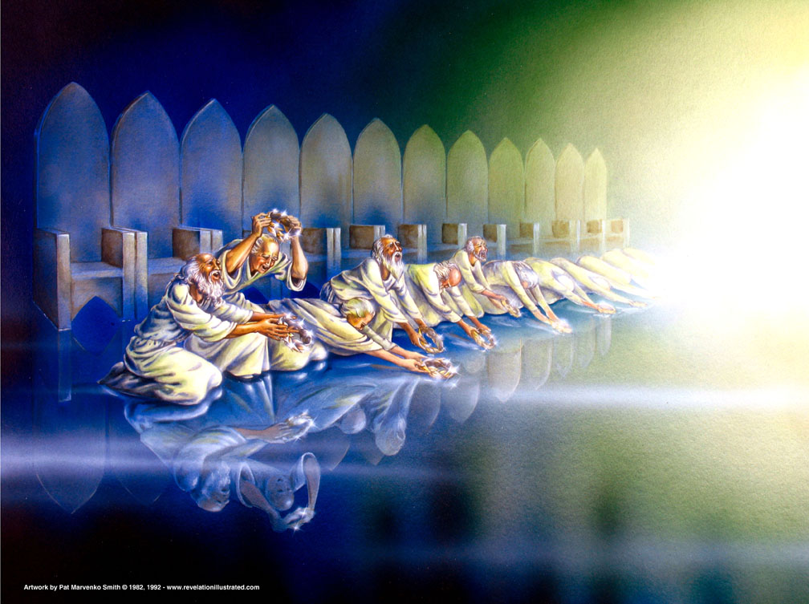
The elders cast their crowns (4:10)
367

Slide 18
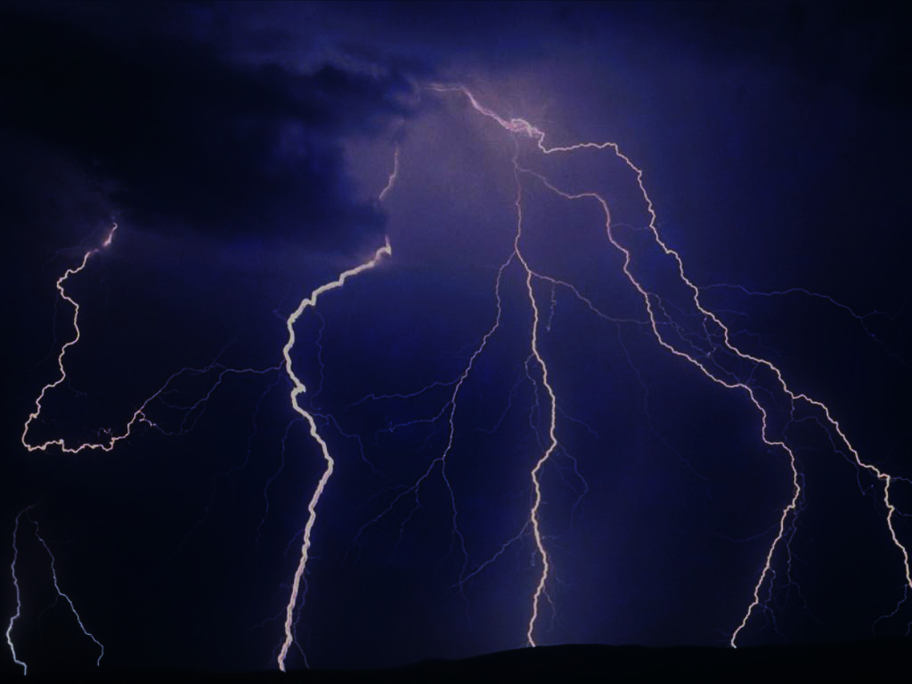
Revelation 4 Main Idea:
God, the wondrous and sovereign Creator of all, is worthy of all worship.

Slide 19
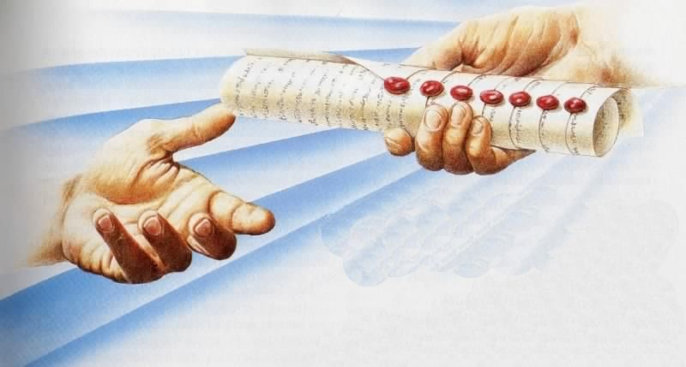
The Seal Judgments
369
The Scroll Sealed with Seven Seals…
is firmly in the right hand of the Father (5:1)!

Slide 20
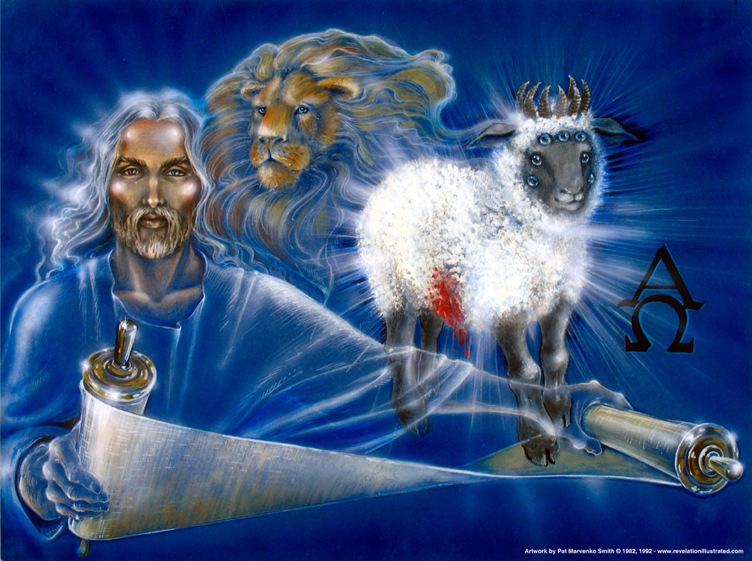
"Then I saw a Lamb that looked as if it had been slaughtered, but it was now standing between the throne and the four living beings and among the twenty-four elders. He had seven horns and seven eyes, which represent the sevenfold Spirit of God that is sent out into every part of the earth" (Rev. 5:6 NLT)
However, Revelation refers to Jesus as the "Lamb" 28 times!
369
Used with permission
Notes:
The Greek word arnion is used 29 times in Revelation, but 13:11 uses it of the False Prophet, who is described in the figure of a ram (adult male sheep) with two horns. However, he is still called a "lamb" probably to draw the contrast with the true Lamb, Jesus Christ.

Slide 21
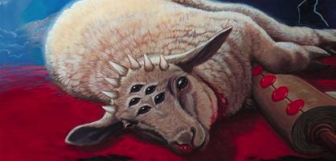
Then I saw a Lamb that looked as if it had been slaughtered… He had seven horns and seven eyes, which represent the sevenfold Spirit of God that is sent out into every part of the earth (5:6a, 6c NLT).
369
Notes:
"The description of the Lamb (Rev. 5:6), if produced literally by an artist, would provide a grotesque picture; but when understood symbolically, conveys spiritual truth. Since seven is the number of perfection, we have here perfect power (seven horns), perfect wisdom (seven eyes), and perfect presence (seven Spirits in all the earth). The theologians would call these qualities omnipotence, omniscience, and omnipresence; and all three are attributes of God. The Lamb is God the Son, Christ Jesus!" (Wiersbe).

Slide 22
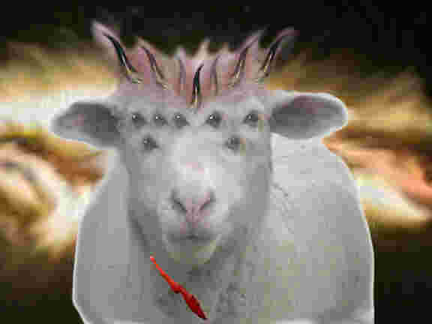
Then I saw a Lamb that looked as if it had been slaughtered, but it was now standing between the throne and the four living beings and among the twenty-four elders (5:6a-b NLT).
369

Slide 23
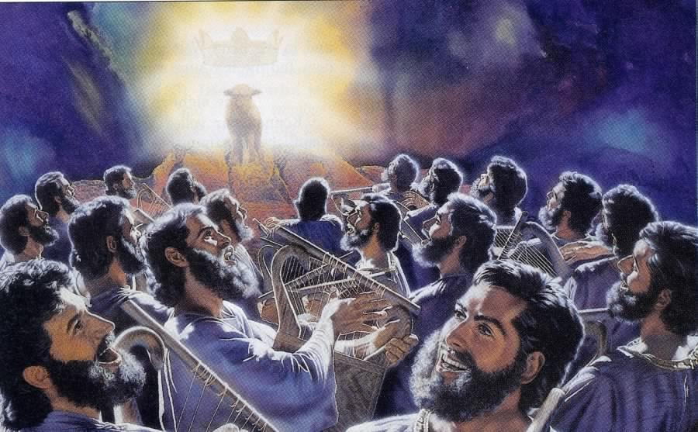
"You are worthy to take the scroll and open its seals…" (5:9)
369

Slide 24
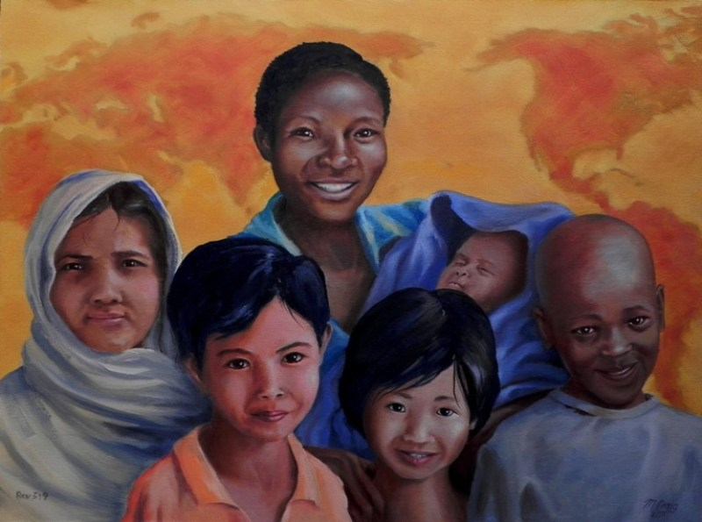
"From every tribe, nation, language and people" (5:9)
369

Slide 25
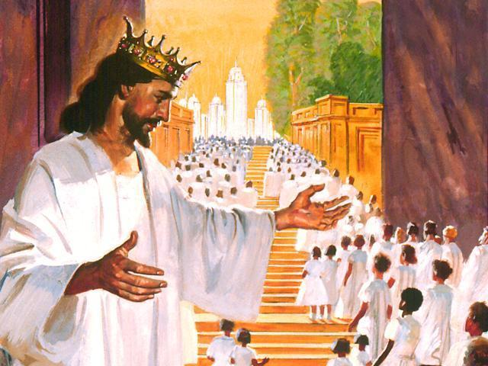
"And you have caused them to become a Kingdom of priests for our God. And they will reign on the earth" (5:10 NLT).
369

Slide 26
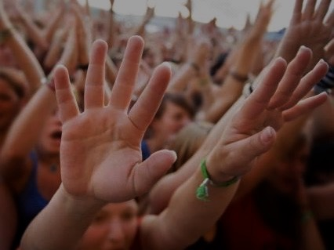
Why worship Jesus? Because of…
369
Who He is (5:5-7)
Where He is (5:6)
What He does (5:8-10)
What He has (5:11-14)
Warren Wiersbe, Bible Exposition Commentary
Notes:
What does Jesus have? He has all…
"power and riches and wisdom and strength and honor and glory and blessing" (5:12)
"Blessing and honor and glory and power" (5:13).

Slide 27
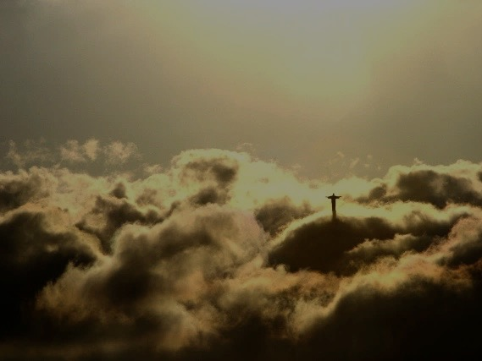
Revelation 5 Main Idea:
Jesus is worthy to reveal the future and be worshiped because He is the Divine Messiah and He redeemed us from the penalty of sin, making us a kingdom of priests.

Slide 28
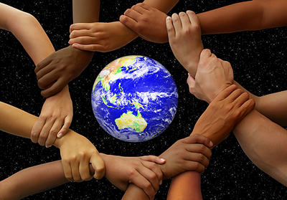
Hymns of Revelation 4–5
369
4:8, 11
Lord God Almighty Praise as Creator
5:9-10, 12
Lamb Praise as Redeemer
5:13
God & Lamb Praise & honor & glory & power
Notes:
"Creation is for God's praise and pleasure, and man has no right to usurp that which rightfully belongs to God. Man plunged creation into sin, so that God's good creation (Gen. 1:31) is today a groaning creation (Rom. 8:22); but because of Christ's work on the cross, it will one day be delivered and become a glorious creation (Rom. 8:18–24)" (Wiersbe).

Slide 29
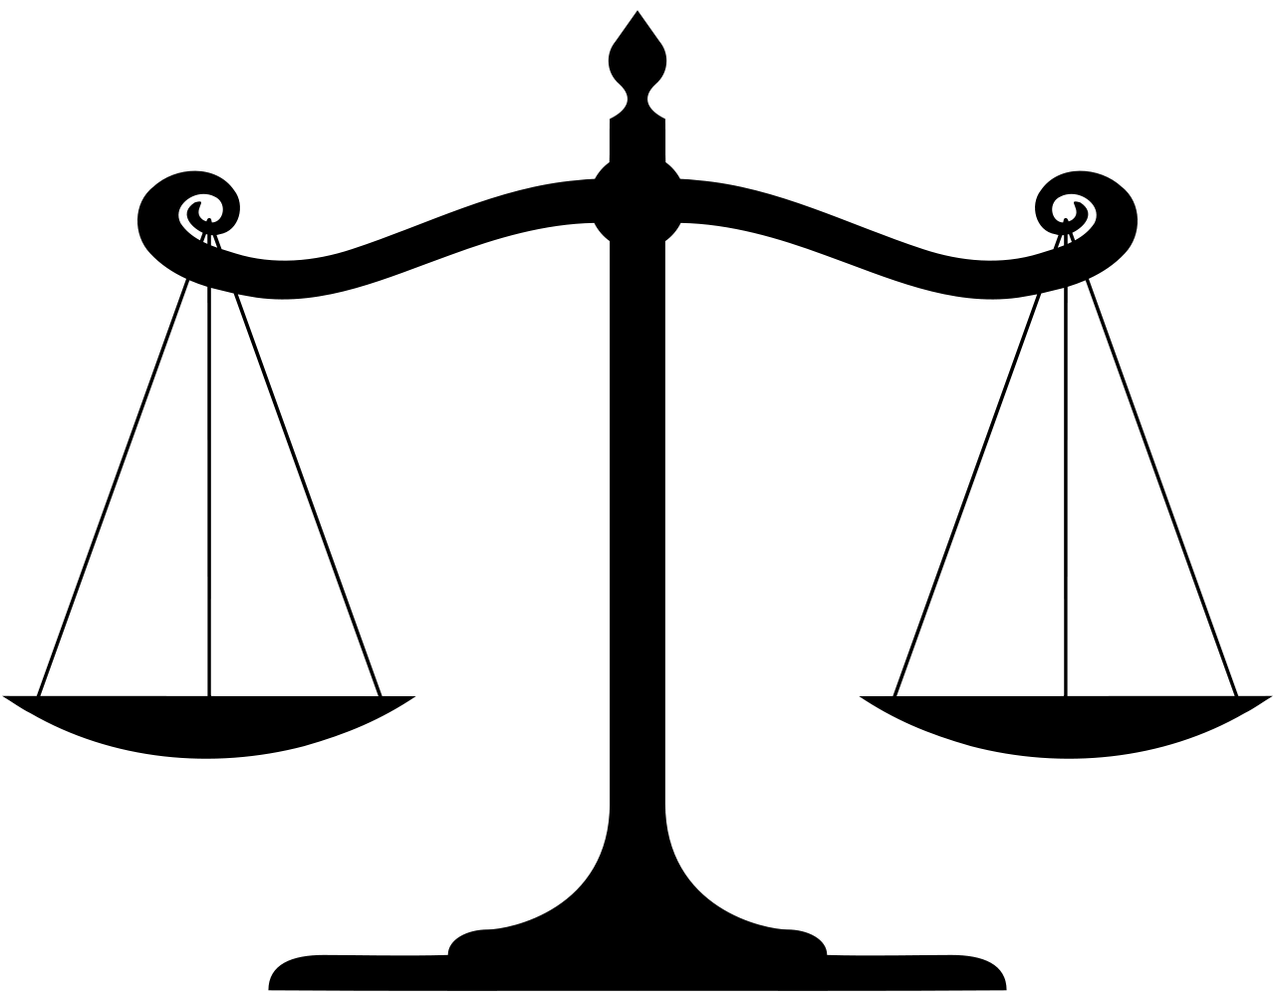
Jesus is balanced!
Justice
Grace

Slide 30
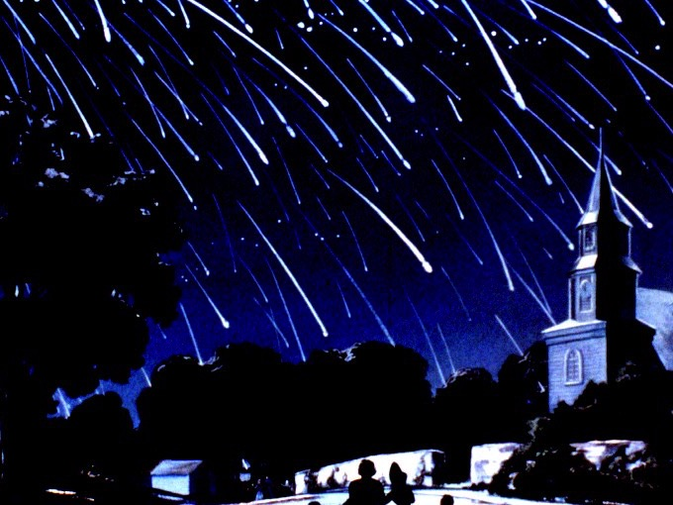
I. Christ will judge the world (Rev. 6)
374
Notes:
"As Christ removed the seals, various dramatic events took place. The seventh seal introduced the seven trumpet judgments (Rev. 8:1–2). Then, when the seventh trumpet had blown, the great day of God's wrath was announced, ushering in the "vial [bowl] judgments" that brought to a climax the wrath of God (Rev. 11:15ff; 15:1). It is possible that the trumpet judgments were written on one side of the scroll and the bowl judgments on the other" (Wiersbe).

Slide 31
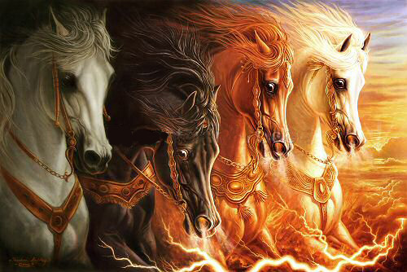
Four Horses (6:1-8)
374

Slide 32
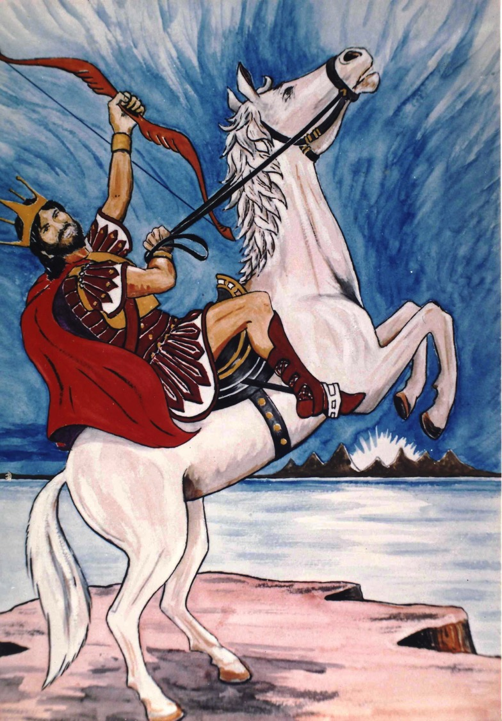
The 1st Seal
374
¹Now I saw when the Lamb opened one of the seals; and I heard one of the four living creatures saying with a voice like thunder, "Come and see."
²And I looked, and behold, a white horse. He who sat on it had a bow; and a crown was given to him, and he went out conquering and to conquer.
Is this Jesus?
Artwork by Sunny Chandra

Slide 33
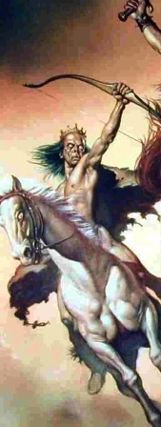
Seal #1 The White Horse Rider Depicts the Antichrist
375
How do we know this?
Different from the Lamb
"White" also refers to evil
Many differences with Christ in 19:11-16
Notes:
"The word for crown in Revelation 6:2 is stephanos, which means "the victor's crown." The crown that Jesus Christ wears is diadema, "the kingly crown" (Rev. 19:12). Antichrist could never wear the diadem, because it belongs only to the Son of God" (Wiersbe).

Slide 34
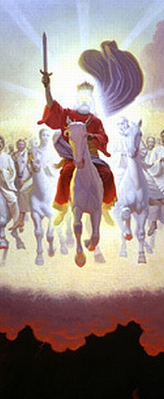
Different Horsemen
375
6:1-2
19:11-16
Purposes
Equipment
Names
Fellow Riders
Time
Context
Crown
Daniel K. K. Wong, "The First Horseman of Revelation 6," Bibliotheca Sacra 153 (April-June 1996): 212-26
Notes:
"The word for crown in Revelation 6:2 is stephanos, which means "the victor's crown." The crown that Jesus Christ wears is diadema, "the kingly crown" (Rev. 19:12). Antichrist could never wear the diadem, because it belongs only to the Son of God" (Wiersbe).

Slide 35
Different Horsemen
375
6:1-2
"The word for crown in Revelation 6:2 is stephanos, which means 'the victor's crown.' The crown that Jesus Christ wears is diadema, 'the kingly crown' (Rev. 19:12). Antichrist could never wear the diadem, because it belongs only to the Son of God" (Wiersbe).
19:11-16
Notes:
"The word for crown in Revelation 6:2 is stephanos, which means "the victor's crown." The crown that Jesus Christ wears is diadema, "the kingly crown" (Rev. 19:12). Antichrist could never wear the diadem, because it belongs only to the Son of God" (Wiersbe).

Slide 36
Chronology of the 70th "Week"
333
336
Adapted from J. Dwight Pentecost, Dallas Theological Seminary, 1988
Middle of the Week
Sign of Son of Man Matt. 24:30
Christ's Return Complete
3½ YEARS
1290 DAYS
Dan. 12:11
30 DAYS
30 DAYS
1260 DAYS
45 DAYS
Rev. 11:3; 12:6
Dan. 12:12
3½ YEARS
3½ YEARS
Election of Beast Rev. 17:13
Covenant Made Dan. 9:27a
Covenant Broken Dan. 9:27b
2nd ADVENT
The Great Tribulation
The Tribulation

Slide 37
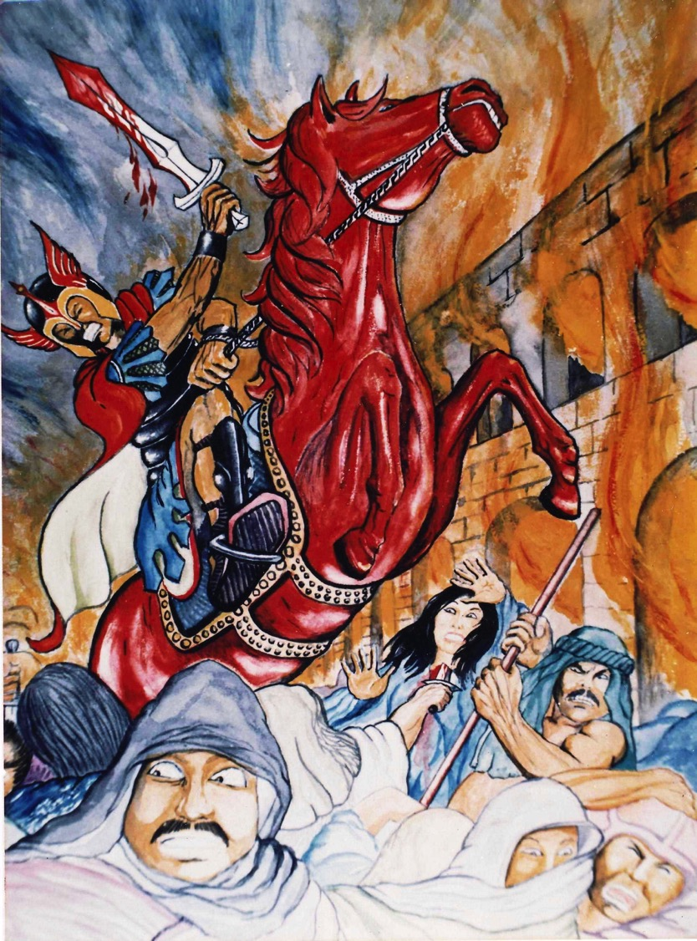
The 2nd Seal
376
³When He opened the second seal, I heard the second living creature saying, "Come and see." ⁴Another horse, fiery red, went out. And it was granted to the one who sat on it to take peace from the earth, and that people should kill one another; and there was given to him a great sword.
Artwork by Sunny Chandra

Slide 38
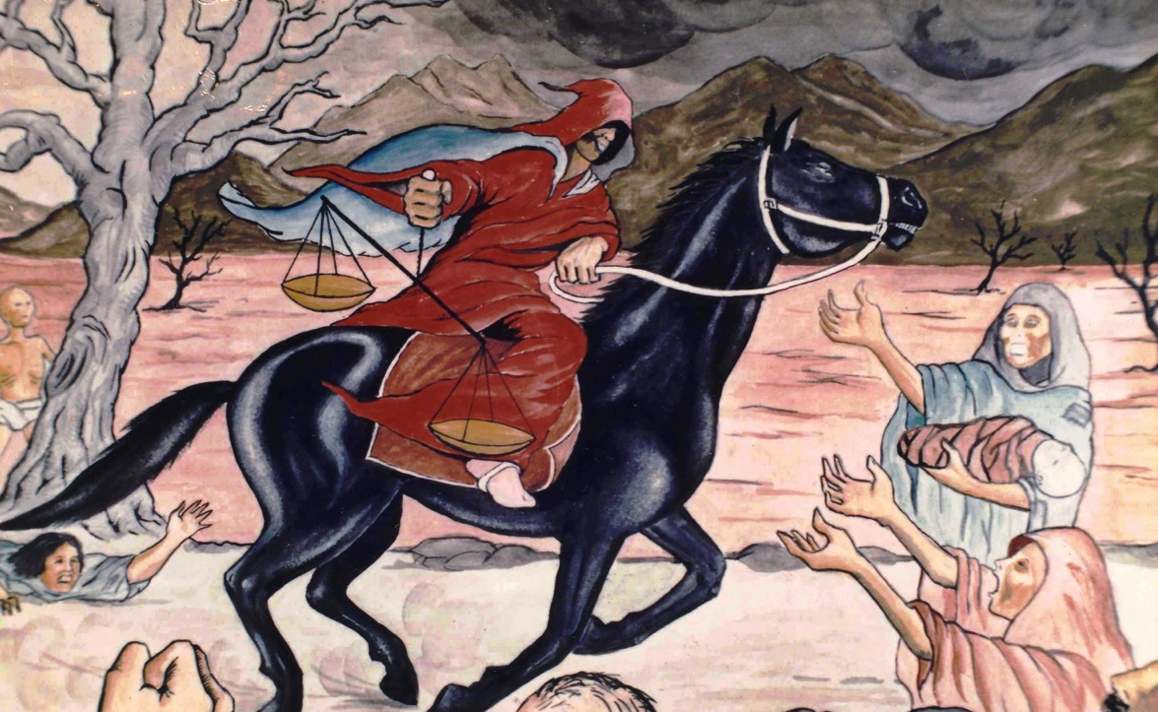
The 3rd Seal
376
⁵When He opened the third seal, I heard the third living creature say, "Come and see." So I looked, and behold, a black horse, and he who sat on it had a pair of scales in his hand.
⁶And I heard a voice in the midst of the four living creatures saying, "A quart of wheat for a denarius, and three quarts of barley for a denarius; and do not harm the oil and the wine."
Artwork by Sunny Chandra

Slide 39
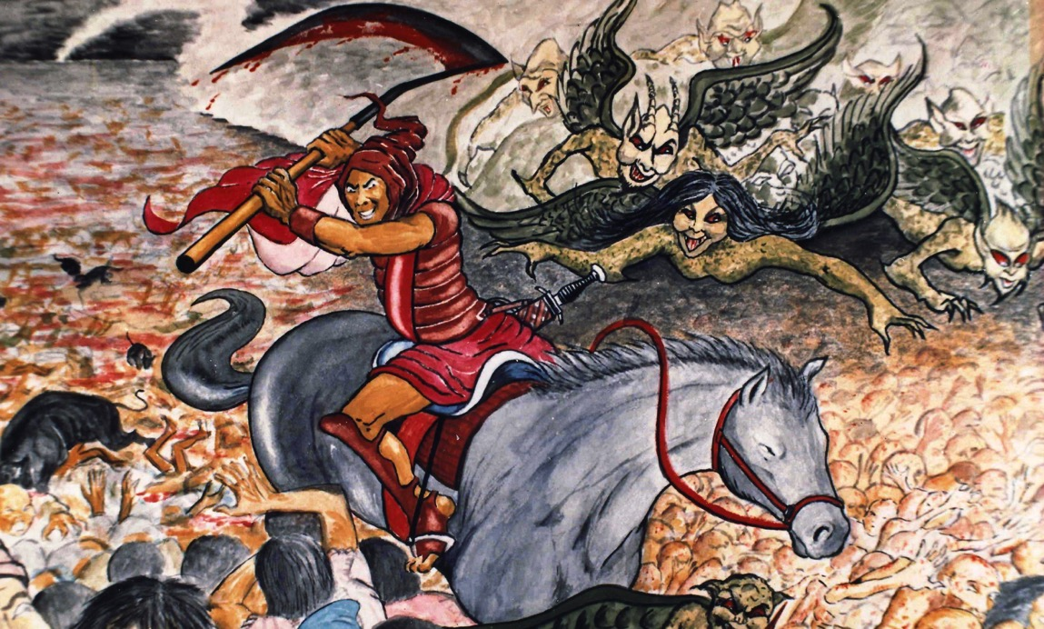
The 4th Seal
⁷When He opened the fourth seal, I heard the voice of the fourth living creature saying, "Come and see."
376
⁸So I looked, and behold, a pale horse. And the name of him who sat on it was Death, and Hades followed with him. And power was given to them over a fourth of the earth, to kill with sword, with hunger, with death, and by the beasts of the earth.
Artwork by Sunny Chandra

Slide 40
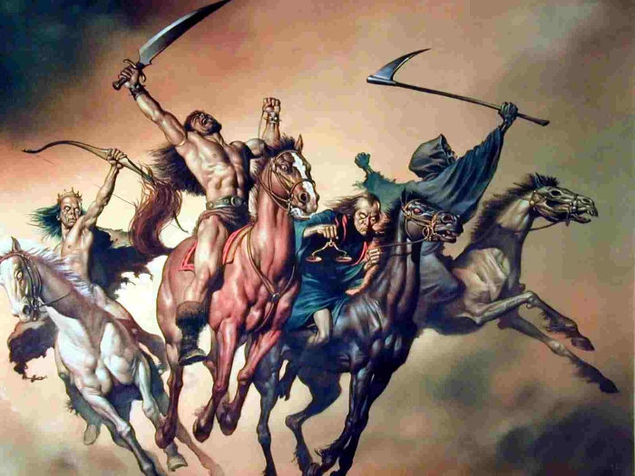
Tragedies of the Four Horses (6:1-8)
374
Conquest
War
Famine
Death

Slide 41
Content of the Judgments
337 376
Matthew 24:5-9 Seal Parallels:
 | SEALS | TRUMPETS | BOWLS
1 | White: conqueror | Hail & fire: 1/3 vegetation | Sores
2 | Red: war | Fire: 1/3 sea creatures | Sea to blood
3 | Black: famine | Star: 1/3 fresh water | Fresh water to blood
4 | Pale: death | Dark: 1/3 sun, moon, stars | Sun burns men
 |  | (Trumpets 5-7 are woes)
5 | Martyrs reassured | Woe #1: locusts | Beast's kingdom dark
6 | Wrath: earthquake, signs | Woe #2: Euphrates prep | Euphrates dries up
 | (144,000 sealed) | (Trump #7 = mystery)
7 | 1/2 hour silence | Woe #3: victory imminent | Earthquake & hail
Deceivers (24:5)
Wars (24:6-7a)
Famines (24:7b)
Death (24:9)
Martyrs (24:9)
Earthquakes & worldwide chaos (24:7c, 10-13)
Adapted from Robert Gromacki, NT Survey and H. Wayne House, Chronological & Background Charts of the NT, 19
Notes:
41

Slide 42
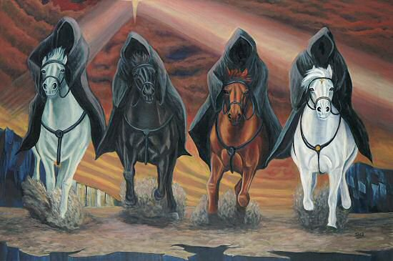
Four Horses (6:1-8)
376

Slide 43
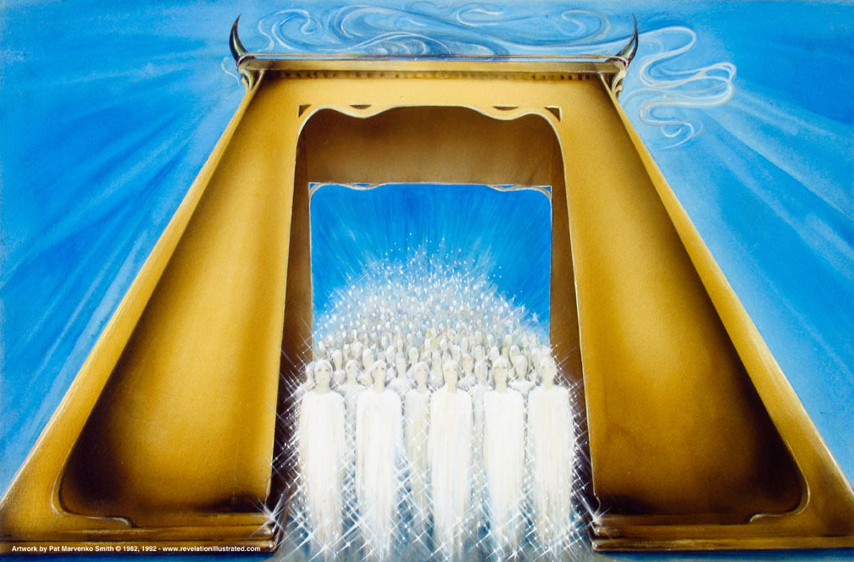
Seal #5: Martyrs Assured under the Altar (6:9-11)
376
Used with permission

Slide 44
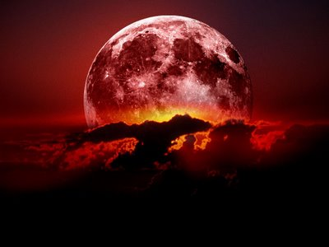
Seal #6: "The moon turned blood red" (6:12)
376

Slide 45
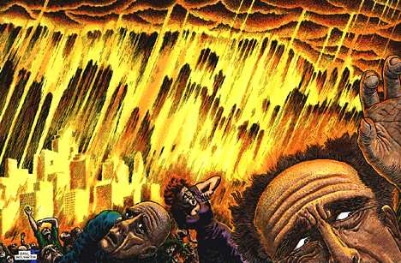
"…Fall on us and hide us from the face of him who sits on the throne and from the wrath of the Lamb!" (6:16 NIV)
376

Slide 46
I. Christ will judge the world (Rev. 6)
374
Notes:
"As Christ removed the seals, various dramatic events took place. The seventh seal introduced the seven trumpet judgments (Rev. 8:1–2). Then, when the seventh trumpet had blown, the great day of God's wrath was announced, ushering in the "vial [bowl] judgments" that brought to a climax the wrath of God (Rev. 11:15ff; 15:1). It is possible that the trumpet judgments were written on one side of the scroll and the bowl judgments on the other" (Wiersbe).

Slide 47
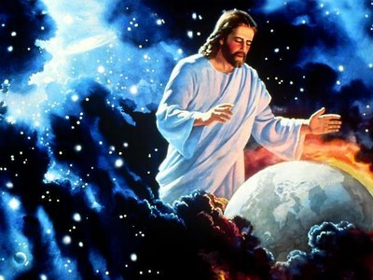
II. Christ will save the believers (Rev. 7).
371

Slide 48
Chronology of Revelation
340
"What you have seen"
(1:19a)
Rev. 1
"What is now"
(1:19b)
Rev. 2–3
"What will take place later"
(1:19c)
Rev. 4–22
Vision of Christ
Church Age
Rapture 3:10
Tribulation
4:1 – 19:10
Second Coming
Millennium
First Half
Second Half
Eternal State
Great White Throne Judgment
Copyright 1989 Rick Griffith
Adapted from a chart by J. D. Pentecost
Notes:
The 3 main divisions of Revelation are summarized in 1:19
The 3 main cycles of judgment are squared in blue
The 4 parenthetical sections appear in parentheses within the scrolls. They do not advance the chronology but add important information that is not associated with a particular judgment.

Slide 49
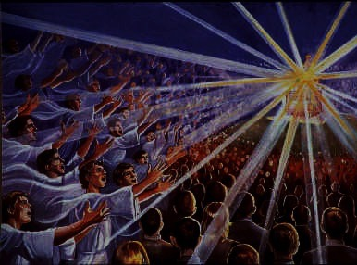
144,000 sealed (7:4-8)
377
And I heard how many were marked with the seal of God— 144,000 were sealed from all the tribes of Israel:
⁵from Judah 12,000
from Reuben 12,000
from Gad 12,000
⁶from Asher 12,000
from Naphtali 12,000
from Manasseh 12,000
⁷from Simeon 12,000
from Levi 12,000
from Issachar 12,000
⁸from Zebulun 12,000
from Joseph 12,000
from Benjamin 12,000
Notes:
"In Scripture, a seal indicates ownership and protection. Today, God's people are sealed by the Holy Spirit (Eph. 1:13–14). This is God's guarantee that we are saved and safe, and that He will one day take us to heaven. The 144,000 Jews will receive the Father's name as their seal (Rev. 14:1), in contrast to the "mark of the beast" that Antichrist will give those who follow him (Rev. 13:17; 14:11; 16:2; 19:20)" (Wiersbe).

Slide 50
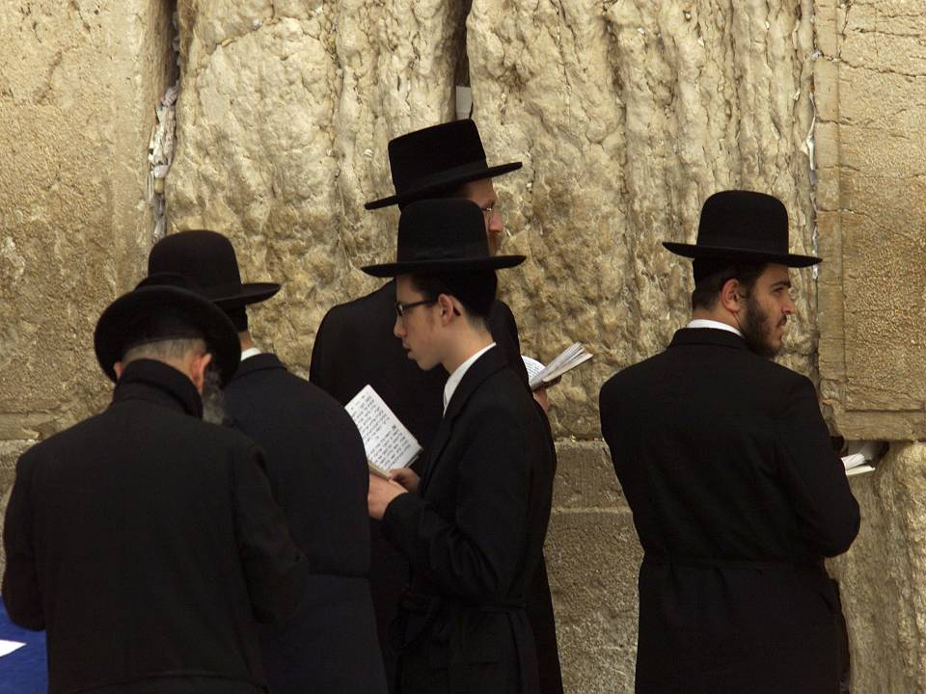
144,000 Jews Saved is Miraculous!
377
Notes:
even the Jews "which pierced Him"

Slide 51
Is There a Future for National Israel?
155q

Slide 52
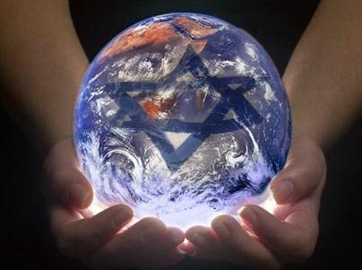
God still has plans for Israel
377
Notes:
even the Jews "which pierced Him"

Slide 53
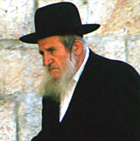
Two Saved Groups Contrasted
378
144,000 | Great Multitude
7:1-8 | 7:9-17
Jews | Gentiles from all nations
Numbered | Cannot be counted
Listed by tribe of Israel | From every nation, tribe, people and language
"seal of God on their foreheads" (7:3-4) | "washed their robes in the blood of the Lamb and made them white" (7:14)
On earth | Standing in heaven

Slide 54
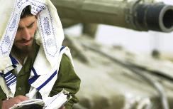
Israel is considered by most nations to be a pain to the world today but…
378

Slide 55
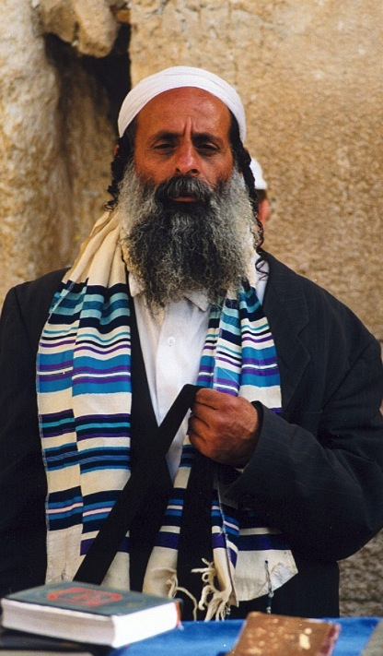
"All Israel will be saved" (Rom. 11:25-27 NIV)
155w
²⁵I do not want you to be ignorant of this mystery, brothers, so that you may not be conceited: Israel has experienced a hardening in part until the full number of the Gentiles has come in.
²⁶And so all Israel will be saved, as it is written:
"The deliverer will come from Zion; he will turn godlessness away from Jacob.
²⁷And this is my covenant with them when I take away their sins."

Slide 56
"And the Good News about the Kingdom will be preached throughout the whole world, so that all nations will hear it; and then the end will come" (Matt. 24:14 NLT).
378
God will evangelize many Gentiles through these 144,000 Jews!
Notes:
"While we are not told explicitly in Scripture that the 144,000 Jews are God's special witnesses, and that the Gentile host is saved through their ministry, this appears to be a logical deduction; otherwise, why are they associated in this chapter? The parallel with Matthew 24:14 also indicates that the 144,000 will witness for the Lord during the Tribulation" (Wiersbe).

Slide 57
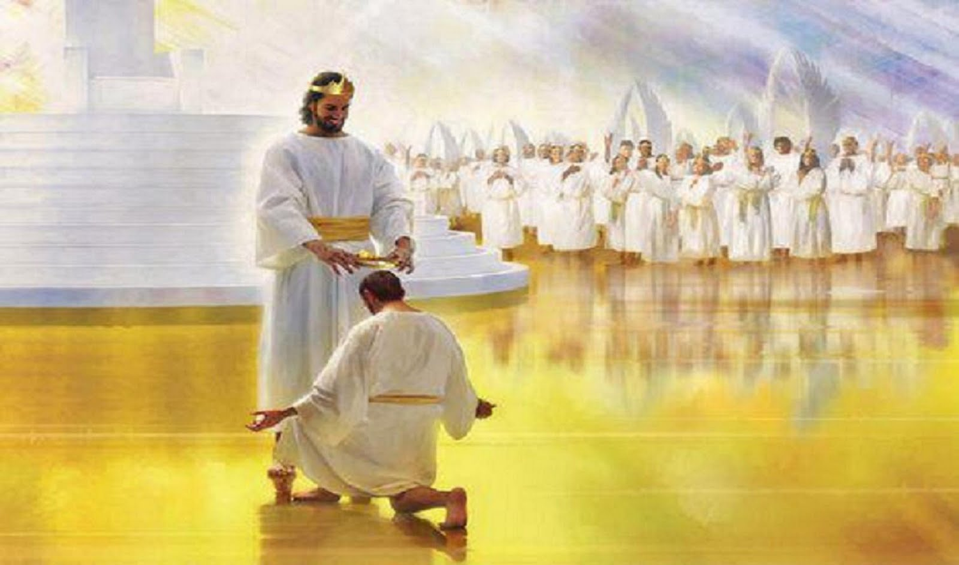
The salvation of Gentiles from every nation indicates God's merciful fulfillment of the Great Commission during the Tribulation (7:9-17)

Slide 58
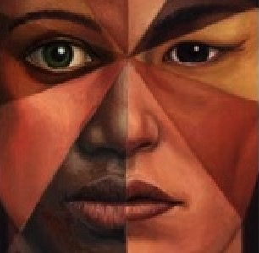
The Multi-Racial People
379
"From every tribe, nation, language and people" (7:9)

Slide 59
The elders fall before the throne (7:11)
379
Used with permission

Slide 60
What's the Point?

Slide 61
Christ balances..
his judgment…
with his grace.
Main Idea of Revelation 6–7
Dr. Rick Griffith • Singapore Bible College • biblestudydownloads.com

Slide 62
I. Christ will judge the world (Rev. 6)
374
Notes:
"As Christ removed the seals, various dramatic events took place. The seventh seal introduced the seven trumpet judgments (Rev. 8:1–2). Then, when the seventh trumpet had blown, the great day of God's wrath was announced, ushering in the "vial [bowl] judgments" that brought to a climax the wrath of God (Rev. 11:15ff; 15:1). It is possible that the trumpet judgments were written on one side of the scroll and the bowl judgments on the other" (Wiersbe).

Slide 63
II. Christ will save the believers (Rev. 7).
371

Slide 64
Do you have a defective view of Christ?
371

Slide 65
Christ's Sovereignty in Revelation
Christ's Sovereignty in Revelation
381
In His Person (1)
Over Churches (2–3)
Over All Creation (4–22)

Slide 66
Christ has the right to judge you but prefers to save you!
371

Slide 68
Jesus Wins!
Series on Revelation

Slide 69
NT Sermons link at biblestudydownloads.com
Get this presentation for free!

