Slide 1
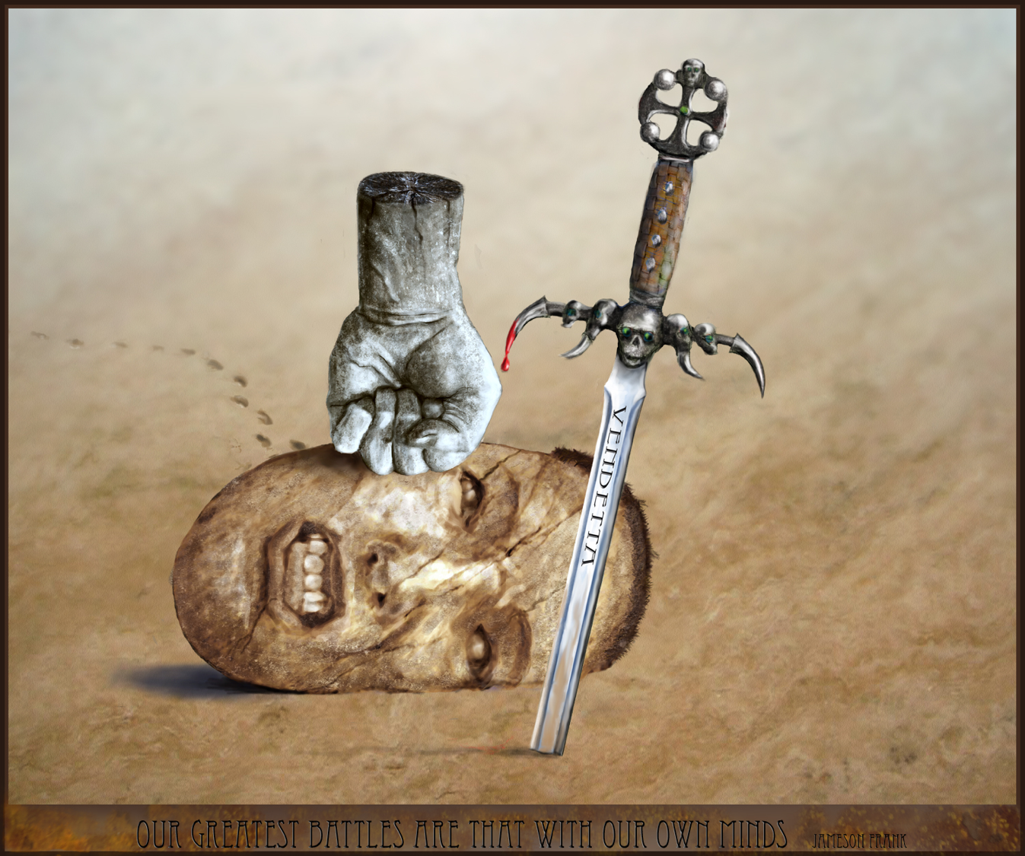
Our Greatest Battle
Matthew 6:5-15
Dr. Rick Griffith, Crossroads International Church Singapore
BibleStudyDownloads.org

Slide 2
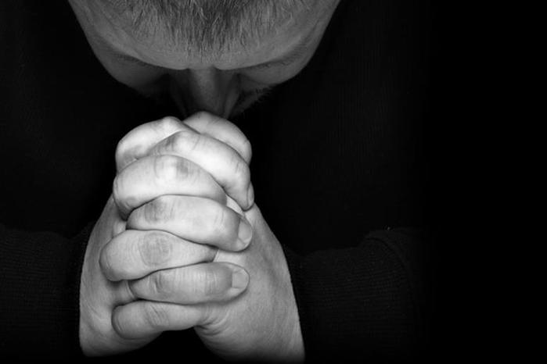
The Lord's Prayer

Slide 3
The Struggle is Real

Slide 4
What is our greatest battle—our most difficult struggle?

Slide 5
What is Our Greatest Battle?

Slide 6
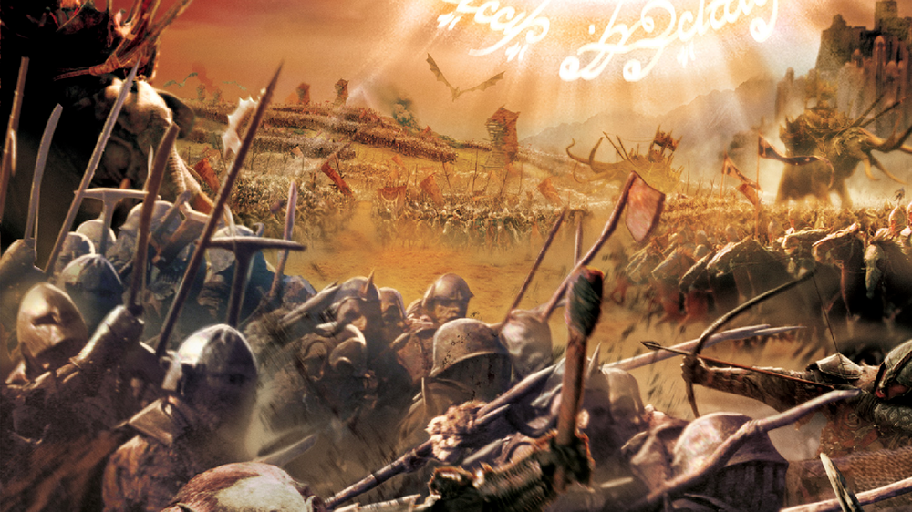
What is Our Greatest Battle?

Slide 7
What is Our Greatest Battle?

Slide 8
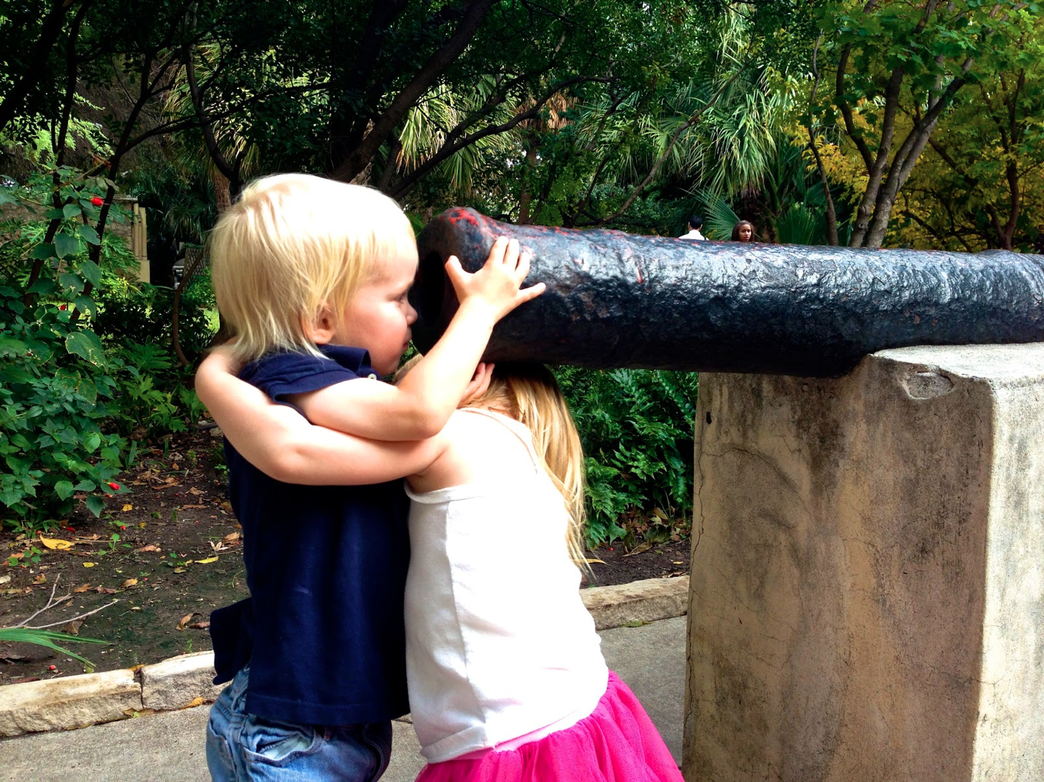
What is Our Greatest Battle?

Slide 9
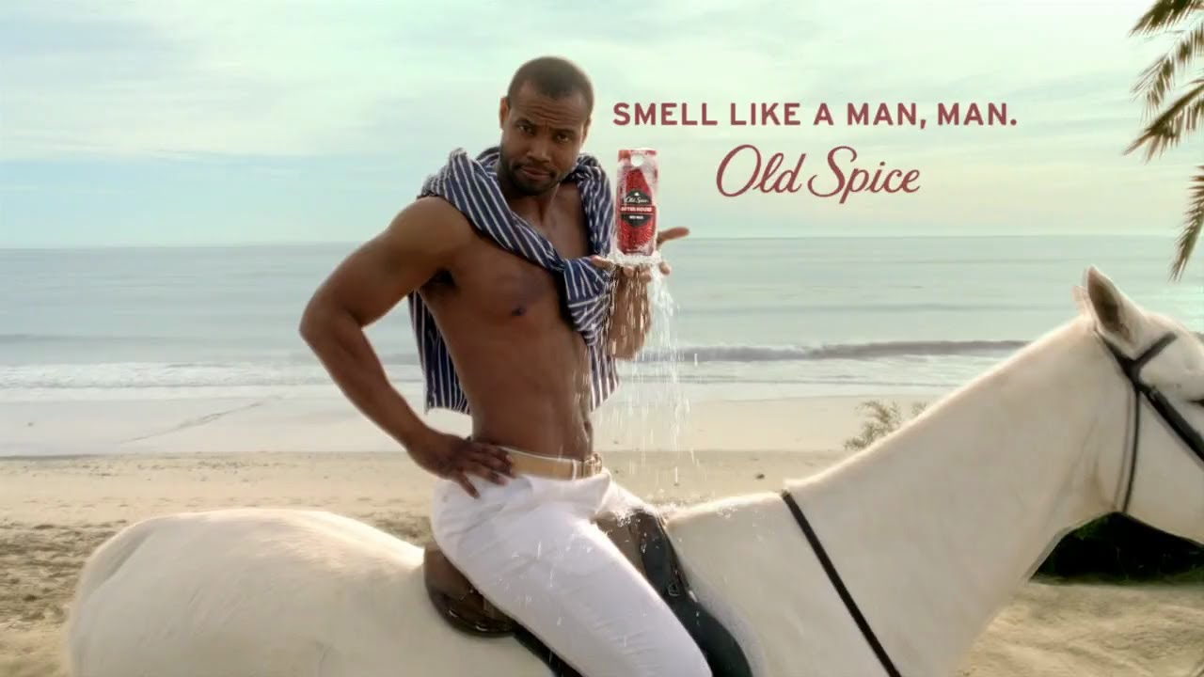
What is Our Greatest Battle?

Slide 10
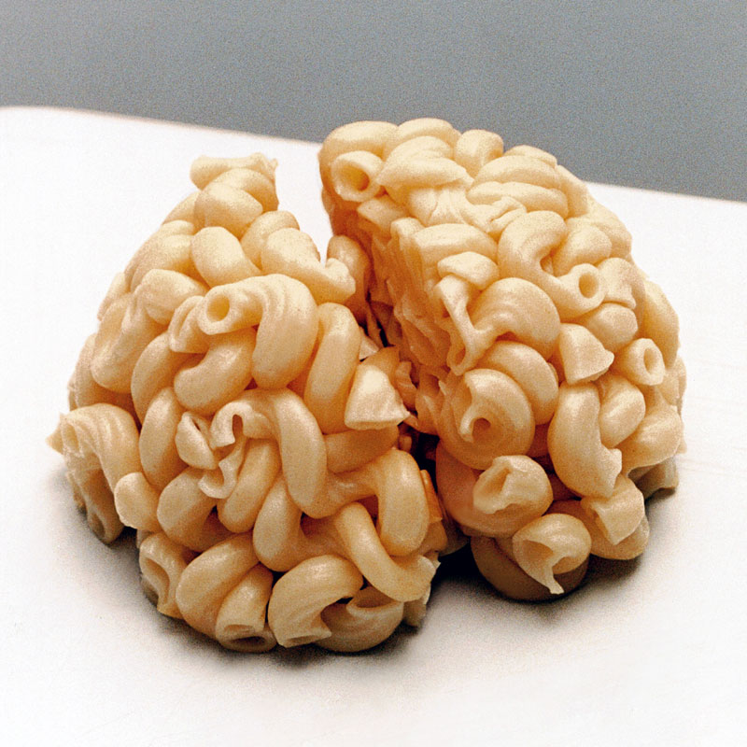
What is Our Greatest Battle?

Slide 11
What is Our Greatest Battle?

Slide 12
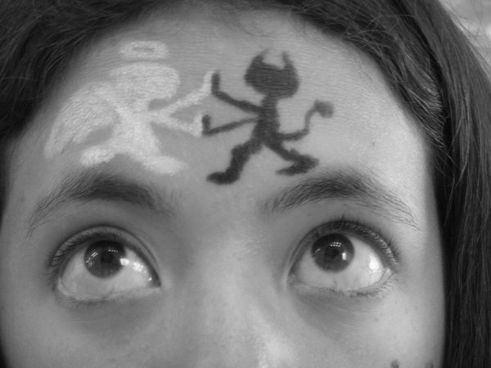
What is Our Greatest Battle?

Slide 13
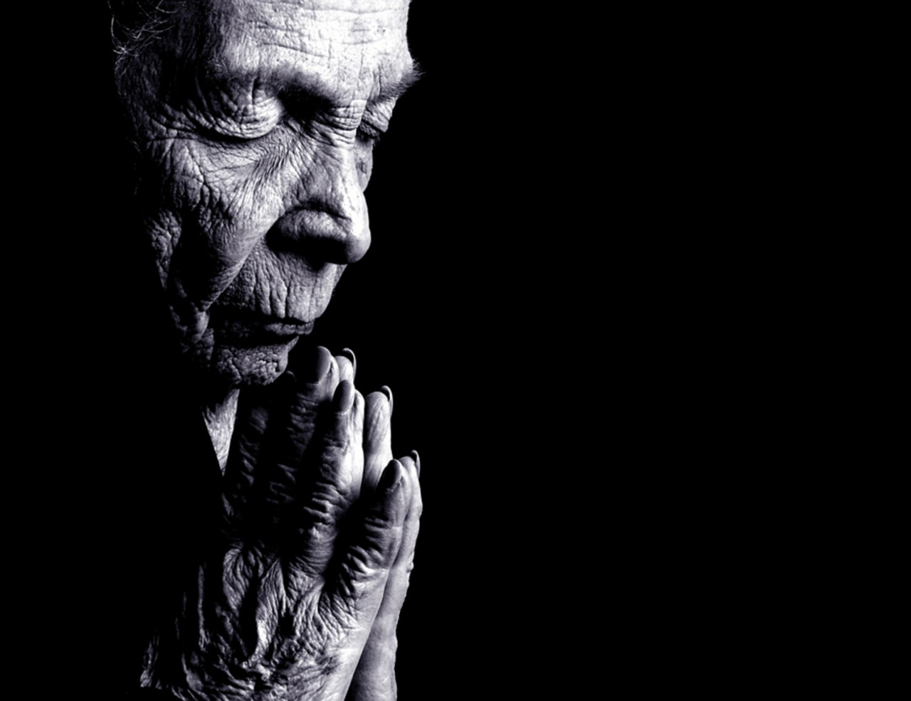
Prayer: Our Greatest Battle

Slide 14
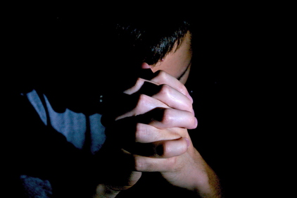
How are you doing at… Prayer?

Slide 15
PRAYER
JUST DO IT.

Slide 16
Prayer

Slide 17
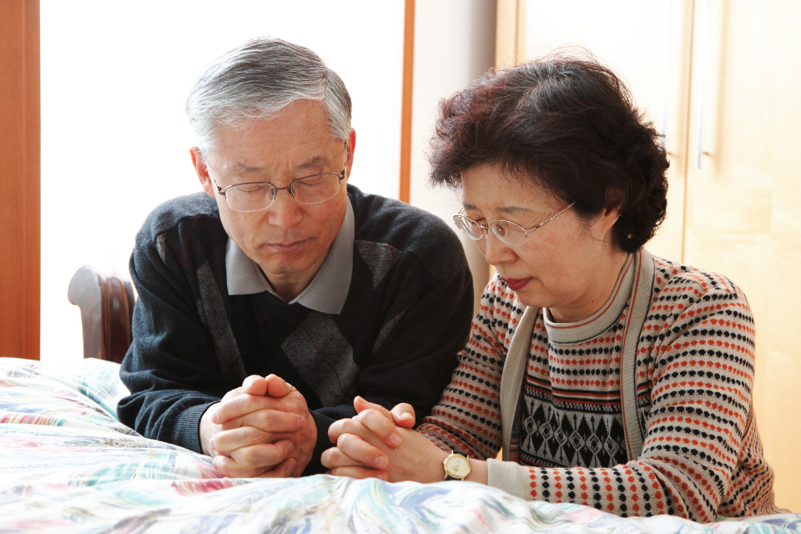
Prayer

Slide 18
Our Great Battle

Slide 19
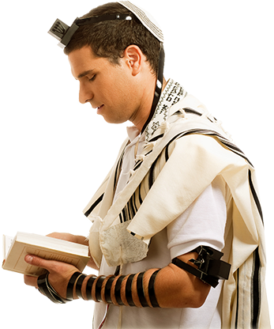
Not a new problem.

Slide 20
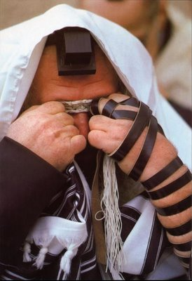
The Sermon on the Mount
Pharisee Teaching (Matthew 5)
Pharisee Practice (Matthew 6)
Notes:
We've been studying Jesus in his famous Sermon on the Mount where he had just finished telling the crowd to love their enemies.
• That ended chapter 5 where he kept saying, "You have heard that it was said…" when he compared the Pharisee view of external righteousness with the genuine, internal purity God requires. In Matthew 5 Jesus speaks critically of the teaching of the Pharisees.
• In Matthew 6 Jesus begins to talk not about the proverbs of the Pharisees but about their practice—not their doctrine but their deeds.

Slide 21
"Be careful not to do your 'acts of righteousness' before men, to be seen by them. If you do, you will have no reward from your Father in heaven" (6:1 NIV).
Notes:
Jesus warned us not to show off our good deeds (6:1a).
What kinds of good deeds for show does Jesus mean in verse 1?
The following verses warn against public show in almsgiving, prayer, fasting, investing, faith and humility!
Each of these actions is actually a good practice. However, if we do it for men rather than for God, we are rewarded on earth rather than in heaven!
These "acts of righteousness" are vertical, not horizontal. "Righteousness is not primarily a matter between a person and others, but between a person and God. So one's acts should not be demonstrated before others for then his reward should come from them (vv. 1-2)" (BKC, emphasis his).
How far into the chapter does this warning not to please men apply (1)?
It goes at least to 7:12 to address many issues that we face today that we are tempted to do for human show.
So 6:1 is really a guide for the next several sections—basically ask yourself not what you do but why you do it!

Slide 22
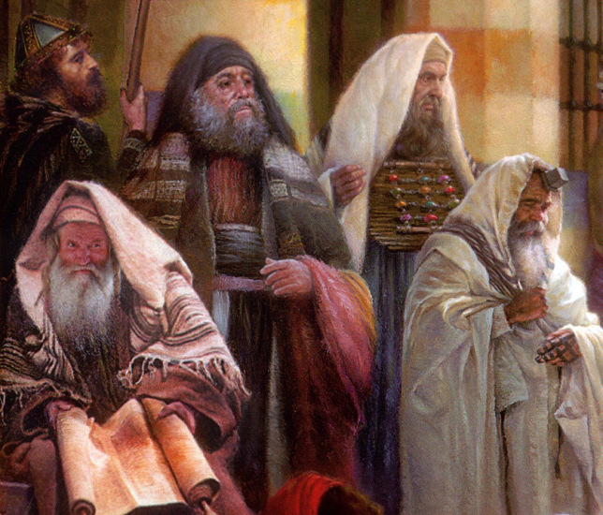
"When you give to someone in need, don't do as the hypocrites do—blowing trumpets in the synagogues and streets to call attention to their acts of charity! I tell you the truth, they have received all the reward they will ever get" (6:2 NLT).
Notes:
The way not to give to the needy is by showing off (6:2a).
The religious teachers of Jesus' day were prosperity teachers.
The Pharisees were rich and gave credit to their piety before God.
As such, they frowned upon the poor as they saw them as less godly and therefore judged with poverty. What a heartless and erroneous theology!

Slide 23
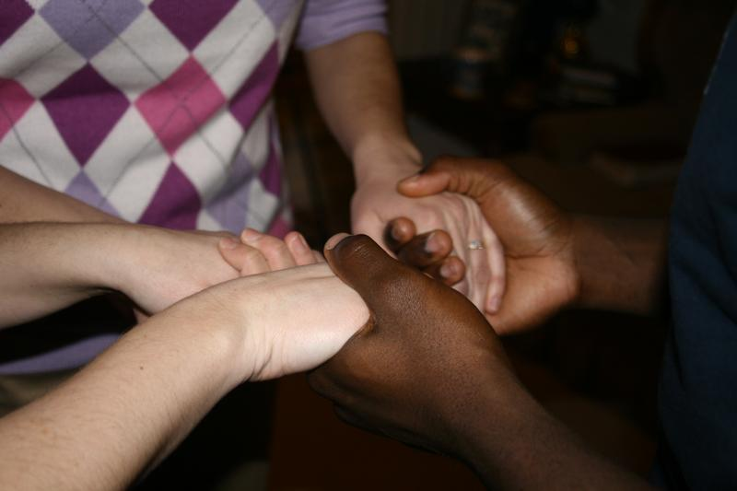
How should we pray?

Slide 24
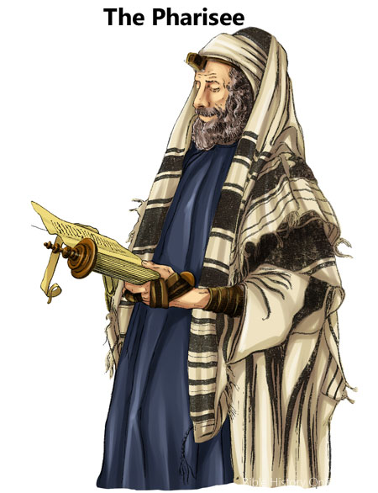
The way not to pray is with self-focus like the Pharisees (6:5-8).

Slide 25
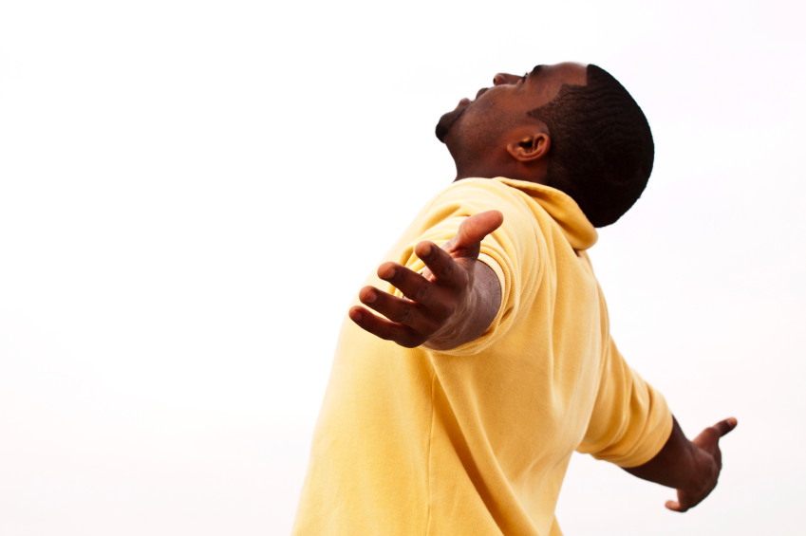
"When you pray, don't be like the hypocrites who love to pray publicly on street corners and in the synagogues where everyone can see them. I tell you the truth, that is all the reward they will ever get" (6:5 NLT).

Slide 26
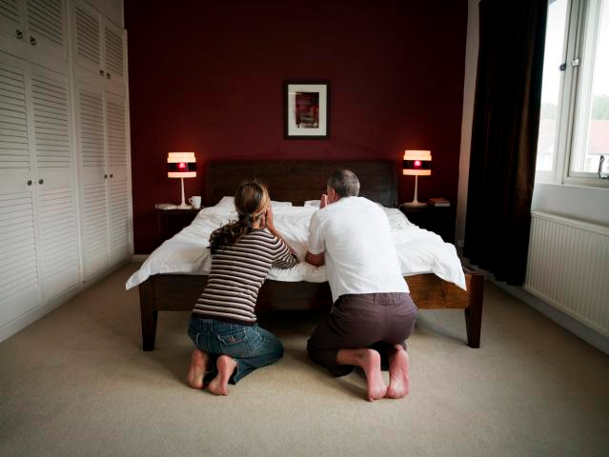
"But when you pray, go away by yourself, shut the door behind you, and pray to your Father in private. Then your Father, who sees everything, will reward you" (6:6 NLT).

Slide 27
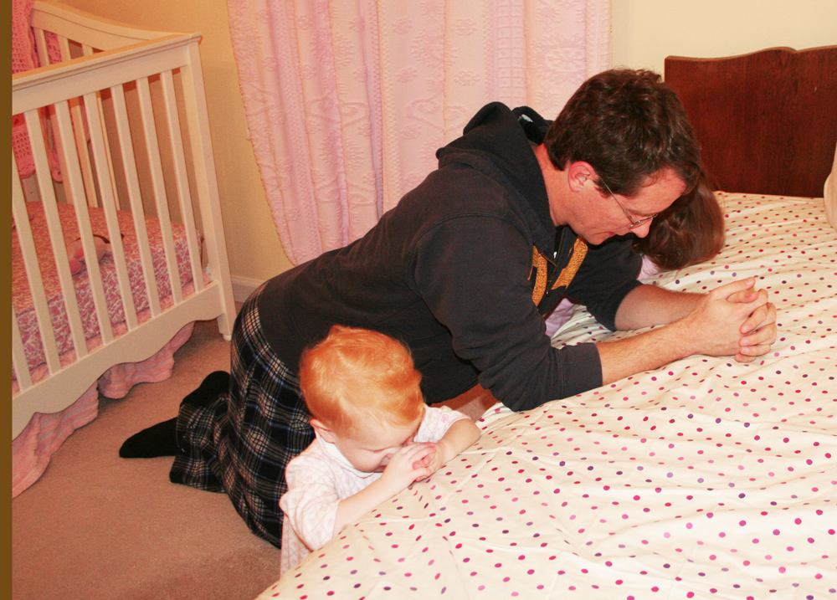
Title

Slide 28
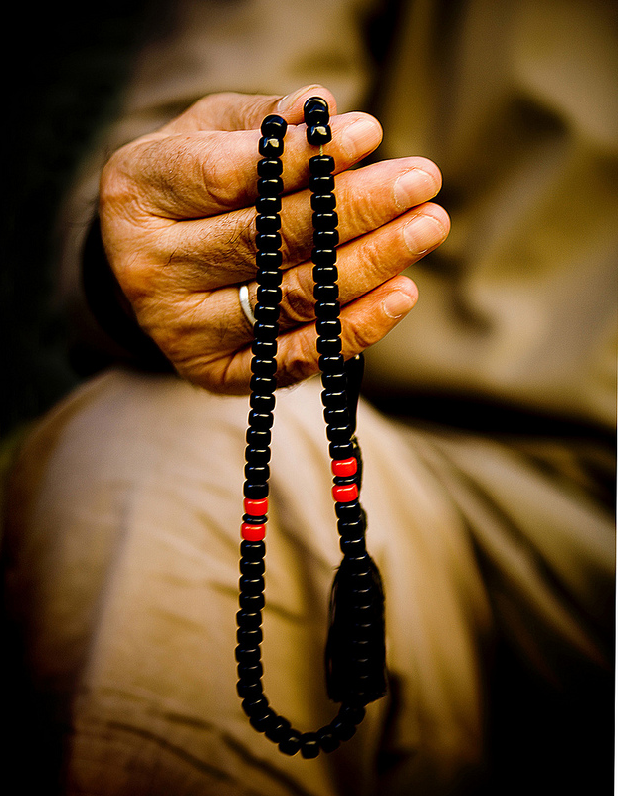
"When you pray, don't babble on and on as people of other religions do. They think their prayers are answered merely by repeating their words again and again" (6:7 NLT).

Slide 29
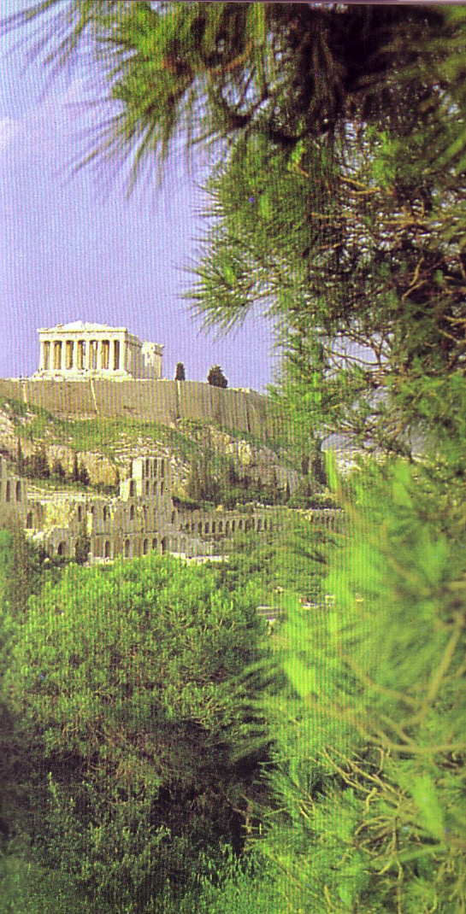
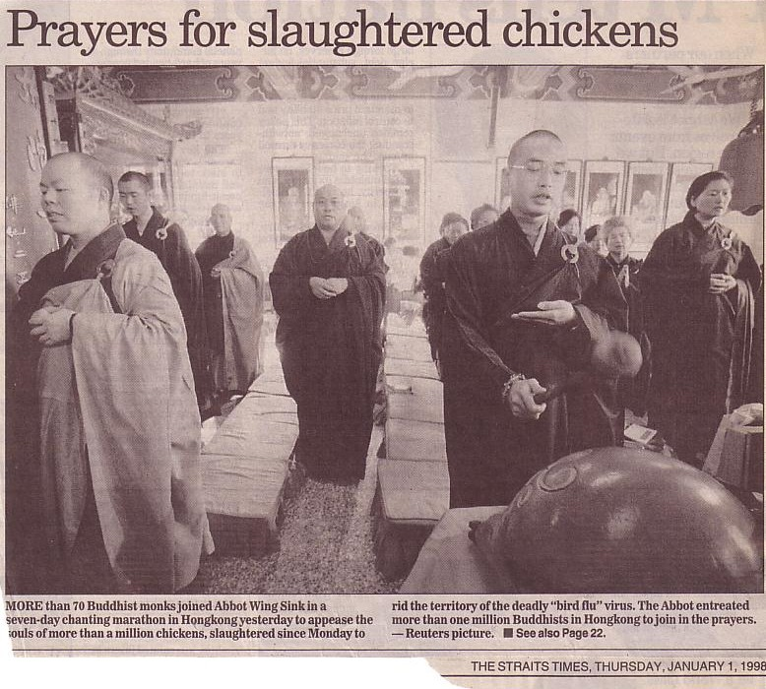
"I saw altars to many gods —even to the unknown god" (Paul in Acts 17)
Prayers for slaughtered chickens
The Parthenon above the other altars in Athens
"More than 70 Buddhist monks joined Abbot Wing Sink in a seven-day chanting marathon in Hong Kong yesterday to appease the souls of more than a million chickens, slaughtered since Monday to rid the territory of the deadly 'bird flu' virus. The Abbot entreated more than one million Buddhists in Hong Kong to join in the prayers." —Reuters picture, The Straits Times, Thursday, January 1, 1998
Notes:
"More than 70 Buddhist monks joined Abbot Wing Sink in a seven-day chanting marathon in Hong Kong yesterday to appease the souls of more than a million chickens, slaughtered since Monday to rid the territory of the deadly 'bird flu' virus. The Abbot entreated more than one million Buddhists in Hong Kong to join in the prayers." —Reuters picture, The Straits Times, Thursday, January 1, 1998

Slide 30
Why are repetitive prayers so bad (6:7)?
"We must pray sincerely (vv. 7–8). The fact that a request is repeated does not make it a 'vain repetition,' for both Jesus and Paul repeated their petitions (Matt. 26:36–46; 2 Cor. 12:7–8). A request becomes a 'vain repetition' if it is only a babbling of words without a sincere heart desire to seek and do God's will. The mere reciting of memorized prayers can be vain repetition. The Gentiles had such prayers in their pagan ceremonies (see 1 Kings 18:26)" (Wiersbe, Matthew, 57).

Slide 31
Why are repetitive prayers so bad (6:7)?
"My friend Dr. Robert A. Cook has often said, 'All of us have one routine prayer in our system; and once we get rid of it, then we can really start to pray!' I have noticed this, not only in my own praying, but often when I have conducted prayer meetings. With some people, praying is like putting the needle on a phonograph record and then forgetting about it. But God does not answer insincere prayers" (Wiersbe, Matthew, 57).

Slide 32
"Don't be like them, for your Father knows exactly what you need even before you ask him!" (6:8 NLT).

Slide 33
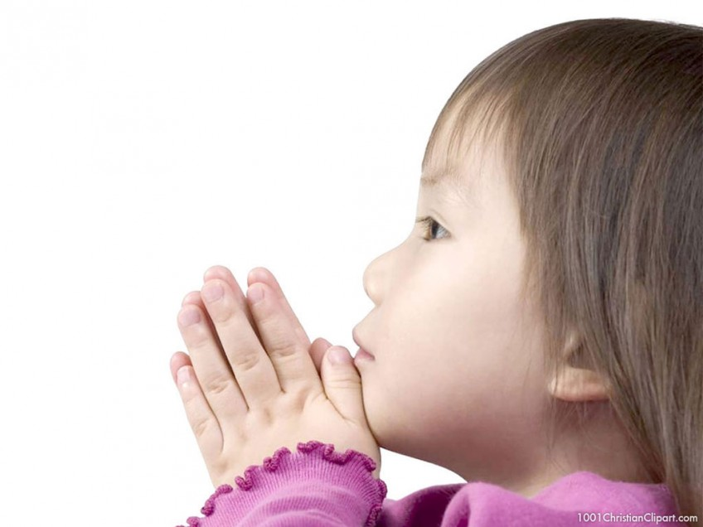
Pray it exactly?

Slide 34
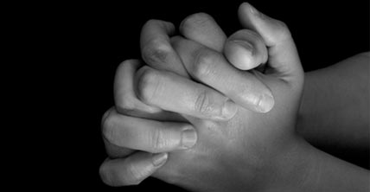
Seven Elements of True Prayers
P
R
A
Y
E
R
S

Slide 35
Praise God as Father (9a).

Slide 36
Prayer

Slide 37
Pray with normal language!
“You can just talk to me normally. I don't just speak King James.”

Slide 38
Praise God as Father (9a).
Reverence God's name as holy (9b).

Slide 39
Confess all known sin.

Slide 40
Praise God as Father (9a).
Reverence God's name as holy (9b).
Anticipate God's kingdom (10a).

Slide 41
Matthew 6:9-10 (NKJV) ⁹ In this manner, therefore, pray: Our Father in heaven, Hallowed be Your name. ¹⁰ Your kingdom come. Your will be done On earth as it is in heaven.

Slide 42
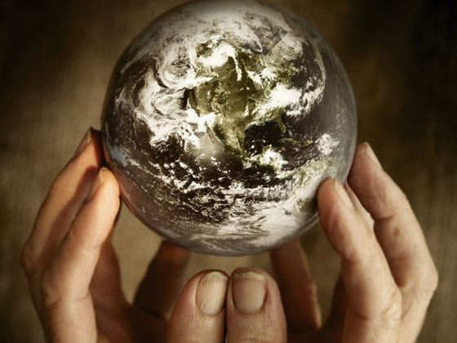
"Thy Kingdom Come"
Matthew 6:10

Slide 43
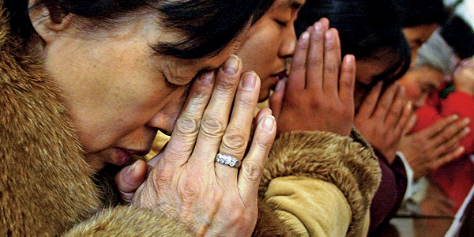
What does it mean to pray… "Thy Kingdom come"?

Slide 44
Not a new idea!
"Many passages speak of the second coming of Christ being followed by a reign of righteousness on earth (Pss. 2; 24; 72; 96; Isa. 2; 9:6-7; 11-12; 63:1-6; 65-66; Jer. 23:5-6; 30:8-11; Dan. 2:44; 7:13-14; Hosea 3:4-5; Amos 9:11-15; Micah 4:1-8; Zeph. 3:14-20; Zech. 8:1-8; 14:1-9; Matt. 19:28; 25:31-46; Acts 15:16-18; Rom. 11:25-27; Jude 14-15; Rev. 2:25-28; 19:11-20:6)."
—John Walvoord, "Revelation," in The Bible Knowledge Commentary, 2:978

Slide 45
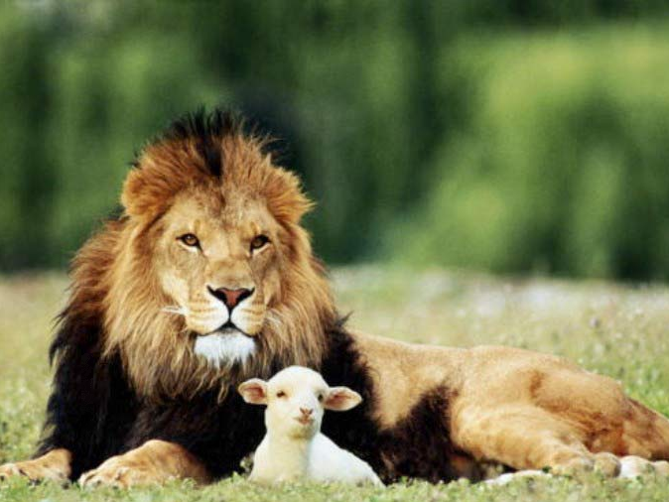
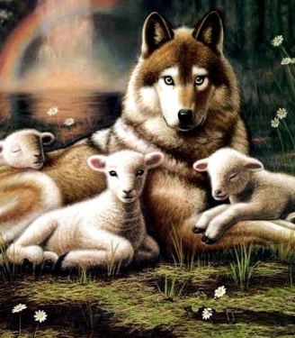
Isaiah 11:6-9
NTS 434
"And the wolf will dwell with the lamb, and the leopard will lie down with the young goat, and the calf and the young lion and the fatling together."
Isa. 11:6
Notes:
45

Slide 46
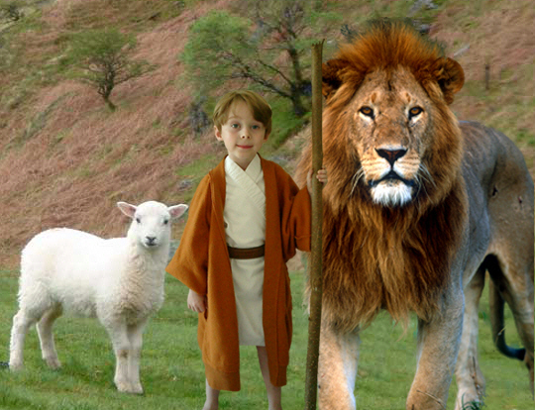
Isaiah 11:6-9
434
"And the wolf will dwell with the lamb, and the leopard will lie down with the young goat, and the calf and the young lion and the fatling together; and a little boy will lead them."
Notes:
46

Slide 47
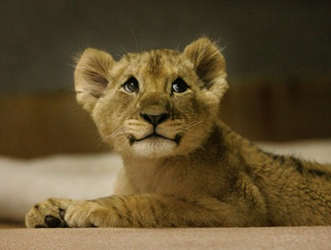
Isaiah 11:6-9
434
⁷ Also the cow and the bear will graze, their young will lie down together, and the lion will eat straw like the ox.
Notes:
47

Slide 48
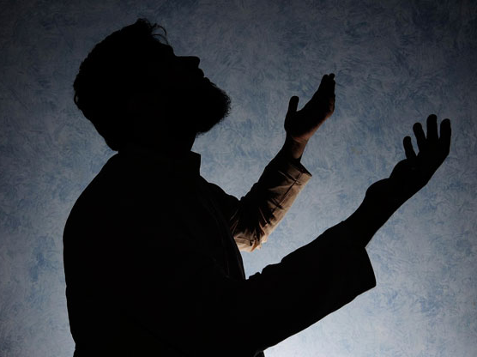
Do your prayers have a forward element? Do you look beyond this life when you pray?

Slide 49
Praise God as Father (9a).
Reverence God's name as holy (9b).
Anticipate God's kingdom (10a).
Yield your will to His (10b).

Slide 50
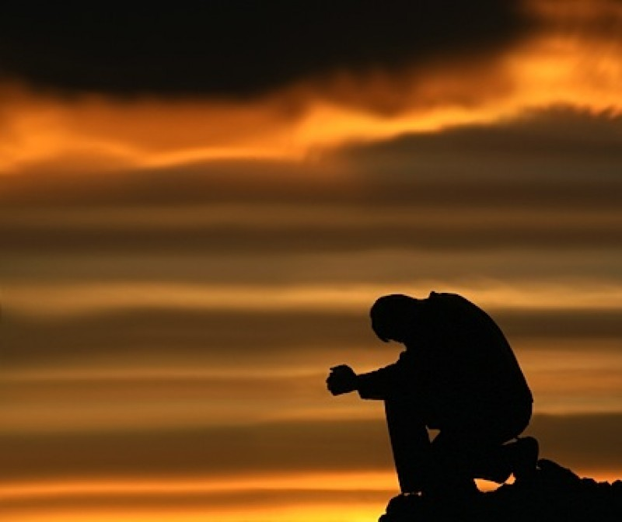
Thy will be done.

Slide 51
Yield to God

Slide 52
Praise God as Father (9a).
Reverence God's name as holy (9b).
Anticipate God's kingdom (10a).
Yield your will to His (10b).
Entreat God for your needs (11).

Slide 53
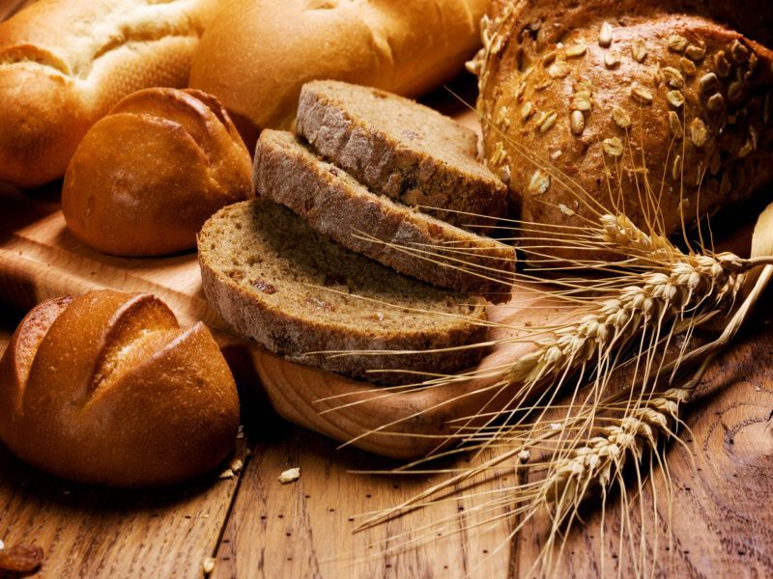
Give us this day our daily bread.

Slide 54
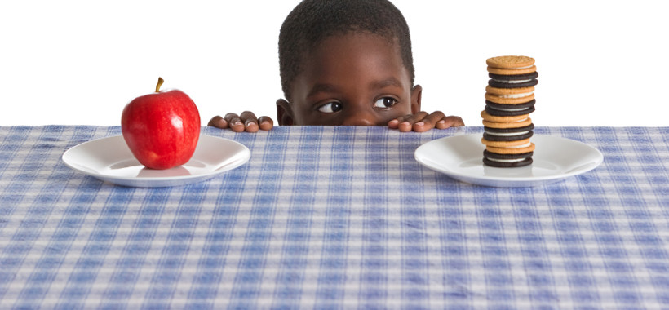
Needs or Wants?

Slide 55
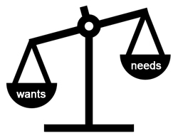
Our Crossroads Era 2006-2011
"...and my God shall supply all of your needs..." (Phil 4:19)
needs
wants

Slide 56
Praise God as Father (9a).
Reverence God's name as holy (9b).
Anticipate God's kingdom (10a).
Yield your will to His (10b).
Entreat God for your needs (11).
Release sins hurting you (12, 14-15).

Slide 57
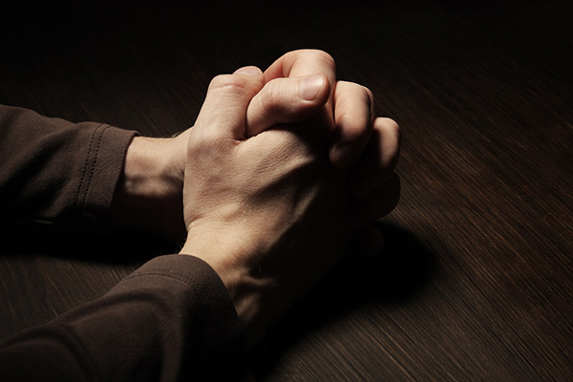
"and forgive us our sins, as we have forgiven those who sin against us" (6:12 NLT).

Slide 58
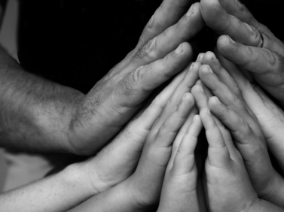
"If you forgive those who sin against you, your heavenly Father will forgive you. ¹⁵But if you refuse to forgive others, your Father will not forgive your sins" (6:14-15 NLT).

Slide 59
Praise God as Father (9a).
Reverence God's name as holy (9b).
Anticipate God's kingdom (10a).
Yield your will to His (10b).
Entreat God for your needs (11).
Release sins hurting you (12, 14-15).
Succeed over temptation (13).

Slide 60
Lead me not into temptation.

Slide 61
Lead me not into temptation; I can find the way myself.

Slide 62
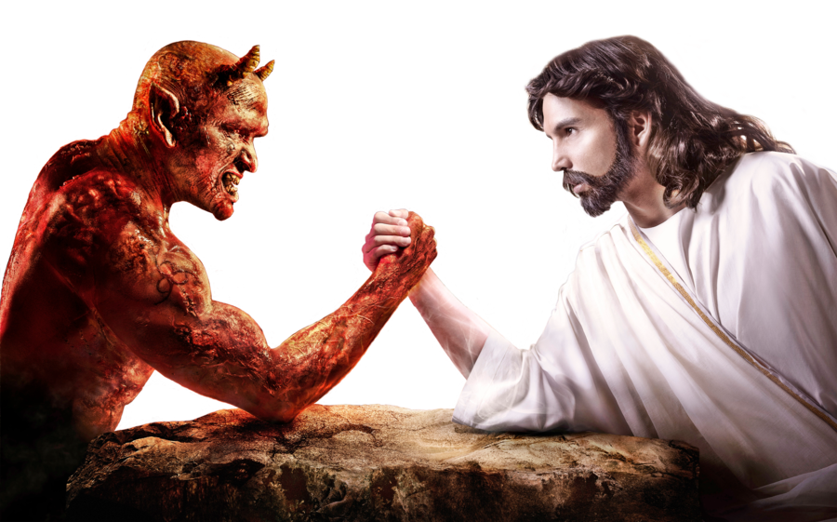
Lead me not into temptation.

Slide 63
What is Our Greatest Battle?

Slide 64
How should we pray?

Slide 65
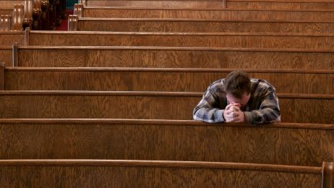
Pray to focus on God, not you. —Main Idea—

Slide 66
Praise God as Father (9a).
Reverence God's name as holy (9b).
Anticipate God's kingdom (10a).
Yield your will to His (10b).
Entreat God for your needs (11).
Release sins hurting you (12, 14-15).
Succeed over temptation (13).

Slide 67
Why no "In Jesus' name, Amen"?

Slide 68
Questions to Consider
Are your prayers mostly about you rather than God?
With whom do you need to reconcile for effective prayer?
Can you say these seven elements right now?
How can your prayer life grow deeper?

Slide 69
Black

Slide 70
NT Sermons link at biblestudydownloads.org
Get this presentation and script for free!

