Slide 1
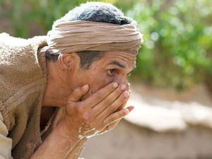
How to Get Rewarded
Matthew 6:16-18
Dr. Rick Griffith, Crossroads International Church Singapore
BibleStudyDownloads.org

Slide 2
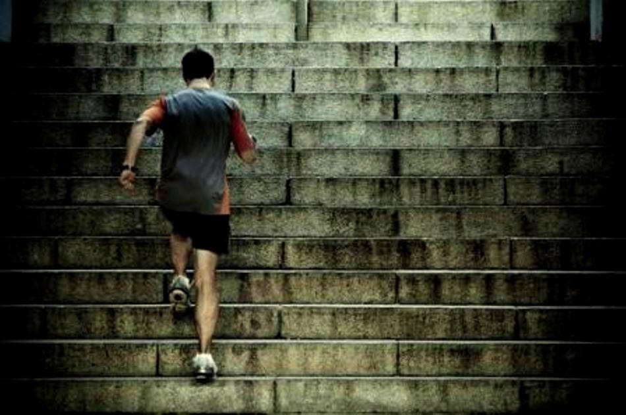
Discipline
Notes:
We all admire disciplined people.

Slide 3
Spiritual Disciplines
Notes:
We all also think a life of spiritual disciplines is good.
But disciplines themselves aren't enough.

Slide 4
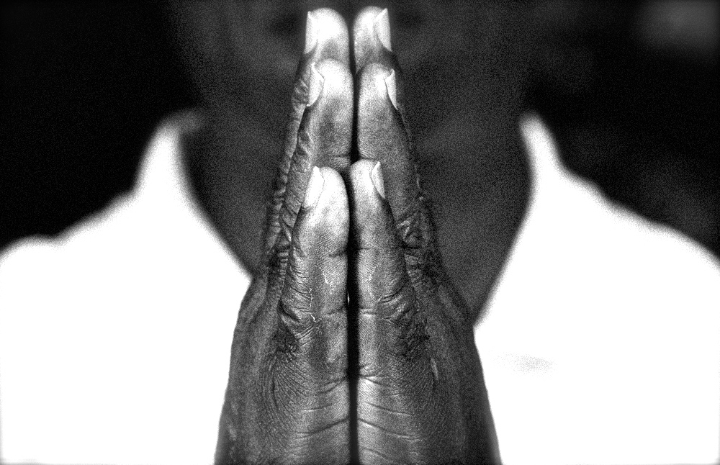
Spiritual Disciplines
Why?
Notes:
Why aren't disciplines enough?
Cuz the reason you do spiritual disciplines counts!
Spiritual disciplines need spiritual motivations.

Slide 5
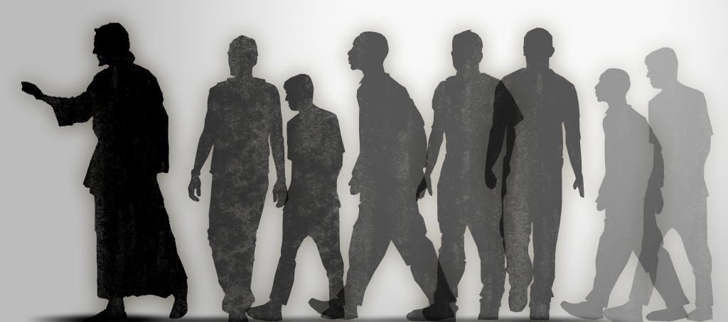
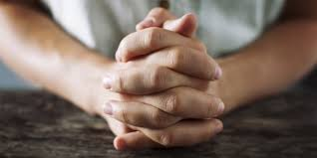
Spiritual Disciplines
Notes:
Have you considered not just what your spiritual disciplines are, but why you do them?
• Why do you pray?
• Why do you read your Bible?
• Why are you disciplined to meet with other believers?
• Why do you serve Christ in other capacities?

Slide 6
How can you do your spiritual disciplines in a way that God rewards?
Notes:
What's the way to make sure your motivation is right so that the Lord will be pleased with you in your disciplined efforts to grow in Him?

Slide 7
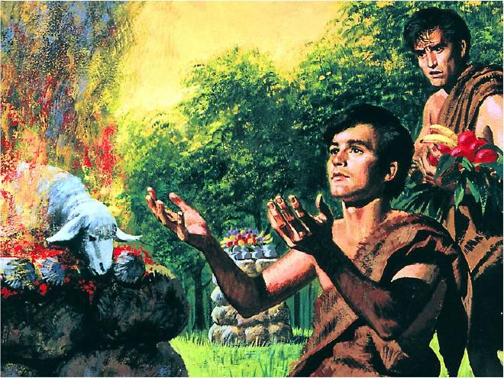
"By Faith…" (Hebrews 11)
"It was by faith that Abel brought a more acceptable offering to God than Cain did. Abel's offering gave evidence that he was a righteous man, and God showed his approval of his gifts. Although Abel is long dead, he still speaks to us by his example of faith" (Heb. 11:4 NLT)
Notes:
Motivation for religious rituals is a long-standing struggle.
Ever since God did not accept Cain's offering in Genesis 4 due to his attitude…

Slide 8
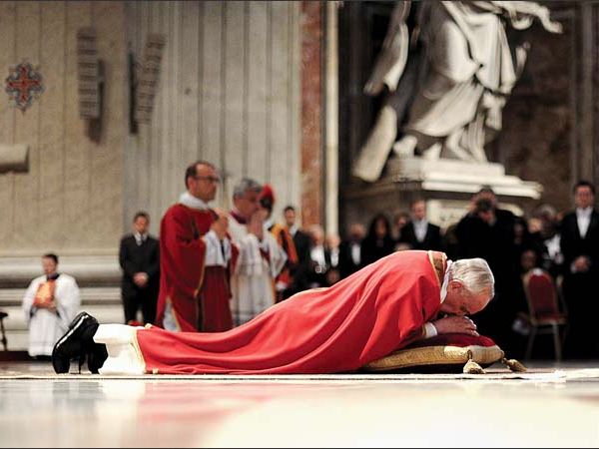
Religious Ritual
Notes:
…people have had thousands of rituals that looked good in the sight of man but not God.

Slide 9
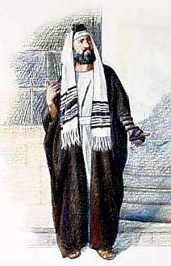
The Respected Pharisee
Notes:
This was true of the time of Christ. The Pharisees had their reward in the sense of the people's respect, but they did not impress God, who could see their hearts.

Slide 10
How can you do your spiritual disciplines in a way that God rewards?
Notes:
Well, in respect to fasting…

Slide 11
I. God rewards only secret fasting (Matt 6:16-18).
Notes:
The Lord blesses fasting that only he knows about.

Slide 12
"And when you fast, don't make it obvious, as the hypocrites do, for they try to look miserable and disheveled so people will admire them for their fasting. I tell you the truth, that is the only reward they will ever get" (6:16 NLT).
Notes:
People reward public fasting (6:16).

Slide 13
Pharisees
Notes:
The way to fast for man's praise is to look gloomy like Pharisees.

Slide 14
"When you fast…"
Notes:
Jesus said, "When you fast…" in the sense that everyone did so—not "if you fast…" (6:16).
Jesus assumes that we all fast, at least occasionally. Don't you?
Notice that he doesn't specify how often it should be done, though.

Slide 15
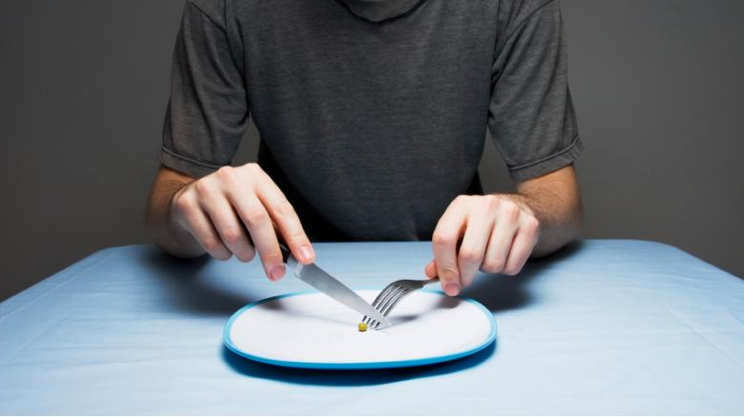
Individual Fasting
Notes:
Sometimes people fasted as individuals.

Slide 16
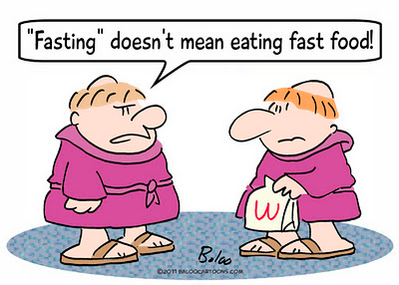
Fasting
"Fasting" doesn't mean eating fast food!
Notes:
Note that we are NOT talking about fast food!

Slide 17
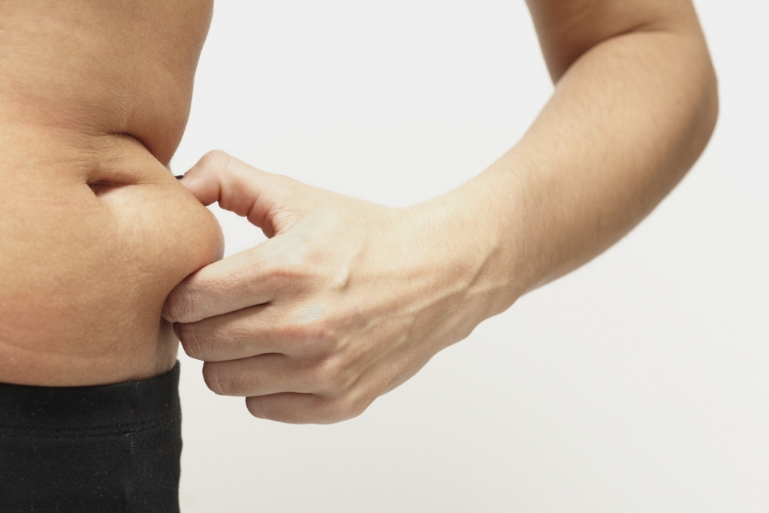
Fasting
Notes:
Also, at times people fast to lose weight—

Slide 18
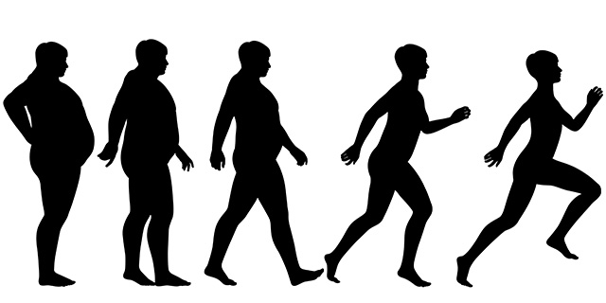
Evolutionary Fasting
Notes:
—and it can be successful and good to eat right…

Slide 19
Fasting
Notes:
and drink just water—but Jesus is not talking about this!

Slide 20
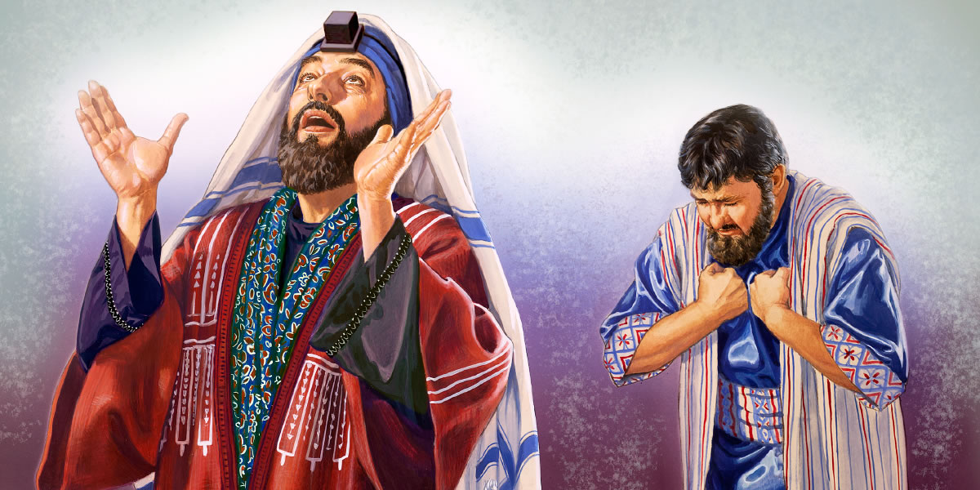
"I fast twice a week, and I give you a tenth of my income" (Luke 18:12 NLT).
Notes:
Fasting is a spiritual discipline. Luke 18:12 records a typical Pharisee fasting practice, "I fast twice a week…"

Slide 21
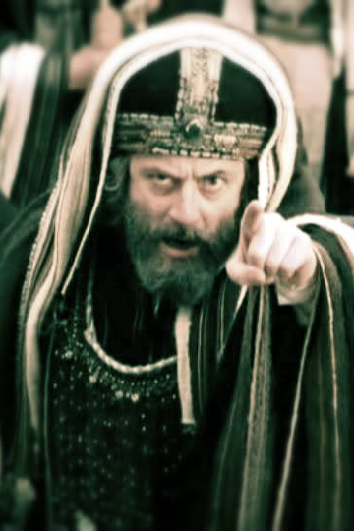
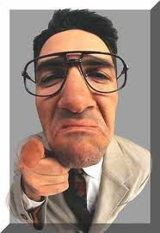
Pharisees, then & now
Notes:
The problem was that this Pharisee thought God was pleased with his fasting—yet he was filled with pride!

Slide 22
Pride
Notes:
We can have the same problem today.

Slide 23
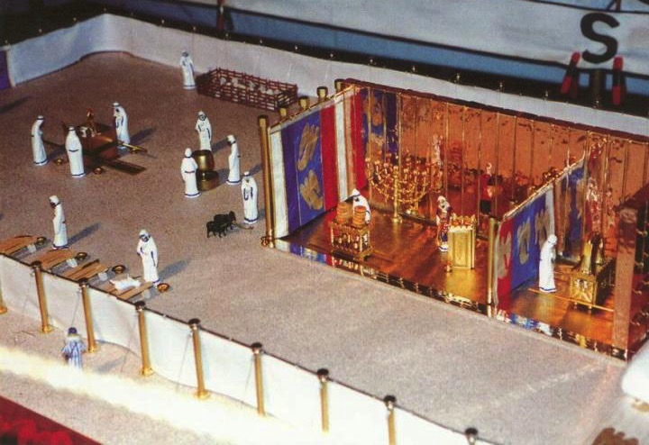
Day of Atonement (Lev. 16:29-34)
Courtyard
Holy Place
Holy of Holies
Notes:
Other fasting times were corporate.
The Day of Atonement was a nationwide fast when the high priest entered the Holy of Holies. Why?

Slide 24
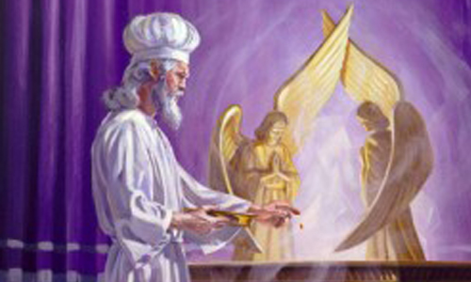
"Then Aaron must slaughter the first goat as a sin offering for the people and carry its blood behind the inner curtain. There he will sprinkle the goat's blood over the atonement cover and in front of it, just as he did with the bull's blood" (Leviticus 16:15 NLT).
Notes:
The high priest entered the Holy of Holies to atone for the sins of the people.

Slide 25
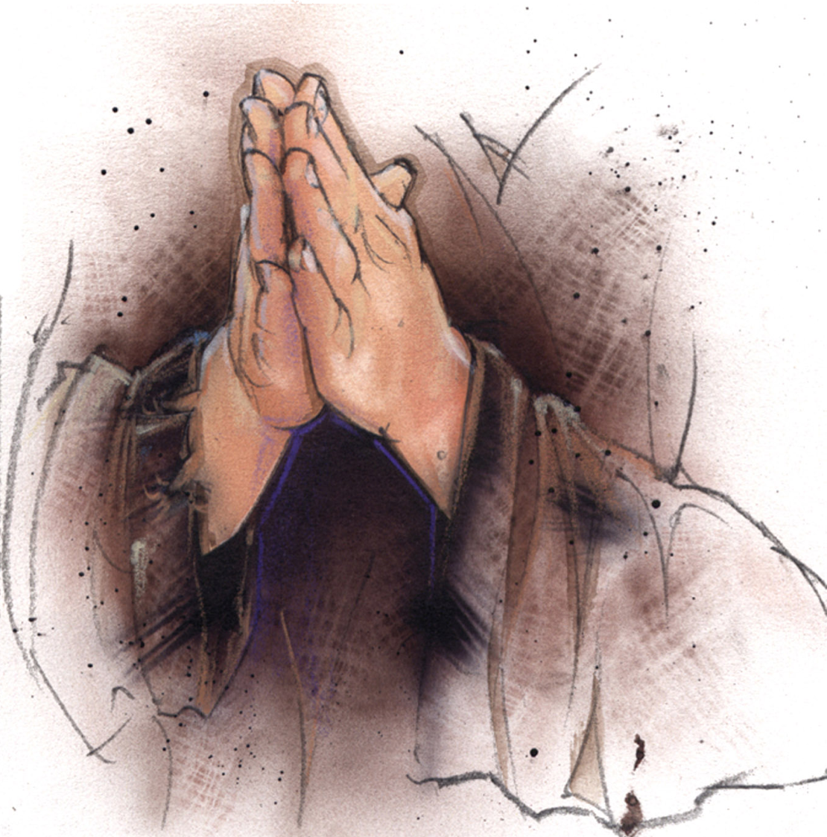
Day of Atonement Fasting (Leviticus 23:29)
Notes:
At this corporate fast day when all Jews went without food, all Jews were to "deny themselves," which likely meant a fast (Lev 23:29).
God commanded fasting in this case.

Slide 26
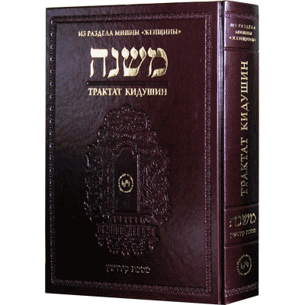
The Mishnah (AD 200)
Notes:
The Mishnah is a Jewish book that recorded Jewish traditions around AD 200.

Slide 27
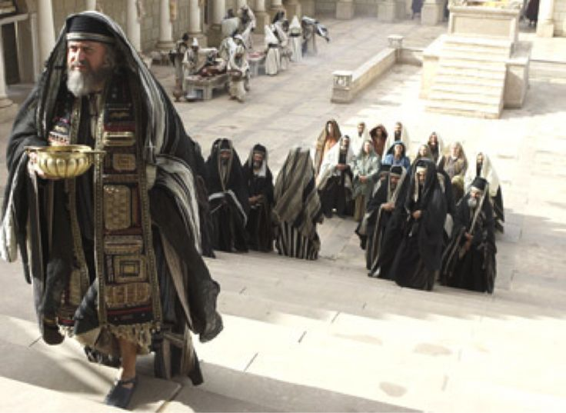
Mishnah Traditions
Notes:
…but these traditions went back to the time of Jesus and also much earlier. It has a section on fasting (pp. 194-201) that teaches the practice of the first century Jews:

Slide 28
Fast During Drought
Notes:
Details about three-day fasts are prescribed when rain has not fallen (Taanith 1.1, pp. 194-95).

Slide 29
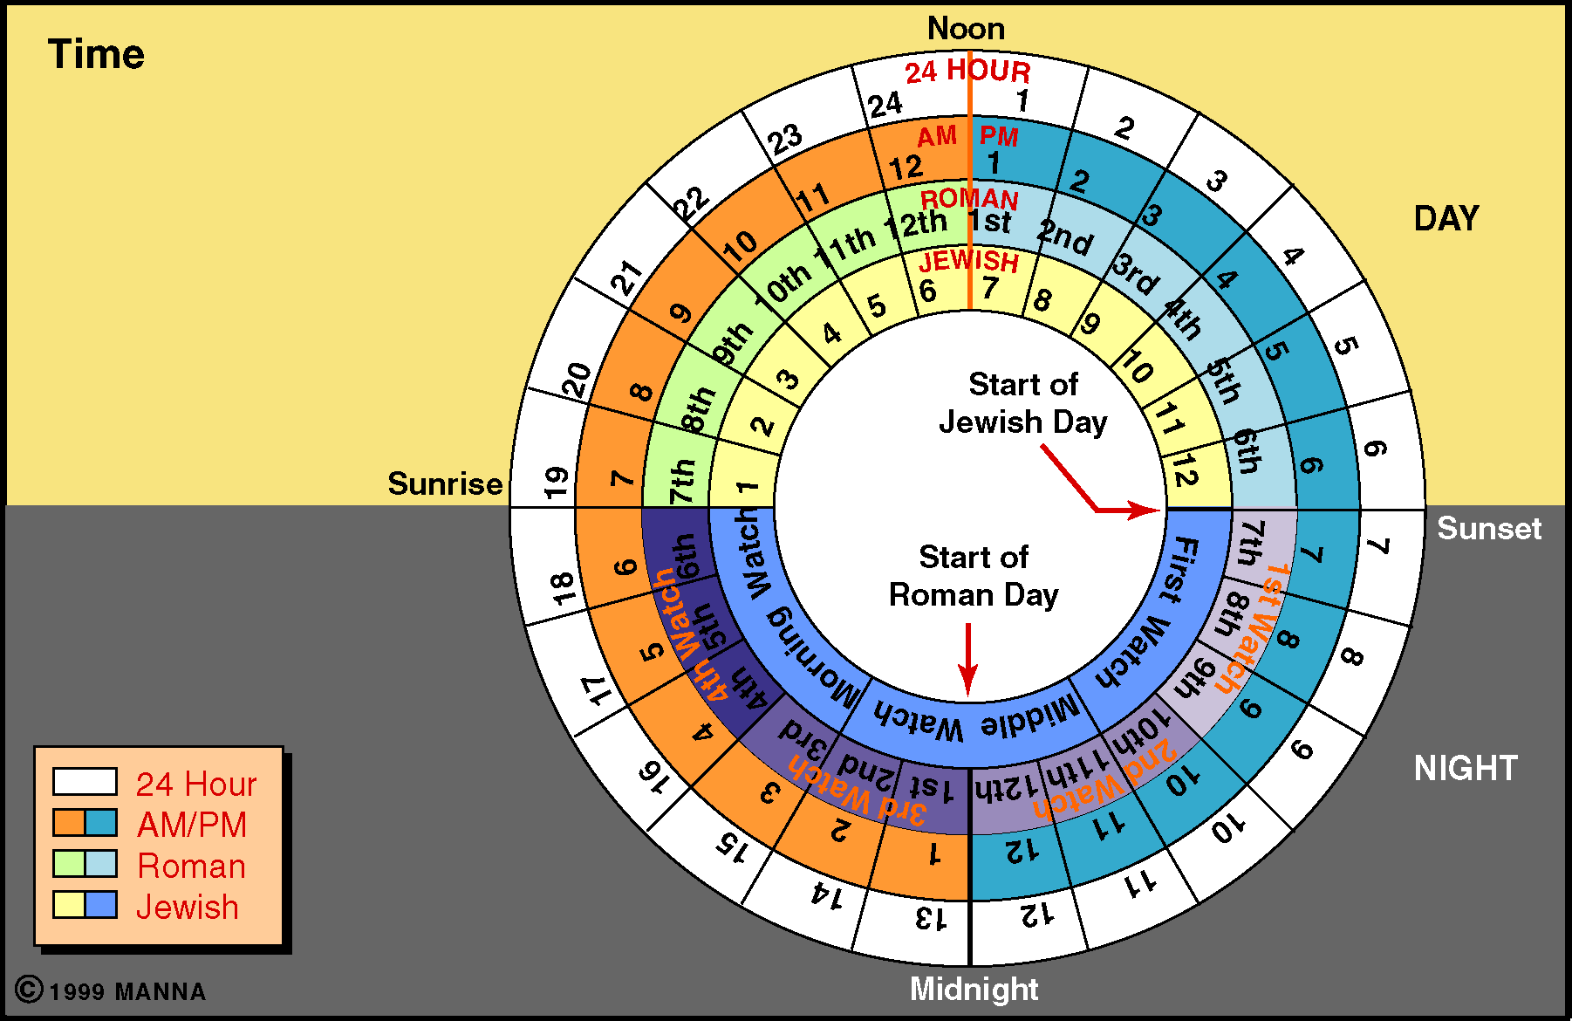
Fast
Eat
Notes:
Some fasts were entire days skipped without food while other times they fasted only during daylight hours similar to Muslims in Ramadan, ending it at the evening dinner (Taanith 2.6, 3.9, p. 197).

Slide 30
Fasting
CALENDAR
Fasting
Notes:
No three-day fasts began on a Thursday evening to Friday (the typical Jewish day beginning at sundown) as these would then prohibit eating on the Friday evening to Saturday Sabbath, which was to be a day of celebration (Taanith 2.9, p. 197).

Slide 31
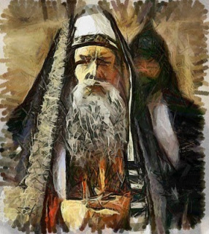
"And when you fast, don't… try to look miserable and disheveled…" (6:16 NLT).
Literally: "ruin their face"
Notes:
Those fasting shouldn't imitate the gloomy Pharisees (6:16b).
Why would the Pharisees not want to look good (6:16)?
Here, by not looking good, they did look good—in the eyes of men!
• The Greek here for "neglect their appearance" (NAU) or "look miserable" (NLT) literally means that they "ruin their face."
Now think about it.
Does fasting itself give one a gloomy face? Not really. Many times we actually feel better while fasting, that clears our bodies of toxins.
Does fasting prevent one from washing his face? "Oh, sorry, I can't wash my face. You see, I'm fasting!"
Does going without food mess up your hair? Obviously not!

Slide 32
"Fasting emphasized the denial of the flesh, but the Pharisees were glorifying their flesh by drawing attention to themselves" (Barbieri, "Matthew," in The Bible Knowledge Commentary, 2:32)

Slide 33
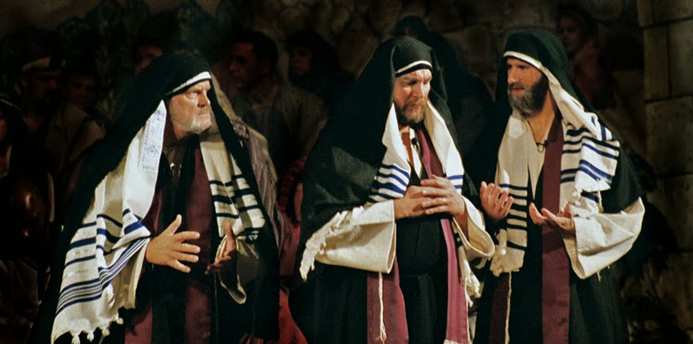
”…the hypocrites… try to look miserable and disheveled so people will admire them for their fasting. I tell you the truth, that is the only reward they will ever get" (6:16 NLT).
Notes:
The Pharisee's motivation for fasting was to look spiritual (6:16c).
But God doesn't reward that type of fasting.

Slide 34
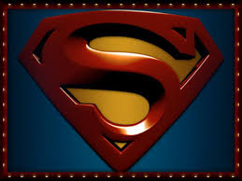
But God rewards secret fasting
Notes:
The way to fast for the Lord's praise is to fast so that others don't notice.

Slide 35
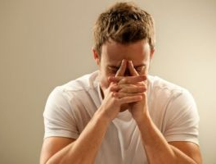
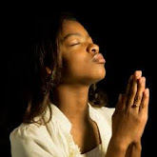
"But when you fast, comb your hair and wash your face" (6:17 NLT).
"But when you fast, put oil on your head and wash your face" (6:17 NIV).
Notes:
Those fasting should make their hair and face look good (6:17).
Fasting is a good discipline.
However, even a good practice can be done with a bad motivation. Therefore, Jesus cautions us not to fast for public show.
We should fast in such as way that people won't know it.
In his cultural context, they would still anoint their head with oil (=still use your hairspray!) and wash their face (=still put your makeup on).

Slide 36
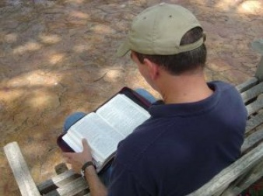
"Then no one will notice that you are fasting, except your Father, who knows what you do in private. And your Father, who sees everything, will reward you" (6:18 NLT).
Notes:
The Father rewards fasting in a way that people do not notice (6:18).

Slide 37
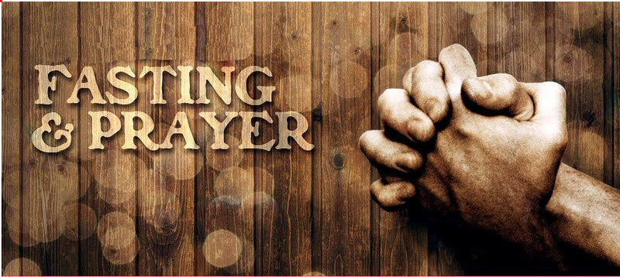
Fast for prayers —not for stares!
Notes:
When you do, God will notice.
When Susan and I fast, we don't tell anyone, but we use the time that it takes for food preparation, eating and cleanup for prayer instead of food.

Slide 38
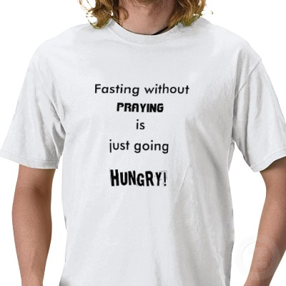
Fasting
Notes:
The point is not to focus to you! Fasting is about drawing your attention to God, not drawing people's attention to you!

Slide 39
Parallel Structure (Matt 6)
ALMS (1-4)
PRAYER (5-15)
FASTING (16-18)
Hypocrites (2)
Hypocrites (5)
Hypocrites (16)
Public show (1-2)
Public show (5)
Public show (16)
Human Reward (2)
Human Reward (5)
Human Reward (16)
Secret (4)
Secret (6)
Secret (18)
Father sees (4)
Father sees (6, 8)
Father sees (18)
Notes:
Barbieri notes, "In all three examples of Pharisaic 'righteousness'—almsgiving (vv. 1-4), praying (vv. 5-15), and fasting (vv. 16-18)—Jesus spoke of hypocrites (vv. 2, 5, 16), public ostentation (vv. 1-2, 5, 16), receiving their reward in full when their actions are done before men (vv. 2, 5, 16), acting in secret (vv. 4, 6, 18), and being rewarded by the Father, who sees or 'knows,' when one's actions are done secretly (vv. 4, 6, 8, 18)" (Barbieri, BKC, 2:33).

Slide 40
ONLY fasting?
Notes:
Now is Jesus only referring to fasting for public show? Yes, in verses 16-18 he is. But remember that the general principle of 6:1 applies to many spiritual disciplines. And what is that teaching?

Slide 41
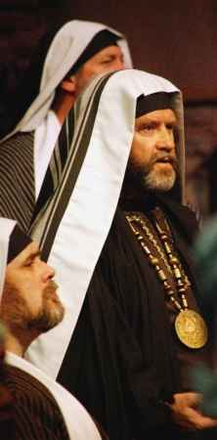
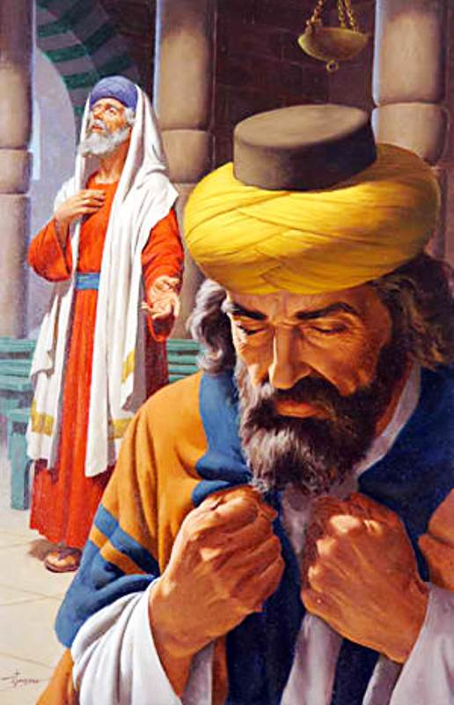
II. Religious rituals get either human or divine rewards—but not both.
Notes:
It's up to us whether we want blessing from God or man on our spiritual disciplines.

Slide 42
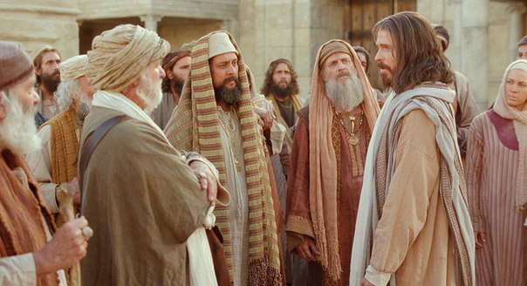
"Be careful not to do your 'acts of righteousness' before men, to be seen by them. If you do, you will have no reward from your Father in heaven" (6:1 NIV).
Notes:
Jesus warns about parading piety (6:1).
We are in the section of the Sermon on the Mount where Jesus calls into question the practices of the Pharisees.
The central idea goes back to Matthew 6:1, where Christ warns us not to do our "acts of righteousness" to be seen by men.
He has already applied this truth to giving (6:1-4) and prayer (6:5-15). Now he turns his attention to fasting (6:16-18).

Slide 43
Parading Public Piety
Notes:
But we can parade our piety in a number of areas!

Slide 44
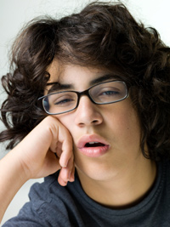
Fasting
Notes:
Prayer: "Man, you look tired!" "Well, I should—you see, I was in an all-night prayer meeting!"

Slide 45
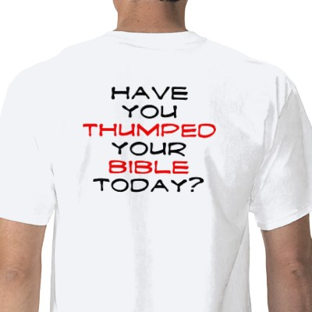
HAVE YOU THUMPED YOUR BIBLE TODAY?
Notes:
Bible: "Why don't you use your iPhone Bible?" "Well, if I did, people might think that I was texting. I carry this big, fat Bible so others will know that I am reading the Word of God!"

Slide 46
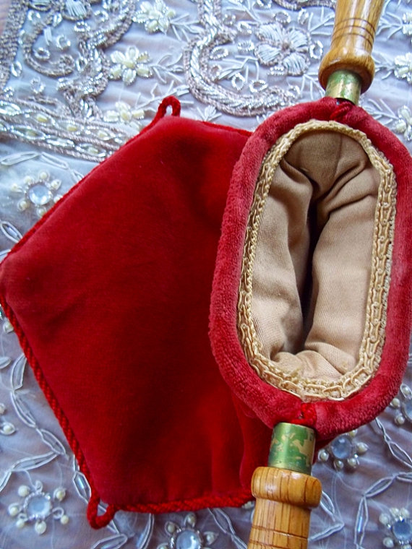
Giving
Notes:
Giving: "I notice that you always put something in the offering." "Well, of course I do. If I sent my offering via bank transfer then only the treasurer would know that I gave!"

Slide 47
Evangelism
Notes:
Evangelism: "Wow, I notice that you are always sharing Christ!" "Sure, I do. Don't we all talk about Jesus everyday?"

Slide 48
How can you do your spiritual disciplines in a way that God rewards?

Slide 49
Main Idea
Choose whom you want to reward you.
Notes:
But how will God bless your spiritual disciplines?

Slide 50
I. God rewards only secret fasting (6:16-18).

Slide 51
II. Religious rituals get either human or divine rewards—but not both.
Notes:
It's up to us whether we want blessing from God or man on our spiritual disciplines.

Slide 52
Where Secret Disciplines Show Up
V
Fasting
Prayer
Bible study
Witnessing
Service
Don't
Notes:
So where do spiritual disciplines show up?
• or should I say, "Don't show up"?
• Don't go without food for people to see—do it to draw near to God instead!
Are you parading your piety in any other way? For example…
• Sharing about your quiet time or prayer life?
• Showing whether you did your Bible study homework?
• Telling other about whom you led to Jesus?
• Making sure others know about your faithfulness to God?

Slide 53
Black

Slide 54
NT Sermons link at biblestudydownloads.org
Get this presentation and script for free!

