Slide 1
When You Are Persecuted…
Matthew 5:10-12
Dr. Rick Griffith
Singapore Bible College

Slide 2
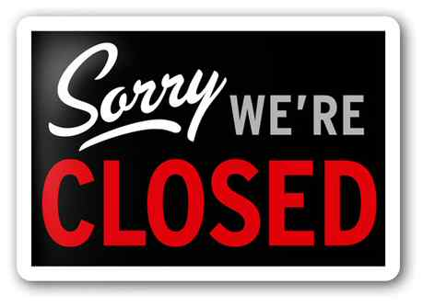
Title
Notes:
Imagine if today you came to worship with your church only to be turned away because the landlord of the property doesn't want to rent to people of faith -- not because of conflicts with building use, but just because of religious discrimination. Imagine then if the landlord was the local government...in an American city. But this is just an urban legend, right?

Slide 3
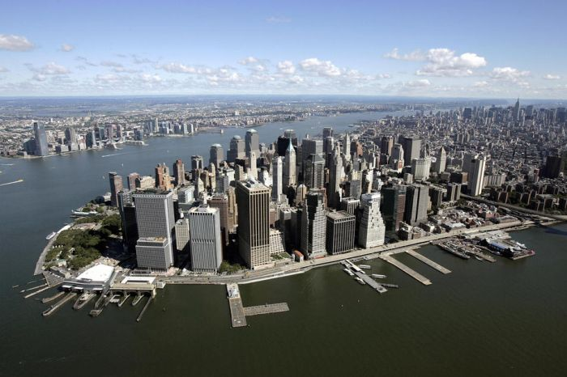
New York City
Notes:
Sadly this is really happening now in New York City. For the past decade, New York's Department of Education has given about 60 small, mostly Christian, upstart or itinerant congregations the option to hold their weekend services in any one of the city's empty school buildings. The only condition is that they pay to use the facilities -- a nice benefit to the cash strapped public education system.

Slide 4
Notice of Eviction
Notes:
Now, the Department of Education has reversed course, and as many as 100 churches face eviction on February 19 [TODAY!], as the school board's ban against the use of property by religious congregations goes into effect.

Slide 5
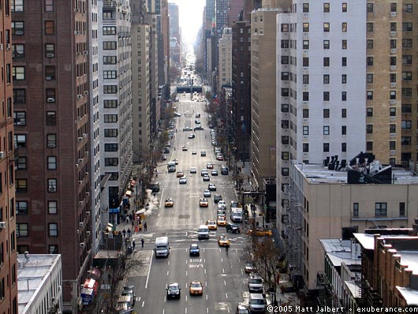
Tough to Find a New Place of Worship
Notes:
The evictions could be devastating to small congregations and church plants in the city. With limited space in one of the most densely populated areas of the world, and real estate costs that are sky-high, opportunities for ministry in many areas of the Big Apple would be effectively shut down” (FRC News email).

Slide 6
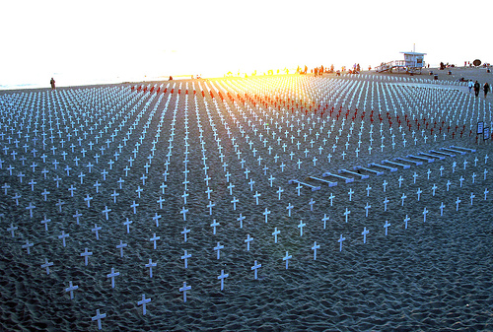
2 Timothy 3:12
“Yes, and everyone who wants to live a godly life in Christ Jesus will suffer persecution.”
Notes:
But that’s way over in New York City,” you say. “Christians don’t need to pay a price for their faith in Singapore.” Really? God’s Word says in 2 Timothy 3:12, “Indeed, all who desire to live godly in Christ Jesus will be persecuted” (NIV).

Slide 7
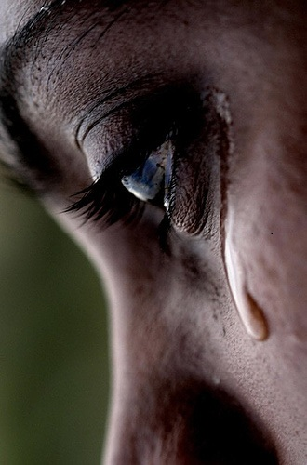
What price are you paying for being a Christian?
Notes:
Sometimes we get passed up on a promotion due to our faith in Christ.
Other times our family does not understand our faith and fights against us—as a new Christian, my parents sometimes kept me from attending church.
Other prices we pay are financial, social, or ridicule for believing in a condemned criminal who died 2000 years ago

Slide 8
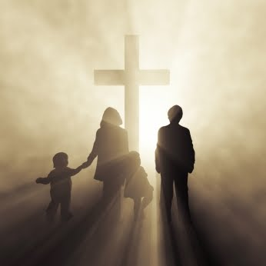
How do you respond to unjust treatment?
Notes:
Anger?
“Hey, this is unfair!”
Or do you get sullen and depressed?

Slide 9
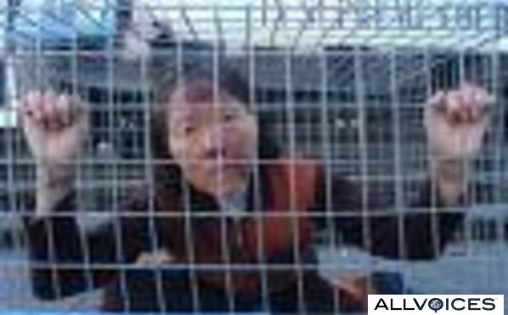
How should you respond to unjust treatment?

Slide 10
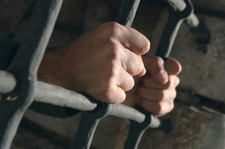
Be joyful!
How should you respond to unjust treatment?
“Consider it all joy when you face trials of various kinds” –James 1:2

Slide 11
Be glad!
How should you respond to unjust treatment?
“Rejoice and be glad!”
–Matt. 5:12a

Slide 12
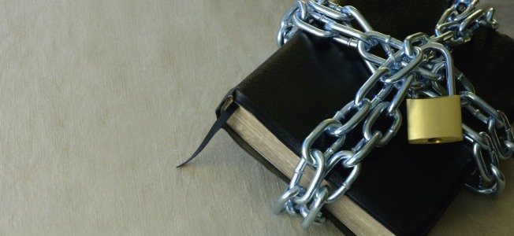
Why should we accept persecution with joy?

Slide 13
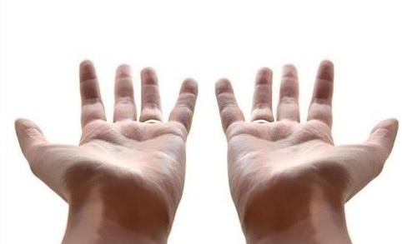
The Beatitudes
Notes:
Today’s text comprises a few verses on the Blessed Life in Matthew 5

Slide 14
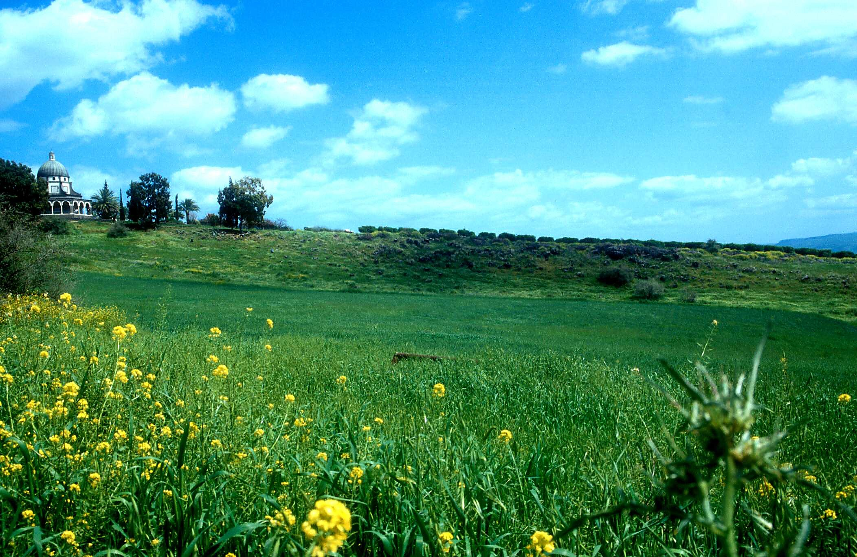
Mount of Beatitudes
Notes:
These verses begin the most famous sermon ever preached—that by Jesus.
He spoke these words on a hill just north of the Sea of Galilee.

Slide 15
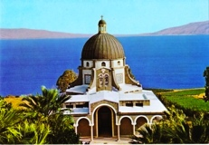
Church of the Beatitudes
Notes:
He spoke these words on a hill just north of the Sea of Galilee.

Slide 16
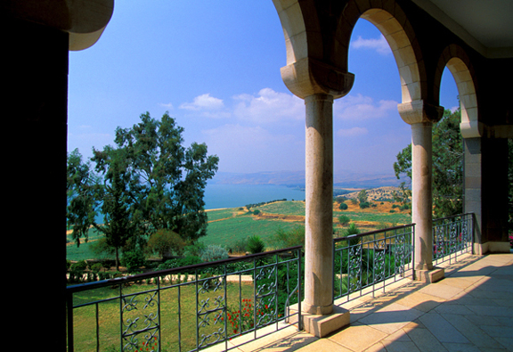
View of the Sea of Galilee
Notes:
Now the Church of the Beatitudes marks the spot—a beautiful setting looking down the grassy hill towards the lake.

Slide 17
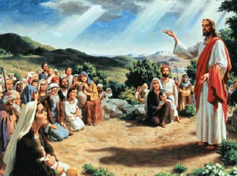
What did Christ teach?
Notes:
But what did Jesus teach at this spot?

Slide 18
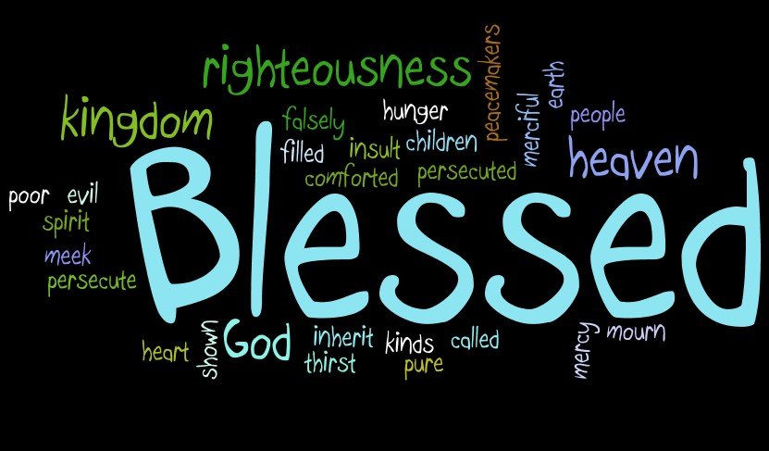
The “Be Attitudes”
“The sermon showed how a person who is in right relationship with God should conduct his life” (Barbieri, BKC)
Notes:
Some call his sermon the “Be Attitudes.” They show not so much what we should do, but what we should be to see God’s blessing on our lives. One scholar says, “The sermon showed how a person who is in right relationship with God should conduct his life” (Barbieri, BKC).
Therefore, as part of Jesus’ sermon, today’s verses show how we respond to persecution when we are rightly related to God.
People who live the Beatitude life will stand out and be persecuted

Slide 19
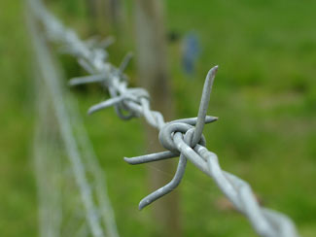
Matthew 5:10-12
Two reasons we should accept persecution with joy
Notes:
Matthew 5:10-12 is the encouragement from Jesus Himself on why we should welcome suffering into our lives.
In these three short verses, Jesus gives two reasons we should accept persecution with joy.
Transition: The first reason we should accept persecution with joy is…

Slide 20
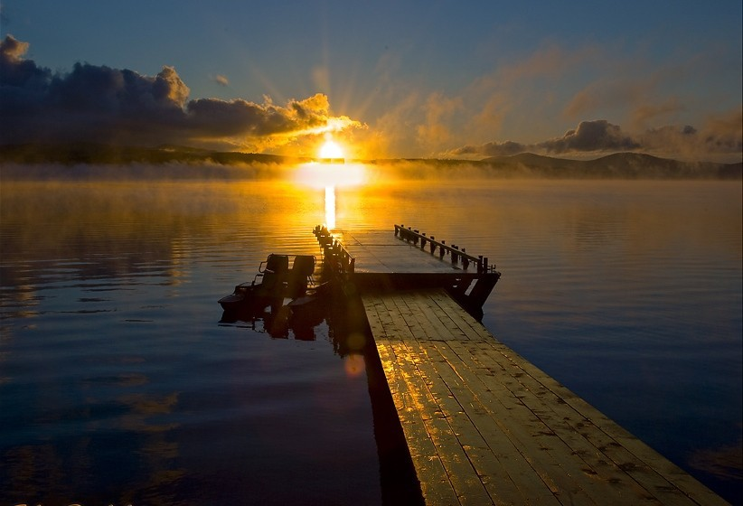
I. Persecution causes us to look forward to our rich rewards (10-12a).

Slide 21
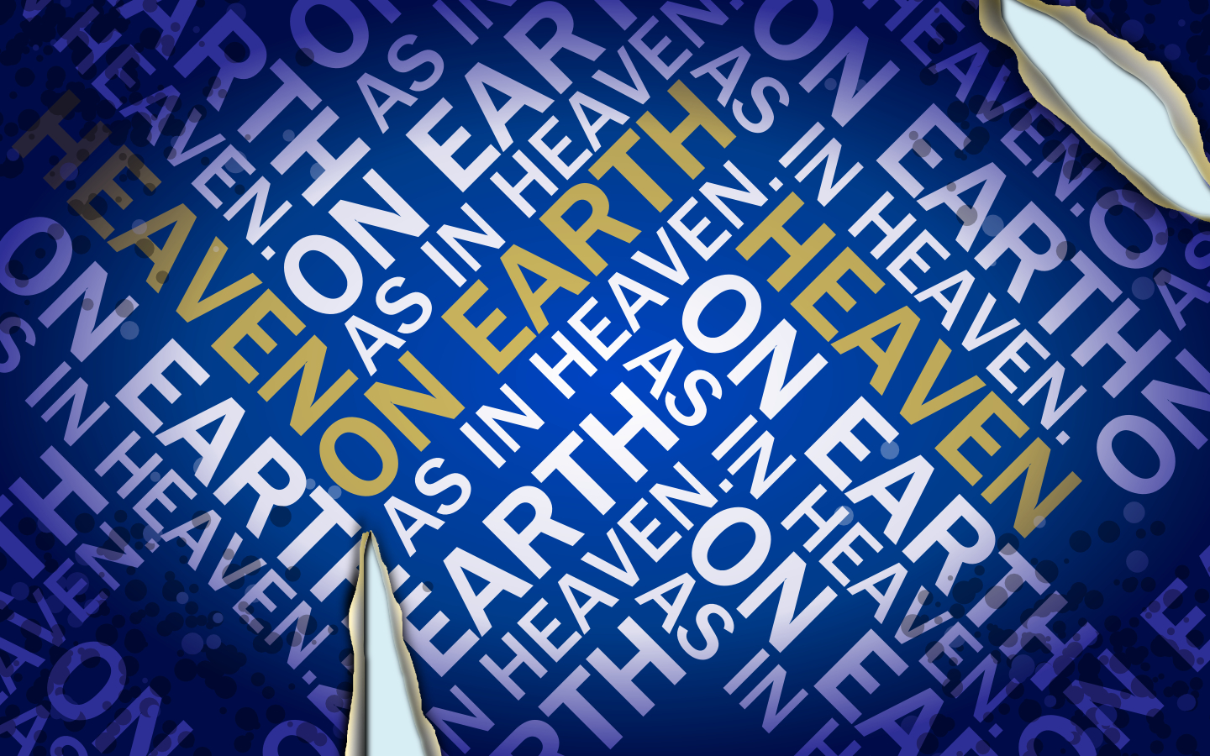
God blesses us when we are persecuted for doing right because our suffering shows we are members of God’s family
“On earth as it is in heaven” (6:9)

Slide 22
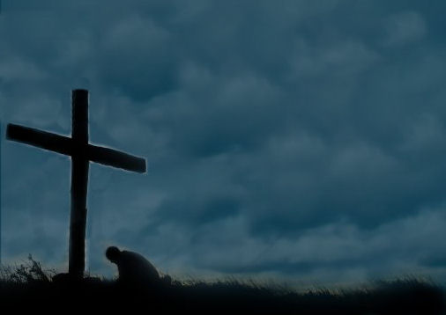
Matthew 5:10 NLT
“God blesses those who are persecuted for doing right, for the Kingdom of Heaven is theirs.”

Slide 23
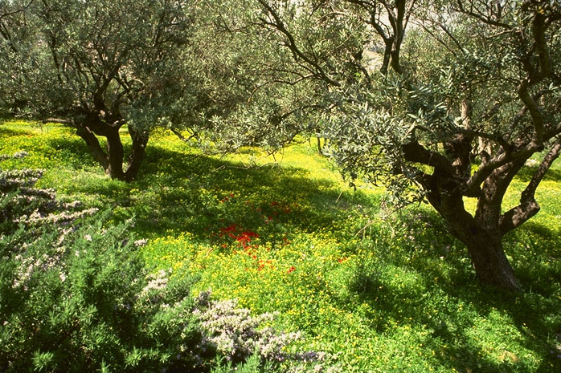
The Kingdom
JESUS
Life
Cross
Church
Gospels
Acts
Epistles
Revelation
The Garden of Gethsemane, Mount of Olives, Jerusalem
64
1

Slide 24
Matt. 3:1-2 NLT
"In those days John the Baptist came to the Judean wilderness and began preaching. His message was, 'Repent of your sins and turn to God, for the kingdom of heaven is near' "
JESUS
Life
Cross
Church
Gospels
Acts
Epistles
Revelation
65

Slide 25
Matt. 4:17, 23
“…Jesus began to preach and say: 'Repent, for the kingdom of heaven is at hand…Jesus was going throughout all Galilee, teaching in their synagogues and proclaiming the gospel of the kingdom…' ”
JESUS
Life
Cross
Church
Gospels
Acts
Epistles
Revelation
65
Notes:
What was Jesus saying to us? In Matthew's fourth chapter, we are told that “Jesus began to preach and say: 'Repent, for the kingdom of heaven is at hand…Jesus was going throughout all Galilee, teaching in their synagogues and proclaiming the gospel of the Kingdom…'”
What is that Kingdom? What did he mean?

Slide 26
Matt. 10:5-7
"Jesus sent out the twelve apostles with these instructions: 'Don't go to the Gentiles or the Samaritans, ⁶ but only to the people of Israel—God's lost sheep. ⁷ Go and announce to them that the kingdom of heaven is near'"
65
Notes:
What was Jesus saying to us? In Matthew's fourth chapter, we are told that “Jesus began to preach and say: 'Repent, for the kingdom of heaven is at hand…Jesus was going throughout all Galilee, teaching in their synagogues and proclaiming the gospel of the Kingdom…'”
What is that Kingdom? What did he mean?

Slide 27
Matt. 6:33
“But seek first His Kingdom and His righteousness, and all these things will be added to you.”
JESUS
Life
Cross
Church
Gospels
Acts
Epistles
Revelation
66
Notes:
Two chapters later, Matthew reports Jesus saying, “But seek first His Kingdom and His righteousness, and all these things will be added to you.”

Slide 28
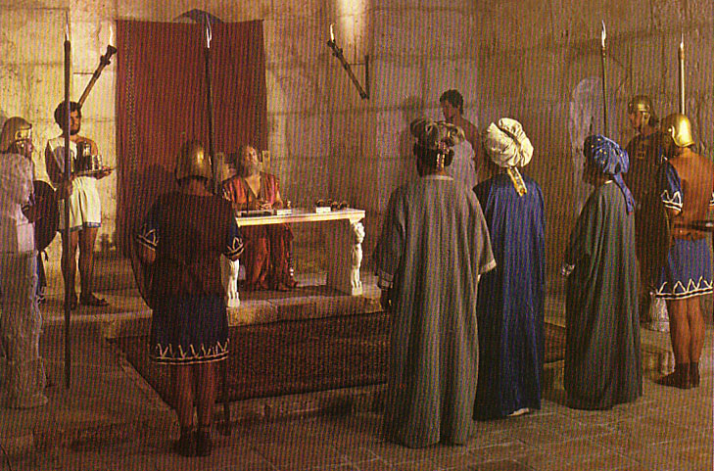
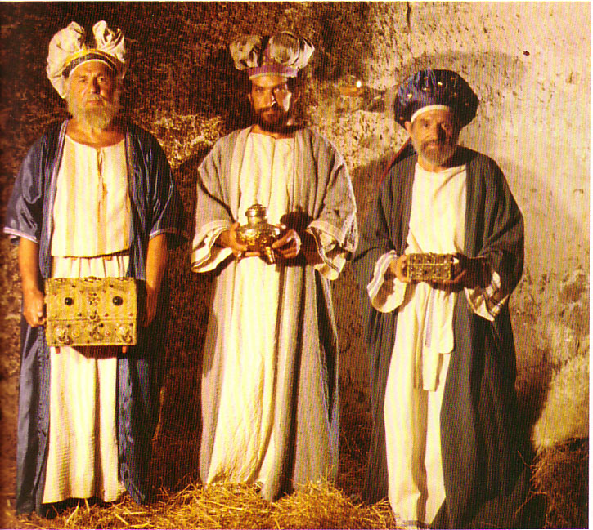
What Kind of Kingdom Did Isaiah (and Matthew) Envision?
78b
Political
Physical
Emotional
Intellectual
Spiritual

Slide 29
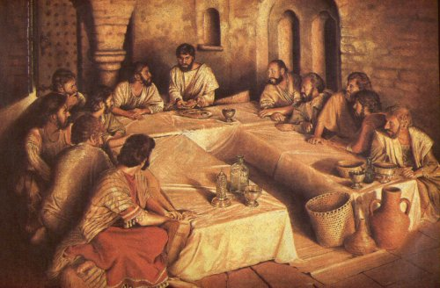
Jesus Promised a Political Kingdom
Then Peter said to him, “We’ve given up everything to follow you. What will we get?”
²⁸Jesus replied, “I assure you that when the world is made new and the Son of Man sits upon his glorious throne, you who have been my followers will also sit on twelve thrones, judging the twelve tribes of Israel” (Matt. 19:27-28)

Slide 30
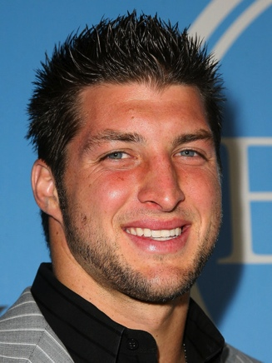
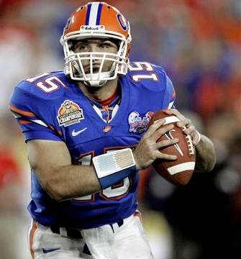
Tim Tebow
Notes:
How many of you have heard of Tim Tebow?
He’s the starting quarterback for the Denver Broncos at a height of 1.91 m. and weight of 111 kg. Born in Manila to Baptist missionary parents and then homeschooled, he is now 24 years old and a football sensation—both in passing and running.

Slide 31
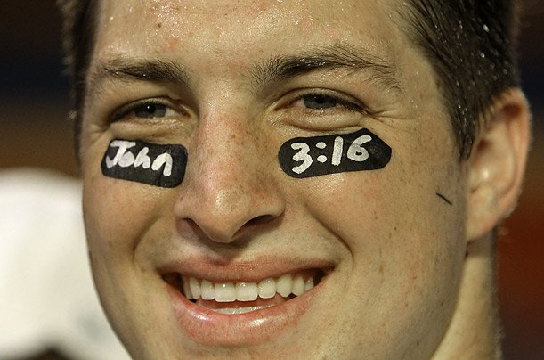
Tim Tebow
Notes:
He’s also an outspoken Christian. “During his college football career, Tebow frequently wore references to biblical verses on his eye black. In a 2009 Championship Game, he wore John 3:16 on his eye black; the verse was the highest-ranked Google search term over the next 24 hours, generating over 90 million searches!”
Tebow also helps the suffering and dying look to the future. Each week he sponsors a dying person and his family to his game—whether home or away—and meets with that person for about an hour after the game.
Not surprisingly, Tim Tebow has many critics due to his righteous life.
In answer to an interview question, Tebow stated that he was a virgin. The statement was subject to much discussion about whether the question was necessary, including criticism of the reporter who originally asked!
He gets a lot of press when he gets a picture taken of him with an attractive girl, implying that he has been unfaithful to his pledge.
One “Poll Finds 43 Percent Believe God Helps Tebow Win” appeared on the website liberalvaluesblog.com on 13 Jan 2012 by Ron Chusid, who wrote: Travis, Clay (July 23, 2009). "Tim Tebow Says He's Still a Virgin, Saving Himself for Marriage". Retrieved 15 August 2010.; cited at http://en.wikipedia.org/wiki/Tebow#cite_note-63
There are certainly a lot of ignorant Americans. A recent poll found that 43 percent believe God helps Tim Tebow win football games.
I wonder how they explain the games in which Tebow doesn’t win. Did Tebow (or his fans) do something wrong to cause God to make him lose, or does God lack the power to control everything in a football game?
Even more importantly, if they believe that God is interested in football to the point of intervening, why doesn’t God intervene in more important areas which might reduce human suffering. Do they really believe that intervening to determine who wins a football game is more important to God than intervening to prevent the Holocaust?
Other reporters have asked if this guy is really for real—“Does he really care for the sick and dying to meet them every week?” Well, he does!
His critics even worked to change the rules so players could not write anything on their eye black!
Tebow has said of his critics, "I just have a passion to play football. When you do things different than other people sometimes do them, and you don't settle for just being average, you open yourself up for criticism. But, I'm ready for it. I've learned to live with it. I never just wanted to do things the same way everybody else does."
5:10
You know what? If Jesus is correct here (and I believe he is!), then Tim Tebow is blessed because of doing right—despite getting criticized for it .

Slide 32
Matthew 5:10 NLT
“God blesses those who are persecuted for doing right, for the Kingdom of Heaven is theirs.”
Notes:
The way we are blessed is “for theirs is the kingdom of heaven.” What’s that mean?

Slide 33
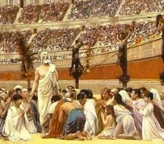
Enemies of the State?
Notes:
First century Christians had a reputation for being enemies of the State. Why?

Slide 34
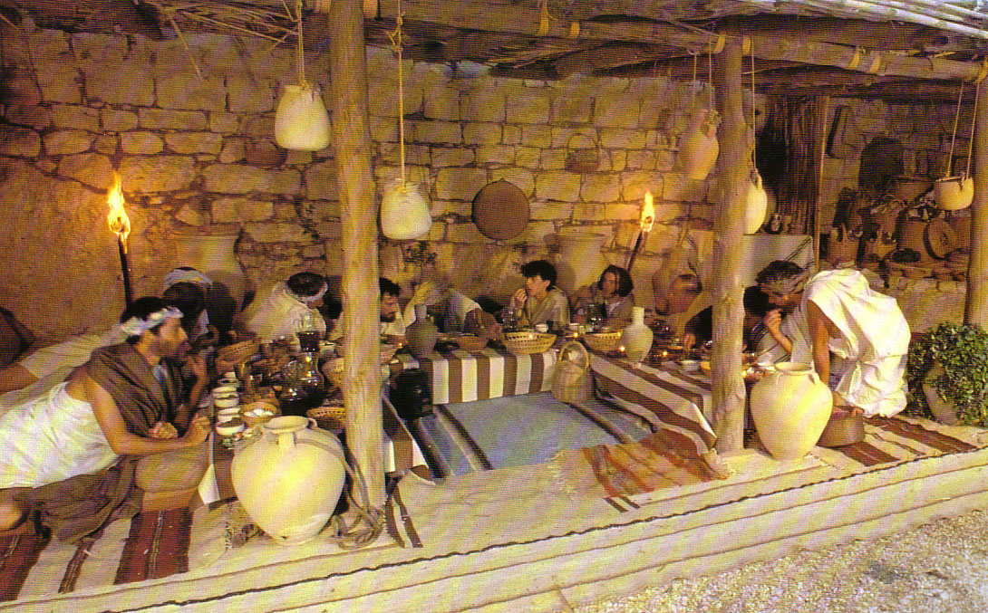
Jewish Passover
Notes:
Jews: Christians were initially seen as a branch of Judaism and thus had the protections of Roman law afforded the mostly wealthy Jews

Slide 35
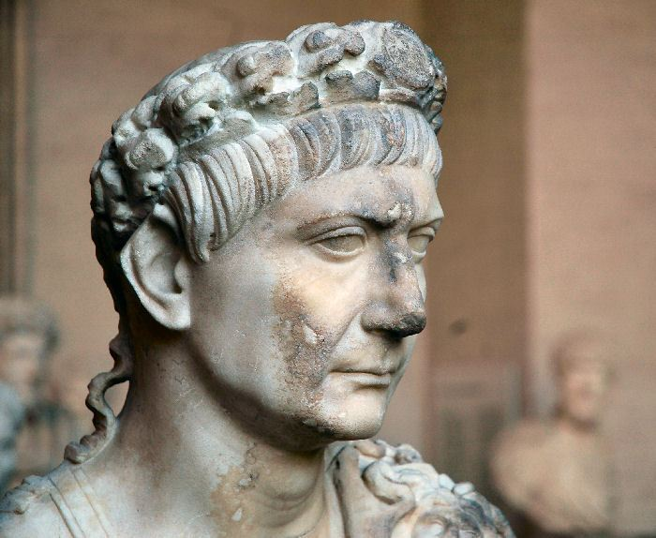
Rome Protected Jews
Notes:
But when many Gentiles became Christians, Jews joined in persecuting them because of their disdain for Jesus as Messiah.

Slide 36
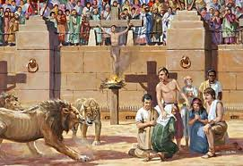
Persecution for Righteousness
Notes:
False rumors also spread about Christians that led to horrible persecution

Slide 37
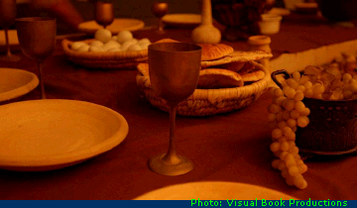
“Do this to remember me”
????
Cannibals!
Notes:
Cannibalism was assumed since they ate Christ’s body and drank his blood

Slide 38
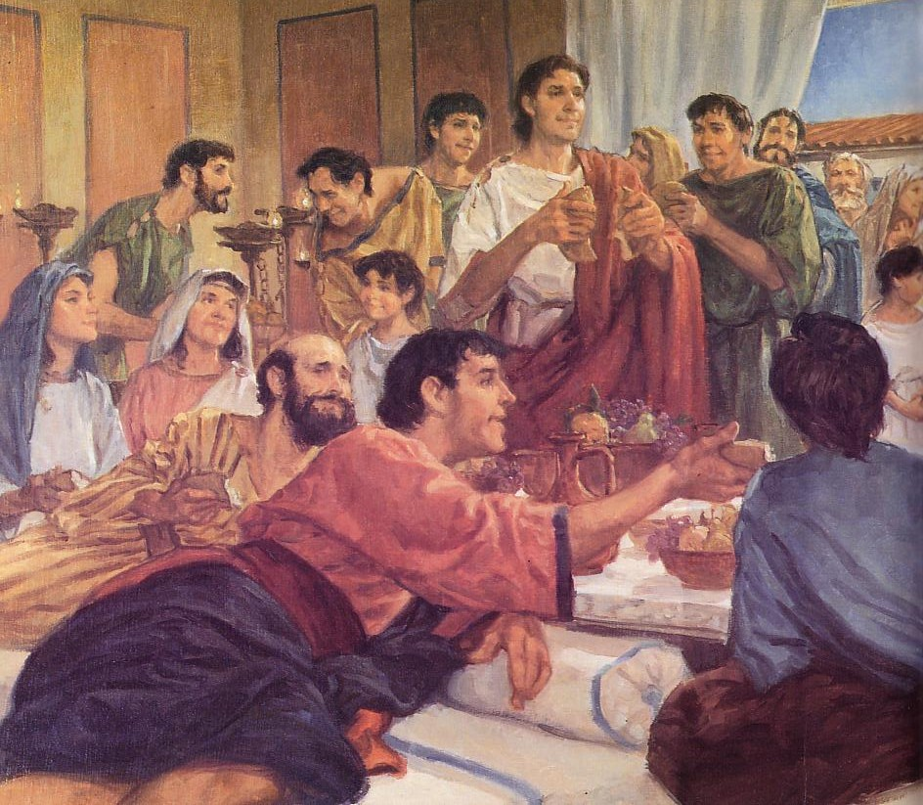
The Agape (Love) Feast
Incest!
????
Notes:
Immorality was assumed since they had “love feasts” and gave the “kiss of peace.” “They call each other ‘brother’ and ‘sister’ so they must have immorality at their love feasts!”

Slide 39
Worship in Catacombs
????
Murder!
Notes:
Murder of their children was surmised since they brought their children into the catacombs for instruction and baptism.

Slide 40
Perpetua's Martyrdom (AD 203)
Notes:
Emperor Worship: Rome had an incredibly vast empire of many languages, traditions, and religions—so appreciation to the State was expected in the form of an annual offering of incense and a simple statement: “Caesar is lord.” Once someone did this, they were give a certificate of being a law-abiding citizen and they could then go worship any god they wanted until next year. Jews were exempted from this, but Christians were not—and they could not say this since they knew that Jesus alone was Lord.
Today some also view us with suspicion when we declare that our primary allegiance is not to the government, but to Christ as Lord. Think how strange we are: We’re the only people who believe our leader was virgin born, resurrected, gives salvation simply by faith alone, and is coming back in the clouds to get us! We’re really different—and therefore suspect.

Slide 41
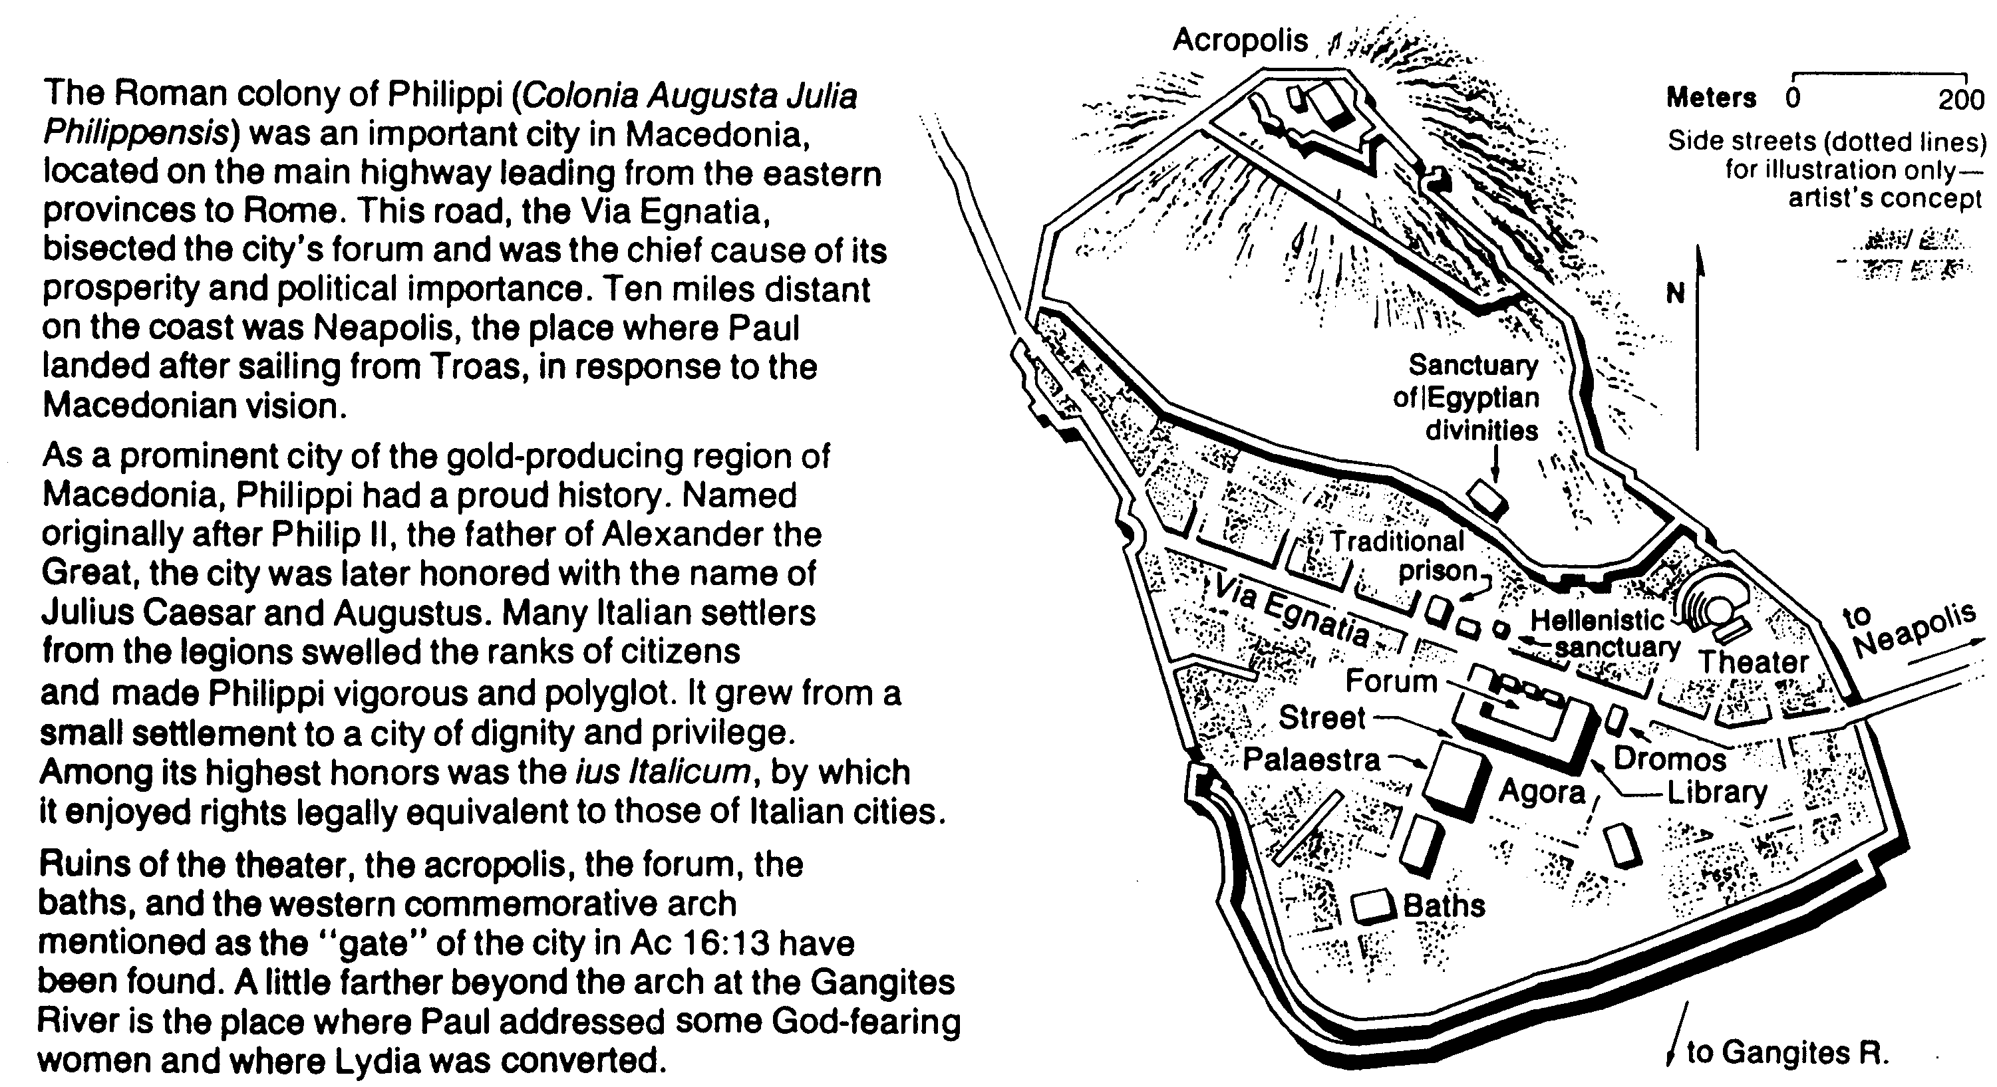
Philippi in the Time of Paul
186b
Bible Visual Resource Book, 247
Philippi was a rich, Roman colony with the same rights as the citizens of Rome!
“But we are citizens of heaven, where the Lord Jesus Christ lives. And we are eagerly waiting for him to return as our Savior” (3:20 NLT)
Notes:
We identify ourselves as citizens of heaven when we suffer for Christ.
We also appreciate what we have in heaven awaiting us!

Slide 42
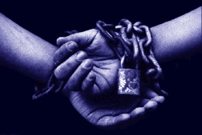
Matthew 5:11-12a NLT
“God blesses you when people mock you and persecute you and lie about you and say all sorts of evil things against you because you are my followers. ¹²Be happy about it! Be very glad! For a great reward awaits you in heaven.”
Notes:
We should rejoice about being persecuted for righteousness because we have greater heavenly rewards (11-12a)
God’s blessing comes when we are insulted, persecuted, and spoken evil of—just as the early Christians were.
We are commanded us to be joyful. The joy here is not an emotion but an attitude.
Christ promises more heavenly reward for those who suffer for his name!

Slide 43
I. Persecution causes us to look forward to our rich rewards (10-12a).
Notes:
(So the first reason we should accept persecution with joy is because persecution causes us to look forward to our rich rewards. The end of verse 12 states the second reason to suffer joyfully…)

Slide 44
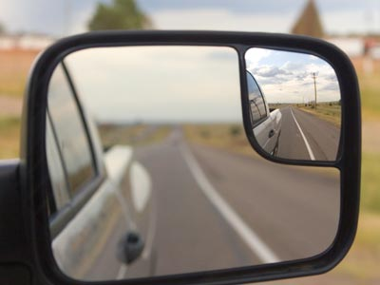
II. Persecution causes us to look back at our rich heritage (12b).
Notes:
Persecution causes us to look back at our rich heritage (12b).
[When we suffer now, it helps us identify with godly people in the past.]

Slide 45
Matthew 5:12b NLT
“And remember, the ancient prophets were persecuted in the same way.”
Notes:
The OT prophets paid a great price for their faith in God

Slide 46
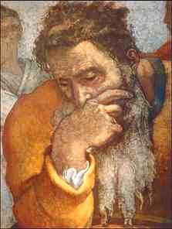
Overview
Jeremiah
Notes:
Jeremiah preached over 40 years but never saw many people respond

Slide 47
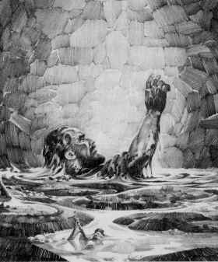
The prophet Jeremiah's life illustrates how costly serving the Lord can be.
Notes:
He was thrown into mud for days. Even Jerusalem was destroyed—just like he said

Slide 48
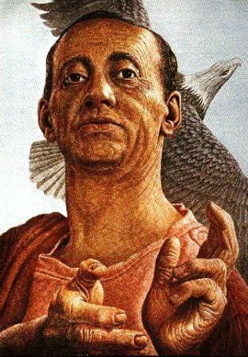
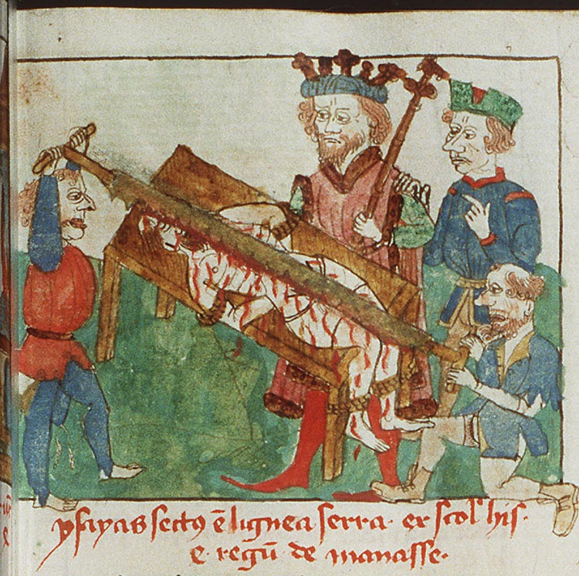
Isaiah the Prophet
Notes:
Isaiah ministered even longer—for 65 years! Yet the Jewish tradition is that he died by being sawn in two

Slide 49
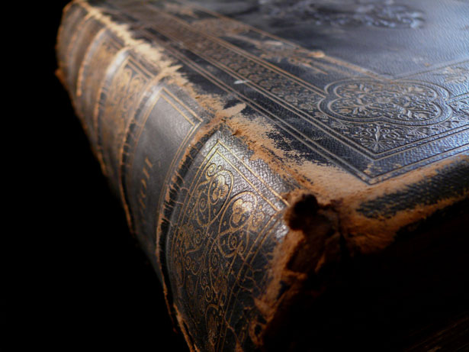
We identify with these great prophets when we suffer for Christ
Notes:
We identify with these great prophets when we suffer for Christ:
We have no reward for suffering due to sin or tactlessness (cf. 1 Pet. 3:14; 4:14-15).
But suffering due to our faith is admirable.
It’s not as if we are masochists who like pain—it’s more of the privilege of identifying with prophets of great faith.
The greatest of all these men of faith, of course, is Christ Himself.

Slide 50
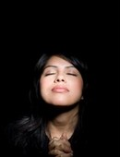
Main Idea:
Rejoice in persecution because it helps you look in two key directions
Notes:
(So how can we sum up what Jesus is saying to us in this passage? Simply this way…)
Rejoice in persecution because it helps you look in two key directions (MI)
Be glad for the opportunity to suffer for Christ since this helps you think about your eternal home and identify with godly saints of old (restatement)

Slide 51
I. Persecution causes us to look forward to our rich rewards (10-12a).

Slide 52
II. Persecution causes us to look back at our rich heritage (12b).

Slide 53
2 Timothy 3:12
“Yes, and everyone who wants to live a godly life in Christ Jesus will suffer persecution.”
Notes:
Think About 2 Tim. 3:12—raise your hand if God brings a situation to mind here…

Slide 54
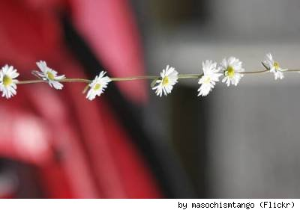
To Think About…
What price are you paying for being a Christian?
How can you look back?
How can you look forward?
Notes:
What price are you paying for being a Christian? At home? Work? With friends?
How can you look forward? Study “overcomers” in Rev. 2–3.
How can you look back? Read Jeremiah or Acts!

Slide 55
Black

