Slide 1
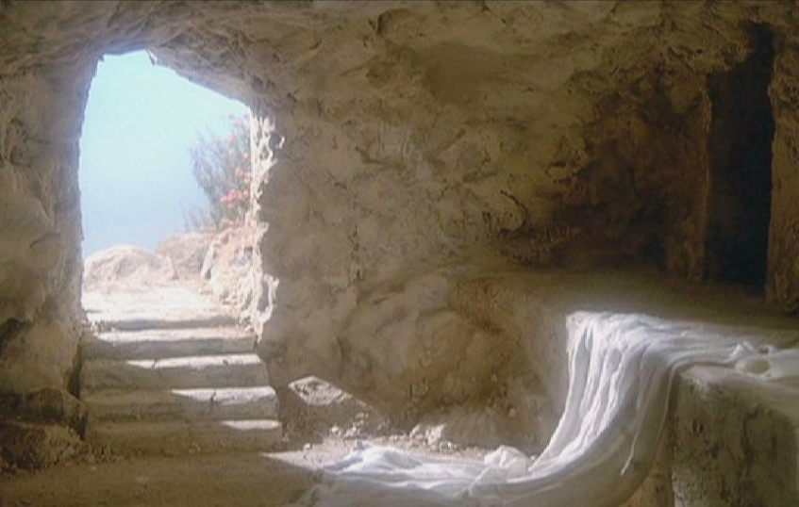
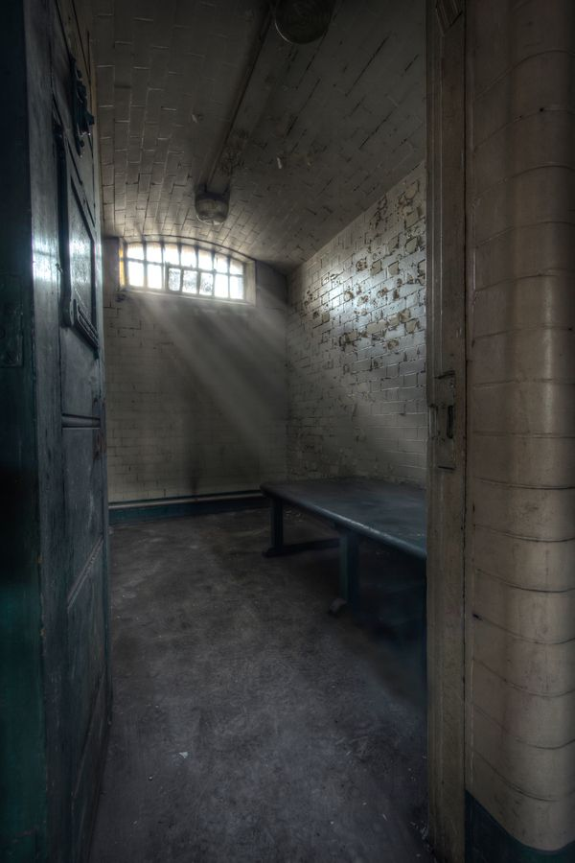
Resurrection Repeated
The Transformation of Forgiveness
Luke 24 – Acts 12

Slide 2
What do you regret?
If you could go back and do over . . . What would you do differently?

Slide 3
Peter’s Bad Passover
Boast of loyalty (Luke 22:33)
Prediction of 3-fold denial (Luke 22:34)
Asleep in prayer (Luke 22:45)
3-fold denial (Luke 22:55-61)
Leaves and weeps alone (Luke 22:62)

Slide 4
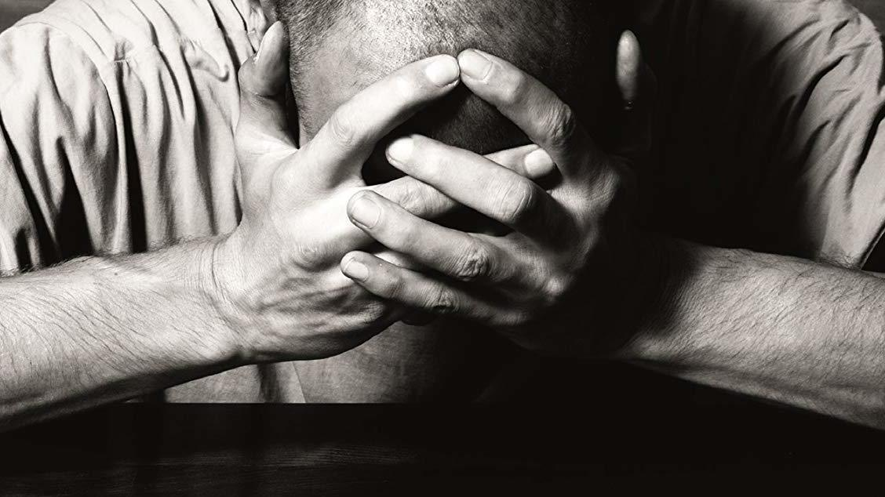
Is there hope for another chance?

Slide 5
Resurrection Repeated
The Transformation of Forgiveness
Luke 24 – Acts 12

Slide 6
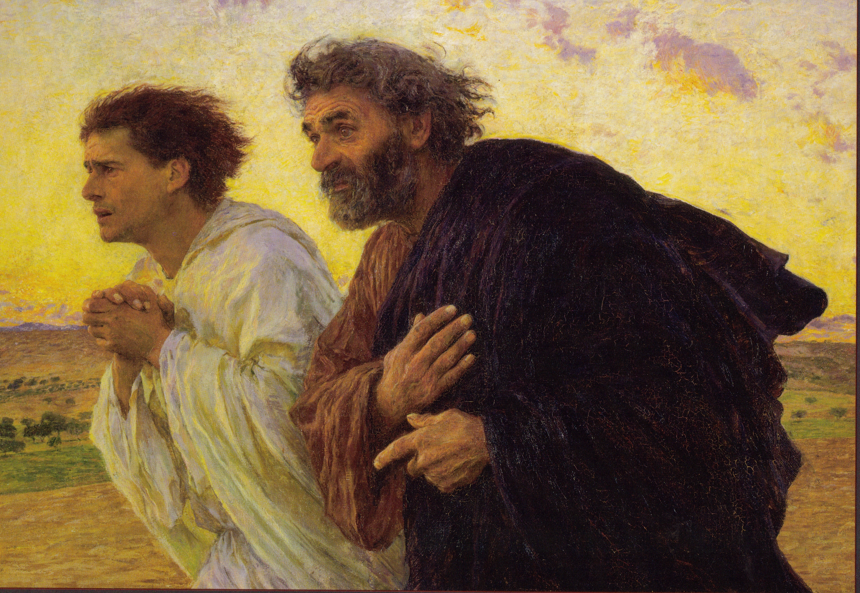
Luke 24:12
“But Peter rose and ran to the tomb; stooping and looking in, he saw the linen cloths by themselves; and he went home marveling at what had happened.”

Slide 7
Peter’s Transformation
Acts 1 – Peter leads disciples
Acts 2 – Peter preaches to crowds
Acts 3-4 – Peter heals people and faces Jewish leaders
Acts 5 – Peter confronts sin in the church
Acts 8 – Peter authorizes Samaritan conversion
Acts 9 – Peter performs miracles
Acts 10 – Peter leads Roman centurion to Christ
Acts 11 – Peter defends Gentile conversion

Slide 8
Peter’s Do Over
Acts 12

Slide 9
11 Similarities
between Jesus’ resurrection and Peter’s release
Jesus seized (Luke 22:54)
Peter seized (Acts 12:4)
Believing thief dies (Luke 23:39-43)
Believing disciple dies (Acts 12:2)
Jesus presented to Jews (Luke 23:13-18)
Peter potentially presented to Jews (Acts 12:4)
Servant girl identifies Peter (Luke 22:56)
Servant girl identifies Peter (Acts 12:13-14)
Unbelieving thief dies (Luke 23:39)
Roman guards die (Acts 12:4, 19)

Slide 10
11 Similarities
between Jesus’ resurrection and Peter’s release
Angel appears (Luke 24:4-7)
Angel appears (Acts 12:7)
Jesus prays (Luke 22:41)
Church prays (Acts 12:12)
Condemned man goes free (Luke 23:18-25)
Condemned man goes free (Acts 12:7-11)
Disciples disbelieve woman (Luke 24:11)
Church disbelieves girl (Acts 12:15-16)
Disciples amazed (Luke 24:12, 41)
Church amazed (Acts 12:17)

Slide 11
11 Similarities
between Jesus’ resurrection and Peter’s release
Tell others (Luke 24:9-10)
Tell others (Acts 12:17)

Slide 12
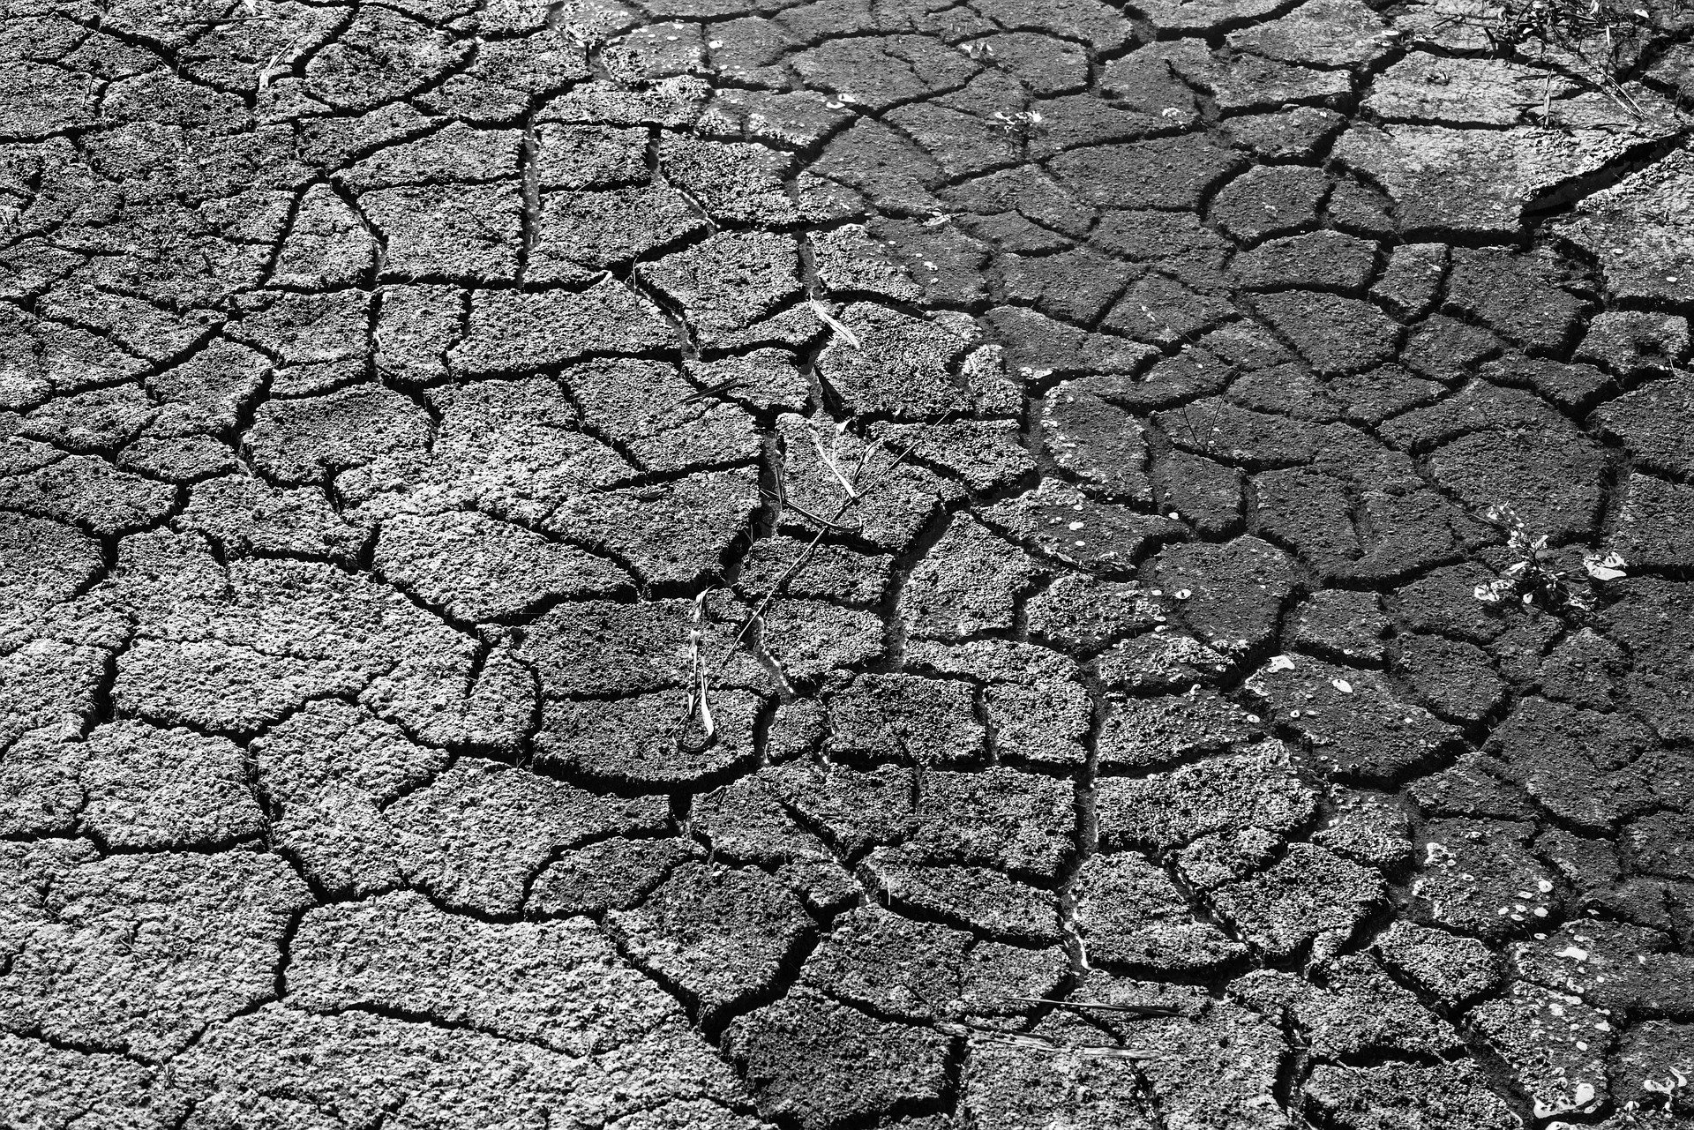
Did you know?
Economic disaster predicted
Acts 11:27-30

Slide 13
What Do We Learn from This Event?
Forgiveness motivates ministry
Suffering and opposition are part of the path for the believer’s discipleship
Part of God’s transformation of our lives includes increasing our courage
Prayer is a primary corporate practice
God uses tragedy and crisis to extend His reign over the world

