Slide 1
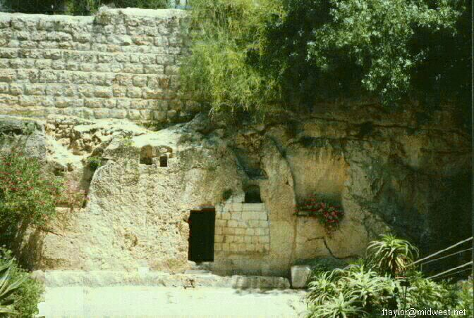
New Life!
John 20
Notes:
1

Slide 2
20 February 2011
20 February 1991
Notes:
2
2

Slide 3
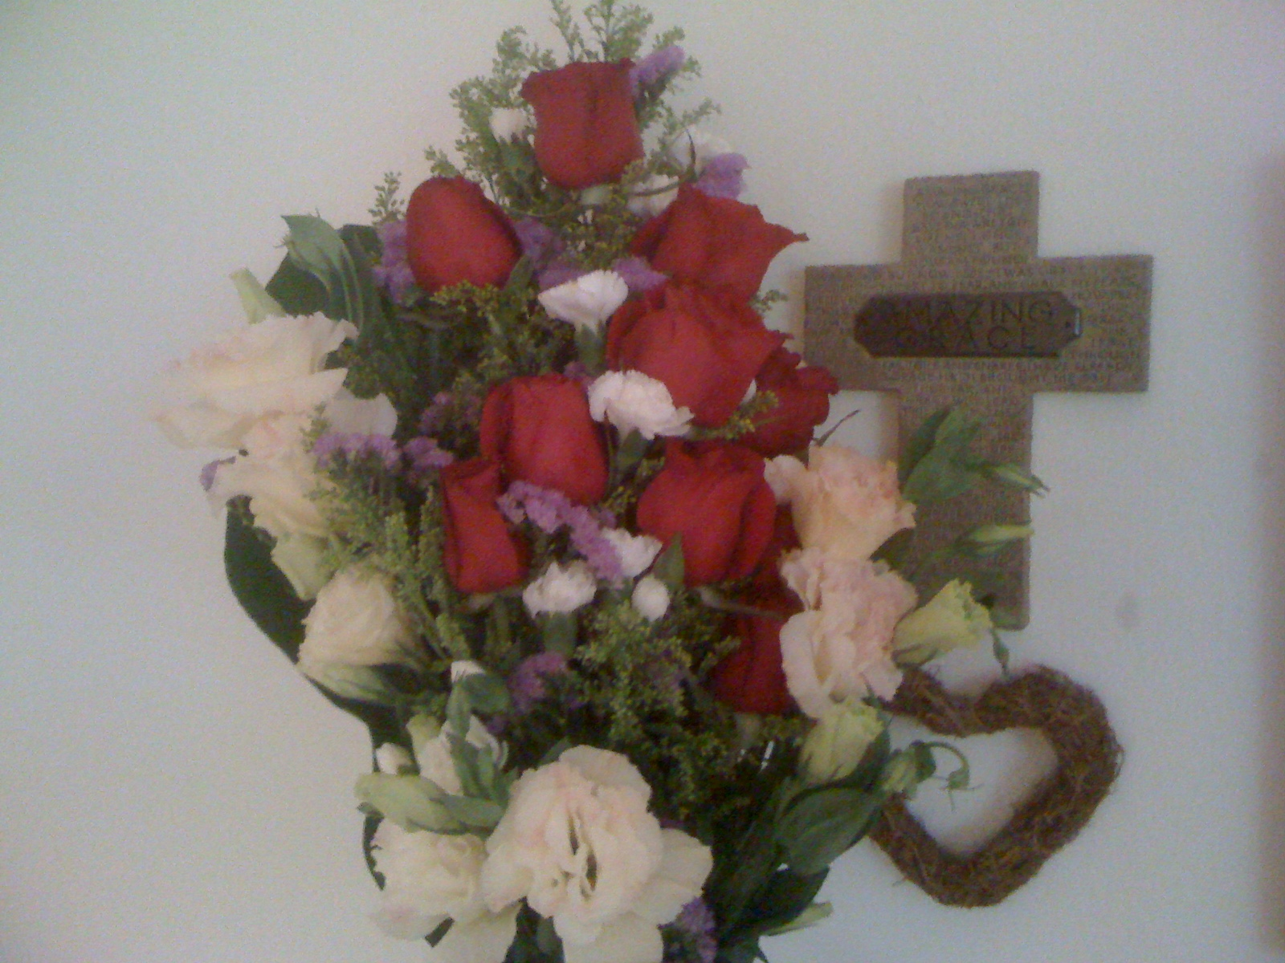
20 Years in Singapore!
Notes:
3
3

Slide 4
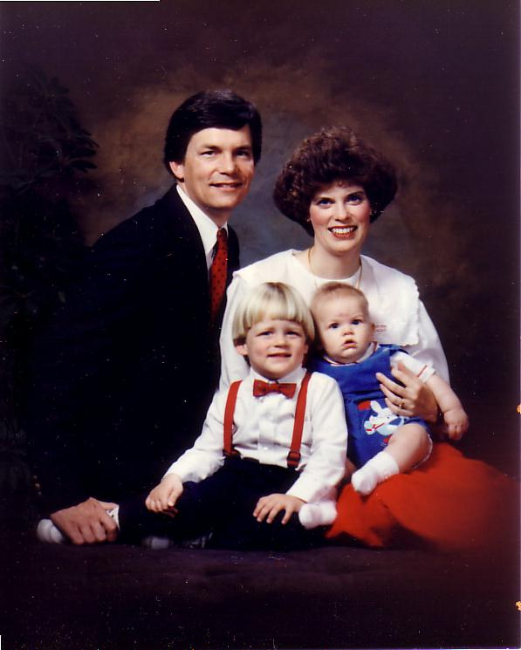
1991: Move to Singapore
Rick, 33
Susan, 30 something
Kurt, 4
Stephen, 1
Notes:
So 10 years after our first move to Asia as singles, we arrived as a family of four.

Slide 5
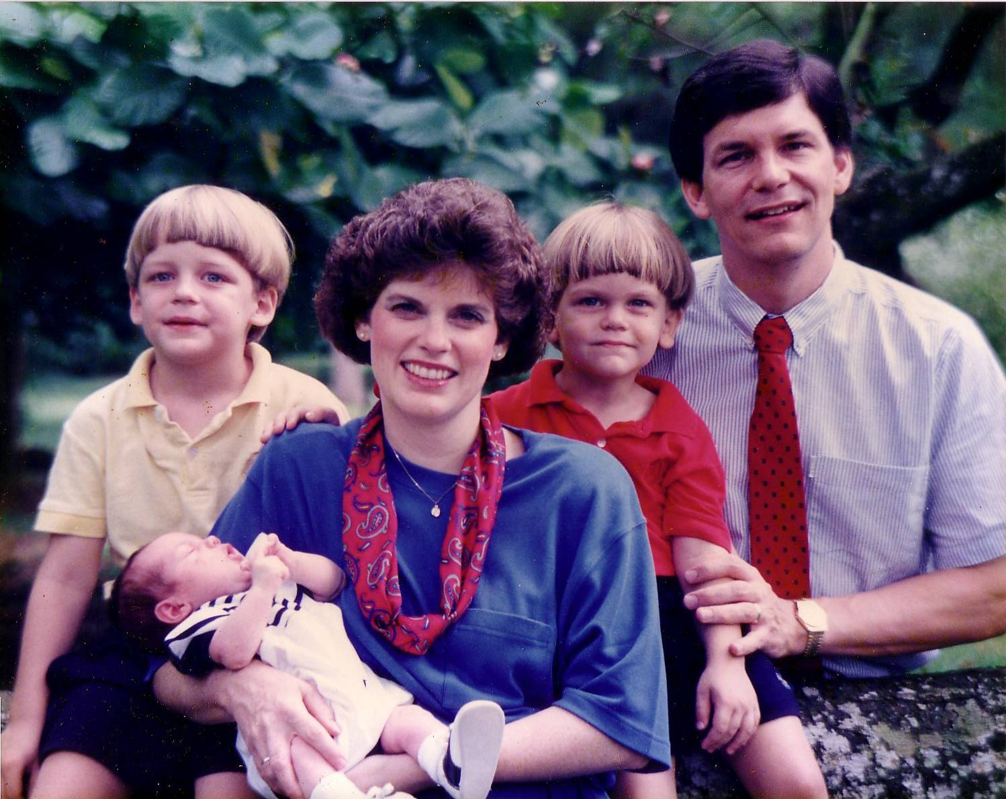
1992
Notes:
In our second year here, our third son John was born.

Slide 6
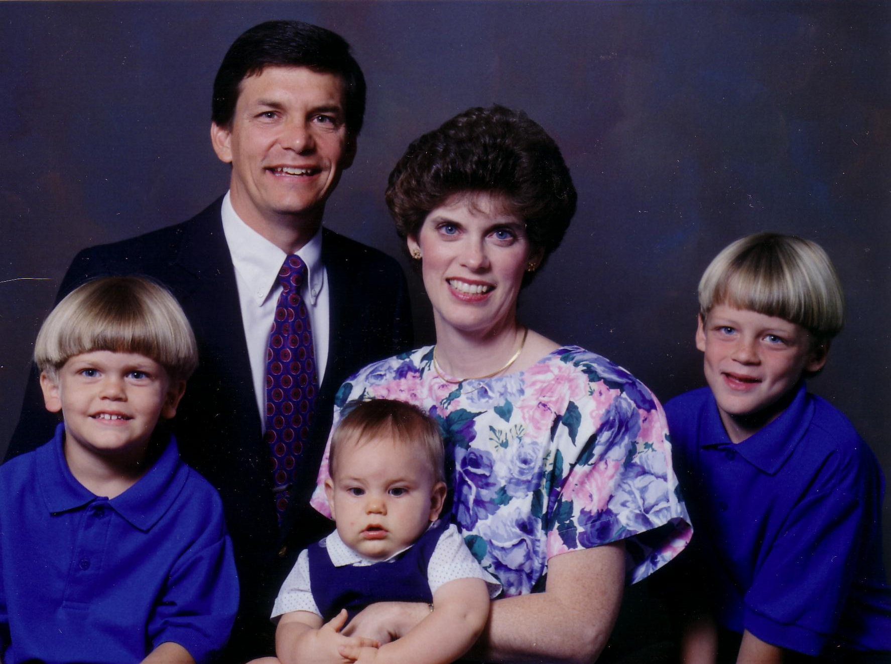
1993
Notes:
The boys continued to grow…

Slide 7
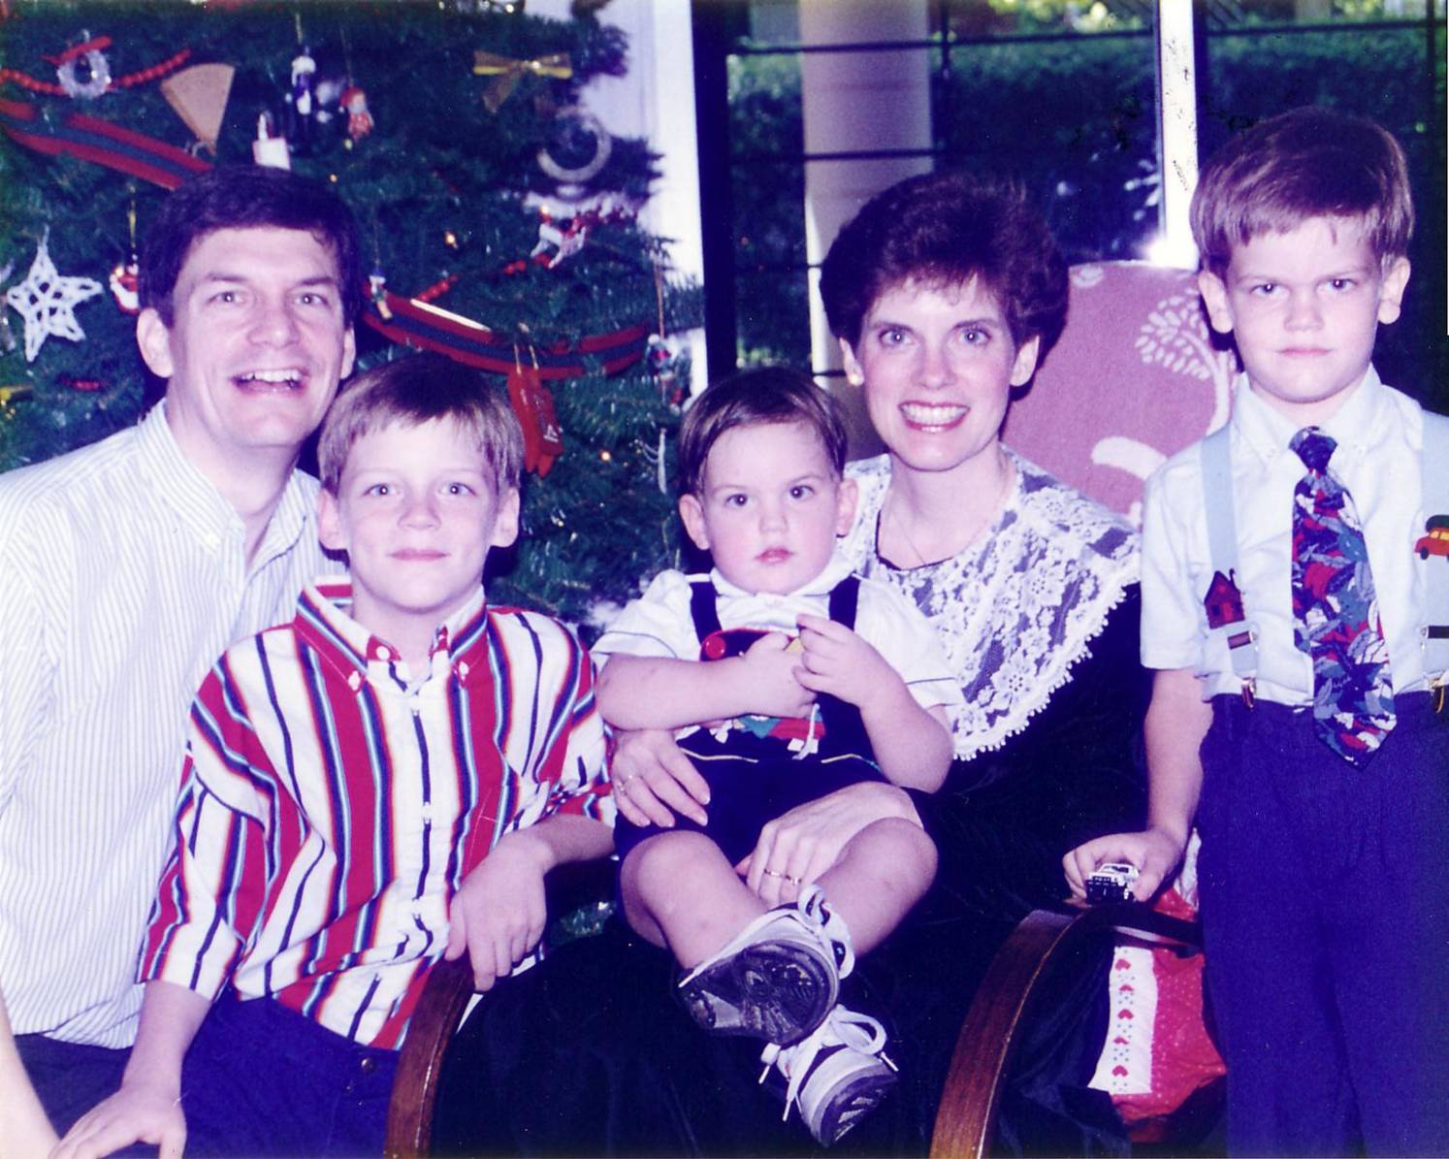
1994
Notes:
It seems natural to spend holidays here…

Slide 8
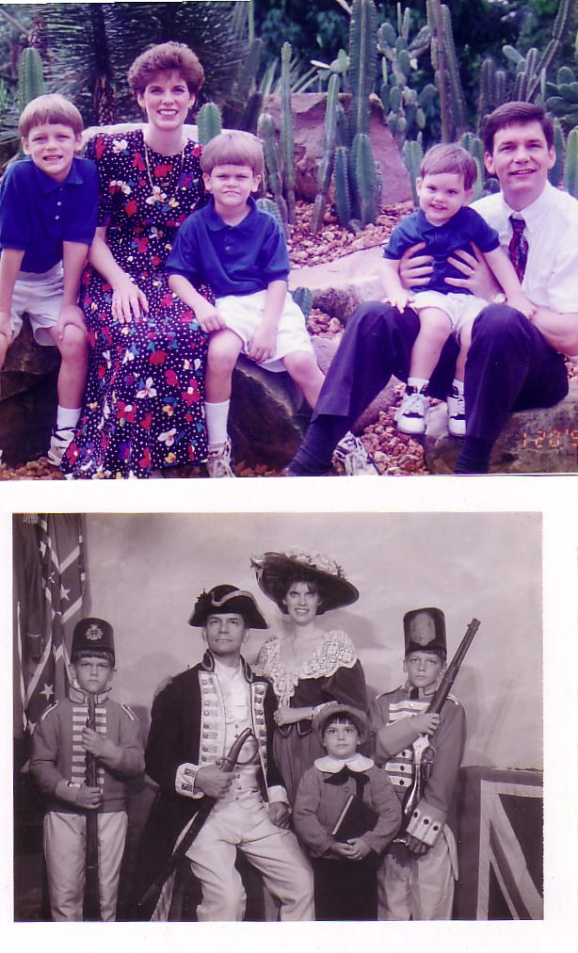
1995
Notes:
When we want dry climate we visit the cactus at the Botanic Gardens!

Slide 9
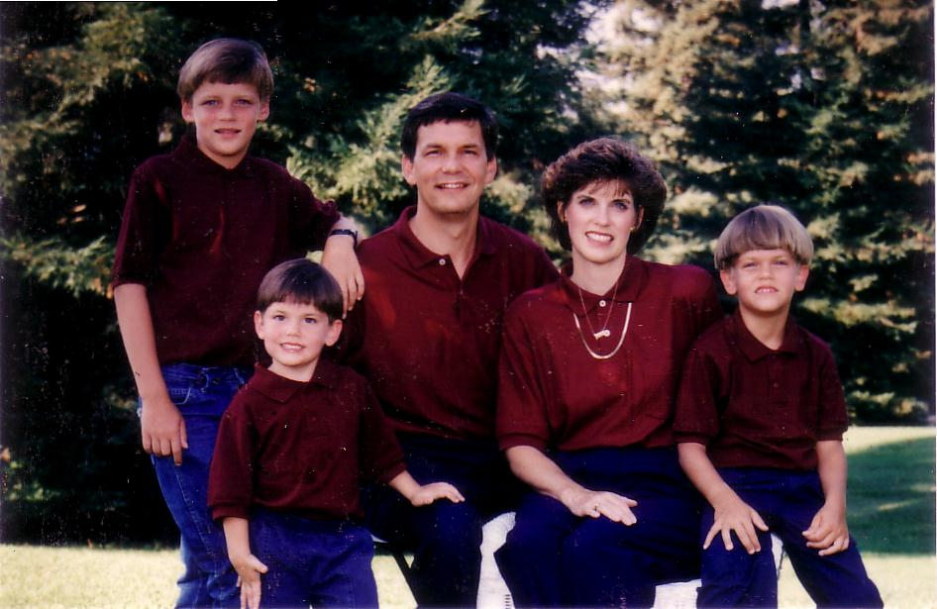
1996
Notes:
We have lived briefly in the USA the past 12 years.

Slide 10
1997
Notes:
These trips remind us of our cultural heritage.

Slide 11
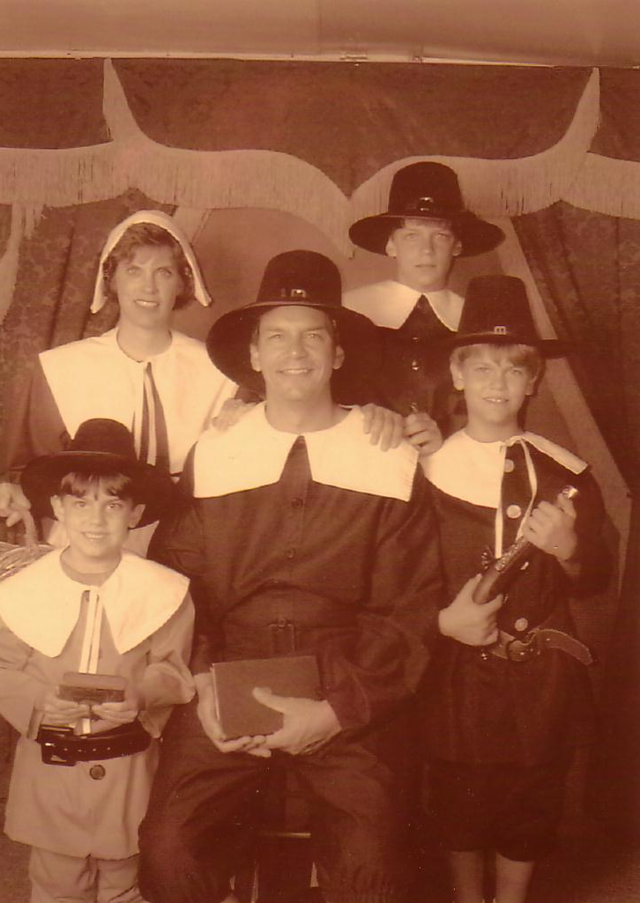
1999
Notes:
After all, my ancestors were Puritans who immigrated to the USA from England in the 1650s.

Slide 12
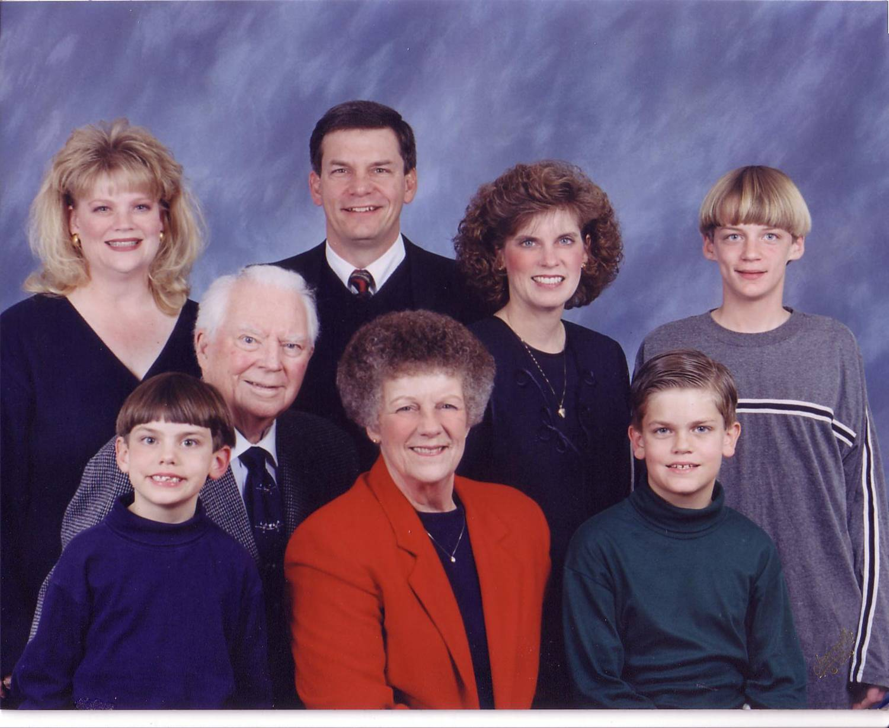
2000
Notes:
So while Singapore is our home, we don't have any family here.

Slide 13
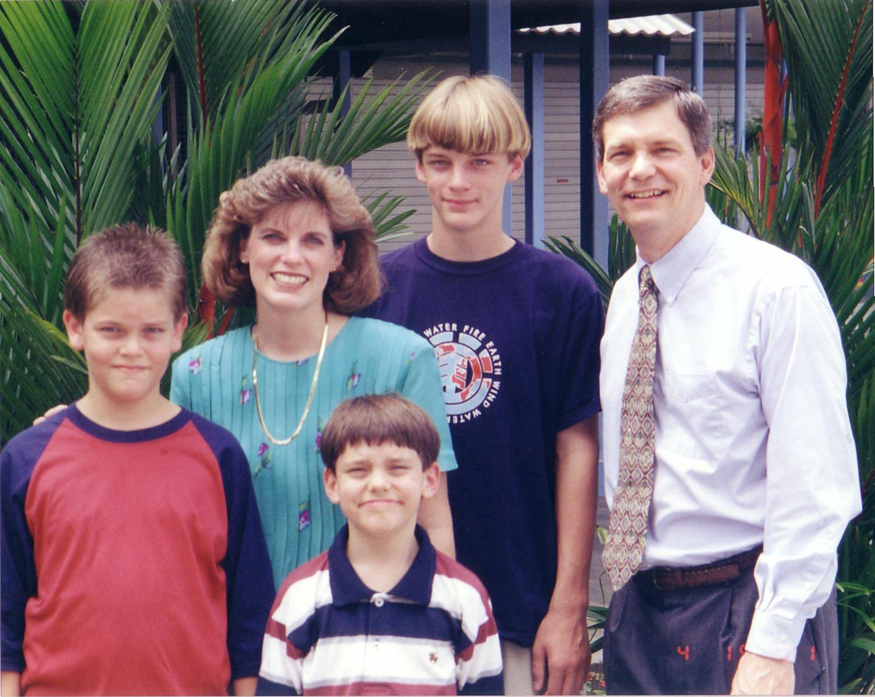
2001
Notes:
As the boys have gotten taller, their family is right in their own home.

Slide 14
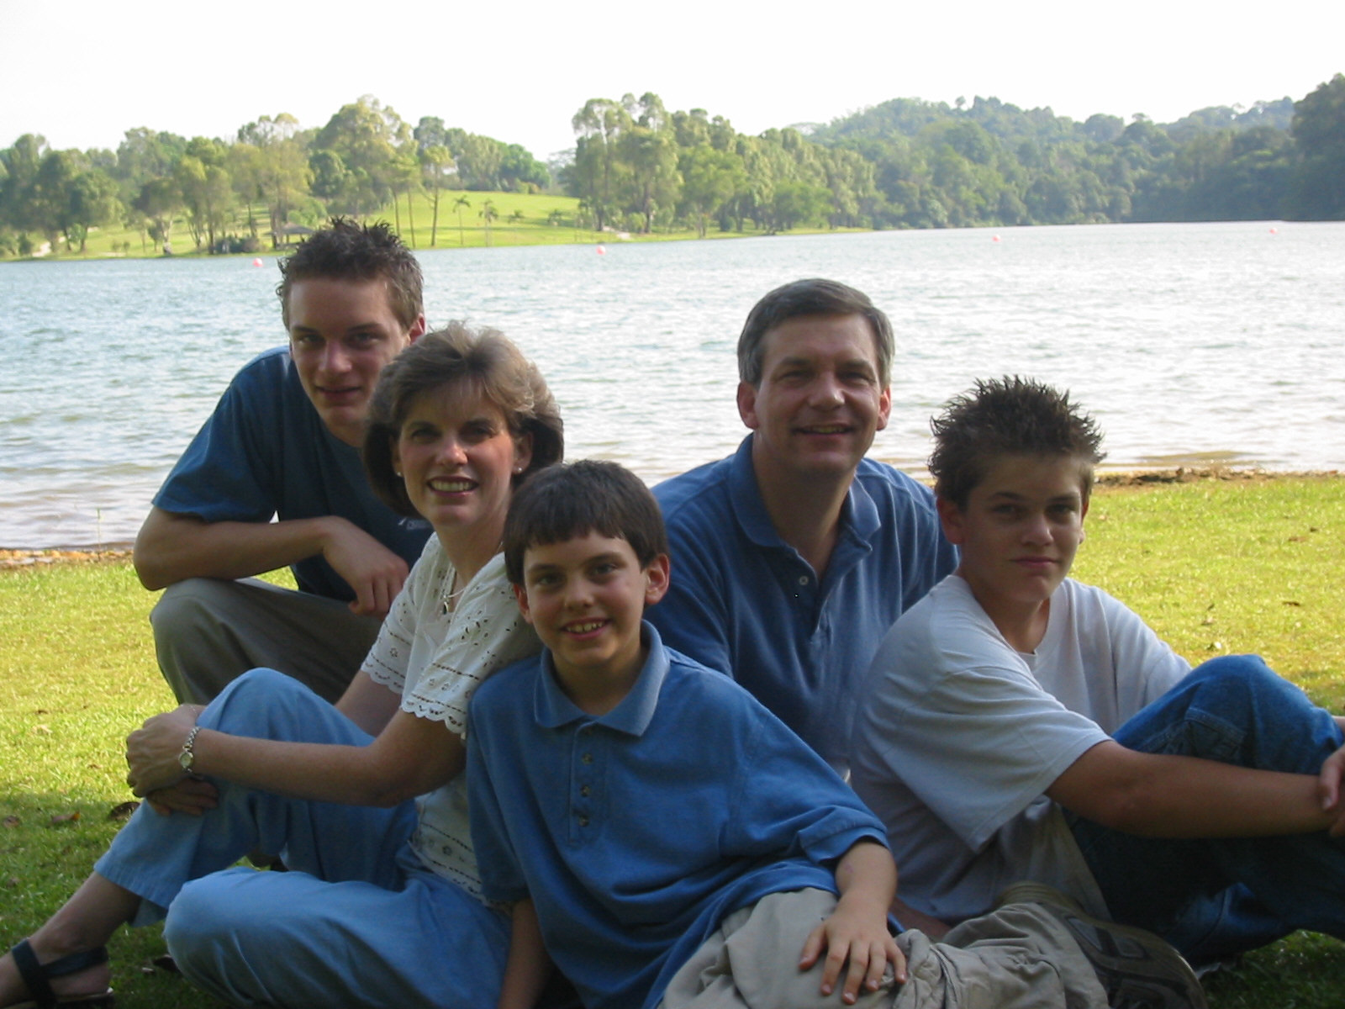
2002
Notes:
As the boys have gotten taller, their family is right in their own home.

Slide 15
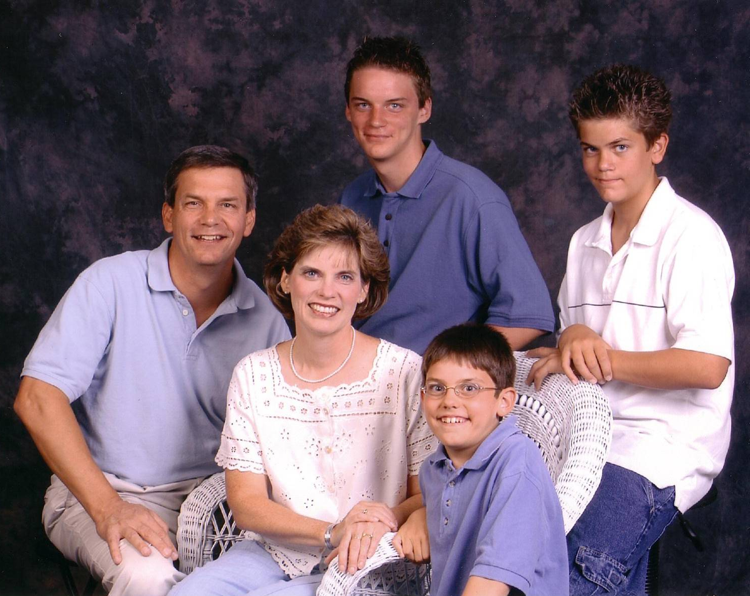
2003
Notes:
And now we're preparing for our oldest to go to college in the states in less than two years.

Slide 16
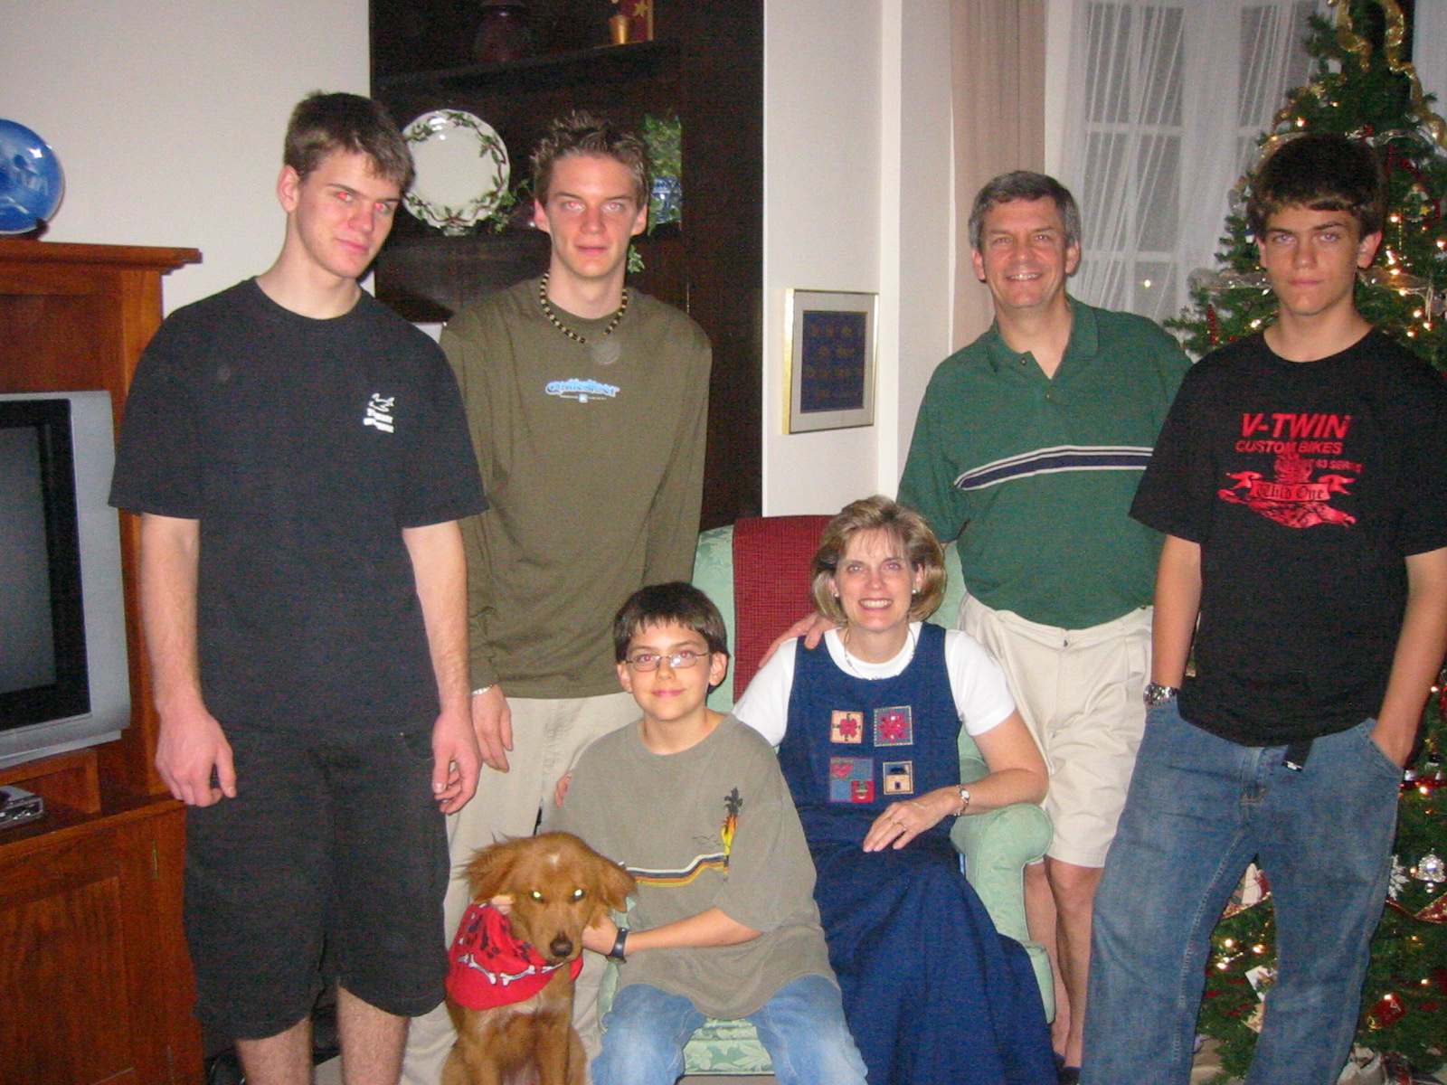
2004
Notes:
As the boys have gotten taller, their family is right in their own home.

Slide 17
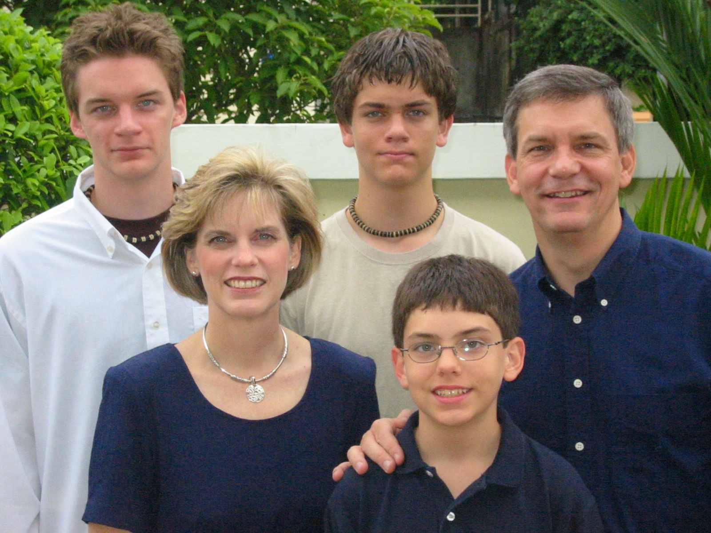
2005
Kurt
Stephen
Rick
Susan
John

Slide 18
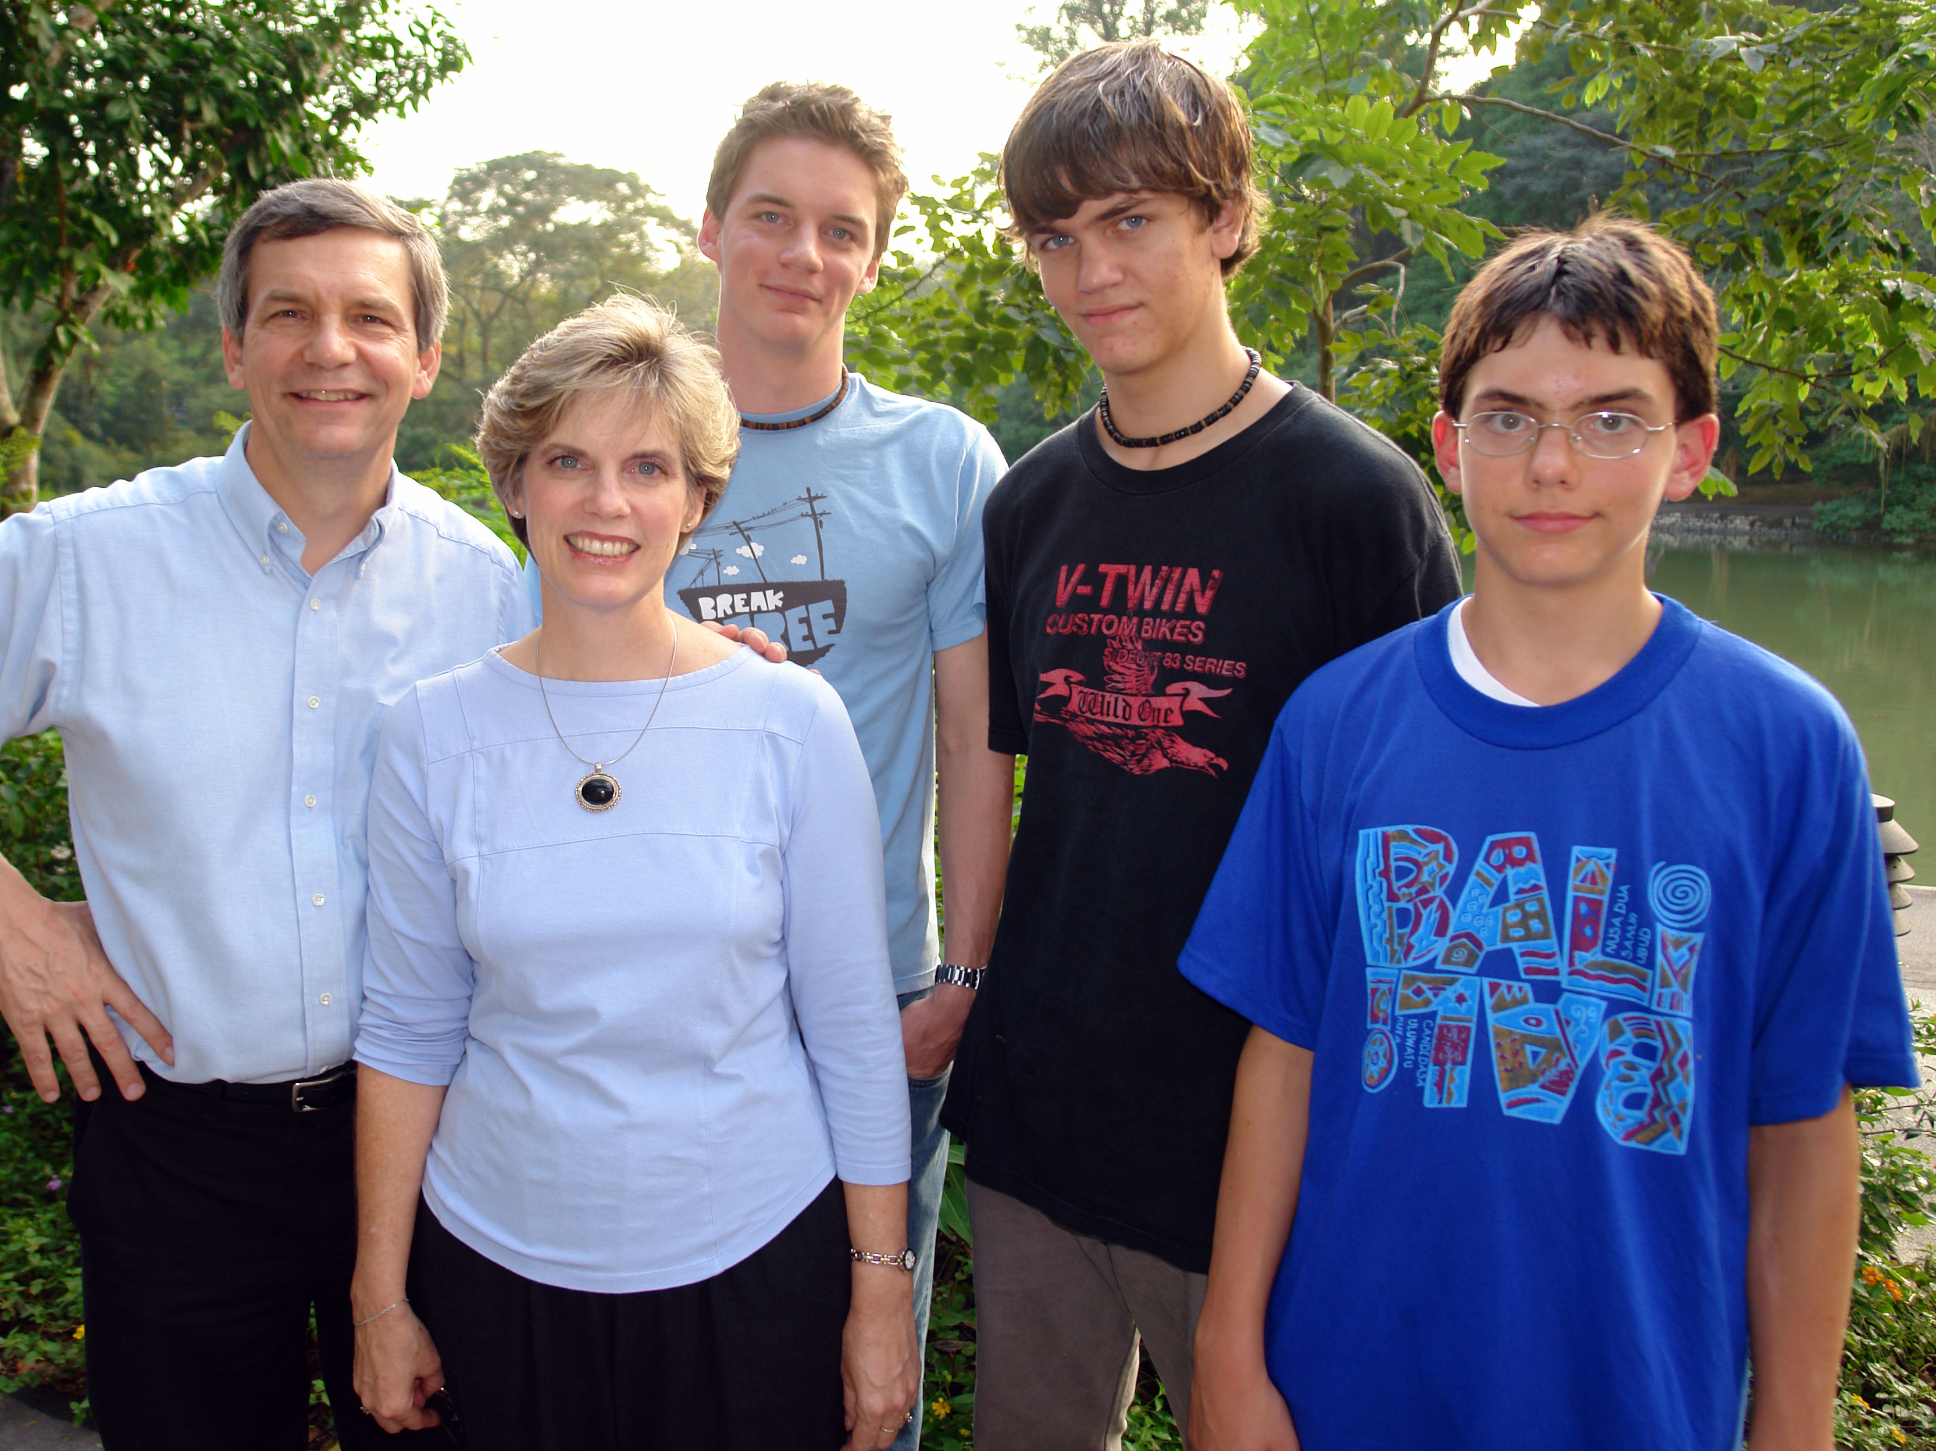
2006

Slide 19
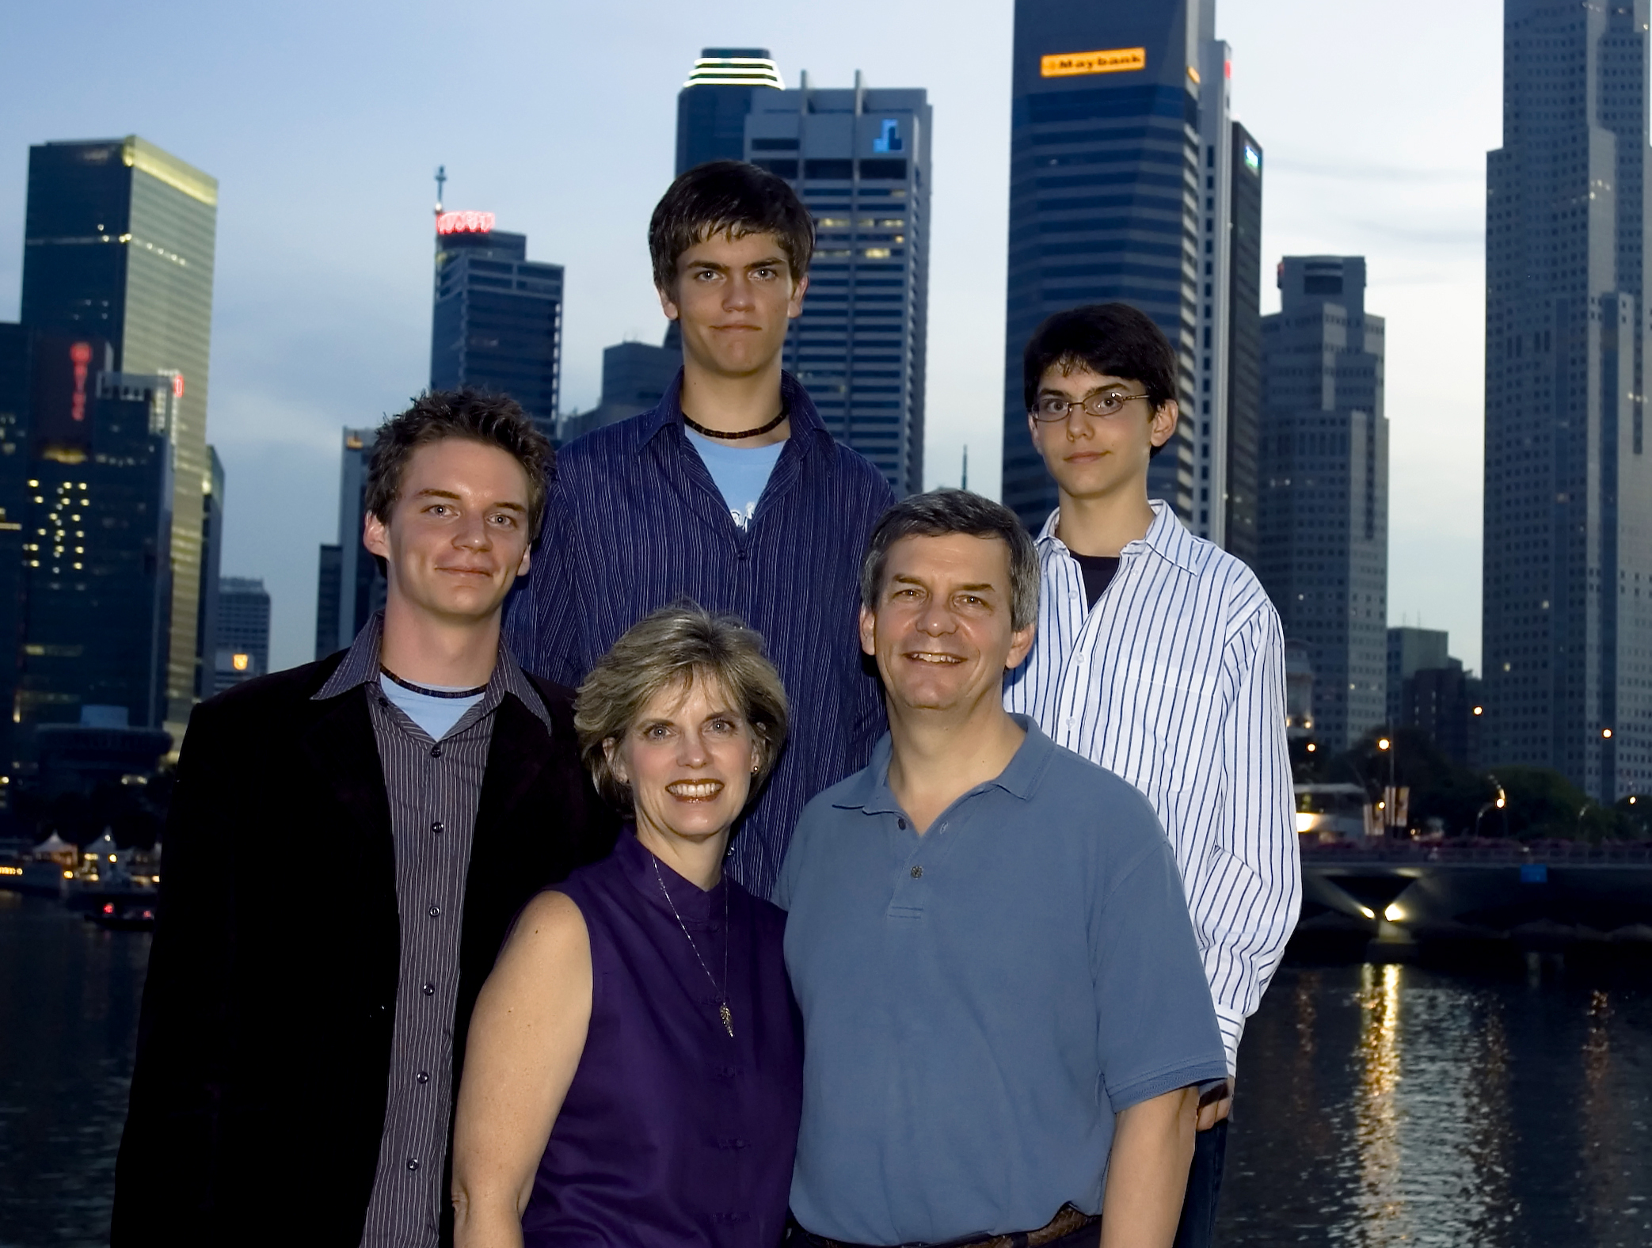
2007

Slide 20
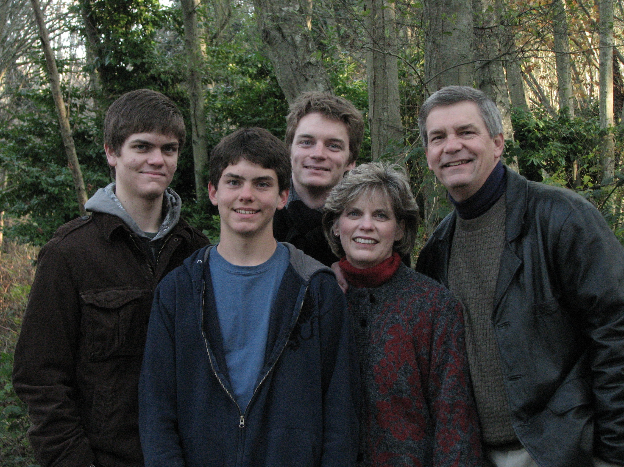
2008

Slide 21
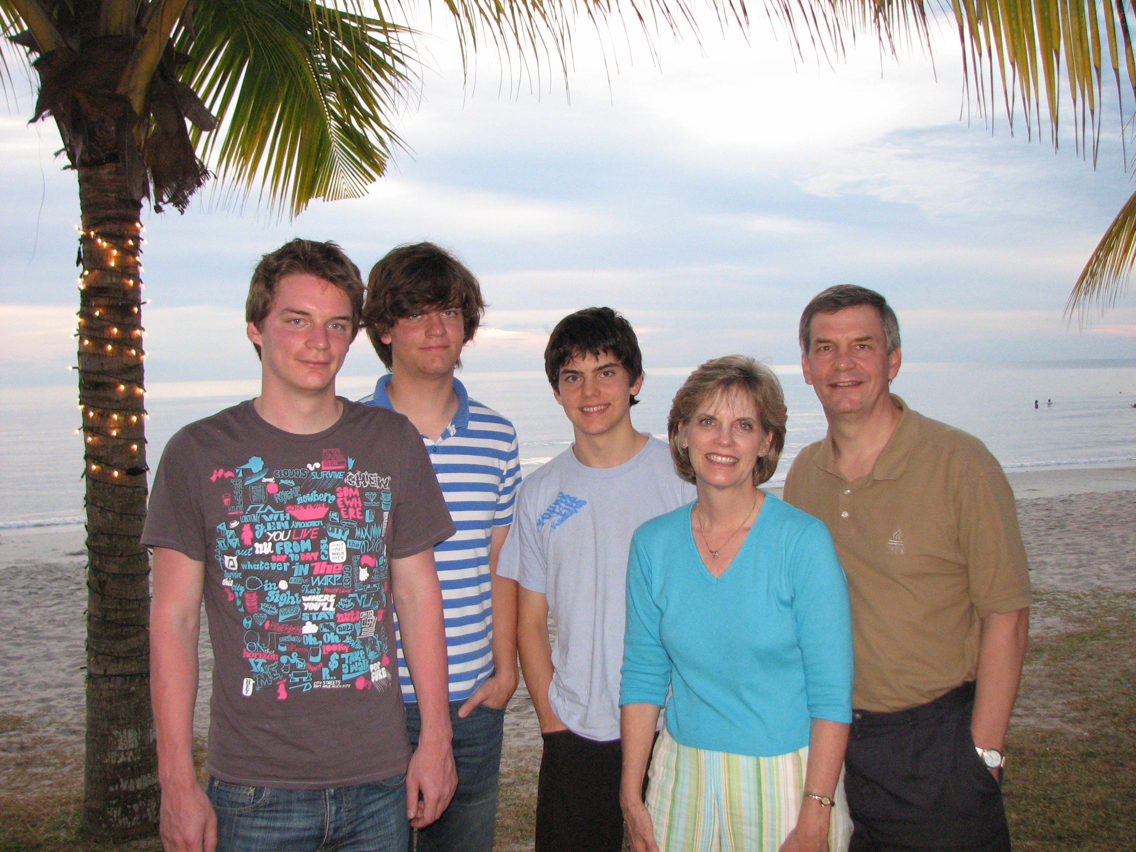
2009

Slide 22
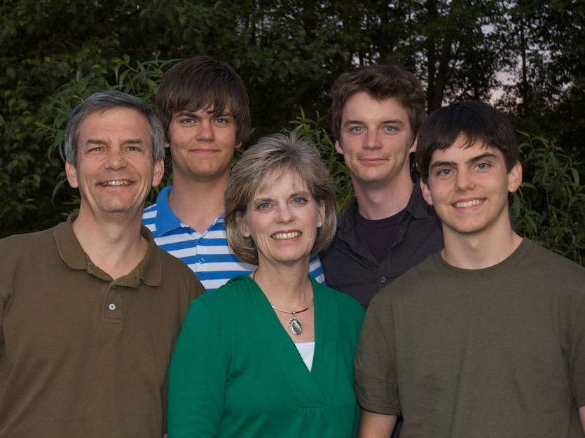
2009
Stephen
Kurt
Rick
Susan
John

Slide 23
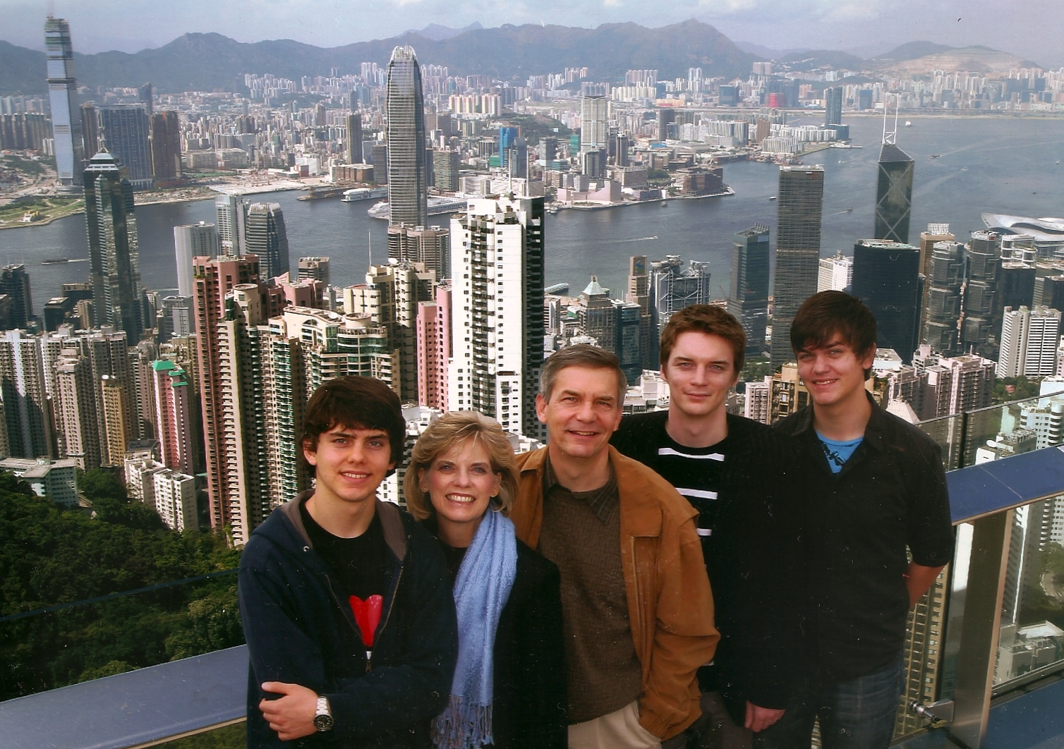
2010
Stephen
Kurt
Rick
Susan
John

Slide 24
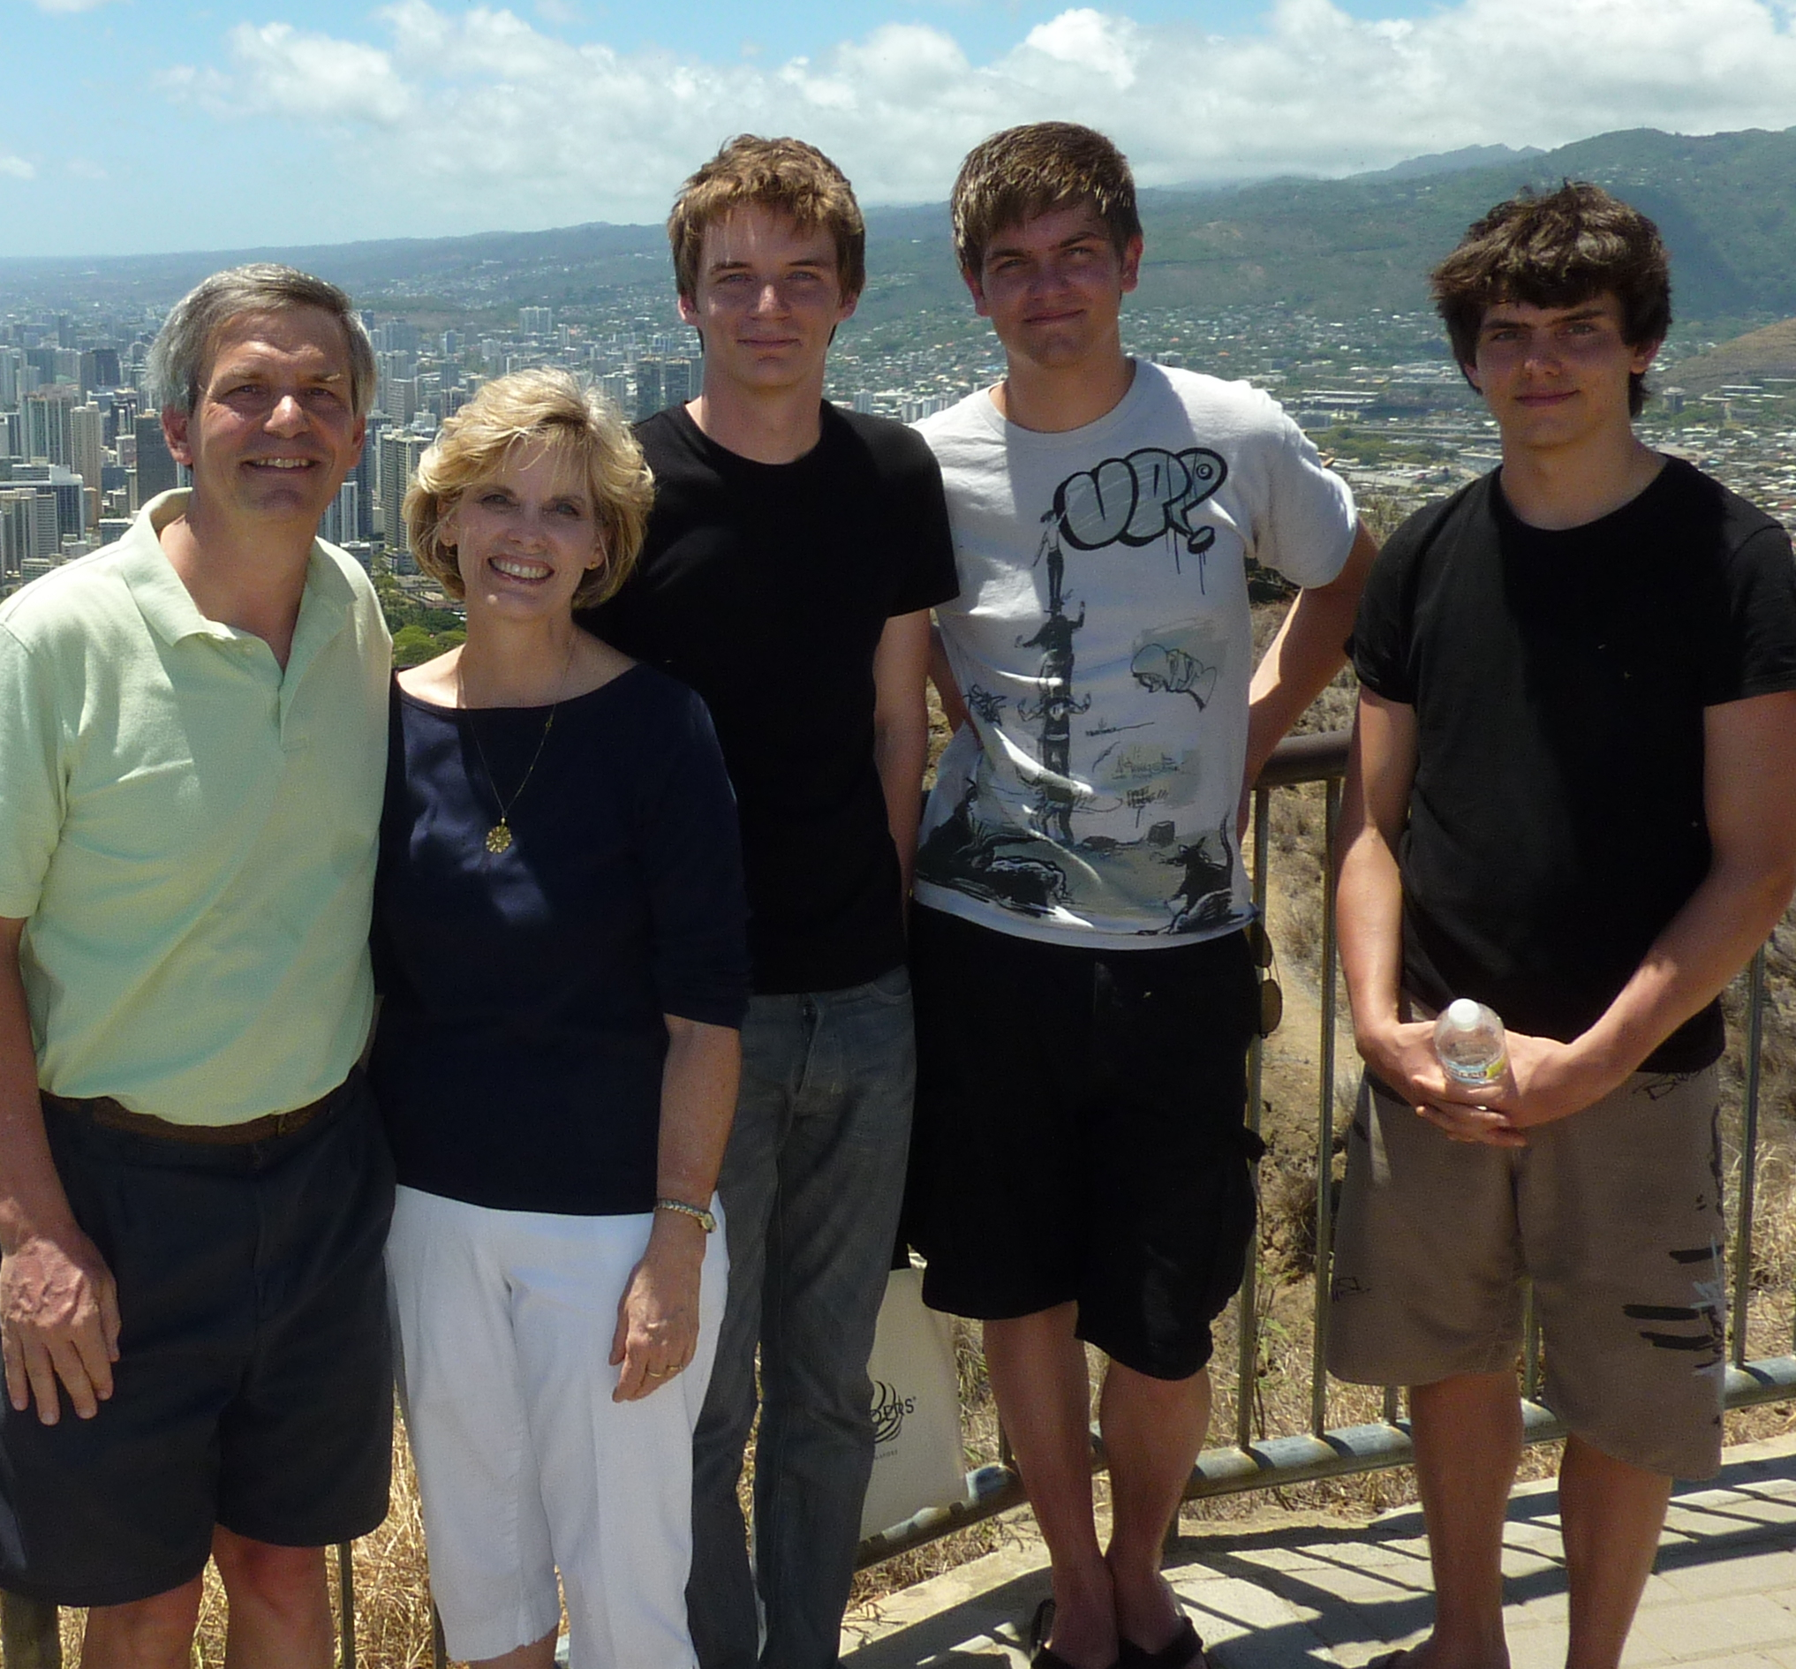
Most recent…

Slide 25

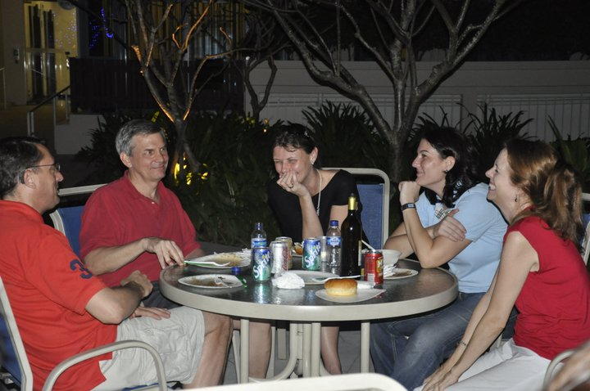
Our People
73 people from 15 nations

Slide 26

Pros & Cons
Men
Women
Kids
Unity
Babies
Outreach
Pastors
Giving

Slide 27
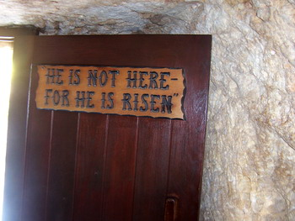
We live because He lives!

Slide 28
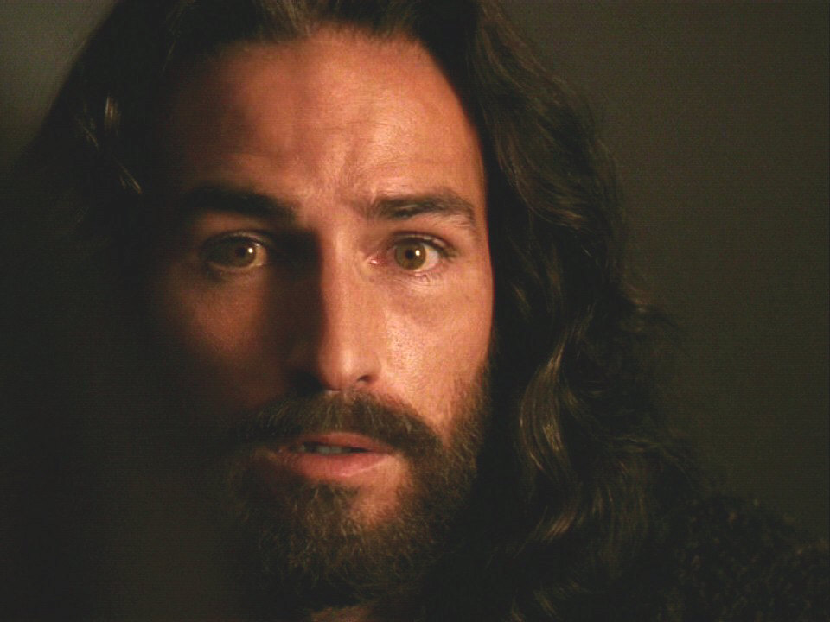
The Resurrection of Jesus Christ
John 20

Slide 29
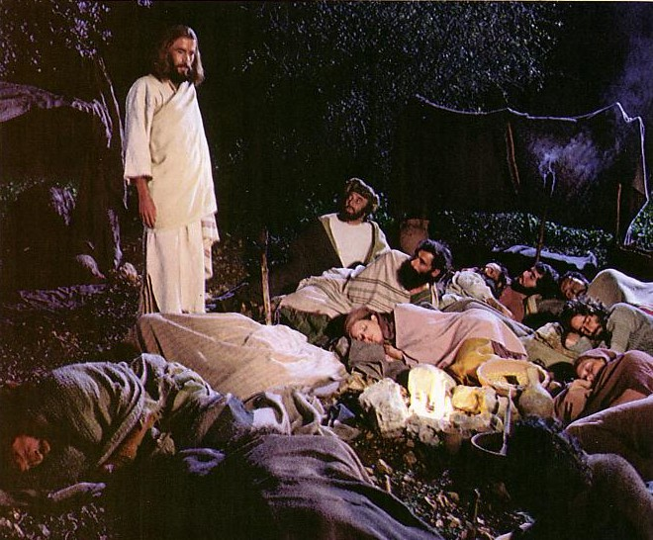
Jesus controlled
His own arrest
(John 18:1-11).

Slide 30
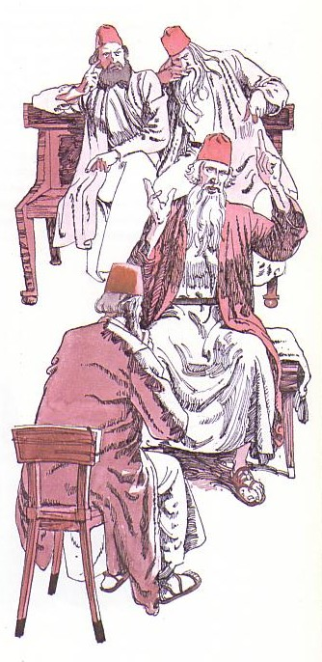
Jesus' illegal trials proved Him innocent
(18:12-19:16a).

Slide 31

Jesus' death paid for our sin (19:16b-42)

Slide 32
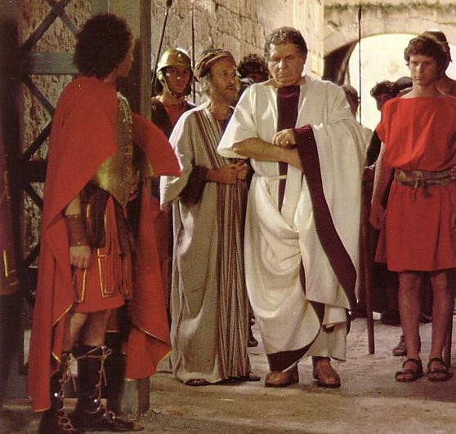
“Make the tomb secure!”

Slide 33
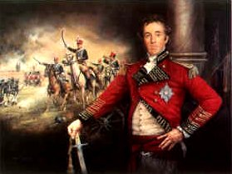
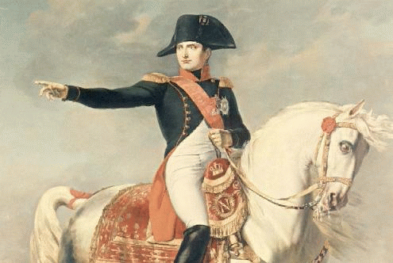
Battle News
Wellington defeated
Napoleon at Waterloo
Jesus defeated
Satan at Calvary
Notes:
33
33

Slide 34
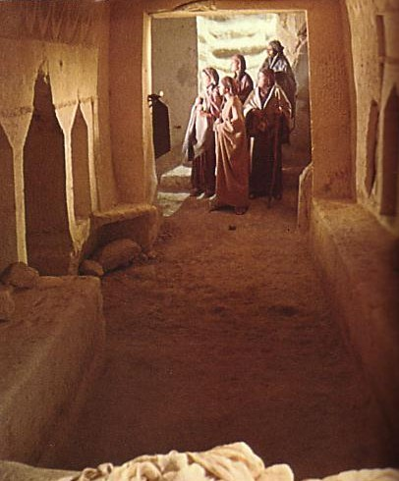
John's Key Idea:
Jesus' resurrection meets each of us at our point of need (John 20).

Slide 35
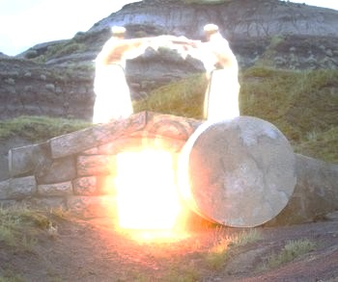
I. The empty tomb shows us that Christ is alive today (20:1-9).

Slide 36
“The Gospel of John” ® Movie
John 20:1-9
Notes:
36

Slide 37
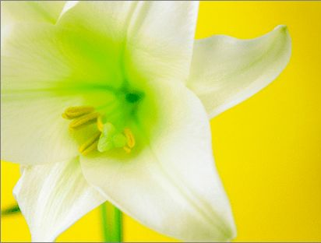
Three Initial Witnesses
Mary (1-2)
John (3-5)
Peter (6-9)

Slide 38
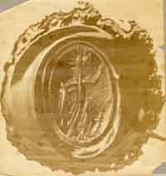
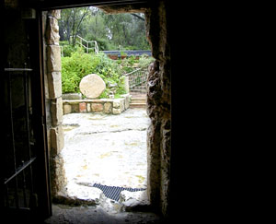
From Inside the Tomb Looking Out
The Roman seal prevented tampering
Notes:
38
38

Slide 39
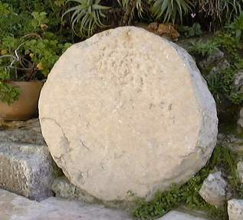
The stone was rolled away…
Notes:
39
39

Slide 40
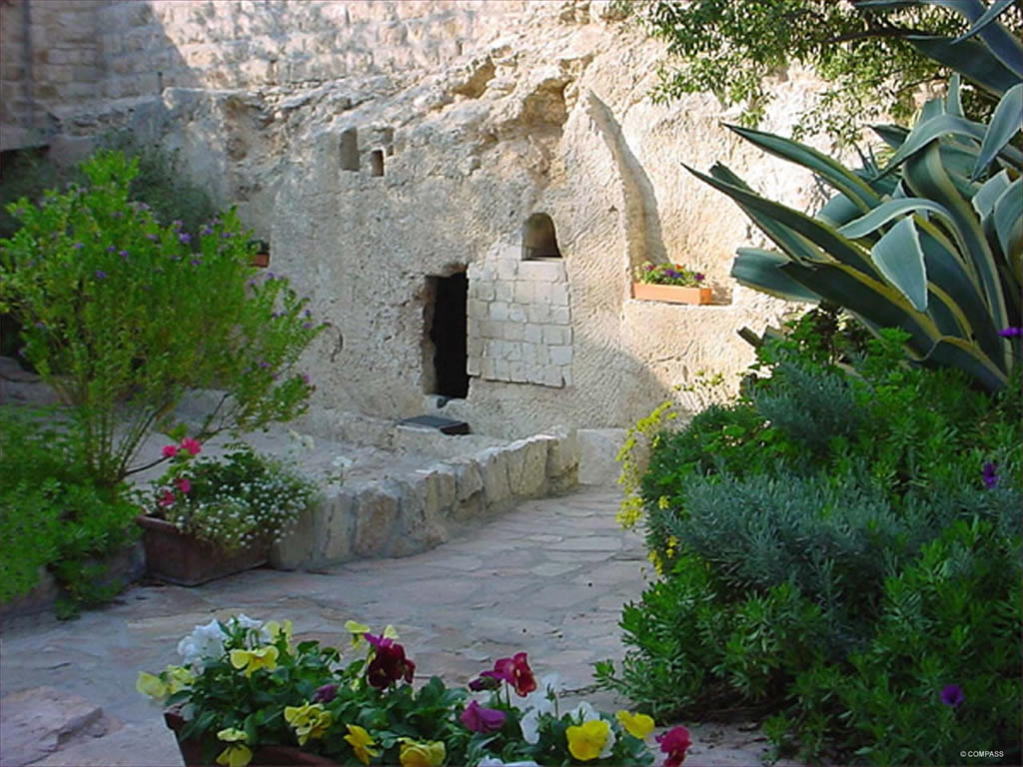
The Garden Tomb
Notes:
40
40

Slide 41
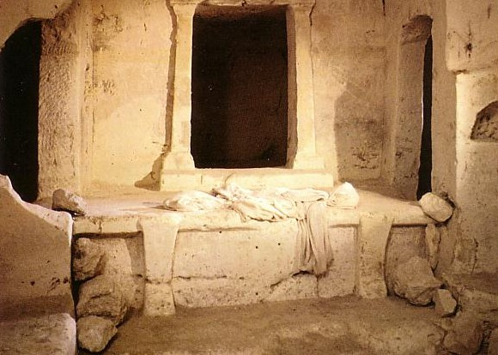
Empty linens

Slide 42
Black
Notes:
42
42

Slide 43
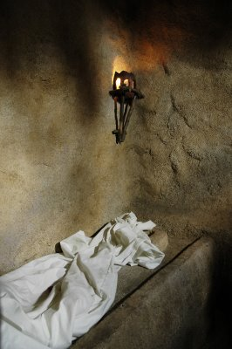
“Seeing” in 20:5-8
John
“looked”
v. 5
John
“saw”
v. 8
“peeped”
“perceived”
Peter
“saw”
v. 6
“beheld attentively”
Notes:
43
43

Slide 44
Black
Notes:
44
44

Slide 45
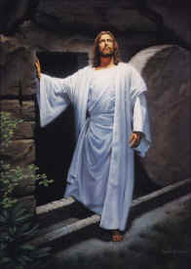
II. Christ's resurrection meets you at your need
(20:10-29)
Comforts the despairing
Mary (10-18)
Notes:
45
45

Slide 46
“The Gospel of John” ® Movie
John 20:10-18
Notes:
46

Slide 47
Black
Notes:
47
47

Slide 48
II. Christ's resurrection meets you at your need
(20:10-29)
Comforts the despairing
Mary (10-18)
Encourages the discouraged disciples (19-23)
Notes:
48
48

Slide 49
“The Gospel of John” ® Movie
John 20:19-23
Notes:
49

Slide 50
Black
Notes:
50
50

Slide 51
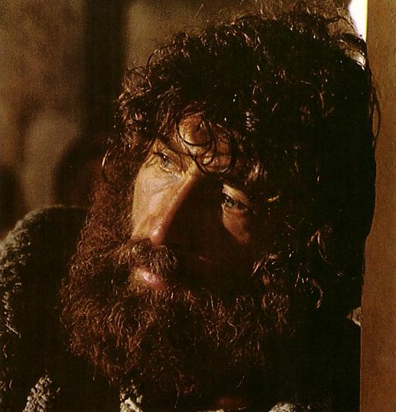
What would it take to turn the despondent Peter around?

Slide 52
Black
Notes:
52
52

Slide 53
II. Christ's resurrection meets you at your need
(20:10-29)
Comforts the despairing
Mary (10-18)
Encourages the discouraged disciples (19-23)
Gives proof to the doubting Thomas (24-29)
Notes:
53
53

Slide 54
“The Gospel of John” ® Movie
John 20:24-29
Notes:
54

Slide 55
Black
Notes:
55
55

Slide 56
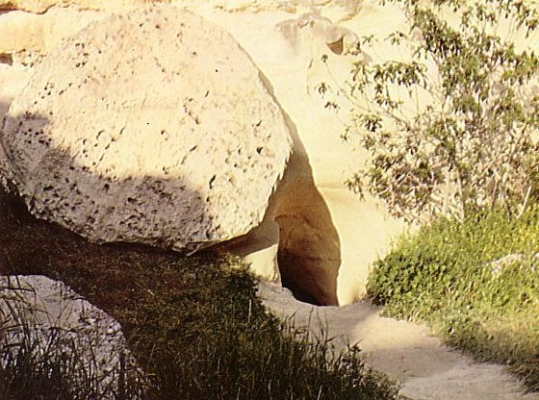
Who moved the stone?
He never died?
Jesus' strength?
Romans?
Jewish Leaders?
Disciples?

Slide 57
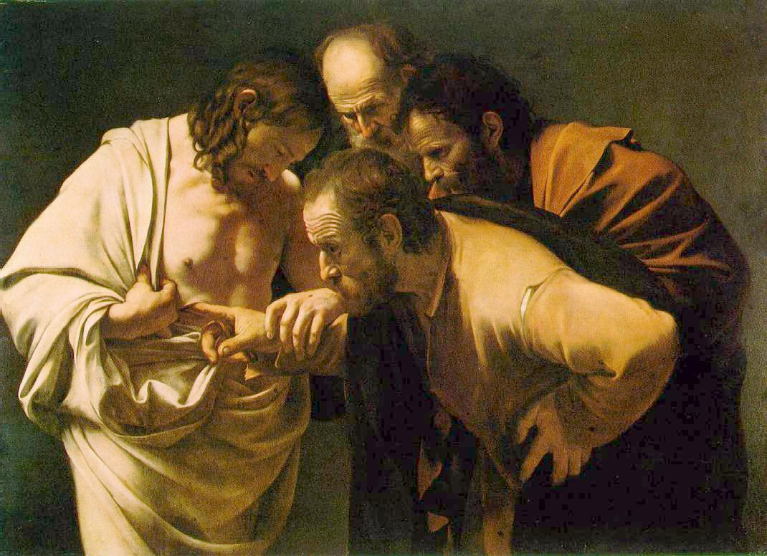
Why did John write about Jesus' miracles?
III. All of Christ's miracles are to bring us to faith in Him (20:30-31)
These [signs] are written so that you may believe that Jesus is the Christ, the Son of God, and that by believing you may have life in his name (John 20:31).

Slide 58
“The Gospel of John” ® Movie
John 20:30-31
Notes:
58

Slide 59
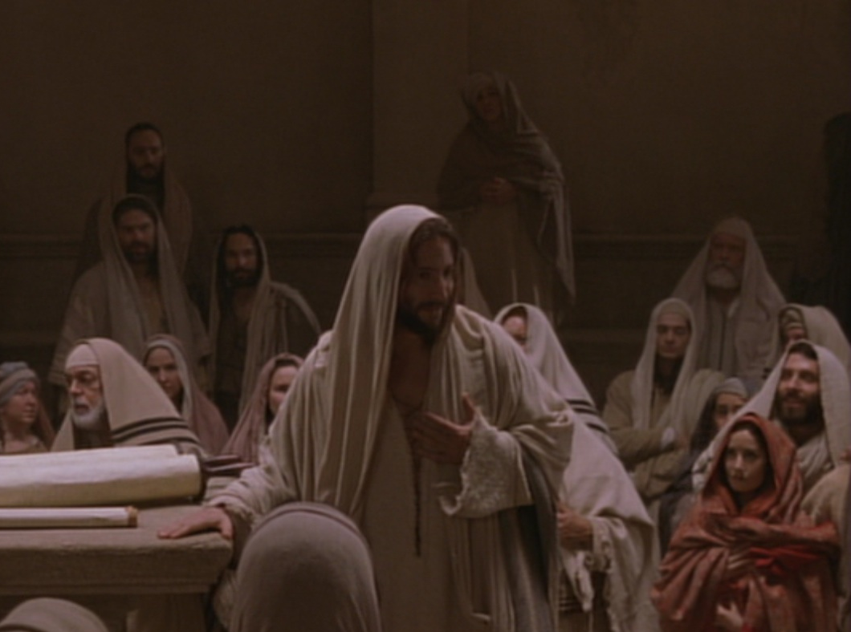
Key Word Believe
John
107
Key Verse
“Jesus did many other miraculous signs in the presence of his disciples, which are not recorded in this book. But these are written that you may believe that Jesus is the Christ, the Son of God, and that by believing
you may have life in his name” (20:30-31).

Slide 60
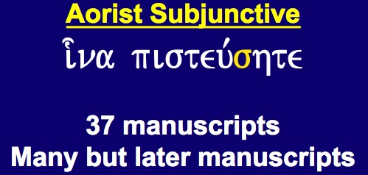
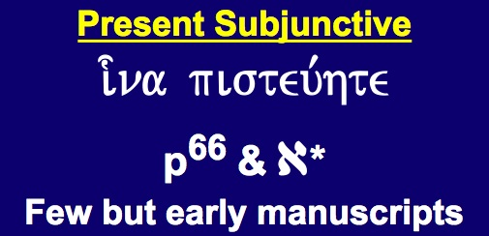
Textual Variants of John 20:31
110
Evangelistic
“…these are written that you may believe that
Jesus is the Christ, the Son
of God, and that by
believing you may have life
in his name”
Edification
“…these are written that you may go on believing that
Jesus is the Christ, the Son of God, and that by believing you may have life in his name”
Aorist Subjunctive
i-na pisteu,shte
37 manuscripts
Many but later manuscripts
Present Subjunctive
i-na pisteu,hte
p⁶⁶ & a*
Few but early manuscripts
Notes:
Most of the manuscripts have the little sigma (= English “s”) that makes the verb for believe in an undefined sense. However, a few early MSS lack this sigma, which turns it into a present tense.

Slide 61
John's Key Idea:
Jesus' resurrection meets each of us at our point of need (John 20).

Slide 62
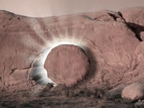
Trust the Living Savior to Meet Your Need Today!
Despair
Comfort
Discouraged
Encouraged
Doubt
Proof
Notes:
62
62

Slide 63

What's So Good About Good Friday?
Jesus controlled His own arrest
Jesus' illegal trials proved Him innocent
Jesus' death paid for our sin
Jesus' resurrection proved He gives eternal life

Slide 64
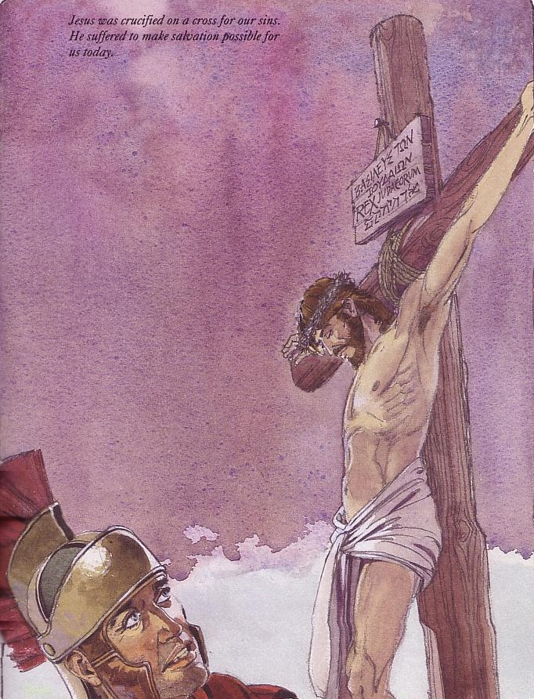
Good Friday is good because on this day Jesus Christ paid for your sin.

Slide 65
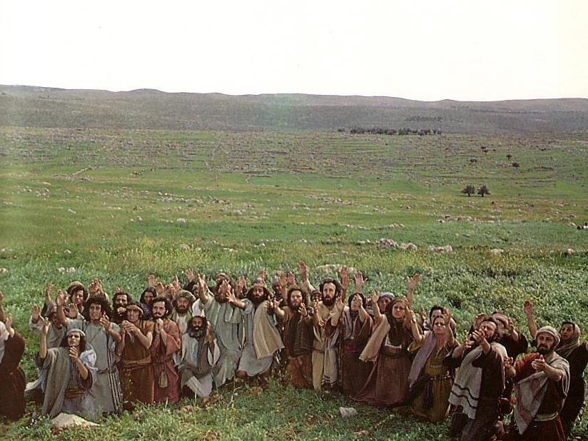
Jesus ascended to the Father
This means he is alive now!

Slide 66
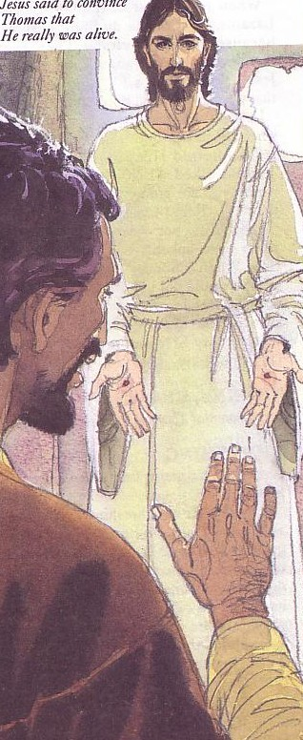

Jesus rose to give you new life!
Jesus rose to give you new life!

Slide 67

How can you know Him?
Admit you have sinned
Believe that Jesus died for you
Confess that you want to turn from sin

Slide 68
Black
Notes:
68
68

Slide 69
Used in Previous Sermons
Notes:
69
69

Slide 70

Because He lives (chorus) 1/1
Because He lives, I can face tomorrow
Because He lives, all fear is gone
Because I know, He holds the future
And life is worth the living
Just because He lives

Slide 71

Easter in View?
Notes:
71
71

Slide 72


“Christ wasn't God”

Slide 73

Gospel of Judas

Slide 74

The “Lost Tomb of Jesus”?

Slide 75

Timing is Critical
March 03
April 06
May 06
March 07

