Slide 1

Better than Angels
Hebrews 1:4–2:18
Dr. Rick Griffith, Crossroads International Church
BibleStudyDownloads.org

Slide 2
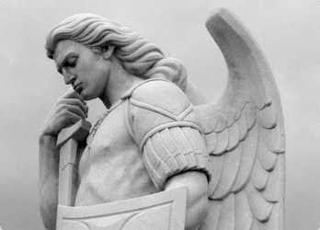
Angels are cool.
Notes:
Angels are cool. Period.

Slide 3
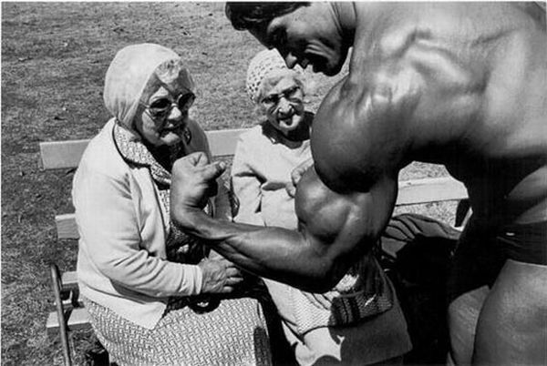
We may think we are strong…
Notes:
Now we may think we are strong but…

Slide 4
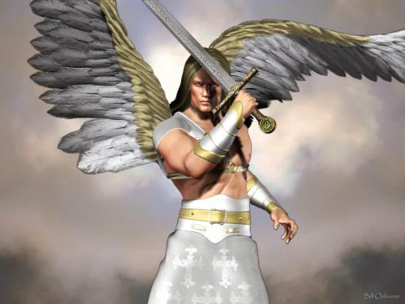
Powerful
Notes:
Angels are the most powerful beings under God himself

Slide 5
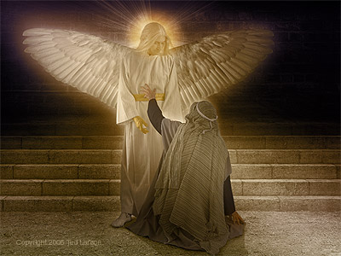
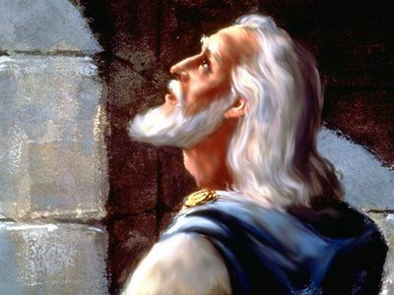
Mighty Angel of Dan. 10

Slide 6
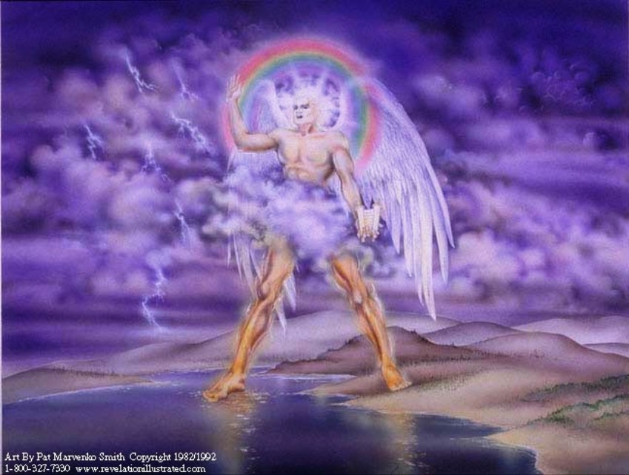
Mighty Angel of Rev. 10

Slide 7
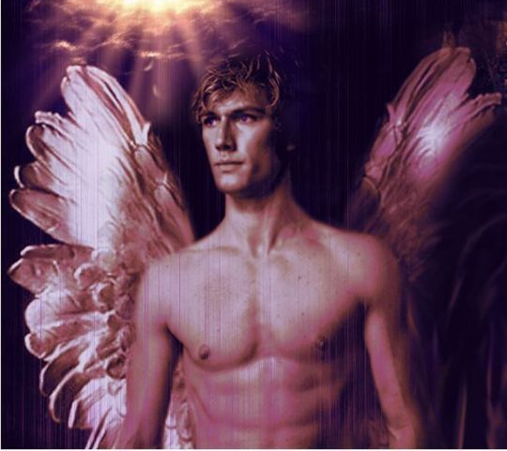
Angels Protect
Notes:
Angels protect God's people

Slide 8
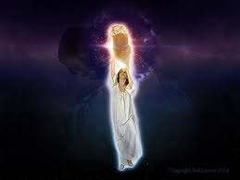
Sweeping Jesus up (Rev. 12)
Notes:
Revelation 12 depicts an angel swooping up the baby Jesus from getting killed

Slide 9
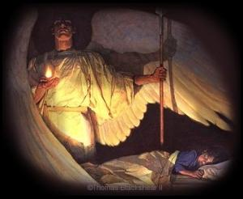
Guardian Angel
Notes:
Jesus taught that angels guard children

Slide 10
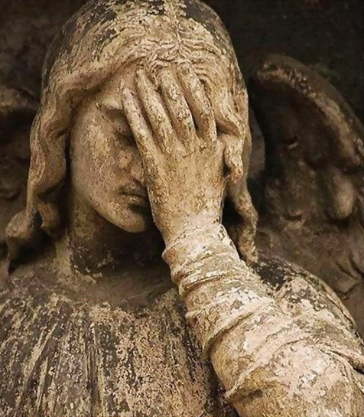
I have a feeling that my Guardian Angel looks like this often.
Notes:
You may not feel that your angel is very pleased with you, but…

Slide 11
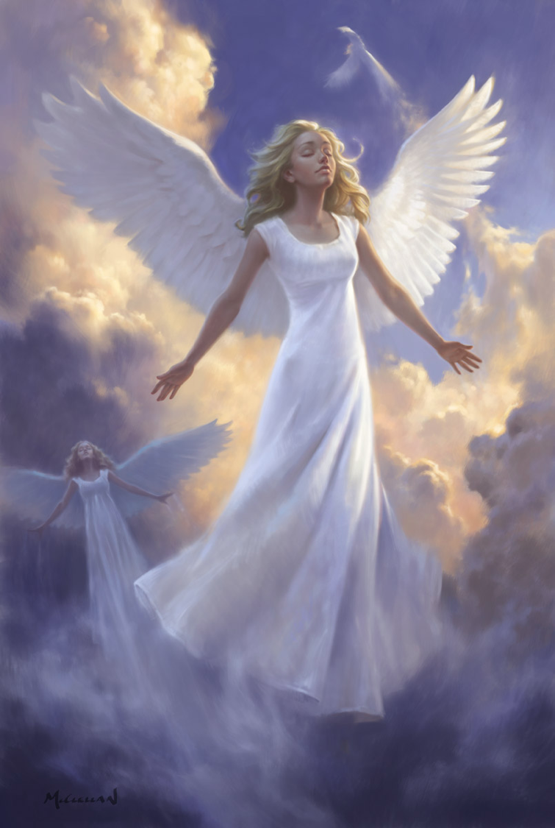
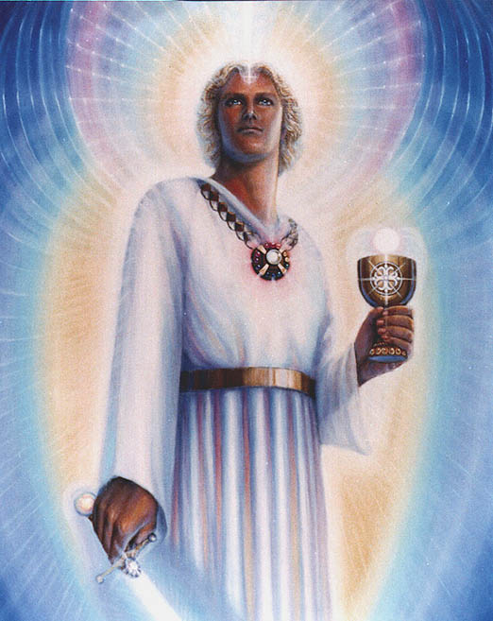
55% of Americans believe in guardian angels (2008)
Notes:
A 2008 survey by Baylor University's Institute for Studies of Religion reveals that 55% of all American adults believe a guardian angel protects them

Slide 12
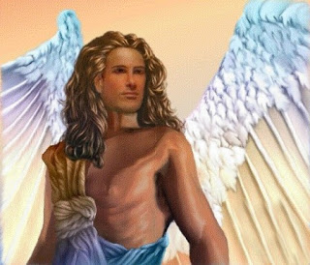
Bring God's Messages
Notes:
Angels bring God's messages—to Abraham, to Daniel, to Mary, to Joseph, etc.

Slide 13
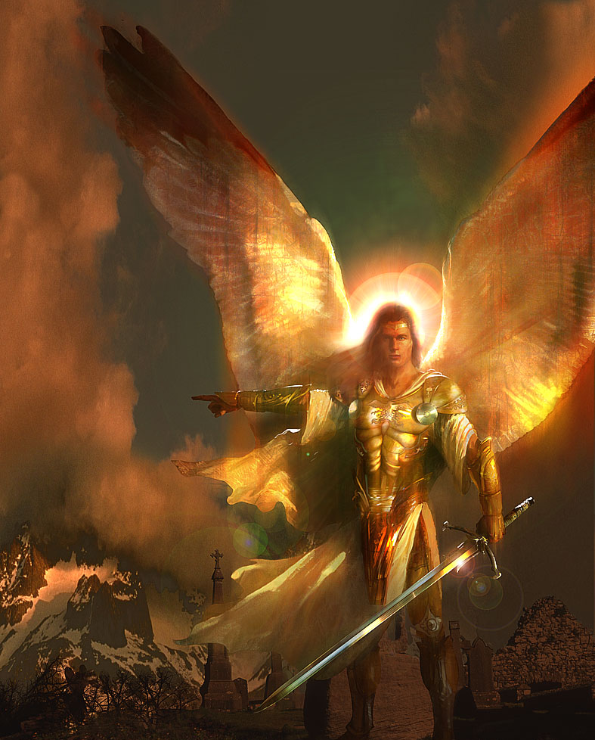
Do you respect them?
Do you believe in angels?
Do you give them
too much respect?
Notes:
Do you believe in angels? A Nielsen survey in 2010 showed that nearly 70% of the U.S. population believes in angels.
Do you respect them? Do you give them too much respect? Like more than Jesus? I hope not!

Slide 14

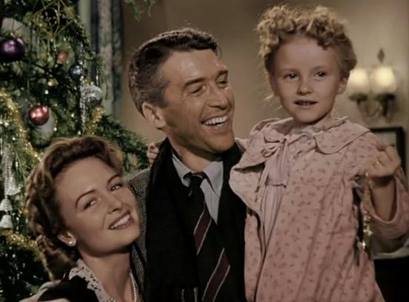
"It's a Wonderful Life!"
"Every time a bell rings,
an angel gets his wings"
Notes:
Sometimes we get our theology of angels from movies like the 1946 film, "It's a Wonderful Life!" It's theology says, "Every time a bell rings, an angel gets his wings." Really?! Do we have chapter and verse for that?

Slide 15
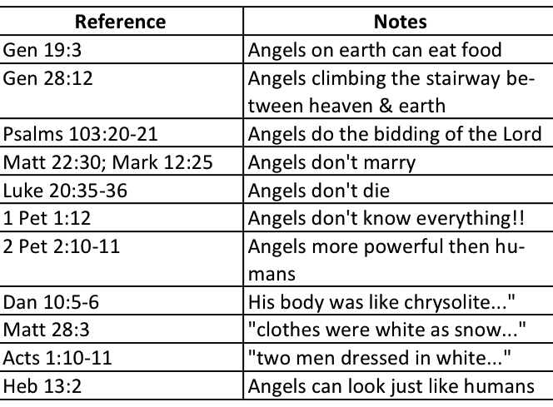
Characteristics of Angels
Robert C. Jones, "Angels: In the Bible, the Apocrypha & the Dead Sea Scrolls"
© 2001, p. 24 at www.sundayschoolcourses.com/angels/angels.pdf
Notes:
One author gives a good summary of the Bible's teaching on angels.

Slide 16
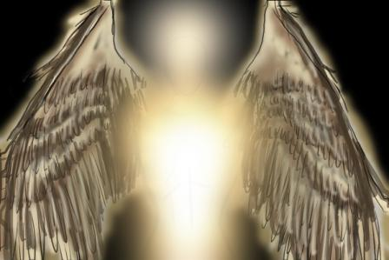
Why worship Jesus instead of angels?
Notes:
What reasons can we give to hold Christ higher than the angelic host?

Slide 17
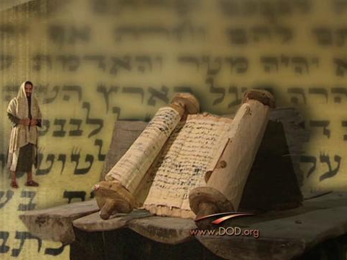
Background to Hebrews
Notes:
Why would this question be relevant to readers of the letter to the Hebrews?

Slide 18
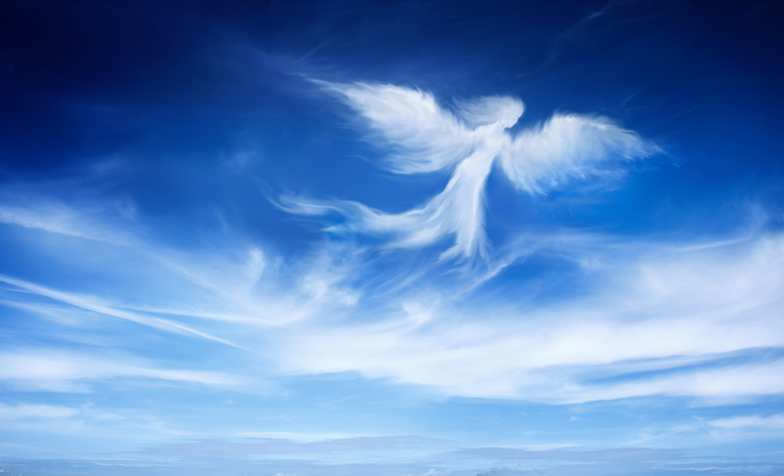
The readers had too high a view of angels
Notes:
Many scholars think that the readers had a very high view of angels—and that Jesus couldn't compare to angels in their eye.
The readers of Hebrews probably belonged to a Jewish sect emphasizing angels so much that they thought angels were better than Jesus.
Perhaps the readers thought, "Well, OK, Jesus supersedes prophets as they were mere men, but angels are far more powerful than any man!"

Slide 19
HEBREWS
256-
257
Author
Recipients
Origin
Destination
UNKNOWN

Slide 20
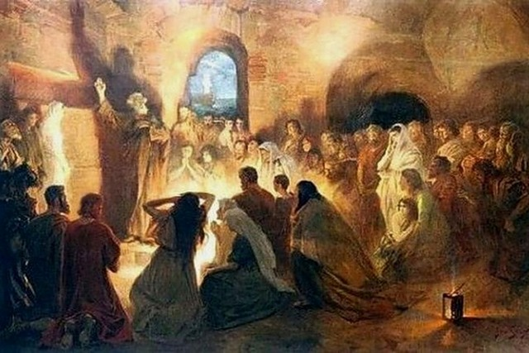
A Specific Jewish Community
"And especially pray that I will be able to come back to you soon" (13:19 NLT).
Notes:
The author already visited them once and wanted to revisit them (13:19, 23).
The readers apparently had a concern for Timothy as well (13:18).

Slide 21
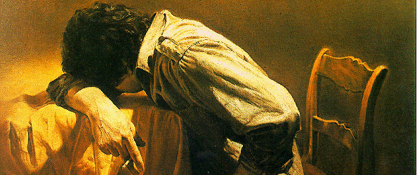
A Jewish Community Under Stress
"You suffered along with those who were thrown into jail, and when all you owned was taken from you, you accepted it with joy. You knew there were better things waiting for you that will last forever" (10:34 NLT).
Notes:
They have a definite history to which the author is acquainted, including their conversion (2:3), ministry to other Christians (6:10), sufferings for the gospel (10:32-34), and present state of spiritual maturity (5:11ff.).
The readers may have been the leaders of a larger community since it is unlikely that the writer would expect the entire church to be teachers (5:12).

Slide 22


Where did these Jews live?
256
Rome?
Asia Minor?
Cypress?
Israel?
Cyrene?

Slide 23
Zane Hodges says to was written to Libya
256
Rome
Cyrene
Notes:
Zane Hodges believes Barnabas wrote the epistle from Rome and sent it to a Jewish community in Cyrene, Libya (BKC, 2:777-79)

Slide 24
I think the readers lived in Israel
256
Rome
Israel
Notes:
However, I think there is good reason for this letter being sent to Israel—and even to a community within Israel—probably to a sectarian group like Qumran

Slide 25
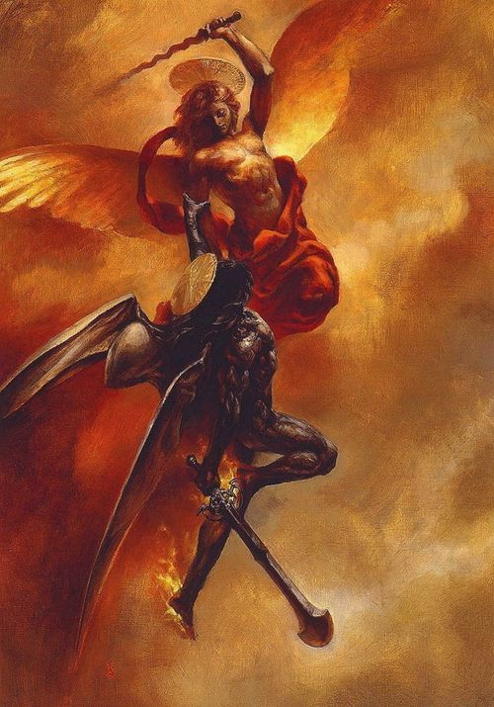
(The War Scroll in 1QM 17:5-6).
"This is the day appointed by Him for the defeat and overthrow of the Prince of the kingdom of wickedness, and He will send eternal succour to the company of His redeemed by the might of the princely Angel of the kingdom of Michael. With everlasting light He will enlighten with joy [the children] of Israel; peace and blessing shall be with the company of God. He will raise up the kingdom of Michael in the midst of the gods, and the realm of Israel in the midst of all flesh"
Notes:
Note that this group taught that angels would rule the world!
http://www.deliriumsrealm.com/michael-belial/
NTB, 263 bottom left (cf. NTB, 184b for 1QM = DSW or Dead Sea War)

Slide 26
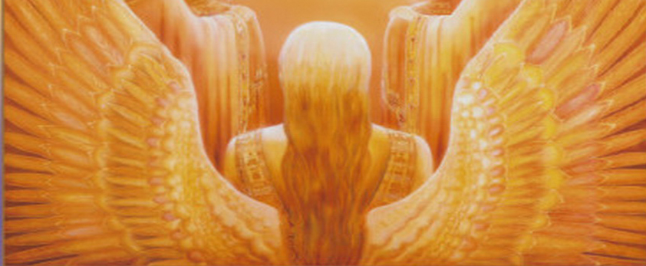
Christ is Superior in His Person
258-59
Superior to the Prophets 1:1-3
Superior to the Angels 1:4–2:18
Notes:
Therefore, just as he had noted Christ as superior to the prophets (1:1-3), so now the writer wisely lays out his case for Jesus as greater than angels

Slide 27
Why worship Jesus instead of angels?
(3 reasons in 1:4–2:18)
Jesus
Us
Jesus
1
2
3
Notes:
Preview: This text of two chapters has three sections. We will see two ways that Jesus supersedes angels in our first and third section, and what we should do in the middle.
Hebrews 1:4–2:18 has three reasons to worship Jesus instead of angels.
The first reason to worship Christ instead of angels is because…

Slide 28
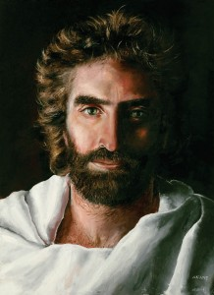
I. Jesus is God worthy of worship (1:4-14).
Notes:
We should worship only God—and Christ qualifies!

Slide 29
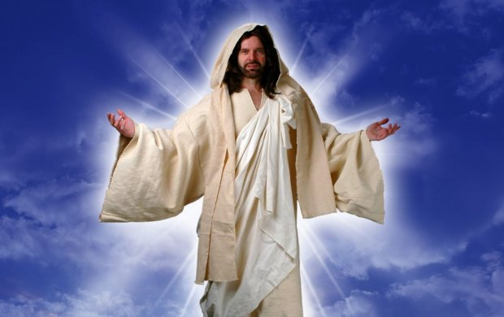
Christ has a better name than angels since he is called God's Son (1:4-5)

Slide 30
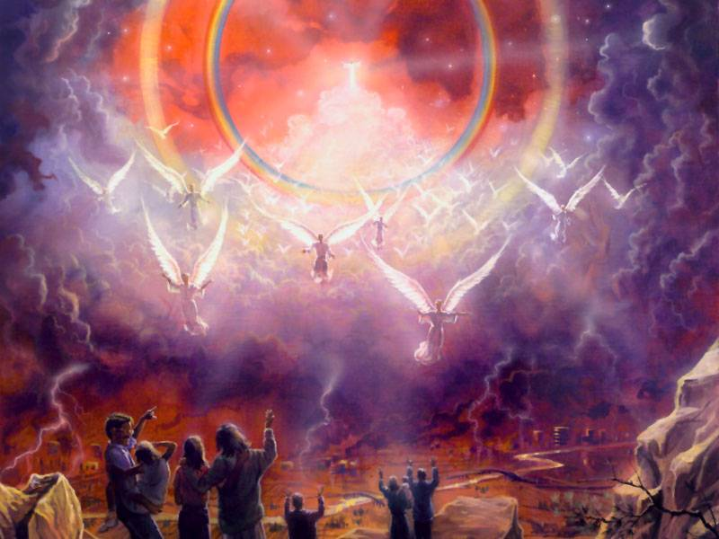
Hebrews 1:4 (NLT)
^{Jesus}
"This shows that the Son is far greater than the angels, just as the name God gave him is greater than their names."
^{Angels}
^{People}
Notes:
Jesus is higher than angels (1:4).

Slide 31
"For God never said to any angel what he said to Jesus:
'You are my Son.
Today I have become your Father.'
God also said,
'I will be his Father,
and he will be my Son.'"
(1:5 NLT).
Notes:
Jesus is the Son of God (1:5)

Slide 32
The Trinity
Father
is
is not
is not
GOD
is
is
Son
Spirit
is not
H. Wayne House, Charts of Christian Theology and Doctrine, 45
Notes:
Jesus is the second person of the Trinity—No angel is in the Trinity!

Slide 33
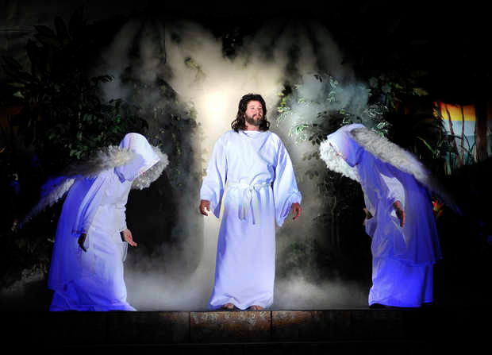
Angels worship Jesus
Notes:
Angels eternally worship Christ as God (1:6-7)

Slide 34
"And when he brought his supreme Son into the world, God said,
'Let all of God's angels worship him.'"
(1:6 NLT).
Notes:
If angels worship Jesus, then he must be higher, right?

Slide 35
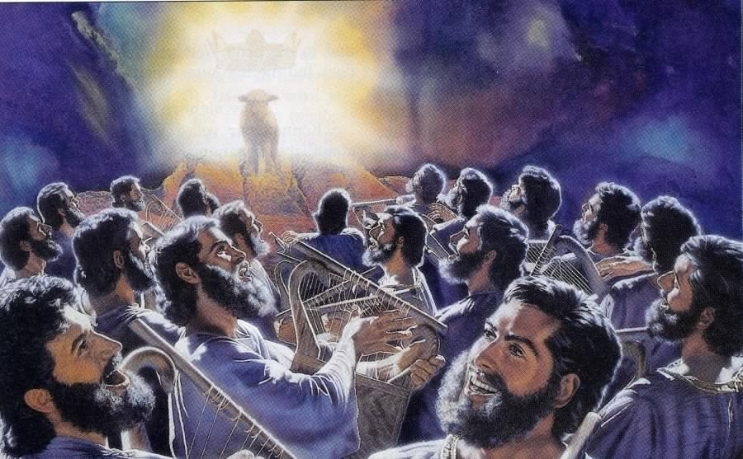
"You are worthy to take the scroll and open its seals…" (5:9)
369
Notes:
Revelation 5 shows angels worshipping the Lamb

Slide 36
"Regarding the angels, he says,
'He sends his angels like the winds, his servants like flames of fire.'"
(1:7 NLT).
Notes:
Angels are amazingly fast—like winds of fire!

Slide 37
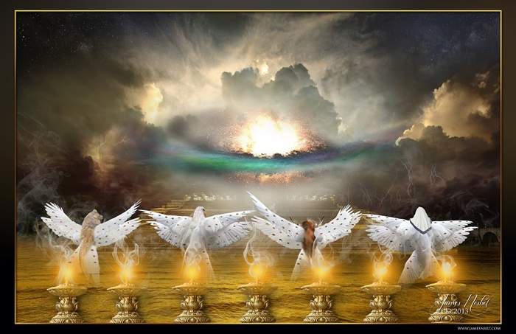
Four Living Creatures
(Rev. 4)
Notes:
Yet they still worship Christ!

Slide 38
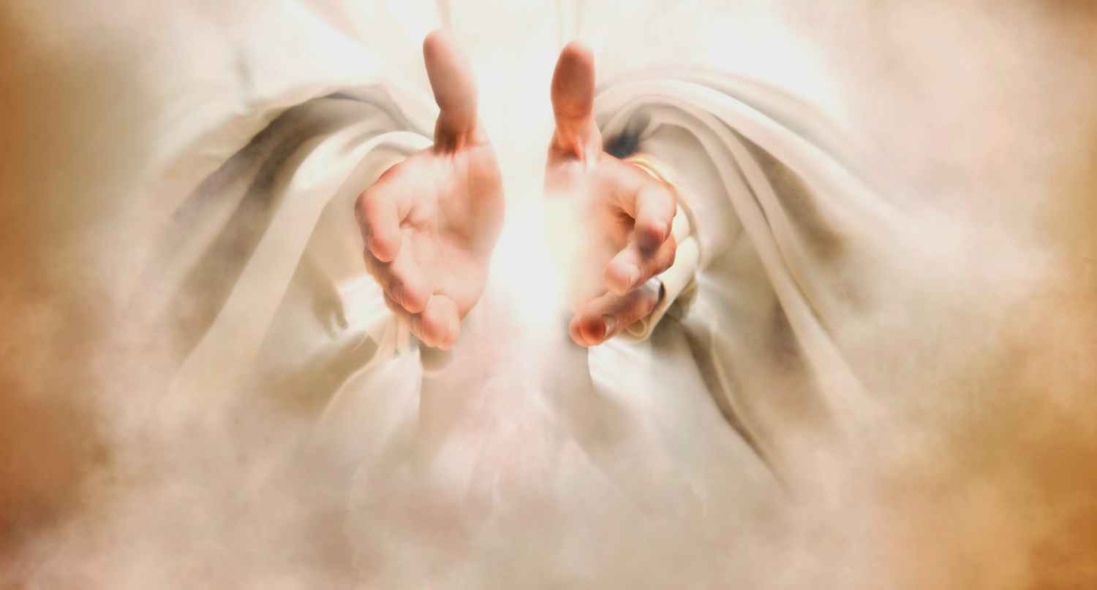
The Father calls Jesus "God"!
Notes:
What better witness to Christ’s identity do you need than the Father?

Slide 39
"But to the Son he says,
'Your throne, O God,
endures forever and ever.
You rule with a scepter of justice.
⁹You love justice and hate evil.
Therefore, O God, your God has anointed you, pouring out the oil of joy on you more than on anyone else.'"
(1:8-9 NLT).
Notes:
The Father calls Jesus "God" in verses 8-9!

Slide 40
"He also says to the Son,
'In the beginning, Lord, you laid the foundation of the earth and made the heavens with your hands. ¹¹They will perish, but you remain forever. They will wear out like old clothing.'"
(1:10-11 NLT).
Notes:
The Father calls Jesus "Lord" and "Creator" in verses 10-11

Slide 41
"He also says to the Son…
'You will fold them [the earth and the heavens] up like a cloak
and discard them like old clothing.
But you are always the same;
you will live forever.'"
(1:10a, 12 NLT).

Slide 42
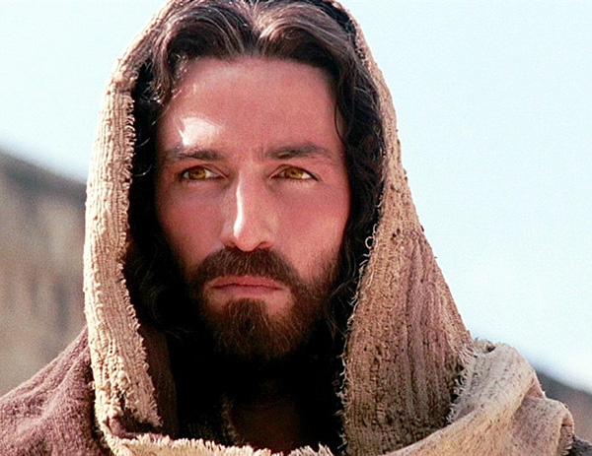
Christ is the final victor while angels only serve those who will share in that victory (1:13-14).

Slide 43
"And God never said to any of the angels,
'Sit in the place of honor at my right hand until I humble your enemies,
making them a footstool under your feet.'"
(1:13 NLT).
Notes:
The Father calls Jesus the highest ruler in verse 13

Slide 44
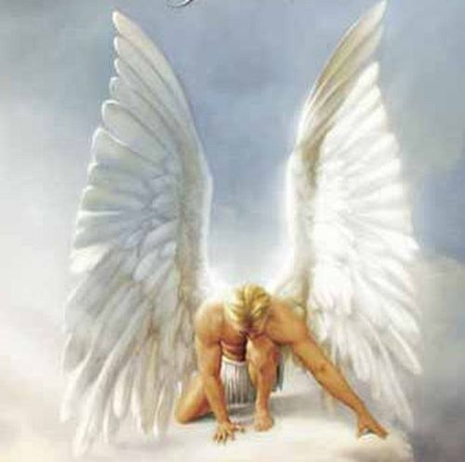
"Therefore, angels are only servants—spirits sent to care for people who will inherit salvation"
(1:14 NLT).
Notes:
In contrast, angels are but servants who care for us (1:14)

Slide 45
Why worship Jesus instead of angels?
(3 reasons in 1:4–2:18)
Jesus
Us
Jesus
1
2
3
Notes:
The second reason to worship Christ instead of angels is because…

Slide 46

Warning
II. Abandoning Jesus brings discipline (2:1-4).
Notes:
Turning our backs on Christ makes God have to turn up the heat in our lives.

Slide 47

Hebrews 2:1-2
  "We must pay more careful attention, therefore, to what we have heard, so that we do not drift away.
  For if the message spoken by angels was binding, and every violation and disobedience received its just punishment, how shall we escape if we ignore such a great salvation?"
Notes:
We shouldn’t drift away from holding Christ above angels (2:1).
God disciplined disobedience to his past teaching through angels (2:2).

Slide 48
Hebrews 2:3-4
  "This salvation, which was first announced by the Lord, was confirmed to us by those who heard him.
  God also testified to it by signs, wonders and various miracles, and gifts of the Holy Spirit distributed according to his will."
Notes:
We won’t escape God’s discipline for rejecting his salvation now (2:3a).
God proclaimed this salvation through Jesus and eyewitnesses, and then confirmed it through miracles (2:3b-4).

Slide 49
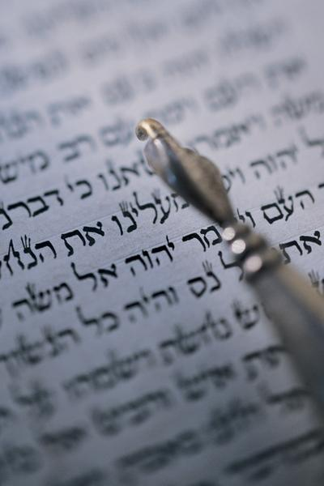
"Should I go back?"
"So we must listen very carefully to the truth we have heard, or we may drift away from it" (2:1 NLT).
Notes:
No penalties are listed here, as in other warning passages (cf. 6:4-7; 10:26-31), but the penalties can’t include hell as the writer was among those who could "drift away" (2:1).

Slide 50

Press On!
A Study of Hebrews
Notes:
The point is not to "drift" but to press on!

Slide 51
Why worship Jesus instead of angels?
(3 reasons in 1:4–2:18)
Jesus
Us
Jesus
1
2
3
Notes:
The third reason to worship Christ instead of angels is because…

Slide 52
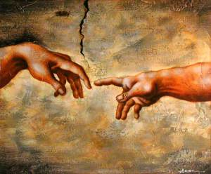
III. Jesus is a man worthy to rule (2:5-18).
Notes:
The original rule was given to the man, Adam—and only a human could fulfill OT prophecies of Messiah’s reign—and Christ qualifies here too

Slide 53
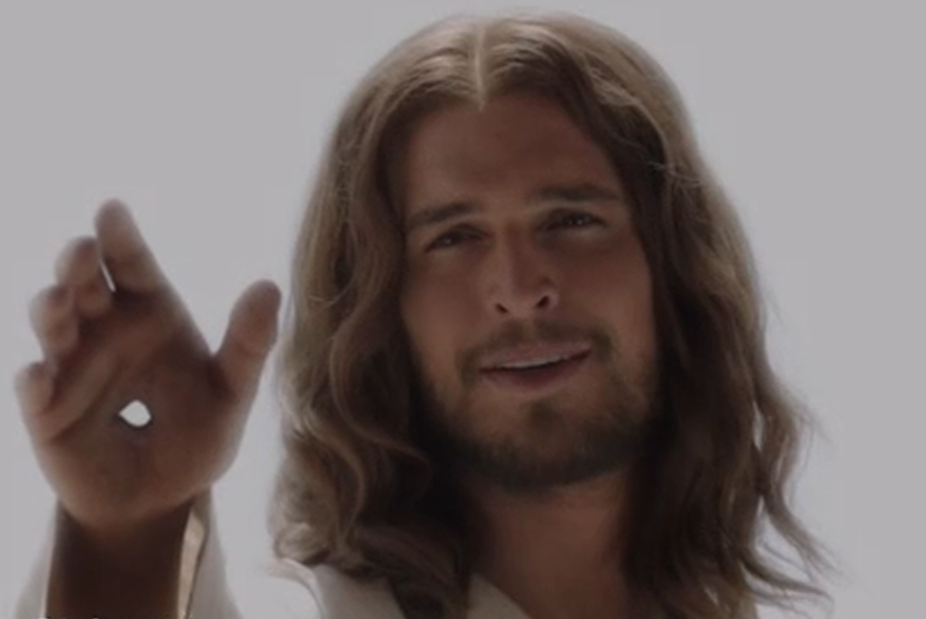
(2:5 NLT)
"And furthermore, it is not angels who will control the future world we are talking about."
Notes:
God never promised angels authority to rule the future world (2:5)

Slide 54
(2:6-8 NLT)
"For in one place the Scriptures say, 'What are mere mortals that you should think about them, or a son of man that you should care for him?
⁷Yet you made them only a little lower than the angels and crowned them with glory and honor.
⁸You gave them authority over all things'"
(2:6-8a NLT).
"But one has testified somewhere, saying,
'What is man, that you remember him?
or the son of man, that you are concerned about him?
⁷You have made him for a little while lower than the angels;
you have crowned him with glory and honor, and have appointed him over the works of your hands;
⁸you have put all things in subjection under his feet'" (2:6-8a NAU).
Notes:
Psalm 8:4-6 promised authority to rule the future world to the man Jesus (2:6-13).
Should we accept as a better translation "what are mere mortals" (2:6 NLT), referring to all men, or is "what is man" (NAU)?
Zane Hodges writes, "A portion of Psalm 8 was now quoted. While the psalm as a whole is often read as a general statement about the role of man in God’s Creation, it is clear in the light of Hebrews 2:5 and the application that follows in verses 8b-9 that the author of Hebrews read it primarily as messianic and eschatological. In doing so he stood well within the New Testament perspective on the Old Testament, a perspective directly traceable to Jesus Himself (cf. Luke 24:25-27, 44-45)" (BKC, 2:784).
I agree with this as verse 8 applies to Jesus—not to mankind: "But we have not yet seen all things put under their authority."
This was not true of Adam, who did have all the earth originally under his authority.
However, while Jesus has all authority now (Matt. 28:19), he does not exercise that full authority over the earth.
In fact, the "son of man" (2:6b) is a title for the ruling Messiah in Daniel 2:13.
Jesus was put under angels while on earth, but that was only temporary so he could go to the cross. Now, "crowned with glory and honor" (2:9b), he is our perfect "ruler" (2:10b).

Slide 55

(2:8b-10 NLT)
"Now when it says 'all things,' it means nothing is left out. But we have not yet seen all things put under their authority.
⁹What we do see is Jesus, who was given a position 'a little lower than the angels'; and because he suffered death for us, he is now 'crowned with glory and honor.' Yes, by God's grace, Jesus tasted death for everyone.
¹⁰God, for whom and through whom everything was made, chose to bring many children into glory. And it was only right that he should make Jesus, through his suffering, a perfect leader, fit to bring them into their salvation."
Notes:
This future rule of the world will go to a man (2:6-8a).
This future rule of the world will go to Jesus via His atoning death as our "brother" (2:8b-13).

Slide 56
2:11-12 (NLT)
ALL:
"So now Jesus and the ones he makes holy have the same Father. That is why Jesus is not ashamed to call them his brothers and sisters.
¹²For he said to God, 'I will proclaim your name to my brothers and sisters. I will praise you among your assembled people.'
He also said, 'I will put my trust in him,' that is, 'I and the children God has given me.'"
Notes:
Read these verses with me…
This future rule of the world will go to Jesus via His atoning death as our "brother" (2:8b-13).

Slide 57
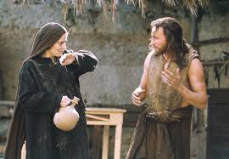
Other wonderful results of Christ's humanity make Him worthy of worship more than any angel (2:14-18).

Slide 58
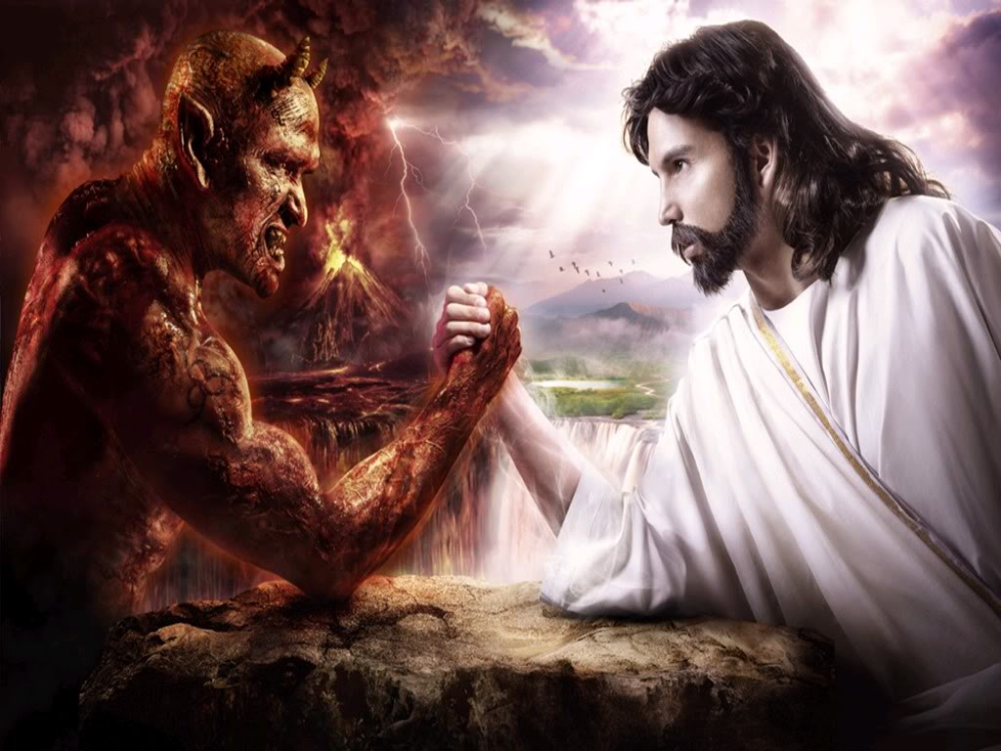
As a man, Christ defeated Satan's grip on other men (2:14-15).

Slide 59
(2:14-15 NLT)
"Because God's children are human beings—made of flesh and blood—the Son also became flesh and blood. For only as a human being could he die, and only by dying could he break the power of the devil, who had the power of death.
¹⁵Only in this way could he set free all who have lived their lives as slaves to the fear of dying."
Notes:
As a man, Christ defeated Satan’s grip on other men (2:14-15)

Slide 60
(2:16-17 NLT)
We also know that the Son did not come to help angels; he came to help the descendants of Abraham.
¹⁷Therefore, it was necessary for him to be made in every respect like us, his brothers and sisters, so that he could be our merciful and faithful High Priest before God. Then he could offer a sacrifice that would take away the sins of the people.
Notes:
As a man, Christ paid for man’s (not angel’s) sin as high priest (2:16-17).

Slide 61
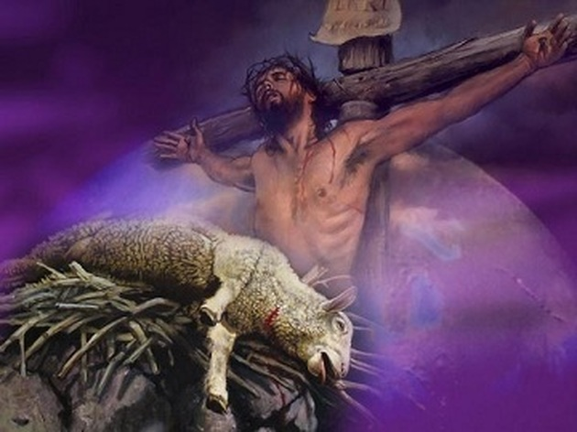
As a man victorious in His suffering, Christ helps us defeat temptation (2:18).
"Since he himself has gone through suffering and testing, he is able to help us when we are being tested"
(2:18 NLT)

Slide 62
Why worship Jesus instead of angels?
(3 reasons in 1:4–2:18)
Jesus
Us
Jesus
1
2
3
Notes:
So why worship Jesus—not angels?

Slide 63

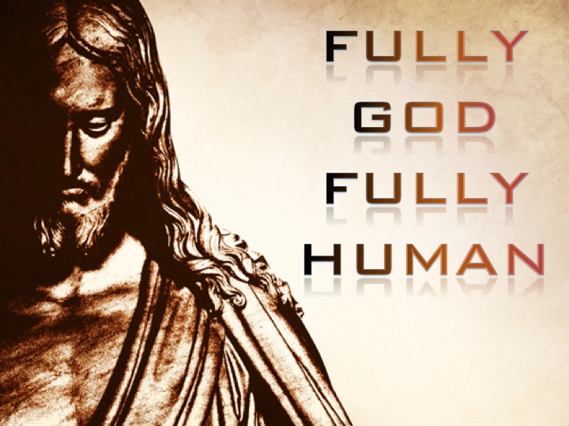
Fully God—Fully Human
Notes:
He is fully God and fully man, and…

Slide 64
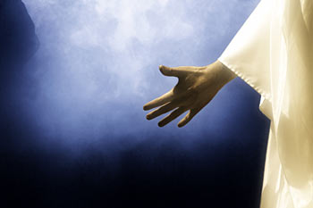
Main Idea
Jesus is God worthy of worship
and man worthy to rule
Notes:
As deity, we should worship him instead of angels—and in his humanity, he qualifies to reign over the world—something that no angel will ever do (restated MI).

Slide 65
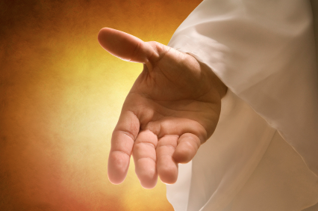
He invites you.

Slide 66
Press On!
Worship Jesus instead of any other lesser being
Notes:
Press on to worship Jesus instead of any other lesser being.

Slide 67
Black

Slide 68


NT Preaching link at BibleStudyDownloads.org
Get this presentation and script for free!

