Slide 1
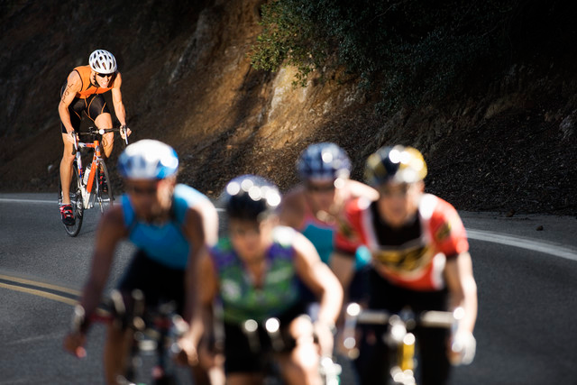
Press On!
Hebrews 13
Dr. Rick Griffith • Crossroads International Church Singapore
BibleStudyDownloads.org

Slide 2

Engaging the Atheists
Notes:
What is the best apologetic for Jesus in an anti-God world?
That is the question that I have been asked to address in this coming Saturday's seminar called "Engaging the Atheists." I hope you can go, especially since it will be in Hawaii.
So what advice would you give me in facilitating a seminar like this? How do you address atheists?
Should we focus on proving the existence of God?

Slide 3
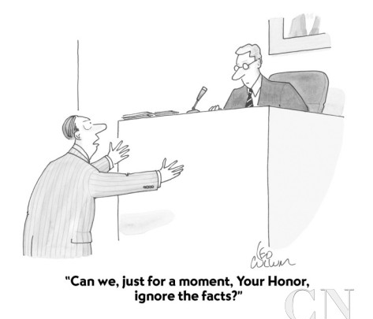
"Can we, just for a moment, Your Honor, ignore the facts?"
Notes:
Should we emphasize the reliability of the Bible? I don't want to be like the guy pleading before the judge, "Can we, just for a moment, Your Honor, ignore the facts?" I want to deal with facts to help atheists to see the truth of God, but how?

Slide 4
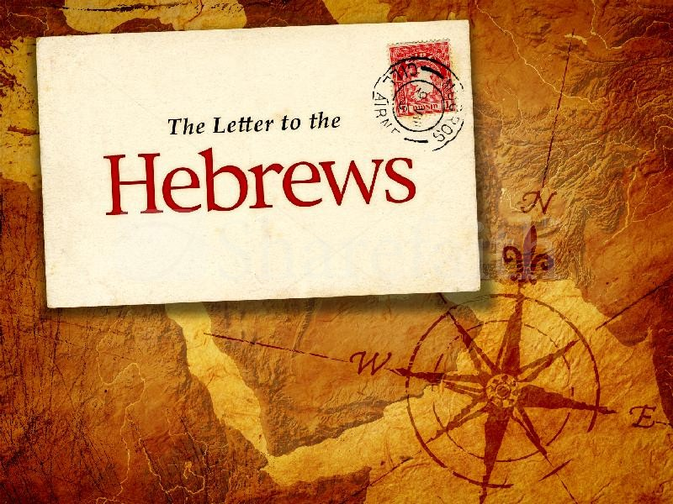

Hebrews
The Letter to the

Slide 5
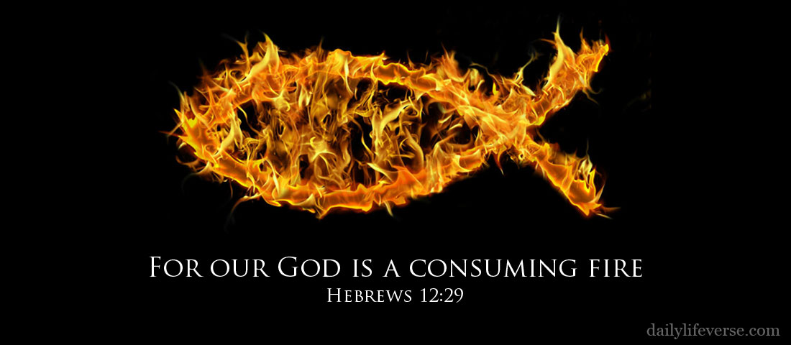
"For our God is a consuming fire"
Hebrews 12:29

Slide 6


Series on the Book of Hebrews
How are you doing at showing Christ's superiority?
JESUS
the great high priest

Slide 7
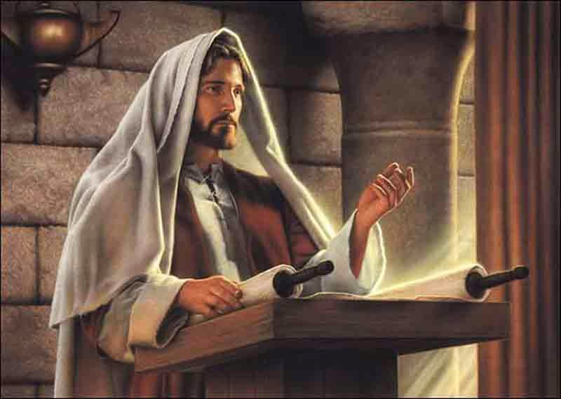
How can we show that Jesus is better than any other belief system?

Slide 8
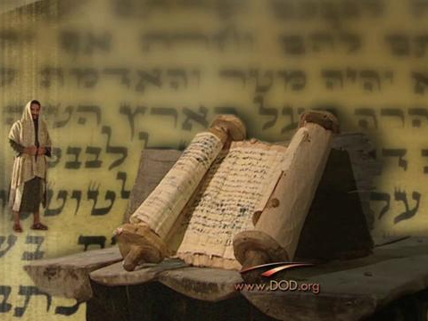
Background to the Letter to the Hebrews

Slide 9

Hebrews: "Press On!"
254
Christ's Superiority Over Judaism as High Priest
Superior in His Person to... |  |  | Superior in His Priestly Work to... |  |  |  | Endurance Through Faith
1:1–4:13 |  |  | 4:14–10:18 |  |  |  | 10:19–13:25
Prophets | Angels | Moses | Aaron | Melch | Old Cov. | Tabernacle & Sacrifices | Willful Sin | Models | Don't Despise Discipline | Don't Ignore God | Press on!
1:1-3 | 1:4–2:18 | 3:1–4:13 | 4:14–6:20 | 7 | 8 | 9:1–10:18 | 10:19-39 | 11:1–12:3 | 12:4-17 | 12:18-29 | 13
Christ's Majesty |  |  | Christ's Ministry |  |  |  | Christian's Manifestation
Theology |  |  |  |  |  |  | Practice
Unknown Author, Recipients, Origin, and Destination!
AD 67-68

Slide 10

The Better Things
266f
Superior Person 1:1–4:13
Superior Work 4:14–10:18
Endure by Faith 10:19–13:25

Slide 11
HEBREWS
256-
257
Author
Recipients
Origin
Destination
UNKNOWN

Slide 12
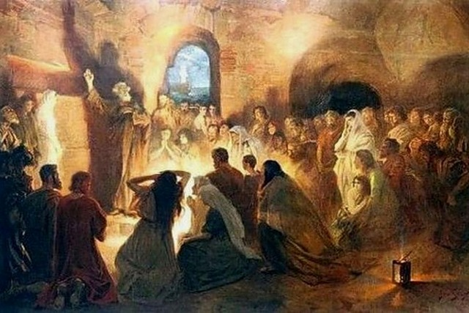
A Specific Jewish Community
"And especially pray that I will be able to come back to you soon" (13:19 NLT).
Notes:
The author already visited them once and wanted to revisit them (13:19, 23).
The readers apparently had a concern for Timothy as well (13:18).

Slide 13
Summary Statement
258
An unknown author shows Hebrew believers the superiority of Christ as High Priest and the superiority of Christianity over Judaism to exhort them to endure persecution rather than return to their former life under Judaism.

Slide 14

Press On!
A Study of Hebrews
Notes:
So the author exhorting them repeatedly in his letter to press on, so I'm calling this new series on Hebrews "Press On!"

Slide 15
How can we show that Jesus is better than any other belief system?
Two ways in Hebrews 13

Slide 16

I. Love in practical ways (13:1-17).
Notes:
We show how great Christ is by giving ourselves to others and to him in hands-on ways.
There is no such thing as theoretical love.

Slide 17
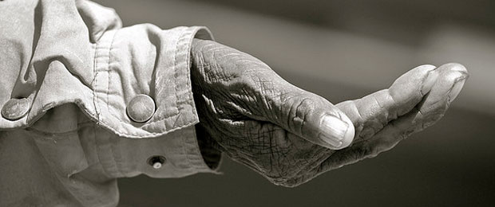
Love people to show the supremacy of Christ (13:1-6).

Slide 18

Show hospitality to all the saints, to strangers, and to prisoners (13:1-3).

Slide 19

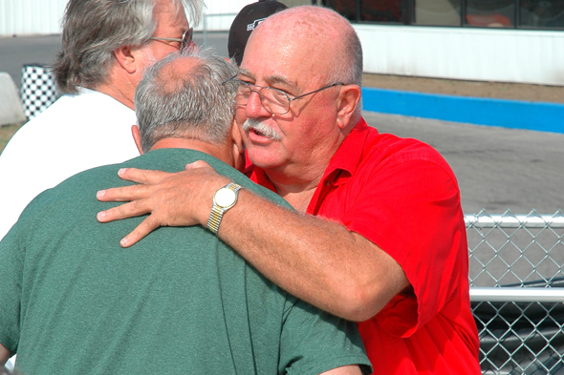
"Keep on loving each other as brothers and sisters" (13:1 NLT).

Slide 20
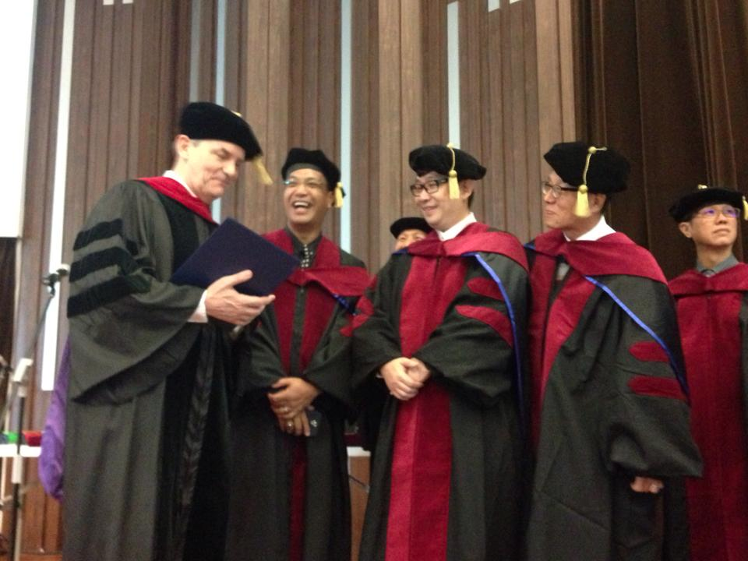
Doctor of Ministry Graduates 9 May 2015

Slide 21
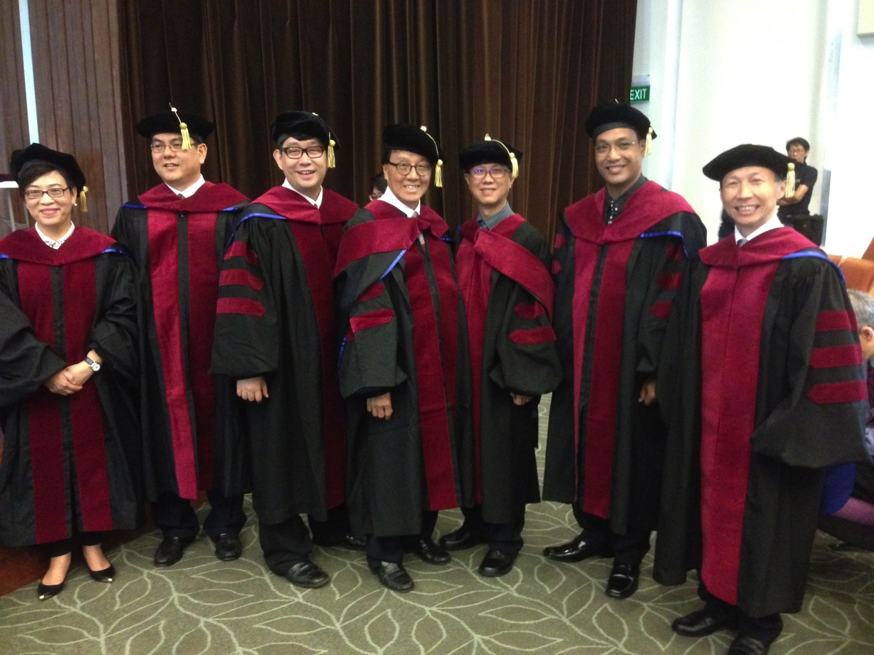
Seven DMin Graduates May 2015
Notes:
2 Chinese: Josephine Lau & Too Take Joie
5 English: Chandra Koewoso, Siew Who, Yap Beng Shin, Neil Mamburam, Alby Yip

Slide 22
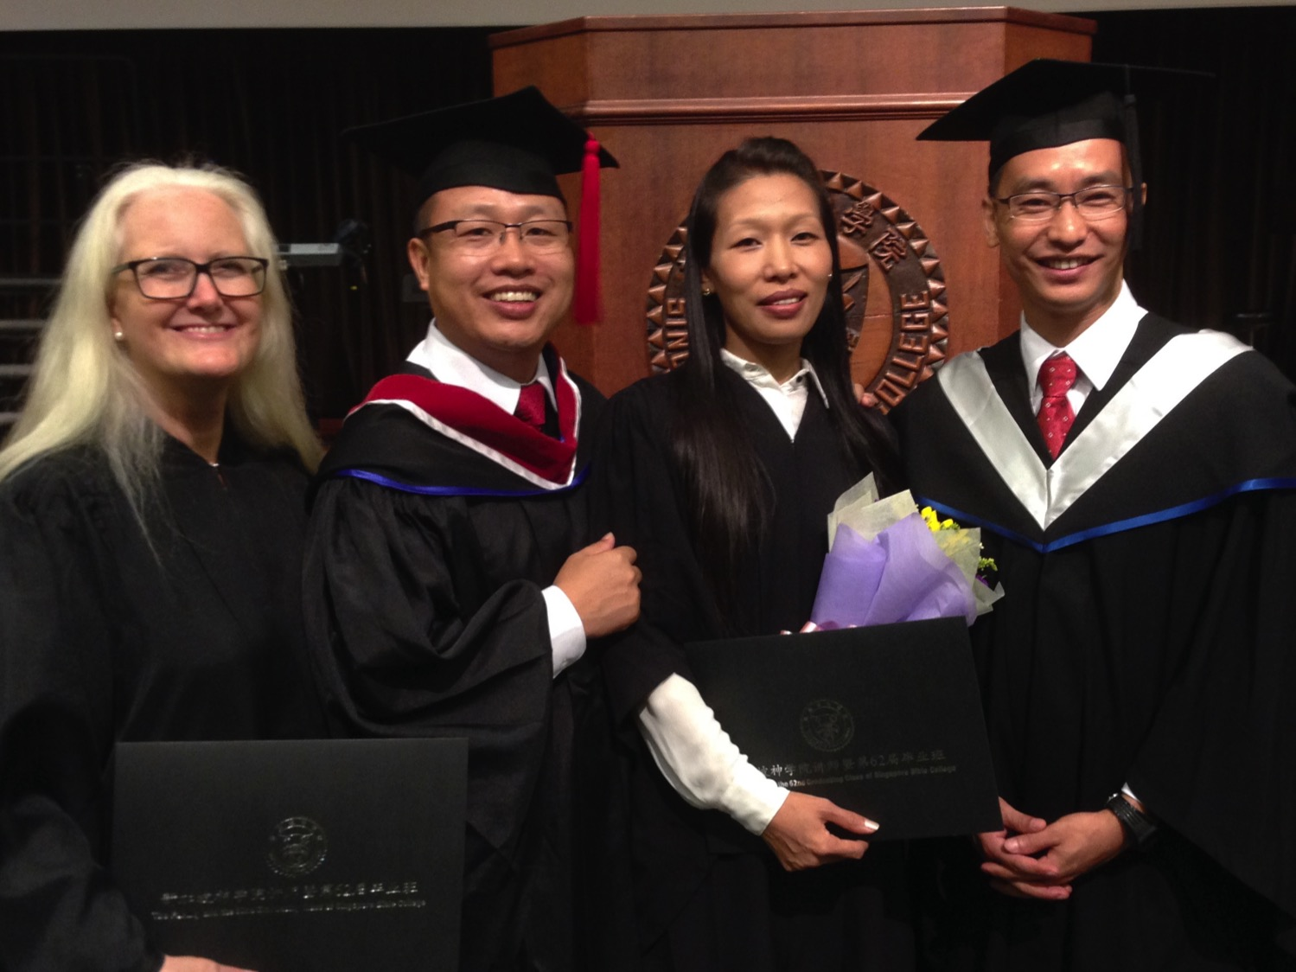
Crossroads Graduates
Colleen
Athan
Chanchan
Themshang
Notes:
On 9 May 2015 we saw four of our Crossroads people graduate from SBC with four different degrees!

Slide 23
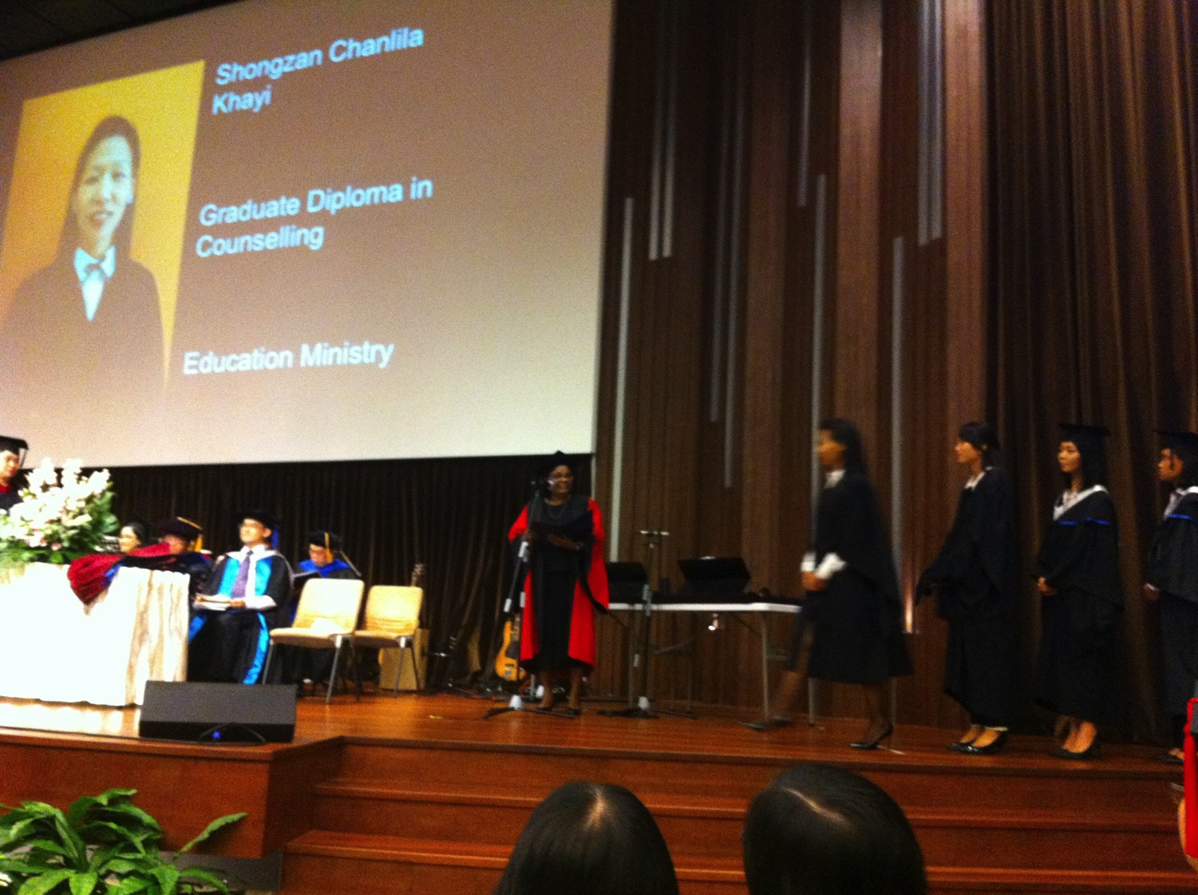
Chanchan Graduating

Slide 24
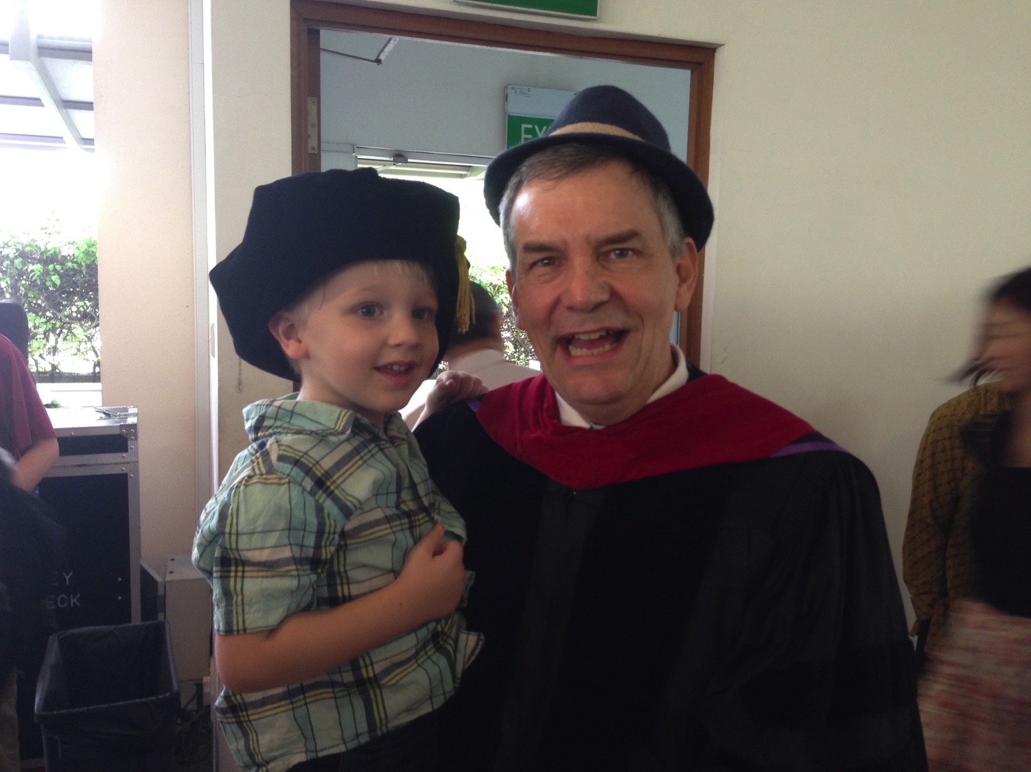
Switching Hats

Slide 25
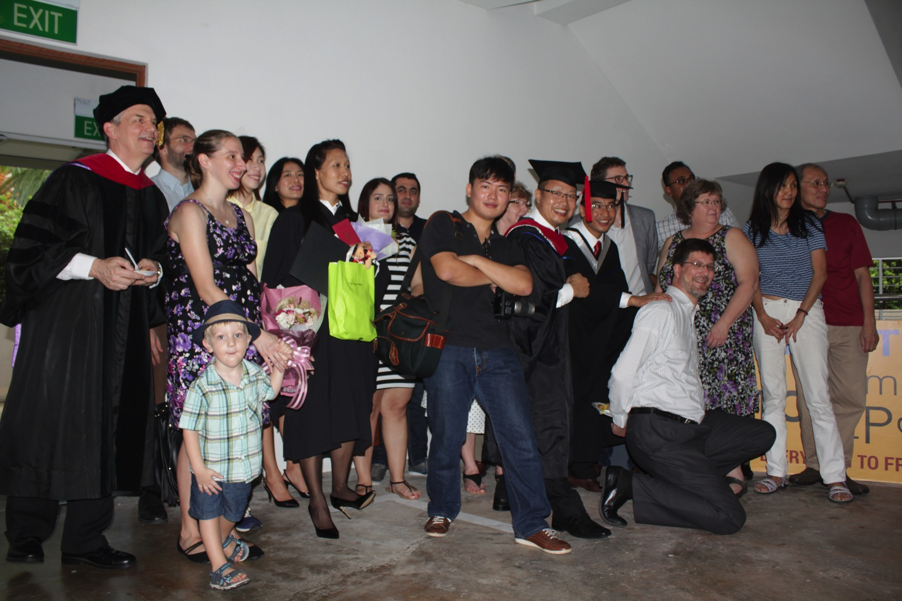
Some of the CIC Family 9 May 2015

Slide 26

Happy Mother's Day!
Notes:
Honor church leaders because they teach and live out God’s word, which is as changeless as is Christ Himself (13:7-8).
Honoring leaders starts with honoring our first leader—our mother! We have given much honor to women in the marketplace since Rosie the Riveter took women out of the homes to build WWII ships, tanks, planes, and other war weapons. Our problem is that we haven’t duly honored “Rosie the Rearer” who brought us up.

Slide 27
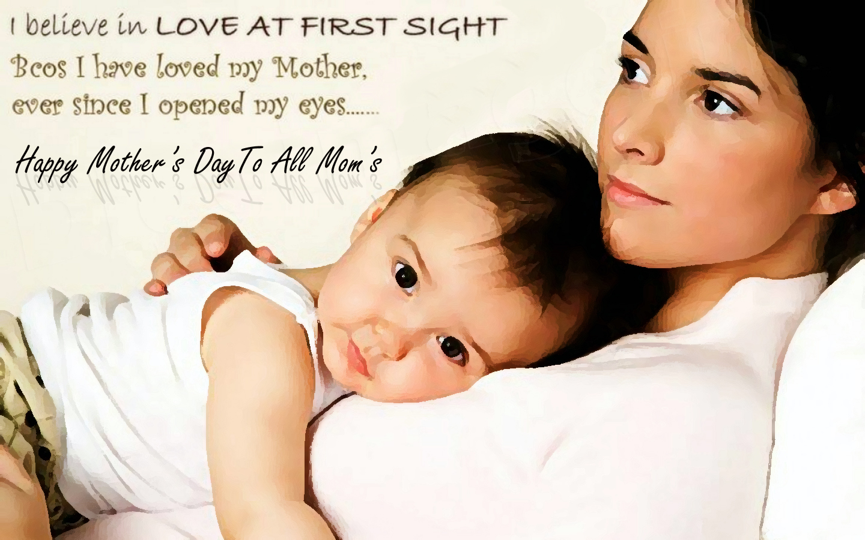
Happy Mother's Day!

Slide 28
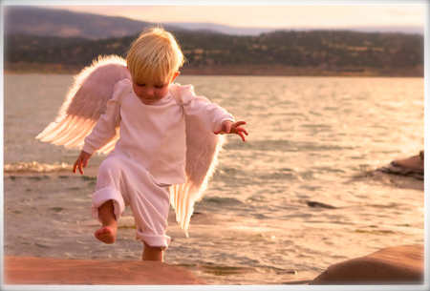

Hebrews 13:2

Slide 29
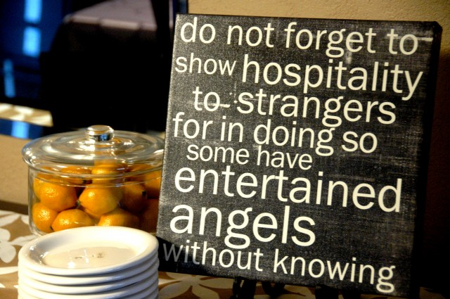

Slide 30
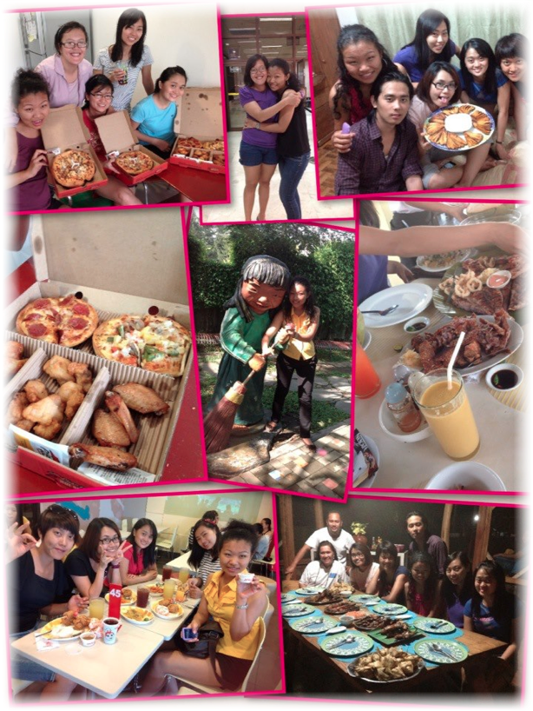


Slide 31



Slide 32
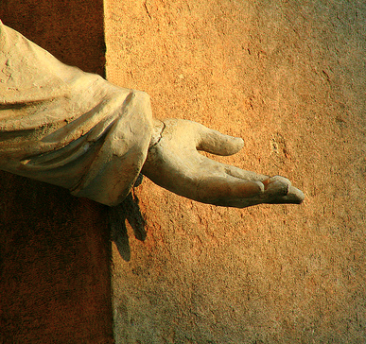
Show hospitality to strangers (13:2a)

Slide 33


"love of strangers"

Slide 34

Why should we show hospitality to strangers?
HOSTING ANGELS
Heb. 13:2 Do not neglect to show hospitality to strangers, for by this some have entertained angels without knowing it (NAU).

Slide 35
Show hospitality to strangers (13:2a)
Hospitality was a big deal for the ancient world:
Jews
Greek (Zeus)
Roman roads
HOSTING ANGELS
Heb. 13:2 Do not neglect to show hospitality to strangers, for by this some have entertained angels without knowing it (NAU).

Slide 36
Show hospitality to strangers (13:2a)
Hospitality is a big deal for Christians today
The NT often emphasizes it
HOSTING ANGELS
Heb. 13:2 Do not neglect to show hospitality to strangers, for by this some have entertained angels without knowing it (NAU).

Slide 37
Texts encouraging hospitality
Romans 12:13
1 Timothy 3:2
Titus 1:8
1 Peter 4:9
Also Acts 10, 21 & 28

Slide 38
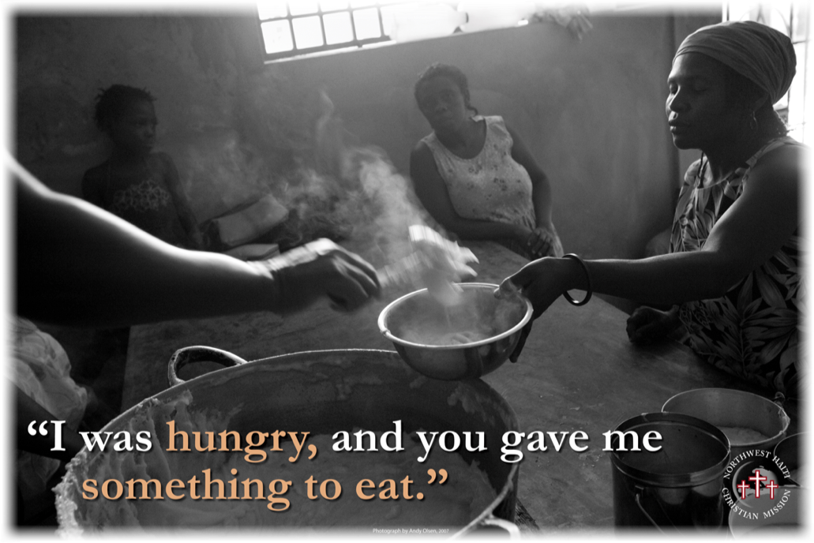

Slide 39
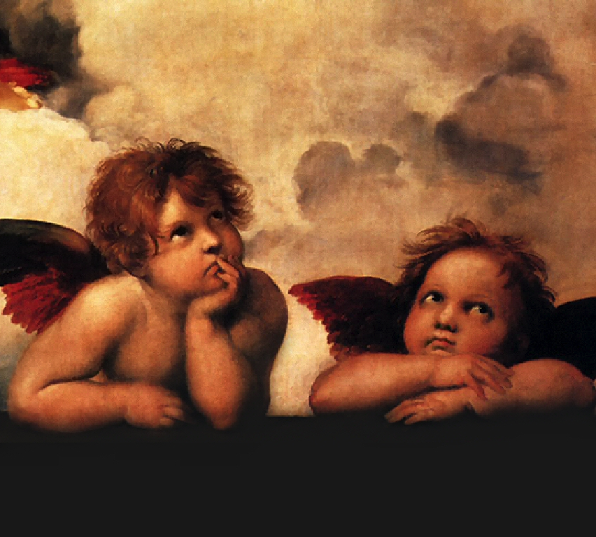
Show hospitality as if you are doing it to angels (13:2b)

Slide 40
Show hospitality as if you are doing it to angels (13:2b)
Some have entertained angels:
Genesis 18–19
Judges 6 & 13
HOSTING ANGELS
Heb. 13:2 Do not neglect to show hospitality to strangers, for by this some have entertained angels without knowing it (NAU).

Slide 41
Matthew 25:31-46
³¹ "But when the Son of Man comes in His glory, and all the angels with Him, then He will sit on His glorious throne. ³² "And all the nations will be gathered before Him; and He will separate them from one another, as the shepherd separates the sheep from the goats; ³³ and He will put the sheep on His right, and the goats on the left. ³⁴ "Then the King will say to those on His right, 'Come, you who are blessed of My Father, inherit the kingdom prepared for you from the foundation of the world. ³⁵ 'For I was hungry, and you gave Me something to eat; I was thirsty, and you gave Me drink; I was a stranger, and you invited Me in; ³⁶ naked, and you clothed Me; I was sick, and you visited Me; I was in prison, and you came to Me. ³⁷ "Then the righteous will answer Him, saying, 'Lord, when did we see You hungry, and feed You, or thirsty, and give You drink? ³⁸ 'And when did we see You a stranger, and invite You in, or naked, and clothe You? ³⁹ 'And when did we see You sick, or in prison, and come to You?' ⁴⁰ "And the King will answer and say to them, 'Truly I say to you, to the extent that you did it to one of these brothers of Mine, even the least of them, you did it to Me.

Slide 42
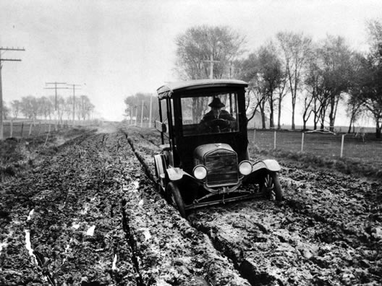
Needs are all around us…

Slide 43
What's your motive?
Entertain or show hospitality
People of your choice
Do it as you should do to Jesus

Slide 44
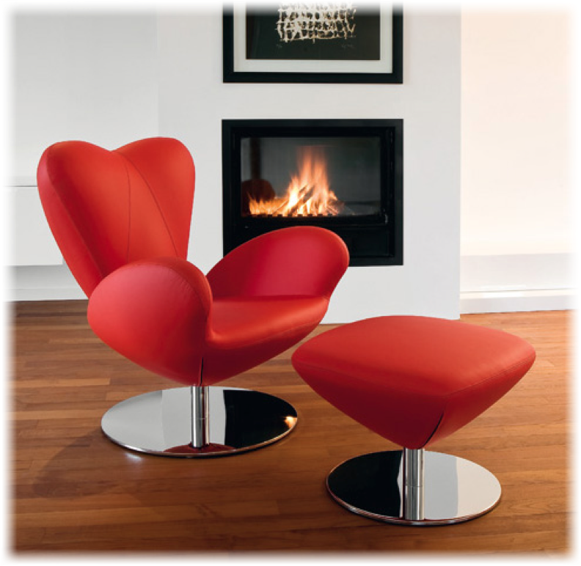
Hebrews 13:2
Show hospitality to strangers and God will show up to you.
Heb. 13:2 Do not neglect to show hospitality to strangers, for by this some have entertained angels without knowing it (NAU).

Slide 45
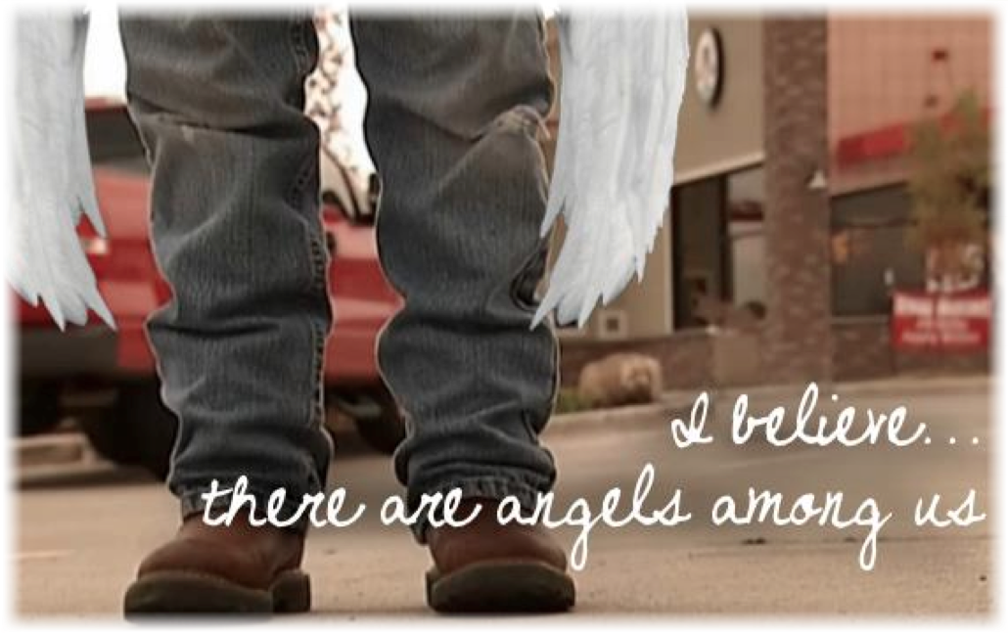

Slide 46
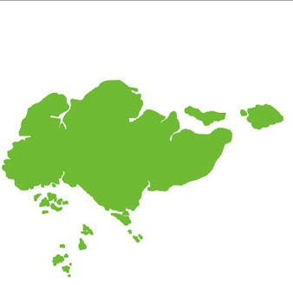
Opportunities in Singapore
37% of Singapore's total workforce of 3.36 million = 1.24 million are foreigners
136,738 travelers per day
Hosting Ministries

Slide 47

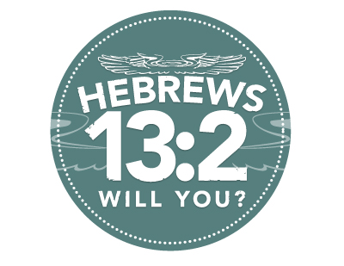

Slide 48

"Remember those in prison, as if you were there yourself" (13:3a NLT).

Slide 49
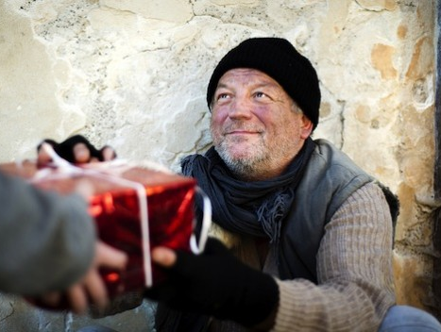
"Remember also those being mistreated, as if you felt their pain in your own bodies" (13:3b NLT).

Slide 50
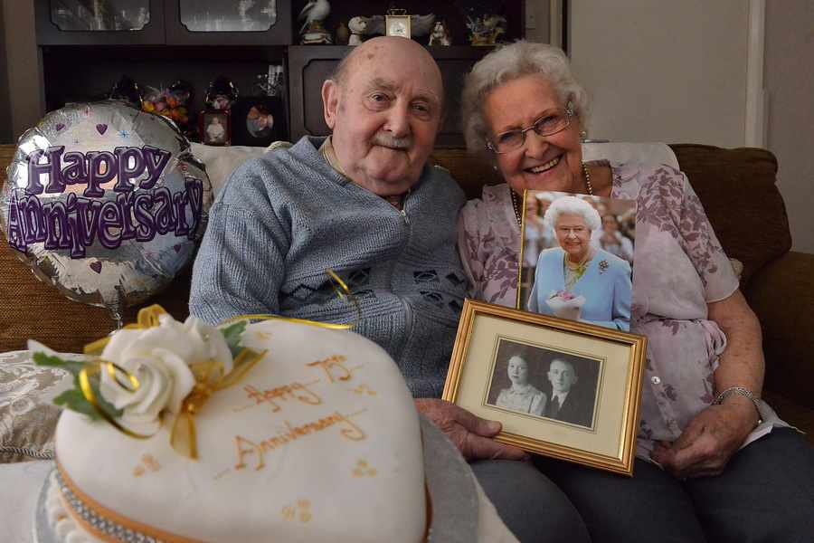
"Give honor to marriage, and remain faithful to one another in marriage"
(13:4a NLT).

Slide 51


First Argument on their Wedding Night…
Husband to Wife: "You better make me coffee in the morning!"
Wife: "I can't make the coffee! That's not biblical!"
Husband: "Where did you ever read that in the Bible?"
Wife: "He-brews."

Slide 52

A Biblical Logo…

Slide 53
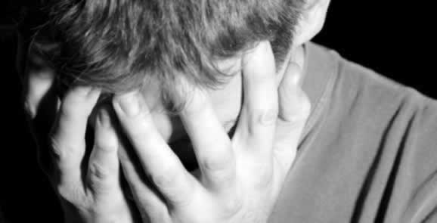
"God will surely judge people who are immoral and those who commit adultery" (13:4b NLT).

Slide 54
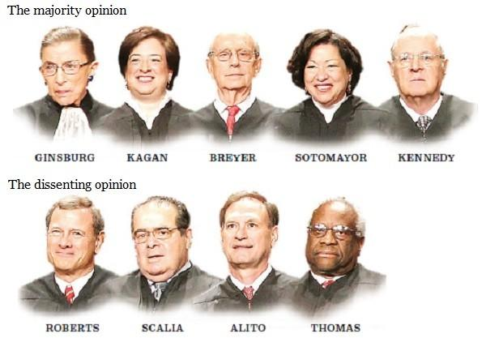
5-4 struck down DOMA in 2013

Slide 55
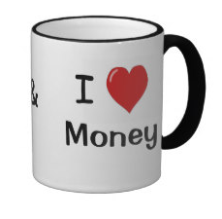
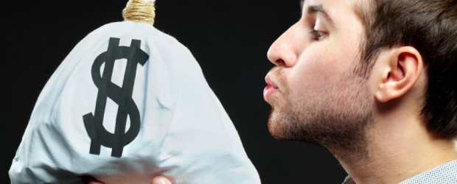
"Don't love money; be satisfied with what you have. For God has said, 'I will never fail you. I will never abandon you'"
(Hebrews 13:5 NLT).
Notes:
"Let's look at just a few facts: Americans have 3 times more space than they did 50 years ago. Yet there's a booming $22 Billion dollar/year Storage Space industry. Which means we have, on average, more than 3 times the stuff, still need extra storage and are willing to pay extra for it. At the same time, credit card debt levels and, not surprisingly, stress levels have gone way up.
Also not surprisingly, happiness levels have flatlined in the last 50 years. Human greed was, perhaps, more glaringly visible than ever before, as the direct source of the last Global Recession. Has humanity looked at that and drastically changed it's MO? Have we looked at ourselves, and wondered how much of that stuff might have trickled into the Church?"
Money Talk – 4 Ways To Stop Loving Money
06/02/2014
http://austinchristian.org/money-talk-4-ways-to-stop-loving-money/

Slide 56

"So we can say with confidence,
'The LORD is my helper, so I will have no fear.
What can mere people do to me?'"
(13:6 NLT).

Slide 57
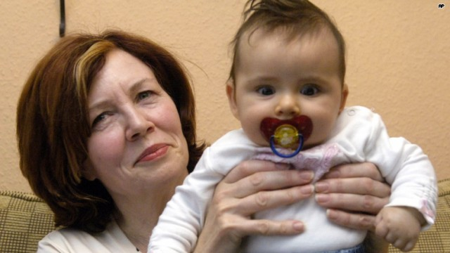

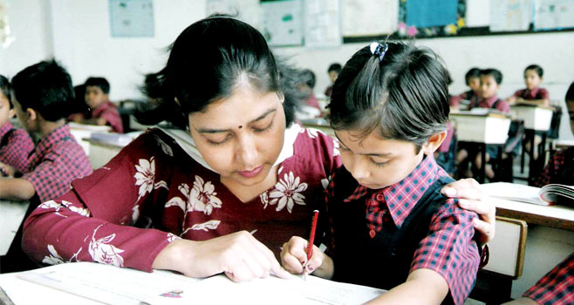
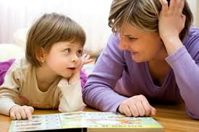
"Remember your leaders who taught you the word of God. Think of all the good that has come from their lives, and follow the example of their faith" (13:7 NLT).
Notes:
Honor church leaders because they teach and live out God’s word, which is as changeless as is Christ Himself (13:7-8).
65-year-old teacher set to be mother of quadruplets
Annegret Raunigk is pregnant with quadruplets at age 65
The pregnancy is a result of artificial insemination where both the eggs and sperm were donated.
Annegret Raunigk, 65, is set to become the oldest woman to ever give birth to quadruplets. The German schoolteacher already has 13 children and seven grandchildren.
Raunigk's pregnancy was the result of artificial insemination using both sperm and eggs that were donated, and her story will be featured in a television documentary.
According to the Daily Mail, Raunigk was "shocked" when the ultrasound showed she was carrying four children. However, she decided to keep all the children, even though the doctor mentioned the possibility of having a selective reduction procedure, where one or more fetuses is aborted in a multi-fetal pregnancy.
The schoolteacher says she is not concerned about her future and believes she will stay healthy throughout her children's adolescent years, the Daily Mail reported. She defended her decision, saying, "I think one needs to decide for oneself and not listen too much to the opinions of others."
Raunigk previously made German headlines when she gave birth to her daughter, Leila, at the age of 55.
By Alexis Brigante
updated5:47 PM EDT, Mon April 13, 2015
http://www.hlntv.com/article/2015/04/13/sixty-five-year-old-teacher-mother-quadruplets accessed 10 May 2015

Slide 58

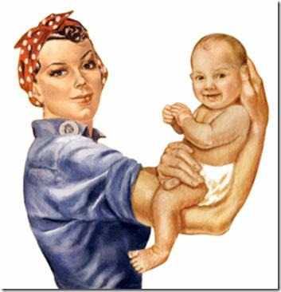
Rosie the Riveter/Rearer
Rosie the Riveter
Rosie the Rearer
Notes:
Honoring leaders starts with honoring our first leader—our mother! We have given much honor to women in the marketplace since Rosie the Riveter took women out of the homes to build WWII ships, tanks, planes, and other war weapons. Our problem is that we haven’t duly honored “Rosie the Rearer” who brought us up.

Slide 59
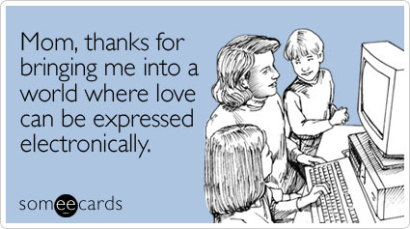
Happy Mother's Day!

Slide 60

Happy Mother's Day!

Slide 61

Jesus Christ is the same yesterday, today, and
Hebrews 13:7
Notes:
His incarnation forever changed him in that he took on a body that he will keep for eternity.
Unlike the leaders of verse 7 who may have passed away, Jesus remained with them and was unchanging.
The contrast is also seen in verse 9 with ideas that constantly change.

Slide 62

"So do not be attracted by strange, new ideas. Your strength comes from God's grace, not from rules about food, which don't help those who follow them"
(13:9 NLT).

Slide 63
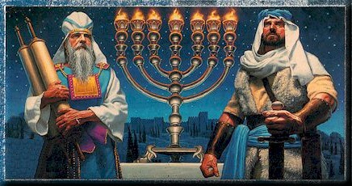
"We have an altar from which the priests in the Tabernacle have no right to eat"
(13:10 NLT).
Notes:
The old sacrificial system was soon to disappear (cf. 8:13). Sadly, priests associated with that system were rejecting Jesus.
But, as believers in the new way, our “altar” provides refuge in the most unlikely places—like outside the camp, which actually provides protection instead rejection!

Slide 64
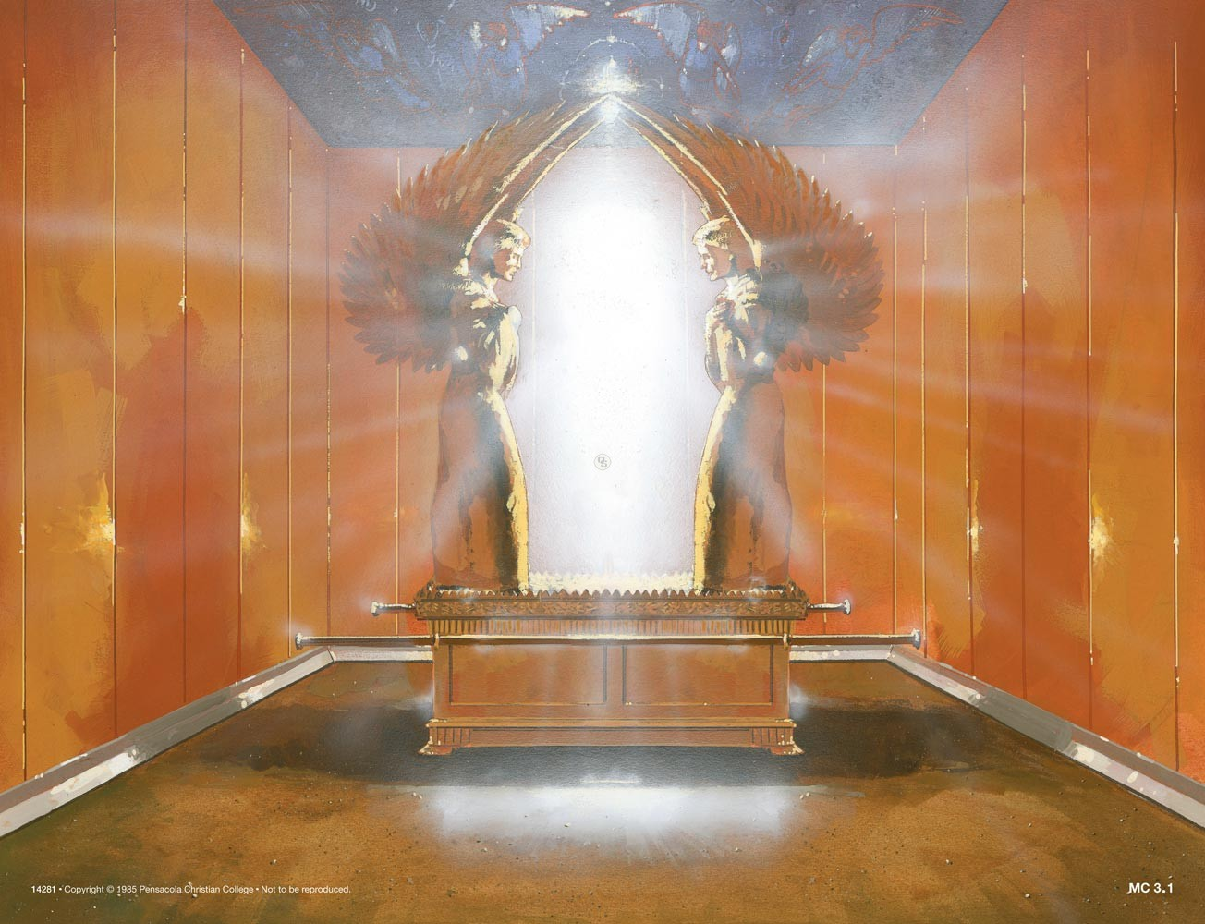
"Under the old system, the high priest brought the blood of animals into the [Most NIV] Holy Place as a sacrifice for sin, and the bodies of the animals were burned outside the camp" (13:11 NLT).

Slide 65


Application: "Leave Jerusalem"
"So also Jesus suffered and died outside the city gates to make his people holy by means of his own blood"
(Heb. 13:12 NLT)
¹³ So let us go out to him, outside the camp, and bear the disgrace he bore"
(Heb. 13:13 NLT)
Leen & Kathleen Ritmeyer, "Akeldama: Potter's Field or High Priest's Tomb?" BAR 20 (Nov/Dec 94): 34

Slide 66

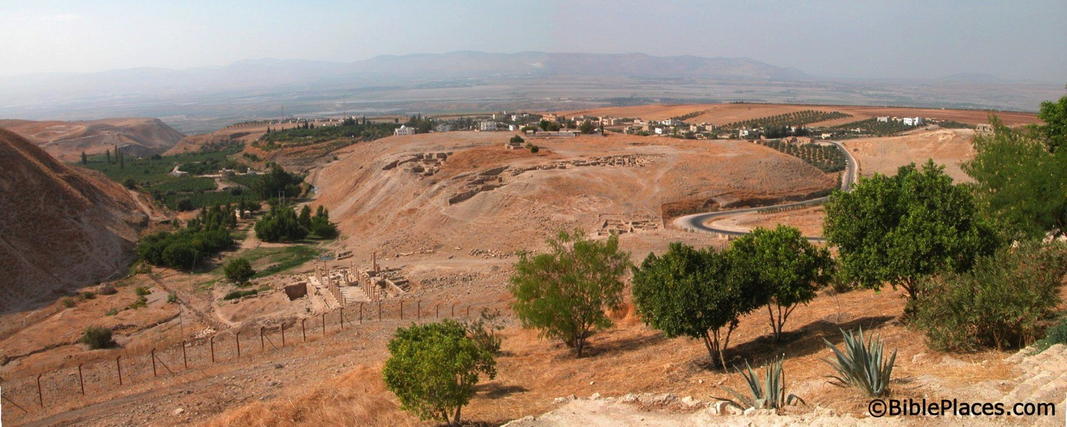
What happened to the Christians in Jerusalem?
A revelation told them to find protection in Pella.
Pella
Jerusalem
Notes:
Todd Bolen: "Pella/Pehel is not mentioned explicitly in the Bible but it was prominent in biblical times. In the days of the judges, it led a rebellion against Egypt which was crushed by Pharaoh Seti I. In NT days, Pella was the site where Christians sought refuge during the Jewish Revolt against the Romans in 66-70 A.D. Eusebius records that the Jewish believers fled here in obedience to a revelation, which some correlate with Jesus' words in Matthew 24:16. This photo views the tell from the east. Several Byzantine churches have been excavated as well as a building believed to be a Late Bronze temple. The Jordan Rift and the mountains of Israel are visible in the background."

Slide 67

The Fire
²⁶ Dear friends, if we deliberately continue sinning after we have received knowledge of the truth, there is no longer any sacrifice that will cover these sins. ²⁷ There is only the terrible expectation of God's judgment and the raging fire that will consume his enemies (Heb. 10:26-27 NLT).
Hell fire?
No, Jerusalem fire!
Notes:
The fire of 10:27 is not hell fire but Jerusalem fire!

Slide 68
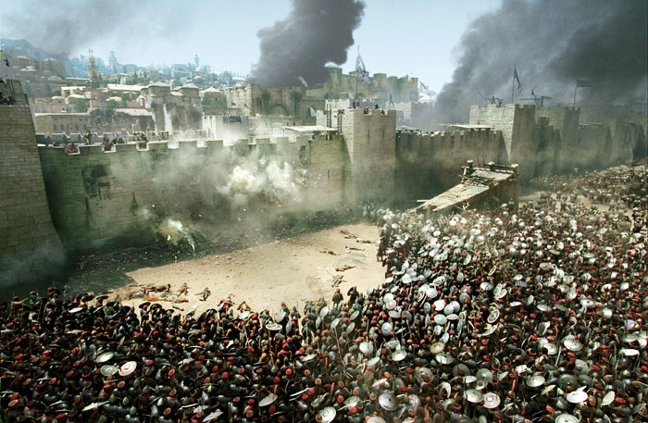
Antonia Fortress Leveled

Slide 69

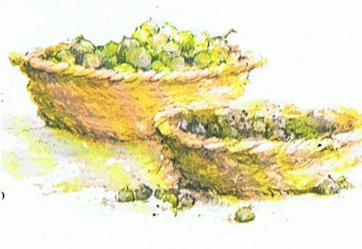
Jeremiah's Application: "Leave Jerusalem"
Jeremiah 24 portrayed all the Jews as two types of figs during Babylon's siege:
The "bad figs" who refused to submit to God's discipline by the Babylonians would disobey God by staying in the city and dying.
The "good figs" would spare their lives by leaving the city to surrender to the Babylonians outside!
AD 70 was no different!
Jews as figs:
good
bad
Babylonians
Jeremiah 24 Figs

Slide 70
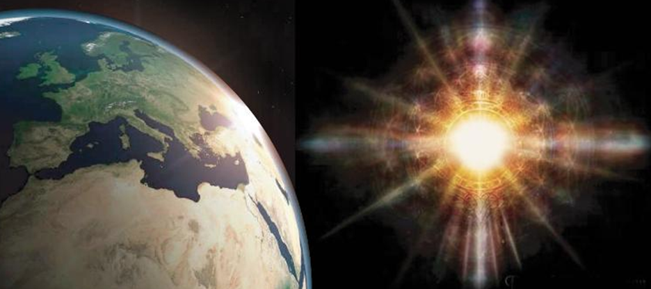
"For this world is not our permanent home; we are looking forward to a home yet to come" (13:14 NLT).

Slide 71

"Therefore, let us offer through Jesus a continual sacrifice of praise to God, proclaiming our allegiance to his name"
(13:15 NLT).

Slide 72
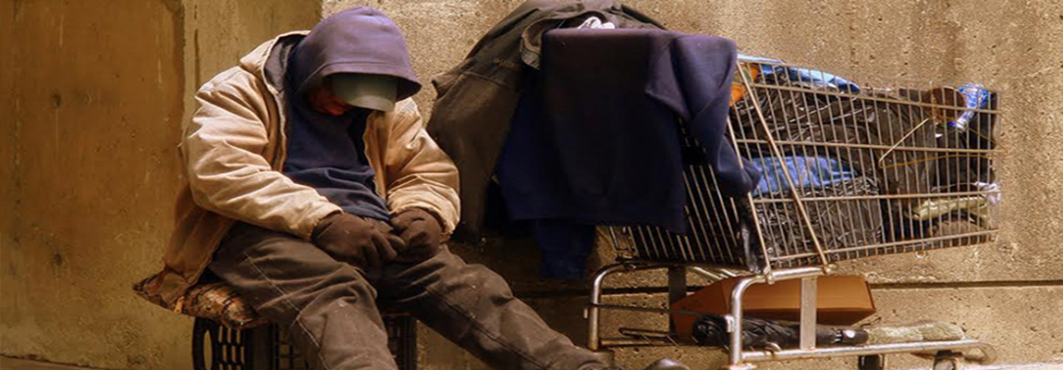
"And don't forget to do good and to share with those in need. These are the sacrifices that please God" (13:16 NLT).

Slide 73
Obey Leaders
Hebrews 13:17
"Obey your leaders and submit to their authority. They keep watch over you as men who must give an account. Obey them so that their work will be a joy, not a burden, for that would be of no advantage to you."
Notes:
73

Slide 74
I. Love in practical ways (13:1-17).
Notes:
We show how great Christ is by giving ourselves to others and to him in hands-on ways.
There is no such thing as theoretical love.

Slide 75


II. Relate to others personably (13:18-25).
Notes:
We show how great Christ is by an individualized, caring approach.
We live in an impersonal age—as seen in the advent of the computerized “care-giver,” the Care-O-Bot 4, the Service Robot: https://www.youtube.com/watch?v=3n42WbbYGZI#t=15

Slide 76
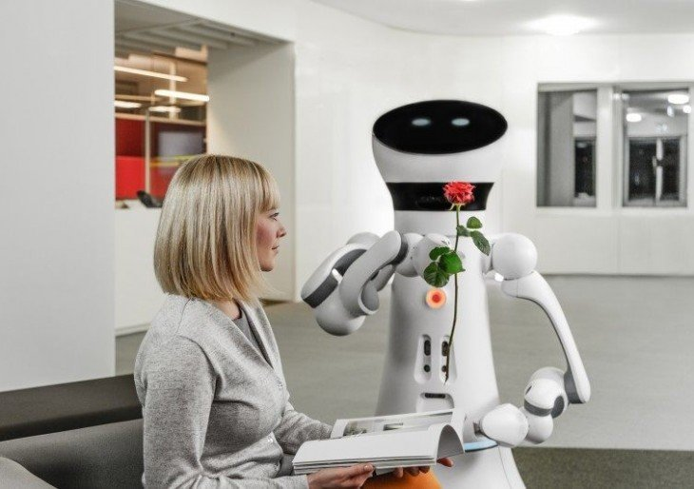
They're Coming: Care-O-Bot 4, the Service Robot
Notes:
They're Coming: Care-O-Bot 4, the Service Robot, Is More Agile, More Personable, And Flirtier
The fourth generation of the Care-O-Bot is an economical solution for those who want a service robot.
"Customers can choose between a wide range of sensors," Fraunhofer Institute's Dr. Ulrich Reiser said. "You might choose to have color cameras in the front and a 3D TOF camera in the back, or several 3D-TOF cameras. The sensor ring is equipped with its own computation unit and receives power supply and Ethernet via standard connector, so you might have several sensor rings and exchange them for different applications."
Its predecessor could serve you drinks, place emergency calls, take care of some medical needs, and set up videoconferences. However, the latest iteration of this robot is a lot more personable.
In addition to doing all the things its predecessor can do, the Care-O-Bot is also designed for commercial use so it can be used as a waiter, an information center, or to deliver objects to specific locations such as hotel rooms. The bot will now also interact with humans by communicating emotions through facial expressions on its touchscreen.
The Care-O-Bot 4 is also more mobile. It now has joints at the torso and neck that give 31 degrees of movement, as opposed to 20 degrees.
The Care-O-Bot 4 is scheduled to be available toward the last part of the year. It will initially only be available in Europe with plans to launch in the United States later. Pricing details will be made available closer to the time of launch.
http://www.amlu.com/2015/01/27/theyre-coming-care-o-bot-4-the-service-robot-is-more-agile-more-personable-and-flirtier/ accessed 10 May 2015

Slide 77
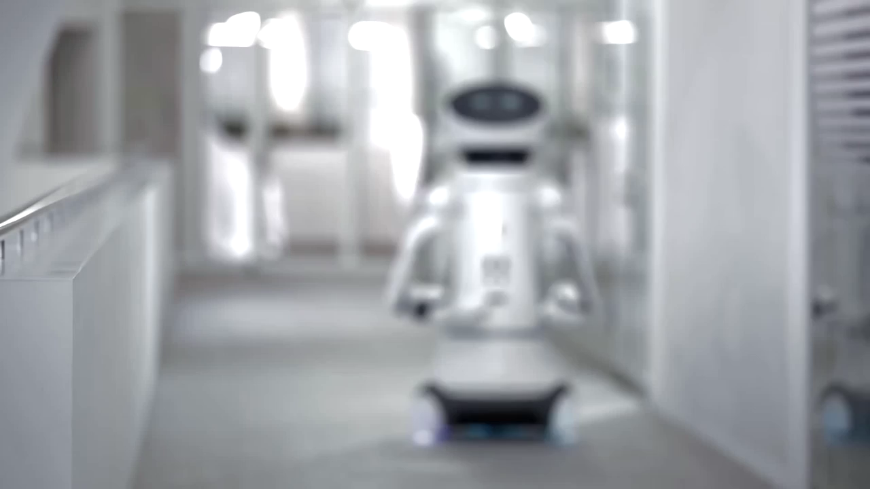
They're Coming: Care-O-Bot 4, the Service Robot
Notes:
https://www.youtube.com/watch?v=3n42WbbYGZI#t=15 accessed 10 May 2015

Slide 78
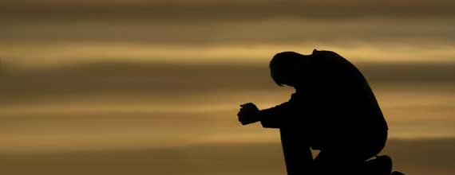
"Pray for us, for our conscience is clear and we want to live honorably in everything we do. ¹⁹And especially pray that I will be able to come back to you soon" (13:18-19 NLT).

Slide 79

"Now may the God of peace— who brought up from the dead our Lord Jesus, the great Shepherd of the sheep, and ratified an eternal covenant with his blood—
²¹may he equip you with all you need for doing his will.
May he produce in you, through the power of Jesus Christ, every good thing that is pleasing to him.
All glory to him forever and ever! Amen" (13:20-21 NLT).
Notes:
What is the “eternal covenant” (20)?
This is new covenant that replaced the old covenant given to Moses at Mt. Sinai.
It is eternal because it is rooted in the blood of Jesus, which lasts forever.
The focus here is not what we believe—though that is crucial—but what we do about what we believe.

Slide 80

"I urge you, dear brothers and sisters, to pay attention to what I have written in this brief exhortation" (13:22 NLT).

Slide 81
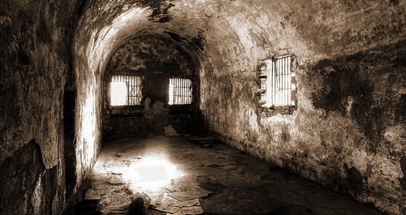
"I want you to know that our brother Timothy has been released from jail. If he comes here soon, I will bring him with me to see you" (13:23 NLT).

Slide 82
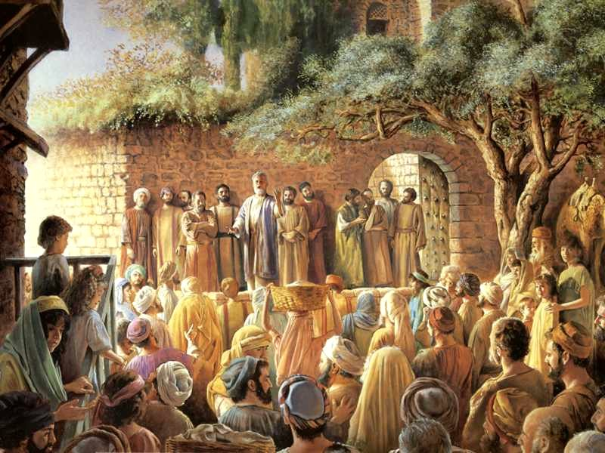
"Greet all your leaders and all the believers there. The believers from Italy send you their greetings" (13:24 NLT).

Slide 83


"May God's grace be with you all"
(13:25 NLT).

Slide 84
How can we show that Jesus is better than any other belief system?

Slide 85

Jesus looks good when we love others
—Main Idea of Hebrews 13

Slide 86
I. Love in practical ways (13:1-17).
Notes:
We show how great Christ is by giving ourselves to others and to him in hands-on ways.
There is no such thing as theoretical love.

Slide 87
II. Relate to others personably (13:18-25).
Notes:
We show how great Christ is by an individualized, caring approach.
We live in an impersonal age—as seen in the advent of the computerized “care-giver,” the Care-O-Bot 4, the Service Robot: https://www.youtube.com/watch?v=3n42WbbYGZI#t=15

Slide 88

Are you better educated in Hebrews or are you transformed now?
Notes:
Today we draw this 12-week study in Hebrews to a close. Has it changed you? Our focus has been Christ Himself—the superiority of Jesus over any other “ism.” Essentially we have asked this question…
How can you make Jesus look good? It is through your love, but how through your love?

Slide 89

In what specific way can you better love those in need?

Slide 90

In what specific way can you better love God?

Slide 91

Grace Exemplified

Slide 92
Black

Slide 93


NT Preaching link at BibleStudyDownloads.org
Get this presentation and script for free!

