Slide 1
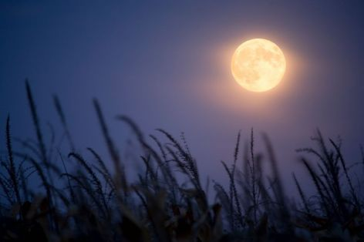
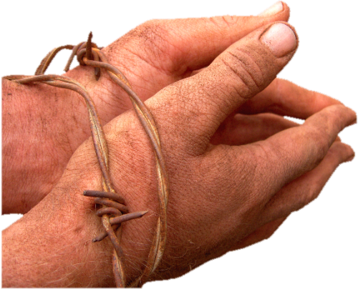
Models of Endurance
Hebrews 11:1–12:3
Dr. Rick Griffith • Crossroads International Church Singapore cicfamily.com & BibleStudyDownloads.org

Slide 2
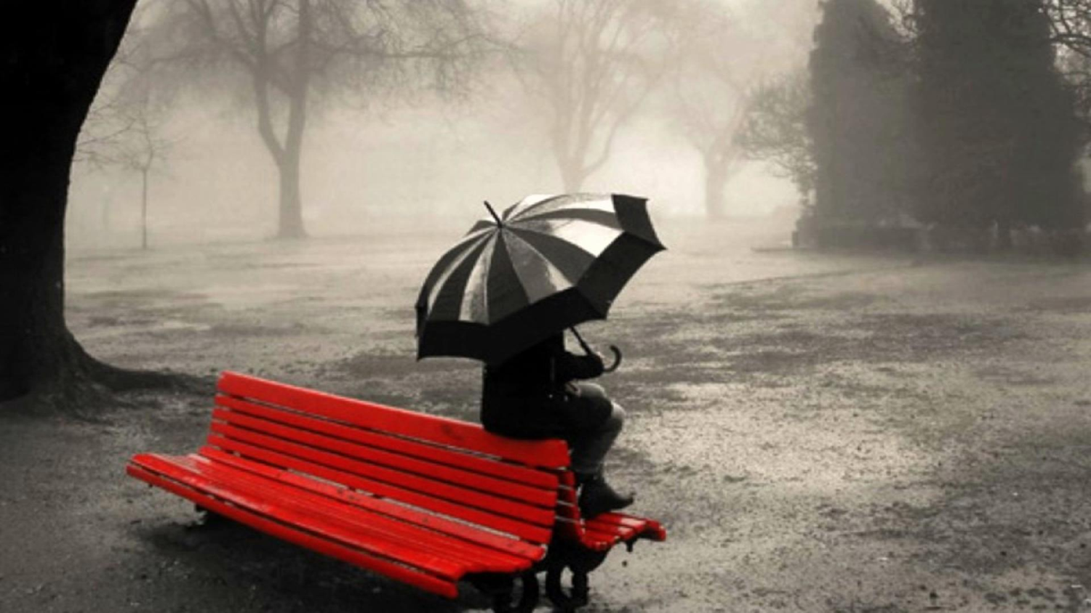
Waiting.
Notes:
We all need to wait. None of us has seen God do all that we trust him for.

Slide 3
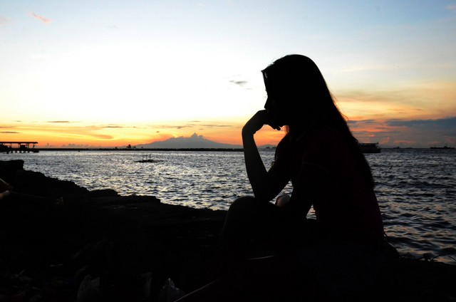
We wait for marriage.
Notes:
Some of us are waiting to get married.

Slide 4
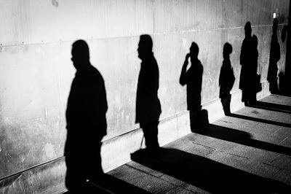
Some wait for direction from God on where we should work
Notes:
Some of us are waiting for clear direction from God on where we should work

Slide 5
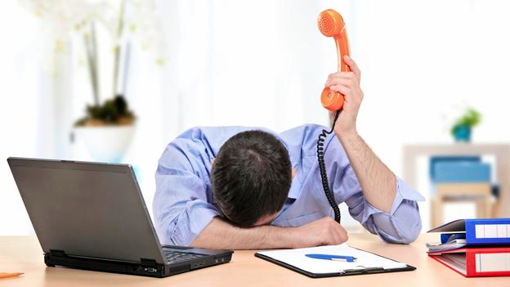
We wait upon God to overcome difficulties at work from being a Christian.

Slide 6
Bad Leadership

Slide 7
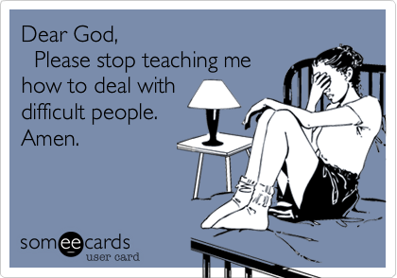
Bad Leadership
Dear God,
Please stop teaching me how to deal with difficult people.
Amen.

Slide 8
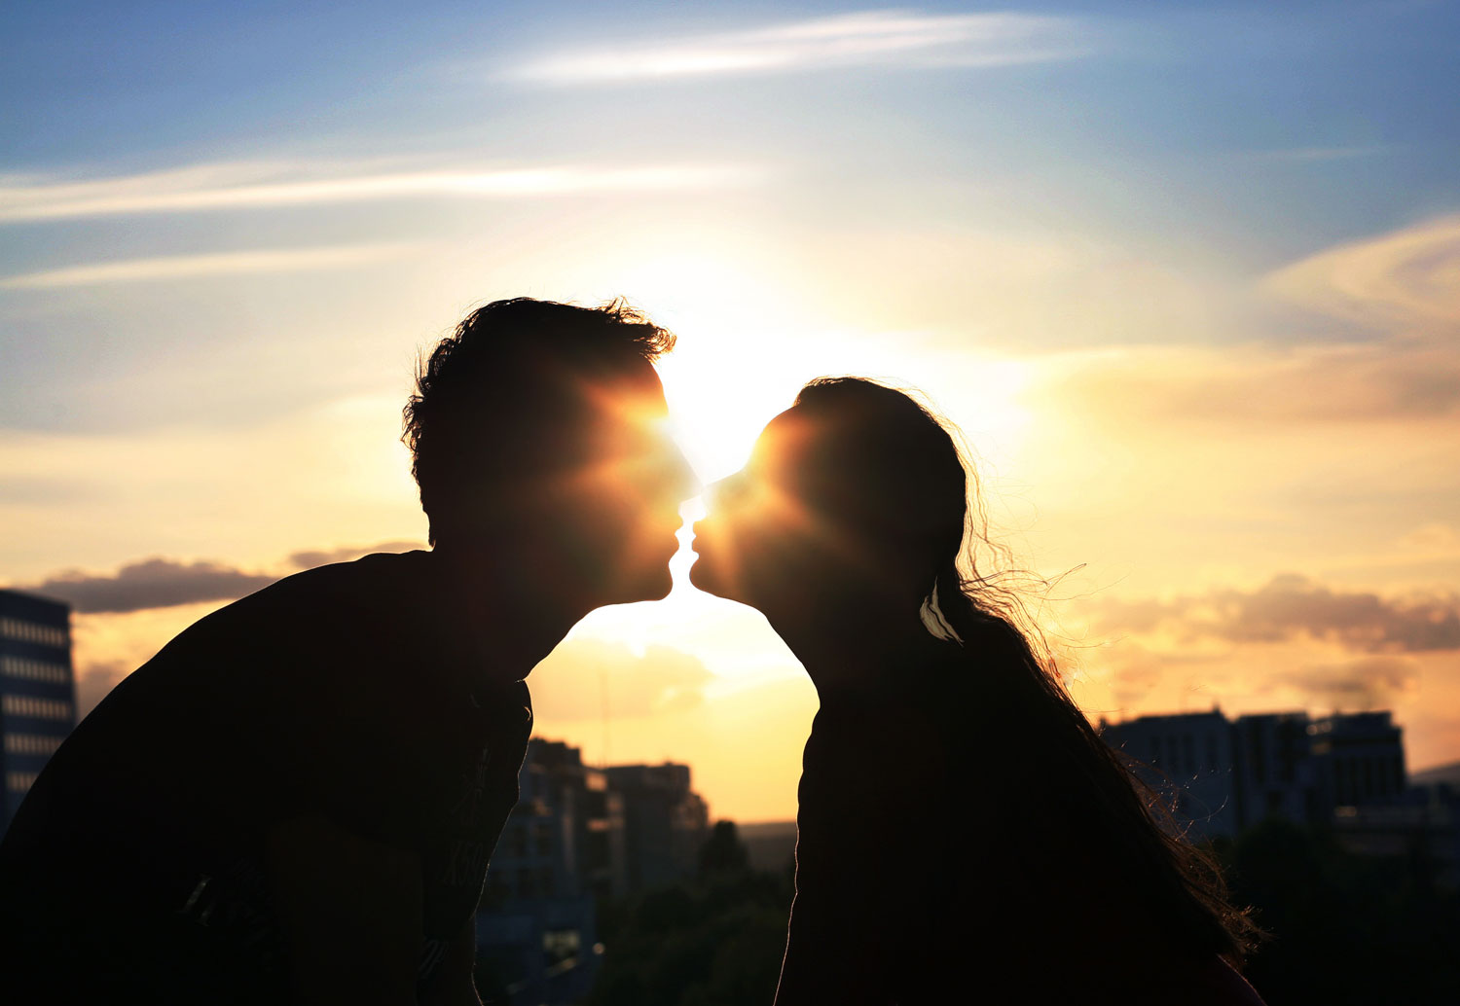
Others wait for a baby.

Slide 9
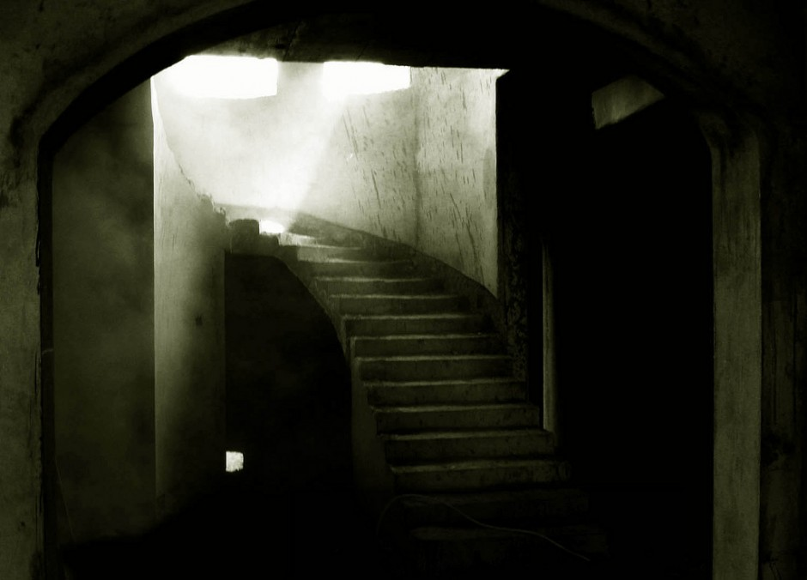
We wait for parents or children to believe in the empty tomb.

Slide 10
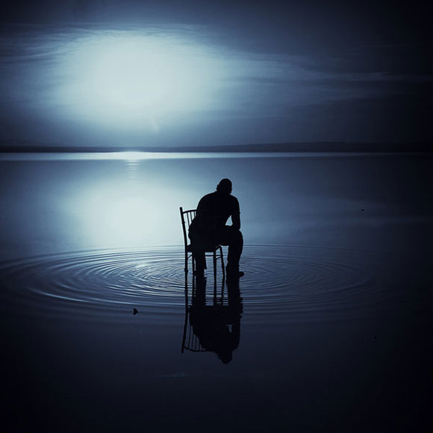
Still Waiting
Notes:
Others are waiting on God for something else that is really important.

Slide 11
What are you waiting for?
(Tell the person next to you.)
Notes:
Waiting isn't bad. Waiting is good.
For one, it teaches us patience. But…

Slide 12
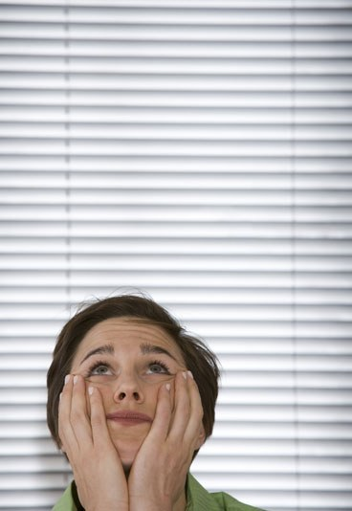
How can you wait in faith?

Slide 13
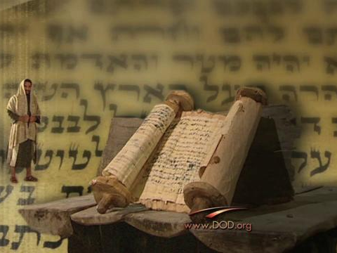
Background to the Letter to the Hebrews
Notes:
The suffering Hebrew readers were tempted to give up their faith by returning to Judaism.
They had waited for relatives to trust Christ—yet most still hadn't believed.
In fact, things got worse and they suffered for their faith.

Slide 14
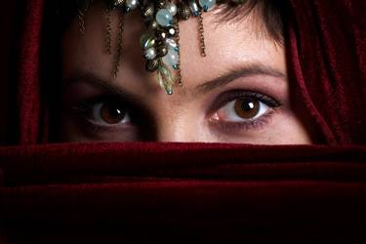
Waiting By Faith Hebrews 11:1–12:3

Slide 15
HALL OF FAME

Slide 16
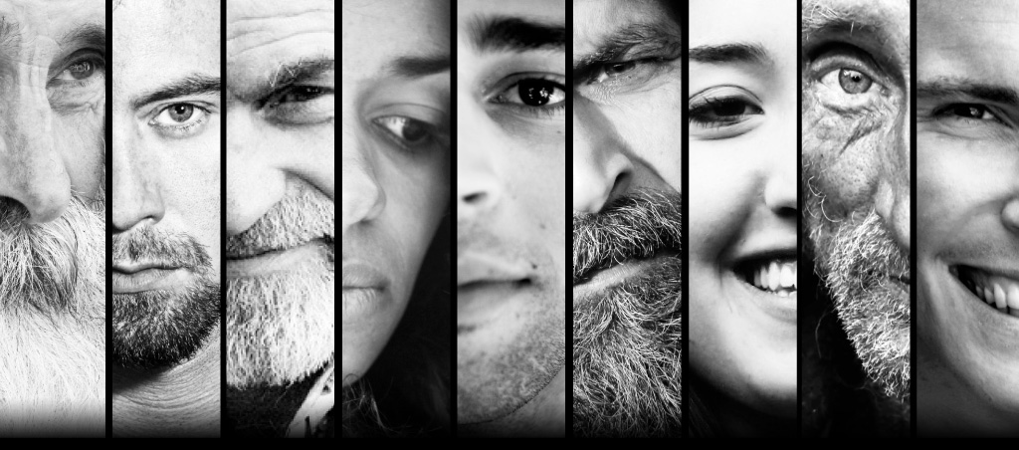
HEROES
ULTIMATE EXAMPLE
OF THE OLD TESTAMENT
KEY PRINCIPLE
Notes:
Our text today has three movements that show three ways to wait in faith: the key principle (11:1-3) followed by heroes (11:4-40) followed by our ultimate example (12:1-3).
How can you wait in faith? We first will see our key principle of waiting in faith…

Slide 17
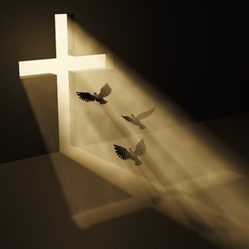
I. Faith sees an unseen hope (11:1-3).
Notes:
Trust obeys with confidence in God's future blessings.

Slide 18
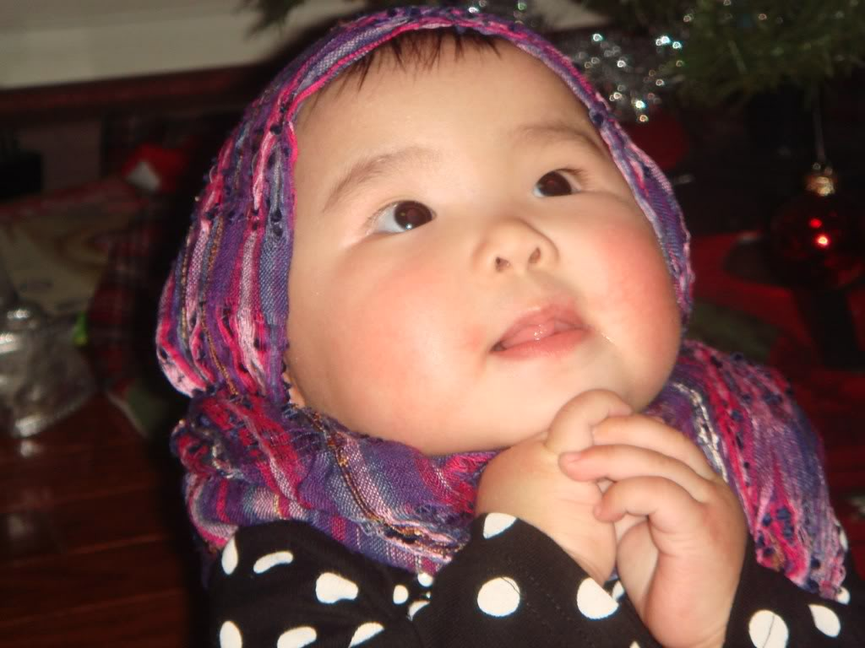
"By Faith…" (Hebrews 11)
"Faith is the confidence that what we hope for will actually happen; it gives us assurance about things we cannot see" (Heb. 11:1 NLT)
Notes:
Definition: Faith sees the unseen (11:1).

Slide 19
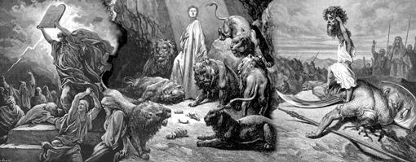
"By Faith…" (Hebrews 11)
"Through their faith, the people in days of old earned a good reputation" (Heb. 11:2 NLT)

Slide 20
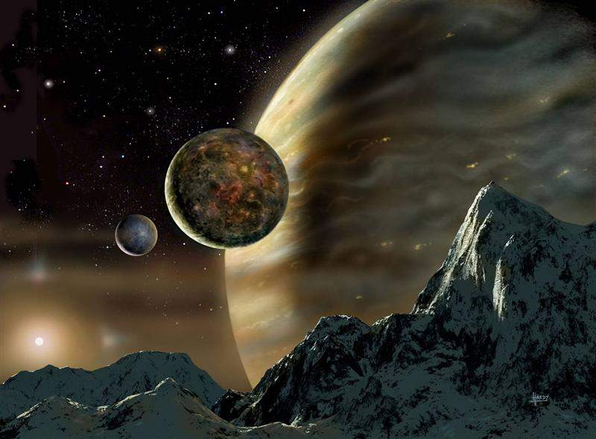
"By Faith…" (Hebrews 11)
"By faith we understand that the entire universe was formed at God's command, that what we now see did not come from anything that can be seen" (Heb. 11:3 NLT)

Slide 21
I. Faith sees an unseen hope (11:1-3).
Notes:
How can you wait in faith? Faith sees an unseen hope. Now the theoretical principle gets practical with many examples. IN the rest of the chapter we are exhorted to…

Slide 22
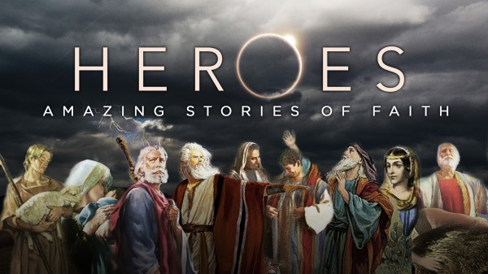
II. Imitate OT saints that persevered (11:4-40).
Notes:
Mimic OT heroes who endured despite not seeing God fulfill his promises.

Slide 23
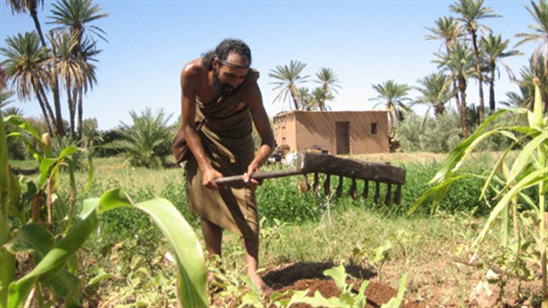
Pre-patriarchal people acted with certainty on an unseen hope (11:4-7).

Slide 24
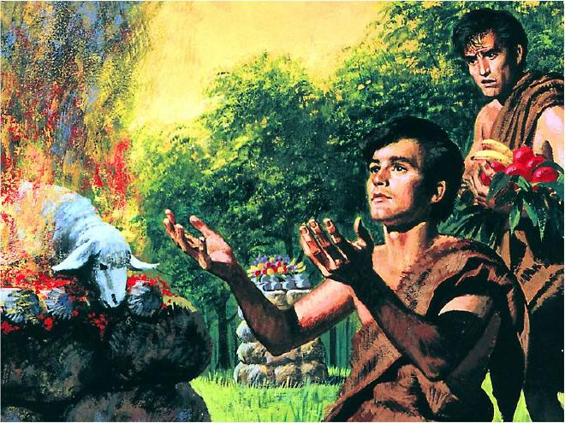
"By Faith…" (Hebrews 11)
"It was by faith that Abel brought a more acceptable offering to God than Cain did. Abel's offering gave evidence that he was a righteous man, and God showed his approval of his gifts. Although Abel is long dead, he still speaks to us by his example of faith" (Heb. 11:4 NLT)

Slide 25
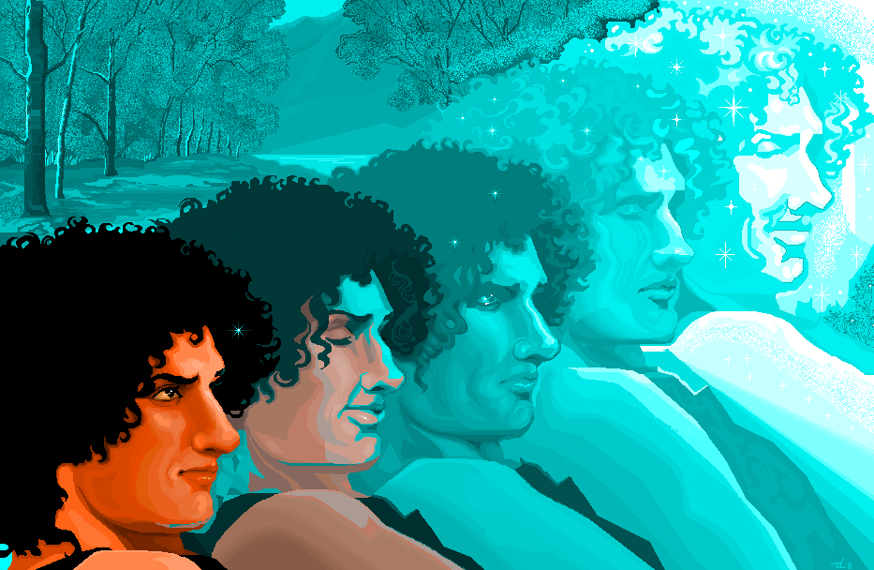
"By Faith…" (Hebrews 11)
"It was by faith that Enoch was taken up to heaven without dying—'he disappeared, because God took him.' For before he was taken up, he was known as a person who pleased God" (Heb. 11:5 NLT)

Slide 26
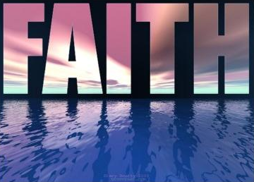
Hebrews 11:6
"And it is impossible to please God without faith. Anyone who wants to come to him must believe that God exists and that he rewards those who sincerely seek him" (Heb. 11:6 NLT)

Slide 27
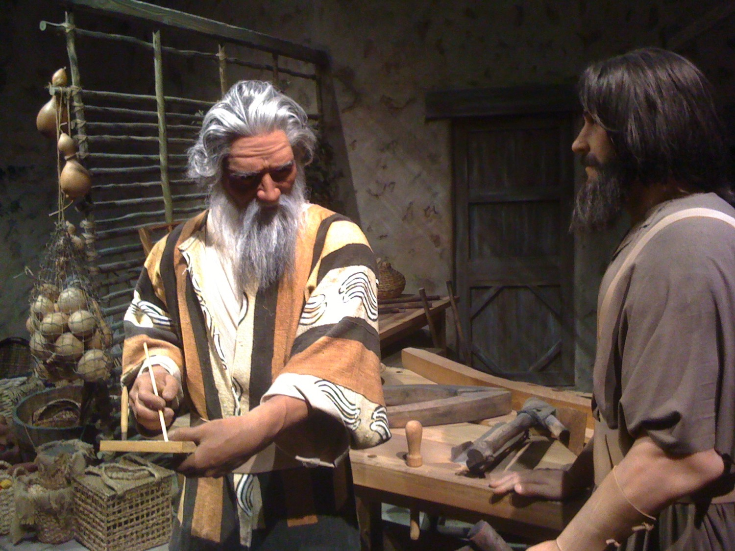
"By Faith…" (Hebrews 11)
"It was by faith that Noah built a large boat to save his family from the flood. He obeyed God, who warned him about things that had never happened before. By his faith Noah condemned the rest of the world, and he received the righteousness that comes by faith" (Heb. 11:7 NLT)

Slide 28
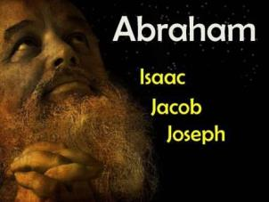
The patriarchs acted with certainty on an unseen hope (11:8-22).
Abraham
Isaac
Jacob
Joseph
Notes:
Abraham blessed his family with unfulfilled but sure hope (11:8-19).

Slide 29
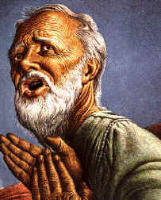
"By Faith…" (Hebrews 11)
"It was by faith that Abraham obeyed when God called him to leave home and go to another land that God would give him as his inheritance. He went without knowing where he was going" (Heb. 11:8 NLT)

Slide 30
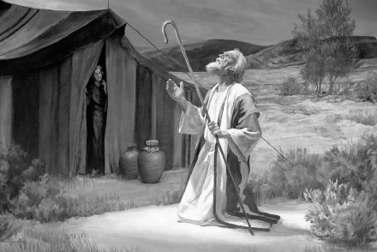
"By Faith…" (Hebrews 11)
"And even when he reached the land God promised him, he lived there by faith—for he was like a foreigner, living in tents. And so did Isaac and Jacob, who inherited the same promise" (Heb. 11:9 NLT)

Slide 31
"By Faith…" (Hebrews 11)
"Abraham was confidently looking forward to a city with eternal foundations, a city designed and built by God" (Heb. 11:10 NLT)

Slide 32
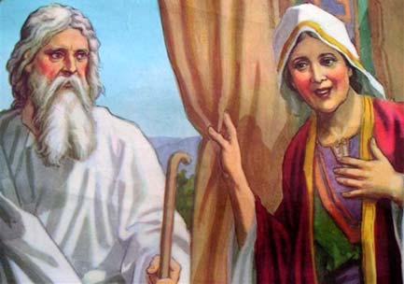
"By Faith…" (Hebrews 11)
"It was by faith that even Sarah was able to have a child, though she was barren and was too old. She believed that God would keep his promise" (Heb. 11:11 NLT)

Slide 33
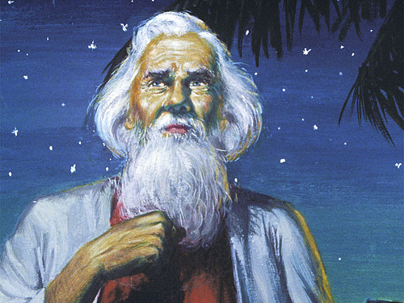
"By Faith…" (Hebrews 11)
"And so a whole nation came from this one man who was as good as dead—a nation with so many people that, like the stars in the sky and the sand on the seashore, there is no way to count them" (Heb. 11:12 NLT)

Slide 34
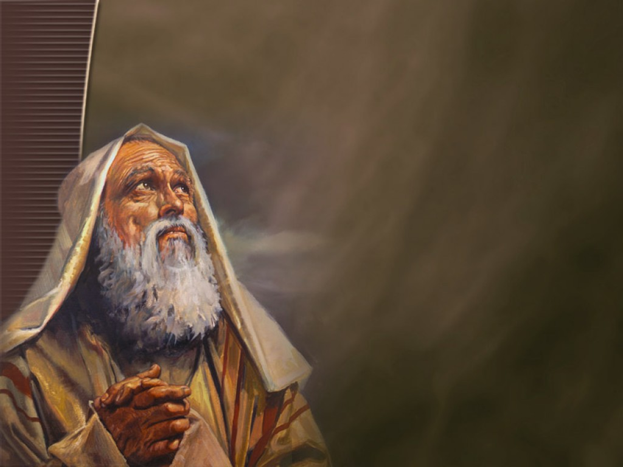
"All these people died still believing what God had promised them. They did not receive what was promised, but they saw it all from a distance and welcomed it. They agreed that they were foreigners and nomads here on earth. ¹⁴Obviously people who say such things are looking forward to a country they can call their own" (11:13-14 NLT).

Slide 35
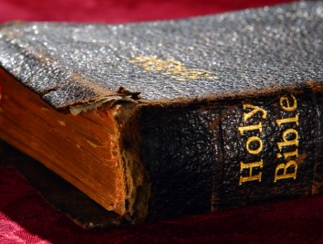
"If they had longed for the country they came from, they could have gone back. ¹⁶But they were looking for a better place, a heavenly homeland. That is why God is not ashamed to be called their God, for he has prepared a city for them" (11:15-16 NLT).

Slide 36
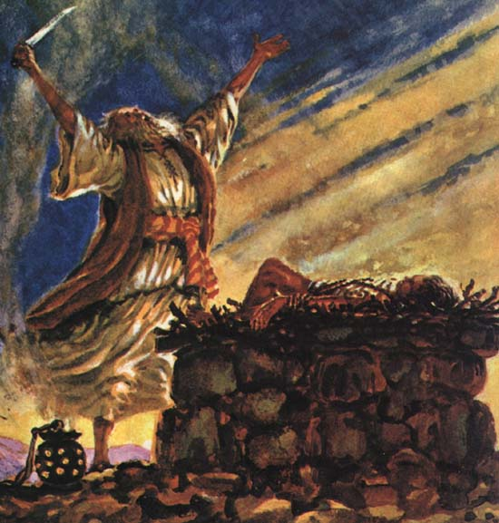
"By Faith…" (Hebrews 11)
"It was by faith that Abraham offered Isaac as a sacrifice when God was testing him. Abraham, who had received God's promises, was ready to sacrifice his only son, Isaac, ¹⁸even though God had told him, 'Isaac is the son through whom your descendants will be counted'" (Heb. 11:17-18 NLT)

Slide 37
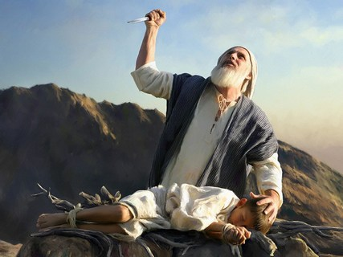
"By Faith…" (Hebrews 11)
"Abraham reasoned that if Isaac died, God was able to bring him back to life again. And in a sense, Abraham did receive his son back from the dead" (Heb. 11:19 NLT)

Slide 38
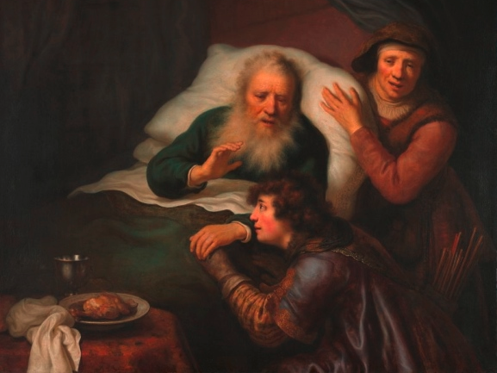
"It was by faith that Isaac promised blessings for the future to his sons, Jacob and Esau" (11:20 NLT).

Slide 39
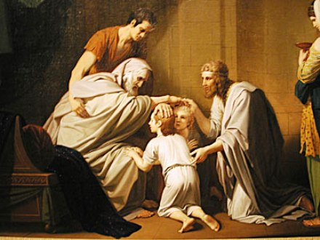
"It was by faith that Jacob, when he was old and dying, blessed each of Joseph's sons and bowed in worship as he leaned on his staff" (11:21 NLT).

Slide 40
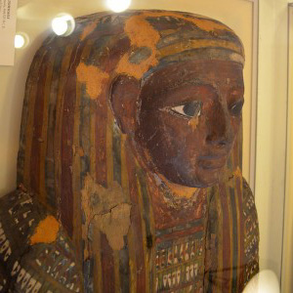
"It was by faith that Joseph, when he was about to die, said confidently that the people of Israel would leave Egypt. He even commanded them to take his bones with them when they left" (11:22 NLT).

Slide 41
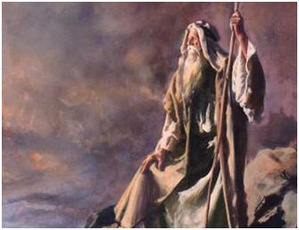
Moses and the conquest generation acted with certainty on an unseen hope (11:23-31).

Slide 42
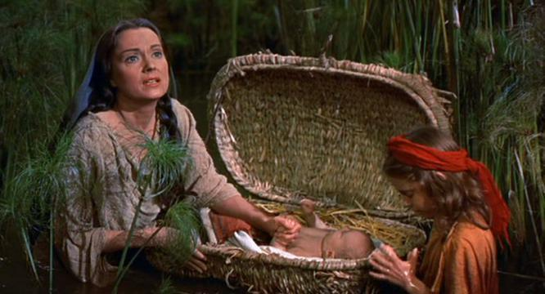
"It was by faith that Moses' parents hid him for three months when he was born. They saw that God had given them an unusual child, and they were not afraid to disobey the king's command" (11:23 NLT).

Slide 43
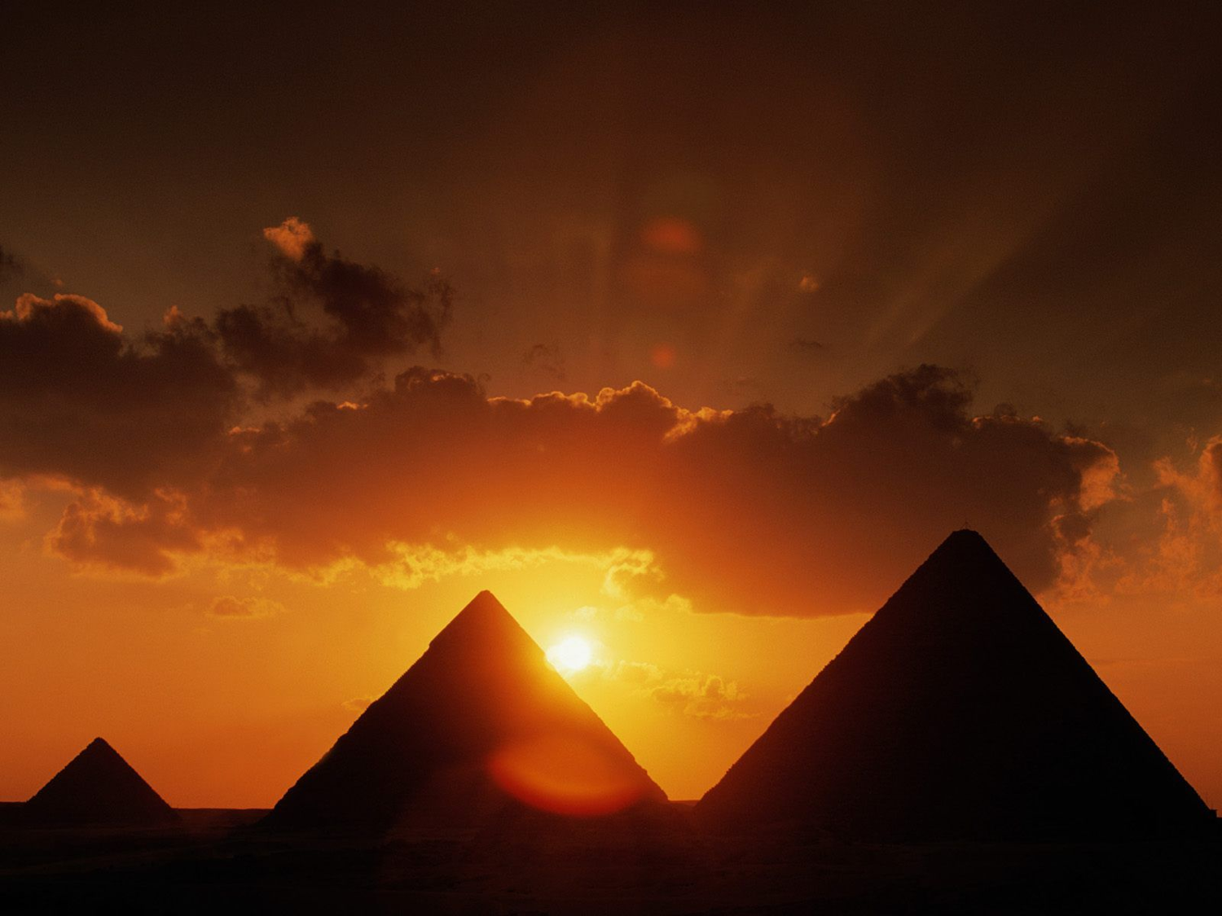
"It was by faith that Moses, when he grew up, refused to be called the son of Pharaoh's daughter. ²⁵He chose to share the oppression of God's people instead of enjoying the fleeting pleasures of sin. ²⁶He thought it was better to suffer for the sake of Christ than to own the treasures of Egypt, for he was looking ahead to his great reward" (11:24-26 NLT).

Slide 44
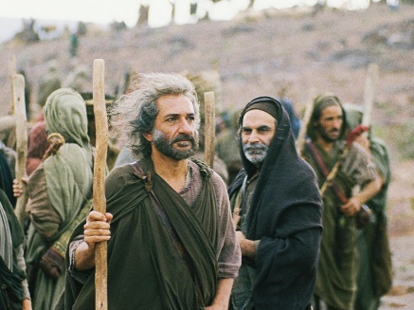
"It was by faith that Moses left the land of Egypt, not fearing the king's anger. He kept right on going because he kept his eyes on the one who is invisible" (11:27 NLT).
Notes:
Moses (1995): In this biblical dramatic mini-series Ben Kingsley takes the role of Moses, who freed his enslaved people from Egypt (with a little help from god). http://blog.jinni.com/2013/10/live-free-or-die-trying/

Slide 45
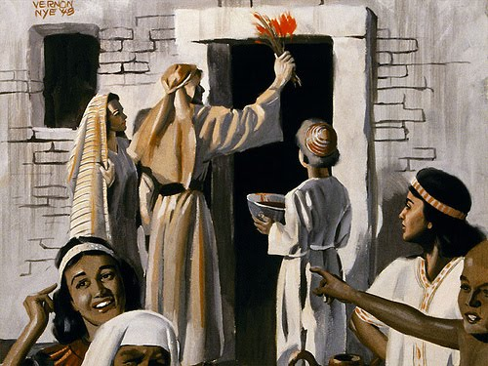
"It was by faith that Moses commanded the people of Israel to keep the Passover and to sprinkle blood on the doorposts so that the angel of death would not kill their firstborn sons" (11:28 NLT).

Slide 46
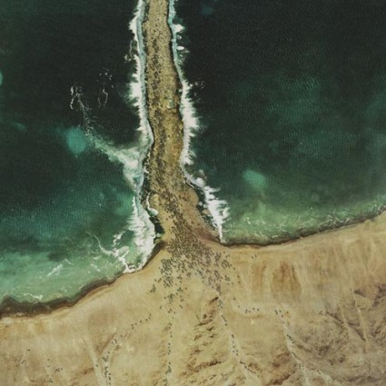
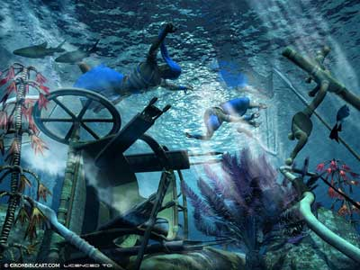
"It was by faith that the people of Israel went right through the Red Sea as though they were on dry ground. But when the Egyptians tried to follow, they were all drowned" (11:29 NLT).

Slide 47
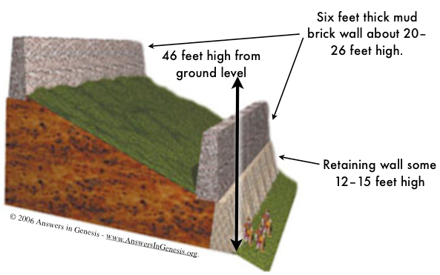
"It was by faith that the people of Israel marched around Jericho for seven days, and the walls came crashing down" (11:30 NLT).

Slide 48
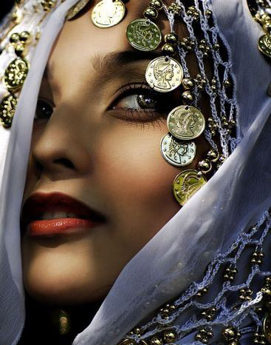
"It was by faith that Rahab the prostitute was not destroyed with the people in her city who refused to obey God. For she had given a friendly welcome to the spies" (11:31 NLT).

Slide 49
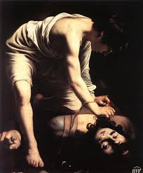
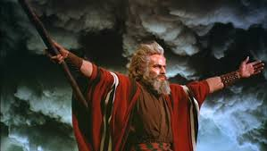
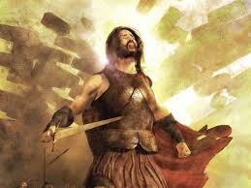
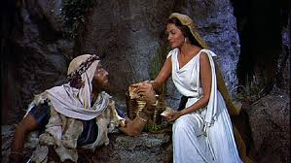
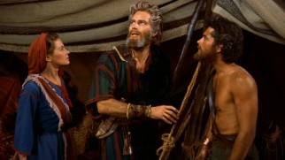
People of many generations acted with certainty on an unseen hope (11:32-38).

Slide 50
"How much more do I need to say? It would take too long to recount the stories of the faith of Gideon, Barak, Samson, Jephthah, David, Samuel, and all the prophets" (11:32 NLT).

Slide 51
"By faith these people overthrew kingdoms, ruled with justice, and received what God had promised them. They shut the mouths of lions…" (11:33 NLT).

Slide 52
"…quenched the flames of fire, and escaped death by the edge of the sword. Their weakness was turned to strength. They became strong in battle and put whole armies to flight" (11:34 NLT).

Slide 53
"Women received their loved ones back again from death. But others were tortured, refusing to turn from God in order to be set free. They placed their hope in a better life after the resurrection" (11:35 NLT).

Slide 54
"Some were jeered at, and their backs were cut open with whips. Others were chained in prisons" (11:36 NLT).

Slide 55
"Some died by stoning, some were sawed in half, and others were killed with the sword" (11:37a NLT).

Slide 56
"Some went about wearing skins of sheep and goats, destitute and oppressed and mistreated" (11:37b NLT).

Slide 57
"They were too good for this world, wandering over deserts and mountains, hiding in caves and holes in the ground" (11:38 NLT).

Slide 58
"All these people earned a good reputation because of their faith, yet none of them received all that God had promised. ⁴⁰For God had something better in mind for us, so that they would not reach perfection without us" (11:39-40 NLT).
Notes:
The faith of OT saints was never fully rewarded in this life (11:39).
Their delayed reward allows us to be rewarded with them (11:40).

Slide 59
How can you wait in faith?
Notes:
How can you wait in faith? Actually, I struggled with whether to call this passage one of waiting, though each person did wait for the promise of God and never saw it fulfilled at death.

Slide 60
Press On!
A Study of Hebrews
Notes:
But is waiting to be contrasted with running? After all, the overall theme of Hebrews is to press on! This section ends with a specific exhortation…

Slide 61
III. Run in the footsteps of Jesus who ran before you (12:1-3).
Notes:
Mimic the perseverance that Christ showed.

Slide 62
KEY VERSE
Hebrews 12:1-2
"Therefore, since we are surrounded by such a great cloud of witnesses, let us throw off everything that hinders and the sin that so easily entangles, and let us run with perseverance the race marked out for us.
Let us fix our eyes on Jesus, the author and perfecter of our faith, who for the joy set before him, endured the cross, scorning its shame and sat down at the right hand of the throne of God."

Slide 63
Endure your situation ("run") by focusing on Christ's example of endurance (12:1-2).

Slide 64
"Therefore, since we are surrounded by such a huge crowd of witnesses to the life of faith…" (12:1a NLT).
Realize that you are not alone!

Slide 65
"…let us strip off every weight that slows us down, especially the sin that so easily trips us up…" (12:1b-c NLT).
Trim down your life
Notes:
Rid yourself of anything weighing you down (12:1b).
Rid yourself especially of the sin of unbelief (12:1c).

Slide 66
"And let us run with endurance the race God has set before us" (12:1d NLT).
Run the right race with endurance

Slide 67
"We do this by keeping our eyes on Jesus, the champion who initiates and perfects our faith. Because of the joy awaiting him, he endured the cross, disregarding its shame. Now he is seated in the place of honor beside God's throne" (12:2 NLT).
Focus on God rewarding Christ's endurance
Notes:
Focus on how God rewarded Christ's endurance:
Jesus leads us in our faith (12:2a).
Jesus completes our faith (12:2b).
Jesus saw faith's joyful reward (12:2c).
Jesus endured the shame of the cross (12:2d).
Jesus experienced faith's reward of honor (12:2e).

Slide 68
"Think of all the hostility he endured from sinful people; then you won't become weary and give up" (12:3 NLT).

Slide 69
Run while you wait—just like those before you (Main Idea)

Slide 70
I. Faith sees an unseen hope (11:1-3).
Notes:
How can you wait in faith? Faith sees an unseen hope. Now the theoretical principle gets practical with many examples. IN the rest of the chapter we are exhorted to…

Slide 71
II. Imitate OT saints that persevered (11:4-40).
Notes:
Mimic OT heroes who endured despite not seeing God fulfill his promises.

Slide 72
III. Run in the footsteps of Jesus who ran before you (12:1-3).
Notes:
Mimic the perseverance that Christ showed.

Slide 73
How can you run while you wait?
Realize that you are not alone.
Trim down your life.
Run the right race with endurance.
Focus on Christ.

Slide 74
Black

Slide 75
NT Preaching link at BibleStudyDownloads.org
Get this presentation and script for free!
Notes:
NT Preaching (np)

