Slide 1
Message
Keith Shubert

Slide 2
Black

Slide 3
400 Years - Silence - Christ
No prophet spoke for 400 years.

Slide 4
Is God dead
or
does He sleep??

Slide 5
Then from each black, accursed mouth The cannon thundered in the South, And with the sound the Carols drowned Of peace on earth, good-will to men!
And in despair I bowed my head
“There is no peace on earth,” I said.
“For hate is strong, and mocks the song
of peace on earth, good will to men.”
Henry Wadsworth Longfellow

Slide 6
God is silent
Superpowers

Slide 7
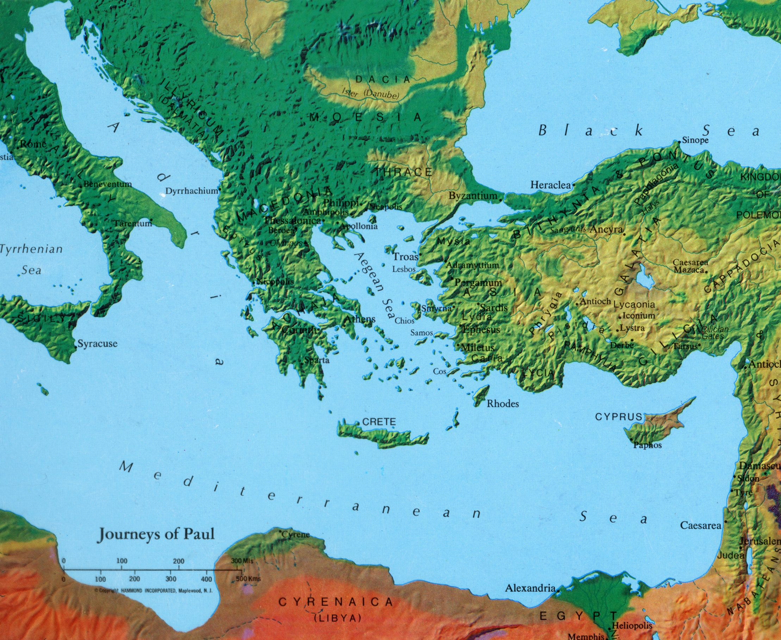

Slide 8
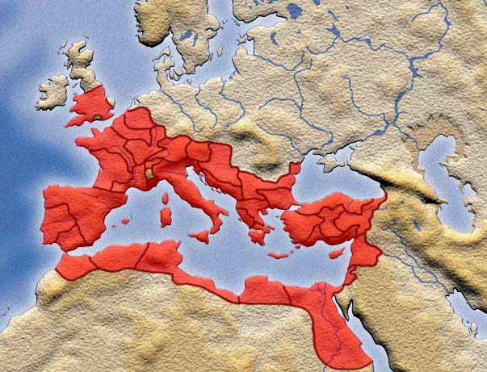

Slide 9
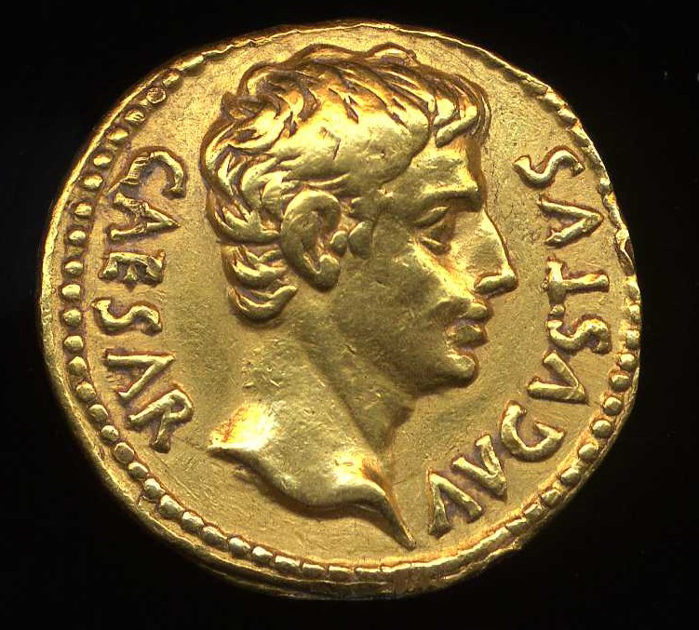

Slide 10
God is silent
Superpowers
Languages

Slide 11
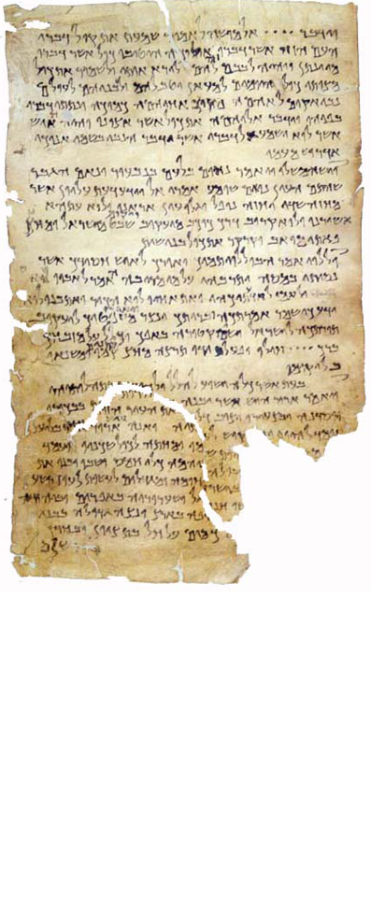

Slide 12
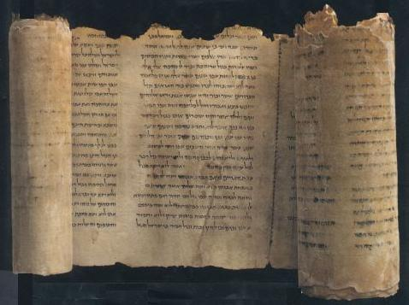

Slide 13
kaiv tau'ta tav dikaiwvmata kaiv tav krivmata o{sa ejneteivlato kuvrio" toi'" uiJoi'" Israhl ejn th'/ ejrhvmw/ ejxelqovntwn aujtw'n ejk gh'" Aijguvptou a[koue Israhl kuvrio" oJ qeov" hJmw'n kuvrio" ei|" ejstin kaiv ajgaphvsei" kuvrion tovn qeovn sou ejx o{lh" th'" kardiva" sou kaiv ejx o{lh" th'" yuch'" sou kaiv ejx o{lh" th'" dunavmewv" sou

Slide 14
God is silent
Superpowers
Languages
Travel

Slide 15
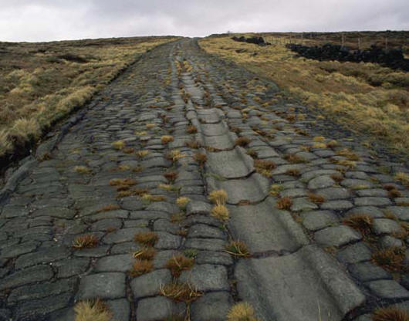

Slide 16
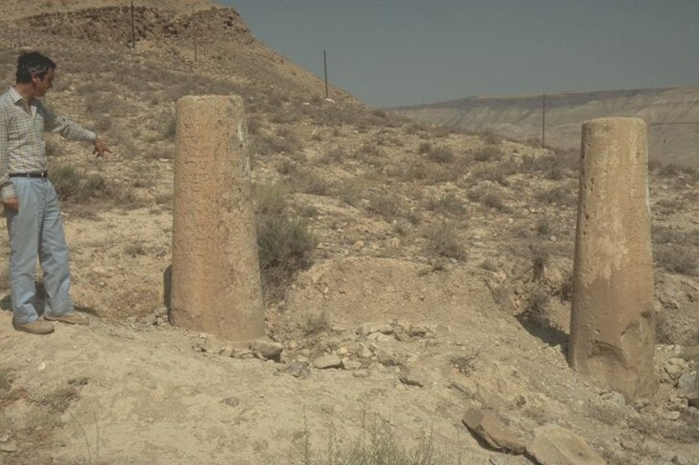

Slide 17
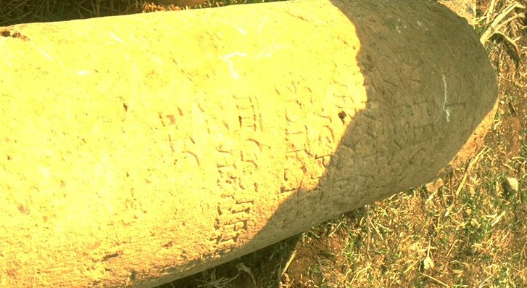

Slide 18
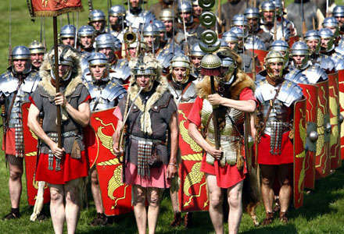

Slide 19
God is silent
Superpowers
Languages
Travel
Worship

Slide 20
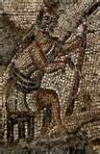
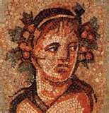

Slide 21
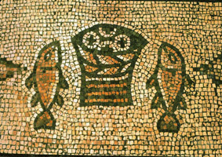

Slide 22
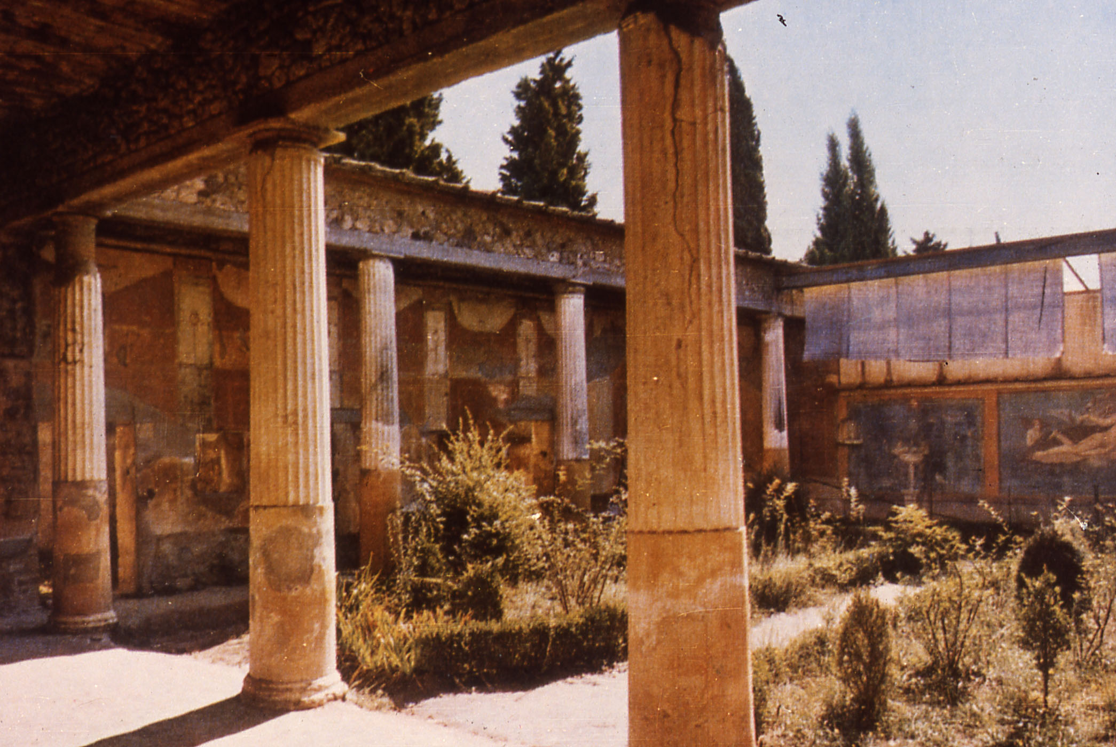

Slide 23
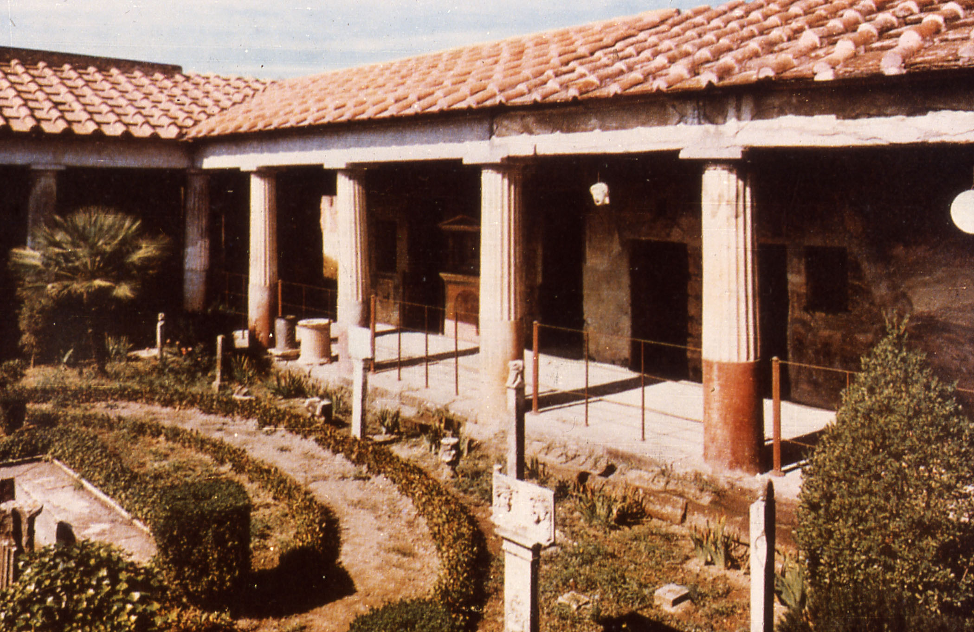

Slide 24
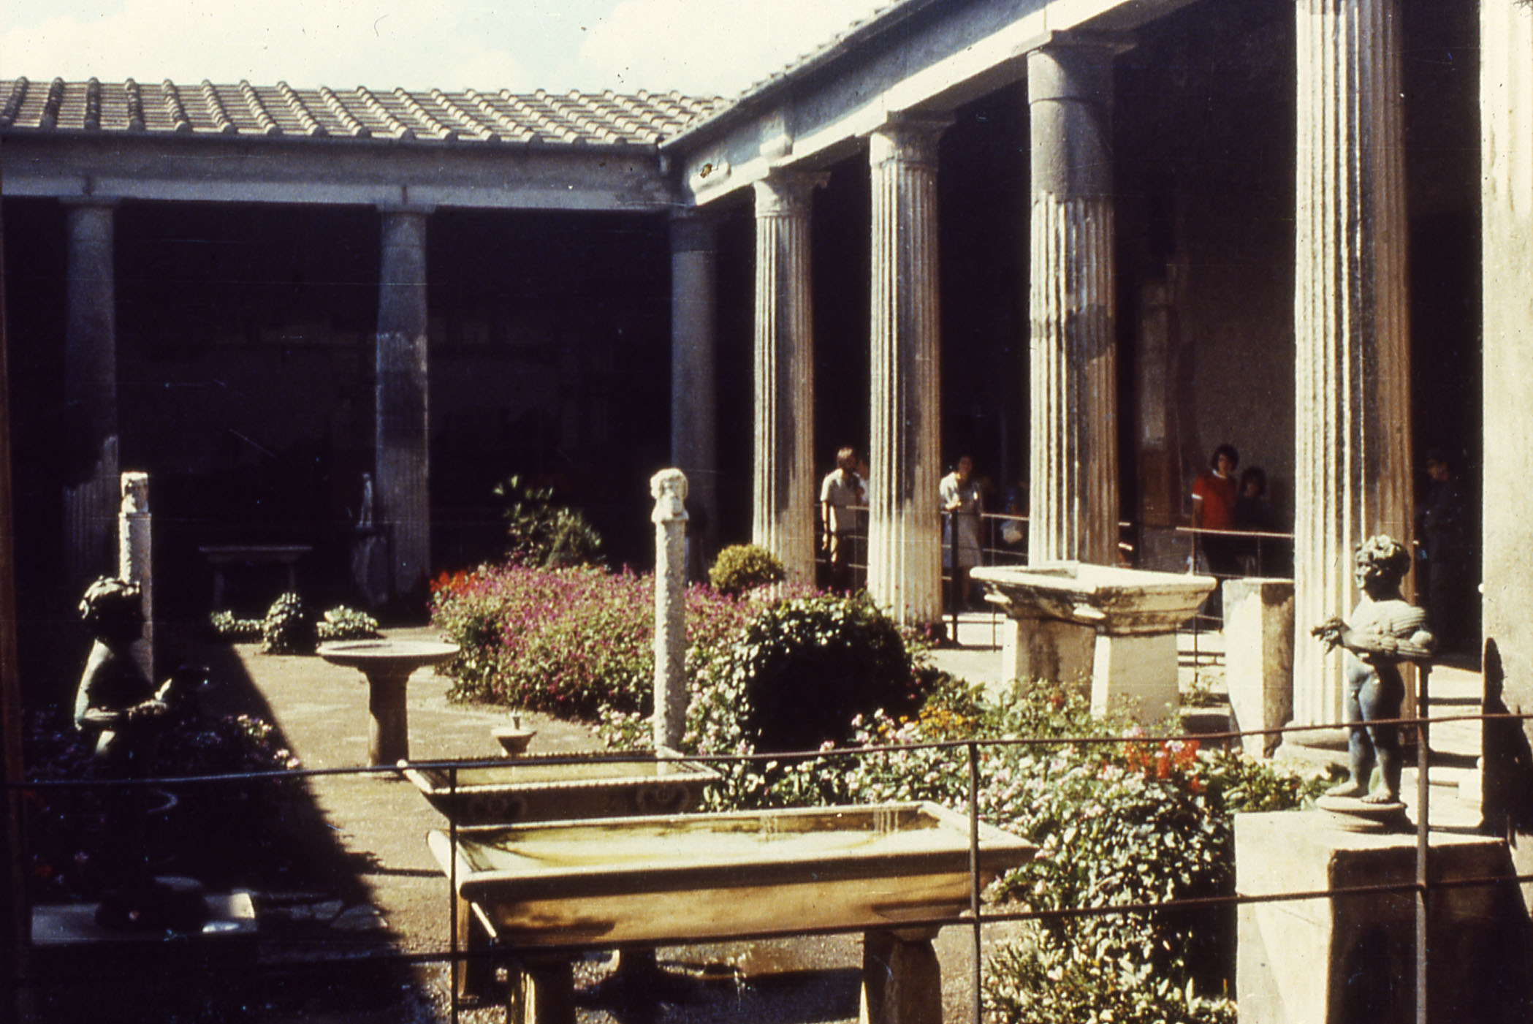

Slide 25
God is silent
Superpowers
Languages
Travel
Worship
Marketplace of ideas

Slide 26
400 Years - Silence - Christ
No prophet spoke for 400 years.
Until John said: “Behold the Lamb of God who takes away the sins of the World.”

Slide 27
But when the fulness of the time came, God sent forth His Son, born of a woman, born under the Law, in order that He might redeem those who were under the Law, that we might receive the adoption as sons.
Galatians 4:4-5

Slide 28
So What?
Lord’s Supper
Second Coming
God’s Sovereignty

Slide 29
Then from each black, accursed mouth The cannon thundered in the South, And with the sound the Carols drowned Of peace on earth, good-will to men!
And in despair I bowed my head
“There is no peace on earth,” I said.
“For hate is strong, and mocks the song
of peace on earth, good will to men.”
Yet pealed the bells more loud and deep:
“God is not dead, nor does He sleep;
The wrong shall fail, the right prevail,
With peace on earth, good will to men.”

Slide 30
Black

