Slide 1
Imitating GOD
Ephesians 5:1-14
Dr. Lewis Winkler

Slide 2
Imitate God And . . .
Live in love (1-2)
Forsake unrighteousness (3-6)
Live in the light (7-14)

Slide 3
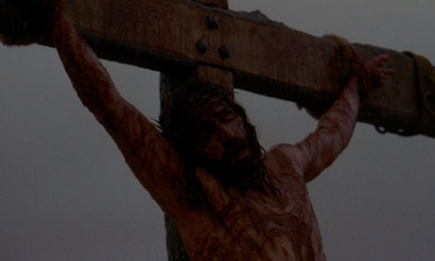
Imitate God and Live in Love (1-2)
We are God's children (1)
We are dearly loved (1)
Christ lovingly gave His life for us (2)

Slide 4
What is the Defining Mark of the Christian?
Passionate Commitment?
Exceptional Holiness?
Right Doctrine?
Success Measured in Material Possessions?

Slide 5
What is the Defining Mark of the Christian?
LOVE!

Slide 6
God's Love:
Sent Christ into the world (John 3:16)
Bought our forgiveness on the cross (Rom. 5:8)
Is the very essence of His being (1 John 4:8)

Slide 7
God's Love:
Without it, we are nothing (1 Corinthians 13:2)
We demonstrate it most clearly through radical self-sacrifice (John 15:13)
We are called to live in love as God's beloved children (Ephesians 5:1-2)

Slide 8
Some Food for Thought:
What is your life most characterized by?
What would your coworkers say?
What would your closest friends or spouse say?
What would God say?

Slide 9
John 13:34-35
“A new command I give you: Love one another. As I have loved you, so you must love one another. By this all men will know that you are my disciples, if you love one another.”

Slide 10
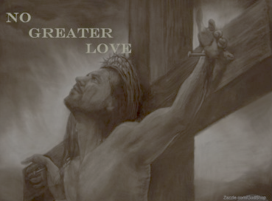
John 15:12-13
“My command is this: Love each other as I have loved you. Greater love has no one than this, that he lay down his life for his friends.”

Slide 11
Imitate God and Forsake Unrighteousness (3-6)
Sexual Immorality
Impurity
Greed/Covetousness
Obscenity
Foolish Talk
Course Joking
Thanksgiving!
Idolatry!

Slide 12
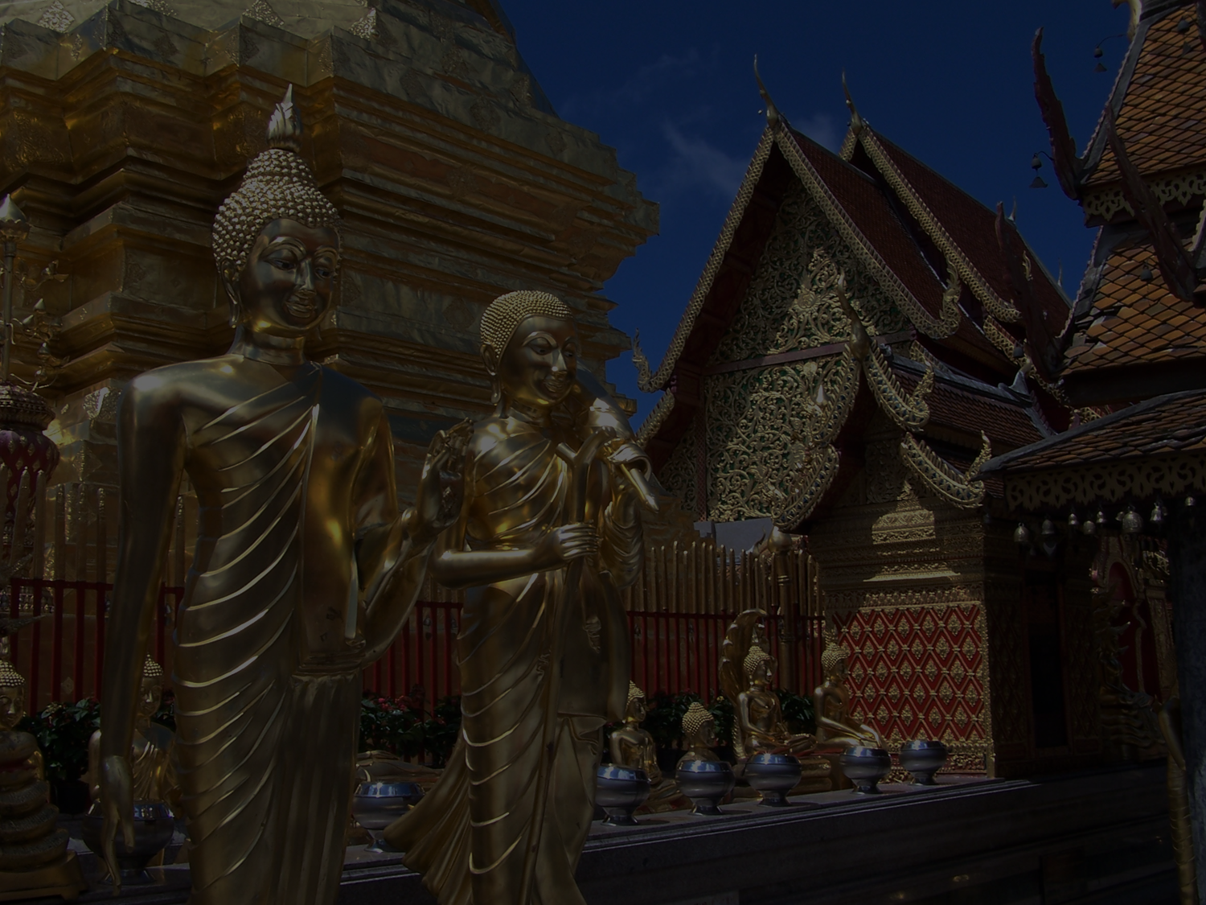
What is Idolatry?
Idolatry is the foolish decision to make something or someone—really anything—more important than God.

Slide 13
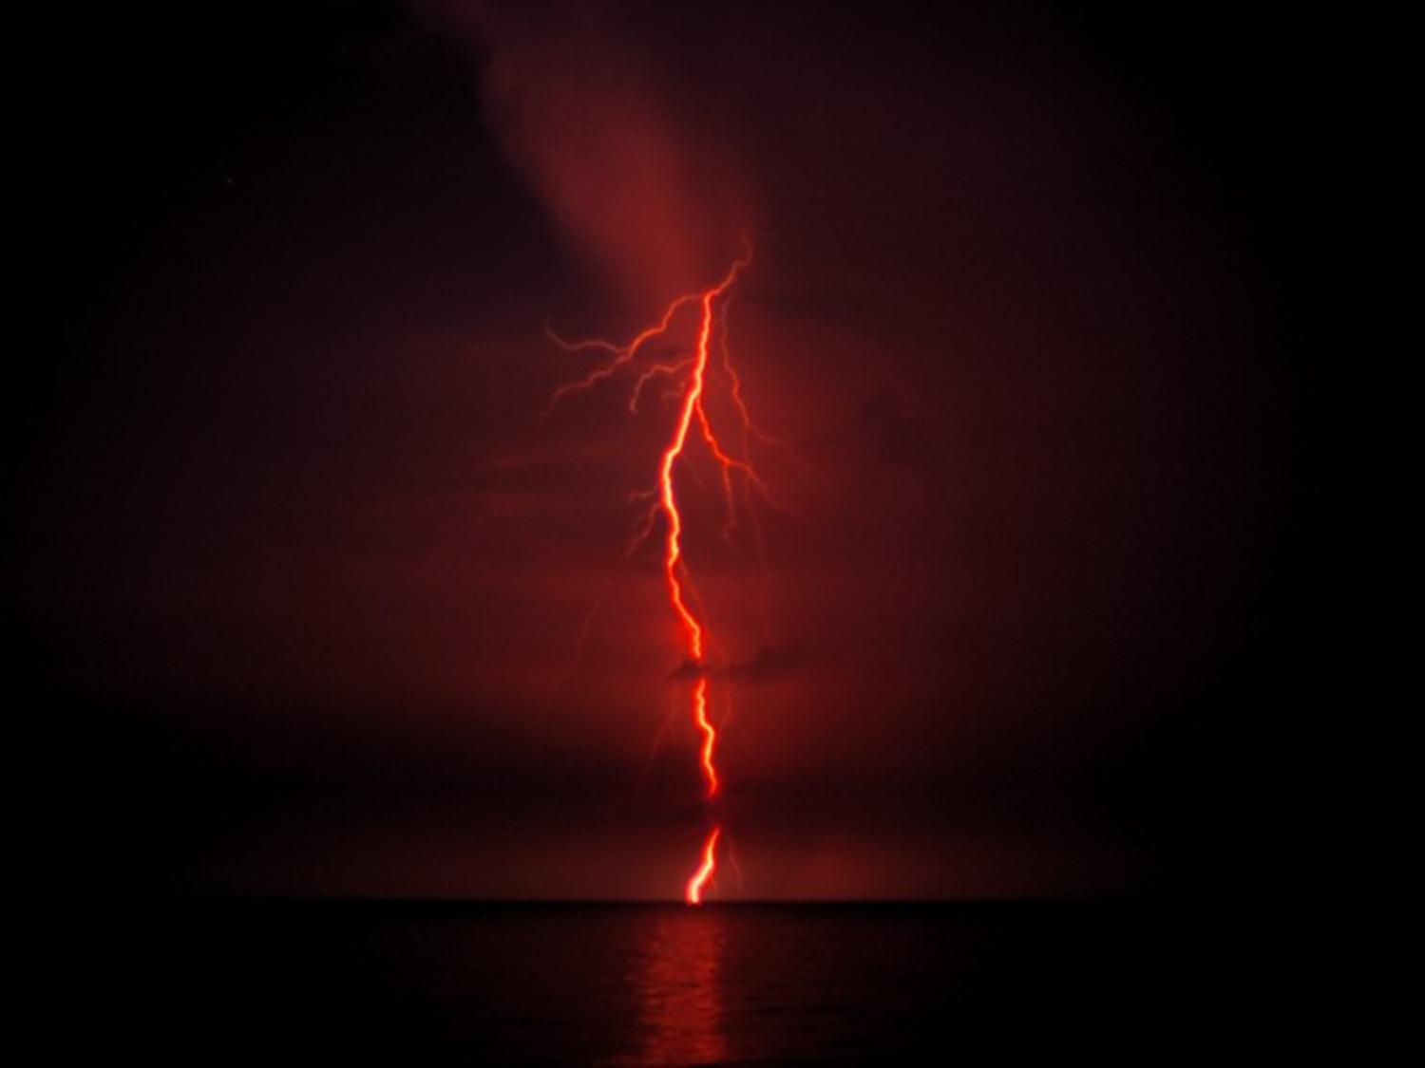
This is the Reason for God's Wrath!

Slide 15
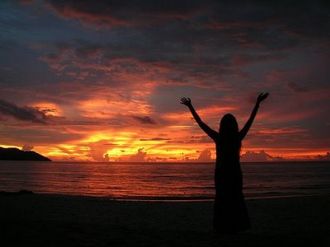
Psalm 139:23-24:
“Search me, O God, and know my heart! Try me and know my thoughts! And see if there be any grievous way in me, and lead me in the way everlasting.”

Slide 16
SOME FOOD FOR THOUGHT:
Are you willing to let God deeply search your heart and show you anything that might not be pleasing to Him?
Are you willing to forsake any and all evil so that you might become more and more like Jesus?

Slide 17
Imitate God and Live in the Light (7-14)
“For he has rescued us from the dominion of darkness and brought us into the kingdom of the son he loves.”
—Colossians 1:13

Slide 18
The Fruit of the Light:
Goodness
Righteousness
Truth
Seeking to Know What Pleases God
Exposing Deeds of Darkness

Slide 19
The Fruit of the Light:
Bringing People Out of Death and Darkness and into Life and Light!

Slide 20
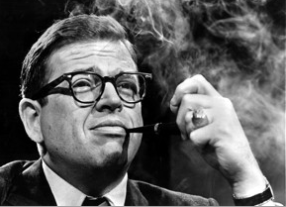
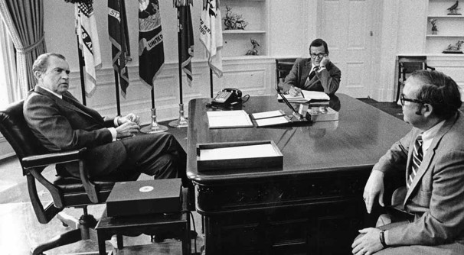
Chuck Colson: A Life Transformed from Darkness into Light
In the White House with President Nixon

Slide 21
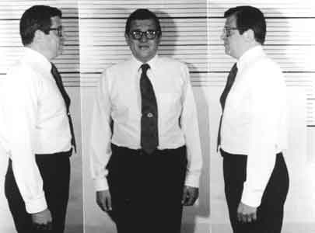
Chuck Colson: A Life Transformed from Darkness into Light

Slide 22
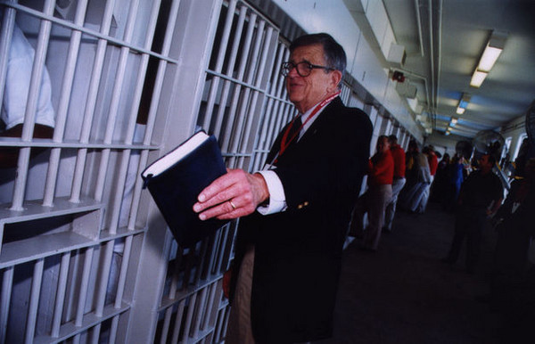
Founder of Prison Fellowship

Slide 23
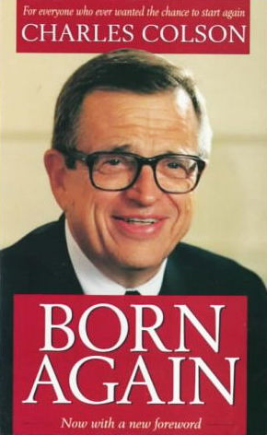
Chuck Colson: A Life Transformed from Darkness into Light

Slide 24
Chuck Colson: A Life Transformed from Darkness into Light

Slide 25
Main Idea
As His children, God calls us to imitate Him by living in love, forsaking unrighteousness, and living in the light.

Slide 26
Personal Application
Sacrificial Love
Goodness
Righteousness
Truth
Seeking to Know What Pleases God
Exposing Deeds of Darkness
Bringing People Out of Death and Darkness and into Life and Light

