Slide 1
Put on a New Life
Colossians 3:5-17
Themshang Horam, Crossroads International Church cicfamily.com & BibleStudyDownloads.org

Slide 2
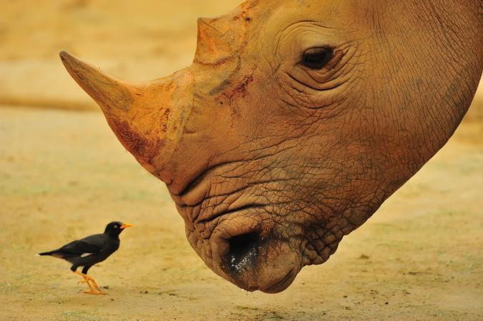
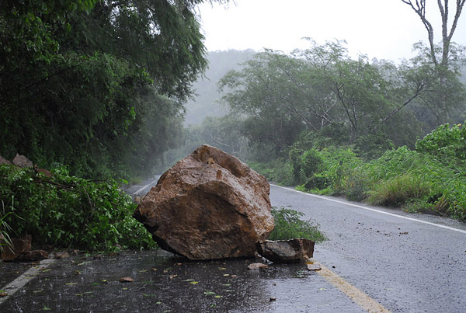
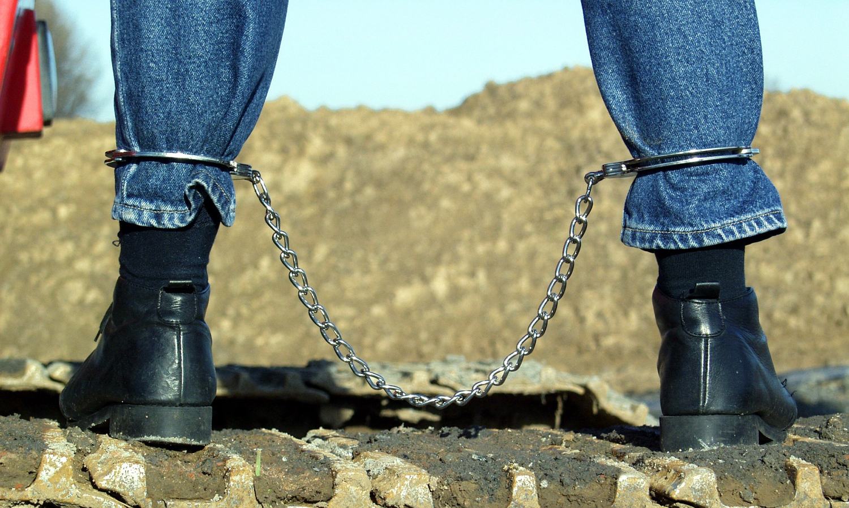
What hinders you?
What are your obstacles?
What binds you?
Notes:
As we expectantly look forward to this New Year, What hinders you to live your life as one whose life is in Christ? What are the hurdles that you face to move forward? And what are the fetters that binds you to live your life as a free man and woman in Christ? What are the things that you need to remove which is preventing you to live a successful life?

Slide 3
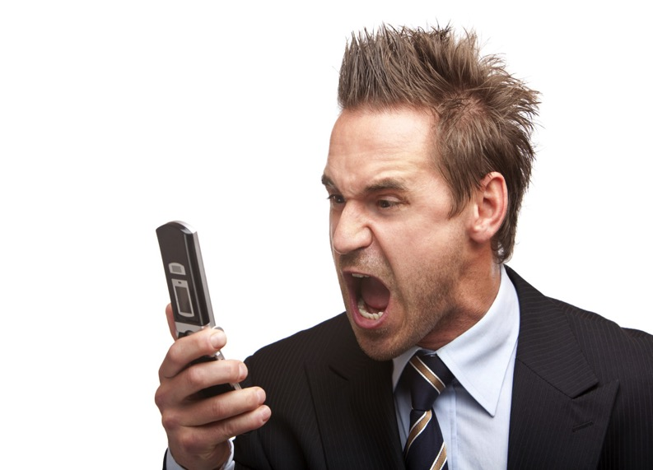
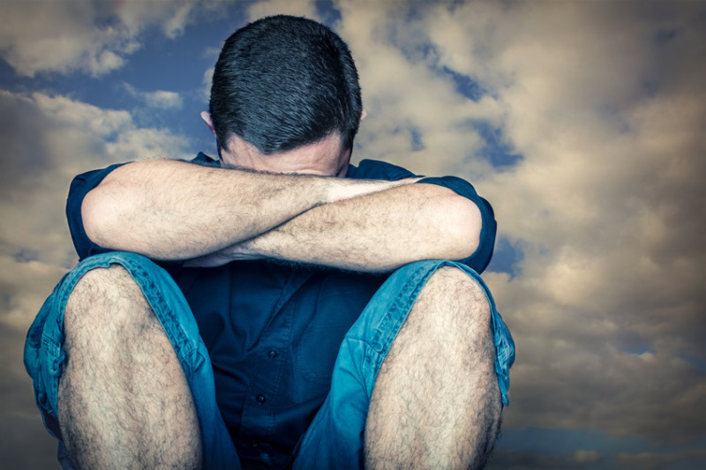
Anger?
Hatred?
Broken
Relationship?
Painful Past?
Greed?
Jealousy?
Notes:
Is it anger? Hatred? Words – things which you are not suppose to say? Jealousy? Broken relationship?

Slide 4
What is bothering you to move forward?
Notes:
What is bothering you to move forward and embrace this New Year with Joy, peace, love and hope? Paul exhorted the Colossians in our passage today (Col. 3:5-15) to remove the things which is hindering/bothering us and is preventing us from living the full life as free man/woman, as victors, as new people. So we need to put off the old clothes and…

Slide 5
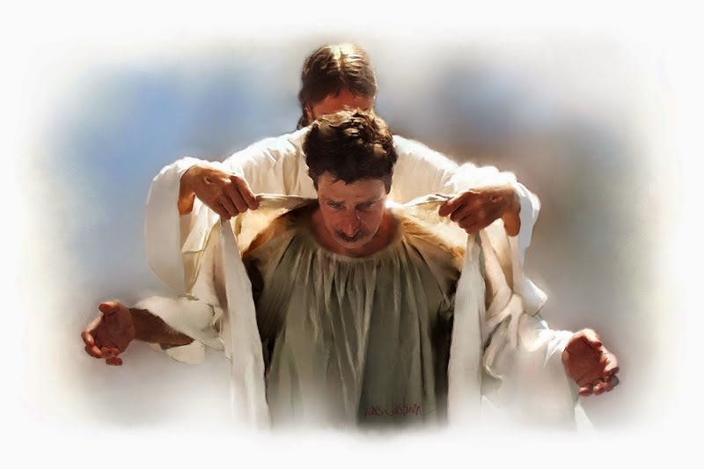
Put on the Virtues of a New Life Colossians 3:5-14
Notes:
I will put off the shabby clothes….

Slide 6
Background
Paul the Apostle wrote the Epistle of Colossians to the church at Colossae from prison in Rome in AD 61 to counter a heresy attacking the deity of Christ.
He countered this heresy in two ways:
First, in chapters 1–2, he established the supremacy of Christ.
He then moved on to chapters 3–4 to give practical instruction for living as those made alive in Christ in light of the supremacy of Christ.
Adapted from Rick Griffith, Singapore Bible College
Notes:
In the light of the supremacy of Christ, Paul exhorted the Colossians to live life as those who have overcome the power of sin through their union in death with Christ. Paul said to the Colossians in verses 1-3 that "You have died with Christ, Your life is hidden with Christ in God and you have been given the grace in Christ to live your life as victors, as new people and as those made alive in Christ".
So then, what do we need to do? We need to: (next slide)

Slide 7
How Can We Put on the Virtues of a New Life? Colossians 3:5-14
Notes:
I will put off the shabby clothes….

Slide 8
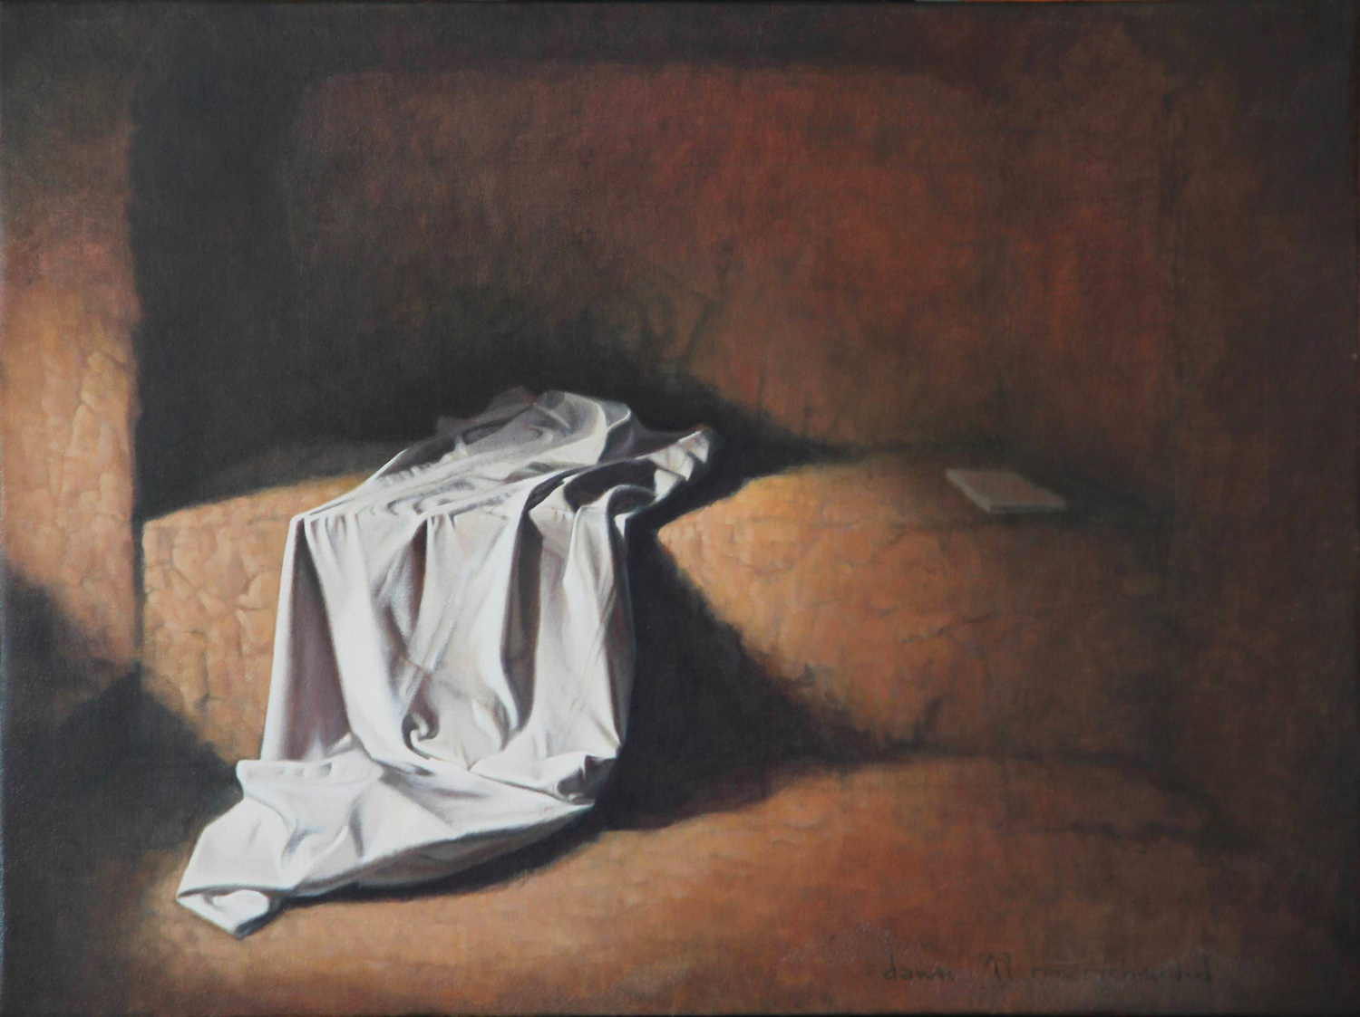
I. Put off the grave clothes (3:5-11).
Notes:
Here in verses 5-11 Paul exhorted the Christians at Colossae to "put to death their sinful ways".

Slide 9
Col. 3:5 "So put to death the sinful, earthly things lurking within you" (NLT). Matthew 18:9a "And if your eye causes you to sin, gouge it out and throw it away" (NLT).
Notes:
Here in verses 5-11 Paul exhorted the Christians at Colossae to "put to death their sinful ways".
"So put to death the sinful, earthly things lurking within you…" (NLT) parallels with what Jesus commanded in Matthew 18:9, "And if your eye causes you to sin, gouge it out and throw it away…" (NLT). Neither Christ's nor Paul's injunction can mean hack, hew or maim the limbs and organs of the body. The whole idea of putting to death or gouge out the eye means "doing away with what is evil" in us.
And what are these sinful earthly things - the evil things in us?

Slide 10
The point – "Do away with what is evil in us"
Notes:
Here in verses 5-11 Paul exhorted the Christians at Colossae to "put to death their sinful ways".
"So put to death the sinful, earthly things lurking within you…" (NLT) parallels with what Jesus commanded in Matthew 18:9, "And if your eye causes you to sin, gouge it out and throw it away…" (NLT). Neither Christ's nor Paul's injunction can mean hack, hew or maim the limbs and organs of the body. The whole idea of putting to death or gouge out the eye means "doing away with what is evil" in us.
And what are these sinful earthly things - the evil things in us?

Slide 11
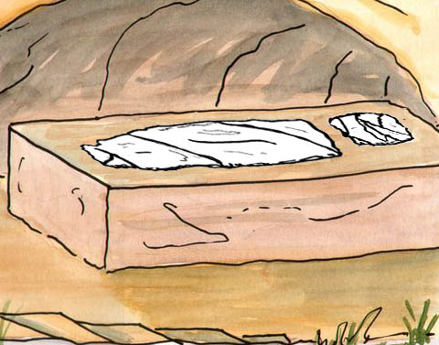
Death to corrupt living (3:5-7)
Notes:
I am sure we are all no stranger to this particular word. I have not been to many countries like most of you but coming from a country like India where corruption is quite prevalent.

Slide 12
Death to corrupt living
Notes:
In my home country of India, to get a job in govt. sector we need to pay heavy bribes to the conducting officers.
In 2012, one of my younger brothers went for an army recruitment… physical fitness passed…written passed…medical exam passed… but was rejected because we were unable to pay the bribe around S$ 4000.
It broke my brother's heart and brought frustration… your corrupt living has an adverse impact not just to you alone but to other people, especially those who are poor.

Slide 13
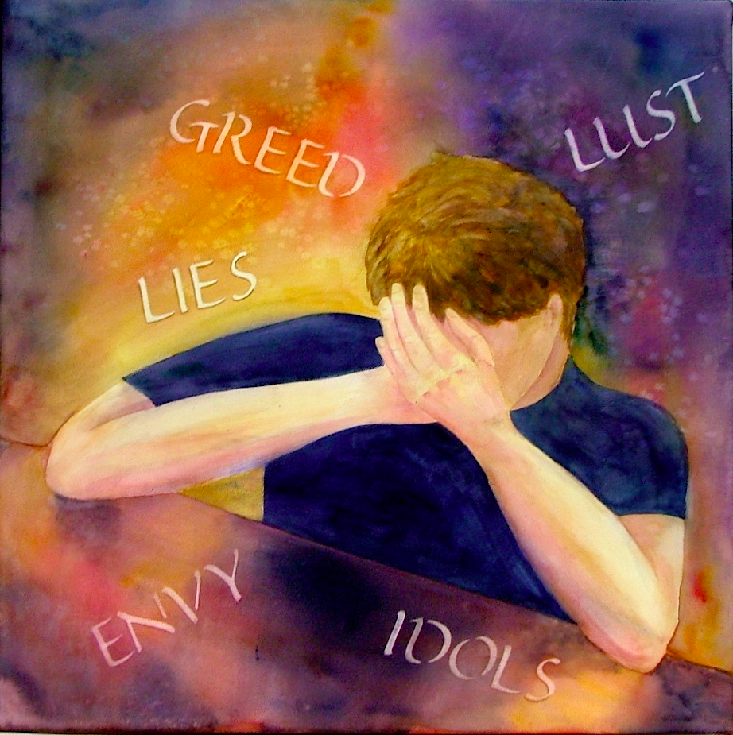
"Have nothing to do with sexual immorality, impurity, lust, and evil desires. Don't be greedy, for a greedy person is an idolater, worshiping the things of this world" (3:5b NLT)
Notes:
Corrupt living is not just the corruption in financial matters. Paul listed a whole range of habits that tags along with corrupt living. They are sexual immorality, impurity, lust, and evil desires and greed.
We need to put away our impure thoughts – thoughts such as desiring or scheming to harm people. We also need to put away sexual impurity. Singles, we no longer care what we did in the past because of our new identity as new people in Christ but from this point forth let us be sexually pure. Married people, as people of God, God demands you to be sexually faithful to your spouses. Evils such as these, and on which the apostle says God's wrath rests, must be slain.

Slide 14
Death to wrong conversation (3:8-9)
Notes:
Paul deals with the sins of speech which seemed, like echoes of the past, to linger on the lips of the Colossians. Proverbs 18:21 says "The tongue can bring death or life; those who love to talk will reap the consequences (NLT)". James says "And the tongue is a flame of fire. It is a whole world of wickedness, corrupting your entire body. It can set your whole life on fire, for it is set on fire by hell itself (Jam 3:6-7 NLT). Jesus Christ said "You brood of snakes! How could evil men like you speak what is good and right? For whatever is in your heart determines what you say. (Mat 12:34 NLT)". Yes we should do away with wrong conversations.

Slide 15
3:8-9
"But now is the time to get rid of anger, rage, malicious behavior, slander, and dirty language. Don't lie to each other, for you have stripped off your old sinful nature and all its wicked deeds"
(3:8-9 NLT)
Notes:
Paul deals with the sins of speech which seemed, like echoes of the past, to linger on the lips of the Colossians. Proverbs 18:21 says "The tongue can bring death or life; those who love to talk will reap the consequences (NLT)". Jesus Christ said "You brood of snakes! How could evil men like you speak what is good and right? For whatever is in your heart determines what you say. (Mat 12:34 NLT)". Yes we should do away with wrong conversations.

Slide 16
A Lesson from Russian History
Kondraty Ryleyev was sentenced to be hanged for his part in an unsuccessful uprising against the Russian czar Nicholas I in December 1825. But the rope broke and Ryleyev, bruised and battered, fell to the ground, got up, and said, "In Russia they do not know how to do anything properly, not even how to make a rope." An accident of this sort usually resulted in a pardon, so a messenger was sent to the czar to know his pleasure.
Nicholas asked, "What did he say?"
"Sire, he said that in Russia they do not even know how to make a rope properly.”
"Well, let the contrary be proved," said the czar.
Notes:
The Point is - James says "And the tongue is a flame of fire. It is a whole world of wickedness, corrupting your entire body. It can set your whole life on fire, for it is set on fire by hell itself (Jam 3:6-7 NLT). What you say and speak determines your where you are heading for.
Source [http://www.sermonillustrations.com/a-z/s/speech.htm]

Slide 17
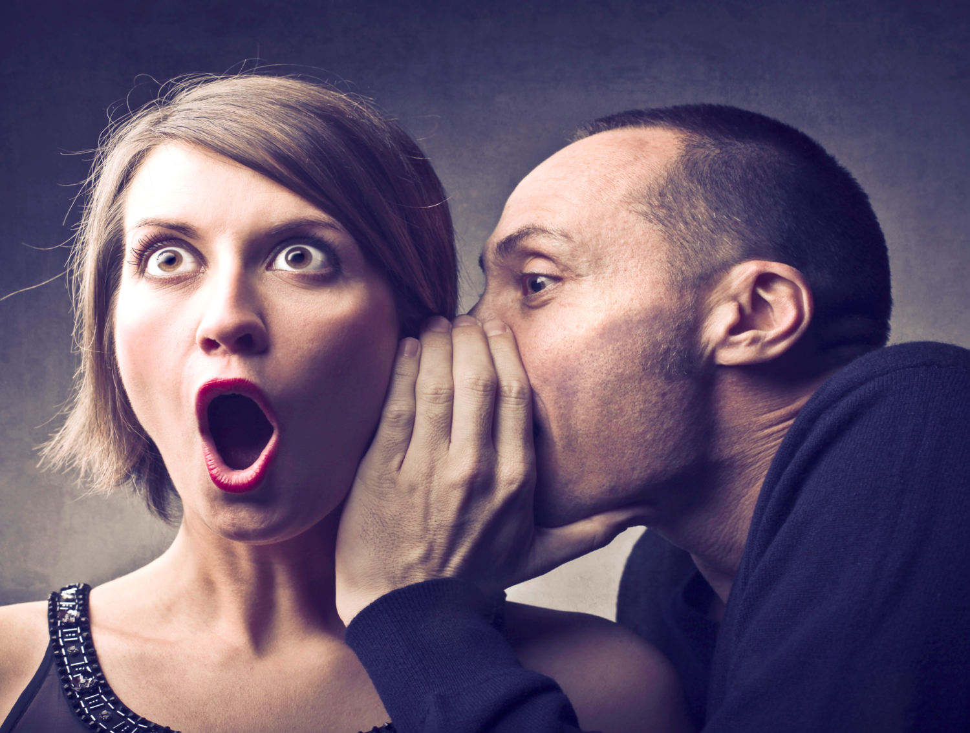
What speech should be put away?
Anger, Rage, Malice, Slander, Dirty Language, Falsehood…
Notes:
Do away with conversations that can cause someone to
1) "Anger," and sin
2) Conversations that will "Enrage"
3) Talks to malign someone's image;
4) "Slander," i.e. blasphemy;
5) "Dirty language," i.e. abusive words;
6) "Falsehood," a word that needs no description. Let us not speak pretentiously but true to our words.

Slide 18
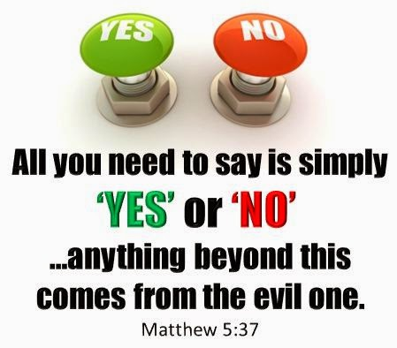
Avoid vows
Notes:
I find this verse quite helpful. Jesus Christ taught us "All you need to say is simply 'Yes' or 'No'; anything beyond this comes from the evil one (Mat 5:37 NIV)"

Slide 19
Death to Conventional Distinctions
Notes:
Paul exhorted the Colossians that as new people who have put on the virtues of new life, they must also put to death the conventional distinctions which leads to divisions in the church. For we are all made new in Christ and in Christ there is no distinction between "…a Jew or a Gentile, circumcised or uncircumcised, barbaric, uncivilized, slave, or free. Christ is all that matters, and he lives in all of us (Col 3:11 NLT)".

Slide 20
3:10-11
"In this new life, it doesn't matter if you are a Jew or a Gentile, circumcised or uncircumcised, barbaric, uncivilized, slave, or free. Christ is all that matters, and he lives in all of us" (3:10-11 NLT).
Notes:
If Christ have made us all one in him, shall we still continue live our life dividing among ourselves? No, I am American and I cannot be with the Indian; I am Indians and I cannot be with the Chinese, Dutch, Pilipino…

Slide 21
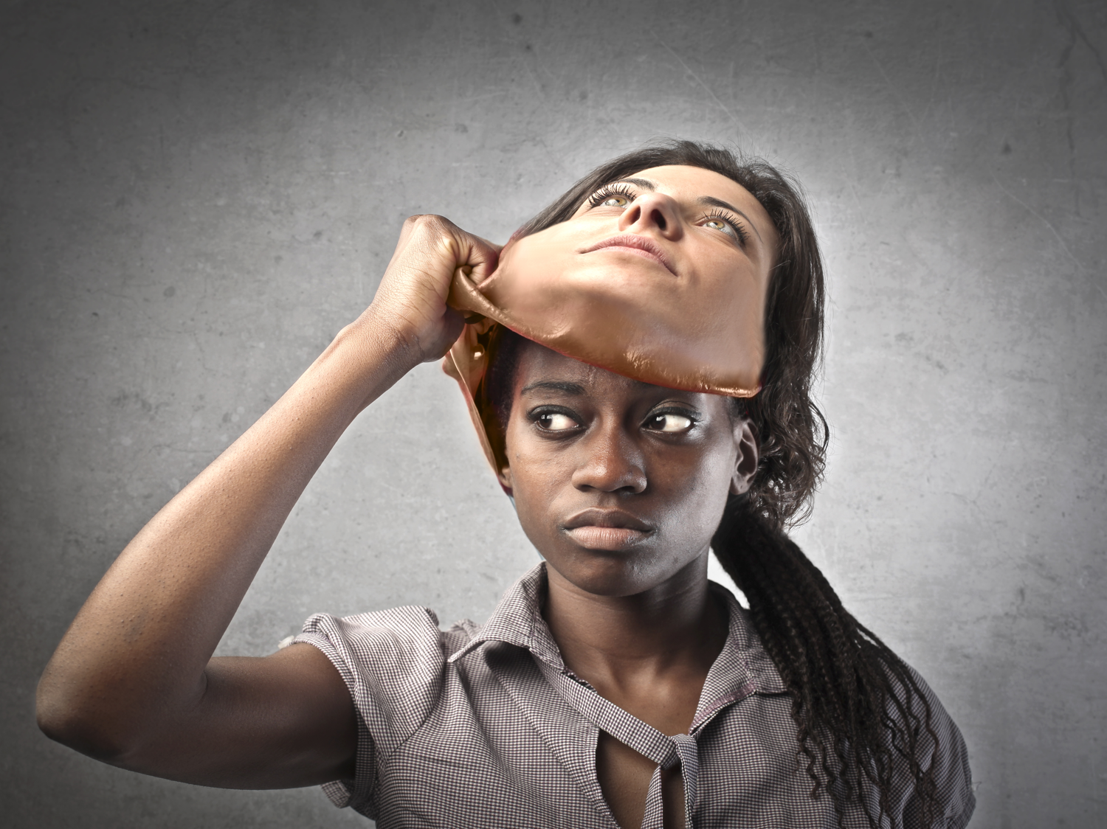
Avoid these distinctions…
Ethnic: "Greek and Jew"
Ceremonial: "circumcision or uncircumcision"
Cultural: "barbarian, uncivilized"
Social: "slave and free"
Notes:
1) Ethnic distinctions: "Greek and Jew". Let us stop drawing boundaries along the line of our ethnic groups.
2) Ceremonial: "circumcision or un-circumcision". The Jewish Christians emphasized so much on ritual purity and that is one of the main contention among the believers in early church. Let us put away that "my denomination is better than yours!" but rather practice what the Bible teach us.
3) Distinctions of culture: "barbarian, uncivilized". Unable to appreciate different culture is often the many causes of conflicts. In India, almost every week we have a report of the people from northeastern India and the mainlanders having clashes because we cannot accept and appreciate our culture.
4) Social: "slave and free." Here the word slave seems to have special reference here to the runaway slave (Onesimus) who was going to carry to his master the apostle's letter, and who was to be received as a brother both of Philemon and Paul. But the point Paul wants to underscore is that there is no longer hierarchical systems in our new identity with Christ.

Slide 22
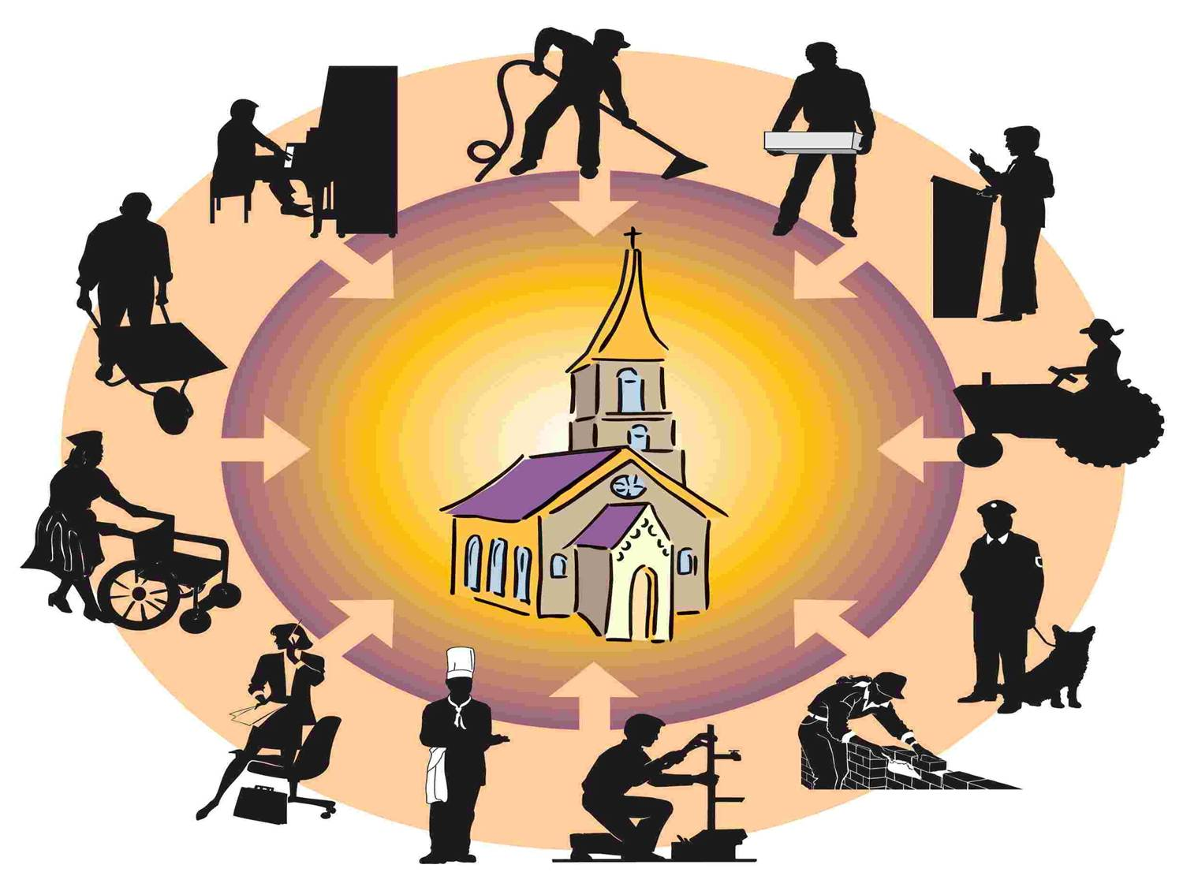
The church embraces all
Notes:
I am glad that here at CIC… I learnt to realize that I need to come down.

Slide 23
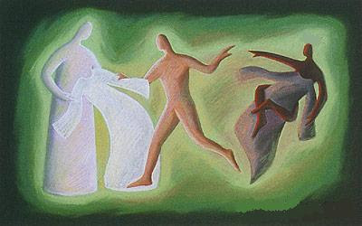
II. Put on the grace of Christ (3:12-14).
Notes:
Let us put away our old sinful habits – things which Christ has already taken it off from us by his death so that we may put on the new dress of grace. Through Christ's death we now have the power the put off our old sinful habits. We can now make a choice to put to death our bad habits – the old man or to let it rule over us and prevent us from living a free life in Christ. Christ has put to death our sinful habits, he have taken away our sinful clothes, lets us not go back to those old ways again but put on the virtues of new life and live as new people made alive in Christ.
What are these grace of Christ that we are to put on as his new people made alive in him?

Slide 24
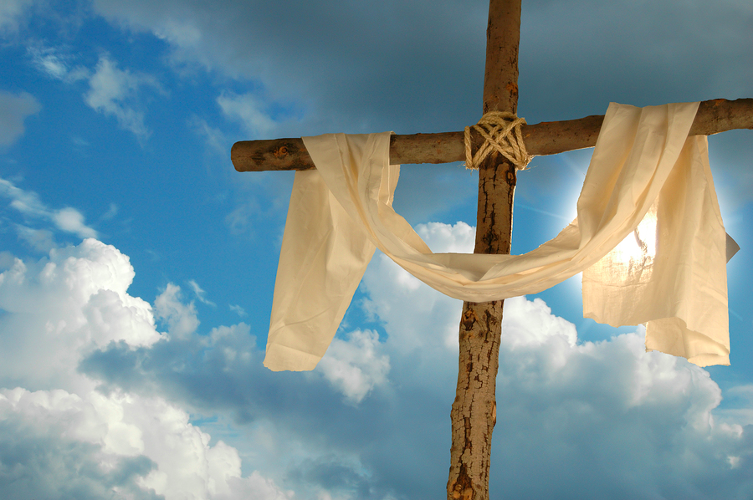
The clothes of compassion (3:12)
Notes:
Put on... compassion. “Since God chose you to be the holy people he loves, you must clothe yourselves with tenderhearted mercy, kindness, humility, gentleness, and patience” (3:12 NLT).
When we are clothed with compassion, we show kindness, humility, gentleness and patience for one another. In the gospel accounts, we know that when Jesus saw the crowds he was filed with compassion (Matt. 9:36; Mk. 6:34). Again in the Gospel of Mark when Jesus saw a leper asking him to heal him of his leprosy, Jesus was moved with compassion and he healed. Elsewhere in the Bible, Exod 34:6; 2 Chron 30:9; Neh 9:17, 31; Pss 85:15; Joel 2:13; and Jn 4:2, this compas-sion is described as grace of God. Paul in Philippians 1:8 says that he love the Philippians and long for them "…with the tender compassion of Christ Jesus (NLT)". This is the compassion that we are talking about. Through Jesus Christ, God has given us this dress – this compassion which we must wear it as new people in Christ.

Slide 25
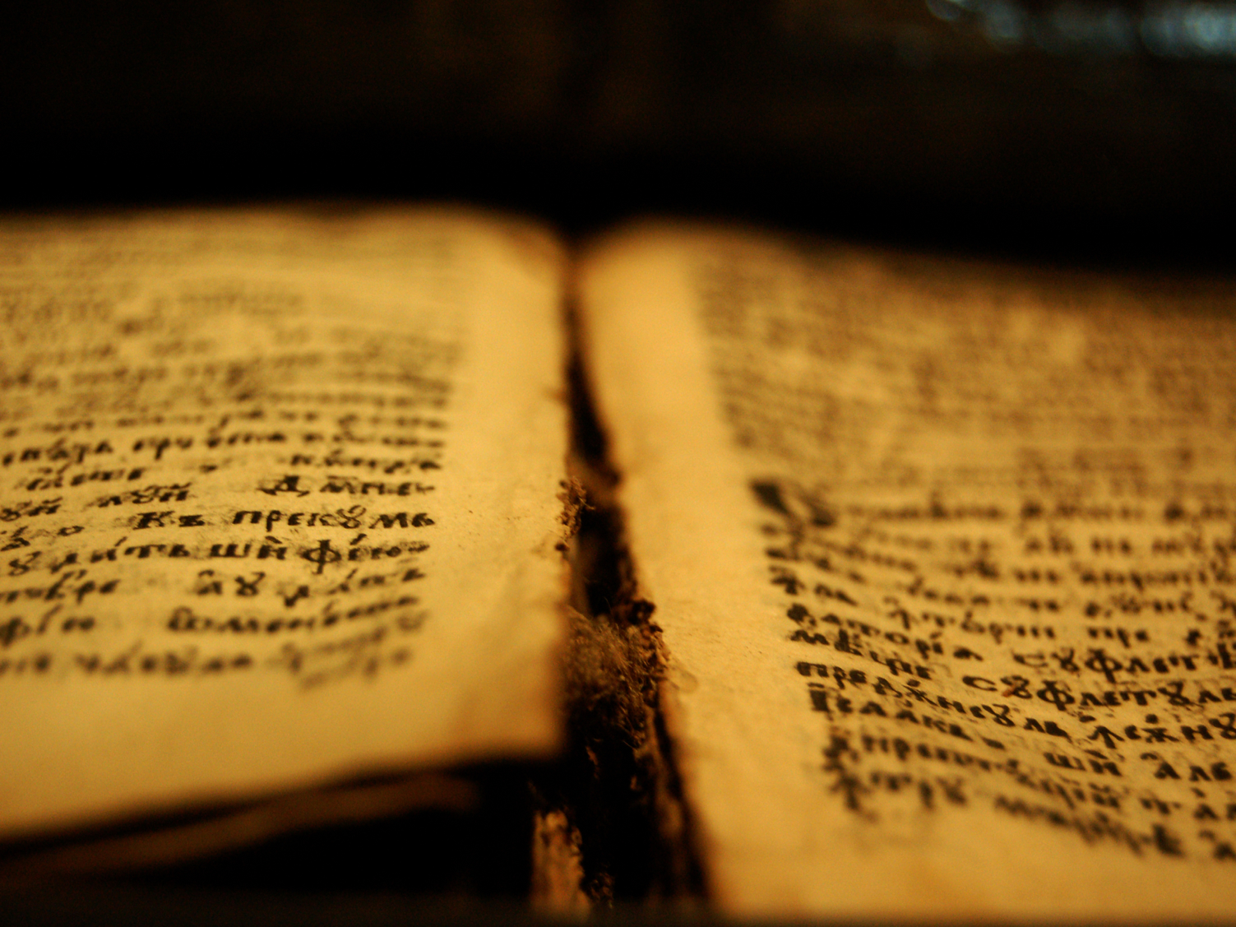
Compassion is described as the grace of God in action (Exod. 34:6; 2 Chron. 30:9; Neh. 9:17, 31; Ps. 85:13; Joel 2:13; and John 4:2).
Notes:
Put on... compassion. Compassion is the tender mercies for fellow human beings. In the Bible, Exo. 34:6; 2 Chro. 30:9; Neh 9:17, 31; Ps. 85:15; Joel 2:13; and Jn 4:2, this compassion is described as grace of God in action. Paul in Philippians 1:8 says that he love the Philippians and long for them "…with the tender compassion of Christ Jesus (NLT)". This is the compassion that we are talking about.

Slide 26
"So [Jonah] complained to the Lord about it: "Didn't I say before I left home that you would do this, Lord? That is why I ran away to Tarshish! I knew that you are a merciful and compassionate God, slow to get angry and filled with unfailing love. You are eager to turn back from destroying people'" (Jonah 4:2 NLT).
Notes:
Put on... compassion. Compassion is the tender mercies for fellow human beings. In the Bible, Exo. 34:6; 2 Chro. 30:9; Neh 9:17, 31; Joel 2:13; and Jon 4:2, this compassion is described as grace of God in action. Paul in Philippians 1:8 says that he love the Philippians and long for them "…with the tender compassion of Christ Jesus (NLT)". This is the compassion that we are talking about.

Slide 27
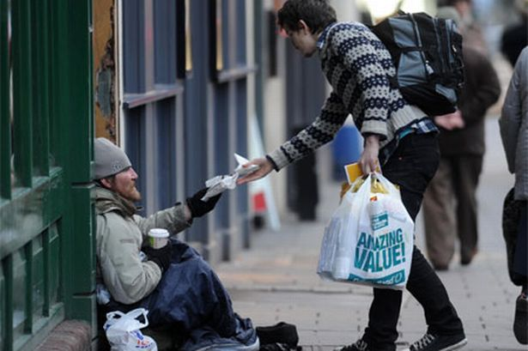
Without compassion, we cannot feel for others.
Notes:
When we are clothed with compassion, we can show kindness, humility, gentleness and patience to one another. In the gospel accounts, we know that when Jesus saw the crowds he was filed with compassion (Matt. 9:36; Mk. 6:34). Again in the Gospel of Mark when Jesus saw a leper asking him to heal him of his leprosy, Jesus was moved with compassion and he healed.
Without compassion, we cannot feel for others. We cannot truly, from our hearts say that I care for you. In order to be able to care for one another we need to be clothed with the grace of compassion.

Slide 28
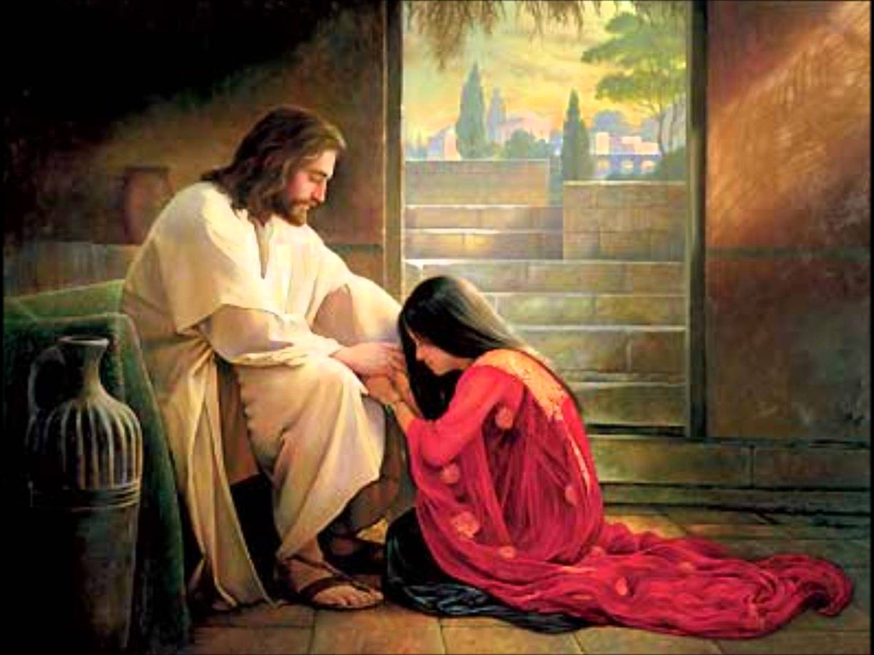
The clothes of forgiveness (3:13)
Notes:
Paul again exhort the Colossians to put on the clothes of forgiveness. “Make allowance for each other’s faults, and forgive anyone who offends you. Remember, the Lord forgave you, so you must forgive others” (3:13 NLT).
He exhorted them that they must forgive one another just as they have received forgiveness for God through Christ. The same applies for us today. We were once in a wretched state of sin. Every time we lived offending God by our thoughts, action and speech. But God forgave us and made us his children. Ephesians 4:32 clearly says that we must forgive one another just as Christ has forgiven us.

Slide 29
"Forgiveness is not giving someone what they deserve but what they need" – Anonymous "The weak can never forgive. Forgiveness is the attribute of the strong" – Gandhi
Notes:
As we claim to have put to death through our union with Christ and have put on the grace of Christ – the forgiveness, I would like you to think about someone who have hurt you beyond words; whom you find it hard to forgive. And ask yourselves, 'is it really to hard for me?'.

Slide 30
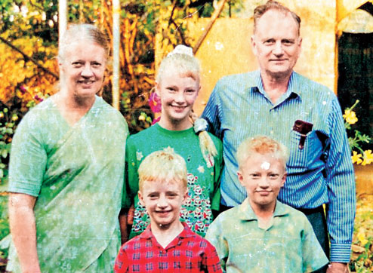
Graham & Gladys Staines
Notes:
Perhaps, the greatest story of forgiveness comes from the life of the widowed lady Gladys Staines.

Slide 31
3:13
"Make allowance for each other's faults, and forgive anyone who offends you. Remember, the Lord forgave you, so you must forgive others" (3:13 NLT)
Notes:
Without forgiveness, there cannot be a very strong relationship. Forgiveness is the clue that binds marriage, friendship and our relationship with one another.
Sometimes, it just you that you need to forgive yourself. We cannot forgive other unless we forgive ourselves of our past foolish mistakes. At one point of time, it was very difficult for me to forgive people who have provoked me and hurt my feelings beyond words. I took revenge for every single offense they made to me. When I was young, if any of relatives scold me for good or wrong reasons, I cannot challenge them so what I did… I killed their chickens, pets… sometimes, I used to take catapult and shoot them from afar… but God worked in my and as I receive Christ, I slowly learned to forgive. It will be ungrateful on our parts if we don't forgive one another because we have received forgiveness from God.
Let us put on the clothe of forgiveness.

Slide 32
The clothes of love (3:14)
Notes:
“Above all, clothe yourselves with love, which binds us all together in perfect harmony” (3:14 NLT).
As we put on the grace clothe of compassion, forgiveness, let us complete it by putting on the clothes of love. Paul said here that it is love that binds everything. Perhaps his best teaching about love is recorded in 1 Corinthians 13. 1 John 4:8 says God is love. As his children, let us also love one another. Let us adorn ourselves with love because love expresses the willingness of the person to give himself to the good of others.

Slide 33
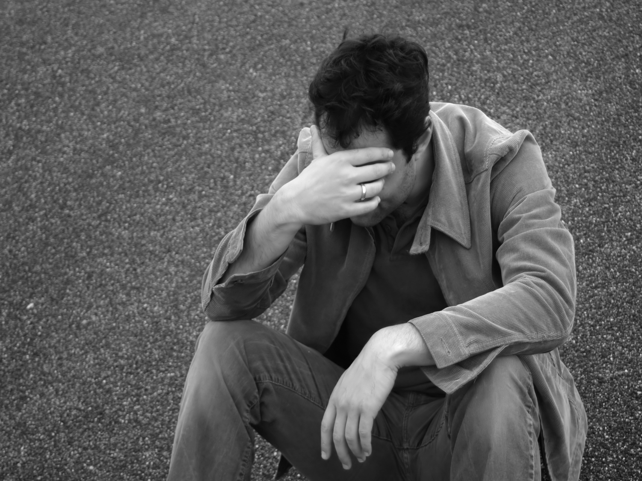
Forgiven but I cannot…
Notes:
Forgiven but I cannot love this man… This is a litmus test for us as Christians. We can forgive but choose not to love. If we truly forgive someone why can't we love? If you have some conflicts with your spouses, parents, friends, room mates in the past or recently, and if you say you have forgiven them but still cannot love, take this as God speaking to you today and accept it as a challenge to love that person.

Slide 34
Without love, our forgiveness is incomplete; without love our compassion is a hidden lamp. Love binds all!
Notes:
Let us put on the cloth of love.

Slide 35
I. Put off the grave clothes II. Put on the grace of Christ
Notes:
We are given the grace to live our life as victors in Christ. God in his grace have set us free by
Put off the grave clothes by making us die to the sins of a. corrupt living b. wrong conversation c. conventional distinctions, and by enabling us to
Put on the grace of Christ a. compassion
b. forgiveness
c. love
Now let us go back to the questions we asked in the beginning:

Slide 36
Anger?
Hatred?
Broken
Relationship?
Thoughts of Disdain?
Painful Past?
Greed?
Jealousy?
Notes:
We have been given the grace to live our life as new people in Christ. As new people we are to adorn ourselves with the virtues – the dress of new life. If we don't put on or cloth our body with clothes, then we all know we will be naked. If we are naked, we are susceptible to heat, cold, insect bites and vulnerable to hosts of dangers.
If you don't put off the grave clothes and put on the new virtues of life – i.e the grace of Christ, then we are naked Christians – naked and exposed to hosts of sins lurking around us. We will be tempted to anger and commit sin, we will want to hate people, we will be haunted by our painful past experience, we will go back to sexually immoral lives.
Are there any grave clothes on you that you need to remove? Think about this.

Slide 37
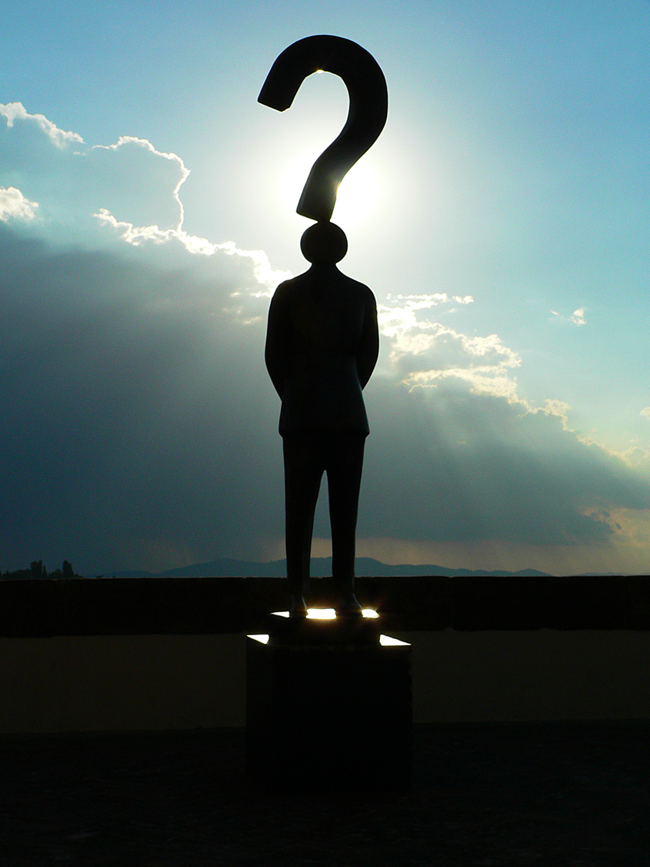
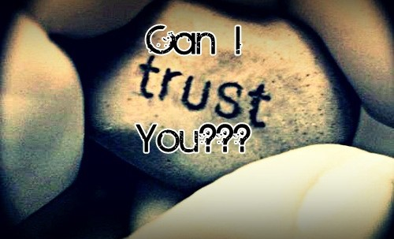
Doubts
Notes:
This year, as I look ahead and see the challenges that I am going to face – in terms of my marriage (if God willing after my graduation from SBC), regarding my ministry, I realized that still need to put to death this doubting Thomas within me. 2000 years ago, Christ have taken away my doubts but I am still wearing it. This doubt in myself makes my confidence keep at its lowest ebb; this doubt prevents me from building up trust in my relationship.

Slide 38
Trust in Christ
Notes:
This year, as I look ahead and see the challenges that I am going to face – in terms of my marriage (if God willing after my graduation from SBC), regarding my ministry, I realized that still need to put to death this doubting Thomas within me. 2000 years ago, Christ have taken away my doubts but I am still wearing it. This doubt in myself makes my confidence keep at its lowest ebb; this doubt prevents me from building up trust in my relationship.

Slide 39
God has given us the grace for a new beginning. Do not let your old habits hinder you from living as one whose life is in Christ.
Notes:
MI: God has given us the grace for a new beginning. Do not let your old habits hinder you from living as one whose life is in Christ.
Let us put to death what hinders us to live as new man/woman in Christ and put on the virtues of new man/woman and face the challenges, hurdles, obstacles as we go along with each day of the New Year.
God bless us all!

Slide 40
Black

Slide 41
NT Preaching link at BibleStudyDownloads.org
Get this presentation and script for free!
Notes:
NT Preaching (np)

