Slide 1
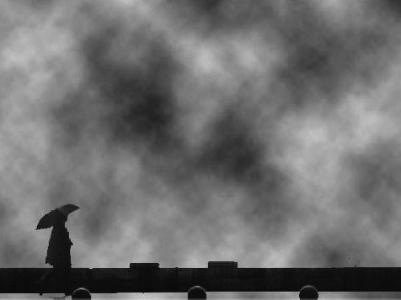
Are You Eager for Change?
Change
Acts 10
25 October 2009
Dr. Rick Griffith • Crossroads International Church Singapore
CICFamily.com & BibleStudyDownloads.org

Slide 2
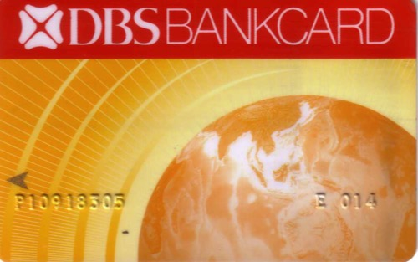

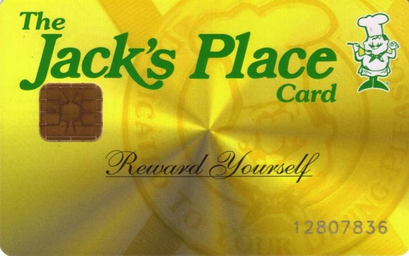

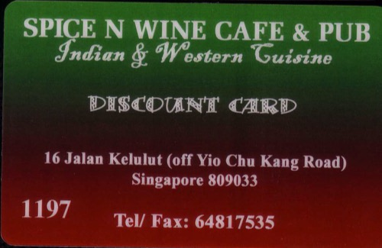
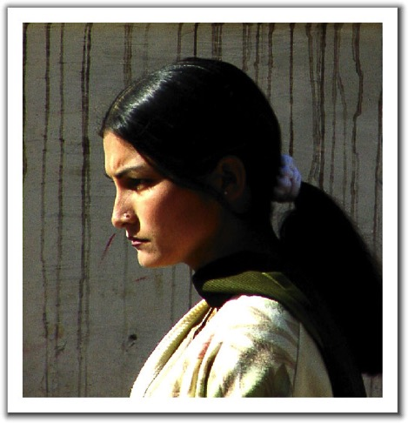

Change
  It's all around us

Slide 3


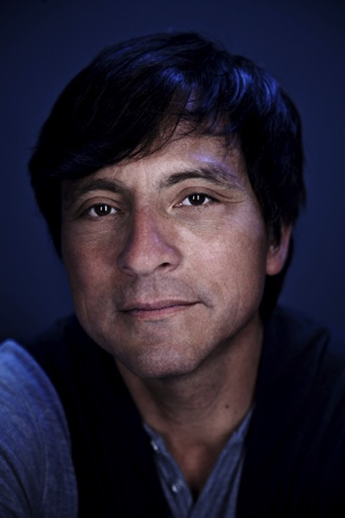
Erwin McManus
An Unstoppable Force
Pastor of Mosaic (a contemporary church in LA)

Slide 4
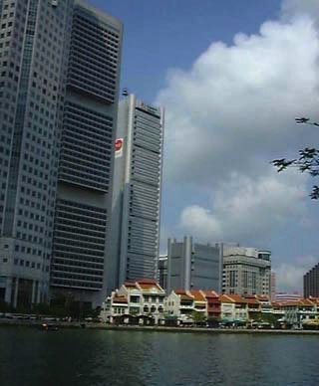

embraces change
Kiasu
EZ-Link card
Upgrading

Slide 5
Crisis & Change
Are You Eager for Change?
2%
Innovators
18%
Early
Adopters
60%
Middle
Adopters
18%
Late
Adopters
2%
Laggards

Slide 6
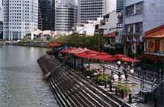
Our Subject Today:
Why must we eagerly
embrace change?

Slide 7

Some Background…
Gentiles entered the Jewish church
Jews hated Gentiles for centuries
Whites
Blacks
Chinese
Malays
Jews
Gentiles

Slide 8
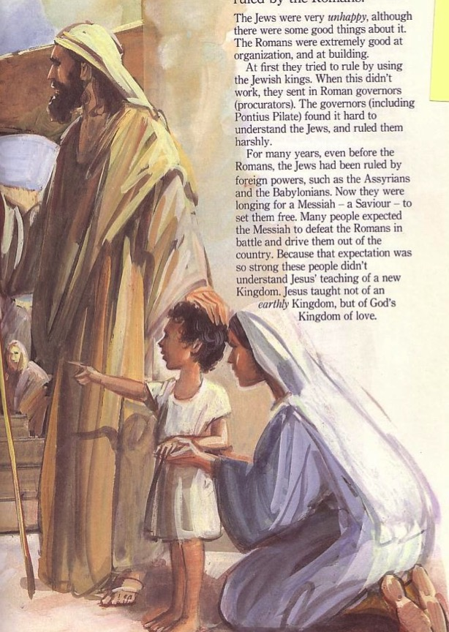
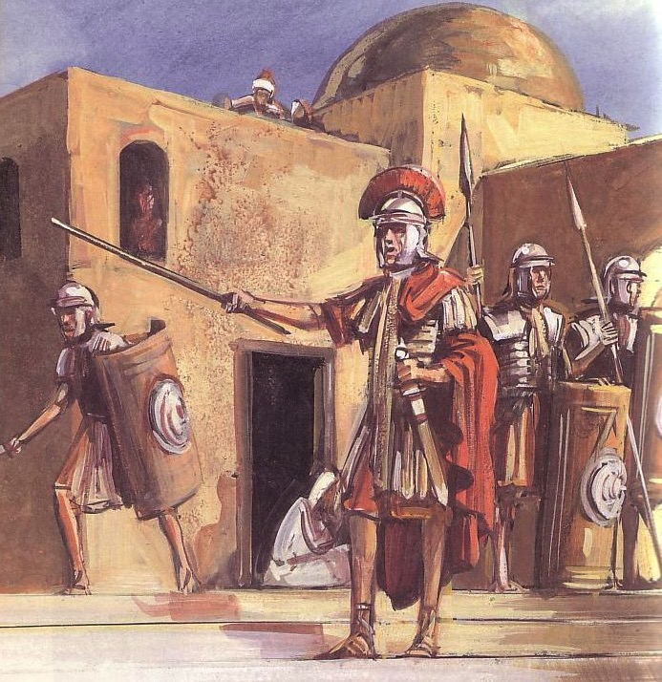
What Were the Ethnic Differences?
Jews
Gentiles
One God
One wife
Many taboos
Many Gods
Immoral
Few
taboos

Slide 9
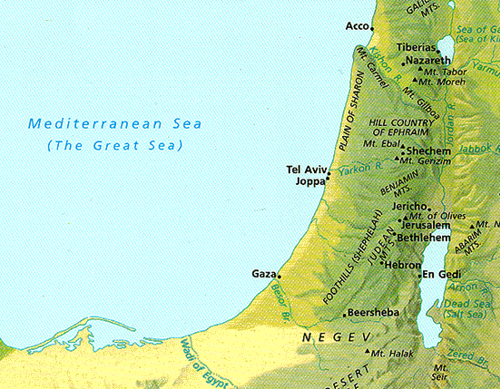
Acts 1-9 Map
“But you will receive power when the Holy Spirit comes on you; and you will be my witnesses in Jerusalem, and in all Judea and Samaria and to the ends of the earth” (Acts 1:8)
Up to Acts 9:32

Slide 10
Where we're going…
  Initiation
  Preparation
  Results

Slide 11
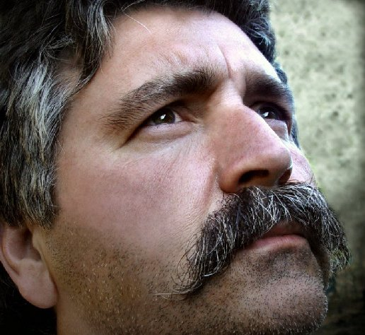
I. God always prepares his people for change

Slide 12
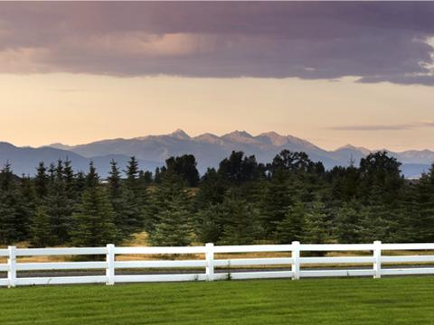
A. God prepared the Jewish church to include Gentiles (9:36–10:16).

Slide 13
DVD 9:36-10:16
Notes:
DVD 9:36-10:16

Slide 14

Three Waves of Change...
God prepared Peter
God prepared Cornelius
God prepared Peter further

Slide 15
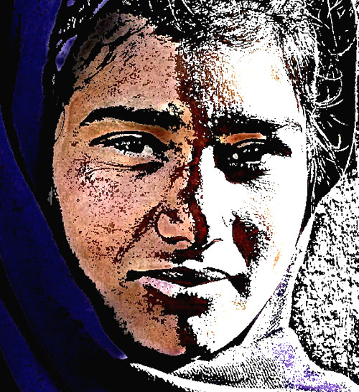
Peter Prep: Step 1
Ministry to Samaritans

Slide 16
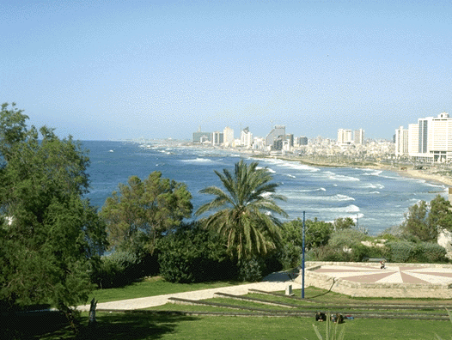
Peter Prep: Step 2
Peter Prep: Step 2
  Live with the tanner by the sea
Joppa

Slide 17
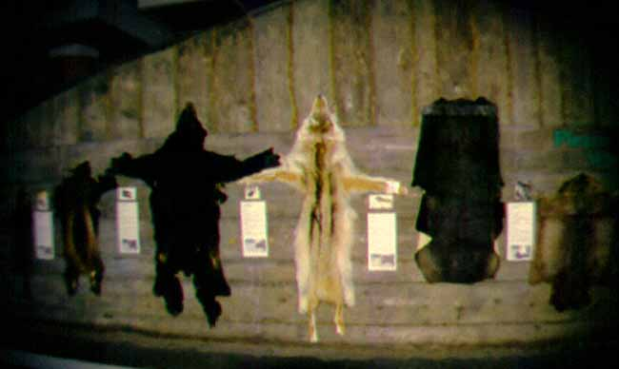
“Woe to him who is a tanner by trade”
The Jewish Babylonian Talmud

Slide 18
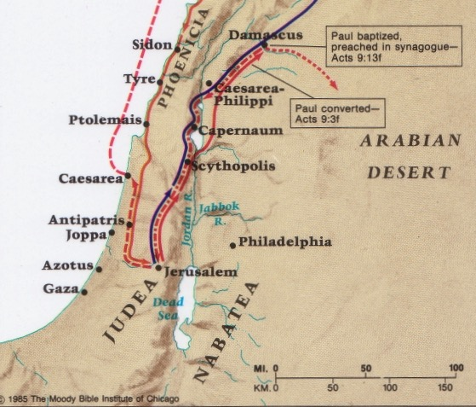
Peter was not like Jonah at Joppa
Caesarea
Joppa

Slide 19
Simon Peter
the Tanner

Slide 20
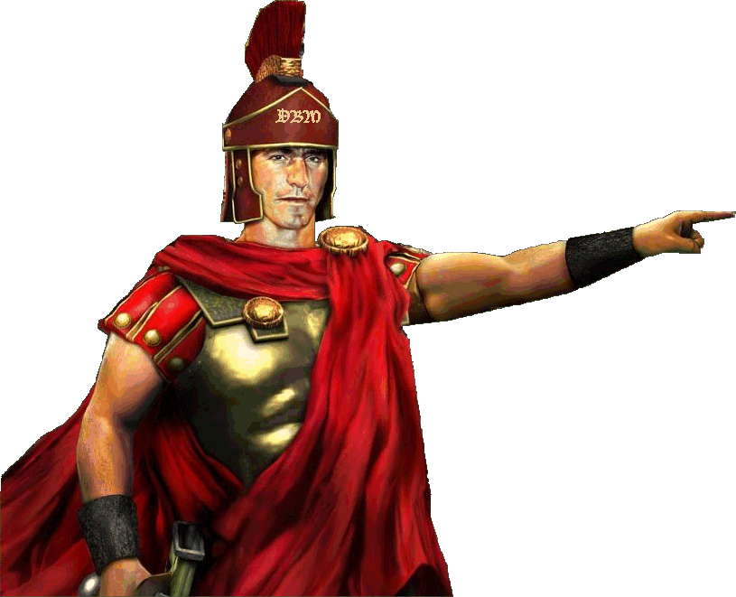
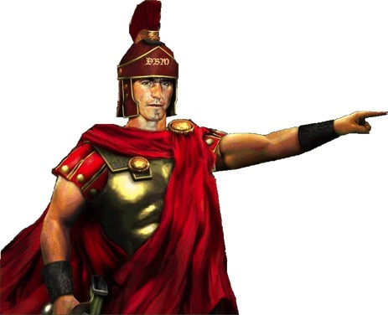
Cornelius Prep
Alms & prayers
Vision

Slide 21
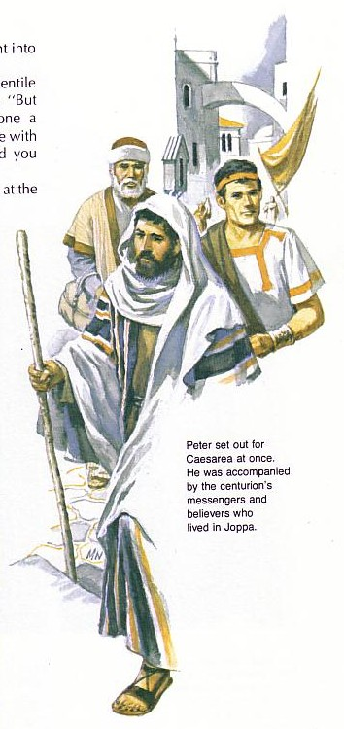
“What's God going to do to these unclean men?”
Peter must have wondered why God wanted him to go with the servants of Cornelius

Slide 22
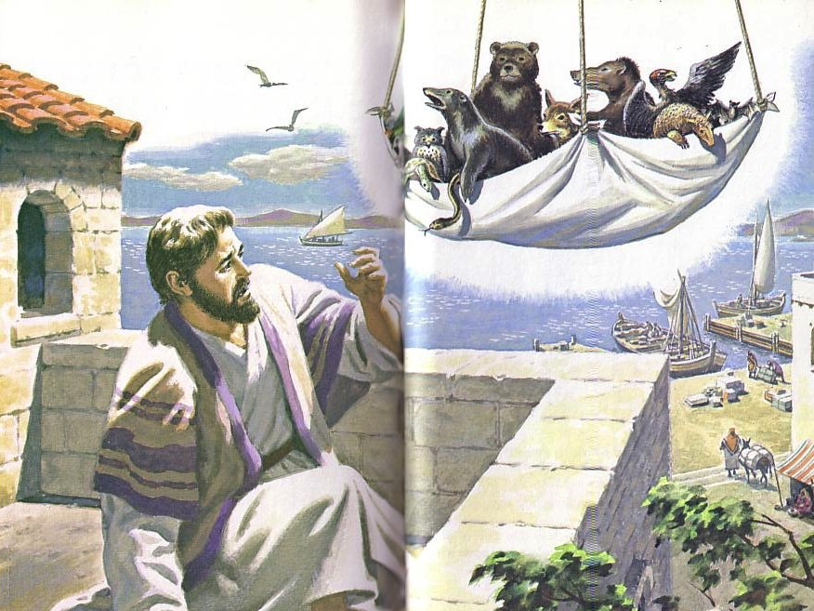
“Get up, Peter! Kill and eat!”
Peter Prep: Step 3
  Eat “unclean” food (10:8-16)
    The sheet “contained all kinds of four-footed animals, as well as reptiles of the earth and birds of the air” (10:12)

Slide 23

What foods?
Camel, rabbit, bacon, ham, snake, and the eagle, vulture, raven, certain kites and owls, the gull, any kind of hawk, the stork, any kind of heron, and the bat.
Leviticus 11

Slide 24
B. God is preparing Crossroads for change today too!

Slide 25
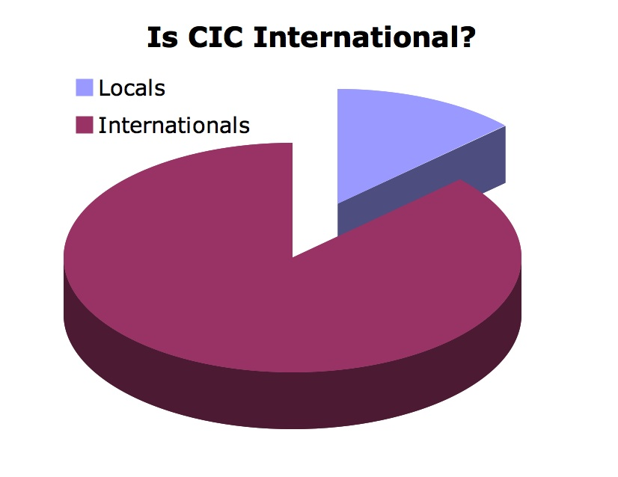
Is CIC International? March 08
10%
90%
Oct 09
Notes:
25
Are we achieving our vision to reach the international community?
Since 90% are foreigners, it looks like we are--though few have come to Christ through us and we need to reach out more.

Slide 26
Black
Notes:
Another way I see God preparing CIC for change is that recently many folks have come out of the woodwork—we have people to lead the home group ministry now, initiated by God Himself. Others are helping with refreshments, and organizing the greeters and ushers. The WT now consistently has drums, bass, guitars, etc.

Slide 27
I. God always prepares his people for change

Slide 28
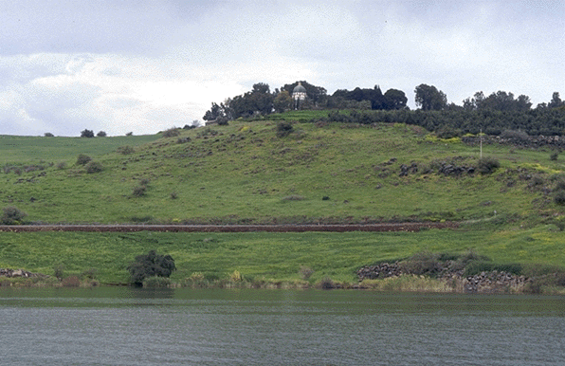
II. God initiates the change himself.

Slide 29

God's initiation
A. God involved Peter in Cornelius's conversion to confirm to the Jewish church that God was doing a new thing (10:17-44)

Slide 30
DVD 10:17-44
Notes:
DVD 10:17-44

Slide 31
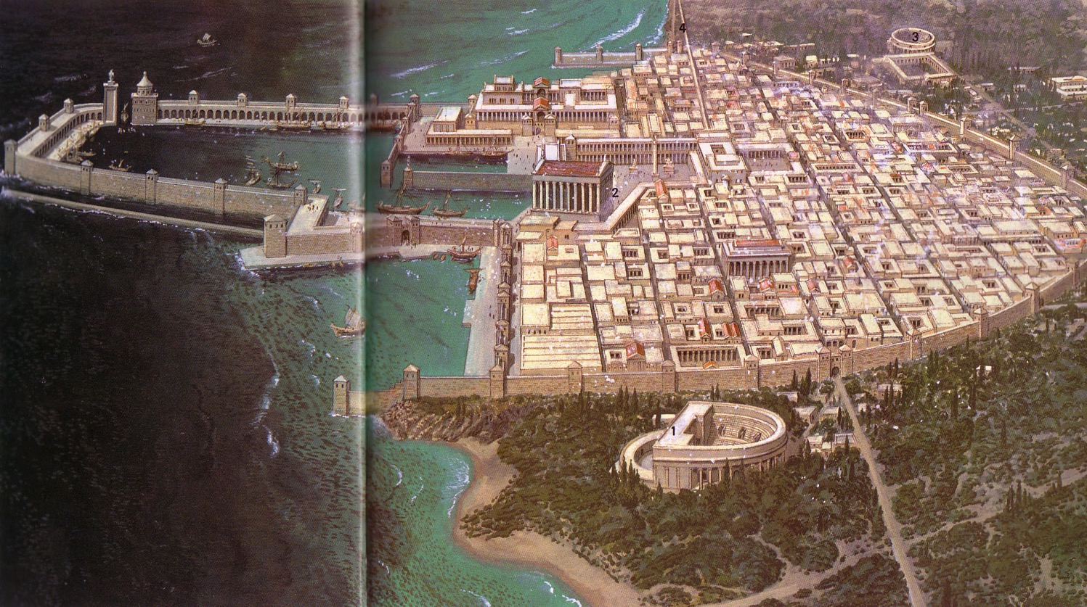
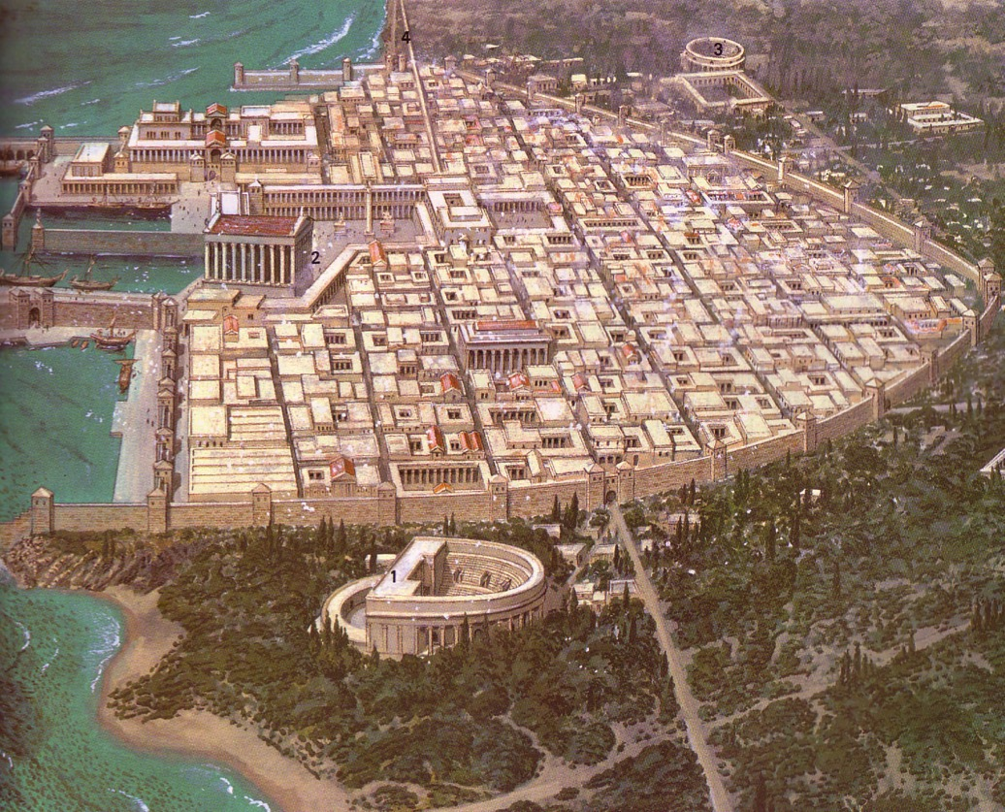
Caesarea: Loved and Despised
Notes:
Romans loved Caesarea, considering it a model city.
Jews despised it as the unclean capital of their conquerors
Yet Peter willingly went there as he saw God initiating change!

Slide 32

Peter's Response:
“I most certainly understand now that God is not one to show partiality, but in every nation the man who fears Him and does what is right, is welcome to Him”
(10:34–35).

Slide 33
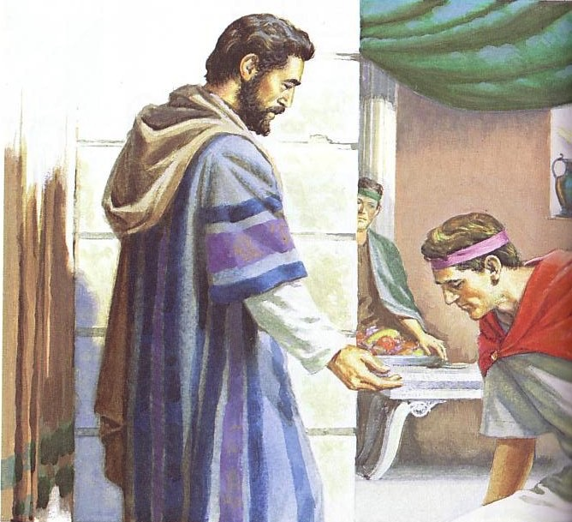
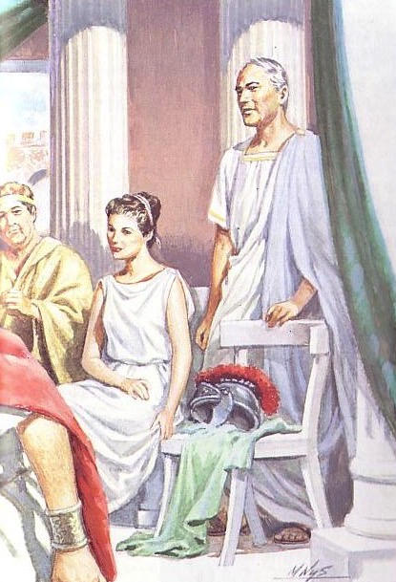
God gave his Spirit to Cornelius

Slide 34

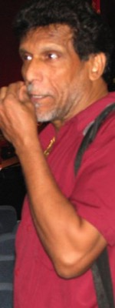
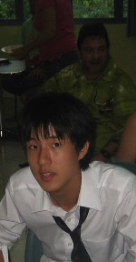


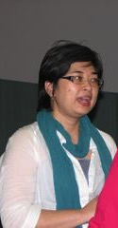
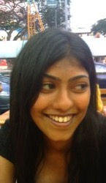
B. God is initiating many changes at CIC that we have little to do with.
  Our Location in Singapore
  International
  Internet Age
Notes:
None of us chose to move to Singapore, but God initiated it
We've had to get with how God is using the internet age to get us to have a website
God has brought people here from 13 nations now! Americans are only 44%.

Slide 35
I. God always prepares his people for change

Slide 36
II. God initiates the change himself.

Slide 37
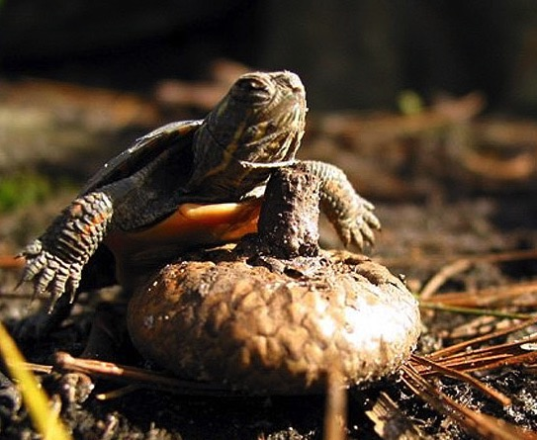
III. We must embrace God's new plans

Slide 38
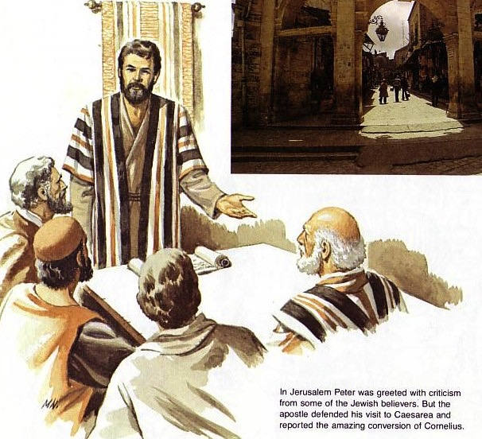
A. The Jerusalem church had to accept Gentile conversion because this change was from God (10:45–11:18)
Peter defends his lack of prejudice

Slide 39
DVD 10:45-11:18
Notes:
DVD 10:45-11:18

Slide 40
Reactions
  Astonishment by Jewish believers (10:45-46)
  Acceptance by Peter
  (10:47-48)
  Accusation by Pharisaical believers (11:1-3)
  Approval by the Jerusalem church (11:4-18)

Slide 41
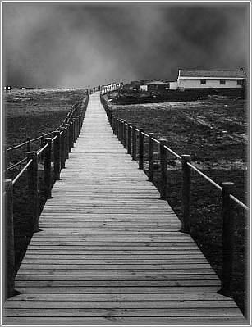
We must eagerly embrace changes when God himself is initiating them

Slide 42
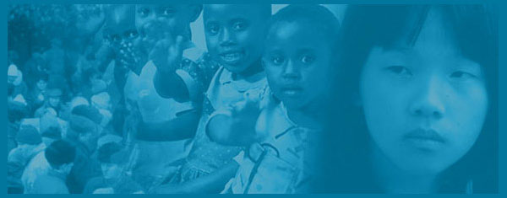
CBI changes . . .
Leadership
Mission handbook
Name change

Slide 43
CBFMS
CBInternational
Conservative
Baptist
Foreign
Mission
Society
Stiff
Narrow
Alien
Sensitive
What's that???

Slide 44

WorldVenture

Slide 45

We must eagerly embrace changes at CIC because God himself is initiating them

Slide 46
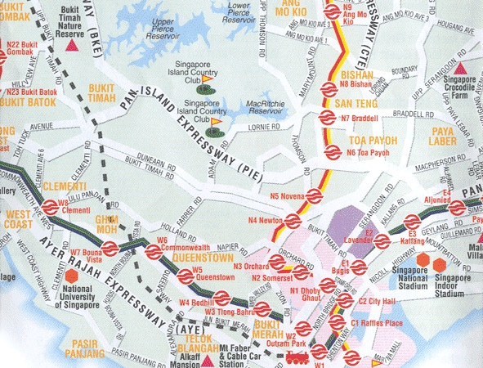

Our Room & Location
CIC
Bus 132
Bus 190
SBC
ICS
YMCA
Bus 105
CIS
OFS
ISS
= PIE exits

Slide 47
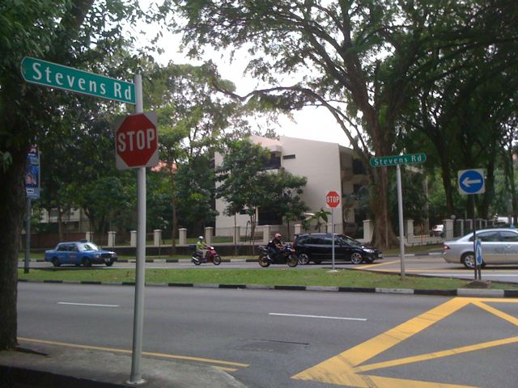
YMCA

Slide 48
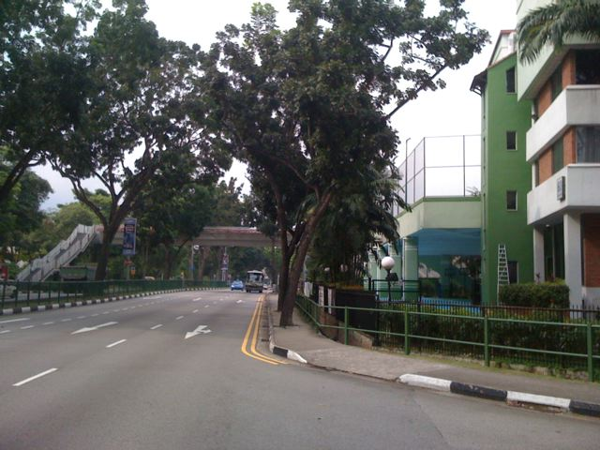
YMCA

Slide 49
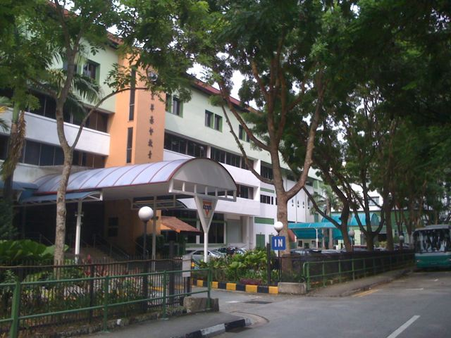
YMCA

Slide 50
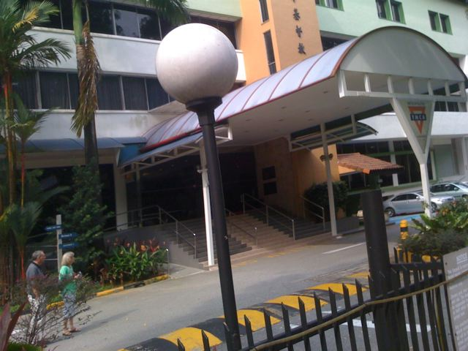
YMCA

Slide 51
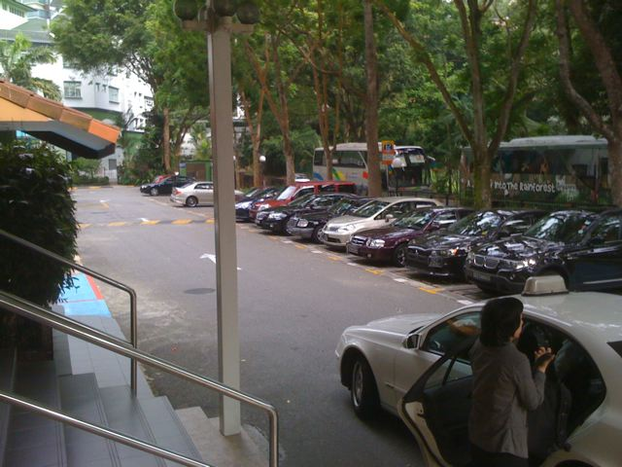
YMCA

Slide 52
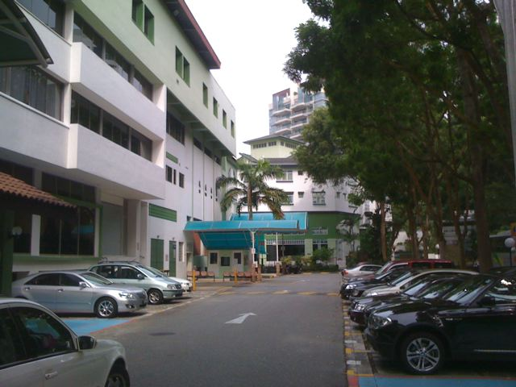
YMCA

Slide 53
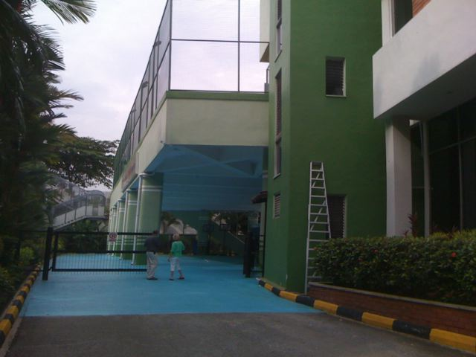
YMCA

Slide 54
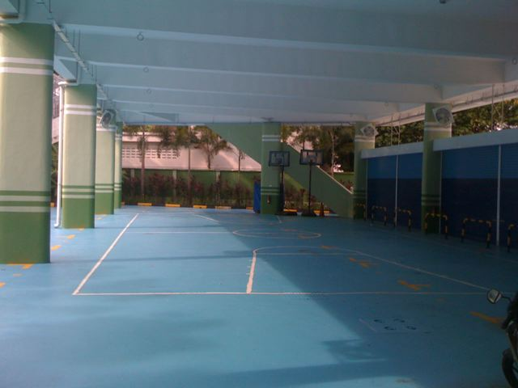
YMCA

Slide 55
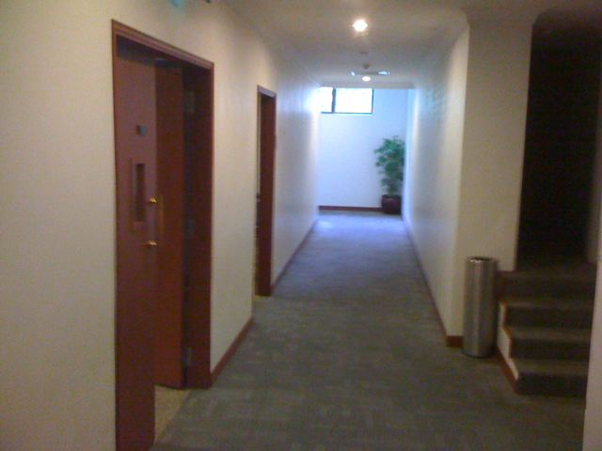
YMCA

Slide 56
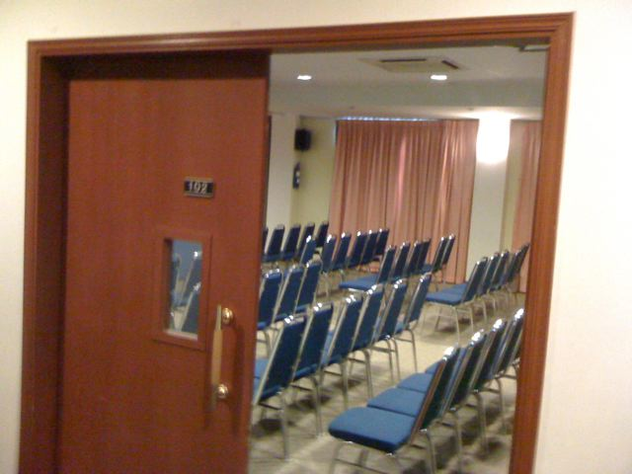
YMCA

Slide 57
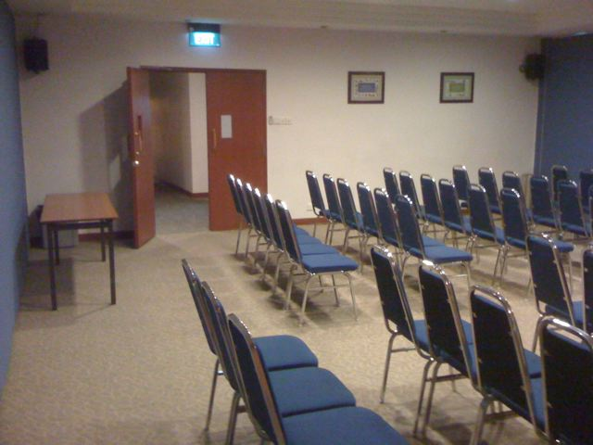
YMCA

Slide 58
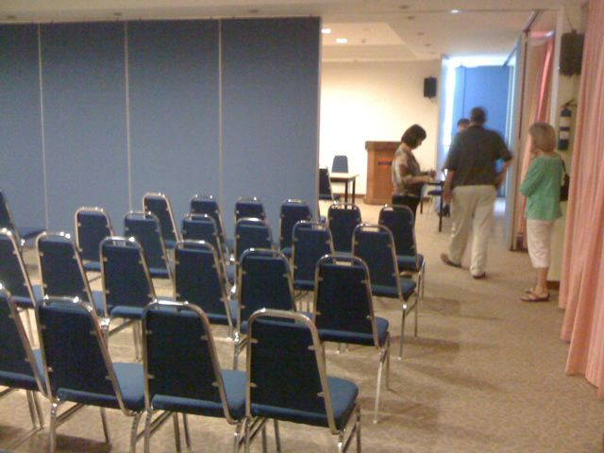
YMCA

Slide 59
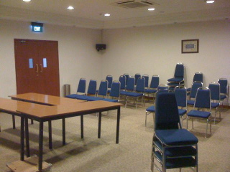
YMCA

Slide 60
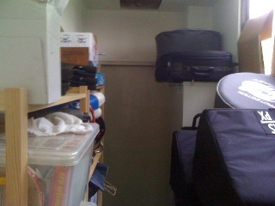
YMCA

Slide 61

YMCA

Slide 62

YMCA

Slide 63

YMCA

Slide 64

YMCA

Slide 65

YMCA

Slide 66

YMCA

Slide 67

YMCA

Slide 68

YMCA

Slide 69

YMCA

Slide 70


Both Venues Have Advantages!
Salvation Army | YMCA
Room to Grow | Right Sized Room
Continuity | Renewal
Proximity to Members | Proximity to Unreached
More Classrooms | Restaurant
A/V Equipment | Service-Oriented
Storeroom | Hotel Ambiance
Drums & Keyboard | Drinking in Service
 | 3 Bus Stops to Orchard
 | Saves $200 Weekly
Notes:
Service-Orientation:
• They cater cheaper than we do here
• They make all the directional signs
• 3-star hotel
• They answer emails, allow us to use the A/C

Slide 71

Still hazy…?

Slide 72

We must eagerly embrace change because God himself is initiating it (Main Idea)

Slide 73

Faith Hops
“I've stopped expecting you to make leaps of faith,
but it would be nice to see a hop now and then.”
Notes:
Sometimes we don't embrace change because we're too comfortable!
That's not us!

Slide 74

Tradition
The whole church watched with nervous anticipation
as the visitors sat where the Martins have sat for 42 years.
Notes:
Other times we are stuck in tradition

Slide 75

Are you willing to embrace any change at Crossroads that will more effectively advance the gospel?

Slide 76
Some ideas . . .
    Consider the YMCA
      Accept new ideas
      Invite your friends
    The world is sharing information—so should we!
      Develop our website
Notes:
Seriously consider the YMCA option
for what is best for the church
even if it is less convenient for you personally
Website: testimonies, current events

Slide 77







cicfamily.com

Slide 78
Some ideas . . .
    Consider the YMCA
      Accept new ideas
      Invite your friends
    The world is sharing information—so should we!
      Develop our website
      Expand our home groups
Notes:
Enriko's $300 honorarium will double to $600 as he restarts home groups

Slide 79

I'm encouraged!
We're making bold changes
Let's be as relevant in the future as we were the past three years

Slide 80




Our Vision is to…
Love God
Love the Church
Love the Nations
Notes:
• Love God
Where it starts—and ends—is in our call to LOVE. As Paul noted, “The greatest of these is love” (1 Cor. 13:13).
What is the most important thing we do as a church? It begins with loving the God who loves us.
• Love Church
Do you genuinely love him? If you don't, then nothing else you do counts, really.
The second thing He said right after this: to love your neighbor as yourself.
• Love Nations
But who is your neighbor? It starts right here in the body—to love the church—but then it extends from this “close neighbor” to those who are out of the reach of this fellowship where we love the nations. Our leadership is committed to make all that we do revolve around one of these three priorities.
80

Slide 82


NT Preaching link at BibleStudyDownloads.org
Get this presentation and script for free!
Notes:
NT Preaching (np)

