Slide 1
Healthy Church Life
1 Timothy 3:8-16
Preached by Dr. Jim Harmeling at Crossroads International Church Singapore • cicfamily.com Uploaded by Dr. Rick Griffith • Singapore Bible College Thousands of files in 49 languages for free at BibleStudyDownloads.org

Slide 2
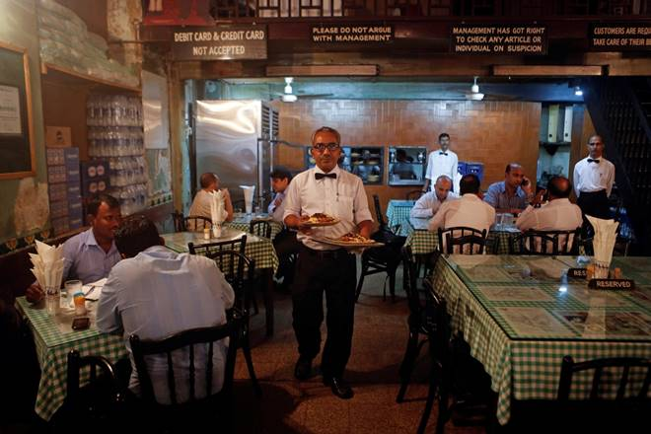

Slide 3
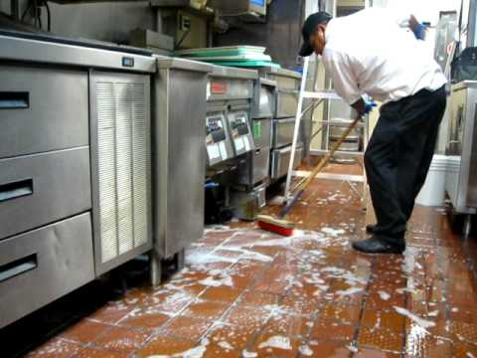
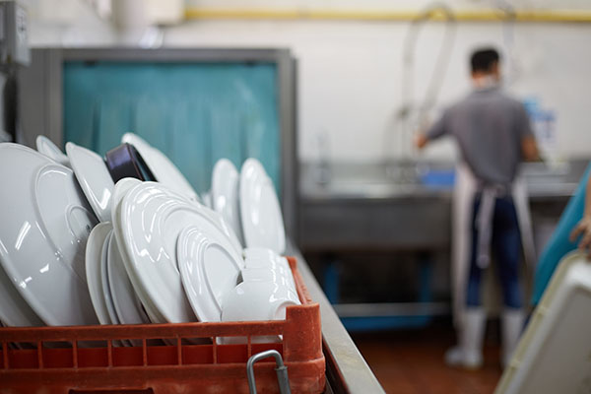

Slide 4
Acts 6:1-2
¹ Now in these days when the disciples were increasing in number, a complaint by the Hellenists arose against the Hebrews because their widows were being neglected in the daily distribution. ² And the twelve summoned the full number of the disciples and said, “It is not right that we should give up preaching the word of God to serve tables.”

Slide 5
Healthy Church Life
Studies in 1 Timothy

Slide 6
Healthy Churches Develop godly leaders
1 Timothy 3:1-16

Slide 7
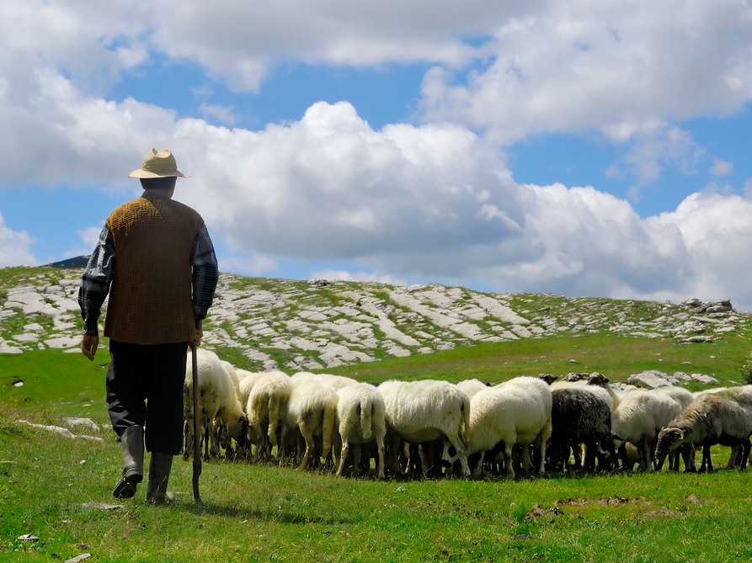
They Raise up Godly Elders (vs. 1-7)
They Develop Godly Deacons (vs. 8-16)
Philippians 1:1
Paul and Timothy, servants of Christ Jesus,
To all the saints in Christ Jesus who are at Philippi, with the overseers and deacons:

Slide 8
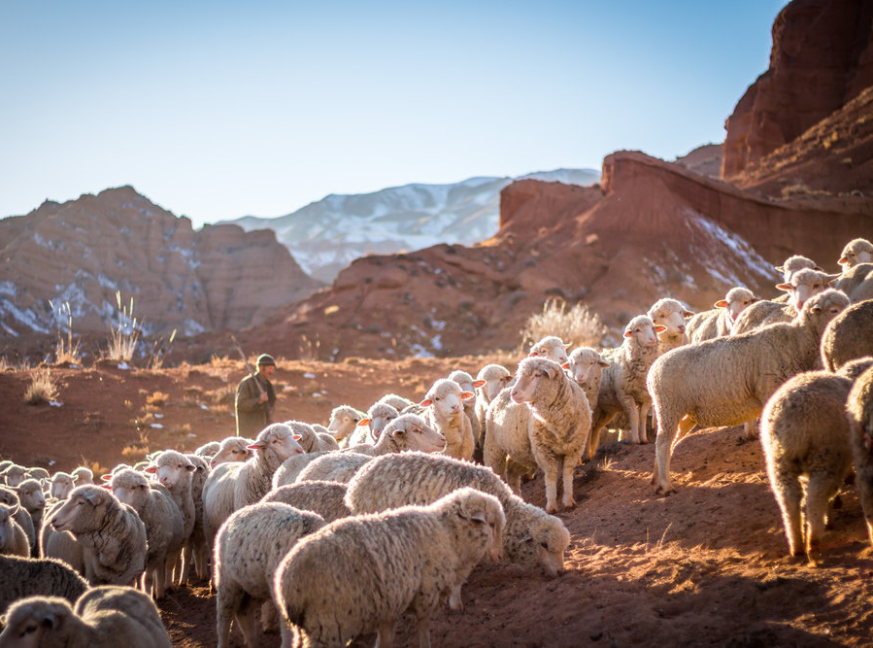
The saying is trustworthy: If anyone aspires to the office of overseer, he desires a noble task.
Elder = Who? Older man
Overseer = What? Oversee
Pastor = How? Like a shepherd

Slide 9
James 5:14
Is anyone among you sick? Let him call for the elders of the church, and let them pray over him, anointing him with oil in the name of the Lord.

Slide 10
Acts 15:1-2, 6
¹ But some men came down from Judea and were teaching the brothers, “Unless you are circumcised according to the custom of Moses, you cannot be saved.” ² And after Paul and Barnabas had no small dissension and debate with them, Paul and Barnabas and some of the others were appointed to go up to Jerusalem to the apostles and the elders about this question.
⁶ The apostles and the elders were gathered together to consider this matter.

Slide 11
What qualities are required in a deacon?
They are respectable (“dignified”)
They do not speak out of both sides of their mouths
(“not double-tongued”)
They do not have addictions (“not addicted to much
wine”)
4. They are not greedy and materialistic (“not greedy for
dishonest gain”)
They are doctrinally sound with a life of integrity
(“They must hold to the mystery of the faith with a
clear conscience”)

Slide 12
What qualities are required in a deacon?
They have been tested in ministry responsibility (“And
let them all be tested first; then let them serve as
deacons if they prove themselves blameless.”)
They manage their homes well (“Let deacons each be the husband of one wife, managing their children and their own households well.”)

Slide 13
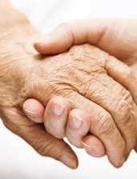
A Challenge to the Women

Slide 14
female deacons?
Why resume character traits of the “deacons” immediately afterwards?
Why then say deacons are husbands of one wife?
Why use the same word for the women throughout this chapter that refers to wives?
Why not select females in Acts 6?
deacon’s wives?
Why are elder’s wives not mentioned?
Why not make it clear these are deacon’s wives by including the personal pronoun, “their” wives, instead of “women”?
Why is Phoebe called a “servant” or “deacon” in Romans 16:1?

Slide 15
They are respectable (“dignified”)
They are self-controlled with their tongue (“not slanderers”)
They have self-control over their life (“sober-minded”).
They are reliable (“faithful in all things”)

Slide 16
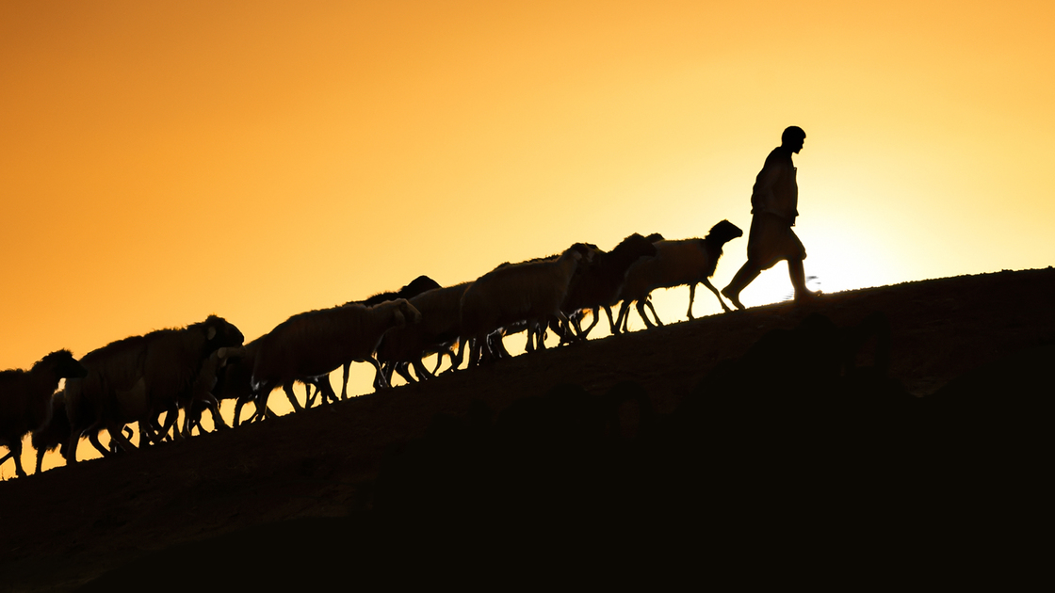
Why are church leaders important?
(vv. 14-16)
The Church has quality: It is ordered
The Church has personality: It is a family of people
The Church has God’s presence: He is living in it
The Church has a mission: It must support and protect the truth

Slide 18
NT Preaching • BibleStudyDownloads.org
Get this presentation for free!

