Slide 1


Elder Roles
Dr. Rick Griffith
International Baptist Church of Singapore
22 May 2005
1 Timothy 3:1
Dr. Rick Griffith, Crossroads International Church Singapore
cicfamily.com & BibleStudyDownloads.org

Slide 2
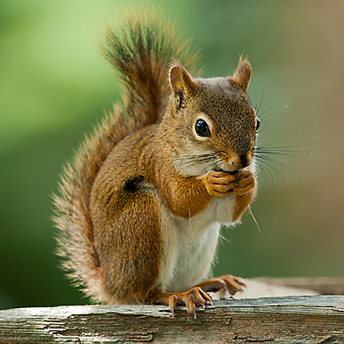
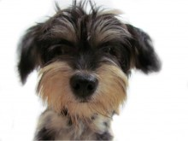
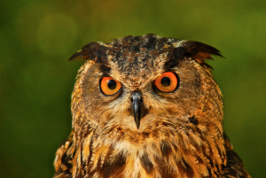
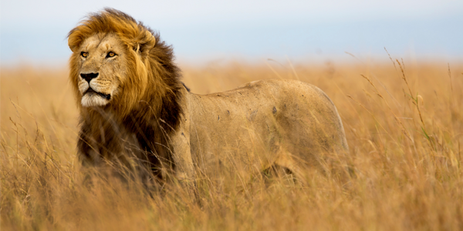
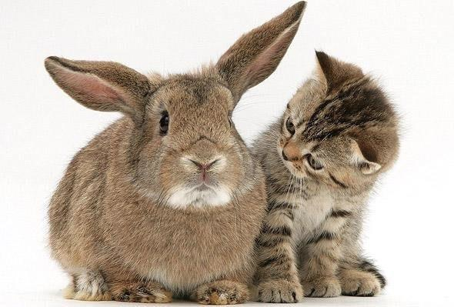
What kind of animal are you?
Notes:
If you could describe yourself as an animal, which one would you pick?
Now, biblically speaking, what animal are you?

Slide 3

Psalm 23
¹The LORD is my shepherd, I shall not be in want. ²He makes me lie down in green pastures, he leads me beside quiet waters, ³he restores my soul. He guides me in paths of righteousness for his name's sake. ⁴Even though I walk through the valley of the shadow of death, I will fear no evil, for you are with me; your rod and your staff, they comfort me. ⁵You prepare a table before me in the presence of my enemies. You anoint my head with oil; my cup overflows. ⁶Surely goodness and love will follow me all the days of my life, and I will dwell in the house of the LORD forever.
Notes:
I'll give you a hint. You are in Psalm 23, the most loved poem ever written. Yes…

Slide 4
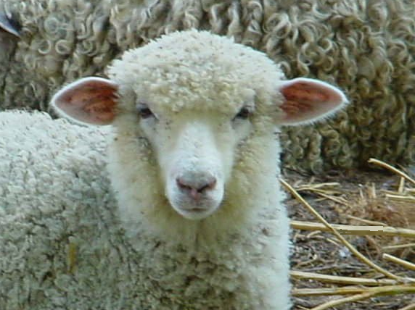
You're a sheep

Slide 5
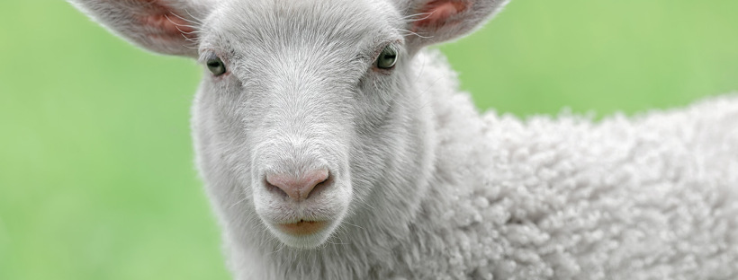
What does it mean to be a "sheep"?
Notes:
Does being a sheep mean you are cute and easy to get along with? Not quite.

Slide 6
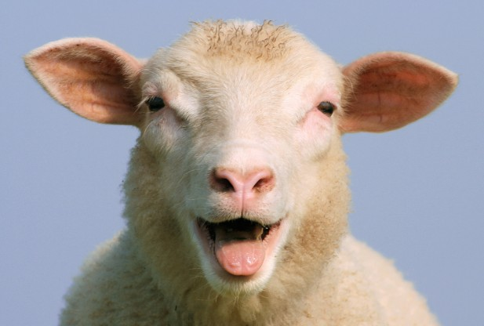
"Dumb, Directionless, Defenseless"
Tim Challies, http://www.challies.com/christian-living/dumb-directionless-defenseless posted 26 Aug 2013, accessed 7 Aug 2016
Notes:
One bogger puts it this way: "Why sheep? Why not cheetahs or wolves or tigers or another animal with a bit of flair, a bit of class? But the Bible tells us often that we are sheep. We are sheep and God is a shepherd. That sheep/shepherd word picture is at the heart of the best-loved Psalm—Psalm 23. I spent some time with that psalm lately and tried to gain a better appreciation of why God saw fit to tell us we are sheep.
I will admit I am not the world's foremost expert on sheep. I grew up in the city and even now live in an area of town that explicitly forbids owning livestock. In place of first-hand knowledge, I spent some time reading about sheep. It was funny. And kind of humbling.
Do a little bit of reading about sheep and you'll soon see they are not survivors. They are not strong and independent creatures, not proud hunters or fierce predators. They're actually kind of pathetic, entirely dependent upon a shepherd for at least three reasons. Two of these reasons are related to the brain of a sheep and the other is related to its body."
Dumb, Directionless, Defenseless
Tim Challies, http://www.challies.com/christian-living/dumb-directionless-defenseless posted 26 Aug 2013, accessed 7 Aug 2016

Slide 7
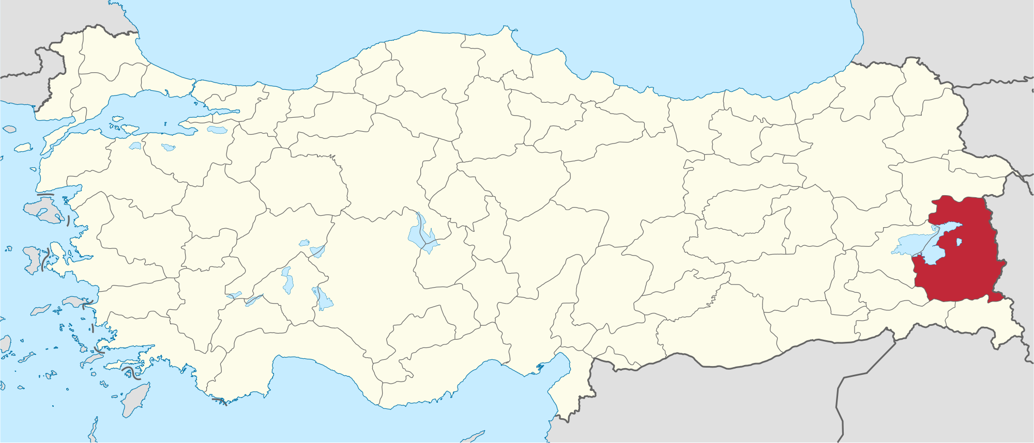
News Story from Van Province, Turkey
Tim Challies, http://www.challies.com/christian-living/dumb-directionless-defenseless posted 26 Aug 2013, accessed 7 Aug 2016
Notes:
"This is a real news story that aptly tells us the first reason sheep need a shepherd: because sheep are dumb.
'Hundreds of sheep followed their leader off a cliff in eastern Turkey, plunging to their deaths this week while shepherds looked on in dismay.'"
Dumb, Directionless, Defenseless
Tim Challies, http://www.challies.com/christian-living/dumb-directionless-defenseless posted 26 Aug 2013, accessed 7 Aug 2016

Slide 8
"Dumb, Directionless, Defenseless"
"Hundreds of sheep followed their leader off a cliff in eastern Turkey, plunging to their deaths this week while shepherds looked on in dismay. Four hundred sheep fell 15 metres to their deaths in a ravine in Van province near Iran but broke the fall of another 1,100 animals who survived. Shepherds from a nearby village neglected the flock while eating breakfast, leaving the sheep to roam free. The loss to local farmers was estimated at $74,000."
—Actual news story
Tim Challies, http://www.challies.com/christian-living/dumb-directionless-defenseless posted 26 Aug 2013, accessed 7 Aug 2016
Notes:
Dumb, Directionless, Defenseless
Tim Challies, http://www.challies.com/christian-living/dumb-directionless-defenseless posted 26 Aug 2013, accessed 7 Aug 2016

Slide 9
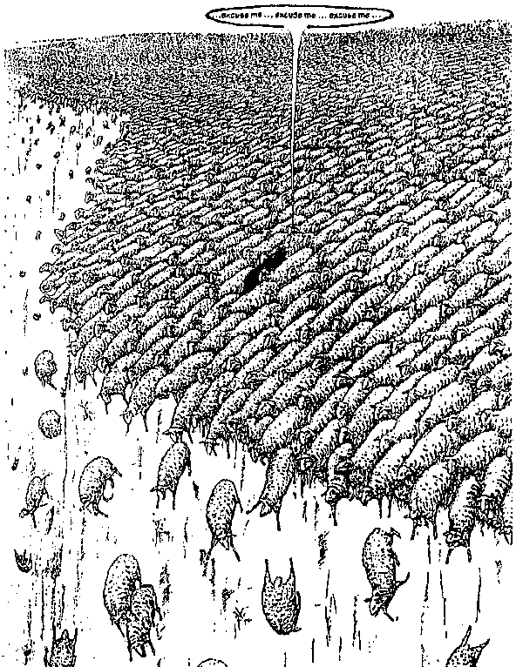
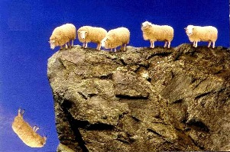
"Dumb, Directionless, Defenseless"
Notes:
"One sheep wandered off a cliff and 1,499 others just followed along. Can you picture it? 1,500 sheep, each walking off a cliff, one after the other."
Dumb, Directionless, Defenseless
Tim Challies, http://www.challies.com/christian-living/dumb-directionless-defenseless posted 26 Aug 2013, accessed 7 Aug 2016
See also https://factualfacts.com/animals/in-2005-in-turkey-a-suicide-sheep-jumped-off-a-cliff-and-1500-sheep-followed-the-first-one/

Slide 10
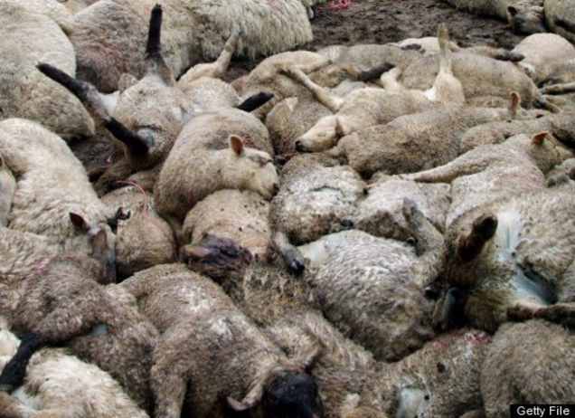
"Dumb, Directionless, Defenseless"
Tim Challies, http://www.challies.com/christian-living/dumb-directionless-defenseless posted 26 Aug 2013, accessed 7 Aug 2016
Notes:
"Soon they were piled so deep that the ones at the bottom were crushed to death and the ones on top were lying on a big downy-soft pillow. It is completely absurd and tells us one important fact about sheep and the first reason sheep absolutely need a shepherd: they are not the smartest animals in the world. In fact, they may well be just about the dumbest animals in the world."
Dumb, Directionless, Defenseless
Tim Challies, http://www.challies.com/christian-living/dumb-directionless-defenseless posted 26 Aug 2013, accessed 7 Aug 2016
See also https://factualfacts.com/animals/in-2005-in-turkey-a-suicide-sheep-jumped-off-a-cliff-and-1500-sheep-followed-the-first-one/

Slide 11
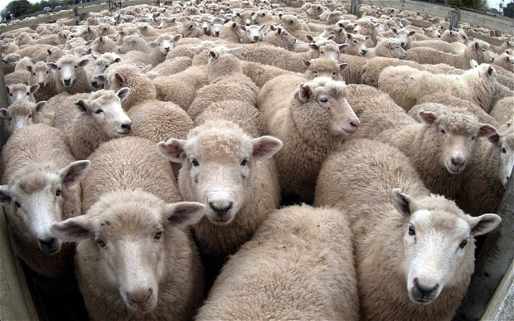
"Dumb, Directionless, Defenseless"
Tim Challies, http://www.challies.com/christian-living/dumb-directionless-defenseless posted 26 Aug 2013, accessed 7 Aug 2016
Notes:
"And here's a second reason sheep need a shepherd: they are directionless. Sheep are prone to wander. Even if you put them in an absolutely perfect environment with everything they need (things like green pastures and still waters), sooner or later they will just wander off. If a shepherd doesn't manage them, if he doesn't micromanage them and keep them under constant surveillance, they'll wander off and be lost.
Left to themselves, sheep will not and cannot last very long."
Dumb, Directionless, Defenseless
Tim Challies, http://www.challies.com/christian-living/dumb-directionless-defenseless posted 26 Aug 2013, accessed 7 Aug 2016

Slide 12
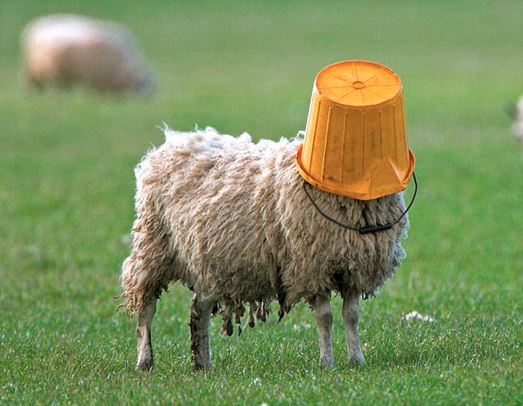
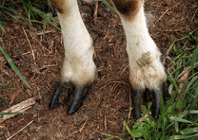
"Dumb, Directionless, Defenseless"
Tim Challies, http://www.challies.com/christian-living/dumb-directionless-defenseless posted 26 Aug 2013, accessed 7 Aug 2016
Notes:
"Sheep are dumb and directionless. They are also defenseless. Left to themselves, sheep will not and cannot last very long. Just about any other domesticated animal can be returned to the wild and will stand a fighting chance of survival. But not sheep. Put a sheep in the wild and you've just given nature a snack.
Think about it: there are different ways animals react when they perceive some kind of danger. Here are three common ones: fight, flight, and posture.
Let's thinking about fight. A sheep gets frightened or sees that he is in danger. Maybe he sees a bear rambling toward him. What is he going to do? He doesn't have claws, he doesn't have fangs, he doesn't have venom, he doesn't have spines or quills or large talons. He's got nothing to protect himself. Fighting is definitely out. But that's okay—there are lots of other animals that don't fight it out."
Dumb, Directionless, Defenseless
Tim Challies, http://www.challies.com/christian-living/dumb-directionless-defenseless posted 26 Aug 2013, accessed 7 Aug 2016

Slide 13
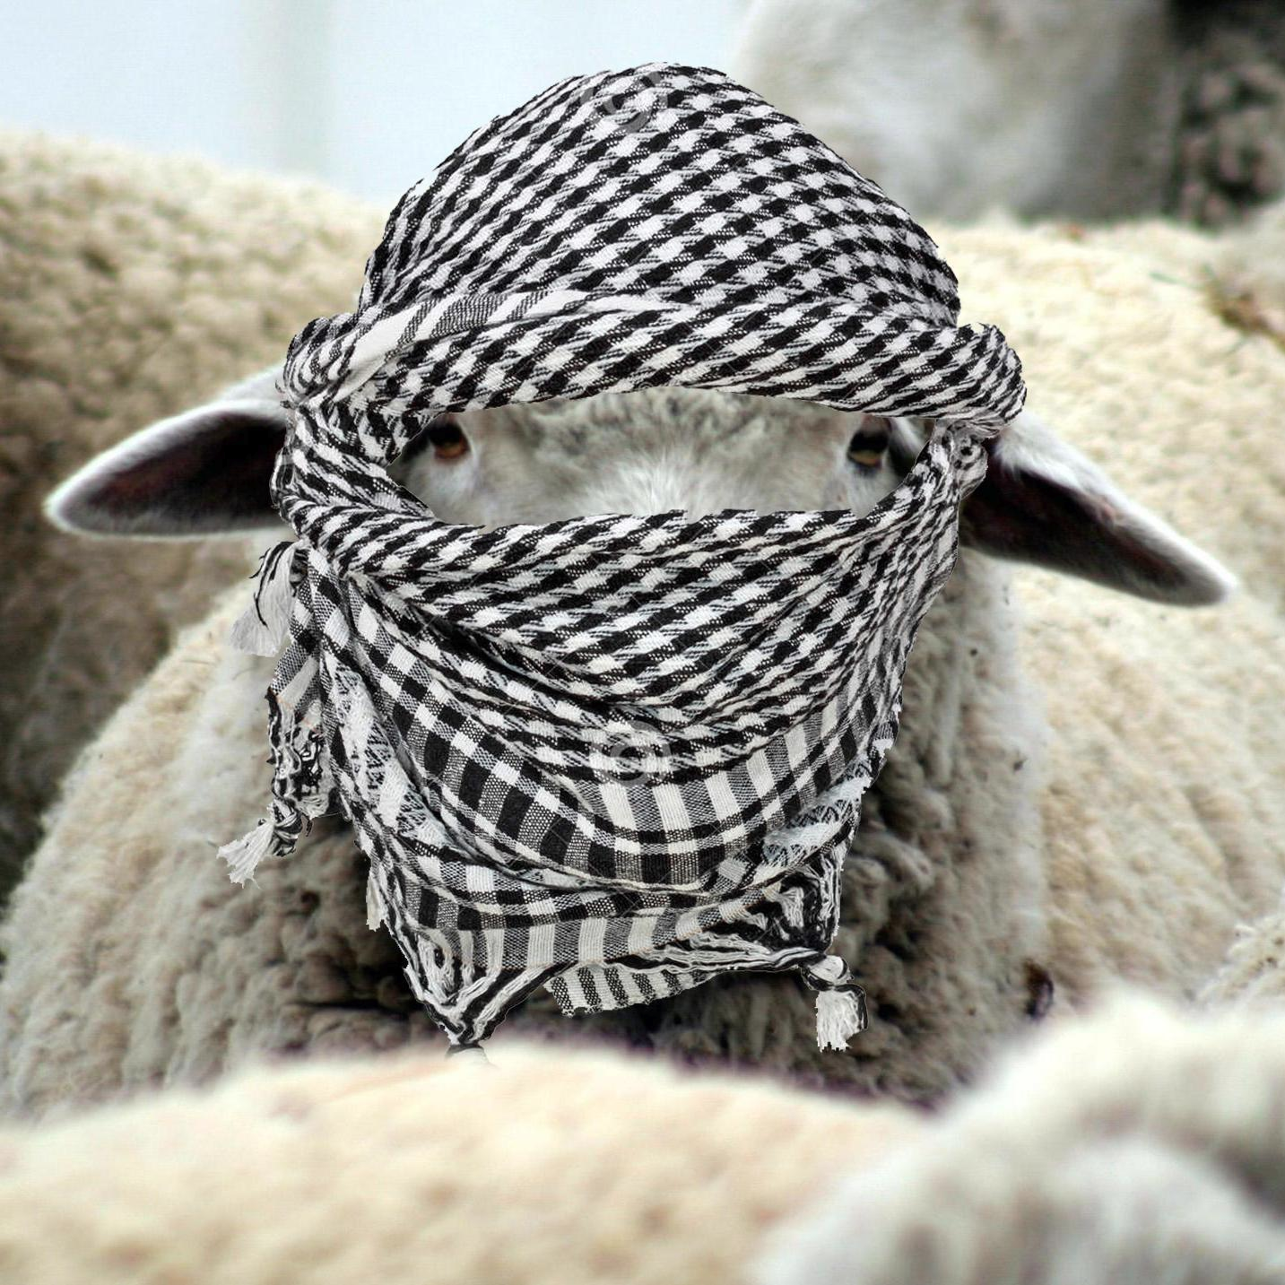
"Dumb, Directionless, Defenseless"
Tim Challies, http://www.challies.com/christian-living/dumb-directionless-defenseless posted 26 Aug 2013, accessed 7 Aug 2016
Notes:
"How about flight, just turning tail and running away? That's a good defense mechanism. Unfortunately sheep aren't fast; they certainly aren't agile, especially when their wool is long, and even more so when their wool is long and wet. Last I checked they don't have wings. A sheep is not going to outrun or outfly a bear. The sheep will not fight and it cannot take flight. So far it is looking pretty good for the bear."
Dumb, Directionless, Defenseless
Tim Challies, http://www.challies.com/christian-living/dumb-directionless-defenseless posted 26 Aug 2013, accessed 7 Aug 2016

Slide 14
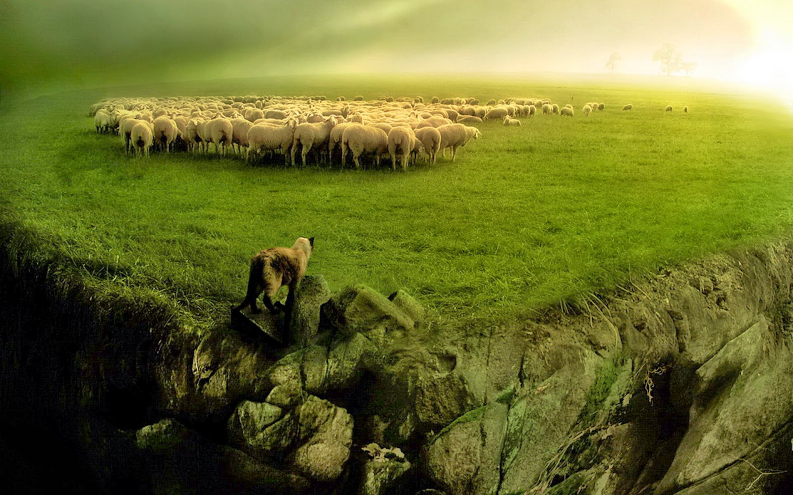
"Dumb, Directionless, Defenseless"
Tim Challies, http://www.challies.com/christian-living/dumb-directionless-defenseless posted 26 Aug 2013, accessed 7 Aug 2016
Notes:
"How about posture? A dog will bark and growl and show his teeth to warn you away. A lion will roar. A rattlesnake will shake his rattle. A cat will arch his back and hiss. The best a sheep can do is baaa. I don't think that bear is going be too intimidated. It is for good reason that no one relies on a guard sheep to keep their property secure.
Sheep can't fight, they can't run away, and they can't scare away. Sheep can't fight, they can't run away, and they can't scare away. So what does a sheep do when danger comes? It flocks. When a bear approaches, the sheep will gather with others in a pack and run in circles in complete panic, just hoping that the bear will choose someone else. Without a shepherd to protect them, they'll be picked off and eaten one by one."
Dumb, Directionless, Defenseless
Tim Challies, http://www.challies.com/christian-living/dumb-directionless-defenseless posted 26 Aug 2013, accessed 7 Aug 2016

Slide 15
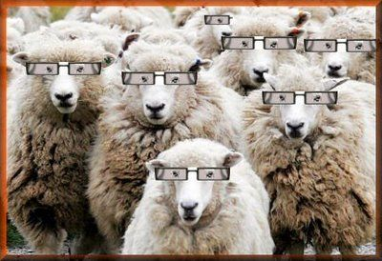
"Dumb, Directionless, Defenseless"
Tim Challies, http://www.challies.com/christian-living/dumb-directionless-defenseless posted 26 Aug 2013, accessed 7 Aug 2016
Notes:
"Sheep are dumb and directionless and defenseless. So I guess when God says that we are sheep who need a shepherd, he doesn't mean it as a compliment to us. It is just a very realistic assessment of who we are and what we need. We are sheep who are completely dependent upon a shepherd.
To say that God is our shepherd and we are sheep, is to humble ourselves, admitting what is true about us, and to elevate God, declaring what is true of him. When you say, 'The Lord is my shepherd,' you are saying something that ought to move your heart in praise and gratitude. To declare that God if your shepherd is to praise and glorify him because God the shepherd stoops down to care for poor, lost, not-so-smart sheep like you and me."
Dumb, Directionless, Defenseless
Tim Challies, http://www.challies.com/christian-living/dumb-directionless-defenseless posted 26 Aug 2013, accessed 7 Aug 2016

Slide 16
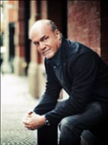
"How Are We Like Sheep?"
"That Jesus compares us to sheep is not a compliment, by the way. Sheep are among the dumbest of all creatures. Most animals, in many cases, will survive if released into the wild. They will learn to fend for themselves and make it. But a sheep released into the wild cannot survive. Sheep have no survival skills whatsoever. They are totally dependent upon the shepherd - just like we are. The sheep come to know that when the shepherd speaks they should follow because his plan for them is better than their plan for themselves."
Greg Laurie, http://www.jesus.org/following-jesus/discipleship/how-are-we-like-sheep.html, accessed 7 Aug 2016

Slide 17
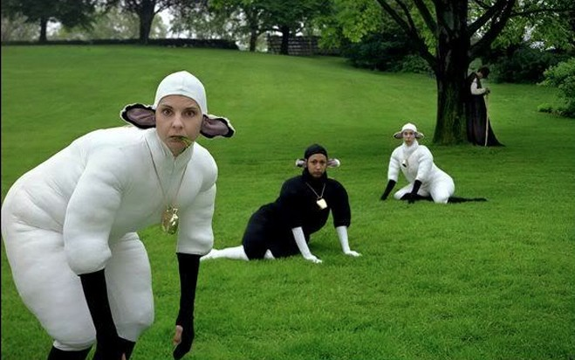
So what do we need?

Slide 18

Two Questions:
Who has the ultimate say in the church?
What is the biblical pattern for church leadership?

Slide 19
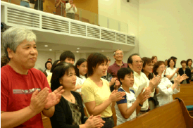
I. Ultimate authority in the local church rests with the congregation
Notes:
The people themselves have the final say in church matters, with no person or organization above it except Christ.

Slide 20
Congregational Authority
In Church Discipline (Matt. 18:17)
  "Take it to the church…"
In Leader Selection (Acts 6:3)
  "Choose… from among you…"
In Maintaining True Doctrine & Practice:
"...examine himself before he eats of the bread and drinks of the cup" (1 Cor. 11:28)
"Friends… test the spirits" (1 John 4:1)
"Contend for the faith" (Jude 3)
Notes:
The final authority in the local church is the people themselves.
• The ultimate authority for church discipline is the church itself—not even its leaders (Matt. 18:15-17). Notice how the final authority is the body of believers.
• Selecting their own leaders is the role of the people in the church rather than these being selected by some outside group (Acts 6:1-6). The apostles appointed only those elected by the congregation. (So if we have a problem with our leaders, we only have ourselves to blame since we selected them! This reminds me of what Dr Paul Meier tells couples in crisis: "Every couple deserves one another." So don't complain about your spouse if you chose him or her! And don't complain about your leaders either.)
• The congregation itself has responsibility to maintain true doctrine and practice. The ordinances are given to the entire church—not just the leaders (1 Cor. 11:23).
Every Christian is to "test the spirits" (1 John 4:1) and contend for the faith (Jude 3). In churches where the congregation has little say, the doctrinal teaching often goes like a see-saw based upon whether the preacher is liberal or evangelical.

Slide 21
Congregation Authority
Ultimate Authority: In accord with generally accepted Baptist church polity, the congregation shall have highest authority in the life of the church. The members shall retain the authority to affirm, by vote, God's call of the pastor-teacher and certain pastoral staff positions, the appointment of elders and deacons and shall approve, by vote, the fiscal budget of the church. The members, subject to these By-Laws, delegate authority to the pastoral staff, elders and other persons of authority to carry out the execution of the approved budget and the daily administration of the church.
CIC By-Laws 3.1.2
Notes:
21
21

Slide 22
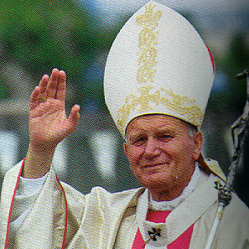
Episcopal Church
Structure
(Simplified)
Bishop
Anglican
Lutheran
Methodist
Orthodox
Catholic
Vicar
Vicar
Vicar
Deacons
Deacons
Deacons
People
People
People
Notes:
The Episcopal form the church government has each church ruled by bishops who are not a part of their church congregation but exercise authority over several churches. This is practiced by Anglicans, Lutherans, Methodists, Orthodox, and Catholics.

Slide 23

Lower Presbyterian Structure
Presbytery
Elders
(Session)
Elders
(Session)
Elders
(Session)
People
People
People
Notes:
Another form of church government is the Presbyterian, where elders who rule the church are called a session. They represent the church to higher bodies outside the local church: a presbytery…

Slide 24
Middle Presbyterian Structure
Synod
Presbytery
Presbytery
Elders
(Session)
Elders
(Session)
Elders
(Session)
Elders
(Session)
Elders
(Session)
Elders
(Session)
People
People
People
People
People
People
Notes:
Then each presbytery makes up a synod…

Slide 25
Highest Presbyterian Structure
General Assembly
Synod
Synod
Presbytery
Presbytery
Presbytery
Presbytery
Elders
(Session)
Elders
(Session)
Elders
(Session)
Elders
(Session)
Elders
(Session)
Elders
(Session)
Elders
(Session)
Elders
(Session)
Elders
(Session)
Elders
(Session)
Elders
(Session)
Elders
(Session)
People
People
People
People
People
People
People
People
People
People
People
People
Notes:
And the various synods comprise the General Assembly.

Slide 26
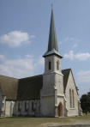
What do we believe at our church?
The Autonomy of the Local Church

Slide 27
Two Questions:
Who has the ultimate say in the church?
What is the biblical pattern for church leadership?
Notes:
So far my comments have related to the ultimate authority in the local church. We've seen that this authority is in the people themselves—not in their elected leadership within the church or in any structure outside the church.
• Now let's shift our focus to the second question: how should a local church be led biblically?

Slide 28
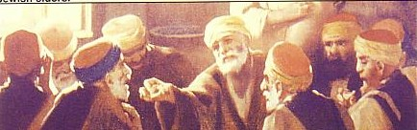
II. The biblical pattern for church leadership is by elders.

Slide 29
Scripture supports a plurality of elders:
plurality
plurality
  Not One Elder…
  But Many…

Slide 30
Elder Roles
    Term - An elder shall serve his office for a term of two (2) years and up to a maximum of three (3) consecutive terms after which he will step down for one (1) term and will be eligible to be elected to hold office as an elder. Where an elder also serves as pastor-teacher of the church, there shall be no limit to his term of office as an elder.
CIC By-Laws 3.2.6
Notes:
30
30

Slide 31
Elder Roles
    Each year, approximately one-third of the elders are to rotate off for the selection of new elders. A pastor-teacher is a voting member of the elders by virtue of his position, although he shall not vote in regard to his remuneration.
CIC By-Laws 3.2.6
Notes:
31
31

Slide 32
Elder Roles
    Number - The optimal number of elders including the pastor-teacher(s) shall be five (5), but the number of non-pastor-teachers shall ideally be at least one (1) more than the number of pastor-teachers on full-time or part-time staff.
CIC By-Laws 3.2.7
Notes:
32
32

Slide 33
Scripture supports a plurality of elders:
plurality
plurality
  Not One Elder…
  But Many…

Slide 34

Not Many of the Same Type

Slide 35

Not Many of the Same Type

Slide 36

Can't Do It All Myself

Slide 37
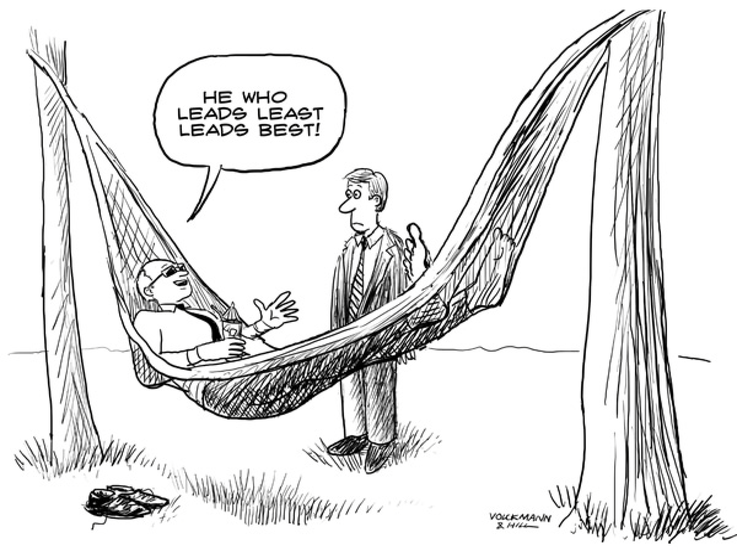
He who leads least leads best!

Slide 38
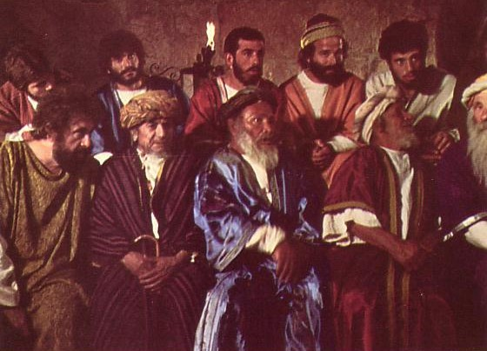
Elders led from the time of Moses
Elders
led with
Moses
1400 BC
"Go, assemble the elders of Israel and say to them…"
(Exod. 3:16)

Slide 39

Who Led the Synagogue?
Elders
led with
Moses
1400 BC
Elders
led
Synagogues
600 BC

Slide 40
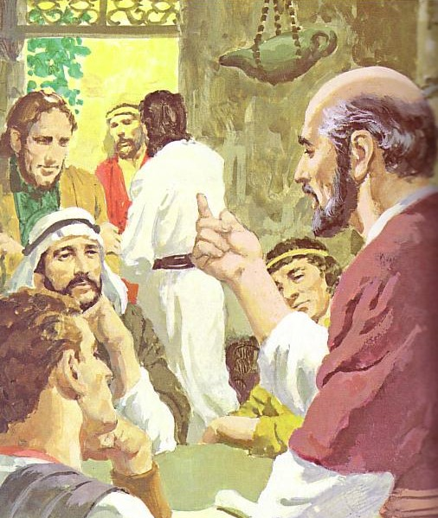
God has advocated group leadership through the ages
Elders
led with
Moses
1400 BC
Elders
led
Synagogues
600 BC
NT
Elders

Slide 41
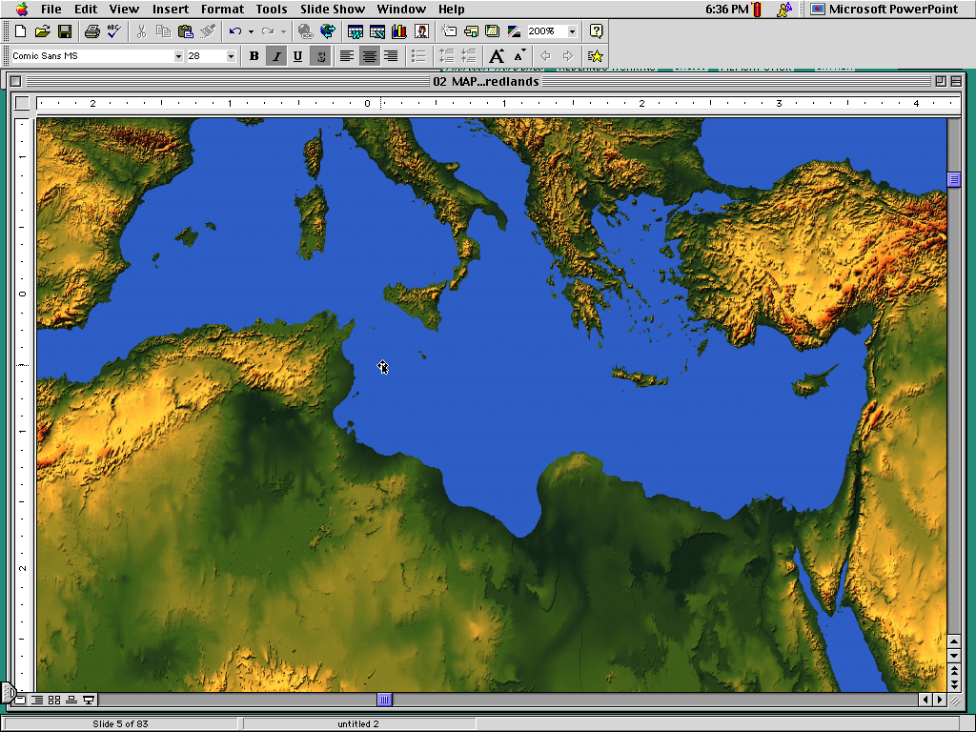
Places Mentioning Elders
elders = overseers = bishops = pastors
Jerusalem (AD 47):
NIV Acts 11:30 This they did, sending their gift to the elders by Barnabas and Saul.
Ephesus (AD 57):
NIV Acts 20:17 From Miletus, Paul sent to Ephesus for the elders of the church.
Galatia (AD 48):
NIV Acts 14:23 Paul and Barnabas appointed elders {or Barnabas ordained elders; or Barnabas had elders elected} for them in each church
Crete (AD 66):
NIV Titus 1:5 The reason I left you in Crete was that you might straighten out what was left unfinished and appoint {or ordain} elders in every town, as I directed you.
Philippi (AD 62):
NIV Philippians 1:1 Paul and Timothy, servants of Christ Jesus, To all the saints in Christ Jesus at Philippi, together with the overseers and deacons:
Pontus, Galatia, Cappadocia, Asia & Bithynia (AD 64)
NIV 1 Peter 5:1 To the elders among you, I appeal as a fellow elder… (cf. 1:1)
Notes:
The New Testament church followed this same pattern of leadership by elders.
Acts 6 At Pentecost only apostles led the Jerusalem church, which was still the case in AD 35 in Acts 6.
• However, Acts 11:30 shows that soon after elders at Jerusalem administrated the relief monies sent to them (AD 47; cf. 16:4).
• Acts 20 Paul met with the elders of the church of Ephesus in Acts 20:17 [A.D. 57].
• In Galatia in AD 48 the pattern was for each church to select its own elders, who were ordained by apostles or other leaders. Acts 14:23 says… [read it]. Notice alternate translations in the NIV footnote include "Barnabas had elders elected."
• This verse, along with Titus 1:5 written to Crete, seems to say apostles or their representatives chose the leaders. But the text only says who appointed or ordained them, not who selected them. They likely had the same practice as Acts 6 where the people picked them and the leaders commissioned them to the task.
• Paul also wrote the church at Philippi in Philippians 1:1, addressing "the overseers and deacons." "Overseers" refers to the same group of "elders." In fact, the NT refers to church elders by three interchangeable titles: "elder[s]" (used 20 times), "overseer[s]" or "bishops" in the KJV (used 6 times), and pastors (used once). While the Philippian church had deacons, they're listed second to the elders, showing that they were subject to them.
• In 1 Peter the Apostle Peter also wrote five provinces in modern-day Turkey and noted that they all had an elder structure: "to the elders among you, I appeal as a fellow elder." These fifteen locations are only those that we know had elders. Since no other form of early church leadership is stated in the NT, it is safe to say that Greece, Rome, and other places also had group leadership. Sometimes the Jewish term "elders" is used whereas other times they're called the Gentile term "overseers."

Slide 42

What type of leaders does this church need?

Slide 43
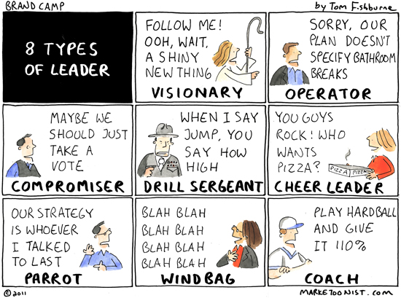
8 Types of Leaders

Slide 44

What type of leader does this church need?
Teacher
CEO
Visionary

Slide 45
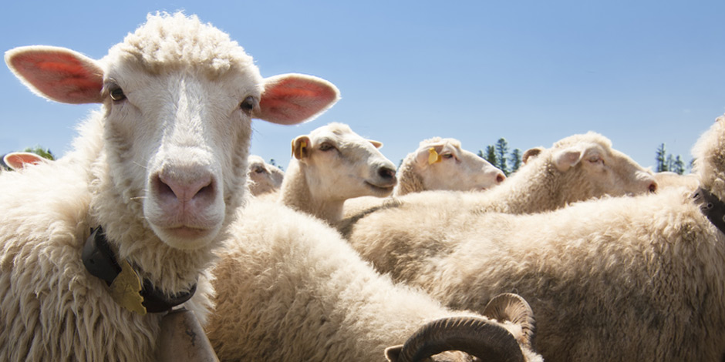
Since we are sheep…

Slide 46
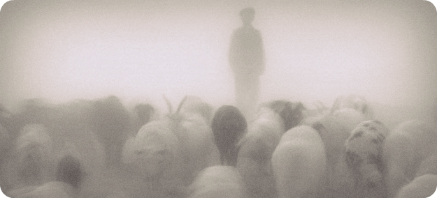
…we need shepherds.

Slide 47
Elder Roles
General - The elders are a group of biblically qualified men who are charged with leading the church under the leadership of Christ Jesus. God develops and selects men to be elders; the church recognizes God's calling through the confirmation/affirmation process described below. The pastor-teacher(s) shall be part of the council of elders upon his call by the church, and shall serve in the role of teaching elder(s) but shall not hold the position of chairman, vice-chairman or secretary of the elders.
CIC By-Laws 3.2.1
Notes:
47
47

Slide 48
Elder Roles
    Responsibilities - The elders are responsible for the general oversight of all matters pertaining to the ministry of the Word and prayer at the church (Acts 6:2, 4; 1 Tim. 5:17), which means they protect against doctrinal error (Acts 15:6; 20:17, 27-31; Titus 1:5, 6a, 9), lead the church (1 Pet. 5:2-3), pray for the sick (James 5:14), preach and teach (1 Tim. 5:17), appoint leaders (1 Tim. 4:14), accept and distribute money (Acts 11:29-30), officially welcome visitors (Acts 15:4), supervise themselves and all the church members (Acts 20:28), and maintain church discipline (1 Thess. 5:12).
CIC By-Laws 3.2.3
Notes:
48
48

Slide 49
Elder Roles
    Responsibilities (continued):
    As part of their general oversight, the elders establish the policies of the church. The elders shall report to the congregation on the affairs and status of the church and its ministries on a quarterly basis, usually March, June, September and December.
CIC By-Laws 3.2.3
Notes:
49
49

Slide 50
Pastoral Leadership of an Elder:
59
Elders teach:
"Shepherd the flock" (Acts 20:28)
"Able to teach" (1 Tim. 3:2)
Scriptural foundation (Tit. 1:9a)
Instruct (1 Thess. 5:12)
Teach God's plan (Acts 20:20, 27)
Get paid for teaching (1 Tim. 5:17)
Highest office teach (Acts 6:1-7)
Jerusalem had apostles & elders

Slide 51
Three Major Tasks of Elders
Administration
Teaching
1 Tim. 3:1, 4-5; 5:17
1 Tim. 3:2; 5:17
Pastor-Teacher
Episkopos =
Epi "over" +
skopos "look" =
"watch over"
Eph. 4:11
Pastoring
1 Pet. 5:1-4
Acts 20:29, 35
1 Thess. 5:12

Slide 52

Three Types of Elders
61
"The elders who direct the affairs of the church well are worthy of double honor, especially those whose work is preaching and teaching"
(1 Tim. 5:17 NIV).
ALL ELDERS
Teach, protect, lead, serve, testify
Unpaid or $
if Needed
PAID MANAGERS
$
PREACHERS
&
TEACHERS
$$

Slide 53
How Elders Relate to Deacons
60
Model 1: Senior Pastor over Deacons
Senior Pastor
Deacons
Unbiblical

Slide 54
How Elders Relate to Deacons
60
Model 2: Senior Pastor alongside Deacons
Senior Pastor
Deacons
Unbiblical

Slide 55
How Elders Relate to Deacons
60
Model 3: Deacons lead elders/pastors
Deacons
Unbiblical
Pastors

Slide 56
How Elders Relate to Deacons
60
Model 4: Elder Board leads Deacon Board
Elders
Deacons

Slide 57
How Elders Relate to Deacons
60
Apostles over "The Seven"
Apostles
"The Seven"
Acts 21:8
DDDDDDD
DDDD
DDDDD

Slide 58
How Elders Relate to Deacons
60
Model 5: Elders with Deacon Committees
Elders
DDDDDDD
DDDD
DDDDD

Slide 59

OK, lah… But…

Slide 60

Leadership by elders and congregational authority are not contradictory

Slide 61
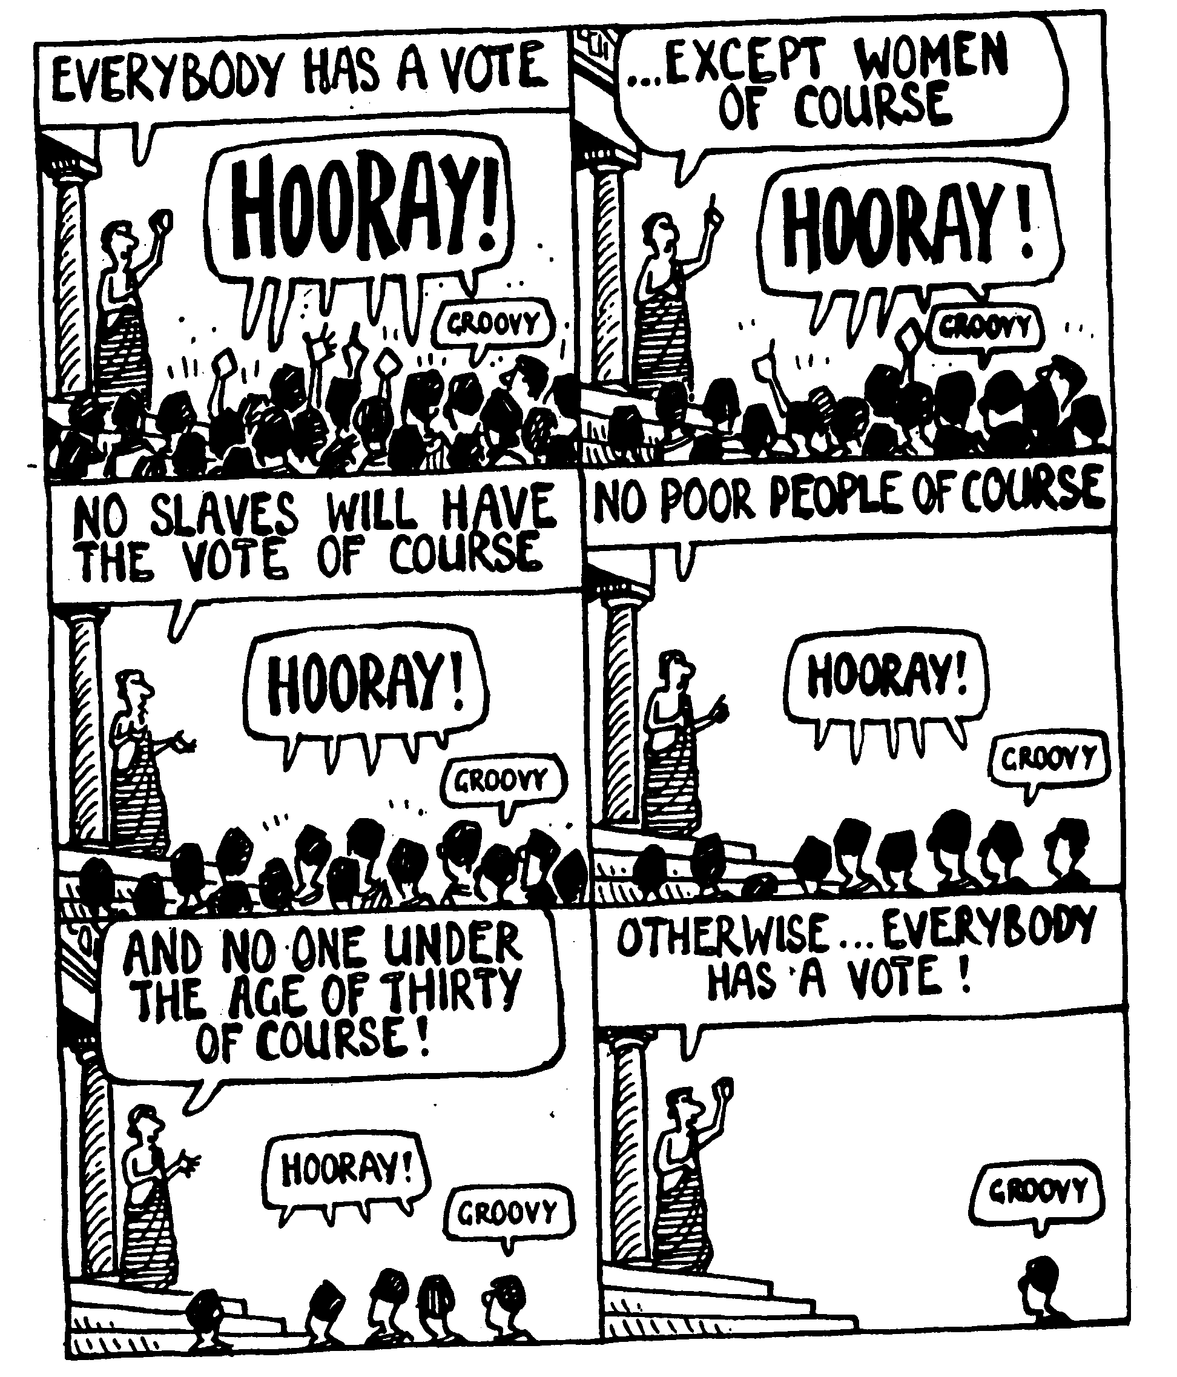
Balancing leadership with congregational involvement

Slide 62
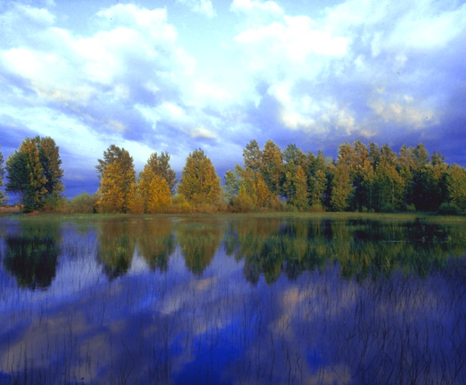
—Main Idea—
Local church authority rests with the people but elders should lead them

Slide 63
Summary on Elders
INTRODUCTION
Therefore, the New Testament presents an elder whose functions are to teach, pastor and administer.
BODY

Slide 64
Elder-Congregation dynamics:
INTRODUCTION
E l d e r s
C o n g r e g a t i o n
L
O
V
E
Regard
themselves as
servants
BODY
Regard
them as
leaders
Notes:
Having seen the structure, it is vital that the dynamics be understood.

Slide 65
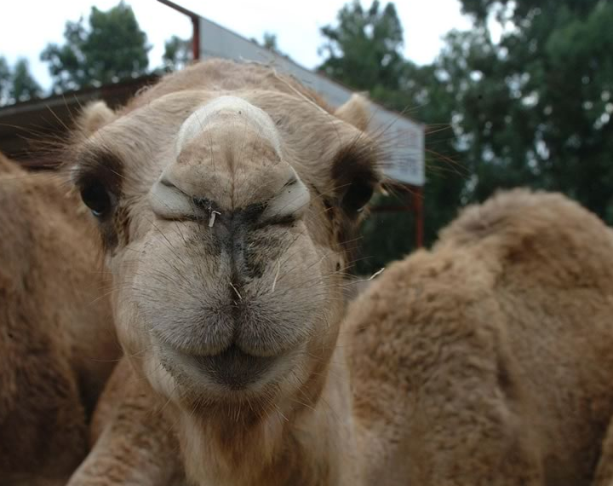
So What?
So what?

Slide 66
Action Points:
Congregational Authority means…
  This is my church…
  So what is your unique role here?
Notes:
Relating to congregational authority, my prayer has been that we all will better see from today's texts that this is our church—not any leader's church, not any other authority. Actually, it's Christ's church. But He's delegated authority and responsibilities to each member.
You have an important part to play at this church! Do you know what your unique contribution is?

Slide 67
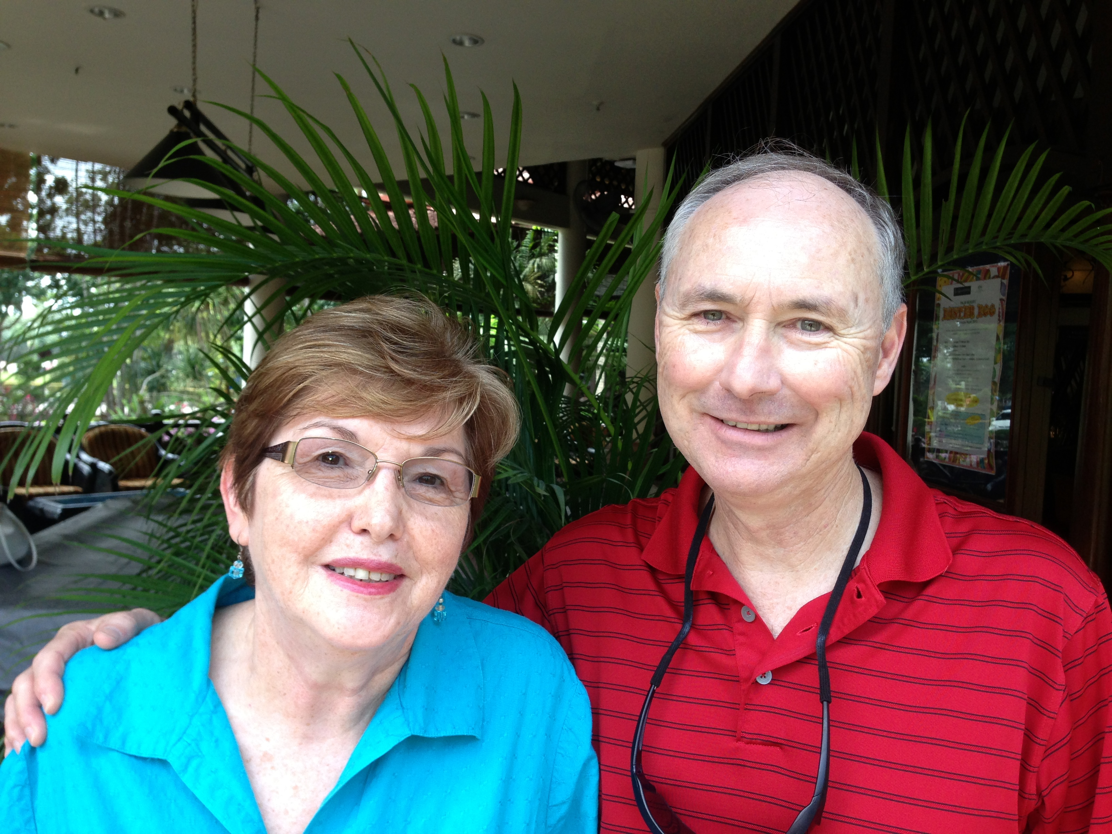
Leland Calhoun Began as Elder
Original Two-Year Term: 1 Dec 13—30 Nov 15
Notes:
67
67

Slide 68
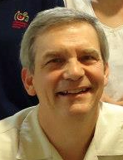
Terms of Elders/Directors
Rick Griffith
Leland Calhoun
24 May 07-
new pastor
1 Dec 13-
30 Nov 15
1 Dec 15-
30 Nov 17
Notes:
68
68

Slide 69
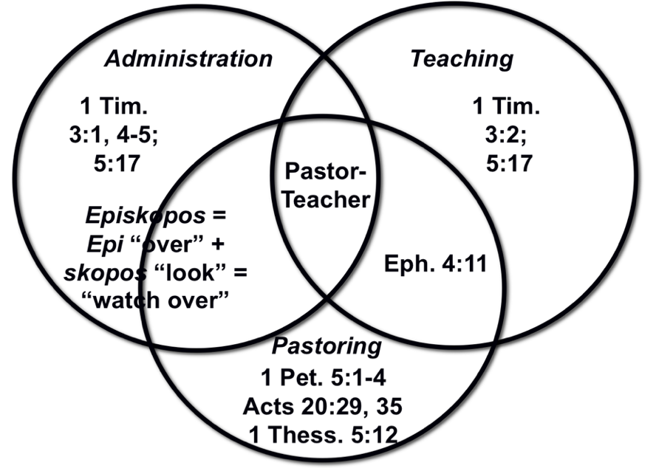
Elder Selection Process
Nominations
Aug 14-28
Interviews
Aug 29-Sep 17
Confirmations
Sep 18-Oct 2
Appointment
Oct 9
CIC By-Laws 3.2.8
Notes:
69
69

Slide 70
Elder Selection
Selection - Selection of elders shall take place at the annual meeting or at such other Tims as the serving elders determine that a new elder is needed to replace an elder who has relinquished his position. An elder who is appointed to replace another elder who has served part of his term shall serve for the remainder of that term and this term shall not count towards the three-term limit imposed under section 3.2.6 above. The selection process shall be as follows:
CIC By-Laws 3.2.8
Notes:
70
70

Slide 71
Elder Confirmation Process
Notice of the beginning of the selection process shall be given to the members approximately eight (8) weeks prior to the annual meeting. At this time of notice, members shall submit a completed Elder Nomination Form to any of the elders in writing within two weeks. The Elder Confirmation Forms shall be made available at the Sunday Worship Service and at the church office and must be completed and returned during this two-week period.
Nominations
Aug 14-28
CIC By-Laws 3.2.8.1
Notes:
71
71

Slide 72
Elder Confirmation Process
The elders shall interview the prospective elder(s) and spouse(s) to determine if the prospective elder(s) meets the qualifications. Upon consensus among the elders that the candidate meet(s) the qualifications for eldership, the elders will contact the candidate(s) again for a specific discussion with him to determine each man's assessment of God's will for him in this matter.
Nominations
Aug 14-28
Interviews
Aug 29-Sep 17
CIC By-Laws 3.2.8.2
Notes:
72
72

Slide 73
Elder Confirmation Process
The elders shall then present to the members the name(s) of those men whom the elders agree possess the biblical qualifications for eldership and who have agreed to serve as elders if subsequently confirmed by the members.
Nominations
Aug 14-28
Interviews
Aug 29-Sep 17
Confirmations
Sep 18-Oct 2
CIC By-Laws 3.2.8.3
Notes:
73
73

Slide 74
Elder Confirmation Process
Members shall have at least two (2) weeks to prayerfully consider the prospective elder(s) and if any of the members have any reservations about a man's qualifications for eldership, they should discuss those reservations with the individual and if not satisfactorily resolved, bring the matter(s) to the attention of the elders.
Nominations
Aug 14-28
Interviews
Aug 29-Sep 17
Confirmations
Sep 18-Oct 2
CIC By-Laws 3.2.8.4
Notes:
74
74

Slide 75
Elder Confirmation Process
At the annual meeting, the elder positions available shall be filled by the candidates with the highest votes subject to each candidate receiving at least a majority vote from the members. Should all of the prospective candidates be excluded through this process, the selection process shall start anew, if deemed necessary by the elders.
Nominations
Aug 14-28
Interviews
Aug 29-Sep 17
Confirmations
Sep 18-Oct 2
CIC By-Laws 3.2.8.5
Notes:
75
75

Slide 76
Elder Confirmation Process
Upon confirmation of acceptance by the elders and the members via the above procedure, the new elder(s) will be confirmed and commissioned for service before the Lord by the laying on of hands of the elders before the congregation.
Nominations
Aug 14-28
Interviews
Aug 29-Sep 17
Confirmations
Sep 18-Oct 2
Appointment
Oct 9
CIC By-Laws 3.2.8.6
Notes:
76
76

Slide 77
Elder Qualifications
Qualifications - A nominee for elder shall have been a member of the church for at least six months in active service prior to the date of his nomination. The biblical qualifications for this position are set forth in 1 Timothy 3:1-7; Titus 1:6-9; and 1 Peter 5:2-3. That elders must be men is evident in the qualification to be a "husband of one wife" who "manages his house" (1 Tim. 3:2, 4; Tit. 1:6).
CIC By-Laws 3.2.2
Notes:
77
77

Slide 78
Action Points:
Congregational Authority means…
  This is my church…
  So what is your unique role here?
Elder Leadership means…
  My greatest need is for a shepherd—not an organizer
  So who should shepherd you at this church?

Slide 80


NT Preaching link at BibleStudyDownloads.org
Get this presentation and script for free!
Notes:
NT Preaching (np)

