Slide 1
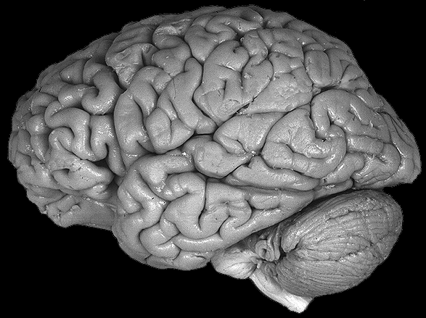
Using Your Gray Matter on Gray Matters
1 Corinthians 8
Dr. Rick Griffith • Crossroads International Church Singapore
cicfamily.com & BibleStudyDownloads.org

Slide 2
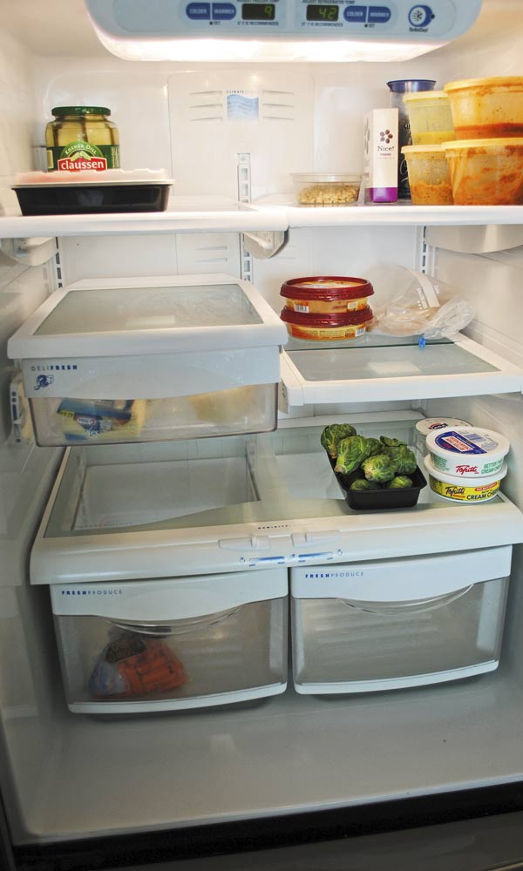
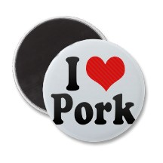
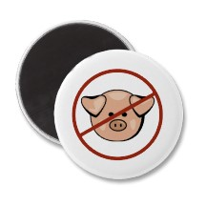
The Pork Debate…

Slide 3
Using Your Gray Matter on Gray Matters
1 Corinthians 8

Slide 4
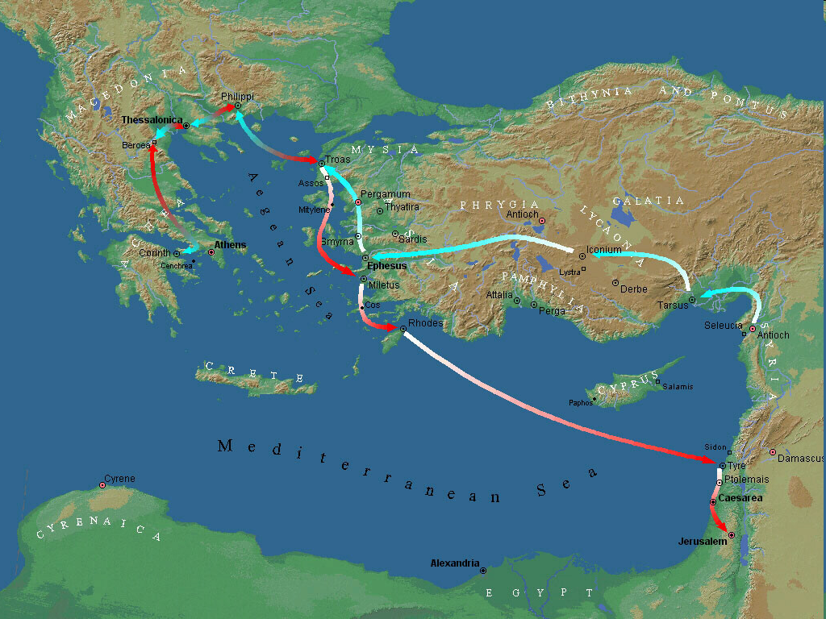
Third Missionary Journey Map
Corinth
Third Missionary Journey
A.D. 53-57

Slide 5
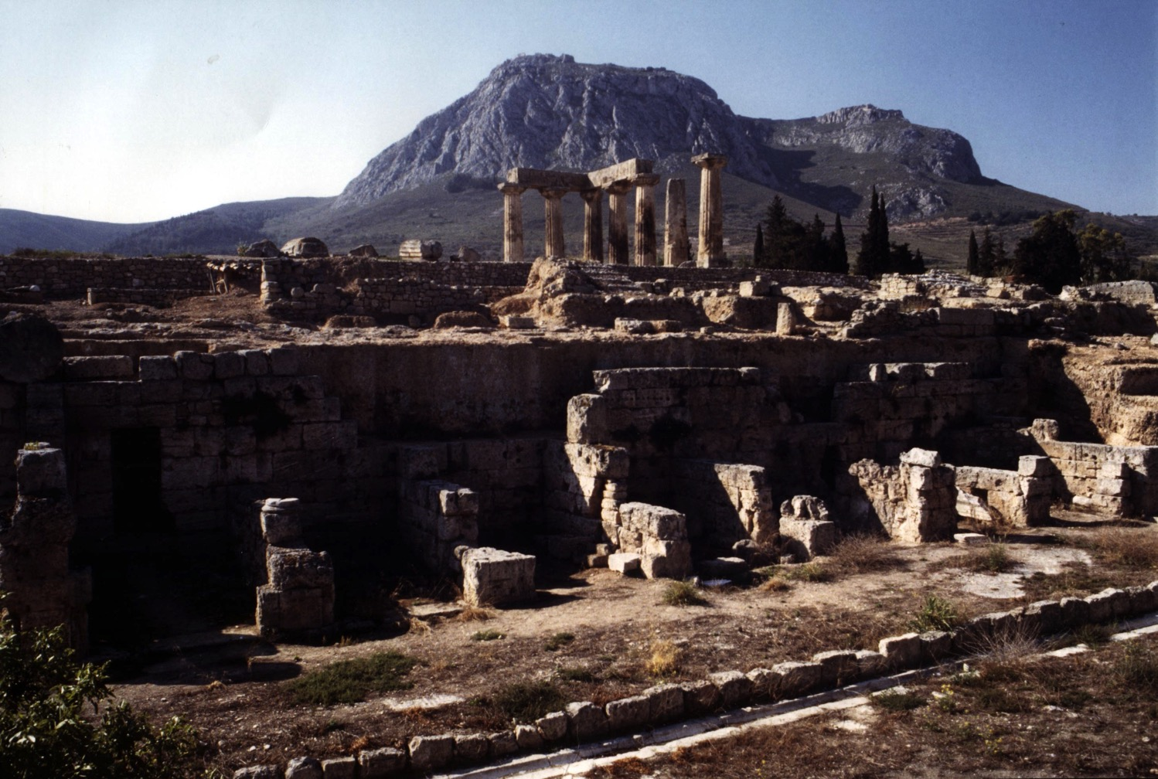
Where Convictions Come From…
Scripture
View of Acrocorinth from the City

Slide 6
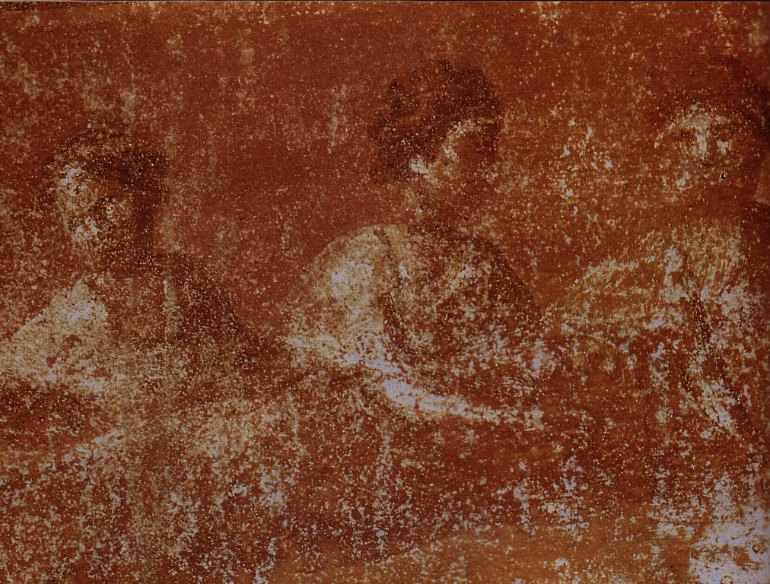
Things wrong at Corinth
Divisions (1-4)
1 Corinthians
Immorality (5-6)
Discontentment (7)

Slide 7
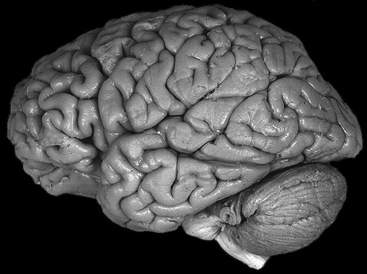
Where Convictions Come From…
Scripture
Conscience
View of Acrocorinth from the City

Slide 8
Black & White
Practices the Bible says are always wrong
Practices the Bible says are always right
Idolatry
Adultery
Murder
Coveting
Contentment
Obedience
Prayer
Purity

Slide 9
Gray Areas
155aa
Practices not forbidden in the Bible over which Christians disagree

Slide 10
Gray Area Examples
155aa
Accepting gifts with the left hand
Being a Democrat (or Republican!)
Buying a Mac (or Windows) computer
Celebrating Christmas or Easter
Celebrating Good Friday
Celebrating Lent
Celebrating Palm Sunday
Changing to a “Christian” name
Chinese New Year giving of hong baos

Slide 11
Gray Area Examples
155aa
Christmas trees in the church sanctuary Clapping in church services
Dancing
Drinking beer
Drinking hard liquor
Drinking wine
Driving a motorcycle
Eating bloody foods
Eating food sacrificed to idols

Slide 12
Gray Area Examples
155aa
Eating junk food
Eating meat
Eating only “Christian food”
Giving only “Christian” greetings (New Year)
Giving to non-religious causes
Having an abortionist gynecologist
Killing in war
Laughing with men and women together
Listening to rock music

Slide 13
But should we follow someone else's conscience?
FOLLOW YOUR CONSCIENCE

Slide 14
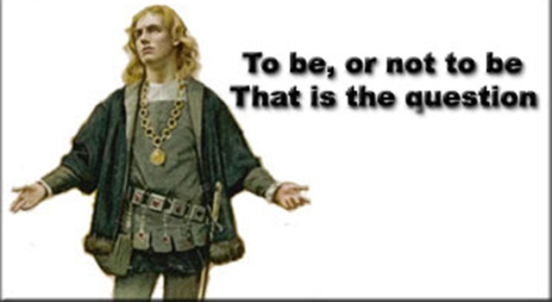
To do, or not to do?

Slide 15
Overview of the Chapters
1–4 Divisions
5–6 Disorders
7–16 Doctrinal Difficulties

Slide 16
The Wayward Local Church
The Wayward Local Church
Reports
Questions
Divisions
Disorders
Difficulties
Concern
1–4
Discipline
5–6
Instruction
7–16
Carnality
3–4
Marriage 7
Worship
11–14
Factions 1–2
Incest 5
Idols 8–10
Resurrection
15
Immorality
Collection 16
Lawsuits 6
Solving church problems theologically

Slide 17
Why should we give up our rights in gray matters?
give up our rights
3 REASONS

Slide 18

I. Meekness shows love more than knowledge (1-3).

Slide 19

Now regarding your question about food that has been offered to idols. Yes, we know that “we all have knowledge” about this issue. But while knowledge makes us feel important, it is love that strengthens the church (8:1 NLT).

Slide 20
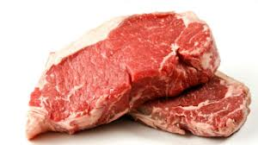
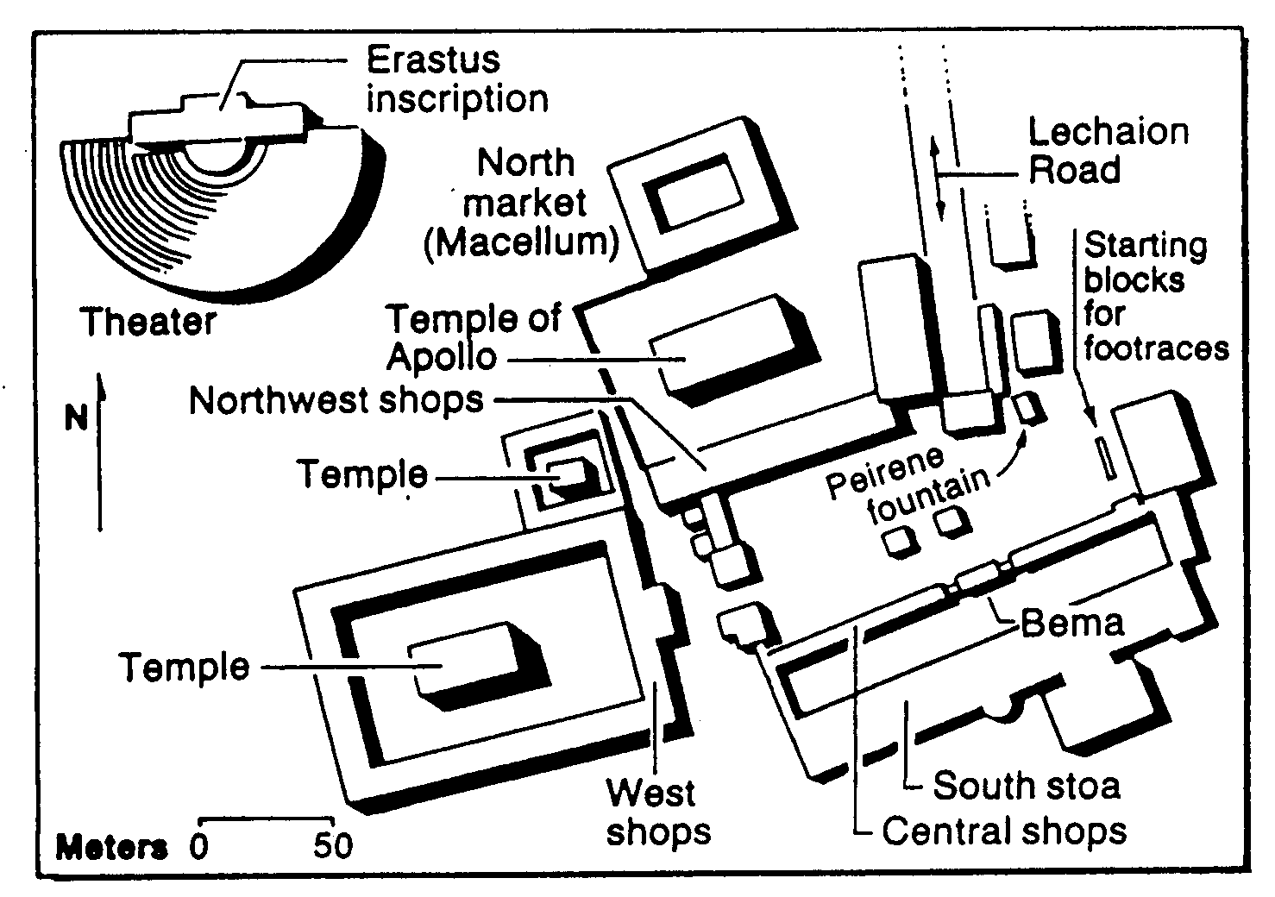
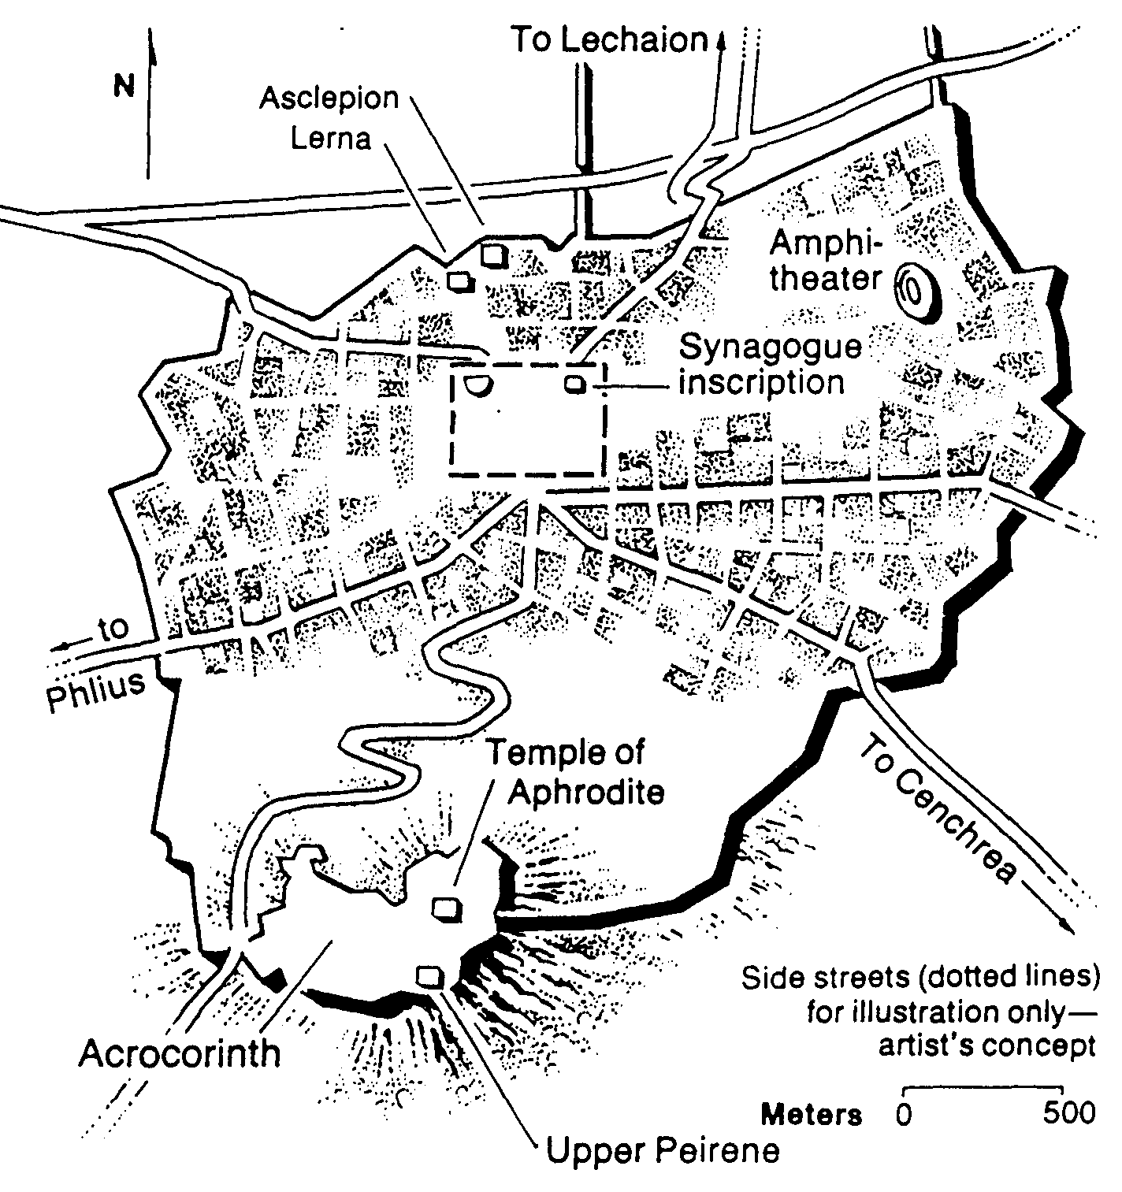
Meat & the Marketplace
161
$5
$2
Bible Visual Resource Book, 235

Slide 21
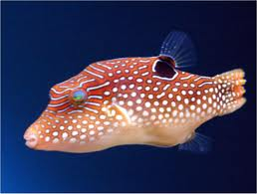
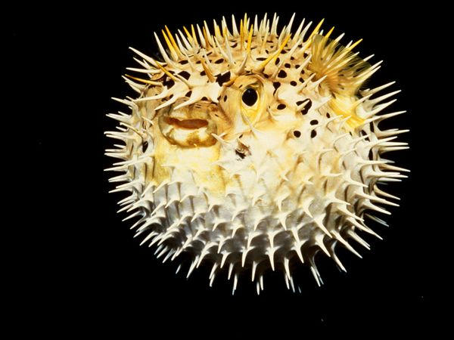
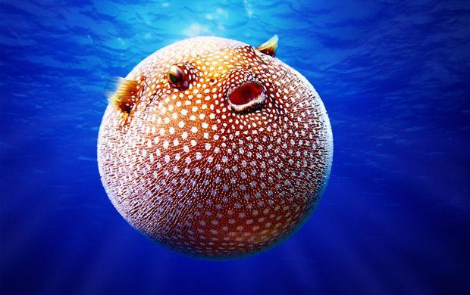
The Pufferfish
"knowledge puffs up, but love builds up"
(8:1 NIV)
" Anyone who claims to know all the answers doesn’t really know very much"
(8:2 NLT)

Slide 22


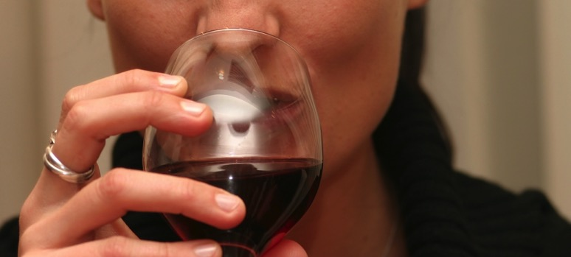
Love
Music
Drinking

Slide 23
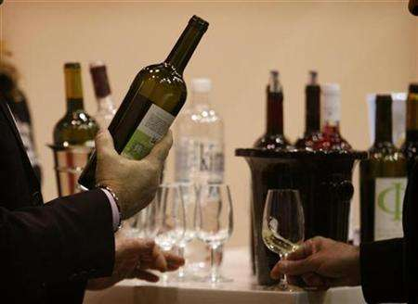
Black

Slide 24
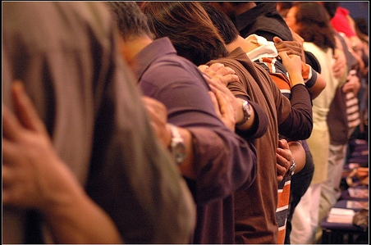
II. Meekness protects the conscience of weak believers (4-8).

Slide 25
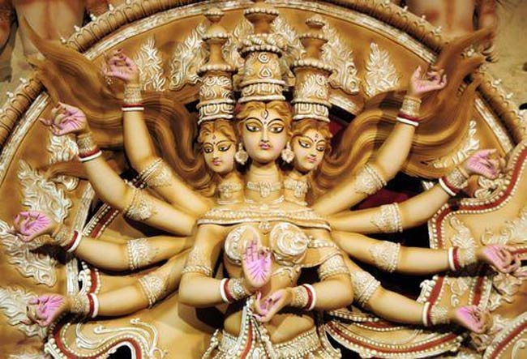
"We all know that an idol is not really a god and that there is only one God" (8:4 NLT)

Slide 26
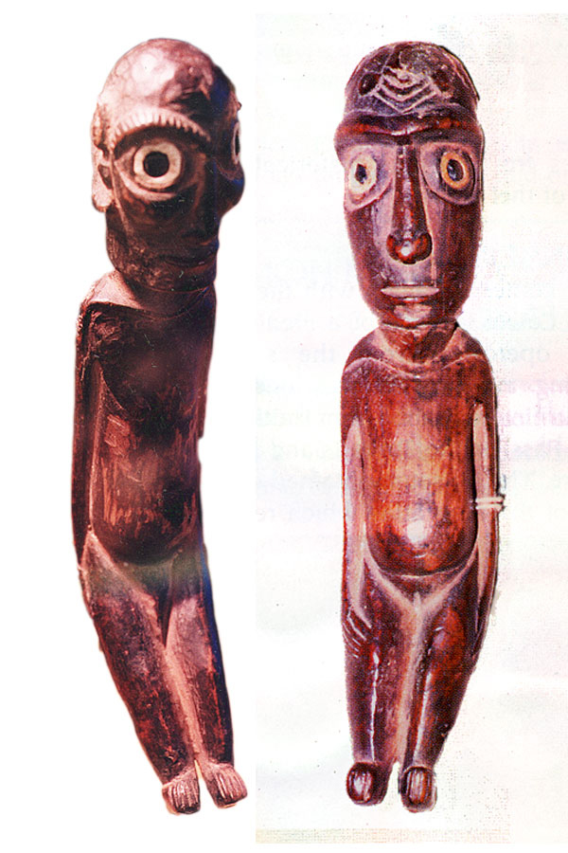
"There may be so-called gods both in heaven and on earth, and some people actually worship many gods and many lords"
(8:5 NLT)

Slide 27
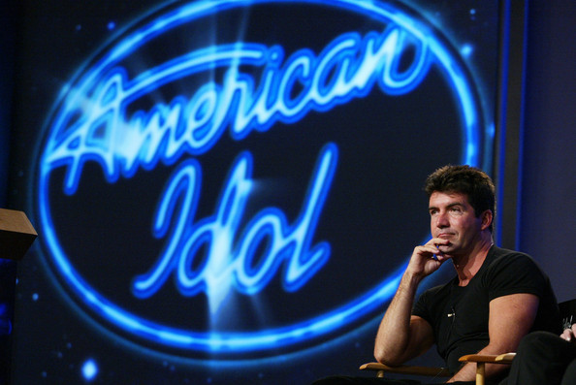
American Idol

Slide 28
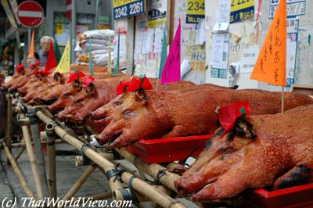
Thai idol food

Slide 29
Black

Slide 30
Why should we give up our rights in gray matters?

Slide 31
I. Meekness shows love more than knowledge (1-3).

Slide 32
II. Meekness protects the conscience of weak believers (4-8).

Slide 33
III. Meekness keeps you from ruining the faith of a weaker brother (9-13).

Slide 34
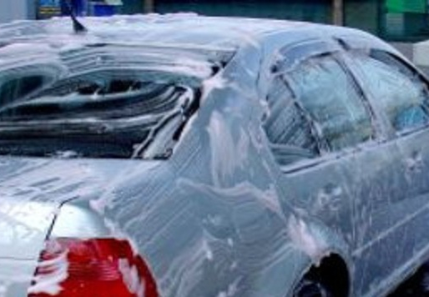
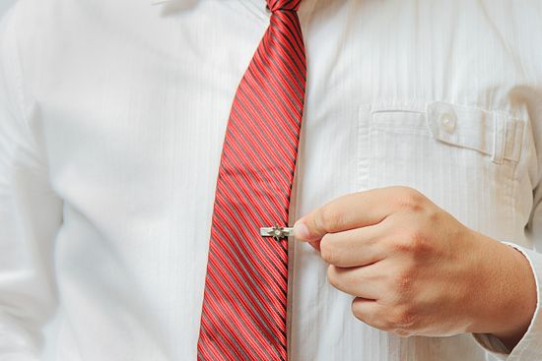
Don't exercise your freedom if it hurts a weaker believer (9).

Slide 35
Bad things happen if you insist on your rights in gray matters (10-12).
You encourage your weaker brother to sin (10)
He could even give up his faith (11)
You sin (12)

Slide 36
Touching Scale
Him
Her
Sex
Sex
Petting
Petting
Kiss the Lips
Kiss the Lips
Kiss the Cheek
Kiss the Cheek
Hug
Hug
Kiss the Hand
Kiss the Hand
Holding Hands
Holding Hands
Handshake
Handshake

Slide 37
Why should we give up our rights in gray matters?

Slide 38

The Big Idea:
Meekness shows love to protect the conscience and faith of weaker believers

Slide 39
Use your brain

Slide 40
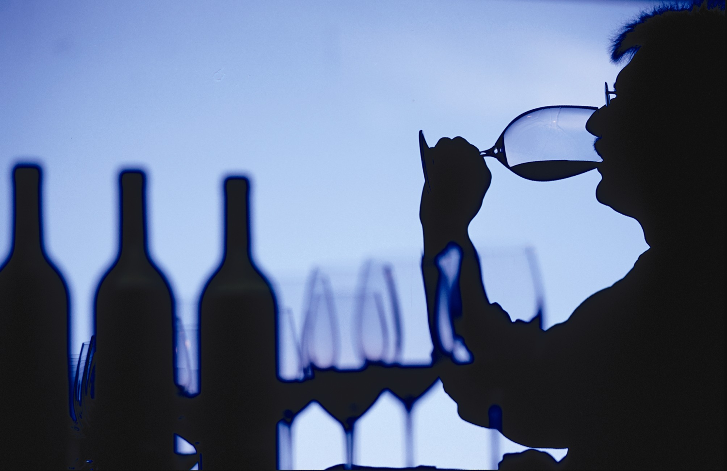
Use your heart

Slide 41
The Pork Debate…

Slide 42
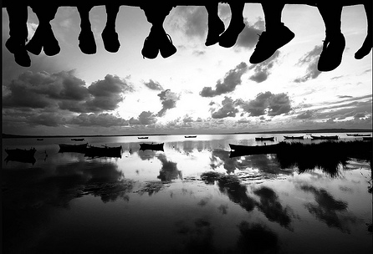
Which gray matter is God asking you to give over to Him?

Slide 43
Black

Slide 44
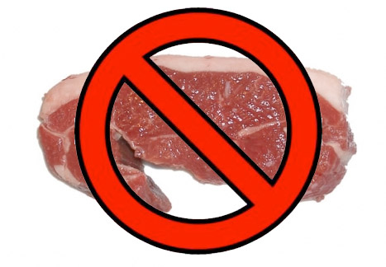
Paul's "Line"
So if what I eat causes another believer to sin, I will never eat meat again as long as I live—for I don’t want to cause another believer to stumble (8:13 NLT).

Slide 45
Black

Slide 46


NT Preaching link at BibleStudyDownloads.org
Get this presentation and script for free!
Notes:
NT Preaching (np)

