Slide 1
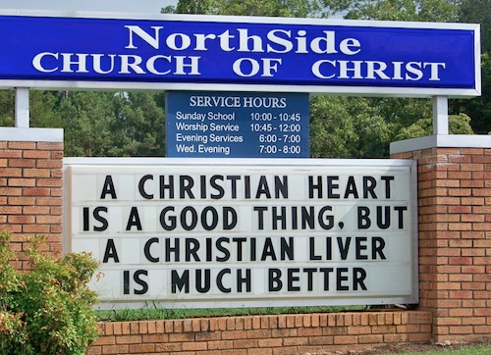
Unchristian Christians
1 Corinthians 5
Dr. Rick Griffith • Crossroads International Church Singapore
cicfamily.com & BibleStudyDownloads.org

Slide 2
Black
Notes:
2

Slide 3

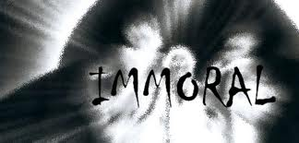
Acceptable?
Notes:
3

Slide 4
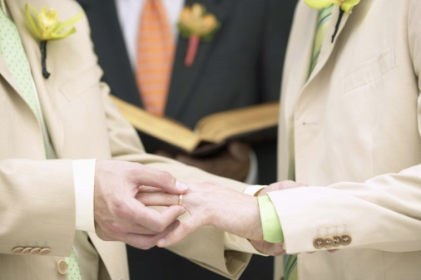
Acceptable?
Notes:
4

Slide 5
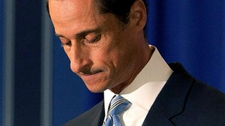
Acceptable?
Notes:
5

Slide 6

Holiness
Notes:
6

Slide 7
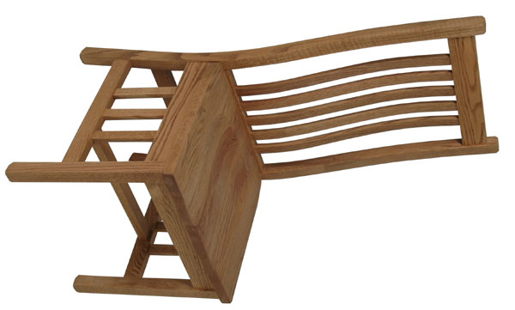
Who sits in your chair?

Slide 8
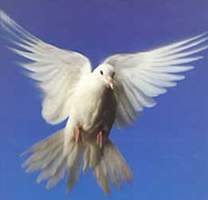
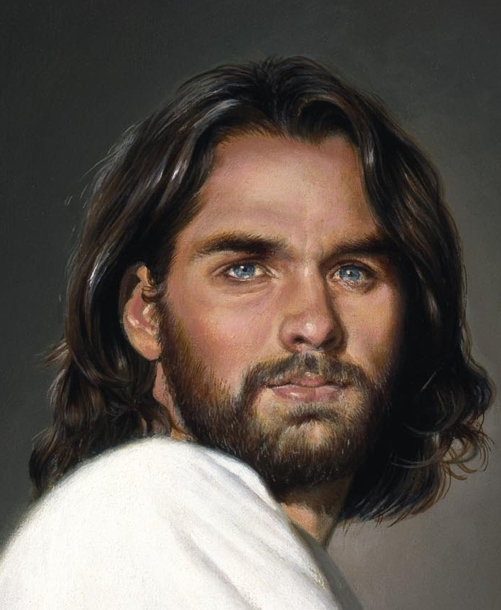
Types of People
Carnal
Christian
(3:1)
Self
Self
Self
Non-Christian (2:14)
Christian (2:15)

Slide 9
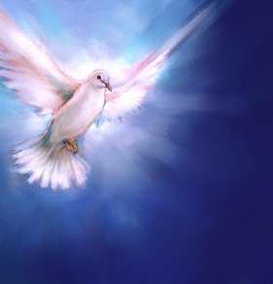
How do we maintain purity in the church?

Slide 10
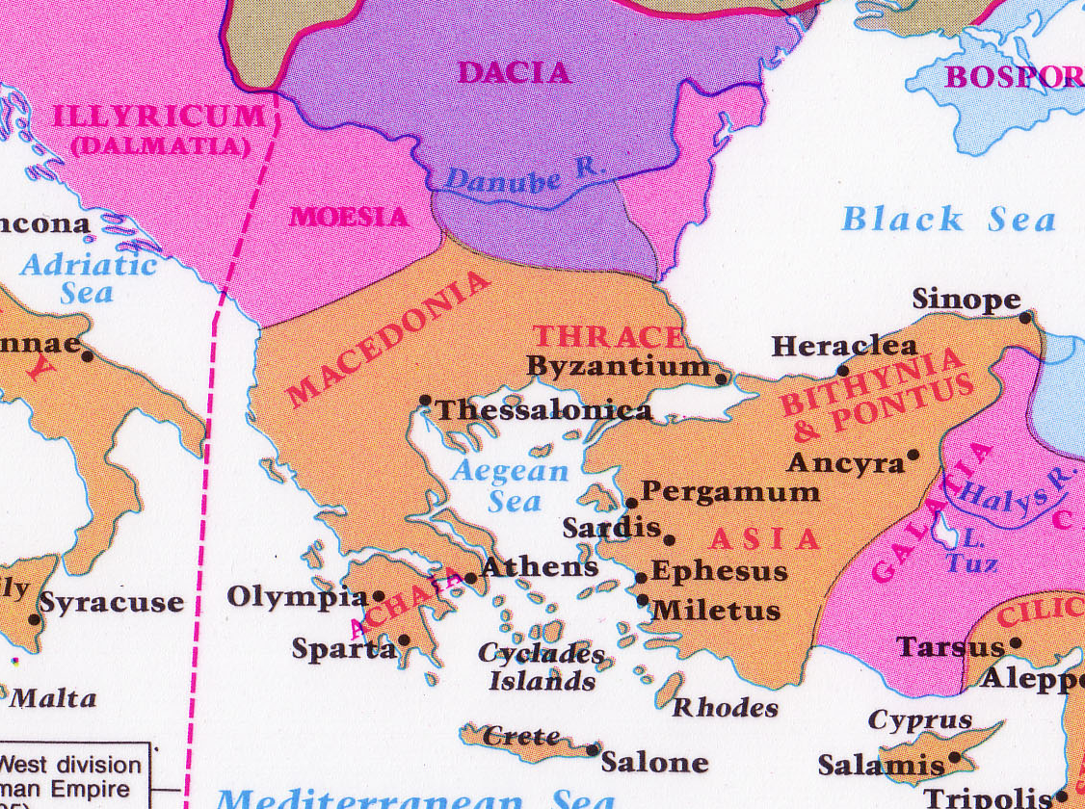
Corinth: Crossroads of Immorality
142
Corinth

Slide 11



Isthmus of Corinth
161a
7 km
Corinth
Acrocorinth
Temple of Aphrodite

Slide 12
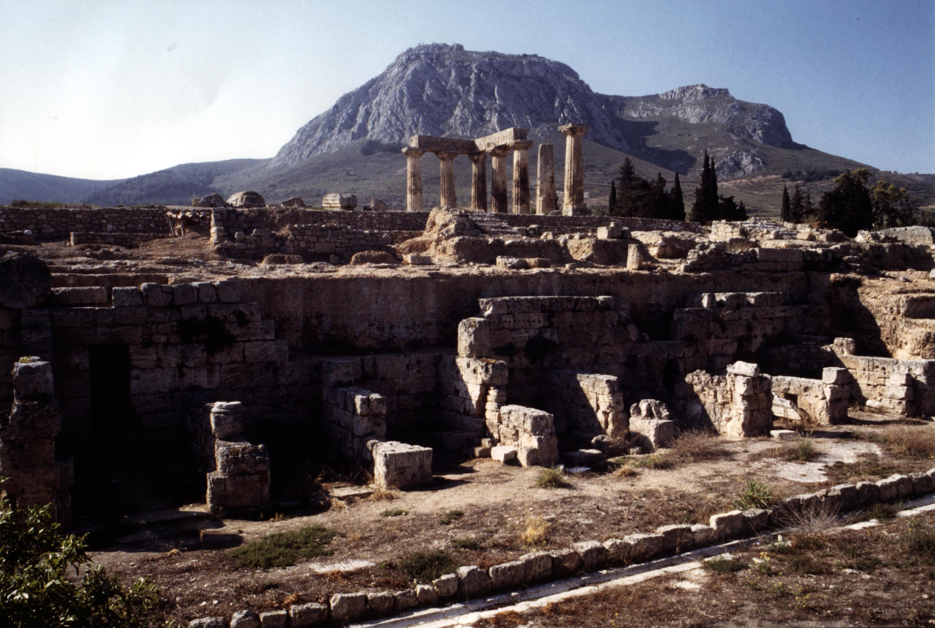
View of Acrocorinth from the City

Slide 13
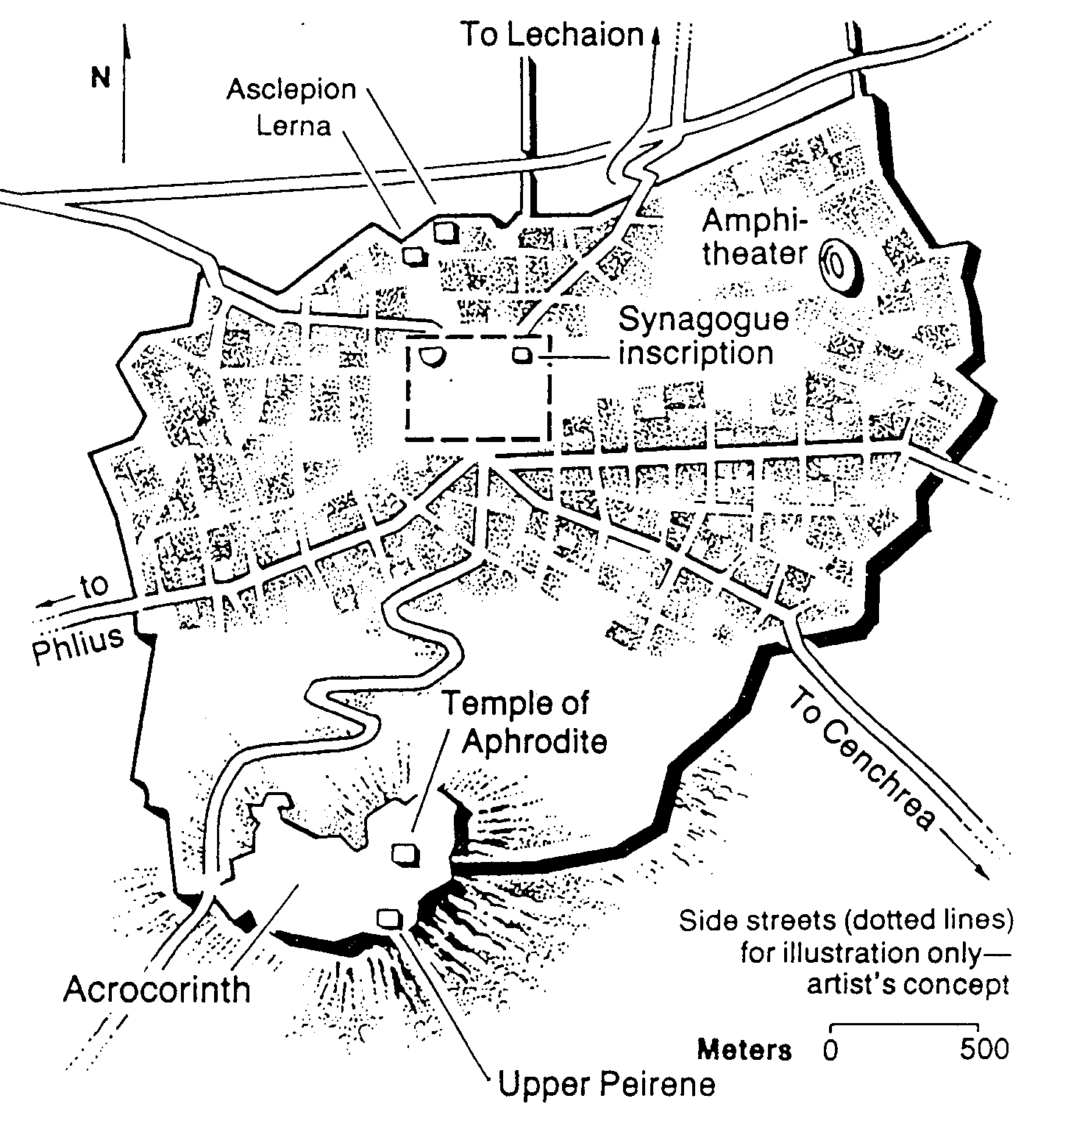
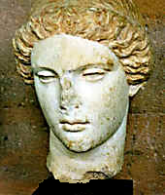
Temple of Aphrodite
Greek Goddess of Love

Slide 14
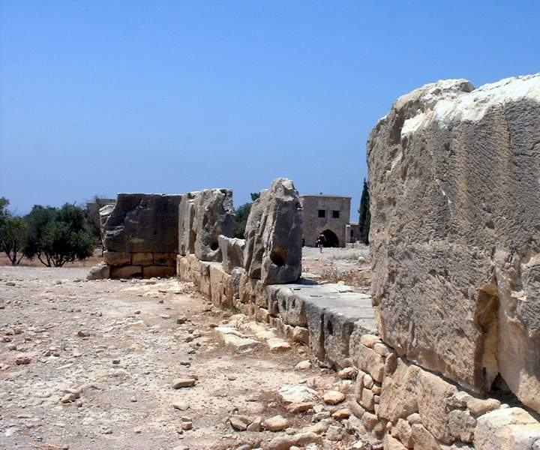
Temple of Aphrodite

Slide 15
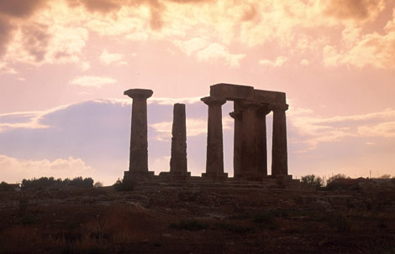
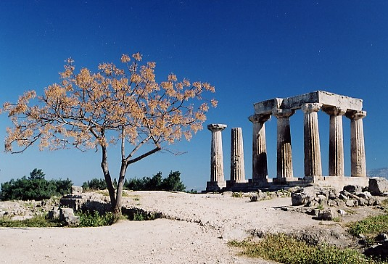
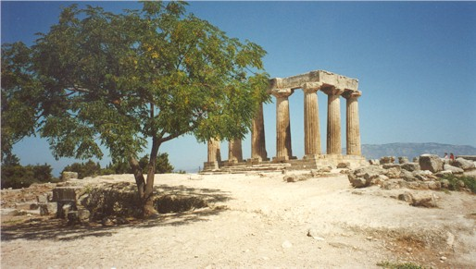
Immorality in All Seasons

Slide 16
The Wayward Local Church
The Wayward Local Church
Reports
Questions
Division
Disorder
Difficulties
Concern
1–4
Discipline
5–6
Instruction
7–16
Carnality
3–4
Marriage 7
Worship
11–14
Factions 1–2
Incest 5
Idols 8–10
Resurrection
15
Immorality
Collection 16
Lawsuits 6
Solving church problems theologically

Slide 17
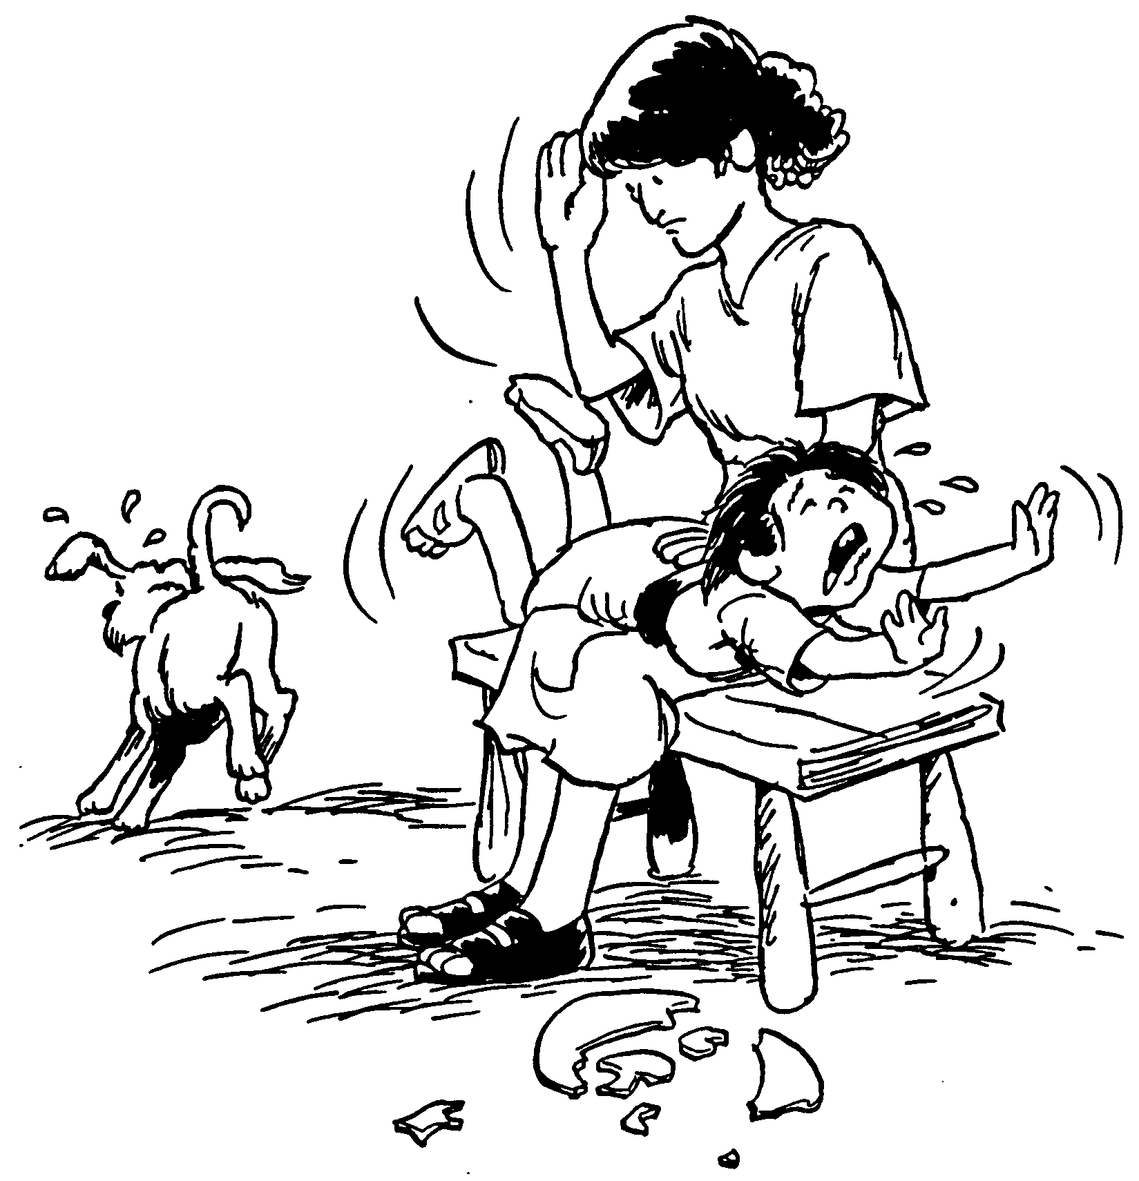
I. Humbly remove members living in sin (1-2).
Care enough to confront!
Spanking the Saints

Slide 18
Restore People in Sin
A. Some Christians tolerate immorality in the church (1).
I can hardly believe the report about the sexual immorality going on among you—something that even pagans don’t do. I am told that a man in your church is living in sin with his stepmother
(1 Cor. 5:1 NLT).

Slide 19
Black

Slide 20
Restore People in Sin
B. We must change our prideful attitude by expelling such people with grief (2).
You are so proud of yourselves, but you should be mourning in sorrow and shame. And you should remove this man from your fellowship (NLT).

Slide 21
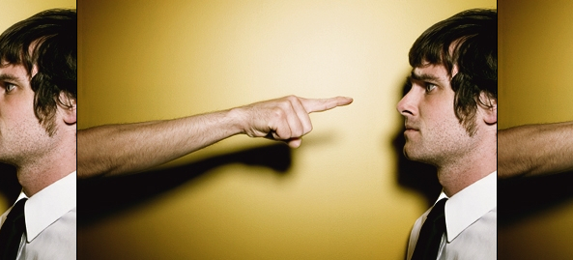
Too often…

Slide 22
Our Goal:
Our Goal:
Restoration!

Slide 23

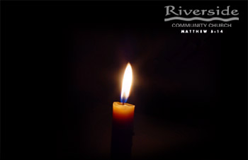
Restore People in Sin
Restore People in Sin
“Brothers, if someone is caught in a sin, you who are spiritual should restore him gently.”
Galatians 6:1

Slide 24
How to Restore (Matt. 18:15-17 NIV)
If your brother sins against you, go and show him his fault, just between the two of you. If he listens to you, you have won your brother over. ¹⁶But if he will not listen, take one or two others along, so that 'every matter may be established by the testimony of two or three witnesses.' ¹⁷If he refuses to listen to them, tell it to the church; and if he refuses to listen even to the church, treat him as you would a pagan or a tax collector.
Notes:
two main teachings on restoring Christians in sin

Slide 25

The Point of Verses 15-17
God's way to restore believers in sin is to keep the matter as private as possible (Matt. 18:15-17).

Slide 26
God's 4-step restoring process…
4
3
2
1
…reveals the issue to more people each step

Slide 27

Step 1 to Restoration
Talk to the person by yourself
M
M
M
M
M
M
M
M
M
M
M
M
M
M
M
M
S
M
M
M
M
M
M
M
M
M
M
M
S = Sinner
M = Member

Slide 28
Step 2 to Restoration
Take 1-2 others along
M
M
M
M
M
M
M
M
M
M
M
M
M
M
M
M
S
M
M
M
M
M
M
M
M
M
M
M
S = Sinner
M = Member

Slide 29
Step 3 to Restoration
Expose the sin to the entire church
M
M
M
M
M
M
M
M
M
M
M
M
M
M
M
M
S
M
M
M
M
M
M
M
M
M
M
M
S = Sinner
M = Member

Slide 30
Step 4 to Restoration
Treat the person like an unbeliever
M
M
M
M
M
M
M
M
M
M
M
M
M
M
M
M
S
M
M
M
M
M
M
M
M
M
M
M
S = Sinner
M = Member
S

Slide 31
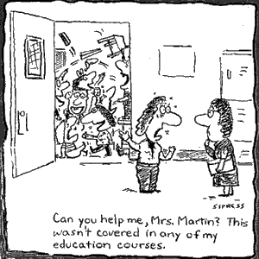
Discipline is needed in many arenas

Slide 32
Black

Slide 33
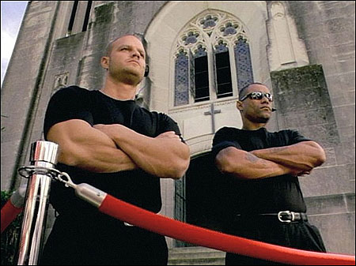
II. Discipline benefits the offender and the church (3-8)

Slide 34
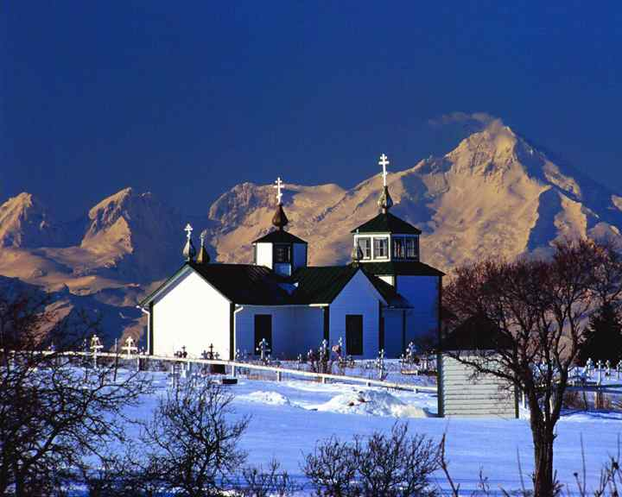
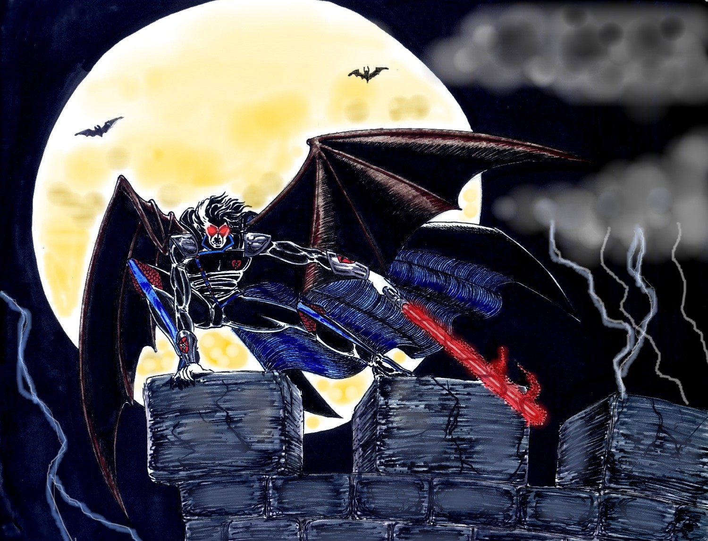
A. Discipline hands a believer over to Satan's dominion to end his hypocrisy
(3-5)
“…deliver over to Satan”

Slide 35
"…so that his body may be destroyed"
“…deliver over to Satan…”
Excom-munication
Physical Punishment

Slide 36
Black

Slide 37
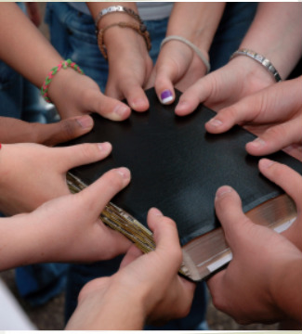
Benefits of Church Discipline
"won him over"
(Matt. 18:15)
"restore him gently" (Gal. 6:1)
"his spirit saved"
(1 Cor. 5:5)

Slide 38
Living in the “toss age”
Cartons
Carpets
Cars
Creatures made in God's image?

Slide 39
A. Discipline hands a believer over to Satan's dominion to end his hypocrisy
(3-5)
“…deliver over to Satan”

Slide 40
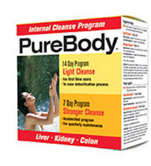
B. Discipline maintains the purity of the body
(6-8)

Slide 41
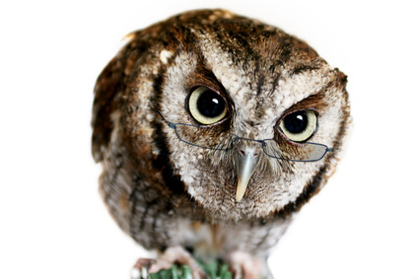
Q & A
Question: How many people does it take to ruin an organization—whether a church or a business?
Answer: One!

Slide 42
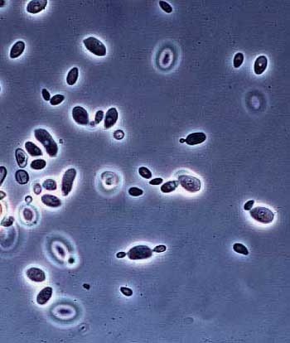
Yeast

Slide 43
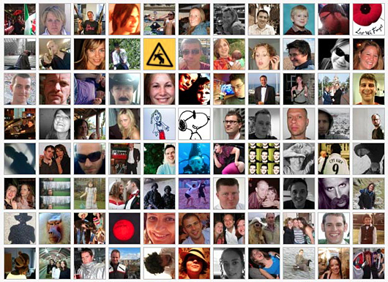
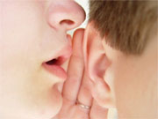

Facebook

Slide 44
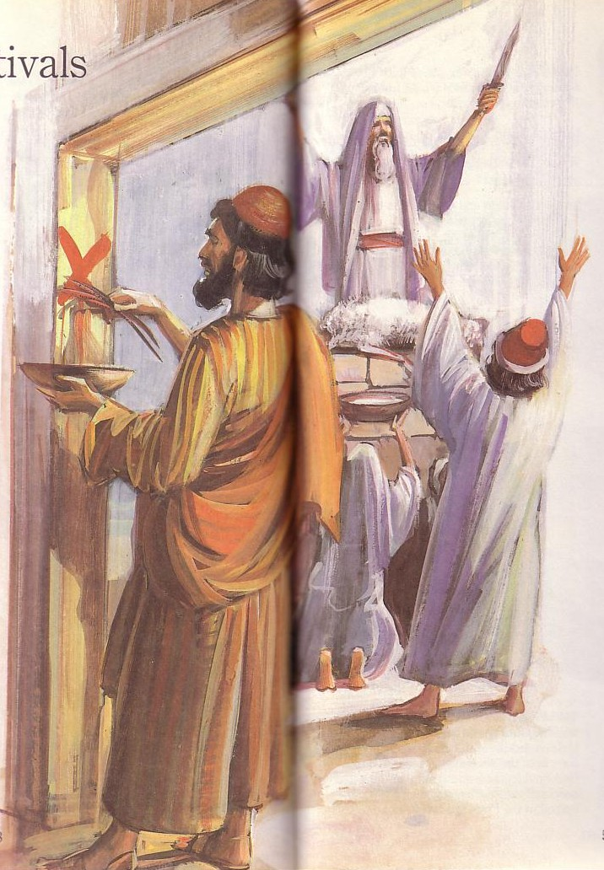
Passover's Past Significance
(Exodus 12)
Get rid of the old “yeast” by removing this wicked person from among you. Then you will be like a fresh batch of dough made without yeast, which is what you really are. Christ, our Passover Lamb, has been sacrificed for us. ⁸So let us celebrate the festival, not with the old bread of wickedness and evil, but with the new bread of sincerity and truth
(1 Cor. 5:7-8 NLT).

Slide 45
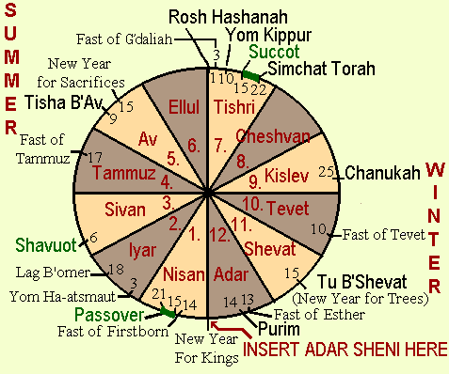
Passover: Pilgrimage Feast #1
127-29, 137
(Firstfruits)
(Unleavened Bread)
Pilgrimage Feasts Circled and in Green
Notes:
http://images.google.com/imgres?imgurl=www.rigal.freeserve.co.uk/jewish/calendar/calenda2a.gif&imgrefurl=http://www.rigal.freeserve.co.uk/jewish/calendar/jcalendar2.htm&h=398&w=477&prev=/images%3Fq%3DJewish%2BCalendar%2BDiagram%26svnum%3D10%26hl%3Den%26lr%3D%26ie%3DUTF-8%26oe%3DUTF-8

Slide 46


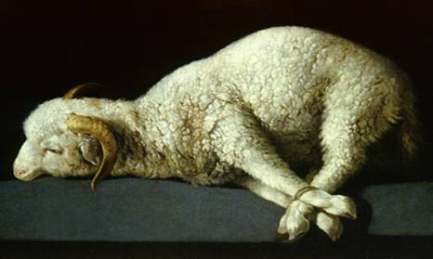
The Passover Lamb

Slide 47
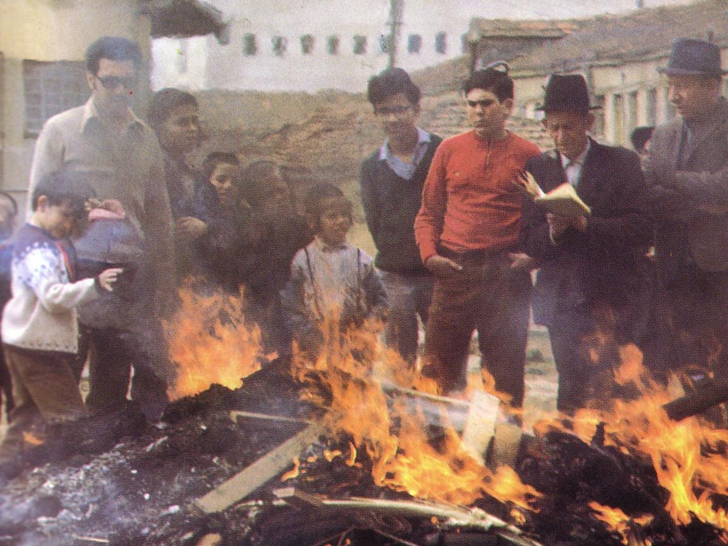
“Burn All the Yeast!”

Slide 48




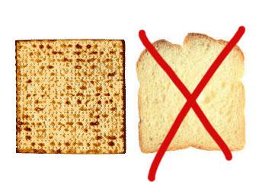
Feast of Unleavened Bread
128, 137
Notes:
www.stephenwilliamson.com/ Hobbies/bakin.htm (Yeast bloom)

Slide 49
Black

Slide 50
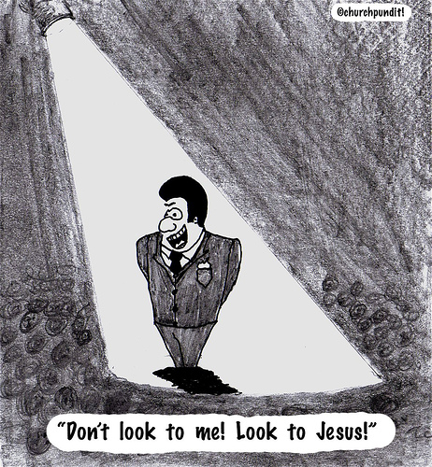
III. Association with immoral people depends on whether or not they are Christians
(9-13).

Slide 51

A. We can associate with an immoral unbeliever (9-10).
but...
B. We can't associate with an immoral Christian (11).

Slide 52

What sins are “bad enough” for church discipline?
1 Cor 5:11
Sexually immoral
Greedy
Idolaters
Slanderers
Drunkards
Swindlers
Other Texts:
Divisive (Tit. 3:10)
Lazy (2 Thess. 3:6)

Slide 53

C. The church must remove immoral Christians (12-13)

Slide 54
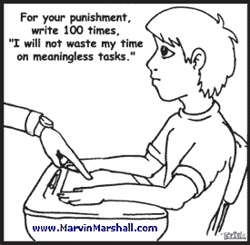
But how should we discipline?

Slide 55
God's 4-step restoring process…
4
3
2
1
…reveals the issue to more people each step

Slide 56
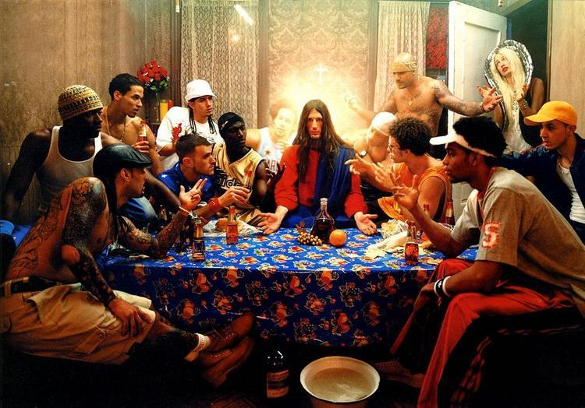
How to Restore (Matt. 18:15-17 NIV)
"Treat him as a sinner or tax collector"
If your brother sins against you, go and show him his fault, just between the two of you. If he listens to you, you have won your brother over. ¹⁶But if he will not listen, take one or two others along, so that 'every matter may be established by the testimony of two or three witnesses.' ¹⁷If he refuses to listen to them, tell it to the church; and if he refuses to listen even to the church, treat him as you would a pagan or a tax collector.
Notes:
two main teachings on restoring Christians in sin

Slide 57
How to Treat One Under Discipline
Don't refer to him/her as a Christian.
Evangelize this person.
Don't let him/her take the Lord's Supper.
Remove the person from membership.
Remove this person from church roles.
Unbeliever
“Deliver over to Satan” one in sex sin
(1 Cor. 5:5).
Don't eat with him/her (1 Cor. 5:11).
Prohibit him/her from attending church?
Worse

Slide 58
How do we maintain purity in the church?

Slide 59

The Focus of the Text
Guard church purity by expelling unrepentant believers
Guard church by expelling unrepentant believers

Slide 60
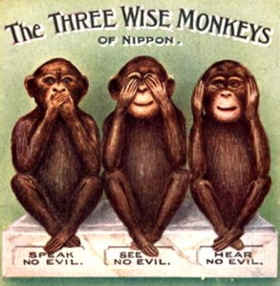
Black

Slide 61
Black

Slide 62
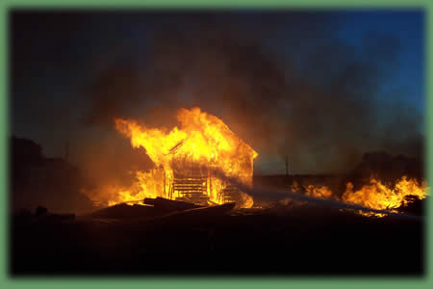
I've Been Through a Fire
I've been through a fire
that has deepened my desire
to know the living God,
more and more.

Slide 63
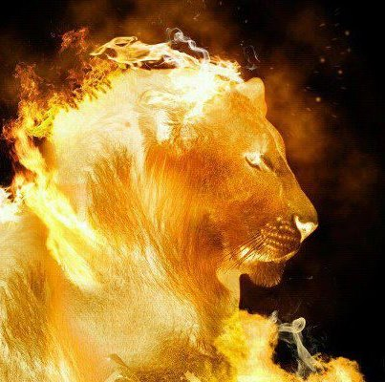
I've Been Through a Fire 2 of 4
It hasn't been much fun
but the work that it has done
in my life has made it worth
the hurt

Slide 64
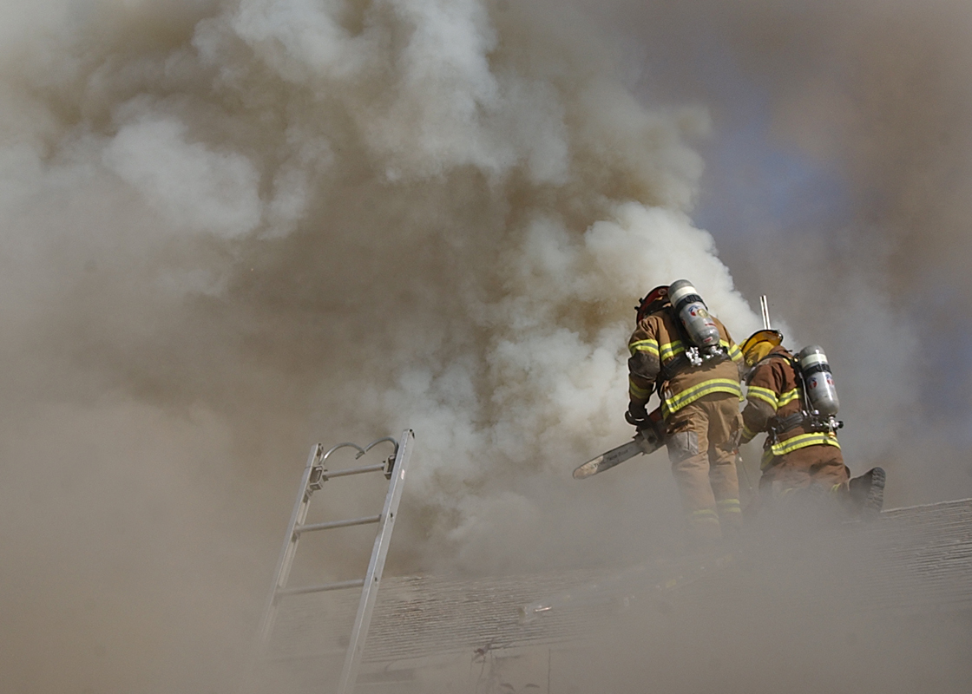
I've Been Through a Fire 3 of 4
You see, sometimes we need the hard times
to bring us to our knees.
Otherwise, we do as we please
and never heed Him.

Slide 65
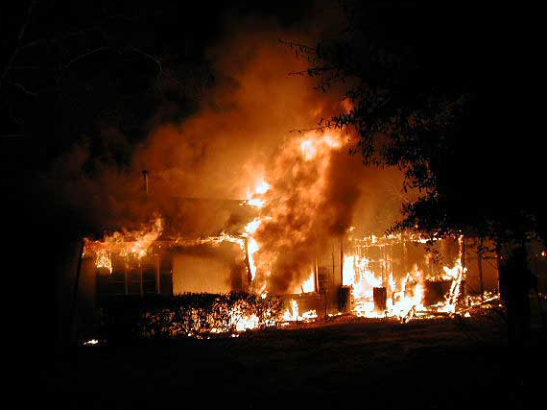
I've Been Through a Fire 4 of 4
But He always knows what's best
and it's when we're in the test
that we really come to know God
as He is

Slide 66

How can we keep this church pure?
a. Start with your own life.

Slide 67
What sins are “bad enough” for church discipline?
1 Cor 5:11
Sexually immoral
Greedy
Idolaters
Slanderers
Drunkards
Swindlers
Other Texts:
Divisive (Tit. 3:10)
Lazy (2 Thess. 3:6)

Slide 68
How can we keep this church pure?
a. Start with your own life.
b. Support the leaders.
c. Care how others are really doing.

Slide 69
Black

Slide 70


NT Preaching link at BibleStudyDownloads.org
Get this presentation and script for free!
Notes:
NT Preaching (np)

