Slide 1
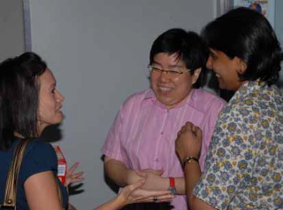
Others-Centered Christianity
1 Corinthians 16
Dr. Rick Griffith • Crossroads International Church Singapore
cicfamily.com & BibleStudyDownloads.org

Slide 2


Transitions
What's yours?
Notes:
2

Slide 3
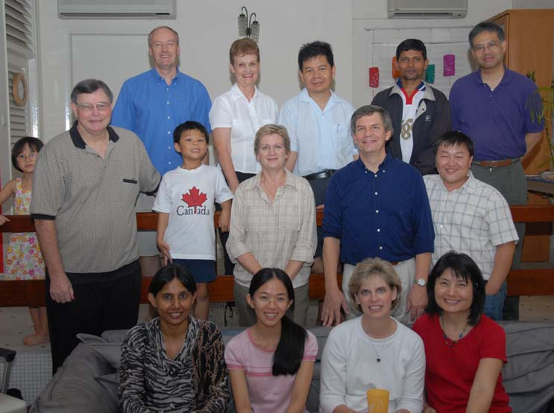
17 believers from 6 countries at our first meeting Friday, 6 Oct 06

Slide 4
2012-2013 Transitions
40
30
20
10
0
July 12
May 13

Slide 5
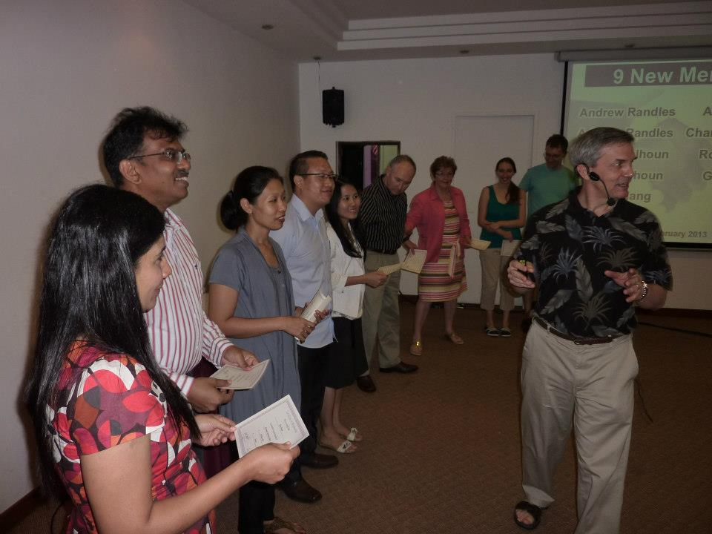
9 New Members on 24 Feb 2013

Slide 6
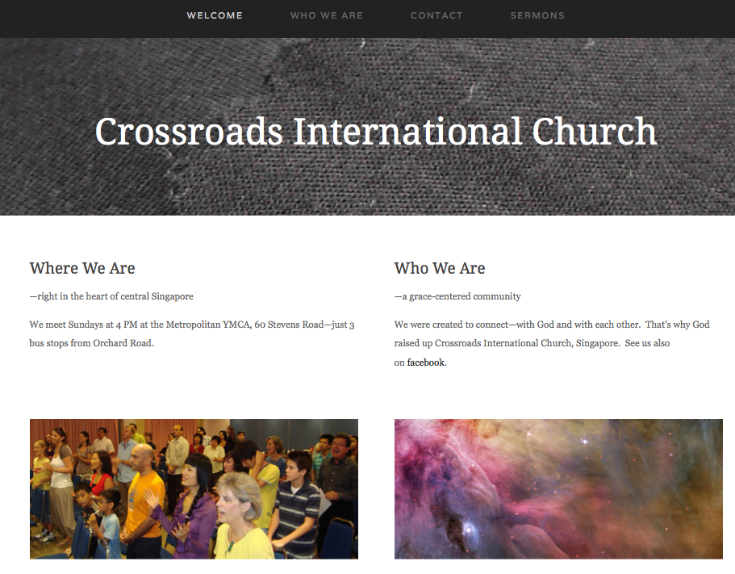
2012-2013 Transitions
Notes:
6

Slide 7
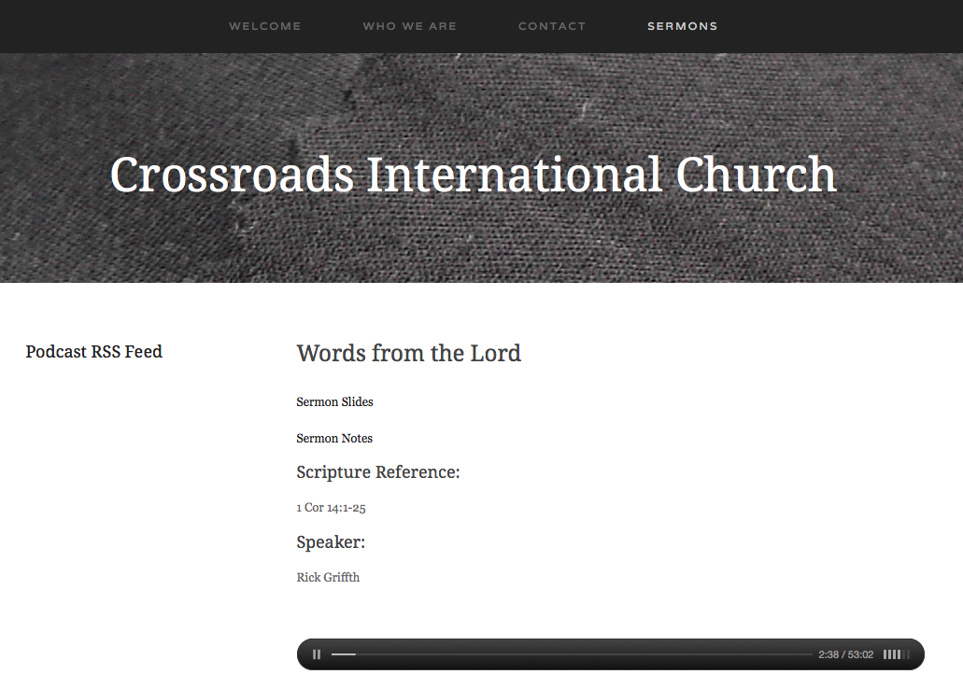
2012-2013 Transitions
Notes:
7

Slide 8
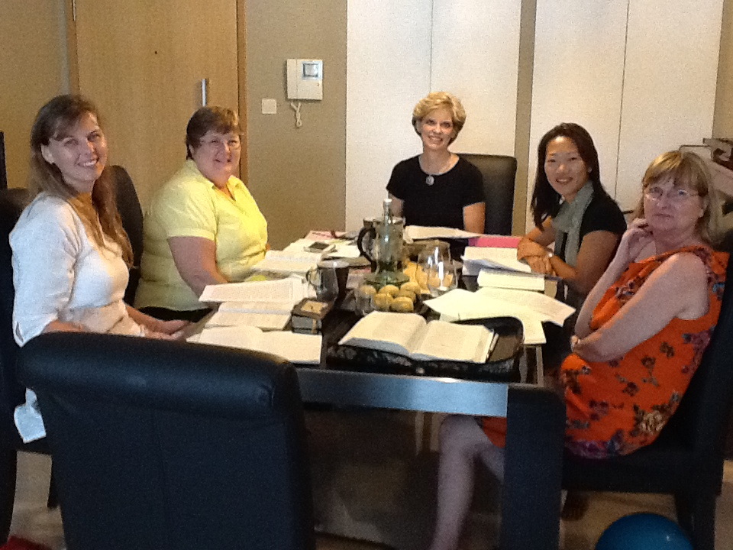
CIC Women Tuesday 10 AM

Slide 9
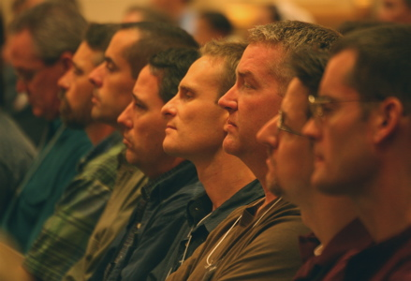
Man2Man
First Saturdays
9 AM

Slide 10
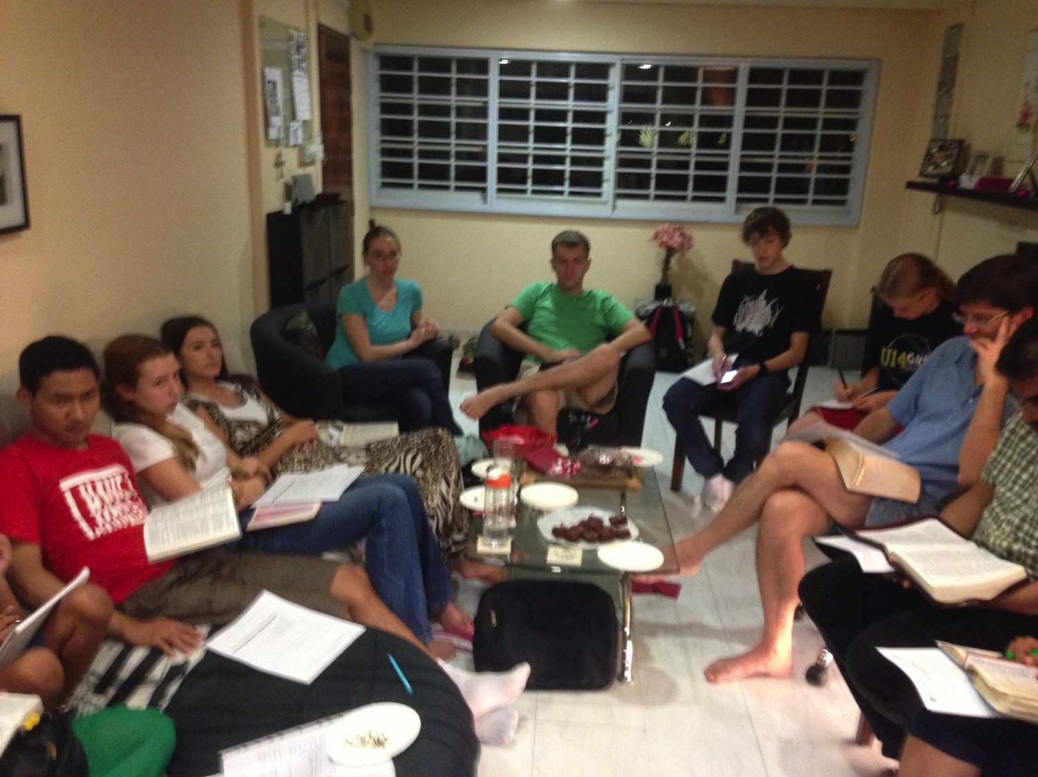
Home Group Friday 7:30 pm

Slide 11
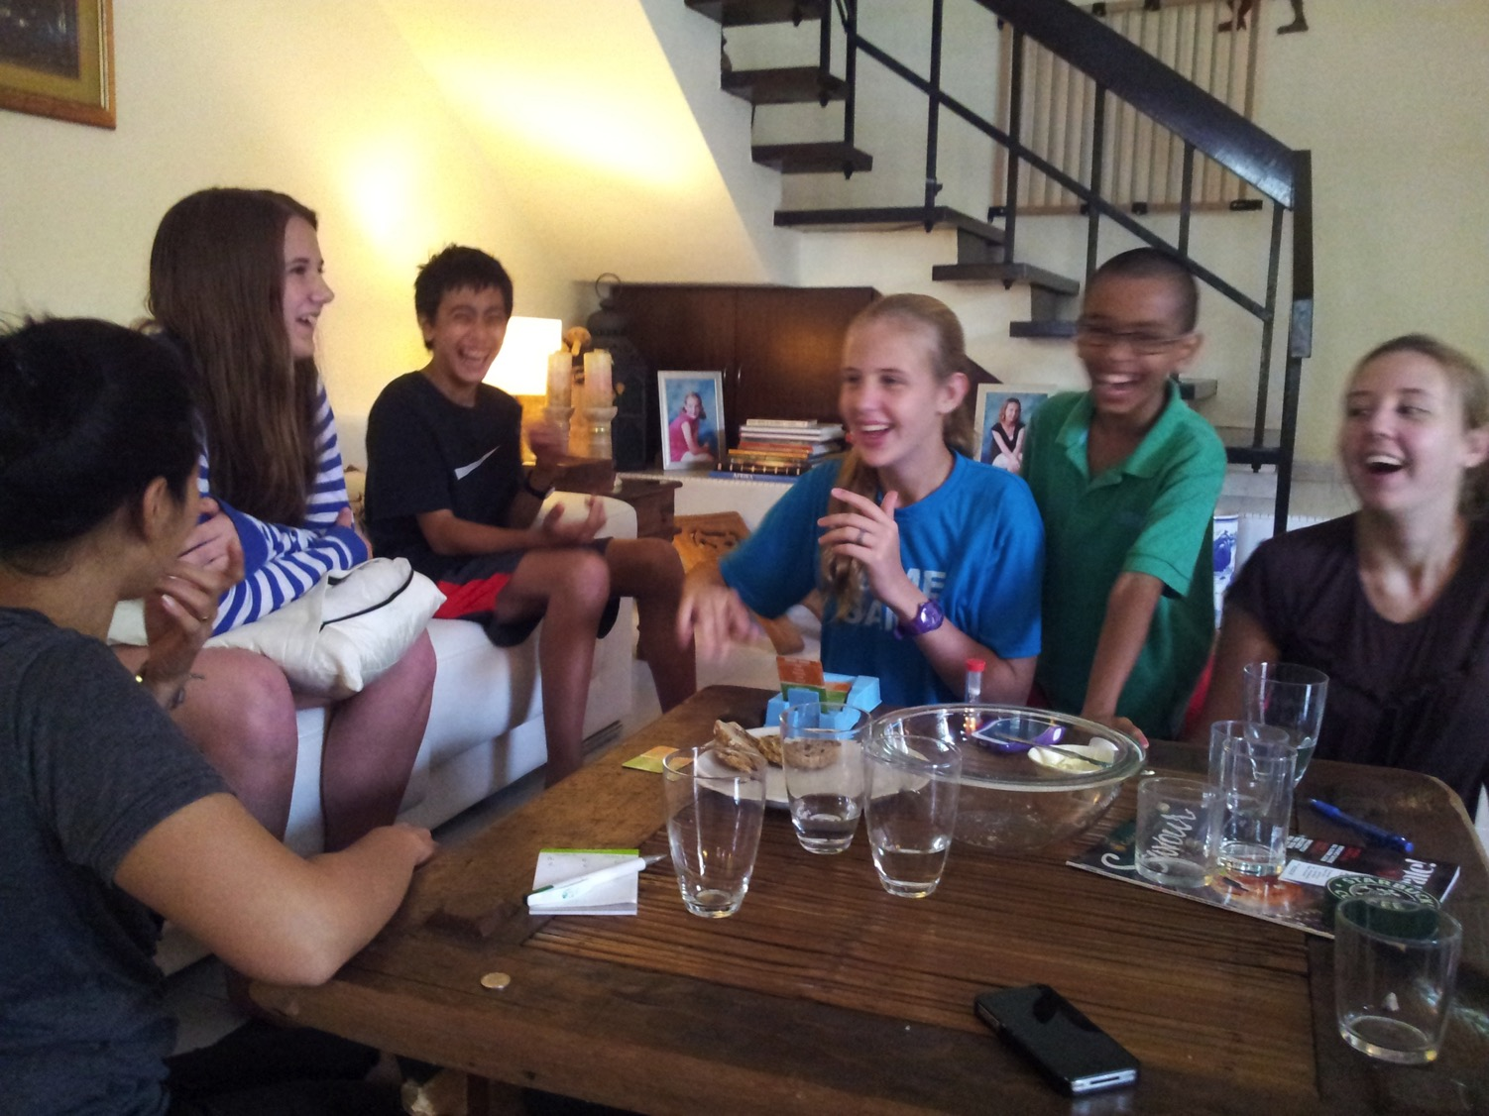
CIC Youth—Saturdays

Slide 12
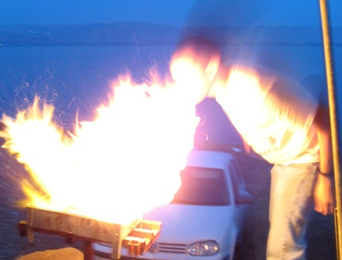
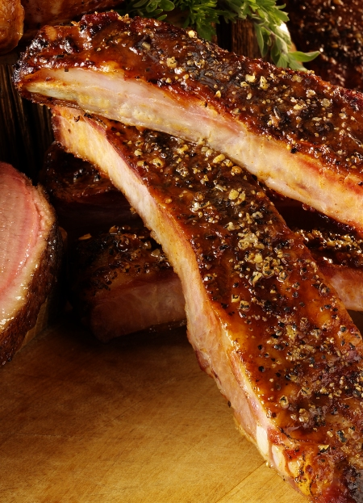
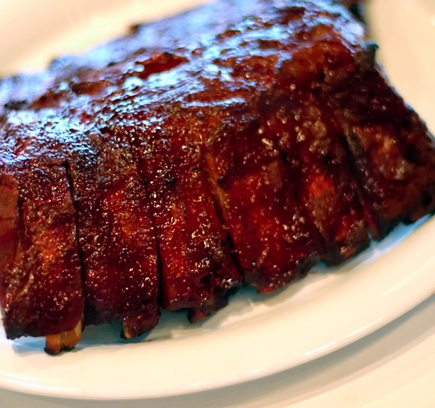
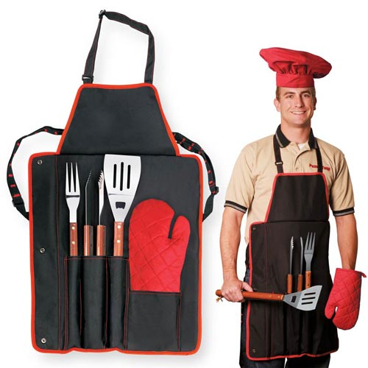
Church
Monthly Dinners

Slide 13

Life Transformation Groups
The Commitment: Meet one hour a week with 1-2 others of the same sex to provide accountability in 3 areas
Confess sin around 10 questions
Read 3 Bible chapters daily
Pray for lost friends
Church Multiplication Associates––www.CMAResources.org
Notes:
An LTG has 2-3 persons committed to growing spiritually. They meet in a home, restaurant, church, business, or wherever they can have a 60-minute accountability session each week.

Slide 14


Discipleship
Church Multiplication Associates––www.CMAResources.org
Notes:
No LTG should be larger than 3 people. Once a member invites a 4th person and it is shown that this 4th person will be committed to the LTG concept, the group of 4 multiplies into 2 groups of 2 persons. The additional members can be believers or unbelievers, as long as they are committed to confession, Bible reading, and prayer.

Slide 15



Life Transformation Groups
Church Multiplication Associates––www.CMAResources.org
Notes:
Ideally, the church is then composed of many LTG groups at different stages, growing to multiply more groups so that accountability remains intact in a small group for each person.

Slide 16

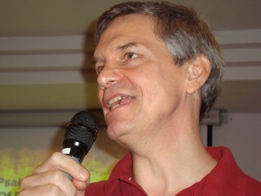
Your Elders
Lewis
Rick

Slide 17

Transitions often turn us inward

Slide 18
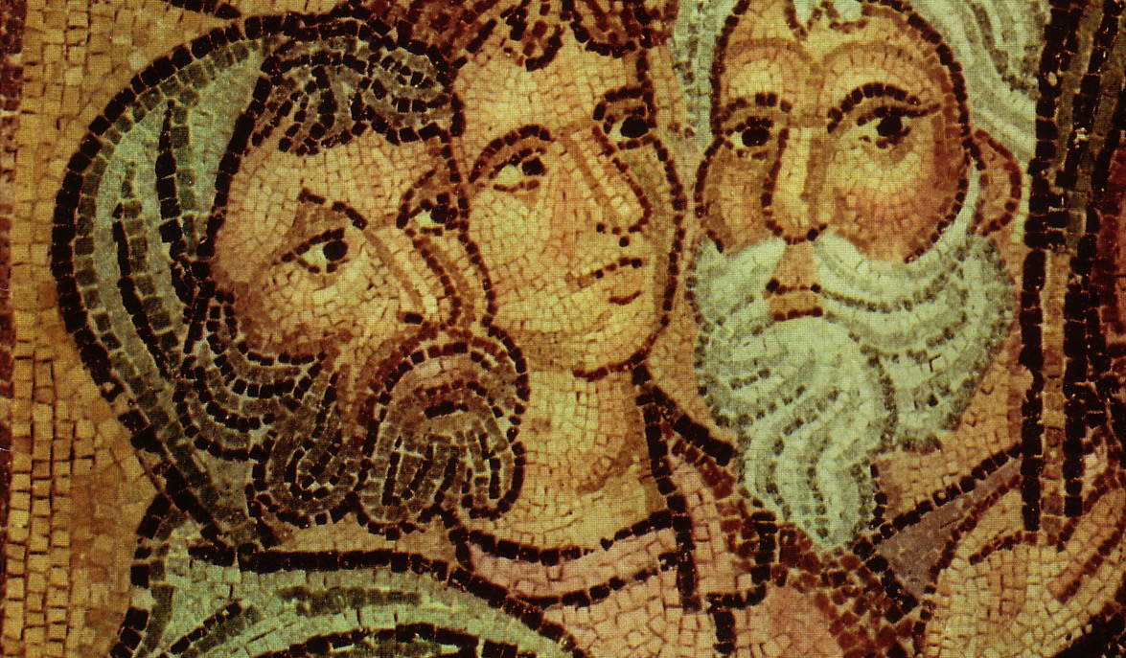
Parties at Corinth
Paul
Action
Party
P
A
P
Apollos
Yippee
Esquire
A
Y
E
Cephas
Triumph
Esquire
C
T
E
Savior
Dvlpmnt
Party
S
D
P

Slide 19
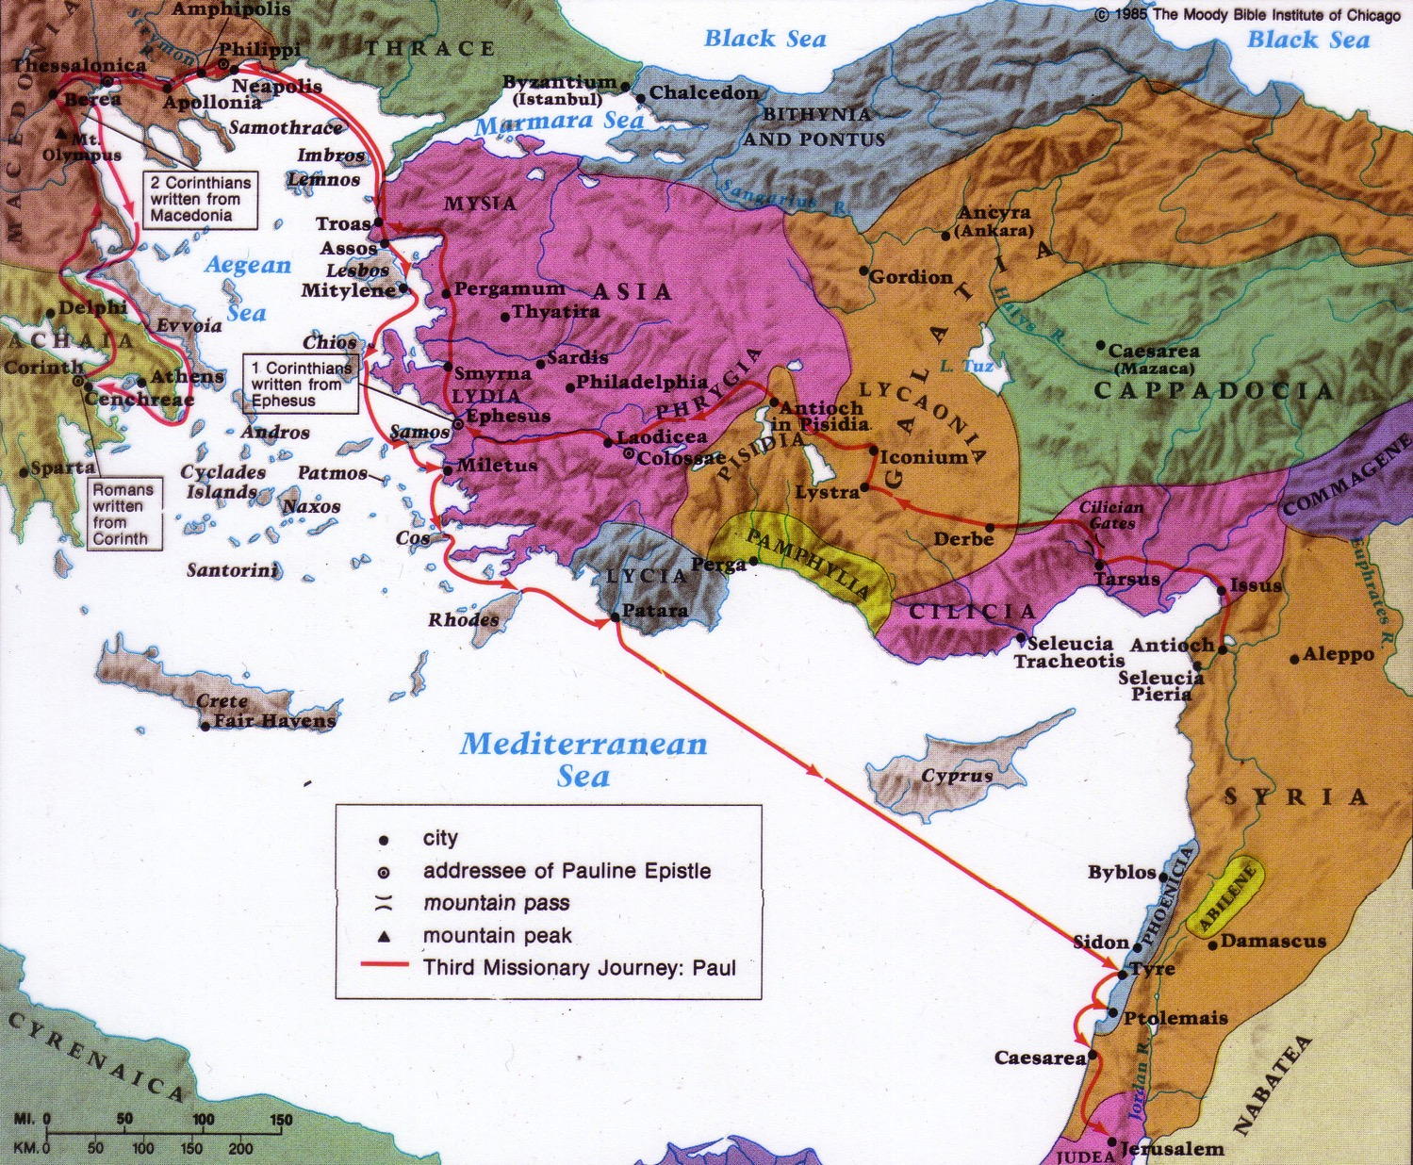
Origin & Destination
1 Corinthians on the Third Missionary Journey
157
Destination:
Corinth
Origin:
Ephesus

Slide 20
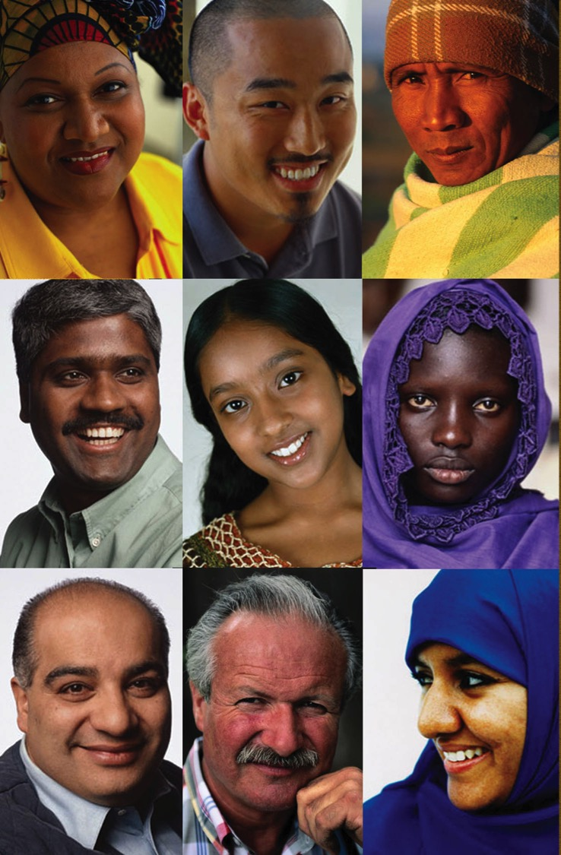
How to advance the gospel during transition…

Slide 21

I. Give to needy saints (1-4).
How to advance the gospel during transition…
“Now about the collection for the saints…”
(1 Cor. 16:1)
Notes:
21
What about our finances? I'll leave this report to our intern and treasurer, Manik Corea.

Slide 22

Give to God's family first

Slide 23
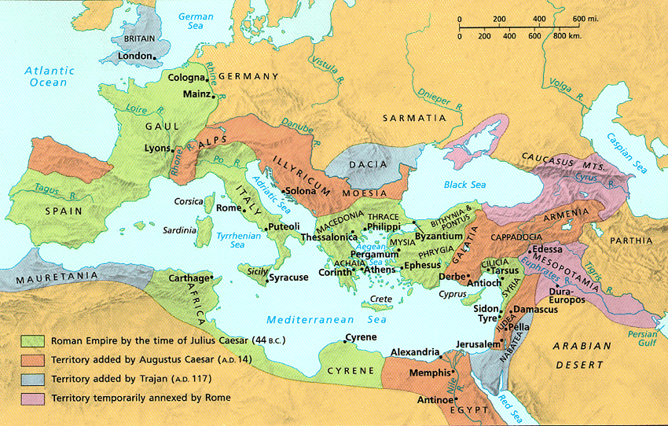
The Collection (16:1-2)
154f

Slide 24
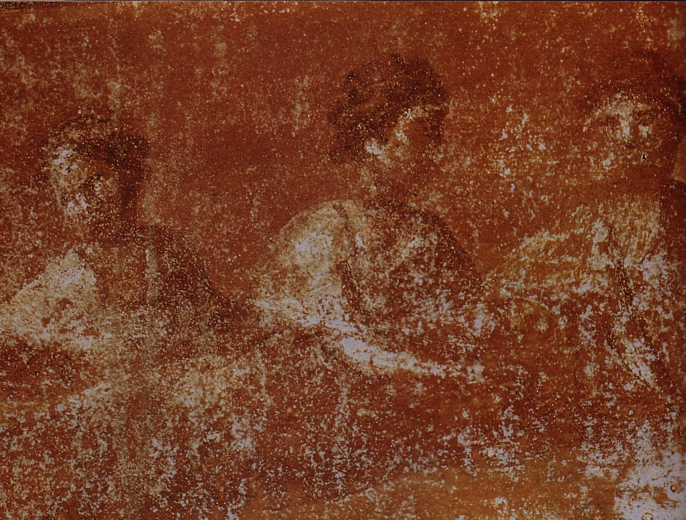
What was the early church really like?
Divorce (7)
Gifts (12-14)
1 Corinthians
Idolatry (8-10)
Incest (5)

Slide 25

Commands on Giving
1. Give to believers in need (1)
Notes:
25

Slide 26


Our Mission Involvement
• Thailand
• Vietnam
• India
• Mongolia
• Philippines
• Myanmar
• Bangladesh
• Afghanistan
• Nepal
• Canada (training for Indonesia)

Slide 27

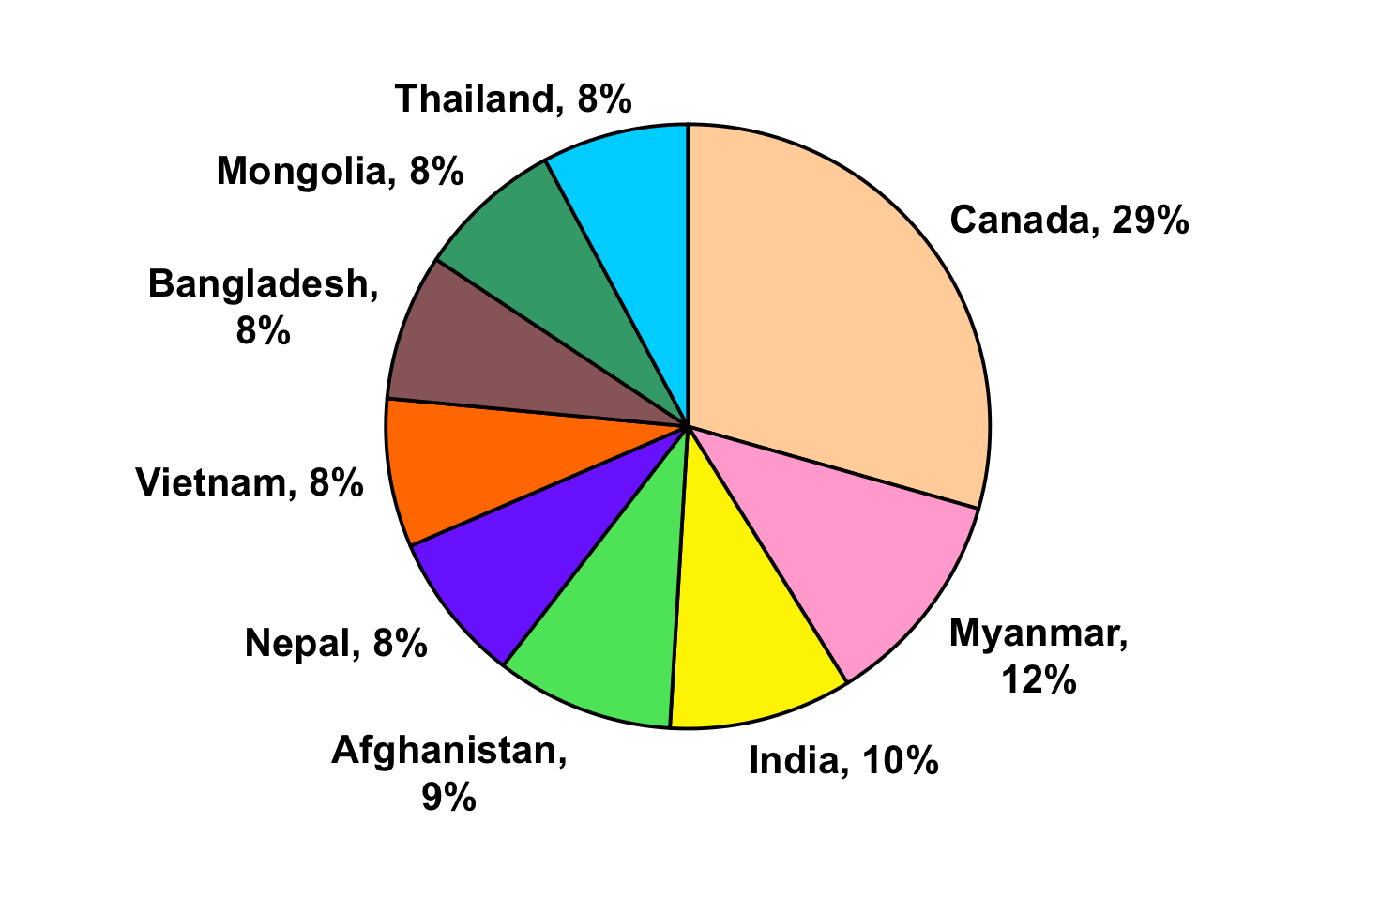
Missions CIC Supported in 2012
66% has helped missionaries who are/have been members of CIC
Notes:
Canada: continuous monthly support for Enriko and Alisa (members with CIC) with their studies and baby Lia
Myanmar: through Singpu for work in Myanmar
India: for pastor training in Manipur
Afghanistan: to support the Hahn family serving there (members of CIC?)
Nepal: through ex SBC student, Ananda, working with evangelism and discipleship
Vietnam: through ex SBC student, Thuy for training and field work
Bangladesh: through Yeob (ex SBC student?), for pastor training, Bible and hymn books
Mongolia: through Budmaa for training and EE work
Thailand: to the Coreas (prayer cards on welcome table!)

Slide 28
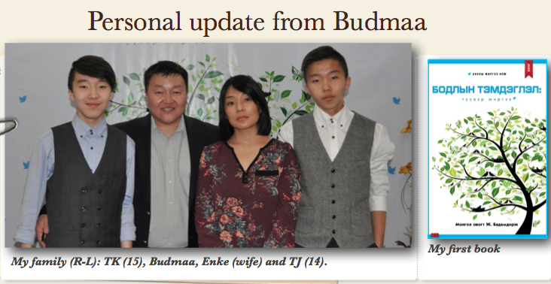
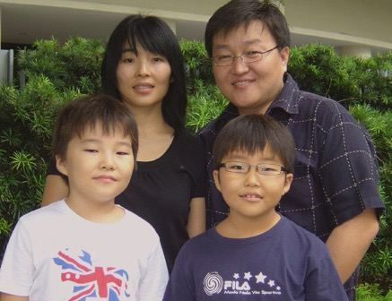
Pastor Budmaa, Director, Evangelism Explosion, Mongolia

Slide 29
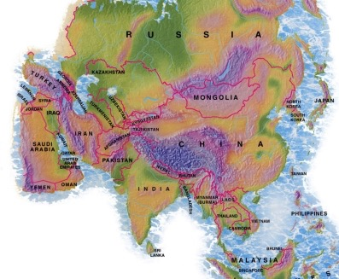
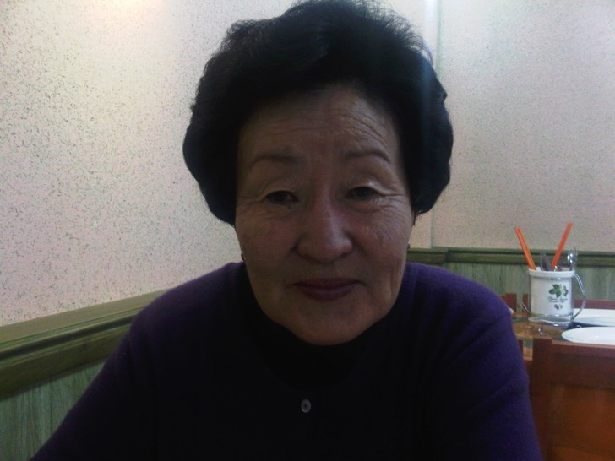
Inner Mongolia (China)
Pastor Budmaa's Mother in Glory

Slide 30
Commands on Giving
1. Give to believers in need (1)
2. Give regularly (2a)
Notes:
30

Slide 31
Black

Slide 32
Commands on Giving
1. Give to believers in need (1)
2. Give regularly (2a)
3. Give proportionately (2b)
Notes:
32

Slide 33
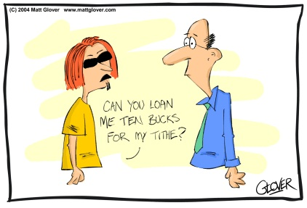
What about the tithe?

Slide 34


Should Christians tithe?

Slide 35

Who Gives More?
Income:
US$10,000
Income:
US$50,000+
4
Gives 2.8%
3
%
Gives 1.5%
2
1
0

Slide 36
$1000 or $50 a week?

Slide 37

Do you want God to bless you based on the net or the gross?

Slide 38
Commands on Giving
1. Give to believers in need (1)
2. Give regularly (2a)
3. Give proportionately (2b)
4. Give responsibly (3-4)
Notes:
38

Slide 39
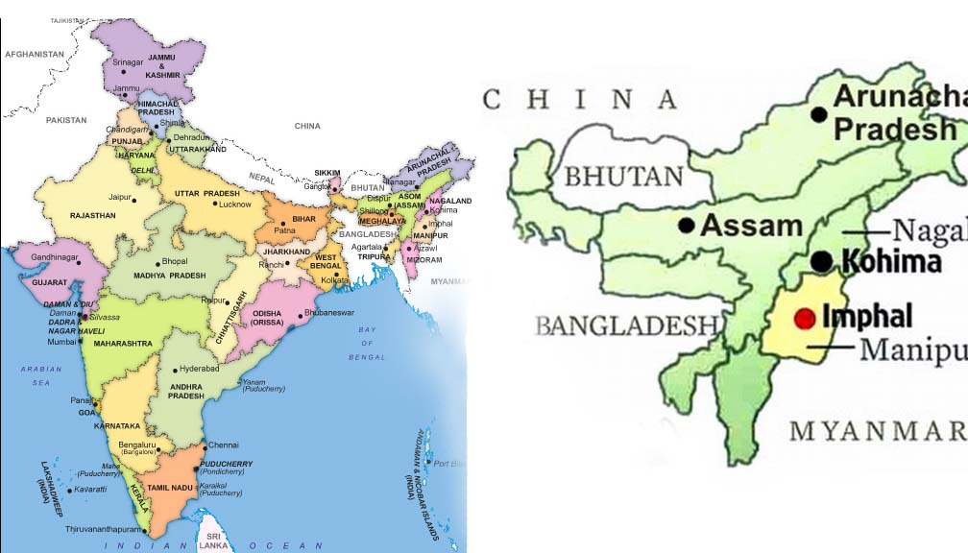
Manipur, North-East India

Slide 40


PTI - bridging the gap
Workplaces
Vocations
Church Studies
People’s lives
Spiritual needs
A Holistic Ministry
Ministry

Slide 41
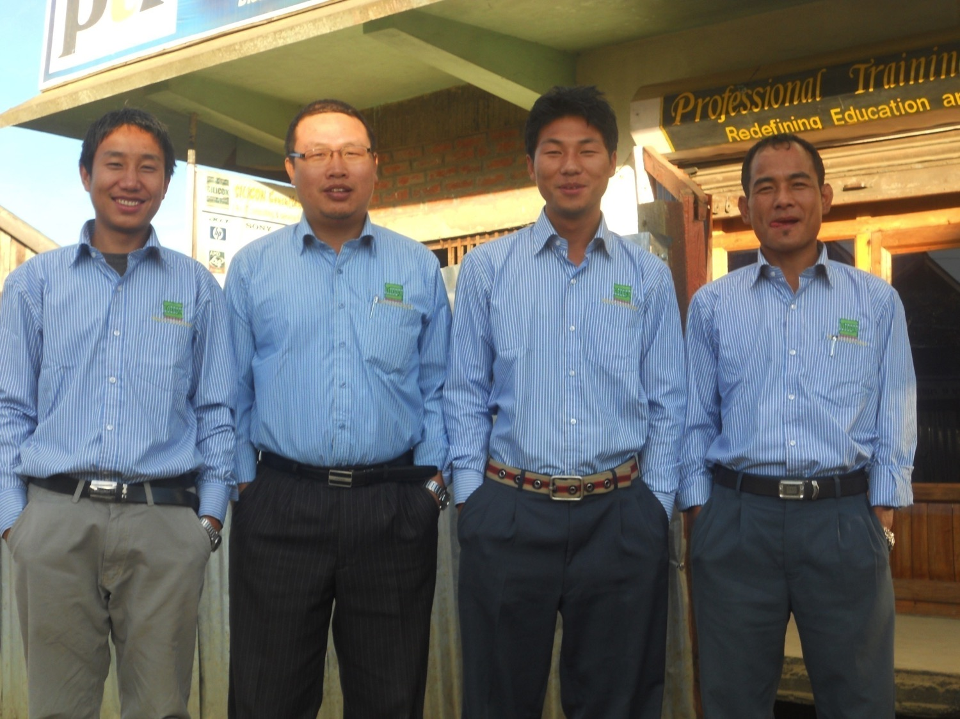
Free Coaching Beneficiaries

Slide 42
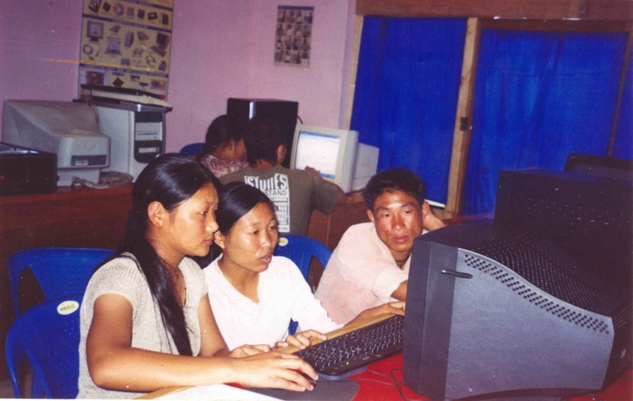
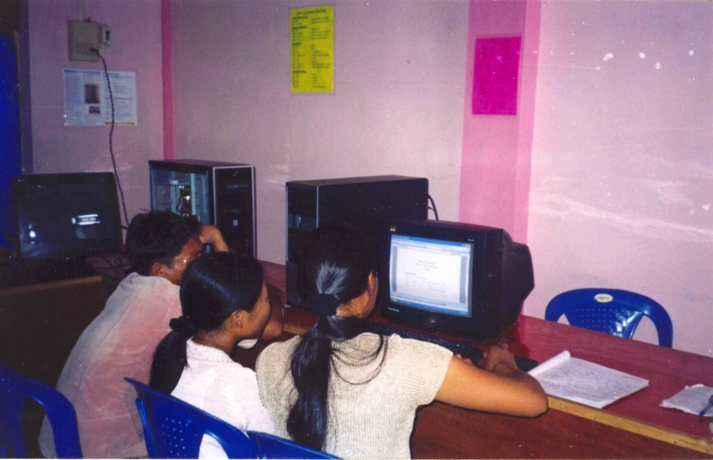
Computer Class

Slide 43
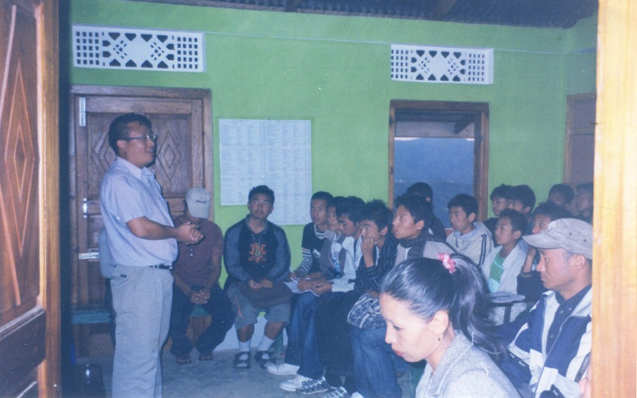
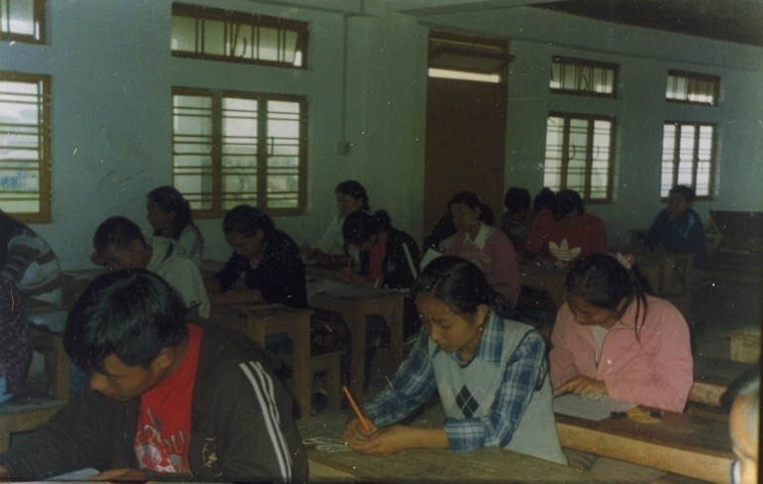
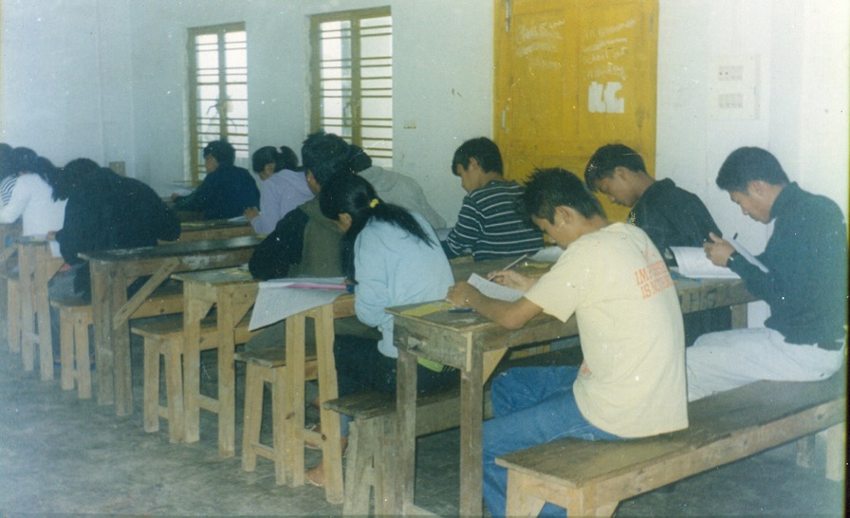
Orientation
Free Coaching

Slide 44
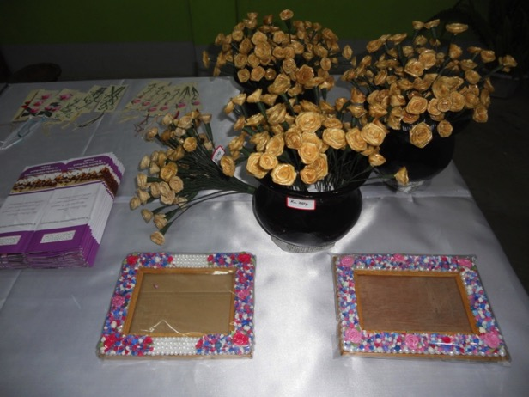
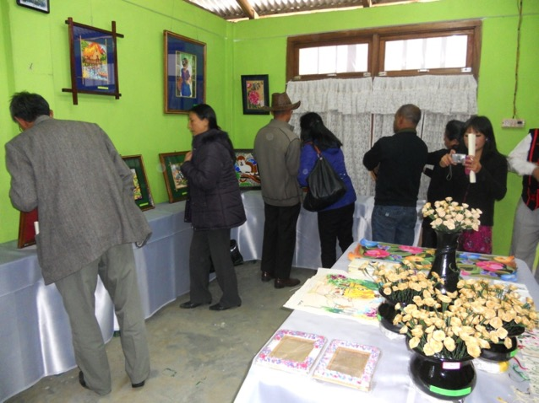
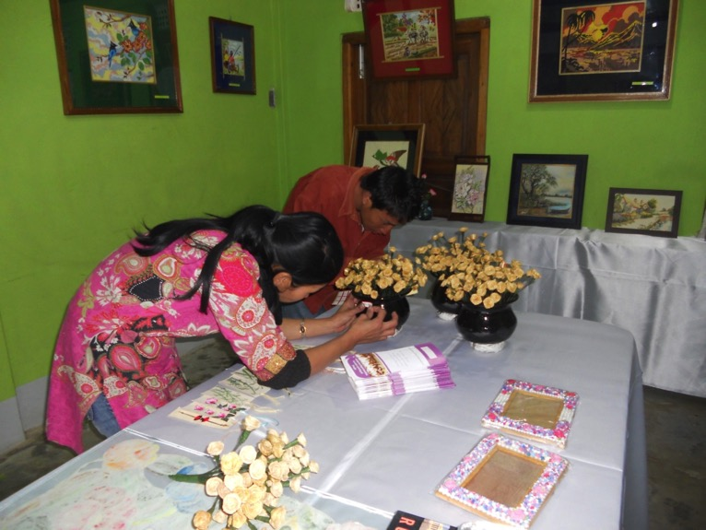

Embroidery, Craft

Slide 45
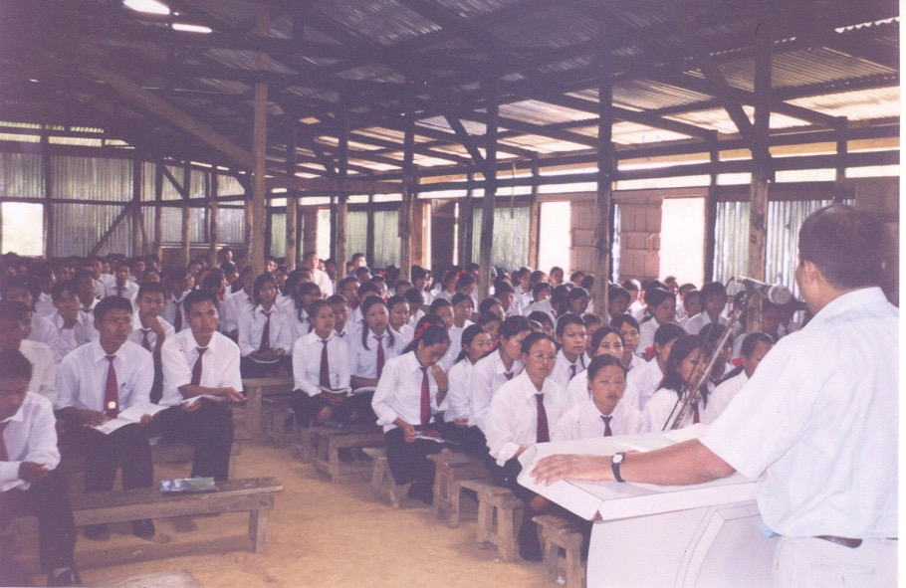
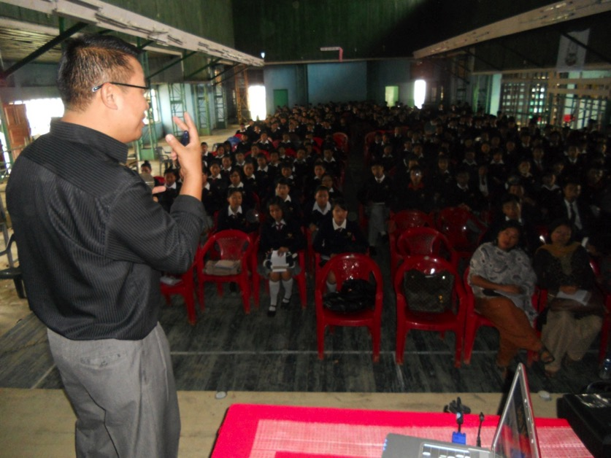
Educational Campaign

Slide 46
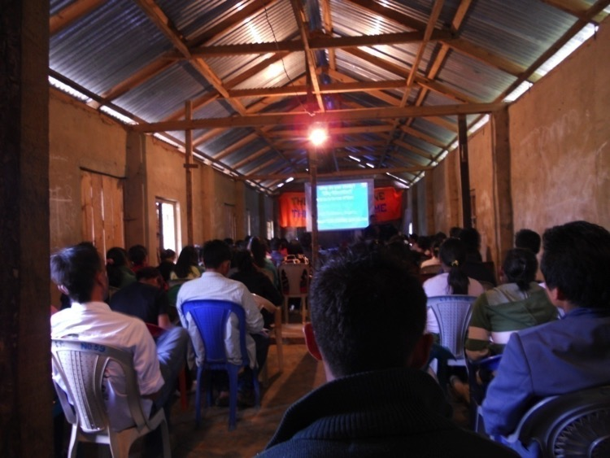
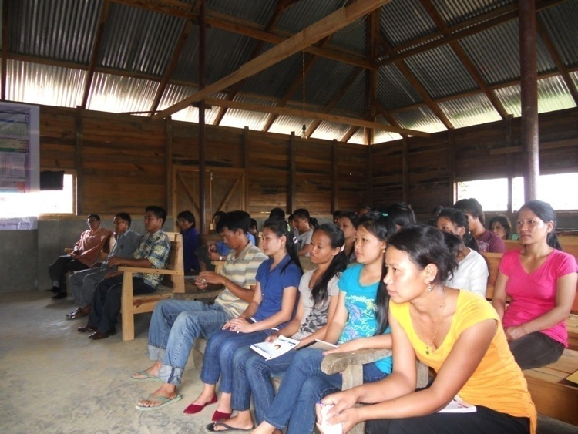
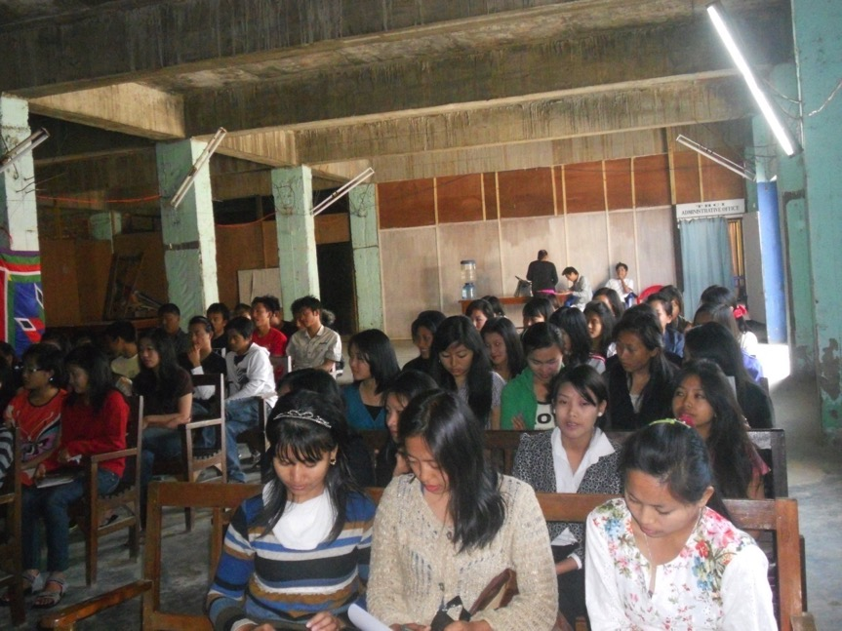
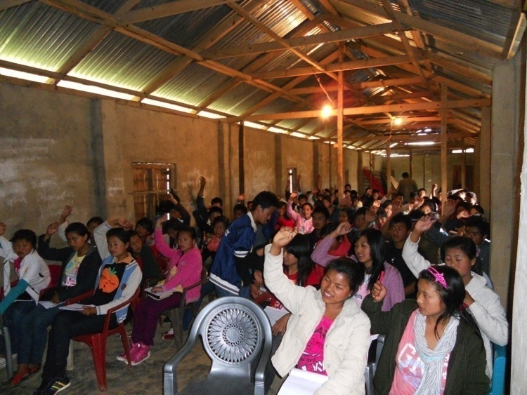
Bible Camps

Slide 47
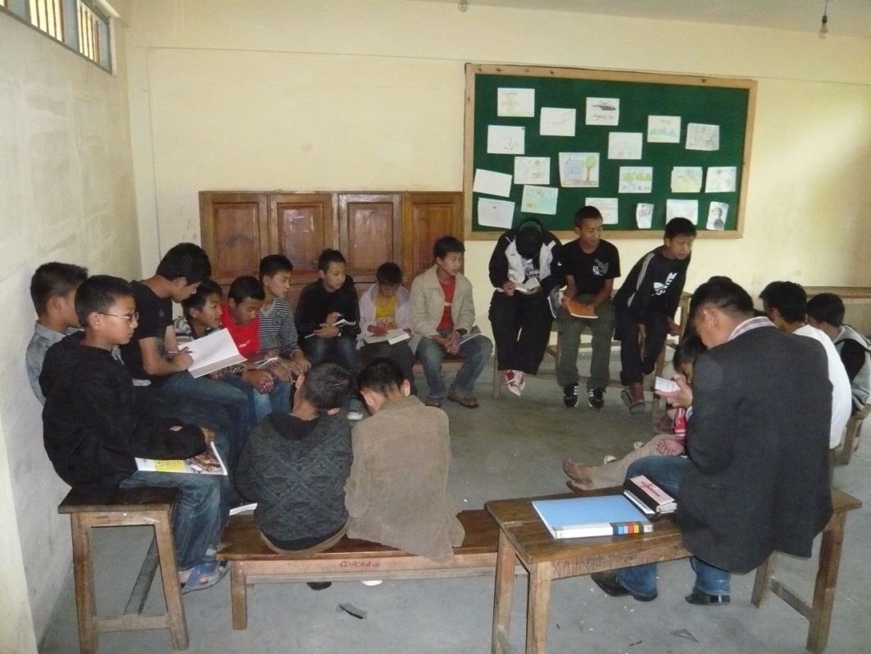
Bible Study

Slide 48
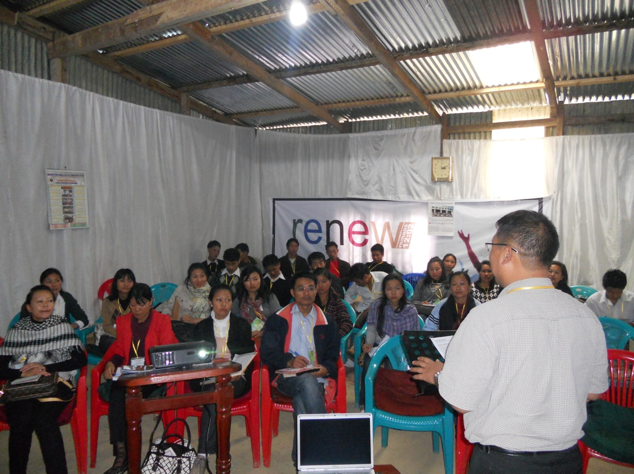

Slide 49
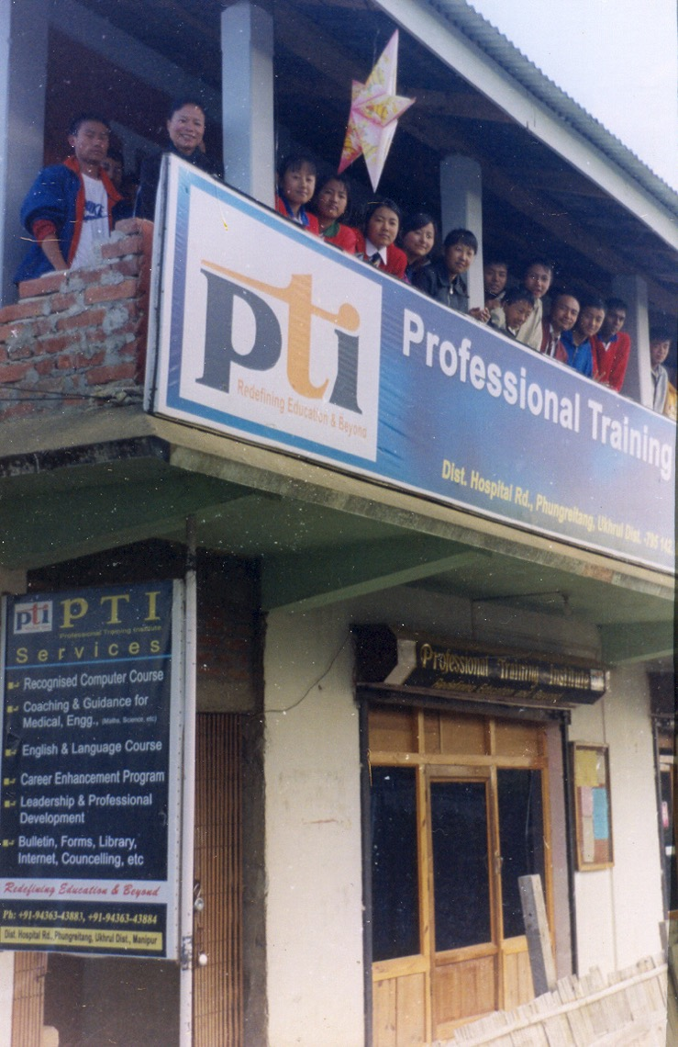

PTI Building

Slide 50
Black

Slide 51
I. Give to needy saints (1-4).
How to advance the gospel during transition…
“Now about the collection for the saints…”
(1 Cor. 16:1)
Notes:
51
What about our finances? I'll leave this report to our intern and treasurer, Manik Corea.

Slide 52

II. Minister as a team (5-18)
How to advance the gospel during transition…
Notes:
52
Like a sports team needs a common goal, so do we.
Praise God for the unity of this body. I have been a part of 13 churches in my 36 years as a Christian--and this is the most united!

Slide 53
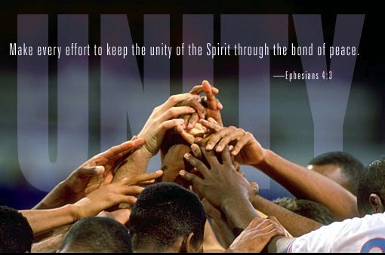
A. Show teamwork with your leaders (5-18)
• Assist them financially (5-9)
• Encourage them (10-11)
• Recognize their calling (12)

Slide 54
B. Show teamwork within yourselves (19-24)

Slide 55


Main Idea
Advance the gospel by…
giving and…
teamwork

Slide 56
A. Show teamwork with your leaders (5-18)
• Assist them financially (5-9)
• Encourage them (10-11)
• Recognize their calling (12)
• Submit to them (13-18)

Slide 57
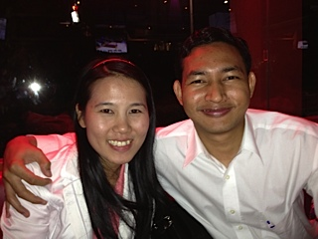
Kim & Singpu Mangsian

Slide 58
Black

Slide 59


NT Preaching link at BibleStudyDownloads.org
Get this presentation and script for free!
Notes:
NT Preaching (np)

