Slide 1
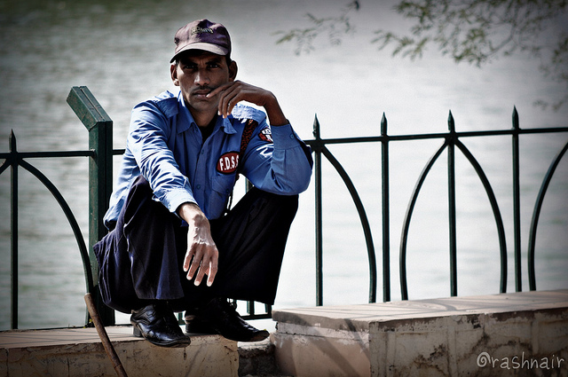
Whom Do You Need?
1 Corinthians 12:12-31
Dr. Rick Griffith • Crossroads International Church Singapore
cicfamily.com & BibleStudyDownloads.org

Slide 2
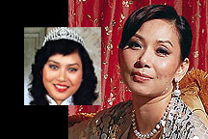
Cally Kwong
Easily Hurt Woman
"Never rely on another person…"

Slide 3

Colleagues
Notes:
3

Slide 4

Singapore
Notes:
4

Slide 5

Causeway Water Pipeline
Notes:
5

Slide 6

Whom do you need?
Notes:
6

Slide 7

Whom do you need?
Everyone!
Notes:
7

Slide 8

But why do you need others in this church?
1 Corinthians 12:12-31
Notes:
8

Slide 9
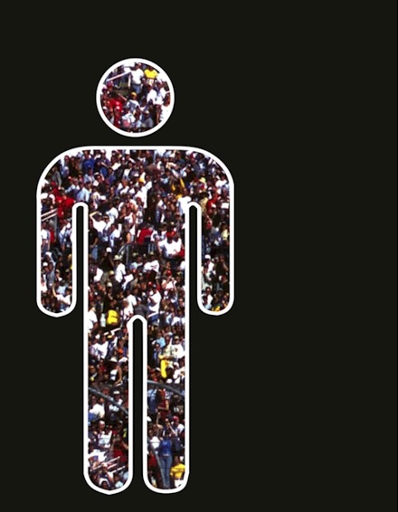
I. It takes all the different gifts for the church to exist (12-13).
Why you need others…
Notes:
9

Slide 10
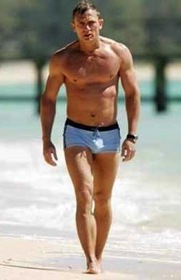
A. A human body has different parts (12).
"The body is a unit, though it is made up of various parts; and though all its parts are many, they form one body. So it is with Christ"
(12:12 NIV)
Notes:
10

Slide 11

The body works together
Notes:
11

Slide 12
B. Believers are different but still part of one body (13)
"So it is with Christ. For we were all baptized by one Spirit into one body—whether Jews or Greeks, slave or free—and we were all given one Spirit to drink" (1 Cor. 12:13 NIV)
Notes:
12

Slide 13
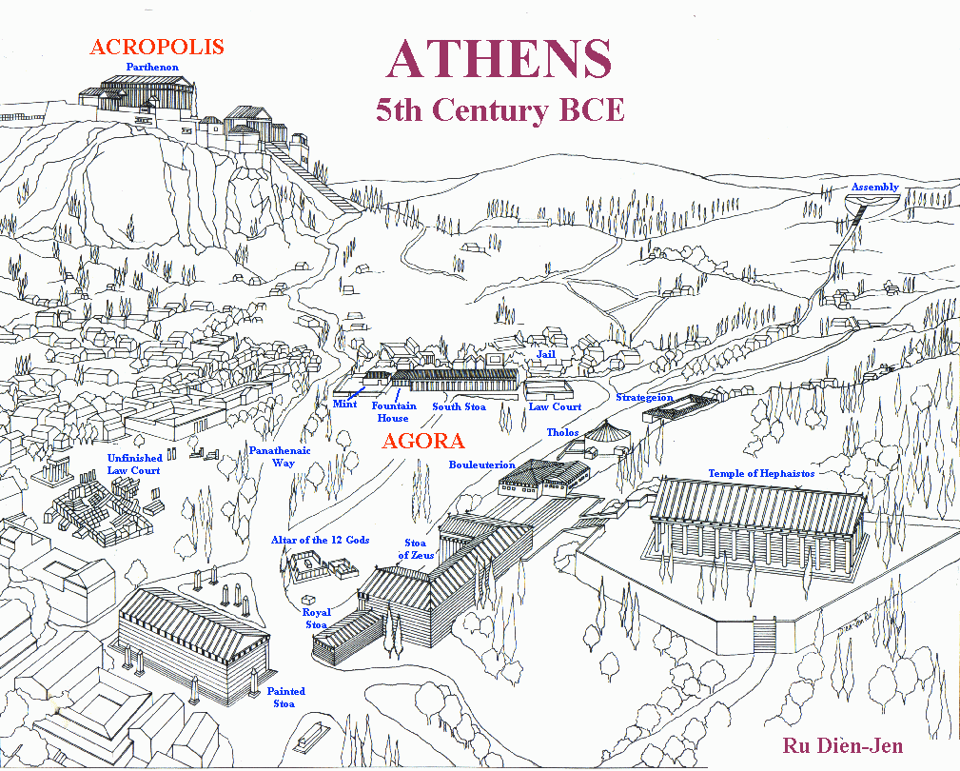
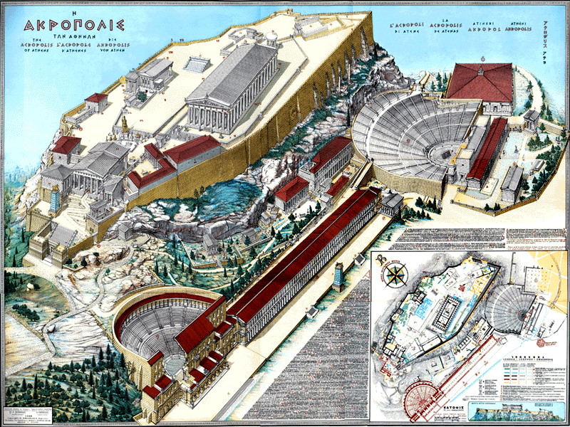
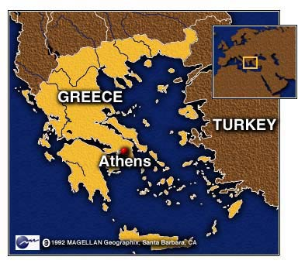
ATHENS
Ecclesia
"called out ones"
Idiotes
"one who does his own thing"
Kurioikos
"house of the Lord"
"church" via Latin
Notes:
13
The church is a body—not a building.
In ancient Athens, the citizens were very appreciative of their privilege to be a vital part of the city-state—and they recognized their responsibility as well. When a herald would call a meeting of the citizens, each would close his shop, drop what he was doing, and walk out of the city, past the Acropolis and to the next hill for a meeting. This group became known as the ecclesia, or "called out ones."
Some citizens, of course, loved the privileges of being part of the city-state but felt no responsibility for it. They left their shops open and refused to join the ecclesia, so the latter called them idiotes, or ones who did their own thing for selfish purposes. We derive our English word "idiot" from this group of lazy people characterized by self concern and social irresponsibility (CHURCH definition of—"called out ones" by Stuart Briscoe, Singapore missionary retreat, 92).
For the first three centuries of Christianity, the body of believers was always called the ecclesia. Only in the time of Constantine in the 4th century did the term kurioikos, "house of the Lord," come about, from which through the Latin we arrive at our English word "church." The early Christians never associated themselves with a building called the "church" (CHURCH body, not a building by W.A. Criswell at DTS chapel). They saw themselves only as the ecclesia, or "called out ones"—called out from the world to be God's own people!

Slide 14
INDWELLING OF THE SPIRIT
"For we were all baptized by one Spirit into one body—whether Jews or Greeks, slave or free—and we were all given one Spirit to drink" (1 Cor. 12:13 NIV)
Notes:
14

Slide 15
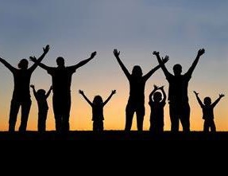
"We were all baptized by one Spirit"
Notes:
15
Similar to when Jesus was baptized with the Spirit at his water baptism, when you trusted Christ, you were baptized or initiated into this universal church.

Slide 16
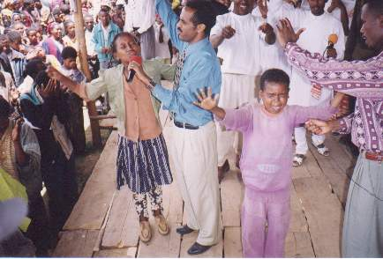
What is Spirit Baptism?
www.ohiem.org/ photo-album/index.htm
Notes:
16
If you're asked if you've received the "baptism of the Spirit," what will you say?

Slide 17
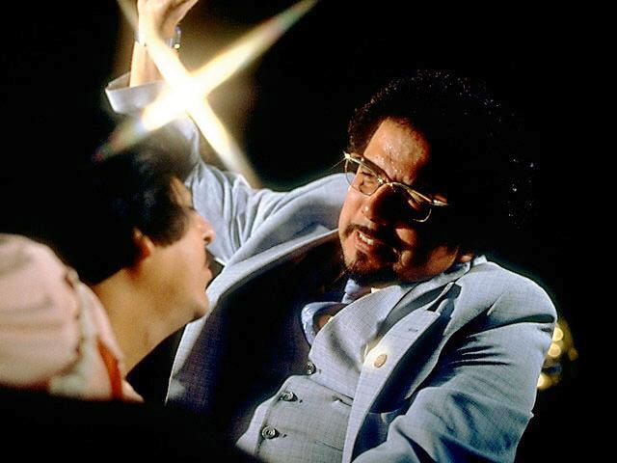
Slaying in the Spirit
xxxiv

Slide 18
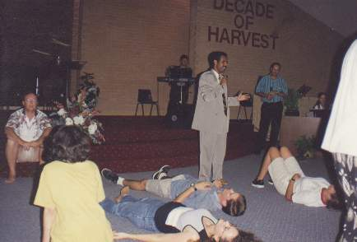
Swimming in the Spirit - Perth, Western Australia
www.ohiem.org/ photo-album/index.htm
Notes:
18
So many aberrations of this exist today—even "swimming in the Spirit"!
www.ohiem.org/ photo-album/index.htm

Slide 19
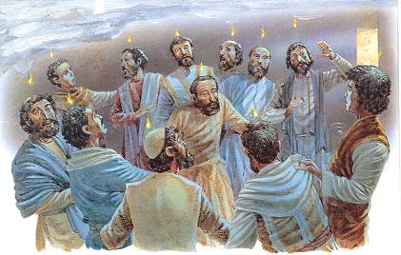
What really happened at Pentecost?
The baptism of the Spirit
The baptism with the Spirit
The baptism in the Spirit
The baptism by the Spirit
baptizo en pneumati
Notes:
I say, “There’s no such thing as the baptism of the Spirit. Scripture never once uses this phrase. The Greek can be translated as “baptized with, in, or by the Spirit.” But if you mean am I baptized with the Spirit, the answer is YES—every Christian has been baptized with the Spirit into the body of Christ.”

Slide 20
Are There Two Types of Christians?
Spirit-baptized Christians
Ordinary Christians
Christians
Non-Christians
Presented & Critiqued by Grudem, Systematic Theology, 776

Slide 21
There is One Type of Christians! Different but in One Body
Spirit-
baptized
Christians
Christians
Non-Christians
Presented & Critiqued by Grudem, Systematic Theology, 776

Slide 22
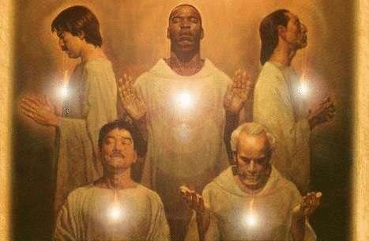
With no members, there would be no church
1 Cor. 12:13 NLT
Some of us are Jews, some are Gentiles, some are slaves, and some are free. But we have all been baptized into one body by one Spirit, and we all share the same Spirit.

Slide 23
I. It takes all the different gifts for the church to exist (12-13).
Why you need others…
Notes:
23

Slide 24
II. It takes the serving gifts for the church to function (14-20)
Why you need others…
47
Speaking | Serving
Teaching | Administering
Evangelism | Faith
Pastor-Teacher | Giving
Encouraging | Service
 | Mercy
Notes:
24

Slide 25

A. The church has many people with different gifts (14)
47
Notes:
25

Slide 26
"Now the body is not made up of one part, but many" (12:14)
47
Speaking | Serving
Teaching | Administering
Evangelism | Faith
Pastor-Teacher | Giving
Encouraging | Service
 | Mercy
Notes:
26

Slide 27
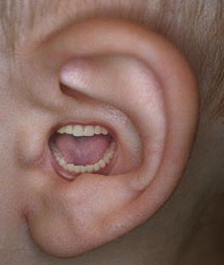
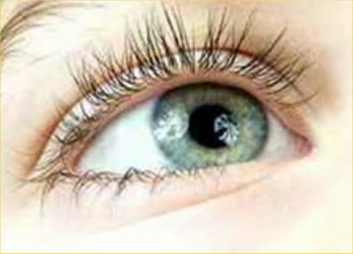
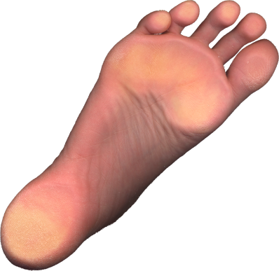
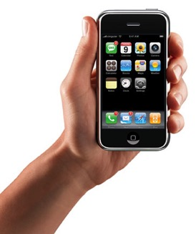

B. Believers with less honored gifts shouldn't feel unneeded (15-16).
¹⁵ If the foot should say,
"Because I am not a hand, I do not belong to the body,"
it would not for that reason cease to be part of the body.
¹⁶ And if the ear should say,
"Because I am not an eye, I do not belong to the body,"
it would not for that reason cease to be part of the body.

Slide 28
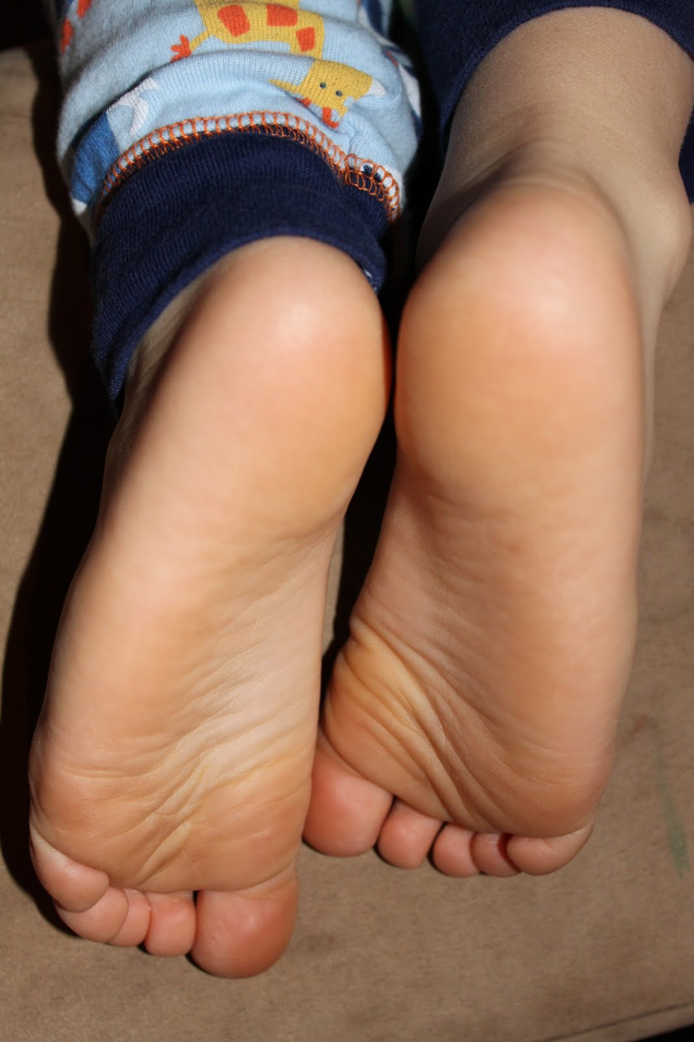
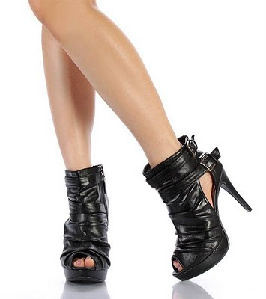
Feet
Notes:
28

Slide 29
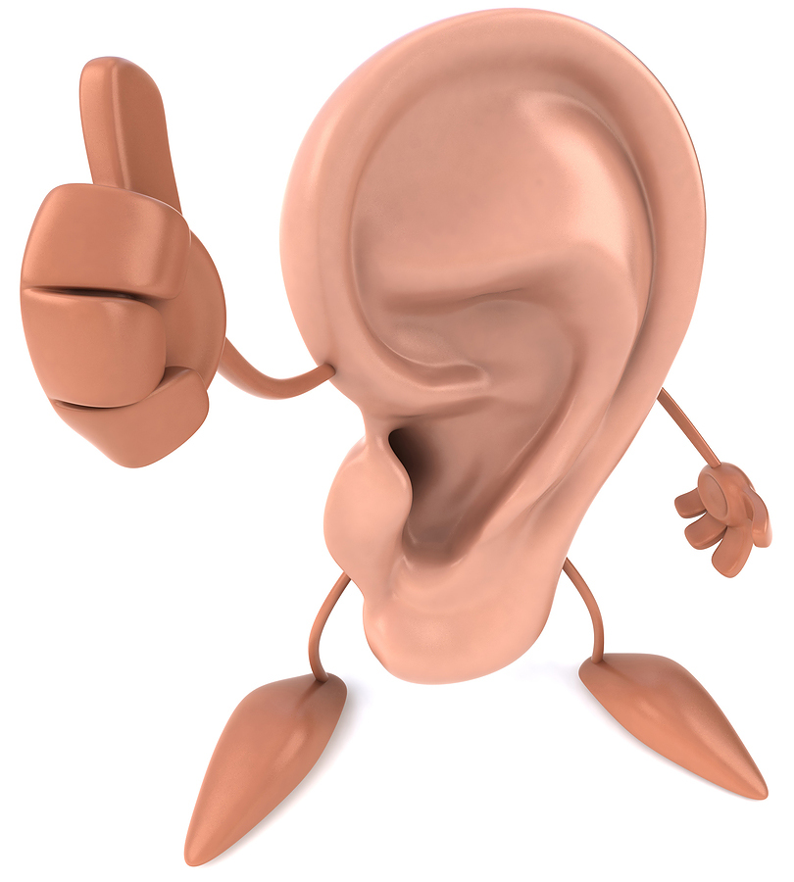
Ear
Notes:
29

Slide 30
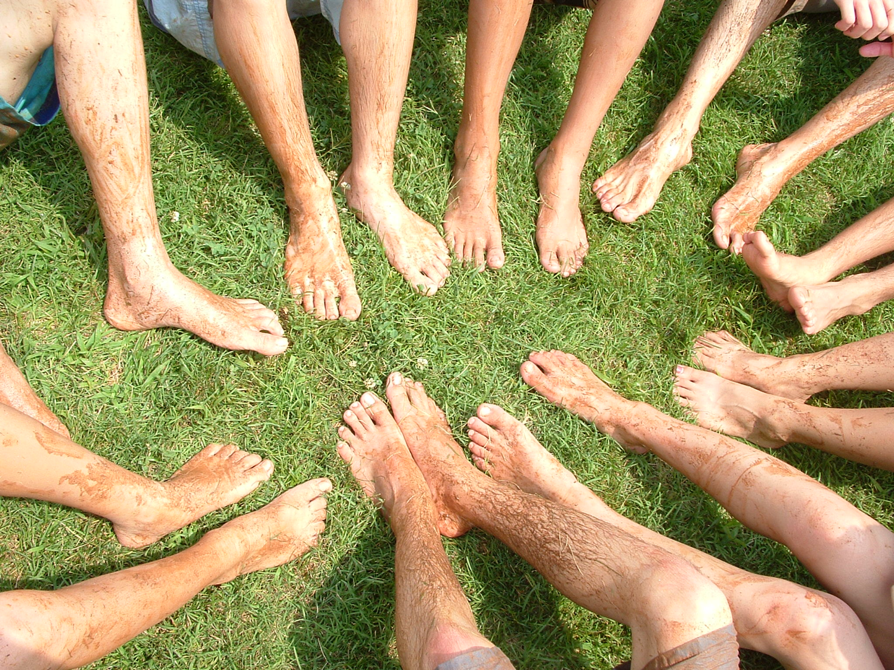
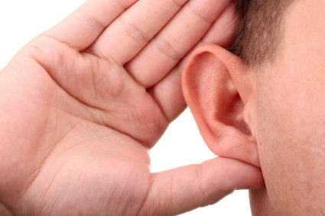
Feet & Ears
Notes:
30

Slide 31
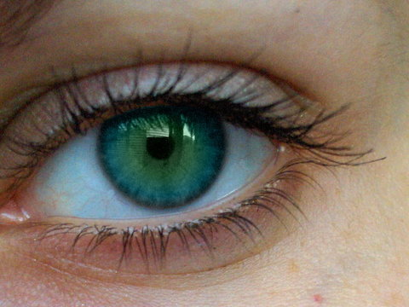
C. Diversity in the church makes it more effective (17-20).
¹⁷If the whole body were an eye, where would the sense of hearing be? If the whole body were an ear, where would the sense of smell be? ¹⁸But in fact God has arranged the parts in the body, every one of them, just as he wanted them to be. ¹⁹If they were all one part, where would the body be? ²⁰As it is, there are many parts, but one body.

Slide 32

The gift of faith
Notes:
32

Slide 33


The gift of tongues
Notes:
33

Slide 34
I. It takes all the different gifts for the church to exist (12-13).
Why you need others…
Notes:
34

Slide 35
II. It takes the serving gifts for the church to function (14-20)
Why you need others…
47
Speaking | Serving
Teaching | Administering
Evangelism | Faith
Pastor-Teacher | Giving
Encouraging | Service
 | Mercy
Notes:
35

Slide 36
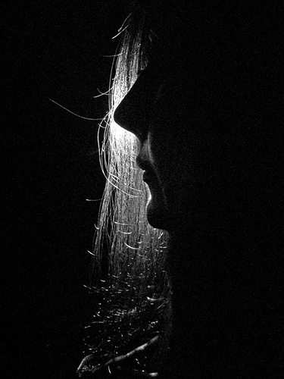
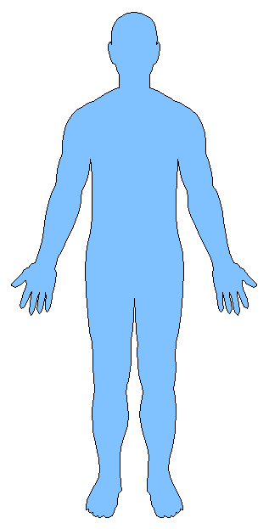
III. It takes humble use of all the gifts for the church to care (21-26).
Why you need others…
Notes:
36

Slide 37
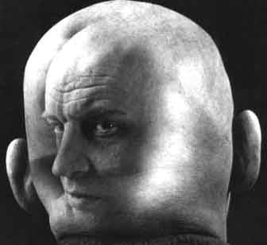
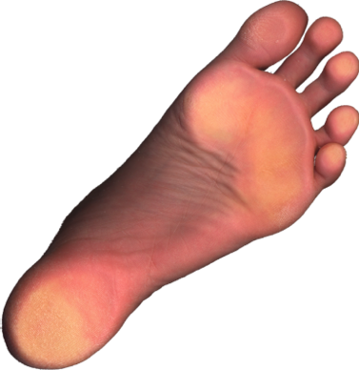
"Up-front" believers, don't pridefully say,
"I don't need you with less honored roles" (21)
"The eye cannot say to the hand,
"I don't need you!"
And the head cannot say to the feet,
"I don't need you!"

Slide 38
Weaker gifts are indispensable (22)
²²On the contrary, those parts of the body that seem to be weaker are indispensable
Notes:
38

Slide 39
Less honorable gifts are honored (23a)
²²On the contrary, those parts of the body that seem to be weaker are indispensable, ²³and the parts that we think are less honorable we treat with special honor.
Notes:
39

Slide 40
But gifts never to be seen are also guarded with modesty (23b)
…And the parts that are unpresentable are treated with special modesty.
Notes:
40

Slide 41
Yet the "up-front" believers need less acknowledgment (24a)
²⁴while our presentable parts need no special treatment.
Notes:
41

Slide 42
God gives greater honor to "behind-the-scenes" believers (24b).
But God has combined the members of the body and has given greater honor to the parts that lacked it.
Notes:
42

Slide 43
God honors serving gifts so we'll care for them too (25-26).
²⁵so that there should be no division in the body, but that its parts should have equal concern for each other. ²⁶If one part suffers, every part suffers with it; if one part is honored, every part rejoices with it.
Notes:
43

Slide 44
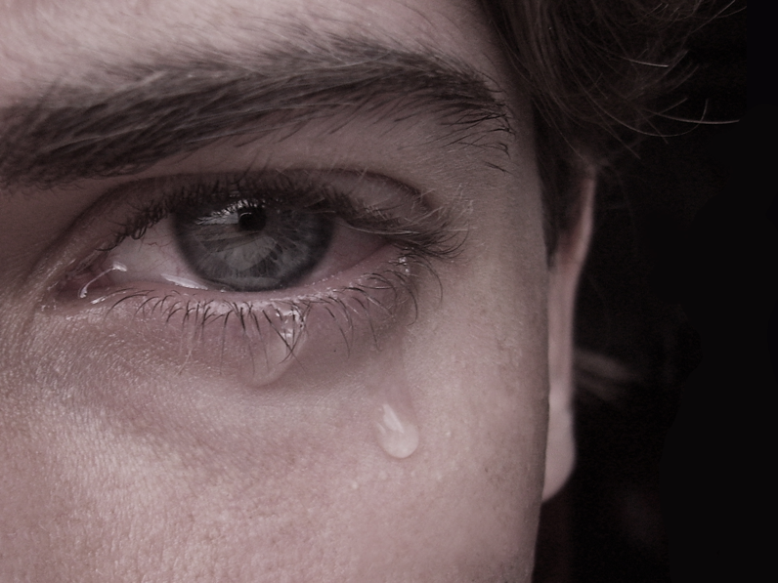

"Sorrows shared are halved, joys shared are doubled."
––Swedish Proverb
Notes:
44

Slide 45
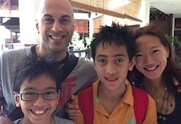
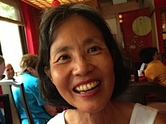
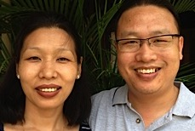
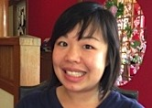
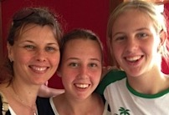
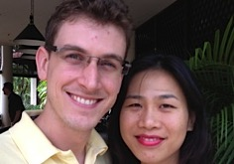
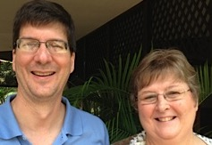
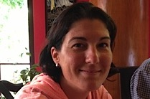
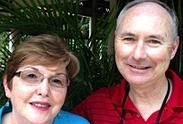
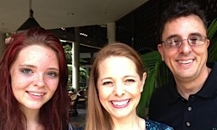
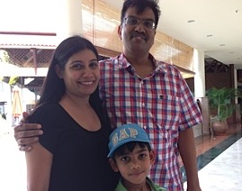
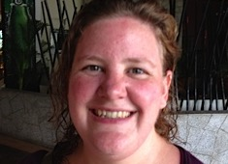


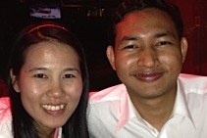
IV. It takes all of our gifts for the church to be diversified (27-31).
Why you need others…
Notes:
45

Slide 46

A. The church is composed of diversified members (27).
"Now you are the body of Christ, and each one of you is a part of it."
Notes:
46

Slide 47
B. The hierarchy of members shows that all don't have the same gifts
(28-30).
And in the church God has appointed
first of all apostles,
second prophets,
third teachers,
then workers of miracles,
also those having gifts of healing,
those able to help others,
those with gifts of administration,
and those speaking in different kinds of tongues.
Are all apostles? Are all prophets? Are all teachers?
Do all work miracles? Do all have gifts of healing?
Do all speak in tongues? Do all interpret?
Notes:
47

Slide 48
C. Emphasize the gifts that edify the most members (31).
1 Corinthians 12:31 "But eagerly desire the greater gifts."
"desire" = "all of you desire" (second person plural)
"greater gifts" = 12:28
Notes:
48

Slide 49
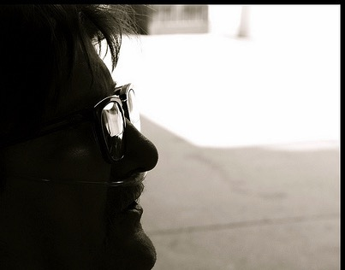
Four reasons we need others
It takes all the different gifts for the church to exist (12-13).
It takes serving gifts for the church to function (14-20).
It takes humble use of all the gifts for the church to care (21-26).
It takes all of our gifts for the church to be diversified (27-31).
Notes:
49

Slide 50
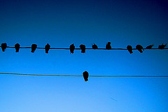
Main Idea
So why do you need
everyone in this church?
You're only one part of the body!
Notes:
50

Slide 51

What's Your Plan?
How can I better show my need for others at this church?
Notes:
51

Slide 52

Spiritual Gifts Inventory
Notes:
52

Slide 53
Black
Notes:
53

Slide 54


NT Preaching link at BibleStudyDownloads.org
Get this presentation and script for free!
Notes:
NT Preaching (np)

