Slide 1
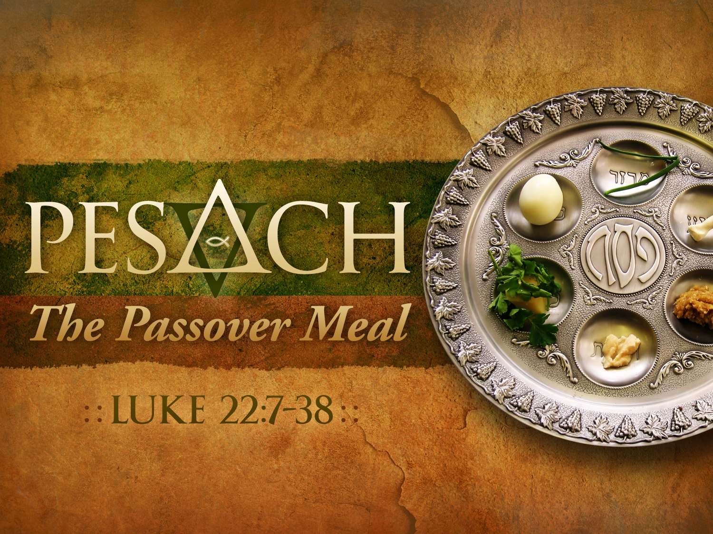
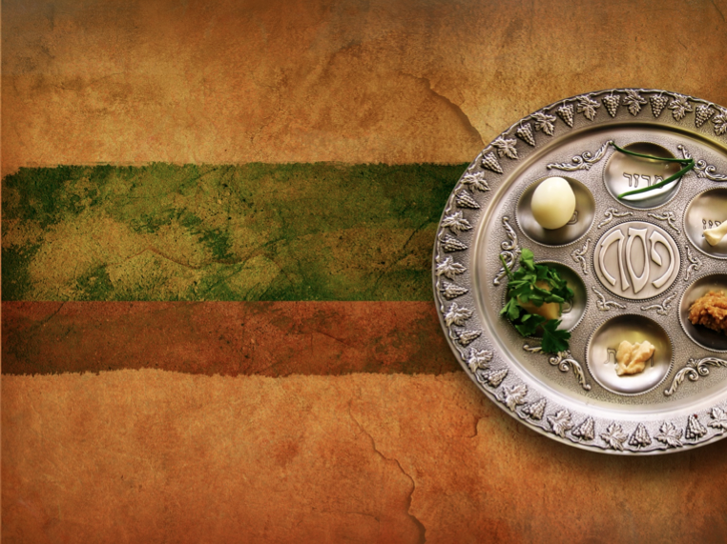
PESACH
The Passover Meal
LUKE 22:7-38
Dr. Rick Griffith • Jordan Evangelical Theological Seminary • BibleStudyDownloads.org

Slide 2
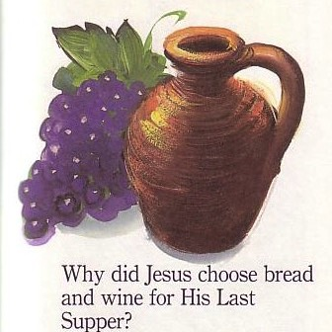
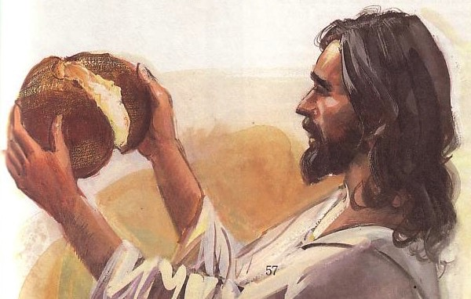
Passover & the Lord's Supper
143
Four Comparisons
Why did Jesus choose bread and wine for His Last Supper?

Slide 3
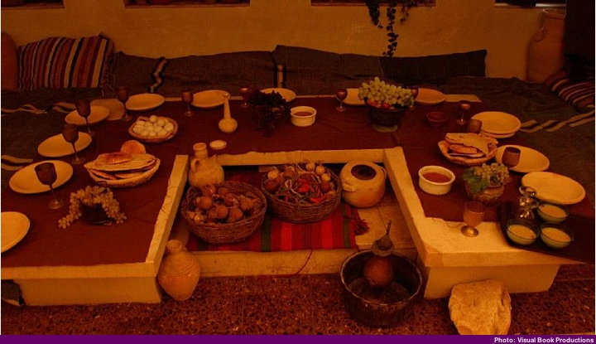
"U" Shaped Table

Slide 4
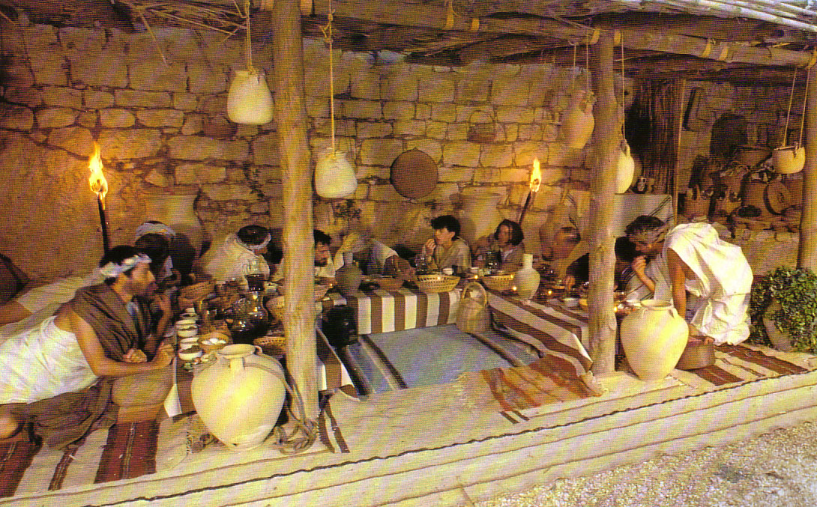
Seating at Jesus' Passover

Slide 5
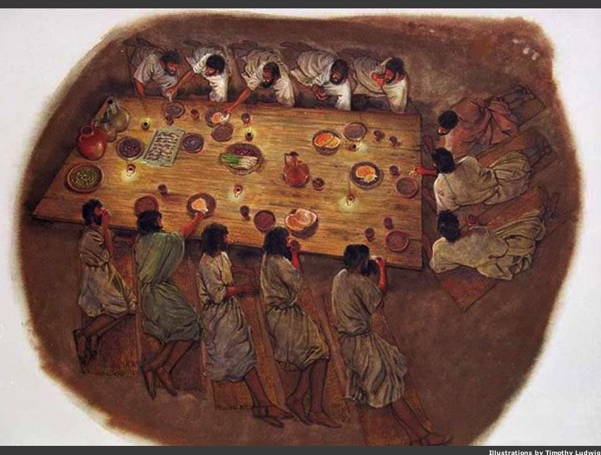
Seating
Notes:
Where did the head of the table sit?

Slide 6
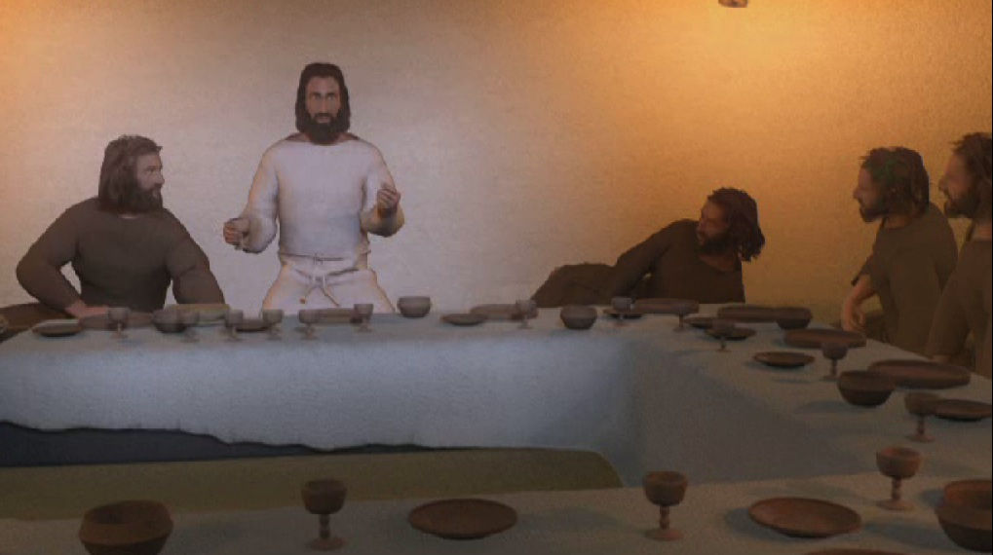
The Head of the Table
Jesus
John
Judas

Slide 7
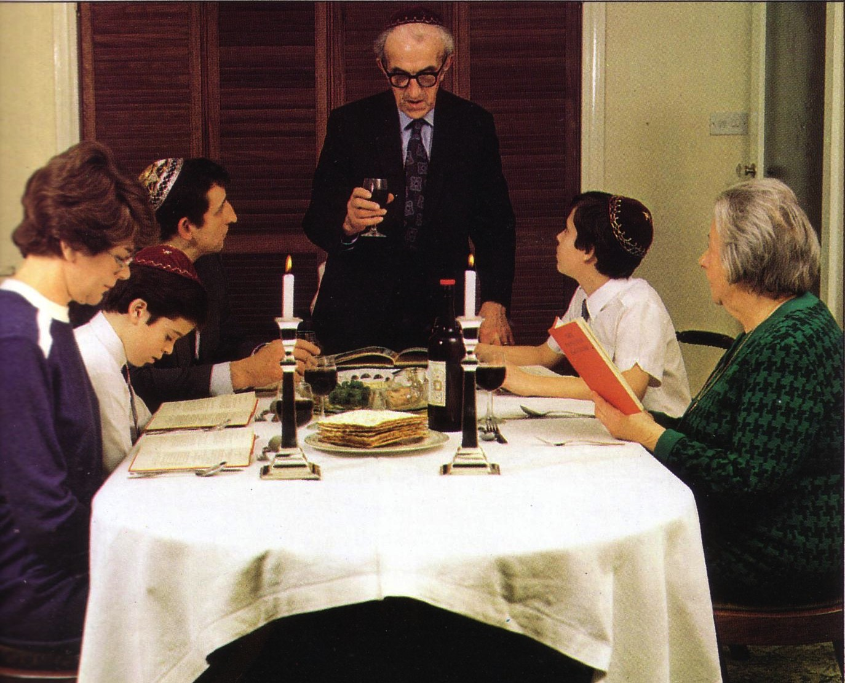
Modern Passover

Slide 8
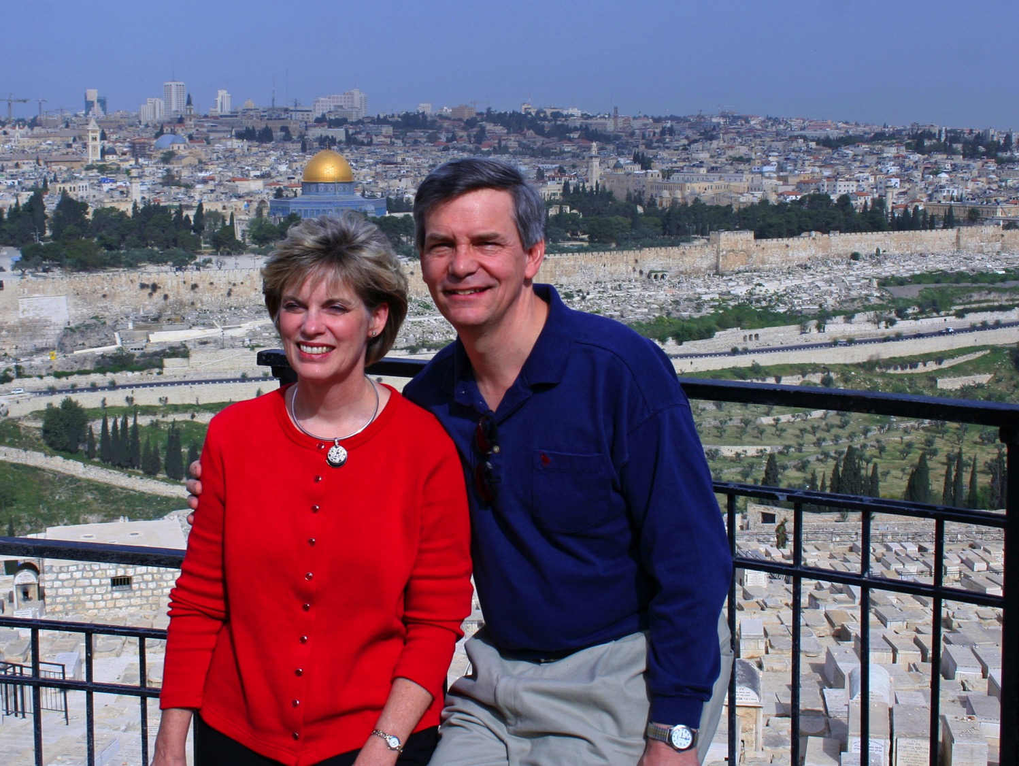
"This year we are here.
Next year in Jerusalem!"

Slide 9

The Agape (Love) Feast

Slide 10

"This cup is the new covenant in my blood" (Jer 31: 31-34)
Israel and Judah reunited (31:31-32)
Spirit indwelling (31:33)
No need for evangelism (31:34a)
Israel forgiven (31:34b)

Slide 11
The Four Directions
(Adapted from David Watson, I Believe in the Holy Spirit)
143
Look... | Passover (Jewish) | Lord's Supper (Christian)
Outward | Whole family involved (Exod. 12:3-4, 16) | Fellowship and unity (1 Cor. 11:17-22; 10:16-17)
Back | Deliverance from Egypt (Exod. 12:31-42) | Deliverance from sin (1 Cor. 11:23-25)
Forward | Wait for messianic age (Ezek. 45:21) | Anticipate return of Christ (1 Cor. 11:26; Mark 14:25)
Inward | Purify house of leaven or evil (Exod. 12:8, 15) | Examine sin in yourself (1 Cor. 11:27-32; cf. 5:6-8)

Slide 12
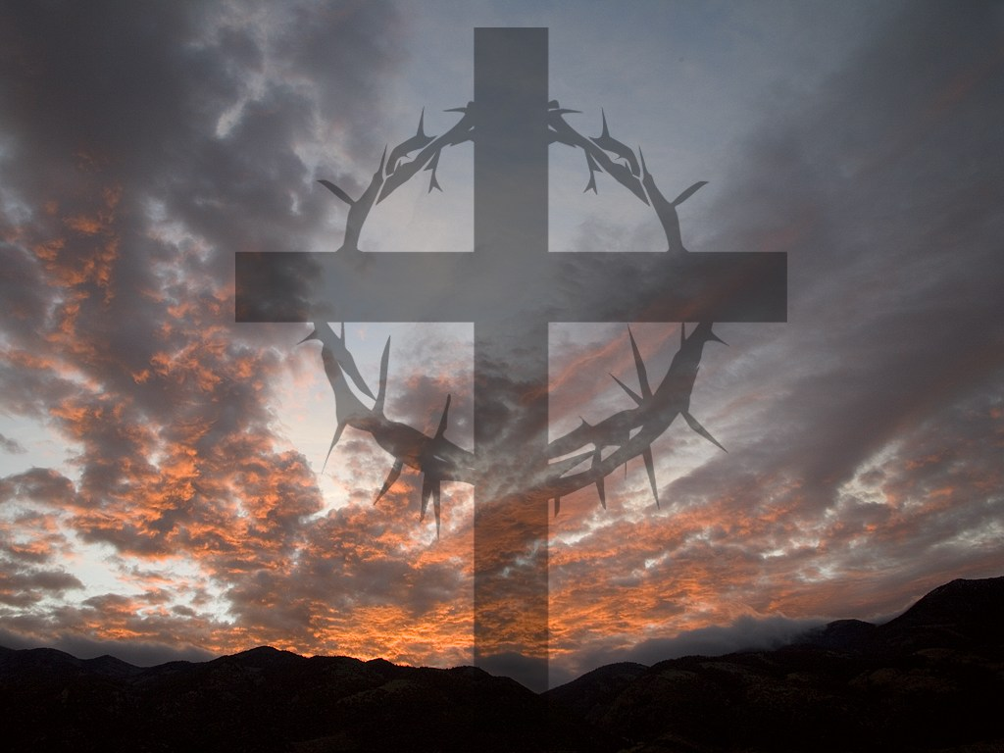
I. Look outward at your relationship with other believers
The Four Directions
outward

Slide 13
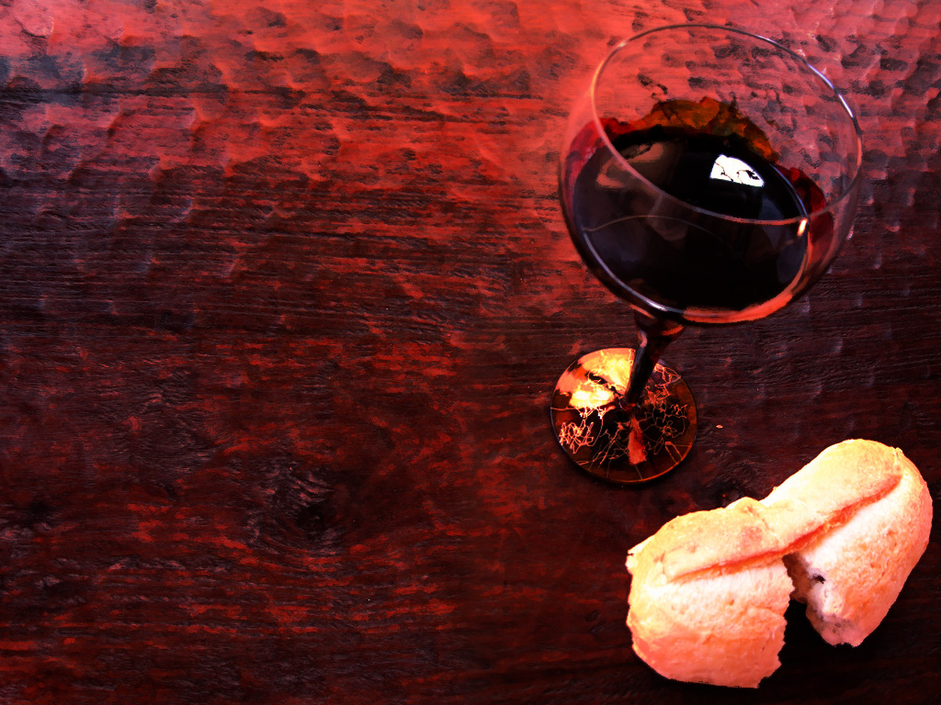
1 Corinthians 11:17-19 (NLT)
But in the following instructions, I cannot praise you. For it sounds as if more harm than good is done when you meet together. ¹⁸First, I hear that there are divisions among you when you meet as a church, and to some extent I believe it. ¹⁹But, of course, there must be divisions among you so that you who have God's approval will be recognized!
Notes:
13

Slide 14
1 Corinthians 11:20-22 (NLT)
When you meet together, you are not really interested in the Lord's Supper. ²¹For some of you hurry to eat your own meal without sharing with others. As a result, some go hungry while others get drunk. ²²What? Don't you have your own homes for eating and drinking? Or do you really want to disgrace God's church and shame the poor? What am I supposed to say? Do you want me to praise you? Well, I certainly will not praise you for this!
Notes:
14

Slide 15

1 Cor. 10:15-18 (NLT)
¹⁵You are reasonable people. Decide for yourselves if what I am saying is true. ¹⁶When we bless the cup at the Lord's Table, aren't we sharing in the blood of Christ? And when we break the bread, aren't we sharing in the body of Christ? ¹⁷And though we are many, we all eat from one loaf of bread, showing that we are one body. ¹⁸Think about the people of Israel. Weren't they united by eating the sacrifices at the altar?

Slide 16
Matthew 5:23-24
?
"Therefore if you are presenting your offering at the altar, and there remember that your brother has something against you, leave your offering there before the altar and go; first be reconciled to your brother, and then come and present your offering."

Slide 17
I. Look outward at your relationship with other believers
The Four Directions
outward

Slide 18
II. Look back at Christ's death for you
The Four Directions
outward
back

Slide 19
1 Corinthians 11:23-25
²³For I received from the Lord what I also passed on to you: The Lord Jesus, on the night he was betrayed, took bread, ²⁴and when he had given thanks, he broke it and said, "This is my body, which is for you; do this in remembrance of me." ²⁵In the same way, after supper he took the cup, saying, "This cup is the new covenant in my blood; do this, whenever you drink it, in remembrance of me."
Notes:
19

Slide 20
II. Look back at Christ's death for you
The Four Directions
outward
back

Slide 21
III. Look forward to Christ's second coming
The Four Directions
outward
back
forward

Slide 22
1 Corinthians 11:26 (NLT)
²⁶For whenever you eat this bread and drink this cup, you proclaim the Lord's death until he comes.
Notes:
22

Slide 23
III. Look forward to Christ's second coming
The Four Directions
outward
back
forward

Slide 24
IV. Look inward to deal with any unconfessed sin
The Four Directions
outward
back
forward
inward

Slide 25
1 Corinthians 11:27-29 (NLT)
²⁷Therefore, whoever eats the bread or drinks the cup of the Lord in an unworthy manner will be guilty of sinning against the body and blood of the Lord. ²⁸A man ought to examine himself before he eats of the bread and drinks of the cup. ²⁹For anyone who eats and drinks without recognizing the body of the Lord eats and drinks judgment on himself.
Notes:
25

Slide 26
1 Corinthians 11:30-32 (NLT)
³⁰ That is why many among you are weak and sick, and a number of you have fallen asleep. ³¹But if we judged ourselves, we would not come under judgment. ³²When we are judged by the Lord, we are being disciplined so that we will not be condemned with the world.
Notes:
26

Slide 27
1 Corinthians 11:33-34 (NLT)
³³So then, my brothers, when you come together to eat, wait for each other. ³⁴If anyone is hungry, he should eat at home, so that when you meet together it may not result in judgment. And when I come I will give further directions.
Notes:
27

Slide 28

Think!
inward

Slide 29
Look in all four directions!
The Four Directions
outward
back
forward
inward

Slide 30
The Four Directions
(Adapted from David Watson, I Believe in the Holy Spirit)
143
Look... | Passover (Jewish) | Lord's Supper (Christian)
Outward | Whole family involved (Exod. 12:3-4, 16) | Fellowship and unity (1 Cor. 11:17-22; 10:16-17)
Back | Deliverance from Egypt (Exod. 12:31-42) | Deliverance from sin (1 Cor. 11:23-25)
Forward | Wait for messianic age (Ezek. 45:21) | Anticipate return of Christ (1 Cor. 11:26; Mark 14:25)
Inward | Purify house of leaven or evil (Exod. 12:8, 15) | Examine sin in yourself (1 Cor. 11:27-32; cf. 5:6-8)

Slide 31
To properly look back on His death and look forward to His return, we need to look outward for others and look inward at our own lives.
The Main Idea
outward
back
forward
inward

Slide 32
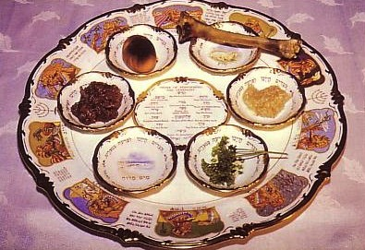
Seder Plate
Matzah
Lamb Shankbone
Charoset
Horseradish
Salt Water
Bitter Herbs
Items on the Seder Plate

Slide 33
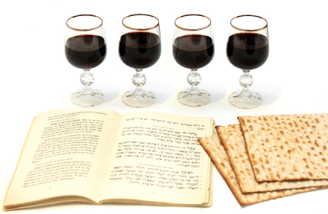
Key Elements

Slide 34
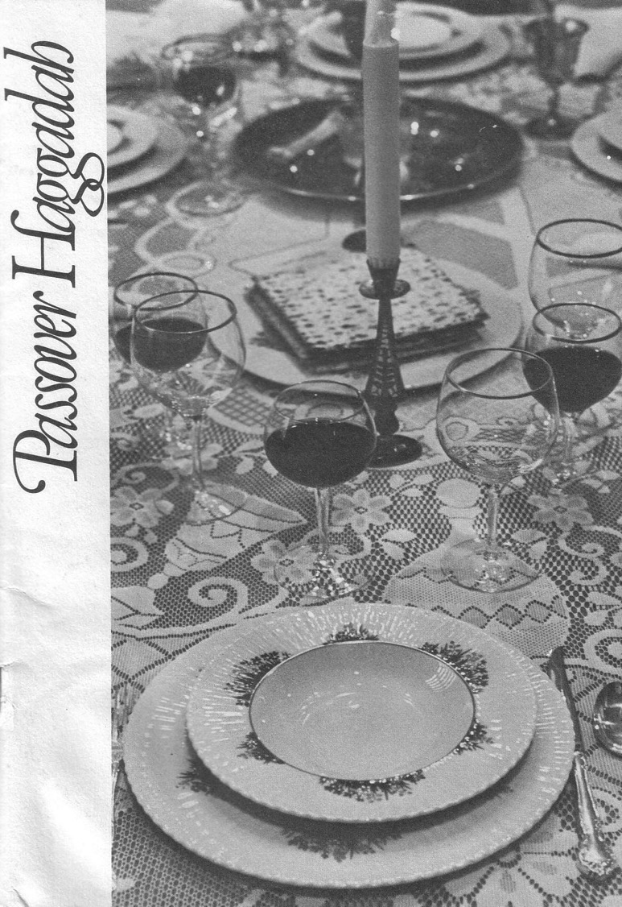
The Four Cups (Exod. 6:6-7)
145
Sanctification
Plagues
Redemption
Praise

Slide 35
The Order of the Celebrations
144
Passover | Lord's Supper
Light candles | Assumed (not recorded)
1st Cup: Blessing/Sanctification, saying, "I will bring you out from under the burdens of the Egyptians" (1st of 4 "I wills" of Exod. 6:6-7) | "Take this and divide it among yourselves… I will not drink again of the fruit of the vine until the kingdom of God comes" (Luke 22:17b-18)
Washing of one's own hands | Washed disciples feet during meal (John 13:2, 4)
Parsley dipped in salt water (bitterness), middle matzah (bread) made visible and broken and 1/2 called "afikomen" (Gr. "he who comes later") wrapped with napkin and hidden | Son of God (second member of the Trinity) made visible, broken, body wrapped, and buried in a tomb (this tradition was added to the Passover by first century AD Jewish believers)
Passover story read (Exod. 12:1-13), 4 Questions, 4 sons, 10 Plagues | Assumed (not recorded)

Slide 36
The Order of the Celebrations
144
Passover | Lord's Supper
2nd Cup: Plagues/Judgment, saying, "I will rid you of their bondage"
Washing hands, eat upper and 1/2 middle matzah and bitter herbs with bottom matzah (bondage)
Passover Supper begins
Eat bitter herbs with charoseth of dates, honey, & almonds (sweetness of life with God's redemption), roasted egg (temple offerings & destruction, grief and new life), shankbone | Jesus dips the sop with Judas and Judas leaves (?)
Eat afikomen—"This is the bread of affliction…" | "This is my body…" (Luke 22:19)

Slide 37
The Order of the Celebrations
144
Passover | Lord's Supper
3rd Cup: Redemption, saying, "I will redeem you with an outstretched arm" | "This is my blood…" (Luke 22:20) Jesus dips the sop with Judas and Judas leaves (?)
4th Cup: Praise/Regathering, saying, "I will take you to me for a people" & read Pss. 113–118 | "For as often as you eat this bread and drink this cup, you proclaim the Lord's death until he comes"
Declaration ("Next year in Jerusalem!"), hymn (Ps. 118), poem, or national anthem | Sang hymn & went to Mt. of Olives (Matt. 26:30)
Cup of Elijah: Filled but untouched; symbolizes his return before Messiah (Mal. 4:5-6; Matt. 11:13-14; 17:11-12; Rev. 11:3-12; 19:11-21), youngest child opens front door "for Elijah" | Assumed (not recorded)

Slide 38
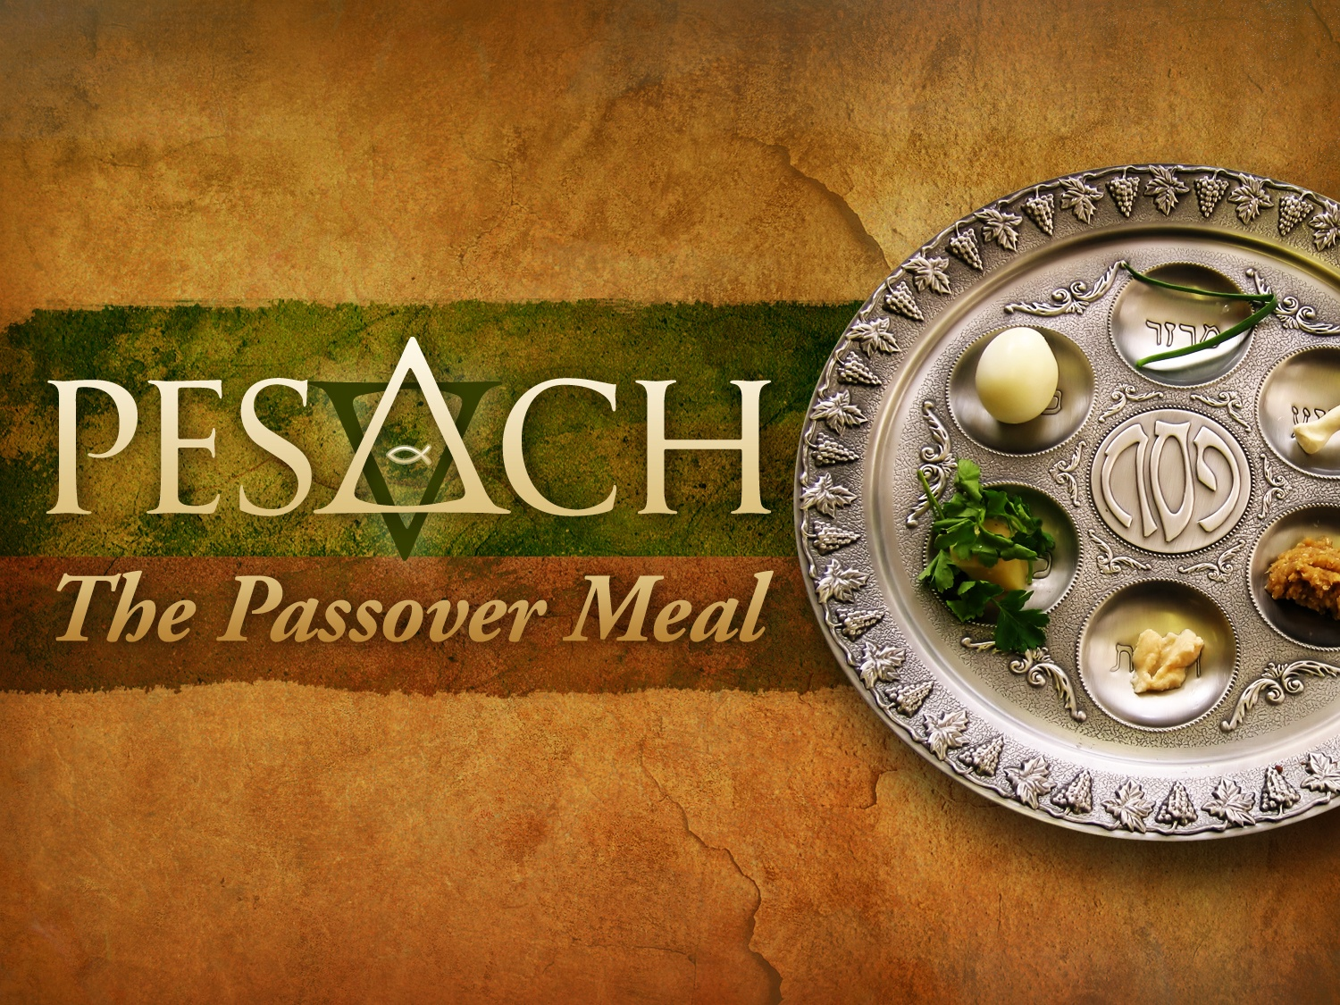
Passover Title Slide (no Scripture)
PESACH
The Passover Meal
Notes:
OS-02-Exodus-166
NB-14-Passover-38

Slide 39

Lighting the Candles
Mothers recite together

Slide 40
The Four Cups (Exod. 6:6-7)
145
"Therefore, say to the Israelites:
'I am the Lord, and I will bring you out from under the yoke of the Egyptians.
Sanctification

Slide 41
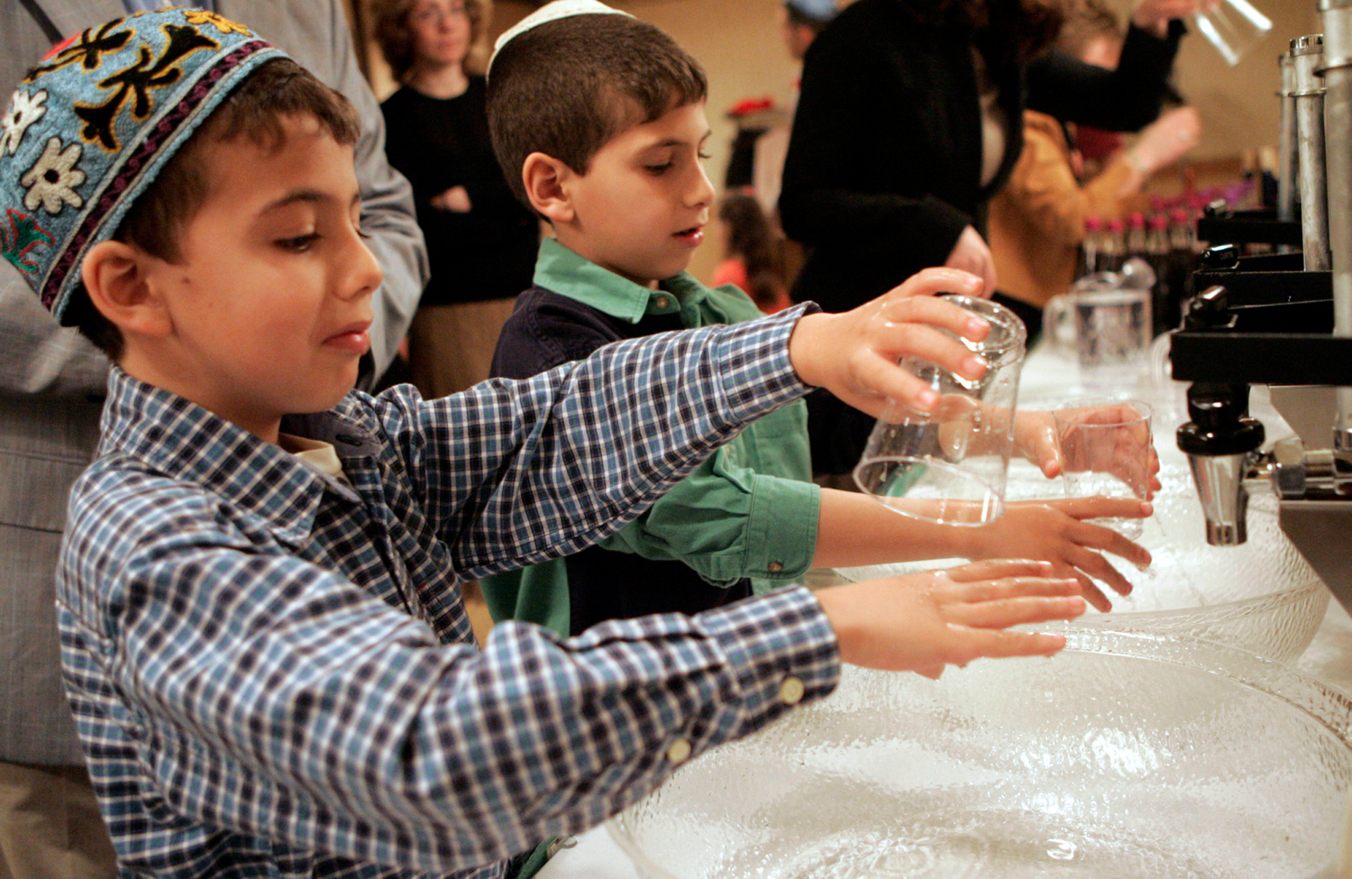
We Teach Kids to Wash Their Hands

Slide 42
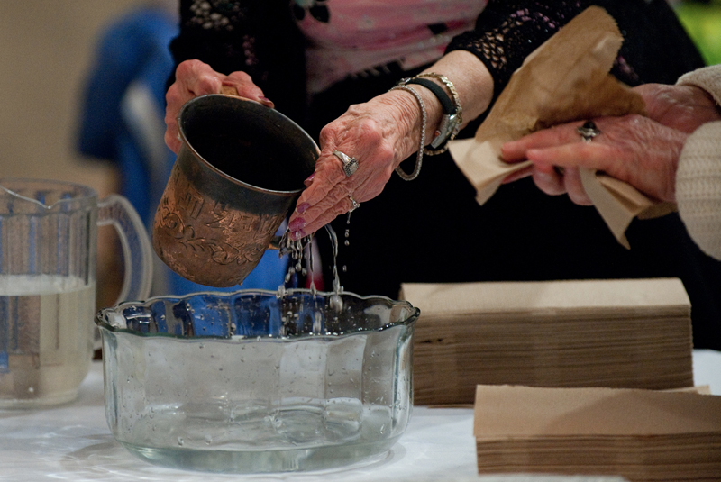
The Seder Leader Washes His Hands

Slide 43
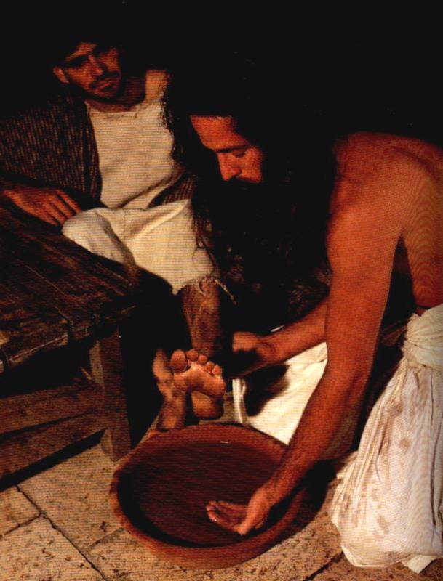
Feet instead of hands

Slide 44


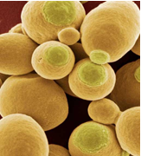

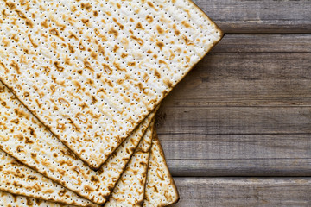
Feast of Unleavened Bread
184
Notes:
www.stephenwilliamson.com/ Hobbies/bakin.htm (Yeast bloom)

Slide 45
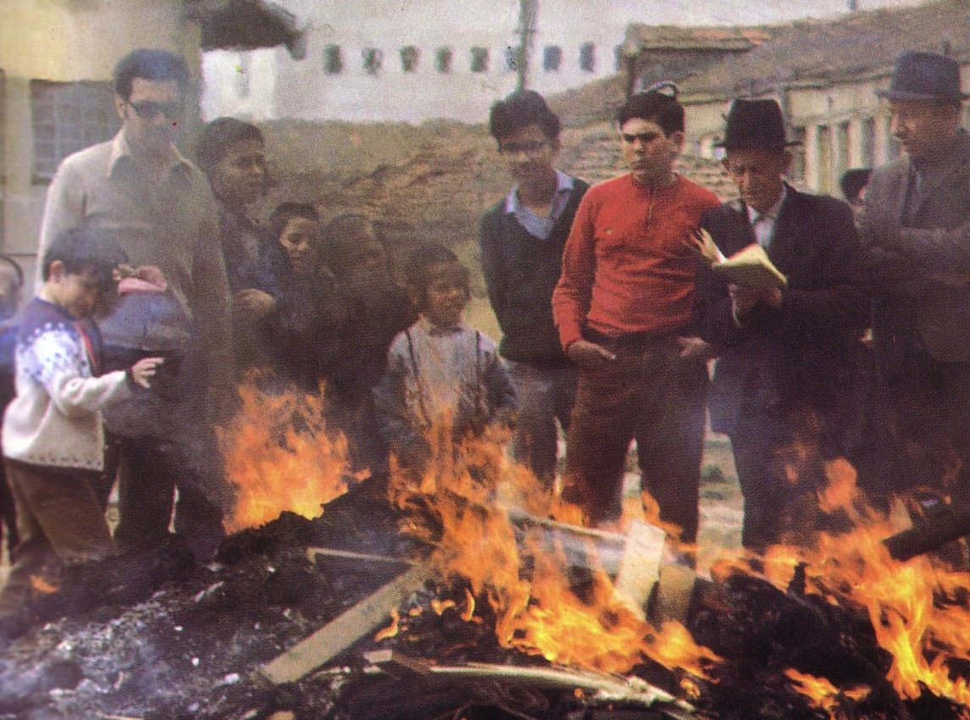
"Burn All the Yeast!"

Slide 46
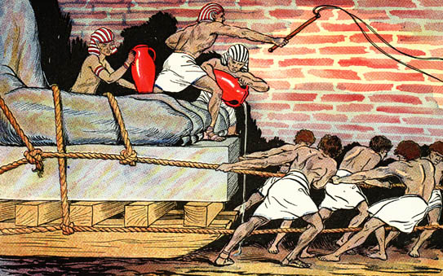
Egyptians Ruthlessly Oppressed Israel

Slide 47
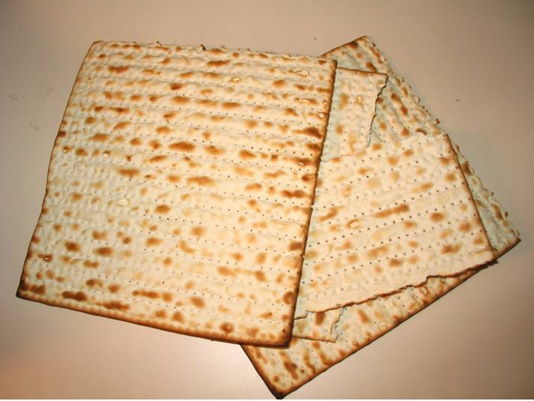
The Three Matzah
Striped and pierced…

Slide 48
Hagadah
The Four Questions

Slide 49
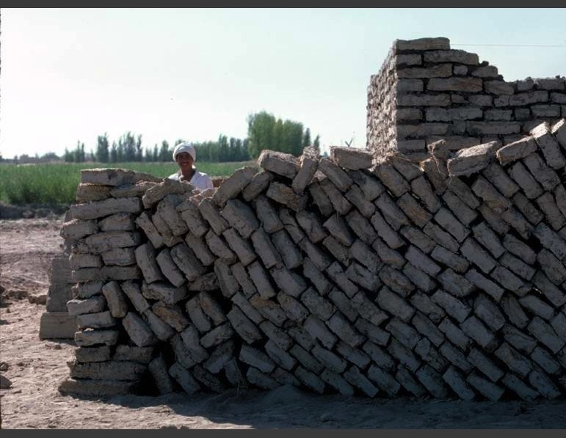
Mud Bricks

Slide 50

Exodus 12:1-16
The Angel of Death Passed Over Houses with Blood on the Doors
Thus says the LORD, "About midnight I will go out in the midst of Egypt" (Exod. 11:4)

Slide 51
The Three Matzah
Striped and pierced…

Slide 52
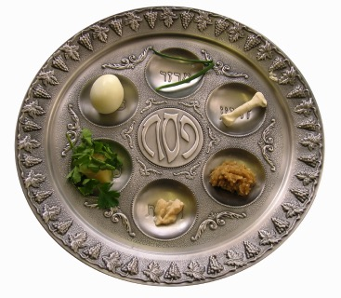
Seder Plate Elements

Slide 53

Jesus' death paid for our sin

Slide 54
The Four Cups (Exod. 6:6-7)
145
"Therefore, say to the Israelites:
'I am the Lord, and I will bring you out from under the yoke of the Egyptians.
Sanctification
Plagues
I will free you from being slaves to them,

Slide 55
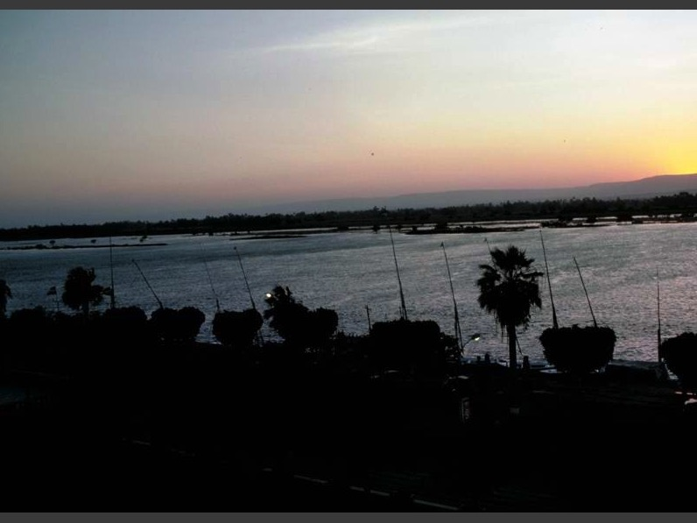
10 PLAGUES
Blood
Frogs
Gnats
Flies
Livestock
Boils
Hail
Locusts
Darkness
Firstborn
Exodus 7-12

Slide 56
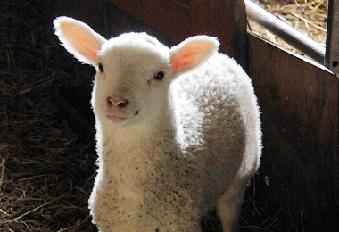

Slide 57

Passover Protection
"The blood will be a sign for you on the houses where you are; and when I see the blood, I will pass over you. No destructive plague will touch you when I strike Egypt."
Exodus 12:13 (NIV)

Slide 58
Faith Pictured
"By faith he kept the Passover and the sprinkling of blood, so that the destroyer of the firstborn would not touch the firstborn of Israel."
Hebrews 11:28 (NIV)

Slide 59
The Lamb Pictured
"The next day John saw Jesus coming toward him and said, 'Look, the Lamb of God, who takes away the sin of the world!'"
John 1:29 (NIV)

Slide 60
The Cross Pictured
"For Christ, our Passover lamb, has been sacrificed."
1 Corinthians 5:7 (NIV)

Slide 61

Faith in a Lamb

Slide 62


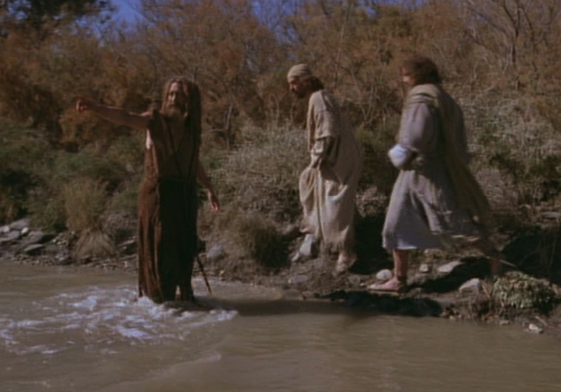
The Passover Lamb
"Look, the Lamb of God,
who takes away
the sin of the world!"
(John 1:29)

Slide 63
The Three Matzah
Striped and pierced…

Slide 64
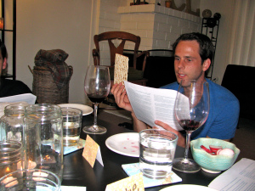
The Passover Leader & Matzah

Slide 65
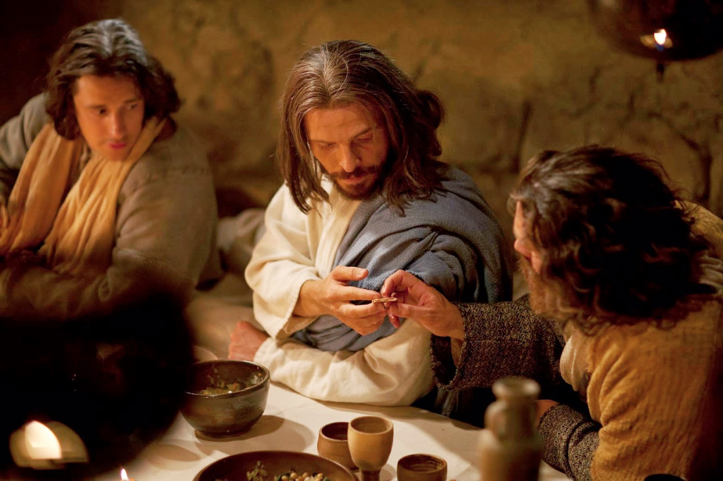
Jesus Passed the Matzah to Judas
Striped and pierced…

Slide 66
The Four Cups (Exod. 6:6-7)
145
"Therefore, say to the Israelites:
'I am the Lord, and I will bring you out from under the yoke of the Egyptians.
Sanctification
Plagues
I will free you from being slaves to them,
and I will redeem you with an outstretched arm and with mighty acts of judgment.
Redemption

Slide 67


… This is my body
GIVEN FOR YOU do this in
REMEMBRANCE of me.
LUKE 22:19

Slide 68
… This cup is the
NEW COVENANT in my blood, which is POURED OUT for you.
The cup (not baptism) is the new covenant sign
LUKE 22:20

Slide 69
Kingdom & Covenants Timeline
22 &
337
9g
Kingdom Teaching...
Adam rules with God (Gen. 1:26, 28; 2:19)
Satan rules as god of this world (Gen. 3:15;
2 Cor. 4:4)
God covenants with Abraham to reestablish man's rule via Israel as a "kingdom of priests" (Gen. 12:1-3; Exod. 19:6)
Israel's failure to witness to nations as a kingdom of priests is judged via exile under foreign rule
Israel rejects Messiah's offer of kingdom (Matt. 12:41-42; 23:37-39)
Jesus extends His kingdom in mystery form to the Church (Matt. 13)
Christ subdues Israel's enemies and nation believes (Rom. 11:26-27)
Christ rules over everything with saints (Eph. 1:9-10; Rev. 20:1-6; 22:5b)
Fall of Man (Gen. 3)
Noahic Covenant
Genesis 6:18; 9:8-17
Land Covenant
ISRAEL
CHURCH
MESSIANIC KINGDOM
(National Focus)
The "New Man" (Eph. 2:15)
Millennial Eternal
land
Genesis 15:18 (cf. Deut. 30:1-10) promises:
Land from Wadi of Egypt to Euphrates River (Isa. 27:12)
Eternal possession of land (Gen. 17:8) after exile/restoration
Whole world blessed via the land (Isa. 14:1-2)
Israel judged for rejecting Messiah by dispersion away from land for 19 centuries
(AD 70–AD 1948) but now partially restored (Ezek. 37:1-7)
Full restoration (Ezek. 37:8-28) Jerusalem world capital
(Isa. 2:1-5)
New Jerusalem
(Rev. 21–22)
Davidic Covenant
Christ is Head over His Church, which is a spiritual temple (Eph. 2:19-22; 2 Cor. 6:16)
Christ reigns over the world
(Isa. 11)
with saints (Rev. 5:10; 20:4-6)
Christ hands kingdom over to Father (1
Cor. 15:24)
Abrahamic Covenant
2 Samuel 7:12-16 promises perpetual:
Sons ("house" never wiped out)
Kingdom (political dynasty)
Throne (right to rule by descendants)
Temple (son to build it)
Genesis 12:1-3
seed
New Covenant
All
things made new!
(Rev. 21:5)
All 5 elements fulfilled in national restoration (Zech. 8)
Jeremiah 31:31-34 promises:
Forgiveness
Indwelling Spirit
New heart, nature, mind
Reunification of Israel and Judah
No need for evangelism
Mosaic Law replaced with first three elements of the New Covenant (Luke 22:20; 2 Cor. 3:6)
blessing
Mosaic Covenant
Law abolished, fulfilled, and replaced at the cross (Rom. 7:1-6;1 Cor. 9:19-21; Heb. 8:13)
Sixth Edition
15 June 2012
Temporary (Gal. 3:19) and conditional (Deut. 28) to reveal sin (Rom. 7:7) and regulate Israel (Gal. 3:23-25)
Scripture has a dual kingdom-covenant emphasis. Israel's role from Abraham to Christ expands to include the Church (continuity) yet the Church never replaces the nation as the "new Israel" (discontinuity). Israel will again enjoy world prominence after trusting in Christ at His second coming.
Notes:
Slides 13 and 127 repeated

Slide 70
The Four Cups (Exod. 6:6-7)
145
"Therefore, say to the Israelites:
'I am the Lord, and I will bring you out from under the yoke of the Egyptians.
Sanctification
Plagues
I will free you from being slaves to them,
and I will redeem you with an outstretched arm and with mighty acts of judgment.
Redemption
Praise
⁷ I will take you as my own people and be your God. Then you will know that I am the Lord your God, who brought you out from under the yoke of the Egyptians."

Slide 71
"This year we are here.
Next year in Jerusalem!"

Slide 72
Coming of Elijah
For Elijah there is:
Extra Place Setting
5th Cup
Open Door

Slide 73
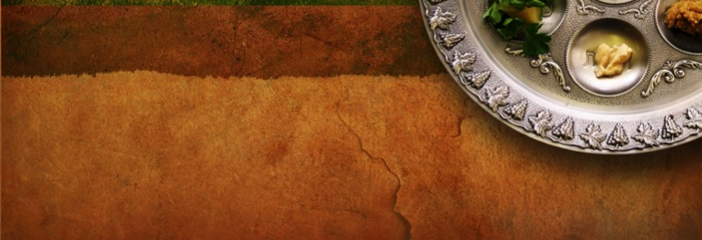
PESACH
The Passover Meal
Notes:
Translators, do NOT translate PESACH as this is Hebrew but translate “The Passover Meal”

Slide 74
O Calvary's Lamb

Slide 75
O Calvary's Lamb
This faltering tongue
Would dare to speak
Of Thee my Lord
From one so weak.
I must not keep from thee my praise.
For thy glory I will lift my voice and sing.

Slide 76
O Calvary's Lamb
O Calvary's Lamb,
O righteous One.
For sinners died
Whose sins were none.
All that I have,
All that I am
I owe to Thee
O Calvary's Lamb.

Slide 77
O Calvary's Lamb
And when my eyes
At last shall see
Thy holy face
I'll bow to thee.
Before Thy throne
With the redeemed
Unto Thee O Lord
I'll lift my voice and sing.

Slide 78
O Calvary's Lamb
O Calvary's Lamb,
O righteous One.
For sinners died
Whose sins were none.
All that I have,
All that I am
I owe to Thee
O Calvary's Lamb.

Slide 79
O Calvary's Lamb
O Calvary's Lamb,
O righteous One.
For sinners died
Whose sins were none.
All that I have,
All that I am
I owe to Thee
O Calvary's Lamb.

Slide 80
O Calvary's Lamb
All that I have,
All that I am
I owe to Thee
O Calvary's Lamb.

Slide 81
Lamb of God

Slide 82
Your only Son
No sin to hide,
But You have sent Him
From Your side
To walk upon this guilty sod
And to become the Lamb of God.

Slide 83
Your gift of Love
They crucified,
They laughed and scorned him as he died,
The humble King
They named a fraud
And sacrificed the Lamb of God.

Slide 84
O Lamb of God,
Sweet Lamb of God,
I love the Holy Lamb of God,
O wash me in His precious Blood,
My Jesus Christ, the Lamb of God.

Slide 85
I was so lost
I should have died,
But You have brought
me to Your side
To be led by Your staff and rod,
And to be called a lamb of God.

Slide 86
O Lamb of God,
Sweet Lamb of God,
I love the holy Lamb of God,
O wash me in His precious blood,
My Jesus Christ, the Lamb of God.

Slide 87
O Lamb of God,
Sweet lamb of God,
I love the Holy Lamb of God,
O wash me in His precious Blood,
My Jesus Christ, the Lamb of God.
O wash me in His precious Blood
My Jesus Christ, the Lamb of God.

Slide 88
Passover Title Slide (no Scripture)

Slide 89
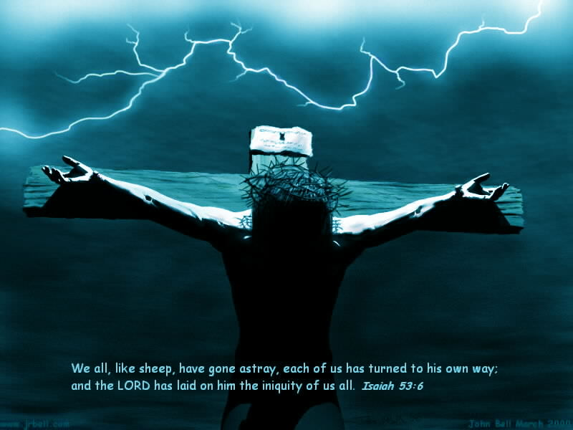
"This is my body, which is for you…"

Slide 90
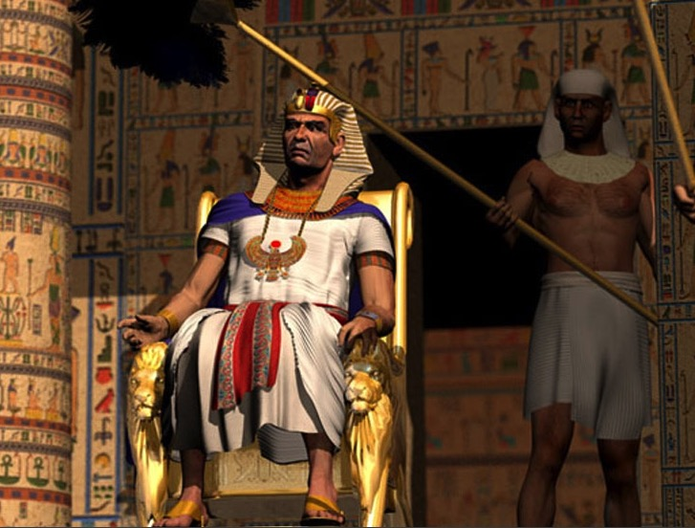
"Ultimate" Power

Slide 91
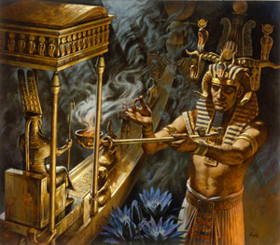
Who has greater power – Pharaoh or Yahweh?

Slide 92
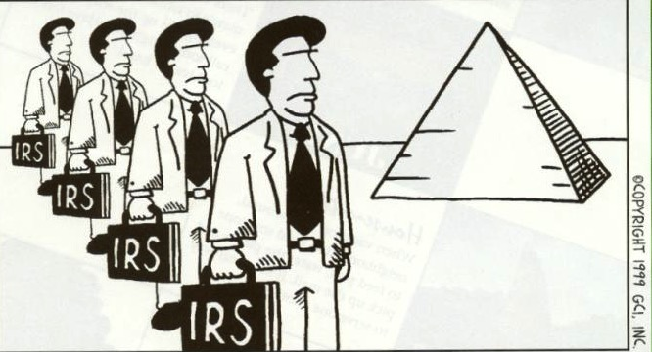

IRS Plague
Luckily for the Egyptians, the eleventh plague was never needed.

Slide 93
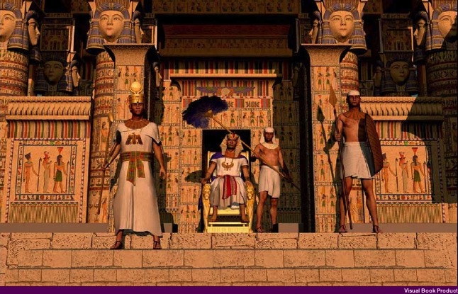
Meaning of Plagues
"On that same night I will pass through Egypt and strike down every firstborn—both men and animals—
and I will bring judgment on all the gods of Egypt. I am the LORD."
Exodus 12:12 (NIV)

Slide 94
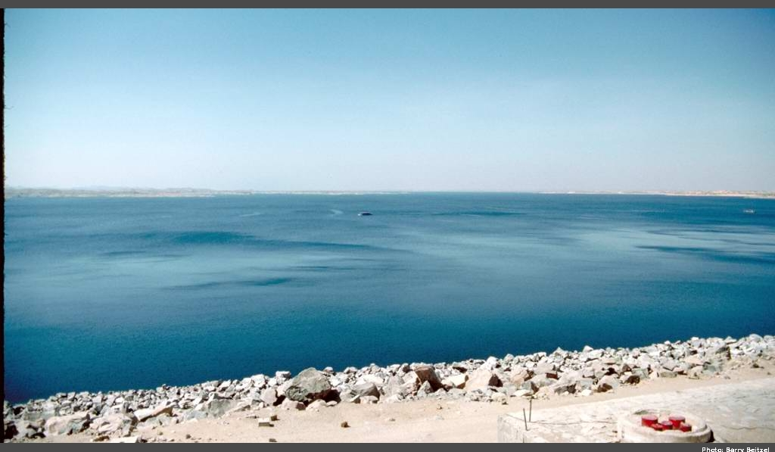
Recalling the Exodus Significance
"The Israelites set out from Rameses on the fifteenth day of the first month, the day after the Passover. They marched out boldly in full view of all the Egyptians, who were burying all their firstborn, whom the LORD had struck down among them"
Numbers 33:3-4 (NIV)

Slide 95
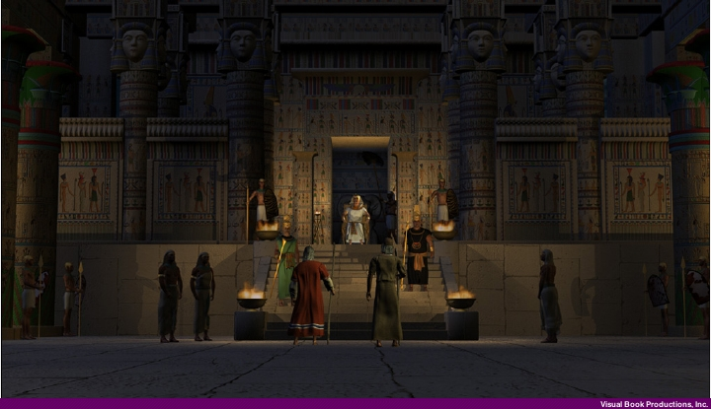
Recalling the Exodus Significance
"for the LORD had brought judgment on their gods."
Numbers 33:4 (NIV)

Slide 96
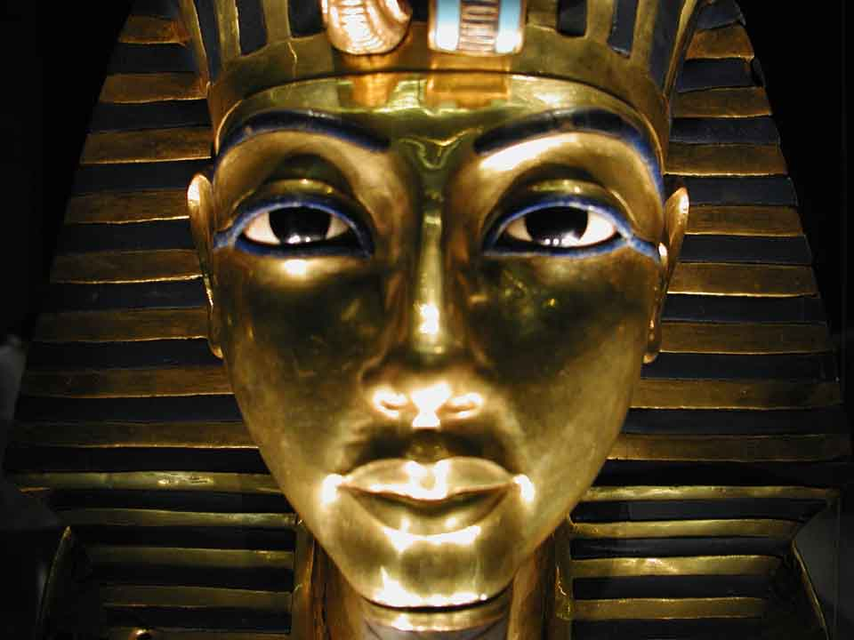
The Plagues and the Gods of Egypt
John H. Walton, Chronological and Background Charts of the OT, 2d ed., 85
106
PLAGUE
REFERENCE
POSSIBLE EGYPTIAN DEITY DIRECTED AGAINST
NILE TURNED TO BLOOD
Exodus
7:14-25
Khnum: guardian of the Nile
Hapi: spirit of the Nile
Osiris: Nile was bloodstream
FROGS
Exodus
8:1-1.5
Heqt: form of frog; god of resurrection
GNATS
(MOSQUITOES)
Exodus
8:16-19
FLIES
Exodus
8:20-32
PLAGUE ON CATTLE
Exodus 9:1-7
Hathor: mother-goddess; form of cow
Apis: bull of god Ptah; symbol of fertility
Mnevis: sacred bull of Heliopolis

Slide 97
The Plagues and the Gods of Egypt
John H. Walton, Chronological and Background Charts of the OT, 2d ed., 85
106
PLAGUE
REFERENCE
POSSIBLE EGYPTIAN DEITY DIRECTED AGAINST
BOILS
Exodus 9:5-12
Imhotep: god of medicine
HAIL
Exodus
9:13-35
Nut: sky goddess
Isis: goddess of life
Seth: protector of crops
LOCUSTS
Exodus l0:1-20
Isis: goddess of life
Seth: protector of crops
DARKNESS
Exodus
10:21-29
Re, Aten, Atum, Horus: all sun gods of sorts
DEATH OF FIRSTBORN
Exodus
11:1-12:36
The deity of Pharaoh: Osiris, the giver of life

Slide 98
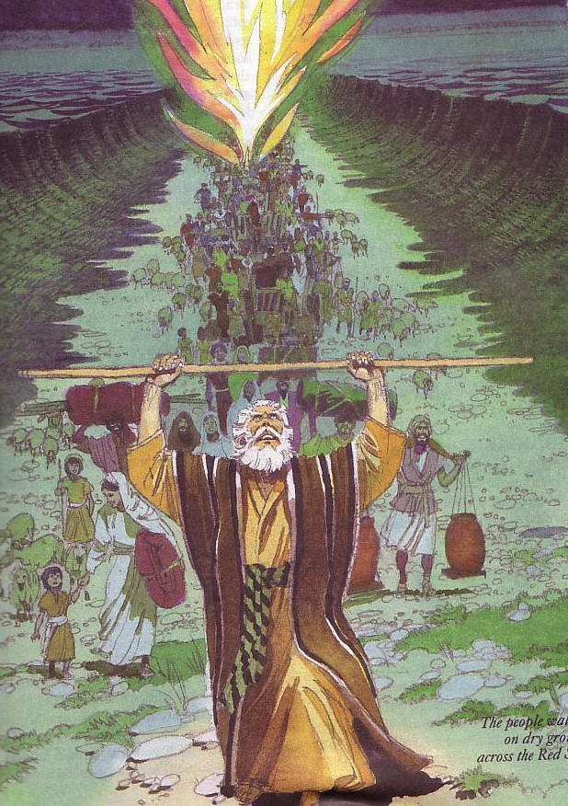
Why is the Exodus so significant?
God is more powerful than Egypt's gods (12:29, 37)!
God fulfilled his promise to the day (12:40-41;
cf. Gen. 15:15)
Typology of Passover lamb (12:3-5, 27, 43,
46; cf. John 1:29; 19:36; 1 Cor. 5:7-8)

Slide 99
The Passover Lamb
"Look, the Lamb of God,
who takes away
the sin of the world!"
(John 1:29)

Slide 100
Passover Protection
"The blood will be a sign for you on the houses where you are; and when I see the blood, I will pass over you. No destructive plague will touch you when I strike Egypt."
Exodus 12:13 (NIV)

Slide 101
Faith Pictured
"By faith he kept the Passover and the sprinkling of blood, so that the destroyer of the firstborn would not touch the firstborn of Israel."
Hebrews 11:28 (NIV)

Slide 102
The Lamb Pictured
"The next day John saw Jesus coming toward him and said, 'Look, the Lamb of God, who takes away the sin of the world!'"
John 1:29 (NIV)

Slide 103
The Cross Pictured
"For Christ, our Passover lamb, has been sacrificed."
1 Corinthians 5:7 (NIV)

Slide 104
Faith in a Lamb

Slide 105

"This is my body…"

Slide 106
Exodus 12:1-16
The Angel of Death Passed Over Houses with Blood on the Doors
Thus says the LORD, "About midnight I will go out in the midst of Egypt" (Exod. 11:4)

Slide 107
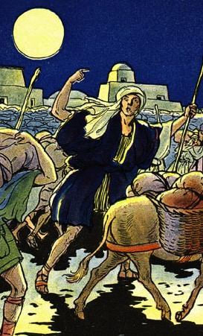
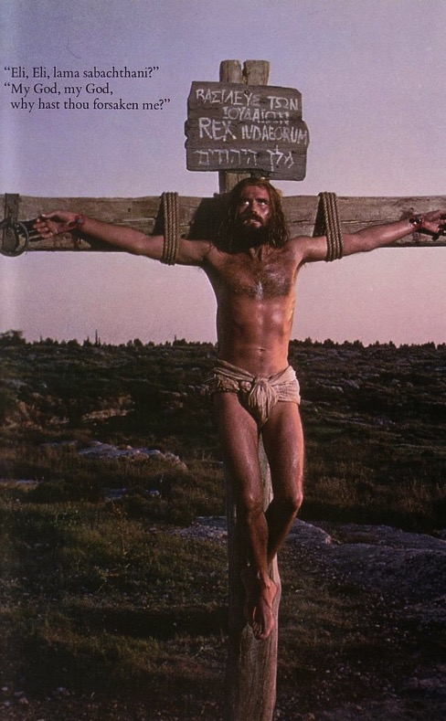
The Common Thread
What the Exodus is to the Old Testament…
the cross of Christ is to the New Testament
Deliverance!

Slide 108
Why is the Exodus so significant?
Beginning of the nation (6:6-8)
New calendar (12:2)

Slide 109
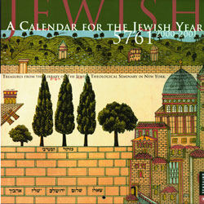

Jewish Calendars
136
Civil
Sacred
Numbered

Slide 110
Hebrew Calendars
The Exodus Night:
While the Israelites were still in the land of Egypt, the LORD gave the following instructions to Moses and Aaron: ²"From now on, this month will be the first month of the year for you" (Exod. 12:1-2)
136
1 Nisan
2 Iyar
3 Sivan
4 Tammuz
5 Av
6 Elul
7 Tishri
8 Cheshvan
9 Kislev
10 Tevet
11 Shevat
12 Adar
Mar-Apr
Sacred Calendar Begins
Civil Calendar Begins
Sep-Oct

Slide 111
Why is the Exodus so significant?
Beginning of the nation (6:6-8)
New calendar (12:2)
Response of faith to receive new life

Slide 112

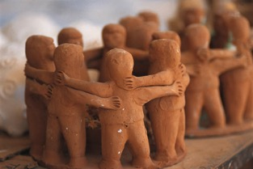
Outline
98
Formation into a Nation Begun
Chapters 1—18
Chapters 19—40
Receive Freedom from Slavery
Receive Law from God
Getting Israel Out of Egypt
Getting Egypt Out of Israel
Narration
Legislation
Free People
Government
Subjection
Deliverance
Instruction
Egypt
Wilderness
Sinai
400 Years
2 Months
10 Months
Toil & Confrontation
(1—11)
Redemption & Protection
(12—18)
Covenant Revealed
(19—31)
Covenant Ratified
(32—40)
Moses as
Returned Fugitive
Moses as
Wilderness Leader
Moses as
Intermediary
Moses as
Lawgiver
Preparation
(1:1–7:13)
Plagues
(7:14–11:10)
Memorials
(12:1–15:21)
Provisions
(15:22–18:27)
Preparation
(19)
3-Part Covenant
(20–31)
Broken &
Renewed
(32–34)
Tabernacle
Built/Filled
(35–40)

Slide 113

Route of the Exodus
Canaan
107
Goshen
Nile River
Mt. Sinai
Egypt
Midian

Slide 114
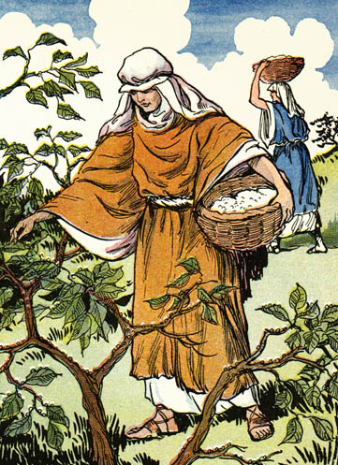
Manna

Slide 115
1 Cor 10:1-4 (NLT)
1 I don't want you to forget, dear brothers and sisters,* about our ancestors in the wilderness long ago. All of them were guided by a cloud that moved ahead of them, and all of them walked through the sea on dry ground. 2 In the cloud and in the sea, all of them were baptized as followers of Moses. 3 All of them ate the same spiritual food, 4 and all of them drank the same spiritual water. For they drank from the spiritual rock that traveled with them, and that rock was Christ.

Slide 116
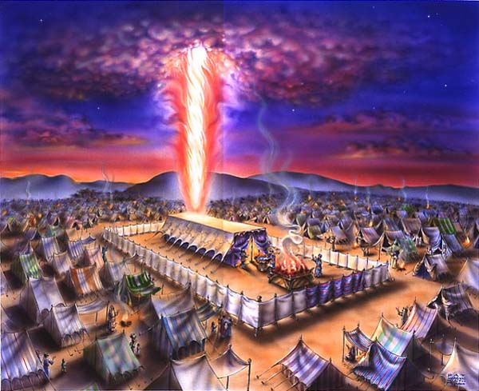
The Cloud
Exodus 40;
1 Cor. 10:1-4

Slide 117


The Sea
Exodus 40;
1 Cor. 10:1-4

Slide 118

The Leader
Exodus 40;
1 Cor. 10:1-4

Slide 119
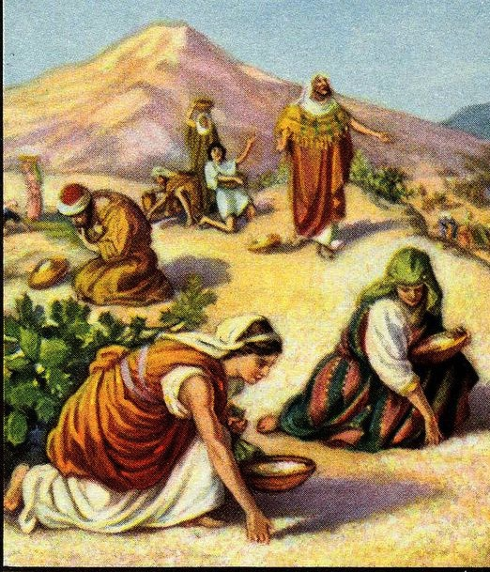
The Food
Exodus 40;
1 Cor. 10:1-4

Slide 120
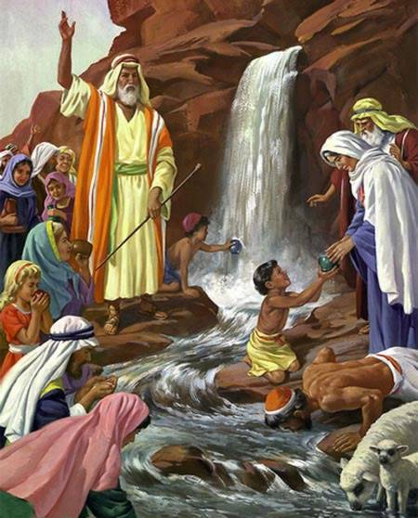
The Water
Exodus 40;
1 Cor. 10:1-4

Slide 121
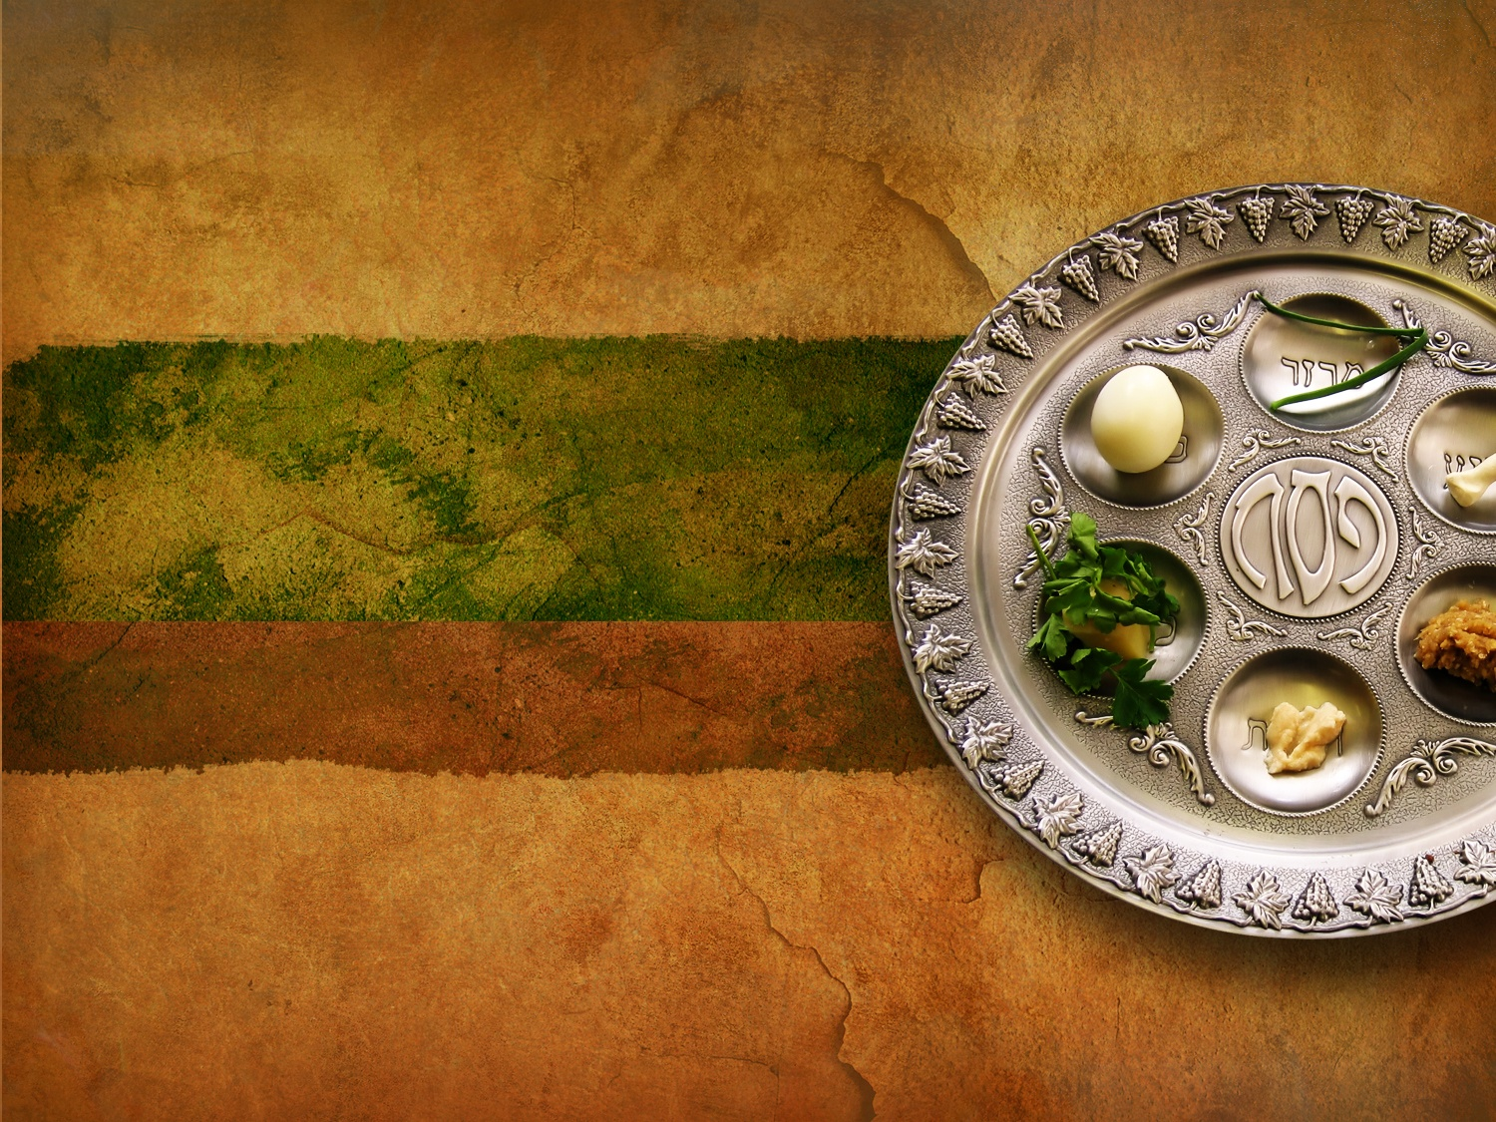
The Seder Plate
Also called the Pesach Seder Plate
Each element symbolizes an important aspect of the Exodus story

Slide 122
Questions on the Seder

Slide 123
Questions on the Lord's Table?
In what sense is the Lord Jesus present at the Table?
How often should believers take the Supper?
Other questions?

Slide 124


Slide 125

Sarah went to Big Church…

Slide 126

"Do this to remember me"
????

Slide 127

How can you honor God in the Lord's Supper?

Slide 128
Passover & the Lord's Supper
Four Comparisons
Why did Jesus choose bread and wine for His Last Supper?

Slide 129
I. Look outward at your relationship with other believers
The Four Directions
outward

Slide 130

1 Corinthians 11:17-19 (NLT)

Slide 131

1 Corinthians 11:20-22 (NLT)

Slide 132
The Agape (Love) Feast

Slide 133
Black

Slide 134
1 Cor 10:15-17 (NLT)
15 You are reasonable people. Decide for yourselves if what I am saying is true. 16 When we bless the cup at the Lord's Table, aren't we sharing in the blood of Christ? And when we break the bread, aren't we sharing in the body of Christ? 17 And though we are many, we all eat from one loaf of bread, showing that we are one body. 18 Think about the people of Israel. Weren't they united by eating the sacrifices at the altar?

Slide 135
Black

Slide 136
Matthew 5:23-24
?
"Therefore if you are presenting your offering at the altar, and there remember that your brother has something against you, leave your offering there before the altar and go; first be reconciled to your brother, and then come and present your offering."

Slide 137
Black

Slide 138
I. Look outward at your relationship with other believers
The Four Directions
outward

Slide 139
II. Look back at Christ's death for you
The Four Directions
outward
back

Slide 140
1 Corinthians 11:23-25
²³For I received from the Lord what I also passed on to you: The Lord Jesus, on the night he was betrayed, took bread, ²⁴and when he had given thanks, he broke it and said, "This is my body, which is for you; do this in remembrance of me." ²⁵In the same way, after supper he took the cup, saying, "This cup is the new covenant in my blood; do this, whenever you drink it, in remembrance of me."
Notes:
140

Slide 141


Passover's Past Significance

Slide 142
The Four Cups (Exod. 6:6-7)
Blessing
Plagues
Redemption
Praise

Slide 143
The Order of the Celebrations
Passover | Lord's Supper
Light candles | Assumed (not recorded)
1st Cup: Blessing/Sanctification, saying, "I will bring you out from under the burdens of the Egyptians" (1st of 4 "I wills" of Exod. 6:6-7) | "Take this and divide it among yourselves… I will not drink again of the fruit of the vine until the kingdom of God comes" (Luke 22:17b-18)
Washing of one's own hands | Washed disciples feet during meal (John 13:2, 4)
Parsley dipped in salt water (bitterness), middle matzah (bread) made visible and broken and 1/2 called "afikomen" (Gr. "he who comes later") wrapped with napkin and hidden | Son of God (second member of the Trinity) made visible, broken, body wrapped, and buried in a tomb (this tradition was added to the Passover by first century AD Jewish believers)
Passover story read (Exod. 12:1-13), 4 Questions, 4 sons, 10 Plagues | Assumed (not recorded)

Slide 144

Seder Plate

Slide 145
The Order of the Celebrations
Passover | Lord's Supper
2nd Cup: Plagues/Judgment, saying, "I will rid you of their bondage"
Washing hands, eat upper and 1/2 middle matzah and bitter herbs with bottom matzah (bondage)
Passover Supper begins
Eat bitter herbs with charoseth of dates, honey, & almonds (sweetness of life with God's redemption), roasted egg (temple offerings & destruction, grief and new life), shankbone | Jesus dips the sop with Judas and Judas leaves (?)
Eat afikomen—"This is the bread of affliction…" | "This is my body…" (Luke 22:19)

Slide 146
The Four Cups (Exod. 6:6-7)
Blessing
Plagues
Redemption
Praise

Slide 147
The Order of the Celebrations
144
Passover | Lord's Supper
3rd Cup: Redemption, saying, "I will redeem you with an outstretched arm" | "This is my blood…" (Luke 22:20) Jesus dips the sop with Judas and Judas leaves (?)
4th Cup: Praise/Regathering, saying, "I will take you to me for a people" & read Pss. 113–118 | "For as often as you eat this bread and drink this cup, you proclaim the Lord's death until he comes"
Declaration ("Next year in Jerusalem!"), hymn (Ps. 118), poem, or national anthem | Sang hymn & went to Mt. of Olives (Matt. 26:30)
Cup of Elijah: Filled but untouched; symbolizes his return before Messiah (Mal. 4:5-6; Matt. 11:13-14; 17:11-12; Rev. 11:3-12; 19:11-21), youngest child opens front door "for Elijah" | Assumed (not recorded)

Slide 148
"This cup is the new covenant in my blood" (Jer 31: 31-34)
Israel and Judah reunited (31:31-32)
Spirit indwelling (31:33)
No need for evangelism (31:34a)
Israel forgiven (31:34b)

Slide 149
Black

Slide 150

Song
"I'm not what
I wanna be,
I'm not what
I'm gonna be,
But thank God
I'm not what I was!"

Slide 151
II. Look back at Christ's death for you
The Four Directions
outward
back

Slide 152
III. Look forward to Christ's second coming
The Four Directions
outward
back
forward

Slide 153
1 Corinthians 11:26 (NLT)
²⁶For whenever you eat this bread and drink this cup, you proclaim the Lord's death until he comes.
Notes:
153

Slide 154
III. Look forward to Christ's second coming
The Four Directions
outward
back
forward

Slide 155
IV. Look inward to confess sin
The Four Directions
outward
back
forward
inward

Slide 156
1 Corinthians 11:27-29 (NLT)
²⁷Therefore, whoever eats the bread or drinks the cup of the Lord in an unworthy manner will be guilty of sinning against the body and blood of the Lord. ²⁸A man ought to examine himself before he eats of the bread and drinks of the cup. ²⁹For anyone who eats and drinks without recognizing the body of the Lord eats and drinks judgment on himself.
Notes:
156

Slide 157
1 Corinthians 11:30-32 (NLT)
³⁰ That is why many among you are weak and sick, and a number of you have fallen asleep. ³¹But if we judged ourselves, we would not come under judgment. ³²When we are judged by the Lord, we are being disciplined so that we will not be condemned with the world.
Notes:
157

Slide 158
1 Corinthians 11:33-34 (NLT)
³³So then, my brothers, when you come together to eat, wait for each other. ³⁴If anyone is hungry, he should eat at home, so that when you meet together it may not result in judgment. And when I come I will give further directions.
Notes:
158

Slide 159
Black

Slide 160
Think!
inward

Slide 161
Look in all four directions!
The Four Directions
outward
back
forward
inward

Slide 162
The Four Directions
(Adapted from David Watson, I Believe in the Holy Spirit)
143
Look... | Passover (Jewish) | Lord's Supper (Christian)
Outward | Whole family involved (Exod. 12:3-4, 16) | Fellowship and unity (1 Cor. 11:17-22; 10:16-17)
Back | Deliverance from Egypt (Exod. 12:31-42) | Deliverance from sin (1 Cor. 11:23-25)
Forward | Wait for messianic age (Ezek. 45:21) | Anticipate return of Christ (1 Cor. 11:26; Mark 14:25)
Inward | Purify house of leaven or evil (Exod. 12:8, 15) | Examine sin in yourself (1 Cor. 11:27-32; cf. 5:6-8)

Slide 163
To properly look back on His death and look forward to His return, we need to look outward for others and look inward at our own lives.
The Main Idea
outward
back
forward
inward

Slide 164
Black

Slide 165
John 3:16 NLT
"For God loved the world so much that he gave his one and only Son, so that everyone who believes in him will not perish but have eternal life."

Slide 166
What outward or inward issues do you need to address right NOW?
Two Directions
outward
inward

Slide 167
Black

Slide 168

Sinless Sacrifice
Notes:
168

Slide 169
His Thorns Brought Our Healing
Notes:
169

Slide 170


During NT Passovers 100,000 Jews visited the Temple!

Slide 171

Remember Me

Slide 172
Questions on the Lord's Table?
In what sense is the Lord Jesus present at the Table?
How often should believers take the Supper?
Other questions?

Slide 173

Three Crosses

Slide 174

"I did this for you"

Slide 175

We Remember His Death for Us

Slide 176

The Lord's Table

Slide 177

It's All By Faith
"God will credit righteousness--for us who believe… He was delivered over to death for our sins…" (Rom. 4:24-25)

Slide 178

"Do this to remember me"

Slide 179


"It is finished"
Justification (3:24)
God's act of declaring us "not guilty" for our sins, making us right with him
Legal
Justice (3:25-26)
The fairness of God where He punishes sin in an individual himself or in a Sinless Substitute (Jesus Christ)
Paid
in Full

Slide 180

He was wounded for my transgressions
He was wounded for my transgressions; …by His stripes I am healed.

Slide 181

THE LORD'S SUPPER

Slide 182

Communion
All who have trusted Christ as Savior are welcome to His table today

Slide 183

Holy Communion
All believers are invited to share Communion with this faith family.
Holy Communion

Slide 184

The Body. The Blood.
THE BODY…
…THE BLOOD

Slide 185

The Cup
Christ
The Bread
Others
1 Corinthians 10:16

Slide 186

Take, eat; this is my body

Slide 187

Welcome

Slide 188

Announcements

Slide 189

We remember His death
All who know Christ are welcome to participate

Slide 190
The Bread and Cup

Slide 191

Christ died for the ungodly
Notes:
191

Slide 192

A Crown of Thorns
Notes:
192

Slide 193

Redemption

Slide 194

I know that my Redeemer lives

Slide 195

The Lost Are Saved

Slide 196

The Bound Are Free

Slide 197

The Cross Frees (no title)

Slide 198

Cross on Blue Clouds

Slide 199

Cross on White Clouds

Slide 200


Slide 201

The sky went dark…

Slide 202

Luke 23:46

Slide 203

The Cross over the sands of time…

Slide 204

Forgive them, Father, for they know not what they do (Luke 23:34)

Slide 205

The cross brings light!

Slide 206

Highly Exalted

Slide 207

Phil. 2:10-11

Slide 208

Jesus, the glory of the Father

Slide 209

Praise the Lord on High!

Slide 210

证道
Message

Slide 211

Now, o Lord, we offer ourselves to you as a living
sacrifice, to be servants of righteousness.
Through Jesus Christ our Lord. Amen

Slide 212

Communion
Communion

Slide 213
Passover Announcement
Passover Celebration
Thursday, April 1, 2010
7:30-8:30 PM
at the YMCA
Join us for an evening of remembrance and experience the significance of the Passover and its relationship to Jesus as our Passover Lamb.

Slide 214

Hevenu shalom aleichem
Hevenu shalom aleichem
Hevenu shalom aleichem
Hevenu shalom aleichem
Heven shalom, shalom, shalom aleichem

Slide 215

Why We Celebrate
JESUS PAID IT ALL

Slide 216

Holy Communion

Slide 217


NT Backgrounds link at BibleStudyDownloads.org
Get this presentation for free!
Notes:
NT Backgrounds (nb)

Slide 218
Black

