Slide 1
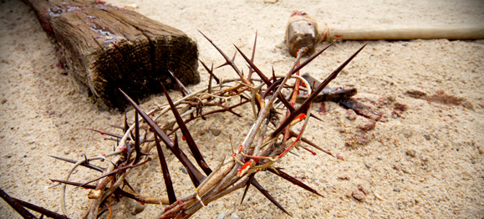
The Passion of Christ
Christology: The Person & Work of Jesus
Dr. Rick Griffith • Jordan Evangelical Theological Seminary • BibleStudyDownloads.org

Slide 2

What's so good about Good Friday?
Notes:
But that name is equally puzzling. Why is Good Friday called "good"?
Our leader died on that day, so it seems strange to call the day "good." No other religion refers to the death of their leader as "good."
We believe that his death was good. How was that?

Slide 3

Passion Week
Mon
Tues
Wed
26
Fri
Thurs
Sun
Fri
Sat
Sat
Sun

Slide 4
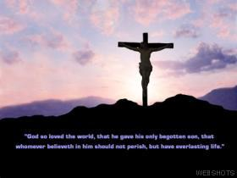
He Died for You!
John 19:16b-42
Dr. Rick Griffith, Crossroads International Church
www.BibleStudyDownloads.org

Slide 5


Love
Notes:
What does love look like?

Slide 6

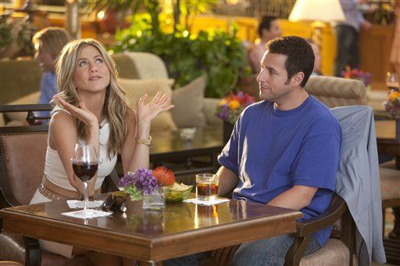
Just Go With It
Notes:
Is it sentimental?

Slide 7

Just Go With It
Notes:
Emotional?

Slide 8
JOHN 15:13
"GREATER LOVE HAS NO ONE THAN THIS, THAN TO LAY DOWN ONE'S LIFE FOR HIS FRIENDS."
Notes:
Well, as Christians we know that love doesn’t masquerade in immorality and lies for personal pleasure.
Love gives the very best—which is life itself. Jesus said it well in John 15:13, “Greater love has no one than this, than to lay down one’s life for his friends.”

Slide 9
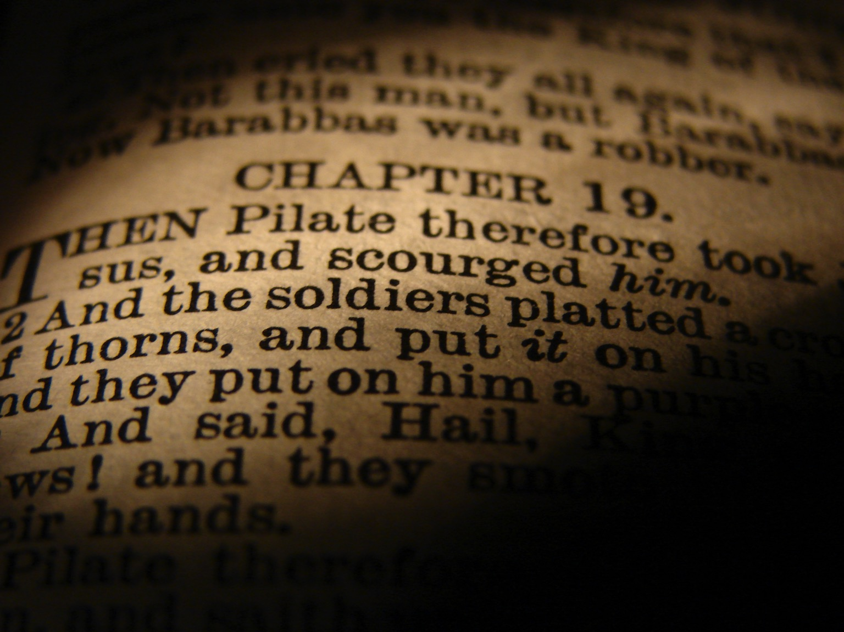
He Died for You!
But how do we know that Christ's death actually paid for our sin?
Notes:
Background: The pressure against Christ up to John 19 has been mounting, but Jesus was not a victim who was being outwitted.

Slide 10
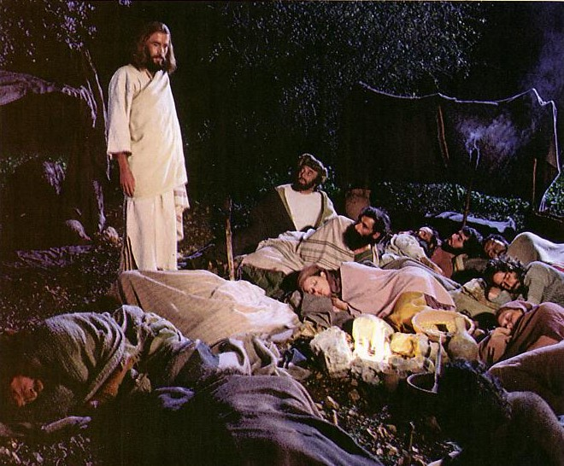
Jesus controlled His own arrest (John 18:1-11).

Slide 11
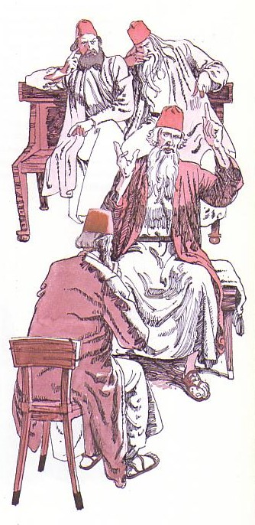
Jesus' illegal trials proved Him innocent (18:12–19:16a).
Notes:
Then his six illegal trials proved him innocent!

Slide 12
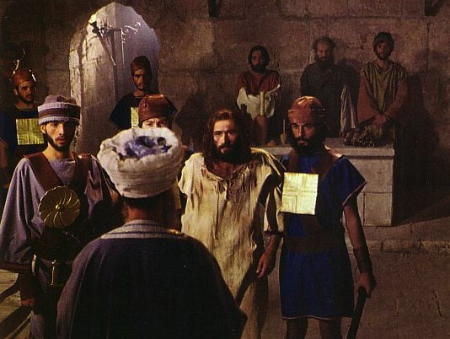
The Jewish Trials: Annas
Illegal
No longer high priest
At night
In a home
No witnesses
No actual charge
Violence
Illegal
Illegal
Illegal
Illegal
Illegal
Notes:
The trial by Annas was illegal.

Slide 13

The Illegal Trial by Caiaphas
Closed meeting
At house of Caiaphas
Held at night
No specific charges
Accusations changed
No defense attorney
Verdict already determined
Bribe
No waiting period
Illegal
Notes:
The trial by Caiaphas was also illegal.

Slide 14

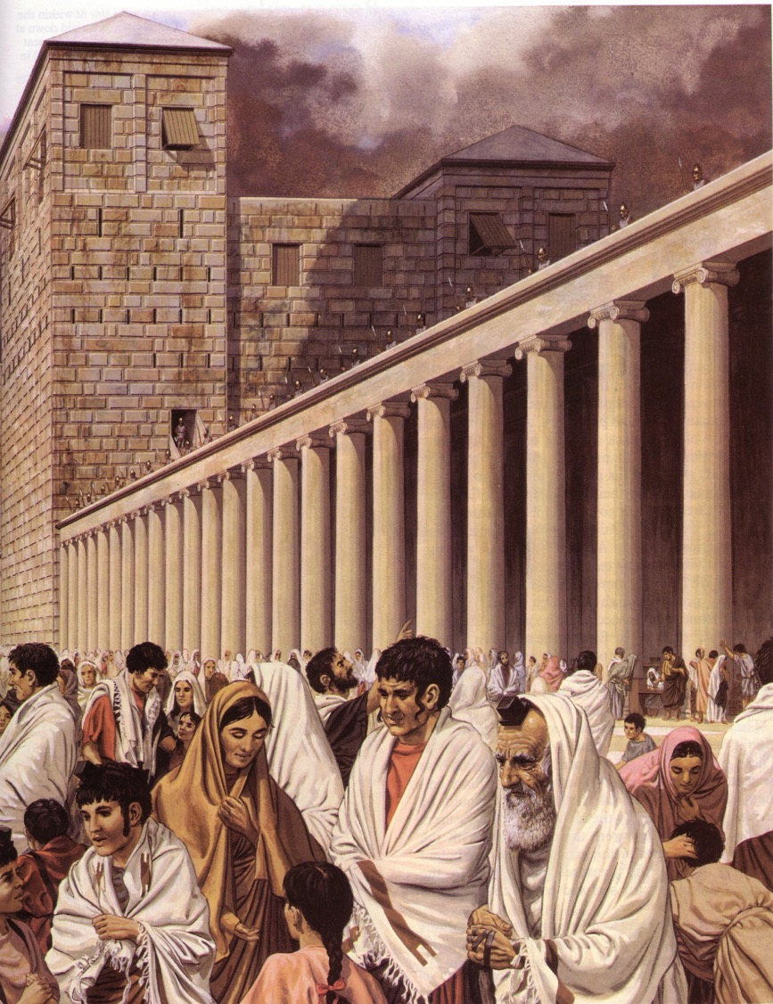
The Roman Trials
Notes:
Then the trials by Romans were illegal.

Slide 15
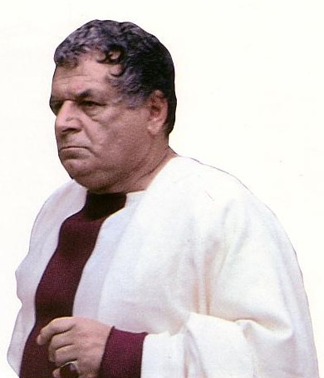
Three Roman Mockeries
Illegal
Pilate
Antipas
Pilate (second time)
Illegal
Illegal
Charge:
Treason
Notes:
Then the trials by Romans were illegal. They also charged Jesus treason but never proved their claim.

Slide 16

Today: Jesus' death paid for our sin (19:16b-42)
Notes:
Today in John 19:16b-42 we finish the passion account where it shows how Christ voluntarily gave his life for us.

Slide 17
Two Movements
Death
Burial
Notes:
Today we’ll see true love in two movements—Christ’s death and burial—that they support the concept of his atonement.
The first evidence that Jesus genuinely took our sin upon him was that…

Slide 18

I. Christ fulfilled Scripture in his selfless death (19:16b-37).
Selflessness
Fulfillments
Carried cross
Notes:
Jesus paid for our sin by dying to fulfill prophecy and with utmost care for others.
• Jesus showed selflessness by carrying his own cross (19:16b-17).
The typical criminal had to do this—even those crucified on either side of Christ.

Slide 19
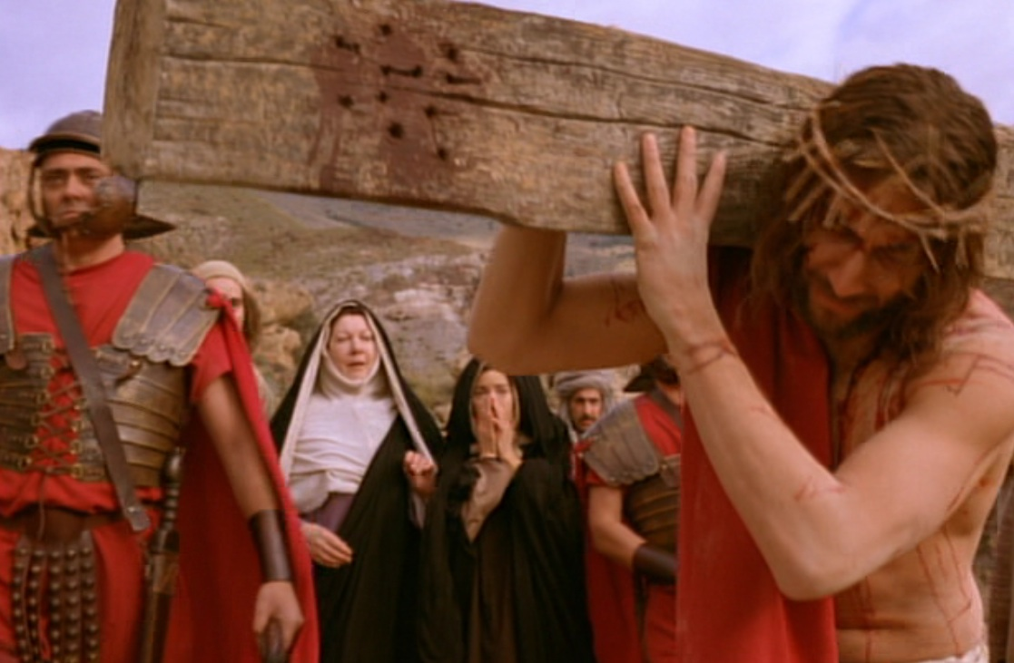
Carrying His Own Cross
Notes:
But Jesus didn’t have to carry his own cross. Matt. 26:53 says had the power to get out of arrest when he could have called 72,000 angels! That’s 12 legions of angels to defend Him. A Roman legion numbered about 6,000 soldiers.

Slide 20
I. Christ fulfilled Scripture in his selfless death (19:16b-37).
Selflessness
Fulfillments
Carried cross
Crucifixion
Notes:
Jesus died selflessly in public crucifixion amidst contempt by the Jews (19:18-22).

Slide 21
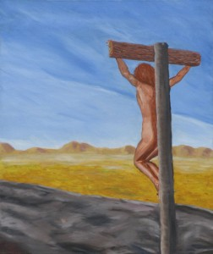
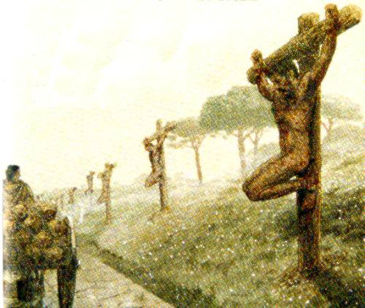
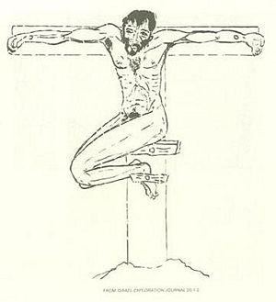
Crucified Naked
Notes:
We can’t really imagine the shame of crucifixion today as we execute criminals clothed. But, despite what the movies show, Jesus was totally naked—no loin cloth!

Slide 22
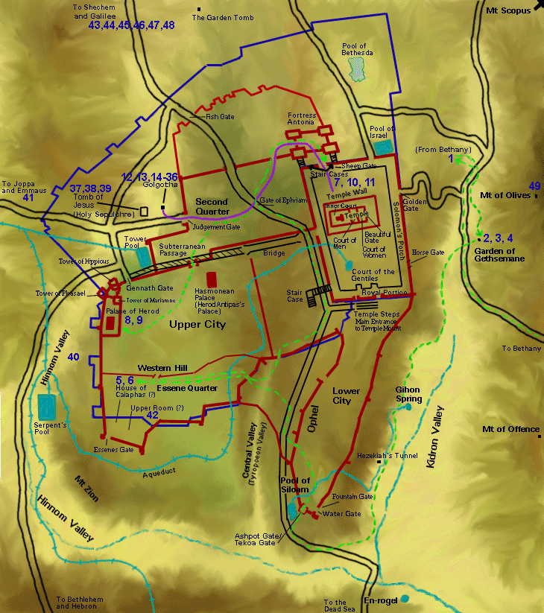
Jesus' Final Movements
Notes:
Jesus’ crucifixion was definitely public—on a main road either at the Garden Tomb or Church of the Holy Sepulcher.

Slide 23
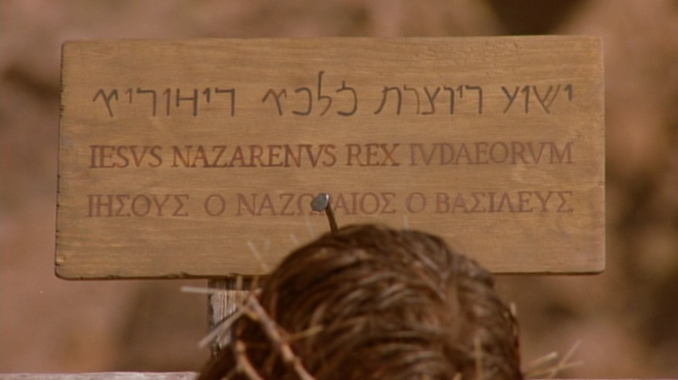
The Placard
Notes:
To intensify the shame, a sign above Jesus was in three languages so the many who passed by on this key road just outside the city could read it. Passover was the biggest holiday of the year with about 90,000 people in Jerusalem.

Slide 24
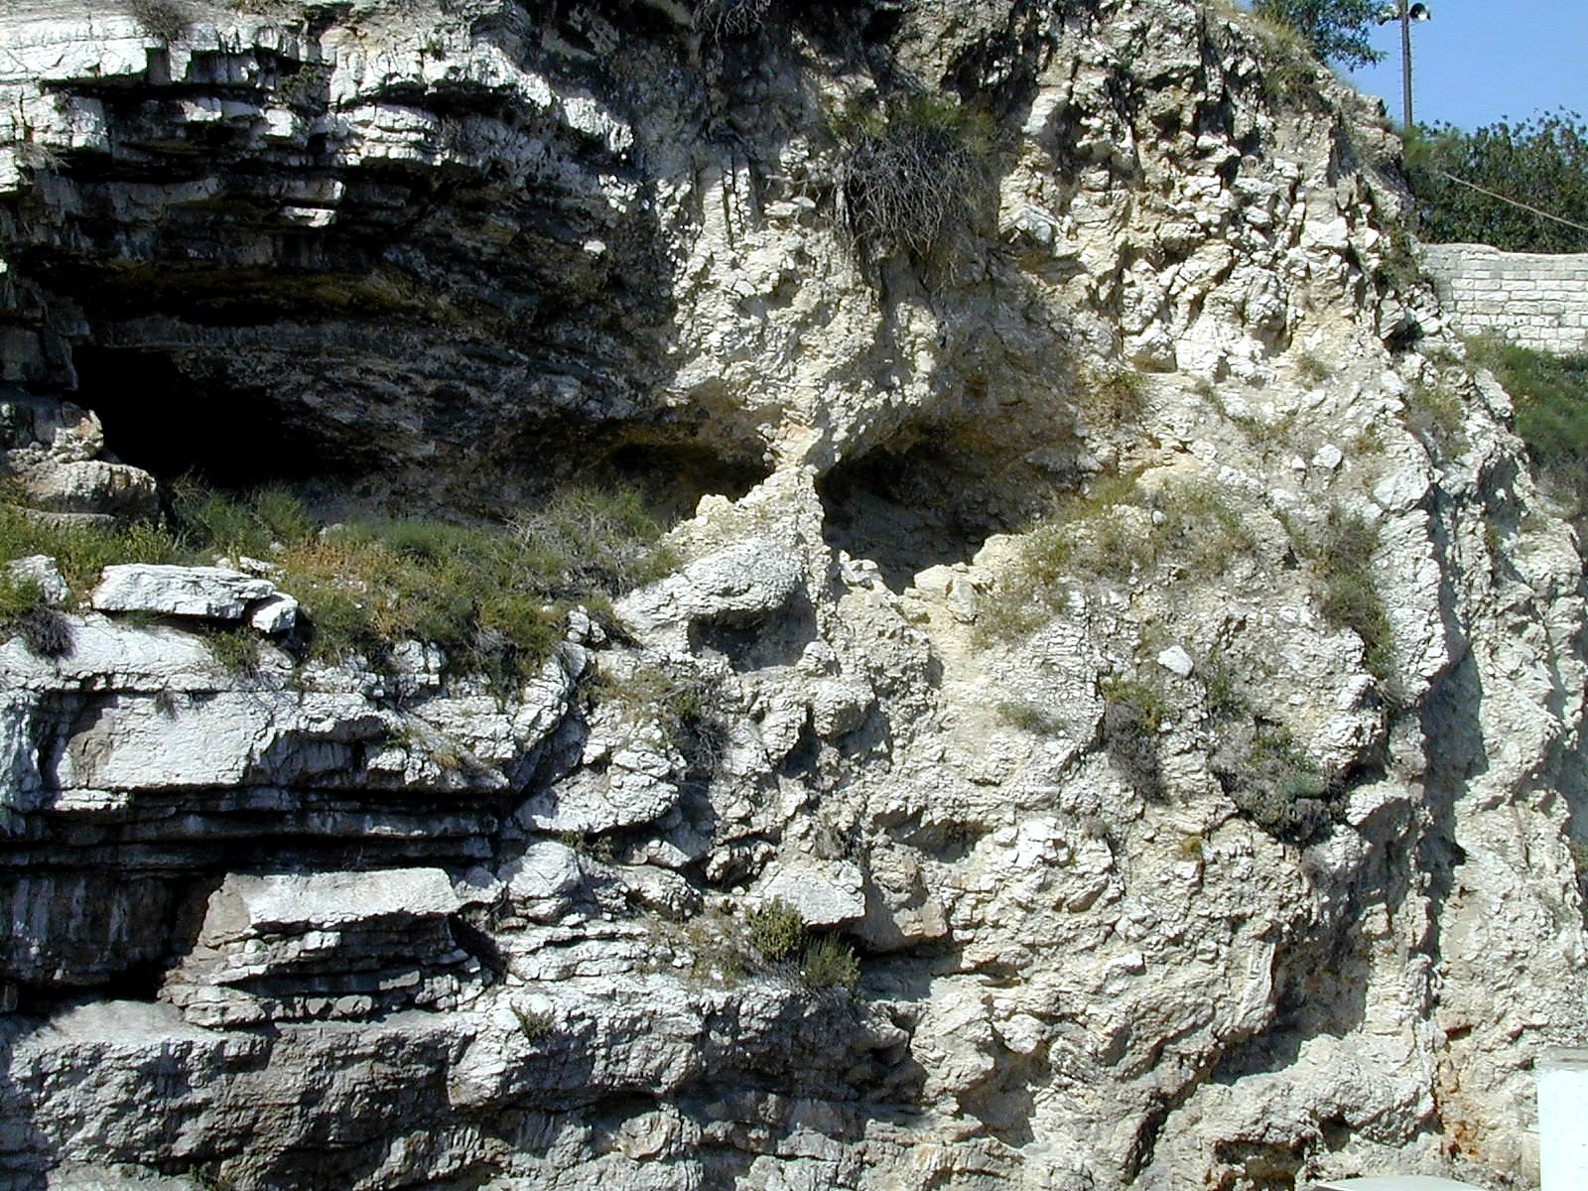
Gordon's Calvary
Notes:
Interestingly, the northern site for the crucifixion of Christ is the outcropping that looks like a skull at Gordon’s Calvary—

Slide 25
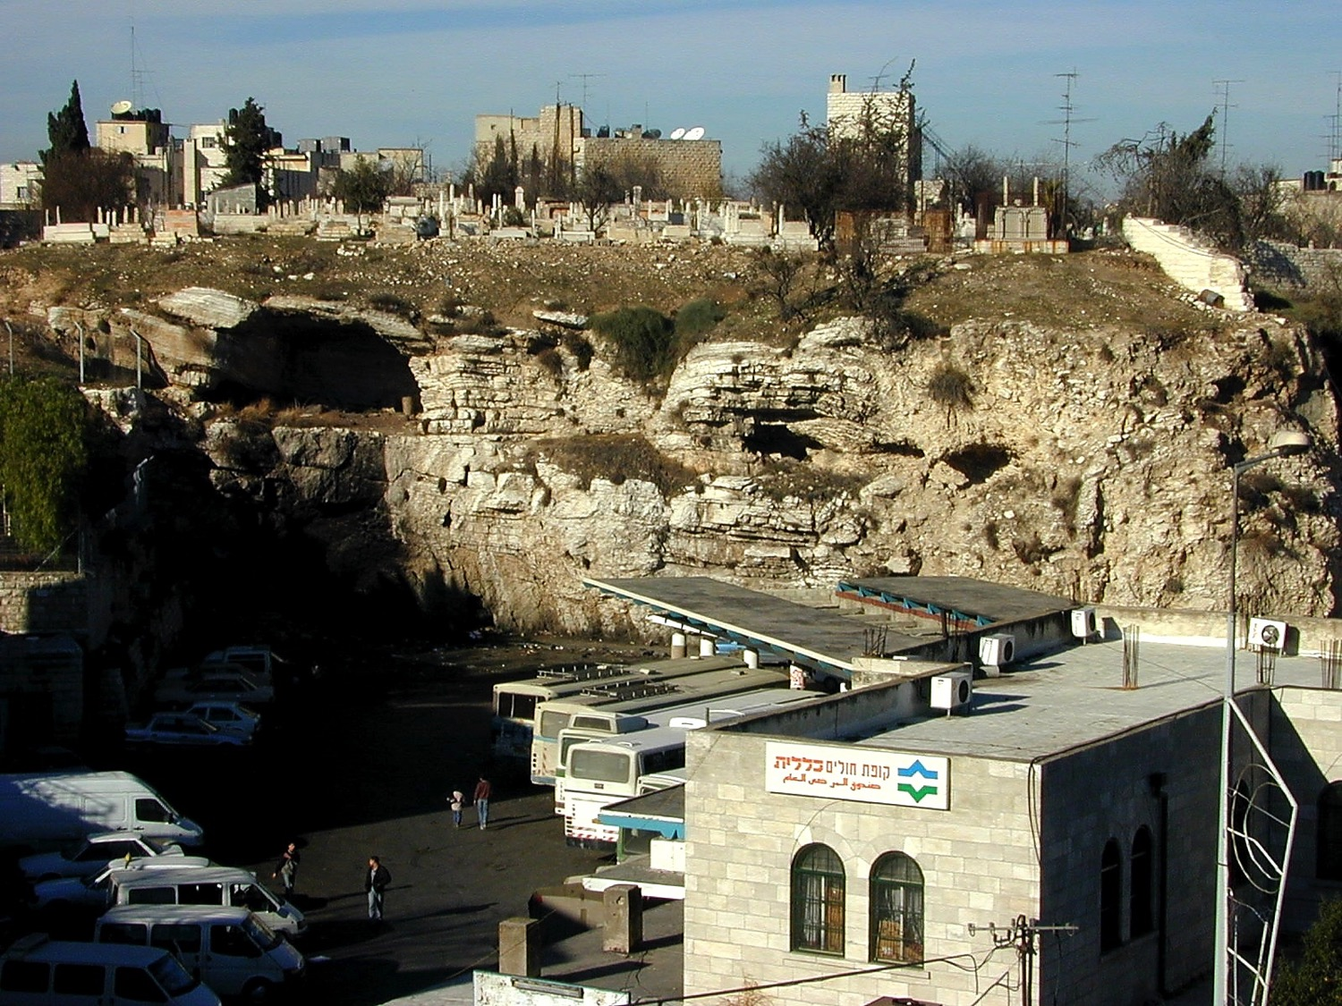
Gordon's Calvary
Notes:
—which is still next to a popular place—a bus station!

Slide 26
I. Christ fulfilled Scripture in his selfless death (19:16b-37).
Selflessness
Fulfillments
Carried cross
Clothes divided
Crucifixion
Notes:
Jesus fulfilled Scripture by allowing His clothes to be divided and bargained for (19:23-24).
One might think that Jesus would, at the least, have his mother take his clothes—but no, he was not spared the indignity of even having his clothes taken from him.

Slide 27
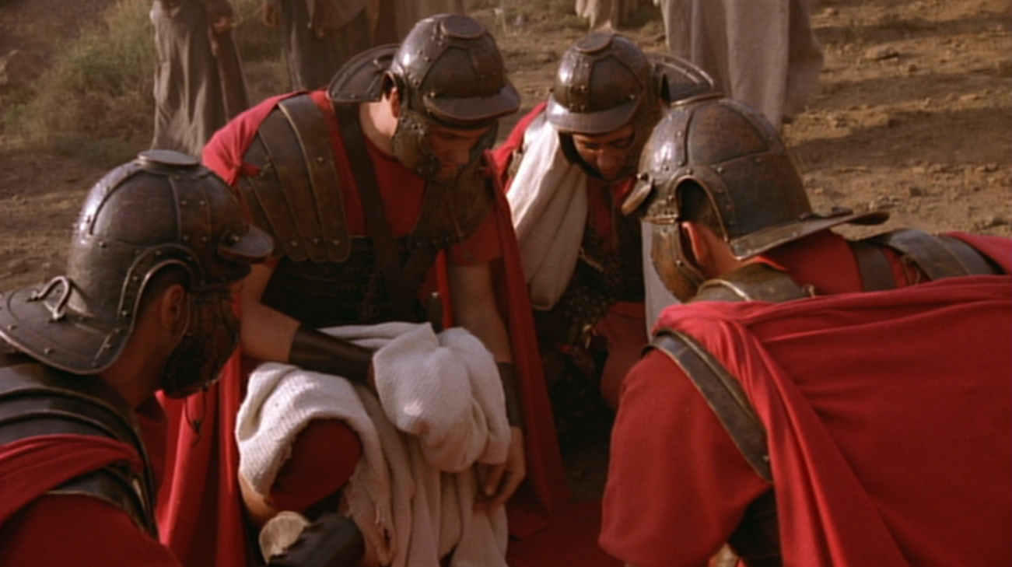
5 Items to Divide
Turban–Sandals–Robe–Outer Garment–Girdle
Notes:
Wiersbe notes, “At most Roman executions, a centurion would be assigned with four soldiers to assist him… It was the privilege of the soldiers to share whatever personal belongings the victims had; so they divided up all that Jesus owned—His personal clothing. He would have had a turban, a pair of sandals, an undergarment (the seamless robe), an outer garment, and a girdle. The four men each took a piece of clothing, and then they gambled for the seamless robe.”
Warren W. Wiersbe, The Bible Exposition Commentary (Wheaton, Ill.: Victor Books, 1996, c1989), Jn 19:17.

Slide 28
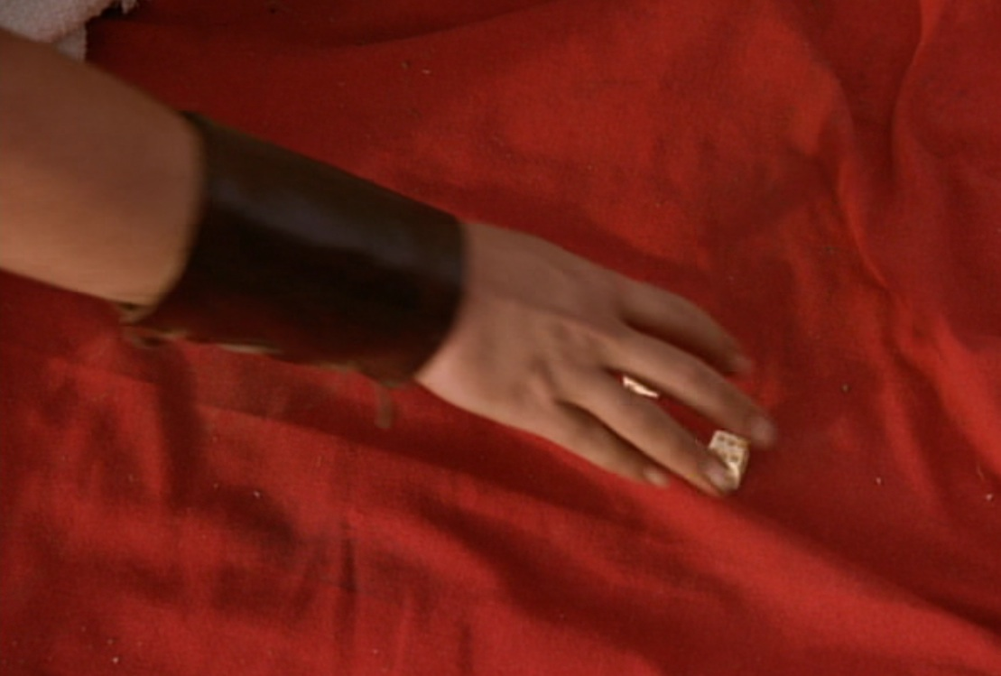
"They divided my garments among themselves and threw dice for my clothing" (Ps. 22:18)
Notes:
Psalm 22:18 was fulfilled in, “They divided my garments among themselves and threw dice for my clothing” (19:24 NLT).

Slide 29
I. Christ fulfilled Scripture in his selfless death (19:16b-37).
Selflessness
Fulfillments
Carried cross
Clothes divided
Crucifixion
Cared for Mary
Notes:
Jesus died selflessly by committing care for His mother to His disciple John (19:25-27).
Most crucified men could not endure such shame and pain, so they heaped abuse on their tormenters. Instead, Jesus prayed that God would forgive them! Rather than concern for himself, Christ also thought about the future care of his mother.

Slide 30
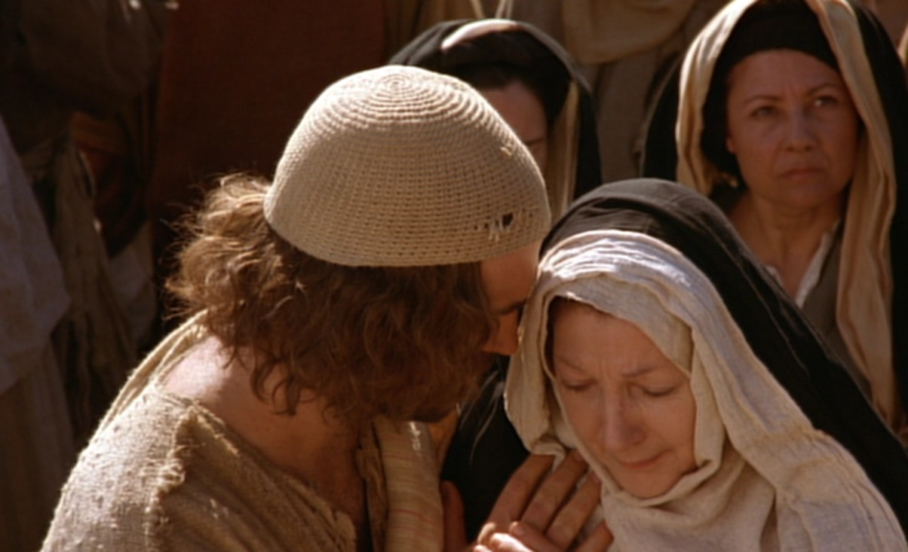
Care for His Mother Mary
Notes:
He cared even after his death through John, to whom he says, “Here is your mother” (19:27).
Why John instead of Jesus’ siblings?
Remember in John 7:5 that his brothers did not even believe in Christ, unlike the beloved disciple John (13:23). But Jesus, as the Good Shepherd (10:4), cares for his own mother as he would the rest of his sheep.

Slide 31
I. Christ fulfilled Scripture in his selfless death (19:16b-37).
Selflessness
Fulfillments
Carried cross
Clothes divided
Crucifixion
Thirsted
Cared for Mary
Notes:
Jesus fulfilled Scripture as the living water who thirsted (19:28-29).

Slide 32
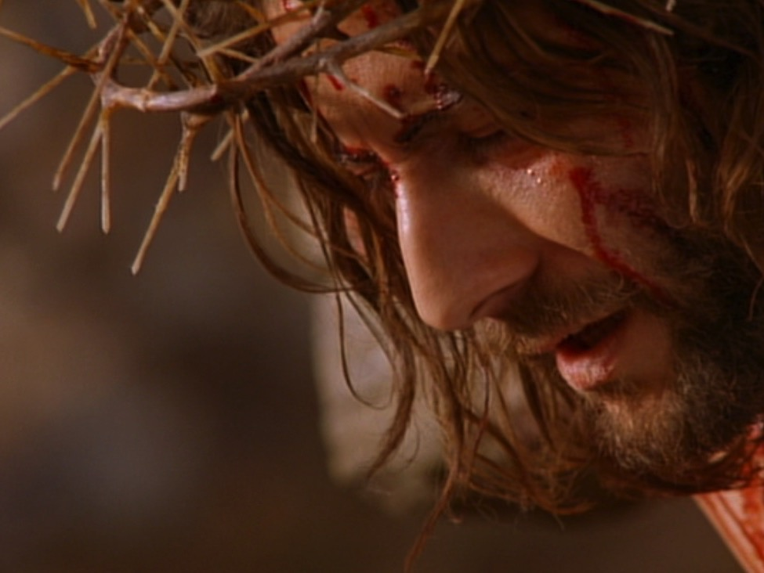
"I am thirsty"
(19:28; cf. Psalm 22:15; 69:21)
Notes:
Psalm 22:15; 69:21 was fulfilled with Christ declaring, “I am thirsty” (John 19:28).
“I am thirsty” (19:28) shows irony, for the One who gives living water (4:14; 7:38-39) willingly allowed himself to thirst. Christ quotes Psalm 69:21 here—a psalm that ends with triumph in his fulfillment of this prophecy.

Slide 33
I. Christ fulfilled Scripture in his selfless death (19:16b-37).
Selflessness
Fulfillments
Carried cross
Clothes divided
Crucifixion
Thirsted
Cared for Mary
Paid for sin
Notes:
Jesus fulfilled Scripture as the One who paid for all sin (19:30).

Slide 34
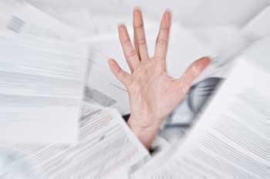
The Heavy Debt of Sin
Notes:
You and I have a tremendous debt to God.
Ray Comfort illustrates it this way: Have you ever broken God’s commandment by lying? What does that make you? Yes, a liar!
Have you ever prioritized something else ahead of God? What does that make you? Yes, an idolater!

Slide 35
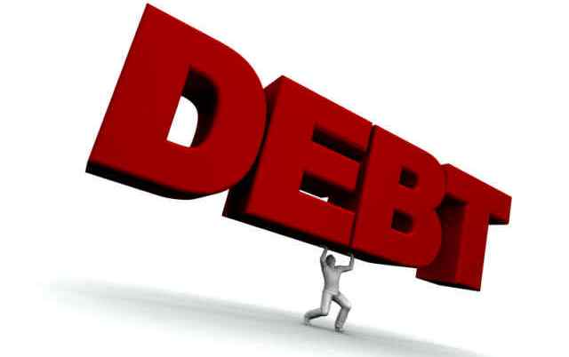
The Debt of Sin
DEBT
Notes:
Suppose you only sinned three times a day—a word, action, or thought less than God—that’s 1000 sins a year! And that’s good year! How many thousands of your sins separate you from God?
We can plead that God is merciful—and he is—but his mercy is balanced with his justice that requires payment for your sin—not just token payment, but death!

Slide 36


"It is finished"
Legal
Paid
in Full
Notes:
When Jesus declared, “It is finished” (19:30), it was a legal term meaning “paid in full.” Our sin on him recalls the many times in John when Christ claimed that his “hour” had not yet come (2:4; 13:1, etc.). Now his “hour” had come to pay the redemption for which He had come.

Slide 37
I. Christ fulfilled Scripture in his selfless death (19:16b-37).
Selflessness
Fulfillments
Carried cross
Clothes divided
Crucifixion
Thirsted
Cared for Mary
Paid for sin
Pierced side
Notes:
Jesus fulfilled Scripture with the piercing of his side instead of breaking his legs (19:31-37).

Slide 38
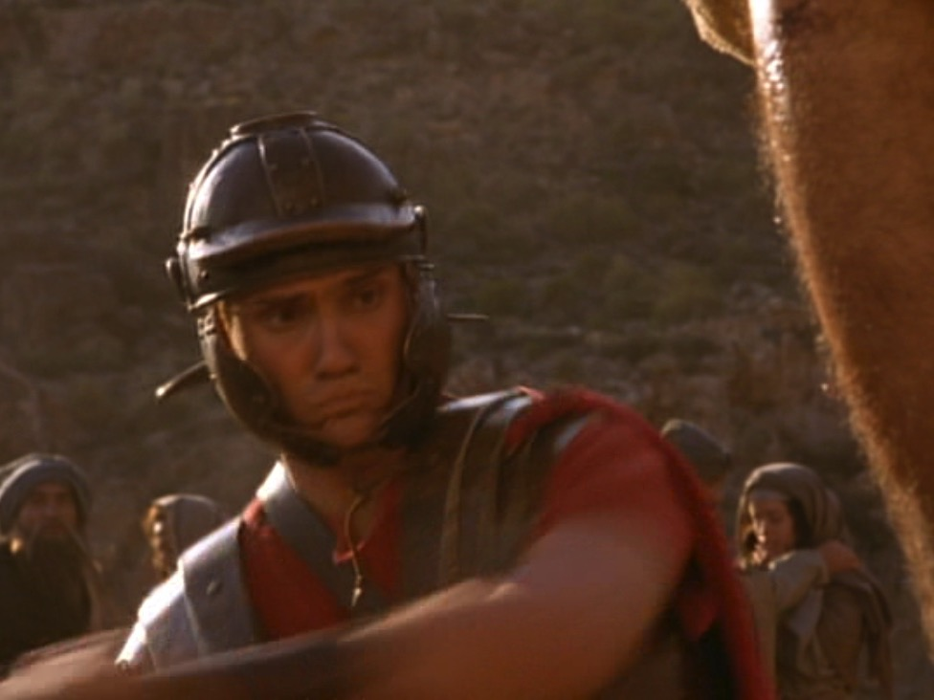
Why break the legs?
Notes:
How would the breaking of a victim’s legs bring death (19:31)? The way to hasten death was to prevent the crucified man from pushing up to take a breath—so breaking the legs prevented breathing. The shock and loss of more blood by having the legs broken with a heavy mallet also hastened death.

Slide 39
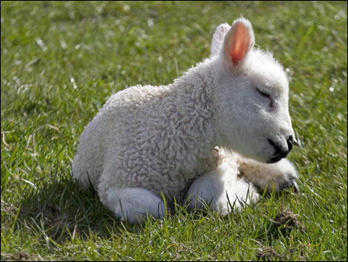
Passover lambs were unblemished
Notes:
The Passover lamb was to be without a defect—including even after death. “Not one of his bones will be broken” (John 19:36 NLT) fulfilled two OT texts:

Slide 40
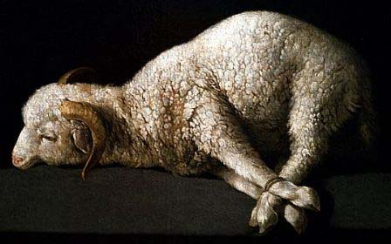
Passover lambs were roasted whole without any legs broken
"Each Passover lamb must be eaten in one house. Do not carry any of its meat outside, and do not break any of its bones"
Exodus 12:46; cf. Num. 9:12
Notes:
Exodus 12:46 commanded, “Each Passover lamb must be eaten in one house. Do not carry any of its meat outside, and do not break any of its bones.”

Slide 41
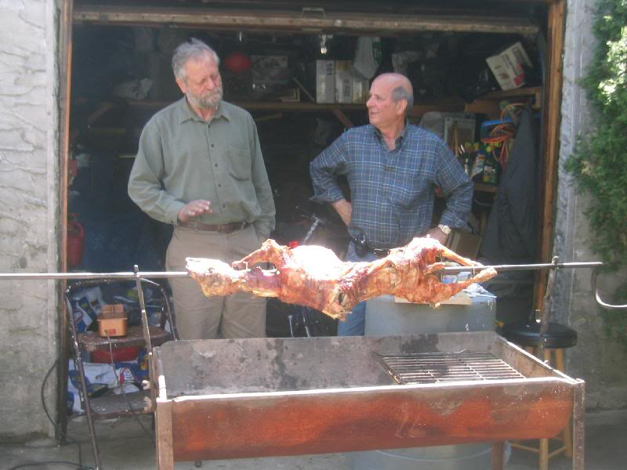
Passover lambs are still roasted whole without any legs broken

Slide 42
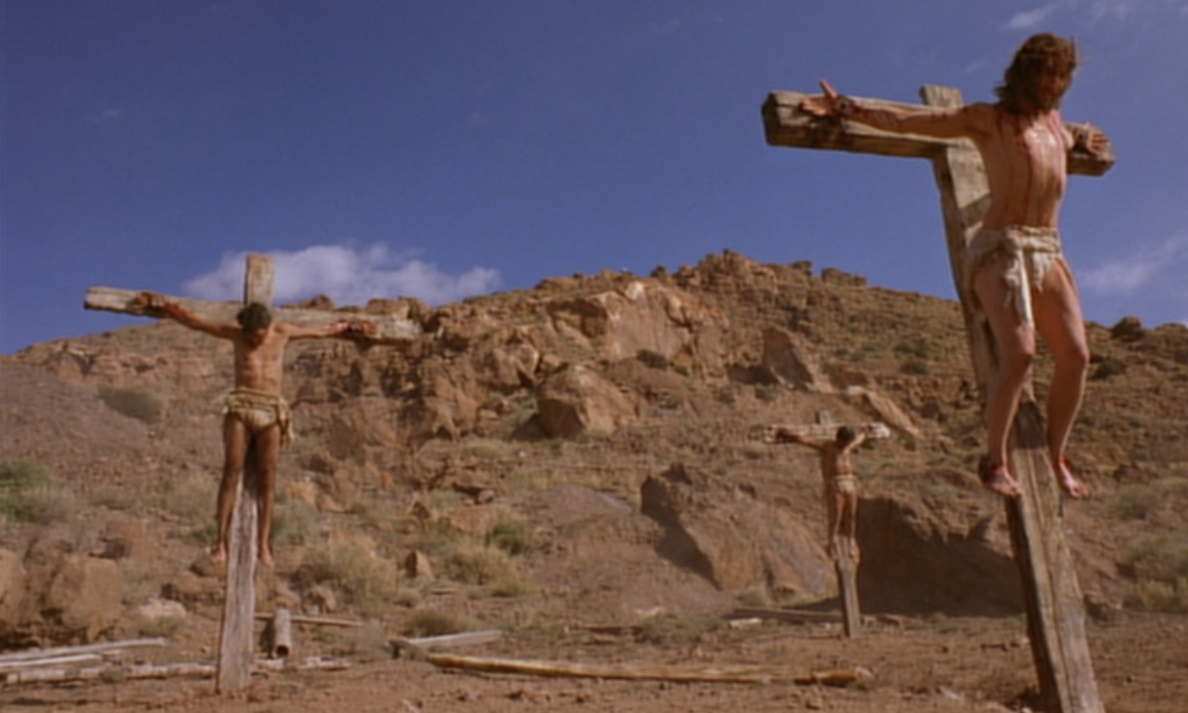
Psalm 34:20 NLT
"For the Lord protects the bones of the righteous;
not one of them is broken!"
Notes:
Ps. 34:20 prophesied, “For the Lord protects the bones of the righteous; not one of them is broken!”

Slide 43
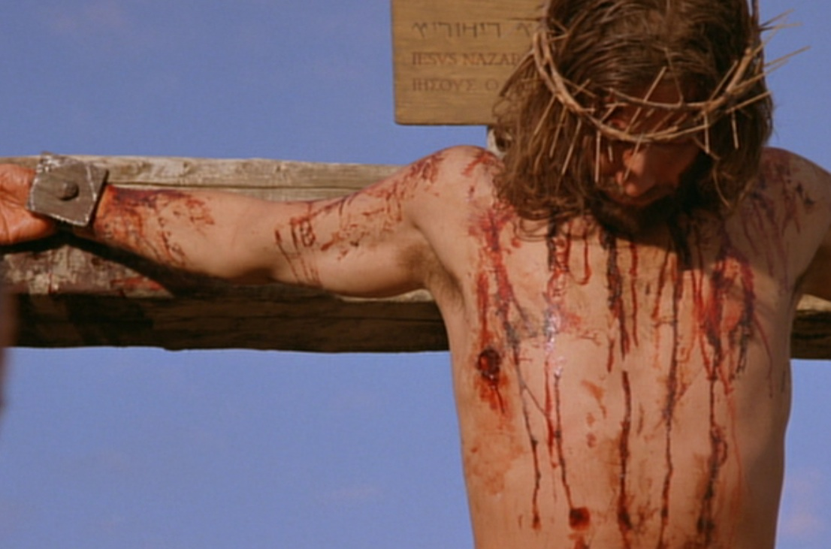
Zech. 12:10 NLT
"Then I will pour out a spirit of grace and prayer on the family of David and on the people of Jerusalem. They will look on me whom they have pierced and mourn for him as for an only son. They will grieve bitterly for him as for a firstborn son who has died."
Notes:
“They will look on the one they pierced” (Zech. 12:10) was fulfilled in John 19:37 with the soldier thrusting a spear into his side.

Slide 44
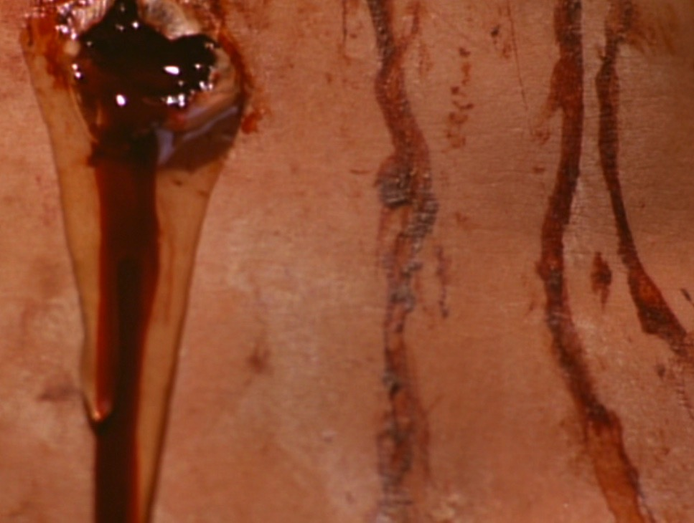
"Blood & Water"
Heart failure?
New temple (2:19)?
Life through his blood (1:13)?
Death (1 John 1:1)?

Slide 45
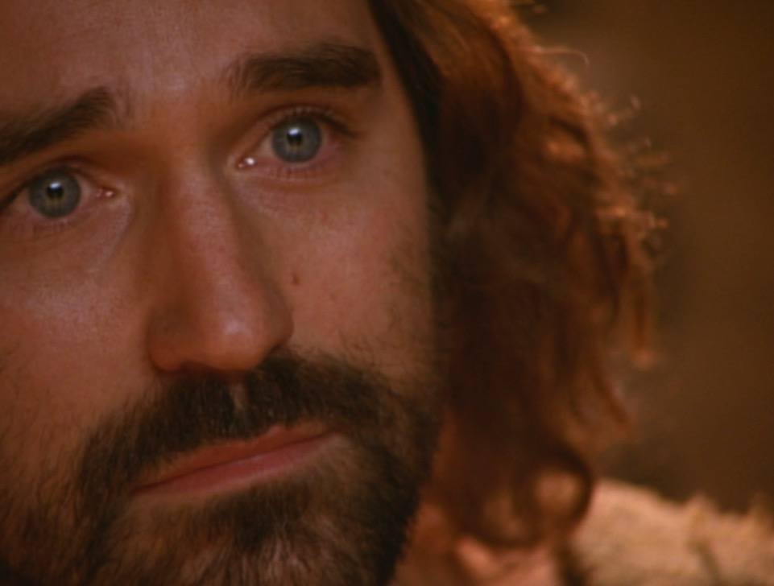
"(This report is from an eyewitness giving an accurate account. He speaks the truth so that you also can believe.)" (19:35 NLT)
Notes:
To sum up, John’s purpose in verse 35 was so you and I can believe in Jesus.

Slide 46
I. Christ fulfilled Scripture in his selfless death (19:16b-37).
Selflessness
Fulfillments
Carried cross
Clothes divided
Crucifixion
Thirsted
Cared for Mary
Paid for sin
Pierced side
Notes:
So verses 16b-37 show the twin evidences of both Christ’s selfless nature and the fulfillment of many OT prophecies. These show us that his death was unlike any other in that it was a sacrificial death for our sins. A second way we know he died for us is in verses 38-42 which show that…

Slide 47
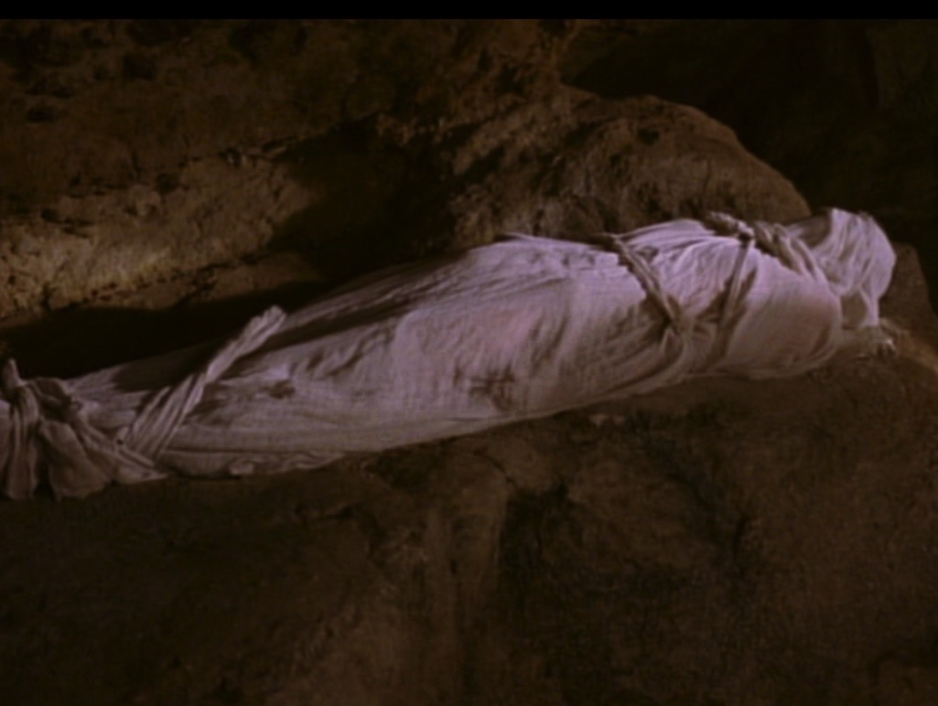
II. Christ's burial proved he was truly dead (19:38-42).
Notes:
We know Jesus really did pay for our sin by the fact that he truly died, which sets the stage for the resurrection in John 20.

Slide 48
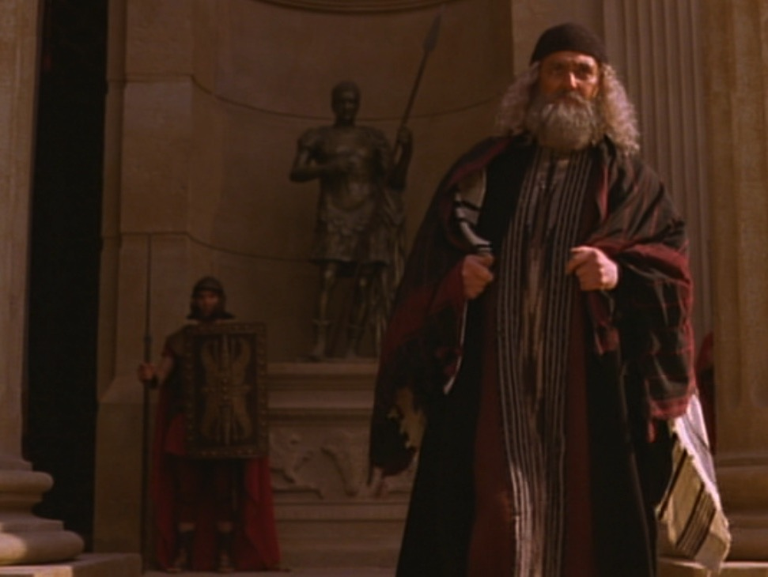
Joseph of Arimathea
Notes:
The previously secret believers, Joseph and Nicodemus, prepared his body for burial in 33 kilos of spices (19:38-40).

Slide 49
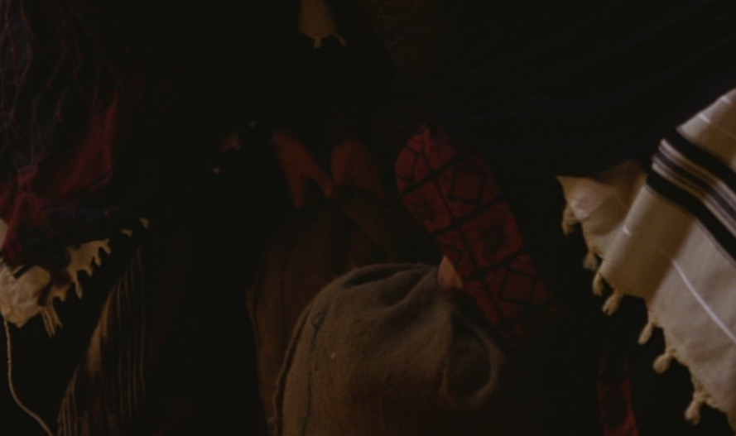
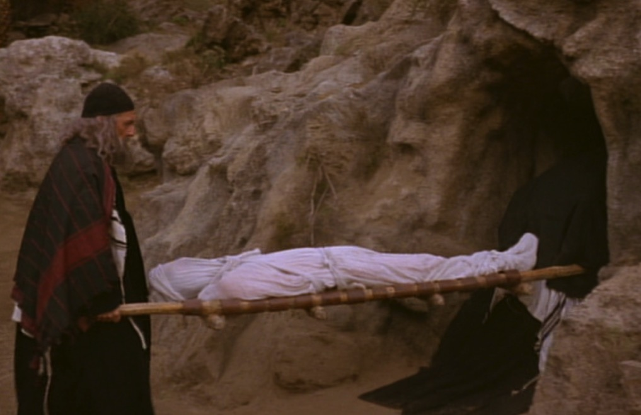
33 Kilos of Spices
Notes:
Where could they get so many spices quickly and a brand new tomb so close by? We don’t know, but what we do know is that…

Slide 50
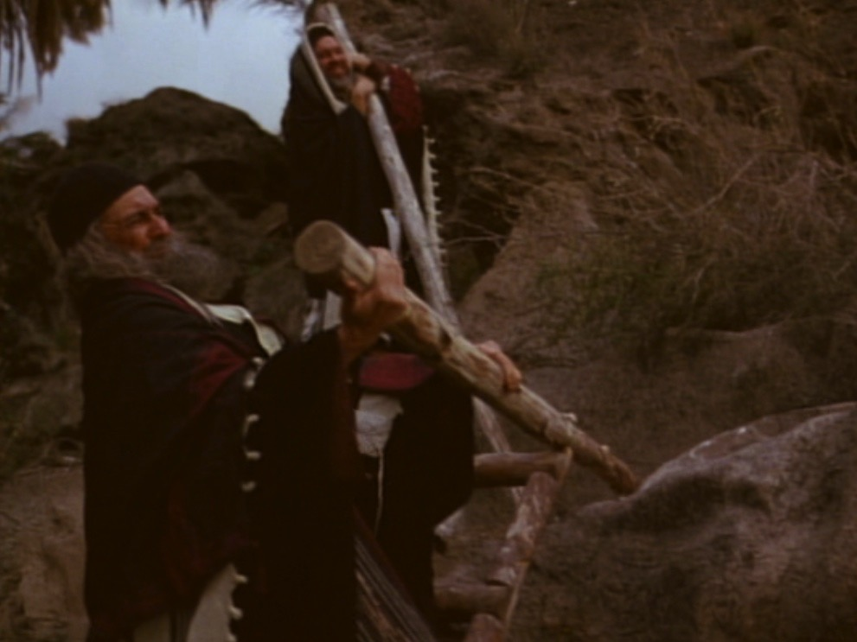
Closing the Tomb
Notes:
The appearance of these men reminds us that there exist many even today who are secret believers—men and women who feel they cannot openly declare Christ.

Slide 51
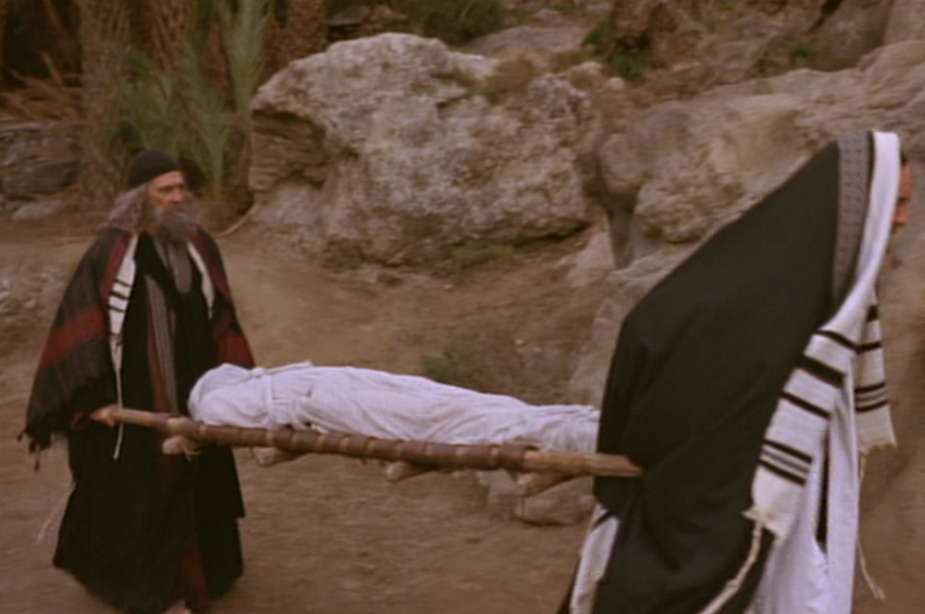
Why was a tomb burial vital?
Notes:
The body was laid in a brand new, expensive, rock-hewn garden tomb rather than in the Potter’s Field (19:41-42).
Why was it so important that Jesus was buried in a tomb?
The wrapping and burial in 33 kilos of spices proved that he was truly dead.

Slide 52
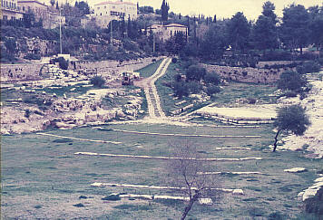
Hinnom Valley
Notes:
Normally a criminal’s body was thrown into the Valley of Hinnom and burned or eaten by dogs. But if his body was burned there, claim of a resurrection would be absurd. So his enemies actually protected his body for credibility purposes!

Slide 53
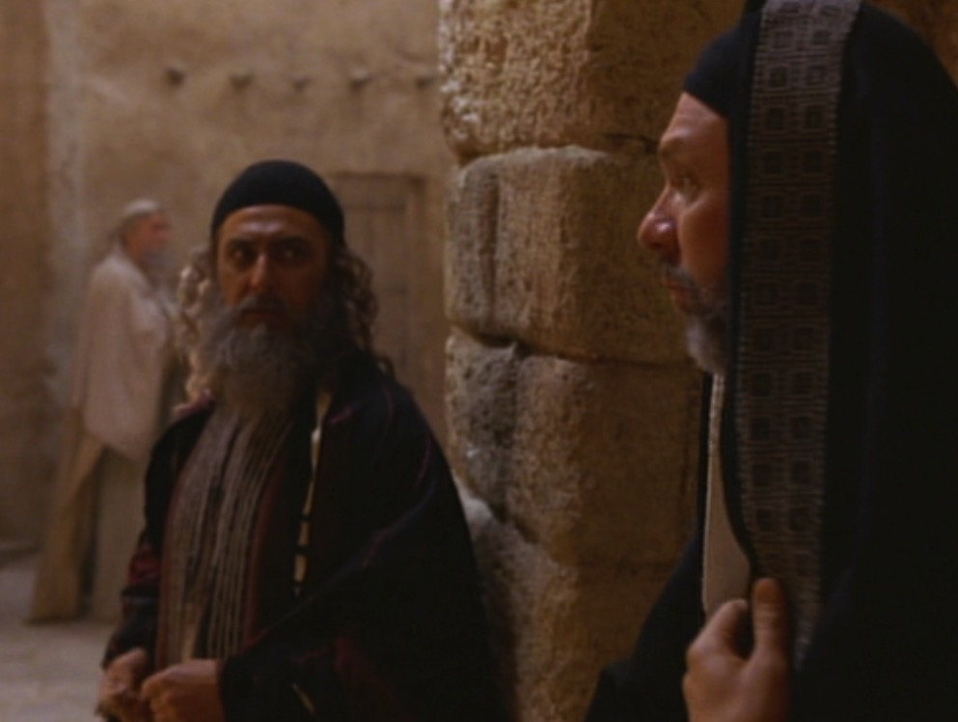
Joseph & Nicodemus
Notes:
The tomb burial allowed secret believers Nicodemus and Joseph to come forward.

Slide 54
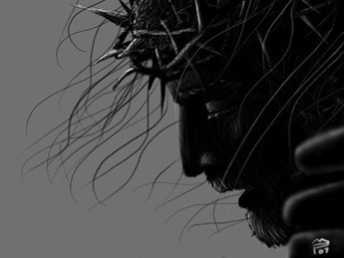
He was truly dead
Notes:
But what was the main reason the burial of Christ is significant? It proved that Christ was indeed dead. You can’t have a resurrection unless you first have a dead man!

Slide 55
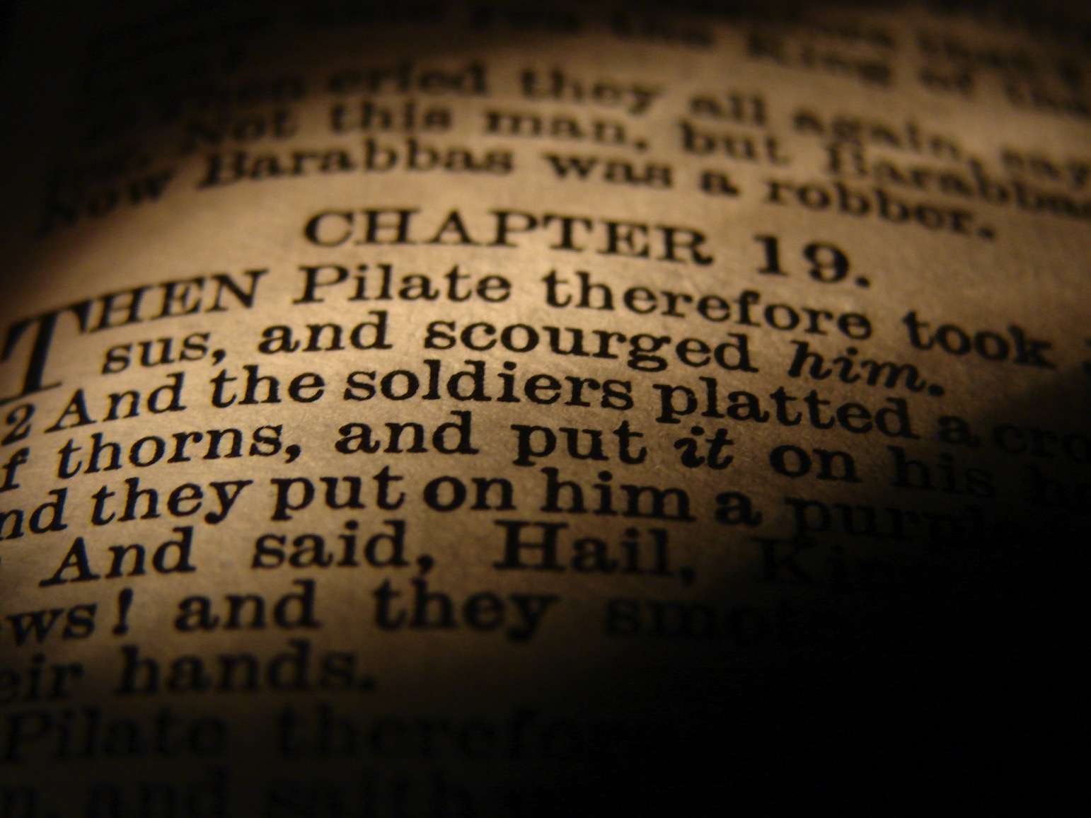
He Died for You!
But how do we know that Christ's death actually paid for our sin?
Notes:
We began with the question, “How do we know that Christ’s death actually paid for our sin?” So how can we be sure his death was unlike any other? I sum up the whole passage in this way…

Slide 56
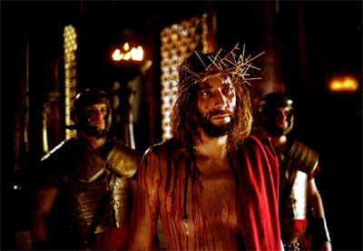
Main Idea
Christ must have died for our sin since it was so prophetic, selfless and certain.
Notes:
Jesus’ death was a selfless fulfillment of Scripture ending in tomb burial (restated MI).

Slide 57
I. Christ fulfilled Scripture in his selfless death (19:16b-37).
Selflessness
Fulfillments
Carried cross
Clothes divided
Crucifixion
Thirsted
Cared for Mary
Paid for sin
Pierced side
Notes:
How do we know that Christ’s death actually paid for our sin?

Slide 58
II. Christ's burial proved he was truly dead (19:38-42).

Slide 59

To End All Wars

Slide 60

To End All Wars

Slide 61
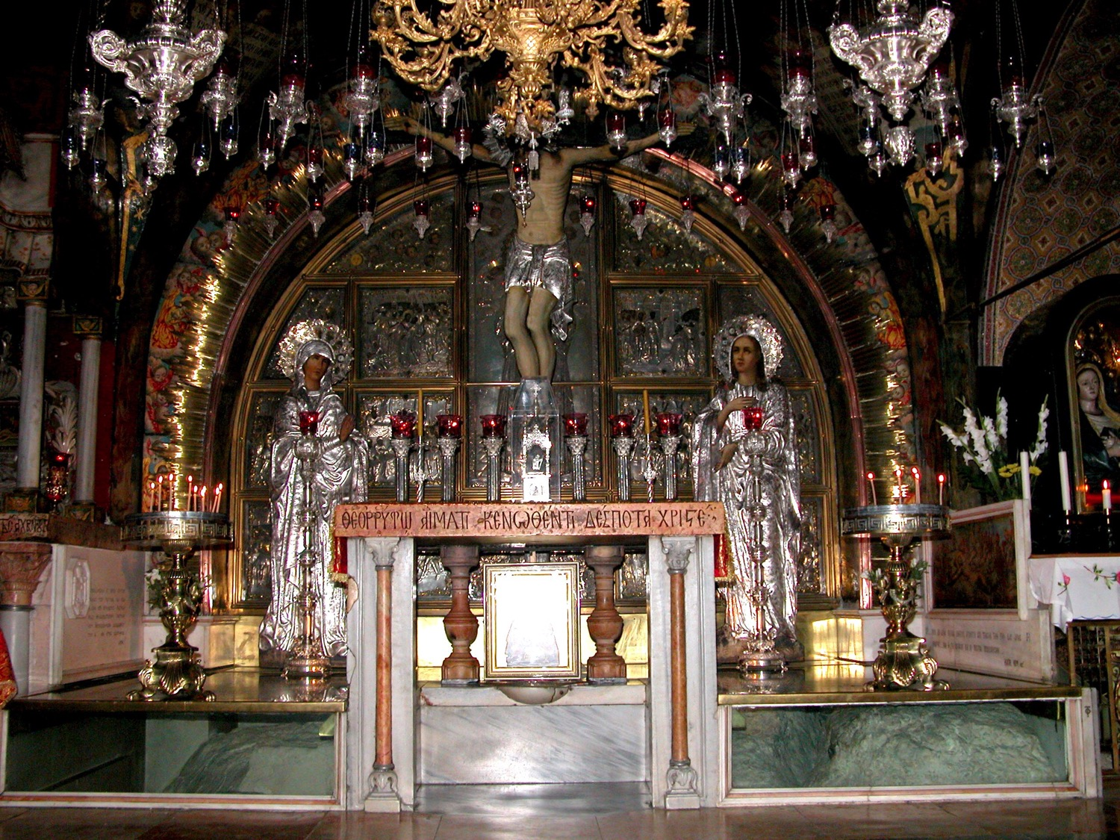
Golgotha, in The Church of the Holy Sepulcher
Notes:
Visiting the tomb of Jesus can get us all caught up in the gaudy display—

Slide 62
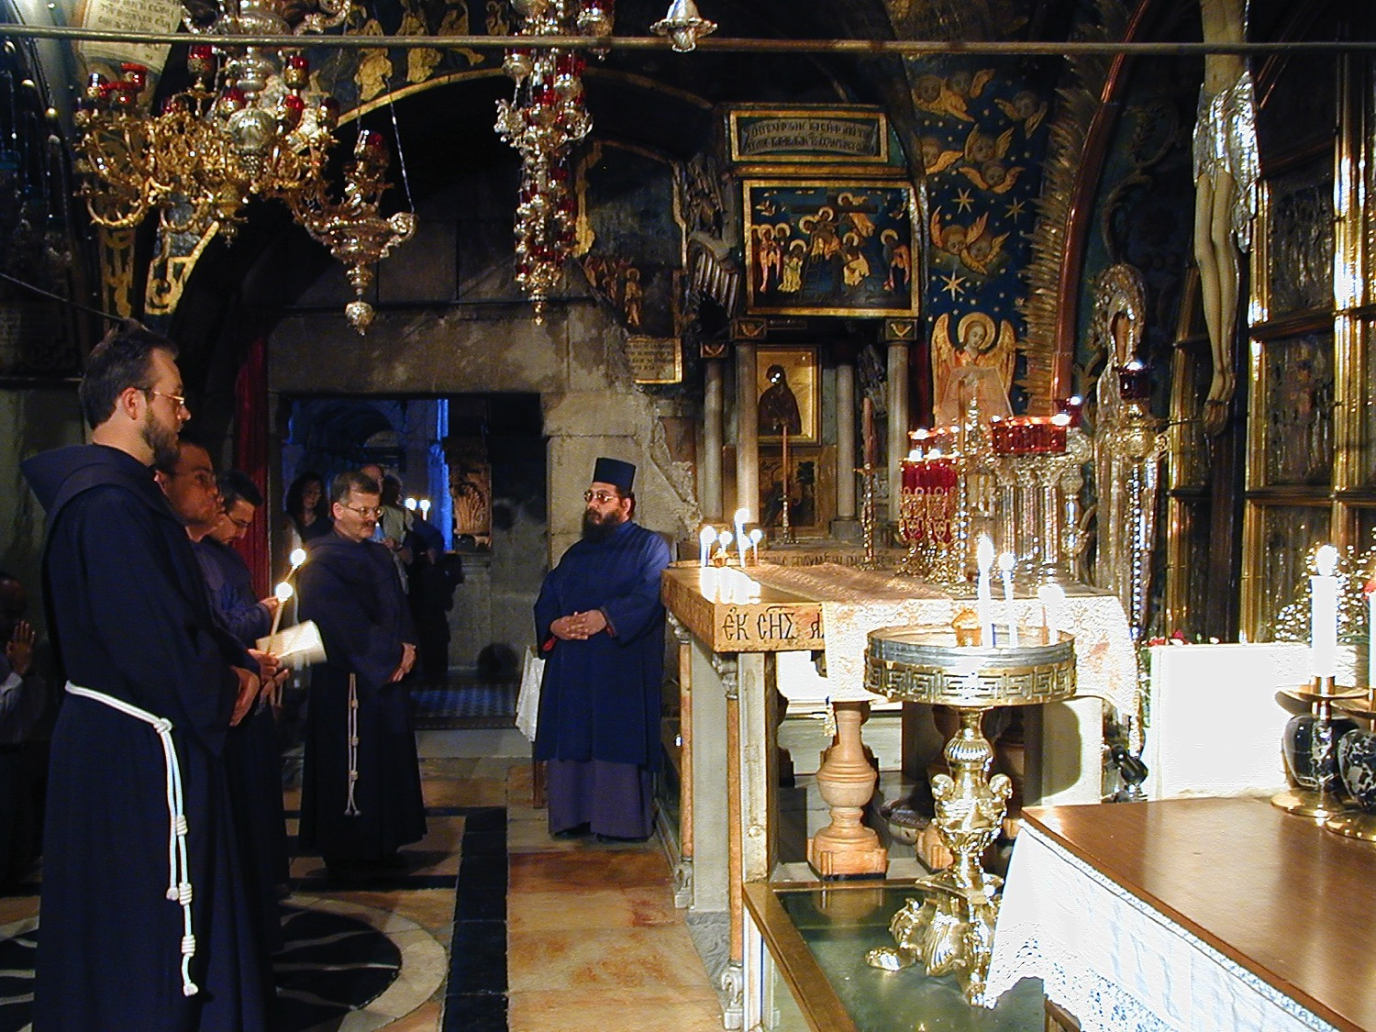
Golgotha, in The Church of the Holy Sepulcher
Notes:
—so that we miss the key point that Christ actually died for our sin.

Slide 63
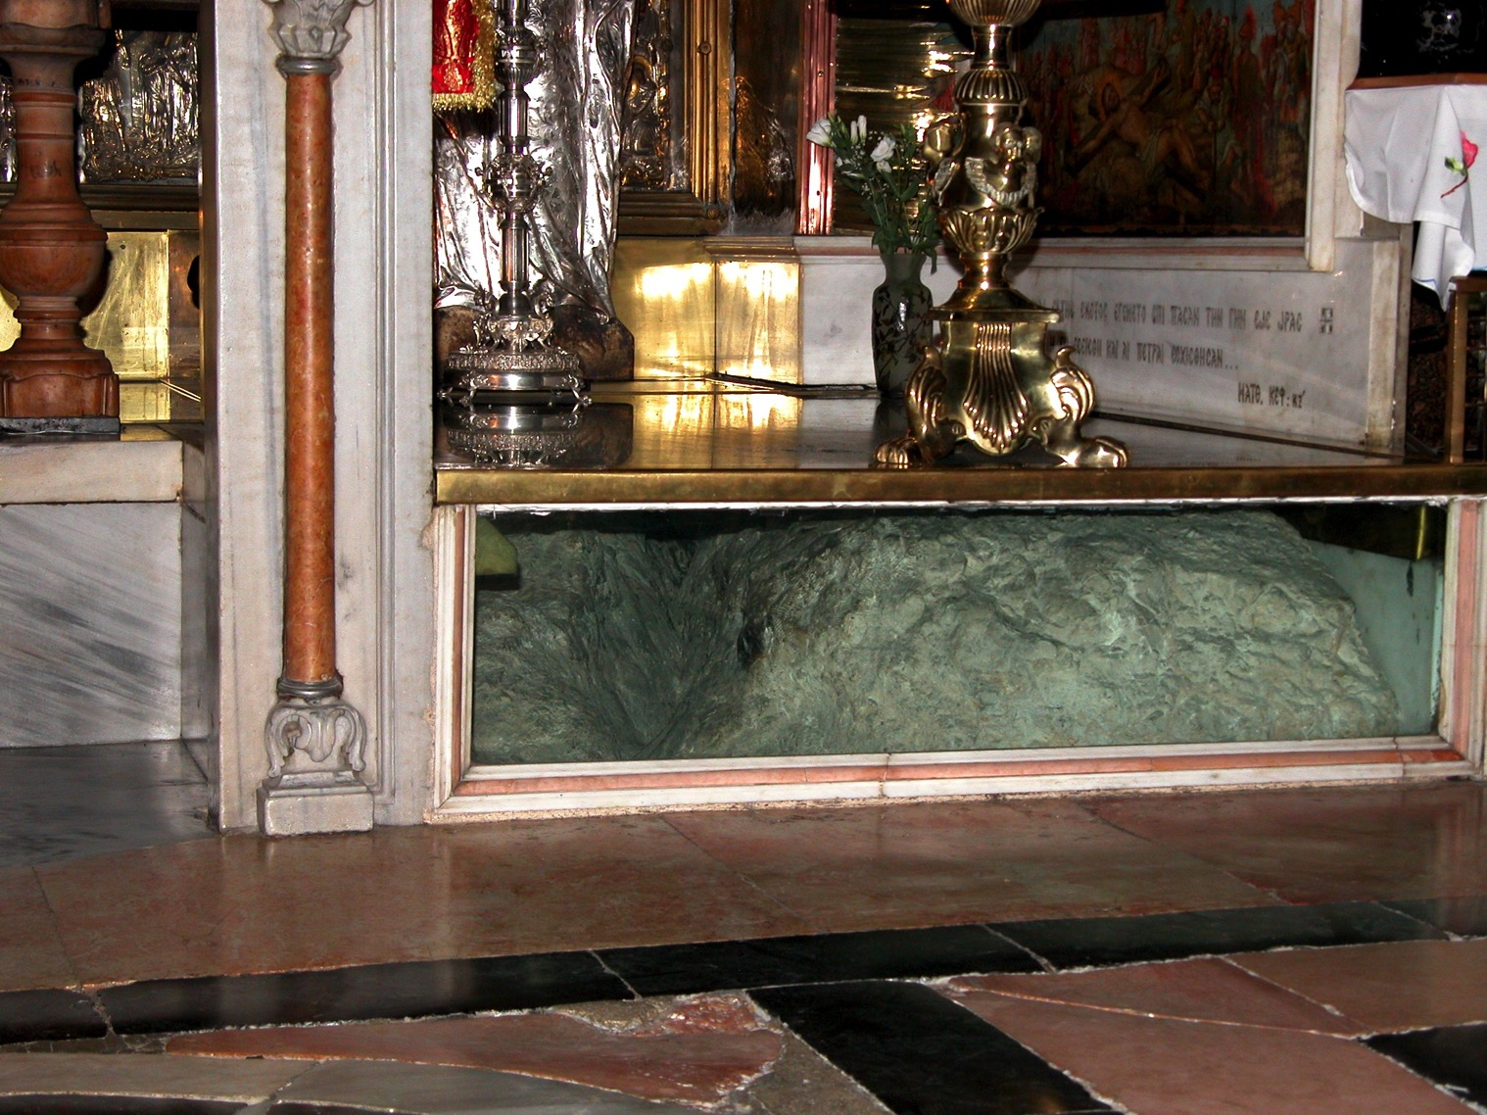
Golgotha, in The Church of the Holy Sepulcher
Notes:
The rock of Golgotha is barely seen!

Slide 64
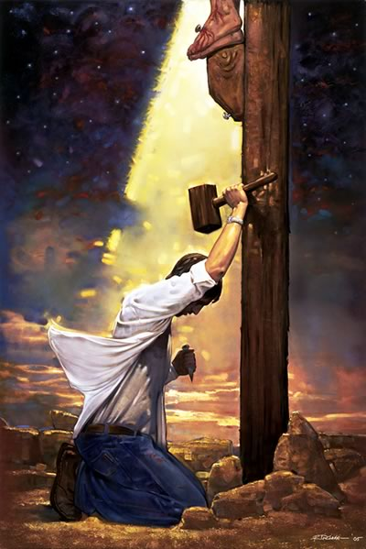
Who crucified Jesus?
Notes:
Let me leave you to answer one of two questions…

Slide 65

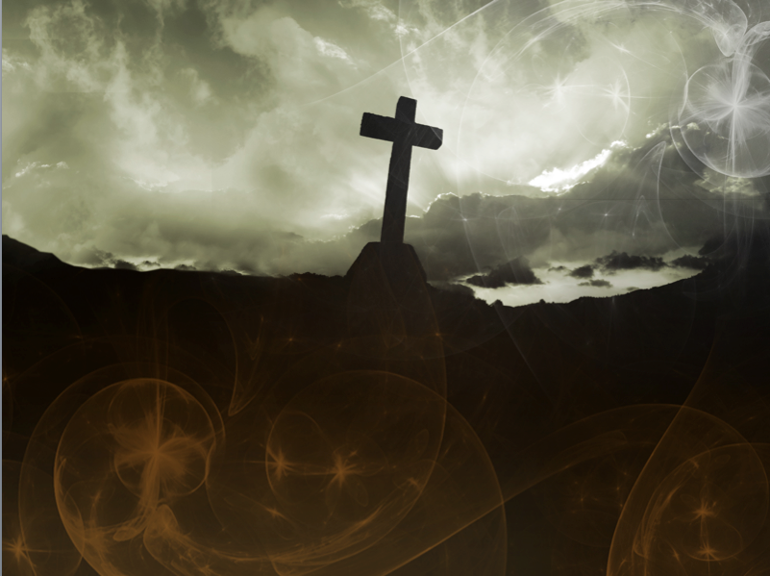
It is Finished
Notes:
Pre-believers: Will you trust in Christ’s death that paid for your sin?

Slide 66
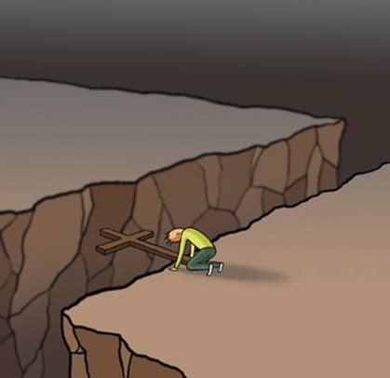
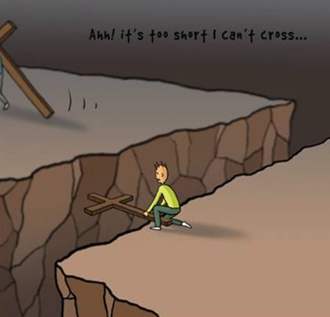
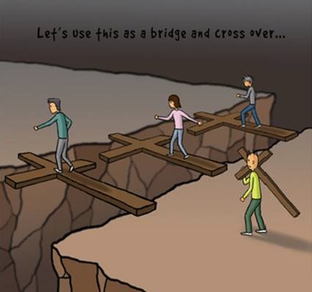











Cross Too Heavy?
Notes:
Believers: What cost could you pay that is too much for the one who died for you? Please watch this sequence of pictures…

Slide 67
Black

Slide 68


Christology link at BibleStudyDownloads.org
Get this presentation for free!
Notes:
Creation (cr)

