Slide 1
Luke
Supplement
Adapted from a 2006 Class Presentation by Mary Magdalene for
Dr. Rick Griffith • Singapore Bible College • BibleStudyDownloads.org

Slide 2
The New Testament Bookshelf
22
The Gospels
History
Matthew
Mark
Luke
John
Acts
Letters by Paul
Luke
1 Thessalonians
2 Thessalonians
1 Corinthians
2 Corinthians
Philippians
Ephesians
Colossians
1 Timothy
Romans
Galatians
2 Timothy
Philemon
Titus
General Letters
Prophecy
Hebrews
1 Peter
2 Peter
1 John
2 John
3 John
James
Jude
Revelation
Notes:
What overall observations can you make in your small group for the NT?
• There are 5 parts to the NT (grouped by category)
• 4 versions of Christ's life but only one of the church
• Most the NT are letters (especially by Paul)
• 6 of Paul's 13 letters are to people he wrote twice (follow-up for Cor., Thess., & Tim.)
• 2 groupings (general epistles & gospels) named after their authors while Paul's after their recipients

Slide 3
Luke
93
Universal Savior Ministers in Sovereign Kingdom Progress
To Seek the Lost
To Save the Lost
Introduction
Ministry
Passion
Conclusion
1:1—4:13
4:14—21:38
22—23
24
Sources
1:1-4
Advent
1:5—2:52
Prepared
3:1—4:13
Galilee
4:14—9:50
Travelogue
9:51—19:27
Rejection
19:28—21:38
Night
22:1—23:25
Crucifix
-ion
23:26-56
Resurrection
24:1-44
Commission
24:45-53
Rick Griffith, “Luke," New Testament Survey Class Notes: Gospel and Acts, Vol. 1. Singapore: Singapore Bible College, 2005.

Slide 4
Authorship
Luke

Slide 5
Authorship
External Evidence
Church Fathers of the early church said that Luke was the Gentile disciple, Paul’s “beloved physician” (Col. 4:14), and Paul’s companion for several portions of his missionary journeys
Proponents:
Muratorian Canon and
the Anti-Marcionite Prologue.
Further citations given by: Irenaeus, Tertullian
Clement of Alexandria,
and Origen.
Internal Evidence
1. Several factors signify that Luke and Acts had the same author.
The “we sections” in Acts.
3. Distinctive medical language is compatible with authorship by a doctor.

Slide 6
Circumstances
Date
Luke’s Gospel was written no later than about AD 62, sometime before the book of Acts.
Origin/Recipients
Luke clearly wrote to Theophilus (1:4).
A mostly, Gentile-Christian community, of which Theophilus (“lover of God”) may have been a part (Blomberg, p. 152).
The title of “most excellent” for Theophilus probably indicates that he was an official. He is most likely a well-to-do Greek who funded Luke’s writing project.

Slide 7
Structure
The opening chapters include a significant cluster of references to various Roman rulers and Roman appointees in power (1:5; 2:1; 3:1).
Luke 24 and Acts 1 overlap, each narrates the resurrection and the ascension of Christ.

Slide 8
Structure
Luke was designing a two-volume, chiastically structured account of the life of Jesus and the growth of the early church.
The resurrection and ascension form the heart of the Christian “kerygma” (proclamation) for Luke.

Slide 9
The Structure of Luke
Jesus in Galilee
Ministry in or near Jerusalem
Infancy
1-2
3:1-4:13
4:14-9:50
9:51 ---------- 18:34
18:35-21:38
22-24
Introduction to Jesus’ Ministry
Travel Narrative
Passion & Resurrection

Slide 10
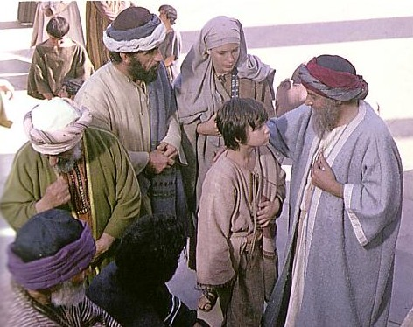
Outline
98
(1:1–4:13) Introduction to Jesus’ Ministry
(4:14–9:50) Ministry in and around Galilee.
(9:51-18:34) Jesus’ Teaching “En Route” to Jerusalem.
(18:35-21:38) Jesus in Judea: Ministry Near and in Jerusalem.
Even at age 12 Jesus knew His real Father
(22–24) The Climax of Jesus’ Life

Slide 11
The Chiastic Outline of Luke-Acts
The Birth of Jesus in the context of world history and Roman rule
Jesus in Galilee
In Samaria and Judea
In Jerusalem
Resurrection and Ascension
Church in Jerusalem
In Judea and Samaria
Throughout the Gentile world
The preaching of the Gospel by Paul extends as far as Rome

Slide 12
Theology

Slide 13
Views of Jesus
Jesus’ Humanity and Compassion for the Outcasts of Society
Savior
Teacher of Parables
Prophet
The Resurrected and Exalted One

Slide 14
Views of Jesus
Jesus’ Humanity and Compassion for the Outcasts of Society
Women
Samaritans and Gentiles
Tax collectors and sinners
The Poor

Slide 15
Views of Jesus
Jesus’ Humanity and Compassion for the Outcasts of Society
Savior
Teacher of Parables
Prophet

Slide 16
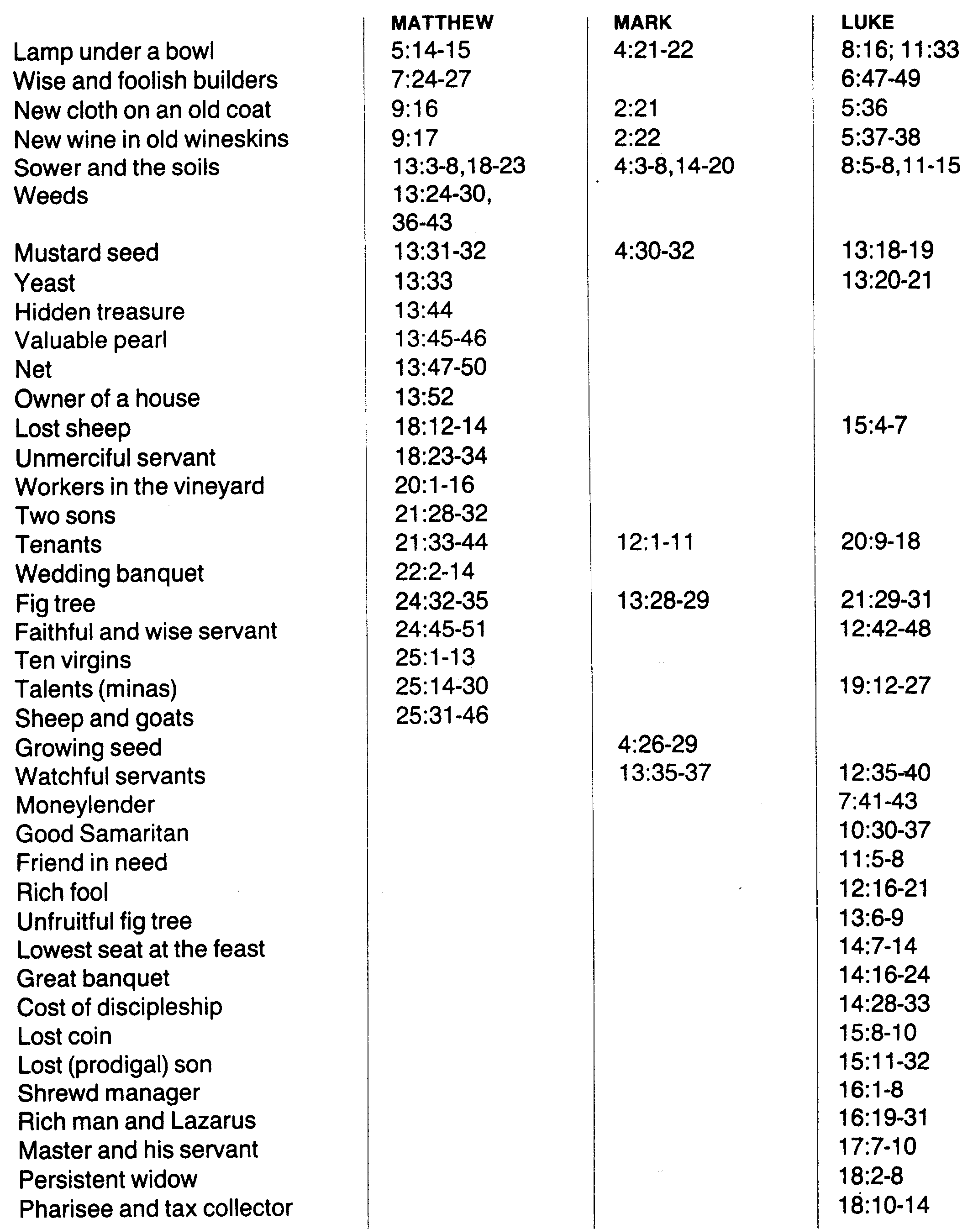
102
Parables
of Jesus

Slide 17
Views of Jesus
Jesus’ Humanity and Compassion for the Outcasts of Society
Savior
Teacher of Parables
Prophet
The Resurrected and Exalted One

Slide 18
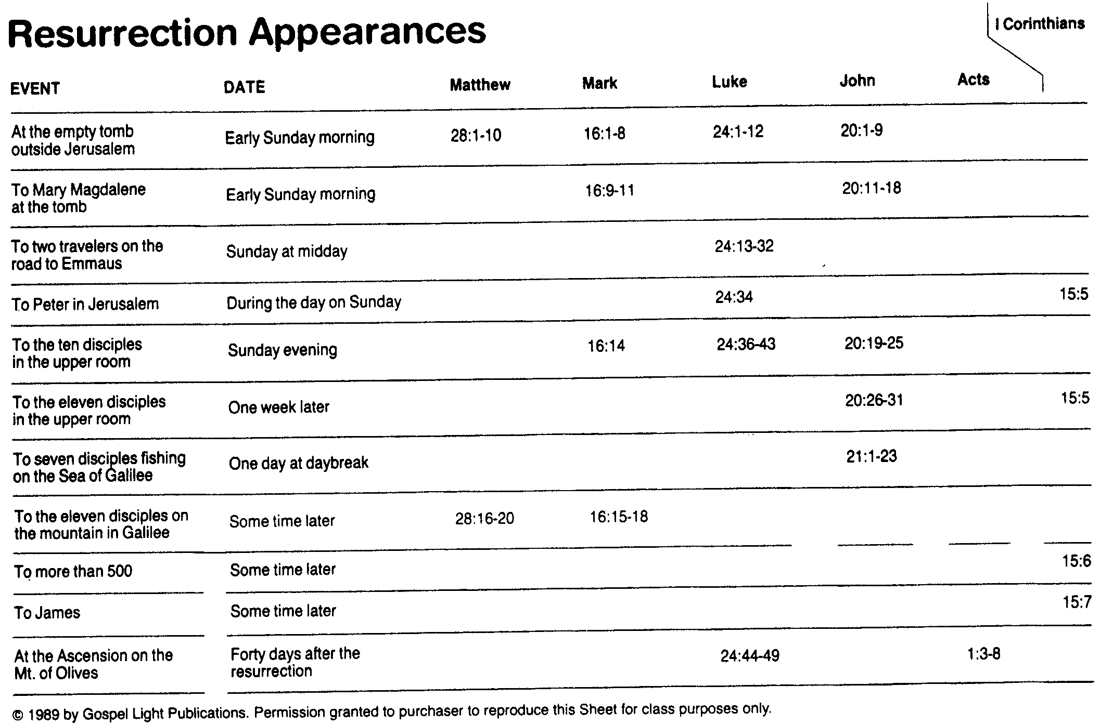
105

Slide 19
Other Themes
Prayer
Money
Gentile
Joy
Glory
Jewish People
Writing Christian History
Holy Spirit

Slide 20
The Four Gospels Compared
51
 | Matthew | Mark | Luke | John
Author
Job before Saved | Tax Collector | None (Youth) | Medical Doctor | Fisherman
Race | Jew | Jew | Gentile | Jew
Office and / or Spiritual Gift | Apostle | Service or Pastoring | Service or Teaching | Apostle
Readers:
Ethnically | Jews | Roman | Gentile (Greek) | World
Interest | Signs (1 Cor. 1:22) |  | Wisdom (1 Cor. 1:22)
Spiritually | Unbelievers | Believers | Unbelievers | Unbelievers
Primary Need | Messiahship and Kingdom Offer | Model in Suffering (exhorts discipleship) | Universality (and kingdom expansion) | Deity

Slide 21
52
The Four Gospels Compared
 | Matthew | Mark | Luke | John
Date Written | 40s | 64-68 | 57-59 | late 60s
Place Written | Antioch or Syria | Rome | Caesarea or Rome | Ephesus
Place Sent | Palestine | Rome | To Theophilus | Asia, etc.
Jesus is… | King of Israel (Messiah) | Suffering Servant (Deity) | Ideal Man (Messiah) | Son of God (Deity)
Key Verse | 21:5 | 10:45 | 19:10 | 20:31
Themes | Law | Power | Grace | Glory
Literary Emphasis | Sermons | Miracles | Parables | Allegories
Arrangement | Topical | Chronological | Chronological | Topical
Genealogy | Abraham to Joseph | None | Adam to Mary | None

Slide 22
Key Verse
“For the Son of Man
came to seek and to save
what was lost”
(Luke 19:10).

Slide 23
The Four Gospels Compared
51
 | Matthew | Mark | Luke | John
Scope | Birth to Resurrection | Ministry to Resurrection | Birth to Resurrection | Ministry to Resurrection
Tone | Prophetic | Pastoral | Historical | Spiritual
Christ’s Words | 60% | 42% | 50% | 50%
Chapters | 28 | 16 | 24 | 21
Verses | 1068 | 661 | 1149 | 878
Verses per Chap. | 38 | 41 | 48 | 42
OT Quotations | 53 | 36 | 25 | 20
OT Allusions | 76 | 27 | 42 | 105
OT References | 129 | 63 | 67 | 125
Unique Material | 42% | 7% | 59% | 92%
Broad Division | --------------------- Synoptic Gospels --------------------- |  |  | Supplementary Gospel

Slide 25


Gospels link at BibleStudyDownloads.org
Get this presentation for free!
Notes:
NT Survey (ns)

