Slide 1
Dinosaurs:
Have you or your kids
been brainwashed?
Dr. Terry Mortenson
Taught by Dr. Terry Mortenson, AnswersinGenesis.org Uploaded by Dr. Rick Griffith, Singapore Bible College All files in many languages for free download at BibleStudyDownloads.org

Slide 3
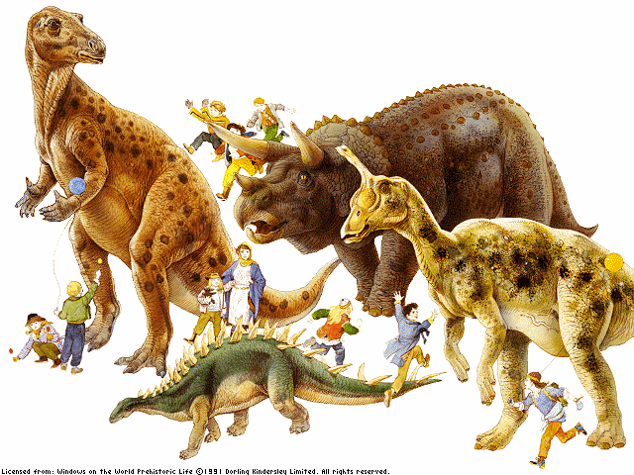

Slide 4
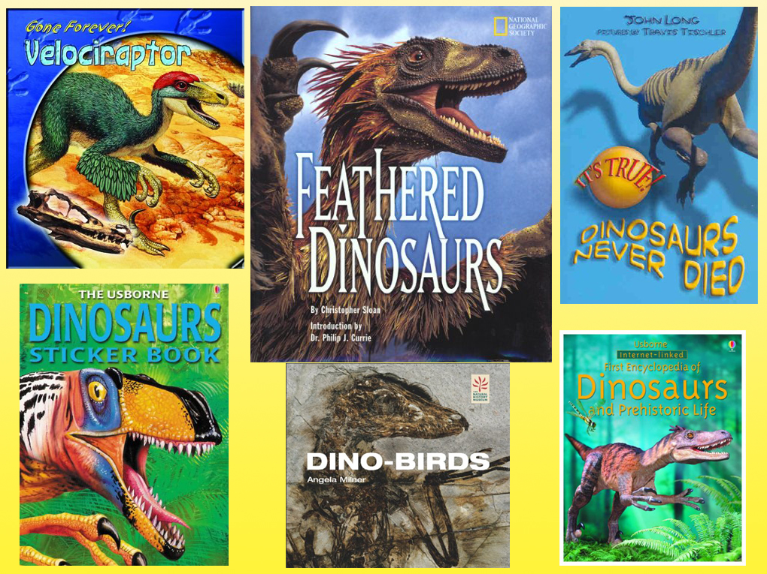

Slide 5
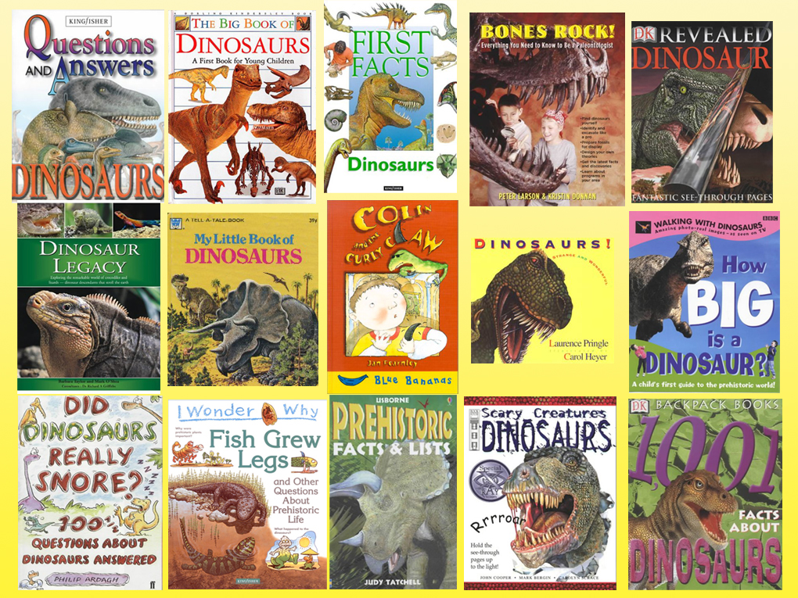

Slide 6
And this is only
some of the books.

Slide 7
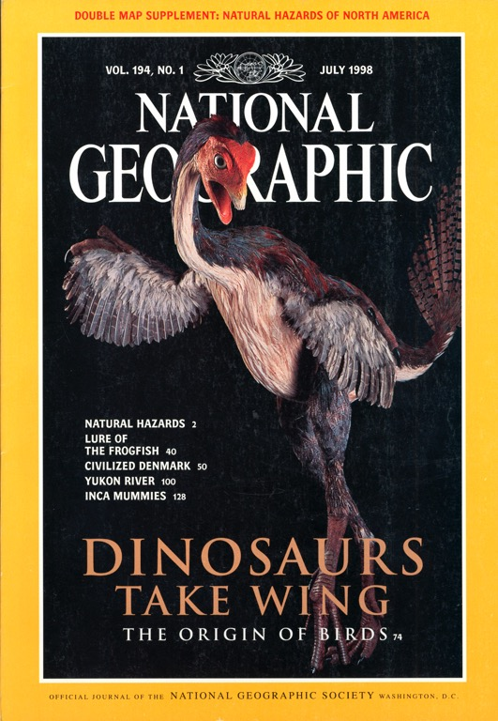
DINOSAURS TAKE WING
The Origin of Birds
July 1998

Slide 8
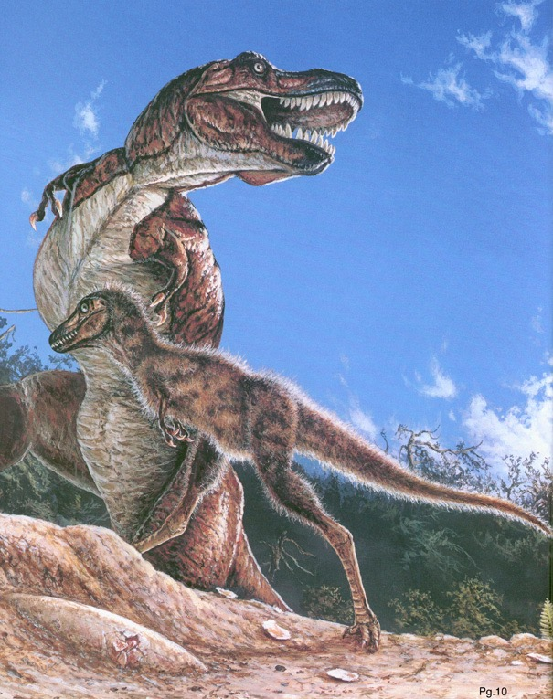
“Feathers for T. Rex?”
National Geographic
Nov. 1999

Slide 9
How do you fit dinosaurs into the Bible?
YOU DON’T!

Slide 10
Use the Bible to explain dinosaurs!

Slide 11
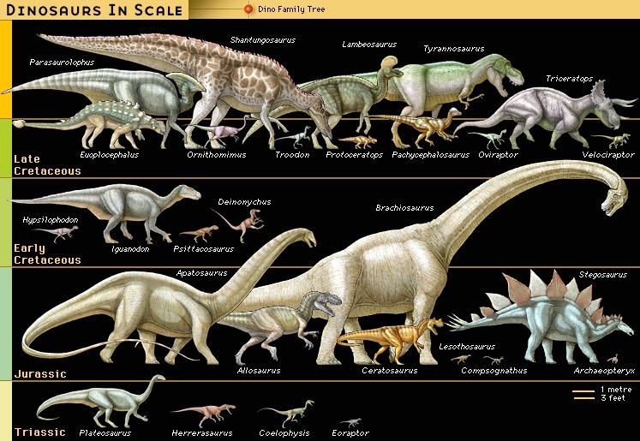
Millions
of years
65
145
208
245
(Encyclopaedia Britannica, CD, 1999)

Slide 14
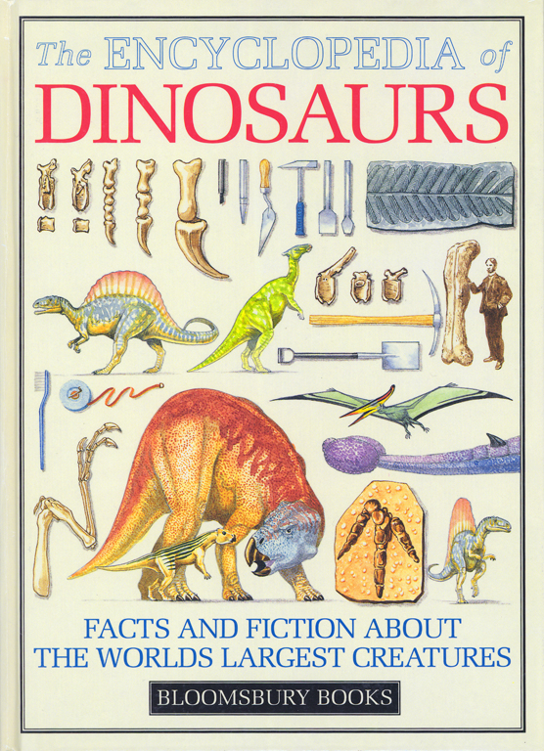
“Evolving reptiles”
“Small lizard-like reptiles evolved from amphibians at least 340 million years ago.”
“From such pioneers evolved several reptile groups identified by differences in the skull behind the eyes.”
David Lambert, The Encyclopedia of Dinosaurs (London: Bloomsbury Books, 1994), p. 16, published in association with the British Museum of Natural History.
Notes:
In one sentence they explain the origin of reptiles.
In the very next sentence they explain the origin of all other reptiles, including dinosaurs.

Slide 15
“The demise of T. rex and most other dinosaurs some 65 million years ago may grab all the headlines. But paleontologists are equally concerned with puzzling out how these mighty beasts got their start. Who were their ancestors?”
Michael Balter, “Pint-Sized Predator Rattles the Dinosaur Family Tree,” Science, Vol 331: 6014 (14 Jan. 2011), p. 134.

Slide 17
“Birds are living dinosaurs!”
Museum of the Rockies, Bozeman, Montana

Slide 18
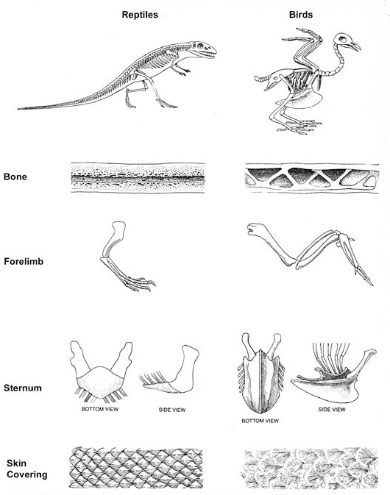
“Evolution of birds from reptiles can be considered a process of adaptation by which birds ‘solved’ the ‘problem’ of flight.”
Richard Lewontin, “Adaptation,” Scientific American (Sept. 1978), p. 214.
Notes:
The marrow (which produces blood cells) in all bones (of birds, mammals, reptiles, etc) decays away after death leaving empty spaces.
In life, bird bones have pneumatic spaces in long bones that communicate with the respiratory system.
But reptiles don’t have pneumatic bones. Evolutionists confuse us because they talk about “avian dinosaurs” and “non-avian dinosaurs.” But Dr. Menton says that most creationists would classify avian dinosaurs as 100% “birds” and non-avian dinosaurs as “dinosaurs.”
If you close off the trachea of bird and break open a wing bone, the bird can still breathe for awhile at least.

Slide 19
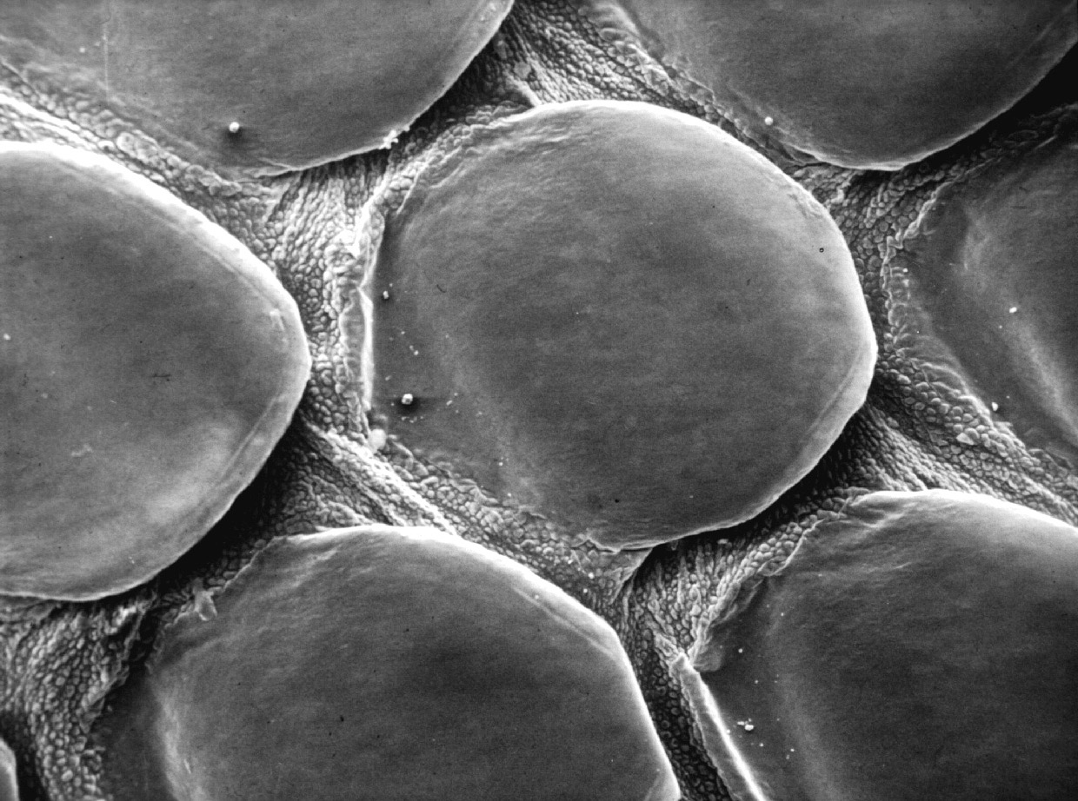

Slide 21
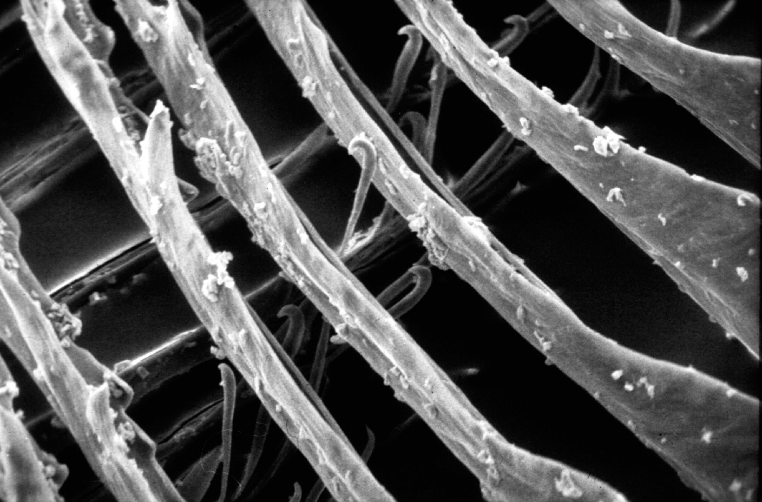
Notes:
From NAB1, ch. 24, David Menton:
In actual fact, feathers are profoundly different from scales in both their structure and growth. Feathers grow individually from tube-like follicles similar to hair follicles. Reptilian scales, on the other hand, are not individual follicular structures but rather comprise a continuous sheet on the surface of the body. Thus, while feathers grow and are shed individually (actually in symmetrically matched pairs!), scales grow and are shed as an entire sheet of skin.
The feather vane is made up of hundreds of barbs, each bearing hundreds of barbules interlocked with tiny hinged hooklets. This incredibly complex structure bears not the slightest resemblance to the relatively simple reptilian scale. Still, evolutionists continue to publish imaginative scenarios of how long-fringed reptile scales evolved by chance into feathers, but evidence of “sceathers” eludes them.

Slide 22
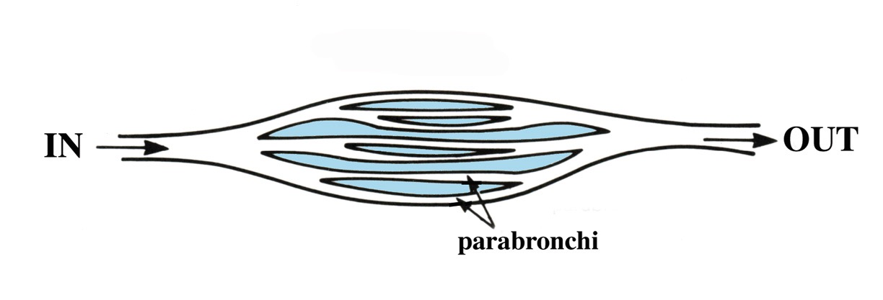
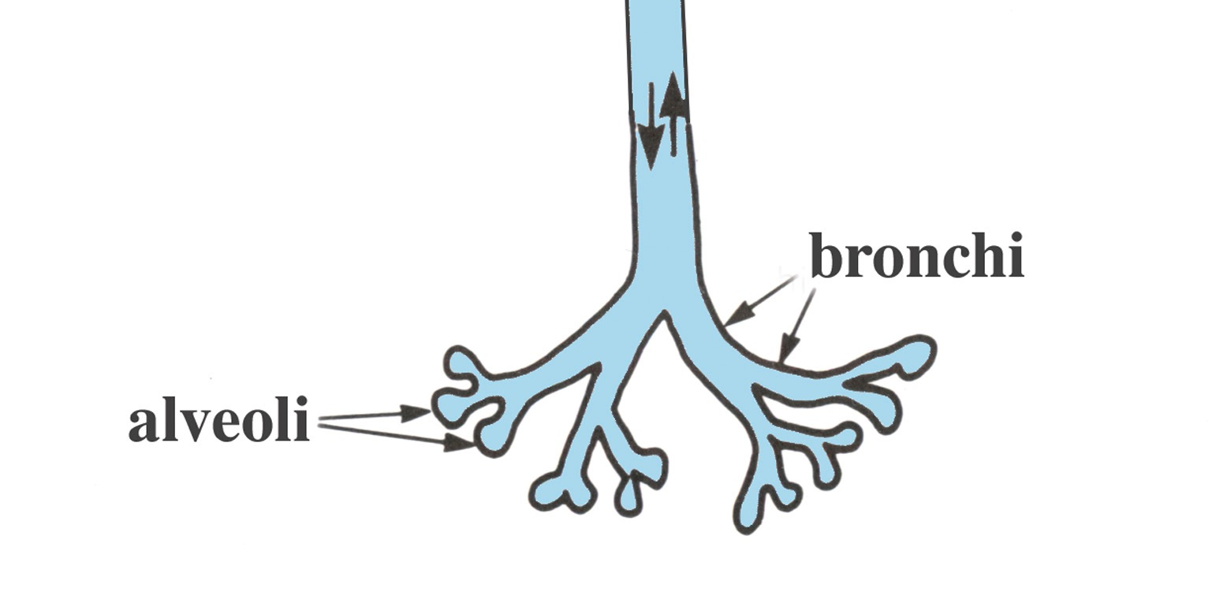
Bird lung
Reptile lung
Notes:
The bird lung is a unique respiratory system. Only birds have airsacs (which function as bellows to keep air flowing continuously through the unidirectional lungs) and pneumatic bones, and they have no diaphram.
Dinosaurs don’t have connections between bones and the respiratory system, as birds have. And dinosaurs and crocodilians do have diaphrams.
To refute the claim that crocodilians have uni-directional flow-through respiratory, see:
Dave Menton in NAB1, Ch. 24, “Did dinosaurs turn into birds?” (https://answersingenesis.org/dinosaurs/feathers/did-dinosaurs-turn-into-birds/)
“One of the most distinctive features of birds is their lungs. Bird lungs are small in size and nearly rigid, but they are, nevertheless, highly efficient to meet the high metabolic needs of flight. Bird respiration involves a unique “flow-through ventilation” into a set of nine interconnecting flexible air sacs sandwiched between muscles and under the skin. The air sacs contain few blood vessels and do not take part in oxygen exchange, but rather function like bellows to move air through the lungs.
“The air sacs permit a unidirectional flow of air through the lungs resulting in higher oxygen content than is possible with the bidirectional air flow through the lungs of reptiles and mammals. But in those creatures, the air flow moves through the same tubes at different times both into and out of the lungs of reptiles and mammals, and this results in a mixture of oxygen-rich air with oxygen-depleted air (air that has been in the lungs for a while). The unidirectional flow through bird lungs not only permits more oxygen to diffuse into the blood but also keeps the volume of air in the lungs nearly constant, a requirement for maintaining a level flight path.”

Slide 23
“Researchers at Oregon State University have made a fundamental new discovery about how birds breathe and have a lung capacity that allows for flight – and the finding means it's unlikely that birds descended from any known theropod dinosaurs.”
“Discovery Raises New Doubts About Dinosaur-Bird Links,” www.sciencedaily.com, 2009 June 9.
Notes:
http://www.sciencedaily.com/releases/2009/06/090609092055.htm, accessed 5 Sept 2014.

Slide 24
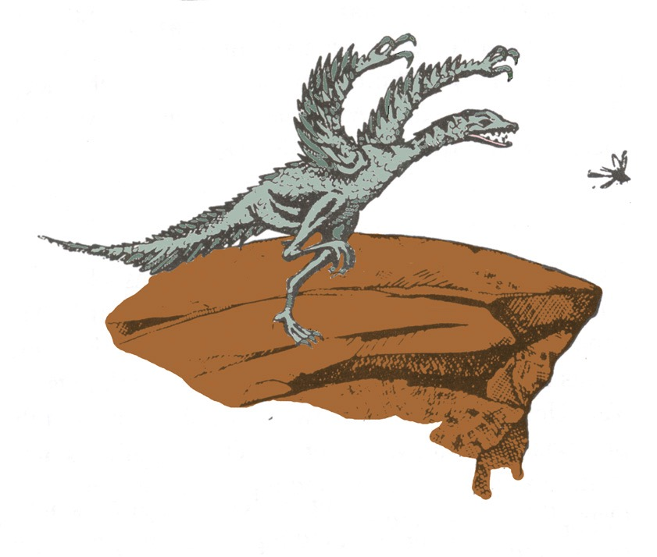
Ground to Air theory
Notes:
Source: Gary Parker, Creation: Facts of Life (Master Books), p. 152.
For a fuller explanation see the summary of the evolutionist theory, proposed by Dr. John Ostrom (Yale U. prof and expert on birds) in Jan 1979. It was abandoned as a bad idea in 1983. See Luther Sunderland, Darwin’s Enigma (Santee, CA: Master Books, 1998, 4 ed.), p. 71-72.

Slide 25
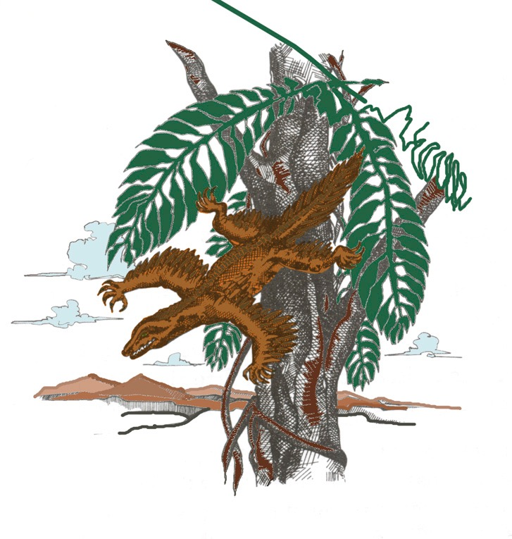
Air to Ground theory
Notes:
Source: Gary Parker, Creation: Facts of Life (Master Books), p. 152. This is the theory of Alan Feduccia, expert ornothologist (see latest statement in his 2012 PDF article on dino-brids in my computer). The proto-bird was a tree-dwelling lizard weighing a couple of pounds, which started as a glider and then evolved into a flyer. Both theories assume reptiles evolved into birds.
Feduccia’s reasons for rejecting the dino-bird ground-up theory (in favor of the tree-down reptile theory):
The time line is all wrong. These alleged dinosaurian ancestors of birds occur 25 million to 80 million years after Archaeopteryx, the earliest known bird.
By the time you get to dinosaurs, you are dealing with fairly large, earthbound creatures, which means they would have had to evolve flight from the ground up, rather than from the trees down. Evolving flight from the ground up is biophysically implausible.
Many of the features of birds and dinosaurs—the hands and teeth for example—don't match. The theropod dinosaur hand consists of the thumb and the next two fingers. The bird hand is made up of the middle three fingers. You can't just flip a switch to go from one type of hand to the other. Of course, it doesn't matter what line of evidence you come up with, you are automatically wrong if it is anything contrary to the dinosaurian origins of birds.
From Kathy A. Svitil, “Discover Dialogue: Ornithologist and Evolutionary Biologist Alan Feduccia Plucking Apart the Dino-Birds,” Discover, Vol. 24:2 (Feb. 2003), http://www.discover.com/feb_03/breakdialogue.html.

Slide 26
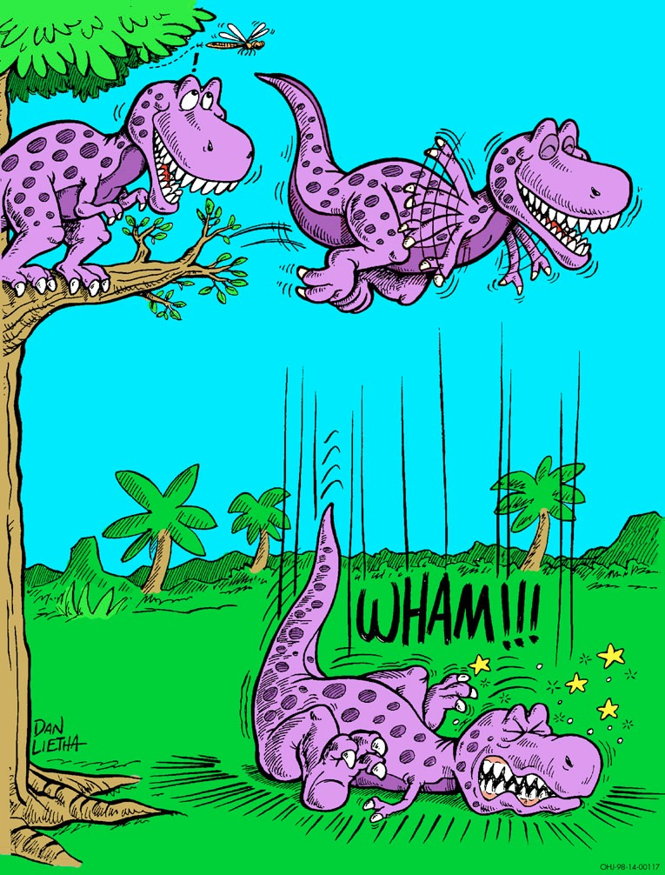
Notes:
Dan Leitha, AiG picture

Slide 27
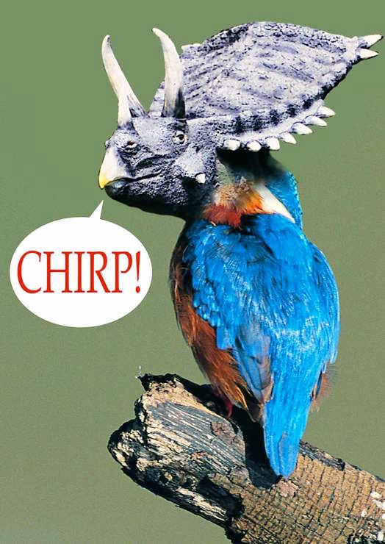
“Keep Warm” Theory
“Indeed, the simplest and most profound objection to all thermoregulatory theories is: why feathers? Feathers are extremely complex both structurally and embryologically.”
(Alan Feduccia, The Age of Birds, p. 55)
Brrrrr!
Tricerakeet

Slide 28
1999
Feathers for T. Rex?
“New bird-like fossils are missing links in dinosaur evolution.”
Christopher P. Sloan, “Feathers for T-Rex?,” National Geographic, 196:5 (Nov. 1999), pp. 98-107.

Slide 29
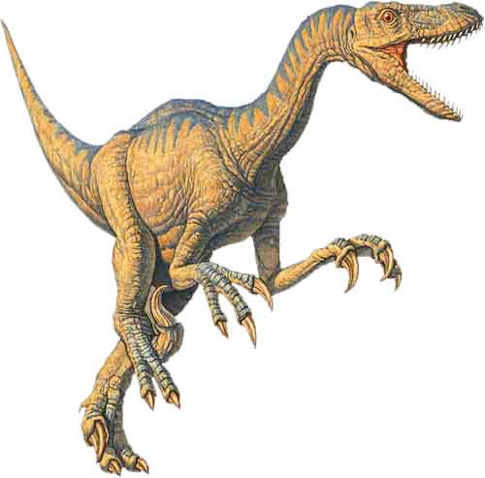
Fraud!
We can now say that
BIRDS ARE THEROPODS
just as confidently as we say that
humans are mammals.
Notes:
This picture in the article is NOT Archaeoraptor liaoningensis, but rather Sinorthosaurus millenii, which is another dino-bird discussed in the article very similar to Archaeoraptor liaoningensis.
Source: National Geographic, 196:5 (Nov. 1999), p. 105.
Therapod (velociraptor) picture: http://www.arizonaskiesmeteorites.com/Dinosaur_Fossils_For_Sale/T_rex_fossils_Tyrannosaurus_rex/Velociraptor/, accessed 1 may 2007

Slide 30
Discover (Feb 2003):
What about all the other evidence for feathered dinosaurs?
Alan Feduccia:
When we see actual feathers preserved on specimens, we need to carefully determine if we are looking at secondarily flightless birds that have retained feathers and only superficially resemble dinosaurs, or if the specimens are in fact related to dinosaurs. That’s a difficult issue to deal with right now, given the existence of fake fossils.
Kathy A. Svitil, “Discover Dialogue: Ornithologist and Evolutionary Biologist Alan Feduccia Plucking Apart the Dino-Birds,” Discover, Vol. 24:2 (Feb. 2003), www.discover.com.
Notes:
www.discover.com/feb_03/breakdialogue.html
Feduccia is ornithologist and evolutionary biologist at Univ. of N. Carolina in Chapel Hill.
Feduccia says that birds and dinosaurs evolved from some common reptile ancestor but that birds did not evolve from dinosaurs.
Based on his teams research, he said in 2005 that the surface patterns in supposed “dino-bird” fossils found in China are not primitive feathers but rather “bits of decomposed skin and supporting tissues that just happen to resemble feathers to a modest degree.”
See “Scientists Say No Evidence Exists That Therapod Dinosaurs Evolved Into Birds,” Science Daily, 10 Oct. 2005, http://www.sciencedaily.com/releases/2005/10/051010085411.htm, accessed 1 May 2007.

Slide 31
Discover: So far, only one feathered dinosaur, Archaeoraptor, has been publicly acknowledged as a forgery. You think there are others?
Feduccia: Archaeoraptor is just the tip of the iceberg. There are scores of fake fossils out there, and they have cast a dark shadow over the whole field. When you go to these fossil shows, it’s difficult to tell which ones are faked and which ones are not. I have heard that there is a fake-fossil factory in northeastern China, in Liaoning Province, near the deposits where many of these recent alleged feathered dinosaurs were found.
Notes:
www.discover.com/feb_03/breakdialogue.html
Kathy A. Svitil, “Discover Dialogue: Ornithologist and Evolutionary Biologist Alan Feduccia Plucking Apart the Dino-Birds,” Discover, Vol. 24:2 (Feb. 2003), <www.discover.com>.

Slide 32
“Almost every one [of the Chinese bird fossils] that I’ve seen on the commercial market has some reconstruction to make it look prettier. ... Adhesives and fake rock have become very easy [for Chinese peasants] to make and very difficult to spot. ... You can’t spot it [fake fossil] without a microscope, or ultraviolet or X-rays.”
Kraig Derstler (paleontologist, University of New Orleans) quoted in Jeff Hecht, “F is for fake,” New Scientist, 19 Feb 2000, p. 12.

Slide 33
Feduccia continues:
“Journals like Nature don’t require specimens to be authenticated, and the specimens immediately end up back in China, so nobody can examine them. They may be miraculous discoveries, they may be missing links as they are claimed, but there is no way to authenticate any of this stuff.”
Kathy A. Svitil, “Discover Dialogue: Ornithologist and Evolutionary Biologist Alan Feduccia Plucking Apart the Dino-Birds,” Discover, Vol. 24:2 (Feb. 2003), www.discover.com.
Notes:
www.discover.com/feb_03/breakdialogue.html

Slide 34
Feduccia said the publication and promotion of feathered dinosaurs by the popular press and by prestigious journals and magazines, including National Geographic, Nature and Science, have made it difficult for opposing views to get a proper hearing. He said:
“With the advent of ‘feathered dinosaurs,’ we are truly witnessing the beginnings of the meltdown of the field of paleontology.”
2005
D. Williamson, “Latest study: scientists say no evidence exists that theropod dinosaurs evolved into birds,” DUNC News Services, www.unc.edu, 10 Oct. 2005.
Notes:
http://www.unc.edu/news/archives/oct05/feducci100705.htm, accessed 12 May 2014
Whole article:
CHAPEL HILL -- No good evidence exists that fossilized structures found in China and which some paleontologists claim are the earliest known rudimentary feathers were really feathers at all, a renowned ornithologist says. Instead, the fossilized patterns appear to be bits of decomposed skin and supporting tissues that just happen to resemble feathers to a modest degree.
Led by Dr. Alan Feduccia of the University of North Carolina at Chapel Hill, a team of scientists says that as a result of their new research and other studies, continuing, exaggerated controversies over "feathered dinosaurs" make no sense.
"We all agree that birds and dinosaurs had some reptilian ancestors in common," said Feduccia, professor of biology in UNC’s College of Arts and Sciences. "But to say dinosaurs were the ancestors of the modern birds we see flying around outside today because we would like them to be is a big mistake.
"The theory that birds are the equivalent of living dinosaurs and that dinosaurs were feathered is so full of holes that the creationists have jumped all over it, using the evolutionary nonsense of ‘dinosaurian science’ as evidence against the theory of evolution," he said. "To paraphrase one such individual, ‘This isn’t science . . . This is comic relief.’"
A report on the team’s latest research appears in the Journal of Morphology published online Monday (Oct. 10). Other authors are Drs. Theagarten Lingham-Soliar of the University of KwaZulu-Natal in South Africa and Richard Hinchliffe of the University College of Wales.
Using powerful microscopes, the team examined the skin of modern reptiles, the effects of decomposition on skin and the fossil evidence relating to alleged feather progenitors, also known as "protofeathers."
They found that fossilized patterns that resemble feathers somewhat also occur in fossils known not to be closely related to birds and hence are far more likely to be skin-related tissues, Feduccia said. Much of the confusion arose from the fact that in China in the same area, two sets of fossils were found. Some of these had true feathers and were indeed birds known as "microraptors," while others did not and should not be considered birds at all.
"Collagen is a scleroprotein, the chief structural protein of the connective tissue layer of skin," he said. "Naturally, because of its low solubility in water and its organization as tough, inelastic fiber networks, we would expect it to be preserved occasionally from flayed skin during the fossilization process."
Although a few artists depicted feathered dinosaurs as far back as the 1970s, Feduccia said the strongest case for feathered dinosaurs arose in 1996 with a small black and white photo of the early Cretaceous period small dinosaur Sinosauropteryx, which sported a coat of filamentous structures some called "dino-fuzz."
"The photo subsequently appeared in various prominent publications as the long-sought ‘definitive’ evidence of dinosaur ‘feathers’ and that birds were descended from dinosaurs," he said. "Yet no one ever bothered to provide evidence -- either structural or biological -- that these structures had anything to do with feathers. In our new work, we show that these and other filamentous structures were not protofeathers, but rather the remains of collagenous fiber meshworks that reinforced the skin."
Belief in the existence of the "dino-fuzz feathers" caused some scientists to conclude that they served as insulation, and hence dinosaurs were warm-blooded.
The researchers also examined evidence from five independent, agreeing studies involving structural and genetic analyses related to the "tridactyl," or three-fingered, hand, which is composed of digits 1, 2 and 3 in dinosaurs, Feduccia said. That is the most critical characteristic linking birds to dinosaurs. They found that embryos of developing birds differed significantly in that bird wings arose from digits 2, 3 and 4, the equivalent of index, middle and ring fingers of humans. To change so radically during evolution would be highly unlikely.
"If birds descended from dinosaurs, we would expect the same 1, 2 and 3 pattern," he said.
Current dinosaurian dogma requires that all the intricate adaptations of birds’ wings and feathers for flight evolved in a flightless dinosaur and then somehow became useful for flight only much later, Feduccia said. That is "close to being non-Darwinian."
Also, the current feathered dinosaurs theory makes little sense time-wise either because it holds that all stages of feather evolution and bird ancestry occurred some 125 million years ago in the early Cretaceous fossils unearthed in China.
"That’s some 25 million years after the time of Archaeopteryx, which already was a bird in the modern sense," he said. Superficially bird-like dinosaurs occurred some 25 million to 80 million years after the earliest known bird, which is 150 million years old."
Feduccia said the publication and promotion of feathered dinosaurs by the popular press and by prestigious journals and magazines, including National Geographic, Nature and Science, have made it difficult for opposing views to get a proper hearing.
"With the advent of ‘feathered dinosaurs,’ we are truly witnessing the beginnings of the meltdown of the field of paleontology," he said. "Just as the discovery a four-chambered heart in a dinosaur described in 2000 in an article in Science turned out to be an artifact, feathered dinosaurs too have become part of the fantasia of this field. Much of this is part of the delusional fantasy of the world of dinosaurs, the wishful hope that one can finally study dinosaurs at the backyard bird feeder.
"It is now clear that the origin of birds is a much more complicated question than has been previously thought," Feduccia said.
The UNC scientist is the author of more than 150 papers and six major books, including The Age of Birds, which Harvard University Press published in 1980 and The Origin and Evolution of Birds, published by Yale University Press in 1996.
Among other discoveries, Feduccia found by a careful examination that Archaeopteryx, the earliest known bird and one of the world’s most famous fossils, could fly. Previously, many scientists thought the animal to be an Earth-bound dinosaur.
He determined its flying ability by observing that the fossil’s feathers had leading edges significantly shorter than their trailing edges, which is characteristic of all modern flying birds. The edges of feather of birds incapable of flight, such as ostriches, are symmetrical.

Slide 35
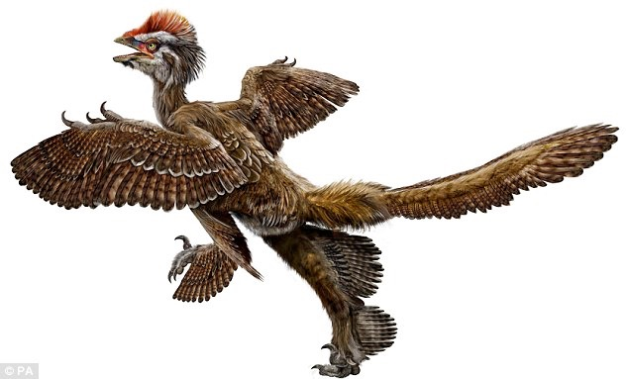
“Feathered fossils prove birds evolved from dinosaurs, say Chinese scientists.”
London, Daily Mail, Sept 2009
Anchiornis huxleyi
Notes:
Anonymous, “Feathered fossils prove birds evolved from dinosaurs, say Chinese scientists,” http://www.dailymail.co.uk/sciencetech/article-1215998/Feathered-fossils-prove-birds-evolved-dinosaurs-say-Chinese-scientists.html, 25 Sept 2009, accessed the same day.
The team - lead by the man dubbed the 'real-life Indiana Jones' - say the fossils represent five different species from two different rock sequences in north-eastern China. All the species have feathers or feather-like structures. The new finds are 'indisputably' older than archaeopteryx, the oldest known bird, which scientists claim provides exceptional evidence that birds evolved from dinosaurs. The theory that birds evolved from dinosaurs has always been troubled by the absence of feathers more ancient than those on the famous archaeopteryx. Addressing the annual meeting of the Society of Vertebrate Paleontologists (SVP) in Bristol, Dr Xu Xing, one of the lead scientists behind the discovery, said: 'These exceptional fossils provide us with evidence that has been missing until now. Now it all fits neatly into place and we have tied up some of the loose ends.‘ The oldest bird, archaeopteryx, was older than the feathered dinosaurs previously found. Therefore, critics claimed, feathered dinosaurs could not have been ancestral to birds.
The dangers Dr Xing faces while searching for dinosaur fossils in some of the remotest regions of China have led him to be compared to Indiana Jones, the fictional archaeologist and action hero played by Harrison Ford.
His latest fossils were found in two separate rock formations - the tiaojishan, which would put the fossils at 168 to 151 million years old, and the daohugou formation, which would make them 164 to 158 million years old.
Archaeopteryx lived 150 to 145 million years ago, so was significantly younger than these new dinosaurs, Dr Xing's team said.
One of the dinosaurs, named anchiornis huxleyi has extensive plumage and profusely feathered feet.
Dr Xing said it had provided important new information on the origins of birds and the evolution of feathers.
He said: 'This fossil provides confirmation that the bird-dinosaur hypothesis is correct and supports the idea that birds descended from theropod dinosaurs, the group of predatory dinosaurs that include allosaurus and velociraptor.'

Slide 36
“The problem of faked fossils in China is serious and growing. Rather than being excavated by palaeontologists on fossil digs, most of the region’s fossils are pulled from the ground by desperately poor farmers and then sold on to dealers and museums.”
John Pickrell, “The great dinosaur fossil hoax,” cosmosmagazine.com, 27 July 2015.
Notes:
https://cosmosmagazine.com/life-sciences/great-dinosaur-fossil-hoax

Slide 37
Changing Reptiles to Birds?
Develop feathers
Change the respiratory system
Change the skeletal system – hollow bones
Change the digestive system
Change the nervous system
Construct bills & beaks
Master the art of nest building
Learn to fly and navigate
Develop sound-producing organ & learn songs
Shrink the dinosaur & shrink the first bird

Slide 38
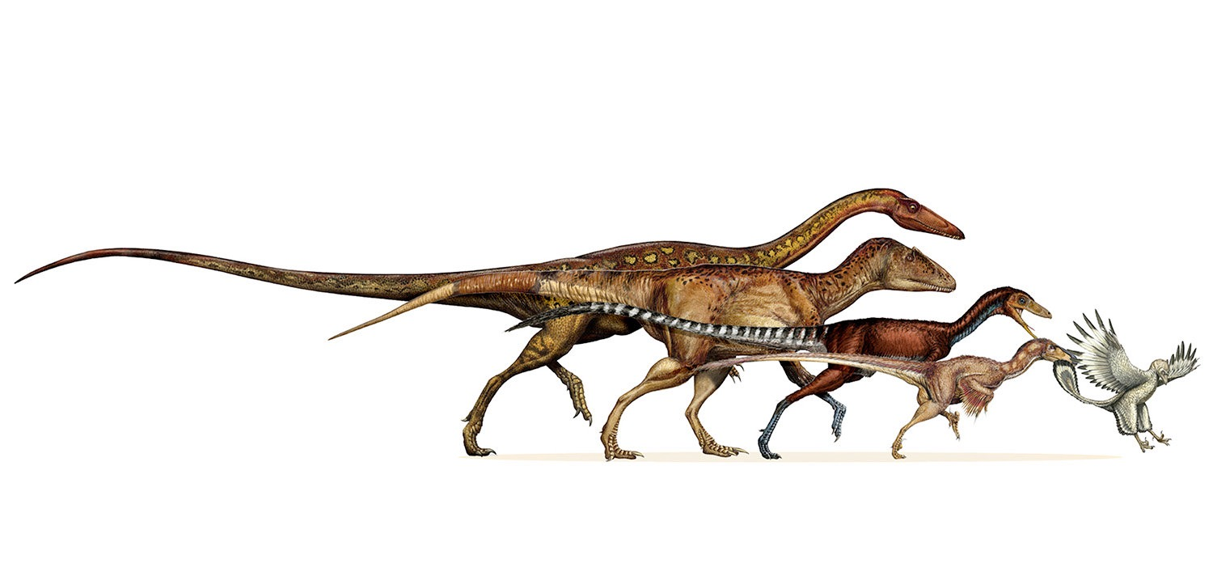
Steady shrinkage over 50 million years!
Michael S. Y. Lee, Andrea Cau, Darren Naish, and Gareth J. Dyke, “Sustained miniaturization and anatomical innovation in the dinosaurian ancestors of birds,” Science, Vol 345:6196 (1 Aug. 2014), pp. 562-566.
Notes:
http://news.yahoo.com/study-traces-dinosaur-evolution-early-birds-180059316.html, Seth Borenstein, “Study traces dinosaur evolution into early birds,” 31 July 2014, accessed 21 Aug 2014.
see next slide for description of how this happened, taken from the paper cited by Borenstein.

Slide 39
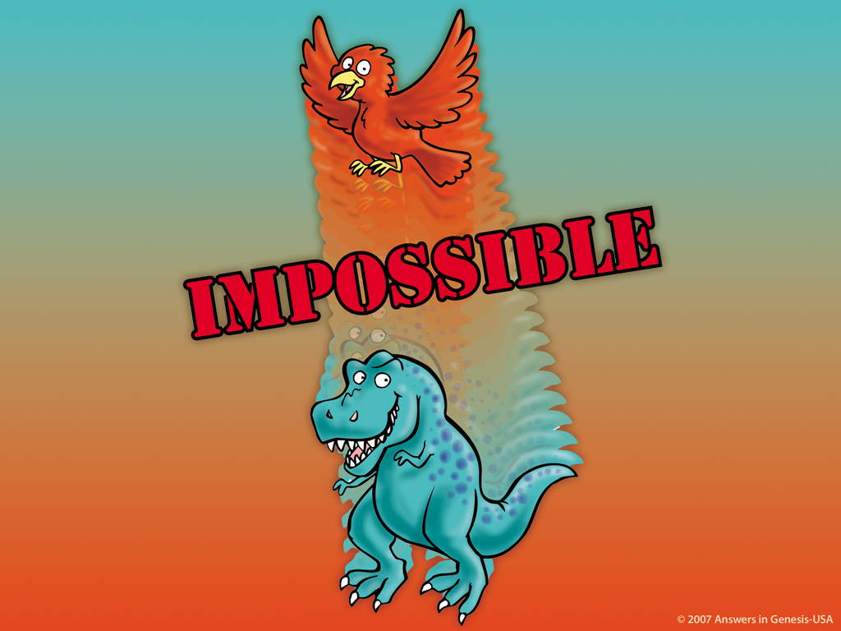
IMPOSSIBLE!

Slide 40
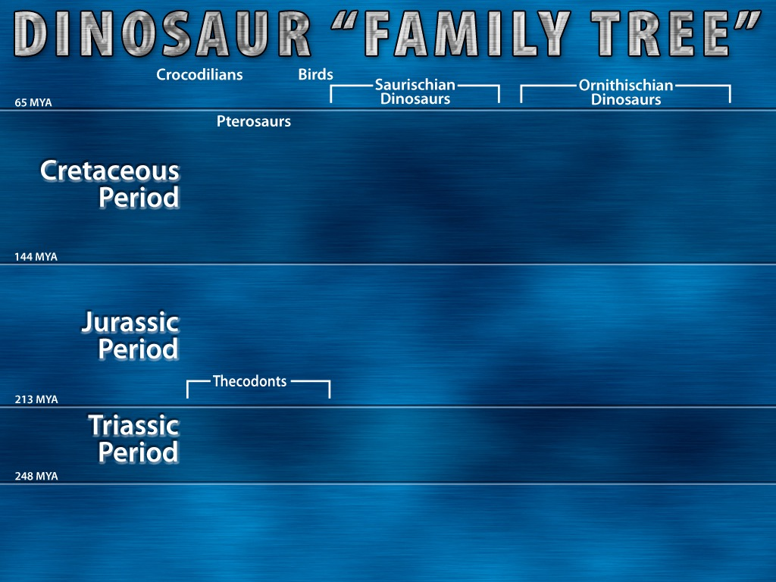
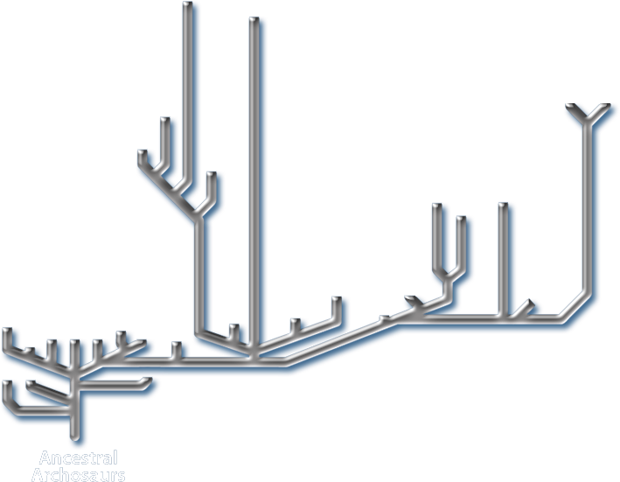
“[Yellow] lines indicate solid fossil evidence”
Notes:
In small print at the bottom of the chart it says: “Tinted areas indicate solid fossil evidence”. The tinted areas were grey [my yellow], the rest of the chart was white [my grey].
“Thecodont ("socket-toothed" reptile), now considered an obsolete term, was formerly used to describe a diverse range of early archosaurs that first appeared in the Latest Permian and flourished until the end of the Triassic period. The group includes the ancestors of dinosaurs (including birds), and ancestors of pterosaurs, and crocodilians, as well as a number of extinct forms that did not give rise to any descendants. … Teeth were set in sockets in the jawbones; an archosaurian characteristic that was inherited by the dinosaurs. … All current vertebrate paleontology textbooks, (e.g. Michael Benton's Vertebrate Palaeontology (first ed. 1990, 2nd ed. 1997), follow the cladistic approach, and so the name Archosauria is used instead. This includes both the Thecodonts and all their descendants.” http://en.wikipedia.org/wiki/Thecodont, accessed 18 April 2008.
Chart from David Lambert, The Encyclopedia of Dinosaurs (London: Bloomsbury Books, 1994), p. 26-27, published in association with the British Museum of Natural History.

Slide 41
“The truth, Makovicky said, is scientists don't really know what happened [to the dinosaurs]. Each hypothesis on its own ‘doesn't fit the pattern very well. Was extinction gradual or sudden? The lack of data doesn't allow us to answer the question’.”
Michelle S. Keller, “Imagining life of dinosaurs Field Museum show aims to transport,” Chicago Tribune, 28 Mar 2007, Metro section, p. 1.
Notes:
Peter Makovicky is curator of dinosaurs at the Chicago Field Museum. http://www.topix.net/content/trb/1345906430078534802600492800613923403796. accessed 15 Aug. 2007.

Slide 42
Use the Bible to explain dinosaurs!

Slide 43
DAY
DAY
DAY
EARTH, SPACE, TIME, LIGHT
EXPANSE
DRY LAND & PLANTS
DAY
DAY
DAY
SUN, MOON & STARS
SEA CREATURES & BIRDS
LAND ANIMALS & MAN

Slide 44
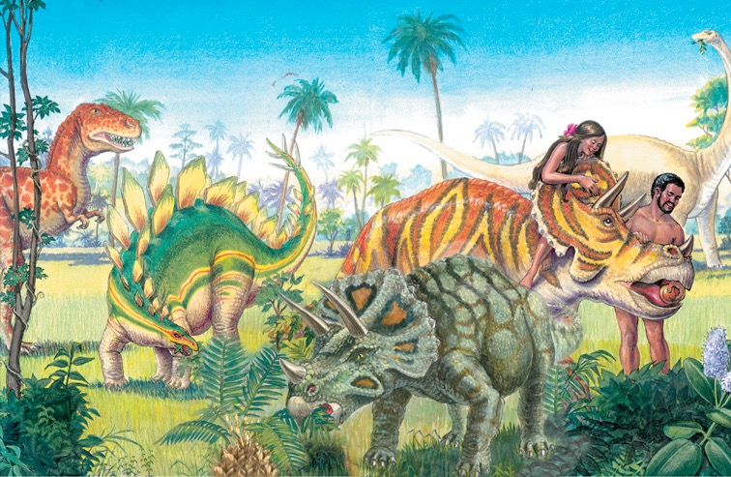
Notes:
We are finding some fossilized dino skin and since melanin is a durable pigment we are able to tell what color some were.

Slide 45
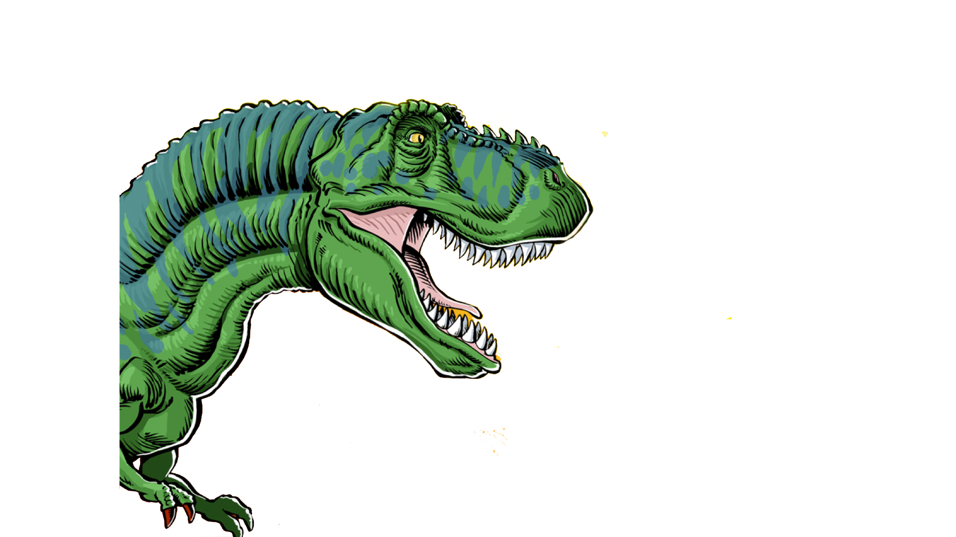
Tyrannosaurus Rex
It had teeth up to 6 inches long!

Slide 46
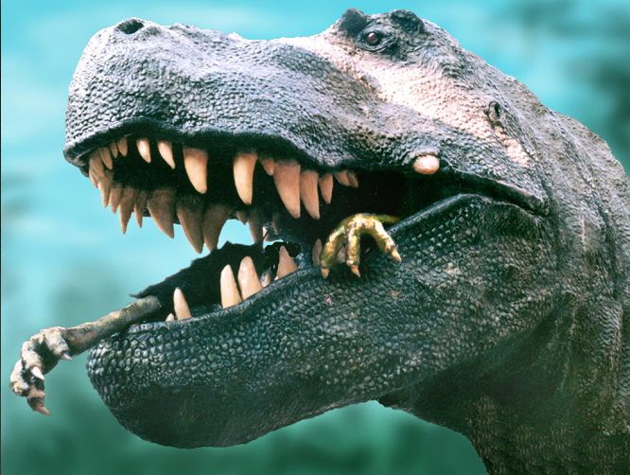
Notes:
Dino expert, Jack Horner (curator of paleontology at the Museum of the Rockies in Montana and technical adviser to Stephen Spielberg for the Jurassic Park films) argues that the monster’s forelegs were too short, its eyes too small and its speed too slow to make it a hunter. On the other hand, like a vulture, a large part of its brain was dedicated to sensing smells and it could travel long distances. So, he concludes, it was a scavenger, not a violent predator. See http://www.msnbc.com/news/922540.asp#BODY

Slide 47
Tyrannosaurus Rex
It had teeth up to 6 inches long!
How would this dinosaur originally
have been described?
a. Plant-eater
b. Meat-eater
c. Scavenger
d. Plant-eater & meat-eater
Notes:
6 inches = 15 centimeters

Slide 48
Genesis 1:29-30
29. Then God said, "Behold, I have given you every plant yielding seed that is on the surface of all the earth, and every tree which has fruit yielding seed; it shall be food for you;
30. and to every beast of the earth and to every bird of the sky and to every thing that moves on the earth which has life, I have given every green plant for food"; and it was so.
Notes:
NASB

Slide 49
“It shall be food for you.”
Genesis 1:29-30

Slide 50
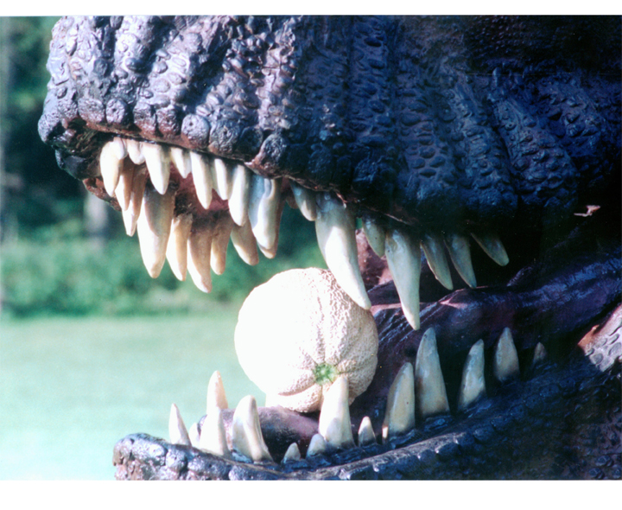

Slide 51
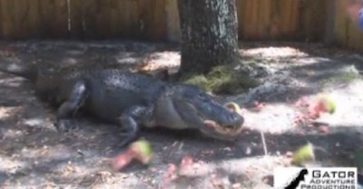
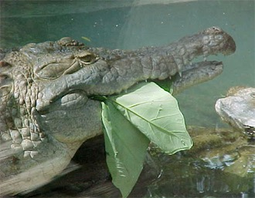
Alligators eating watermelon and leaves
Research: nearly 3/4 of crocodilian species eat fruit frequently and intentionally. (Journal of Zoology 2013)
Notes:
Research: S. Platt et al., “Frugivory and seed dispersal by crocodilians: an overlooked form of saurochory?” Journal of Zoology 291(2013):87–99, doi:10.1111/jzo.12052.
Video of watermelon eating: http://www.youtube.com/watch?v=9xVwIuB-Xm4. Still shot from: http://www.answersingenesis.org/articles/2013/12/02/vegetarian-crocs
See also http://scienceblogs.com/tetrapodzoology/2009/06/27/alligators-vs-melons/ for evidence of them eating other fruits (e.g., lemons, kumquats) and leaves (picture above). This article cites research here: Brito, S. P., Andrade, D. V. & Abe, A. S. 2002. Do caimans eat fruit? Herpetological Natural History 9, 95-96.
Brueggen, J. 2002. Crocodilians: fact vs. fiction. In International Union of the Conservation of Nature, Crocodile Specialist Group 1, pp. 204-210.

Slide 52
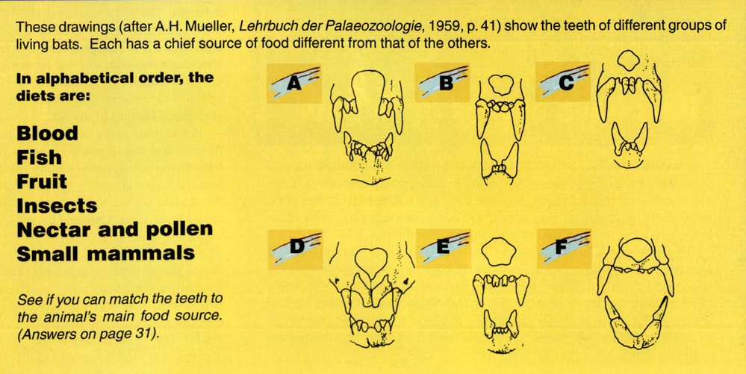
Which bats eat small mammals?
Blood
Fish
Fruit
Insects
Nectar & pollen
Small mammals
Notes:
Creation, 21:1 (Dec. 1998—Feb. 1999), p. 30.

Slide 53
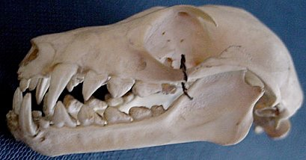
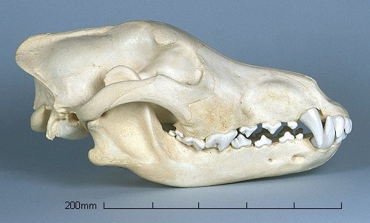
Bat skull
It eats fruit.
Wolf skull
It eats meat.
Notes:
Wolf: http://www.skullsite.co.uk/Wolf/wolf.htm, accessed 1 May 2007
Bat: http://www.hitchams.suffolk.sch.uk/skeletons/bat.htm, accessed 1 May 2007

Slide 54
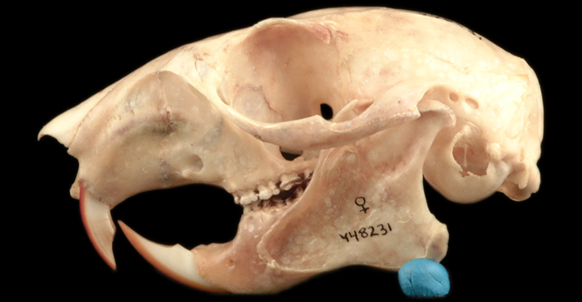
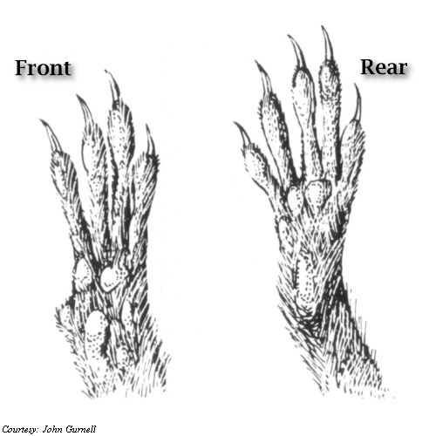
Squirrel skull
Squirrels are largely vegetarian!
Squirrel feet
Notes:
Skull: western gray squirrel: http://naturalhistory.si.edu/lewisandclark/popup.cfm?id=888
Feet: http://unexco.com/sqfeet.jpg

Slide 55
“Although all bears have teeth designed for eating meat, their diet consists mainly of plants.”
Bear exhibit, Taronga Zoo
Sydney, Australia,
July 1999.
Notes:
Photo: http://www.sphoto.com/medium/panda_eating_3370_473.jpg, accessed 3 Nov 2007.

Slide 56
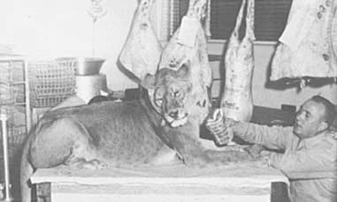
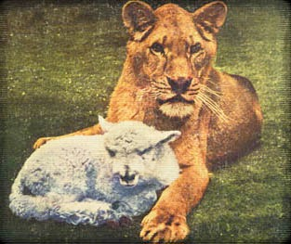
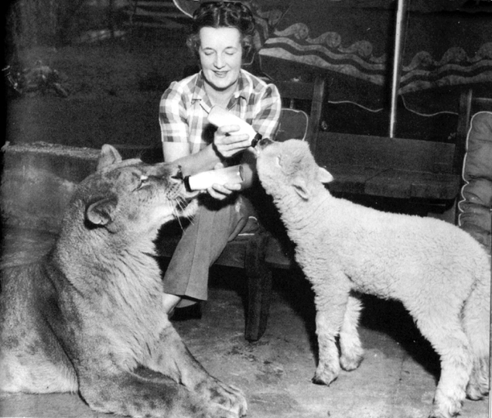
The Lioness That Refused To Eat Meat
Little Tyke drinking milk
“Little Tyke” refusing meat
“Little Tyke” with her best friend “Becky”
Notes:
In the 1950‘s Georges and Margaret Westbeau rescued new-born “Little Tyke” from a cage where her mother was trying to killer her. They nursed her back to health on their ranch near Seattle, WA. Refusing repeated attempts to get her to eat meat, she lived a normal healthy life on a diet of milk, eggs and grains. Here favorite friend at the ranch was Becky the lamb. She was filmed in California for the “You Asked For It” TV series when she was 4 years old. During those three weeks she contracted viral pneumonia and died peacefully a few weeks later.
Info and photos from http://www.vegetarismus.ch/vegepet/tyke.htm and http://www.animalliberationfront.com/Saints/Authors/Stories/LittleTyke.htm, accessed 2014 Feb 20

Slide 57
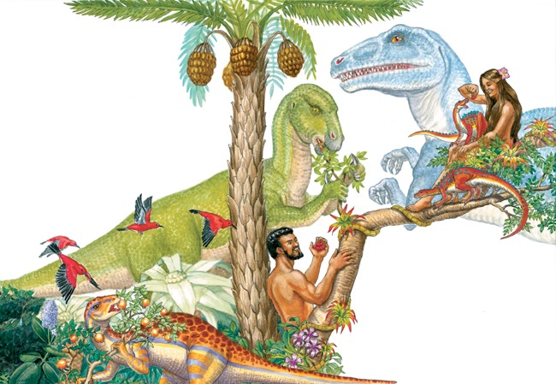

Slide 58
Why
don’t I find
the word
“Dinosaur”
in the
Bible?

Slide 59
KJV Bible
translated
into English
1611

Slide 60
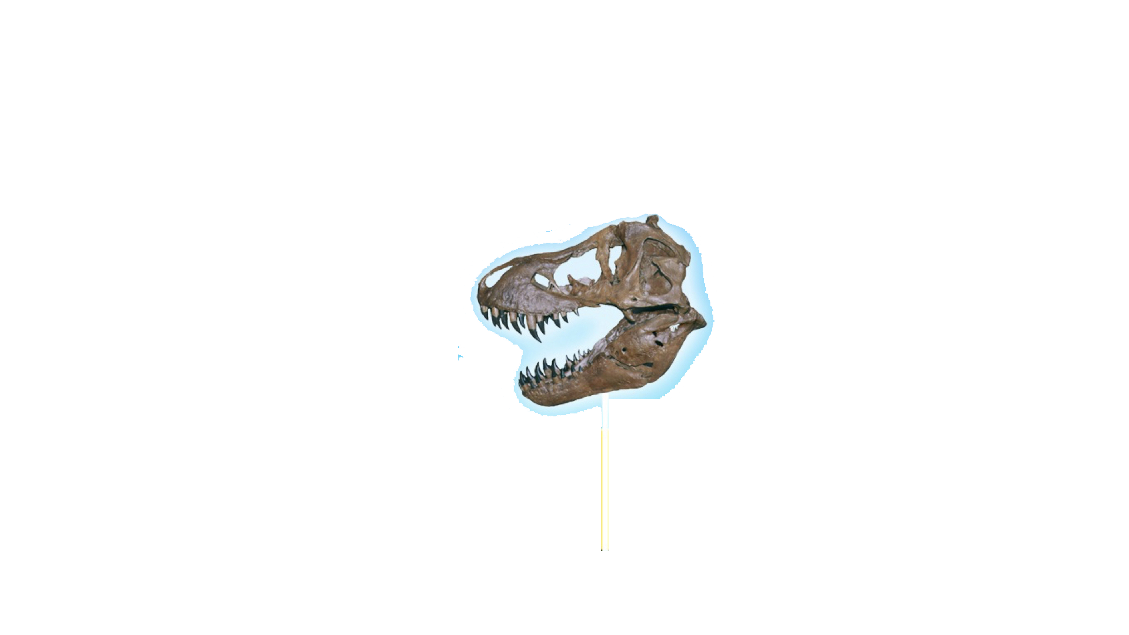
KJV Bible
translated
into English
1611
“Dinosaur”
invented in
1841

Slide 61
KJV Bible
translated
into English
1611
“Dinosaur”
invented in
1841
230 YEARS

Slide 62
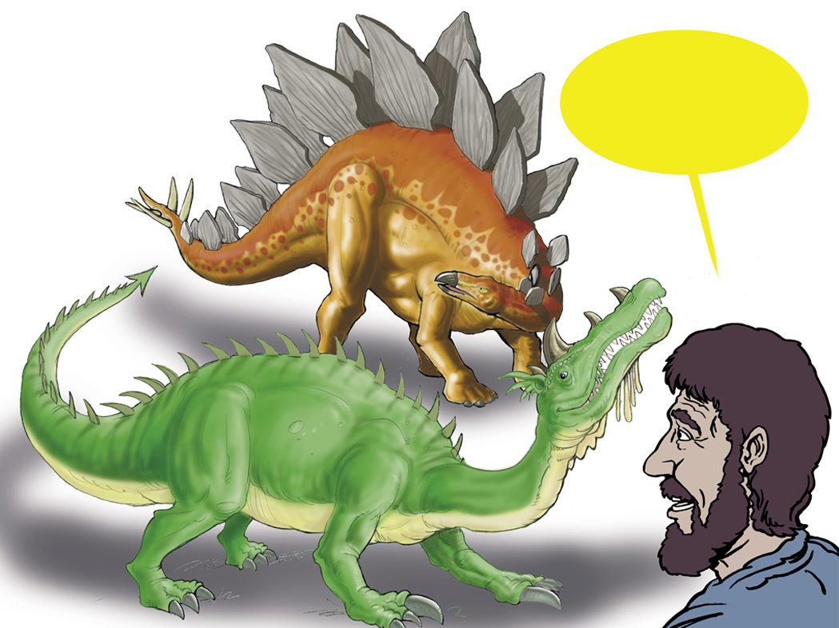
Hebrew for Dragon?
“Tannin”
Notes:
Tannin is used of sea creatures (Isa. 27:1) and land animals (Ps. 91:13). It may be the equivalent of our “reptile,” although the passages where it is used generally seem to refer to great and fearsome creatures.

Slide 63
Isaiah 27:1
In that day the LORD will punish Leviathan, the fleeing serpent, with His fierce and great and mighty sword, even Leviathan, the twisted serpent; And He will kill the dragon who lives in the sea.
Notes:
“Dragon” is tannin in Hebrew.
NASB

Slide 64
Notes:
Revised: September 2005. The plesiosaur’s name is a separate element that can be individually animated.

Slide 65
Isaiah 30:6
The oracle concerning the beasts of the Negev. Through a land of distress and anguish, from where come lioness and lion, viper and flying serpent, they carry their riches on the backs of young donkeys and their treasures on camels’ humps, to a people who cannot profit them;
Notes:
NASB

Slide 66
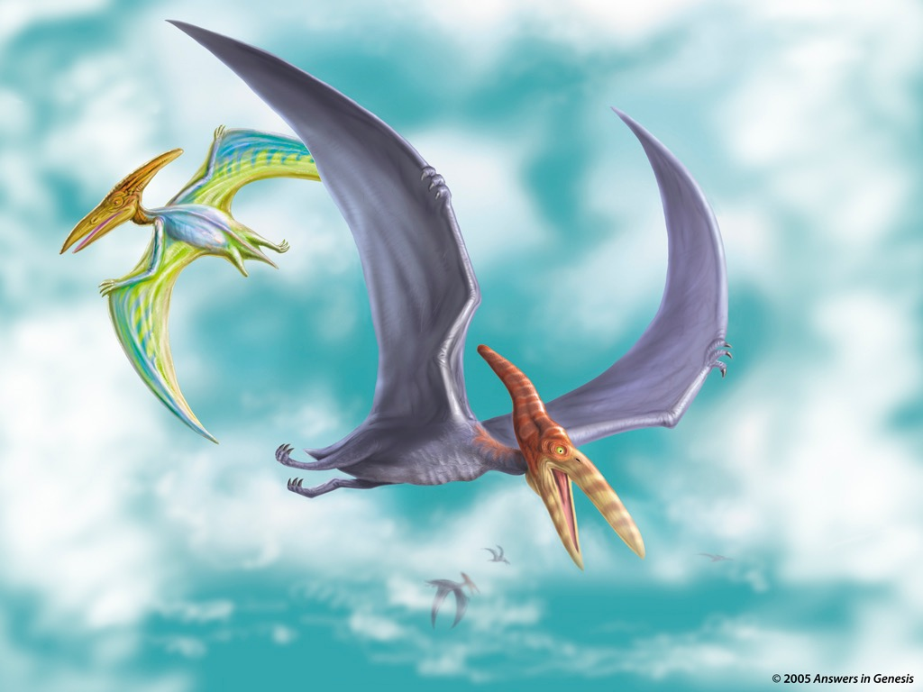
Notes:
http://thescotsman.scotsman.com/index.cfm?id=1911852005 says that according to fossil evidence reported on in Sept. 2005 pterosaurs (the group that included pteranodons) could reach a size of 18m (60 ft) wingspans, the size of a medium-sized commercial plane, which was twice the size scientists previously thought.
Revised: September 2005. The pteranodon’s name is a separate element that can be individually animated.

Slide 67
Job 40:15-16
15. Look at the behemoth, which I made along with you and which feeds on grass like an ox.
16. What strength he has in his loins, what power in the muscles of his belly!
Notes:
Job 38, 39 and first part of chapter 40 mention the horse, lion, eagle, deer, mountain goat, donkey, ox, ostrich and locust, all creatures which Job clearly saw around him.
NIV

Slide 68
Job 40:18-19
18. His bones are tubes of bronze, his limbs like rods of iron.
19. He ranks first among the works of God, …
Notes:
NIV

Slide 69
Job 40:17
His tail sways like a cedar …
“Possibly the hippopotamus or the elephant.”
(The NIV Study Bible)
Notes:
NIV

Slide 70
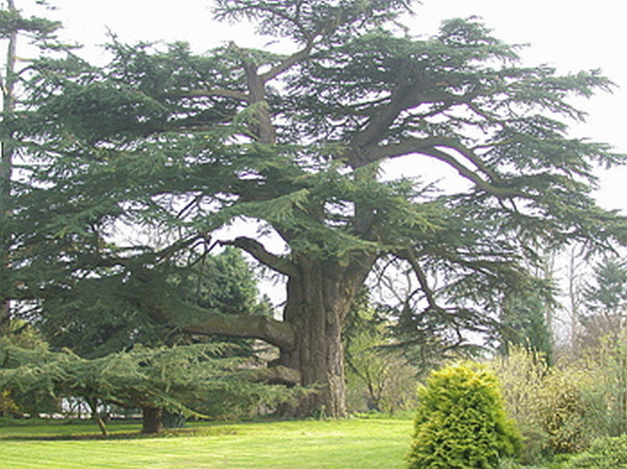
Cedrus libani

Slide 72
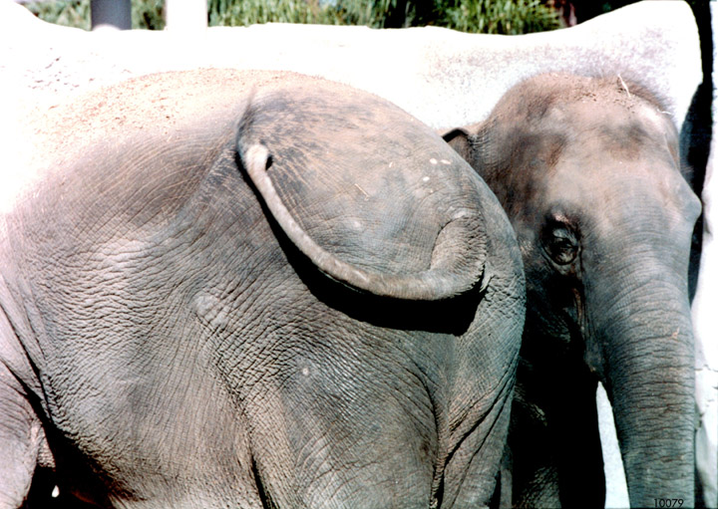

Slide 73
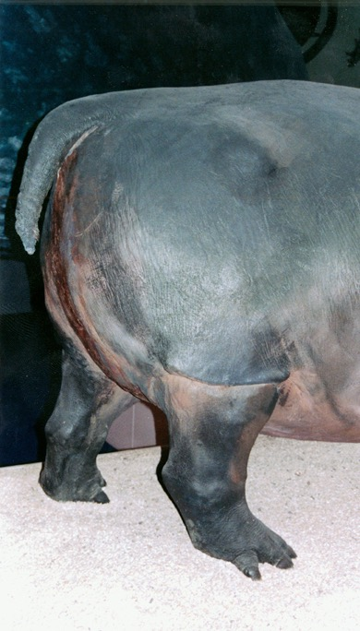

Slide 74
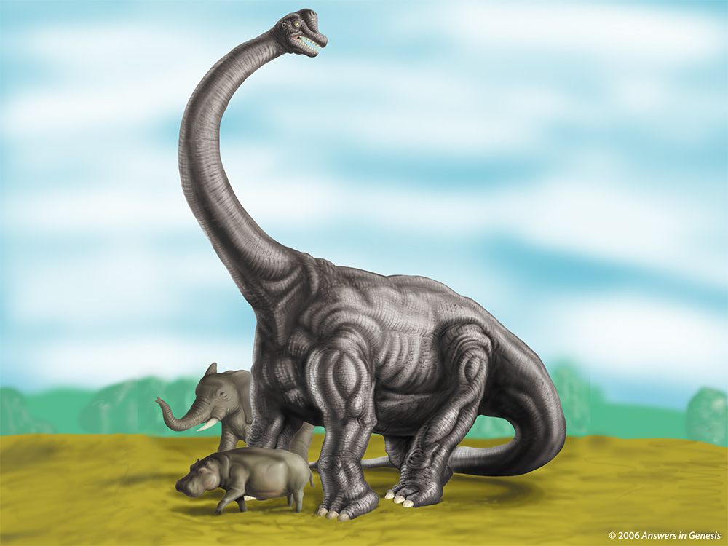
Notes:
Brachiosaur

Slide 75
What
Happened?

Slide 76
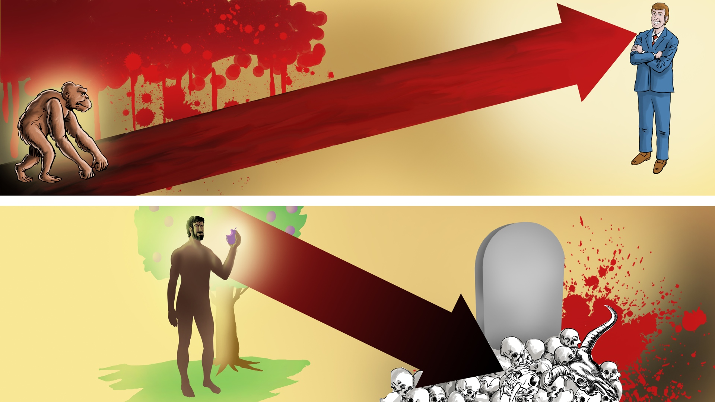
DEATH
Suffering Disease Bloodshed
SIN
DEATH

Slide 77
Genesis 3:14
The LORD God said to the serpent, “Because you have done this, cursed are you more than all cattle, and more than every beast of the field; on your belly you will go, and dust you will eat all the days of your life;”
Notes:
NASB

Slide 78
For we know that the whole creation groans and suffers
the pains of childbirth together until now.
Romans 8:22
SIN
Notes:
NASB

Slide 79
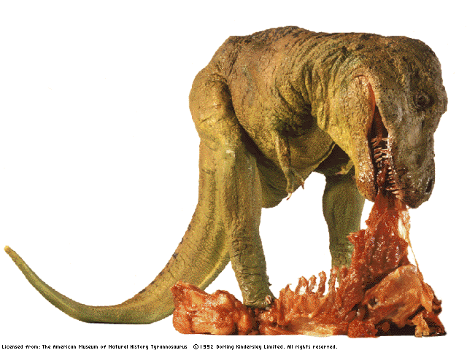
Notes:
From Bodie – here is a link to the Black Hills Institute of Geological Research that excavated Sue, the T-Rex, which had stomach contents of of both an Edmontosaurus (duck-billed dino) and even a couple of Tyranosaurids in the stomach contents too:
http://www.bhigr.com/pages/info/info_sue_3.htm
Live Science has also reported that T-Rexes have cannibalized their own:
http://www.livescience.com/10829-gashes-bones-suggest-rex-cannibal.html
Here is a PNAS article that discussed the failed attack of a T-Rex on a Hadrosaur but left distinct teethmarks on the hadrosaur.
http://www.pnas.org/content/early/2013/07/10/1216534110.full.pdf
A T-rex coprolite was discovered and reported by Dr. Karen Chin and colleagues, (June, 1998 issue of Nature), that a T-Rex had eaten a ceratopsian (Triceratops on this one). Here is the abstract:
http://www.nature.com/nature/journal/v393/n6686/full/393680a0.html

Slide 80
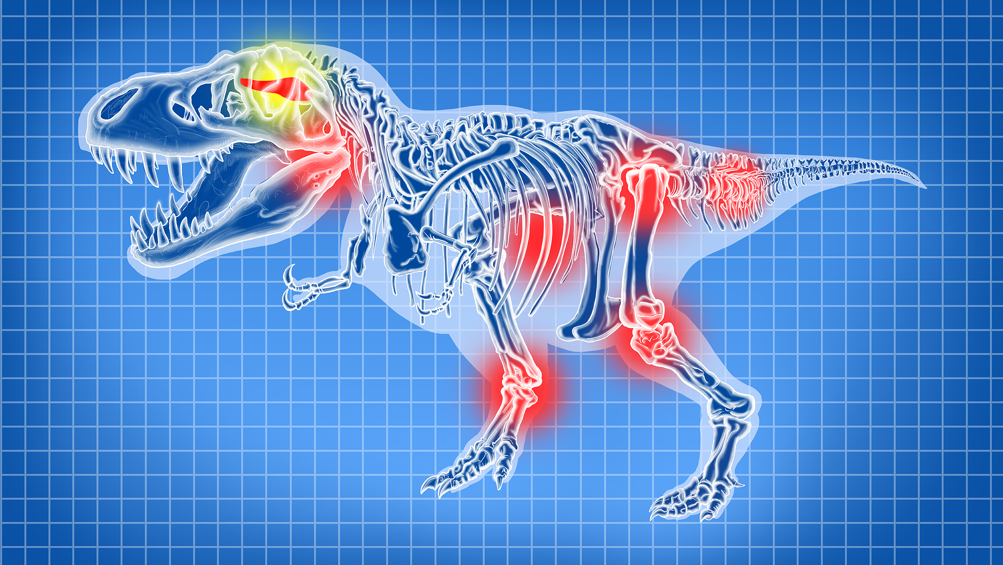
Brain Tumors
Broken
Bones
Cancer
Arthritis
Notes:
John Whitfield, “Dinosaurs got cancer,” Nature, 21 Oct 2003, http://www.nature.com/news/1998/031020/full/news031020-2.html, doi:10.1038/news031020-2, accessed 25 July 2016.
From the article:
Many dinosaurs had cancer, researchers have discovered.
Their tumours were like those of human patients, showing that cancer has been around, essentially unchanged, for a very long time. "Diseases look the same independent of what critter is affected," says radiologist Bruce Rothschild of the Northeastern Ohio Universities College of Medicine in Rootstown.
Rothschild's team travelled North America with a portable X-ray machine, scanning 10,000 dinosaur vertebrae from more than 700 museum specimens. They looked at such well-known dinosaurs as Stegosaurus, Triceratops and Tyrannosaurus.
Only one group - the hadrosaurs, or 'duck-billed dinosaurs' - suffered from cancer (fn 1). The team found 29 tumours in bones from 97 individuals of this herbivorous group from the Cretaceous period, about 70 million years ago.
Dinosaur tumours have been mooted before, but this is the first large-scale survey of them. The researchers found that some bones suggested to be cancerous were just poorly healed fractures.
It's not known for certain what made the hadrosaurs sick, although Rothschild points out that they ate conifers, which are high in carcinogenic chemicals. The structure of their bones also suggests they were warm-blooded, which might have increased their cancer risk.
"We know very little about dinosaur diseases," says palaeontologist David Norman of the University of Cambridge, UK. "Quite why hadrosaurs should be prone to lesions in their tails is a fascinating, if ultimately unanswerable, question." The animals might have been unusually long-lived, allowing more time for tumours to develop, he suggests.
The commonest growths were hemangiomas - benign tumours of the blood vessels that are present in about 10% of humans. "If I showed [the dinosaur bones] to a pathologist, he'd make the same diagnosis," says Rothschild.
The 3.5 metre species Edmontosaurus was most cancer-prone and was the only one with a malignant tumour. About 3% of its bones contained a lump of some sort.
Cancers have been found in everything from coral to budgerigars, but their frequency in most species is unknown.
Understanding what causes tumours in wild and extinct animals might help us to treat and prevent them in humans, says Rothschild. Studying museum specimens could shed light on how diseases have changed over time, he adds: "Routine X-rays would be very valuable in zoological and human collections."
Rothschild, B. M., Tanke, D. H., Helbling, M.II & Martin, L.D.. Epidemiologic study of tumors in dinosaurs. Naturwissenschaften, published online, doi:10.1007/s00114-003-0473-9 (2003).
Also Medical schools are studying dino cancer:
Dinosaur Tumor Studied for Human Cancer Clues
Heather Whipps
3 April 2006
http://www.livescience.com/4013-dinosaur-tumor-studied-human-cancer-clues.html, accessed 28 April 2011. The article begins:
Cancer in dinosaurs and illnesses in other animals are being studied in a groundbreaking new program that combines medical school with the study of natural history.
Educators hope the effort will produce doctors with a better understanding of why we get sick.
Despite being millions of years removed from our time and our own species, illnesses in animals like the dinosaurs can shed light on the evolution of human disease, says Christopher Beard, curator and specialist in vertebrate paleontology at Carnegie Museum of Natural History in Pittsburgh.
"Some diseases that afflict humans today, such as malaria, gout, and cancer, are truly ancient and were handed down to us from our distant ancestors," Beard told LiveScience. "By studying the distribution of these diseases in other living and fossil organisms, we can gain insights into the nature of these diseases.“
Students will now be offered the chance to learn about the history of disease as part of their regular medical school training, the University of Pittsburgh Medical Center announced recently.

Slide 81
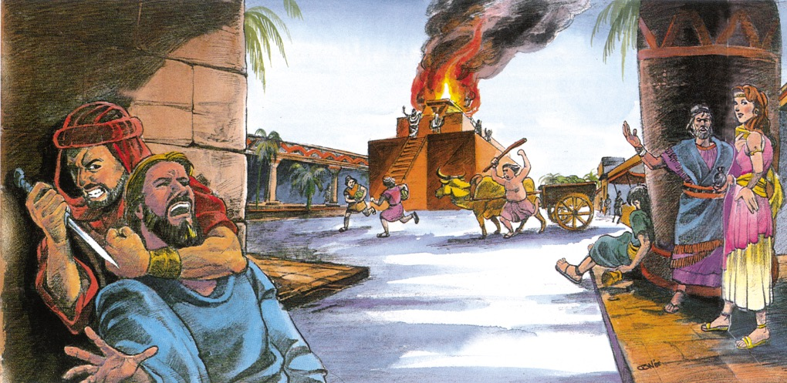
Notes:
John Morris, Noah’s Ark and the Ararat Adventure (Master Books, 1994, 2nd ed.), p. 11. Used by permission of the publisher.
From: Laura Welch <lwelch@nlpg.com> Date: Wednesday, December 14, 2016 at 5:00 PM To: Terry Mortenson <TMortenson@AnswersinGenesis.org> Subject: RE: copyright permission
Yes. You may use this image from Noah’s Ark and the Ararat Adventure for your DVD lecture as noted. We apologize that we do not have the original artwork to send you so I hope what you have will work.
Please note that the illustration is by Jonathan Chong and permission for use is from Master Books in small text below the image on your slide if possible.
Thanks!
Laura
New Leaf Publishing Group
NLPG.COM

Slide 82
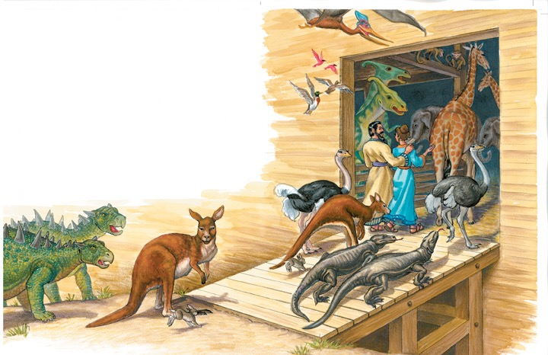
Two of every kind of land animal & bird
Notes:
For translation: “kind” is the word used in the phrase “after its kind” or “after their kind” in Gen. 1:11-12, 21, and 24-25 and Gen. 6:20 and 7:14.
It should NOT be translated with the modern scientific word “species.”

Slide 83
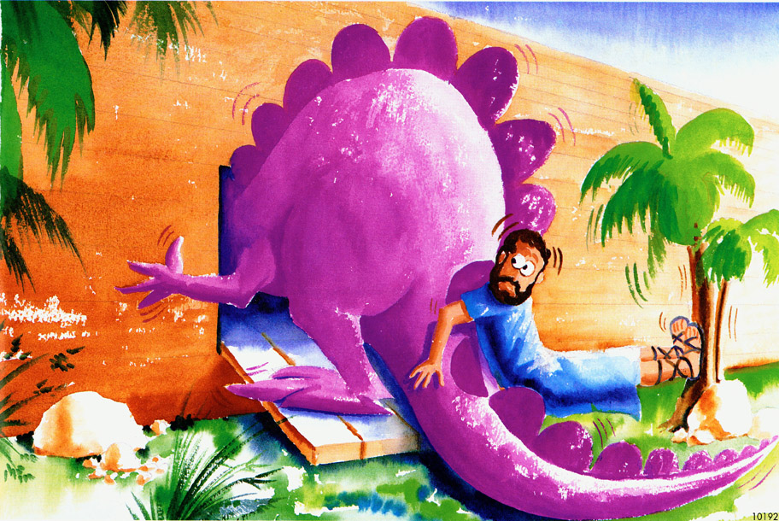

Slide 84
51 ft.
Sky light
Deck 1
Deck 2
Deck 3
85 ft.
510 ft.
Ramps
People and dinosaurs are shown to scale.
Notes:
510 ft = 155 meters
51 ft = 15 meters
85 ft = 26 meters

Slide 85
Ark Encounter
Williamstown, KY
Notes:
About 1.5 times the length and half the width
With the end zones, a football field is 360 feet (Without the end zones, a football field is 300 feet long.)
A football field is 160 feet wide

Slide 86
Notes:
Compsognathus was one of the smallest dinos (2.5 feet long and wighed only 6.5 pounds). Only two known specimens (found in Germany and France)

Slide 87
Notes:
Crocodile in egg: http://pixdaus.com/single.php?id=49609, accessed 17 Oct 2011
Large crocodile with man: http://mackaycartoons.blogdrive.com/archive/50.html

Slide 88
Notes:
Protoceratops

Slide 89
Apatosaurus excelsus Growth
Tonnes
take on board
the Ark
disembark
Age (years)
Based on Gregory M. Erickson et al, “Dinosaurian growth patterns and rapid avian growth rates,” Nature 412:6845 (26 July 2001), p. 431, fig. 2.
Notes:
According to the article, the microscopic study of dinosaurs bones from most major dinosaurian clades showed that they all had similar growth patterns and all the large dinosaur kinds were like Apatosaurus above—very little growth in the first 5 years and then exponential growth in the next few years. “All dinosaurs grew at rates more rapid than those of extant reptiles, but as a whole they did not show rates intermediate between reptiles and birds/mammals, nor values equivalent to the latter. Unexpectedly, our results show that growth in the Dinosauria was unique among major vertebrate groups…” (pp. 429-30).

Slide 90
Evolutionists say:
550 genera and over 1000 species
Notes:
genera prounced as “jen’-er-a”
(not to be confused with genre [e.g., of literature]: pronounced as “zhahn-ruh”)

Slide 91
Apatosaurus excelsus
Diplodocus carnegii
Notes:
Apatosaurus was known previously by the now obsolete name Brontosaurus.
Both are sauripods (two genuses [or genera] in the family of Diplodocidae), surely the same created kind: http://landbeforetime.wikia.com/wiki/Apatosaurus, accessed 28 Aug 2013

Slide 92
German Shepherd
Pit Bull
Boxer
All the same species: Canis familiaris
(the domestic dog)
Notes:
Boxer: http://www.skullsite.co.uk/Boxer/boxer.htm, accessed 2012 Feb 27
Pit bull: http://www.boneclones.com/BC-186.htm, accessed 2012 Feb 27
German Shepherd: http://skullandbone.tumblr.com/post/15556802309/german-shepherd-skull-by-liquidonyx-on-flickr, accessed 2012 Feb 27

Slide 93
Ceratopsia
Notes:
You don’t need to translate the names of the different varieties of ceratops.
Some of the differences may reflect the different stages of development from juvenile to adult, some may be due to genetic variation within the kind, and some possibly due to mutations.

Slide 94
DOG VARIATIONS
Notes:
You don’t need to translate the names of the different breeds of dogs.

Slide 95
Only 50-80
Dinosaur
Kinds

Slide 96
Notes:
Paul S. Taylor, The Great Dinosaur Mystery and the Bible (Colorado Springs, CO: Chariot Victor Publ.), p. 24-25.

Slide 97
Billions of dead things
buried in rock layers
laid down by water
all over the earth

Slide 98
Notes:
From Baumgardner slide—Dinosaur National Monument photo

Slide 99
Fossilized Dinosaur Skin
Notes:
Fossilized skin of dinosaur ‘Minmi’, Queensland. (Photo by Lorraine Walker)
Creation 24:3 (June 2002), p. 7.

Slide 100
T-rex in death throes in water
Notes:
This posture is quite common among dinosaur fossils—so much so it has a name: the opisthotonic death posture. Research has suggested that death associated with immersion in water produces this posture. The violent rising waters of the global Flood would have provided the loads of sediment needed to catastrophically bury billions of animals and plants, triggering opisthotonus in dying dinosaurs and ultimately providing the conditions that preserved many as fossils. https://answersingenesis.org/dinosaurs/extinction/dinosaur-deaths-pose-link-immersion-water/, 10 Dec 2011, accessed 29 Oct 2014.
Source article: http://www.newscientist.com/article/dn21207-watery-secret-of-the-dinosaur-death-pose.html.com/#.VFD77r54NVg, accessed 29 Oct 2014
Photo: http://www.therpf.com/f9/help-please-jurassic-park-fossil-dig-photos-120038/, accessed 2 Dec 2011,
similar photo with man in picture: http://www.sciencebuzz.org/science-topic-areas/life-science/diversity-organisms?page=1, accessed 29 Oct 2014
One of the most complete T-rex skeletons in the world. It is on display in the Royal Tyrell Museum near Drumheller, Alberta, Canada

Slide 101
“No living dinosaurs”
“65 million years”
no human or dinosaur fossils
“No human fossils”

Slide 102
Coelacanth
Rediscovered alive in 1938
“17”
“65 million years”
no coelacanth fossils
“It went extinct with the dinosaurs!”
Notes:
Previously the coelacanth was thought to have become extinct at time that the dinosaurs did, about 65 million years ago, because that was the highest rock layer where fossils have been found. It first appears in the strata dated at about 400 million years. Their fossils have been found in both (supposedly) fresh-water and (supposedly) salt-water deposits.
But then in the 1938 it was captured alive while swimming off the coast of Madagascar and it is virtually identical to the fossil forms. Many more have been accidently captured by fishing trawlers but in captivity they never have survived longer than 20 hours. They were first filmed in 1987 (for 8.5 hours, one fish for 6 hours), swimming in their natural habitat off the coast of Comoro Islands, NW of Madagascar.
In about 2011 a skull of an “anatomically modern coelacanth” was found in rocks dated to be only 17 million years old: http://www.nature.com/ncomms/journal/v3/n4/full/ncomms1764.html (“Earliest known coelacanth skull extends the range of anatomically modern coelacanths to the Early Devonian”), 10 April 2012.
It is a blue sluggish fish and apparently eats squid and other fish. Unlike most fish, it gives birth to live babies. It can swim backward and sometimes swims belly up. At first glance, it looks like a very uncoordinated swimmer. But careful analysis the films of the fins in action shows them to very synchronized like the gait of a trotting horse. They apparently find their food by their generated electric fields, The closest living relative (according to evolutionists) is the lungfish. It apparently lives at depths of about 150-200 meters (480-630 feet). Contrary to what evolutionists stated for decades, the fish never walks on the bottom on the ocean with its fins. It is not a transitional form on the way to becoming an amphibian. It is a 100% fish and beautifully designed that hasn’t changed really at all in supposedly 400 million years. This is all documented by Hans Fricke (who filmed them), “Coelacanths: The Fish That Time Forgot,” National Geographic (June 1988), pp. 824-838.
Since 1988, it has been found in the waters of Japan and Indonesia.

Slide 103
WHY did they become extinct,
if they did?

Slide 104
Possible Causes of Extinction
Man over-hunted them.
Man destroyed their habitat.
Man brought disease into their population.
Rapid climate changes in the post-Flood world.
But they might not be extinct—remember the coelacanth!!!
Notes:
If still alive, the most likely place dinosaurs would be is in biologically rich areas with limited or no human settlements, such as parts of the Congo and Papua New Guinea. Mokole-mbembe is a name of a creature reportedly seen from time to time on the edge of the deep jungles in the Congo and Murray is the T-rex type creature reportedly seen by natives and a Seventh Day Adventist pastor along the shores of Lake Murray in PNG. See Dave Woetzel, “The Cryptid of Lake Murray--a Living Theropod?” Creation Matters 20:3 (May/June 2015), pp. 2-3 (Creation Research Society newsletter).

Slide 105
When did they become extinct,
if they did?

Slide 106
“Fresh” T. rex bones?
“It was exactly like looking at a slice of modern bone. But, of course,
I couldn’t believe it. I said to the lab technician: ‘The bones, after all, are 65 million years old. How could blood cells survive that long?’”
Mary Schweitzer
1993
Virginia Morell, “Dino DNA: The Hunt and the Hype,” Science 261 (9 July 1993), p. 160.
Notes:
1993 Schweitzer-- grad student at Montana St. Univ. Museum of the Rockies, discovery--early 1992.
2005 Schweitzer --professor at U of N. Carolina, Chapel Hill.
David DeWitt explains: “Conventional wisdom held that proteins and DNA could not survive for millions of years. Indeed, an upper limit to the preservation of a stable protein such as collagen was presumed to be about 2.7 million years at 0°C, 180,000 years at 10°C, and only 15,000 years at 20°C.(1) Thus, there was much skepticism that what Schweitzer found was really dinosaur soft tissue when it was initially reported. Secular scientists were hesitant to believe that such tissue and proteins could persist for 65 million years.”
(1): Nielsen-Marsh, C., Biomolecules in fossil remains: A multidisciplinary approach to endurance, The Biochemist June 2002 pages 12–14, http://www.biochemist.org/bio/02403/0012/024030012.pdf. Quoted from DeWitt’s article: http://www.answersingenesis.org/articles/2007/04/13/t-rex-big-chicken#fnList_1_5, “Tyrannosaurus rex: a big chicken?”, 13 April 2007.
Picture from http://www.meas.ncsu.edu/faculty/schweitzer/schweitzer.htm, downloaded 29 March 2005.

Slide 107
Recovered T-rex soft tissue
Tissue fragment (left) is “flexible and resilient and, when stretched (arrow), returns to its original shape” Regions of bone (right) show fibrous character, “not normally seen in fossil bone.”
2005
Mary H. Schweitzer, et al, “Soft-Tissue Vessels and Cellular Preservation in Tyrannosaurus rex,” Science 307:5717 (25 March 2005), pp. 1952-55.
Notes:
By 2005 Schweitzer was professor at U of N. Carolina, Chapel Hill.

Slide 108
Tyrannosaurus rex Soft Tissue Raises Tantalizing Prospects
CREDIT:
Mary Schweitzer
“Dissolved T. rex bone yielded flexible, branching vessels (left), some of which contain cell-like structures (right).”
Elizabeth Pennisi, “Tyrannosaurus rex Soft Tissue Raises Tantalizing Prospects,” Science 307: 5718 (25 March 2005), pp. 1852-53.
Notes:
Since 2005 this research has been further confirmed by Schweitzer and other researchers many times.
In 2009 she and her colleagues studied hadrosaur bones that show evidence of having been buried rapidly in a deep deposit of sandstone in the Judith River formation in Montana. See summary of the May 2009 Science article in “Proteins, Soft Tissue from 80 Million-Year-Old Hadrosaur Add Weight to Theory that Molecules Preserve Over Time,” http://www.physorg.com/news160320581.html, 30 April 2009, accessed 3 Aug. 2009. Further support is in M.H. Schweitzer et al, “Molecular analyses of dinosaur osteocytes support the presence of endogenous molecules,” Bone 52:1 (2013), pp. 414-423.
See also this 2007 article arguing for the authenticity of Schweitzer's conclusions: http://news.nationalgeographic.com/news/2007/04/070412-dino-tissues.html, accessed 2011 June 29.
Now dino DNA recovered: Schweitzer, M. H. et al. Molecular analyses of dinosaur osteocytes support the presence of endogenous molecules, Bone, 17 October 2012 | doi:10.1016/j.bone.2012.10.010. See also Thomas, B., Did scientists find T. Rex DNA? icr.org/article/7093/, 7 November 2012, Also Jonathan Sarfati’s article: http://creation.com/dino-dna-bone-cells, 2012 Dec. 11, accessed 2013 Jan 10, and these AiG News-to-Note: http://www.answersingenesis.org/articles/2012/10/27/news-to-note-10272012#three. AiG also covered the discovery cited in footnote 18 of this article in http://www.answersingenesis.org/articles/2012/10/20/news-to-note-10202012#three.
Triceratops soft tissue discovered: Mark H. Armitage and Kevin L. Anderson, “Soft sheets of fibrillar bone from a fossil of the supraorbital horn of the dinosaur Triceratops horridus,” Acta Histochemica *** (2013), pp. ***-*** (get details from Andrew Snelling). Abstract concludes: “This is the first report of sheets of soft tissues from Triceratops horn bearing layers of osteocytes, and extends the range and type of dinosaur specimens known to contain non-fossilized material in bone matrix.” Both authors are professors in biology at state universities. Both are YECs.
in 2015: Blood cells and collagen apparently in T-Rex book of poor quality: Andy Coghlan, “Dinosaur blood extracted from 75-million-year-old fossil,” http://www.newscientist.com/article/dn27687-dinosaur-blood-cells-extracted-from-75millionyearold-fossil.html#.VXdETFxVhHx, 2015 June 9, accessed the same day.

Slide 109
“80 million year old” duck-billed dinosaur blood vessels
“Tiny, delicate vessels that carried blood through a duck-
billed dinosaur 80 million years ago never fossilized and still contain the beast's tissue, a new study finds.”
2015
Laura Geggel, “80-Million-Year-Old Dinosaur Flood Vessels Never Fossilized,” news.discovery.com (10 Dec. 2015).
Notes:
http://news.discovery.com/animals/dinosaurs/80-million-year-old-dinosaur-blood-vessels-never-fossilized-151210.htm, accessed 22 Dec. 2015.

Slide 110
Carbon-14 in Dinosaur Bones
Dinosaur
C-14 “age”
Sample
Triceratops, MT
Triceratops, MT
Hadrosaur, MT
Hadrosaur, MT
Acrocanthosaurus, TX
~30,890 years
~33,830 years
~22,380 years
~22,990 years
~23,760 years
Internal bone
Outer bone
Internal bone
Outer bone
bone surface--very large sample
Similar results from dinosaur bones found in China and Belgium.
Notes:
http://www.dinosaurc14ages.com/carbondating.htm
See also http://crev.info/2015/06/c14-dinosaur-bone/ (Dave Coppedge’s site)

Slide 111
Almost every culture has dragon legends.
Canadian Children’s Museum
Notes:
Dragons do not look like any living animal, but they do look remarkably similar to dinosaurs.

Slide 112
The Flag of Wales

Slide 113
“There is a petroglyph in Natural Bridges National Monument that bears striking resemblance to a dinosaur, specifically a Brontosaurus, with a long tail and neck, small head and all.”
Fran Barnes (authority on rock art of southwest America) “Messages on Stone,” Creation ex nihilo Vol. 19:2, p. 23.
Notes:
Natural Bridges National Monument is a located about 50 miles (80 km) northwest of the Four Corners boundary of southeast Utah, at the junction of White Canyon and Armstrong Canyon, part of the Colorado River drainage. It features the second and fourth largest natural bridges in the world, carved from the white Permian sandstone of the Cedar Mesa Formation.
This has been disputed here: http://www.foxnews.com/scitech/2011/03/29/creationists-claim-humans-lived-dinosaurs-scientists-disagree/?test=faces.
But AiG’s response is here: http://www.answersingenesis.org/articles/2011/03/18/feedback-senter-and-cole.

Slide 114
Natural Bridges National Monument, Utah
Notes:
Natural Bridges National Monument is a located about 50 miles (80 km) northwest of the Four Corners boundary of southeast Utah, at the junction of White Canyon and Armstrong Canyon, part of the Colorado River drainage. It features the second and fourth largest natural bridges in the world, carved from the white Permian sandstone of the Cedar Mesa Formation.
This has been disputed here: http://www.foxnews.com/scitech/2011/03/29/creationists-claim-humans-lived-dinosaurs-scientists-disagree/?test=faces.
But AiG’s response is here: http://www.answersingenesis.org/articles/2011/03/18/feedback-senter-and-cole.

Slide 115
Notes:
Natural Bridges National Monument is a located about 50 miles (80 km) northwest of the Four Corners boundary of southeast Utah, at the junction of White Canyon and Armstrong Canyon, part of the Colorado River drainage. It features the second and fourth largest natural bridges in the world, carved from the white Permian sandstone of the Cedar Mesa Formation. The petroglyph is under Kachina Bridge.
This has been disputed here: http://www.foxnews.com/scitech/2011/03/29/creationists-claim-humans-lived-dinosaurs-scientists-disagree/?test=faces.
But AiG’s response is here: http://www.answersingenesis.org/articles/2011/03/18/feedback-senter-and-cole.

Slide 116
Angkor Thom (temple), Cambodia
12th century ruins of Khmer Civilization
Notes:
12th century bas-relief picture of a dinosaur in the ruins of Angkor outside of Siem Reap, Cambodia. The ruins of Angkor Thom have purposely not been restored, though other ruins of this ancient Khmer kingdom (9th--12th century) have been restored. The original edifices of Angkor Thom were constructed during the latter end of the kingdom. The most significant of the buildings of Angkor Thom is the great temple-monastery of Ta Prohm.
On the side of the west entrance to the temple are stone carvings of various common animals—pigs, monkeys, water buffaloes, roosters, snakes—and what appears to be a dinosaur! There are no mythological figures among them, so one can reasonably conclude that these figures depict the animals that were commonly seen by the ancient Khmer people in the twelfth century. Some have questioned the authenticity of the relief.
http://www.answersingenesis.org/docs2007/0115angkor.asp for pictures and info.
Inset photo and info: http://www.unexplainedearth.com/angkor.php, accessed 15 Sept 2007,
Further documentation of the authenticity of this from a different investigator is here: http://www.bible.ca/tracks/tracks-cambodia.htm, accessed 11 Aug. 2008

Slide 117
Brass plate on the tomb of Bishop Bell (died 1496), in the floor of
Carlisle Cathedral, Carlisle, U.K.
Notes:
Also engraved in the plate and easily recognizable are a bat, dogs, fish, a bird, an eel, a wild pig and a fox.
Photo taken by Phillip Bell, when he was with AiG-UK

Slide 118
A “Living Fossil”
“It went extinct 150 million years ago.”
Found alive in 1994
“The discovery of the Wollemi Pine is the equivalent of finding a small dinosaur still alive on earth.”
Wollemi Pine
Notes:
Supposedly went extinct 150 million years ago (Jurassic period—age of Dinosaurs) but found alive and healthy in 1994 in Wollemi National Park 200 km (125 mi) northwest of Sydney, Australia, and virtually identical to the fossil form found about 100 km (62 miles) away. Soon they will growing in gardens all over the world.
Wollemi pines are now well known to have the capacity to re-sprout after a catastrophe. New trunks can grow from old roots that may be 1000s of years old.
See Andrew Snelling’s ICR Impact article, No. 394 (April 2006), at www.ICR.org.
Photo from Ken Ham 27 Mar 2008
For Dr. Carl Werner’s list of living fossils (from his book, Living Fossils, New Life Publ, 2008): https://docs.google.com/document/d/1ixDBEuNJxwlbKDBV-54fLRkLmZs8SyJ1k0mYF0LgxUQ/edit

Slide 119
The Bible can’t
be trusted in this
scientific age!

Slide 120
The World
Evolution
Apemen
Theistic
Evolution
Millions
of Years
No Global
Flood
Bible
History
Not True
Age Dating
Methods

Slide 122
Notes:
http://www.dinosoria.com/diapo_jurassic/images/jurassic_park019(1)_jpg.jpg

Slide 123
Natural History Museum, London

Slide 124
I’d like to see what the church
can do about this!

Slide 125
Trust in Jesus
The Church

Slide 126
Creation Museum, Cincinnati, OH

Slide 127
Dinosaur Den

Slide 128
Palm Plaza

Slide 129
Ebenezer the Allosaur
Notes:
Found in western Colorado, we have 97% of the skull and over 50% of the skeleton
When alive Ebenezer was 30-foot-long, 10-foot-high.
Valued professionally at $1,000,000.
Andrew Snelling: “Of the 60 Allosaurus specimens found, only a half-dozen have such a complete skull, and it may be one of the two finest allosaur skulls in the world. It is also much larger than the famous ‘Big Al’ dinosaur at the Museum of the Rockies in Montana.”
Went on display at the Creation Museum in late May 2014.
https://answersingenesis.org/ministry-news/creation-museum/15-million-dinosaur-exhibit-dedicated-today/?utm_source=homepage&utm_medium=featured-slider&utm_campaign=allosaurus

Slide 130
DINOSAURS
Missionary Lizards!

Slide 131
GOSPEL MESSAGE
DEATH
SIN

Slide 132
Use the Bible to explain dinosaurs!
Dinosaurs & man on Day 6
Thousands of years ago
All originally vegetarian
No death before the Fall
Fossils mainly from Noah’s Flood

Slide 133
Our thinking in
every area!

Slide 135
Answers Book 1, 2, 3 & 4
whole books—FREE online
www.AnswersInGenesis.org
Answers/Online Books.
90-7-538_NewAnswersBookSet
Notes:
Answer the 130 most asked questions

Slide 136
The New Answers Book 1
gap theory?
races?
day-age theory?
global Flood?
Cain’s wife?
carbon-dating?
distant starlight?
dinosaurs?

Slide 137
Answers for Kids Vol. 1, 2, 3, 4, 5 & 6

Slide 138
Creation Museum, Cincinnati, OH

Slide 139
Ark Encounter, Williamstown, KY

Slide 140
Black

Slide 141
Creation link at BibleStudyDownloads.org
Get this presentation for free!
Notes:
Creation (cr)

