Slide 1
Dr. Terry Mortenson
Millions of Years:
the Idea’s origin and
Devastating impact
Taught by Dr. Terry Mortenson, AnswersinGenesis.org Uploaded by Dr. Rick Griffith, Singapore Bible College All files in many languages for free download at BibleStudyDownloads.org

Slide 3
Dr. Terry Mortenson
Millions of Years:
Where Did the Idea Come From?

Slide 4
Dr. Terry Mortenson
Millions of Years:
the Idea’s origin and
Devastating impact

Slide 5
GEOLOGIC TIMESCALE
ERA
PERIOD
EPOCH
SUCCESSION OF LIFE
CENOZOIC
recent life
QUATERNARY
0-1 Million Years
3.5 Billion Years
TERTIARY
62 Million Years
CRETACEOUS
72 Million Years
MESOZOIC
middle life
JURASSIC
46 Million Years
TRIASSIC
49 Million Years
PERMIAN
50 Million Years
PENNSYLVANIAN
30 Million Years
CARBONIFEROUS
MISSISSIPPIAN
35 Million Years
DEVONIAN
60 Million Years
SILURIAN
20 Million Years
PALEOZOIC
middle life
ORDOVICIAN
75 Million Years
According to Evolution
CAMBRIAN
100 Million Years
PRECAMBRIAN

Slide 6
2 Corinthians 10:4–5
4 For the weapons of our warfare are not of the flesh, but divinely powerful for the destruction of fortresses.
5 We are destroying speculations and every lofty thing raised up against the knowledge of God, and we are taking every thought captive to the obedience of Christ.
Notes:
NASB

Slide 7
Colossians 2:8
8 See to it that no one takes you captive through philosophy and empty deception, according to the tradition of men, according to the elementary principles of the world, rather than according to Christ.
Notes:
NASB

Slide 8
Operation Science vs Origin Science

Slide 9
OPERATION SCIENCE
“Scientific Method”
The use of observable, repeatable experiments
in a controlled environment (e.g., a lab)
to understand how things operate or function
in the present physical universe
in order to find cures for disease, produce new technology, or put a man on the moon, etc.

Slide 10
OBSERVATIONAL
SCIENCE
EXPERIMENTAL
SCIENCE
Biology
Chemistry
Physics
Engineering
Medical Research

Slide 11
Grand Canyon, USA
Notes:
147703743_Thinkstock2012_GrandCanyon.jpg
Downloaded by Brandie

Slide 12
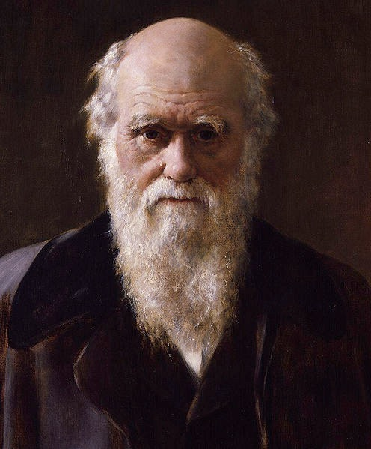
Charles Darwin
Notes:
IMAGE: Wikimedia.org This work is based on a work in the public domain. It has been digitally enhanced and/or modified. This derivative work has been (or is hereby) released into the public domain by its author, Dcoetzee. This applies worldwide.
In some countries this may not be legally possible; if so: Dcoetzee grants anyone the right to use this work for any purpose, without any conditions, unless such conditions are required by law.

Slide 13
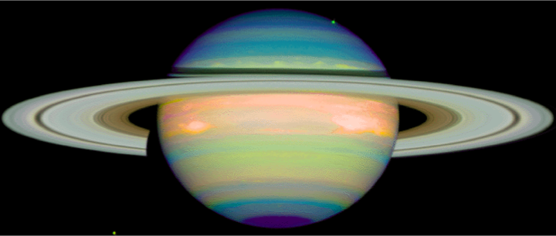
TitleAndActionSafe
Saturn
Notes:
http://nssdc.gsfc.nasa.gov/image/planetary/saturn/hst_saturn_nicmos.jpg

Slide 14
Origin SCIENCE
“Legal-Historical Method”
The use of reliable, eyewitness testimony
(if any is available)
and observable evidence to determine the past, unobservable, unrepeatable event(s), which produced
the observable evidence we see in the present.

Slide 15
ORIGIN SCIENCE
HISTORICAL SCIENCE
Historical Geology
Paleontology
Archaeology
Cosmology
Forensics

Slide 17
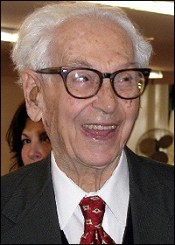
“Evolution is a historical process that cannot be proven by the same arguments and methods by which purely physical or functional phenomena can be documented.”
Ernst Mayr, What Evolution Is (New York: Basic Books, 2001), p. 13.
Notes:
Mayr (died at 100+, 1904-2005), great evolutionary zoologist at Harvard.
New York Times: “the Charles Darwin of the 20th century”

Slide 18
1770–1830
New Theories of Earth History

Slide 19
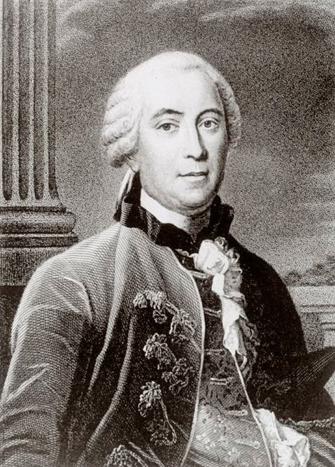
Comte de Buffon
(1707–1788)
Naturalist
Epochs of Nature (1778)
Notes:
Source: Ian Taylor

Slide 20
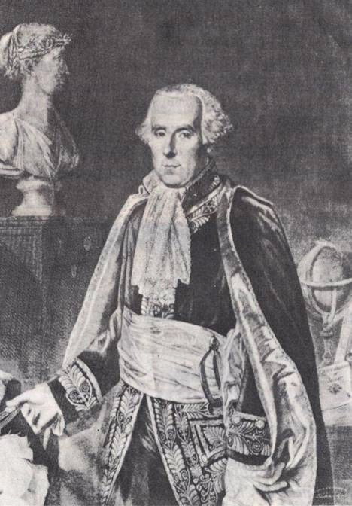
Pierre Laplace
(1749–1827)
Astronomer
Exposition of the System of the Universe (1796)
Notes:
Source: The Historical Perspective (Milton Keynes: Open University Press, 1973), p. 51.

Slide 21
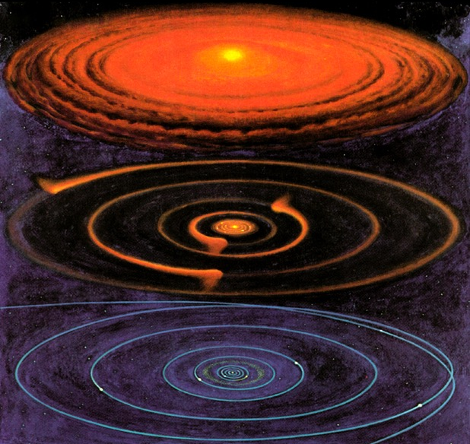
Nebular Hypothesis
Notes:
Picture from Roy A. Gallant, National Geographic Picture Atlas of Our Universe (Wash. DC: National Geographic Society, 1986), p. 38. Similar to the diagram in Robert A. Wallace, Jack L. King and Gerald P. Sanders, Biology: the Science of Life (Glenview, IL: Scott, Foresman & Co., 1986), p. 426.

Slide 22
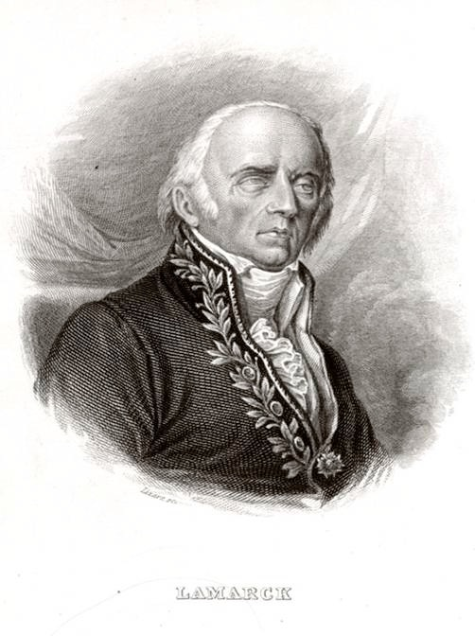
Jean Lamarck
(1744–1829)
Naturalist
Philosophy of Zoology (1809)
Notes:
Source: Ian Taylor

Slide 23
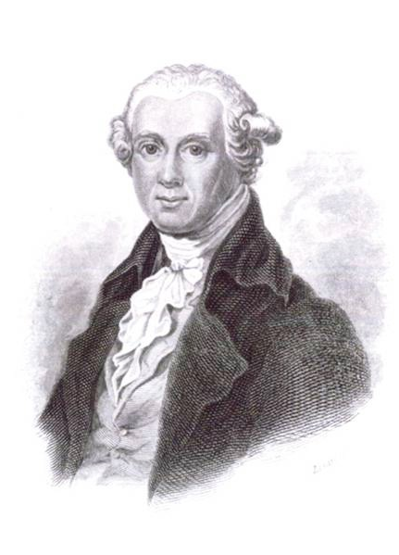
Abraham Werner
(1749–1817)
Mineralogy Professor
Short Classification & Description of the Various Rocks (1786)
Notes:
Werner was very kind and helpful to his students but extremely dogmatic about this speculative theory of the earth. As such he had an enormous impact on his students, who swallowed his theory or at least his belief in millions of years for the age of the earth.

Slide 24
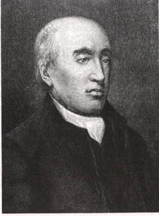
James Hutton
(1726–1797)
Doctor, Farmer, Geologist
Theory of the Earth (1788, 1795)
Notes:
Hutton’s theory written in incomprehensible English was “translated” by John Playfair (mathematician at Univ. of Edinburgh) in Illustrations of the Huttonian Theory of the Earth (Edinburgh, 1802)

Slide 25
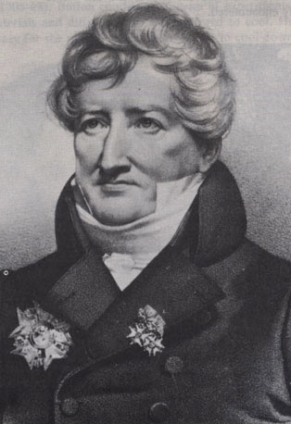
Georges Cuvier
(1769–1832)
Comparative Anatomist, Paleontologist
Theory of the Earth (1812)
Notes:
He believed in multiple local or regional catastrophes. All the animals were not killed in these events and creatures migrated in after the events to repopulate the flooded areas.

Slide 26
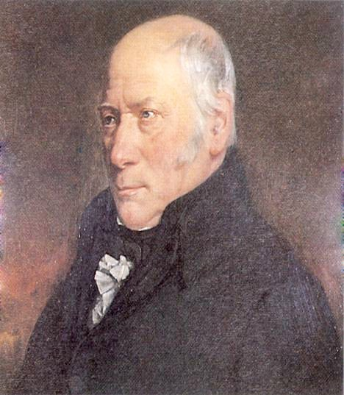
William Smith
(1769–1839)
Drainage Engineer, Surveyor, Geologist
“Father of English Stratigraphy”
Notes:
Source: The Age of the Earth (London: Institute of Geological Sciences), p. 8.

Slide 27
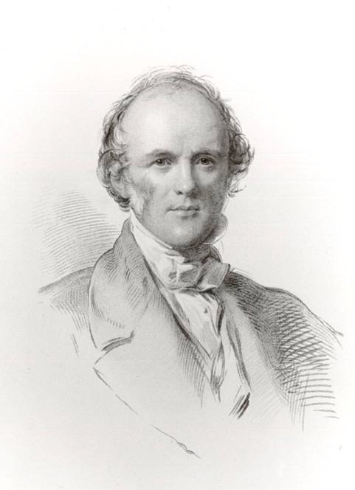
Charles Lyell
(1797–1875)
Lawyer, Geologist
Principles of Geology
(3 vol., 1830-33)
Notes:
Source: Ian Taylor

Slide 28
Old–Earth Theories (1778–1833)
Buffon:
Laplace:
Lamarck:
Werner:
Hutton:
Cuvier:
Smith:
Lyell:
Cooling earth, 75,000 years
Nebular hypothesis, long ages
Biological evolution, long ages
Receding ocean, 1 million years
Uniformitarianism, no beginning?
Catastrophism, millions of years
Fossils date rocks, millions of years
Uniformitarianism, millions of years

Slide 29
Early 19th Century Views of Earth History
Catastrophist view (e.g., Cuvier, Smith)
SB
C
C
C
C
P
(millions of years)
Uniformitarian view (e.g., Hutton, Lyell)
SB?
P
(millions of years)
Biblical/Traditional view (Scriptural geologists)
SCW
F
P
(ca. 6000 years)
Notes:
SB = Supernatural Beginning
C = Catastrophe
P = Present (today, our times)
SCW = Supernatural Creation Week
F = Flood (Noah’s)

Slide 30
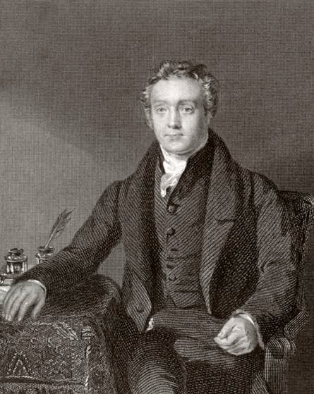
Thomas Chalmers (1780–1847)
Presbyterian Minister
& Naturalist
gap theory
Notes:
Gap theory: there is a long period of time between Genesis 1:1 and Genesis 1:2
Source: Ian Taylor

Slide 31
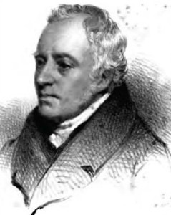
George Stanley Faber
(1773–1854)
Anglican Theologian
day-age theory
Notes:
Day-age theory: the days of Genesis 1 are figurative of long periods of time (millions of years)
photo: http://atlantipedia.ie/samples/tag/ignatius-donnelly/, accessed 2016 Jan 9

Slide 32
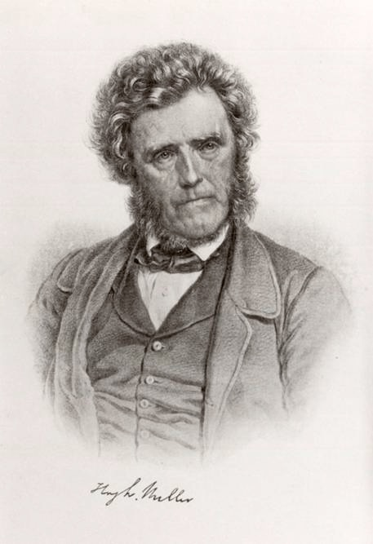
Hugh Miller
(1802–1856)
Geologist
gap theory
later, day-age theory
Notes:
Source: Ian Taylor

Slide 33
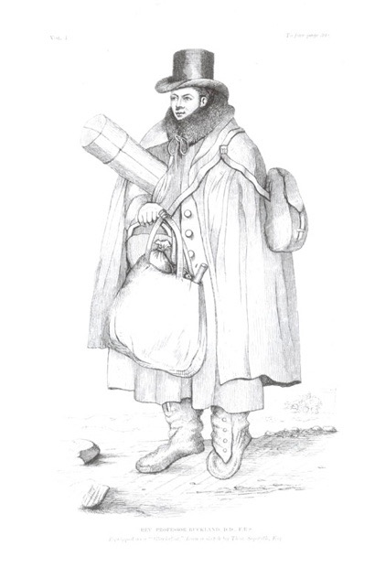
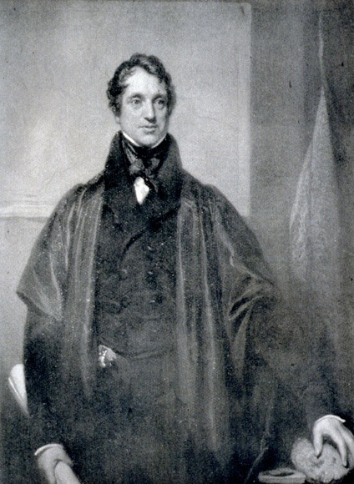
William Buckland
(1784–1856)
Adam Sedgwick
(1785–1873)
global, geologically limited flood
Notes:
Source: Ian Taylor

Slide 34
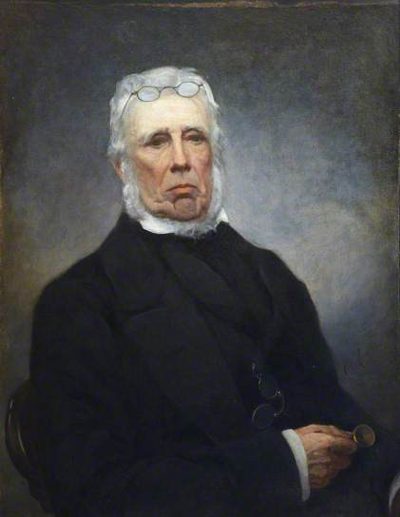
John Fleming
(1785–1857)
Presbyterian Minister & Zoologist
global, peaceful flood
Notes:
Fleming published his idea in a journal article in 1826. He said the Bible describes a tranquil flood that didn’t displace the plants or even the soil and therefore would have left no geological evidence. Lyell exploited Flemings argument to say the same, especially noting that the dove found an “olive branch” (the Bible says “olive leaf”).
Photo: http://www.bbc.co.uk/arts/yourpaintings/paintings/professor-john-fleming-17851857-125652, accessed 2016 Jan 9, information about copyright in a link on this page. I have in my picture/creation folder under Fleming, John 1785-1857
A copyright free photo is at http://britishbryozoans.myspecies.info/gallery?f%5B0%5D=tid%3A3356, accessed 2016 Jan 9, which I have in my picture/creation folder under Fleming, John 1785-1857 B&W

Slide 35
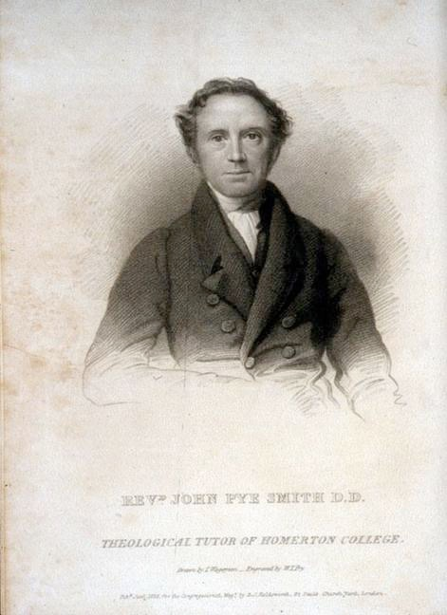
John Pye Smith
(1774–1851)
Congregational Theologian
local flood
Notes:
Local flood = localized in the Mesopotamian Valley of the Tigris and Euphrates rivers (modern-day Iraq)
Source: my slide

Slide 36
Liberal Theologians
Genesis 1–11 is mythology.

Slide 37
Early 1800s: Compromises with
Old–Earth Geology
1810s gap theory (Chalmers)
1820s day-age theory (Faber)
global peaceful flood (Fleming)
1830s Local flood theory (Pye Smith)
Genesis is myth (liberals)

Slide 38
Early 1800s: Faithfulness to Scripture
1820–50 young-earth creationism
(“Scriptural geologists”)

Slide 39
The Real Nature of the Debate
Philosophical and Religious
Worldview Conflict

Slide 40
GOD
GOD
The
Universe
The
Universe
The
Universe
Deism
Atheism
Christianity
Notes:
Diagrams from Wayne Grudem, Systematic Theology (1994), p 268.

Slide 41
Old–Earth Theology
Buffon:
Laplace:
Lamarck:
Werner:
Hutton:
Cuvier:
Smith:
Lyell:
deist or vague theist
open atheist
deist or atheist
deist or atheist
deist or atheist
deist or vague theist
deist or vague theist
deist or unitarian
Notes:
And many Christians who were influenced by these writers became semi-deists in their thinking about the world.

Slide 42
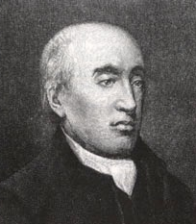
“The past history of our globe must
be explained
by what can be seen to
be happening now. ... No powers
are to be employed that are not
natural to the globe, no action to be
admitted except those of which we
know the principle.”
James Hutton, quoted in Arthur Holmes, Principles of Physical Geology, 2nd ed. (Edinburgh, Scotland: Thomas Nelson and Sons Ltd., 1965), pp. 43–44.
Notes:
Original source of last part of quote is James Hutton, Theory of the Earth (Edinburgh: William Creech, 1795), Vol. 2, p 547. I could not find the first part of the quote in Hutton’s vol. 1 or vol. 2. I also didn’t find the first part of the quote in Hutton’s 1788 article.
But the statement clearly reflects Hutton’s view.

Slide 43
“But, surely, general deluges form
no part of the theory of the earth;
for, the purpose of this earth is
evidently to maintain vegetable and
animal life, and not to destroy them.”
The Present is the key to the past
James Hutton, Theory of the Earth (Edinburgh: William Creech, 1795), vol. 1, p. 273.
Notes:
Quoted in Arthur Holmes, Principles of Physical Geology, (UK: Thomas Nelson & Sons Ltd., 1965), pp. 43–44.

Slide 44
The PRESENT is NOT
the key to the PAST.
PAST?
PAST
WORLD
PRESENT WORLD

Slide 45
100% Infallible Account of the All-knowing Eyewitness Creator!
Holy Bible
PAST and PRESENT!
PAST
WORLD
PRESENT WORLD
REVELATION is the key to the PAST and the PRESENT!

Slide 46
Early 19th Century Views of Earth History
Catastrophist view (e.g., Cuvier, Smith)
SB
C
C
C
C
P
(millions of years)
The Present is the Key to the Past
Uniformitarian view (e.g., Hutton, Lyell)
SB?
P
(millions of years)
Biblical/Traditional view (Scriptural geologists)
Revelation is the Key to the Past and the Present
SCW
F
P
(ca. 6000 years)
Notes:
Please note, creationists reason from the present to the past. But they do so within the presuppositional framework of the eye-witness testimony of the Creator given in Genesis.
Secular and most Christian geologists, however, reason from the present to the past within the presuppositional framework of uniformitarian naturalism, by which they deny God’s witness concerning supernatural creation Week, the cosmos-altering curse at the Fall of Adam, and the global catastrophic Flood at the time of Noah.

Slide 47
“I have always been strongly impressed with the weight of an observation of an excellent writer and skillful geologist who said that ‘for the sake of revelation as well as of science—of truth in every form—the physical part of Geological inquiry ought to be conducted as if the Scriptures were not in existence.’”
Charles Lyell, quoted in M.J.S. Rudwick, “Charles Lyell Speaks in the Lecture Theatre,” Brit. J. Hist. Sci., IX:2:32 (July 1976): 150.
Notes:
Quote from Lyell’s lecture at King’s College London, 4 May 1832

Slide 48
In his words, Lyell wanted to
“free the science [of geology] from Moses.”
Silence God’s
eye-witness testimony
Charles Lyell, quoted in Katherine Lyell, Life, Letters and Journals of Sir Charles Lyell, Bart. (London: John Murray, 1881), vol. 1, p. 268.
Notes:
The quote is from Lyell’s letter on 14 June 1830 to fellow uniformitarian geologist, George Poulett Scrope (also a member of Parliament), whom Lyell was encouraging and instructing on how to write his article for the Quarterly Review to accomplish what Lyell prescribed above so that the British church leaders would accept the millions of years and reject Genesis.

Slide 49
“I always feel as if my books came half
out of Lyell's brains and that I never
acknowledge this sufficiently, nor do I
know how I can, without saying so in so
many words—for I have always thought
that the great merit of the Principles [of
Geology], was that it altered the whole tone of one's mind & therefore that when seeing a thing never seen by Lyell, one yet saw it partially through his eyes.”
Charles Darwin, The Correspondence of Charles Darwin, Vol. 3 (Cambridge, UK: Cambridge Univ. Press, 1987), p. 55.
Notes:
Letter 772, to his good friend Leonard Horner, 29 Aug. 1844. Darwin’s books on geology up to this point included:
Letters on Geology (1835)
Journal of researches into the geology & natural history of the various countries visited by H.M.S. Beagle (1839)
The structure and distribution of coral reefs (1842)
Geological observations on the volcanic islands visited during the voyage of H.M.S. Beagle (1844)
photo: Wikimedia.org. This work is based on a work in the public domain. It has been digitally enhanced and/or modified. This derivative work has been (or is hereby) released into the public domain by its author, D. Coetzee. This applies worldwide. In some countries this may not be legally possible; if so, D. Coetzee grants anyone the right to use this work for any purpose, without any conditions, unless such conditions are required by law.

Slide 50
Uniformitarian Naturalism
Nature is all that exists.
Everything can, and indeed must, be explained by time plus chance plus the laws of nature working on matter.
Processes of geological change have always been operating in the past at the same rate, frequency and power as today.

Slide 51
Old-earth geologist
Christian
Naturalistic Assumptions
Biblical Assumptions

Slide 52
Neutral
Ground

Slide 53
But he’s still using his naturalistic assumptions!
Neutral
Ground

Slide 54
Neutral
Ground

Slide 55
I win!
Neutral
Ground

Slide 56
Operation Science vs Origin Science
Worldview is critical!

Slide 57
Naturalistic
Assumptions
Biblical Assumptions
FACTS
It’s a battle of worldviews.
ROCKS AND FOSSILS
Old Earth
No Global Flood
Young Earth
Global Flood

Slide 58
1 Timothy 6:20–21
20 O Timothy, guard what was entrusted to you, avoiding worldly and empty chatter and the opposing arguments of what is falsely called “knowledge”— 21 which some have professed and thus gone astray from the faith. Grace be with you.
Notes:
“Science” (from the Latin, scientia, meaning knowledge) is the Greek, gnosis, meaning knowledge.
NASB

Slide 59
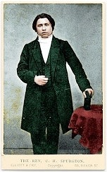
“Can any man tell me when the
beginning was? Years ago we
thought the beginning of this world
was when Adam came upon it;”
C.H. Spurgeon, “Election” (1855), The New Park Street Pulpit (Pasadena, TX: Pilgrim Publ. 1990), vol. 1, p. 318.
Notes:
Charles Haddon Spurgeon (1834-92) was 21 years old when he preached this sermon.
This is at the beginning of his point that divine election is eternal.
Sermon was preached on 2 Sept. 1855.
http://www.spurgeon.org/sermons/0041.htm, p. 10.

Slide 60
“but we have discovered that
thousands of years before that God
was preparing chaotic matter to
make it a fit abode for man, putting
races of creatures upon it, who
might die and leave behind the
marks of his handiwork and
marvelous skill, before he tried his
hand on man.”
C.H. Spurgeon, “Election” (1855), The New Park Street Pulpit (Pasadena, TX: Pilgrim Publ. 1990), vol. 1, p. 318.
Notes:
This is at the beginning of his point that divine election is eternal.
http://www.spurgeon.org/sermons/0041.htm, p. 10.

Slide 61
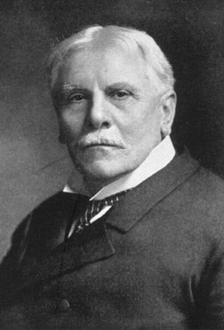
C.I. Scofield
(1843–1921)
Scofield Reference Bible
(1909)
Gap Theory
“The first creative act refers to the dateless past, and gives scope for all the geologic ages.”
Notes:
That statement is all Scofield said about the gap (1917 edition). No argument, nothing. Just a bald assertion. The 1967 edition said at v. 1, “Scripture gives no data for determining how long ago the universe was created.” At v. 2, it gives two weak statements for the gap theory.
The picture: http://www.creationdays.dk/C.%20I.%20Scofield/0.php
Scofield Reference Bible (revised in 1967 and still in print) has been used by tens of millions of Christians worldwide, many of whom act as if Scofield’s notes are as inspired as the Biblical text.

Slide 62
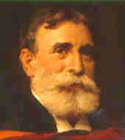
Princeton Seminary
Charles Hodge (1779–1878)
Old-Earth
A.A. Hodge (1823–1886)
Theistic Evolution??
B.B. Warfield (1851–1921)
Theistic Evolution?
Notes:
C. Hodge (1797-1878)—initially favored gap theory, then by 1860 he favored the day-age view.
He was adamantly opposed to Darwinism, but not to theistic evolution
In his 25-page chapter on the doctrine of creation (Systematic Theology, 1871, vol. 1, pp. 550–574), Hodge mentions 6 verses from Genesis, but he discusses none of the Biblical verses relevant to determining the length of the Creation days or the age of the earth. In a couple of sentences he mentions the young-earth view and the gap theory, but gives no arguments against those views. Rather he has several pages defending the day-age view (mostly by a lengthy quote by an OEC geologist [Dana]), but without using any Scripture from Genesis!
A.A. Hodge toyed with belief in evolution, open to gap or day-age but not sure if Gen. 1-11 was history
B.B. Warfield (1851-1921) open to theistic evolution, and even toyed with the idea that maybe, just maybe, human evolution (under God’s providential control, of course) could be harmonized with the Genesis 2 account of the origin of man
See Joseph Pipa & David Hall, eds., Did God Create in Six Days? (Taylor, SC: Southern Presbyterian Press, 1999), pp. 5-15. All the contributing authors to this book were Reformed.

Slide 63
1915–2001
Notes:
After Princeton he continued preaching with the National Council of Churches. He had increasing health problems, esp. chest pains. A doctor said there was nothing physically wrong with him and suggested that the symptoms were the result of his inner conflict about doubting Scripture even as he preached it to others.
1957—left the ministry to become a secular journalist and author
2001—died as an atheist after suffering from Alzheimer’s disease.

Slide 64
I believe that there is no supreme
being with human attributes—no
God in the biblical sense—but that
life is the result of timeless
evolutionary forces, having reached
its present transient state over
millions of years.
Charles Templeton, Farewell to God (Toronto: McClelland & Stewart, 1996), p. 232.

Slide 65
Princeton Seminary
Charles Hodge (1779–1878)
Old-Earth
A.A. Hodge (1823–1886)
Theistic Evolution??
B.B. Warfield (1851–1921)
Theistic Evolution?
Charles Templeton (1915–2001)
Apostate
Notes:
C. Hodge (1797-1878)—initially favored gap theory, then by 1860 day-age, but was adamantly opposed to Darwinism, but not theistic evolution
In his 25-page chapter on the doctrine of creation (1871, vol. 1, pp. 550–574), Hodge mentions 6 verses from Genesis, but he discusses none of the Biblical verses relevant to determining the length of the Creation days or the age of the earth. In a couple of sentences he mentions the young-earth view and the gap theory, but no arguments against those views. Rather he has several pages defending the day-age view (mostly by a lengthy quote by an OEC geologist [Dana], but without using any Scripture from Genesis!
A.A. Hodge toyed with belief in evolution, open to gap or day-age but not sure if Gen. 1-11 was history
B.B. Warfield (1851-1921) open to theistic evolution, but not of man, but not sure
Based on Joseph Pipa & David Hall, Did God Create in Six Days? (Taylor, SC: Southern Presbyterian Press, 1999), pp 5-15.

Slide 66
“The Christian who believes that the
idea of an ancient earth is unbiblical
would do better to deny the validity of
any kind of historical geology and insist
that the rocks must be the product of
pure miracle rather than try to explain them in terms of the [Noahic] flood. An examination of the earth apart from ideological presuppositions is bound to lead to the conclusion that it is ancient.”
Davis Young, “The Discovery of Terrestrial History,” in Howard J. Van Till, Robert E. Snow, John H. Stek and Davis A. Young, Portraits of Creation (Grand Rapids: Eerdmans, 1990), p. 81.
Notes:
Young is Professor Emeritus of Geology at Calvin College in Michigan and son of the famous OT professor, E.J. Young, at Westminster Theological Seminary (1936-68).

Slide 67
“I conclude, then that I have no
reason to disbelieve the standard
theories of the geologists,
including their estimate for the age
of the earth. They may be wrong,
for all I know; but if they are wrong, it’s not
because they have improperly smuggled philosophical assumptions into their work.”
C. John Collins, Science and Faith: Friends or Foes? (Wheaton: Crossways, 2003), p. 250.
Notes:
OT prof at Covenant Theological Seminary
Editor of the OT notes for the ESV Study Bible
Picture: http://www.wts.edu/stayinformed/view.html?id=1225, accessed 2013 Mar 4

Slide 68
“Although our conclusions are
tentative, at this point in our
understanding, Scripture seems to
be more easily understood to
suggest (but not to require) a
young-earth view, while the
observable facts of creation seem
increasingly to favor an old-earth view.”
Wayne Grudem, Systematic Theology (Grand Rapids: Zondervan, 1994), p. 307.

Slide 69
COME TO
JESUS! COME TO
THE CROSS AND BE
SAVED!

Slide 70
Millions of Years

Slide 71
IT DIDN’T
HIT THE CROSS!
GENESIS

Slide 72
GENESIS

Slide 73
IT’S JUST
A
SIDE ISSUE!
GENESIS

Slide 74
Psalm 11:3
If the foundations are destroyed, what can the righteous do?
Notes:
NASB and NKJV

Slide 75
Age Dating Methods
Apemen
Evolution
No Global Flood
Millions of Years
GENESIS

Slide 76
Evolution
Age
Dating
Methods
Apemen
Millions
of Years
GENESIS
NO
Global
Flood
Notes:
The rockets and explosions image and the words on the image can be moved to reveal the individual letters in “GENESIS.”
After clicking on the image, double-click on the words on the image to translate the words.

Slide 77
IT DIDN’T
HIT THE CROSS!
DIRECT HIT!
G
E
E
S
I
N
S
Notes:
Letters are in individual text boxes: G-E-N-E-S-I-S

Slide 78
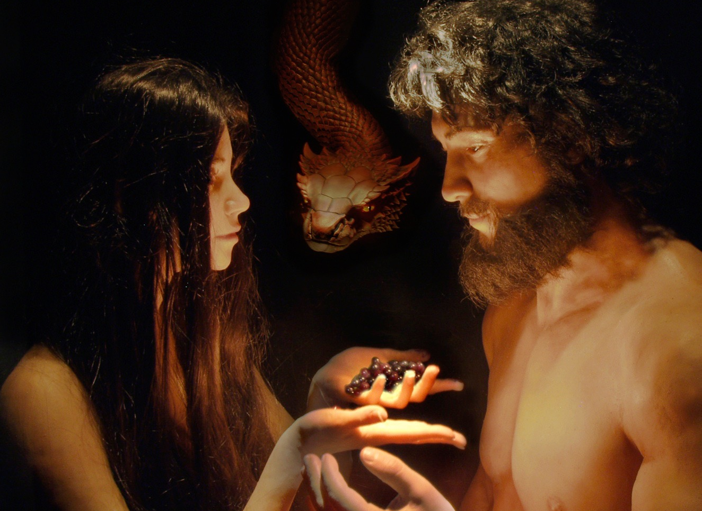
Has God said?
You will not die.

Slide 79
2 Corinthians 11:3
But I am afraid that, as the serpent deceived Eve by his craftiness, your minds will be led astray from the simplicity and purity of devotion to Christ.
Notes:
NASB

Slide 80
UNBELIEF
G
E
E
S
I
N
S

Slide 81
Progressive
Creation
Theistic
Evolution
Gap
Theory
Day Age
Theory
G
E
E
S
I
N
S
Framework
Hypothesis
Notes:
The rockets and explosions image and the words on the image can be moved to reveal the individual letters in “GENESIS.”
After clicking on the image, double-click on the words on the image to translate the words.

Slide 82
Creation
Ministry
GENESIS

Slide 83
Age Dating Methods
Apemen
Evolution
No Global Flood
Millions of Years
Creation
Ministry
GENESIS

Slide 84
Age Da
Evolution
Age
Dating
Methods
Apemen
Millions
of Years
NO
Global
Flood
Creation
Ministry
GENESIS

Slide 85
Age Da
WARNING! WARNING! WARNING!
Evolution
Age
Dating
Methods
Apemen
Millions
of Years
NO
Global
Flood
Creation
Ministry
GENESIS

Slide 86
COME TO
JESUS! COME TO
THE CROSS AND BE
SAVED!
Creation
Creation
Ministry
Ministry
GENESIS

Slide 87
2 Corinthians 10:4–5
4 For the weapons of our warfare are not of the flesh, but divinely powerful for the destruction of fortresses.
5 We are destroying speculations and every lofty thing raised up against the knowledge of God, and we are taking every thought captive to the obedience of Christ.
Notes:
NASB

Slide 88
“Today it is perhaps the Darwinian view of nature more than any other that is responsible for the agnostic and skeptical outlook of the twentieth century.”
Michael Denton, Evolution: A Theory in Crisis (London: Burnett Books, 1985), p. 358.
Notes:
Denton is medical doctor and PhD molecular biologist.
At the time of his book, he was an agnostic regarding the existence of God.

Slide 89
“The [Darwinian] revolution began when
it became obvious
that the earth was very ancient
rather than having been
created only 6000 years ago.
This finding was the snowball that started
the whole avalanche.”
Ernst Mayr, “The Nature of the Darwinian Revolution,” Science, vol. 176 (2 June 1972), p. 988.
Notes:
Mayr (1904-2005, died at age 100), Harvard zoologist
Picture from http://library.mcz.harvard.edu/history/images/mayr.jpg, accessed 19 Feb. 2004

Slide 91
If you can figure out how to add "Genesis 1-11” at an angle in your language as in the previous slide. Then delete this instruction box and the previous slide. Otherwise, we will just use the previous slide.

Slide 92
Psalm 40:4
How blessed is the man who has made the LORD his trust, and has not turned to the proud, nor to those who lapse into falsehood.
Proverbs 29:25
The fear of man brings a snare, but he who trusts in the Lord will be safe.
Notes:
NASB, except that in Prov. 29:25 is says “exalted” in place of “safe” since the Hebrew word has both connotation. The person who trusts in the Lord will be exalted or lifted high up out of a snare.

Slide 94
Answers Book 1, 2, 3 & 4
All FREE in English online
www.AnswersInGenesis.org
Answers/Online Books
90-7-538_NewAnswersBookSet
Notes:
Antworten auf die 130 häufigsten Fragen

Slide 95
The New Answers Book 1
gap theory?
races?
day-age theory?
global Flood?
Cain’s wife?
carbon-dating?
distant starlight?
dinosaurs?

Slide 96
Creation Museum, Cincinnati, OH

Slide 97
Ark Encounter, Williamstown, KY

Slide 99
Millions of Years
Where did the idea come from?
$12⁹⁹
by Terry Mortenson
30-9-500_MillionsOfYears

Slide 100
The Great Turning Point
The Church’s Catastrophic Mistake on Geology — Before Darwin
$24⁹⁹
by Dr. Terry Mortenson
10-2-167_TheGreatTurningPoint

Slide 101
Coming to Grips with Genesis
14 scholars give a careful Biblical & historical defense of young-earth creationism
edited by Dr. Terry Mortenson
& Dr. Thane H. Ury
10-3-121_ComingToGripsWithGenesis

Slide 102
Answers for Kids Vol. 1, 2, 3, 4, 5 & 6

Slide 103
Black

Slide 104
Creation link at BibleStudyDownloads.org
Get this presentation for free!
Notes:
Creation (cr)

