Slide 1
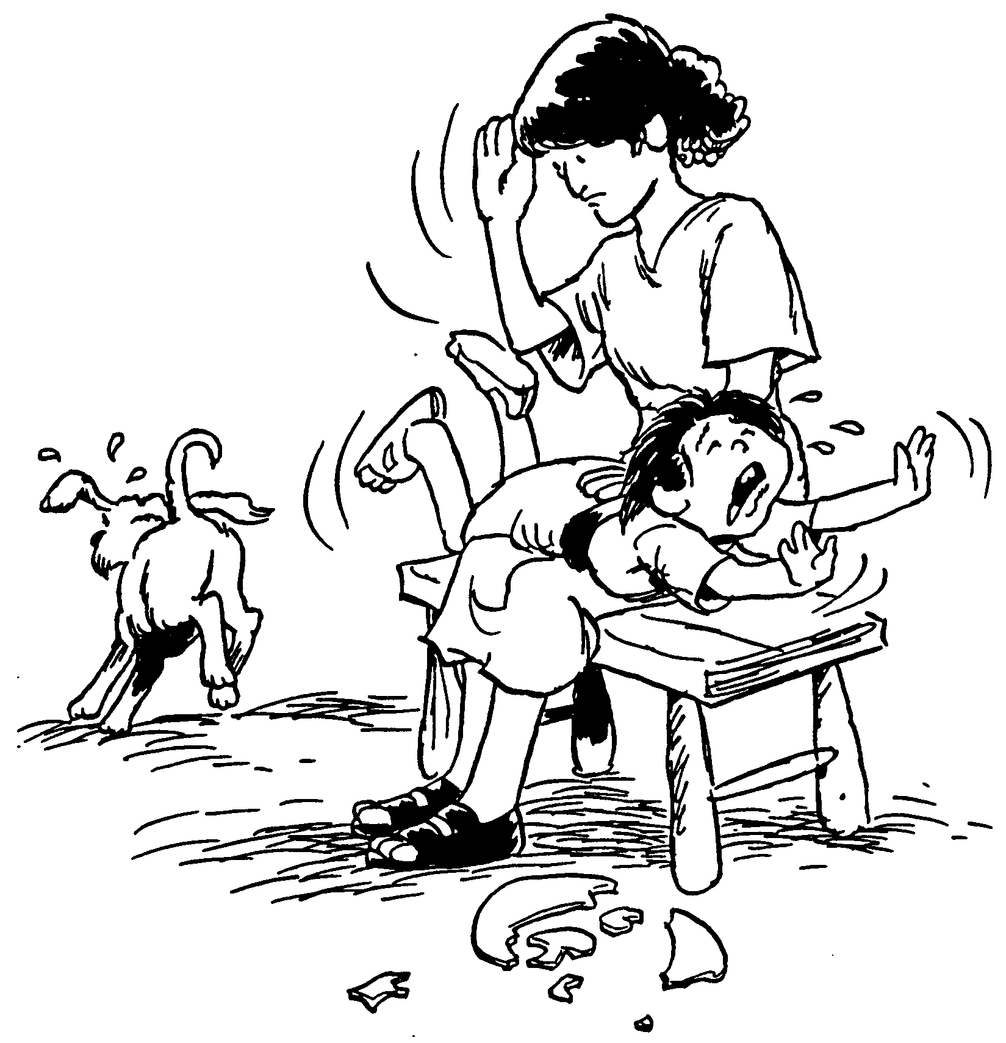
Church Discipline
Dr. Rick Griffith • Jordan Evangelical Theological Seminary • BibleStudyDownloads.org

Slide 2

God's Priority:
HOLINESS

Slide 3

Do you have a PLAN for church DISCIPLINE?

Slide 4
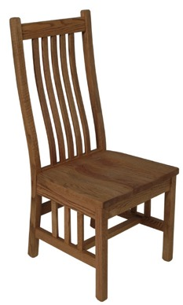
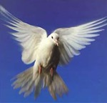

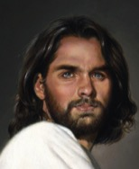
Types of People in
1 Corinthians
Carnal
Christian
(3:1)
Self
Self
Self
Non-Christian (2:14)
Christian (2:15)

Slide 5
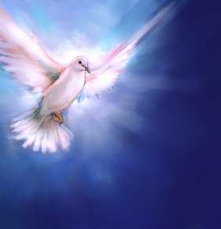
How do we maintain purity in the church?

Slide 6
Issues to Discuss
95
What is church discipline?
Why don't we often do it?
What results when we fail to do it?
How do we discipline believers?
Why is discipline important?
What sins are worthy of discipline?

Slide 7
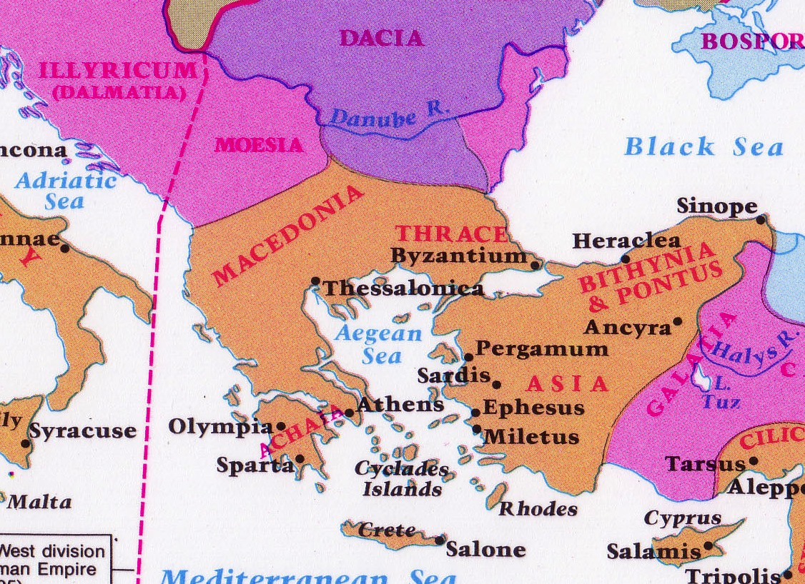
Corinth: Crossroads of Immorality
Corinth

Slide 8



Isthmus of Corinth
7 km
Corinth
Acrocorinth
Temple of Aphrodite

Slide 9
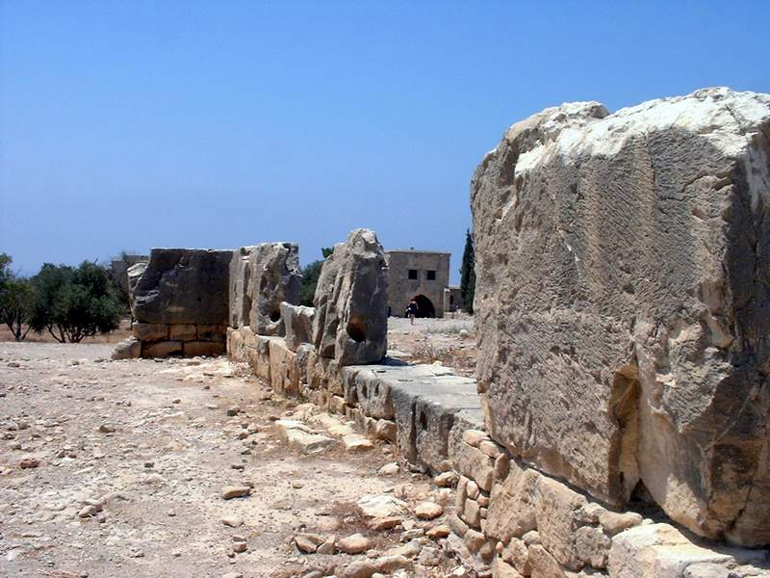
Temple of Aphrodite

Slide 10
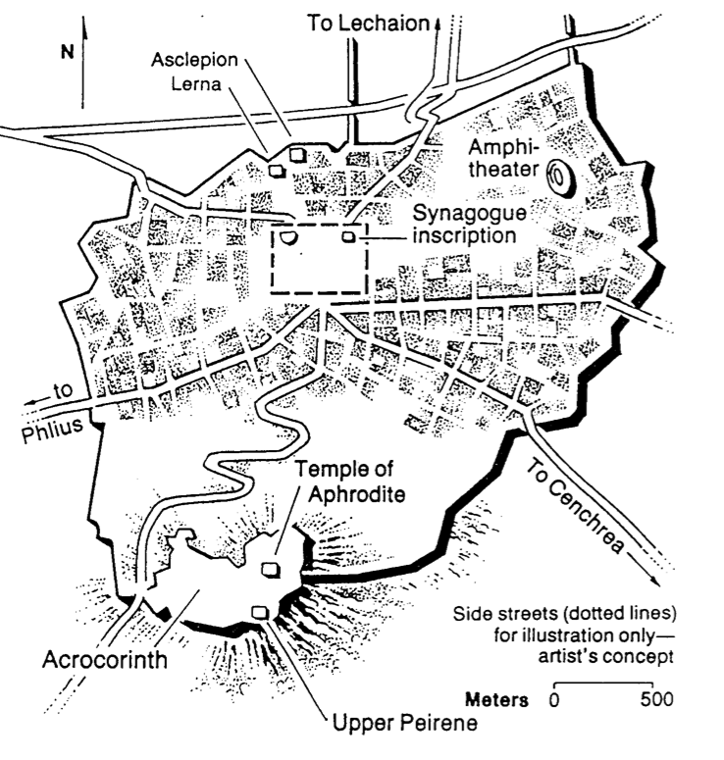
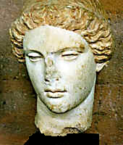
Temple of Aphrodite
Greek Goddess of Love

Slide 11
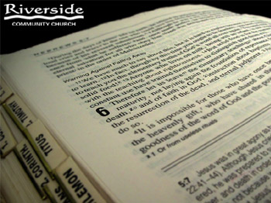
What is Church Discipline?
95-96
96
What it is…

Slide 12

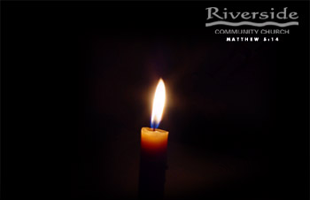
Personal Responsibility
95
"Brothers, is someone is caught in a sin, you who are spiritual should restore him gently. But watch yourself, or you also may be tempted."
Galatians 6:1

Slide 13
Discipline is tough love to restore wayward believers to God and His Church
Care enough to confront!
Spanking the Saints

Slide 14

Our Goal:
Our Goal:
Restoration!

Slide 15

He heals the brokenhearted

Slide 16
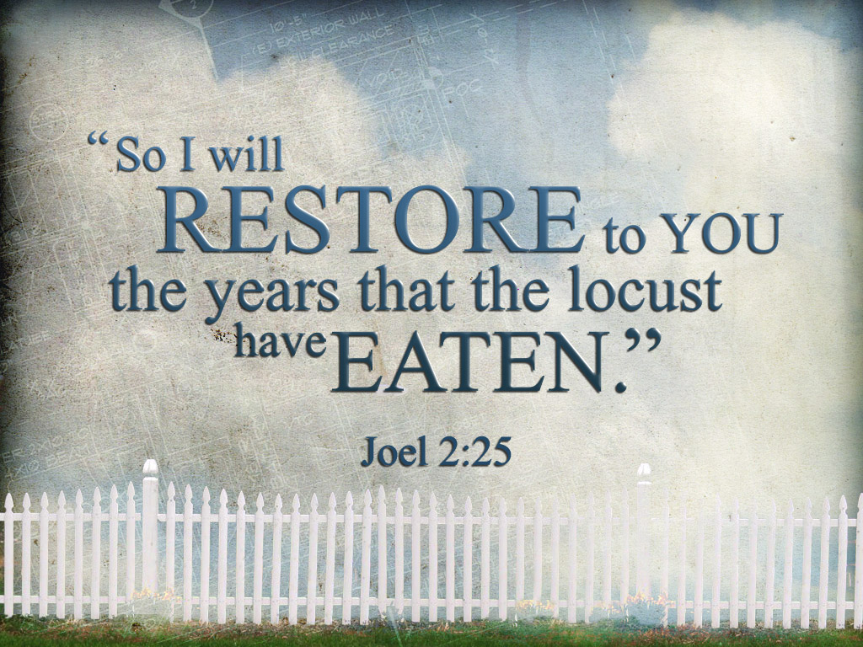
I will restore what the locust has eaten

Slide 17

Healed to Heal Others

Slide 18
What is Church Discipline?
95-96
96
What it is…
What it is not…
Excommunication
Public Humiliation
"Holier Than Thou"
"Heresy Hunts"

Slide 19
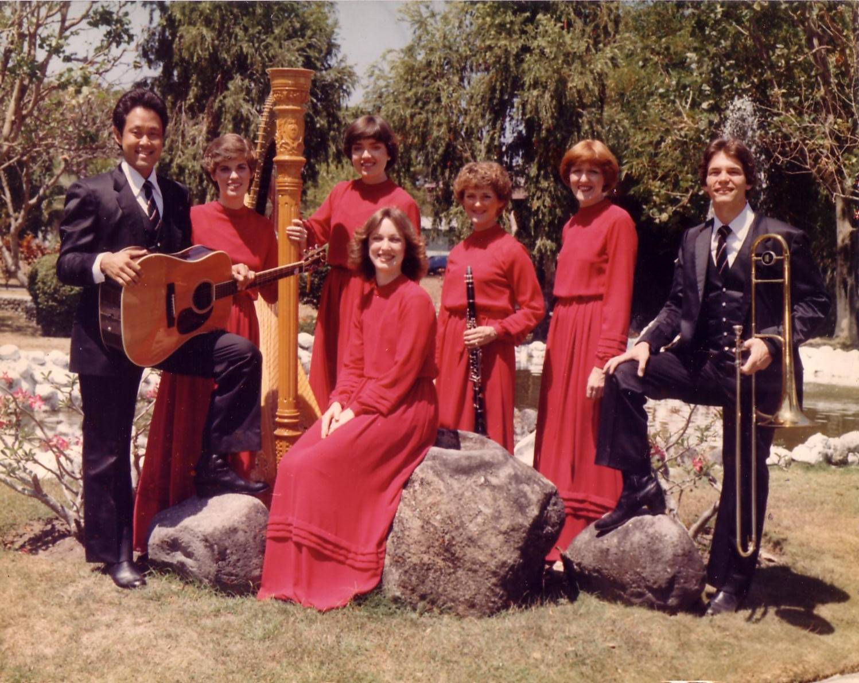
The Crossroads (1981-83)
Notes:
After college it seemed the natural thing to do to join Campus Crusade staff in the Philippines on a seven-member music team.

Slide 20
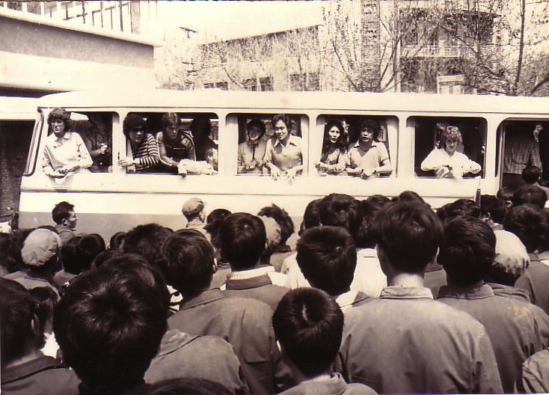
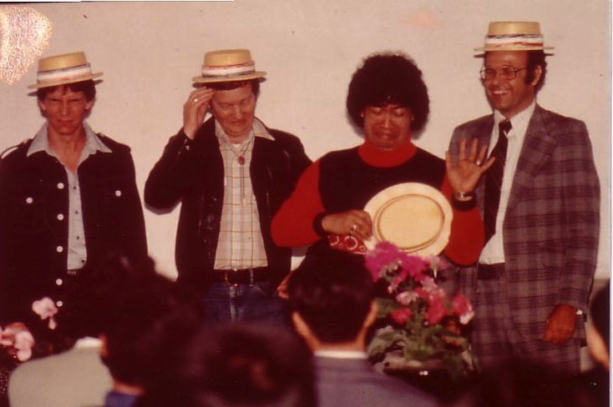
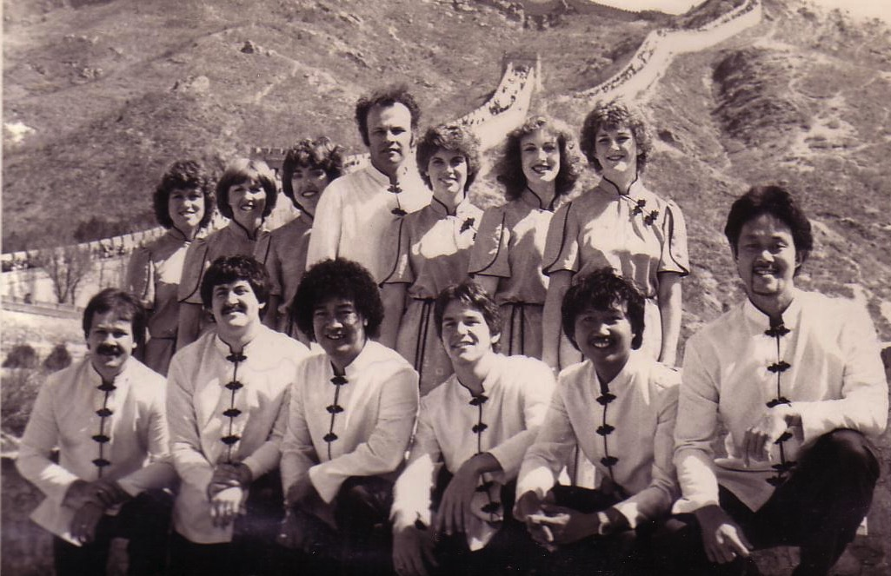
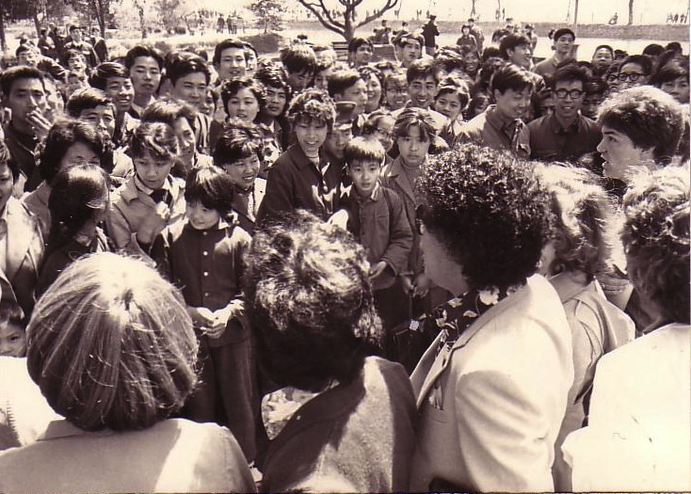
China, 1981
Notes:
Our first tour to China we were celebrities as the first Christian musical team to visit the New China. We sang in music conservatories, parks, and even from the bus! God began to open my eyes to the needs of East Asia…

Slide 21
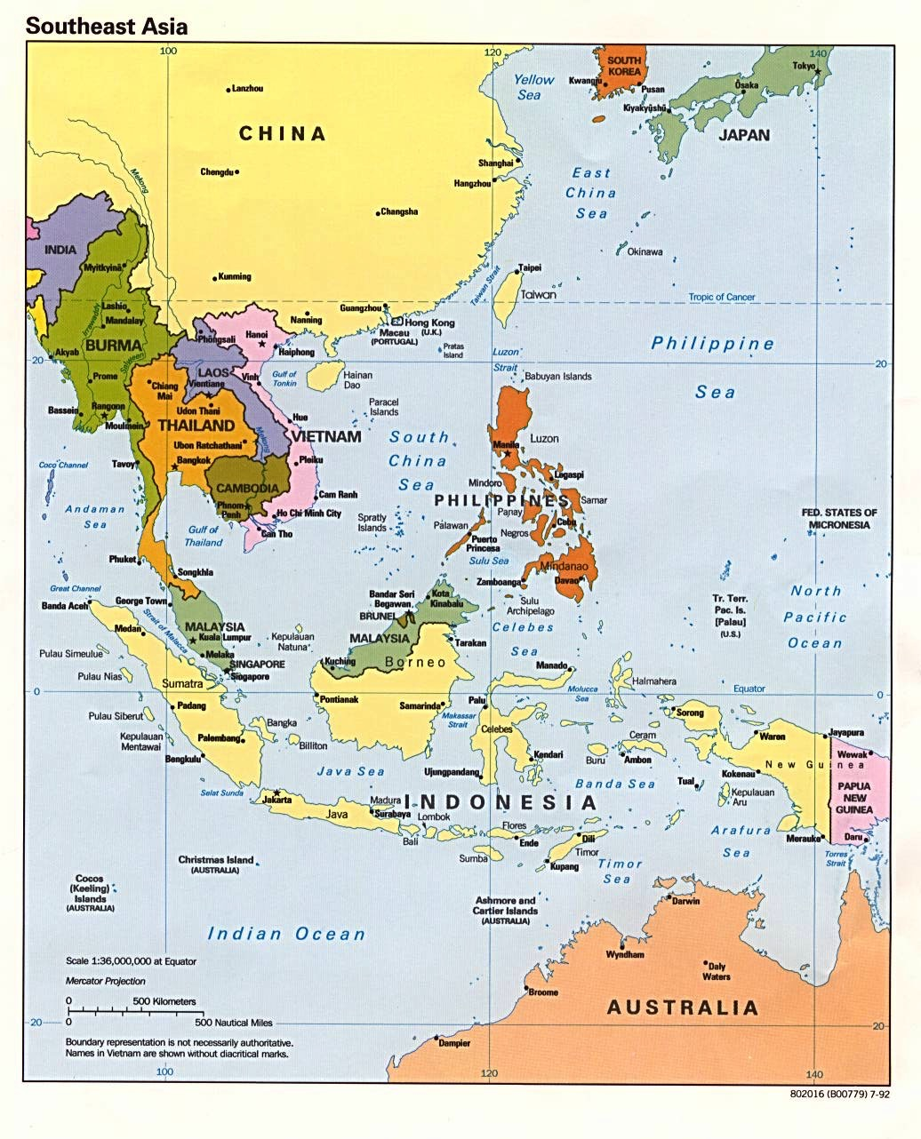
Crossroads Ministry
Korea
China
Japan
Hong Kong
Taiwan
Macau
Thailand
Philippines
Malaysia
Singapore
Indonesia
Notes:
The Crossroads team shared the gospel in 11 Asian nations and saw over 10,000 people indicate decisions to trust Christ! Again I was amazed at God's grace!

Slide 22

Relational Pillars
Relational Pillars
for all of your ministry relationships

Slide 23

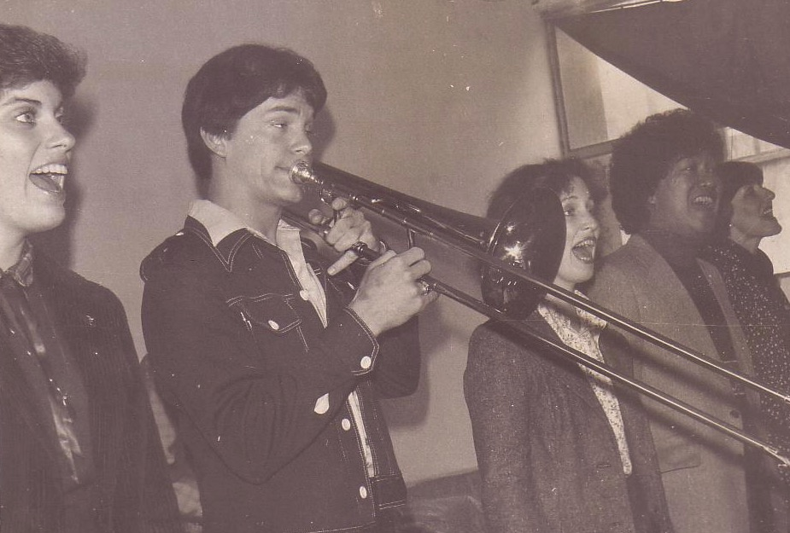
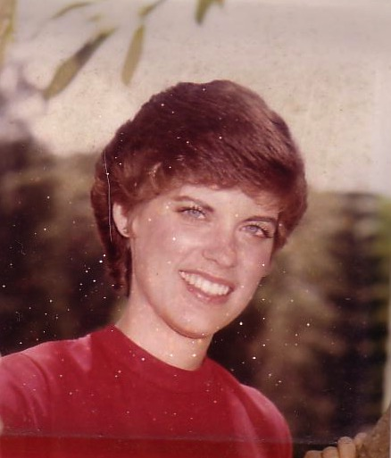
Romance, 1982
Notes:
God also began to open my eyes to the woman singing next to me! She initially despised me but after a year or so she saw the light. That's our engagement picture. In 1983 we returned to the USA..

Slide 24
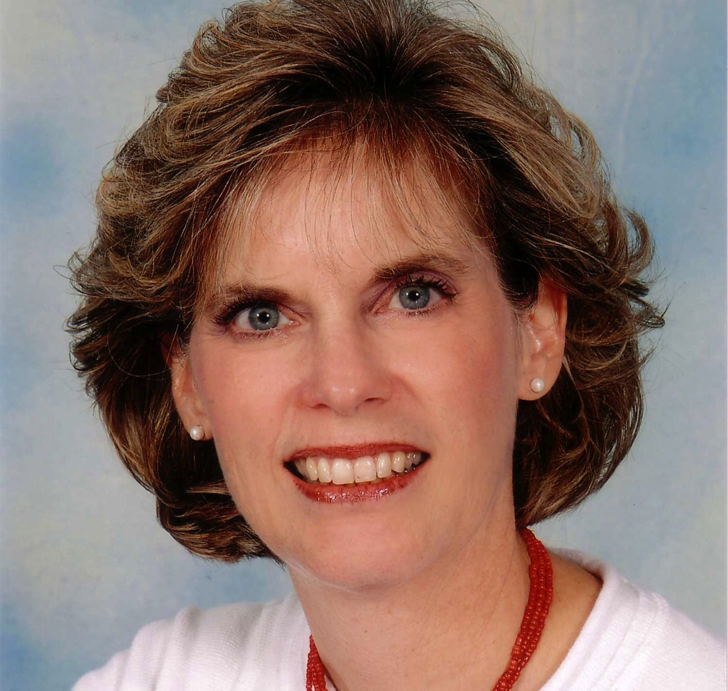
Susan Kay Griffith

Slide 25

Matthew's Relational Pillars
Matthew's Relational Pillars
5:23-24
You are:
Offender
Issue:
General
Notes:
Have you ever had a problem with another believer? (If you say "no," then I wonder which planet you have been living on!) Are you in fellowship with every Christian that you know now—your family members, your work colleagues, your neighbors and friends? If you're not in harmony, what should you do?

Slide 26


Matthew 5:23-24

Slide 27
Matthew 5:23-24
?
"Therefore if you are presenting your offering at the altar, and there remember that your brother has something against you, leave your offering there before the altar and go; first be reconciled to your brother, and then come and present your offering."

Slide 28
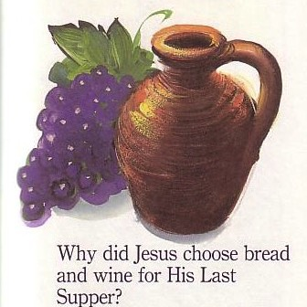
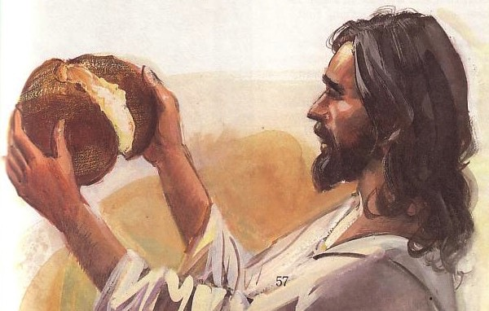
The Lord's Supper

Slide 29
The Four Directions
(Adapted from David Watson, I Believe in the Holy Spirit)
Look | Passover (Jewish) | Lord's Supper (Christian)
Outward | Whole family involved (Exod. 12:3-4, 16) | Fellowship and unity (1 Cor. 11:17-22; 10:16-17)
Back | Deliverance from Egypt (Exod. 12:31-42) | Deliverance from sin (1 Cor. 11:23-25)
Forward | Wait for messianic age (Ezek. 45:21) | Anticipate return of Christ (1 Cor. 11:26; Mark 14:25)
Inward | Purify house of leaven or evil (Exod. 12:8, 15) | Examine sin in yourself (1 Cor. 11:27-32; cf. 5:6-8)

Slide 30
Matthew's Relational Pillars
Matthew's Relational Pillars
5:23-24
18:15-17
You are:
Offender
Offended
Issue:
General
Sin

Slide 31

B. Reasons Churches Fail to Discipline
96
Ignorance
Doubt
Failure
Fear
Excuses
Impurity
Unsocial
Leaders divided

Slide 32
What's Your Personal Experience?
Share when you have seen church discipline succeed to restore a person. What was done right?
Or share a story when the process was done poorly and the person wasn't restored. What did you learn from it?

Slide 33
Results of Failing to Discipline
96
Lack of Purity
Lack of Power
Lack of Progress
Lack of Unity

Slide 34
Issues to Discuss
97
What is church discipline?
Why don't we often do it?
What results when we fail to do it?
How do we discipline believers?

Slide 35


How to Restore Relationships
Matthew 18:15-20
10 December 2006
6 March 2011

Slide 36
Matthew 18:15-20
If your brother sins against you, go and show him his fault, just between the two of you. If he listens to you, you have won your brother over. ¹⁶But if he will not listen, take one or two others along, so that 'every matter may be established by the testimony of two or three witnesses.' ¹⁷If he refuses to listen to them, tell it to the church; and if he refuses to listen even to the church, treat him as you would a pagan or a tax collector.
¹⁸I tell you the truth, whatever you bind on earth will be bound in heaven, and whatever you loose on earth will be loosed in heaven. ¹⁹Again, I tell you that if two of you on earth agree about anything you ask for, it will be done for you by my Father in heaven. ²⁰For where two or three come together in my name, there am I with them.
How to Restore
15-17
Why to Restore
18-20
Notes:
two main teachings on restoring Christians in sin

Slide 37



How do we restore sinning Christians properly?
Our First Question Today (for vv. 15-17)
Notes:
Fill in your bulletin outline

Slide 38


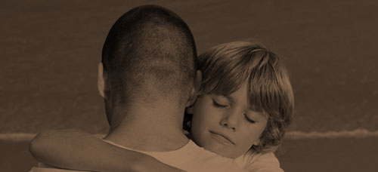
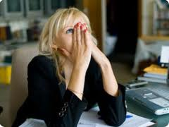
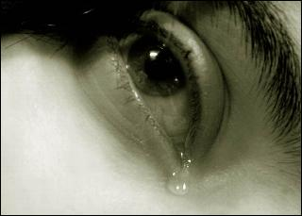
Other Relationships
Notes:
What to do with Christmas?

Slide 39
Matthew 18
The Value of
One
1
1
Child (1-9)
1
Sheep
(10-14)
1
Sinner
(15-20)
1
Debtor
(21-35)
Notes:
Context: The value of one child (1-9), one sheep (10-14), one sinner (15-20), one debtor (21-35).
15-20 at the heart (advance slide to read)

Slide 40
God's 4-step restoring process…
4
3
2
1
…reveals the issue to more people each step

Slide 41

The Point of Verses 15-17
I. God's way to restore believers in sin is to keep the matter as private as possible (15-17).

Slide 42

Step 1 to Restoration
Talk to the person by yourself
M
M
M
M
M
M
M
M
M
M
M
M
M
M
M
M
S
M
M
M
M
M
M
M
M
M
M
M
S = Sinner
M = Member

Slide 43
Matthew's Relational Pillars
Matthew's Relational Pillars
5:23-24
18:15-17
You are:
Offender
Offended
Issue:
General
Sin

Slide 44
Matthew's Relational Pillars
Matthew's Relational Pillars
5:23-24
18:15-17
You are:
Offender
Offended
Issue:
General
Sin
Initiative:
You!
You!

Slide 45
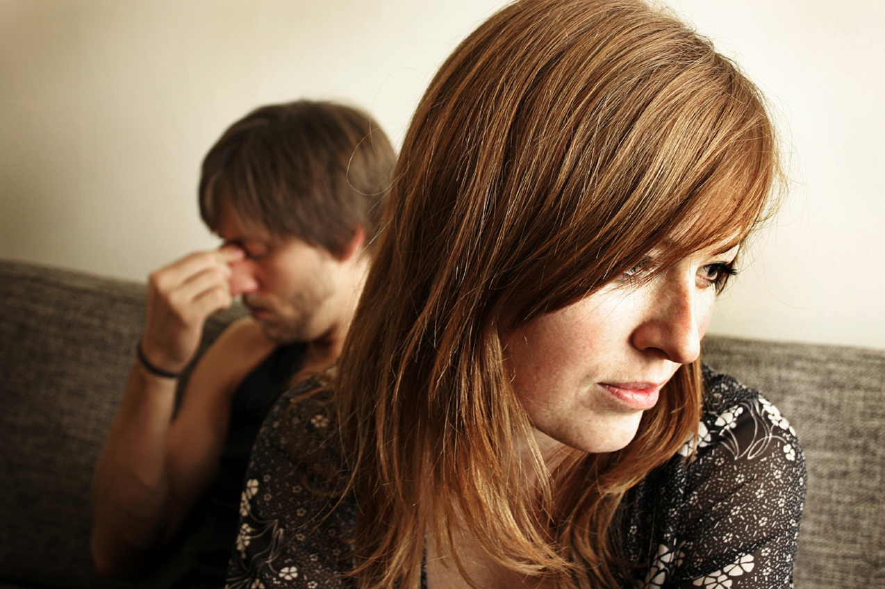
Go in Person

Slide 46
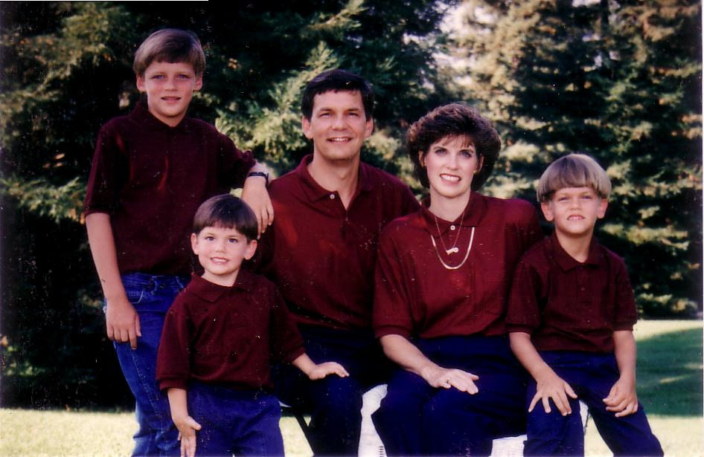
1996
Notes:
We have lived briefly in the USA the past 12 years.

Slide 47
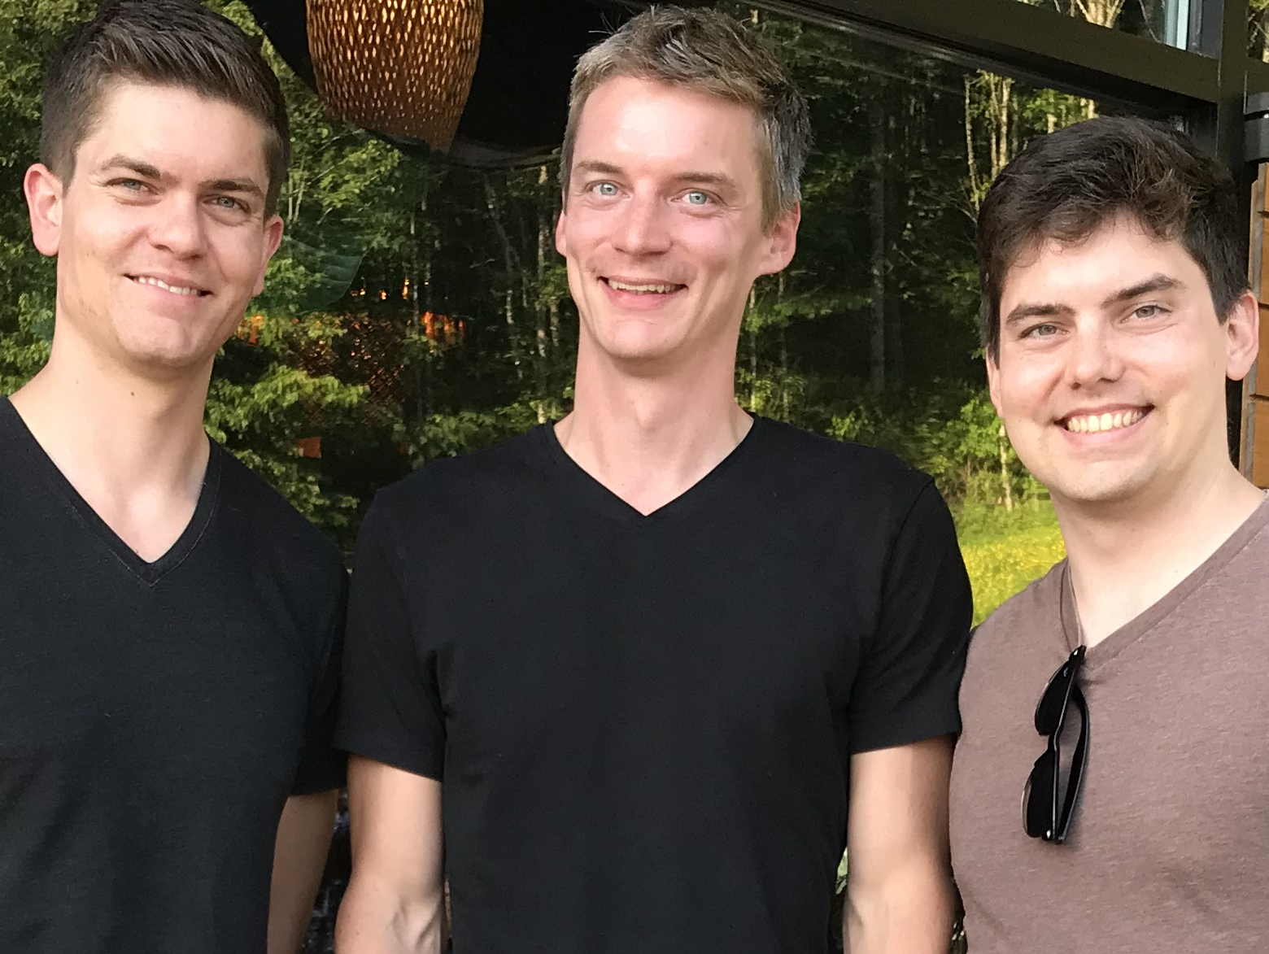
Brothers…

Slide 48
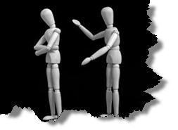
Why don't we confront others?
Ignorance
Doubt
Failure
Fear
Excuses
Impurity
Unsocial

Slide 49
Step 1 to Restoration
Talk to the person by yourself
M
M
M
M
M
M
M
M
M
M
M
M
M
M
M
M
S
M
M
M
M
M
M
M
M
M
M
M
S = Sinner
M = Member

Slide 50
Step 2 to Restoration
Take 1-2 others along
M
M
M
M
M
M
M
M
M
M
M
M
M
M
M
M
S
M
M
M
M
M
M
M
M
M
M
M
S = Sinner
M = Member

Slide 51

Questions on Step 2
Who should these people be?
Why take 1-2 others?

Slide 52
Deut. 19:15
`rb")D" ~Wqïy" ~ydIÞ[e-hv'(l{v. yPiî-l[;
Aa± ~ydIª[e ynEåv. ŸyPiä-l[; aj'_x/y<¥ rv<åa] aj.xeÞ-lk'B. taJ'êx;-lk'l.W '!wO['-lk'l. vyaiªB. dx'øa, d[e' •~Wqy"-al{)

Slide 53
Deut. 19:15
One witness is not enough to convict a man accused of any crime or offense he may have committed. A matter must be established by the testimony of two or three witnesses.

Slide 54
Step 3 to Restoration
Expose the sin to the entire church
M
M
M
M
M
M
M
M
M
M
M
M
M
M
M
M
S
M
M
M
M
M
M
M
M
M
M
M
S = Sinner
M = Member

Slide 55
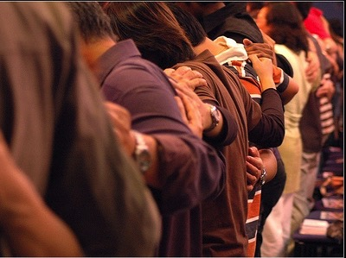
Why tell the whole church?

Slide 56
Step 4 to Restoration
Treat the person like an unbeliever
M
M
M
M
M
M
M
M
M
M
M
M
M
M
M
M
S
M
M
M
M
M
M
M
M
M
M
M
S = Sinner
M = Member
S

Slide 57

Sins Worthy of Discipline
How NOT to Discipline
EXCOMMUNICATE !

Slide 58
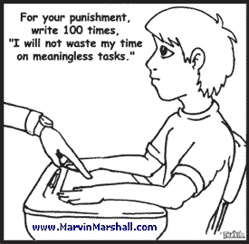
But how should we discipline?
For your punishment, write 100 times, "I will not waste my time on meaningless tasks."

Slide 59

Sins Worthy of Discipline
How to Discipline Him/Her
Don't refer to him/her as a Christian.
Evangelize this person.
Don't let him/her take the Lord's Supper.
Remove the person from membership.
Remove this person from church roles.
Unbeliever
"Deliver over to Satan" one in sex sin
(1 Cor. 5:5).
Don't eat with him/her (1 Cor. 5:11).
Prohibit him/her from attending church?
Worse

Slide 60
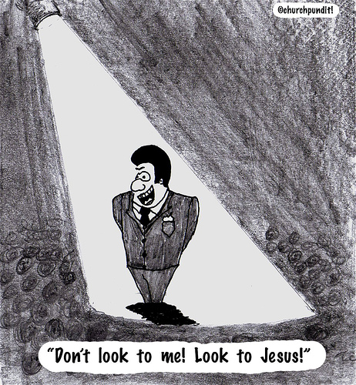
Association with immoral people depends on whether or not they are Christians
(1 Cor 5:9-13).
98

Slide 61
A. We can associate with an immoral unbeliever (1 Cor. 5:9-10).
98
but...
B. We can't associate with an immoral Christian (1 Cor. 5:11).

Slide 62
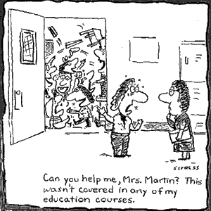
Discipline is needed in many arenas
Can you help me, Mrs. Martin? This wasn't covered in any of my education courses.

Slide 63
Issues to Discuss
98
What is church discipline?
Why don't we often do it?
What results when we fail to do it?
How do we discipline believers?
Why is discipline important?

Slide 64
Reasons for Discipline
98-99
The Church Extends God's Authority (Matt. 18:18-20)
It Benefits the Offender
It Benefits the Church Body
It Benefits the Individual Believers Not Living in Sin
It Benefits the Authority Structures of the Body
Points 2-5 adapted from Ted Kitchens, Aftershock: What to Do When Leaders
(and Others) Fail You (Portland, Oregon: Multnomah, 1992)

Slide 65

Matthew 18:18-20 answers this question:
Why do we restore sinning Christians properly?
98

Slide 66

The Point of Verses 18-20
99
The local church acts as an extension of the authority of God Himself!

Slide 67
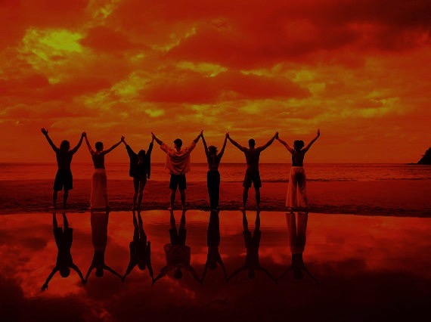
Why discipline?
When we seek to restore someone…
99
We act in the place
of the Father
(18-19)

Slide 68
A Better Translation…
NAU is a Better Translation…
99
NIV "I tell you the truth, whatever you bind on earth
will be {or have been} bound in heaven, and whatever you loose on earth will be {or have been} loosed in heaven."
NAU "Truly I say to you, whatever you bind on earth shall have been bound in heaven; and whatever you loose on earth shall have been loosed in heaven."

Slide 69

Matthew 18:19
99
"Again, I tell you that if two of you on earth agree about anything you ask for, it will be done for you by my Father in heaven" (NIV).

Slide 70
Psalm 82:1, 6
(to Israel's rulers/gods)
"I said, 'You are "gods"; you are all sons of the Most High… but you will die like men…"

Slide 71
Why discipline?
When we seek to restore someone…
99
We act in the place
of the Father
(18-19)
We act in the presence & authority of Christ
(20)

Slide 72
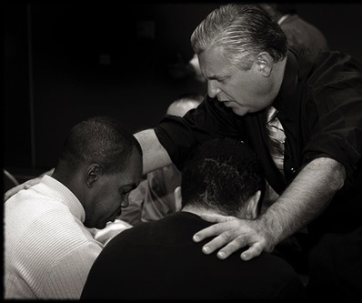
Matthew 18:20
99
"For where
two or three come together in my name, there I am with them" (NIV).

Slide 73
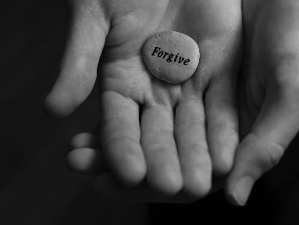
Main Idea:
99
We must restore sinning members properly since we act on God's behalf

Slide 74
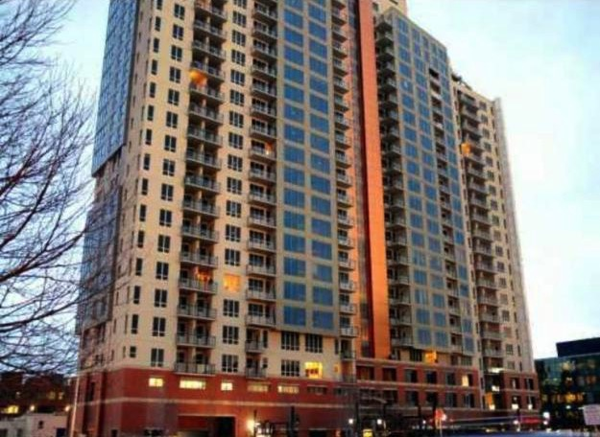
2. Discipline benefits the offender
(1 Cor. 5:3-8)
99
"By wisdom a house is built and through understanding it is established"
(Prov. 24:3)

Slide 75
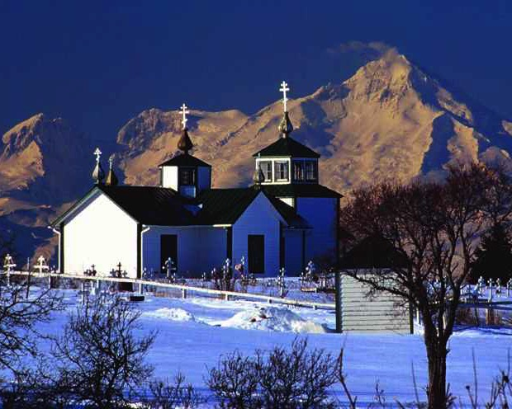
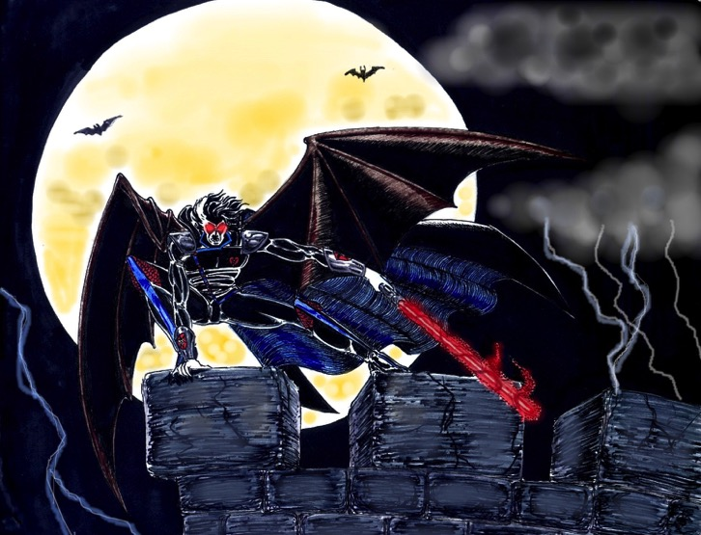
c) Discipline hands a believer over to Satan's dominion to end his hypocrisy
(3-5)
99
"…deliver over to Satan"

Slide 76
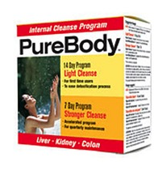
a) Discipline maintains the purity of the body
(1 Cor. 5:6-8)
99

Slide 77
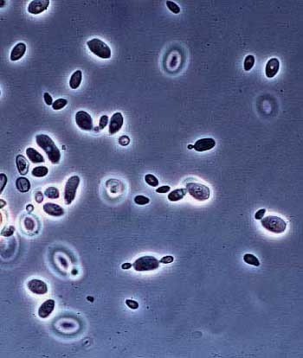
Yeast

Slide 78
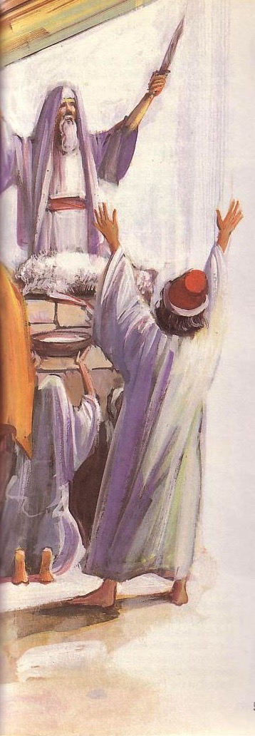
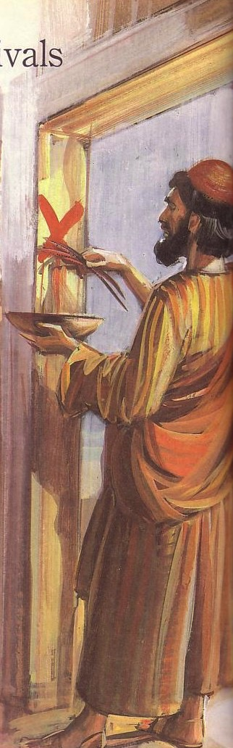
Passover's Past Significance
(Exodus 12)

Slide 79
Passover
Feasts
Leviticus 23
1 Nisan
2 Iyar
3 Sivan
4 Tammuz
5 Av
6 Ellul
7 Tishri
8 Cheshvan
9 Kislev
10 Tevet
11 Shevat
12 Adar
Recalls Exodus
Christ our redeemer
Notes:
#82 in original file

Slide 80

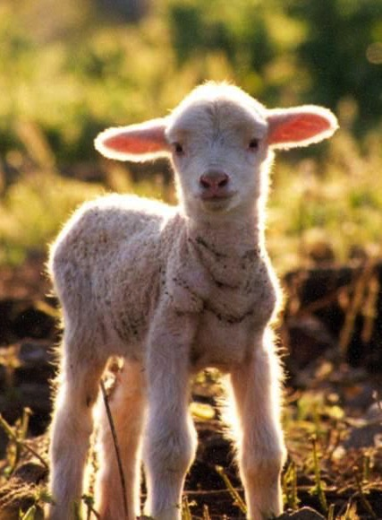
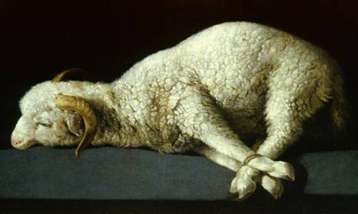
The Passover Lamb

Slide 81
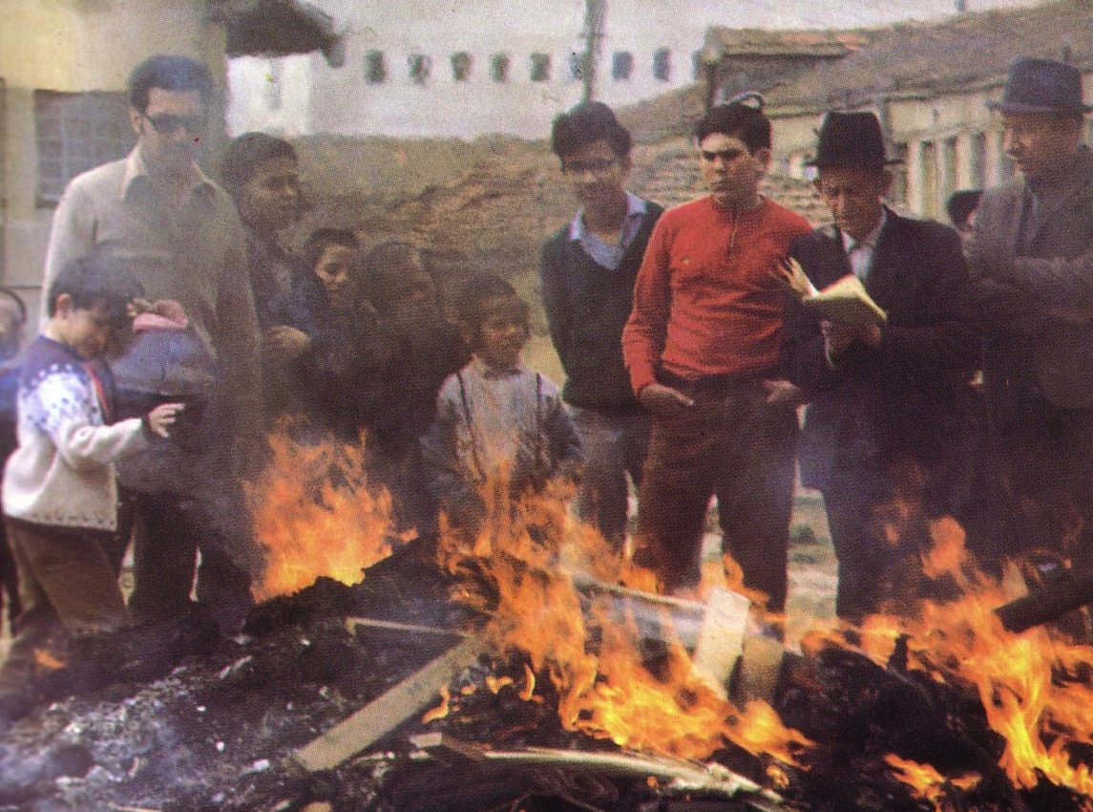
"Burn All the Yeast!"

Slide 82




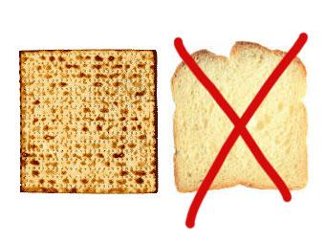
Feast of Unleavened Bread
99
Notes:
www.stephenwilliamson.com/ Hobbies/bakin.htm (Yeast bloom)

Slide 83
Issues to Discuss
99
What is church discipline?
Why don't we often do it?
What results when we fail to do it?
How do we discipline believers?
Why is discipline important?
What sins are worthy of discipline?

Slide 84

What sins are "bad enough" for church discipline?
1 Cor 5:11
Sexually immoral
Greedy
Idolaters
Slanderers
Drunkards
Swindlers
Other Texts:
Divisive (Tit. 3:10)
Lazy (2 Thess. 3:6)

Slide 85

Sins Worthy of Discipline
99-100
Private offenses that violate Christian love
Divisions that hinder Christian unity
Moral deviations that break Christian law
Teaching doctrines that reject essential Christian truth
Adapted from Ted Kitchens, "Perimeters of Corrective Church Discipline,"
BibSac 148 (April-June 1991): 211-212

Slide 86
How do we maintain purity in the church?

Slide 87
Living in a "toss away age"
Cartons
Carpets
Cars
Creatures made in God's image?

Slide 88
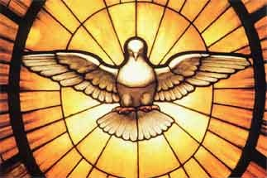
The Focus of 1 Corinthians 5
Guard church purity by expelling unrepentant believers
Guard church by expelling unrepentant believers

Slide 89
Matthew's Relational Pillars
Matthew's Relational Pillars
5:23-24
18:15-17
You are:
Offender
Offended
Issue:
General
Sin
Initiative:
You!
You!

Slide 90
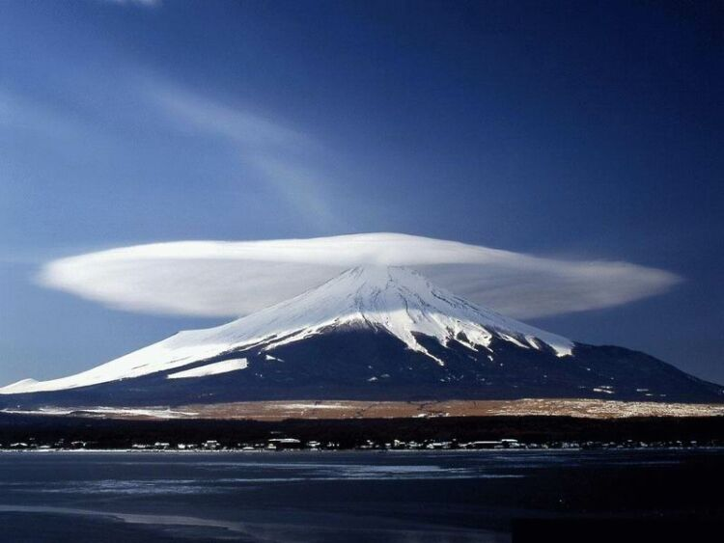
The Overall Principle
"If possible, as far as it depends on you, be at peace with all men"
Romans 12:18

Slide 91
Matthew's Relational Pillars
Matthew's Relational Pillars
5:23-24
18:15-17
The Overall Principle: Romans 12:18
You are:
Offender
Offended
Issue:
General
Sin
Initiative:
You!
You!

Slide 92

Make us one 3/3
Make us one, Lord,
make us one,
Holy Spirit, make us one.
Let Your love flow
so the world will know
we are one in You.

Slide 93
Individualism
What examples of self-centeredness do you see in society today?
How do you think concern for self rather than others shows itself in the church?

Slide 94

JAMES 5:19-20
¹⁹My brothers, if one of you should wander from the truth and someone should bring him back, ²⁰remember this: Whoever turns a sinner from the error of his way will save him from death and cover over a multitude of sins.

Slide 95



Who are the wanderers?
plana,w lead astray, mislead, deceive; pass. stray away, go astray; be mistaken; be deceived or misled; wander about
This refers to Christians who reject the will of God by straying from the truth by their behavior in an active, not passive sense

Slide 96
The Wanderer is a Christian:
"My brothers, if one of you…"
One cannot "wander from the truth" if he has not first experienced it.

Slide 97

Divine Spankings
"'My son, do not make light of the Lord's discipline, and do not lose heart when he rebukes you, because the Lord disciplines those he loves, and he punishes everyone he accepts as a son.' Endure hardship as discipline; God is treating you as sons. For what son is not disciplined by his father? If you are not disciplined (and everyone undergoes discipline), then you are illegitimate children and not true sons" (Hebrews 12:5-8).

Slide 98

Abusing the Elements
NIV 1 Corinthians 11:30 [Gluttony at the Lord's Supper] "is why many among you are weak and sick, and a number of you have fallen asleep.

Slide 99

Some Sins Lead to Death
"If anyone sees his brother commit a sin that does not lead to death, he should pray and God will give him life. I refer to those whose sin does not lead to death. There is a sin that leads to death. I am not saying that he should pray about that" (1 John 5:16 NIV).

Slide 100
Making this Text Real to Me
Whom do I need to help restore?
How will I do it?

Slide 101
What's God Saying to You?
a. The Church Body
M
M
M
M
M
M
M
M
M
M
M
M
b. Your Own Life
M
M
M
M
S
M
M
M
M
M
M
M
M
c. Helping Others
M
M
M

Slide 102

I've Been Through a Fire
I've been through a fire
that has deepened my desire
to know the living God,
more and more.
It hasn't been much fun
but the work that it has done
in my life has made it worth the hurt

Slide 103

I've Been Through a Fire 2 of 3
You see, sometimes we need the hard times
to bring us to our knees.
Otherwise, we do as we please
and never heed Him.

Slide 104

I've Been Through a Fire 3 of 3
But He always knows what's best
and it's when we're in the test
that we really come to know God
as He is

Slide 105

How can you keep your church pure?
a. Start with your own life.
b. Support the leaders.
c. Care how others are really doing.

Slide 106

Tough Questions
101

Slide 107

1. What about non-members?
101

Slide 108

2. Should we still remove them publicly if they request their membership withdrawn?
101

Slide 109

3. Should we pursue disciplined members to another church?
101
"Do unto others what you would have others do to you"

Slide 110
Black

Slide 111


Church PPT link at BibleStudyDownloads.org
Get this presentation for free!
Notes:
Church (ch)

