Slide 1
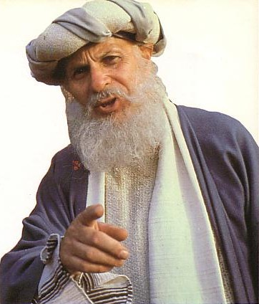
EFFECTIVE STAFF/BOARD RELATIONSHIPS
How to build healthy staff/board relationships
Designed by Dr. Scott Wooddell Uploaded by Dr. Rick Griffith • Jordan Evangelical Theological Seminary All files in many languages for free download at BibleStudyDownloads.org

Slide 2
EFFECTIVE STAFF/BOARD RELATIONSHIPS
1. Spend time in the Word every meeting
2. Spend time praying together every meeting
3. Spend time sharing with one another every meeting

Slide 3
EFFECTIVE STAFF/BOARD RELATIONSHIPS
4. Serve together as frequently as possible
5. Face hard things together

Slide 4
BUILD RELATIONSHIPS STRATIGICALLY
1. Understand your authority as the leader of the board
2. Keep your board focused on the important matters of the church
3. Know your board members well

Slide 5
BUILD RELATIONSHIPS STRATIGICALLY
4. Train your board member in vital skills
5. Develop new board members regularly
6. Evaluate board members on a consistent basis
7. Have retreats on a regular basis

Slide 6
PERSONAL RELATIONSHIPS WITH BOARD MEMBERS
1. Spend time with each individual board member
2. Make the personal and spiritual needs of your board members your top priority
3. Draw close to those who often oppose you
4. Be open and clear about your agenda

Slide 7
Black

Slide 8
Church Dynamics link at BibleStudyDownloads.org
Get this presentation for free!
Notes:
Church Dynamics (cd)

