Slide 1
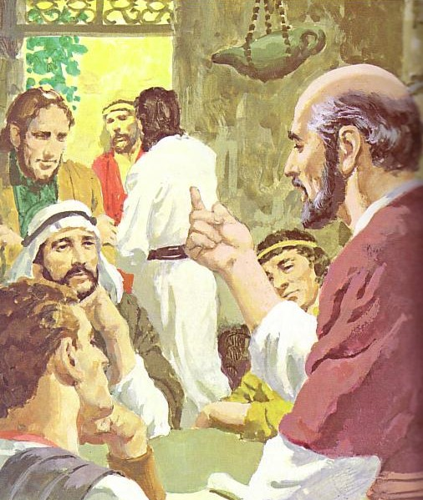
DEVELOPING LEADERS
Discipling
Christ-like
leaders
Designed by Dr. Scott Wooddell Uploaded by Dr. Rick Griffith • Jordan Evangelical Theological Seminary All files in many languages for free download at BibleStudyDownloads.org

Slide 2
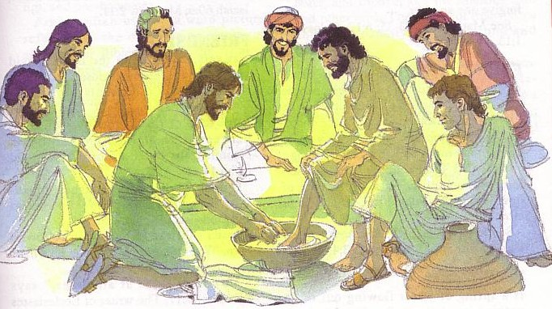
DEVELOP LEADERS WHO:
1. Think with the mind of Christ (Philippians 2:5-11)
2. Serve with the hands of Christ
(John 13:1-17)
3. Care with the heart of Christ (Matthew 11:28-30)

Slide 3
Black

Slide 4
Church Dynamics link at BibleStudyDownloads.org
Get this presentation for free!
Notes:
Church Dynamics (cd)

