Slide 1
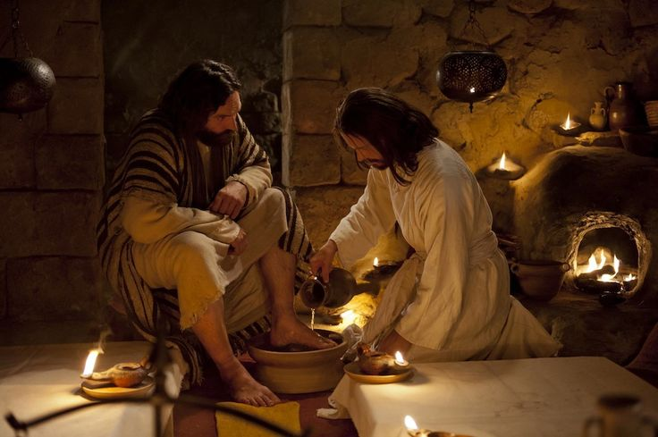
SERVANT LEADERSHIP
Designed by Dr. Scott Wooddell Uploaded by Dr. Rick Griffith • Jordan Evangelical Theological Seminary All files in many languages for free download at BibleStudyDownloads.org

Slide 2
SERVANT LEADERSHIP

Slide 3
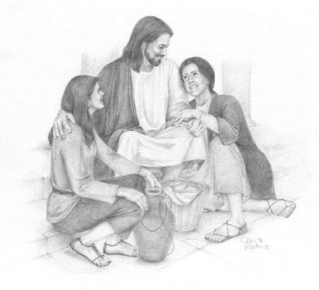
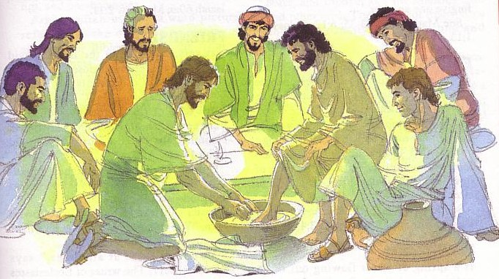
SERVANT LEADERSHIP
1. Servant Leaders Love (John 13:1-2)
They love everyone unconditionally.
They love everyone fully.

Slide 4
SERVANT LEADERSHIP
2. Servant Leaders Serve (John 13:3-5)
Their security comes from their relationship with
Christ.
Their security comes from believing in God’s
sovereignty.

Slide 5
SERVANT LEADERSHIP
3. Servant Leaders Confront (John 13:6-8)
They confront with love.
They confront with humility.

Slide 6
SERVANT LEADERSHIP
4. Servant Leaders Correct (John 13:9-11)
They correct with authority.
They correct with purpose.

Slide 7
SERVANT LEADERSHIP
5. Servant Leaders Model (John 13:12-17)
They know who they are in Christ.
They call on others to follow their lead.
They stand first in line to wash the feet of others.

Slide 8
SERVANT LEADERSHIP
6. Servant Leaders Know Their Followers (John 13:18-19)
7. Servant Leaders Accept Everyone as Christ Accepts us (John 13:20)

Slide 9
Black

Slide 10
Church Dynamics link at BibleStudyDownloads.org
Get this presentation for free!
Notes:
Church Dynamics (cd)

