Slide 1
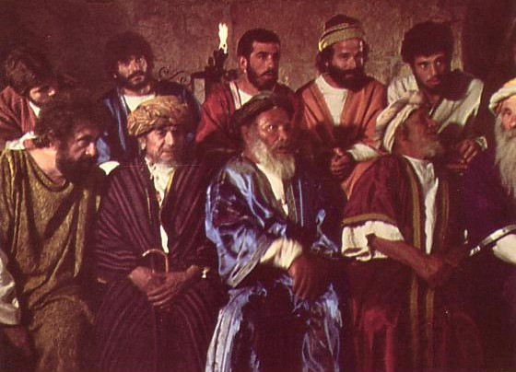
RESPONSIBILITIES OF CHURCH LEADERS
Designed by Dr. Scott Wooddell Uploaded by Dr. Rick Griffith • Jordan Evangelical Theological Seminary All files in many languages for free download at BibleStudyDownloads.org

Slide 2
RESPONSIBILITIES OF CHURCH LEADERS
Church leaders have many roles and responsibilities

Slide 3
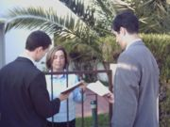
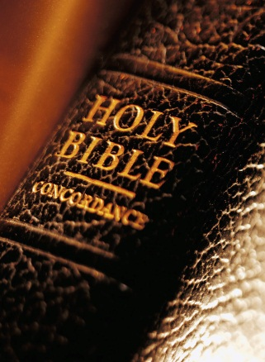
1. Vision
ELDERS LEAD THE CHURCH IN ACCOMPLISHING ITS PURPOSE (Matthew 28:19-20)
Elders lead the church in evangelizing the lost.
Elders lead the church in disciplining the saints.
“Make disciples of all nations”

Slide 4
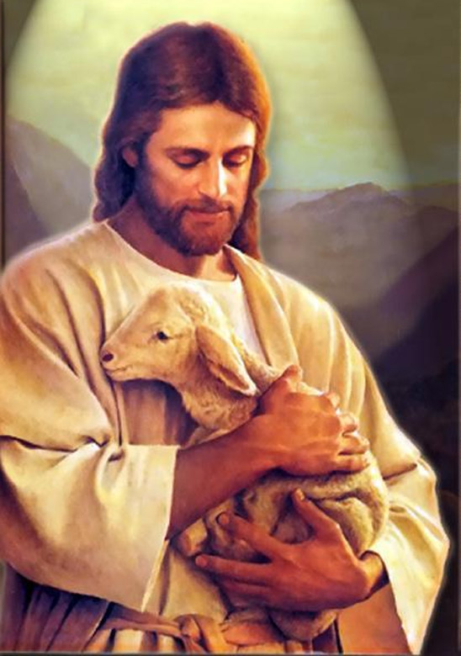
2. Provision
ELDERS LEAD THE CHURCH BY FEEDING CHRIST’S SHEEP (John 21:15-17)
Elders serve as teachers according to their gifts.
Elders serve as counselors according to their gifts.
Elders serve as disciplers according to their gifts.

Slide 5
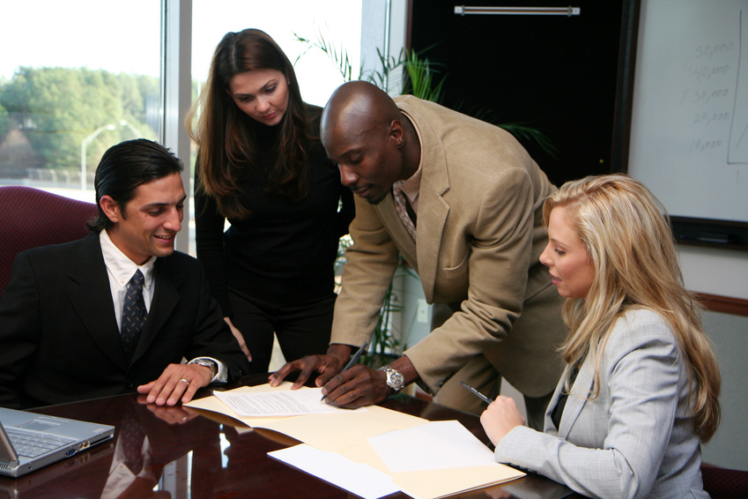
3. Administration
ELDERS LEAD THE CHURCH BY STRUCTURING TO MEET THE NEEDS OF THE PEOPLE (Acts 6:1-7)
1. Unmet need in the church means tension in the church.
2. When tensions are triggered in the church, leaders must lead so followers will follow.

Slide 6
4. Protection
ELDERS LEAD THE CHURCH BY GUARDING GOD’S FLOCK (Acts 20:28-31)
1. Elders must be aware of the dangers to God’s flock.
2. Elders must be able to defend against the dangers to God’s flock

Slide 7
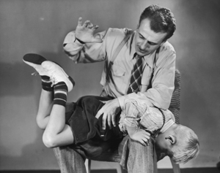
5. Purification
ELDERS LEAD THE CHURCH BY DISCIPLINING SINNING SAINTS (1 Corinthians 5:1-13)
1. The purity of the church is a top priority.
2. Elders must protect purity in a proper way.

Slide 8
6. Qualification
CHURCH LEADERS LEAD THE CHURCH BY MODELING GODLY CHARACTER (1 Timothy 3:1-7; Titus 1:5-9)
1. The primary responsibility of leadership is modeling.
2. Leaders who do not lead by modeling, don’t lead at all.
“Follow my example as I follow the example of Christ.”
The Apostle Paul
(1 Corinthians 11:1)

Slide 9
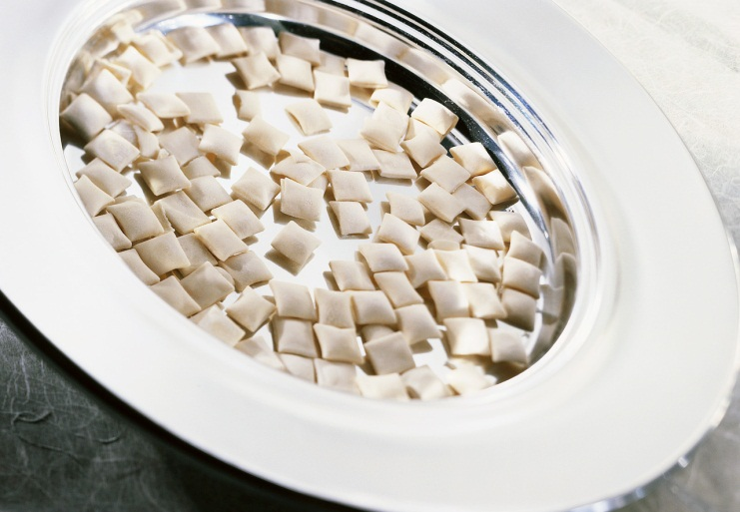
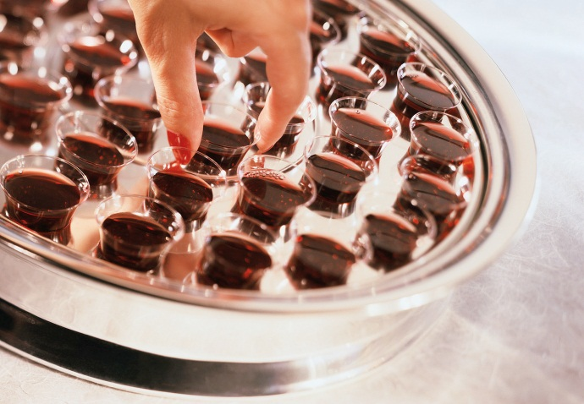
7. Compassion
ELDERS LEAD THE CHURCH BY CARING FOR THE FLOCK (James 5:14)
Elders lead the church by caring for the flock (James 5:14) Elders lovingly care for the spiritual and physical needs of the sheep

Slide 10
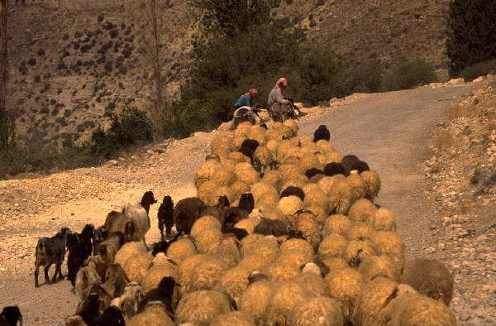
8. Motivation
ELDERS LEAD THE CHURCH BY SHEPHERDING GOD’S FLOCK (1 Peter 5:1-5)
1. Elders shepherd God’s flock through the exercise of oversight.
2. Elders who shepherd God’s flock will be rewarded.
3. Elders who shepherd God’s flock must be worthy of being followed.

Slide 11
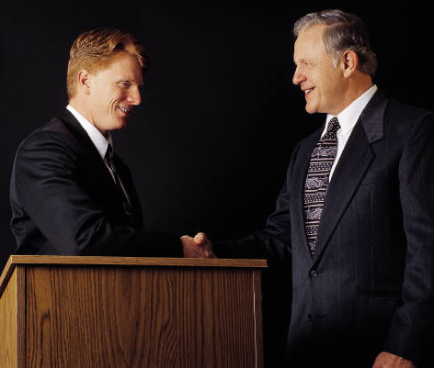
9. Resolution
ELDERS LEAD THE CHURCH BY RESOLVING DOCTRINAL AND PERSONAL CONFLICTS IN THE FLOCK (Acts 15:1-2; 6; 19-22)

Slide 12
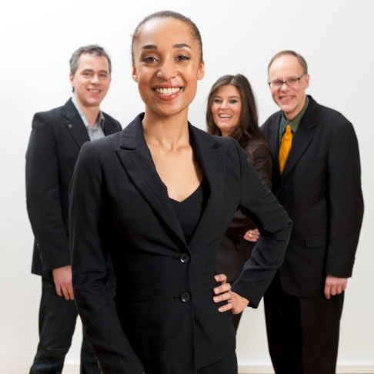
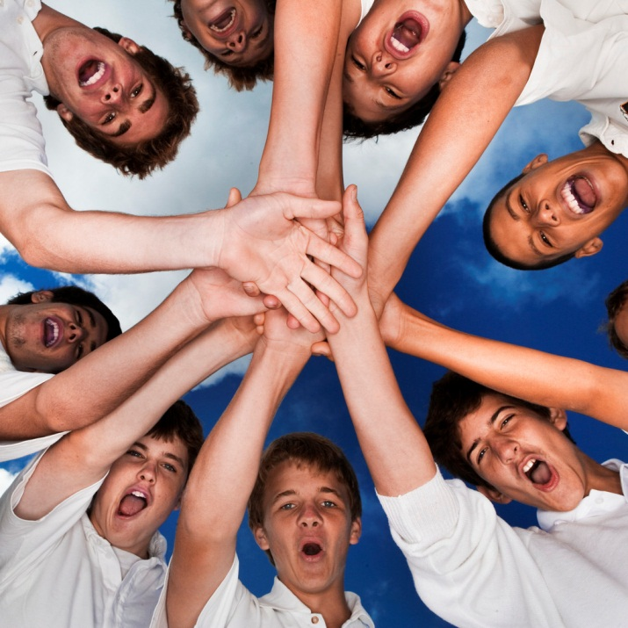
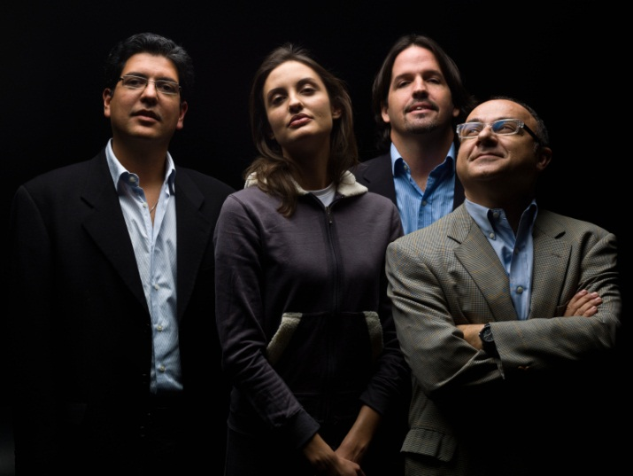
A HEALTHY CHURCH BOARD
They work together as a team
They display courage
They show trust and respect
They deal well with disagreements

Slide 13
Black

Slide 14
Church Dynamics link at BibleStudyDownloads.org
Get this presentation for free!
Notes:
Church Dynamics (cd)

