Slide 1
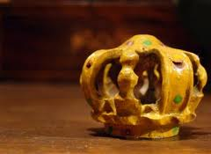
Typology in the Bible
45a
Dr. Rick Griffith • Jordan Evangelical Theological Seminary • BibleStudyDownloads.org

Slide 2
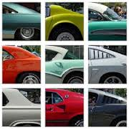
Defining Terms
45a
Type
Antitype
Example
Shadow
Figure

Slide 3
Types Requirements
45b
Natural correspondence/resemblance
Historical reality
Prefiguring or foreshadowing
"Fulfilled" (completed or heightened)
Divinely designed
Designated as such

Slide 4
Designated Types
45f
Melchizedek
Aaron
Passover
Tabernacle veil
Tabernacle
Tabernacle sacrifices
Sabbath

Slide 5
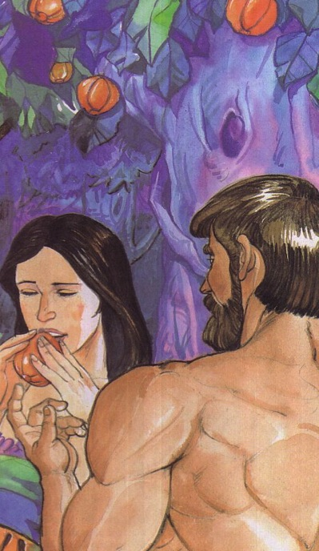
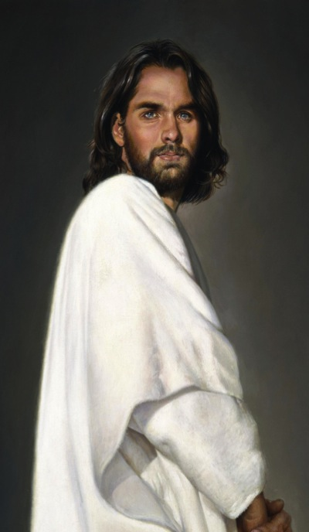
Adam versus Christ
Romans 5:12-21
1 Cor. 15:22
1 Cor. 15:45-49

Slide 6
Song of Solomon
A Prime Example of Typology Abuse
Walk Thru the Bible

Slide 7
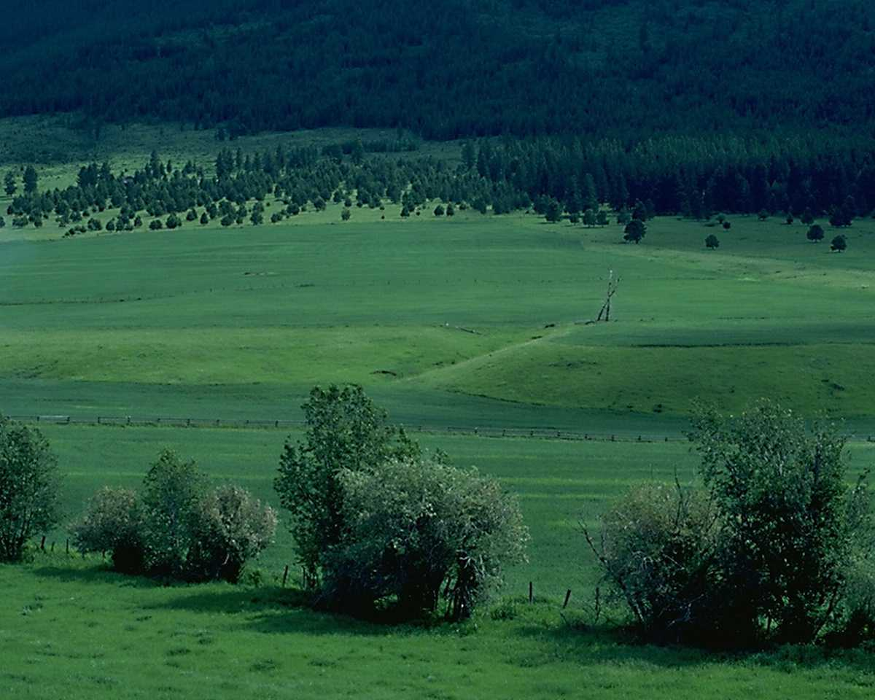
Overview
425
Dialogue of Marital Love
Courtship to Wedding
Growth in Marriage
1:1–5:1
5:2–8:14
Beginning of Love
Broadening of Love
Selfish Love
"My lover is mine and I am his" (2:16a)
Selfless Love
"I am my lover's and he is mine" (6:3a)
Single
Married
Puppy Love
Love Untested
Love Tried and True
Love Recalled
Courtship 1:1–3:5
Wedding
3:6–5:1
Growth
5:2–8:4
Flashback
8:5-14
Longing
1:1-11
Intensification
1:12–3:5
Procession
3:6-11
Consummation
4:1–5:1
Struggles
5:2–6:13
Praise & Response
7:1–8:4
Love's Strength
8:5-7
Love's Virginity
8:8-14
Both at the vineyard
Honeymoon
begins
Honeymoon ends
Both at the vineyard
Break up
5:2-16
Make up
6:1-13
ca. 1 Year

Slide 8
Keys
Love
425
Key Word
Key Verse
"I belong to my lover, and his desire is for me" (Song of Songs 7:10)

Slide 9
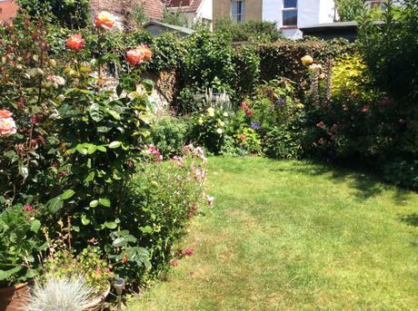
? R(A)
"Awake, north wind, and come, south wind!
Blow on my garden, that its fragrance may spread abroad. Let my lover come into his garden and taste its choice fruits" (4:16).

Slide 10
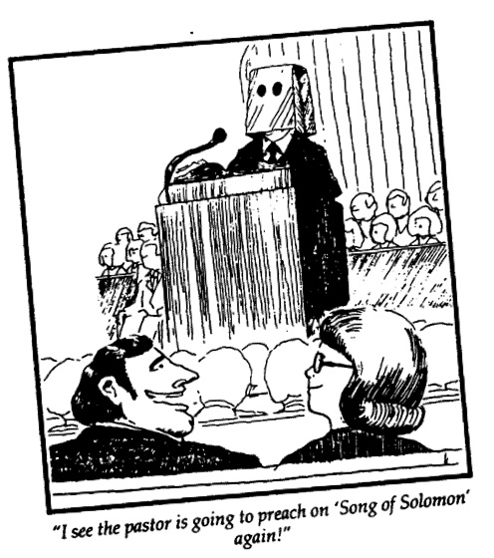
Are you embarrassed?
428
"I see pastor is going to preach on 'Song of Solomon' again!"

Slide 11
We are sexual creatures!
Just Here to Meet Women
"Pastor, I want you to know, this small group study on honestly has had a huge impact on my life."

Slide 12
Characteristics
428
This book has been the most variously interpreted book in all the Bible. In fact, it was the most studied biblical book of the middle ages! The following summarizes in general the various hermeneutical approaches, which also touch on the issues of literary genre and unity:
1. Allegorical Views see no historical situation (human love) & relate the book only to divine love. Yet all allegories are speculative, not textually based, & have led to many excesses.
The allegorical view became so popular in the Middle Ages that more commentaries were written on the Song than on any other book.

Slide 13
Characteristics
429
This book has been the most variously interpreted book in all the Bible. In fact, it was the most studied biblical book of the middle ages! The following summarizes in general the various hermeneutical approaches, which also touch on the issues of literary genre and unity:
2. Typological Views see a historical situation (human love) as a type of divine love. These include viewing the Song as typifying the relationship between God & Israel or the Church, between Christ & the Church, or between Christ & the individual.
In response it can be said that they also are speculative as they lack support from the book itself & from the New Testament.

Slide 14
Characteristics
429
This book has been the most variously interpreted book in all the Bible. In fact, it was the most studied biblical book of the middle ages! The following summarizes in general the various hermeneutical approaches, which also touch on the issues of literary genre and unity:
3. Literal Views see a historical situation of human love without an underlying meaning.
a. The rustic wedding song theory.
b. The anthological theory.
c. The funeral love feast theory.
d. The dramatic theory.
e. The normal marital love theory.
f. The marriage sex theory.
The natural sense of the Song depicts a dialogue of marital love designed to encourage the praise of one's spouse as unique & special. This is supported by the fact that the entire book is a conversation & the flow traces the development of marital love.

Slide 15
Characteristics
430
G. Why so many interpretations of this book?
Lack of structure
Difficulty in determining the number of characters and who is speaking
Embarrassment of the interpreter who attempts to take this as referring to sexual love
Symbolic language is not always easy to interpret

Slide 16
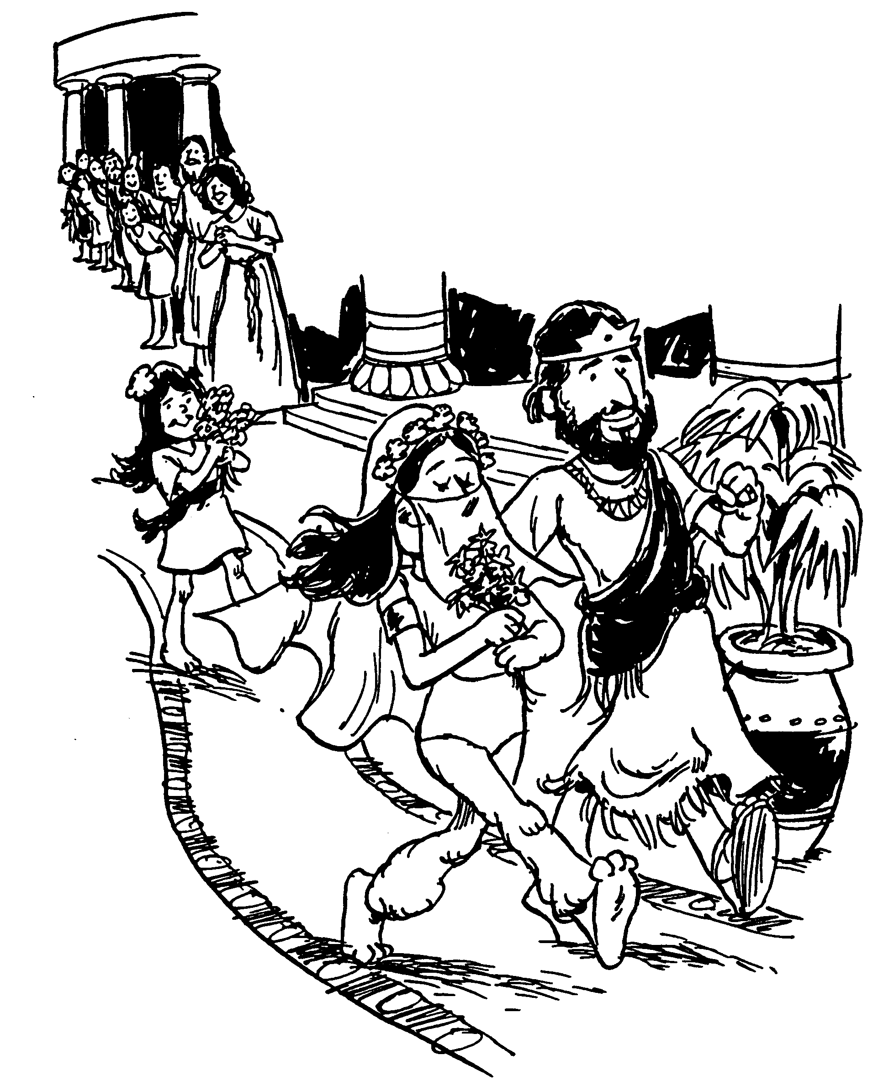
Solomon's Song of Songs
Dialogue of Marital Love

Slide 17
So What?
425
Exercise premarital sexual restraint so that marriage can be enjoyed to its fullest (i.e., allow love to blossom in its own time–2:7b; 3:5b; 8:4b).
Expect a good marriage to take work, then work at it.
Compliment both the physical and non-physical virtues of your spouse.

Slide 18
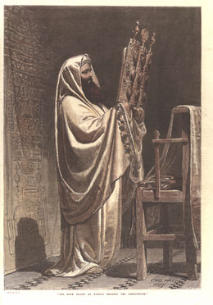
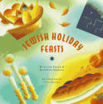
Bible Feasts
45g
Holy Day Celebrations in the Old Testament

Slide 19
Eschatology of Israel's Feasts (Lev. 23)
184
Date
Length
Feast
Significance (Past)
Typology (Future)
* Feasts celebrated in the Millennium (Isa. 66:23; Ezek. 45:21; 46:1; Zech. 14:16-19; Luke 22:16)
† Feasts celebrated in three annual Jerusalem pilgrimages by all male Israelites (Exod. 23:14-17)
Weekly
1 day
Sabbath*
(Shabbat)
Reminder of:
• Creation rest of God
• Deliverance from Egypt
Sign of Mosaic Covenant
(Exod. 20, 31; Deut 5)
Millennial rest
(Heb. 4:1-11)
1-14
(Nisan)
1 day
(Read Song
of Songs)
Passover*†
(Pesach)
Redemption from Egypt by blood of the sacrificial lamb (Exod. 12)
Redemption from sin by Christ's death as Lamb
(1 Cor. 5:7b)
1-15
to 1-21
(Nisan)
7 days
Unleavened
Bread*†
Separation/break from dependence upon Egypt to dependence upon God
Separated life of the redeemed for God
(1 Cor. 5:7a, 8)
1-16 (Day after Harvest Sabbath)
1 day
Firstfruits
(barley sheaf ceremony)
Anticipation of God's future material provisions
-begins grain harvest
Resurrection of Christ
(1 Cor. 15:20)
3-6
(Sivan)
1 day
(Read Ruth)
Pentecost†
(Shavuoth)
(Weeks)
(Harvest)
Thanksgiving for God's past material provisions - ends grain harvest (Deut. 16:9-12)
Coming of the Holy Spirit to complete Christ's resurrection (Acts 2)
Notes:
Each annual "appointed time" (Heb.) had both commemorative (historical) and anticipatory (eschatological) meaning. In other words, the seven celebrations each year not only look at God's past work, but they look forward to God's prophetic future for the nation. It fits that Jesus would die on the very day of Passover that looks back at Israel's redemption from Egypt and looks forward to Israel's redemption realized when the nation trusts in their Messiah and are saved (Rom 11:26-27). In fact, each typological element looks to Jesus. Every year when Jews follow the seven feasts, they prophetically instruct themselves in how they fit into Yahweh's plan for the ages! Sadly, most of them cannot see this. Pray that they will.
____________
Common-531
AP-03-Fulfilled Prphecies-21
BS-13-Types-19
ES-26-Restoration of Israel-5
NB-11-Religion-Feasts-7
OB-25-Feasts-17
OS-03-Leviticus-275
OS-05-Deuteronomy-221

Slide 20
Eschatology of Israel's Feasts (Lev. 23)
184
Date
Length
Feast
Significance (Past)
Typology (Future)
Spring-Summer
no feasts
—
Enjoyment of the harvest
Church Age
7-1
(Tishri)
1 day
Trumpets
(New Year)
(Rosh Hashanah)
Preparation for national redemption and cleansing on Day of Atonement
Rapture (1 Thess. 4:13f.) Revelation (Matt. 24:31)
—Kingdom preparation
7-10
(Tishri)
1 day
Day of Atonement (Yom Kippur)
National repentance and cleansing from sins of the people (Lev. 16)
National repentance of Israel in the Tribulation (Rom. 11:26-27)
7-15
to 7-21
(Tishri)
7 days
(Read
Eccles.)
Tabernacles*†
(Booths/Tents)
(Succot)
(the Lord)
(Ingathering)
Anticipated fulfillment of the Abrahamic Covenant (Neh. 8)
Actual fulfillment of the Abrahamic Covenant
—Kingdom (Matt. 17:4)
* Feasts celebrated in the Millennium (Isa. 66:23; Ezek. 45:21; 46:1; Zech. 14:16-19; Luke 22:16)
† Feasts celebrated in three annual Jerusalem pilgrimages by all male Israelites (Exod. 23:14-17)
7-22
(Tishri)
1 day
Shemini Atzeret
(Simchat Torah)
"8th Day of Assembly" "Rejoicing in the Torah"
Notes:
God commanded the seven feasts in two seasons so that no feasts would be celebrated in the spring and summer. This four-month gap commemorated each year by Israel points to our present age when God is building his mostly Gentile Church. It will be interrupted with the Festival of Trumpets at the coming of Messiah to resume Israel's prophetic calendar, leading to the nation's salvation (Rom 11:26-27) and the earthly kingdom to follow, typified in Tabernacles.
____________
Common-532
AP-03-Fulfilled Prphecies-22
BS-13-Types-20
ES-26-Restoration of Israel-6
NB-11-Religion-Feasts-8
OB-25-Feasts-18
OS-03-Leviticus-276
OS-05-Deuteronomy-222

Slide 21
Eschatology of Israel's Feasts (Lev. 23)
184
Date
Length
Feast
Significance (Past)
Typology (Future)
The following days are not commanded in Scripture and probably have no eschatological significance:
This Typology column shows that the order of Israel's annual feasts prophetically parallels her experience as a nation throughout history!
5-9
(Ab)
1 day
(Read Lam.)
9th of Ab
(Tish'ah be'ab)
Destructions of Jerusalem:
586 BC & AD 70
9-25
(Kislev)
1 day
+ 7 more days of candle lighting
Hanukkah
(Dedication)
(Lights)
(Illumination)
(Maccabees)
Saving of the nation
under Judas Maccabeus
in 164 BC
(cf. John 10:22)
* Feasts celebrated in the Millennium (Isa. 66:23; Ezek. 45:21; 46:1; Zech. 14:16-19; Luke 22:16)
† Feasts celebrated in three annual Jerusalem pilgrimages by all male Israelites (Exod. 23:14-17)
12-14/15
(Adar)
2 days
(Read Esther)
Purim
(Lots)
Saving of the nation
under Esther (9:21)
Notes:
Jews added these three feasts beyond the seven noted in Lev 23.
Note also the two footnotes appearing in the preceding two slides:
* Three feasts will be celebrated in the Millennium (Isa. 66:23; Ezek. 45:21; 46:1; Zech. 14:16-19; Luke 22:16)
† Three feasts were commanded in three annual Jerusalem pilgrimages by all male Israelites (Exod. 23:14-17)
There exists overlap in these millennial and pilgrimmage feasts, as expected, for the most significant feasts of the past will unite the nation in the future.
____________
Common-533
AP-03-Fulfilled Prphecies-23
BS-13-Types-21
ES-26-Restoration of Israel-7
NB-11-Religion-Feasts-9
OB-25-Feasts-19
OS-03-Leviticus-277
OS-05-Deuteronomy-223

Slide 22
Feasts Historically Looked Backward to Israel's Past
45g
1 Nisan
2 Iyar
3 Sivan
4 Tammuz
5 Av
6 Elul
7 Tishri
8 Cheshvan
9 Kislev
10 Tevet
11 Shevat
12 Adar
Passover
Unleavened Bread
Firstfruits
Pentecost
Tabernacles/Booths
Day of Atonement
Trumpets
3 Pilgrimage Feasts

Slide 23
Feasts Also Prophetically Look Forward to Israel's Future
45g
1 Nisan
2 Iyar
3 Sivan
4 Tammuz
5 Av
6 Elul
7 Tishri
8 Cheshvan
9 Kislev
10 Tevet
11 Shevat
12 Adar
Passover
Redemption
Unleavened Bread
Separation
Firstfruits
Resurrection
Pentecost
Spirit
Kingdom
Tabernacles/Booths
Repentance
Day of Atonement
Rapture
Trumpets
3 Pilgrimage Feasts

Slide 24
Bible Study link at BibleStudyDownloads.org
Get this presentation for free!
Notes:
Bible Study (bs)

