Slide 1
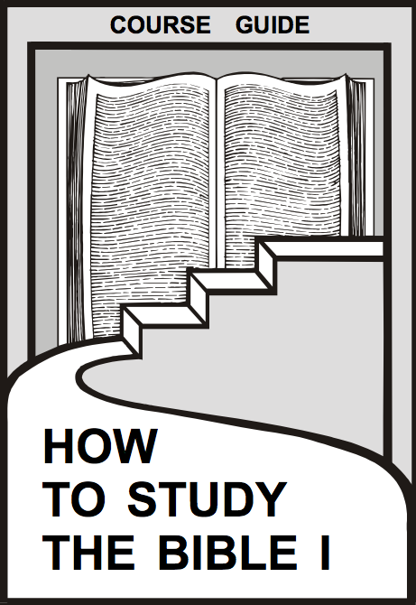
Overview of the 3-Step Method
Course Guide
We must study before we can interpret!
Dr. Rick Griffith • Jordan Evangelical Theological Seminary • BibleStudyDownloads.org

Slide 2
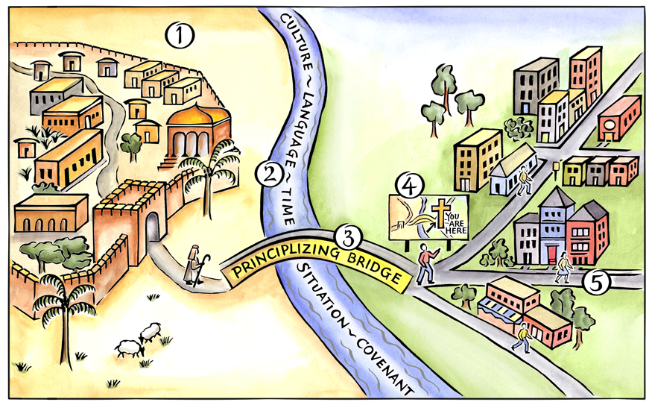
Basics of the Journey
Duvall & Hays, Grasping God's Word
Notes:
Above is a pictorial representation of our consistent approach to biblical interpretation. We call it the Interpretative Journey. There are 5 steps on this journey:
Grasping the Text in Their Town
Measuring the Width of the River to Cross
Crossing the Principlizing Bridge
Consult the Biblical Map
Grasping the Text in Our Town
By embarking on this journey we commit to the goal of grasping the meaning of text. We do not create meaning out of a text; rather, we seek to find the meaning that is already there.
Duvall, J. Scott, and J. Daniel Hays. Grasping God's Word: A Hands-on Approach to Reading, Interpreting, and Applying the Bible. Third Edition. Grand Rapids: Zondervan, 2012.

Slide 3
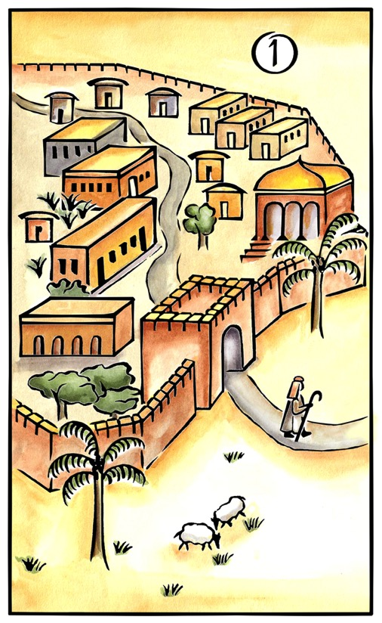
Step 1: Grasping the Text in Their Town
Basics of the Journey
Question: What did the text mean to the biblical audience?
Duvall & Hays, Grasping God's Word

Slide 4
Basics of the Journey
Step 1 Their Town:
Read the text carefully and make observations.
Study the historical and literary context.
Synthesize the meaning of the passage for the biblical audience.
Duvall & Hays, Grasping God's Word
Notes:
The synthesis statement should use past tense verbs and refer to the biblical audience.

Slide 5
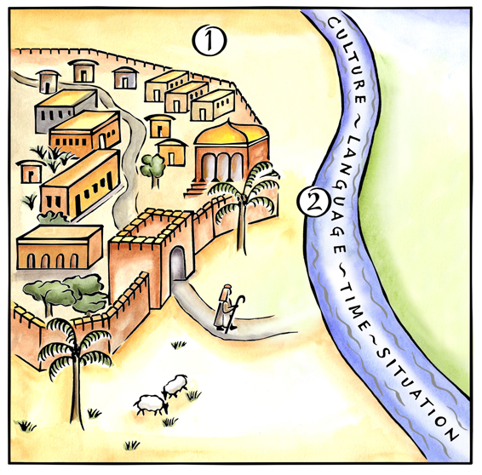
Basics of the Journey
Step 2: Measuring the Width of the River to Cross
Question: What are the differences between the biblical audience and us?
Duvall & Hays, Grasping God's Word

Slide 6
Basics of the Journey
Step 2 River Measurement:
Account for common differences: culture, language situation, time and covenant.
Focus on the unique differences found in a specific text.
If you are studying an Old Testament passage, you must account for the life and work of Jesus Christ.
Duvall & Hays, Grasping God's Word
Notes:
Students often get bogged down in the common differences that possibly have little impact on the interpretation of a passage. It is important for them to realize that to take the Interpretative Journey means that we must account for the unique set of differences that we find in any given text.

Slide 7
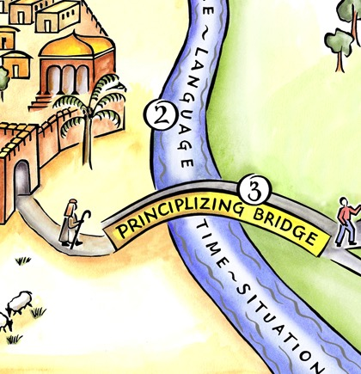
Basics of the Journey
Step 3: Crossing the Principlizing Bridge
Question: What is the theological principle in this text?
Duvall & Hays, Grasping God's Word
Notes:
This theological principle is connected to the meaning that was discovered in Step 1.

Slide 8
Basics of the Journey
Step 3 Principlizing Bridge:
Recall the differences in Step 2.
Identify similarities between the biblical and modern audiences.
Holding the differences and similarities together, identify a broad theological principle.
Write out the theological principle, using present tense verbs.
Duvall & Hays, Grasping God's Word

Slide 9
A theological principle should…
Basics of the Journey
be reflected in the text.
be timeless and not tied to a specific situation.
not be culturally bound.
correspond to the teaching of the rest of Scripture.
be relevant to both the biblical and contemporary audience.
Duvall & Hays, Grasping God's Word
Notes:
Above is a list of 5 criteria that describe a good theological principle.

Slide 10
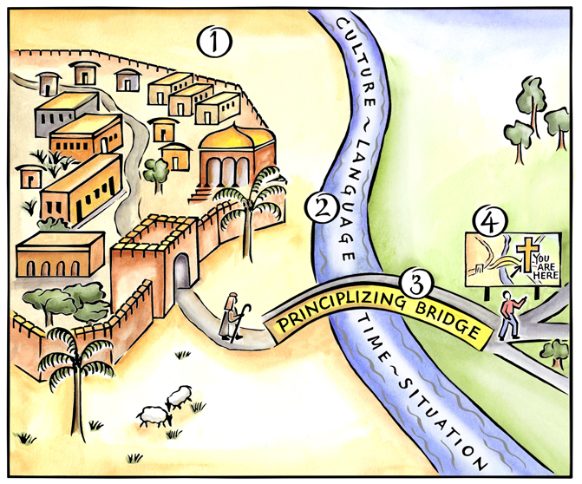
Basics of the Journey
Step 4: Consult the Biblical Map
Question: How does our theological principle fit with the rest of the Bible?
Duvall & Hays, Grasping God's Word

Slide 11
Basics of the Journey
Step 4 Biblical Map:
Does this principle correlate with the rest of the Bible?
If in the Old Testament, run your theological principle through the grid of the New Testament.
Duvall & Hays, Grasping God's Word
Notes:
Point 1 describes the parts-whole spiral.
Point 2 forces us to ask if the New Testament adds to or modifies our principle.

Slide 12
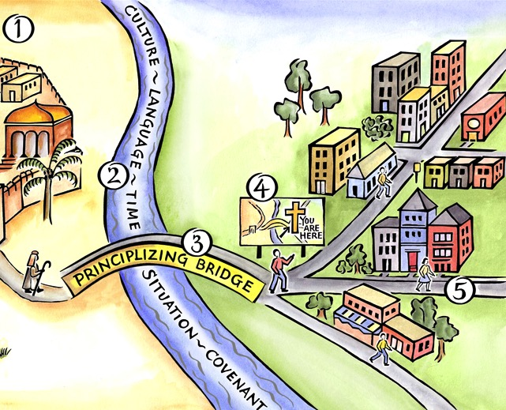
Basics of the Journey
Step 5: Grasping the Text in Our Town
Question: How should individual Christians today live out the theological principles?
Duvall & Hays, Grasping God's Word
Notes:
This step moves an abstract principle to concrete application.

Slide 13
Basics of the Journey
Their Town
Our Town
Biblical Map
River Measurement
Principlizing Bridge
Duvall & Hays, Grasping God's Word
Notes:
Above is a pictorial representation of our consistent approach to biblical interpretation. We call it the Interpretative Journey. There are 5 steps on this journey:
Grasping the Text in Their Town
Measuring the Width of the River to Cross
Crossing the Principlizing Bridge
Consult the Biblical Map
Grasping the Text in Our Town
By embarking on this journey we commit to the goal of grasping the meaning of text. We do not create meaning out of a text; rather, we seek to find the meaning that is already there.

Slide 14
The Inductive Approach
20
 | Book (Synthetic)
Observe (What do I see?) | Passage or Detail (Analytical) | Interpret the Observations (What does it mean?)
 | Topic (Topical)

Slide 15
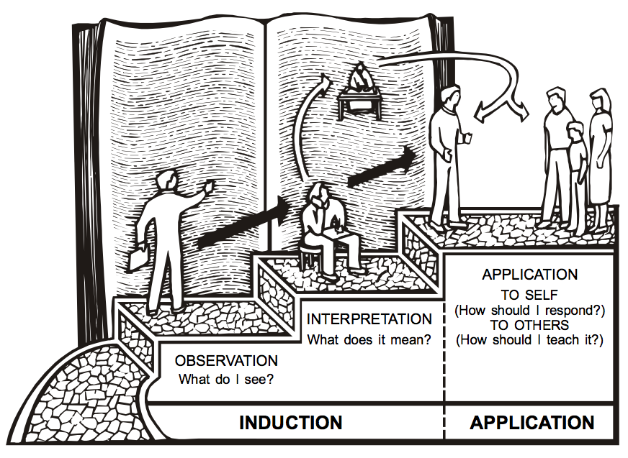
The 3-Step Process
20
APPLICATION
TO SELF
INTERPRETATION
(How should I respond?)
What does it mean?
TO OTHERS
OBSERVATION
(How should I teach it?)
What do I see?
INDUCTION
APPLICATION

Slide 16
Basics of the Journey
Observation
Application
Their Town
Our Town
Interpretation
Biblical Map
River Measurement
Principlizing Bridge
Duvall & Hays, Grasping God's Word
Notes:
This is a pictorial representation of our consistent approach to biblical interpretation. We call it the Interpretative Journey. There are 5 steps on this journey:
Grasping the Text in Their Town
Measuring the Width of the River to Cross
Crossing the Principlizing Bridge
Consult the Biblical Map
Grasping the Text in Our Town
By embarking on this journey, we commit to the goal of grasping the meaning of the text. We do not create meaning out of a text; rather, we seek to find the meaning that is already there.

Slide 17
Bible Study link at BibleStudyDownloads.org
Get this presentation for free!
Notes:
Bible Study (bs)

