Slide 1
Getting to Know Each Other
Dr. Rick Griffith • Jordan Evangelical Theological Seminary • BibleStudyDownloads.org

Slide 2
Please share with your group:
Name
Country
Programme
Family
Church
Ministry Vision

Slide 3
The Power of God's Word (Isa. 55:8-9 NLT)
"My thoughts are nothing like your thoughts," says the LORD.
"And my ways are far beyond anything you could imagine."
^{"9}For just as the heavens are higher than the earth, so my ways are higher than your ways and my thoughts higher than your thoughts."

Slide 4
The Power of God's Word (Isa. 55:10a NLT)
"The rain and snow come down from the heavens
and stay on the ground to water the earth."

Slide 5
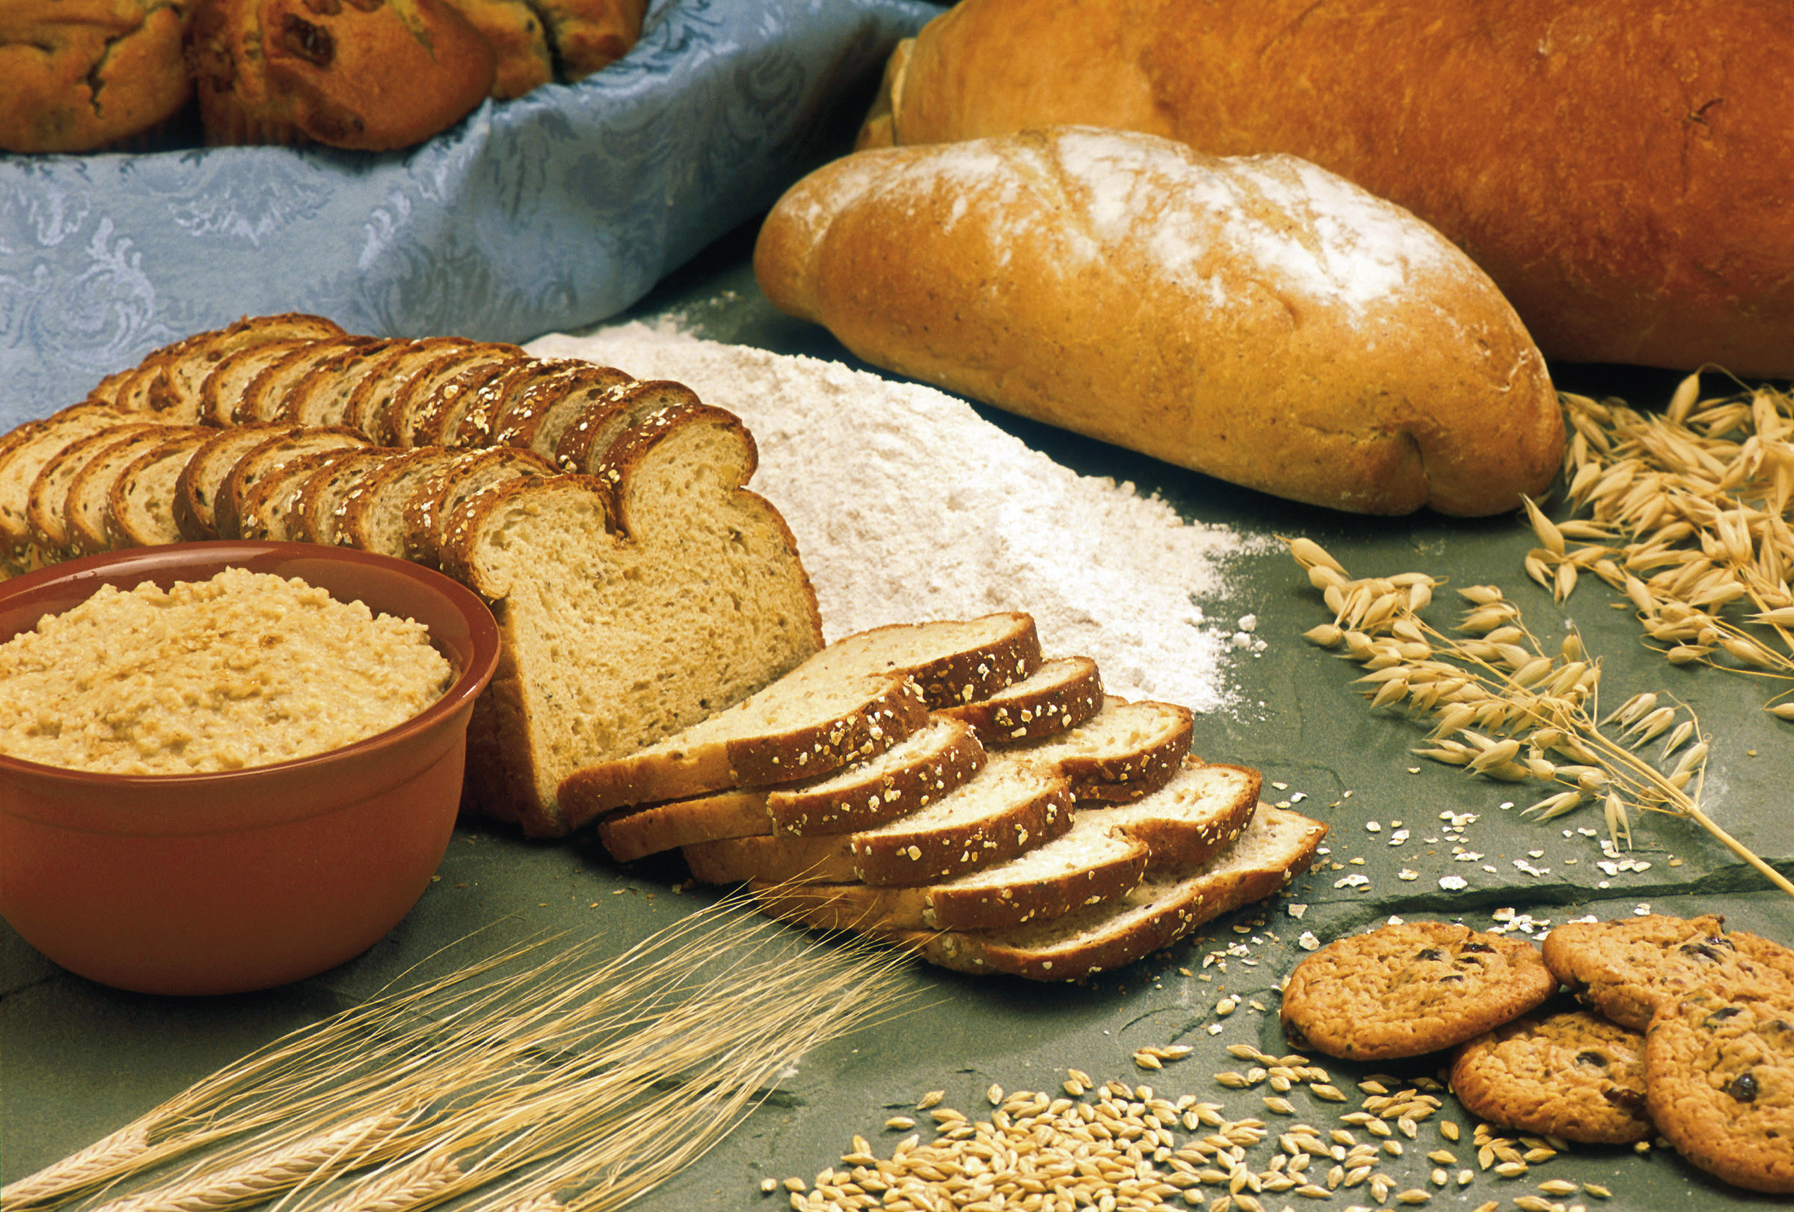
The Power of God's Word (Isa. 55:10b NLT)
"They cause the grain to grow,
producing seed for the farmer
and bread for the hungry."

Slide 6
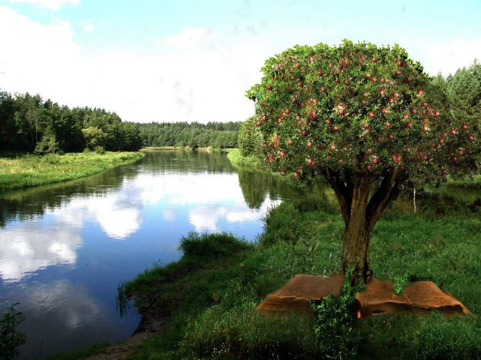
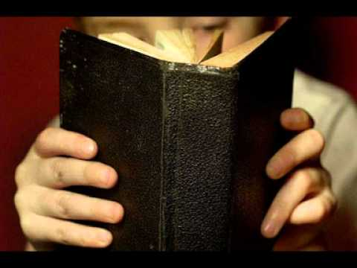
The Power of God's Word (Isa. 55:11 NLT)
"It is the same with my word.
I send it out, and it always produces fruit.
It will accomplish all I want it to,
and it will prosper everywhere I send it."

Slide 7
SBC Courses I Teach
(English • Bahasa • Chinese)
Survey • The Bible…Basically
OT NT Bible Study
Backgrounds • Research & Writing
OT NT Geography
Theology • Creation • Jesus
Church • Spirit • Salvation • Future
Preaching
Homiletics 1 Homiletics 2
Notes:
I get to teach these leaders every book of the Bible in survey courses, plus backgrounds to both the OT and NT, several areas of theology, and how to preach.

Slide 8
Bible Study link at BibleStudyDownloads.org
Get this presentation for free!
Notes:
Bible Study (bs)

Slide 9
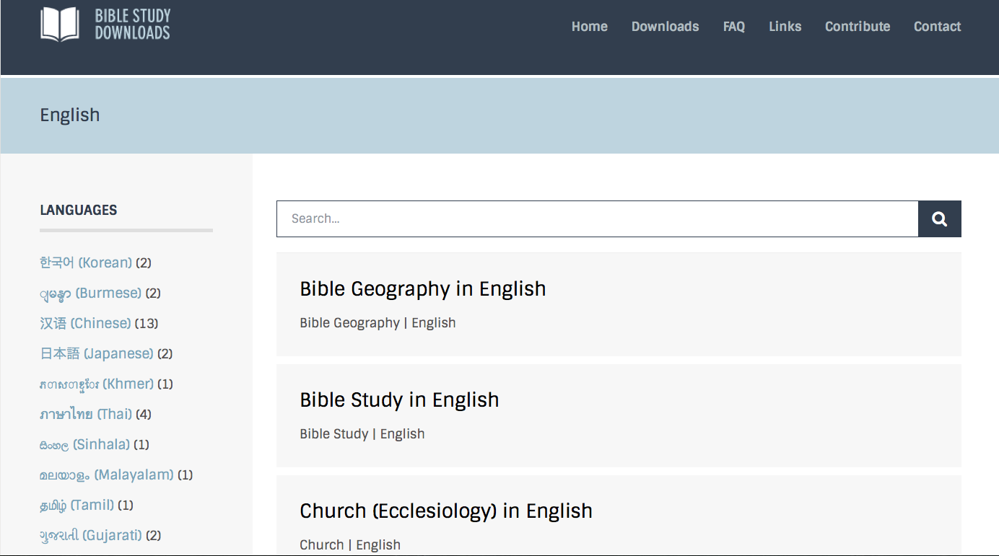
BibleStudyDownloads.org
7
Notes:
This has resulted in Bible teaching and study materials—mostly PowerPoint—in 44 languages! All a teacher needs to do is to click on a file and it downloads for free to teach any book of the Bible and many other subjects.

Slide 10
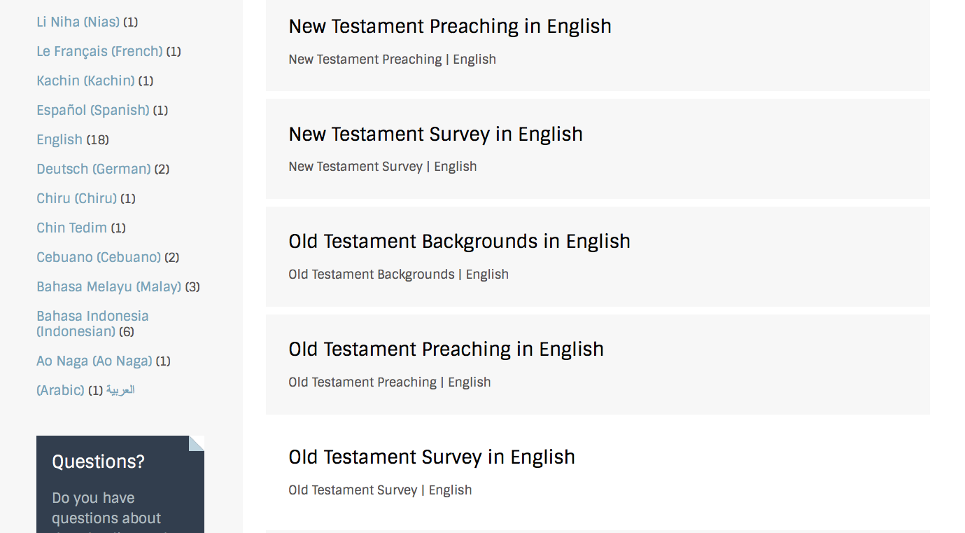
BibleStudyDownloads.org
7
Notes:
This has resulted in Bible teaching and study materials—mostly PowerPoint—in 42 languages! All a teacher needs to do is to click on a file and it downloads for free to teach any book of the Bible and many other subjects.

Slide 11
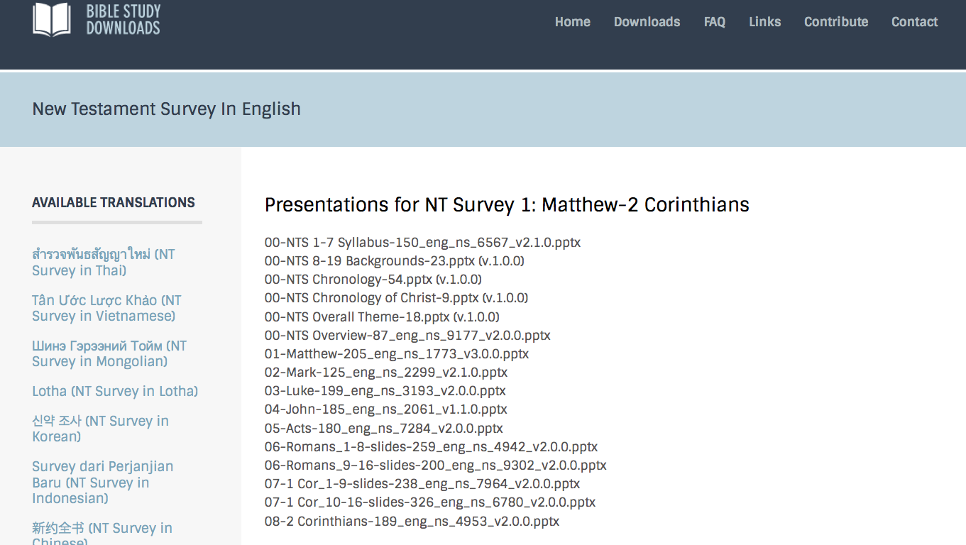
BibleStudyDownloads.org
7
Notes:
This has resulted in Bible teaching and study materials—mostly PowerPoint—in 42 languages! All a teacher needs to do is to click on a file and it downloads for free to teach any book of the Bible and many other subjects.

Slide 12
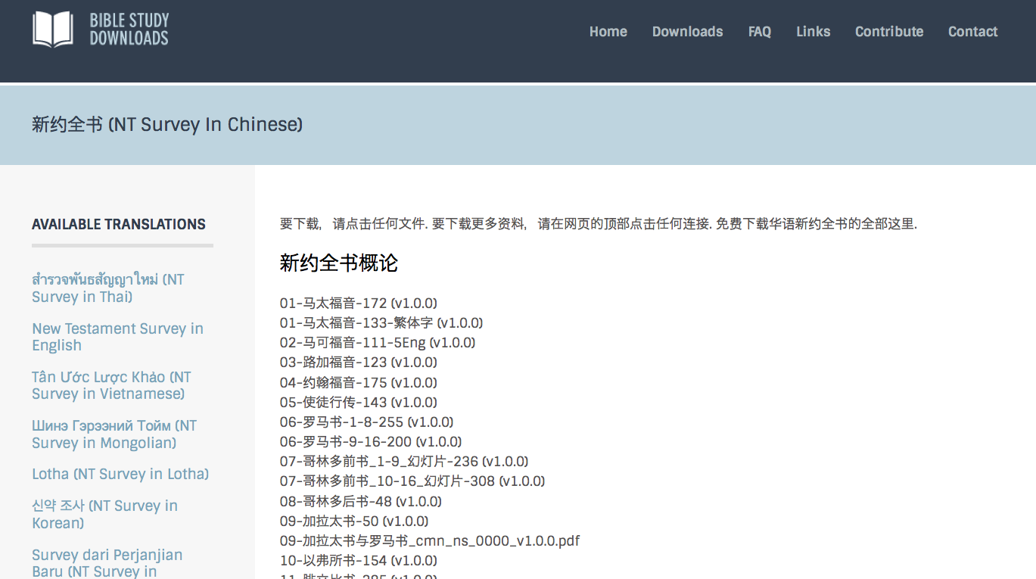
BibleStudyDownloads.org
7
Notes:
This has resulted in Bible teaching and study materials—mostly PowerPoint—in 42 languages! All a teacher needs to do is to click on a file and it downloads for free to teach any book of the Bible and many other subjects.

Slide 13
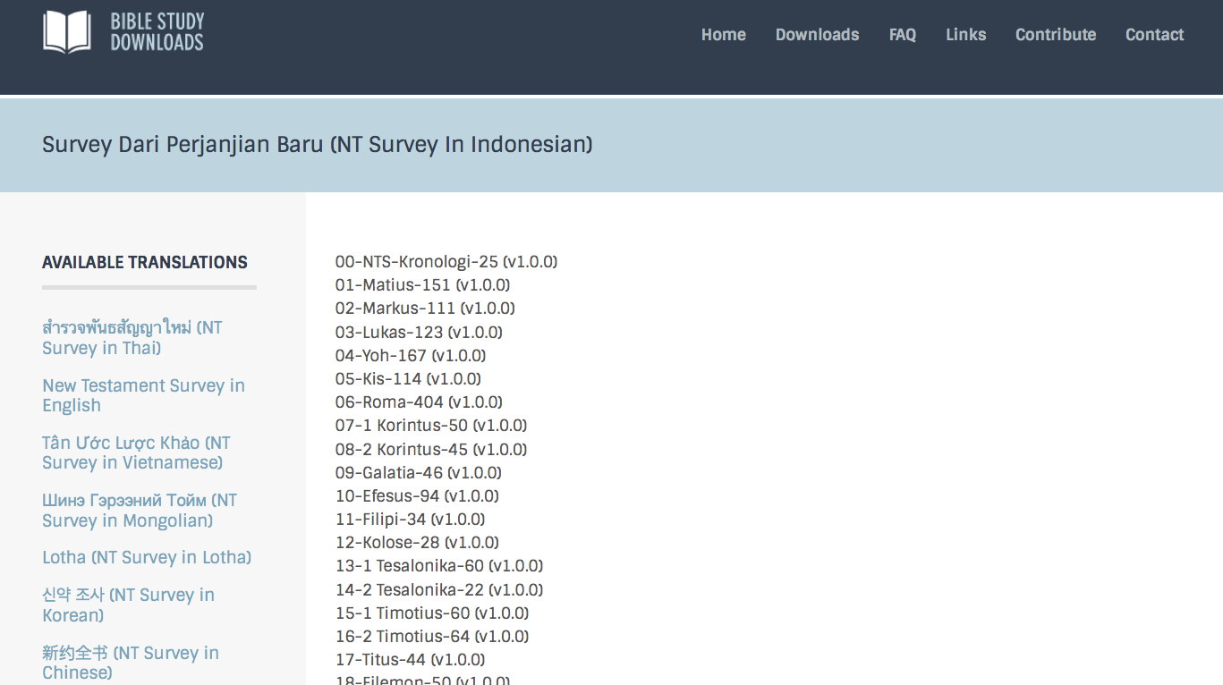
BibleStudyDownloads.org
7
Notes:
This has resulted in Bible teaching and study materials—mostly PowerPoint—in 42 languages! All a teacher needs to do is to click on a file and it downloads for free to teach any book of the Bible and many other subjects.

Slide 14
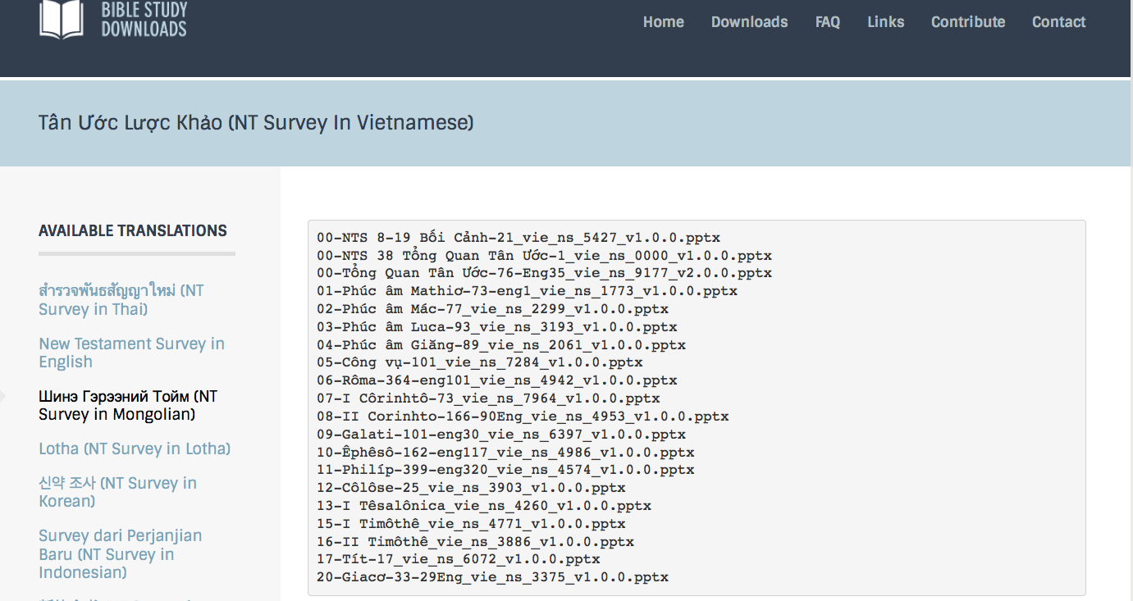
BibleStudyDownloads.org
7
Notes:
This has resulted in Bible teaching and study materials—mostly PowerPoint—in 42 languages! All a teacher needs to do is to click on a file and it downloads for free to teach any book of the Bible and many other subjects.

Slide 15
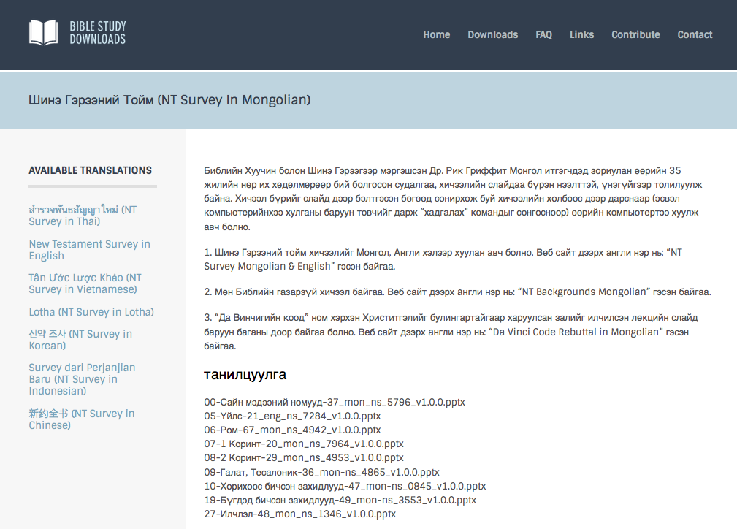
BibleStudyDownloads.org
7
Notes:
This has resulted in Bible teaching and study materials—mostly PowerPoint—in 42 languages! All a teacher needs to do is to click on a file and it downloads for free to teach any book of the Bible and many other subjects.

Slide 16
Crossroads People Jan 2017
UK
RUSSIA
FRANCE
MONGOLIA
GERMANY
ITALY
JAPAN
NETHERLANDS
KOREA
LEBANON
HONG KONG
TAIWAN
CANADA
CHINA
MYANMAR
EGYPT
INDIA
USA
MALAYSIA
PHILIPPINES
ZIMBABWE
SINGAPORE
NEW ZEALAND
CIC
INDONESIA
Notes:
Our Jan 2017 church 51 people stem from 12 different countries around the world (46 vcards). Canada (Gloria Lee), Netherlands (Desiree), Mark Lass (Germany), Hong Kong (Larry Pun), Cynthia, Pashauli (India), Yoshie & Kaori (Japan), Naomi & Ping (Malaysia), Raymond (Myanmar), Miriam (USA), Micah, Jasper (Philippines), Singapore (Albina), Sarah (UK)
This does not include people who have recently attended only once: Dowon (Korea)
Nor does it include missionaries living back in their countries but still are members of CIC: Maple (Taiwan), Budmaa (Mongolia)

Slide 17
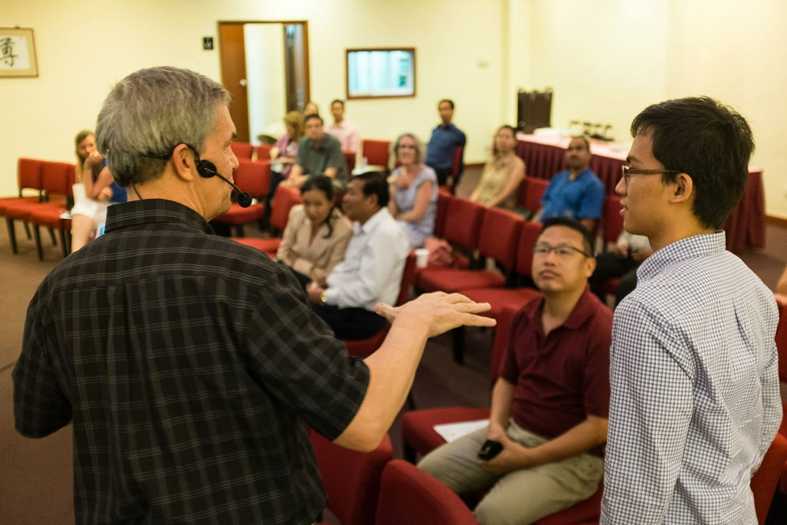
Our People
9
2017: 37 people from 12 nations
Notes:
We also helped start Crossroads International Church in 2006 where I serve as the pastor-teacher.

Slide 18
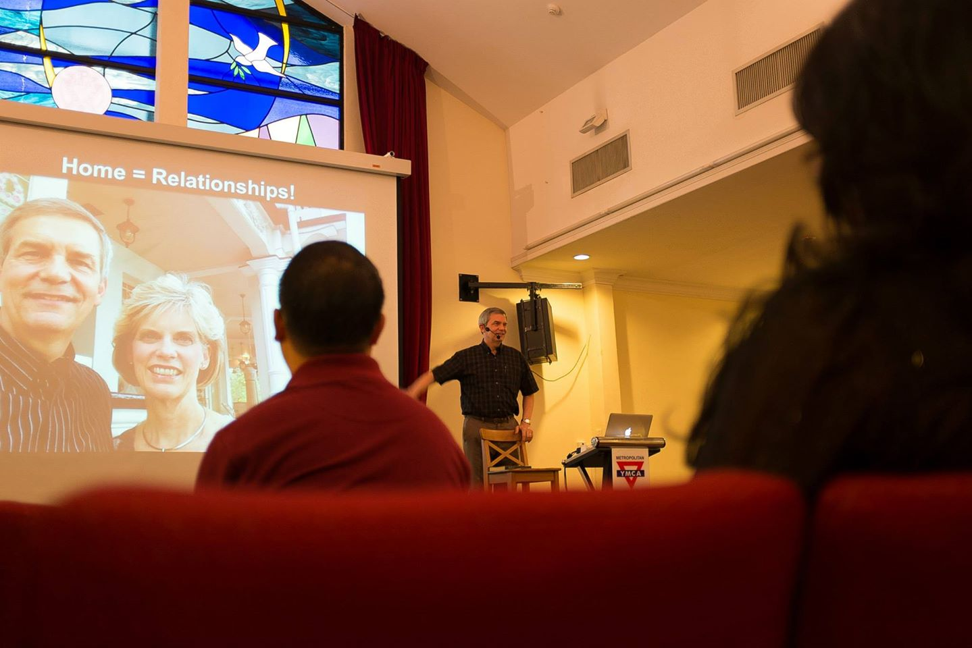
Our People
9
Preaching through Scripture
Notes:
RICK: Yes, we helped start Crossroads International Church in 2006 and I serve as the pastor-teacher.

Slide 19
Ministries God Gave Us
WorldVenture Singapore field leader
Singapore Bible College Bible & preaching professor
Singapore Bible College Doctor of Ministry director
Adjunct Professor teaching in 12 nations
The Bible…Basically translation director
BibleStudyDownloads.org web author
Crossroads International Church pastor-teacher

Slide 20
Bible Study link at BibleStudyDownloads.org
Get this presentation for free!
Notes:
Bible Study (bs)

Slide 21
Black

